Slide 1

Biology 2e
Chapter 39 The Respiratory System

Slide 2
Chapter outline
Systems of Gas Exchange
Gas Exchange across Respiratory Surfaces
Breathing
Transport of Gases in Human Bodily Fluids

Slide 3
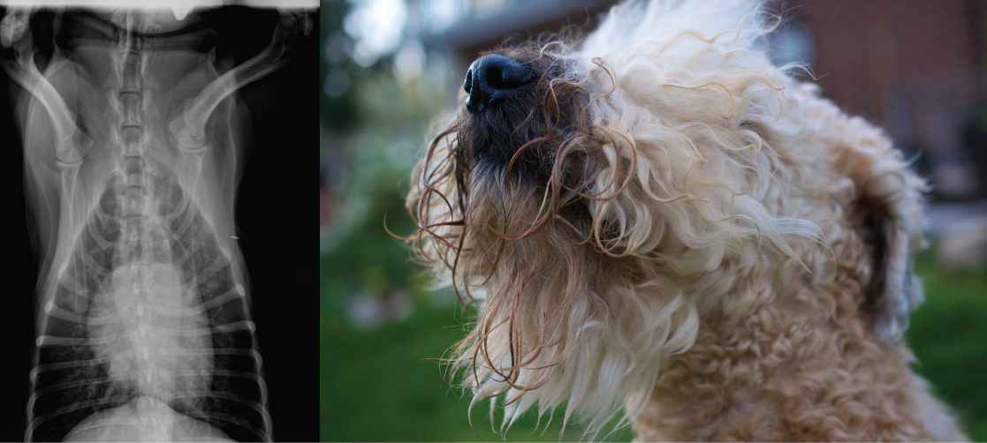
Figure 39.1
Lungs, which appear as nearly transparent tissue surrounding the heart in this X-ray of a dog (left), are the central organs of the respiratory system. The left lung is smaller than the right lung to accommodate space for the heart. A dog’s nose (right) has a slit on the side of each nostril. When tracking a scent, the slits open, blocking the front of the nostrils. This allows the dog to exhale though the now-open area on the side of the nostrils without losing the scent that is being followed. (credit a: modification of work by Geoff Stearns; credit b: modification of work by Cory Zanker)
Notes:
An X-ray on the left shows a dog heart, which appears as a white, oblong mass, surround by virtually transparent lung tissue. The photo on the right shows a dog.

Slide 4
39.1 Systems of Gas Exchange
Learning Objectives
Describe the passage of air from the outside environment to the lungs
Explain how the lungs are protected from particulate matter

Slide 5
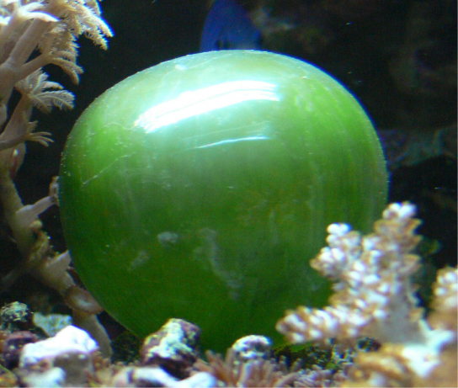
Figure 39.2
The cell of the unicellular alga Ventricaria ventricosa is one of the largest known, reaching one to five centimeters in diameter. Like all single-celled organisms, V. ventricosa exchanges gases across the cell membrane.
Notes:
The photo shows a round, green cell with a smooth, shiny surface. The cell resembles a balloon.

Slide 6
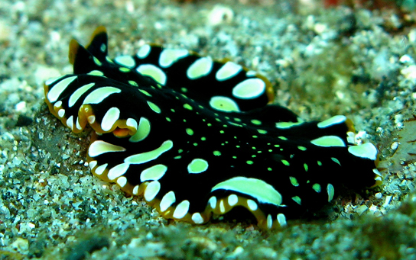
Figure 39.3
This flatworm’s process of respiration works by diffusion across the outer membrane. (credit: Stephen Childs)
Notes:
The photo shows a worm with a flat, ribbon-like body, resting on sand. The worm is black with white spots.

Slide 7
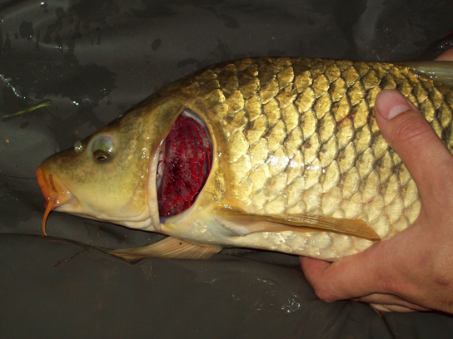
Figure 39.4
This common carp, like many other aquatic organisms, has gills that allow it to obtain oxygen from water. (credit: "Guitardude012"/Wikimedia Commons)
Notes:
The photo shows a carp with a wedge of skin at the back of the head cut away, revealing pink gills.

Slide 8
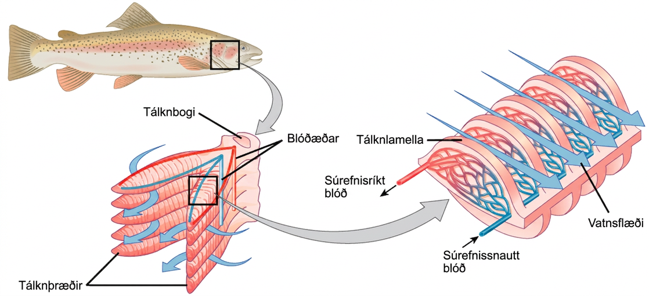
Figure 39.5
As water flows over the gills, oxygen is transferred to blood via the capillaries in the lamellae. (credit "fish": modification of work by Duane Raver, NOAA)
Notes:
The illustration shows a fish, with a box indicating the location of the gills, behind the head. A close-up image shows the gills, each of which resembles a feathery worm. Two stacks of gills attach to a structure called a columnar gill arch, forming a tall V. Water travels in from the outside of the V, between each gill, then travels out of the top of the V. Arteries from the hearth bring deoxygenated blood into the gill from the base of the gill arch, and arteries travel back out on the opposite side carrying the oxygenated blood toward the organs. A close-up image of a single gill shows that water travels over the gill lamella, passing over arteries with oxygenated blood first, then over the arteries with deoxygenated blood coming from the hearth. A rich capillary network in the lamellae of the gills facilitates the gas exchange.

Slide 9
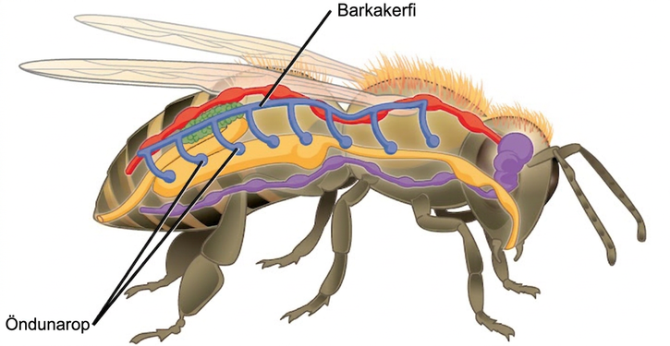
Figure 39.6
Insects perform respiration via a tracheal system.
Notes:
The illustration shows the tracheal system of a bee. Openings called spiracles appear along the side of the body. Vertical tubes lead from the spiracles to a tube that runs along the top of the body from front to back.

Slide 10
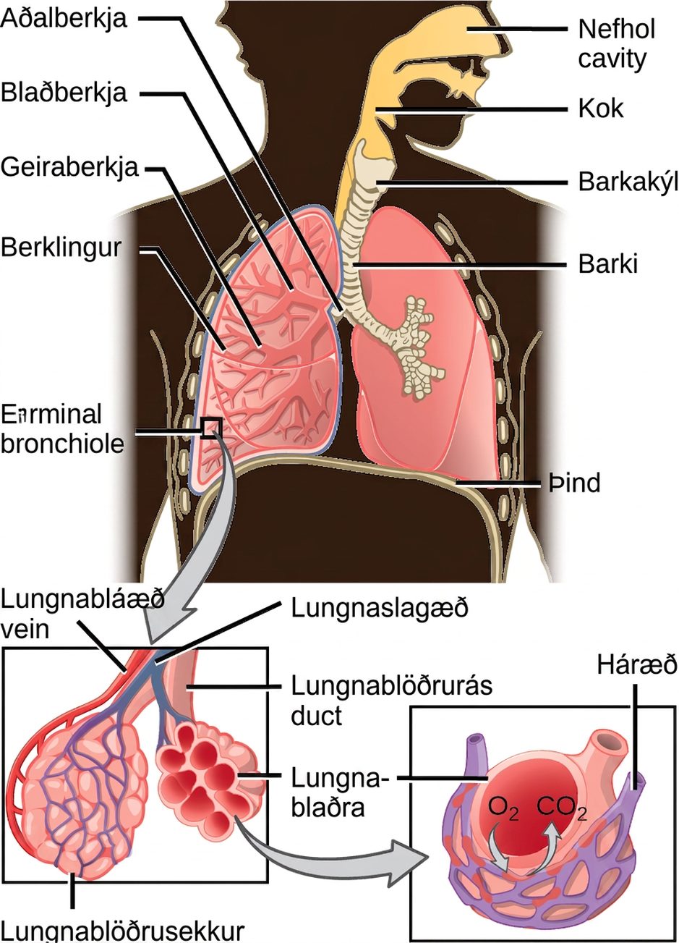
Figure 39.7
Air enters the respiratory system through the nasal cavity and pharynx, and then passes through the trachea and into the bronchi, which bring air into the lungs. (credit: modification of work by NCI)
Notes:
The illustration shows the flow of air through the human respiratory system. The nasal cavity is a wide cavity above and behind the nostrils, and the pharynx is the passageway behind the mouth. The nasal cavity and pharynx join and enter the trachea through the larynx. The larynx is somewhat wider than the trachea and flat. The trachea has concentric, ring-like grooves, giving it a bumpy appearance. The trachea bifurcates into two primary bronchi, which are also grooved. The primary bronchi enter the lungs, and branch into secondary bronchi. The secondary bronchi in turn branch into many tertiary bronchi. The tertiary bronchi branch into bronchioles, which branch into terminal bronchioles. Each terminal bronchiole ends in an alveolar sac. Each alveolar sac contains many alveoli clustered together, like bunches of grapes. The alveolar duct is the air passage into the alveolar sac. The alveoli are hollow, and air empties into them. Pulmonary arteries bring deoxygenated blood to the alveolar sac (and thus appear blue), and pulmonary veins return oxygenated blood (and thus appear red) to the heart. Capillaries form a web around each alveolus. The diaphragm is a membrane that pushes up against the lungs.

Slide 11
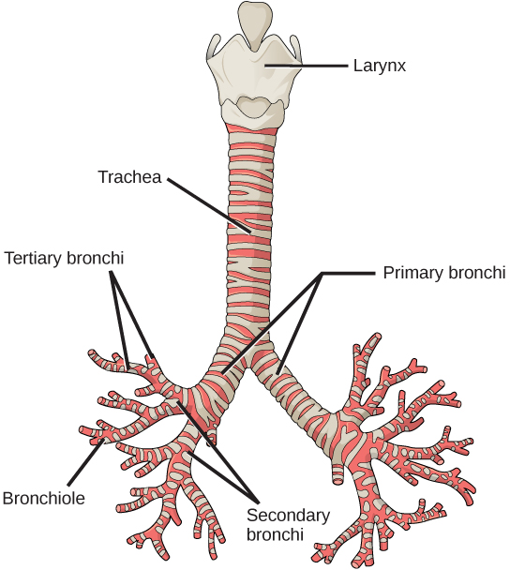
Figure 39.8
The trachea and bronchi are made of incomplete rings of cartilage. (credit: modification of work by Gray's Anatomy)
Notes:
The illustration shows the trachea, or windpipe. The larynx is a wide collar at the top of the trachea. At the bottom, the trachea bifurcates into smaller tubes, called primary bronchi, which enter the right and left lungs. Inside the lungs, the bronchi branch into primary and secondary bronchi, then into bronchioles.

Slide 12
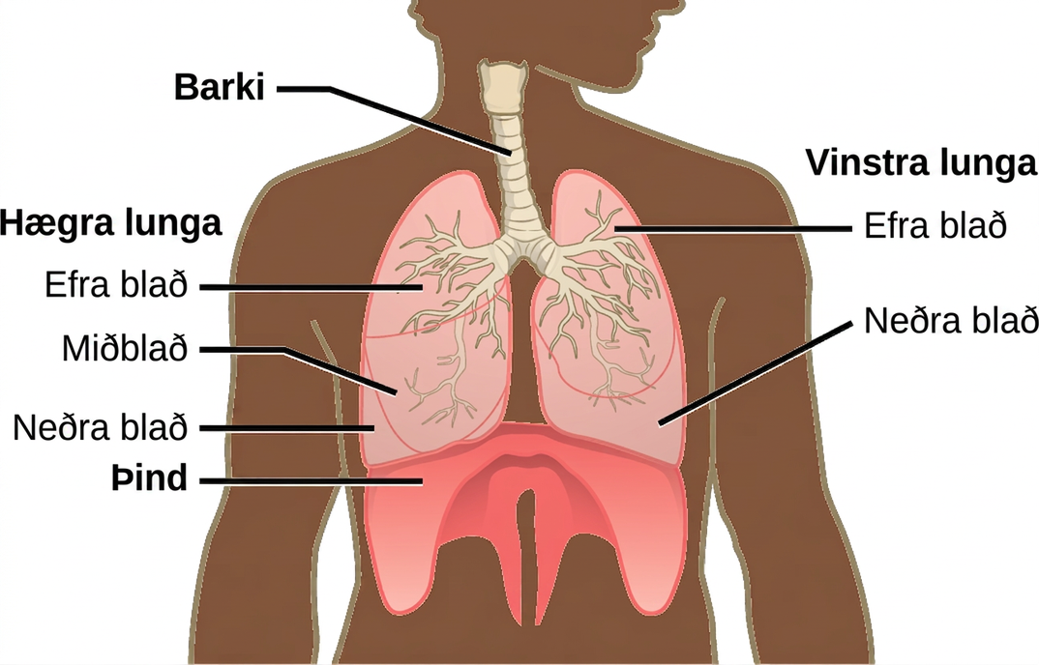
Figure 39.9
The trachea bifurcates into the right and left bronchi in the lungs. The right lung is made of three lobes and is larger. To accommodate the heart, the left lung is smaller and has only two lobes.
Notes:
The illustration shows the trachea, which starts at the top of the neck and continues down into the chest, where it branches into the bronchi, which enter the lungs. The left lung has two lobes. The upper lobe is located in front of and above the lower lobe. The right lung has three lobes. The upper lobe is on the top, the lower lobe is on the bottom, and the middle lobe is sandwiched between them. The diaphragm presses against the bottom of the lungs and has the appearance of skin stretched over the top of a drum. Wide flaps of the diaphragm extend downward on the front left and right sides of the body. On the back, thin flaps of diaphragm stretch downward on either side of the spine.

Slide 13
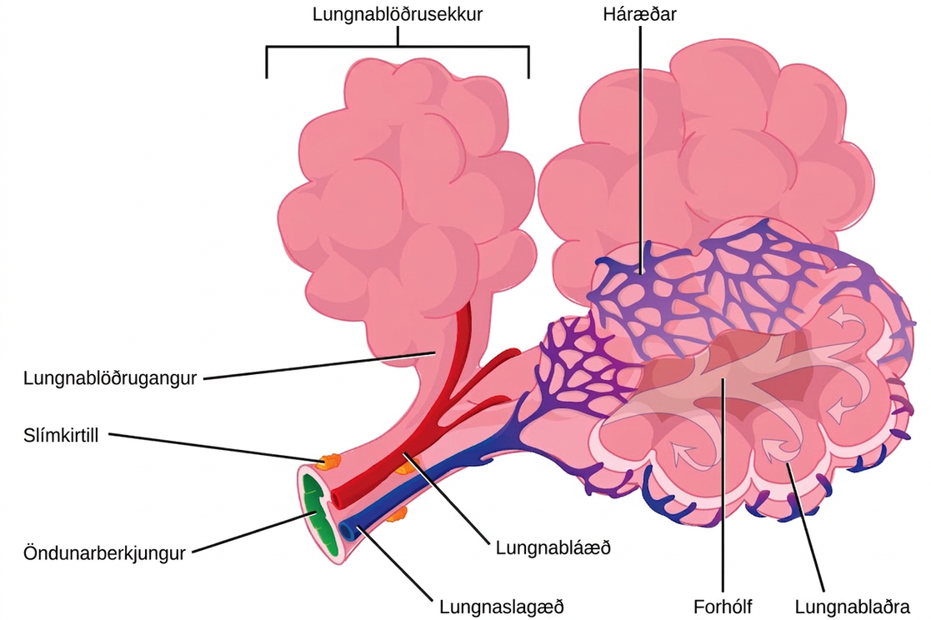
Figure 39.10
Terminal bronchioles are connected by respiratory bronchioles to alveolar ducts and alveolar sacs. Each alveolar sac contains 20 to 30 spherical alveoli and has the appearance of a bunch of grapes. Air flows into the atrium of the alveolar sac, then circulates into alveoli where gas exchange occurs with the capillaries. Mucous glands secrete mucous into the airways, keeping them moist and flexible. (credit: modification of work by Mariana Ruiz Villareal)
Notes:
The illustration shows a terminal bronchial tube branching into three alveolar ducts. At the end of each duct is an alveolar sac made up of 20 to 30 alveoli clustered together, like grapes. The airspace in the middle of the alveolar sac, called the atrium, is continuous with the air space inside the alveolus so that air can circulate from the atrium to the alveolus. Capillaries surround each alveolus, and this is where gas exchange occurs. A pulmonary artery (shown in blue) runs along the terminal bronchiole, bringing deoxygenated blood from the heart to the alveoli. A pulmonary vein (shown in red) running along the bronchiole brings oxygenated blood back to the heart. Small, flat mucous glands are associated with the outside of the bronchial tubes.

Slide 14
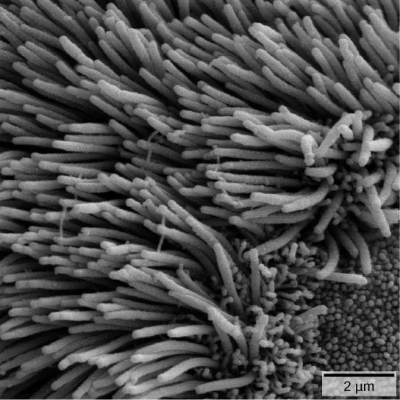
Figure 39.11
The bronchi and bronchioles contain cilia that help move mucus and other particles out of the lungs. (credit: Louisa Howard, modification of work by Dartmouth Electron Microscope Facility)
Notes:
In this micrograph, cilia are long, thin, hairlike projections.

Slide 15
39.2 Gas Exchange across Respiratory Surfaces
Learning Objectives
Name and describe lung volumes and capacities
Understand how gas pressure influences how gases move into and out of the body

Slide 16
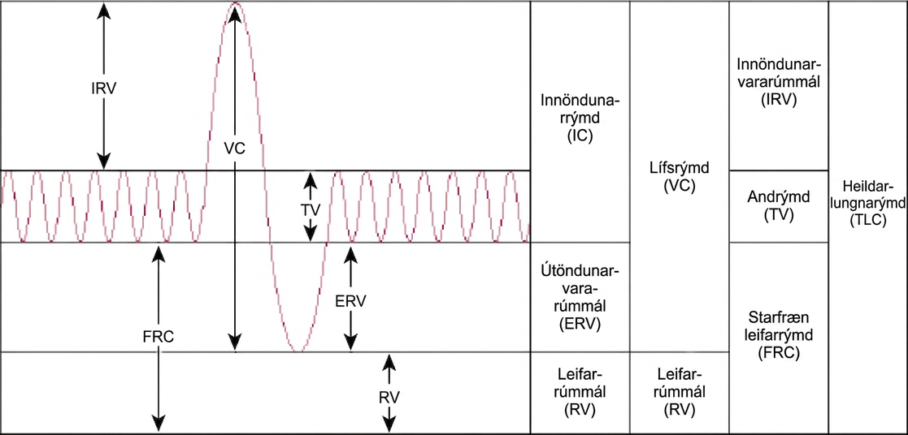
Figure 39.12
Human lung volumes and capacities are shown. The total lung capacity of the adult male is six liters. Tidal volume is the volume of air inhaled in a single, normal breath. Inspiratory capacity is the amount of air taken in during a deep breath, and residual volume is the amount of air left in the lungs after forceful respiration.
Notes:
The chart shows the exchange of air during inhalation and exhalation, which resembles a wave pattern. During normal breathing, only about eight percent of air in the lungs is exchanged, and the amount of air in the lungs is one-half the total lung capacity. When a person breathes in deeply, total lung capacity is attained. The amount of air taken in is called the inspiratory capacity. Forceful exhalation results in expulsion of the expiratory reserve volume. A residual volume of air of about eight percent is left in the lungs. The vital capacity is the difference between the total lung capacity and the residual volume. The inspiratory reserve volume is the difference between the total lung capacity and the amount of air in the lungs after taking a normal breath. The functional residual capacity is the amount of air in the lungs after normal exhalation.

Slide 17
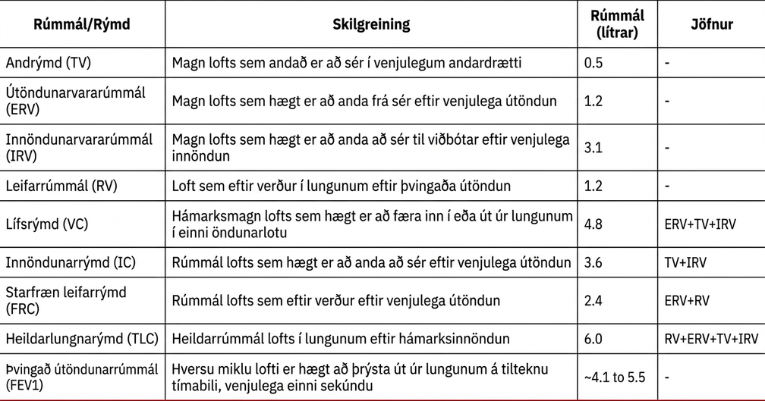
Table 39.1

Slide 18
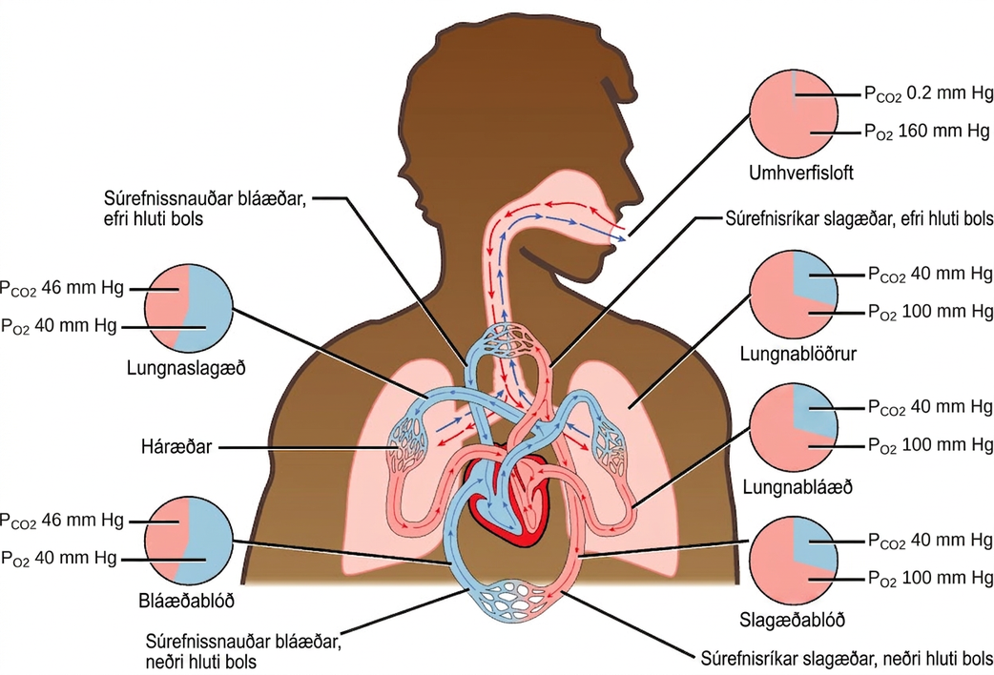
Figure 39.13
The partial pressures of oxygen and carbon dioxide change as blood moves through the body.
Notes:
The illustration shows the movement of deoxygenated air into the lungs, and oxygenated air out of the lungs. Also shown is the circulation of blood through the body. Circulation begins when deoxygenated blood in arteries leaves the right side of the heart and enters the lungs. Oxygenated blood exits the lungs, and enters the left side of the heart, which pumps it to the rest of the body via arteries. The partial pressure of oxygen in the atmosphere is 160 millimeters of mercury, and the partial pressure of carbon dioxide is 0.2 millimeters of mercury. The partial pressure of oxygen in the arteries is 100 millimeters of mercury, and the partial pressure of carbon dioxide is 40 millimeters of mercury. The partial pressure of oxygen in the veins is 40 millimeters of mercury, and the partial pressure of carbon dioxide is 46 millimeters of mercury.

Slide 19
39.3 Breathing
Learning Objectives
Describe how the structures of the lungs and thoracic cavity control the mechanics of breathing
Explain the importance of compliance and resistance in the lungs
Discuss problems that may arise due to a V/Q mismatch

Slide 20
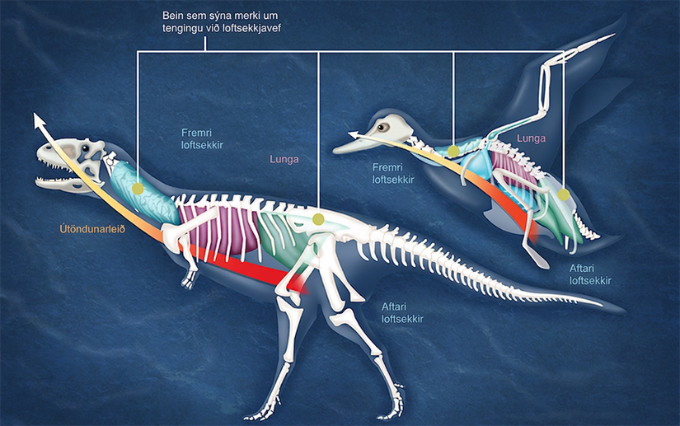
Figure 39.14
Dinosaurs, from which birds descended, have similar hollow bones and are believed to have had a similar respiratory system. (credit: modification of work by Zina Deretsky, National Science Foundation)
Notes:
Illustration compares a dinosaur and a bird. Both have anterior air sacs in front of the lungs, and posterior air sacs behind them. The air sacs connect to hollow openings in bones.

Slide 21
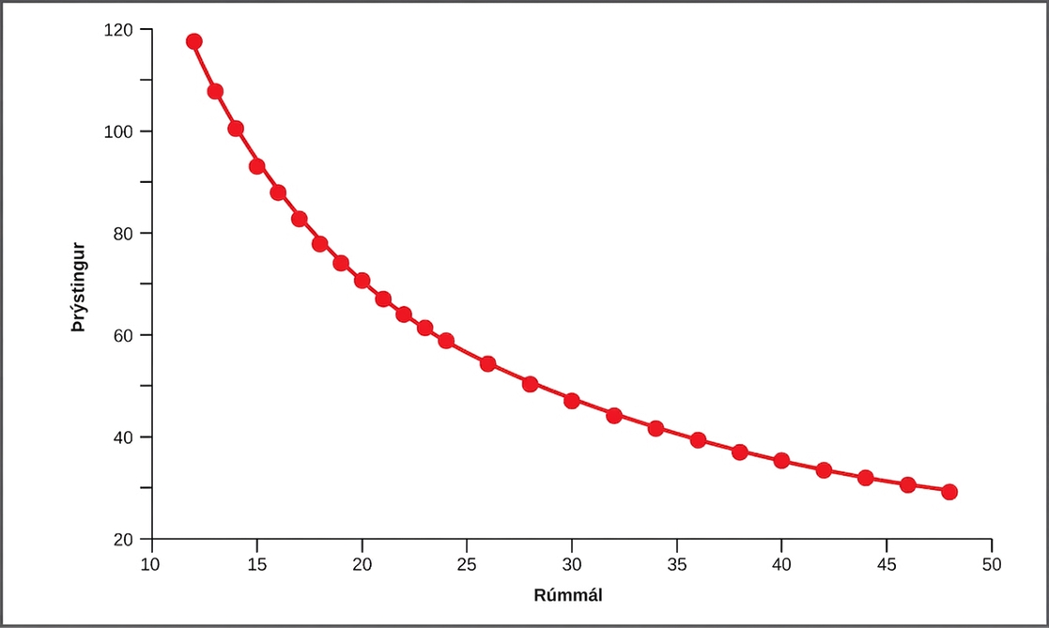
Figure 39.15
This graph shows data from Boyle’s original 1662 experiment, which shows that pressure and volume are inversely related. No units are given as Boyle used arbitrary units in his experiments.
Notes:
In this graph, pressure is plotted against volume. The line curves downward from a state of high pressure and low volume, steeply at first, then more gradually and levels off at a state of low pressure and high volume.

Slide 22
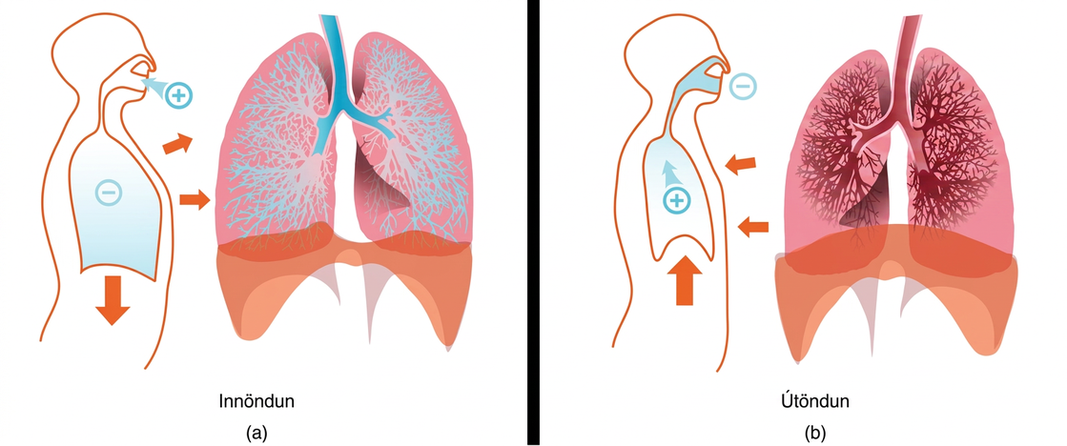
Figure 39.16
The lungs, chest wall, and diaphragm are all involved in respiration, both (a) inhalation and (b) expiration. (credit: modification of work by Mariana Ruiz Villareal)
Notes:
Part a shows expanded lungs with alveoli filled with air during inhalation. The diaphragm is pulled downward, and the muscles of the chest wall are pulled outward. Part b shows collapsed lungs during expiration. The diaphragm is pushed upward, and the chest cavity muscles are pushed inward.

Slide 23
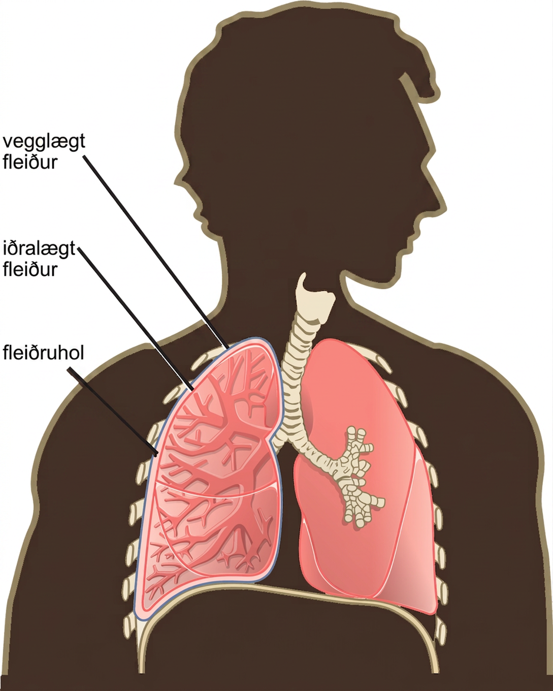
Figure 39.17
A tissue layer called pleura surrounds the lung and interior of the thoracic cavity. (credit: modification of work by NCI)
Notes:
The illustration shows human lungs. Each lung is covered by an inner visceral pleura and an outer parietal pleura. The intrapleural space is the space between the two membranes.

Slide 24
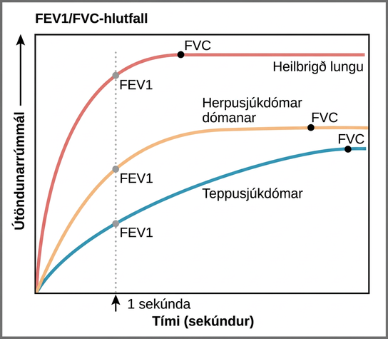
Figure 39.18
The ratio of FEV1 (the amount of air that can be forcibly exhaled in one second after taking a deep breath) to FVC (the total amount of air that can be forcibly exhaled) can be used to diagnose whether a person has restrictive or obstructive lung disease. In restrictive lung disease, FVC is reduced but airways are not obstructed, so the person is able to expel air reasonably fast. In obstructive lung disease, airway obstruction results in slow exhalation as well as reduced FVC. Thus, the FEV1/FVC ratio is lower in persons with obstructive lung disease (less than 69 percent) than in persons with restrictive disease (88 to 90 percent).
Notes:
The graph plots volume exhaled versus time. In normal lungs, almost all of the air can be forcibly exhaled within one second after taking a deep breath, resulting in a curve that rises steeply at first then plateaus shortly after one second. The volume after 1 second is the F E V 1, and it is almost as high as the volume at which the plateau is reached, which is the F V C. In lungs of persons with restrictive lung disease, the F V C is considerably lower but the person can exhale reasonably fast, resulting in a curve that is similar in shape, but with a lower plateau, or F V C, than for normal lungs. The F E V 1 value is still a significant proportion of the F V C value. In lungs of persons with obstructive lung disease, the F V C is low and exhalation is much slower, resulting in a flatter curve with a lower plateau. The slower exhalation results in a F E V 1 value much lower than the F V C value.

Slide 25
39.4 Transport of Gases in Human Bodily Fluids
Learning Objectives
Describe how oxygen is bound to hemoglobin and transported to body tissues
Explain how carbon dioxide is transported from body tissues to the lungs

Slide 26
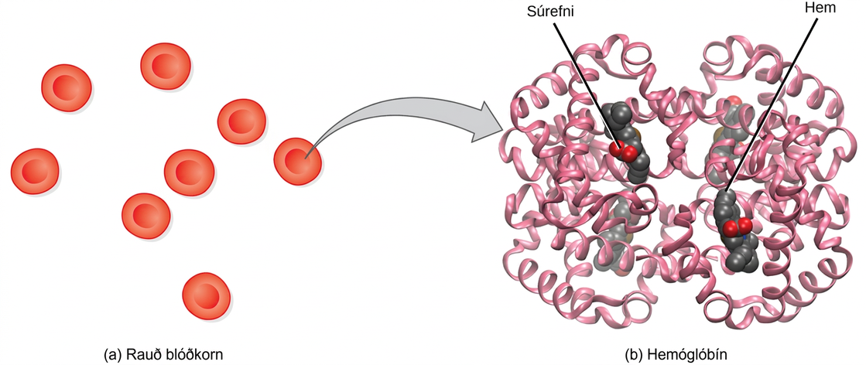
Figure 39.19
The protein inside (a) red blood cells that carries oxygen to cells and carbon dioxide to the lungs is (b) hemoglobin. Hemoglobin is made up of four symmetrical subunits and four heme groups. Iron associated with the heme binds oxygen. It is the iron in hemoglobin that gives blood its red color.
Notes:
Part a shows disc-shaped red blood cells. An arrow points from a red blood cell to the hemoglobin in part b. Hemoglobin is made up of coiled helices. The left, right, bottom, and top parts of the molecule are symmetrical. Four small heme groups are associated with hemoglobin. Oxygen is bound to the heme.

Slide 27
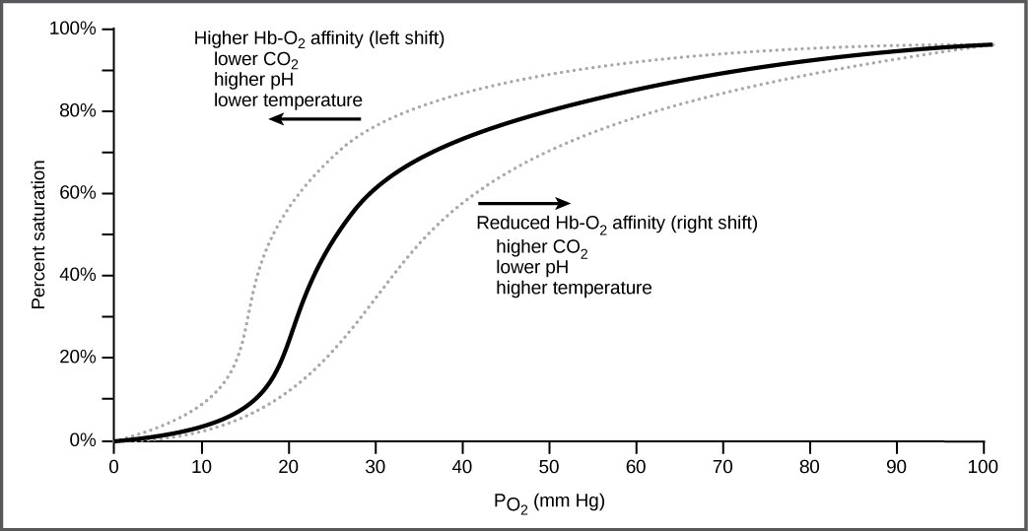
Figure 39.20
The oxygen dissociation curve demonstrates that, as the partial pressure of oxygen increases, more oxygen binds hemoglobin. However, the affinity of hemoglobin for oxygen may shift to the left or the right depending on environmental conditions.
Notes:
The graph plots percent oxygen saturation of hemoglobin on the Y axis as a function of oxygen partial pressure measured in mm Hg on the X axis. Oxygen saturation increases in an S shaped curve. The curve rises slowly at first, then curves upward. It rises quickly from about 20 percent saturation at 20 mm Hg of partial pressure to about 60 percent saturation at 30 mm Hg of partial pressure. The curve then starts leveling out, gradually rising to nearly 100 percent saturation at 100 mm Hg of partial pressure. The curve shifts to the left under conditions of low carbon dioxide, high p H, and low temperature, and to the right in conditions of high carbon dioxide, low p H, or high temperature.

Slide 28
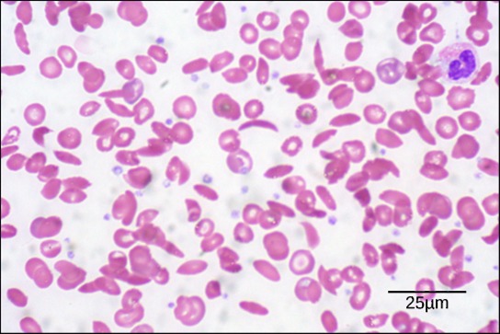
Figure 39.21
Individuals with sickle cell anemia have crescent-shaped red blood cells. (credit: modification of work by Ed Uthman; scale-bar data from Matt Russell)
Notes:
The micrograph shows a smear of red blood cells, some are disc-shaped and compressed in the center, whereas some are crescent-shaped. Each red blood cell is about five microns across.

Slide 29
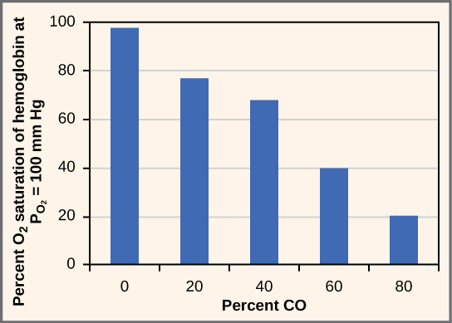
Figure 39.22
As percent CO increases, the oxygen saturation of hemoglobin decreases.
This OpenStax ancillary resource is © Rice University under a CC BY-NC-SA 4.0 International license; it may be reproduced or modified for noncommercial purposes only but must be attributed to OpenStax, Rice University and any changes must be noted. Any adaptation must be shared under the same type of license.
Notes:
Percent oxygen saturation of hemoglobin at an oxygen pressure of 100 millimeters of mercury decreases as percent carbon monoxide increases. In the absence of carbon monoxide, hemoglobin is 98 percent saturated with oxygen. At twenty percent carbon monoxide, hemoglobin is 77 percent saturated with oxygen. At forty percent carbon monoxide, hemoglobin is 68 percent saturated with oxygen. At sixty percent carbon monoxide, hemoglobin is 40 percent saturated with oxygen. At eighty percent carbon monoxide, hemoglobin is 20 percent saturated with oxygen.

