Slide 1

Biology 2e
Chapter 46 Ecosystems

Slide 2
Chapter outline
Ecology of Ecosystems
Energy Flow through Ecosystems
Biogeochemical Cycles

Slide 3
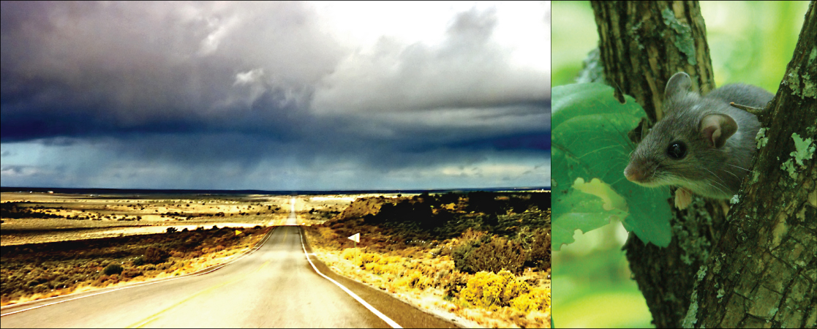
Figure 46.1
In the southwestern United States, rainy weather causes an increase in production of pinyon nuts, causing the deer mouse population to explode. Deer mice may carry a virus called Sin Nombre (a hantavirus) that causes respiratory disease in humans and has a high fatality rate. In 1992–1993, wet El Niño weather caused a Sin Nombre epidemic. Navajo healers, who were aware of the link between this disease and weather, predicted the outbreak. (credit "highway": modification of work by Phillip Capper; credit "mouse": modification of work by USFWS)
Notes:
Left photo shows a long, straight highway in the middle of a desert. Right photo shows a mouse.

Slide 4
46.1 Ecology of Ecosystems
Learning Objectives
Describe the basic ecosystem types
Explain the methods that ecologists use to study ecosystem structure and dynamics
Identify the different methods of ecosystem modeling
Differentiate between food chains and food webs and recognize the importance of each

Slide 5
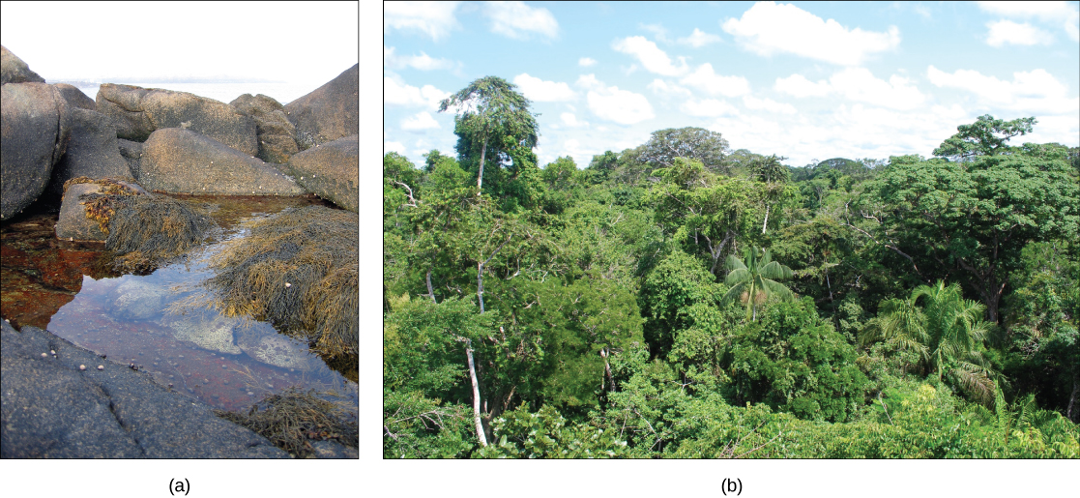
Figure 46.2
A (a) tidal pool ecosystem in Matinicus Island in Maine is a small ecosystem, while the (b) Amazon Rainforest in Brazil is a large ecosystem. (credit a: modification of work by “takomabibelot”/Flickr; credit b: modification of work by Ivan Mlinaric)
Notes:
Left photo shows a rocky tide pool with seaweed and snails. Right photo shows the Amazon Rainforest landscape, with seemingly every inch of land covered by plants of some kind.

Slide 6
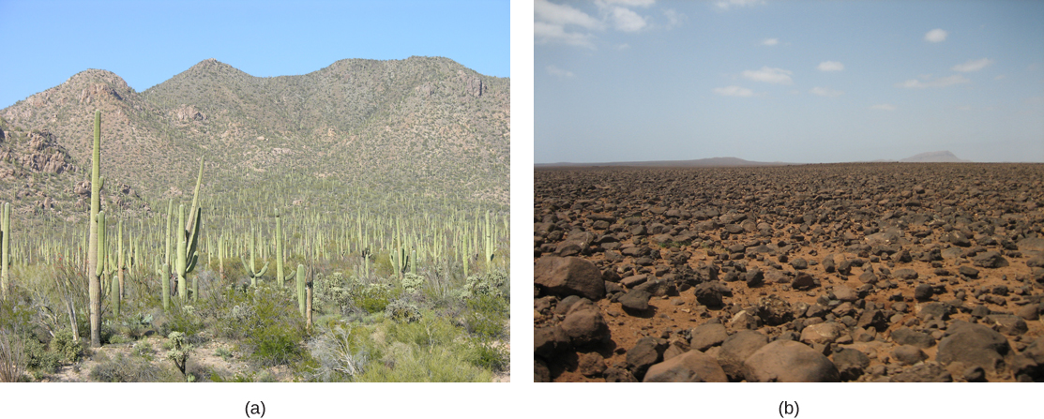
Figure 46.3
Desert ecosystems, like all ecosystems, can vary greatly. The desert in (a) Saguaro National Park, Arizona, has abundant plant life, while the rocky desert of (b) Boa Vista island, Cape Verde, Africa, is devoid of plant life. (credit a: modification of work by Jay Galvin; credit b: modification of work by Ingo Wölbern)
Notes:
Photo (a) shows saguaro cacti that look like telephone poles with arms extended from them. Photo (b) shows a barren plain of red soil littered with rocks.

Slide 7
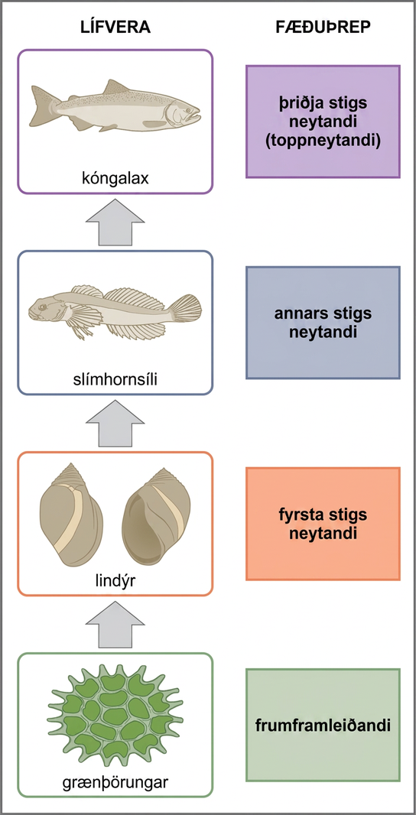
Figure 46.4
These are the trophic levels of a food chain in Lake Ontario at the United States-Canada border. Energy and nutrients flow from photosynthetic green algae at the bottom to the top of the food chain: the Chinook salmon.
Notes:
In this illustration the bottom trophic level is the primary producer, which is green algae. The primary consumers are mollusks, or snails. The secondary consumers are small fish called slimy sculpin. The tertiary and apex consumer is Chinook salmon.

Slide 8
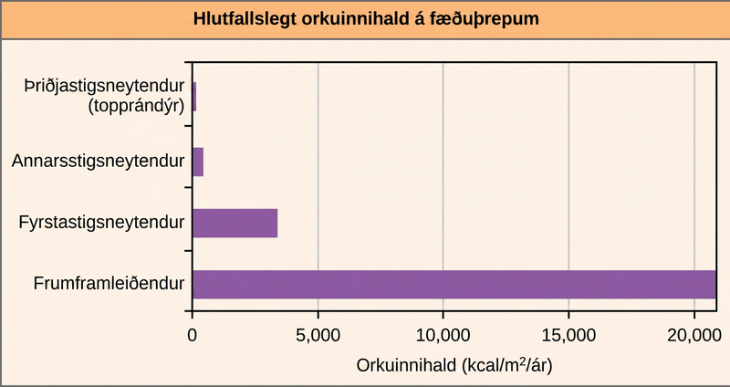
Figure 46.5
The relative energy in trophic levels in a Silver Springs, Florida, ecosystem is shown. Each trophic level has less energy available and supports fewer organisms at the next level.
Notes:
Graph shows energy content in different trophic levels. The energy content of primary producers is over 20,000 kilocalories per meter squared per year. The energy content of primary consumers is much smaller, about 3,400 kilocalories per meter squared per year. The energy content of secondary consumers is 383 kilocalories per meter squared per year, and the energy content of tertiary consumers is only 21 kilocalories per meter squared per year.

Slide 9
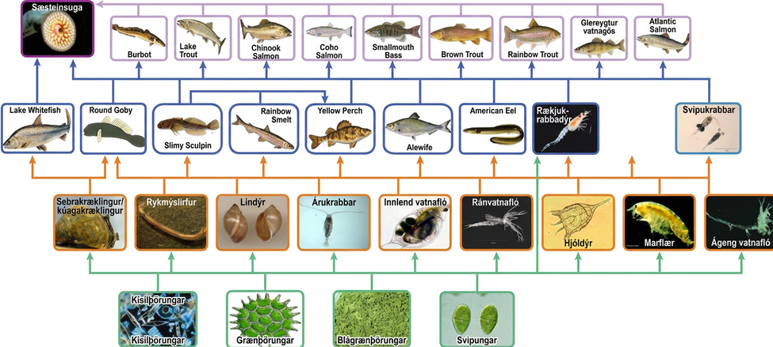
Figure 46.6
This food web shows the interactions between organisms across trophic levels in the Lake Ontario ecosystem. Primary producers are outlined in green, primary consumers in orange, secondary consumers in blue, and tertiary (apex) consumers in purple. Arrows point from an organism that is consumed to the organism that consumes it. Notice how some lines point to more than one trophic level. For example, the opossum shrimp eats both primary producers and primary consumers. (credit: NOAA, GLERL)
Notes:
The bottom level of the illustration shows primary producers, which include diatoms, green algae, blue-green algae, and flagellates. The next level includes the primary consumers that eat primary producers. These include invertebrates such as waterfleas and mussels. Primary consumers are in turn eaten by secondary consumers, which are typically small fish and shrimp. The small fish are eaten by larger fish, the tertiary, or apex consumers. Finally, all fish are eaten by the sea lamprey. For the most part, every organism at a given level eats every organism in the level below and nothing else, but there are exceptions. For example, not all secondary consumers eat all primary consumers. Lake whitefish only eat zebra and quagga mussels, round goby eat all primary consumers, and the other secondary consumers eat every primary consumer except for the zebra and quagga mussels. The secondary consumer yellow perch eats two other secondary consumers from its own level, the slimy sculpin and the rainbow smelt, in addition to eating primary consumers from the level below. Some organisms can also skip a level. The secondary consumer opossum shrimp eats most primary consumers in the level immediately below and all of the primary producers two levels below. Sea lamprey eat all tertiary and secondary consumers. Thus, the food web is complex with interwoven layers.

Slide 10
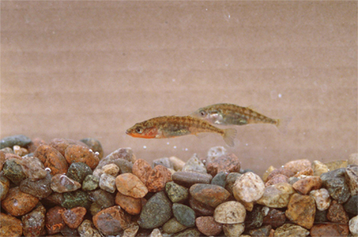
Figure 46.7
The three-spined stickleback evolved from a saltwater fish to freshwater fish. (credit: Barrett Paul, USFWS)
Notes:
Photo shows two small fish swimming above a rocky bottom.

Slide 11
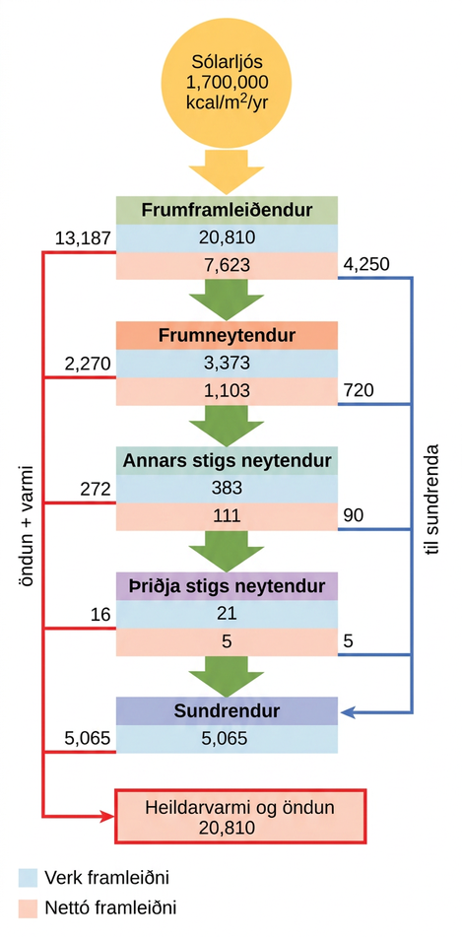
Figure 46.8
This conceptual model shows the flow of energy through a spring ecosystem in Silver Springs, Florida. Notice that the energy decreases with each increase in trophic level.
Notes:
Flow chart shows that the ecosystem absorbs 1,700,00 calories per meter squared per year of sunlight. Primary producers have a gross productivity of 20,810 calories per meter squared per year. 13,187 calories per meter squared per year is lost to respiration and heat, so the net productivity of primary producers is 7,623 calories per meter squared per year. 4,250 calories per meter squared per year is passed on to decomposers, and the remaining 3,373 calories per meter squared per year is passed on to primary consumers. Thus, the gross productivity of primary consumers is 3,373 calories per meter squared per year. 2,270 calories per meter squared per year is lost to heat and respiration, resulting in a net productivity for primary consumers of 1,103 calories per meter squared per year. 720 calories per meter squared per year is lost to decomposers, and 383 calories per meter squared per year becomes the gross productivity of secondary consumers. 272 calories per meter squared per year is lost to heat and respiration, so the net productivity for secondary consumers is 111 calories per meter squared per year. 90 calories per meter squared per year is lost to decomposers, and the remaining 21 calories per meter squared per year becomes the gross productivity of tertiary consumers. Sixteen calories per meter squared per year is lost to respiration and heat, so the net productivity of tertiary consumers is 5 calories per meter squared per year. All this energy is lost to decomposers. In total, decomposers use 5,065 calories per meter squared per year of energy, and 20,810 calories per meter squared per year is lost to respiration and heat.

Slide 12
46.2 Energy Flow through Ecosystems
Learning Objectives
Describe how organisms acquire energy in a food web and in associated food chains
Explain how the efficiency of energy transfers between trophic levels affects ecosystem structure and dynamics
Discuss trophic levels and how ecological pyramids are used to model them

Slide 13
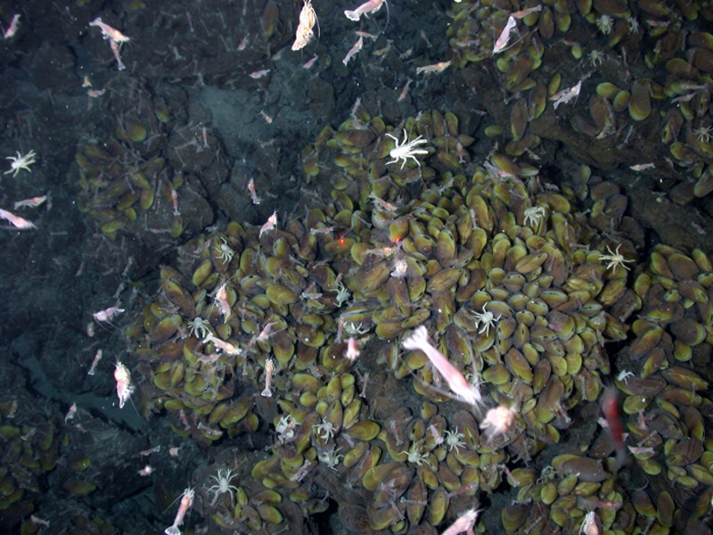
Figure 46.9
Swimming shrimp, a few squat lobsters, and hundreds of vent mussels are seen at a hydrothermal vent at the bottom of the ocean. As no sunlight penetrates to this depth, the ecosystem is supported by chemoautotrophic bacteria and organic material that sinks from the ocean’s surface. This picture was taken in 2006 at the submerged NW Eifuku volcano off the coast of Japan by the National Oceanic and Atmospheric Administration (NOAA). The summit of this highly active volcano lies 1535 m below the surface.
Notes:
Photo shows shrimp, lobster, and white crabs crawling on a rocky ocean floor littered with mussels.

Slide 14
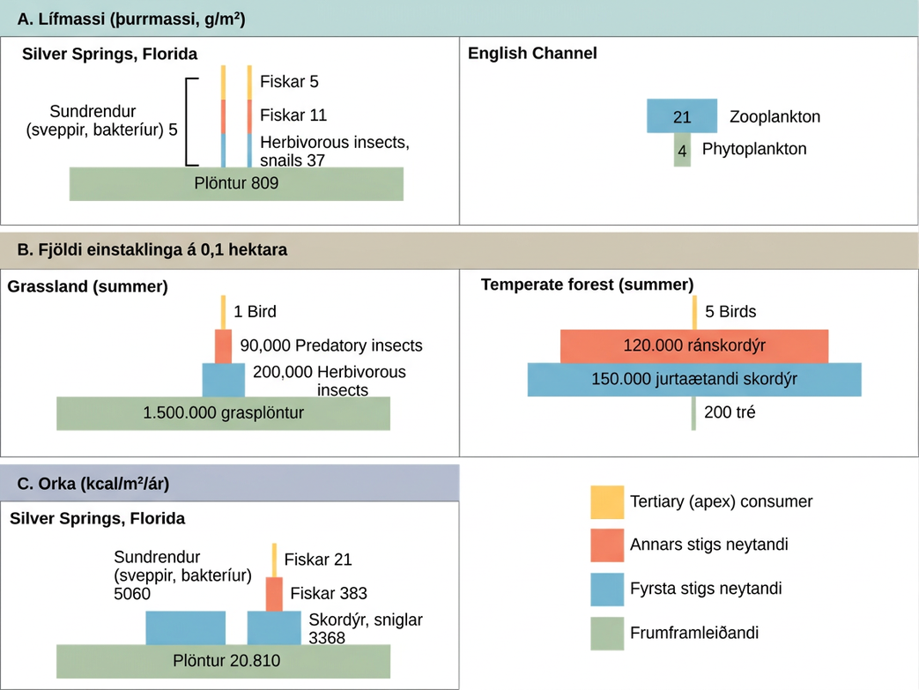
Figure 46.10
Ecological pyramids depict the (a) biomass, (b) number of organisms, and (c) energy in each trophic level.
Notes:
Section A, biomass, indicated by dry mass g slash m squared. On the left is a pyramid diagram of dry biomass in grams per meter squared in Silver Springs, Florida. The biomass of plants is 809. The biomass of primary consumers, including herbivorous insects and snails is 37. The biomass of secondary consumer fishes is 11, and the biomass of tertiary consumer fishes is 5. Primary, secondary and tertiary decomposers have a combined biomass of 5. On the right is a pyramid diagram of dry biomass in grams per meter squared in the English Channel. The biomass is 4 phytoplankton and 21 zooplankton. Section B, number of individuals per 0.1 hectare. On the left is a pyramid diagram of the number of individuals per 0.1 hectare in a summer grassland. There are 1,500,000 grass plants, 200,000 herbivorous insects, 90,000 predatory insects, and 1 bird On the right is a pyramid diagram of organisms per 0.1 hectare in a temperate forest. There are 200 trees, 150,000 herbivorous insects, 120,000 predatory insects, and 5 birds. Section C, energy, k cal slash m squared slash year. In Silver Springs Florida, the energy of plants is 20,810. The energy of primary consumers, including insects and snails, is 3,368. The energy of secondary consumer fishes is 383, and the energy of tertiary consumer fishes is 21. The energy of decomposers, including fungi and bacteria, is 5,060.

Slide 15
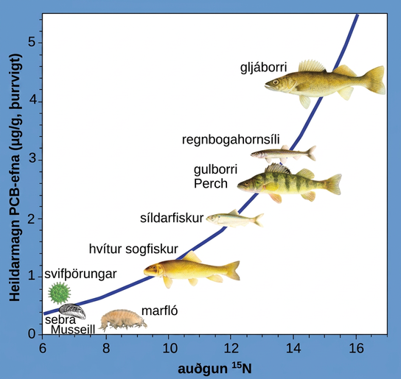
Figure 46.11
This chart shows the PCB concentrations found at the various trophic levels in the Saginaw Bay ecosystem of Lake Huron. Numbers on the x-axis reflect enrichment with heavy isotopes of nitrogen (15N), which is a marker for increasing trophic level. Notice that the fish in the higher trophic levels accumulate more PCBs than those in lower trophic levels. (credit: Patricia Van Hoof, NOAA, GLERL)
Notes:
The illustration is a graph that plots total P C Bs in micrograms per gram of dry weight versus nitrogen 15 enrichment. It shows that P C Bs become increasingly concentrated at higher trophic levels. The slope of the graph becomes increasingly steep from phytoplankton, the primary consumer, to walleye, the tertiary consumer.

Slide 16
46.3 Biogeochemical Cycles
Learning Objectives
Discuss the biogeochemical cycles of water, carbon, nitrogen, phosphorus, and sulfur
Explain how human activities have impacted these cycles and the potential consequences for Earth

Slide 17
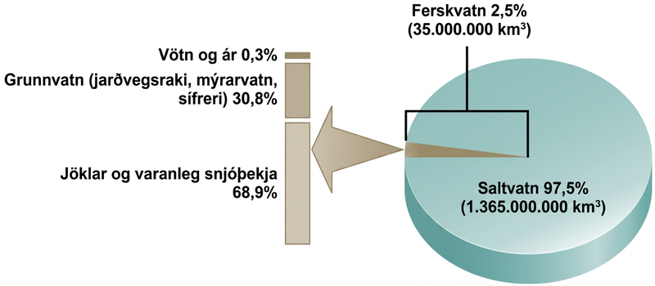
Figure 46.12
Only 2.5 percent of water on Earth is fresh water, and less than 1 percent of fresh water is easily accessible to living things.
Notes:
The pie chart shows that 97.5 percent of water on Earth, or 1,365,000,000 k m cubed, is salt water. The remaining 2.5 percent, or 35,000,000 kilometers cubed, is fresh water. Of the fresh water, 68.9 percent is frozen in glaciers or permanent snow cover. 30.8 percent is groundwater, which is soil moisture, swamp water, and permafrost. The remaining 0.3 percent is in lakes and rivers.

Slide 18
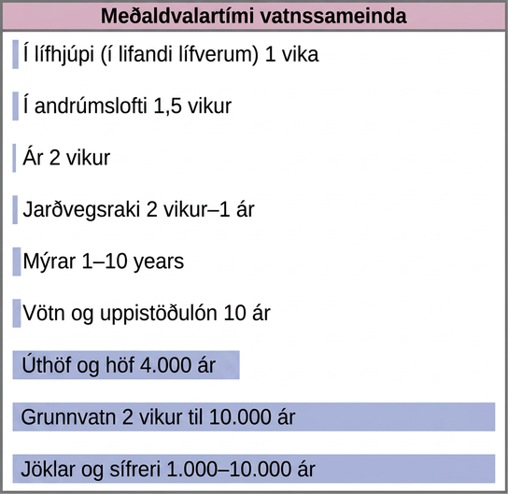
Figure 46.13
This graph shows the average residence time for water molecules in the Earth’s water reservoirs.
Notes:
Bars on the graph show the average residence time for water molecules in various reservoirs. The residence time for glaciers and permafrost is 1,000 to 10,000 years. The residence time for groundwater is 2 weeks to 10,000 years. The residence time for oceans and seas is 4,000 years. The residence time for lakes and reservoirs is 10 years. The residence time for swamps is 1 to ten years. The residence time for soil moisture is 2 weeks to 1 year. The residence time for rivers is 2 weeks. The atmospheric residence time is 1.5 weeks. The biospheric residence time, or residence time in living organisms, is 1 week.

Slide 19
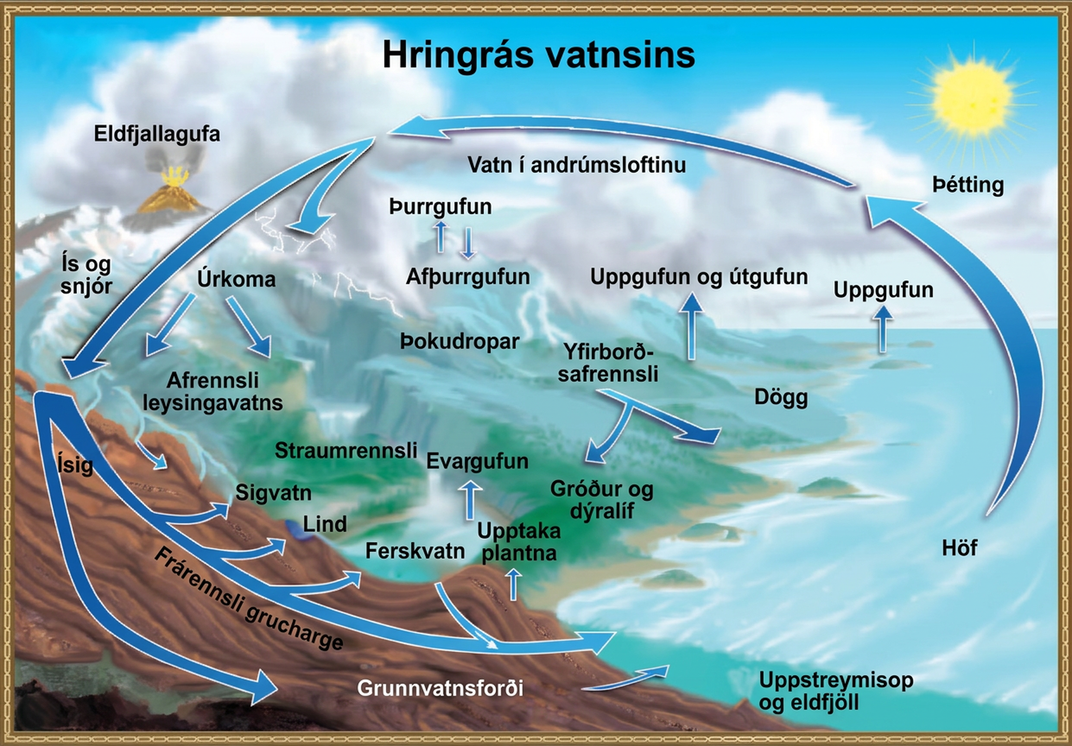
Figure 46.14
Water from the land and oceans enters the atmosphere by evaporation or sublimation, where it condenses into clouds and falls as rain or snow. Precipitated water may enter freshwater bodies or infiltrate the soil. The cycle is complete when surface or groundwater reenters the ocean. (credit: modification of work by John M. Evans and Howard Perlman, USGS)
Notes:
Illustration shows the water cycle. Water enters the atmosphere through evaporation, evapotranspiration, sublimation, and volcanic steam. Condensation in the atmosphere turns water vapor into clouds. Water from the atmosphere returns to the Earth via precipitation or desublimation. Some of this water infiltrates the ground to become groundwater. Seepage, freshwater springs, and plant uptake return some of this water to the surface. The remaining water seeps into the oceans. The remaining surface water enters streams and freshwater lakes, where it eventually enters the ocean via surface runoff. Some water also enters the ocean via underwater vents or volcanoes.

Slide 20
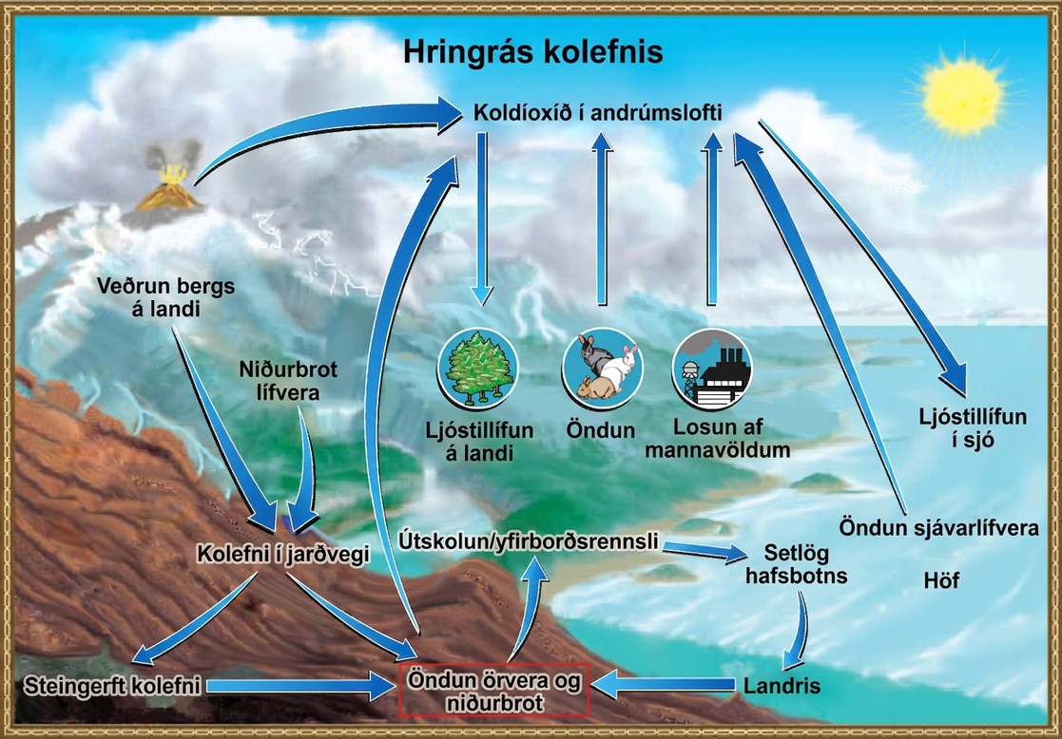
Figure 46.15
Carbon dioxide gas exists in the atmosphere and is dissolved in water. Photosynthesis converts carbon dioxide gas to organic carbon, and respiration cycles the organic carbon back into carbon dioxide gas. Long-term storage of organic carbon occurs when matter from living organisms is buried deep underground and becomes fossilized. Volcanic activity and, more recently, human emissions, bring this stored carbon back into the carbon cycle. (credit: modification of work by John M. Evans and Howard Perlman, USGS)
Notes:
The illustration shows the carbon cycle. Carbon enters the atmosphere as carbon dioxide gas that is released from human emissions, respiration and decomposition, and volcanic emissions. Carbon dioxide is removed from the atmosphere by marine and terrestrial photosynthesis. Carbon from the weathering of rocks and decomposition of organisms becomes soil carbon, which over time can become fossil carbon. Carbon enters the ocean from land via leaching and runoff. Uplifting of ocean sediments can return carbon to land.

Slide 21
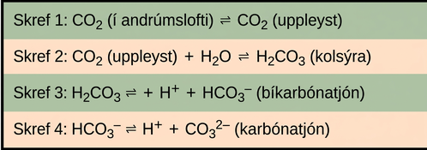
Figure 46.16
Carbon dioxide reacts with water to form bicarbonate and carbonate ions.
Notes:
In step 1, atmospheric carbon dioxide dissolves in water. In step 2 dissolved carbon dioxide, which is written as upper case C upper case O subscript 2 baseline, reacts with water, written as upper case H subscript 2 baseline upper case O, to form carbonic acid which is upper H subscript 2 baseline upper C upper O subscript 3 baseline. In step 3, carbonic acid dissociates into a proton, shown as upper case H plus sign, and a bicarbonate ion, shown as upper H upper C upper O subscript 3 negative. In step 4 the bicarbonate ion dissociates into another proton and a carbonate ion, shown as upper C upper O subscript 3 baseline superscript two negative.

Slide 22
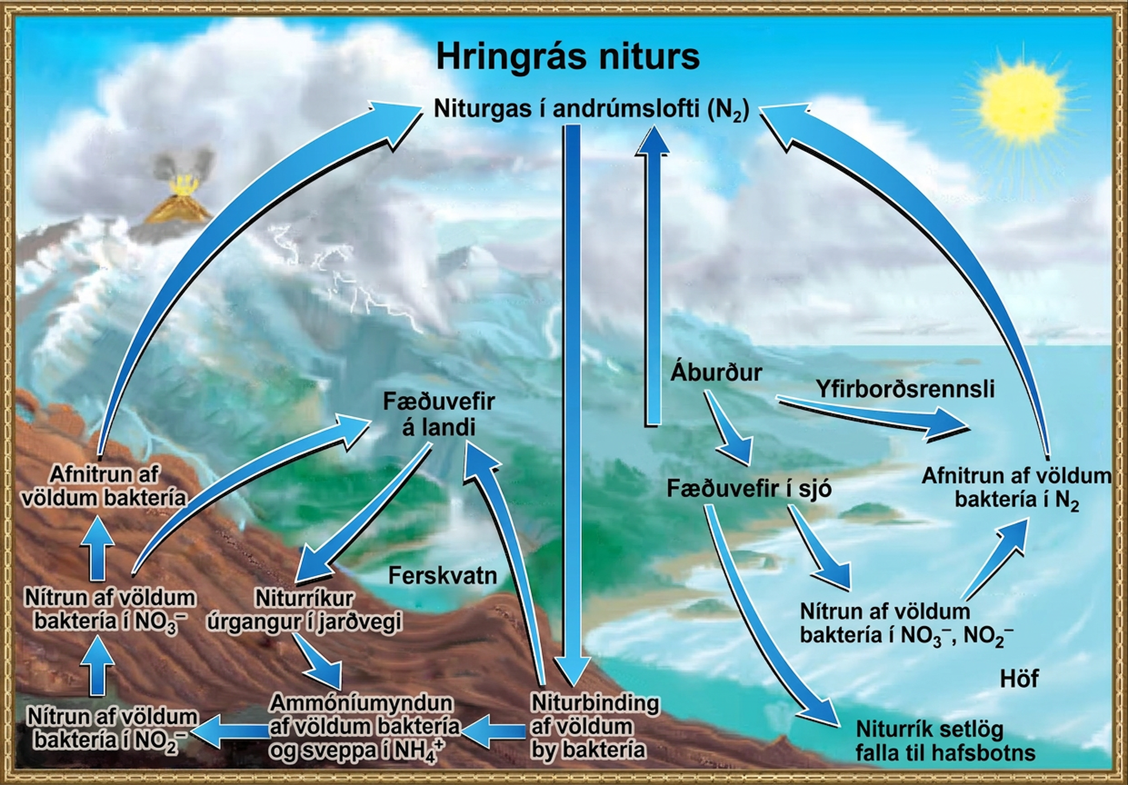
Figure 46.17
Nitrogen enters the living world from the atmosphere via nitrogen-fixing bacteria. This nitrogen and nitrogenous waste from animals is then processed back into gaseous nitrogen by soil bacteria, which also supply terrestrial food webs with the organic nitrogen they need. (credit: modification of work by John M. Evans and Howard Perlman, USGS)
Notes:
This illustration shows the nitrogen cycle. Nitrogen gas from the atmosphere is fixed into organic nitrogen by nitrogen-fixing bacteria. This organic nitrogen enters terrestrial food webs, and it leaves the food webs as nitrogenous wastes in the soil. Ammonification of this nitrogenous waste by bacteria and fungi in the soil converts the organic nitrogen to ammonium ion, or upper N upper H 4 plus. Ammonium is converted to nitrite, or upper N upper O 2 minus, then to nitrate, or upper N upper O 3 minus by nitrifying bacteria. Denitrifying bacteria convert the nitrate back into nitrogen gas, which re-enters the atmosphere. Nitrogen from runoff and fertilizers enters the ocean, where it enters marine food webs. Some organic nitrogen falls to the ocean floor as sediment. Other organic nitrogen in the ocean is converted to nitrite and nitrate ions, which is then converted to nitrogen gas in a process analogous to the one that occurs on land.

Slide 23
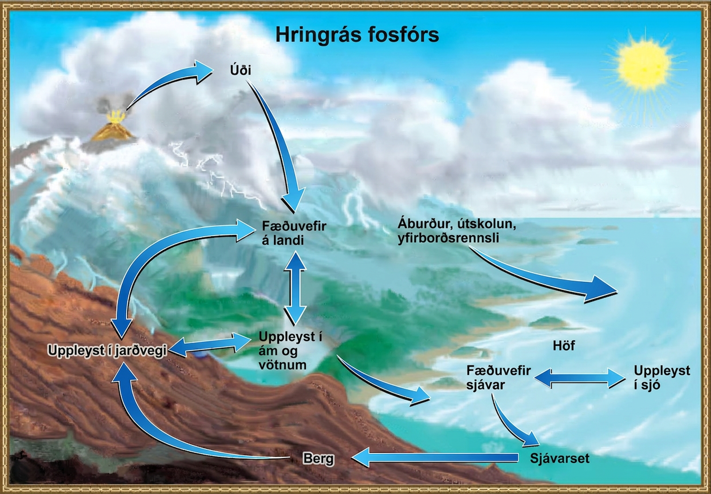
Figure 46.18
In nature, phosphorus exists as the phosphate ion (PO43−). Weathering of rocks and volcanic activity releases phosphate into the soil, water, and air, where it becomes available to terrestrial food webs. Phosphate enters the oceans via surface runoff, groundwater flow, and river flow. Phosphate dissolved in ocean water cycles into marine food webs. Some phosphate from the marine food webs falls to the ocean floor, where it forms sediment. (credit: modification of work by John M. Evans and Howard Perlman, USGS)
Notes:
The illustration shows the phosphorus cycle. Phosphate enters the atmosphere from volcanic aerosols. As this aerosol precipitates to Earth, it enters terrestrial food webs. Some of the phosphate from terrestrial food webs dissolves in streams and lakes, and the remainder enters the soil. Another source of phosphate is fertilizers. Phosphate enters the ocean via leaching and runoff, where it becomes dissolved in ocean water or enters marine food webs. Some phosphate falls to the ocean floor where it becomes sediment. If uplifting occurs, this sediment can return to land.

Slide 24
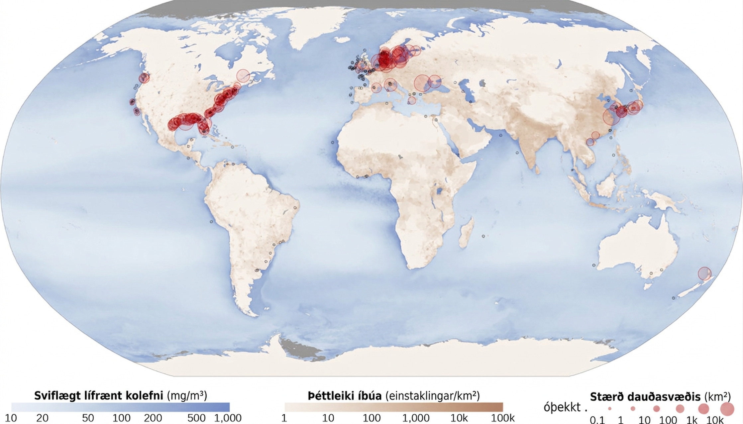
Figure 46.19
Dead zones occur when phosphorus and nitrogen from fertilizers cause excessive growth of microorganisms, which depletes oxygen and kills fauna. Worldwide, large dead zones are found in coastal areas of high population density. (credit: NASA Earth Observatory)
Notes:
World map shows areas where dead zones occur. Dead zones are present along the eastern and western shore of the United States, in the North and Mediterranean Seas and off the east coast of Asia.

Slide 25
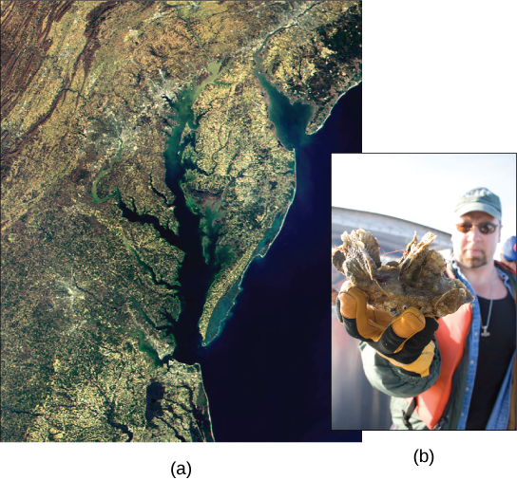
Figure 46.20
This (a) satellite image shows the Chesapeake Bay, an ecosystem affected by phosphate and nitrate runoff. A (b) member of the Army Corps of Engineers holds a clump of oysters being used as a part of the oyster restoration effort in the bay. (credit a: modification of work by NASA/MODIS; credit b: modification of work by U.S. Army)
Notes:
Satellite image shows the Chesapeake Bay. Inset is a photo of a man holding a clump of oysters.

Slide 26
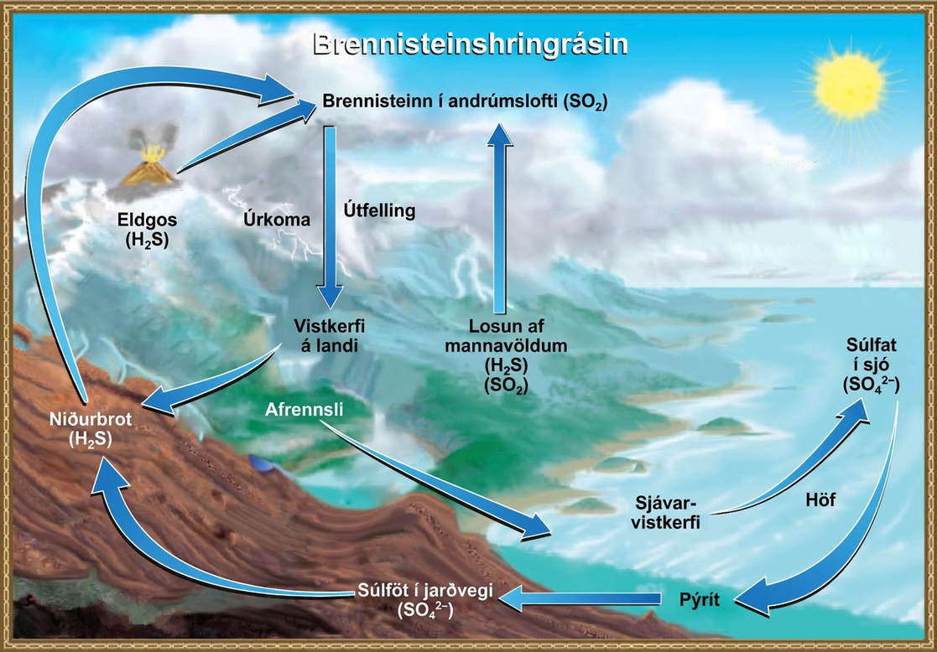
Figure 46.21
Sulfur dioxide from the atmosphere becomes available to terrestrial and marine ecosystems when it is dissolved in precipitation as weak sulfurous acid or when it falls directly to the Earth as fallout. Weathering of rocks also makes sulfates available to terrestrial ecosystems. Decomposition of living organisms returns sulfates to the ocean, soil, and atmosphere. (credit: modification of work by John M. Evans and Howard Perlman, USGS)
Notes:
This illustration shows the sulfur cycle. Sulfur enters the atmosphere as sulfur dioxide, or upper S upper O 2, via human emissions, decomposition of upper H 2 upper S, and volcanic eruptions. Precipitation and fallout from the atmosphere return sulfur to the Earth, where it enters terrestrial ecosystems. Sulfur enters the oceans via runoff, where it becomes incorporated in marine ecosystems. Some marine sulfur becomes pyrite, which is trapped in sediment. If upwelling occurs, the pyrite enters the soil and is converted to soil sulfates.

Slide 27
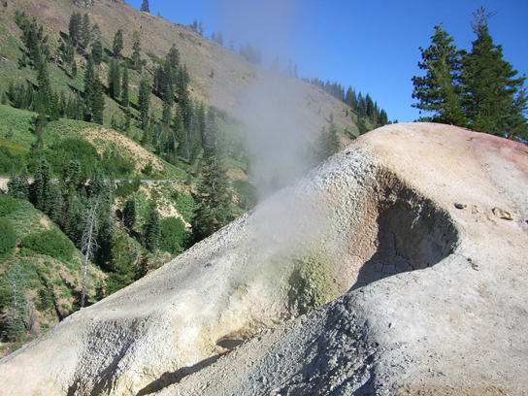
Figure 46.22
At this sulfur vent in Lassen Volcanic National Park in northeastern California, the yellowish sulfur deposits are visible near the mouth of the vent.
This OpenStax ancillary resource is © Rice University under a CC BY-NC-SA 4.0 International license; it may be reproduced or modified for noncommercial purposes only but must be attributed to OpenStax, Rice University and any changes must be noted. Any adaptation must be shared under the same type of license.
Notes:
This photo shows a white pyramid-shaped mound with gray steam escaping from it.

