Slide 1

Biology 2e
Chapter 12 Mendel's Experiments and Heredity

Slide 2
Chapter outline
Mendel’s Experiments and the Laws of Probability
Characteristics and Traits
Laws of Inheritance

Slide 3
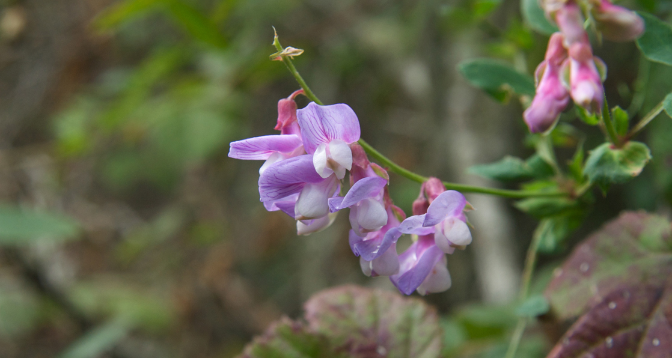
Figure 12.1
Experimenting with thousands of garden peas, Mendel uncovered the fundamentals of genetics. (credit: modification of work by Jerry Kirkhart)
Notes:
Photo shows pea-plant flower, with purple petals that fold back on themselves.

Slide 4
12.1 Mendel’s Experiments and the Laws of Probability
Learning Objectives
Describe the scientific reasons for the success of Mendel’s experimental work
Describe the expected outcomes of monohybrid crosses involving dominant and recessive alleles
Apply the sum and product rules to calculate probabilities

Slide 5
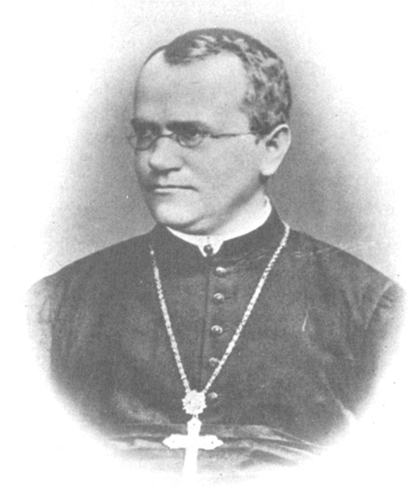
Figure 12.2
Johann Gregor Mendel is considered the father of genetics.
Notes:
Sketch of Gregor Mendel, a monk who wore reading glasses and a large cross.

Slide 6
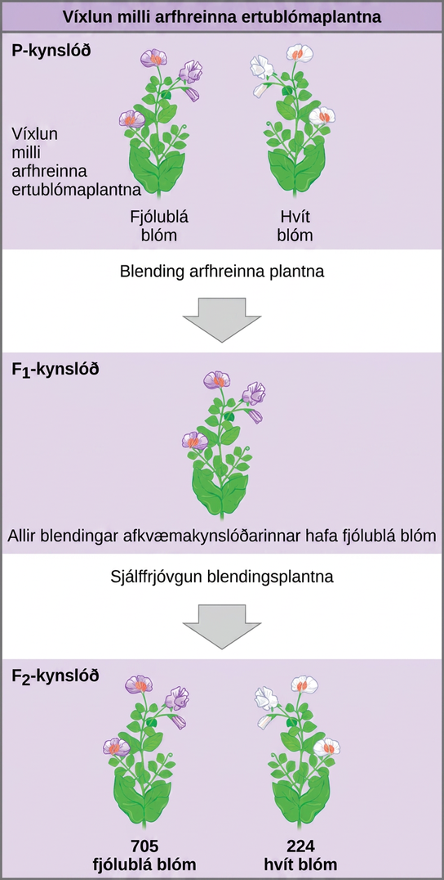
Figure 12.3
In one of his experiments on inheritance patterns, Mendel crossed plants that were true-breeding for violet flower color with plants true-breeding for white flower color (the P generation). The resulting hybrids in the F1 generation all had violet flowers. In the F2 generation, approximately three quarters of the plants had violet flowers, and one quarter had white flowers.
Notes:
The diagram shows a cross between pea plants that are true-breeding for purple flower color and plants true-breeding for white flower color. This cross-fertilization of the upper P generation resulted in an upper case F subscript 1 baseline generation with all violet flowers. Self-fertilization of the upper F subscript one baseline generation resulted in an upper F subscript 2 baseline generation that consisted of 705 plants with violet flowers, and 224 plants with white flowers.

Slide 7
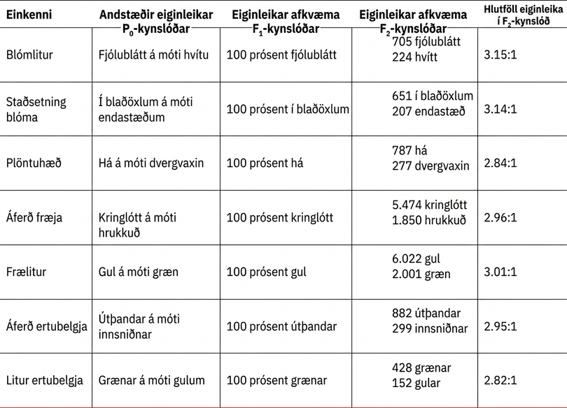
Table 12.1

Slide 8
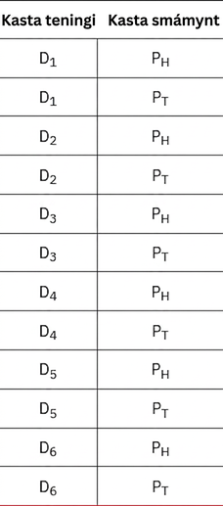
Table 12.2

Slide 9
Table 12.3
Product Rule | Sum Rule
For independent events A and B, the probability (P) of them both occurring (A and B) is (P_{A} × P_{B}) | For mutually exclusive events A and B, the probability (P) that at least one occurs (A or B) is (P_{A} + P_{B})

Slide 10
12.2 Characteristics and Traits (1 of 2)
Learning Objectives
Explain the relationship between genotypes and phenotypes in dominant and recessive gene systems
Develop a Punnett square to calculate the expected proportions of genotypes and phenotypes in a monohybrid cross
Explain the purpose and methods of a test cross

Slide 11
12.2 Characteristics and Traits (2 of 2)
Learning Objectives
Identify non-Mendelian inheritance patterns such as incomplete dominance, codominance, recessive lethals, multiple alleles, and sex linkage

Slide 12
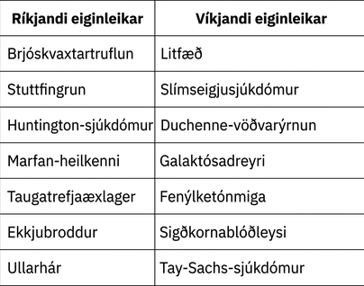
Table 12.4

Slide 13
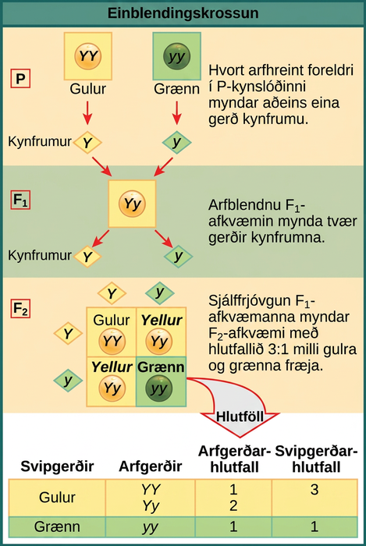
Figure 12.4
In the P generation, pea plants that are true-breeding for the dominant yellow phenotype are crossed with plants with the recessive green phenotype. This cross produces F1 heterozygotes with a yellow phenotype. Punnett square analysis can be used to predict the genotypes of the F2 generation.
Notes:
This illustration shows a monohybrid cross. In the upper P generation, one parent has a dominant yellow phenotype and the genotype upper Y upper Y, and the other parent has the recessive green phenotype and the genotype lower y lower y. Each parent produces one kind of gamete, resulting in an upper F subscript 1 baseline generation with a dominant yellow phenotype and the genotype upper Y lower y. Self-pollination of the upper F subscript 1 baseline generation results in an upper F subscript 2 baseline generation with a 3 to 1 ratio of yellow to green peas. One out of three of the yellow pea plants has a dominant genotype of upper Y upper Y, and 2 out of 3 have the heterozygous phenotype upper Y lower y. The homozygous recessive plant has the green phenotype and the genotype lower y lower y.

Slide 14
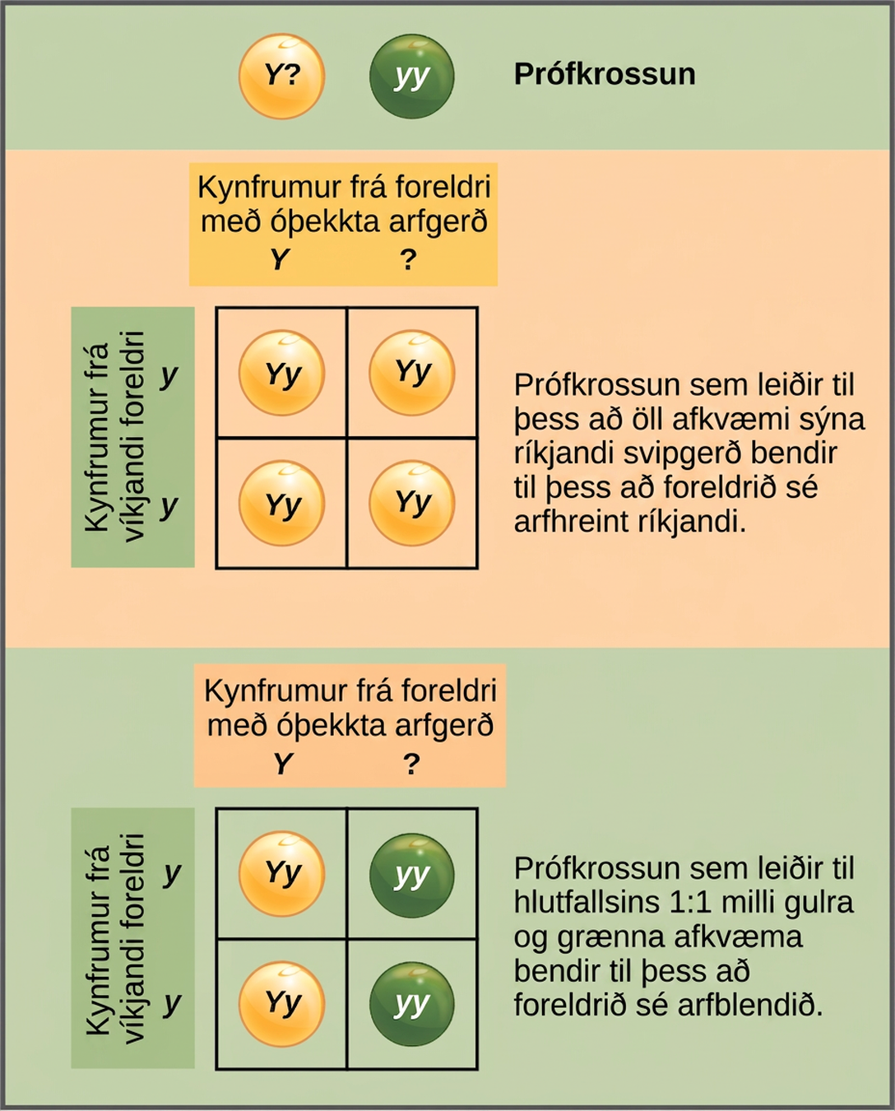
Figure 12.5
A test cross can be performed to determine whether an organism expressing a dominant trait is a homozygote or a heterozygote.
Notes:
In a test cross, a parent with a dominant phenotype but unknown genotype is crossed with a recessive parent. If the parent with the unknown phenotype is homozygous dominant, all of the resulting offspring will have at least one dominant allele. If the parent with the unknown phenotype is heterozygous, fifty percent of the offspring will inherit a recessive allele from both parents and will have the recessive phenotype.

Slide 15
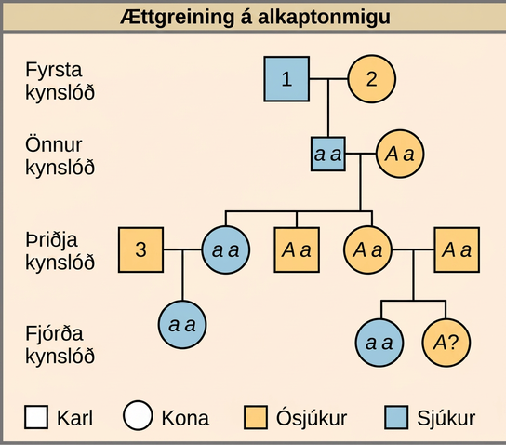
Figure 12.6
Alkaptonuria is a recessive genetic disorder in which two amino acids, phenylalanine and tyrosine, are not properly metabolized. Affected individuals may have darkened skin and brown urine, and may suffer joint damage and other complications. In this pedigree, individuals with the disorder are indicated in blue and have the genotype aa. Unaffected individuals are indicated in yellow and have the genotype AA or Aa. Note that it is often possible to determine a person’s genotype from the genotype of their offspring. For example, if neither parent has the disorder but their child does, they must be heterozygous. Two individuals on the pedigree have an unaffected phenotype but unknown genotype. Because they do not have the disorder, they must have at least one normal allele, so their genotype gets the “A?” designation.
Notes:
This is a pedigree of a family that carries the recessive disorder alkaptonuria. In the second generation, an unaffected mother and an affected father have three children. One child has the disorder, so the genotype of the mother must be upper case A lower case a, and the genotype of the father is lower case a lower case a. One unaffected child goes on to have two children, one affected and one unaffected. Because her husband was not affected, she and her husband must both be heterozygous. The genotype of their unaffected child is unknown, and is designated upper A question mark. In the third generation, the other unaffected child had no offspring. The affected third-generation child goes on to have one child with the disorder. Her husband is unaffected and is labeled 3. The first generation father is affected and is labeled 1; The first generation mother is unaffected and is labeled 2 The Visual Connection question asks the genotype of the three numbered individuals.

Slide 16
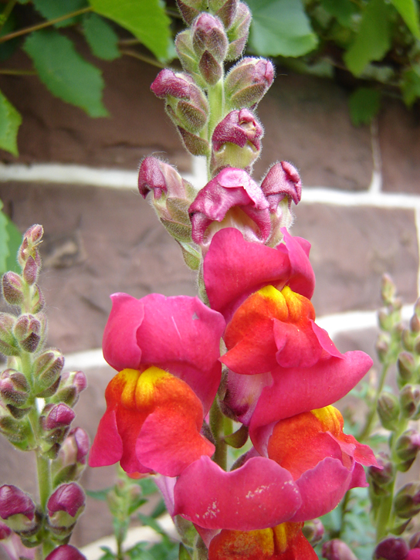
Figure 12.7
These pink flowers of a heterozygote snapdragon result from incomplete dominance. (credit: “storebukkebruse”/Flickr)
Notes:
Photo is of a snapdragon with a pink flower.

Slide 17
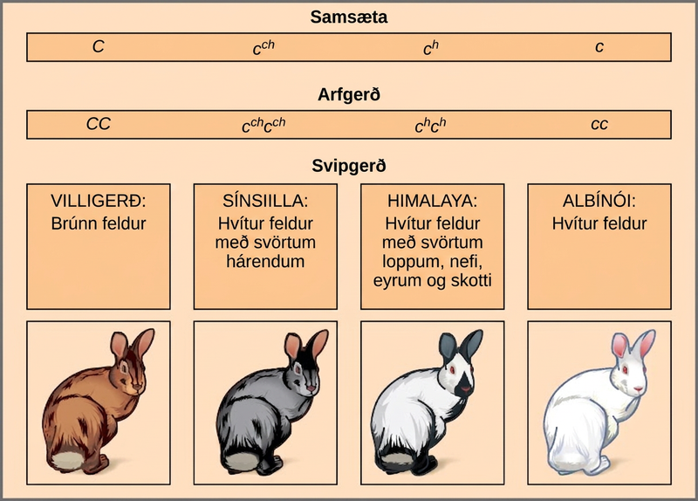
Figure 12.8
Four different alleles exist for the rabbit coat color (C) gene.
Notes:
This illustration shows the four different variants for coat color in rabbits at the c allele. The genotype upper case C upper case C produces the wild type phenotype, which is brown. The genotype lower case c superscript c h baseline lower case c superscript c h baseline produces the chinchilla phenotype, which is black-tipped white fur. The genotype lower case c superscript h baseline, lower case c superscript h baseline, produces the Himalayan phenotype, which is white on the body and black on the extremities. The genotype lower case c lower case c produces the recessive phenotype, which is white.

Slide 18
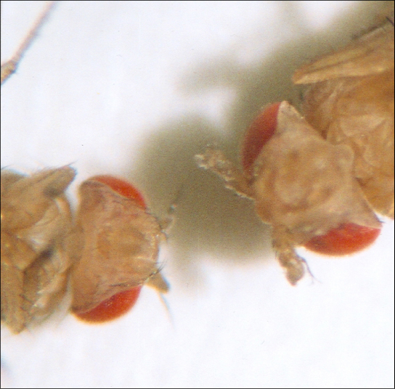
Figure 12.9
As seen in comparing the wild-type Drosophila (left) and the Antennapedia mutant (right), the Antennapedia mutant has legs on its head in place of antennae.
Notes:
This photo shows Drosophila that has normal antennae on its head, and a mutant that has legs on its head.

Slide 19
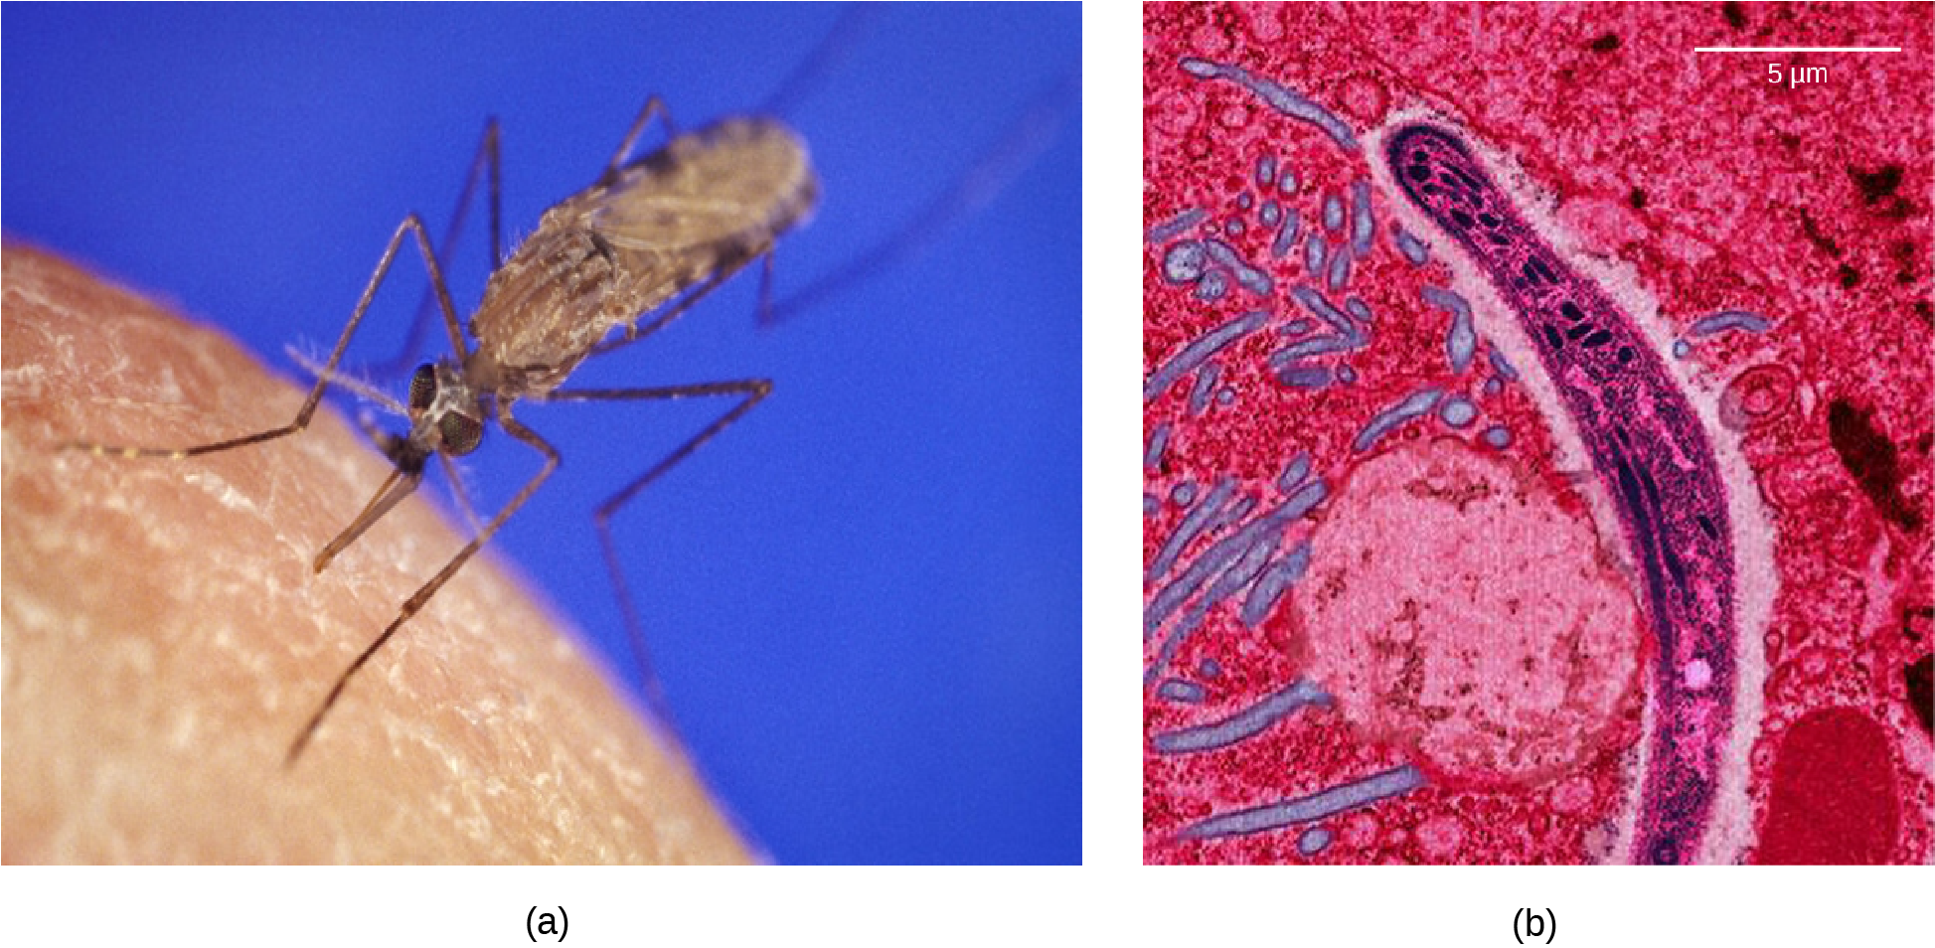
Figure 12.10
The (a) Anopheles gambiae, or African malaria mosquito, acts as a vector in the transmission to humans of the malaria-causing parasite (b) Plasmodium falciparum, here visualized using false-color transmission electron microscopy. (credit a: James D. Gathany; credit b: Ute Frevert; false color by Margaret Shear; scale-bar data from Matt Russell)
Notes:
Photo A shows the Anopheles gambiae mosquito, which carries malaria. Photo b shows a micrograph of sickle-shaped Plasmodium falciparum, the parasite that causes malaria. The Plasmodium is about 0.75 microns across.

Slide 20
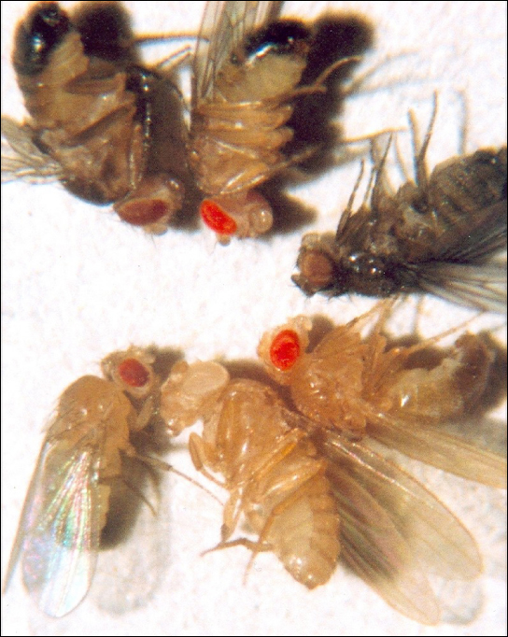
Figure 12.11
In Drosophila, several genes determine eye color. The genes for white and vermilion eye colors are located on the X chromosome. Others are located on the autosomes. Clockwise from top left are brown, cinnabar, sepia, vermilion, white, and red. Red eye color is wild-type and is dominant to white eye color.
Notes:
Photo shows six fruit flies, each with a different eye color.

Slide 21
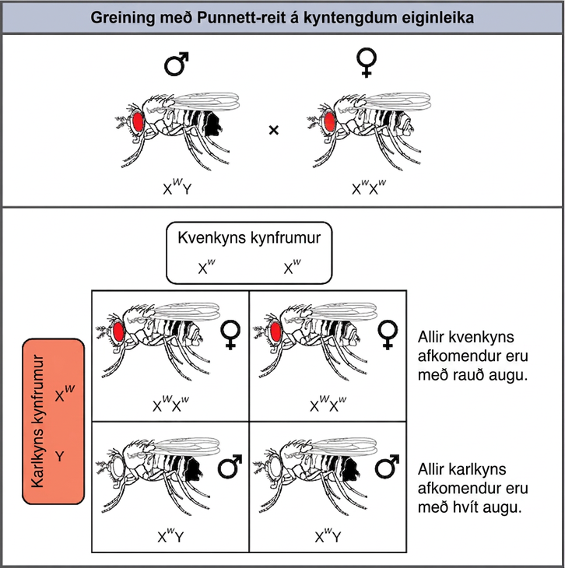
Figure 12.12
Punnett square analysis is used to determine the ratio of offspring from a cross between a red-eyed male fruit fly and a white-eyed female fruit fly.
Notes:
This illustration shows a Punnett square analysis of fruit fly eye color, which is a sex-linked trait. A red-eyed male fruit fly with the genotype X superscript upper case W baseline, Y, is crossed with a white-eyed female fruit fly with the genotype X superscript lower case w baseline, X superscript lower case w baseline. All of the female offspring acquire a dominant upper case W allele from the father and a recessive lower case w allele from the mother, and are therefore heterozygous dominant with red eye color. All of the male offspring acquire a recessive lower case w allele from the mother and a Y chromosome from the father and are therefore hemizygous recessive with white eye color.

Slide 22
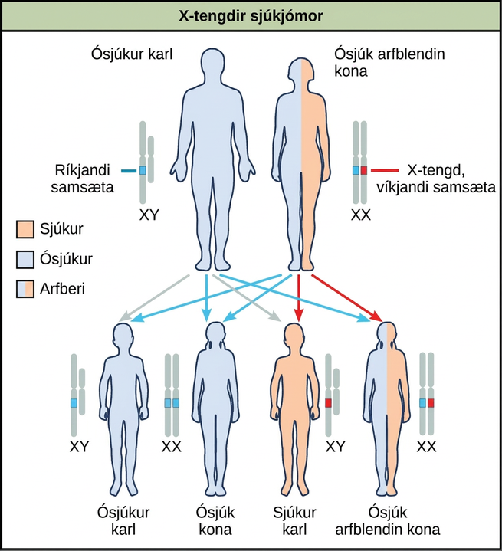
Figure 12.13
The male offspring of a person who is a carrier of a recessive X-linked disorder will have a 50 percent chance of being affected. A female will not be affected, but she will have a 50 percent chance of being a carrier like the female parent.
Notes:
A diagram shows an unaffected male with a dominant allele and an unaffected carrier female with an x-linked recessive allele. Four figures of offspring are shown representing the various resulting genetic combinations: unaffected male offspring, unaffected female offspring, affected male offspring, and unaffected carrier female offspring.

Slide 23
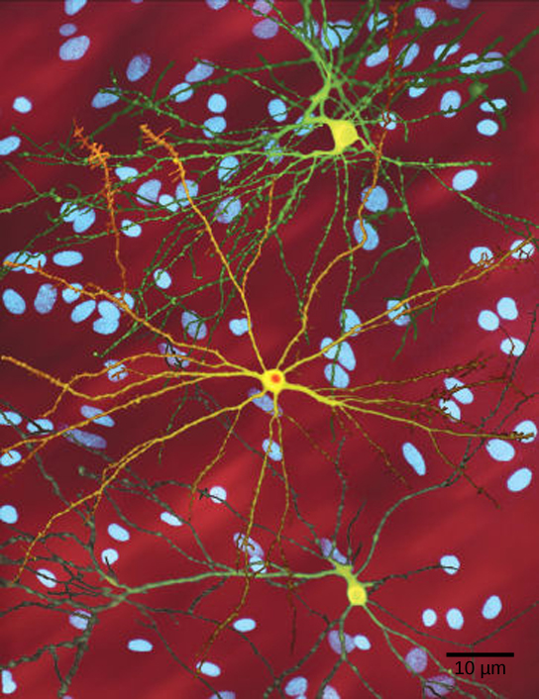
Figure 12.14
The neuron in the center of this micrograph (yellow) has nuclear inclusions characteristic of Huntington’s disease (orange area in the center of the neuron). Huntington’s disease occurs when an abnormal dominant allele for the Huntington gene is present. (credit: Dr. Steven Finkbeiner, Gladstone Institute of Neurological Disease, The Taube-Koret Center for Huntington's Disease Research, and the University of California San Francisco/Wikimedia)
Notes:
Micrograph shows a neuron with nuclear inclusions characteristic of Huntington's disease.

Slide 24
12.3 Laws of Inheritance (1 of 2)
Learning Objectives
Explain Mendel’s law of segregation and independent assortment in terms of genetics and the events of meiosis

Slide 25
12.3 Laws of Inheritance (2 of 2)
Learning Objectives
Use the forked-line method and the probability rules to calculate the probability of genotypes and phenotypes from multiple gene crosses
Explain the effect of linkage and recombination on gamete genotypes
Explain the phenotypic outcomes of epistatic effects between genes

Slide 26
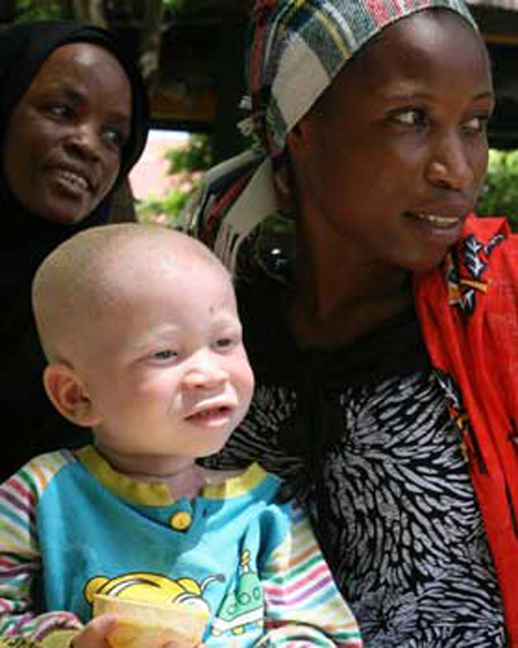
Figure 12.15
The child in the photo expresses albinism, a recessive trait.
Notes:
Photo shows an albino child with his black mother.

Slide 27
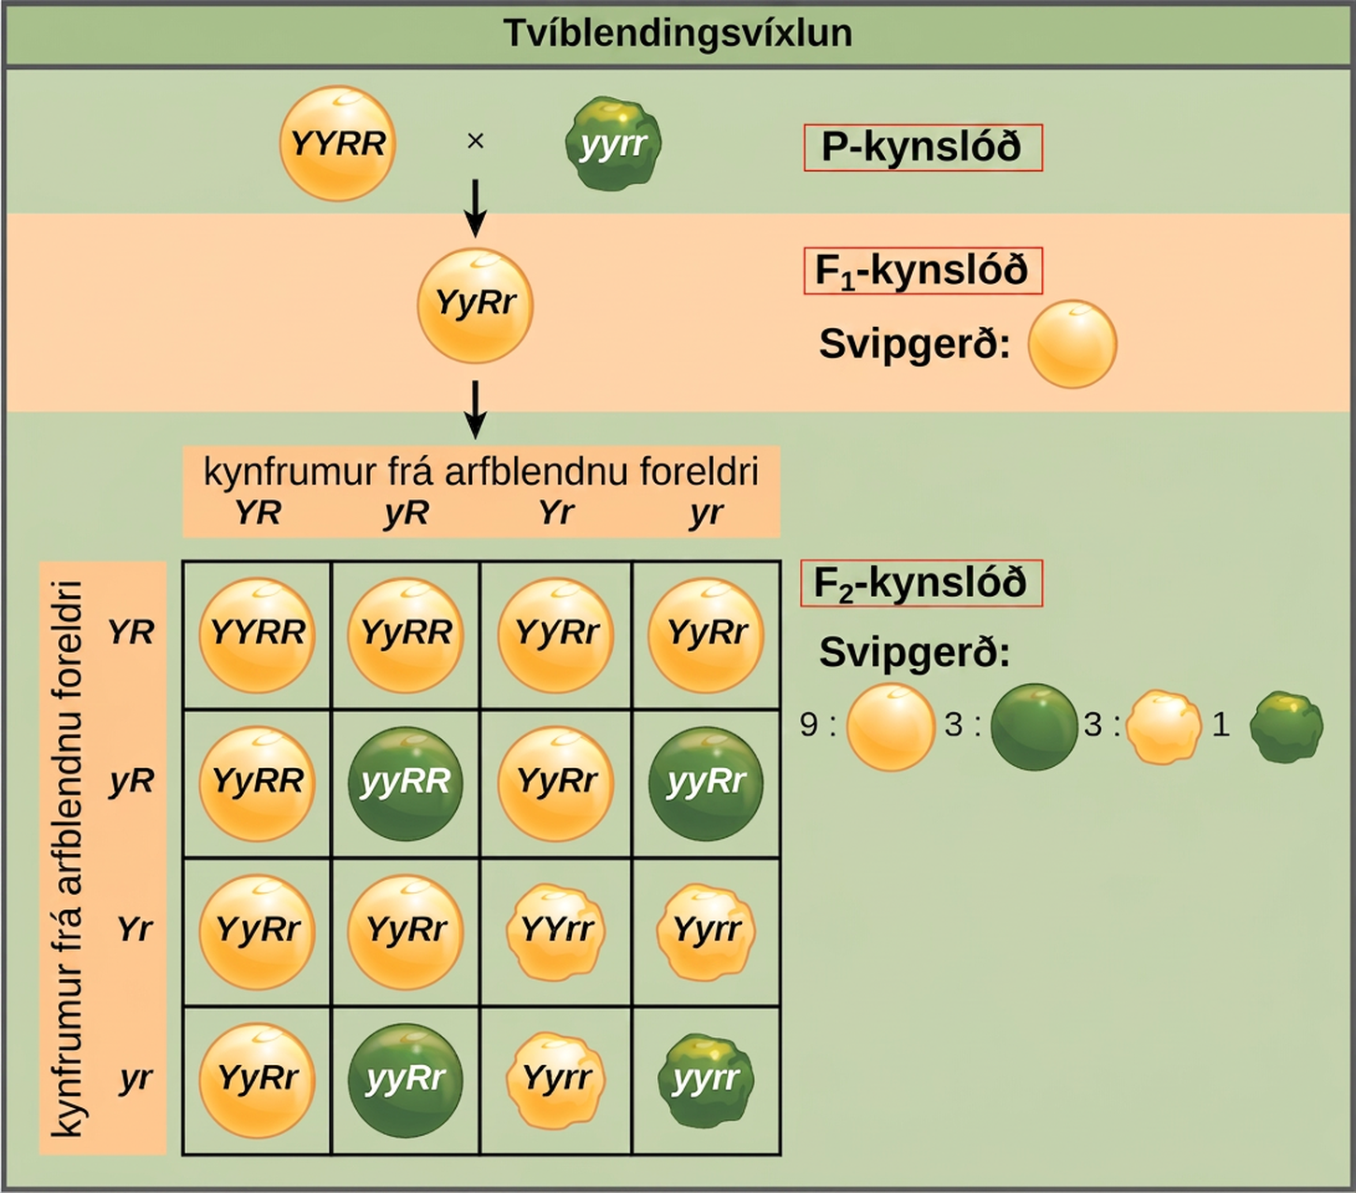
Figure 12.16
This dihybrid cross of pea plants involves the genes for seed color and texture.
Notes:
This illustration shows a dihybrid cross between pea plants. In the upper case P generation, a plant that has the homozygous dominant phenotype of round, yellow peas is crossed with a plant with the homozygous recessive phenotype of wrinkled, green peas. The resulting F subscript 1 baseline offspring have a heterozygous genotype and round, yellow peas. Self-pollination of the F subscript 1 baseline generation results in F subscript 2 baseline offspring with a phenotypic ratio of 9 colon 3 colon 3 colon 1 for yellow round, green round, yellow wrinkled and green wrinkled peas, respectively.

Slide 28
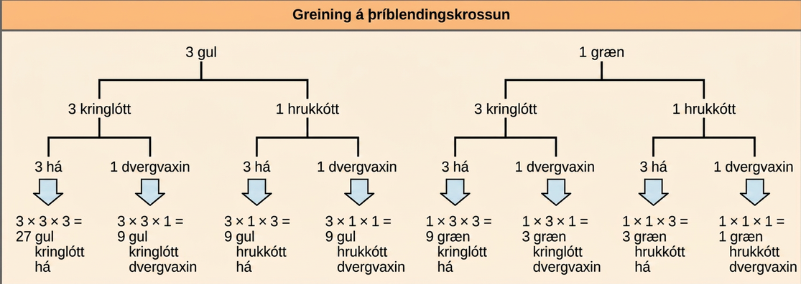
Figure 12.17
The forked-line method can be used to analyze a trihybrid cross. Here, the probability for color in the F2 generation occupies the top row (3 yellow:1 green). The probability for shape occupies the second row (3 round: 1 wrinkled), and the probability for height occupies the third row (3 tall:1 dwarf). The probability for each possible combination of traits is calculated by multiplying the probability for each individual trait. Thus, the probability of F2 offspring having yellow, round, and tall traits is 3 × 3 × 3, or 27.
Notes:
A forked-line diagram is shown for the F subscript 2 baseline generation of a trihybrid cross of pea plants with the dominant yellow, round, and tall phenotype with pea plants of the recessive green, wrinkled, dwarf phenotype. The top row shows that the color ratio is 3 yellow to 1 green in the F subscript 2 baseline generation. The second row shows that the probability that plants of either pea color having the round or wrinkled texture is 3 to 1. The third row shows that the probability of plants with either of the above textures having a round or wrinkled phenotype is 3 to 1. The probability of all three phenotypes occurring together is determined by multiplying each individual probability together. The probability ratio is 27 yellow slash round slash tall colon; 9 yellow slash round slash dwarf, colon, 9 yellow slash wrinked slash tall, colon, 3 yellow slash wrinkled slash dwarf, colon, 9 green slash round slash tall, colon, 3 green slash round slash dwarf, colon 3 green slash wrinkled slash tall, colon, 1 green slash wrinkled slash dwarf.

Slide 29
Table 12.5
General Rule | Number of Heterozygous Gene Pairs
Number of different F₁ gametes | 2^{n}
Number of different F₂ genotypes | 3^{n}
Given dominant and recessive inheritance, the number of different F₂ phenotypes | 2^{n}

Slide 30
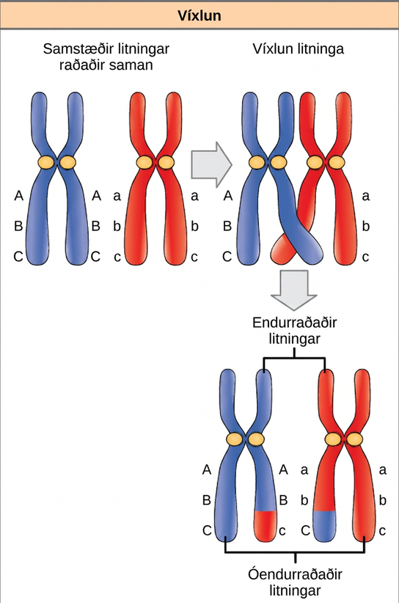
Figure 12.18
The process of crossover, or recombination, occurs when two homologous chromosomes align during meiosis and exchange a segment of genetic material. Here, the alleles for gene C were exchanged. The result is two recombinant and two non-recombinant chromosomes (for clarity, only one recombination event between two of the four chromatids is represented).
Notes:
This illustration shows a pair of homologous chromosomes. One of the pair has the alleles upper case A upper case B upper case C, and the other has the alleles lower case a lower case b lower case c. During meiosis, crossover occurs between two of the chromosomes and genetic material is exchanged, resulting in one recombinant chromosome that has the alleles upper A upper B lower c and another that has the alleles lower a lower b upper C. The other two chromosomes are non-recombinant and have the same arrangement of genes as before meiosis.

Slide 31
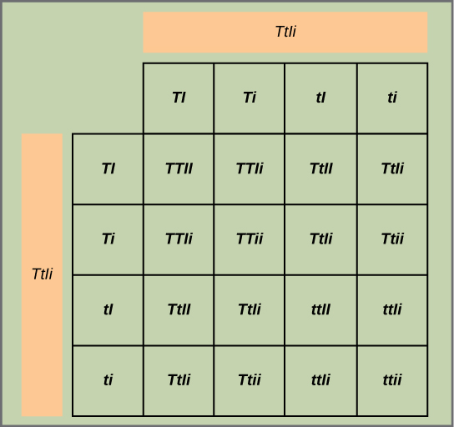
Figure 12.19
This figure shows all possible combinations of offspring resulting from a dihybrid cross of pea plants that are heterozygous for the tall/dwarf and inflated/constricted alleles.
Notes:
This figure shows all possible combinations of offspring resulting from a dihybrid cross of pea plants that are heterozygous for the tall slash dwarf and inflated slash constricted alleles.

Slide 32
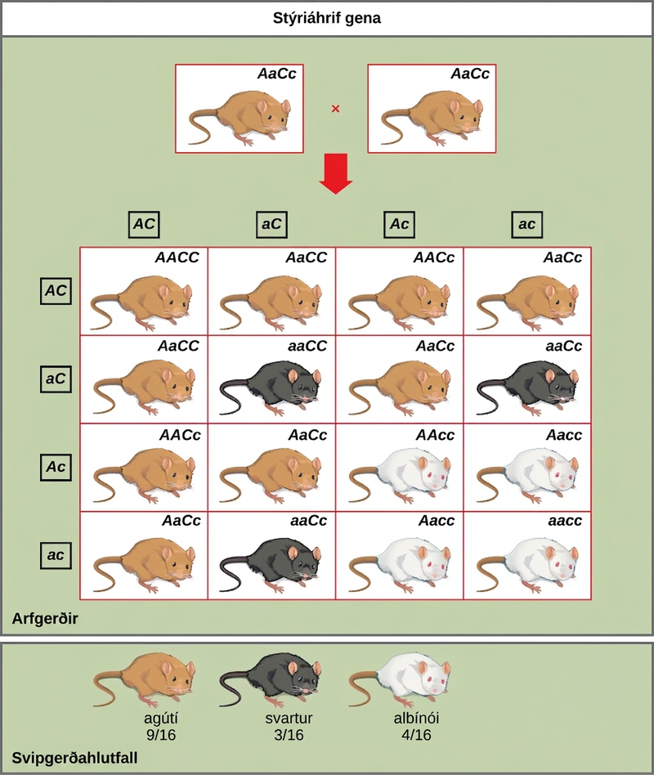
Figure 12.20
In mice, the mottled agouti coat color (A) is dominant to a solid coloration, such as black or gray. A gene at a separate locus (C) is responsible for pigment production. The recessive c allele does not produce pigment, and a mouse with the homozygous recessive cc genotype is albino regardless of the allele present at the A locus. Thus, the C gene is epistatic to the A gene.
This OpenStax ancillary resource is © Rice University under a CC BY-NC-SA 4.0 International license; it may be reproduced or modified for noncommercial purposes only but must be attributed to OpenStax, Rice University and any changes must be noted. Any adaptation must be shared under the same type of license.
Notes:
A cross between two agouti mice with the heterozygous genotype upper A lower a upper C lower c is shown. Each mouse produces four different kinds of gametes, which are upper A upper C, and lower a upper C, and upper A lower c, and lower a lower c. A 4 by 4 Punnett square is used to determine the genotypic ratio of the offspring. The phenotypic ratio is 9 slash 16 agouti, 3 slash 16 black, and 4 slash 16 white.

