Slide 1

Biology 2e
Chapter 21 Viruses

Slide 2
Chapter outline
Viral Evolution, Morphology, and Classification
Virus Infections and Hosts
Prevention and Treatment of Viral Infections
Other Acellular Entities: Prions and Viroids

Slide 3
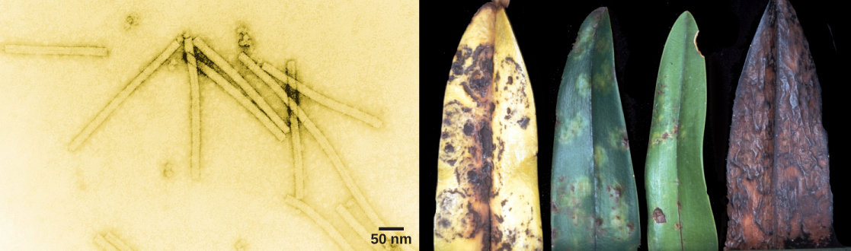
Figure 21.1
The tobacco mosaic virus, seen here by transmission electron microscopy (left), was the first virus to be discovered. The virus causes disease in tobacco and other plants, such as the orchid (right). (credit a: USDA ARS; credit b: modification of work by USDA Forest Service, Department of Plant Pathology Archive North Carolina State University; scale-bar data from Matt Russell)
Notes:
The left electron micrograph shows the tobacco mosaic virus, which is shaped like a long, thin rectangle. The right photo shows an orchid leaf in varying states of decay. Initial symptoms are yellow and brown spots. Eventually, the entire leaf turns yellow with brown blotches, then completely brown.

Slide 4
21.1 Viral Evolution, Morphology, and Classification (1 of 2)
Learning Objectives
Describe how viruses were first discovered and how they are detected
Discuss three hypotheses about how viruses evolved
Describe the general structure of a virus
Recognize the basic shapes of viruses
Understand past and emerging classification systems for viruses

Slide 5
21.1 Viral Evolution, Morphology, and Classification (2 of 2)
Learning Objectives
Describe the basis for the Baltimore classification system

Slide 6
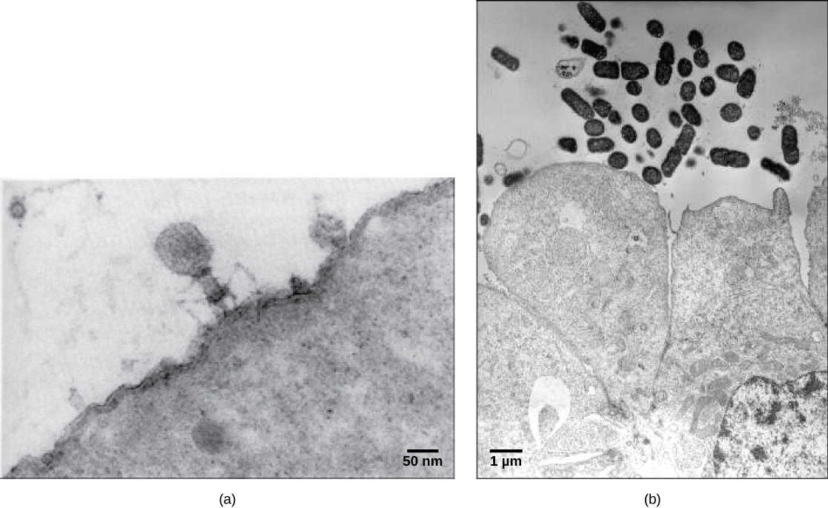
Figure 21.2
Most virus particles are visible only by electron microscopy. In these transmission electron micrographs, (a) a virus is as dwarfed by the bacterial cell it infects, as (b) these E. coli cells are dwarfed by cultured colon cells. (credit a: modification of work by U.S. Dept. of Energy, Office of Science, LBL, PBD; credit b: modification of work by J.P. Nataro and S. Sears, unpub. data, CDC; scale-bar data from Matt Russell)
Notes:
Micrograph a shows a virus with a hexagonal head that stands on thin, bent legs. The virus sits on the surface of a cell that is so large that only a small fraction of its surface is visible. Micrograph b shows small bacterial cells that are about the size of the organelles in the adjacent colon cells.

Slide 7
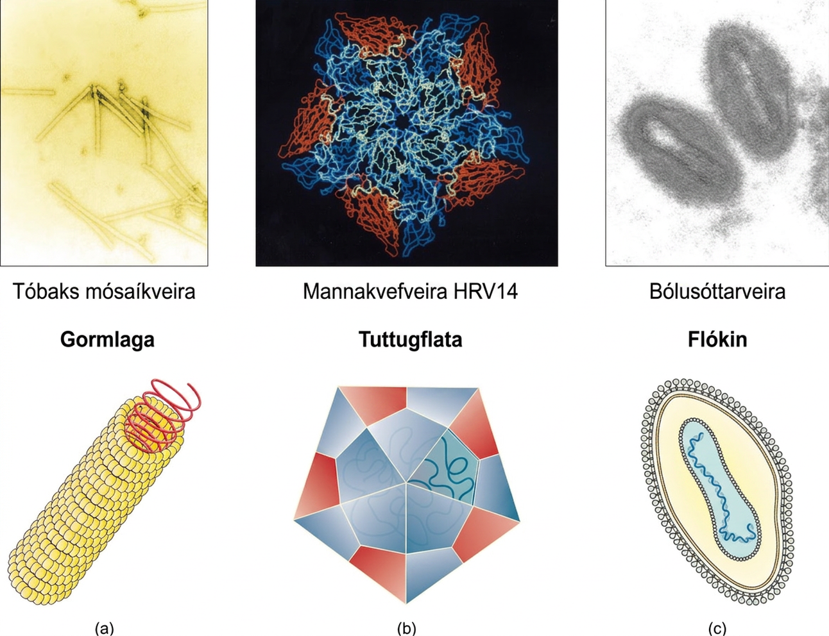
Figure 21.3
Viral capsids can be (a) helical, (b) polyhedral, or (c) have a complex shape. (credit a “micrograph”: modification of work by USDA ARS; credit b “micrograph”: modification of work by U.S. Department of Energy)
Notes:
Figure a is a helical virus which has a long linear structure. The outer proteins are small spheres arranged into a long, hollow tube. Inside the tube is the genetic material. Tobacco mosaic virus is an example of a helical virus. Figure b is an icosahedral virus which has a polyhedron structure. The example shown is human rhinovirus which has a pentagon structure. Complex viruses have a more complex structure in figure C. The example is variola which has an ovoid structure.

Slide 8
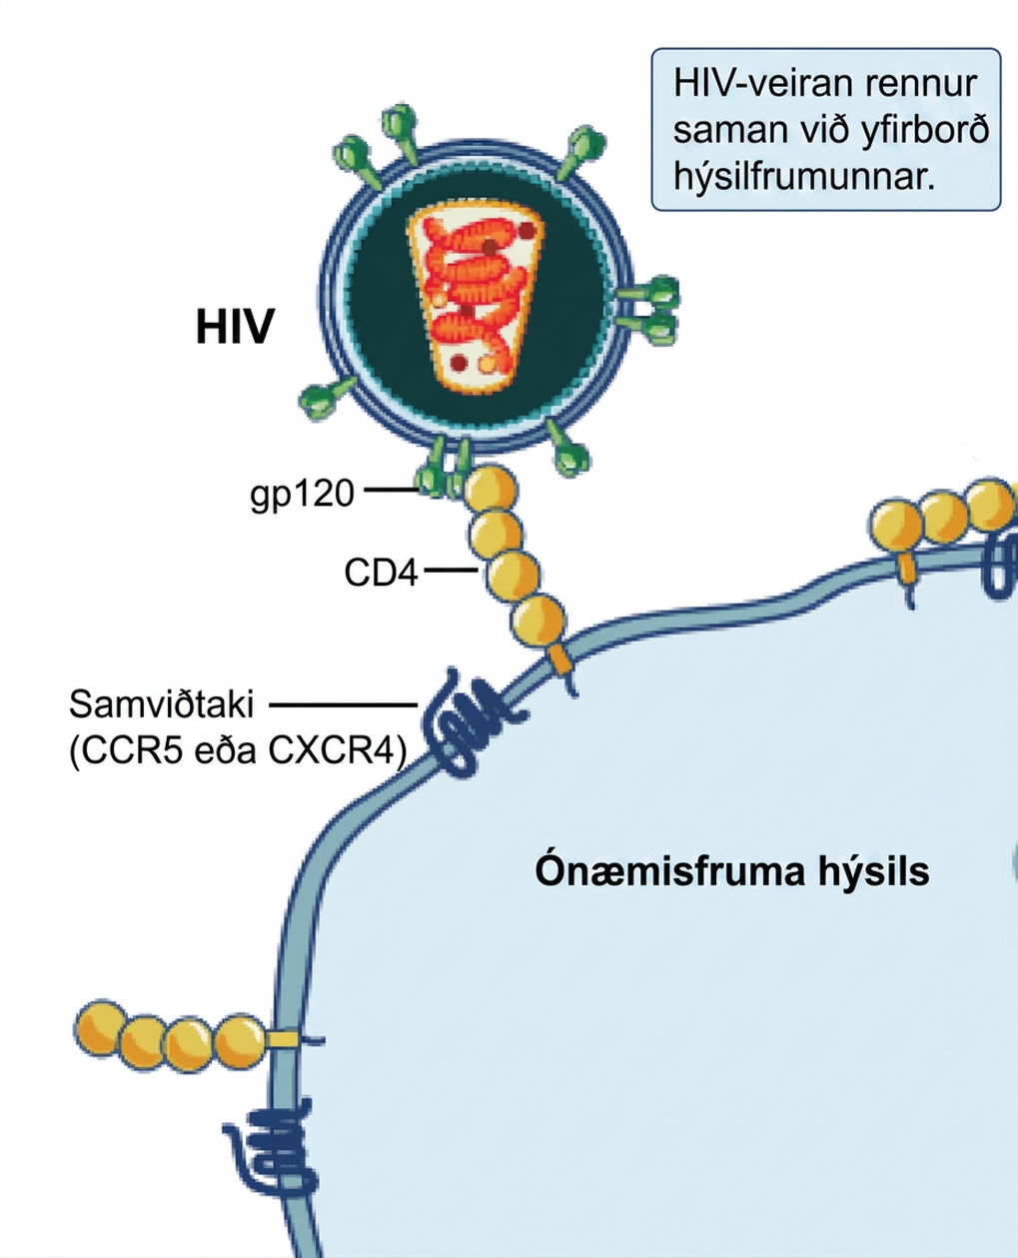
Figure 21.4
A virus and its host receptor protein. The HIV virus binds the CD4 receptor on the surface of human cells. CD4 receptors help white blood cells to communicate with other cells of the immune system when producing an immune response. (credit: modification of work by NIAID, NIH)
Notes:
In the illustration an H I V virus attaches to a C D 4 molecule embedded in the plasma membrane of a host immune cell.

Slide 9
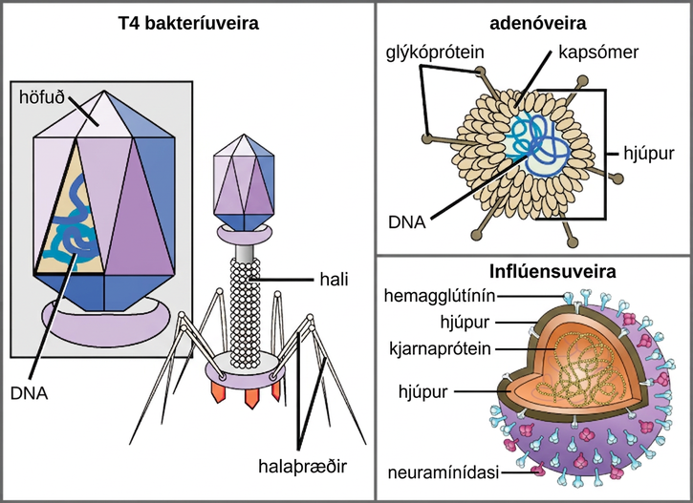
Figure 21.5
Complex Viruses. Viruses can be either complex or relatively simple in shape. This figure shows three relatively complex virions: the bacteriophage T4, with its DNA-containing head group and tail fibers that attach to host cells; adenovirus, which uses spikes from its capsid to bind to host cells; and the influenza virus, which uses glycoproteins embedded in its envelope to bind to host cells. The influenza virus also has matrix proteins, internal to the envelope, which help stabilize the virion’s shape. (credit “bacteriophage, adenovirus”: modification of work by NCBI, NIH; credit "influenza virus": modification of work by Dan Higgins, Centers for Disease Control and Prevention)
Notes:
Illustration a shows bacteriophage T 4, which houses its D N A genome in a hexagonal head. A long, straight tail extends from the bottom of the head. Tail fibers attached to the base of the tail are bent, like spider legs. In b, adenovirus houses its D N A genome in a round capsid made from many small capsomere subunits. Glycoproteins extend from the capsomere, like pins from a pincushion. In c, the influenza virus houses its R N A genome and a bullet-shaped capsid. A spherical viral envelope, lined with matrix proteins, surrounds the capsid. Two different varieties of glycoprotein spike are embedded in the envelope. Approximately 80 percent of the spikes are hemagglutinin. The remaining 20 percent or so of the glycoprotein spikes consist of neuraminidase.

Slide 10
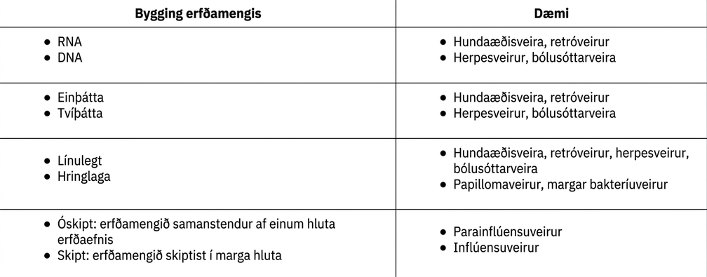
Table 21.1

Slide 11
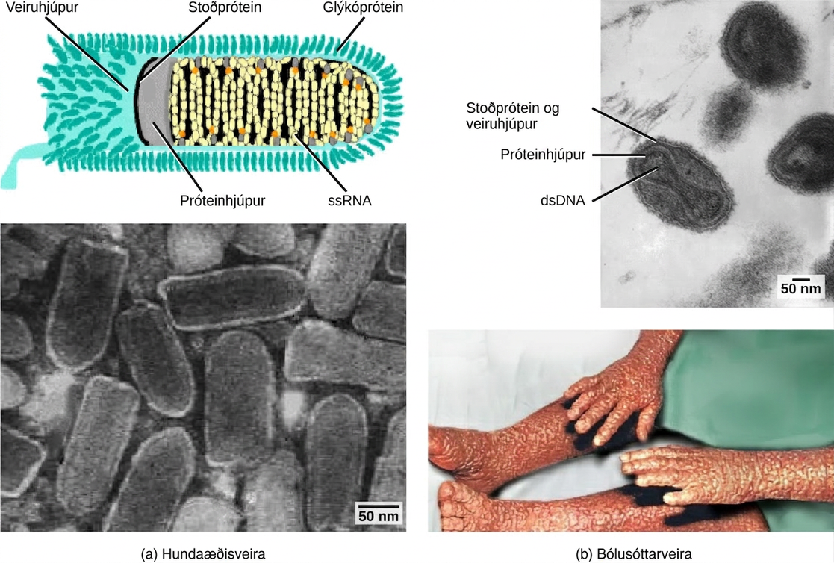
Figure 21.6
Viruses can be classified according to their core genetic material and capsid design. (a) Rabies virus has a single-stranded RNA (ssRNA) core and an enveloped helical capsid, whereas (b) variola virus, the causative agent of smallpox, has a double-stranded DNA (dsDNA) core and a complex capsid. Rabies transmission occurs when saliva from an infected mammal enters a wound. The virus travels through neurons in the peripheral nervous system to the central nervous system, where it impairs brain function, and then travels to other tissues. The virus can infect any mammal, and most die within weeks of infection. Smallpox is a human virus transmitted by inhalation of the variola virus, localized in the skin, mouth, and throat, which causes a characteristic rash. Before its eradication in 1979, infection resulted in a 30 to 35 percent mortality rate. (credit “rabies diagram”: modification of work by CDC; “rabies micrograph”: modification of work by Dr. Fred Murphy, CDC; credit “small pox micrograph”: modification of work by Dr. Fred Murphy, Sylvia Whitfield, CDC; credit “smallpox photo”: modification of work by CDC; scale-bar data from Matt Russell)
Notes:
Part a is an illustration of the rabies virus, which is bullet shaped. R N A is coiled inside a capsid, which is encased in a matrix protein lined viral envelope studded with glycoproteins. Part a below is a micrograph of a cluster of bullet shaped rabies viruses. Part b is a micrograph of variola virus, which has D N A encased in a bow shaped capsid. An oval matrix protein-lined envelope surrounds the capsid. Part b below shows irregular, bumpy lesions on the arms and legs of a person with smallpox.

Slide 12
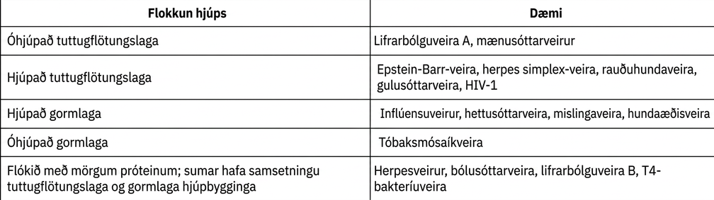
Table 21.2

Slide 13
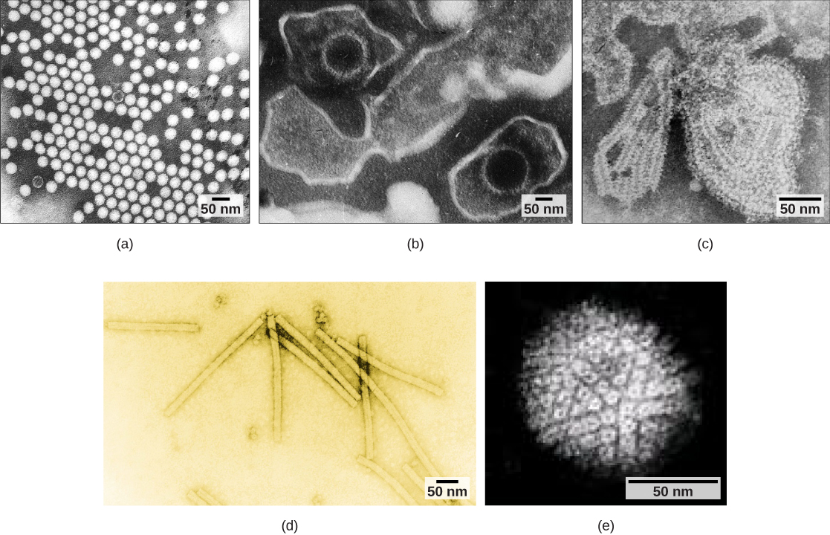
Figure 21.7
Transmission electron micrographs of various viruses show their capsid structures. The capsid of the (a) polio virus is naked icosahedral; (b) the Epstein-Barr virus capsid is enveloped icosahedral; (c) the mumps virus capsid is an enveloped helix; (d) the tobacco mosaic virus capsid is naked helical; and (e) the herpesvirus capsid is complex. (credit a: modification of work by Dr. Fred Murphy, Sylvia Whitfield; credit b: modification of work by Liza Gross; credit c: modification of work by Dr. F. A. Murphy, CDC; credit d: modification of work by USDA ARS; credit e: modification of work by Linda Stannard, Department of Medical Microbiology, University of Cape Town, South Africa, NASA; scale-bar data from Matt Russell)
Notes:
Micrograph a shows icosahedral polioviruses arranged in a grid; micrograph b shows two Epstein-Barr viruses with icosahedral capsids encased in an oval membrane; micrograph c shows a mumps virus capsid encased in an irregular membrane; micrograph d shows rectangular tobacco mosaic virus capsids; and micrograph e shows a spherical herpesvirus envelope studded with glycoproteins.

Slide 14
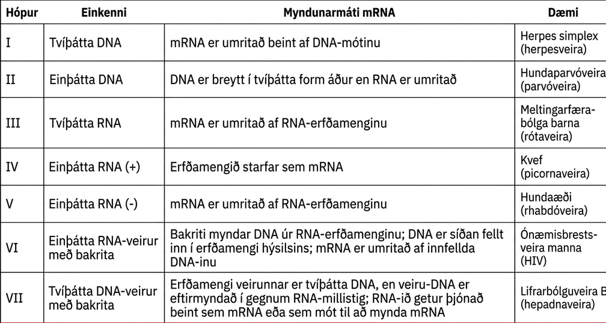
Table 21.3

Slide 15
21.2 Virus Infections and Hosts
Learning Objectives
List the steps of replication and explain what occurs at each step
Describe the lytic and lysogenic cycles of virus replication
Explain the transmission of plant and animal viruses
Discuss some of the diseases caused by plant and animal viruses
Discuss the economic impact of plant and animal viruses

Slide 16
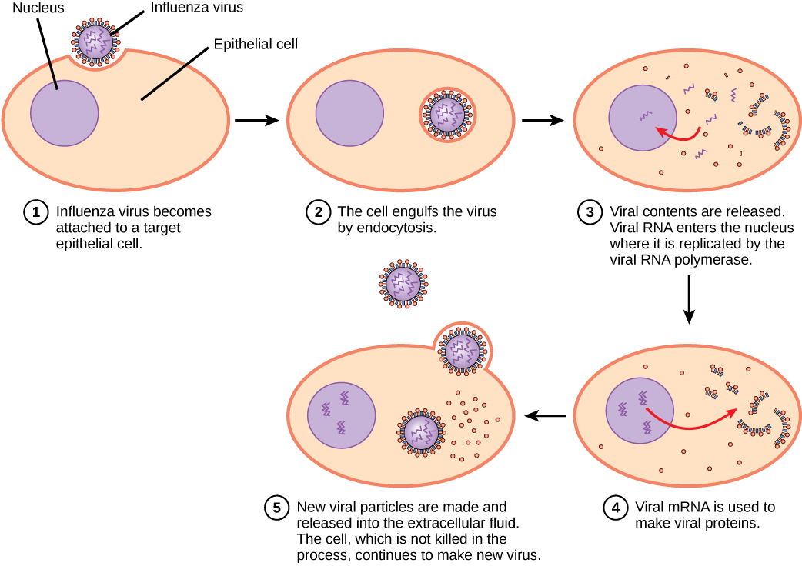
Figure 21.8
The influenza reproductive cycle. In influenza virus infection, glycoproteins on the capsid attach to a host epithelial cell. Following this, the virus is engulfed. RNA and proteins are then made and assembled into new virions.
Notes:
The illustration shows the steps of an influenza virus infection. In step 1, influenza virus becomes attached to a target epithelial cell. In step 2, the cell engulfs the virus by endocytosis, and the virus becomes encased in the cell's plasma membrane. In step 3, the membrane dissolves, and the viral contents are released into the cytoplasm. Viral m R N A enters the nucleus, where it is replicated by viral R N A polymerase. In step 4, viral m R N A exits to the cytoplasm, where it is used to make viral proteins. In step 5, new viral particles are released into the extracellular fluid. The cell, which is not killed in the process, continues to make new virus.

Slide 17
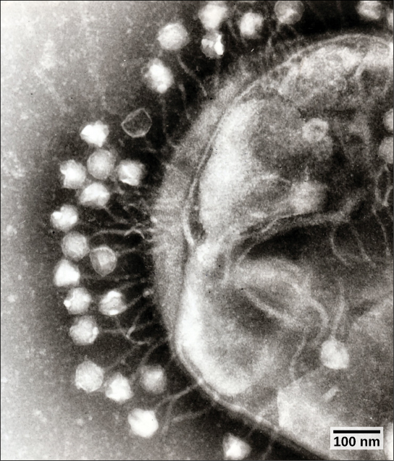
Figure 21.9
Bacteriophages attached to a host cell (transmission electron micrograph). In bacteriophage with tails, like the one shown here, the tails serve as a passageway for transmission of the phage genome. (credit: modification of work by Dr. Graham Beards; scale-bar data from Matt Russell)
Notes:
The micrograph shows hexagonal bacteriophage capsids attached to a host bacterial cell by slender stalks.

Slide 18
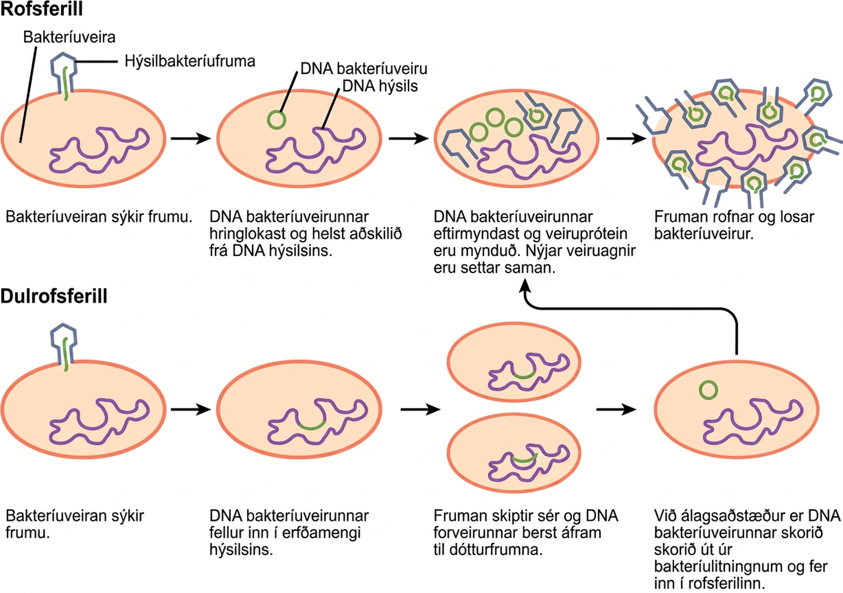
Figure 21.10
A temperate bacteriophage has both lytic and lysogenic cycles. In the lytic cycle, the phage replicates and lyses the host cell. In the lysogenic cycle, phage DNA is incorporated into the host genome, where it is passed on to subsequent generations. Environmental stressors such as starvation or exposure to toxic chemicals may cause the prophage to excise and enter the lytic cycle.
Notes:
The bacteriophage lytic cycle begins when the phage attaches via a slender stalk to the host cell. Linear DNA from the viral head is injected into the host cell. The phage DNA circularizes, remaining separate from the host DNA. The phage DNA replicates, and new phage proteins are made. New phage particles are assembled. The cell lyses, releasing the phage. The bacteriophage lysogenic cycle begins the same way as the lytic cycle, with phage infecting a host cell. However, the phage DNA becomes incorporated into the host genome. The cell divides, and phage DNA is passed on to daughter cells. Under stressful conditions, the phage DNA is excised from the bacterial chromosome and enters the lytic cycle.

Slide 19
Table 21.4
Symptom | Appears as
Hyperplasia | Galls (tumors)
Hypoplasia | Thinned, yellow splotches on leaves
Cell necrosis | Dead, blackened stems, leaves, or fruit
Abnormal growth patterns | Malformed stems, leaves, or fruit
Discoloration | Yellow, red, or black lines, or rings in stems, leaves, or fruit

Slide 20
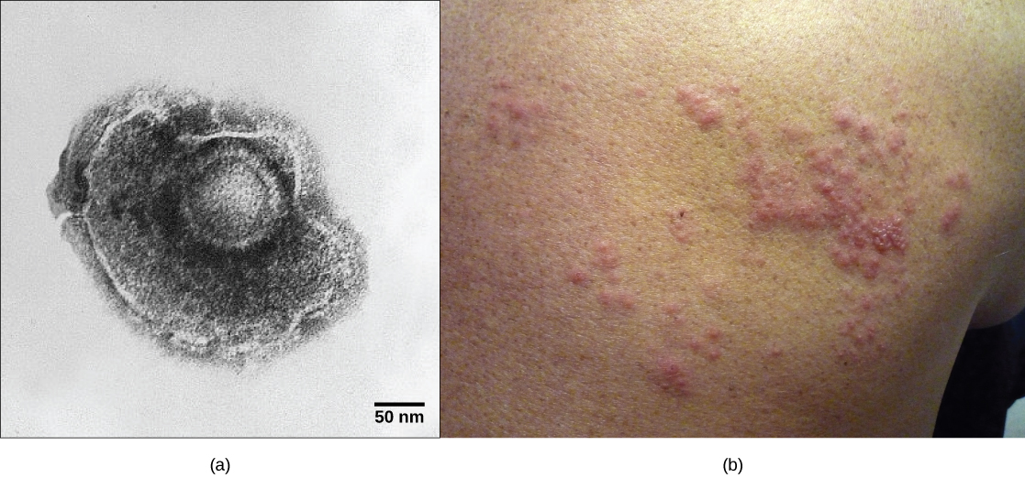
Figure 21.11
A latent virus infection. (a) Varicella-zoster, the virus that causes chickenpox, has an enveloped icosahedral capsid visible in this transmission electron micrograph. Its double-stranded DNA genome becomes incorporated in the host DNA and can reactivate after latency in the form of (b) shingles, often exhibiting a rash. (credit a: modification of work by Dr. Erskine Palmer, B. G. Martin, CDC; credit b: modification of work by “rosmary”/Flickr; scale-bar data from Matt Russell)
Notes:
Part a shows a micrograph of the varicella zoster virus, which has an icosahedral capsid surrounded by an irregularly shaped envelope. Part b shows a red, bumpy shingles rash on a person's face.

Slide 21
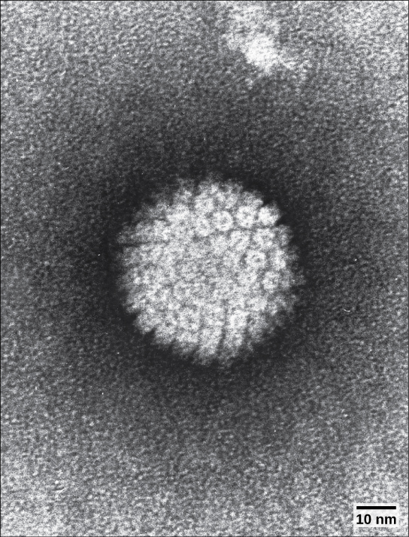
Figure 21.12
HPV, or human papillomavirus, has a naked icosahedral capsid visible in this transmission electron micrograph and a double-stranded DNA genome that is incorporated into the host DNA. The virus, which is sexually transmitted, is oncogenic and can lead to cervical cancer. (credit: modification of work by NCI, NIH; scale-bar data from Matt Russell)
Notes:
The micrograph shows an icosahedral virus with glycoproteins protruding from its capsid.

Slide 22
21.3 Prevention and Treatment of Viral Infections
Learning Objectives
Identify major viral illnesses that affect humans
Compare vaccinations and anti-viral drugs as medical approaches to viruses

Slide 23
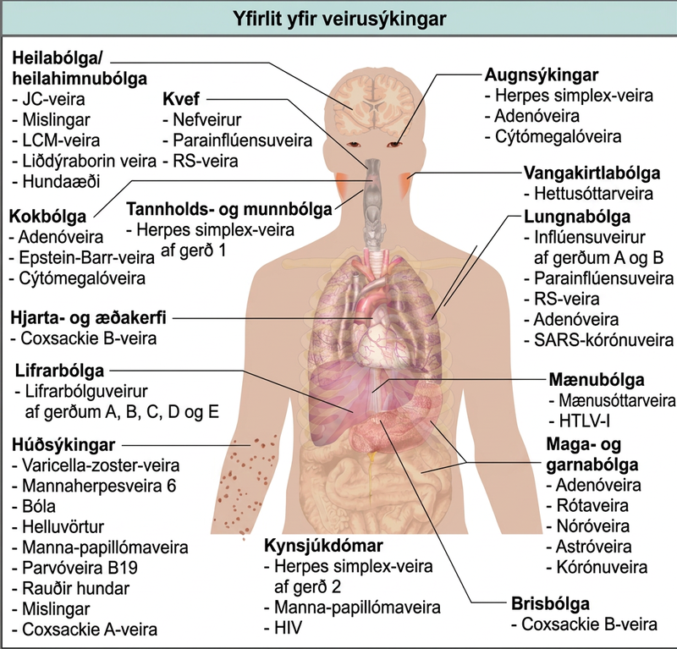
Figure 21.13
A sampling of human viruses. Viruses can cause dozens of ailments in humans, ranging from mild illnesses to serious diseases. (credit: modification of work by Mikael Häggström)
Notes:
The illustration shows an overview of human viral diseases. Viruses that cause encephalitis or meningitis, or inflammation of the brain and surrounding tissues, include measles, arbovirus, rabies, J C virus, and L C M virus. The common cold is caused by rhinovirus, parainfluenza virus, and respiratory syncytial virus. Eye infections are caused by herpes simple virus, adenovirus, and cytomegalovirus. Pharyngitis, or inflammation of the pharynx, is caused by adenovirus, Epstein-Barr virus, and cytomegalovirus. Parotitis, or inflammation of the parotid glands, is caused by mumps virus. Gingivostomatitis, or inflammation of the oral mucosa, is caused by herpes simplex type I virus. Pneumonia is caused by influenza virus types A and B, parainfluenza virus, respiratory syncytial virus, adenovirus, and SARS coronavirus. Cardiovascular problems are caused by coxsackie B virus. Hepatitis is caused by hepatitis virus types A, B, C, D, and E. Myelitis in the spinal cord is caused by poliovirus and H L T V dash 1. Skin infections are caused by varicella-zoster virus, human herpesvirus 6, smallpox, molluscum contagiosum, human papillomavirus, parvovirus B 19, rubella, measles, and coxsackie A virus. Gastroenteritis, or digestive disease, is caused by adenovirus, rotavirus, norovirus, astrovirus, and coronavirus. Sexually transmitted diseases are caused by herpes simplex type 2, human papillomavirus, and H I V. Pancreatitis is caused by coxsackie B virus.

Slide 24
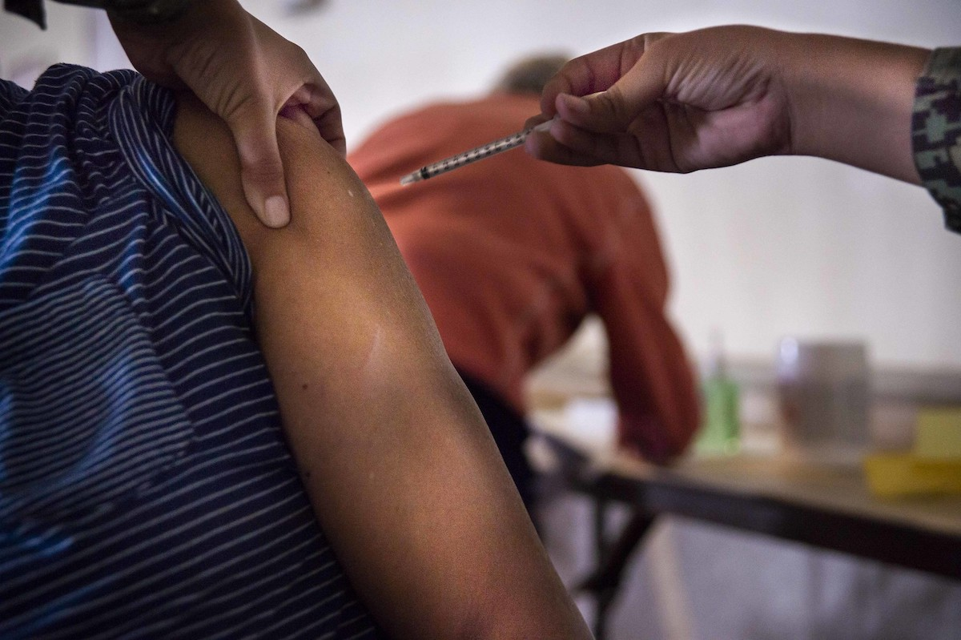
Figure 21.14
Vaccinations are designed to boost immunity to a virus to prevent infection. (credit: Navy Medicine)
Notes:
The photo shows a person receiving an injection in the arm.

Slide 25
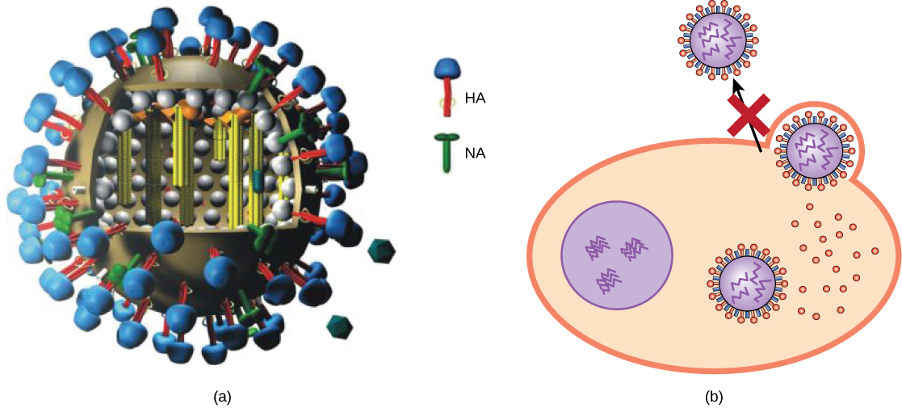
Figure 21.15
Action of an antiviral drug. (a) Tamiflu inhibits a viral enzyme called neuraminidase (NA) found in the influenza viral envelope. (b) Neuraminidase cleaves the connection between viral hemagglutinin (HA), also found in the viral envelope, and glycoproteins on the host cell surface. Inhibition of neuraminidase prevents the virus from detaching from the host cell, thereby blocking further infection. (credit a: modification of work by M. Eickmann)
Notes:
Part a shows the structure of the influenza virus, which is icosahedral with a viral envelope. Neuraminidase and hemagglutinin are embedded in the envelope. Part b shows that Tamiflu prevents the step in influenza infection in which virions leave the cell.

Slide 26
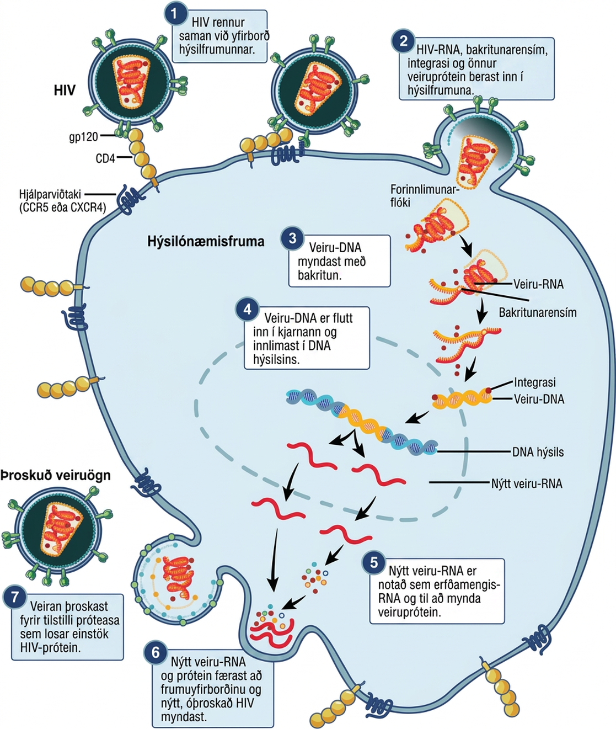
Figure 21.16
Life cycle of HIV. HIV, an enveloped, icosahedral virus, attaches to the CD4 receptor of an immune cell and fuses with the cell membrane. Viral contents are released into the cell, where viral enzymes convert the single-stranded RNA genome into DNA and incorporate it into the host genome. (credit: NIAID, NIH)
Notes:
The illustration shows the steps in the H I V life cycle. In step 1, g p 120 glycoproteins in the viral envelope attach to a C D 4 receptor on the host cell membrane. The glycoproteins then attached to a co-receptor, C C R 5 or C X C R 4, and the viral envelope fuses with the cell membrane. In step 2, H I V R N A, reverse transcriptase, integrase, and other viral proteins are released into the host cell. In step 3, viral D N A is formed from R N A by reverse transcriptase. In step 4, Viral D N A is then transported across the nuclear membrane, where it integrates into the host D N A. In step 5, new viral R N A is made; it is used as genomic R N A and to make viral proteins. In step 6, new viral R N A and proteins move to the cell surface and a new, immature H I V forms. In the final step 7, the virus matures when a protease releases individual H I V proteins.

Slide 27
21.4 Other Acellular Entities: Prions and Viroids
Learning Objectives
Describe prions and their basic properties
Define viroids and their targets of infection

Slide 28
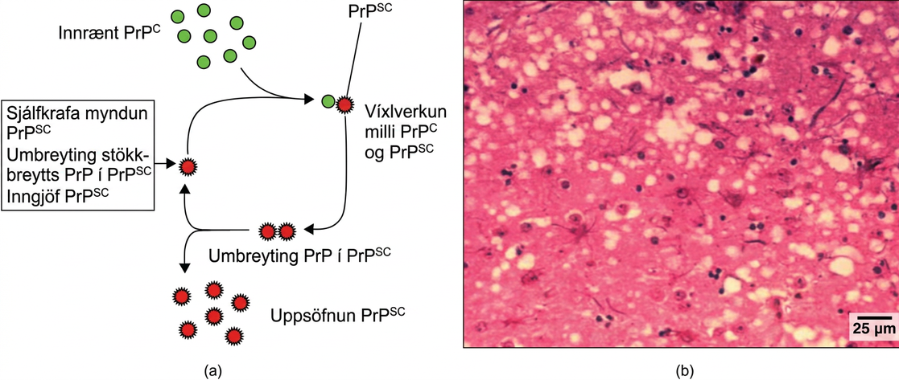
Figure 21.17
Mad Cow Disease in humans. (a) Endogenous normal prion protein (PrPc) is converted into the disease-causing form (PrPsc) when it encounters this variant form of the protein. PrPsc may arise spontaneously in brain tissue, especially if a mutant form of the protein is present, or it may occur via the spread of misfolded prions consumed in food into brain tissue. (b) This prion-infected brain tissue, visualized using light microscopy, shows the vacuoles that give it a spongy texture, typical of transmissible spongiform encephalopathies. (credit b: modification of work by Dr. Al Jenny, USDA APHIS; scale-bar data from Matt Russell)
Notes:
Part A illustrates how normal prion protein, called P r P, is converted into the disease causing form P r P. P r P superscript lowercase s lowercase c may spontaneously form in brain tissue, may be introduced when a mutant form of the protein misfolds, or may introduced into the brain tissue by inoculation. The misfolded protein causes normal P r P already present in the brain to misfold. A chain reaction occurs, leading to a large amount of misfolded protein. Part B is a light microscopy image of prion-infected brain tissue.

Slide 29
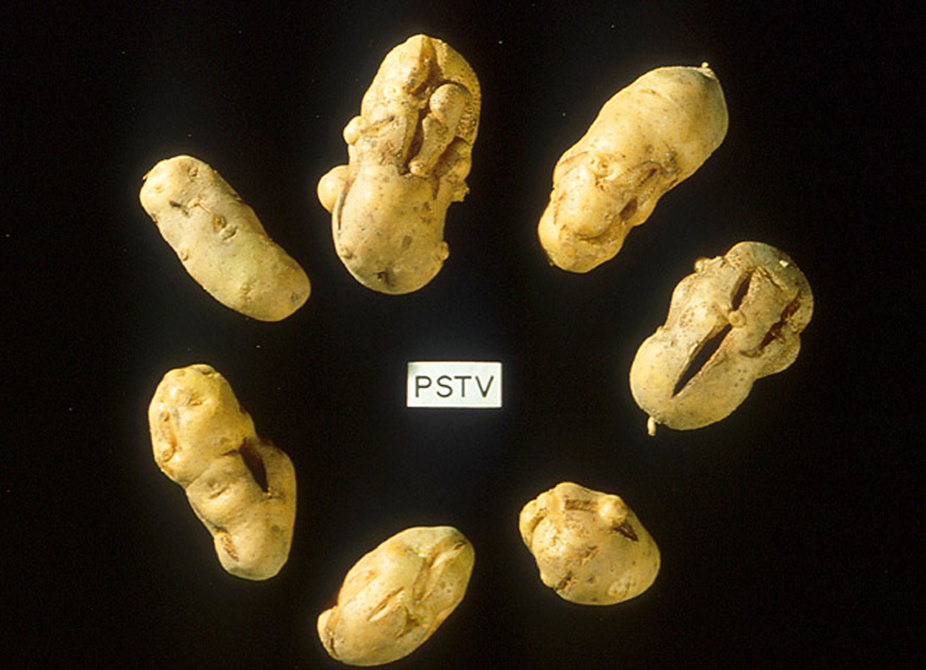
Figure 21.18
These potatoes have been infected by the potato spindle tuber viroid (PSTV), which is typically spread when infected knives are used to cut healthy potatoes, which are then planted. (credit: Pamela Roberts, University of Florida Institute of Food and Agricultural Sciences, USDA ARS)
Notes:
The photo shows shriveled, cracked potatoes.

Slide 30
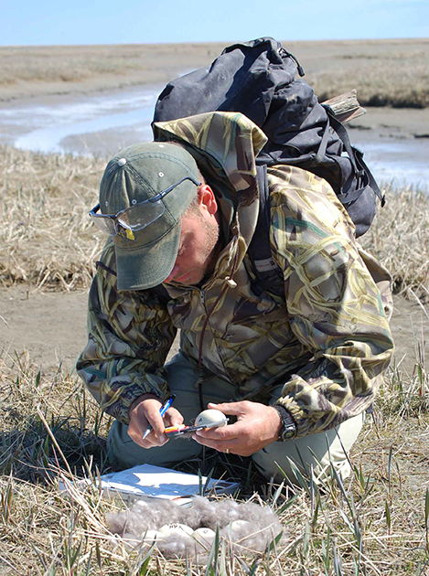
Figure 21.19
This virologist is engaged in fieldwork, sampling eggs from this nest for avian influenza. (credit: Don Becker, USGS EROS, U.S. Fish and Wildlife Service)
This OpenStax ancillary resource is © Rice University under a CC BY-NC-SA 4.0 International license; it may be reproduced or modified for noncommercial purposes only but must be attributed to OpenStax, Rice University and any changes must be noted. Any adaptation must be shared under the same type of license.
Notes:
This photo shows a scientist in a field, measuring the length of an egg.

