Slide 1

Biology 2e
Chapter 22 Prokaryotes: Bacteria and Archaea

Slide 2
Chapter outline
Prokaryotic Diversity
Structure of Prokaryotes: Bacteria and Archaea
Prokaryotic Metabolism
Bacterial Diseases in Humans
Beneficial Prokaryotes

Slide 3
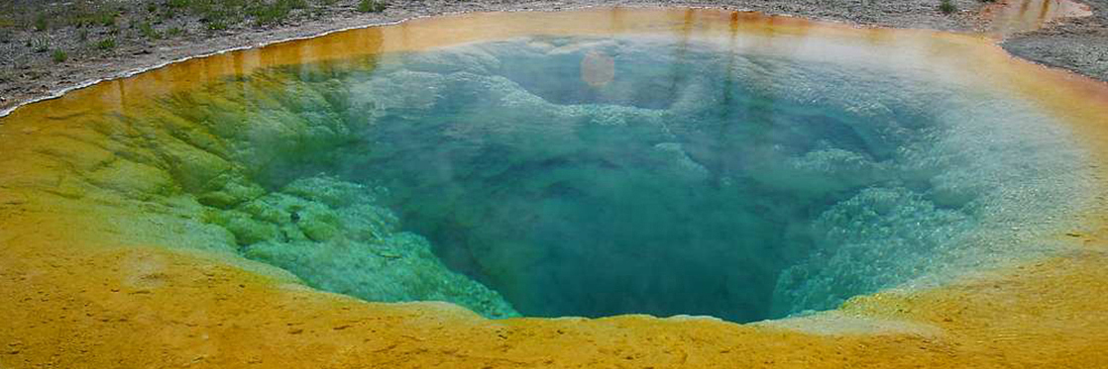
Figure 22.1
Certain prokaryotes can live in extreme environments such as the Morning Glory pool, a hot spring in Yellowstone National Park. The spring’s vivid blue color is from the prokaryotes that thrive in its very hot waters. (credit: modification of work by Jon Sullivan)
Notes:
The photo shows a hot spring with a vivid blue color in the middle and a golden color around the edge.

Slide 4
22.1 Prokaryotic Diversity
Learning Objectives
Describe the evolutionary history of prokaryotes
Discuss the distinguishing features of extremophiles
Explain why it is difficult to culture prokaryotes

Slide 5
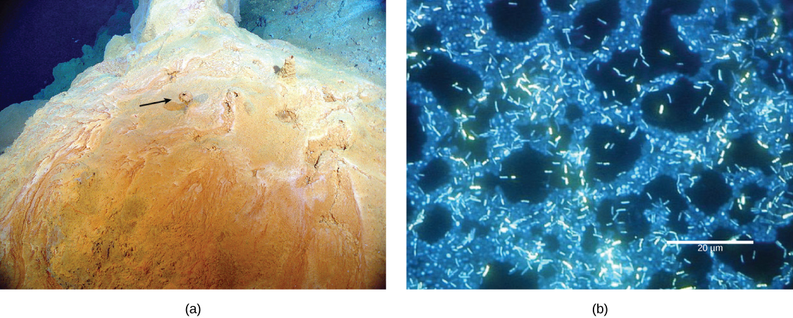
Figure 22.2
A microbial mat. (a) This microbial mat, about one meter in diameter, is growing over a hydrothermal vent in the Pacific Ocean in a region known as the “Pacific Ring of Fire.” The mat’s colony of bacteria helps retain microbial nutrients. Chimneys such as the one indicated by the arrow allow gases to escape. (b) In this micrograph, bacteria are visualized using fluorescence microscopy. (credit a: modification of work by Dr. Bob Embley, NOAA PMEL, Chief Scientist; credit b: modification of work by Ricardo Murga, Rodney Donlan, CDC; scale-bar data from Matt Russell)
Notes:
The part a photo shows a reddish-yellow mound with small chimneys growing out of it. Part b micrograph shows rod-shaped bacteria about two microns long swimming over a thicker mat of bacteria.

Slide 6
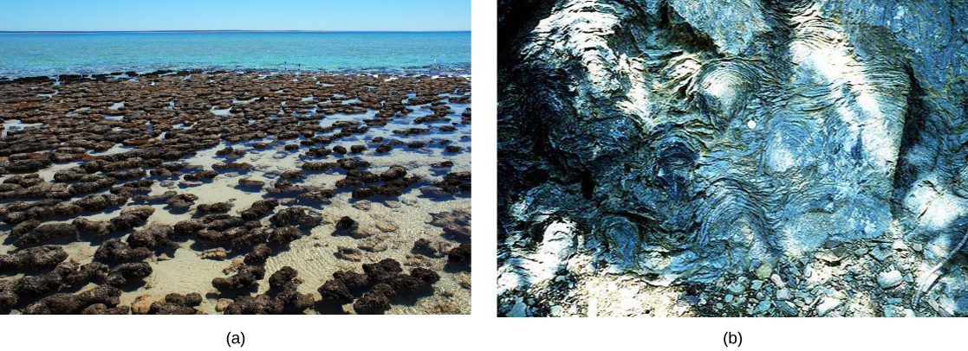
Figure 22.3
Stromatolites. (a) These living stromatolites are located in Shark Bay, Australia. (b) These fossilized stromatolites, found in Glacier National Park, Montana, are nearly 1.5 billion years old. (credit a: Robert Young; credit b: P. Carrara, NPS)
Notes:
Photo A shows a mass of gray mounds in shallow water. Photo B shows a swirl pattern in white and gray marbled rock.

Slide 7
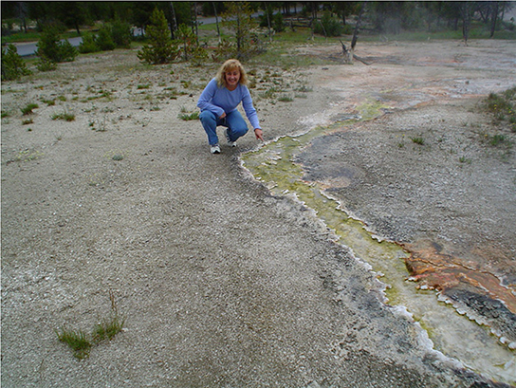
Figure 22.4
Cyanobacteria. This hot spring in Yellowstone National Park flows toward the foreground. Cyanobacteria in the spring are green, and as water flows down the gradient, the intensity of the color increases as cell density increases. The water is cooler at the edges of the stream than in the center, causing the edges to appear greener. (credit: Graciela Brelles-Mariño)
Notes:
This photo shows a woman squatting next to a stream of green-colored water.

Slide 8
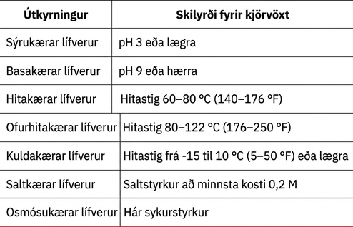
Table 22.1

Slide 9
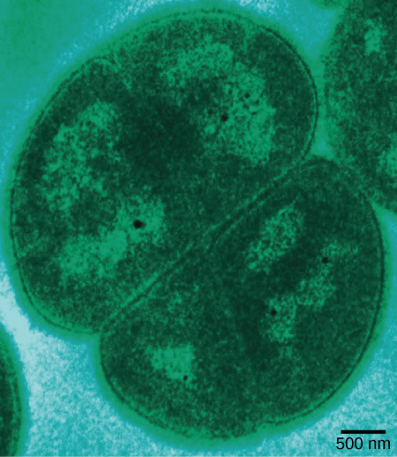
Figure 22.5
Radiation-tolerant prokaryotes. Deinococcus radiodurans, visualized in this false color transmission electron micrograph, is a prokaryote that can tolerate very high doses of ionizing radiation. It has developed DNA repair mechanisms that allow it to reconstruct its chromosome even if it has been broken into hundreds of pieces by radiation or heat. (credit: modification of work by Michael Daly; scale-bar data from Matt Russell)
Notes:
This micrograph shows an oval Deinococcus cell about 2.5 microns in diameter, dividing.

Slide 10
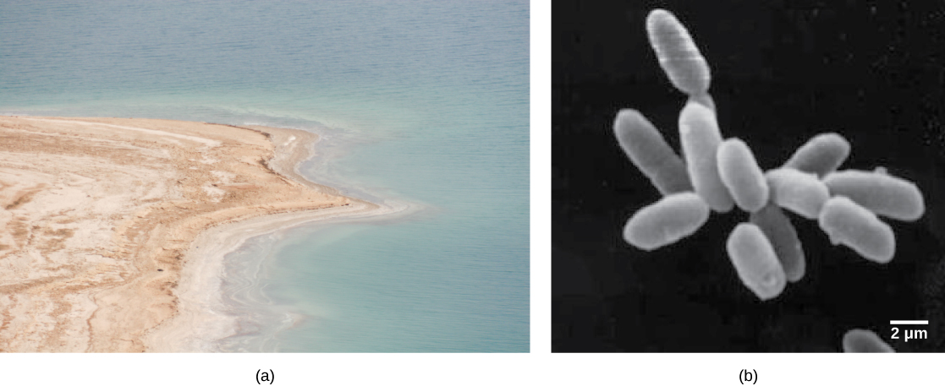
Figure 22.6
Halophilic prokaryotes. (a) The Dead Sea is hypersaline. Nevertheless, salt-tolerant bacteria thrive in this sea. (b) These halobacteria cells can form salt-tolerant bacterial mats. (credit a: Julien Menichini; credit b: NASA; scale-bar data from Matt Russell)
Notes:
Photo A shows the Dead Sea and its accompanying brown shoreline. Micrograph B shows rod-shaped halobacteria.

Slide 11
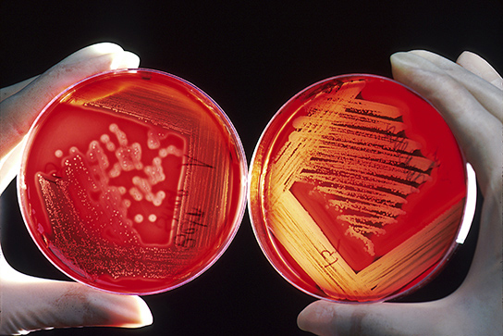
Figure 22.7
Bacteria growing on blood agar plates. In these agar plates, the growth medium is supplemented with red blood cells. Blood agar becomes transparent in the presence of hemolytic Streptococcus, which destroys red blood cells and is used to diagnose Streptococcus infections. The plate on the left is inoculated with non-hemolytic Staphylococcus (large white colonies), and the plate on the right is inoculated with hemolytic Streptococcus (tiny clear colonies). If you look closely at the right plate, you can see that the agar surrounding the bacteria has turned clear. (credit: Bill Branson, NCI)
Notes:
Two bacterial plates with red agar are shown. Both plates are covered with bacterial colonies. On the right plate, which contains hemolytic bacteria, the red agar has turned clear where bacteria are growing. On the left plate, which contains non-hemolytic bacteria, the agar is not clear.

Slide 12
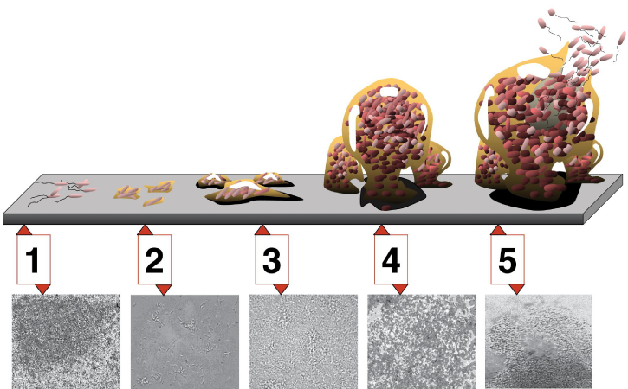
Figure 22.8
Development of a biofilm. Five stages of biofilm development are shown. During stage 1, initial attachment, bacteria adhere to a solid surface via weak van der Waals interactions (forces produced by induced electrical interactions between atoms). During stage 2, irreversible attachment, hairlike appendages called pili permanently anchor the bacteria to the surface. During stage 3, maturation I, the biofilm grows through cell division and recruitment of other bacteria. An extracellular matrix composed primarily of polysaccharides holds the biofilm together. During stage 4, maturation II, the biofilm continues to grow and takes on a more complex shape. During stage 5, dispersal, the biofilm matrix is partly broken down, allowing some bacteria to escape and colonize another surface. Micrographs of a Pseudomonas aeruginosa biofilm in each of the stages of development are shown. (credit: D. Davis, Don Monroe, PLoS)
Notes:
During the first stage of biofilm development, a few bacteria adhere to a surface. During stage 2, the bacteria grow hairy appendages called pili. During stage 3, the microfilm grows into lumpy colonies. In stage 4, the microfilm grows into a more ball-like shape that is anchored to the surface by a smaller clump of bacteria. In stage 5, the ball of bacteria is larger, and bacteria with flagella swim away.

Slide 13
22.2 Structure of Prokaryotes: Bacteria and Archaea
Learning Objectives
Describe the basic structure of a typical prokaryote
Describe important differences in structure between Archaea and Bacteria

Slide 14
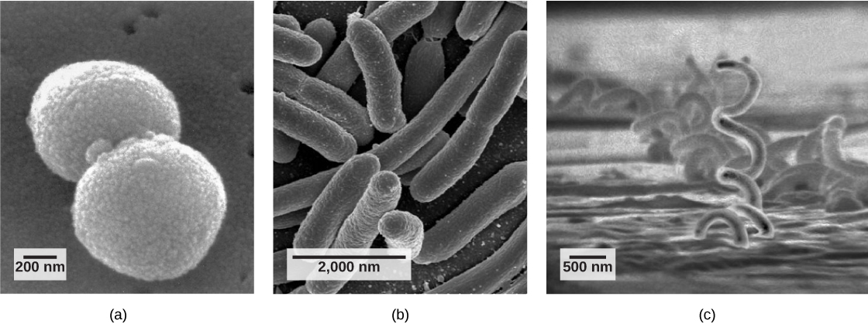
Figure 22.9
Common prokaryotic cell types. Prokaryotes fall into three basic categories based on their shape, visualized here using scanning electron microscopy: (a) cocci, or spherical (a pair is shown); (b) bacilli, or rod-shaped; and (c) spirilli, or spiral-shaped. (credit a: modification of work by Janice Haney Carr, Dr. Richard Facklam, CDC; credit c: modification of work by Dr. David Cox; scale-bar data from Matt Russell)
Notes:
Part a: The micrograph shows ball-shaped cocci about 800 nanometers across. Part b: The micrograph shows elongated, oval-shaped bacilli about 2000 nanometers long. Part c: The micrograph shows corkscrew-shaped spirilli that are quite long and 500 nanometers in diameter.

Slide 15
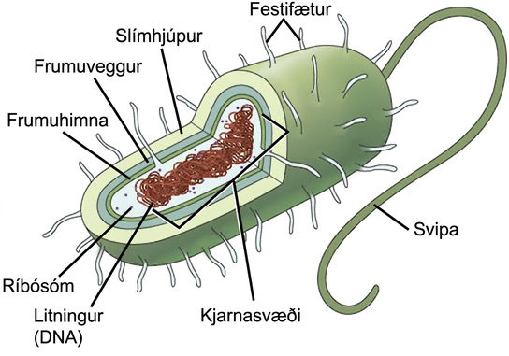
Figure 22.10
The features of a typical prokaryotic cell. Flagella, capsules, and pili are not found in all prokaryotes.
Notes:
In this illustration, the prokaryotic cell is rod shaped. The circular chromosome is concentrated in a region called the nucleoid. The fluid inside the cell is called the cytoplasm. Ribosomes, depicted as small circles, float in the cytoplasm. The cytoplasm is encased by a plasma membrane, which in turn is encased by a cell wall. A capsule surrounds the cell wall. The bacterium depicted has a flagellum protruding from one narrow end. Pili are small protrusions that project from the capsule all over the bacterium, like hair.

Slide 16
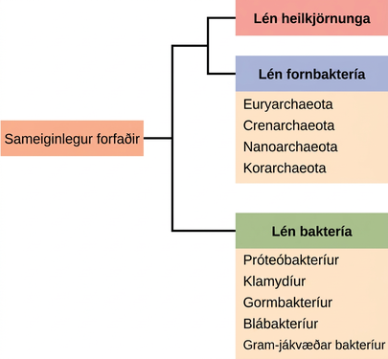
Figure 22.11
The three domains of living organisms. Bacteria and Archaea are both prokaryotes but differ enough to be placed in separate domains. An ancestor of modern Archaea is believed to have given rise to Eukarya, the third domain of life. Major groups of Archaea and Bacteria are shown.
Notes:
The trunk of the phylogenetic tree is a universal ancestor. The tree forms two branches. One branch leads to the domain bacteria, which includes the phyla proteobacteria, chlamydias, spirochetes, cyanobacteria, and Gram-positive bacteria. The other branch branches again, into the eukarya and archaea domains. Domain archaea includes the phyla euryarchaeotes, crenarchaeotes, nanoarchaeotes, and korarchaeotes.

Slide 17
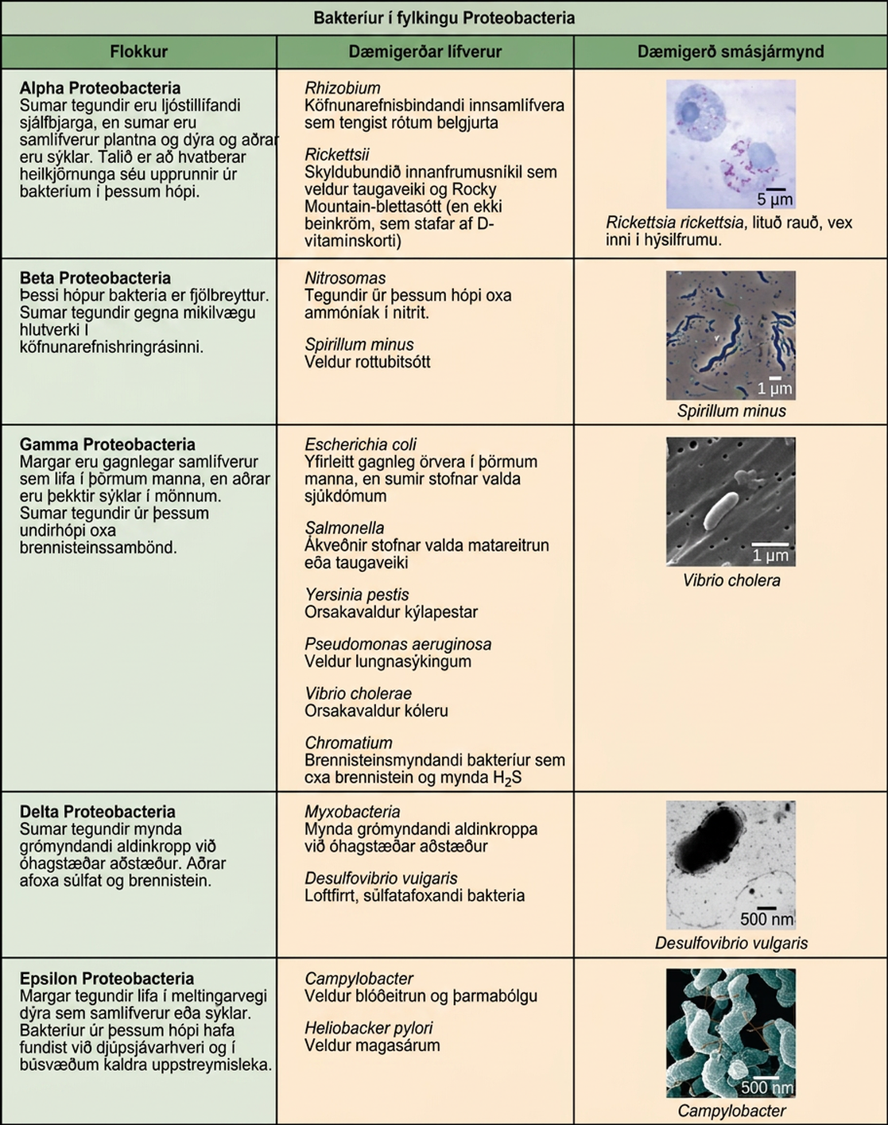
Figure 22.12
The Proteobacteria. Phylum Proteobacteria is one of up to 52 bacteria phyla. Proteobacteria is further subdivided into five classes, Alpha through Epsilon. (credit “Rickettsia rickettsii”: modification of work by CDC; credit “Spirillum minus”: modification of work by Wolframm Adlassnig; credit “Vibrio cholera”: modification of work by Janice Haney Carr, CDC; credit “Desulfovibrio vulgaris”: modification of work by Graham Bradley; credit “Campylobacter”: modification of work by De Wood, Pooley, USDA, ARS, EMU; scale-bar data from Matt Russell)
Notes:
Characteristics of the five classes of bacterial phylum proteobacteria are described. The classes are alpha, beta, gamma, delta and epsilon. Most species of Alpha Proteobacteria are photoautotrophic but some are symbionts of plants and animals, and others are pathogens. Eukaryotic mitochondria are thought to be derived from bacteria in this group. Representative organisms include Rhizobium, a nitrogen-fixing endosymbiont associated with the roots of legumes, and Rickettsia, an obligate intracellular parasite that causes typhus and Rocky Mountain Spotted Fever (but not rickets, which is caused by Vitamin D deficiency). A micrograph shows rod-shaped Rickettsia rickettsii inside a much larger eukaryotic cell. Beta Proteobacteria is a diverse group of bacteria. Some species play an important role in the nitrogen cycle. Representative organisms include Nitrosomas, which oxidize ammonia into nitrite, and Spirillum minus, which causes rat bite fever. A micrograph of spiral-shaped Spirillum minus is shown. Gamma Proteobacteria include many beneficial symbionts that populate the human gut, as well as familiar human pathogens. Some species from this subgroup oxidize sulfur compounds. Representative organisms include Escherichia coli, normally a beneficial microbe of the human gut, but some strains cause disease; Salmonella, certain strains of which cause food poisoning or typhoid fever; Yersinia pestis, the causative agent of Bubonic plague; Psuedomonas aeruganosa, which causes lung infections; Vibrio cholera, the causative agent of cholera; and Chromatium, sulfur-producing bacteria that oxidize sulfur, producing H2S. Micrograph shows rod-shaped Vibrio cholera, which are about 1 micron long. Some species of Delta Proteobacteria generate a spore-forming fruiting body in adverse conditions. Others reduce sulfate and sulfur. Representative organisms include Myxobacteria, which generate spore-forming fruiting bodies in adverse conditions, and Desulfovibrio vulgaris, an aneorobic, sulfate-reducing bacterium. Micrograph shows a bent rod-shaped Desulfovibrio vulgaris bacterium with a long flagellum. Epsilon Proteobacteria includes many species that inhabit the digestive tract of animals as symbionts or pathogens. Bacteria from this group have been found in deep-sea hydrothermal vents and cold seep habitats. Representative organisms include Campylobacter, which causes blood poisoning and intestinal inflammation, and Heliobacter pylori, which causes stomach ulcers. Micrograph shows short spiral, or s shaped, Campylobacter bacteria.

Slide 18
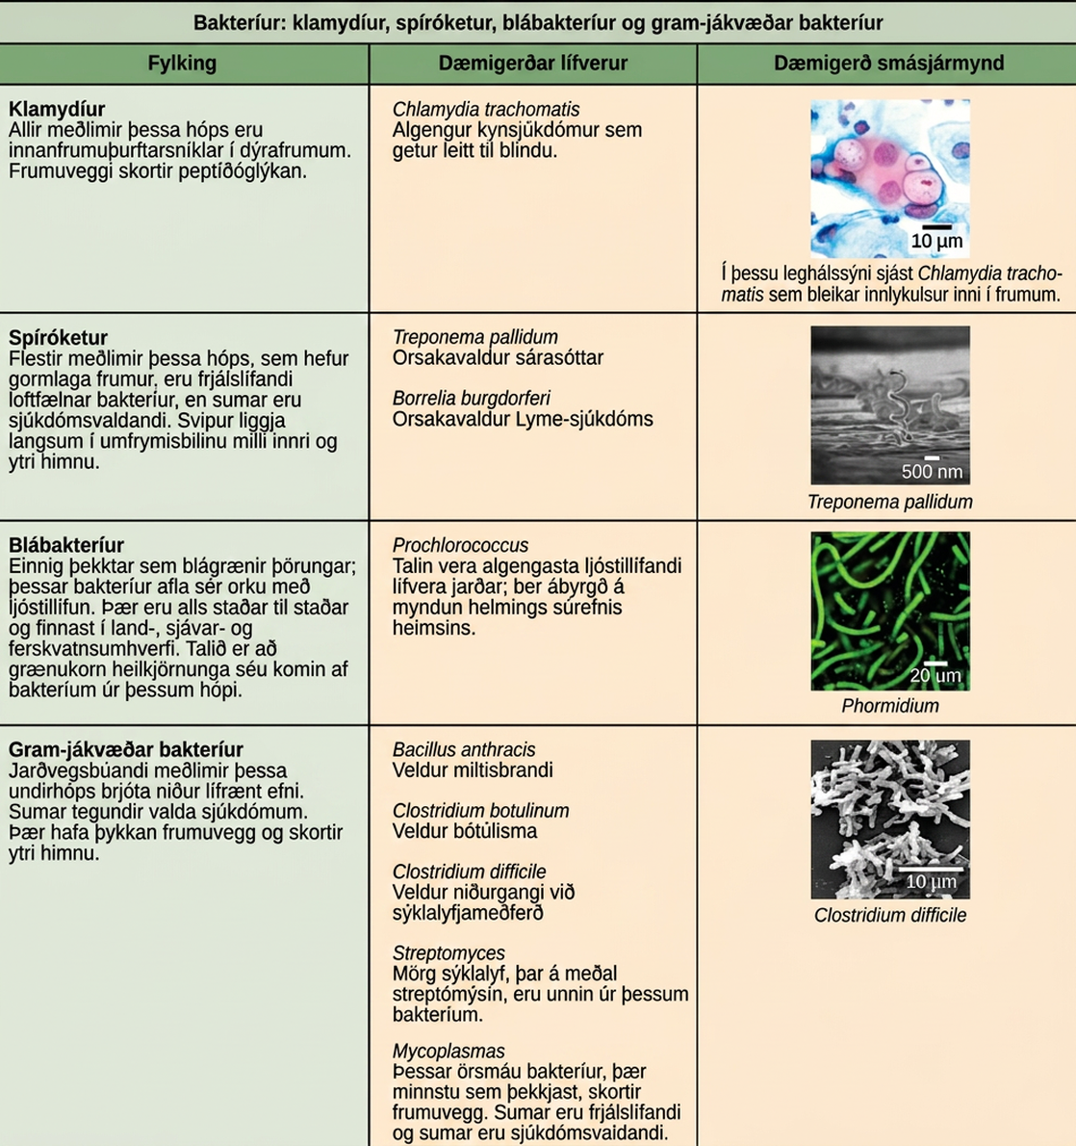
Figure 22.13
Other bacterial phyla. Chlamydia, Spirochetes, Cyanobacteria, and Gram-positive bacteria are described in this table. Note that bacterial shape is not phylum-dependent; bacteria within a phylum may be cocci, rod-shaped, or spiral. (credit “Chlamydia trachomatis”: modification of work by Dr. Lance Liotta Laboratory, NCI; credit “Treponema pallidum”: modification of work by Dr. David Cox, CDC; credit “Phormidium”: modification of work by USGS; credit “Clostridium difficile”: modification of work by Lois S. Wiggs, CDC; scale-bar data from Matt Russell)
Notes:
This table describes the other four bacterial phyla classes. The first phylum described is chlamydias. All members of this group are obligate intracellular parasites of animal cells. Cells walls lack peptidoglycan. Micrograph shows a pap smear of cells infected with Chlamydia trachomatis. Chlamydia infection is the most common sexually transmitted disease and can lead to blindness. All members of the phylum Spirochetes have spiral-shaped cells. Most are free-living anaerobes, but some are pathogenic. Flagella run lengthwise in the periplasmic space between the inner and outer membrane. Representative species include Treponema pallidum, the causative agent of syphilis and Borrelia burgdorferi, the causative agent of Lyme disease Micrograph shows corkscrew-shaped Trepanema pallidum, about 1 micron across. Bacteria in the phylum Cyanobacteria, also known as blue-green algae, obtain their energy through photosynthesis. They are ubiquitous, found in terrestrial, marine, and freshwater environments. Eukaryotic chloroplasts are thought to be derived from bacteria in this group. The cyanobacterium Prochlorococcus is believed to be the most abundant photosynthetic organism on earth, responsible for generating half the world’s oxygen. Micrograph shows a long, thin rod-shaped species called Phormidium. Gram-positive Bacteria have a thick cell wall and lack an outer membrane. Soil-dwelling members of this subgroup decompose organic matter. Some species cause disease. Representative species include Bacillus anthracis, which causes anthrax; Clostridium botulinum, which causes botulism; Clostridium difficile, which causes diarrhea during antibiotic therapy; Streptomyces, from which many antibiotics, including streptomyocin, are derived; and Mycoplasmas, the smallest known bacteria, which lack a cell wall. Some are free-living, and some are pathogenic. Micrograph shows Clostridium difficile, which are rod-shaped and about 3 microns long.

Slide 19
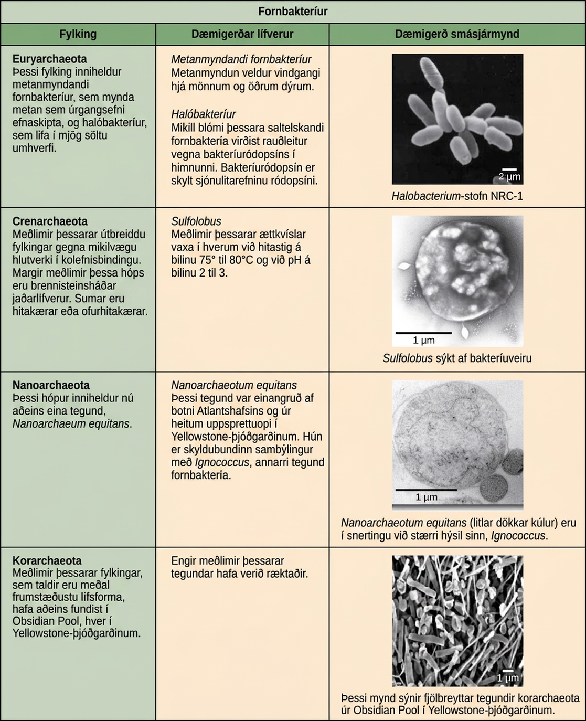
Figure 22.14
Archaeal phyla. Archaea are separated into four phyla: the Korarchaeota, Euryarchaeota, Crenarchaeota, and Nanoarchaeota. (credit “Halobacterium”: modification of work by NASA; credit “Nanoarchaeotum equitans”: modification of work by Karl O. Stetter; credit “Korarchaeota”: modification of work by Office of Science of the U.S. Dept. of Energy; scale-bar data from Matt Russell)
Notes:
Characteristics of the four phyla of archaea are described. Euryarchaeotes includes methanogens, which produce methane as a metabolic waste product, and halobacteria, which live in an extreme saline environment. Methanogens cause flatulence in humans and other animals. Halobacteria can grow in large blooms that appear reddish, due to the presence of bacteriorhodopsin in the membrane. Bacteriorhodopsin is related to the retinal pigment rhodopsin. Micrograph shows rod shaped Halobacterium. Members of the ubiquitous Crenarchaeotes phylum play an important role in the fixation of carbon. Many members of this group are sulfur dependent extremophiles. Some are thermophilic or hyperthermophilic. Micrograph shows cocci shaped Sulfolobus, a genus which grows in volcanic springs at temperatures between 75 degrees and 80 degrees Celsius and at a lower case p upper case H between 2 and 3. The phylum Nanoarchaeotes currently contains only one species, Nanoarchaeum equitans, which has been isolated from the bottom of the Atlantic Ocean, and from the a hydrothermal vent at Yellowstone National Park. It is an obligate symbiont with Ignicoccus, another species of archaebacteria. Micrograph shows two small, round N. equitans cells attached to a larger Ignicoccus cell. Korarchaeotes are considered to be one of the most primitive forms of life and so far have only been found in the Obsidian Pool, a hot spring at Yellowstone National Park. Micrograph shows a variety of specimens from this group which vary in shape.

Slide 20
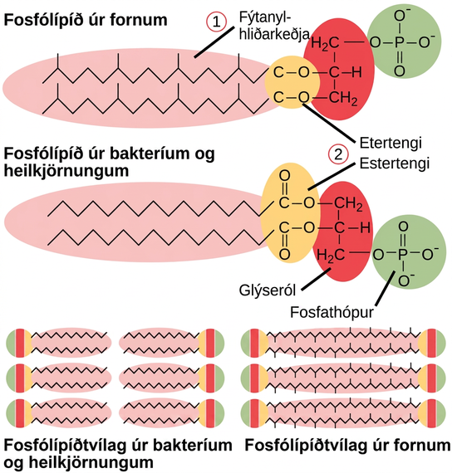
Figure 22.15
Bacterial and archaeal phospholipids. Archaeal phospholipids differ from those found in Bacteria and Eukarya in two ways. First, they have branched phytanyl sidechains instead of linear ones. Second, an ether bond instead of an ester bond connects the lipid to the glycerol.
Notes:
This illustration compares phospholipids from Bacteria and Eukarya to those from Archaea. In Bacteria and Eukarya, fatty acids are attached to glycerol by an ester linkage, while in Archaea, isoprene chains are linked to glycerol by an ether linkage. In the ester linkage, the first carbon in the fatty acid chain has an oxygen double-bonded to it, whereas in the ether linkage, it does not. In Archaea, the isoprene chains have methyl groups branching off from them, whereas such branches are absent in Bacteria and Eukarya. Both types of phospholipids result in similar lipid bilayers.

Slide 21
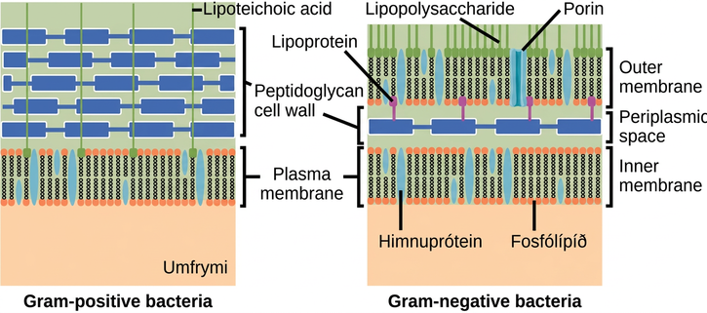
Figure 22.16
Cell walls in Gram-positive and Gram-negative bacteria. Bacteria are divided into two major groups: Gram positive and Gram negative. Both groups have a cell wall composed of peptidoglycan: in Gram-positive bacteria, the wall is thick, whereas in Gram-negative bacteria, the wall is thin. In Gram-negative bacteria, the cell wall is surrounded by an outer membrane that contains lipopolysaccharides and lipoproteins. Porins are proteins in this cell membrane that allow substances to pass through the outer membrane of Gram-negative bacteria. In Gram-positive bacteria, lipoteichoic acid anchors the cell wall to the cell membrane. (credit: modification of work by "Franciscosp2"/Wikimedia Commons)
Notes:
The left illustration shows the cell wall of Gram-positive bacteria. The cell wall is a thick layer of peptidoglycan that exists outside the plasma membrane. A long, thin molecule called lipoteichoic acid anchors the cell wall to the cell membrane. The right illustration shows Gram-negative bacteria. In Gram-negative bacteria, a thin peptidoglycan cell wall is sandwiched between an outer and an inner plasma membrane. The space between the two membranes is called the periplasmic space. Lipoproteins anchor the cell wall to the outer membrane. Lipopolysaccharides protrude from the outer membrane. Porins are proteins in the outer membrane that allow entry of substances.

Slide 22
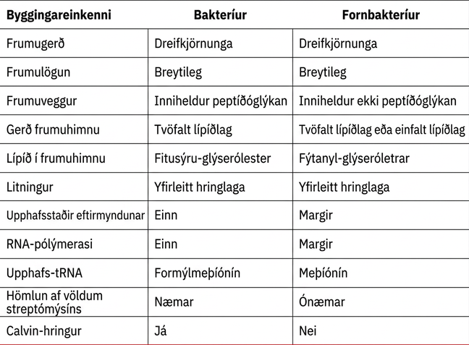
Table 22.2

Slide 23
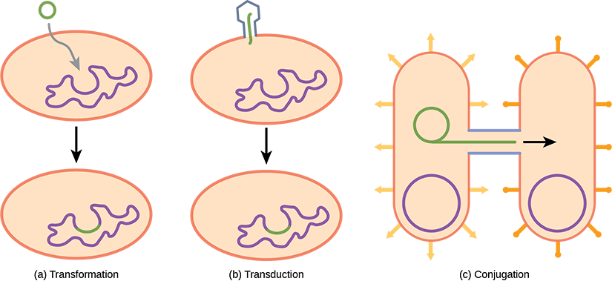
Figure 22.17
Gene transfer mechanisms in prokaryotes. There are three mechanisms by which prokaryotes can exchange DNA. In (a) transformation, the cell takes up prokaryotic DNA directly from the environment. The DNA may remain separate as plasmid DNA or be incorporated into the host genome. In (b) transduction, a bacteriophage injects DNA into the cell that contains a small fragment of DNA from a different prokaryote. In (c) conjugation, DNA is transferred from one cell to another via a mating bridge, or pilus, that connects the two cells after the sex pilus draws the two bacteria close enough to form the bridge.
Notes:
Illustration A shows transformation, where a small, circular piece of DNA is absorbed by a prokaryotic cell. The DNA then gets incorporated in the genome. Illustration B shows transduction, where a bacteriophage injects DNA into a prokaryotic cell. The DNA then gets incorporated in the genome. Illustration C shows conjugation, where two bacteria are connected by a pilus. A small loop of DNA is transferred from one cell to the other via the pilus.

Slide 24
22.3 Prokaryotic Metabolism
Learning Objectives
Identify the macronutrients needed by prokaryotes, and explain their importance
Describe the ways in which prokaryotes get energy and carbon for life processes
Describe the roles of prokaryotes in the carbon and nitrogen cycles

Slide 25
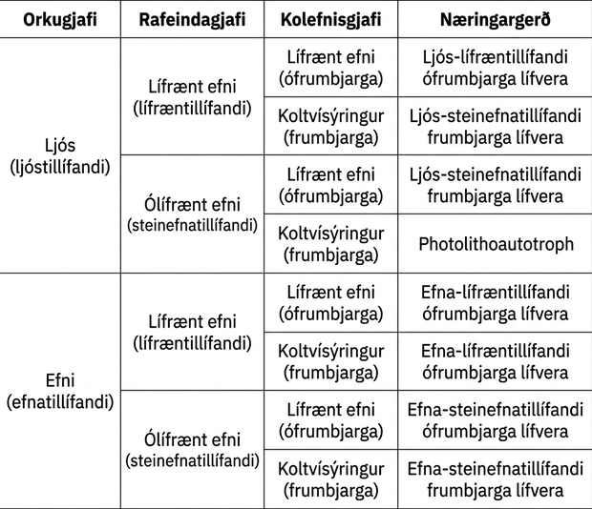
Table 22.3

Slide 26
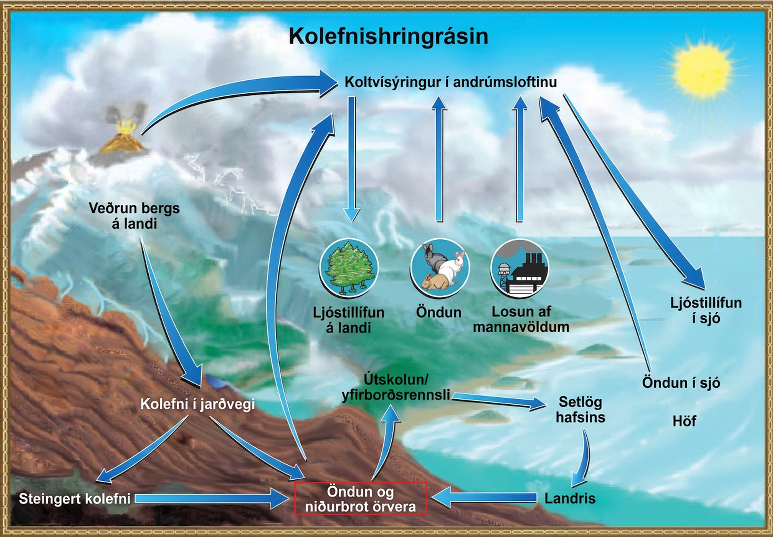
Figure 22.18
The carbon cycle. Prokaryotes play a significant role in continuously moving carbon through the biosphere. (credit: modification of work by John M. Evans and Howard Perlman, USGS)
Notes:
An illustration shows the carbon lifecycle. Carbon dioxide in the atmosphere occurs by way of volcanic eruptions, animal, microbial and marine respiration, and human emissions - such as from factories. It is absorbed by terrestrial photosynthesis from plants, and marine photosynthesis. The weathering of terrestrial rocks turns into soil carbon, which then branches into either fossil carbon or directly to microbial respiration and decomposition. Fossil carbon also contributes to microbial respiration and decomposition. This decomposition has a leaching, or runoff effect, and enters the ocean as sediments. Those sediments can be uplifted and also end up contributing to microbial respiration and decomposition.

Slide 27
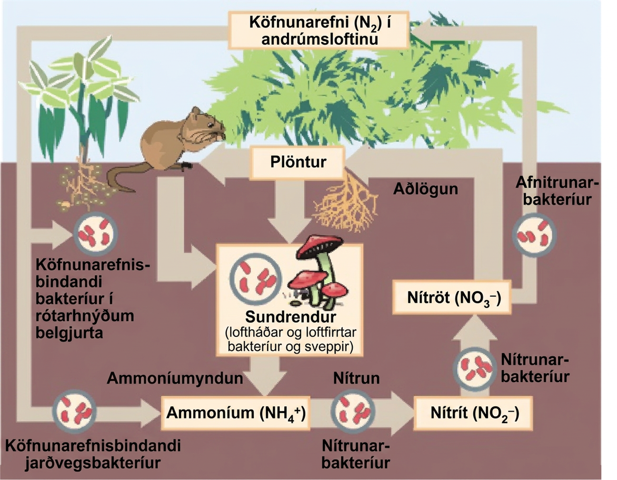
Figure 22.19
The nitrogen cycle. Prokaryotes play a key role in the nitrogen cycle. (credit: Environmental Protection Agency)
Notes:
This illustration shows the role of bacteria in the nitrogen cycle. Nitrogen-fixing bacteria in root nodules of legumes convert nitrogen gas, or upper case N 2, into organic nitrogen found in plants. Nitrogen-fixing soil bacteria produce ammonium ion, or upper N upper H 4 plus sign. Decomposers, including bacteria and fungi, decompose organic matter, also releasing upper N upper H 4 plus sign. Nitrification is the process by which nitrifying bacteria produce nitrites, shown as upper N upper O 2 negative, and nitrates, shown as upper N upper O 3 negative. Nitrates are assimilated by plants, then animals, then decomposers. Denitrifying bacteria convert nitrates to nitrogen gas, completing the cycle.

Slide 28
22.4 Bacterial Diseases in Humans
Learning Objectives
Identify bacterial diseases that caused historically important plagues and epidemics
Describe the link between biofilms and foodborne diseases
Explain how overuse of antibiotics may be creating “super bugs”
Explain the importance of MRSA with respect to the problems of antibiotic resistance

Slide 29
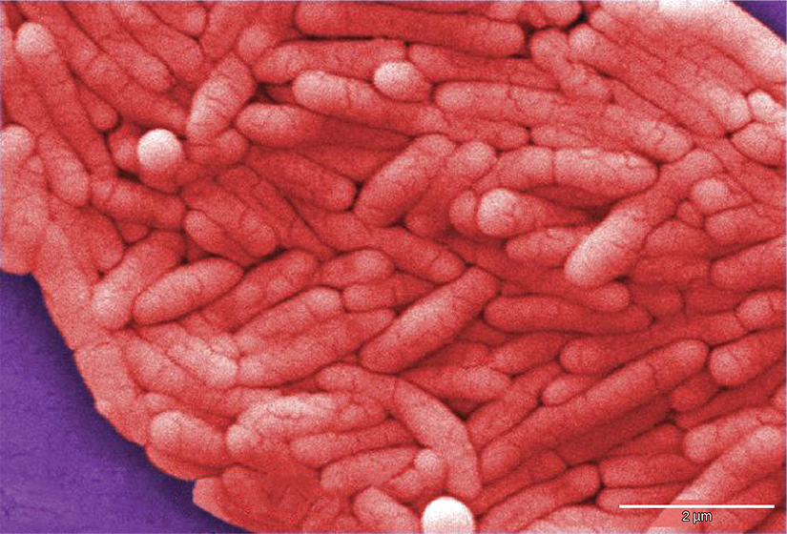
Figure 22.20
Salmonella enterica. Salmonella enterica serovar Typhi, the causative agent of Typhoid fever, is a Gram-negative, rod-shaped gamma proteobacterium. Typhoid fever, which is spread through feces, causes intestinal hemorrhage, high fever, delirium, and dehydration. Today, between 16 and 33 million cases of this re-emerging disease occur annually, resulting in over 200,000 deaths. Carriers of the disease can be asymptomatic. In a famous case in the early 1900s, a cook named Mary Mallon (“Typhoid Mary”) unknowingly spread the disease to over fifty people, three of whom died. Other serotypes of Salmonella cause food poisoning. (credit: modification of work by NCI, CDC)
Notes:
Micrograph shows pink rod-shaped bacteria.

Slide 30
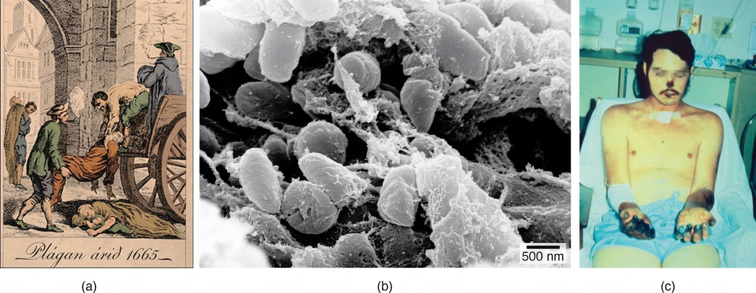
Figure 22.21
The Black Death. The (a) Great Plague of London killed an estimated 200,000 people, or about 20 percent of the city’s population. The causative agent, the (b) bacterium Yersinia pestis, is a Gram-negative, rod-shaped bacterium from the class Gammaproteobacteria. The disease is transmitted through the bite of an infected flea, which is carried on a rodent. Symptoms include swollen lymph nodes, fever, seizure, vomiting of blood, and (c) gangrene. (credit b: Rocky Mountain Laboratories, NIAID, NIH; scale-bar data from Matt Russell; credit c: Textbook of Military Medicine, Washington, D.C., U.S. Dept. of the Army, Office of the Surgeon General, Borden Institute)
Notes:
Illustration A shows two men loading a dead body onto a cart. Another body lies in the street. Label beneath the illustration says, Plague in 1665. Micrograph B shows rod shaped bacteria. Photo C shows a man with black gangrene on his fingers, arm, nose and lips.

Slide 31
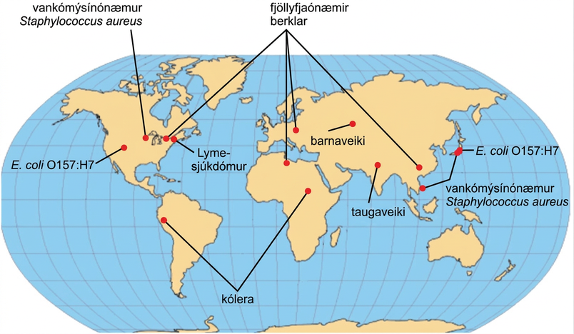
Figure 22.22
Emerging diseases. The map shows regions where bacterial diseases are emerging or re-emerging. (credit: modification of work by NIH)
Notes:
Emerging or re-emerging bacterial diseases are shown on a world map. Multidrug resistant tuberculosis is emerging in North America, Europe, north Africa, and Asia. Vancomycin resistant Staphylococcus aureus and E coli O 1 5 7 colon H 7 are emerging in North America and East Asia. Lyme disease is spreading in North America. Cholera is emerging in Africa and South America. Diptheria and typhoid fever are re emerging in Asia.

Slide 32
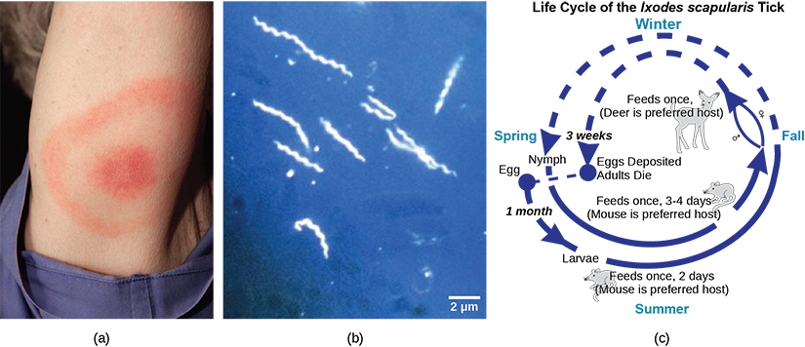
Figure 22.23
Lyme Disease. Lyme disease often, but not always, results in (a) a characteristic bullseye rash. The disease is caused by a (b) Gram-negative spirochete bacterium of the genus Borrelia. The bacteria (c) infect ticks, which in turn infect mice. Deer are the preferred secondary host, but the ticks also may feed on humans. Untreated, the disease causes chronic disorders in the nervous system, eyes, joints, and heart. The disease is named after Lyme, Connecticut, where an outbreak occurred in 1995 and has subsequently spread. The disease is not new, however. Genetic evidence suggests that Ötzi the Iceman, a 5,300-year-old mummy found in the Alps, was infected with Borrelia. (credit a: James Gathany, CDC; credit b: CDC; scale-bar data from Matt Russell)
Notes:
Part A shows the red, bullseye-shaped rash of a person infected with Borrelia. Part B shows a micrograph of Borrelia, which look like tiny corkscrews. Part C shows the life cycle of the bacteria, which begins when Borrelia infect a tick egg. The egg hatches into larva, which feeds on a mouse, then into a nymph, which also feeds on a mouse. The nymph feeds again, this time on a deer, or sometimes a human.

Slide 33
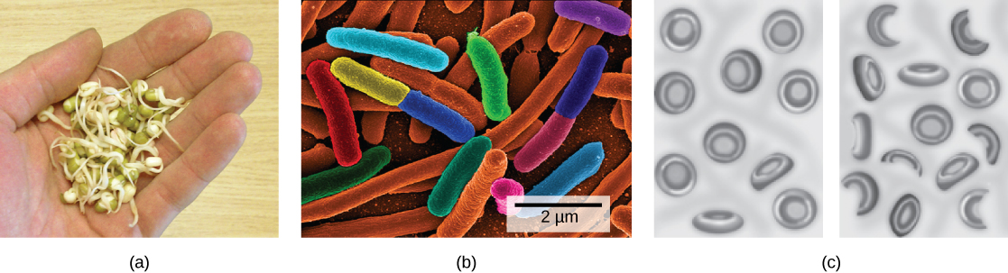
Figure 22.24
Foodborne pathogens. (a) Vegetable sprouts grown at an organic farm were the cause of an (b) E. coli outbreak that killed 32 people and sickened 3,800 in Germany in 2011. The strain responsible, E. coli O104:H4, produces Shiga toxin, a substance that inhibits protein synthesis in the host cell. The toxin (c) destroys red blood cells resulting in bloody diarrhea. Deformed red blood cells clog the capillaries of the kidney, which can lead to kidney failure, as happened to 845 patients in the 2011 outbreak. Kidney failure is usually reversible, but some patients experience kidney problems years later. (credit c: NIDDK, NIH)
Notes:
Photo A shows round green seeds with stems sprouting from them. Micrograph B shows rod-shaped bacteria about 2 microns in length. Sketch C shows normal, disk-shaped red blood cells on the left. On the right, many of the red blood cells are incomplete or fragmented.

Slide 34
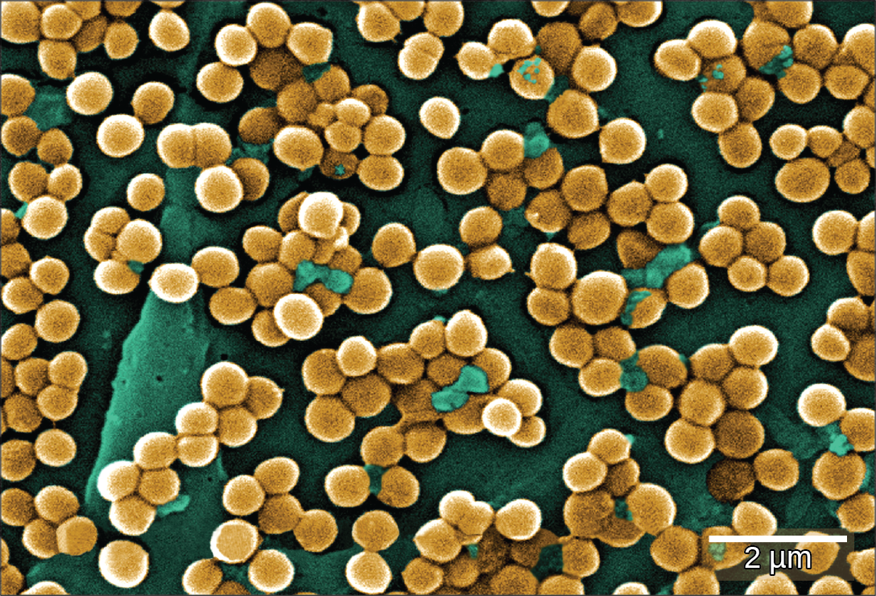
Figure 22.25
MRSA. This scanning electron micrograph shows methicillin-resistant Staphylococcus aureus bacteria, commonly known as MRSA. S. aureus is not always pathogenic, but can cause diseases such as food poisoning and skin and respiratory infections. (credit: modification of work by Janice Haney Carr; scale-bar data from Matt Russell)
Notes:
The micrograph shows clusters of round bacteria clinging to a surface. Each bacterium is about 0.4 microns across.

Slide 35
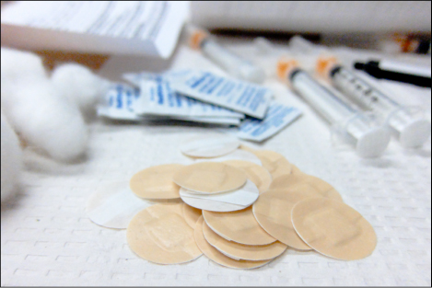
Figure 22.26
Vaccination. Vaccinations can slow the spread of communicable diseases. (credit: modification of work by Daniel Paquet)
Notes:
This photo shows syringes, adhesive bandages, and alcohol swabs.

Slide 36
22.5 Beneficial Prokaryotes
Learning Objectives
Explain the need for nitrogen fixation and how it is accomplished
Describe the beneficial effects of bacteria that colonize our skin and digestive tracts
Identify prokaryotes used during the processing of food
Describe the use of prokaryotes in bioremediation

Slide 37
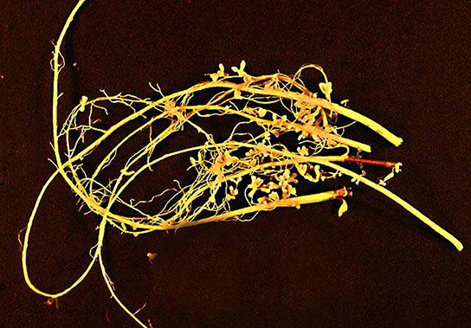
Figure 22.27
Nitrogen-fixation nodules on soybean roots. Soybean (Glycine max) is a legume that interacts symbiotically with the soil bacterium Bradyrhizobium japonicum to form specialized structures on the roots called nodules where nitrogen fixation occurs. (credit: USDA)
Notes:
This photo shows a legume root, which is thin and yellow with nodules sticking out of it.

Slide 38
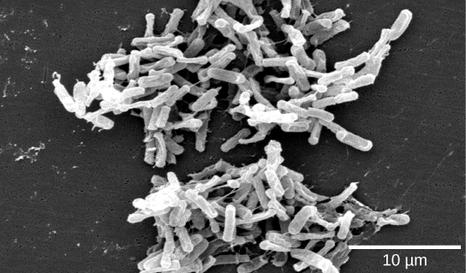
Figure 22.28
Clostridium difficile. This scanning electron micrograph shows Clostridium difficile, a Gram-positive, rod-shaped bacterium that causes severe diarrhea. Infection commonly occurs after the normal gut fauna are eradicated by antibiotics, and in the hospital can be deadly to seriously ill patients. (credit: modification of work by CDC, HHS; scale-bar data from Matt Russell)
Notes:
Micrograph shows small clusters of white rod-shaped bacteria against a dark background.

Slide 39
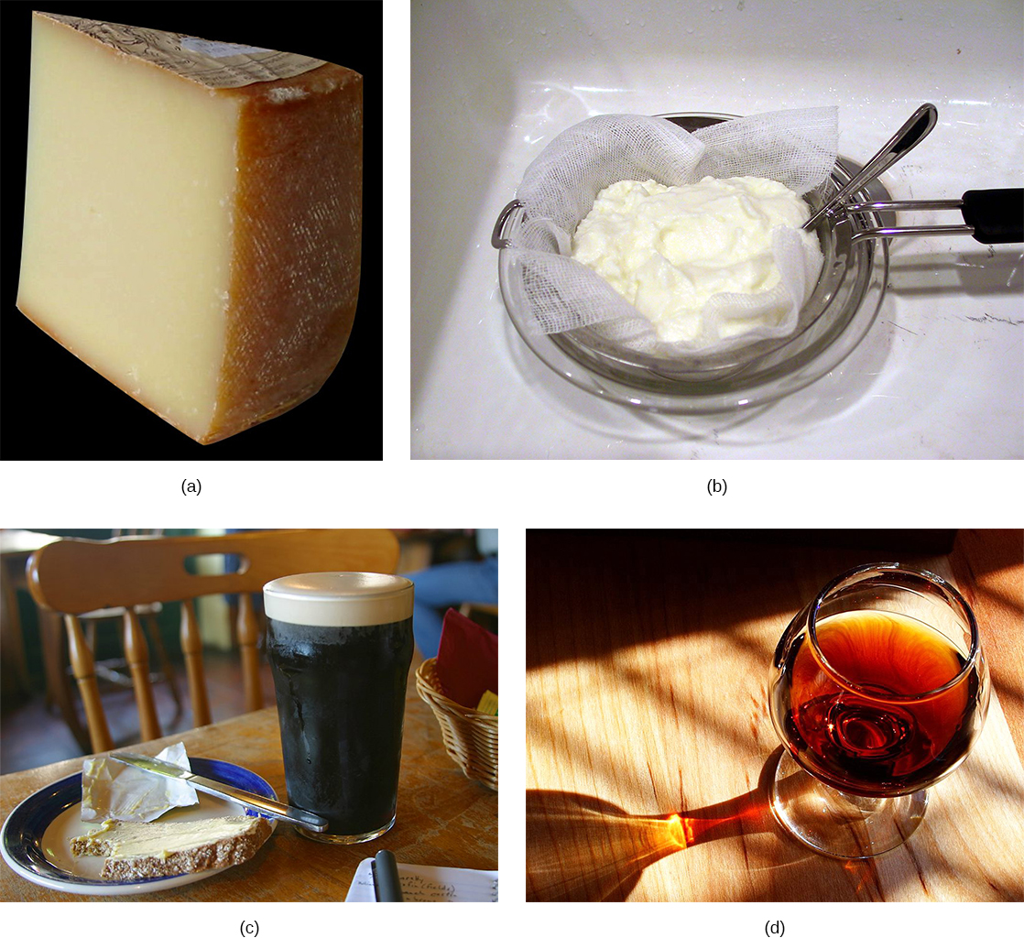
Figure 22.29
Some foods produced by microorganisms. Some of the products derived from the use of prokaryotes in early biotechnology include (a) cheese, (b) yogurt, (c) beer and bread, and (d) wine. (credit bread: modification of work by F. Rodrigo/Wikimedia Commons; credit wine: modification of work by Jon Sullivan; credit beer and bread: modification of work by Kris Miller; credit yogurt: modification of work by Jon Sullivan)
Notes:
The photo collage shows cheese, yogurt, wine, and beer and bread.

Slide 40
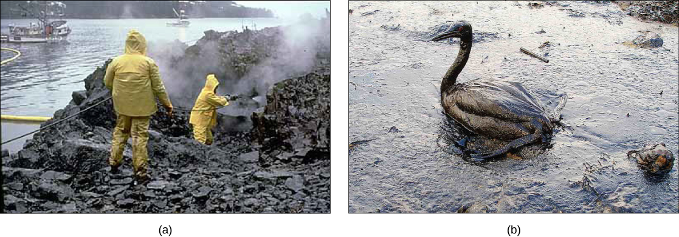
Figure 22.30
Prokaryotes and bioremediation. (a) Cleaning up oil after the Exxon Valdez spill in Alaska, workers hosed oil from beaches and then used a floating boom to corral the oil, which was finally skimmed from the water surface. Some species of bacteria are able to solubilize and degrade the oil. (b) One of the most catastrophic consequences of oil spills is the damage to fauna. (credit a: modification of work by NOAA; credit b: modification of work by GOLUBENKOV, NGO: Saving Taman)
This OpenStax ancillary resource is © Rice University under a CC BY-NC-SA 4.0 International license; it may be reproduced or modified for noncommercial purposes only but must be attributed to OpenStax, Rice University and any changes must be noted. Any adaptation must be shared under the same type of license.
Notes:
Part a: This photo shows two men in yellow raingear hosing off oil-drenched rocks on a sea-shore. Part b: This photo shows an oil-drenched bird sitting in oily water.

