Slide 1

Biology 2e
Chapter 47 Conservation Biology and Biodiversity

Slide 2
Chapter outline
The Biodiversity Crisis
The Importance of Biodiversity to Human Life
Threats to Biodiversity
Preserving Biodiversity

Slide 3
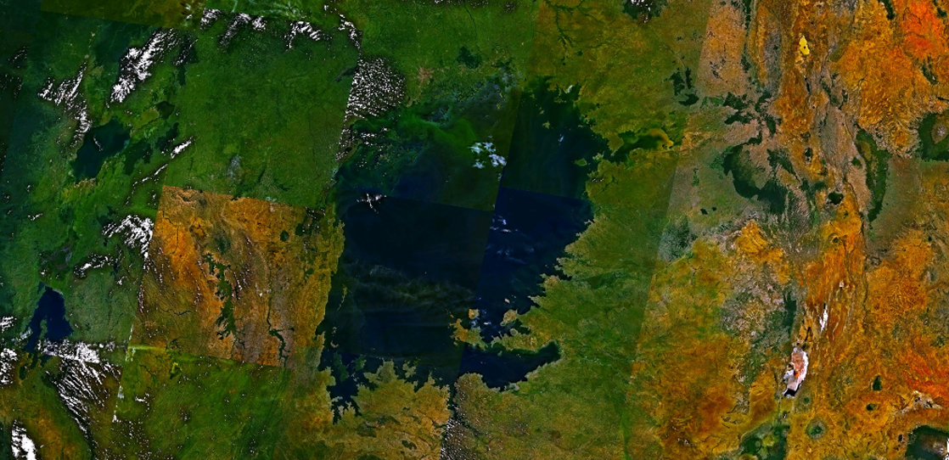
Figure 47.1
Lake Victoria in Africa, shown in this satellite image, was the site of one of the most extraordinary evolutionary findings on the planet, as well as a casualty of devastating biodiversity loss. (credit: modification of work by Rishabh Tatiraju, using NASA World Wind software)
Notes:
Satellite image shows a large blue lake surrounded by green land.

Slide 4
47.1 The Biodiversity Crisis
Learning Objectives
Define biodiversity in terms of species diversity and abundance
Describe biodiversity as the equilibrium of naturally fluctuating rates of extinction and speciation
Identify historical causes of high extinction rates in Earth’s history

Slide 5
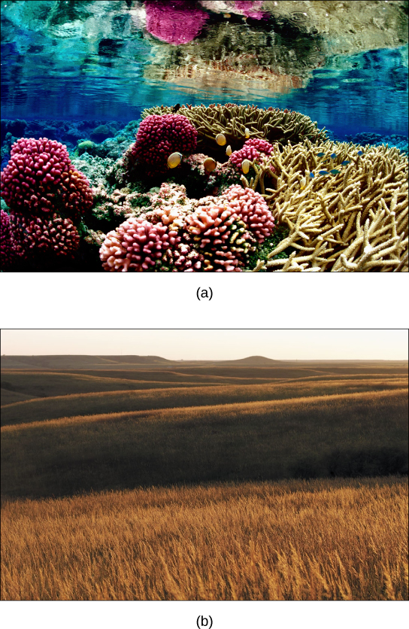
Figure 47.2
The variety of ecosystems on Earth—from (a) coral reef to (b) prairie—enables a great diversity of species to exist. (credit a: modification of work by Jim Maragos, USFWS; credit b: modification of work by Jim Minnerath, USFWS)
Notes:
Photo a shows a coral reef. Some of the coral is lobe-shaped, with bumpy pink protrusions, and the other coral has long, slender beige branches. Fish swim among the coral. Photo b shows a rolling prairie, with nothing but tall brown grass as far as the eye can see.

Slide 6
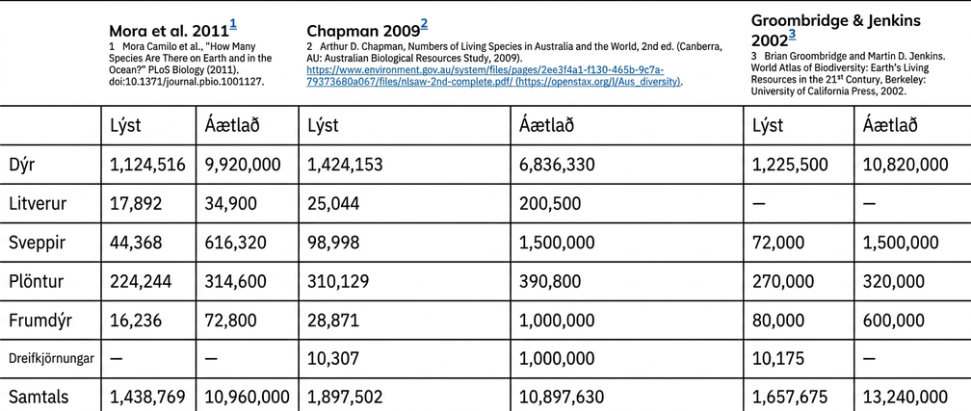
Table 47.1

Slide 7
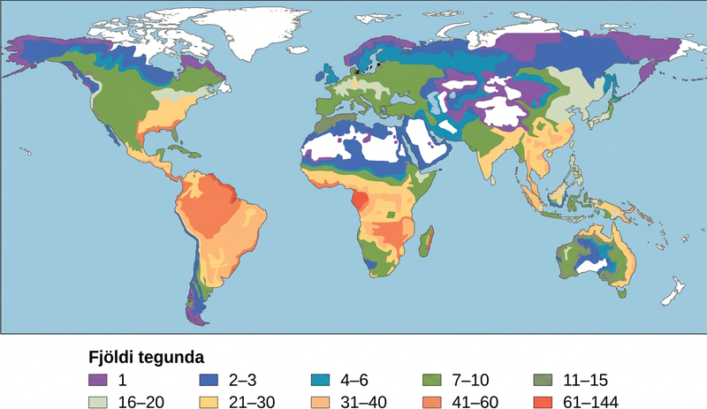
Figure 47.3
This map illustrates the number of amphibian species across the globe and shows the trend toward higher biodiversity at lower latitudes. A similar pattern is observed for most taxonomic groups. The white areas indicate a lack of data in this particular study.
Notes:
The number of amphibian species in different areas is specified on a world map. The greatest number of species, 61-144, are found in the Amazon region of South America and in parts of Africa. Between 21 and 60 species are found in other parts of South America and Africa, and in the eastern United States and Southeast Asia. Other parts of the world have between 1 and 20 amphibian species, with the fewest species occurring at northern and southern latitudes. Generally, more amphibian species are found in warmer, wetter climates.

Slide 8
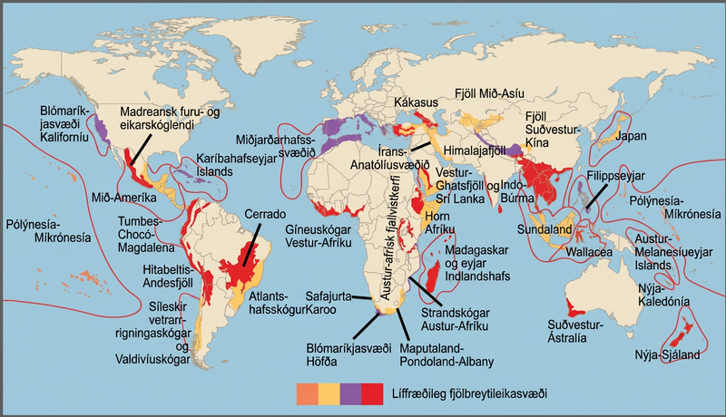
Figure 47.4
Conservation International has identified 34 biodiversity hotspots, which cover only 2.3 percent of the Earth’s surface but have endemic to them 42 percent of the terrestrial vertebrate species and 50 percent of the world’s plants.
Notes:
Biodiversity hotspots are indicated on a world map. Most hotspots occur in coastal regions and on islands. Some of the hotspots include New Zealand, Madagascar, Thailand, Vietnam, the west coast of Central America, and southwest Austrailia. Some other areas indicated are the California cost, labeled as the California floristic province, the Mediterranean Basin, and the Carribean islands.

Slide 9
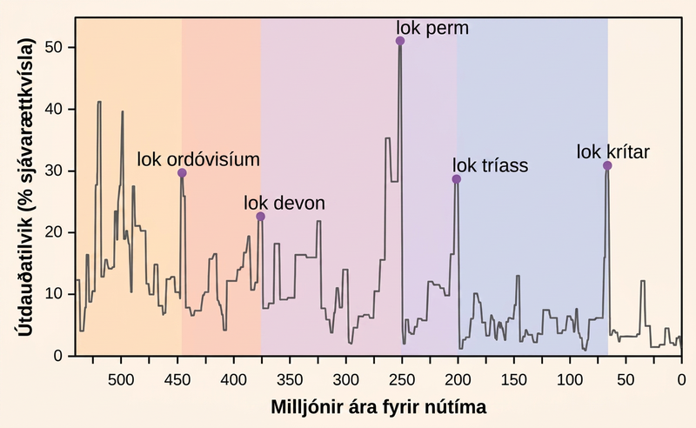
Figure 47.5
Percent extinction occurrences of marine genera as reflected in the fossil record have fluctuated throughout Earth’s history. Sudden and dramatic losses of biodiversity, called mass extinctions, have occurred five times.
Notes:
The chart shows percent extinction intensity of eliminated marine genera versus time in millions of years before present. Extinction intensity spikes at boundaries between periods, including the end of the Ordovician which had 30 percent extinction occurrences of marine genera approximately 450 million years ago. The late Devonian had approximately 25 percent extinction occurrences of marine genera at roughly 375 million years ago. The end of the Permian had 50 percent extinction occurrences of marine genera approximately 250 million years ago. The end of the Triassic had roughly 30 percent extinction occurrences of marine genera 200 million years ago. And the end of the Cretaceous periods had over 30 percent extinction occurrences of marine genera roughly 70 million years ago.

Slide 10
Table 47.2
Geological Period | Mass Extinction Name | Time (millions of years ago)
Ordovician–Silurian | end-Ordovician O–S | 450–440
Late Devonian | end-Devonian | 375–360
Permian–Triassic | end-Permian | 251
Triassic–Jurassic | end-Triassic | 205
Cretaceous–Paleogene | end-Cretaceous K–Pg (K–T) | 65.5
This table shows the names and dates for the five mass extinctions in Earth’s history.

Slide 11
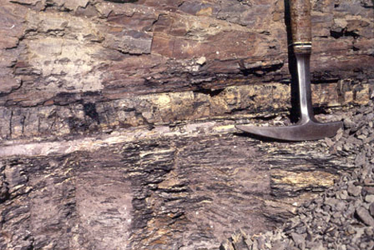
Figure 47.6
In 1980, Luis and Walter Alvarez, Frank Asaro, and Helen Michels discovered, across the world, a spike in the concentration of iridium within the sedimentary layer at the K–Pg boundary. These researchers hypothesized that this iridium spike was caused by an asteroid impact that resulted in the K–Pg mass extinction. In the photo, the iridium layer is the light band. (credit: USGS)
Notes:
Photo shows sedimentary rock with a distinct white band in the middle representing the K dash P g boundary. The rock below this layer, which has fine bands of dark and light gray, is distinct in appearance from the smoother, redder rock above.

Slide 12
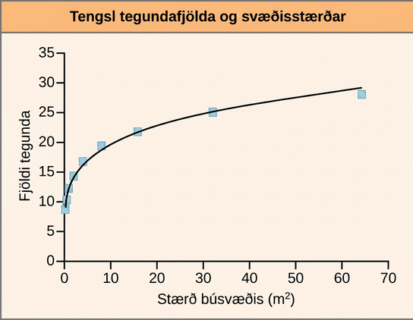
Figure 47.7
Studies have shown that the number of species present increases with the size of the habitat. (credit: modification of work by Adam B. Smith)
Notes:
A graph plots the number of species present versus area in meters squared. The number of species present increases as a power function, such that the slope of the curve increases sharply at first, then more gradually as area increases.

Slide 13
47.2 The Importance of Biodiversity to Human Life
Learning Objectives
Identify chemical diversity benefits to humans
Identify biodiversity components that support human agriculture
Describe ecosystem services

Slide 14

Figure 47.8
Catharanthus roseus, the Madagascar periwinkle, has various medicinal properties. Among other uses, it is a source of vincristine, a drug used in the treatment of lymphomas. (credit: Forest and Kim Starr)
Notes:
Photo shows white and pink periwinkle flowers. Each flower has five triangular petals, with the narrow end of the petal meeting at the flowers center. Pairs of waxy oval leaves grow perpendicular to one another on a separate stem.

Slide 15
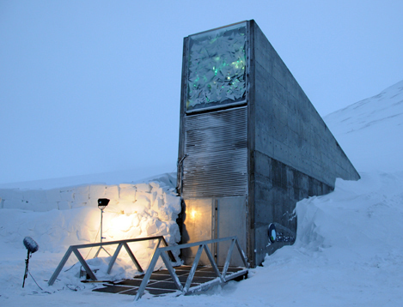
Figure 47.9
The Svalbard Global Seed Vault is a storage facility for seeds of Earth’s diverse crops. (credit: Mari Tefre, Svalbard Global Seed Vault)
Notes:
The photo shows a tall structure with a bunker-like door that disappears into a snowbank.

Slide 16
47.3 Threats to Biodiversity
Learning Objectives
Identify significant threats to biodiversity
Explain the effects of habitat loss, the introduction of exotic species, and hunting on biodiversity
Identify the early and predicted effects of climate change on biodiversity

Slide 17
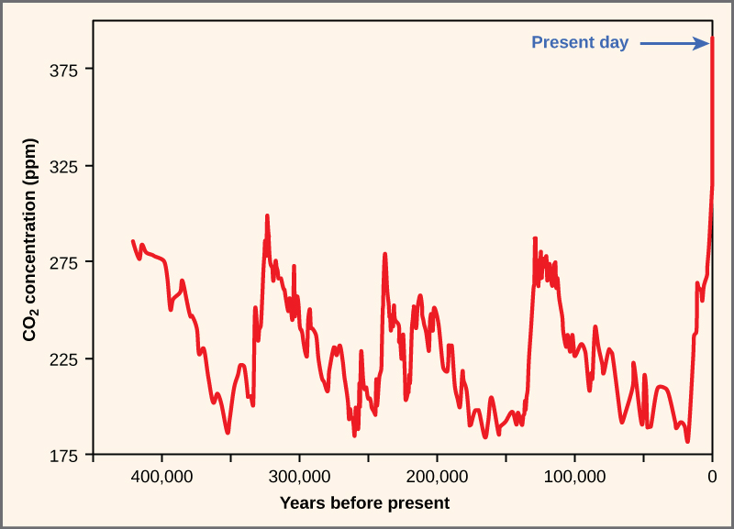
Figure 47.10
Atmospheric carbon dioxide levels fluctuate in a cyclical manner. However, the burning of fossil fuels in recent history has caused a dramatic increase in the levels of carbon dioxide in the Earth’s atmosphere, which have now reached levels never before seen in human history. Scientists predict that the addition of this “greenhouse gas” to the atmosphere is resulting in climate change that will significantly impact biodiversity in the coming century.
Notes:
The graph plots atmospheric carbon dioxide concentration in parts per million over time (years before present). Historically, carbon dioxide levels have fluctuated in a cyclical manner, from about 280 parts per million at the peak to about 180 parts per million at the low point. This cycle repeated every one hundred thousand years or so, from about 425,000 years ago until recently. Prior to the industrial revolution, the atmospheric carbon dioxide concentration was at a high point in the cycle. Since then the carbon dioxide level has rapidly climbed to its current level of 395 parts per million. This carbon dioxide level is far higher than any previously recorded levels.

Slide 18
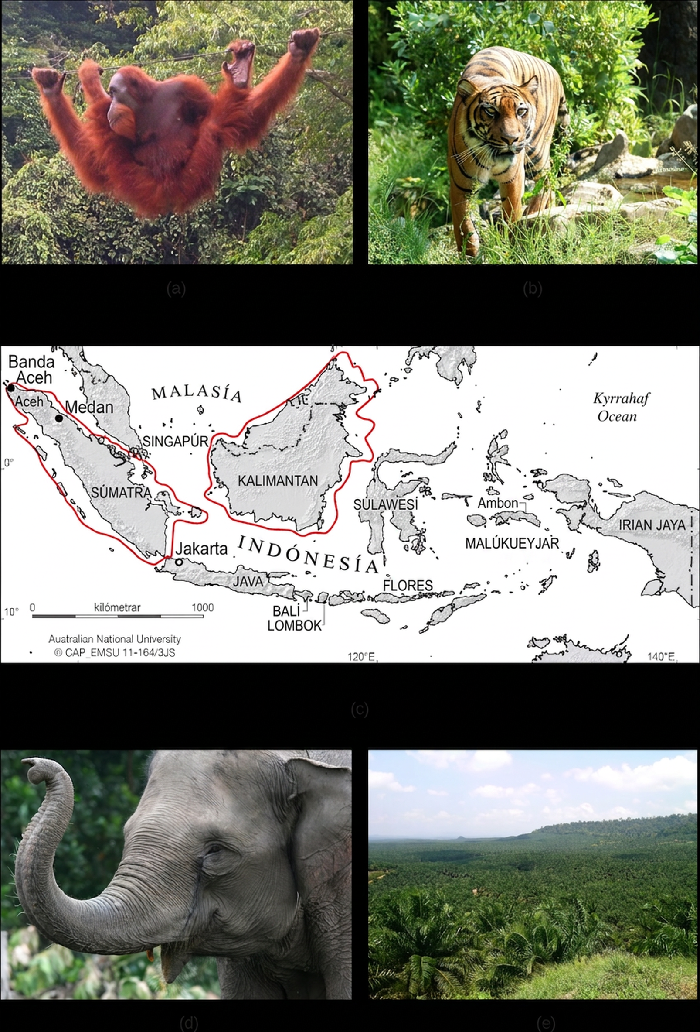
Figure 47.11
(a) One of three species of orangutan, Pongo pygmaeus, is found only in the rainforests of Borneo, and another species of orangutan (Pongo abelii) is found only in the rainforests of Sumatra. These animals are examples of the exceptional biodiversity of (c) the islands of Sumatra and Borneo. Other species include the (b) Sumatran tiger (Panthera tigris sumatrae) and the (d) Sumatran elephant (Elephas maximus sumatranus), both critically endangered species. Rainforest habitat is being removed to make way for (e) oil palm plantations such as this one in Borneo’s Sabah Province. (credit a: modification of work by Thorsten Bachner; credit b: modification of work by Dick Mudde; credit c: modification of work by U.S. CIA World Factbook; credit d: modification of work by “Nonprofit Organizations”/Flickr; credit e: modification of work by Dr. Lian Pin Koh)
Notes:
Photo A shows an orangutan hanging from a wire in a lush rainforest filled with many different kinds of vegetation. Photo B shows a tiger. Map C shows the islands of Borneo and Sumatra in the south Pacific, just northwest of Australia. Sumatra is in the country of Indonesia. Half of Borneo is in Indonesia, and half is in Malaysia. Photo D shows a gray elephant. Photo E shows rolling hills covered with homogenous short, bushy oil palm trees.

Slide 19
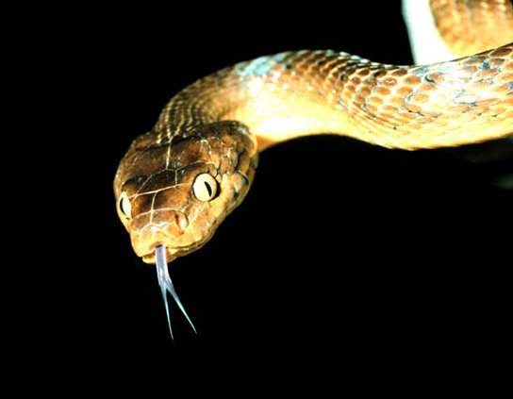
Figure 47.12
The brown tree snake, Boiga irregularis, is an exotic species that has caused numerous extinctions on the island of Guam since its accidental introduction in 1950. (credit: NPS)
Notes:
Photo shows a snake mottled brown and tan, with a forked tongue sticking out of its mouth.

Slide 20
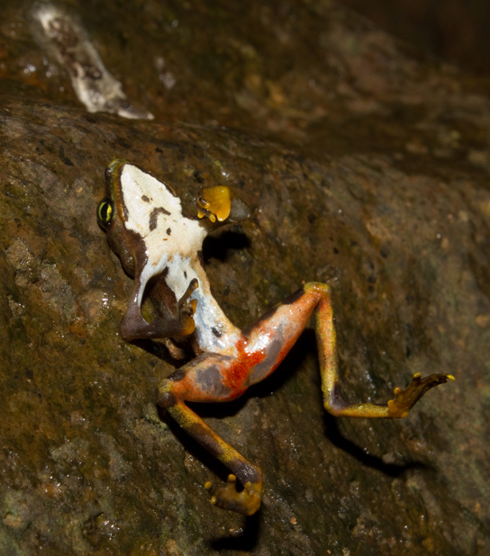
Figure 47.13
This Limosa Harlequin Frog (Atelopus limosus), an endangered species from Panama, died from a fungal disease called chytridiomycosis. The red lesions are symptomatic of the disease. (credit: Brian Gratwicke)
Notes:
Photo shows a dead frog laying upside-down on a rock. The frog has bright red lesions on its hind quarters.

Slide 21
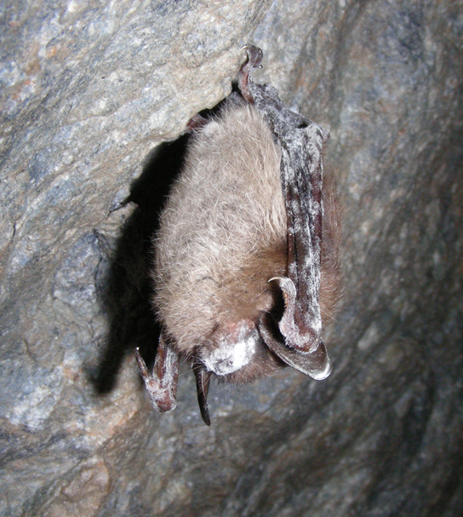
Figure 47.14
This little brown bat in Greeley Mine, Vermont, March 26, 2009, was found to have white-nose syndrome. (credit: Marvin Moriarty, USFWS)
Notes:
Photo shows a bat hanging from the roof of a cave. The bat has a powdery white residue on its head and wings.

Slide 22
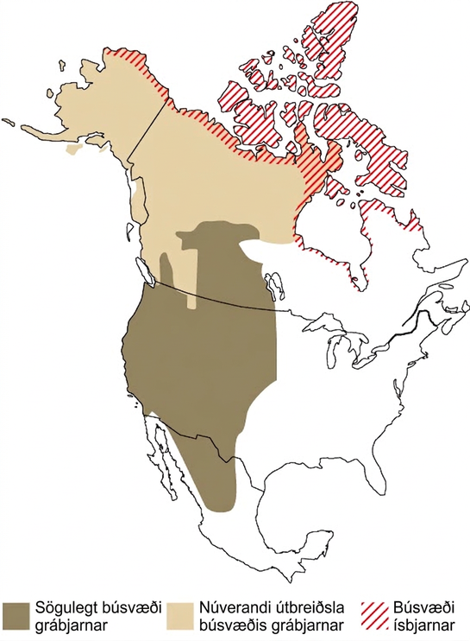
Figure 47.15
Since 2008, grizzly bears (Ursus arctos horribilis) have been spotted farther north than their historic range, a possible consequence of climate change. As a result, grizzly bear habitat now overlaps polar bear (Ursus maritimus) habitat. The two species of bears, which are capable of mating and producing viable offspring, are considered separate “ecological” species because historically they lived in different habitats and never met. However, in 2006 a hunter shot a wild grizzly-polar bear hybrid known as a grolar bear, the first wild hybrid ever found.
Notes:
Map A compares the historic and current ranges of grizzly bears with the range of polar bears. Historically, grizzly bear habitat extended from Mexico through the western United States and into the mid-latitudes of Canada. But in recent years this range has expanded northward, to the northern tip of Canada and throughout Alaska. This range now overlaps with the polar bear range in the northern extremes of Alaska in Canada.

Slide 23
47.4 Preserving Biodiversity
Learning Objectives
Identify new technologies and methods for describing biodiversity
Explain the legislative framework for conservation
Describe principles and challenges of conservation preserve design
Identify examples of the effects of habitat restoration
Discuss the role of zoos in biodiversity conservation

Slide 24
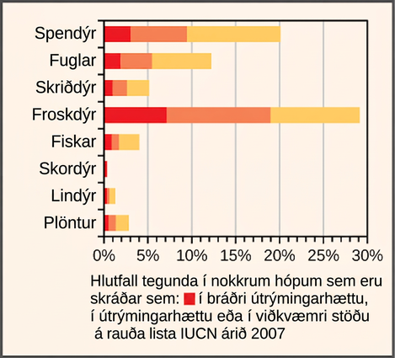
Figure 47.16
This chart shows the percentage of various animal species, by group, on the IUCN Red List as of 2007.
Notes:
Bar graph shows the percentage of animal species, by group, that are critically endangered, endangered, or vulnerable. Approximately 20 percent of mammal species are on the I U C N Red List. Of these, about 10 percent are vulnerable, 7 percent are endangered, and 4 percent are critically endangered. Approximately 12 percent of bird species are on the Red List. Of these, about 6 percent are vulnerable, 4 percent are endangered, and 2 percent are critically endangered. Approximately 5 percent of reptile species are on the Red List. Of these, about 3 percent are vulnerable, 2 percent are endangered, and 1 percent are critically endangered. Approximately 29 percent of amphibian species are on the Red List. Of these, about 10 percent are vulnerable, 12 percent are endangered, and 7 percent are critically endangered. Approximately 4 percent of fish species are on the Red List. Of these, about 2 percent are vulnerable, 1 percent are endangered, and 1 percent are critically endangered. Less than 1 percent of insect species fall on the Red List. Approximately 1.5 percent of mollusk species are on the Red List. Of these, about 1 percent are vulnerable, and 0.25 percent each are endangered or critically endangered. Approximately 3 percent of plant species are on the Red List. Of these, about 2 percent are vulnerable, .5 percent each are endangered or critically endangered.

Slide 25
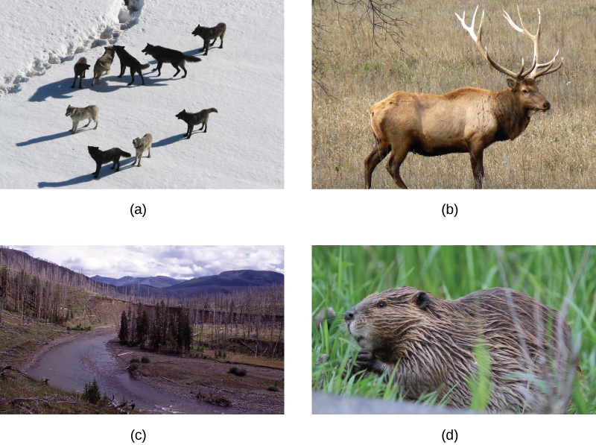
Figure 47.17
(a) The Gibbon wolf pack in Yellowstone National Park, March 1, 2007, represents a keystone species. The reintroduction of wolves into Yellowstone National Park in 1995 led to a change in the grazing behavior of (b) elk. To avoid predation, the elk no longer grazed exposed stream and riverbeds, such as (c) the Lamar Riverbed in Yellowstone. This allowed willow and cottonwood seedlings to grow and recolonized large areas. The seedlings decreased erosion and provided shading to the creek, which improved fish habitat. A new colony of (d) beaver may also have benefited from the habitat change. (credit a: modification of work by Doug Smith, NPS; credit c: modification of work by Jim Peaco, NPS; credit d: modification of work by “Shiny Things”/Flickr)
This OpenStax ancillary resource is © Rice University under a CC BY-NC-SA 4.0 International license; it may be reproduced or modified for noncommercial purposes only but must be attributed to OpenStax, Rice University and any changes must be noted. Any adaptation must be shared under the same type of license.
Notes:
Photo A shows a pack of wolves walking on snow. Photo B shows an elk. Photo C shows a river running through a meadow with a few copses of trees, some living and some dead. Photo D shows a beaver.

