Slide 1

Biology 2e
Chapter 40 The Circulatory System

Slide 2
Chapter outline
Overview of the Circulatory System
Components of the Blood
Mammalian Heart and Blood Vessels
Blood Flow and Blood Pressure Regulation

Slide 3
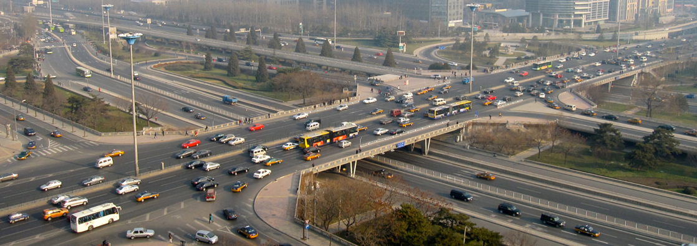
Figure 40.1
Just as highway systems transport people and goods through a complex network, the circulatory system transports nutrients, gases, and wastes throughout the animal body. (credit: modification of work by Andrey Belenko)
Notes:
Photo shows intersecting highways and secondary roads.

Slide 4
40.1 Overview of the Circulatory System
Learning Objectives
Describe an open and closed circulatory system
Describe interstitial fluid and hemolymph
Compare and contrast the organization and evolution of the vertebrate circulatory system

Slide 5
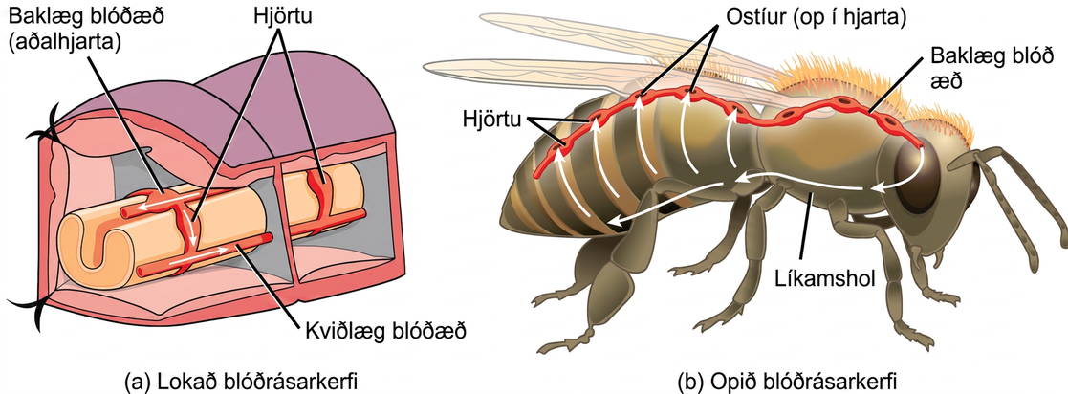
Figure 40.2
In (a) closed circulatory systems, the heart pumps blood through vessels that are separate from the interstitial fluid of the body. Most vertebrates and some invertebrates, like this annelid earthworm, have a closed circulatory system. In (b) open circulatory systems, a fluid called hemolymph is pumped through a blood vessel that empties into the body cavity. Hemolymph returns to the blood vessel through openings called ostia. Arthropods like this bee and most mollusks have open circulatory systems.
Notes:
Illustration A shows the closed circulatory system of an earthworm. Dorsal and ventral blood vessels run along the top and bottom of the intestine, respectively. The dorsal and ventral blood vessels are connected by ring-like hearts. Hearts are also associated with the dorsal blood vessel. These hearts pump blood forward, and the ring-like hearts pump blood down to the ventral vessel, which returns blood to the back of the body. Illustration B shows the open circulatory system of a bee. The dorsal blood vessel, which contains multiple hearts, runs along the top of the bee. Blood exits the dorsal blood vessel through an opening in the head, into the body cavity. Blood reenters the blood vessels through openings in the hearts called ostia.

Slide 6
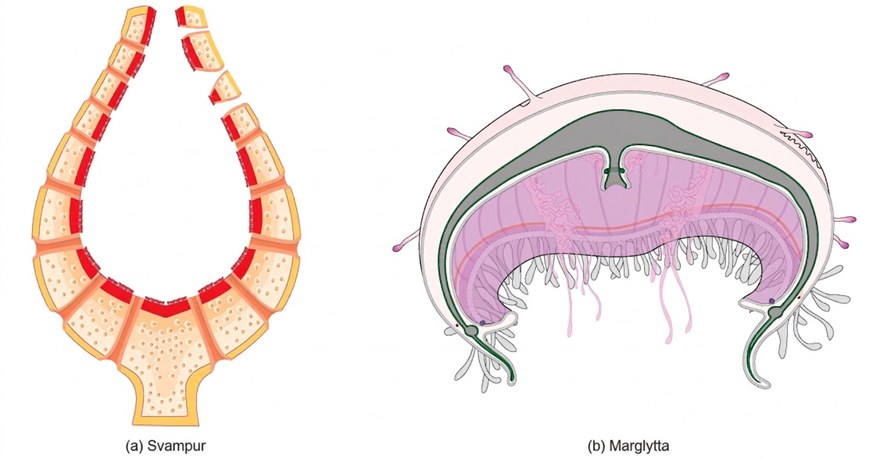
Figure 40.3
Simple animals consisting of a single cell layer such as the (a) sponge or only a few cell layers such as the (b) jellyfish do not have a circulatory system. Instead, gases, nutrients, and wastes are exchanged by diffusion.
Notes:
Illustration A shows a cross section of a sponge, which has a thin, vase-like body bathed both inside and out by fluid. Illustration B shows a bell-shaped jellyfish.

Slide 7
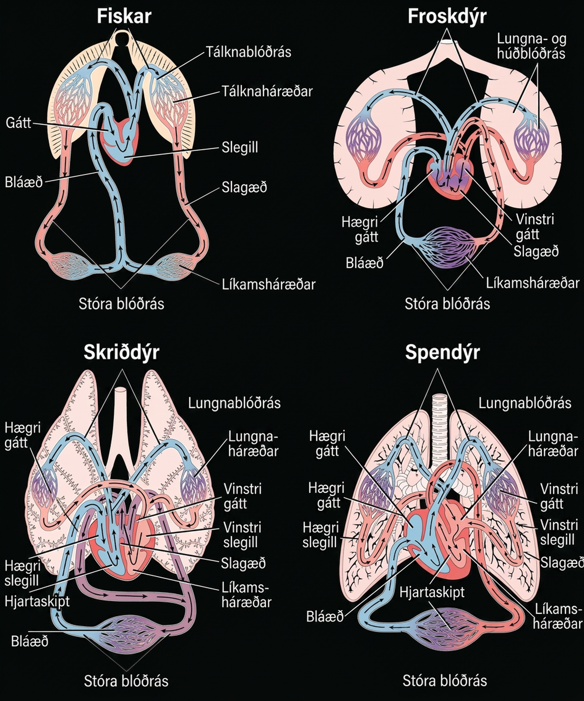
Figure 40.4
(a) Fish have the simplest circulatory systems of the vertebrates: blood flows unidirectionally from the two-chambered heart through the gills and then the rest of the body. (b) Amphibians have two circulatory routes: one for oxygenation of the blood through the lungs and skin, and the other to take oxygen to the rest of the body. The blood is pumped from a three-chambered heart with two atria and a single ventricle. (c) Reptiles also have two circulatory routes; however, blood is only oxygenated through the lungs. The heart is three chambered, but the ventricles are partially separated so some mixing of oxygenated and deoxygenated blood occurs except in crocodilians and birds. (d) Mammals and birds have the most efficient heart with four chambers that completely separate the oxygenated and deoxygenated blood; it pumps only oxygenated blood through the body and deoxygenated blood to the lungs.
Notes:
Illustration A shows the circulatory system of fish, which have a two-chambered heart with one atrium and one ventricle. Blood in systemic circulation flows from the body into the atrium, then into the ventricle. Blood exiting the heart enters gill circulation, where gases are exchanged by gill capillaries. From the gills blood re-enters systemic circulation, where gases in the body are exchanged by body capillaries. Illustration B shows the circulatory system of amphibians, which have a three-chambered heart with two atriums and one ventricle. Blood in systemic circulation enters the heart, flows into the right atrium, then into the ventricle. Blood leaving the ventricle enters pulmonary and skin circulation. Capillaries in the lung and skin exchange gases, oxygenating the blood. From the lungs and skin blood re-enters the heart through the left atrium. Blood flows into the ventricle, where it mixes with blood from systemic circulation. Blood leaves the ventricle and enters systemic circulation. Illustration C shows the circulatory system of reptiles, which have a three-chambered heart. While the right and left atrium are completely separated, there is only a partial septum separating the ventricles, and thus there is some mixing of blood between these chambers. Blood from systemic circulation enters the right atrium, then flows from the right ventricle and enters pulmonary circulation, where blood is oxygenated in the lungs. From the lungs blood travels back into the heart through the left atrium. Because the left and right atrium are not separated, some mixing of oxygenated and deoxygenated blood occurs. Blood is pumped into the left ventricle, then into the body. Illustration D shows the circulatory system of mammals, which have a four-chambered heart. Circulation is similar to that of reptiles, but the four chambers are completely separate from one another, which improves efficiency.

Slide 8
40.2 Components of the Blood
Learning Objectives
List the basic components of the blood
Compare red and white blood cells
Describe blood plasma and serum

Slide 9
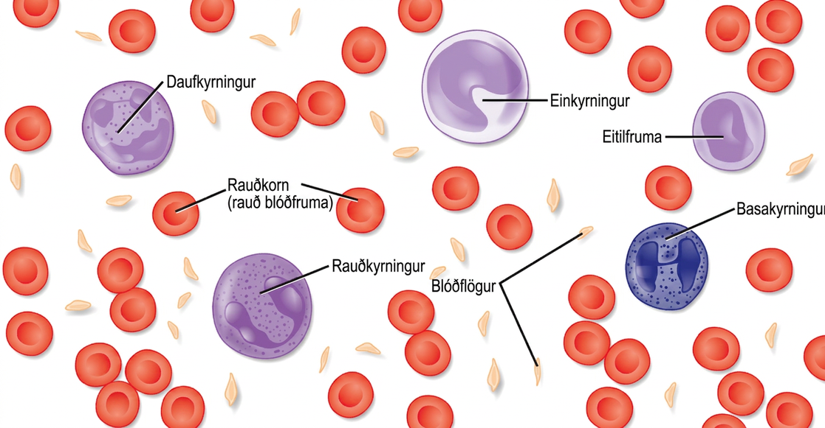
Figure 40.5
The cells and cellular components of human blood are shown. Red blood cells deliver oxygen to the cells and remove carbon dioxide. White blood cells—including neutrophils, monocytes, lymphocytes, eosinophils, and basophils—are involved in the immune response. Platelets form clots that prevent blood loss after injury.
Notes:
Illustration shows different types of blood cells and cellular components. Red blood cells are disc-shaped and indented in the middle. Platelets are long and thin, and about half the length of red blood cells. Neutrophils, monocytes, lymphocytes, eosinophils, and basophils are about twice the diameter of red blood cells and spherical. Monocytes and eosinophils have U shaped nuclei. Eosinophils contain granules, but monocytes do not. Basophils and neutrophils both have irregularly shaped, multi-lobed nuclei and granules.

Slide 10
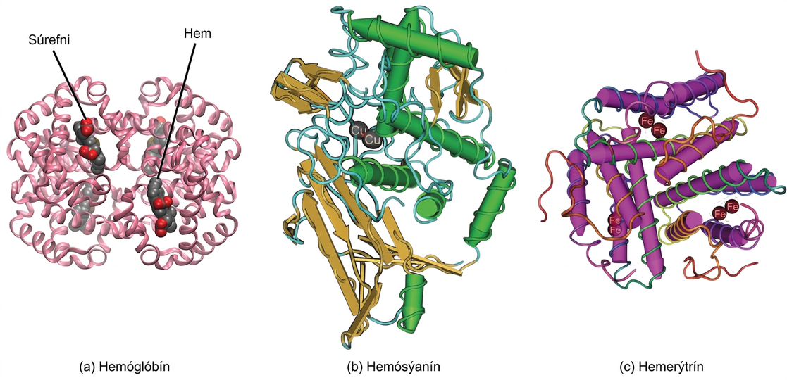
Figure 40.6
In most vertebrates, (a) hemoglobin delivers oxygen to the body and removes some carbon dioxide. Hemoglobin is composed of four protein subunits, two alpha chains and two beta chains, and a heme group that has iron associated with it. The iron reversibly associates with oxygen, and in so doing is oxidized from Fe2+ to Fe3+. In most mollusks and some arthropods, (b) hemocyanin delivers oxygen. Unlike hemoglobin, hemocyanin is not carried in blood cells, but floats free in the hemolymph. Copper instead of iron binds the oxygen, giving the hemolymph a blue-green color. In annelids, such as the earthworm, and some other invertebrates, (c) hemerythrin carries oxygen. Like hemoglobin, hemerythrin is carried in blood cells and has iron associated with it, but despite its name, hemerythrin does not contain heme.
Notes:
Molecular model A shows the structure of hemoglobin, which is made up of four protein subunits, each of which is coiled into helices. Left, right, bottom, and top parts of the molecule are symmetrical. Four small heme groups are associated with hemoglobin. Oxygen is bound to the heme. Molecular model B shows the structure of hemocyanin, a protein made up of coiled helices and ribbon-like sheets. Two copper ions are associated with the protein. Molecular model C shows the structure of hemerythrin, a protein made of coiled helices with four iron ions associated with it.

Slide 11
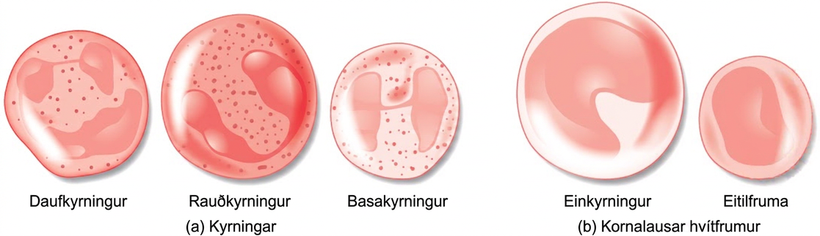
Figure 40.7
(a) Granulocytes—including neutrophils, eosinophils and basophils—are characterized by a lobed nucleus and granular inclusions in the cytoplasm. Granulocytes are typically first-responders during injury or infection. (b) Agranulocytes include lymphocytes and monocytes. Lymphocytes, including B and T cells, are responsible for adaptive immune response. Monocytes differentiate into macrophages and dendritic cells, which in turn respond to infection or injury.
Notes:
Illustration A shows the granulocytes, which include neutrophils, eosinophils, and basophils. The three cell types are similar in size, with lobed nuclei and granules in the cytoplasm. Illustration B shows agranulocytes, including lymphocytes and monocytes. The monocyte is somewhat larger than the lymphocyte and has a U-shaped nucleus. The lymphocyte has an oblong nucleus.

Slide 12
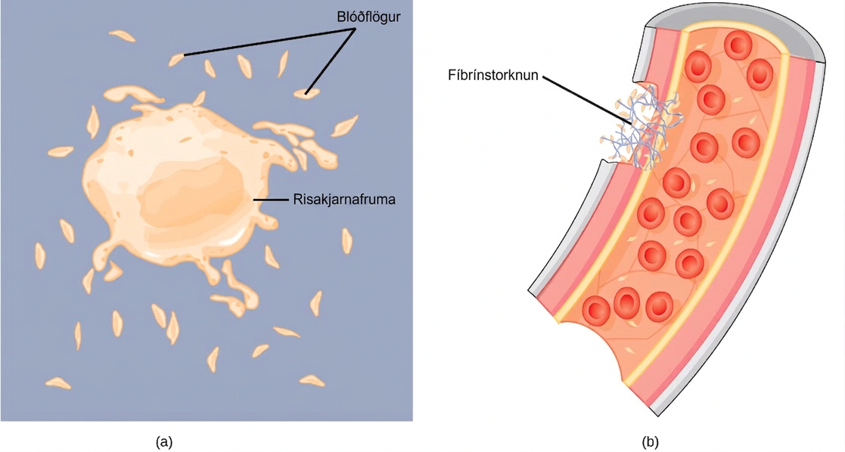
Figure 40.8
(a) Platelets are formed from large cells called megakaryocytes. The megakaryocyte breaks up into thousands of fragments that become platelets. (b) Platelets are required for clotting of the blood. The platelets collect at a wound site in conjunction with other clotting factors, such as fibrinogen, to form a fibrin clot that prevents blood loss and allows the wound to heal.
Notes:
Part A shows a large, somewhat irregularly shaped cell called a megakaryocyte shedding small, oblong platelets. Part B shows a fibrin clot plugging a cut in a blood vessel. The clot is made up of platelets and a fibrous material called fibrin.

Slide 13
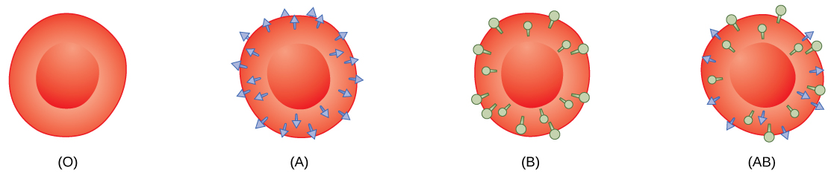
Figure 40.9
Human red blood cells may have either type A or B glycoproteins on their surface, both glycoproteins combined (AB), or neither (O). The glycoproteins serve as antigens and can elicit an immune response in a person who receives a transfusion containing unfamiliar antigens. Type O blood, which has no A or B antigens, does not elicit an immune response when injected into a person of any blood type. Thus, O is considered the universal donor. Persons with type AB blood can accept blood from any blood type, and type AB is considered the universal acceptor.
Notes:
Type O, type A, type B and type A B red blood cells are shown. Type O cells do not have any antigens on their surface. Type A cells have A antigen on their surface. Type B cells have B antigen on their surface. Type A B cells have both antigens on their surface. The antigens appear as small protrusions on the cell surface.

Slide 14
40.3 Mammalian Heart and Blood Vessels
Learning Objectives
Describe the structure of the heart and explain how cardiac muscle is different from other muscles
Describe the cardiac cycle
Explain the structure of arteries, veins, and capillaries, and how blood flows through the body

Slide 15
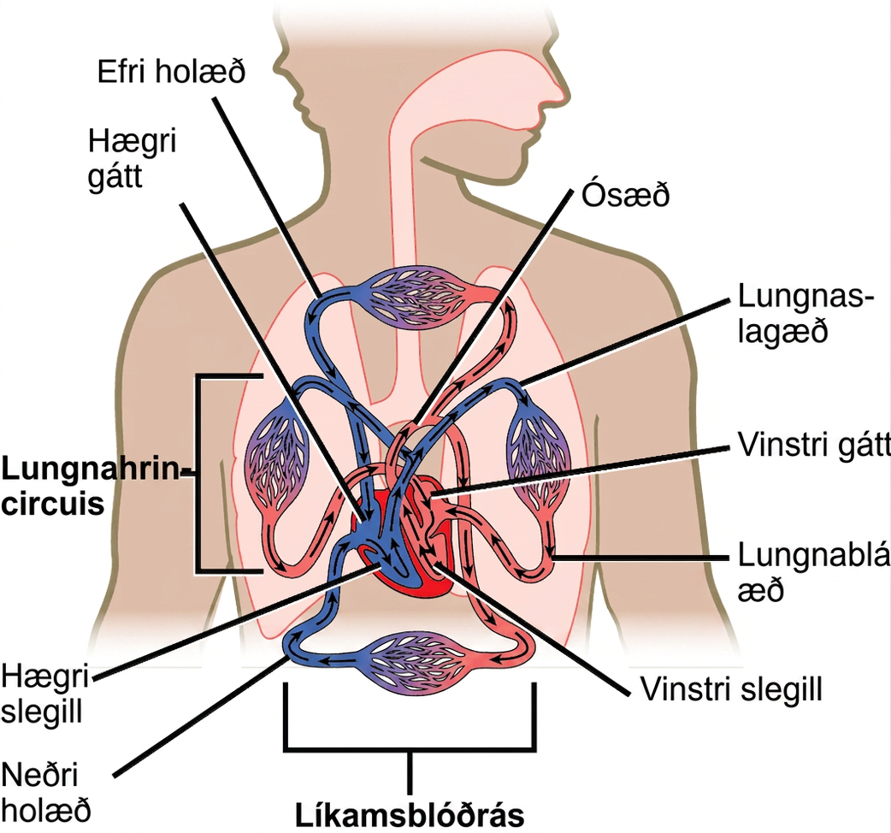
Figure 40.10
The mammalian circulatory system is divided into three circuits: the systemic circuit, the pulmonary circuit, and the coronary circuit. Blood is pumped from veins of the systemic circuit into the right atrium of the heart, then into the right ventricle. Blood then enters the pulmonary circuit, and is oxygenated by the lungs. From the pulmonary circuit, blood reenters the heart through the left atrium. From the left ventricle, blood reenters the systemic circuit through the aorta and is distributed to the rest of the body. The coronary circuit, which provides blood to the heart, is not shown.
Notes:
Illustration shows blood circulation through the mammalian systemic and pulmonary circuits. Blood enters the right atrium, the upper right chamber of the heart, through veins of the systemic circuit. The major vein that feeds the heart from the upper body is the superior vena cava, and the major vein that feeds the heart from the lower body is the inferior vena cava. From the right atrium blood travels down to the right ventricle, then up to the pulmonary artery. From the pulmonary artery blood enters capillaries of the lung. Blood is then collected by the pulmonary vein, and re-enters the heart through the upper left chamber of the heart, the left atrium. Blood travels down to the left ventricle, then re-enters the systemic circuit through the aorta, which exits through the top of the heart. Blood enters tissues of the body through capillaries of the systemic circuit.

Slide 16
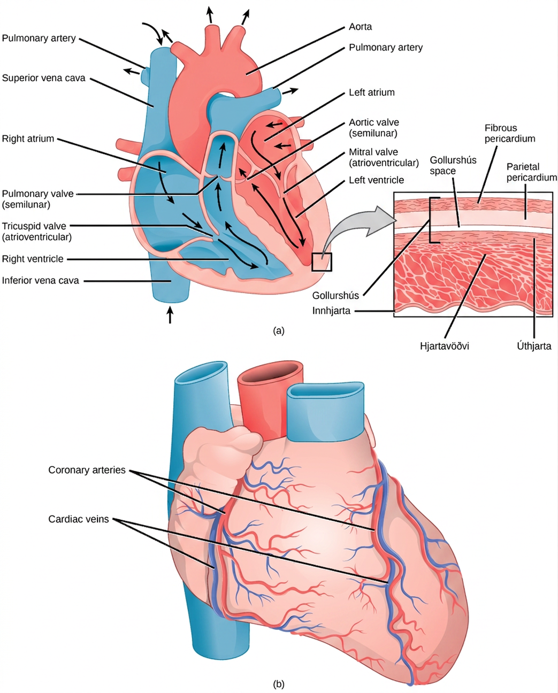
Figure 40.11
(a) The heart is primarily made of a thick muscle layer, called the myocardium, surrounded by membranes. One-way valves separate the four chambers. (b) Blood vessels of the coronary system, including the coronary arteries and veins, keep the heart musculature oxygenated.
Notes:
Illustration A shows the parts of the heart. Blood enters the right atrium through an upper, superior vena cava and a lower, inferior vena cava. From the right atrium, blood flows through the funnel-shaped tricuspid valve into the right ventricle. Blood then travels up and through the pulmonary valve into the pulmonary artery. Blood re-enters the heart through the pulmonary veins, and travels down from the left atrium, through the mitral valve, into the left ventricle. Blood then travels up through the aortic valve, into the aorta. The tricuspid and mitral valves are atrioventricular and funnel-shaped. The pulmonary and aortic valves are semilunar and slightly curved. An inset shows a cross section of the heart. The myocardium is the thick muscle layer. The inside of the heart is protected by the endocardium, and the outside is protected by the pericardium. Illustration B shows the outside of the heart. Coronary arteries and coronary veins run from the top down along the right and left sides.

Slide 17
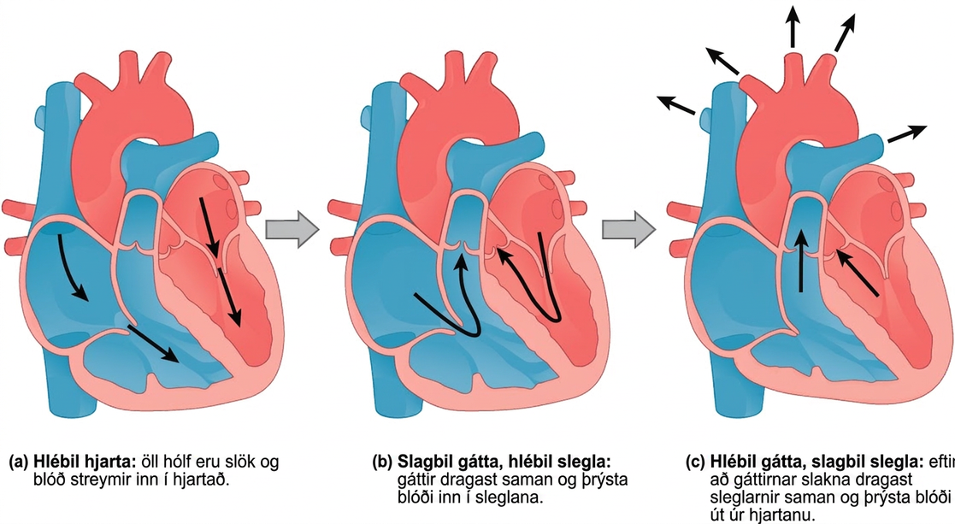
Figure 40.12
During (a) cardiac diastole, the heart muscle is relaxed and blood flows into the heart. During (b) atrial systole, the atria contract, pushing blood into the ventricles. During (c) atrial diastole, the ventricles contract, forcing blood out of the heart.
Notes:
Illustration A shows cardiac diastole. The cardiac muscle is relaxed, and blood flows into the heart atria and into the ventricles. Illustration B shows atrial systole; the atria contract, pushing blood into the ventricles, which are relaxed. Illustration C shows atrial diastole; after the atria relax, the ventricles contract, pushing blood out of the heart.

Slide 18
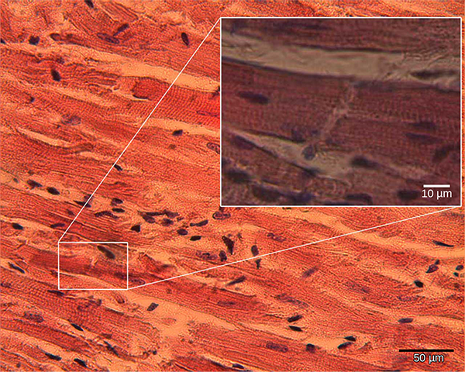
Figure 40.13
Cardiomyocytes are striated muscle cells found in cardiac tissue. (credit: modification of work by Dr. S. Girod, Anton Becker; scale-bar data from Matt Russell)
Notes:
Micrograph shows cardiac muscle cells, which are oblong and have prominent striations.

Slide 19
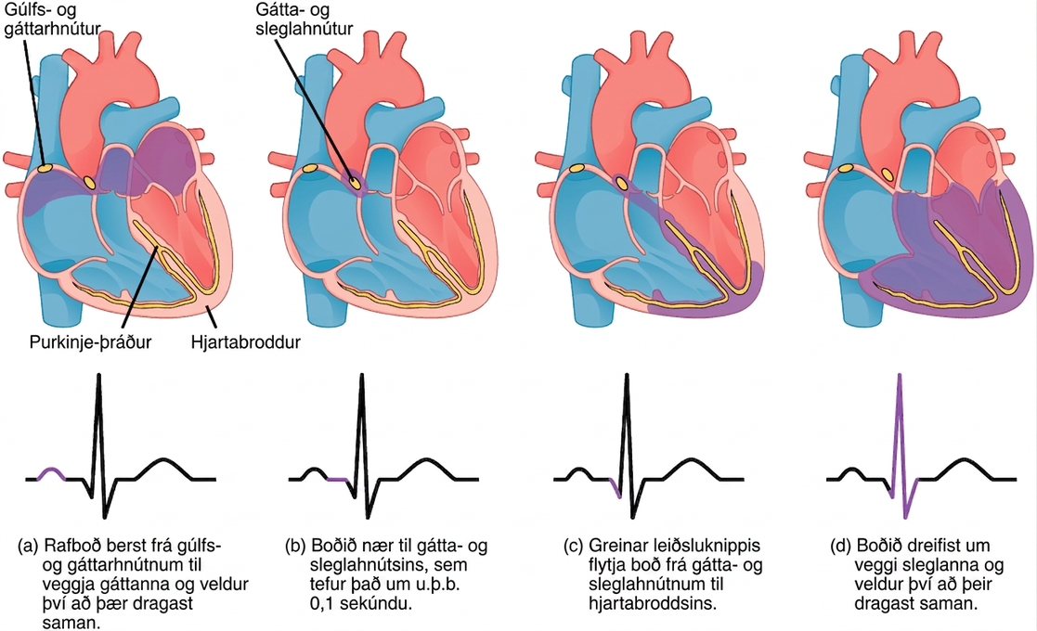
Figure 40.14
The beating of the heart is regulated by an electrical impulse that causes the characteristic reading of an ECG. The signal is initiated at the sinoatrial node. The signal then (a) spreads to the atria, causing them to contract. The signal is (b) delayed at the atrioventricular node before it is passed on to the (c) heart apex. The delay allows the atria to relax before the (d) ventricles contract. The final part of the ECG cycle prepares the heart for the next beat.
Notes:
The sinoatrial node is located at the top of the right atrium, and the atrioventricular node is located between the right atrium and right ventricle. The heart beat begins with an electrical impulse at the sinoatrial node, which spreads throughout the walls of the atria, resulting in a bump in the ECG reading. The signal then coalesces at the atrioventricular node, causing the ECG reading to flat-line briefly. Next, the signal passes from the atrioventricular node to the Purkinje fibers, which travel from the atriovenricular node and down the middle of the heart, between the two ventricles, to the apex (the bottom of the heart), then up the sides of the ventricles. As the signal passes down the Purkinje fibers the ECG reading falls. The signal then spreads throughout the ventricle walls, and the ventricles contract, resulting in a sharp spike in the ECG. The spike is followed by a flat-line, longer than the first, then a bump.

Slide 20
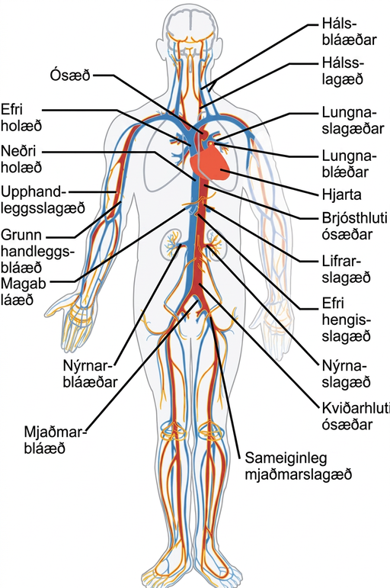
Figure 40.15
The major human arteries and veins are shown. (credit: modification of work by Mariana Ruiz Villareal)
Notes:
Illustration shows the major human blood vessels. From the heart, blood is pumped into the aorta and distributed to systemic arteries. The carotid arteries bring blood to the head. The brachial arteries bring blood to the arms. The thoracic aorta brings blood down the trunk of the body along the spine. The hepatic, gastric and renal arteries, which branch from the thoracic aorta, bring blood to the liver, stomach and kidneys, respectively. The iliac artery brings blood to the legs. Blood is returned to the heart through two major veins, the superior vena cava at the top, and the inferior vena cava at the bottom. The jugular veins return blood from the head. The basilic veins return blood from the arms. The hepatic, gastric and renal veins return blood from the liver, stomach and kidneys, respectively. The iliac vein returns blood from the legs.

Slide 21
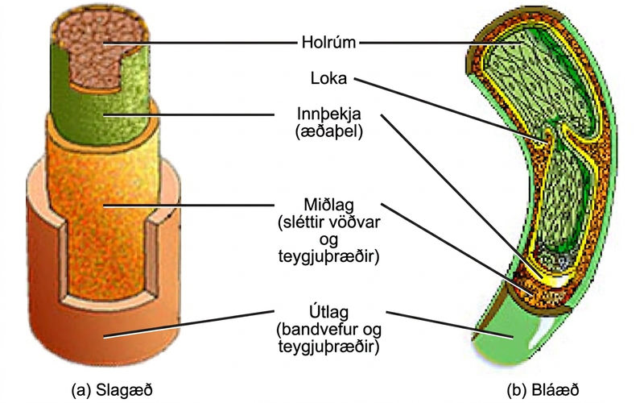
Figure 40.16
Arteries and veins consist of three layers: an outer tunica externa, a middle tunica media, and an inner tunica intima. Capillaries consist of a single layer of epithelial cells, the tunica intima. (credit: modification of work by NCI, NIH)
Notes:
Illustrations A and B show that arteries and veins consist of three layers, an inner endothelium called the tunica intima, a middle layer of smooth muscle and elastic fibers called the tunica media, and an outer layer of connective tissues and elastic fibers called the tunica externa. The outer two layers are thinner in the vein than in the artery. The central cavity is called the lumen. Veins have valves that extend into the lumen.

Slide 22
40.4 Blood Flow and Blood Pressure Regulation
Learning Objectives
Describe the system of blood flow through the body
Describe how blood pressure is regulated

Slide 23
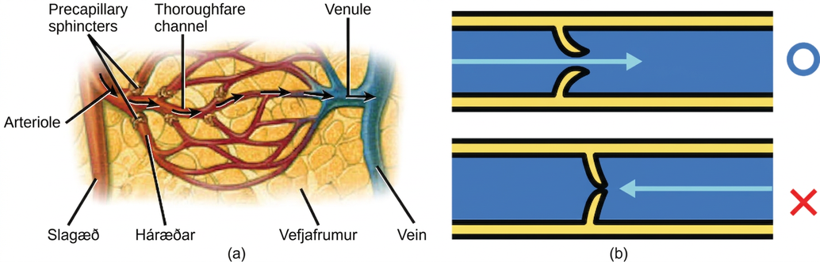
Figure 40.17
(a) Precapillary sphincters are rings of smooth muscle that regulate the flow of blood through capillaries; they help control the location of blood flow to where it is needed. (b) Valves in the veins prevent blood from moving backward. (credit a: modification of work by NCI)
Notes:
Illustration A shows an artery branching off into an arteriole, which branches into a capillary bed. The start of each capillary has a sphincter regulating flow through it. The capillaries converge into a venule, which joins a vein. Part B shows a valve in a blood vessel. The valve is slightly curved such that flow in one direction pushes it open, while flow in the other direction pushes it closed.

Slide 24
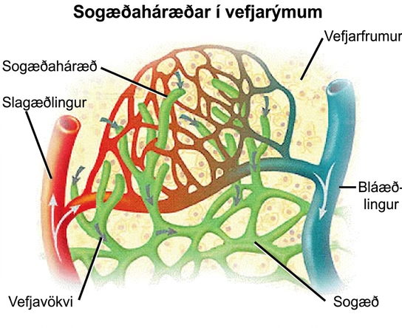
Figure 40.18
Fluid from the capillaries moves into the interstitial space and lymph capillaries by diffusion down a pressure gradient and also by osmosis. Out of 7,200 liters of fluid pumped by the average heart in a day, over 1,500 liters is filtered. (credit: modification of work by NCI, NIH)
Notes:
Illustration shows an arteriole and a venule branching off into a capillary bed. Lymph capillaries surround the capillary bed. Fluid diffuses from the blood vessels into the lymphatic vessels.

Slide 25
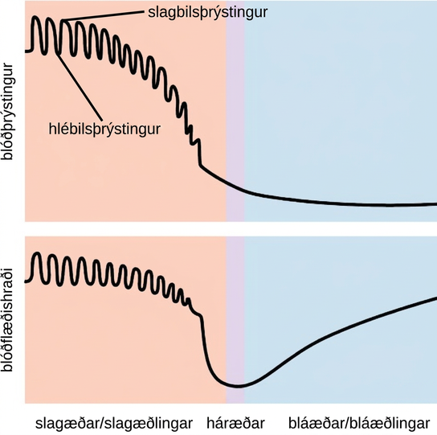
Figure 40.19
Blood pressure is related to the blood velocity in the arteries and arterioles. In the capillaries and veins, the blood pressure continues to decrease but velocity increases.
This OpenStax ancillary resource is © Rice University under a CC BY-NC-SA 4.0 International license; it may be reproduced or modified for noncommercial purposes only but must be attributed to OpenStax, Rice University and any changes must be noted. Any adaptation must be shared under the same type of license.
Notes:
Graph A shows blood pressure, which starts high in the arteries and gradually drops as blood passes through the capillaries and veins. Blood velocity drops gradually in the arteries, then precipitously in the capillaries. Velocity increases as blood enters the veins. In the arteries, both blood pressure and velocity fluctuate to a higher level during systole and a lower level during diastole.

