Slide 1

Biology 2e
Chapter 16 Gene Expression

Slide 2
Chapter outline
Regulation of Gene Expression
Prokaryotic Gene Regulation
Eukaryotic Epigenetic Gene Regulation
Eukaryotic Transcription Gene Regulation
Eukaryotic Post-transcriptional Gene Regulation
Eukaryotic Translational and Post-translational Gene Regulation
Cancer and Gene Regulation

Slide 3
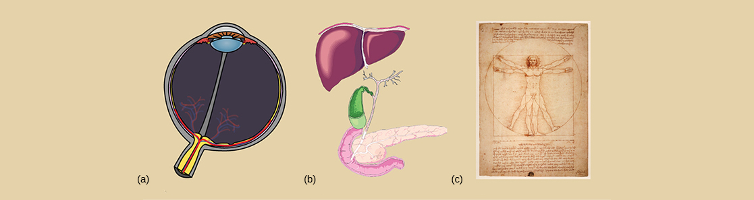
Figure 16.1
The genetic content of each somatic cell in an organism is the same, but not all genes are expressed in every cell. The control of which genes are expressed dictates whether a cell is, for example, (a) an eye cell or (b) a liver cell. It is the differential gene expression patterns that arise in different cells that give rise to (c) a complete organism.
Notes:
Part A depicts a cross section of an eyeball, which has a lens at the front and a cluster of blood vessels at the back. Part B depicts a liver, which is shaped like a triangle. Beneath the liver is a lobe-shaped gall bladder connected to a pancreas by a stem-like vessel. Part C is a sketch, drawn by Leonardo Da Vinci, of a man standing erect with outstretched arms. Superimposed on this image, the man has his legs spread and his arms uplifted.

Slide 4
16.1 Regulation of Gene Expression (1 of 2)
Learning Objectives
Discuss why every cell does not express all of its genes all of the time
Describe how prokaryotic gene regulation occurs at the transcriptional level

Slide 5
16.1 Regulation of Gene Expression (2 of 2)
Learning Objectives
Discuss how eukaryotic gene regulation occurs at the epigenetic, transcriptional, post-transcriptional, translational, and post-translational levels

Slide 6
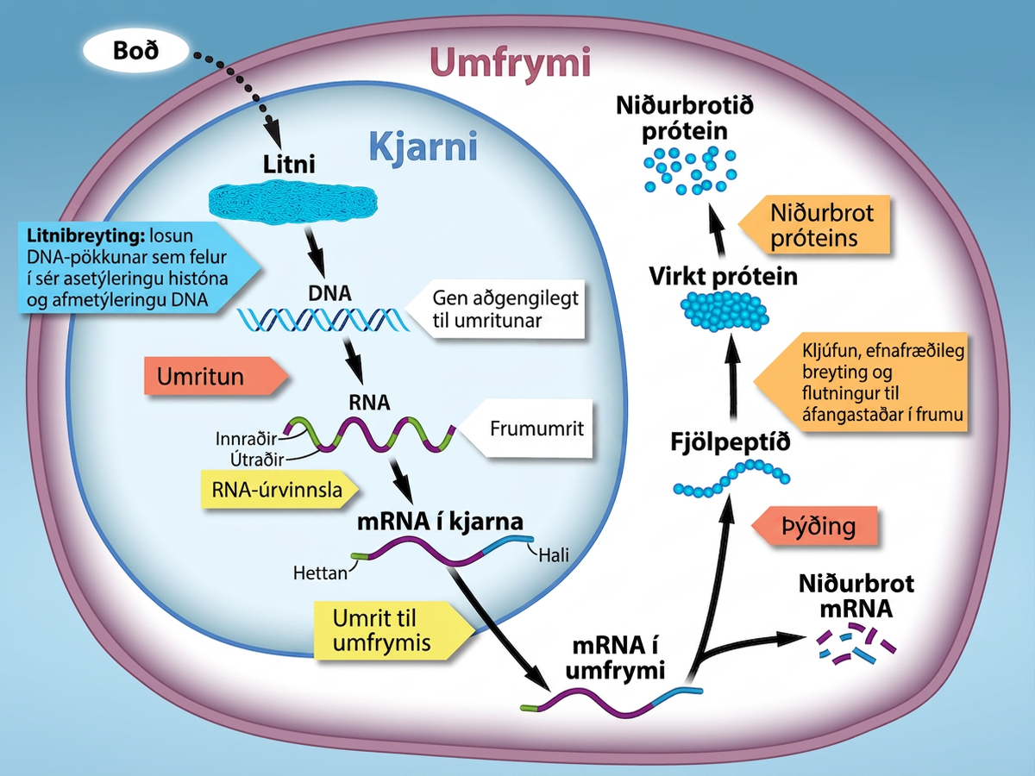
Figure 16.2
Locations of gene regulation. The regulation of gene expression occurs at multiple steps going from DNA to the functional gene product, usually a protein. It begins with chromatin structure making the DNA more or less accessible for transcription by RNA polymerase. In eukaryotes, the primary mRNA transcript must be processed before it can be translated in the cytoplasm. The final level of active protein in the cell depends not only on the rate of synthesis, but also on the rate of degradation of mRNA and protein. Credit: Rao, A. and Ryan, K. Department of Biology, Texas A&M University.
Notes:
A cell diagram is shown. A signal leads to chromatin unpacking through histone acetylation, DNA methylation, which triggers DNA transcription, RNA processing by adding 5’ cap, poly A tail, and splicing of introns and exons, and m R N A to leaving the nucleus and entering the cytoplasm. In the cytoplasm, translation occurs, leading to formation of a polypeptide, its processing and modification to produce protein’s functional form, transport to designated cellular and extracellular destinations, eventual degradation of both the mRNA and the protein.

Slide 7
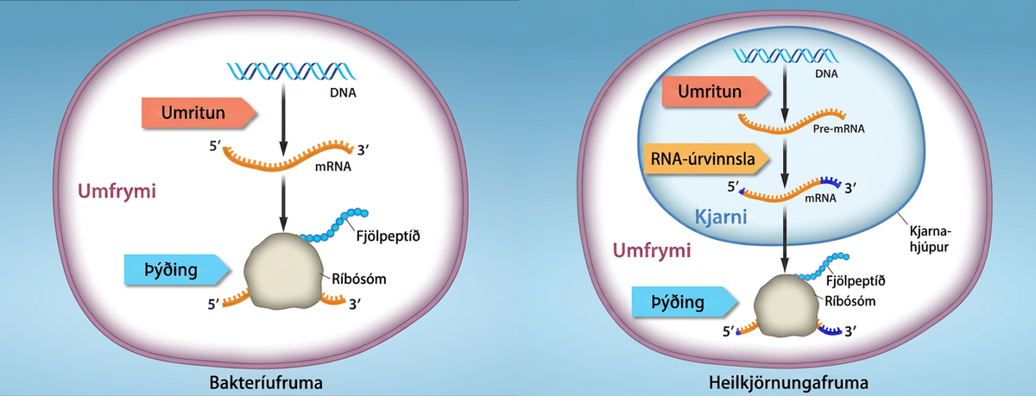
Figure 16.3
Regulation in prokaryotes and eukaryotes. A. Prokaryotic transcription and translation occur simultaneously in the cytoplasm, and regulation occurs primarily at the transcriptional level. B. Eukaryotic gene expression is regulated during transcription and RNA processing, which take place in the nucleus, and during protein translation, which takes place in the cytoplasm. Further regulation may occur through post-translational modifications of proteins in both prokaryotes and eukaryotes. Credit: Rao, A., Ryan, K. Fletcher, S. and Tag, A. Department of Biology, Texas A&M University.
Notes:
Prokaryotic cells do not have a nucleus, and D N A is located in the cytoplasm. Ribosomes attach to the m R N A as it is being transcribed from D N A. Thus, transcription and translation occur simultaneously. In eukaryotic cells, the D N A is located in the nucleus, and ribosomes are located in the cytoplasm. After being transcribed, pre m R N A is processed in the nucleus to make the mature mRNA, which is then exported to the cytoplasm where ribosomes become associated with it and translation begins.

Slide 8
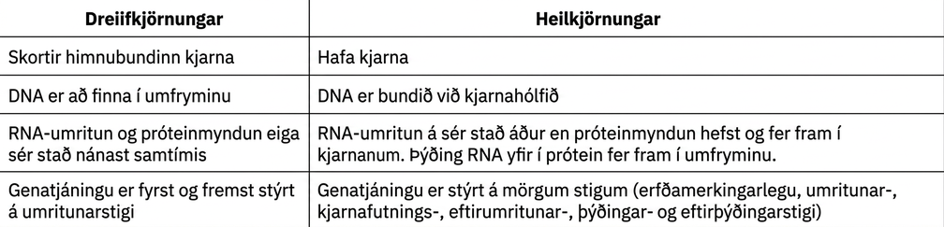
Table 16.1

Slide 9
16.2 Prokaryotic Gene Regulation
Learning Objectives
Describe the steps involved in prokaryotic gene regulation
Explain the roles of activators, inducers, and repressors in gene regulation

Slide 10
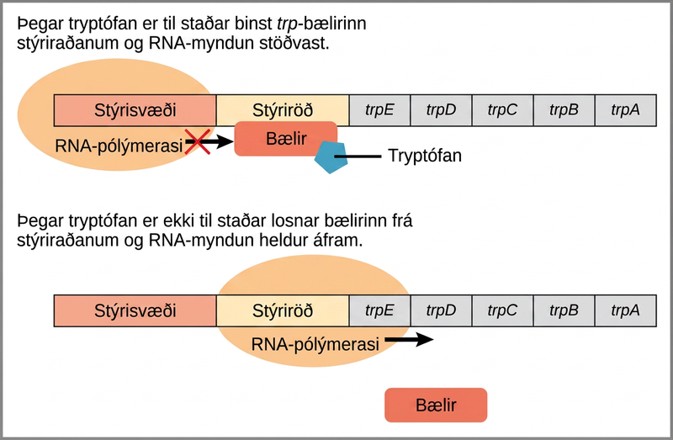
Figure 16.4
The tryptophan operon. The five genes that are needed to synthesize tryptophan in E. coli are located next to each other in the trp operon. When tryptophan is plentiful, two tryptophan molecules bind the repressor protein at the operator sequence. This physically blocks the RNA polymerase from transcribing the tryptophan genes. When tryptophan is absent, the repressor protein does not bind to the operator and the genes are transcribed.
Notes:
The t r p operon has a promoter, an operator, and five genes named t r p upper case E; t r p upper case D, t r p upper case C, t r p upper case B, and t r p upper case A that are located in sequential order on the D N A. R N A polymerase binds to the promoter. When tryptophan is present, the t r p repressor binds the operator and prevents the R N A polymerase from moving past the operator; therefore, R N A synthesis is blocked. In the absence of tryptophan, the repressor dissociates from the operator. R N A polymerase can now slide past the operator, and transcription begins.

Slide 11
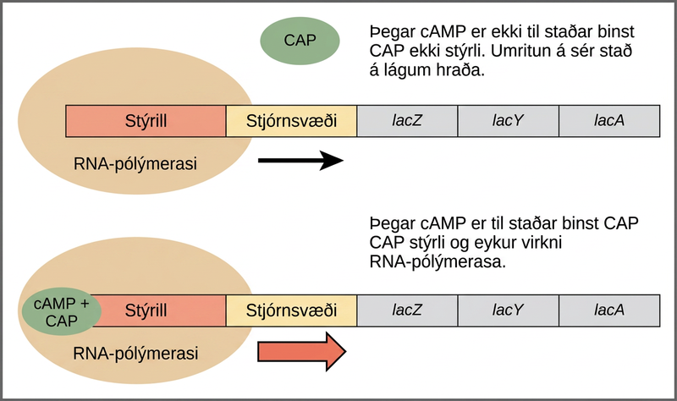
Figure 16.5
Transcriptional activation by the CAP protein. When glucose levels fall, E. coli may use other sugars for fuel but must transcribe new genes to do so. As glucose supplies become limited, cAMP levels increase. This cAMP binds to the CAP protein, a positive regulator that binds to a promoter region upstream of the genes required to use other sugar sources.
Notes:
The lac operon consists of a promoter, an operator, and three genes named lac Z, lac Y, and lac A that are located in sequential order on the D N A. In the absence of c A M P, the CAP protein does not bind the D N A. R N A polymerase binds the promoter, and transcription occurs at a slow rate. In the presence of c A M P, a C A P + c A M P complex binds to the promoter and increases R N A polymerase activity. As a result, the rate of R N A synthesis is increased.

Slide 12
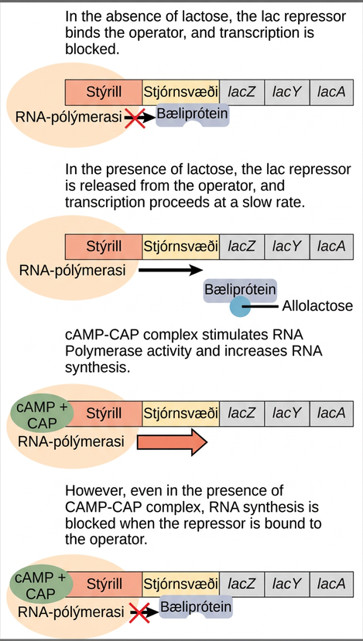
Figure 16.6
Regulation of the lac operon. Transcription of the lac operon is carefully regulated so that its expression only occurs when glucose is limited and lactose is present to serve as an alternative fuel source.
Notes:
The lac operon consists of a promoter, an operator, and three genes named lac Z, lac Y, and lac A. R N A polymerase binds to the promoter. In the absence of lactose, the lac repressor binds to the operator and prevents RNA polymerase from transcribing the operon. In the presence of lactose, the repressor is released from the operator, and transcription proceeds at a slow rate. Binding of the c A M P plus sign CAP complex to the promoter stimulates R N A polymerase activity and increases R N A synthesis. However, even in the presence of the c A M P plus sign CAP complex, R N A synthesis is blocked if the repressor binds to the promoter.

Slide 13
Table 16.2
Glucose | CAP binds | Lactose | Repressor binds | Transcription
+ | - | - | + | No
+ | - | + | - | Some
- | + | - | + | No
- | + | + | - | Yes

Slide 14
16.3 Eukaryotic Epigenetic Gene Regulation
Learning Objectives
Explain how chromatin remodeling controls transcriptional access
Describe how access to DNA is controlled by histone modification
Describe how DNA methylation is related to epigenetic gene changes

Slide 15
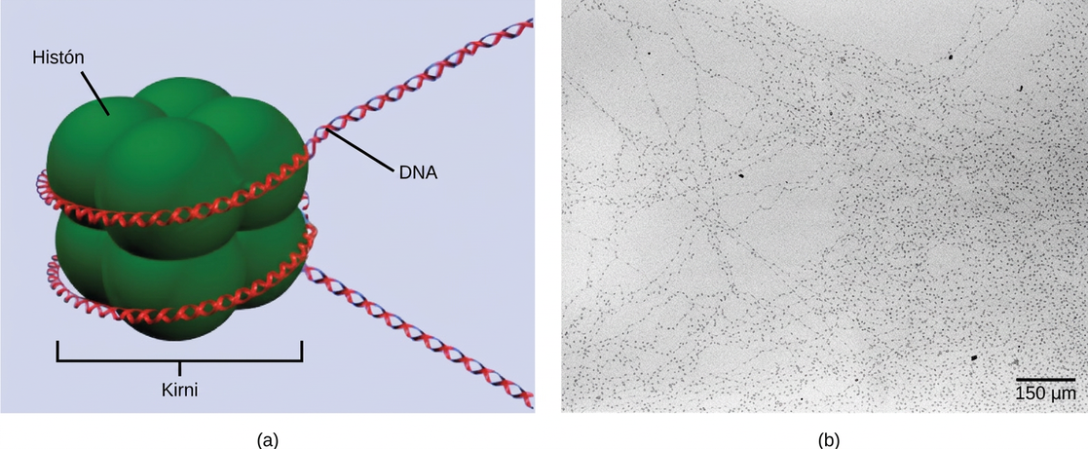
Figure 16.7
DNA is folded around histone proteins to create (a) nucleosome complexes. These nucleosomes control the access of proteins to the underlying DNA. When viewed through an electron microscope (b), the nucleosomes look like beads on a string. (credit “micrograph”: modification of work by Chris Woodcock)
Notes:
Part A depicts a nucleosome composed of spherical histone proteins that are fused together. A double-stranded D N A helix wraps around the nucleosome twice. Free D N A extends from either end of the nucleosome. Part B is an electron micrograph of D N A that is associated with nucleosomes. Each nucleosome looks like a bead. The beads are connected together by free D N A. Nine beads strung together is approximately 150 n m across.

Slide 16
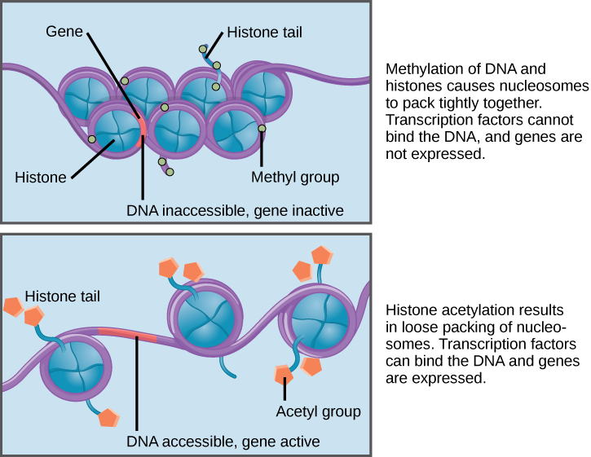
Figure 16.8
Nucleosomes can slide along DNA. When nucleosomes are spaced closely together (top), transcription factors cannot bind and gene expression is turned off. When the nucleosomes are spaced far apart (bottom), the DNA is exposed. Transcription factors can bind, allowing gene expression to occur. Modifications to the histones and DNA affect nucleosome spacing.
Notes:
Nucleosomes are depicted as wheel like structures. The nucleosomes are made up of histones, and have D N A wrapped around the outside. Each histone has a tail that juts out from the wheel. When D N A and the histone tails are methylated, the nucleosomes pack tightly together so there is no free D N A. Transcription factors cannot bind, and genes are not expressed. Acetylation of histone tails results in a looser packing of the nucleosomes. Free D N A is exposed between the nucleosomes, and transcription factors are able to bind genes on this exposed D N A.

Slide 17
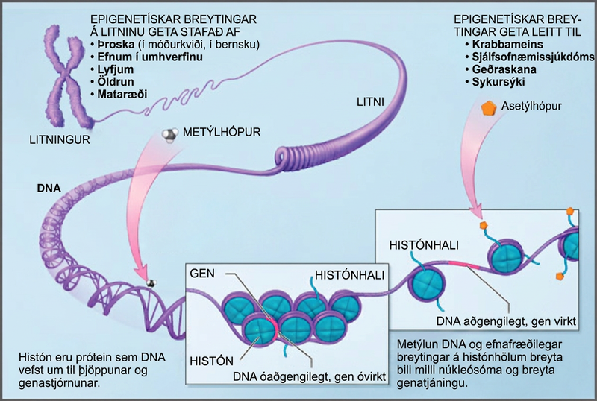
Figure 16.9
Histone proteins and DNA nucleotides can be modified chemically. Modifications affect nucleosome spacing and gene expression. (credit: modification of work by NIH)
Notes:
Illustration shows a chromosome that is partially unraveled and magnified, revealing the DNA double helix that had been wound around histone proteins. Histones are proteins around which DNA winds for compaction and gene regulation. Methylation of D N A and chemical modification of histone tails are known as epigenetic changes. Epigenetic changes alter the spacing of nucleosomes and change gene expression. Epigenetic changes may result from development, either in utero or in childhood, environmental chemicals, drugs, aging, or diet. Epigenetic changes may result in cancer, autoimmune disease, mental disorders, and diabetes.

Slide 18
16.4 Eukaryotic Transcription Gene Regulation
Learning Objectives
Discuss the role of transcription factors in gene regulation
Explain how enhancers and repressors regulate gene expression

Slide 19
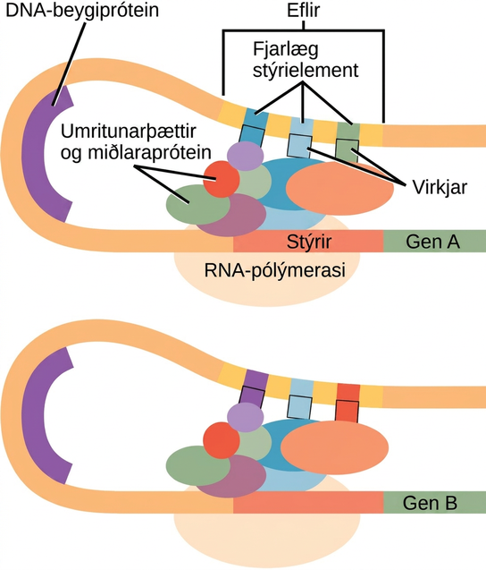
Figure 16.10
Interaction between proteins at the promoter and enhancer sites. An enhancer is a DNA sequence that promotes transcription. Each enhancer is made up of short DNA sequences called distal control elements. Activators bound to the distal control elements interact with mediator proteins and transcription factors. Two different genes may have the same promoter but different distal control elements, enabling differential gene expression.
Notes:
Eukaryotic gene expression is controlled by a promoter immediately adjacent to the gene, and an enhancer far upstream. The D N A folds over itself, bringing the enhancer next to the promoter. Transcription factors and mediator proteins are sandwiched between the promoter and the enhancer. Short D N A sequences within the enhancer called distal control elements bind activators, which in turn bind transcription factors and mediator proteins bound to the promoter. R N A polymerase binds the complex, allowing transcription to begin. Different genes have enhancers with different distal control elements, allowing differential regulation of transcription.

Slide 20
16.5 Eukaryotic Post-transcriptional Gene Regulation
Learning Objectives
Understand RNA splicing and explain its role in regulating gene expression
Describe the importance of RNA stability in gene regulation

Slide 21
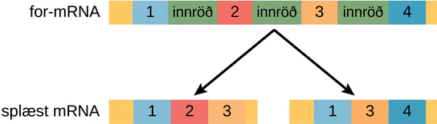
Figure 16.11
Pre-mRNA can be alternatively spliced to create differently mature mRNAs which will ultimately lead to formation of different proteins from the same gene.
Notes:
A pre m R N A has four exons separated by three introns. The pre m R N A can be alternatively spliced to create two different mRNA molecules, each with three exons. One mRNA contains exons one, two, and three. The other mRNA contains exons one, three and four. Each of the two mRNA molecules will produce two different polypeptides.

Slide 22
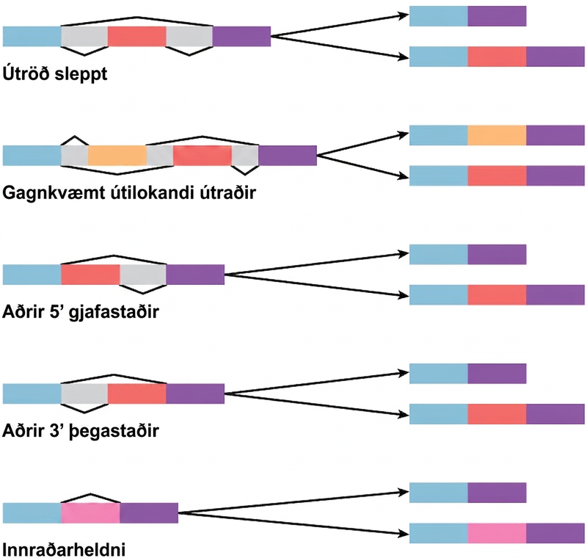
Figure 16.12
There are five basic modes of alternative splicing.
Notes:
Diagram shows five methods of alternative splicing of pre-mRNA. When exon skipping occurs, an exon is spliced out in one mature mRNA product and retained in another. When mutually exclusive exons are present in the pre-mRNA, only one is retained in the mature mRNA. When an alternative 5’ donor site is present, the location of the 5’ splice site is variable. When an alternative 3’ acceptor site is present, the location of the 3’ splice site is variable. Intron retention results in an intron being retained in one mature mRNA and spliced out in another.

Slide 23
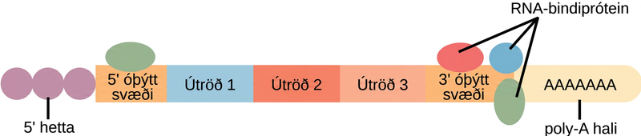
Figure 16.13
RNA-binding proteins. The protein-coding region of this processed mRNA is flanked by 5' and 3' untranslated regions (UTRs). The presence of RNA-binding proteins at the 5' or 3' UTR influences the stability of the RNA molecule.
Notes:
In the mature R N A molecule, exons are spliced together between the 5 prime and 3 prime untranslated regions. A 5 prime cap is attached to the 5 prime untranslated region, and a poly A tail is attached to the 3 prime untranslated region. R N A binding proteins associate with the 5 prime and 3 prime untranslated regions.

Slide 24
16.6 Eukaryotic Translational and Post-translational Gene Regulation
Learning Objectives
Understand the process of translation and discuss its key factors
Describe how the initiation complex controls translation
Explain the different ways in which the post-translational control of gene expression takes place

Slide 25
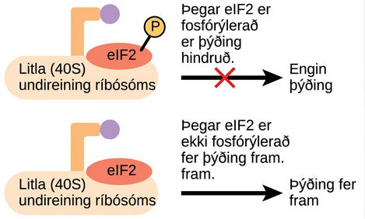
Figure 16.14
Gene expression can be controlled by factors that bind the translation initiation complex.
Notes:
The lower case e lower case I upper case F dash 2 protein is a translation factor that binds to the small 40 S ribosome subunit. When e I F dash 2 is phosphorylated, translation is blocked.

Slide 26
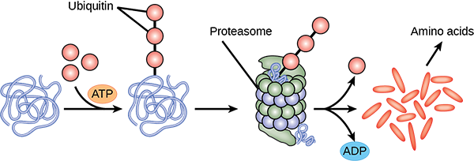
Figure 16.15
Proteins with ubiquitin tags are marked for degradation within the proteasome.
Notes:
Multiple ubiquitin groups combine to bind to a protein. The tagged protein is then fed into the hollow tube of a proteasome. The proteasome degrades the protein. This produces ADP and amino acids, and the ubiquitin is also released.

Slide 27
16.7 Cancer and Gene Regulation
Learning Objectives
Describe how changes to gene expression can cause cancer
Explain how changes to gene expression at different levels can disrupt the cell cycle
Discuss how understanding regulation of gene expression can lead to better drug design
This OpenStax ancillary resource is © Rice University under a CC BY-NC-SA 4.0 International license; it may be reproduced or modified for noncommercial purposes only but must be attributed to OpenStax, Rice University and any changes must be noted. Any adaptation must be shared under the same type of license.

