Slide 1

Biology 2e
Chapter 36 Sensory Systems

Slide 2
Chapter outline
Sensory Processes
Somatosensation
Taste and Smell
Hearing and Vestibular Sensation
Vision

Slide 3
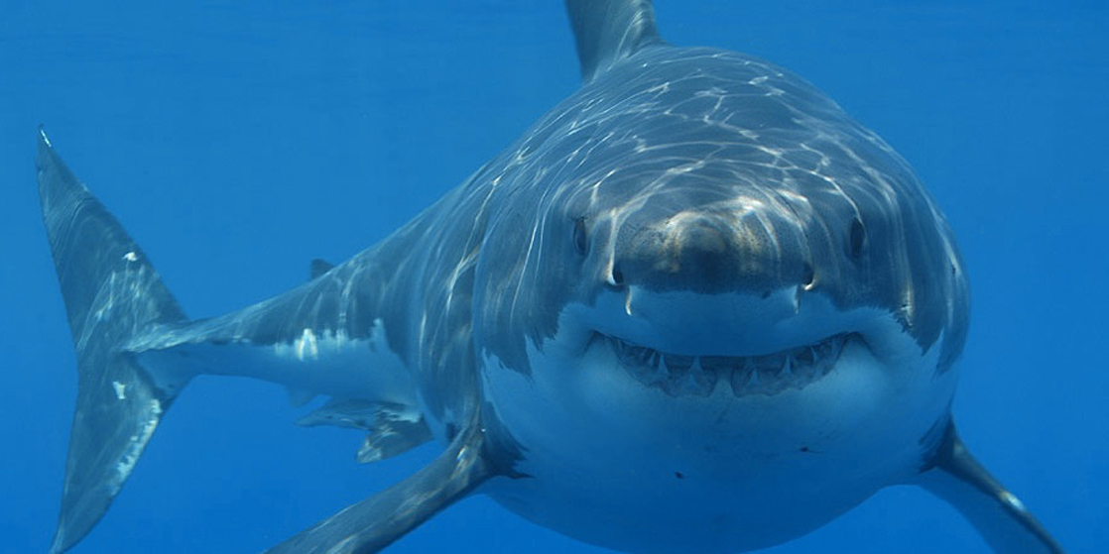
Figure 36.1
This shark uses its senses of sight, vibration (lateral-line system), and smell to hunt, but it also relies on its ability to sense the electric fields of prey, a sense not present in most land animals. (credit: modification of work by Hermanus Backpackers Hostel, South Africa)
Notes:
Photo shows a shark swimming toward the camera.

Slide 4
36.1 Sensory Processes
Learning Objectives
Identify the general and special senses in humans
Describe three important steps in sensory perception
Explain the concept of just-noticeable difference in sensory perception

Slide 5
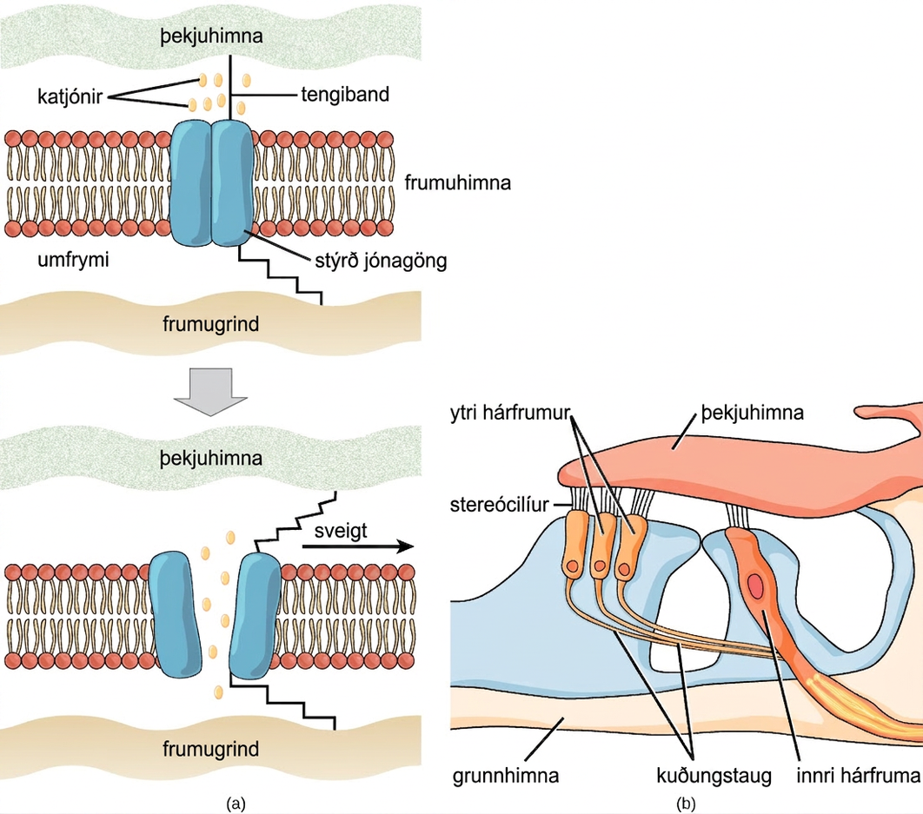
Figure 36.2
(a) Mechanosensitive ion channels are gated ion channels that respond to mechanical deformation of the plasma membrane. A mechanosensitive channel is connected to the plasma membrane and the cytoskeleton by hair-like tethers. When pressure causes the extracellular matrix to move, the channel opens, allowing ions to enter or exit the cell. (b) Stereocilia in the human ear are connected to mechanosensitive ion channels. When a sound causes the stereocilia to move, mechanosensitive ion channels transduce the signal to the cochlear nerve.
Notes:
Illustration A shows a closed gated ion channel embedded in the plasma membrane. A hair-like tether connects the channel to the extracellular matrix outside the cell, and another tether connects the channel to the inner cytoskeleton. When the extracellular matrix is deflected, the tether tugs on the gated ion channel, pulling it open. Ions may now enter or exit the cell. Illustration B shows stereocilia, hair-like projections on outer hair cells that are attached to the tectorial membrane of the inner ear. The outer hair cells are connected to the cochlear nerve.

Slide 6
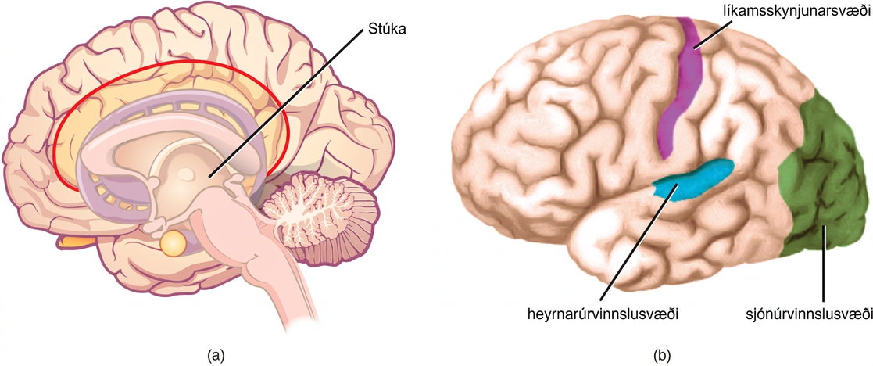
Figure 36.3
In humans, with the exception of olfaction, all sensory signals are routed from the (a) thalamus to (b) final processing regions in the cortex of the brain. (credit b: modification of work by Polina Tishina)
Notes:
Illustration A shows side view of a human brain. The thalamus is in the inner, middle part. Illustration B shows the location of sensory processing regions in the brain. The visual processing region is at the back of the brain, the auditory processing region is in the middle of the brain, and the somatosensory processing region is located in a sliver-like region in the upper part of the brain and extending halfway down.

Slide 7
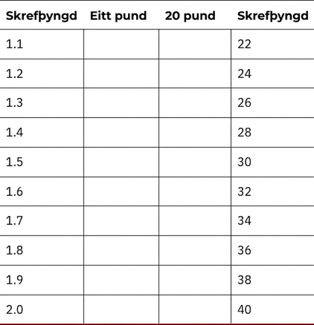
Table 36.1

Slide 8
36.2 Somatosensation
Learning Objectives
Describe four important mechanoreceptors in human skin
Describe the topographical distribution of somatosensory receptors between glabrous and hairy skin
Explain why the perception of pain is subjective

Slide 9
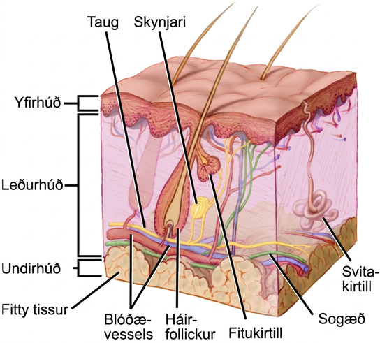
Figure 36.4
Mammalian skin has three layers: an epidermis, a dermis, and a hypodermis. (credit: modification of work by Don Bliss, National Cancer Institute)
Notes:
Illustration shows a cross section of mammalian skin. The outer epidermis is a thin layer, smooth on the outside. The middle dermis is much thicker than the epedermis. Blood, nerve and lymph vessels run along the bottom of it, and smaller capillaries and nerve endings extend to the upper part. One nerve ends in a receptor. Sweat glands extend from the dermis into the epidermis. Hair follicles extend from the base of the dermis to the upper part where they are joined by oil glands. Hairs extend from the follicles, through the epidermis and out of the skin. The hypodermis is a fatty layer beneath the dermis, below the blood vessels, and bases of the hair follicles.

Slide 10
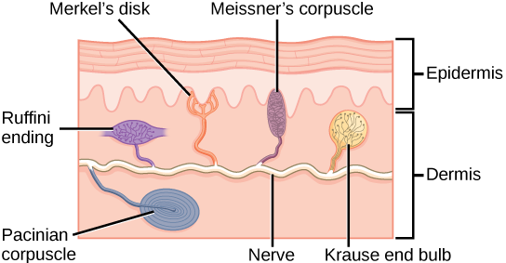
Figure 36.5
Four of the primary mechanoreceptors in human skin are shown. Merkel’s disks, which are unencapsulated, respond to light touch. Meissner’s corpuscles, Ruffini endings, and Pacinian corpuscles are all encapsulated. Meissner’s corpuscles respond to touch and low-frequency vibration. Ruffini endings detect stretch, deformation within joints, and warmth. Pacinian corpuscles detect transient pressure and high-frequency vibration. Krause end bulbs are encapsulated thermo receptors that detect cold.
Notes:
Illustration shows the location of various mechanoreceptors in a cross section of the epidermis and dermis. A nerve runs along the middle of the dermis, and all the mechanoreceptors are connected to it. Ruffini endings, Merkel’s disks, and Meissner’s corpuscles are all located in the upper dermis above the nerve. Ruffini endings are bulbous, horizontal mechanoreceptors located in the middle of the upper dermis. Meissner’s corpuscles are bulbous, vertical mechanoreceptors that touch the bottom of the epidermis. Merkel’s disks have finger-like projections that also touch the bottom of the epidermis. The roundish Krause end bulbs are also encapsulated within the dermis. The last type of mechanoreceptor, Pacini corpuscles, are oval mechanoreceptors located in the lower dermis.

Slide 11
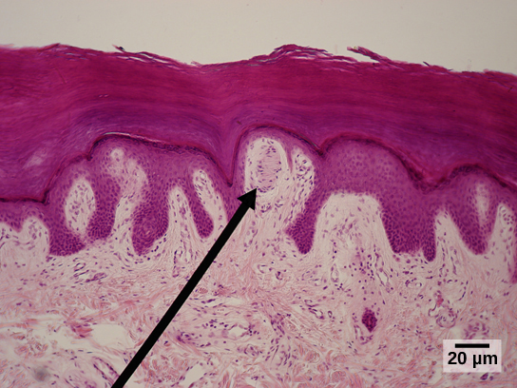
Figure 36.6
Meissner corpuscles in the fingertips, such as the one viewed here using bright field light microscopy, allow for touch discrimination of fine detail. (credit: modification of work by "Wbensmith"/Wikimedia Commons; scale-bar data from Matt Russell)
Notes:
Micrograph shows the epidermis, which stains dark pink and the dermis, which stains light pink. Finger-like projections of epidermis extend into the dermis. Between two of these finger like projections is an oval Meissner corpuscle about ten microns across and 20 microns long.

Slide 12
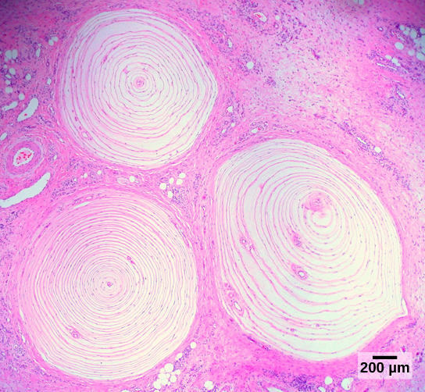
Figure 36.7
Pacinian corpuscles, such as these visualized using bright field light microscopy, detect pressure (touch) and high-frequency vibration. (credit: modification of work by Ed Uthman; scale-bar data from Matt Russell)
Notes:
Micrograph shows three Pacinian corpuscles embedded in the dermis. The corpuscles are round and about 1.4 millimeters across and have rings, like a tree stump.

Slide 13
36.3 Taste and Smell
Learning Objectives
Explain in what way smell and taste stimuli differ from other sensory stimuli
Identify the five primary tastes that can be distinguished by humans
Explain in anatomical terms why a dog’s sense of smell is more acute than a human’s

Slide 14
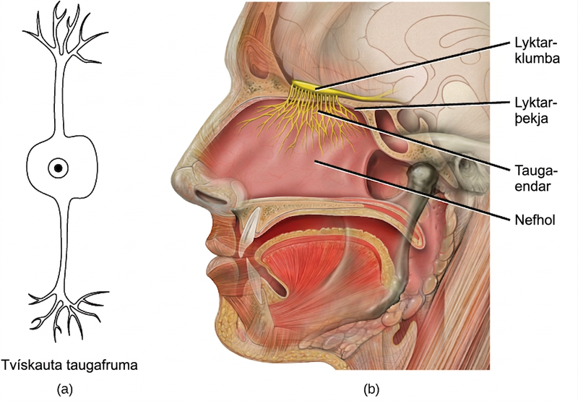
Figure 36.8
In the human olfactory system, (a) bipolar olfactory neurons extend from (b) the olfactory epithelium, where olfactory receptors are located, to the olfactory bulb. (credit: modification of work by Patrick J. Lynch, medical illustrator; C. Carl Jaffe, MD, cardiologist)
Notes:
Illustration A shows a bipolar neuron, which has two dendrites. Illustration B shows a cross section of a human head. The nostrils lead to the nasal cavity, which sits above the mouth. The olfactory bulb is just above the olfactory epithelium that lines the nasal cavity. Nerve endings, resembling a cluster of small, thin extensions much like the roots of a plant, run from the bulb into the nasal cavity.

Slide 15

Figure 36.9
The flehmen response in this tiger results in the curling of the upper lip and helps airborne pheromone molecules enter the vomeronasal organ. (credit: modification of work by "chadh"/Flickr)
Notes:
Photo shows a tiger snarling.

Slide 16
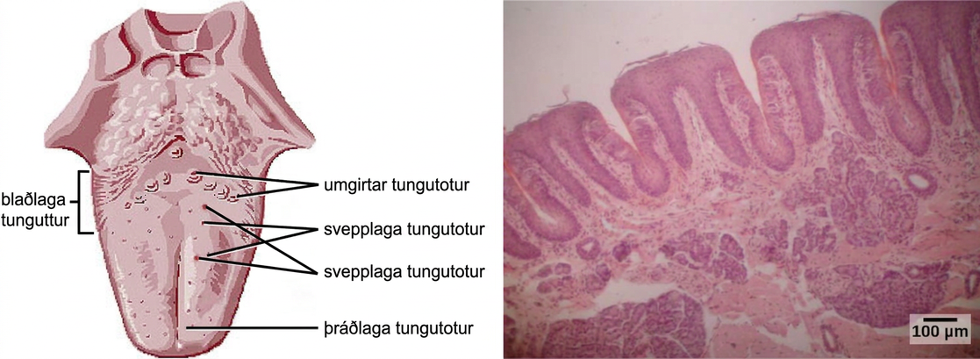
Figure 36.10
(a) Foliate, circumvallate, and fungiform papillae are located on different regions of the tongue. (b) Foliate papillae are prominent protrusions on this light micrograph. (credit a: modification of work by NCI; scale-bar data from Matt Russell)
Notes:
An illustration shows small, filiform papillae scattered across the front two thirds of the tongue. Larger circumvallate papillae form an inverted V at the back of the tongue. Medium-sized fungiform papillae are shown scattered across the back two thirds of the tongue. Foliate papillae form ridges on the back edges of the tongue. A micrograph shows a cross-section of a tongue in which the foliate papillae can be seen as square protrusions about 200 microns across and deep.

Slide 17
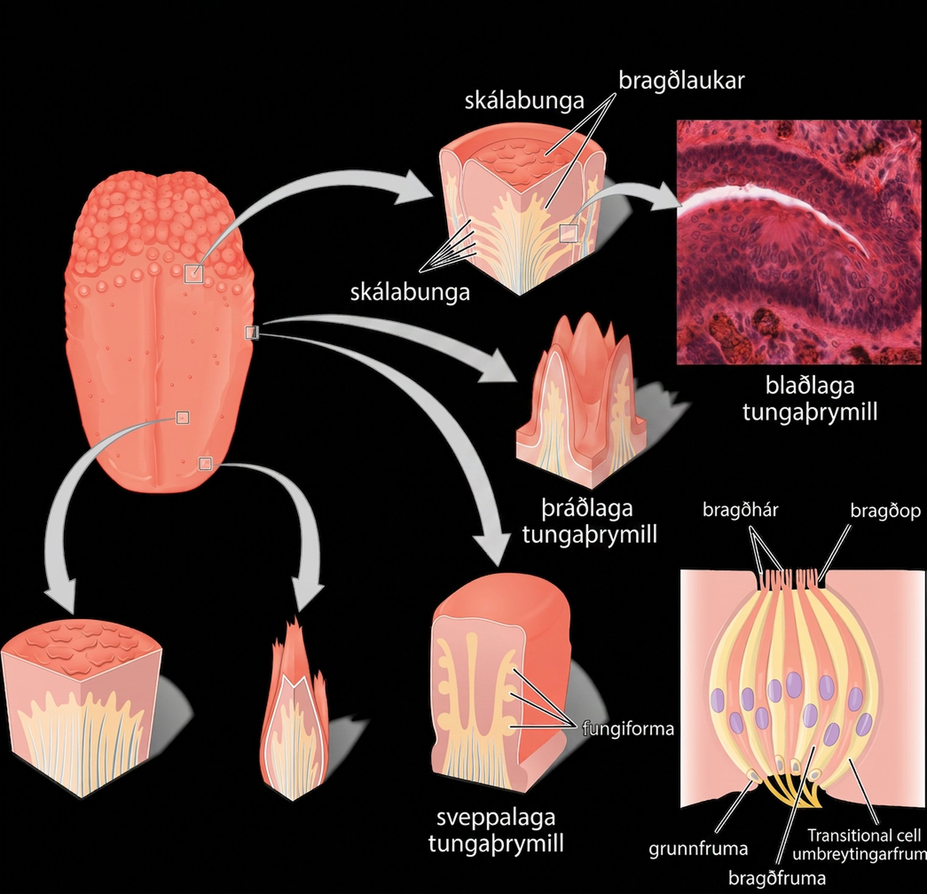
Figure 36.11
Pores in the tongue allow tastants to enter taste buds in the tongue. (credit: modification of work by Vincenzo Rizzo)
Notes:
The left panel shows the image of a tongue with callouts that show magnified views of different parts of the tongue. The right panel shows a micrograph of the circumvallate papilla, and the bottom right panel shows the structure of a taste bud. At the surface, the taste bud has hair like projects that are labeled taste hairs. These extend up through a taste pore, and lead to a basal cell, gustatory cell, and transitional cell.

Slide 18
36.4 Hearing and Vestibular Sensation
Learning Objectives
Describe the relationship of amplitude and frequency of a sound wave to attributes of sound
Trace the path of sound through the auditory system to the site of transduction of sound
Identify the structures of the vestibular system that respond to gravity

Slide 19
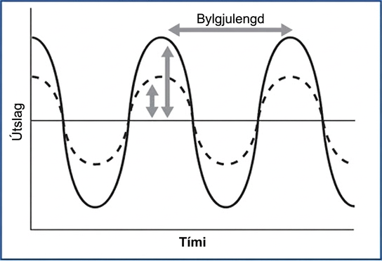
Figure 36.12
For sound waves, wavelength corresponds to pitch. Amplitude of the wave corresponds to volume. The sound wave shown with a dashed line is softer in volume than the sound wave shown with a solid line. (credit: NIH)
Notes:
A graph shows time going left to right, with amplitude going up and down. The graph shows a regularly repeating sine wave line running from left to right while going gradually up, then down, then up again. The horizontal distance between two crests is the wavelength. The amplitude is the height of the wave from the average height to the peak. On the graph, two waves with the same wavelength are superimposed on one another. The dashed wave does not go as far up or down as the solid wave.

Slide 20
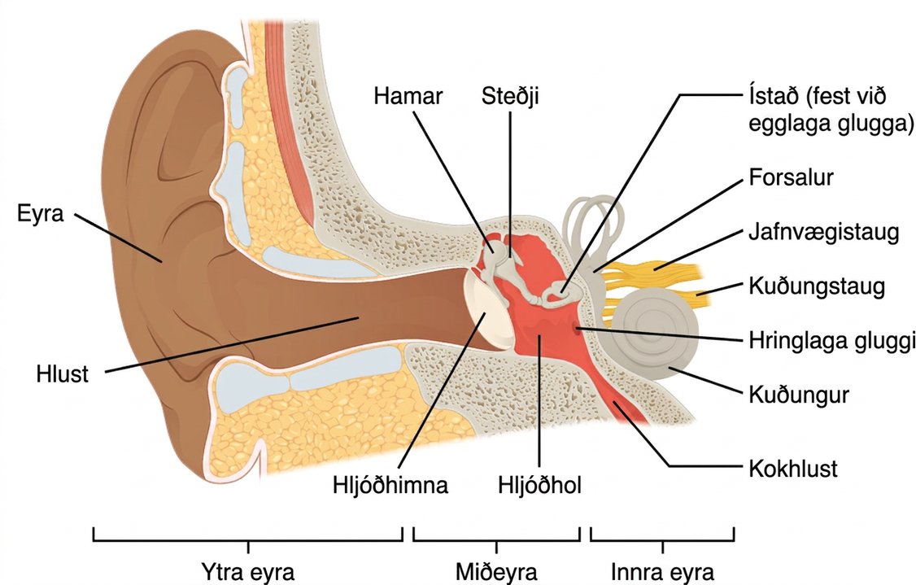
Figure 36.13
Sound travels through the outer ear to the middle ear, which is bounded on its exterior by the tympanic membrane. The middle ear contains three bones called ossicles that transfer the sound wave to the oval window, the exterior boundary of the inner ear. The organ of Corti, which is the organ of sound transduction, lies inside the cochlea.
Notes:
This image shows the structure of the ear with the major parts labeled. The external ear contains the auricle, ear canal, and tympanic membrane. The middle ear contains the ossicles and is connected to the pharynx by the Eustachian tube. The inner ear contains the cochlea and vestibule, which are responsible for audition and equilibrium, respectively.

Slide 21
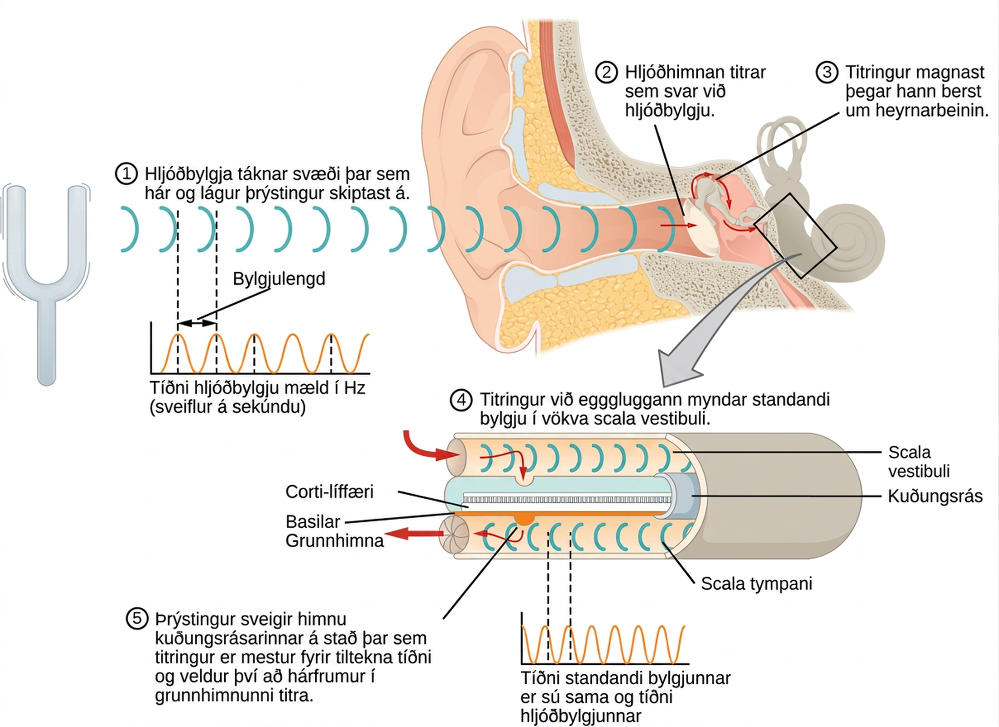
Figure 36.14
A sound wave causes the tympanic membrane to vibrate. This vibration is amplified as it moves across the malleus, incus, and stapes. The amplified vibration is picked up by the oval window causing pressure waves in the fluid of the scala vestibuli and scala tympani. The complexity of the pressure waves is determined by the changes in amplitude and frequency of the sound waves entering the ear.
Notes:
This diagram shows how sound waves travel through the ear, and each step details the process. A sound wave causes the tympanic membrane to vibrate. This vibration is amplified as it moves across the malleus, incus, and stapes. The amplified vibration is picked up by the oval window causing pressure waves in the fluid of the scala vestibuli and scala tympani. The complexity of the pressure waves is determined by the changes in amplitude and frequency of the sound waves entering the ear.

Slide 22
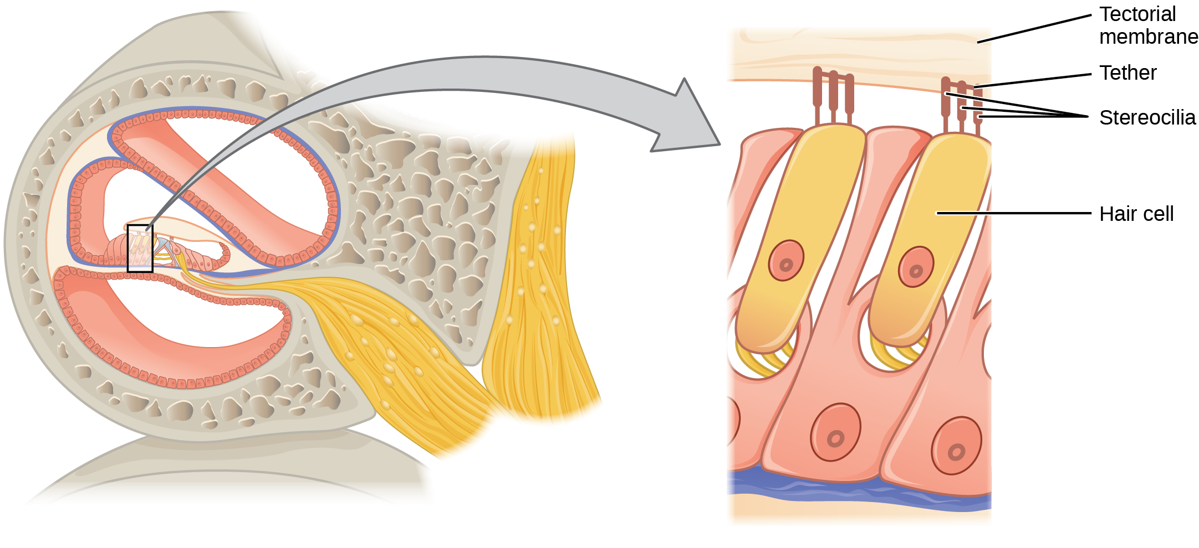
Figure 36.15
The hair cell is a mechanoreceptor with an array of stereocilia emerging from its apical surface. The stereocilia are tethered together by proteins that open ion channels when the array is bent toward the tallest member of their array, and closed when the array is bent toward the shortest member of their array.
Notes:
This diagram shows the structure of the hair cell. The right panel shows a magnified view of the hair cell. The hair cell is a mechanoreceptor with an array of stereocilia emerging from its apical surface. The stereocilia are tethered together by proteins that open ion channels when the array is bent toward the tallest member of their array, and closed when the array is bent toward the shortest member of their array.

Slide 23
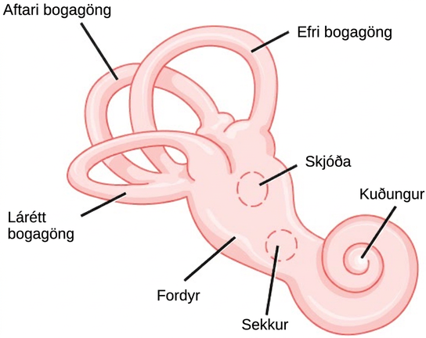
Figure 36.16
The structure of the vestibular labyrinth is shown. (credit: modification of work by NIH)
Notes:
This illustration shows the snail shell-shaped cochlea, which widens into the vestibule. Two circular organs, the utricle and the saccule, are located in the vestibule. Three ring-like canals, the horizontal canal, the posterior canal, and the superior canal, extend from the top of the vestibule. Each canal projects in a different direction.

Slide 24
36.5 Vision
Learning Objectives
Explain how electromagnetic waves differ from sound waves
Trace the path of light through the eye to the point of the optic nerve
Explain tonic activity as it is manifested in photoreceptors in the retina

Slide 25
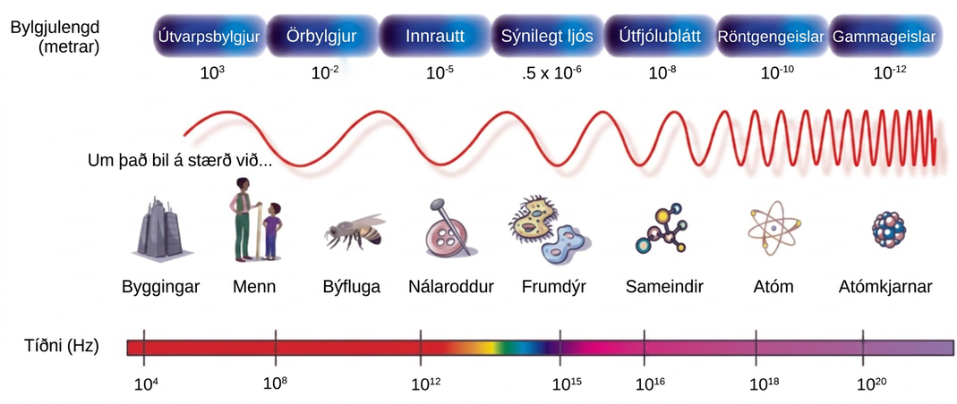
Figure 36.17
In the electromagnetic spectrum, visible light lies between 380 nm and 740 nm. (credit: modification of work by NASA)
Notes:
The illustration shows the electromagnetic spectrum, which consists of different wavelengths of electromagnetic radiation. Radio waves have the longest wavelength, about 10 to the 3rd power meters. Wavelength gets increasingly shorter for microwave, infrared, visible, ultraviolet, x rays and gamma rays. Gamma rays have a wavelength of about 10 to the –12th power meters. Frequency is inversely proportional to wavelength.

Slide 26
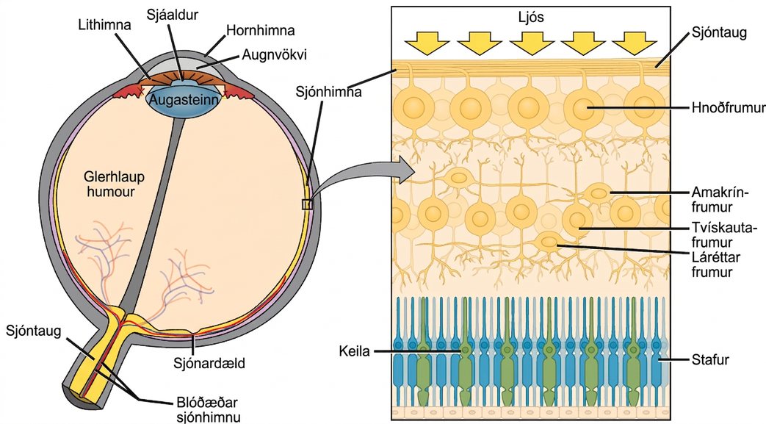
Figure 36.18
(a) The human eye is shown in cross section. (b) A blowup shows the layers of the retina.
Notes:
The left illustration shows a human eye, which is round and filled with vitreous humour. The optic nerve and retinal blood vessels exit the back of the eye. At the front of the eye is the lens with a pupil in the middle. The lens is covered by the iris, which in turn is covered by the cornea, which is a convex bump protruding from the eye. The aqueous humour is a gel-like substance between the cornea and iris. The retina is the lining of the inner eye. A second illustration is a blowup which shows that the optic nerve is at the surface of the retina. Beneath the optic nerve is a layer of ganglion cells, and beneath this is a layer of bipolar cells. Both ganglia and bipolar cells are nerve cells with root-like appendages. Beneath the bipolar cell layer are the rods and cones. Rods and cones are similar in structure and column-like.

Slide 27
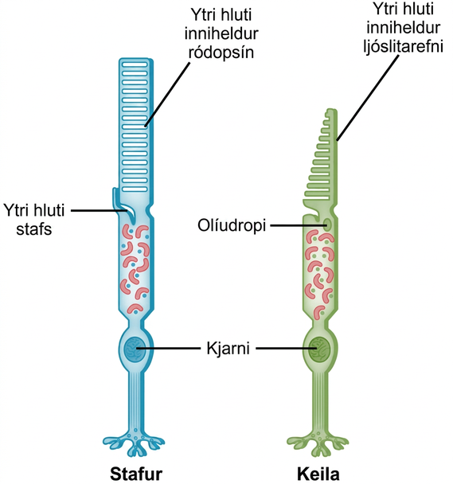
Figure 36.19
Rods and cones are photoreceptors in the retina. Rods respond in low light and can detect only shades of gray. Cones respond in intense light and are responsible for color vision. (credit: modification of work by Piotr Sliwa)
Notes:
This illustration shows that rods and cones are both long, column-like cells with the nucleus located in the bottom portion. The rod is longer than the cone. The outer segment of the rod contains rhodopsin. The outer segment of the cone contains other photo-pigments. An oil droplet is located beneath the outer segment of the cone.

Slide 28
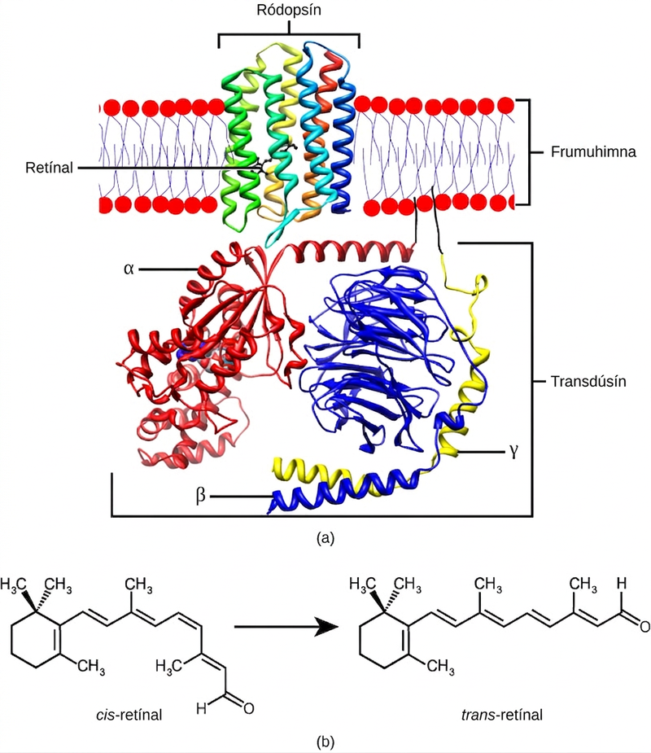
Figure 36.20
(a) Rhodopsin, the photoreceptor in vertebrates, has two parts: the trans-membrane protein opsin, and retinal. When light strikes retinal, it changes shape from (b) a cis to a trans form. The signal is passed to a G-protein called transducin, triggering a series of downstream events.
Notes:
Molecular model A shows the structure of rhodopsin, a trans-membrane protein with seven helices spanning the membrane. A small organic molecule called retinal is tucked inside. B shows the molecular structure of retinal, which has a ring with a hydrocarbon chain attached. A ketone (double bonded oxygen) is at the end of the chain. In cis retinal the chain is kinked. In trans retinal the chain is straight.

Slide 29
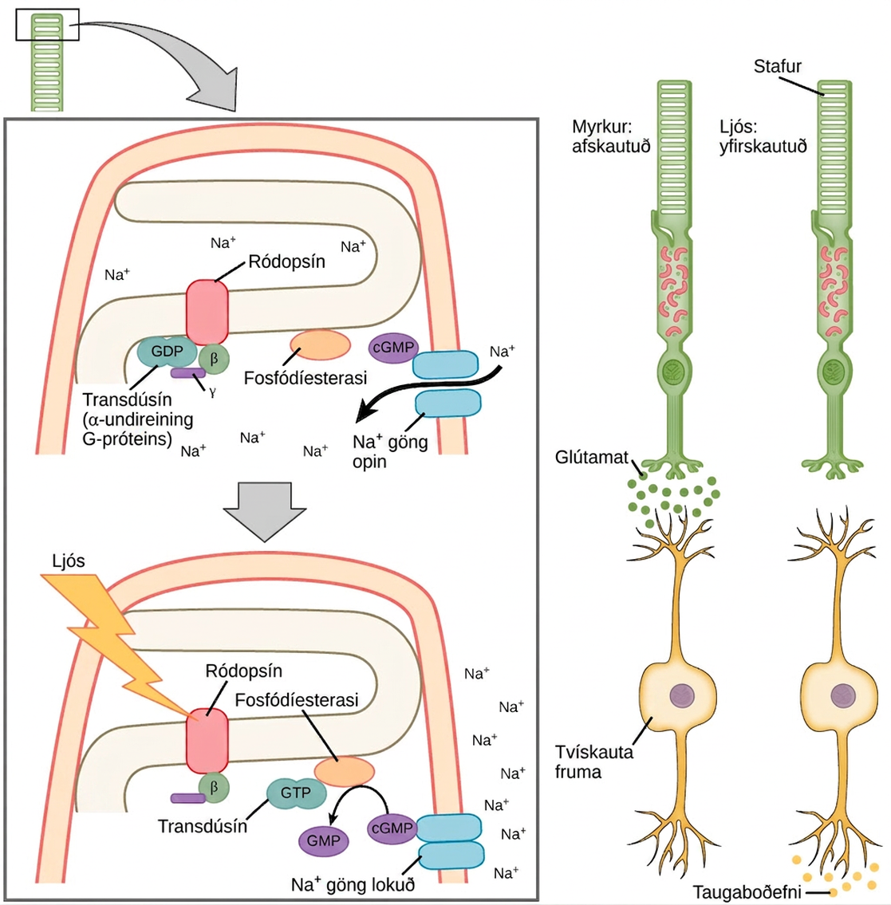
Figure 36.21
When light strikes rhodopsin, the G-protein transducin is activated, which in turn activates phosphodiesterase. Phosphodiesterase converts cGMP to GMP, thereby closing sodium channels. As a result, the membrane becomes hyperpolarized. The hyperpolarized membrane does not release glutamate to the bipolar cell.
Notes:
Illustration A shows the signal transduction pathway for rhodopsin, which is located in internal membranes at the top of rod cells. When light strikes rhodopsin, a G protein called transducin is activated. Transducin has three subunits, alpha, beta and gamma. Upon activation, G D P on the alpha subunit is replaced with G T P. The subunit dissociates, and binds phosphodiesterase. Phosphodiesterase, in turn, converts c G M P to G M P, which closes sodium ion channels. As a result, sodium can no longer enter the cell, and the membrane becomes hyperpolarized. Illustration b shows that the tall, thin rod cell is stacked on top of a bipolar nerve cell. In the dark the membrane is depolarized, and glutamate is released from the rod cell to the axon terminal of the bipolar cell. In the light, no glutamate is released.

Slide 30
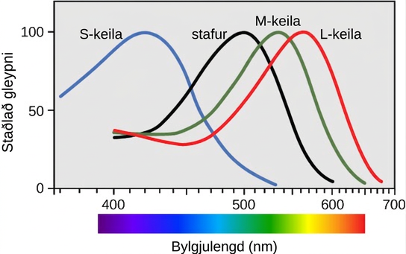
Figure 36.22
Human rod cells and the different types of cone cells each have an optimal wavelength. However, there is considerable overlap in the wavelengths of light detected.
Notes:
Graph plots normalized absorbance for rods and S, M and L cones against wavelength. For all four cell types, the trend is an approximately bell-shaped curve with a steeper decrease than increase. For S cones the peak absorbance is 420 nanometers. For rods the peak absorbance is 498 nanometers. For M cones the peak absorbance is 534 nanometers. For L cones the peak absorbance is 564 nanometers.

Slide 31

Figure 36.23
View this flag to understand how retinal processing works. Stare at the center of the flag (indicated by the white dot) for 45 seconds, and then quickly look at a white background, noticing how colors appear.
This OpenStax ancillary resource is © Rice University under a CC BY-NC-SA 4.0 International license; it may be reproduced or modified for noncommercial purposes only but must be attributed to OpenStax, Rice University and any changes must be noted. Any adaptation must be shared under the same type of license.
Notes:
A Norwegian flag is shown in false colors of green, yellow and black (normally, the colors are red, white and blue, like the American flag.

