Slide 1

Biology 2e
Chapter 20 Phylogenies and the History of Life

Slide 2
Chapter outline
Organizing Life on Earth
Determining Evolutionary Relationships
Perspectives on the Phylogenetic Tree

Slide 3
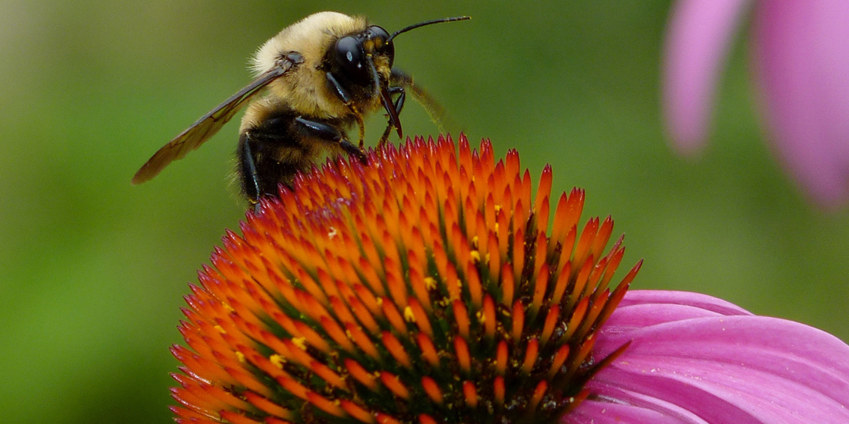
Figure 20.1
A bee's life is very different from a flower's, but the two organisms are related. Both are members of the domain Eukarya and have cells containing many similar organelles, genes, and proteins. (credit: modification of work by John Beetham)
Notes:
Photo shows a bee collecting nectar from a flower.

Slide 4
20.1 Organizing Life on Earth
Learning Objectives
Discuss the need for a comprehensive classification system
List the different levels of the taxonomic classification system
Describe how systematics and taxonomy relate to phylogeny
Discuss a phylogenetic tree's components and purpose

Slide 5
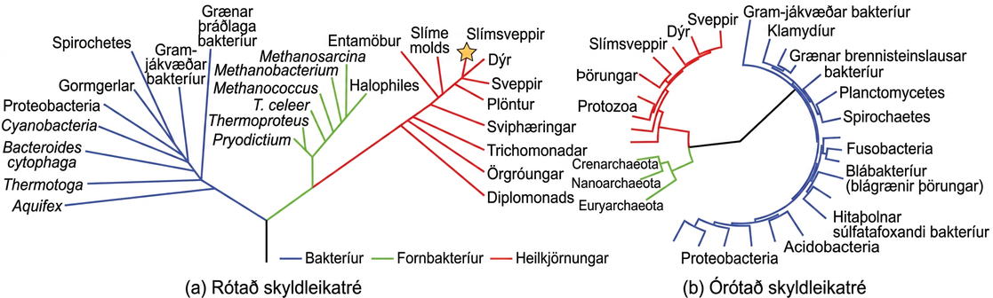
Figure 20.2
Both of these phylogenetic trees show the relationship of the three domains of life—Bacteria, Archaea, and Eukarya—but the (a) rooted tree attempts to identify when various species diverged from a common ancestor while the (b) unrooted tree does not. (credit a: modification of work by Eric Gaba)
Notes:
The phylogenetic tree in part a is rooted and resembles a living tree, with a common ancestor indicated as the base of the trunk. Two branches form from the trunk. The left branch leads to the domain Bacteria. The right branch branches again, giving rise to Archaea and Eukarya. Smaller branches within each domain indicate the groups present in that domain. The phylogenetic tree in part B is unrooted. It does not resemble a living tree; rather, groups of organisms within the Archaea, Eukarya, and Bacteria domains are arranged in a circle. Lines connect the groups within each domain. The groups within Archaea and Eukarya are then connected together. A line from the Archaea/ Eukarya domains, and another from the Bacteria meet in the center of the circle. There is no root, and therefore no indication of which domain arose first.

Slide 6
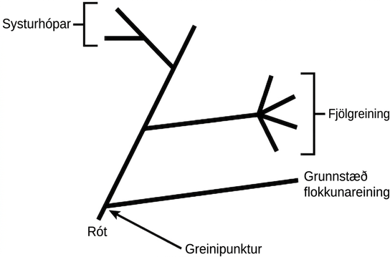
Figure 20.3
A phylogenetic tree's root indicates that an ancestral lineage gave rise to all organisms on the tree. A branch point indicates where two lineages diverged. A lineage that evolved early and remains unbranched is a basal taxon. When two lineages stem from the same branch point, they are sister taxa. A branch with more than two lineages is a polytomy.
Notes:
Illustration shows a phylogenetic tree that starts at a root, indicating that all organisms on the tree share a common ancestor. Shortly after the root, the tree branches out. One branch gives rise to a single, basal lineage, and the other gives rise to all other organisms on the tree. The next branch forks at one point into four different lineages, an example of polytomy. The final branch gives rise to two lineages, an example of sister taxa.

Slide 7
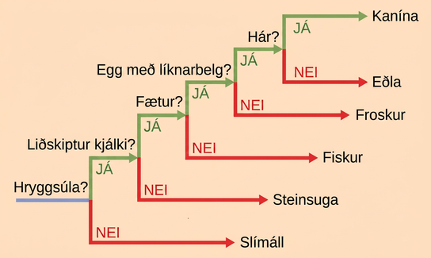
Figure 20.4
An organism that lacked a vertebral column roots this ladder-like phylogenetic tree of vertebrates. At each branch point, scientists place organisms with different characters in different groups based on shared characteristics.
Notes:
The ladder-like phylogenetic tree starts with a trunk at the left. A question next to the trunk asks whether a vertebral column is present. If the answer is no, a branch leads downward to lancelet. If the answer is yes, a branch leads upward to another question: is a hinged jaw present? If the answer is no, a branch leads downward to lamprey. If the answer is yes, a branch leads upward to another question: are legs present? If the answer is no, a branch leads downward to fish. If the answer is yes, a branch leads upward to another question: does the egg have amnion? If the answer is no, the branch leads downward to frog. If the answer is yes, the branch leads upward to another question: is hair present? If the answer is no, the branch leads downward to lizard. If the answer is yes, the branch leads upward to rabbit.

Slide 8
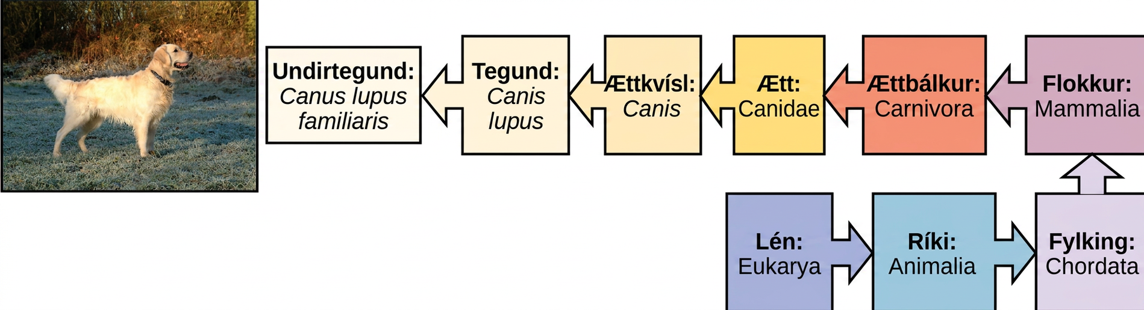
Figure 20.5
The taxonomic classification system uses a hierarchical model to organize living organisms into increasingly specific categories. The common dog, Canis lupus familiaris, is a subspecies of Canis lupus, which also includes the wolf and dingo. (credit “dog”: modification of work by Janneke Vreugdenhil)
Notes:
The illustration shows the classification of a dog, which belongs in the domain Eukarya, kingdom Animalia, phylum Chordata, class Mammalia, order Carnivora, family Canidae, genus Canis, species Canis lupus, and the subspecies is Canis lupus familiaris.

Slide 9
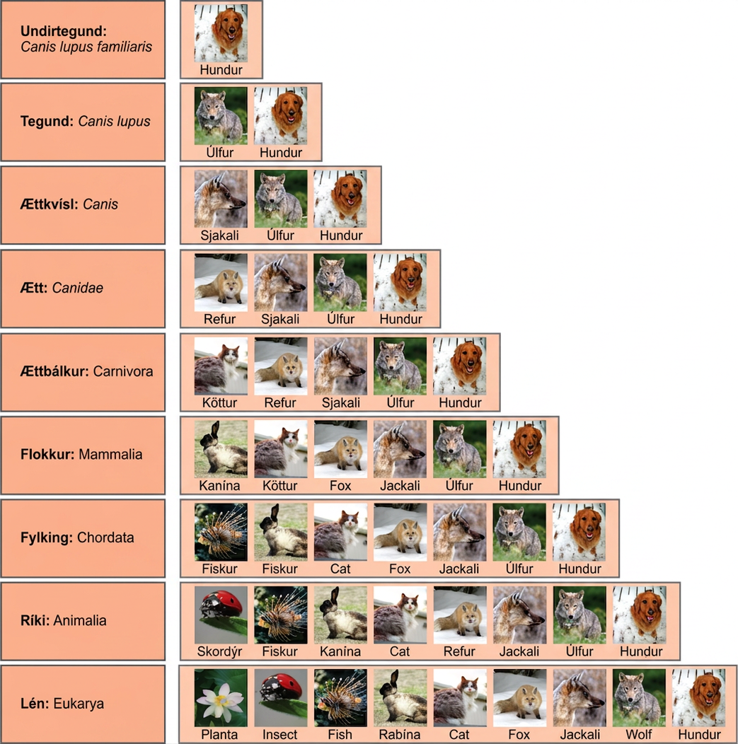
Figure 20.6
At each sublevel in the taxonomic classification system, organisms become more similar. Dogs and wolves are the same species because they can breed and produce viable offspring, but they are different enough to be classified as different subspecies. (credit “plant”: modification of work by "berduchwal"/Flickr; credit “insect”: modification of work by Jon Sullivan; credit “fish”: modification of work by Christian Mehlführer; credit “rabbit”: modification of work by Aidan Wojtas; credit “cat”: modification of work by Jonathan Lidbeck; credit “fox”: modification of work by Kevin Bacher, NPS; credit “jackal”: modification of work by Thomas A. Hermann, NBII, USGS; credit “wolf”: modification of work by Robert Dewar; credit “dog”: modification of work by "digital_image_fan"/Flickr)
Notes:
Illustration shows the taxonomic groups shared by various species. All of the organisms shown are in the domain Eukarya: plants, insects, fish, rabbits, cats, foxes, jackals wolves, and dogs. Of these, insects, fish, rabbits, cats, foxes, jackals, wolves and dogs are in the kingdom Animalia. Within the kingdom Animalia, fish, rabbits, cats, foxes, jackals, wolves, and dogs are in the phylum Chordata. Rabbits, cats, foxes, jackals, wolves, and dogs are in the class Mammalia. Cats, foxes, jackals, wolves, and dogs are in the order Carnivora. Foxes, jackals, wolves, and dogs are in the family Canidae. Jackals, wolves and dogs are in the genus Canis. Wolves and Dogs have the species name Canis lupus. Dogs have the subspecies name Canis lupus familiaris.

Slide 10
20.2 Determining Evolutionary Relationships
Learning Objectives
Compare homologous and analogous traits
Discuss the purpose of cladistics
Describe maximum parsimony

Slide 11
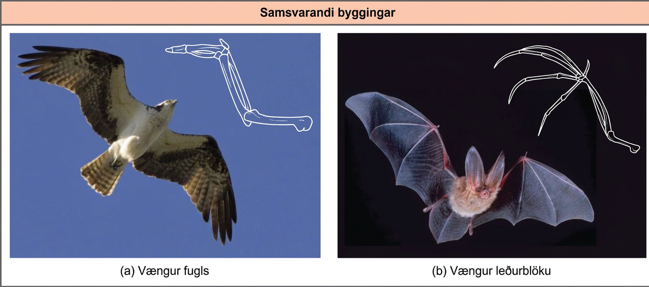
Figure 20.7
Bat and bird wings are homologous structures, indicating that bats and birds share a common evolutionary past. (credit a: modification of work by Steve Hillebrand, USFWS; credit b: modification of work by U.S. DOI BLM)
Notes:
Photo a shows a bird in flight with a corresponding drawing of a bird wing. Photo b is a bat in flight with a corresponding drawing of a bat wing. Both the bird wing and the bat wing share common bones, analogous to the bones in the arms and fingers of humans. However, in the bat wing, the finger bones are long and separate and form a scaffolding on which the wing's membrane is stretched. In the bird wing, the finger bones are short and fused together at the front of the wing.

Slide 12
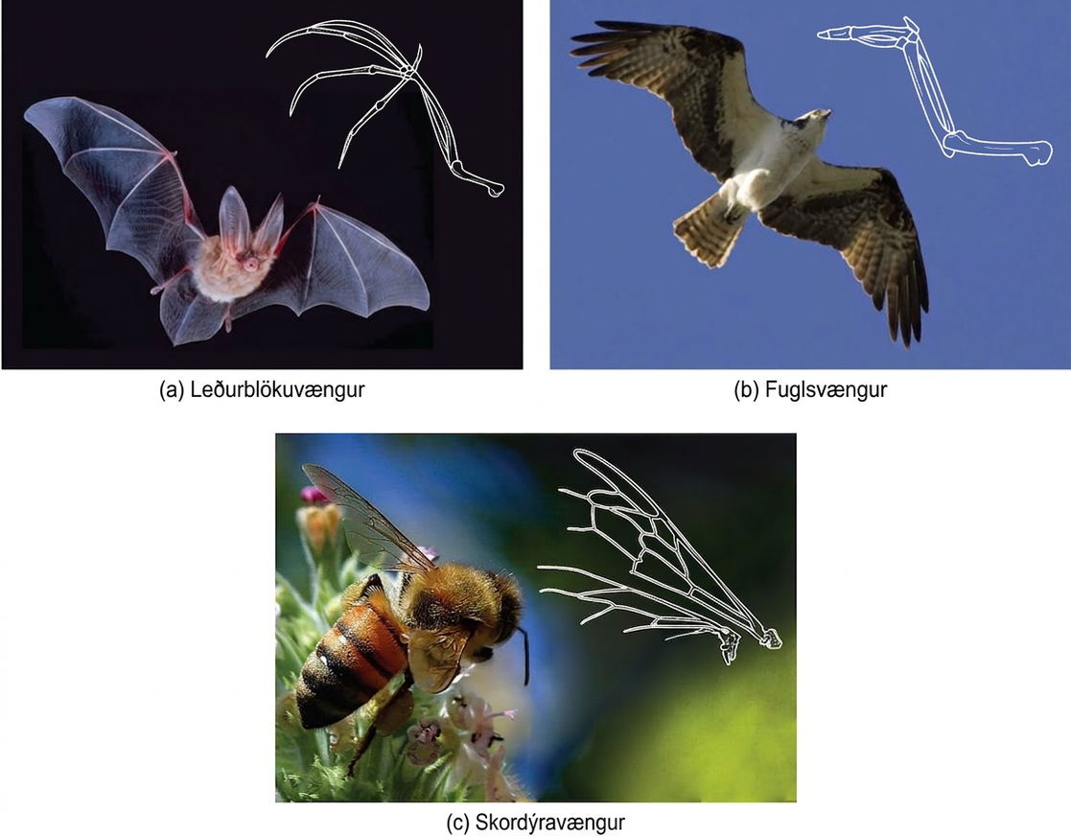
Figure 20.8
The (c) wing of a honeybee is similar in shape to a (b) bird wing and (a) bat wing, and it serves the same function. However, the honeybee wing is not composed of bones and has a distinctly different structure and embryonic origin. These wing types (insect versus bat and bird) illustrate an analogy—similar structures that do not share an evolutionary history. (credit a: modification of work by U.S. DOI BLM; credit b: modification of work by Steve Hillebrand, USFWS; credit c: modification of work by Jon Sullivan)
Notes:
Photo a shows a bat wing, photo b shows a bird wing, and photo c shows a honeybee wing, and all three are similar in overall shape. However, the bird wing and bat wing are both made from homologous bones that are similar in appearance. The honeybee wing is made of a thin, membranous material rather than bone.

Slide 13
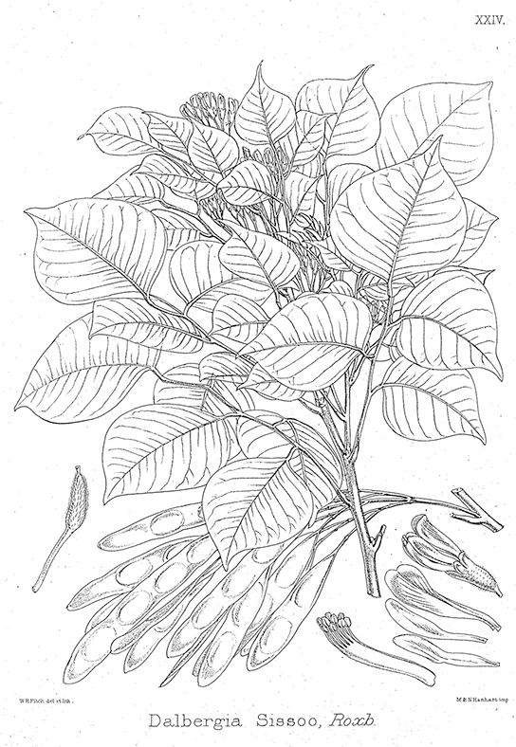
Figure 20.9
Dalbergia sissoo (D. sissoo) is in the Fabaceae, or legume family. Scientists found that D. sissoo shares a DNA marker with species within the Fabaceae family that have antifungal properties. Subsequently, researchers found that D. sissoo had fungicidal activity, supporting the idea that DNA markers are useful to screen plants with potential medicinal properties.
Notes:
The illustration shows a Dalbergia sissoo plant, which is short with pods and teardrop-shaped leaves.

Slide 14
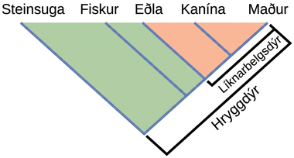
Figure 20.10
Lizards, rabbits, and humans all descend from a common ancestor that had an amniotic egg. Thus, lizards, rabbits, and humans all belong to the clade Amniota. Vertebrata is a larger clade that also includes fish and lamprey.
Notes:
The illustration shows the V-shaped Vertebrata clade, which includes lampreys, fish, lizards, rabbits, and humans. Lampreys are at the left tip of the V, and humans are at the right tip. Three more lines are drawn parallel to the lamprey line; each of these lines starts further up the right arm of the V than the last. At the end of each line, from left to right, are fish, lizards, and rabbits. Lizards, rabbits, and humans are in the clade Amniota, which form a small V nested in the upper right-hand corner of the V-shaped Vertebrata clade.

Slide 15
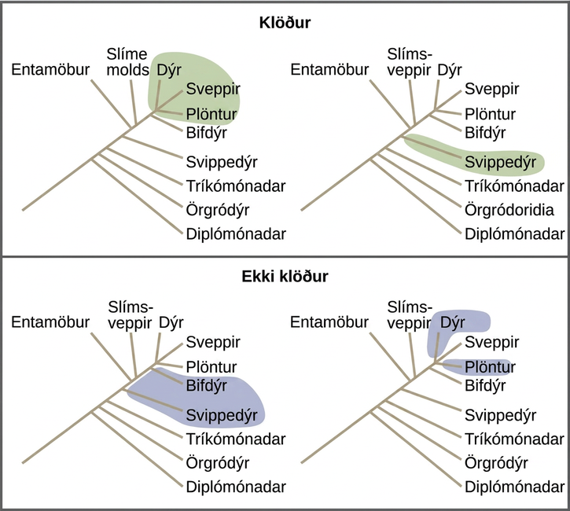
Figure 20.11
All the organisms within a clade stem from a single point on the tree. A clade may contain multiple groups, as in the case of animals, fungi and plants, or a single group, as in the case of flagellates. Groups that diverge at a different branch point, or that do not include all groups in a single branch point, are not clades.
Notes:
Illustrations show a phylogenetic tree that includes eukaryotic species. A central line represents the trunk of the tree. From this trunk, various groups branch. In order from the bottom, these are diplomonads, microsporidia, trichomonads, flagellates, entamoebae, slime molds, and ciliates. At the top of the tree, animals, fungi and plants all branch from the same point and are shaded to show that they belong in the same clade. Flagellates are on a branch by themselves, and they also form their own clade and are shaded to show this. In another image, Flagellates and ciliates are shaded to show that they branch from different points on the tree and are not considered clades. Likewise, a grouping of animals and plants but not fungi would not be considered a clade. A clade cannot exclude a branch originating at the same point as the others.

Slide 16
20.3 Perspectives on the Phylogenetic Tree (1 of 2)
Learning Objectives
Describe horizontal gene transfer
Illustrate how prokaryotes and eukaryotes transfer genes horizontally

Slide 17
20.3 Perspectives on the Phylogenetic Tree (2 of 2)
Learning Objectives
Identify the web and ring models of phylogenetic relationships and describe how they differ from the original phylogenetic tree concept

Slide 18
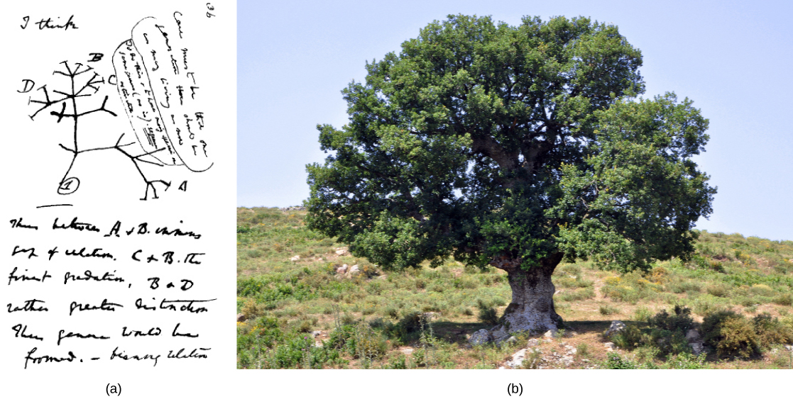
Figure 20.12
The (a) concept of the “tree of life” dates to an 1837 Charles Darwin sketch. Like an (b) oak tree, the “tree of life” has a single trunk and many branches. (credit b: modification of work by "Amada44"/Wikimedia Commons)
Notes:
Image a shows Charles Darwin's sketch of lines branching, like those on a tree. Photo b shows a photo of an oak tree with many branches.

Slide 19
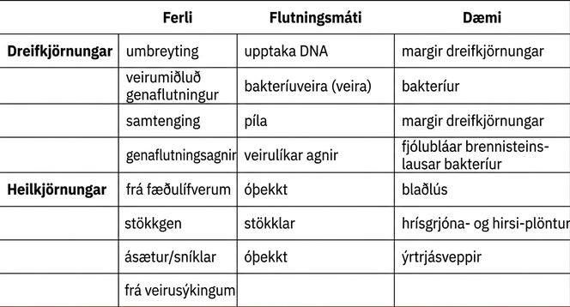
Table 20.1

Slide 20
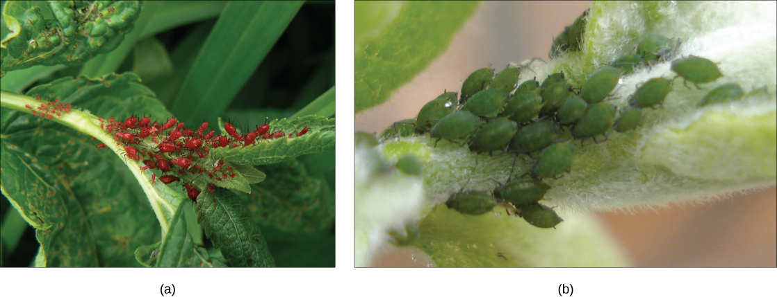
Figure 20.13
(a) Red aphids get their color from red carotenoid pigment. Genes necessary to make this pigment are present in certain fungi, and scientists speculate that aphids acquired these genes through HGT after consuming fungi for food. If mutation inactivates the genes for making carotenoids, the aphids revert back to (b) their green color. Red coloration makes the aphids considerably more conspicuous to predators, but evidence suggests that red aphids are more resistant to insecticides than green ones. Thus, red aphids may be more fit to survive in some environments than green ones. (credit a: modification of work by Benny Mazur; credit b: modification of work by Mick Talbot)
Notes:
Photo a shows small, oval-shaped red aphids crawling on a leaf. Photo b shows green aphids.

Slide 21
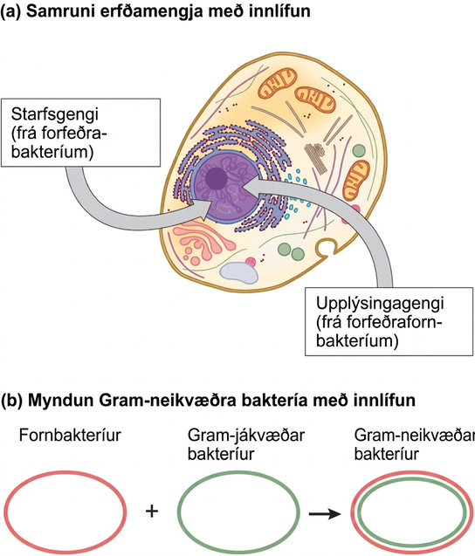
Figure 20.14
The scientific community now widely accepts the theory that mitochondria and chloroplasts are endosymbiotic in origin. More controversial is the proposal that (a) the eukaryotic nucleus resulted from fusing archaeal and bacterial genomes with their operational genes (whose products are involved in biochemical pathways) and informational genes (whose products are involved in transcription and translation), and that (b) Gramnegative bacteria, which have two membranes, resulted from fusing Archaea and Gram-positive bacteria, each of which has a single membrane.
Notes:
Part A shows a eukaryotic cell. The illustration indicates that, within the nucleus, operational genes were inherited from an ancestral bacteria, and informational genes were inherited from an ancestral Archaebacteria. Part B indicates that the outer membrane of Gram negative bacteria is derived from Archaea, and the inner membrane is derived from Gram positive bacteria.

Slide 22
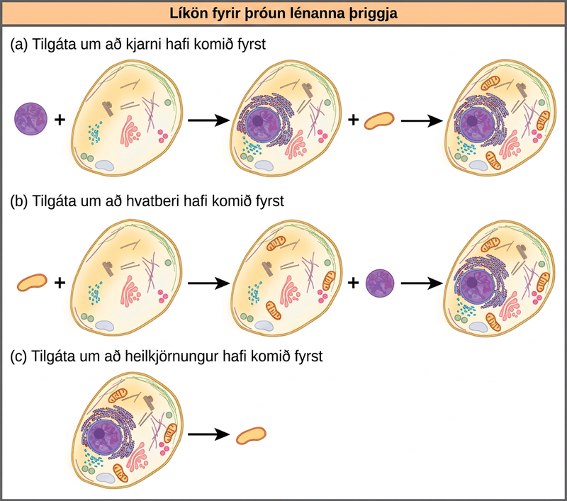
Figure 20.15
Three alternate hypotheses of eukaryotic and prokaryotic evolution are (a) the nucleus-first hypothesis, (b) the mitochondrion-first hypothesis, and (c) the eukaryote-first hypothesis.
Notes:
Part A shows the nucleus-first hypothesis. According to this hypothesis, a primary endosymbiotic event resulted in an ancestral eukaryotic cell acquiring a nucleus, and a secondary endosymbiotic event resulted in the acquisition of a mitochondrion. Part B shows the mitochondrion-first hypothesis. According to this hypothesis, the mitochondrion was acquired before the nucleus, but both were acquired by endosymbiosis. Part C shows the eukaryote-first hypothesis. According to this hypothesis, prokaryotes evolved from eukaryotic cells that lost their nuclei and organelles.

Slide 23
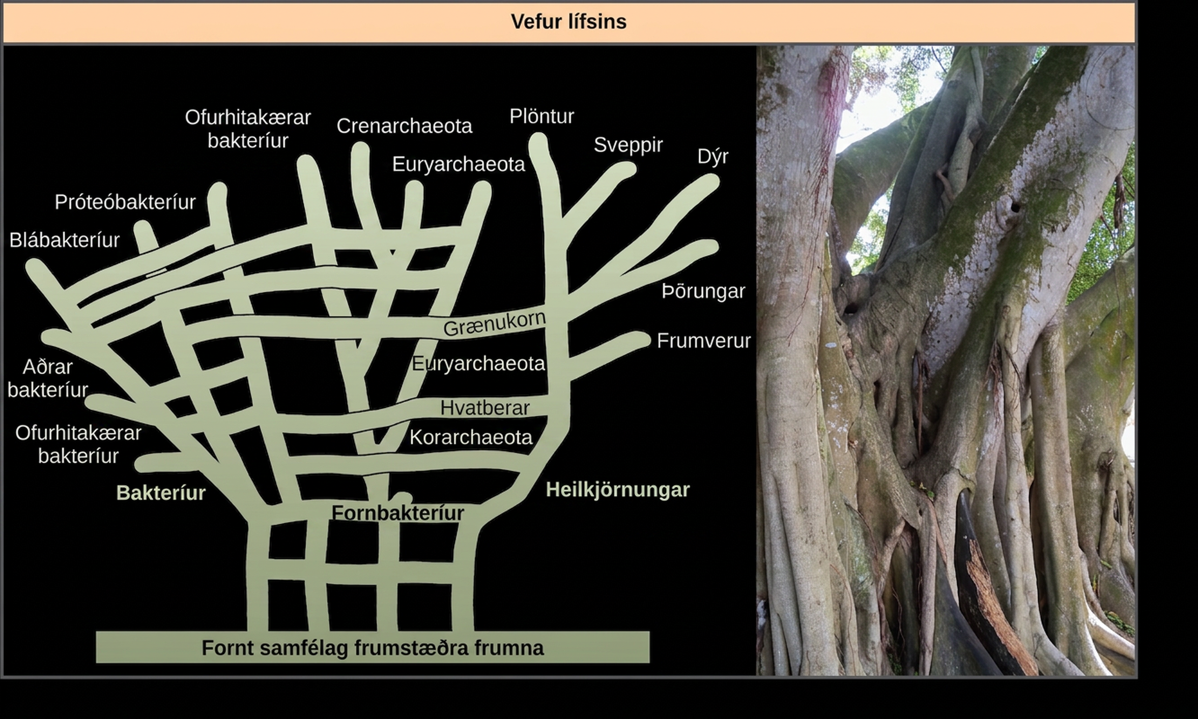
Figure 20.16
In W. Ford Doolittle's (a) phylogenetic model, the “tree of life” arose from a community of ancestral cells, has multiple trunks, and has connections between branches where horizontal gene transfer has occurred. Visually, this concept is better represented by (b) the multi-trunked Ficus than by an oak's single trunk similar to Darwin's tree in Figure 20.12. (credit b: modification of work by "psyberartist"/Flickr)
Notes:
Illustration A shows the web of life. The base of this web is an ancestral community of primitive cells. This pool of ancestral cells gave rise to the three domains of life, shown as bacteria, archaea, and eukarya. However, because of gene transfer and endosymbiosis events, connections occur between the branches at various points. Thus, eukaryotic chloroplasts and mitochondria originated in bacterial lineages, and archaea and bacteria have exchanged genes. The overall shape of the web has the ancestral community of primitive cells forming a horizontal base like the ground, multiple trunks extending up from it with some cross connections, continuing with tree-like branches reaching upward. Some of the branches also have horizontal cross connections between them, such as those for introducing chloroplasts and mitochondria into Eukarya. Part B is a photo of a multi-trunked Ficus tree.

Slide 24
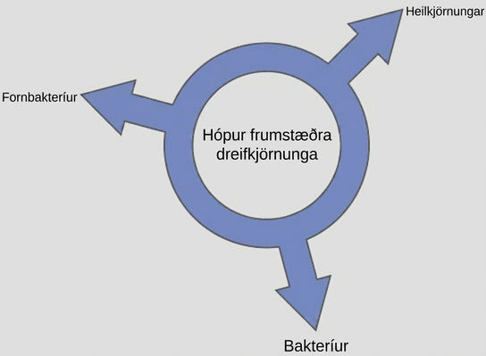
Figure 20.17
According to the “ring of life” phylogenetic model, the three domains of life evolved from a pool of primitive prokaryotes.
This OpenStax ancillary resource is © Rice University under a CC BY-NC-SA 4.0 International license; it may be reproduced or modified for noncommercial purposes only but must be attributed to OpenStax, Rice University and any changes must be noted. Any adaptation must be shared under the same type of license.
Notes:
Illustration shows a ring with the words, pool of primitive prokaryotes, in the middle. Three arrows point outward from the ring, pointing at the three domains, Bacteria, Archaea, and Eukarya, indicating that all three domains arose from a common pool of prokaryotes.

