Slide 1

Biology 2e
Chapter 29 Vertebrates

Slide 2
Chapter outline
Chordates
Fishes
Amphibians
Reptiles
Birds
Mammals
The Evolution of Primates

Slide 3
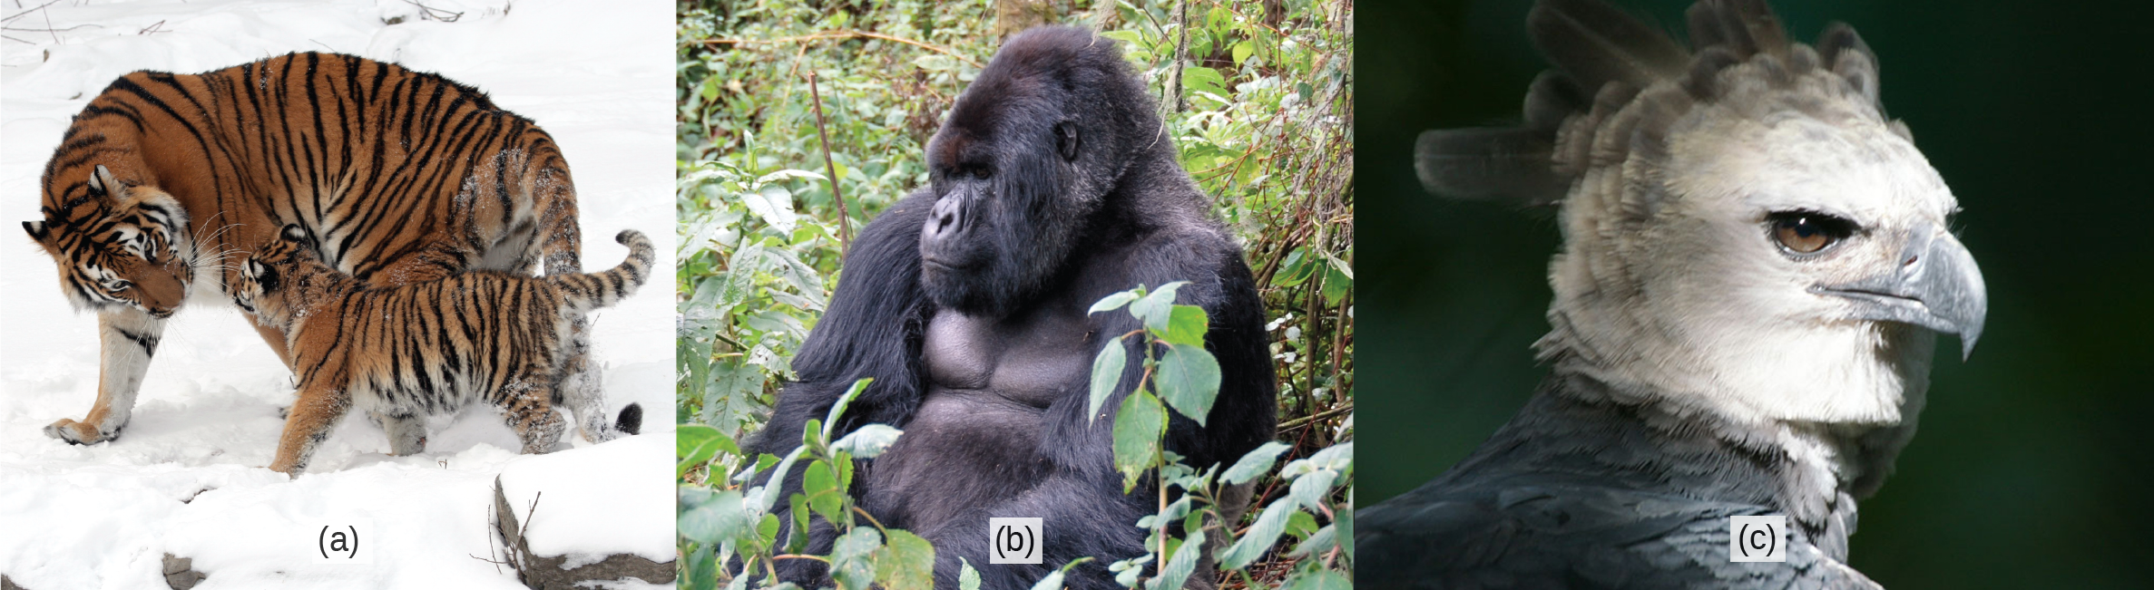
Figure 29.1
Examples of critically endangered vertebrate species include (a) the Siberian tiger (Panthera tigris), (b) the mountain gorilla (Gorilla beringei), and (c) the harpy eagle (Harpia harpyja). (The harpy eagle is considered "near threatened" globally, but critically endangered in much of its former range in Mexico and Central America.) (credit a: modification of work by Dave Pape; credit b: modification of work by Dave Proffer; credit c: modification of work by Haui Ared)
Notes:
Photos show a tiger, a gorilla, and an eagle.

Slide 4
29.1 Chordates
Learning Objectives
Describe the distinguishing characteristics of chordates
Identify the derived characters of craniates that sets them apart from other chordates
Describe the developmental fate of the notochord in vertebrates

Slide 5
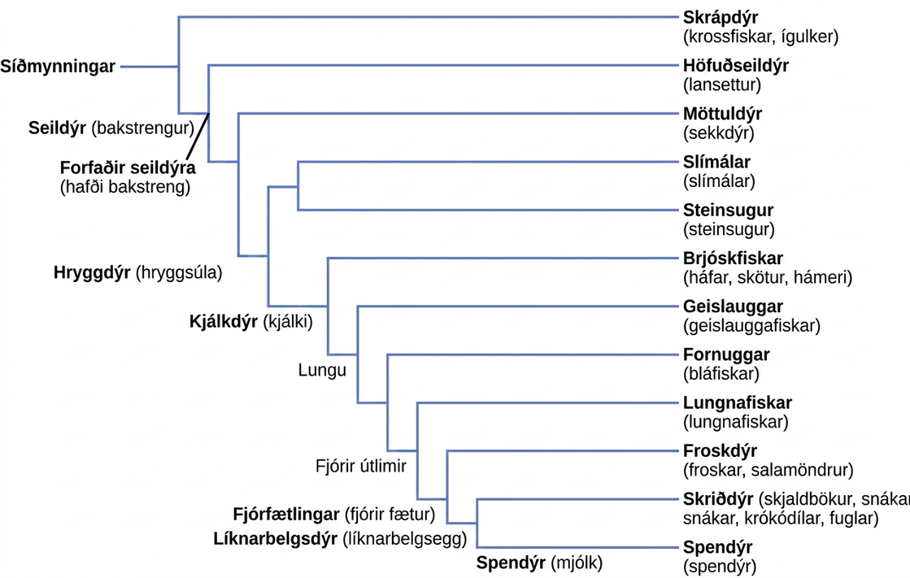
Figure 29.2
Deuterostome phylogeny. All chordates are deuterostomes possessing a notochord at some stage of their life cycle.
Notes:
The deuterostome phylogenetic tree includes Echinodermata and chordata. Chordates possess an notochord and include chephalochordates (lancelets), urochordata (tunicates) craniata, which have a cranium. Craniata includes the Myxini (hagfish) and vertebrata, which possess a vertebral column. Vertebrata includes the Petromyzontida (lampreys) and Gnathostomes, which possess a jaw. Gnathostomes include Actinopterygii (ray finned fishes) and animals with four limbs. Animals with four limbs include Actinistia (coelacanths) , dipnoi (lungfishes) and tetrapods, or animals with four legs. Tetrapods include amphibian (frogs and salamanders) and Amniotic, which possess an amniotic egg. Amniota includes reptilian (turtles, snakes, crocodiles and birds) and mammalia, or animals that produce milk.

Slide 6
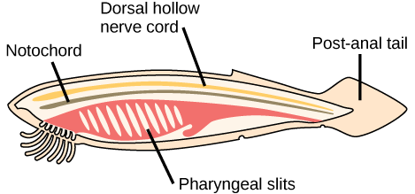
Figure 29.3
Chordate features. In chordates, four common features appear at some point during development: a notochord, a dorsal hollow nerve cord, pharyngeal slits, and a post-anal tail. The endostyle is embedded in the floor of the pharynx.
Notes:
The illustration shows a fish-shaped chordate. A long, thin dorsal hollow nerve cord runs the length of the chordate, along the top. Immediately beneath the nerve cord is a notochord that also runs the length of the organism. Beneath the notochord, pharyngeal slits cut diagonally into tissue toward the front of the organism. A post-anal tail occurs at the rear.

Slide 7
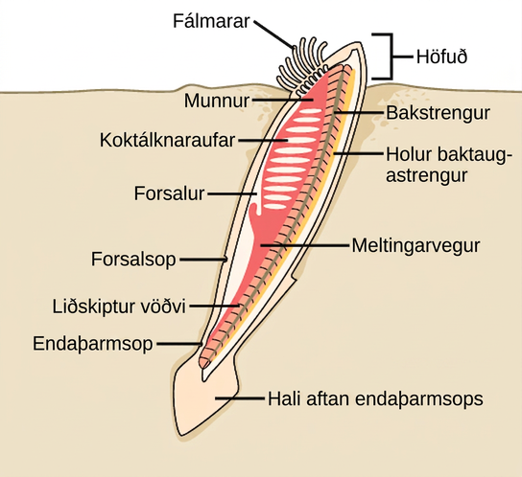
Figure 29.4
Cephalochordate anatomy. In the lancelet and other cephalochordates, the notochord extends into the head region. Adult lancelets retain all five key characteristics of chordates: a notochord, a dorsal hollow nerve cord, pharyngeal slits, an endostyle, and a post-anal tail.
Notes:
The illustration shows a lancelet with a head protruding from the sand, and the rest of the body buried. On the head, tentacles surround the mouth. The mouth leads to a digestive tract. The anus is just before the post anal tail. The pharyngeal slits are next to the atrium, which empties into the atriopore. The body has segmented muscles running along it from top to bottom.

Slide 8
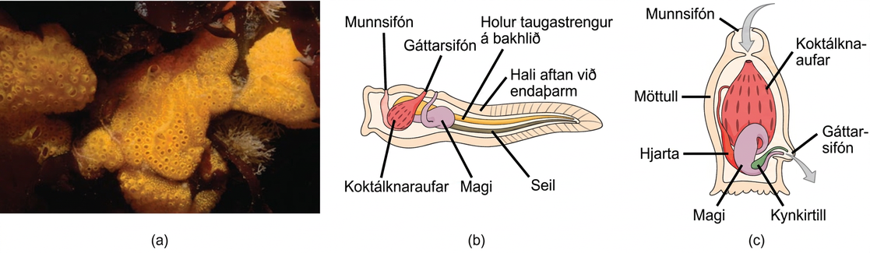
Figure 29.5
Urochordate anatomy. (a) This photograph shows a colony of the tunicate Botrylloides violaceus. (b) The larval stage of the tunicate possesses all of the features characteristic of chordates: a notochord, a dorsal hollow nerve cord, pharyngeal slits, an endostyle, and a post-anal tail. (c) In the adult stage, the notochord, nerve cord, and tail disappear, leaving just the pharyngeal slits and endostyle. (credit: modification of work by Dann Blackwood, USGS)
Notes:
Photo A shows tunicates, which are sponge-like in appearance and have holes along the surface. Illustration B shows the tunicate larval stage, which resembles a tadpole, with a post anal tail at the narrow end. A dorsal hollow nerve cord run along the upper back, and a notochord runs beneath the nerve cord. The digestive tract starts with an oral siphon at the front of the animal connected to a stomach. Above the stomach is the atrial siphon. The pharyngeal slits, which are located in between the stomach and mouth, are connected to an atrial opening at the top of the body. Illustration C shows an adult tunicate, which resembles a tree stump anchored at the bottom. Water enters through an oral siphon at the top of the body and passes through the pharyngeal slits, where it is filtered. Water then exits through another opening at the side of the body. A heart, stomach and gonad are tucked beneath the pharyngeal slit. The outer surface is called a tunic.

Slide 9
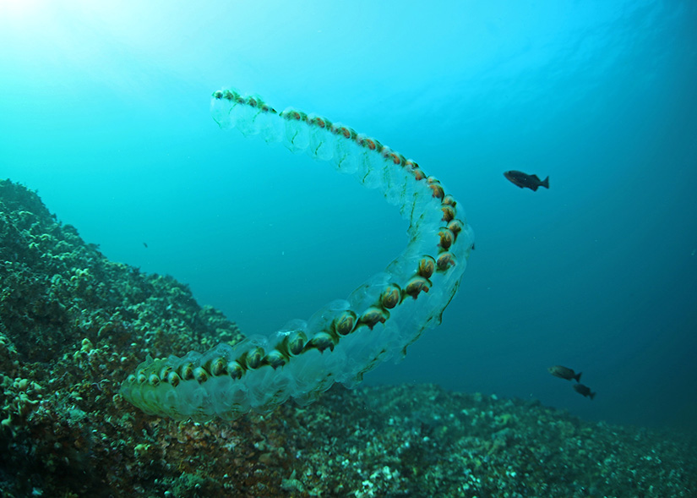
Figure 29.6
Salps. These colonial tunicates feed on phytoplankton. Salps are sequential hermaphrodites, with younger female colonies fertilized by older male colonies. (credit: Oregon Department of Fish & Wildlife via Wikimedia Commons)
Notes:
The image displays a group of salps near a coral reef. This appears as a long, globular chain, with interior sections shaped like snails.

Slide 10
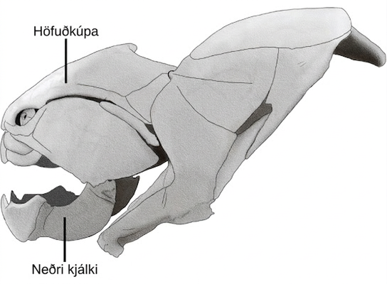
Figure 29.7
A craniate skull. The subphylum Craniata (or Vertebrata), including this placoderm fish (Dunkleosteus sp.), are characterized by the presence of a cranium, mandible, and other facial bones. (credit: “Steveoc 86”/Wikimedia Commons)
Notes:
The cranium wraps around the upper part of the head. The mandible is the lower jaw. Other bones complete the skull.

Slide 11
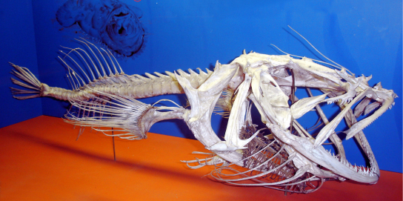
Figure 29.8
A vertebrate skeleton. Vertebrata are characterized by the presence of a backbone, such as the one that runs through the middle of this fish. All vertebrates are in the Craniata clade and have a cranium. (credit: Ernest V. More; taken at Smithsonian Museum of Natural History, Washington, D.C.)
Notes:
Photo shows a fish skeleton with a vertebral column extending back from the skull.

Slide 12
29.2 Fishes
Learning Objectives
Describe the difference between jawless and jawed fishes
Discuss the distinguishing features of sharks and rays compared to other modern fishes

Slide 13
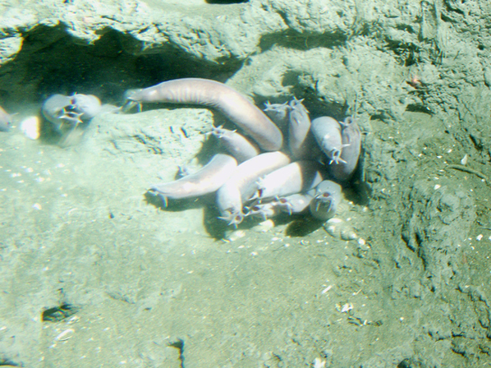
Figure 29.9
Hagfish. Pacific hagfish are scavengers that live on the ocean floor. (credit: Linda Snook, NOAA/CBNMS)
Notes:
The photo shows wormlike hagfish clustered in a muddy hole.

Slide 14
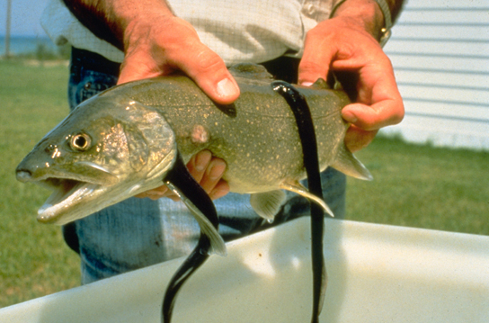
Figure 29.10
Lamprey. These parasitic sea lampreys, Petromyzon marinus, attach by suction to their lake trout host, and use their rough tongues to rasp away flesh in order to feed on the trout’s blood. (credit: USGS)
Notes:
The photo shows leech-like sea lampreys latched onto a large fish. The sea lampreys have a long, smooth, slender body.

Slide 15
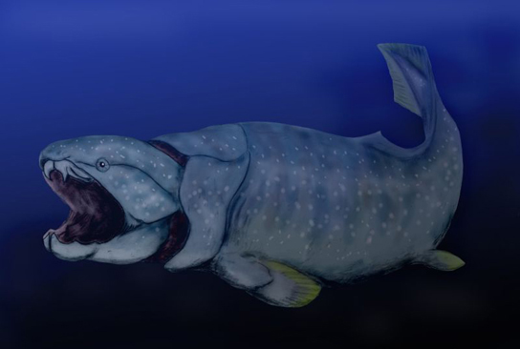
Figure 29.11
A placoderm. Dunkleosteus was an enormous placoderm from the Devonian period, 380 to 360 million years ago. It measured up to 10 meters in length and weighed up to 3.6 tons. Its head and neck were armored with heavy bony plates. Although Dunkleosteus had no true teeth, the edge of the jaw was armed with sharp bony blades. (credit: Nobu Tamura)
Notes:
The illustration shows a large fish with a very wide mouth.

Slide 16
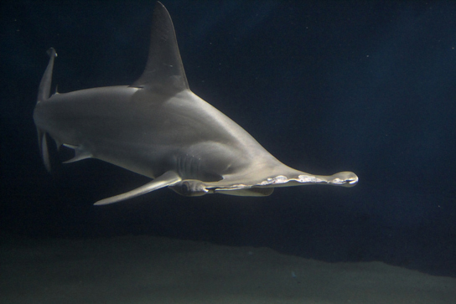
Figure 29.12
Shark. Hammerhead sharks tend to school during the day and hunt prey at night. (credit: Masashi Sugawara)
Notes:
The photo shows a hammerhead shark, whose head is broad and flat, with eyes at each outer edge.

Slide 17
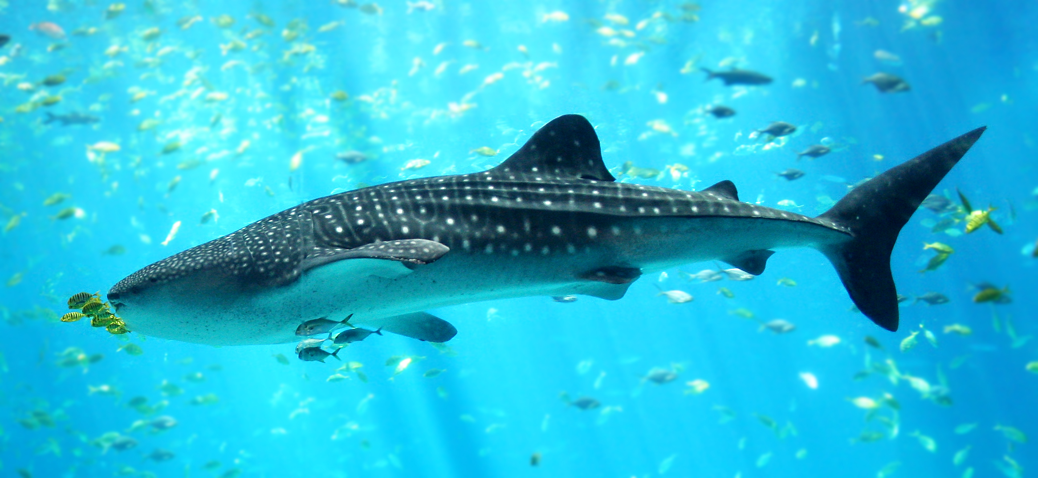
Figure 29.13
Whale shark in the Georgia Aquarium. Whale sharks are filter-feeders and can grow to be over 10 meters long. Whale sharks, like most other sharks, are ovoviviparous. (credit: modified from Zac Wolf [Own work] [CC BY-SA 2.5 (http://creativecommons.org/licenses/by-sa/2.5)], via Wikimedia Commons)
Notes:
The image displays a whale shark swimming in the Georgia Aquarium.

Slide 18
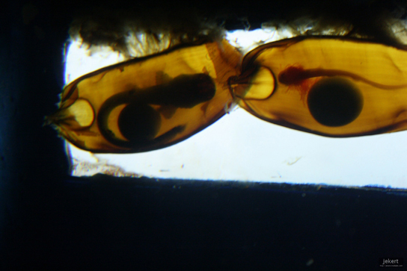
Figure 29.14
Shark egg cases. Shark embryos are clearly visible through these transparent egg cases. The round structure is the yolk that nourishes the growing embryo. (credit: Jek Bacarisas)
Notes:
The photo shows long, thin shark embryos encased in egg cases.

Slide 19
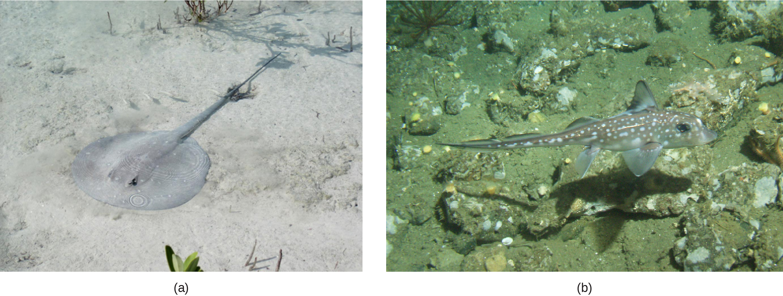
Figure 29.15
Cartilaginous fish. (a) Stingray. This stingray blends into the sandy bottom of the ocean floor. A spotted ratfish (b) Hydrolagus colliei. (credit: a "Sailn1"/Flickr b: Linda Snook / MBNMS [Public domain], via Wikimedia Commons.)
Notes:
Photo A shows a stingray with a long, thin body and a circular head, resting on the sandy bottom. Photo B shows a spotted ratfish with fins and a long slender tail, but with no visible gill slits.

Slide 20
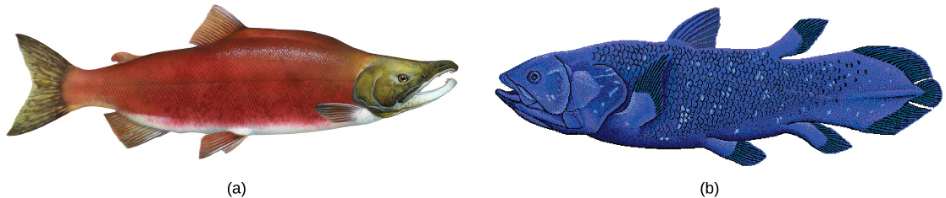
Figure 29.16
Osteichthyes. The (a) sockeye salmon and (b) coelacanth are both bony fishes of the Osteichthyes clade. The coelacanth, sometimes called a lobe-finned fish, was thought to have gone extinct in the Late Cretaceous period, 100 million years ago, until one was discovered in 1938 near the Comoros Islands between Africa and Madagascar. (credit a: modification of work by Timothy Knepp, USFWS; credit b: modification of work by Robbie Cada)
Notes:
The illustration compares a bright red salmon (a) and a blue coelacanth (b), both of which are similar in shape and have fins.

Slide 21
29.3 Amphibians
Learning Objectives
Describe the important difference between the life cycle of amphibians and the life cycles of other vertebrates
Distinguish between the characteristics of Urodela, Anura, and Apoda
Describe the evolutionary history of amphibians

Slide 22
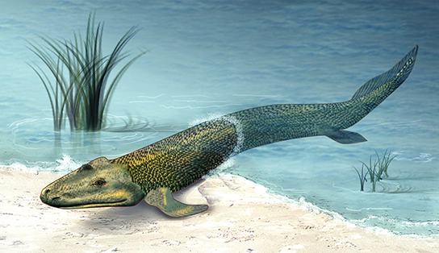
Figure 29.17
Tiktaalik. The recent fossil discovery of Tiktaalik roseae suggests evidence for an animal intermediate to finned fish and legged tetrapods, sometimes called a "fishapod." (credit: Zina Deretsky, National Science Foundation)
Notes:
The image shows a tetrapod-like fish with fin-like legs.

Slide 23
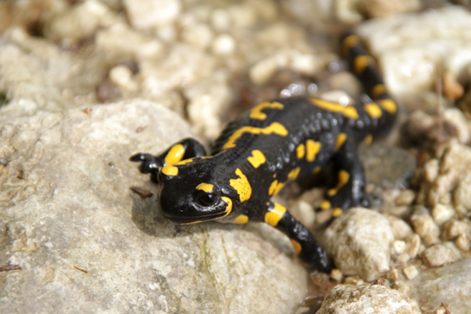
Figure 29.18
Salamander. Most salamanders have legs and a tail, but respiration varies among species. (credit: Valentina Storti)
Notes:
The photo shows a black salamander with bright yellow spots.

Slide 24
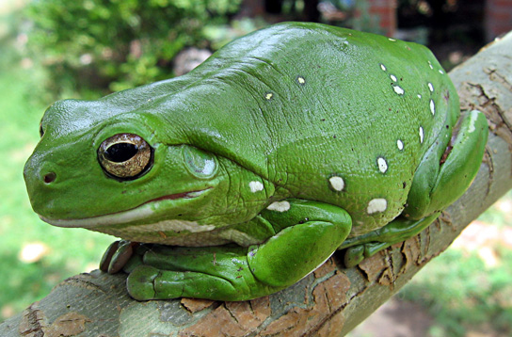
Figure 29.19
Tree frog. The Australian green tree frog is a nocturnal predator that lives in the canopies of trees near a water source.
Notes:
The photo shows a big, bright green frog sitting on a branch.

Slide 25
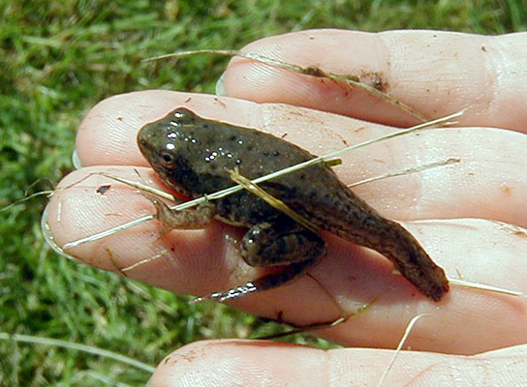
Figure 29.20
Amphibian metamorphosis. A juvenile frog metamorphoses into a frog. Here, the frog has started to develop limbs, but its tadpole tail is still evident.
Notes:
The photo shows a frog with a long tail from the tadpole stage.

Slide 26
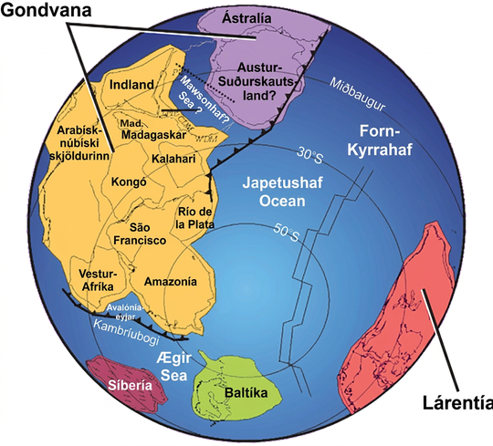
Figure 29.21
Paleozoic continents. During the Paleozoic Era, around 550 million years ago, the continent Gondwana formed. Both Gondwana and the continent Laurentia were located near the equator.
Notes:
A world map shows two continents, Gondwana and Laurentia, which are shaped very differently from the continents of today. Gondwana was made up of two smaller subcontinents separated by a narrow sea. One continent contained modern Antarctica, and the other contained parts of Africa.

Slide 27
29.4 Reptiles
Learning Objectives
Describe the main characteristics of amniotes
Explain the difference between anapsids, synapsids, and diapsids, and give an example of each
Identify the characteristics of reptiles
Discuss the evolution of reptiles

Slide 28
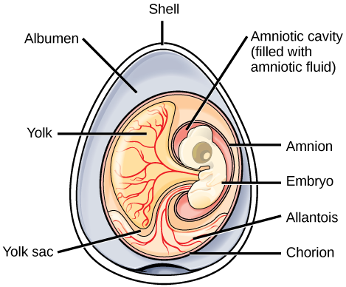
Figure 29.22
An amniotic egg. The key features of an amniotic egg are shown.
Notes:
The illustration shows a cross section of an egg. The outer covering is called the shell. There is a circular mass inside with many different parts. Surrounding the mass, within the shell is the albumen. The outer layer of the circular mass is the chorion. An embryo is contained within an amniotic cavity, filled with amniotic fluid. Attached to the embryo is a yolk sac, filled with a yolk substance. Vein like features, called allantois, extend from the chorion to the embryo.

Slide 29
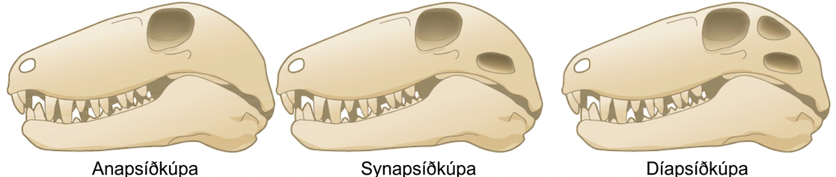
Figure 29.23
Amniote skulls. Compare the skulls and temporal fenestrae of anapsids, synapsids, and diapsids. Anapsids have no openings, synapsids have one opening, and diapsids have two openings.
Notes:
The illustration compares three different skull types. All three skulls are elongated and similar in shape; the only difference between them is the number of holes behind the eye. The anapsid skull (left) has no openings. The synapsid skull (middle) has one opening, and the diapsid skull (right) has two openings, one on top of the other.

Slide 30
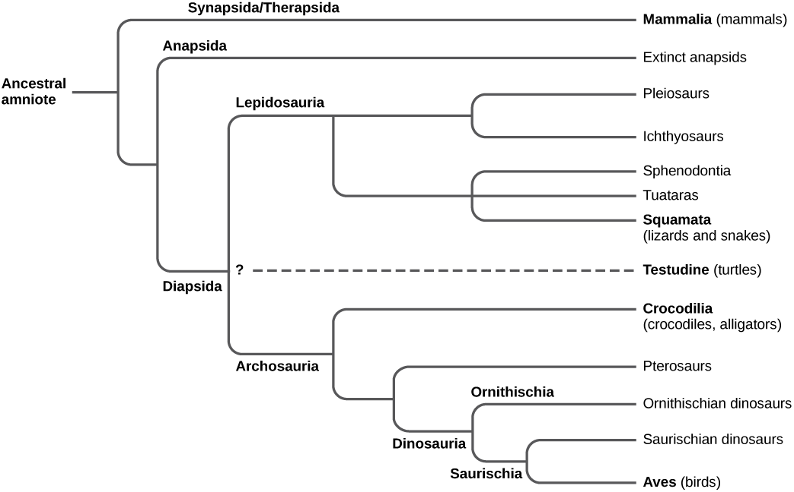
Figure 29.24
Amniote phylogeny. This chart shows the evolution of amniotes. The placement of Testudines (turtles) is currently still debated.
Notes:
The trunk of the amniote phylogenetic tree is the ancestral amniote. Initially, the tree branches into diapsids, anapsids, and synapsids. Synapsids give rise to mammals, which are therapsids. Anapsids are all extinct. Diapsids are subdivided into two groups, lepidosaurs and archosaurs. Lepidosauria includes plesiosaurs, ichthyosaurs, Sphenodontia and Squamata, which includes lizards and snakes. Archosauria branches into Crocodilia, pterosaurs, dinosaurs, and birds.

Slide 31
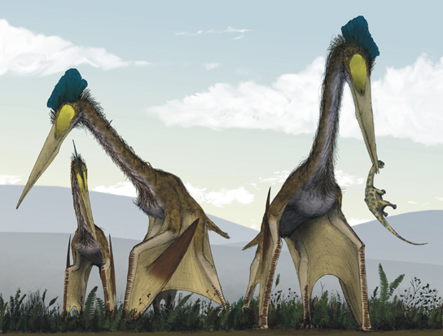
Figure 29.25
Pterosaurs. Pterosaurs, such as this Quetzalcoatlus, which existed from the late Triassic to the Cretaceous period (230 to 65.5 million years ago), possessed wings but are not believed to have been capable of powered flight. Instead, they may have been able to soar after launching from cliffs. (credit: Mark Witton, Darren Naish)
Notes:
The illustration shows pterosaurs, which resemble large modern birds with long necks, long beaks, and bat-like wings.

Slide 32
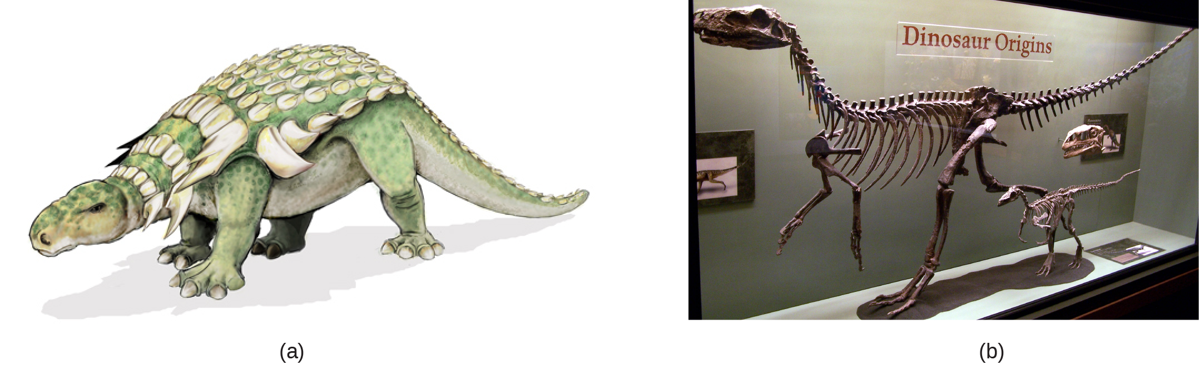
Figure 29.26
Ornithischian and saurischian Dinosaurs. Edmontonia was an armored dinosaur that lived in the Late Cretaceous period, 145.5 to 65.6 million years ago. Herrerasaurus and Eoraptor (b) were late Triassic saurischian dinosaurs dating to about 230 million years ago. (credit: a Mariana Ruiz Villareal b Zach Tirrell from Plymouth, USA, Dino Origins)
Notes:
Illustration A shows a dinosaur that walks on four legs, has a long tail, and an armored back. Photo B shows a skeleton of a Eoraptor in a museum.

Slide 33
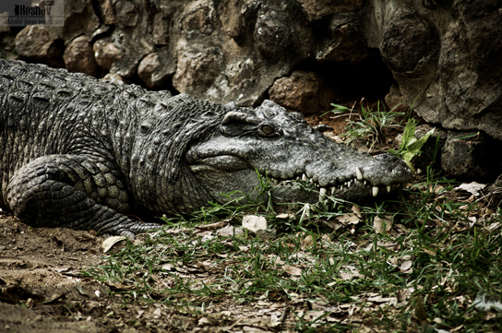
Figure 29.27
A crocodilian. Crocodilians, such as this Siamese crocodile (Crocodylus siamensis), provide parental care for their offspring. (credit: Keshav Mukund Kandhadai)
Notes:
The photo shows a crocodile sitting in the mud.

Slide 34
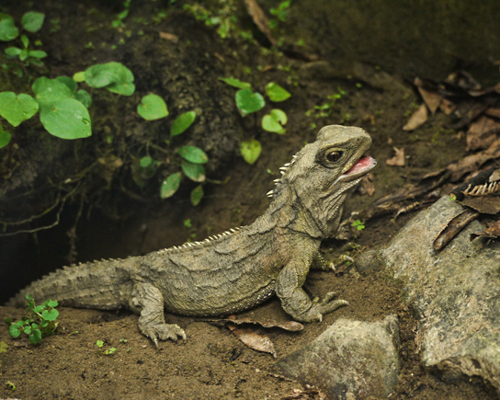
Figure 29.28
A tuatara. This tuatara from New Zealand may resemble a lizard but belongs to a distinct lineage, the Sphenodontidae family. (credit: Sid Mosdell)
Notes:
This photo shows a green lizard with short spines on its back.

Slide 35
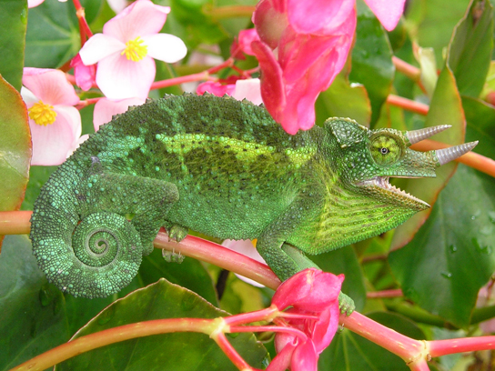
Figure 29.29
A chameleon. This Jackson’s chameleon (Trioceros jacksonii) blends in with its surroundings.
Notes:
The photo shows a green lizard with its tail curled like a snail shell. The lizard has two horns and matches the leaves of the plant on which it sits.

Slide 36
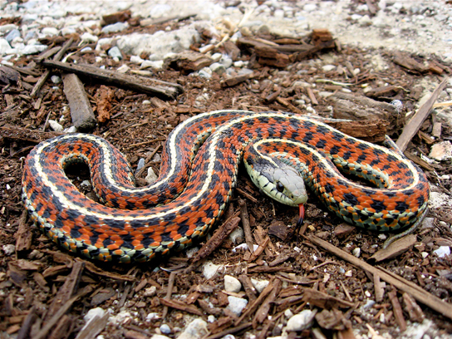
Figure 29.30
A nonvenomous snake. The garter snake belongs to the genus Thamnophis, the most widely distributed reptile genus in North America. (credit: Steve Jurvetson)
Notes:
The photo shows a snake with orange and black bands and white stripes.

Slide 37
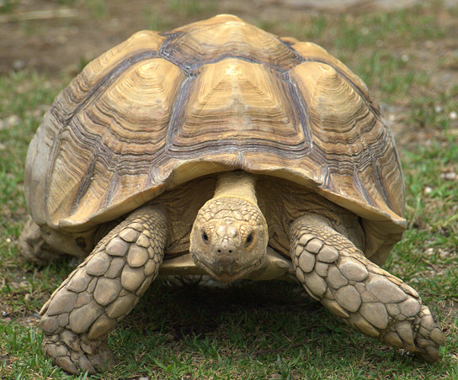
Figure 29.31
A tortoise. The African spurred tortoise (Geochelone sulcata) lives at the southern edge of the Sahara Desert. It is the third largest tortoise in the world. (credit: Jim Bowen)
Notes:
The photo shows a very large tortoise, that has a huge shell which encases its body. Its legs, neck and head protrude from the shell.

Slide 38
29.5 Birds
Learning Objectives
Describe the evolutionary history of birds
Describe the derived characteristics in birds that facilitate flight

Slide 39
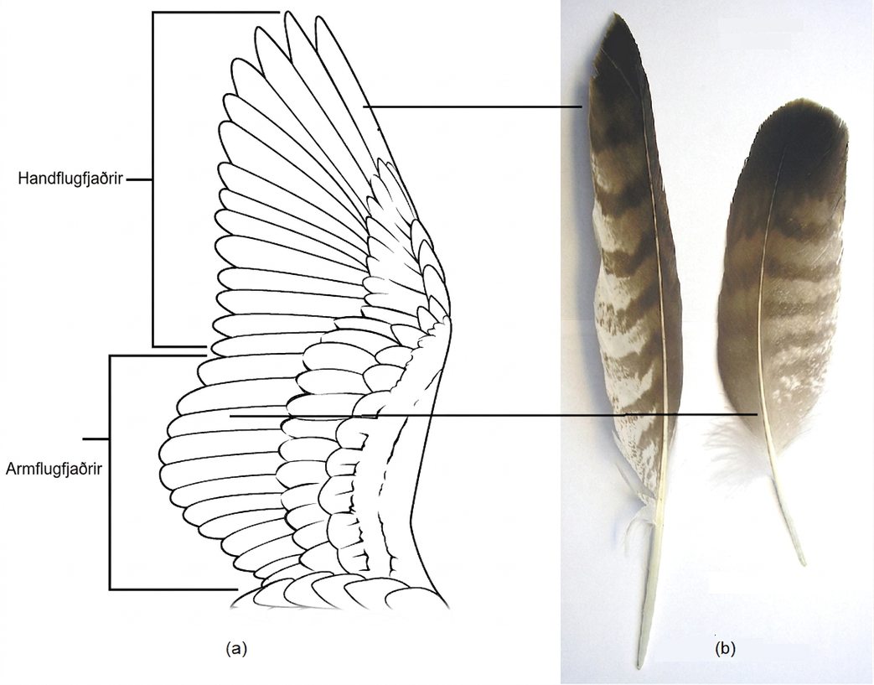
Figure 29.32
Flight feathers. (a) Primary feathers are located at the wing tip and provide thrust; secondary feathers are located close to the body and provide lift. (b) Primary and secondary feathers from a common buzzard (Buteo buteo). (Credit b: Mod. from S. Seyfert https://commons.wikimedia.org/w/index.php?curid=613813)
Notes:
Illustration A shows a bird's wing. Primary feathers fan out and back from the outer part of the wing. Secondary feathers extend back from the inner part of the wing. Photo B shows individual primary and secondary feathers. The primary feather is long and slender. The secondary feather is shorter and wider.

Slide 40
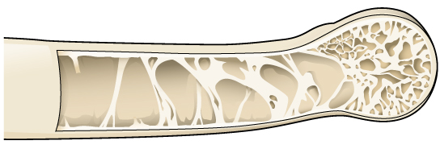
Figure 29.33
Pneumatic bone. Many birds have hollow, pneumatic bones, which make flight easier.
Notes:
The illustration shows a hollow bone with structural supports providing reinforcement.

Slide 41
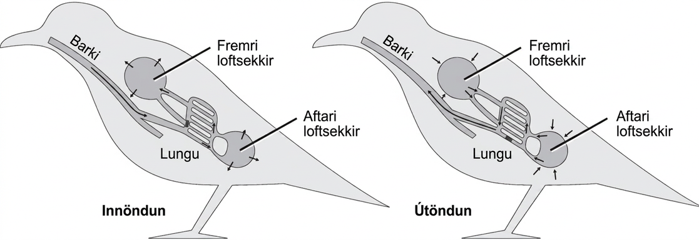
Figure 29.34
Air flow in bird lungs. Avian respiration is an efficient system of gas exchange with air flowing unidirectionally. A full ventilation cycle takes two breathing cycles. During the first inhalation, air passes from the trachea into posterior air sacs. The first exhalation moves the air from the posterior air sacs to the lungs. The second inhalation moves the air in the lungs to the anterior air sacs, and the second exhalation moves the air in the anterior air sacs out of the body. Overall, each inhalation moves air into the air sacs, while each exhalation moves fresh air through the lungs and "used" air out of the body. The air sacs are connected to the hollow interior of bones. (credit: modification of work by L. Shyamal)
Notes:
The illustration shows the direction of airflow in both inhalation and exhalation in birds. During inhalation, air passes from the beak down the trachea to the posterior air sac located behind the lungs. From the posterior air sac, air enters the lungs, and the anterior air sac in front of the lungs. Air from both air sacs also enters hollows in bones. During exhalation air from hollows in the bones enters the air sacs, then the lungs, then the trachea, where it exits through the beak.

Slide 42
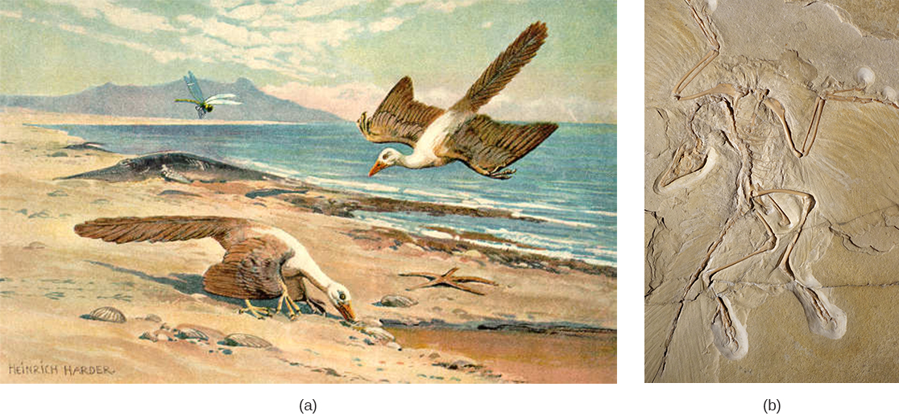
Figure 29.35
Archaeopteryx. (a) Archaeopteryx lived in the late Jurassic period around 150 million years ago. It had cuplike thecodont teeth like a dinosaur, but had (b) flight feathers like modern birds, which can be seen in this fossil. Note the claws on the wings, which are still found in a number of birds, such as the newborn chicks of the South American Hoatzin. (credit b: modification of work by Daderot/Wikimedia Commons, CC0 1.0)
Notes:
Part a shows a bird on the ground, and another coasting toward the ground. Part b shows a fossilized bird, with feathers visible.

Slide 43
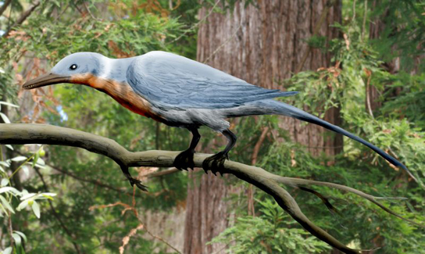
Figure 29.36
Enantiornithean bird. Shanweiniao cooperorum was a species of Enantiornithes that did not survive past the Cretaceous period. (credit: Nobu Tamura)
Notes:
The photo shows a bird sitting on a branch.

Slide 44
29.6 Mammals (1 of 2)
Learning Objectives
Name and describe the distinguishing features of the three main groups of mammals
Describe the likely line of evolutionary descent that produced mammals

Slide 45
29.6 Mammals (2 of 2)
Learning Objectives
List some derived features that may have arisen in response to mammals’ need for constant, high-level metabolism
Identify the major clades of eutherian mammals

Slide 46
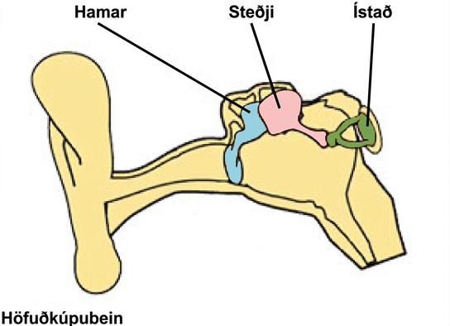
Figure 29.37
Mammalian ear bones. Bones of the mammalian middle ear are modified from bones of the jaw and skull in reptiles. The stapes is found in other vertebrates (e.g., the columella of birds) whereas in mammals, the malleus and incus are derived from the articular and quadrate bones, respectively. (credit: NCI)
Notes:
The illustration shows the three bones of the inner ear, the malleus, the incus, and the stapes, which are connected together inside the ear canal.

Slide 47
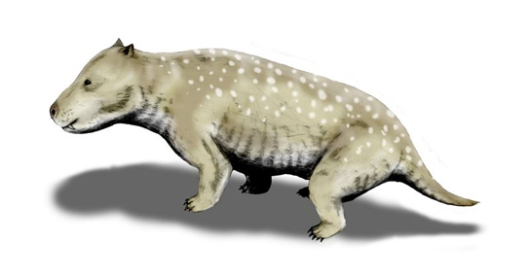
Figure 29.38
Cynodont. Cynodonts ("dog teeth"), which first appeared in the Late Permian period 260 million years ago, are thought to be the ancestors of modern mammals. Holes in the upper jaws of cynodonts suggest that they had whiskers, which might also indicate the presence of hair. (credit: Nobu Tamura)
Notes:
The illustration shows an animal resembling a short-haired dog.

Slide 48
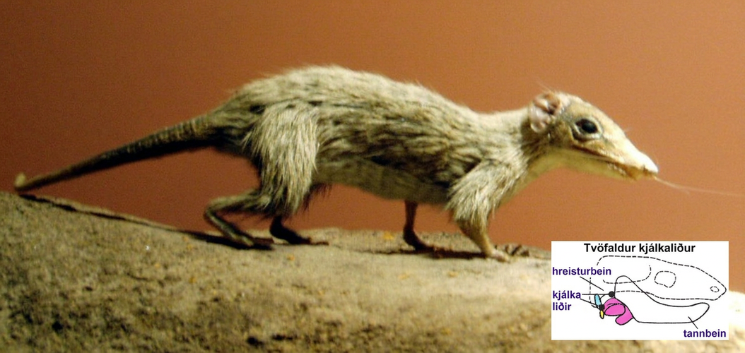
Figure 29.39
A morganucodont. This morganucodont Megazotrodon, an extinct basal mammal, may have been nocturnal and insectivorous. Inset: Jaw of a morganucodont, showing a double hinge, one between the dentary and squamosal and one between the articular (yellow) and quadrate (blue) bones. In living mammals, the articular and quadrate bones have been incorporated into the middle ear. (Credit: By Nordelch [Megazostrodon Natural History Museum] Wikimedia Commons. Credit inset: Mod from Philcha. https://commons.wikimedia.org/w/index.php? curid=3631949)
Notes:
Image of morganucodont. Inset: Jaw showing double hinge, one between dentary and squamosal and one between articular (yellow) and quadrate (blue) bones.

Slide 49
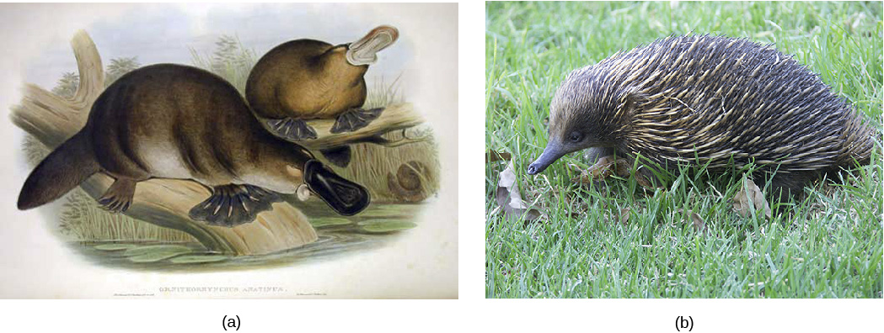
Figure 29.40
Egg-laying mammals. (a) The platypus, a monotreme, possesses a leathery beak and lays eggs rather than giving birth to live young. (b) The echidna is another monotreme, with long hairs modified into spines. (credit b: modification of work by Barry Thomas)
Notes:
Illustration A shows two platypuses with webbed feet, broad flat tails, and broad flat bills. Photo B shows an echidna with a slender snout and a body covered in short spines.

Slide 50
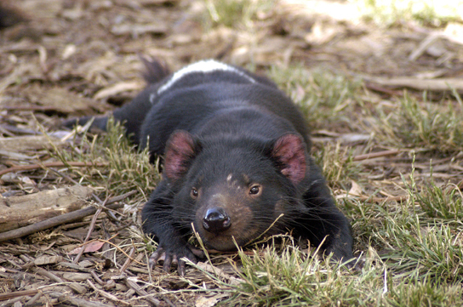
Figure 29.41
A marsupial mammal. The Tasmanian devil is one of several marsupials native to Australia. (credit: Wayne McLean)
Notes:
The illustration shows an animal resembling a small bear lying in the grass.

Slide 51
29.7 The Evolution of Primates
Learning Objectives
Describe the derived features that distinguish primates from other animals
Describe the defining features of the major groups of primates
Identify the major hominin precursors to modern humans
Explain why scientists are having difficulty determining the true lines of descent in hominids

Slide 52
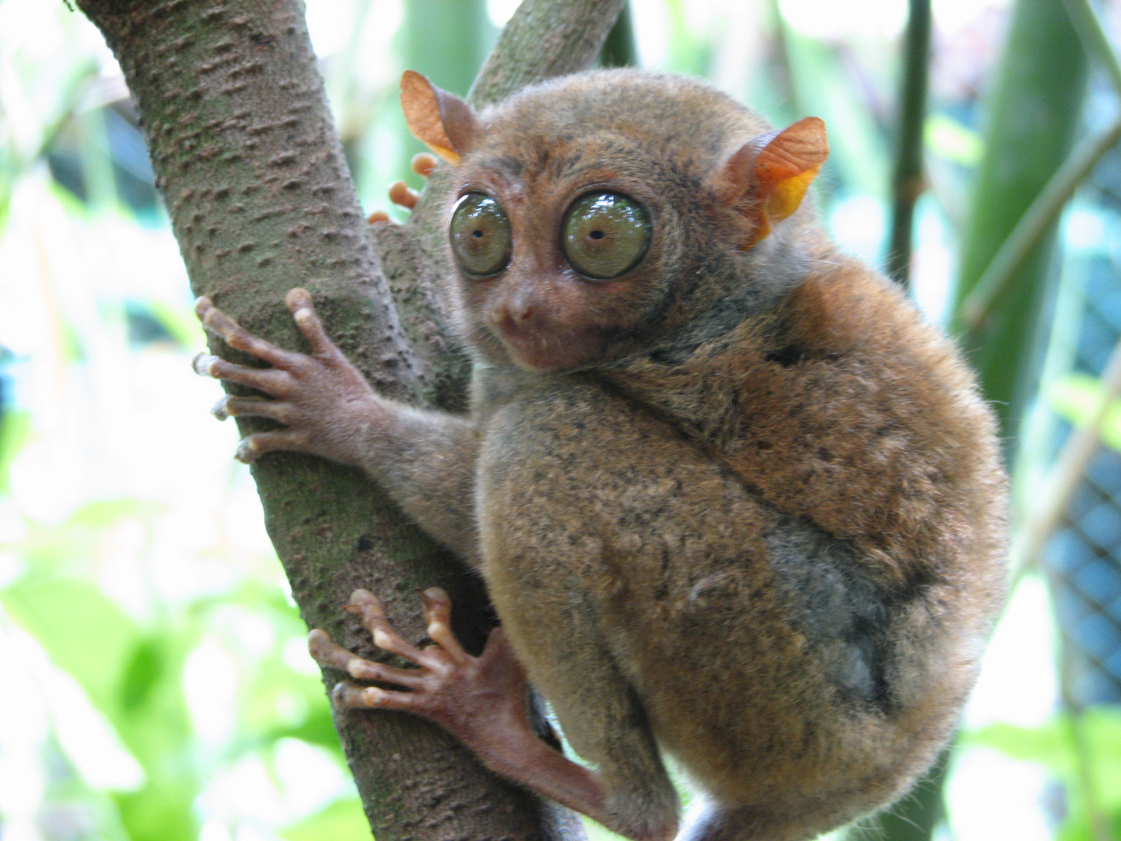
Figure 29.42
A Philippine tarsier. This tarsier, Carlito syrichta, is one of the smallest primates—about 5 inches long, from nose to the base of the tail. The tail is not shown, but is about twice the length of the body. Note the large eyes, each of which is about the same size as the animal's brain, and the long hind legs. (credit: mtoz (http://creativecommons.org/licenses/by-sa/2.0), via Wikimedia Commons)
Notes:
Image depicts a Tarsier in a tree.

Slide 53
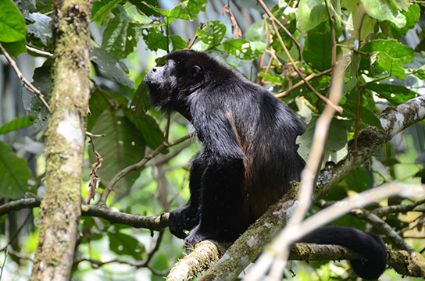
Figure 29.43
A New World monkey. The howler monkey is native to Central and South America. It makes a call that sounds like a lion roaring. (credit: Xavi Talleda)
Notes:
The photo shows a black monkey with its mouth open in a howl.

Slide 54
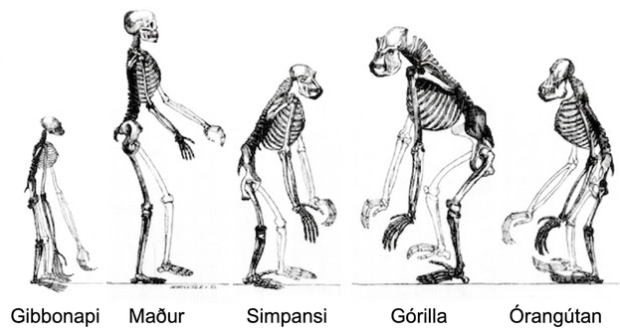
Figure 29.44
Primate skeletons. All great apes have a similar skeletal structure. (credit: modification of work by Tim Vickers)
Notes:
Image depicts various skeletons of great ape primates, including gibbon, chimp, and human. The skeletons have significant similarities, but their posture and structures differ. Most apes have much longer arms relative to their height than do humans. Only humans and gibbons have an upright posture. And gorillas, chimps, and orangutans have much larger vertebrae (relative to their size) in the neck and upper back.

Slide 55
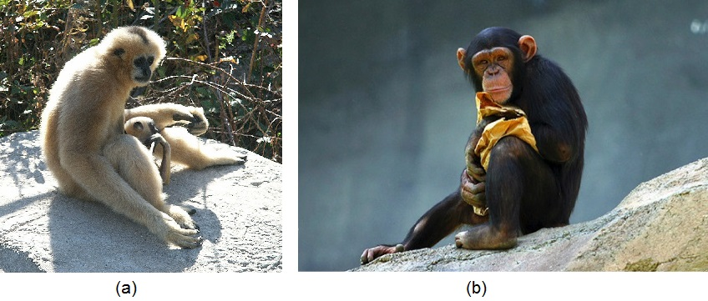
Figure 29.45
Lesser and great apes. This white-cheeked gibbon (a) is a lesser ape. In gibbons of this species, females and infants are buff and males are black. This young chimpanzee (b) is one of the great apes. It possesses a relatively large brain and has no tail. (credit a: MAC. credit b: modification of work by Aaron Logan)
Notes:
Image A shows a gibbon mother and baby. Image B shows a young chimpanzee.

Slide 56
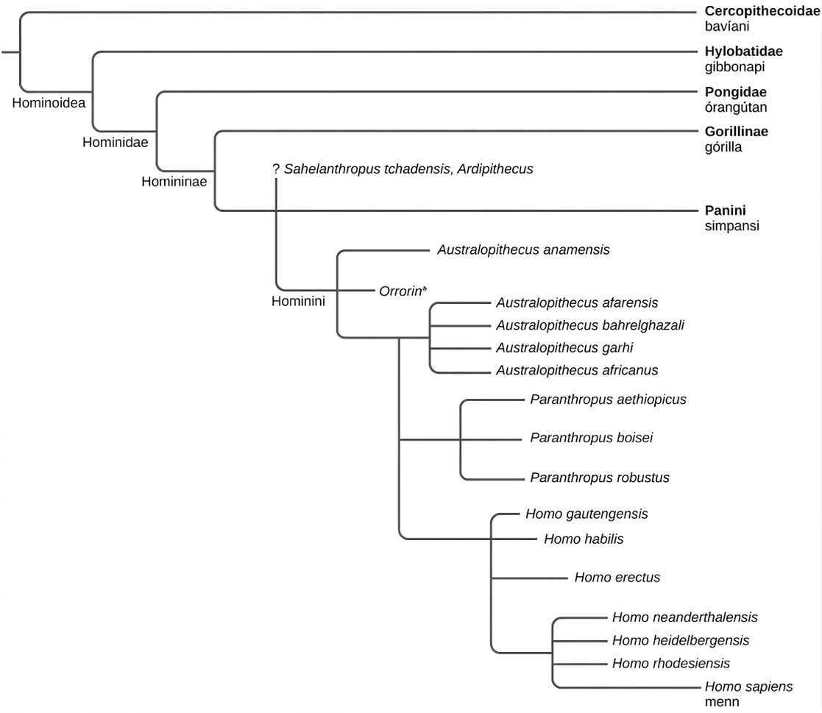
Figure 29.46
Hominin phylogeny. This chart shows evolutionary relationship among Hominins and hypothesized relation to modern humans. (*still debated phylogeny position).
Notes:
The evolutionary tree shows the relationship between humans and other apes. All apes, including gibbons, orangutans, gorillas, chimpanzees, humans, and human ancestors, belong in the superfamily Hominoidea. Of these, all but gibbons are great apes that belong in the family Hominidae. Gorillas, chimpanzees, humans, and human ancestors belong in the subfamily Homininae. Humans and their direct ancestors belong in the tribe Hominini.

Slide 57
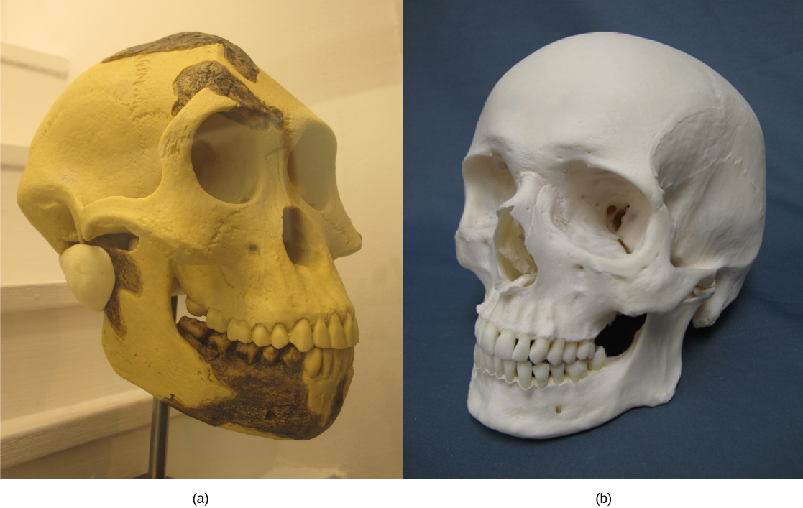
Figure 29.47
Australopithicene and modern human skulls. The skull of (a) Australopithecus afarensis, an early hominid that lived between two and three million years ago, resembled that of (b) modern humans but was smaller with a sloped forehead, larger teeth, and a prominent jaw.
Notes:
Photo A shows an A. afarensis skull, which is similar in shape but the forehead slopes back and the jaw juts out. Photo B shows a human skull.

Slide 58
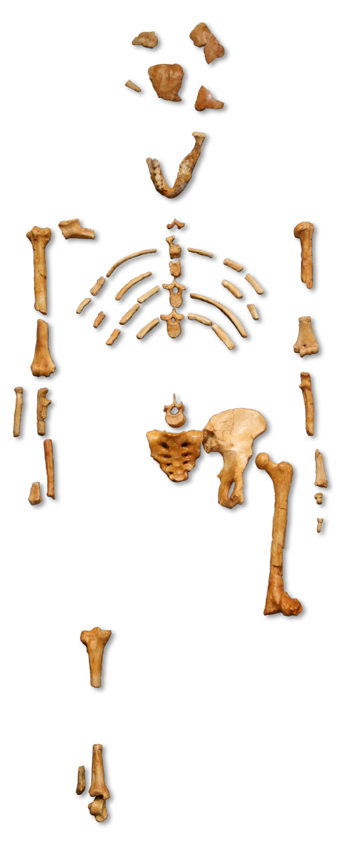
Figure 29.48
Lucy. This adult female Australopithecus afarensis skeleton, nicknamed Lucy, was discovered in the mid-1970s. (credit: “120”/Wikimedia Commons)
Notes:
Partial skeleton is human-like but child-sized.

Slide 59
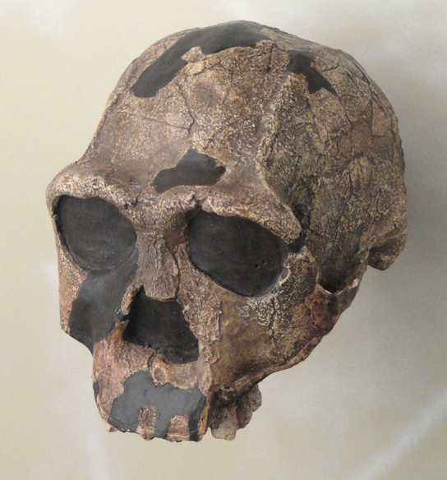
Figure 29.49
Homo erectus. Homo erectus had a prominent brow and a nose that pointed downward rather than forward.
Notes:
The photo shows a skull that looks similar to a human skull but has prominent brow ridges.

Slide 60
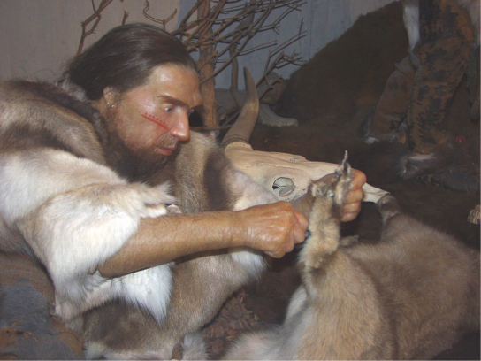
Figure 29.50
Neanderthal. The Homo neanderthalensis used tools and may have worn clothing.
This OpenStax ancillary resource is © Rice University under a CC BY-NC-SA 4.0 International license; it may be reproduced or modified for noncommercial purposes only but must be attributed to OpenStax, Rice University and any changes must be noted. Any adaptation must be shared under the same type of license.
Notes:
The illustration shows a very human looking Neanderthal wearing fur and cutting a hide with a stone tool.

