Slide 1
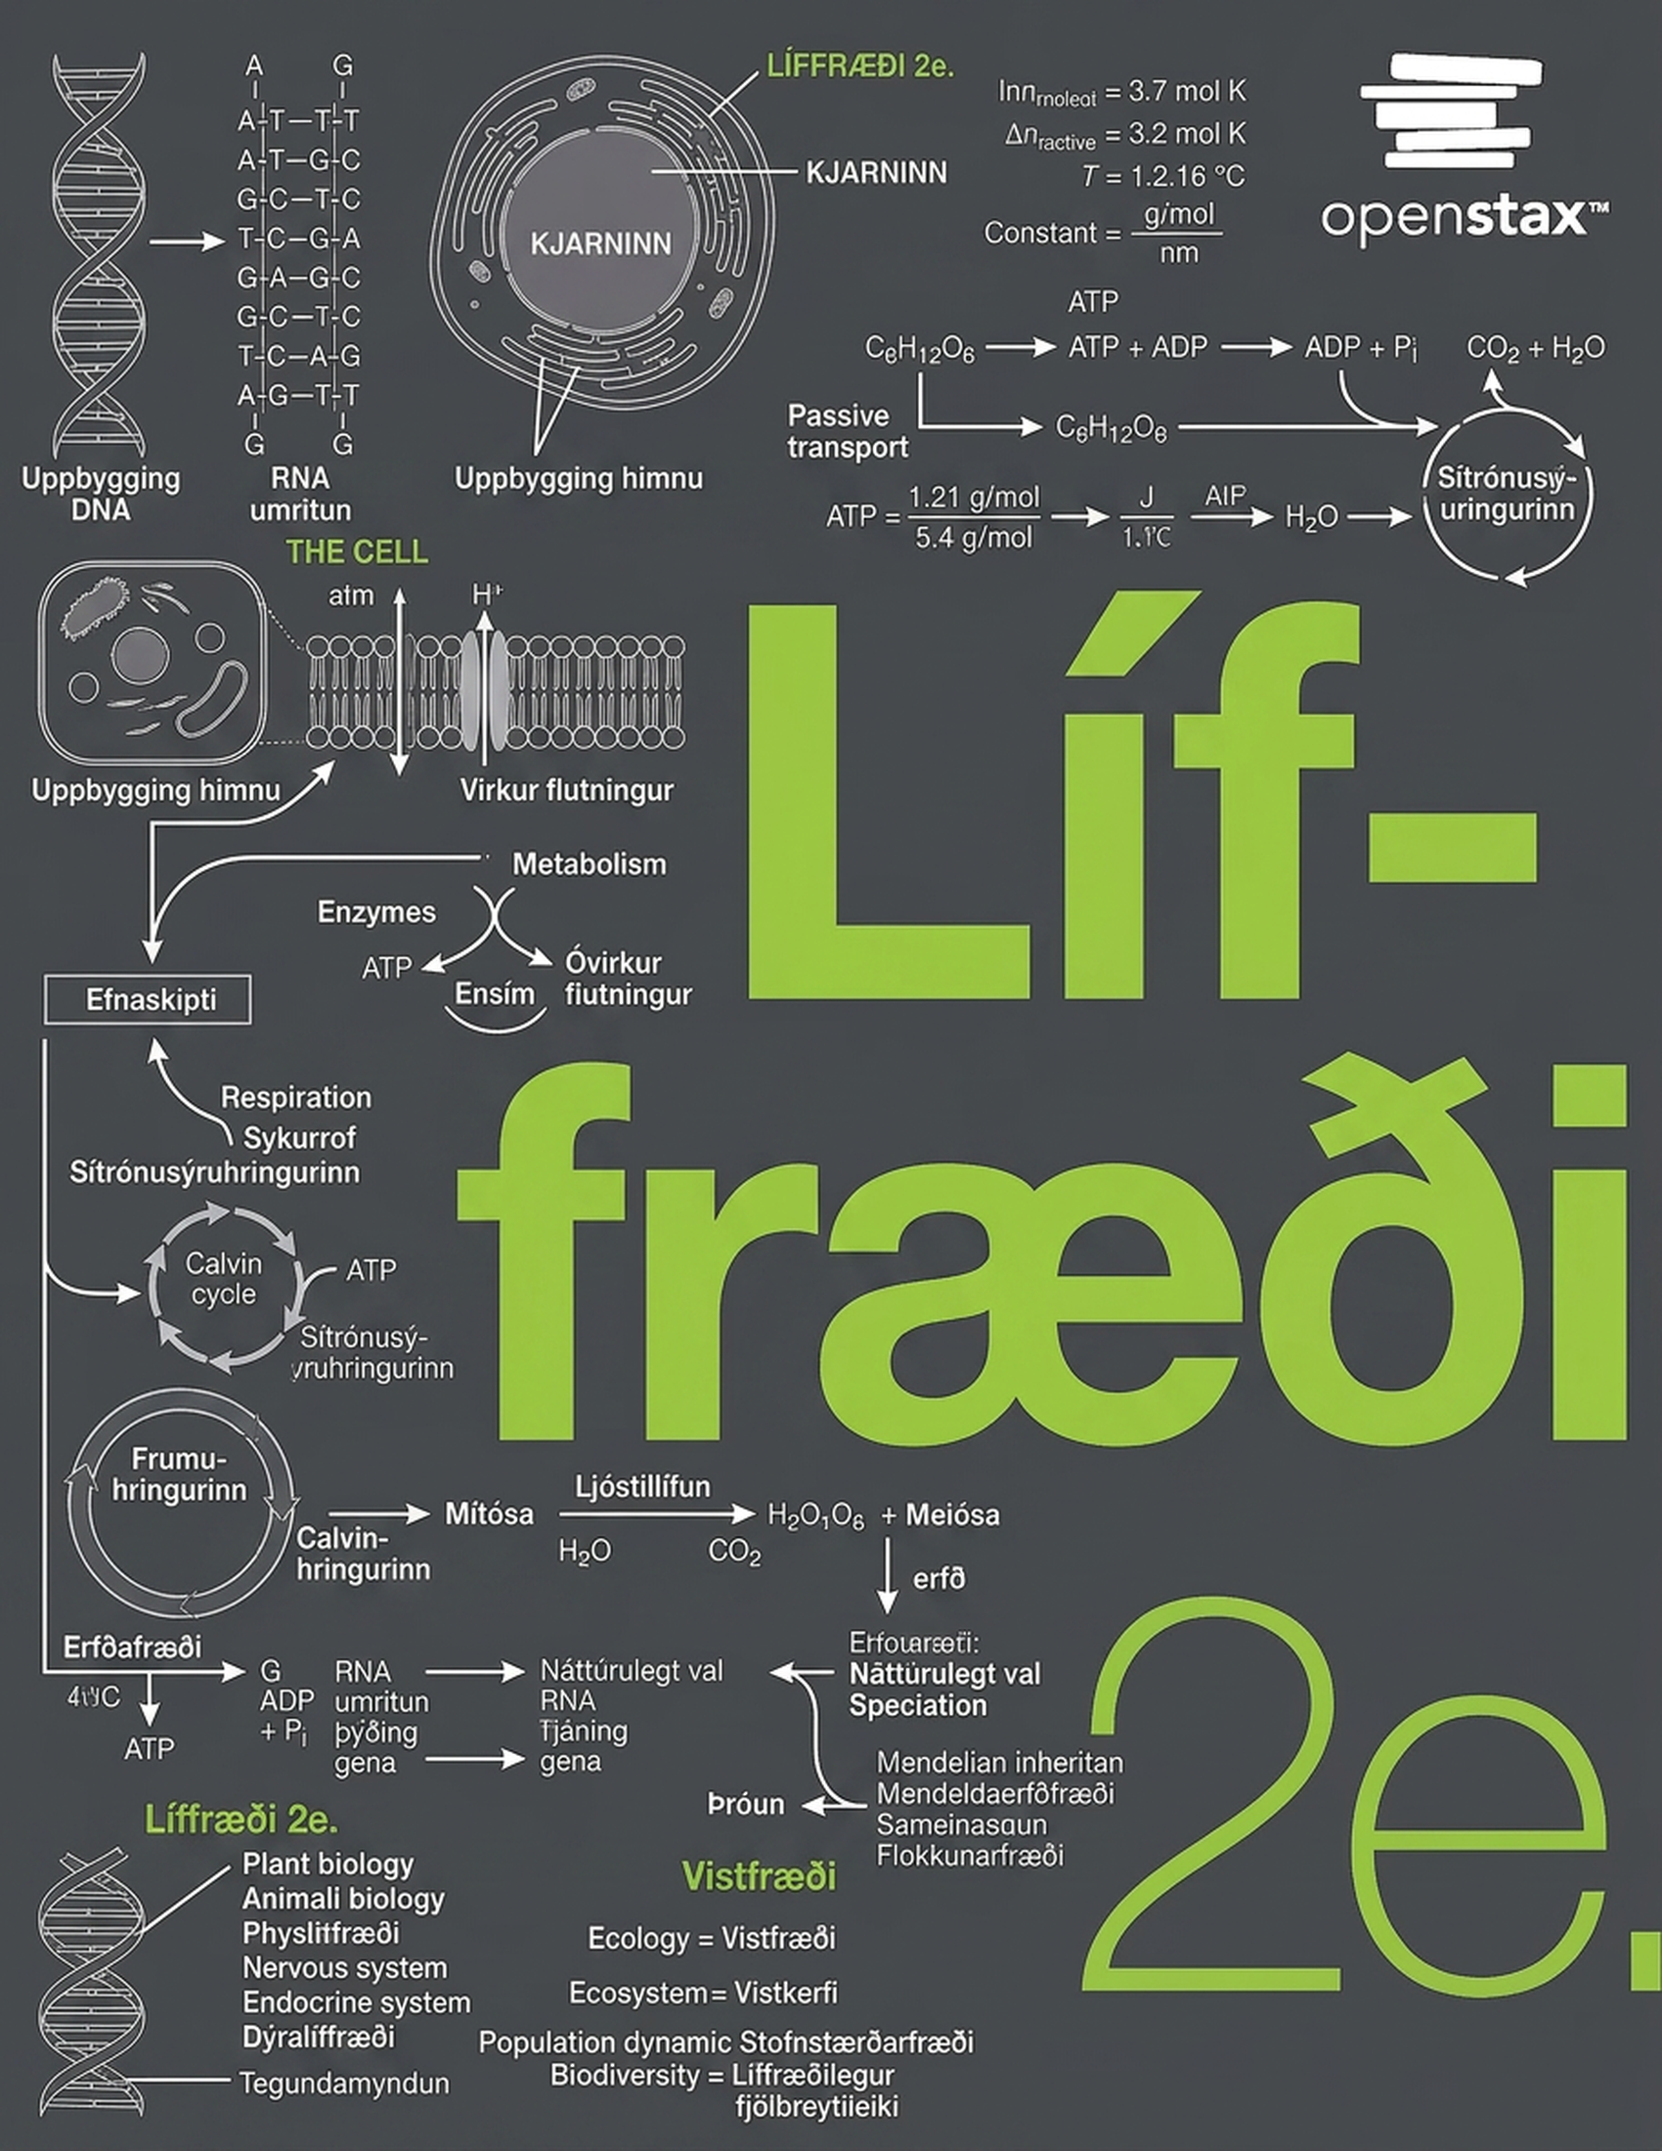
Biology 2e
Chapter 19 The Evolution of Populations

Slide 2
Chapter outline
Population Evolution
Population Genetics
Adaptive Evolution

Slide 3
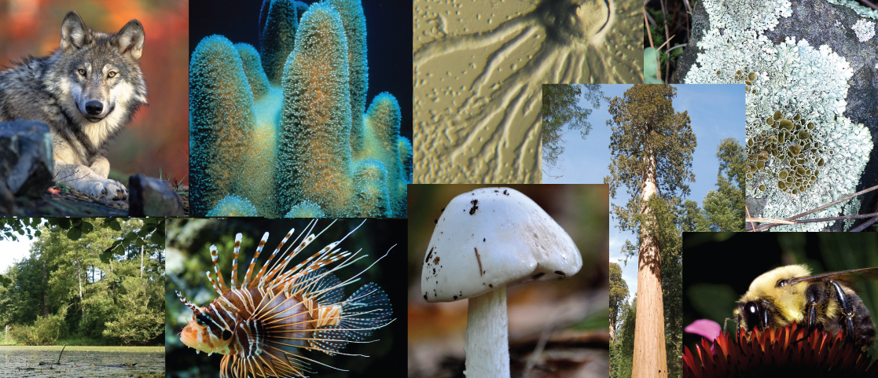
Figure 19.1
Living things may be single-celled or complex, multicellular organisms. They may be plants, animals, fungi, bacteria, or archaea. This diversity results from evolution. (credit "wolf": modification of work by Gary Kramer; credit "coral": modification of work by William Harrigan, NOAA; credit "river": modification of work by Vojtěch Dostál; credit "fish" modification of work by Christian Mehlführer; credit "mushroom": modification of work by Cory Zanker; credit "tree": modification of work by Joseph Kranak; credit "bee": modification of work by Cory Zanker)
Notes:
This photo collage shows a wolf, a cucumber-shaped protozoan, a sea sponge, a slime mold, lichen, the shore of a lake with algae and trees, a spiny lion fish, a mushroom, a sequoia, and a bee drinking nectar from a flower.

Slide 4
19.1 Population Evolution
Learning Objectives
Define population genetics and describe how scientists use population genetics in studying population evolution
Define the Hardy-Weinberg principle and discuss its importance

Slide 5
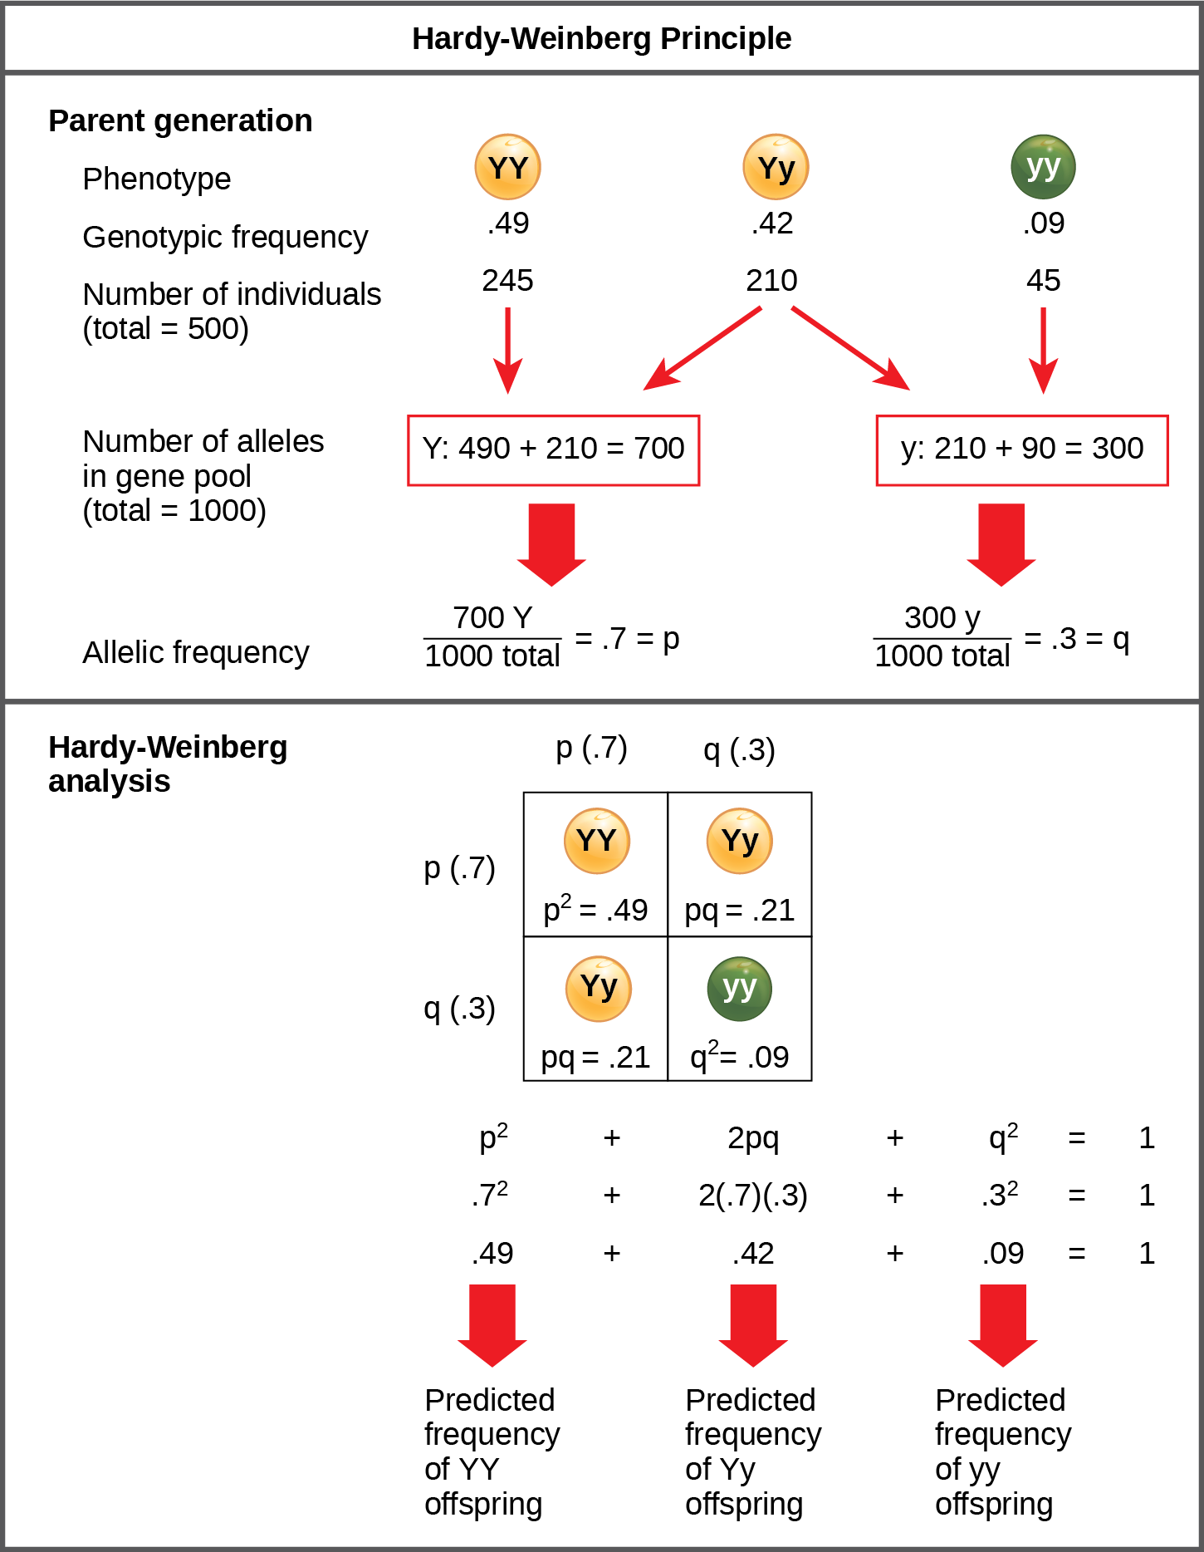
Figure 19.2
When populations are in the Hardy-Weinberg equilibrium, the allelic frequency is stable from generation to generation and we can determine the allele distribution from the Hardy-Weinberg equation. If the allelic frequency measured in the field differs from the predicted value, scientists can make inferences about what evolutionary forces are at play.
Notes:
The Hardy-Weinberg principle is used to predict the genotypic distribution of offspring in a given population. In the example given, pea plants have two different alleles for pea color. The dominant capital Y allele results in yellow pea color, and the recessive small y allele results in green pea color. The distribution of individuals in a population of 500 is given. Of the 500 individuals, 245 are homozygous dominant (capital Y capital Y) and produce yellow peas. 210 are heterozygous (capital Y small y) and also produce yellow peas. 45 are homozygous recessive (small y small y) and produce green peas. The frequencies of homozygous dominant, heterozygous, and homozygous recessive individuals are 0.49, 0.42, and 0.09, respectively. Each of the 500 individuals provides two alleles to the gene pool, or 1000 total. The 245 homozygous dominant individuals provide two capital Y alleles to the gene pool, or 490 total. The 210 heterozygous individuals provide 210 capital Y and 210 small y alleles to the gene pool. The 45 homozygous recessive individuals provide two small y alleles to the gene pool, or 90 total. The number of capital Y alleles is 490 from homozygous dominant individuals plus 210 from homozygous recessive individuals, or 700 total. The number of small y alleles is 210 from heterozygous individuals plus 90 from homozygous recessive individuals, or 300 total. The allelic frequency is calculated by dividing the number of each allele by the total number of alleles in the gene pool. For the capital Y allele, the allelic frequency is 700 divided by 1000, or 0.7; this allelic frequency is called p. For the small y allele the allelic frequency is 300 divided by 1000, or 0.3; the allelic frequency is called q. Hardy-Weinberg analysis is used to determine the genotypic frequency in the offspring. The Hardy-Wienberg equation is p-squared plus 2pq plus q-squared equals 1. For the population given, the frequency is 0.7-squared plus 2 times .7 times .3 plus .3-squared equals one. The value for p-squared, 0.49, is the predicted frequency of homozygous dominant (capital Y capital Y) individuals. The value for 2pq, 0.42, is the predicted frequency of heterozygous (capital Y small y) individuals. The value for q-squared, .09, is the predicted frequency of homozygous recessive individuals. Note that the predicted frequency of genotypes in the offspring is the same as the frequency of genotypes in the parent population. If all the genotypic frequencies, .49 plus .42 plus .09, are added together, the result is one.

Slide 6
19.2 Population Genetics
Learning Objectives
Describe the different types of variation in a population
Explain why natural selection can only act upon heritable variation
Describe genetic drift and the bottleneck effect
Explain how each evolutionary force can influence a population's allele frequencies

Slide 7
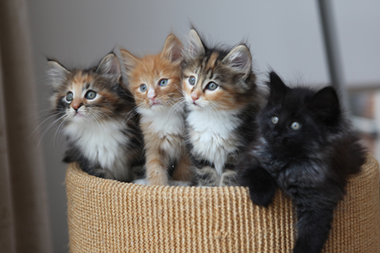
Figure 19.3
The distribution of phenotypes in this litter of kittens illustrates population variation. (credit: Pieter Lanser)
Notes:
This photo shows four kittens in a basket: two are gray, black, orange, and white, the third cat is orange and white, and the fourth cat is black.

Slide 8
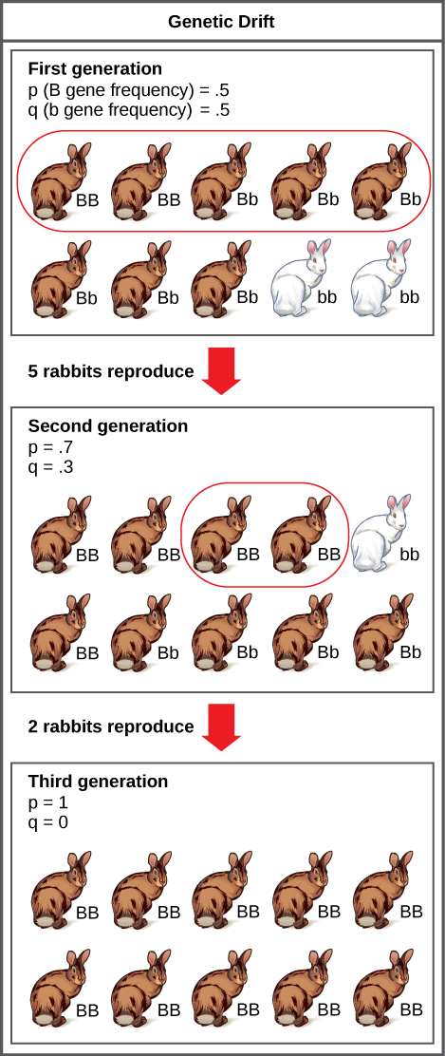
Figure 19.4
Genetic drift in a population can lead to eliminating an allele from a population by chance. In this example, rabbits with the brown coat color allele (B) are dominant over rabbits with the white coat color allele (b). In the first generation, the two alleles occur with equal frequency in the population, resulting in p and q values of .5. Only half of the individuals reproduce, resulting in a second generation with p and q values of .7 and .3, respectively. Only two individuals in the second generation reproduce, and by chance these individuals are homozygous dominant for brown coat color. As a result, in the third generation the recessive b allele is lost.
Notes:
A population has 10 rabbits. 2 of these rabbits are homozygous dominant for the B allele and have brown coat color. 6 are heterozygous and also have brown coat color. Two are homozygous recessive and have white coat color. The frequency of the capital B allele, p, is .5 and the frequency of the small b allele, q, is also .5. Only 5 of the rabbits, including 2 homozygous dominant and 3 heterozygous individuals, produce offspring. 5 of the resulting offspring are homozygous dominant, 4 are heterozygous, and 1 is homozygous recessive. The frequency of alleles in the second generation is p=.7 and q=.3. Only 2 rabbits in the second generation produce offspring, and both of these are homozygous dominant. As a result, the recessive small b allele is lost in the third generation, and all of the rabbits are heterozygous dominant with brown coat color.

Slide 9
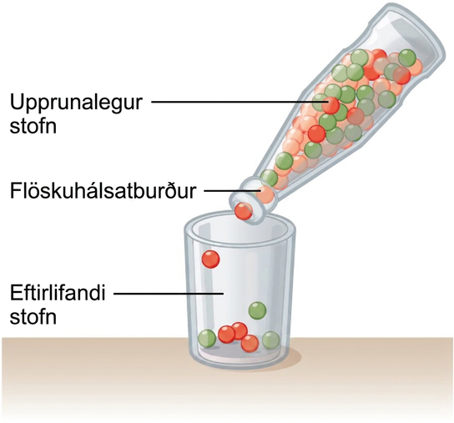
Figure 19.5
A chance event or catastrophe can reduce the genetic variability within a population.
Notes:
This illustration shows a narrow-neck bottle filled with red, orange, and green marbles. The bottle is tipped so the marbles pour into a glass. Because of the bottleneck, only seven marbles escape, and these are all orange and green. The marbles in the bottle represent the original population, and the marbles in the glass represent the surviving population. Because of the bottleneck effect, the surviving population is less diverse than the original population.

Slide 10
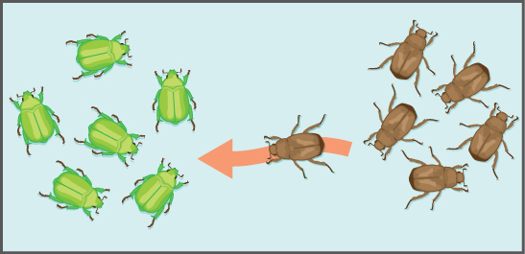
Figure 19.6
Gene flow can occur when an individual travels from one geographic location to another.
Notes:
This illustration shows an individual from a population of brown insects traveling toward a population of green insects.

Slide 11
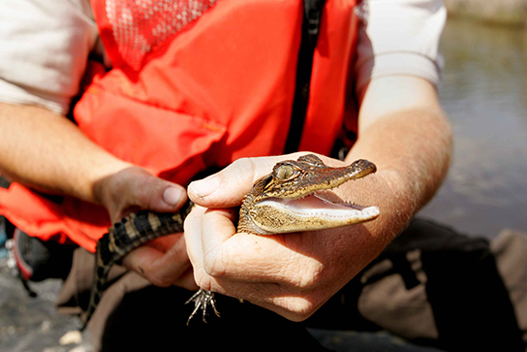
Figure 19.7
The temperature at which the eggs are incubated determine the American alligator's (Alligator mississippiensis) sex. Eggs incubated at 30°C produce females, and eggs incubated at 33°C produce males. (credit: Steve Hillebrand, USFWS)
Notes:
This photo shows a person holding a baby alligator.

Slide 12
19.3 Adaptive Evolution
Learning Objectives
Explain the different ways natural selection can shape populations
Describe how these different forces can lead to different outcomes in terms of the population variation

Slide 13
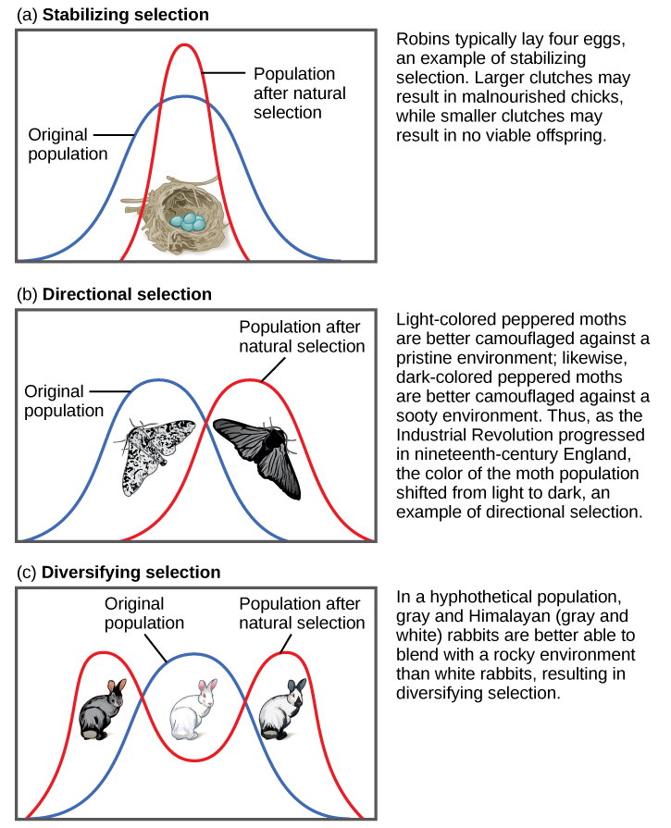
Figure 19.8
Different types of natural selection can impact the distribution of phenotypes within a population. In (a) stabilizing selection, an average phenotype is favored. In (b) directional selection, a change in the environment shifts the spectrum of observed phenotypes. In (c) diversifying selection, two or more extreme phenotypes are selected for, while the average phenotype is selected against.
Notes:
Part (a) shows a robin clutch size as an example of stabilizing selection. Robins typically lay four eggs. Larger clutches may result in malnourished chicks, while smaller clutches may result in no viable offspring. A wide bell curve indicates that, in the original population, there was a lot of variability in clutch size. Overlaying this wide bell curve is a narrow one that represents the clutch size after natural selection, which is much less variable. Part (b) shows moth color as an example of directional selection. Light-colored pepper moths are better camouflaged against a pristine environment, while dark-colored peppered moths are better camouflaged against a sooty environment. Thus, as the Industrial Revolution progressed in nineteenth-century England, the color of the moth population shifted from light to dark, an example of directional selection. A bell curve representing the original population and one representing the population after natural selection only slightly overlap. Part (c) shows rabbit coat color as an example of diversifying selection. In this hypothetical example, gray and Himalayan (gray and white) rabbits are better able to blend into their rocky environment than white ones. The original population is represented by a bell curve in which white is the most common coat color, while gray and Himalayan colors, on the right and left flank of the curve, are less common. After natural selection, the bell curve splits into two peaks, indicating gray and Himalayan coat color have become more common than the intermediate white coat color.

Slide 14
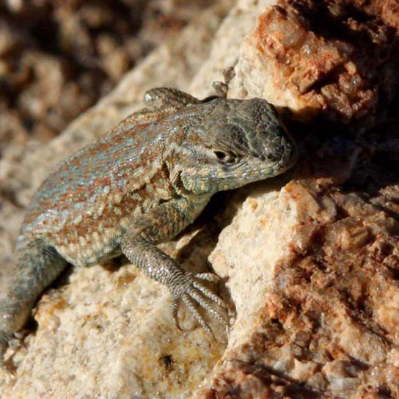
Figure 19.9
A yellow-throated side-blotched lizard is smaller than either the blue-throated or orange-throated males and appears a bit like the females of the species, allowing it to sneak copulations. (credit: “tinyfroglet”/Flickr)
Notes:
Photo shows a mottled green and brown lizard sitting on a rock.

Slide 15
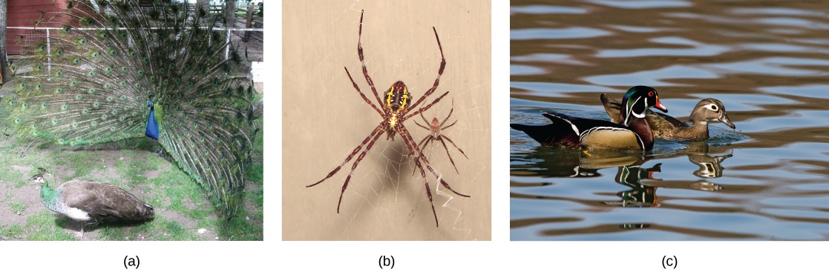
Figure 19.10
Sexual dimorphism in (a) peacocks and peahens, (b) Argiope appensa spiders (the female spider is the large one), and in (c) wood ducks. (credit “spiders”: modification of work by “Sanba38”/Wikimedia Commons; credit “duck”: modification of work by Kevin Cole)
This OpenStax ancillary resource is © Rice University under a CC BY-NC-SA 4.0 International license; it may be reproduced or modified for noncommercial purposes only but must be attributed to OpenStax, Rice University and any changes must be noted. Any adaptation must be shared under the same type of license.
Notes:
The photo on the left shows a peacock with a bright blue body and flared tail feathers standing next to a brown, drab peahen. The middle photo shows a large female spider sitting on a web next to its much smaller male counterpart. The photo on the right shows a brightly colored male wood duck swimming next to a drab brown female.

