Slide 1
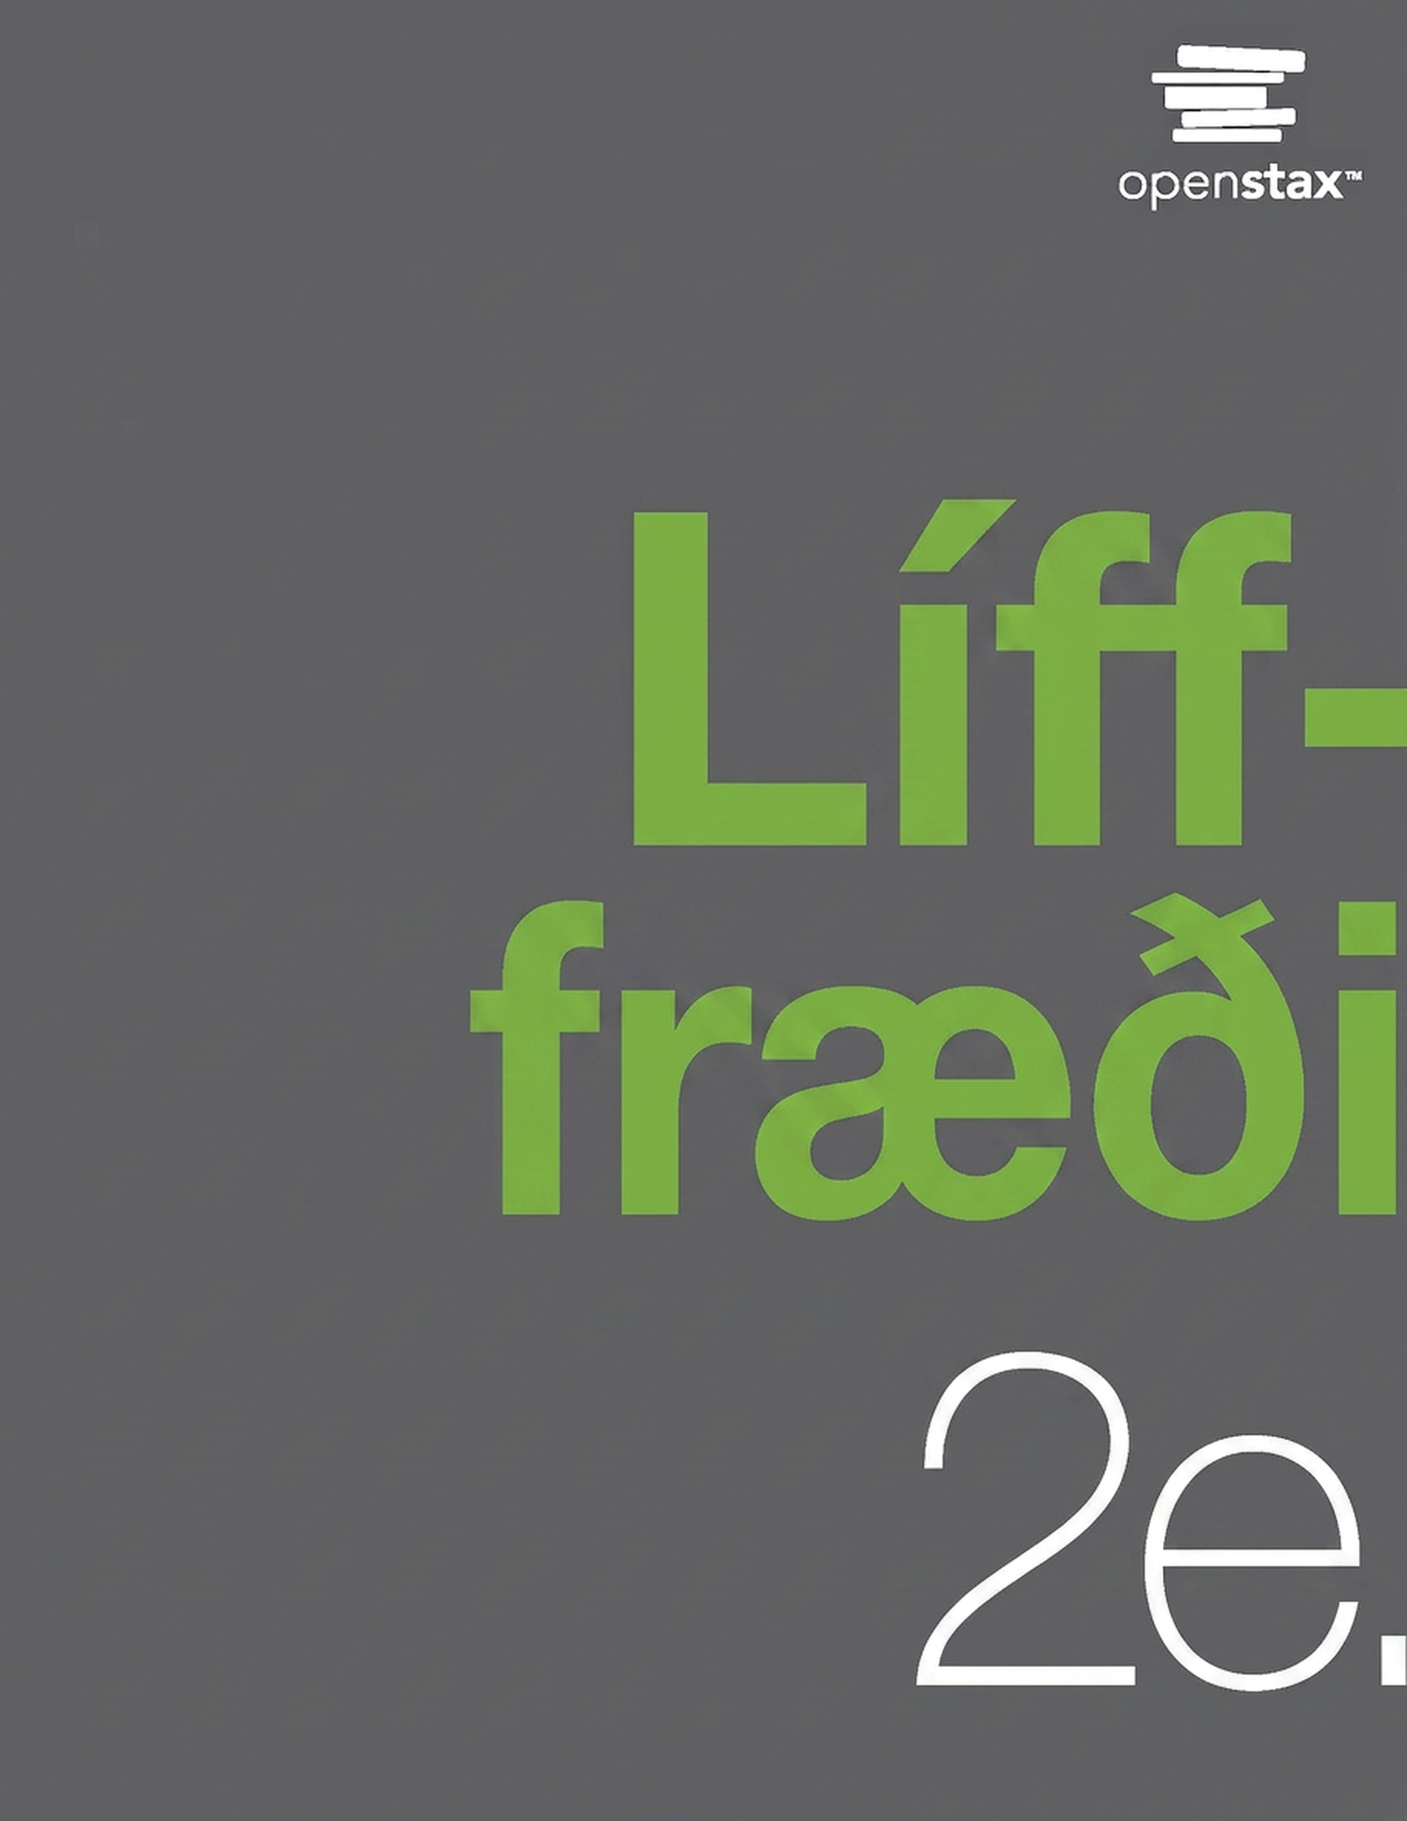
Biology 2e
2. kafli Efnafræðilegur grundvöllur lífs

Slide 2
Yfirlit kafla
Atóm, samsætur, jónir og sameindir: byggingareiningarnar
Vatn
Kolefni

Slide 3
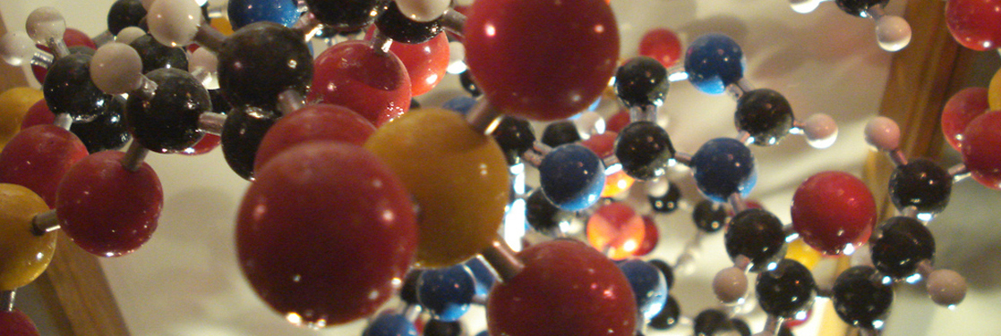
Figure 2.1
Atóm eru byggingareiningar sameinda í alheiminum - lofti, jarðvegi, vatni, bergi . . . og einnig í frumum allra lífvera. Í þessu líkani af lífrænni sameind eru atóm kolefnis (svört), vetnis (hvít), niturs (blá), súrefnis (rauð) og fosfórs (gul) sýnd í hlutfallslegri atómstærð. Silfurlituðu stangirnar tákna efnatengi. (höfundarupplýsing: byggt á verki eftir Christian Guthier)
Notes:
A molecular model shows hundreds of atoms, represented by yellow, red, black, blue and white balls, connected together by rods to form a molecule. The molecule has a complex but very specific three-dimensional structure with rings and branches.

Slide 4
2.1 Atóm, samsætur, jónir og sameindir: byggingareiningarnar (1 af 2)
Markmið náms
Skilgreina efni og frumefni
Lýsa innbyrðis tengslum róteinda, nifteinda og rafeinda
Bera saman hvernig rafeindir geta flust milli atóma eða verið deilt á milli þeirra

Slide 5
2.1 Atóm, samsætur, jónir og sameindir: byggingareiningarnar (2 af 2)
Markmið náms
Útskýra hvernig náttúruleg frumefni sameinast og mynda sameindir, frumur, vefi, líffærakerfi og lífverur

Slide 6
Table 2.1
Frumefni | Life (Humans) | Lofthjúpur | Jarðskorpa
Súrefni (O) | 65% | 21% | 46%
Kolefni (C) | 18% | snefill | snefill
Vetni (H) | 10% | snefill | 0.1%
Nitrogen (N) | 3% | 78% | snefill

Slide 7
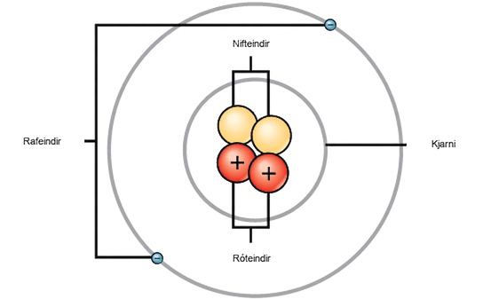
Figure 2.2
Frumefni, eins og helín sem sýnt er hér, eru gerð úr atómum. Atóm eru gerð úr róteindum og nifteindum í kjarnanum, en rafeindir eru á svigrúmum umhverfis kjarnann.
Notes:
This illustration shows that, like planets orbiting the sun, electrons orbit the nucleus of an atom. The nucleus contains two neutrally charged neutrons, and two positively charged protons represented by spheres. A single, circular orbital surrounding the nucleus contains two negatively charged electrons on opposite sides.

Slide 8
Table 2.2
 | Hleðsla | Massi (amu) | Staðsetning
Róteind | +1 | 1 | kjarni
Nifteind | 0 | 1 | kjarni
Rafeind | –1 | 0 | svigrúm

Slide 9
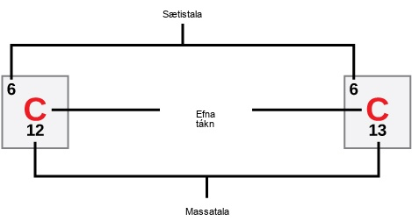
Figure 2.3
Kolefni hefur sætistöluna sex og tvær stöðugar samsætur með massatölurnar tólf og þrettán. Hlutfallslegur atómmassi þess er 12.011
Notes:
Carbon is indicated by its atomic symbol, a capital C. Carbon has the atomic number six and two stable isotopes, carbon-12 and carbon-13.

Slide 10
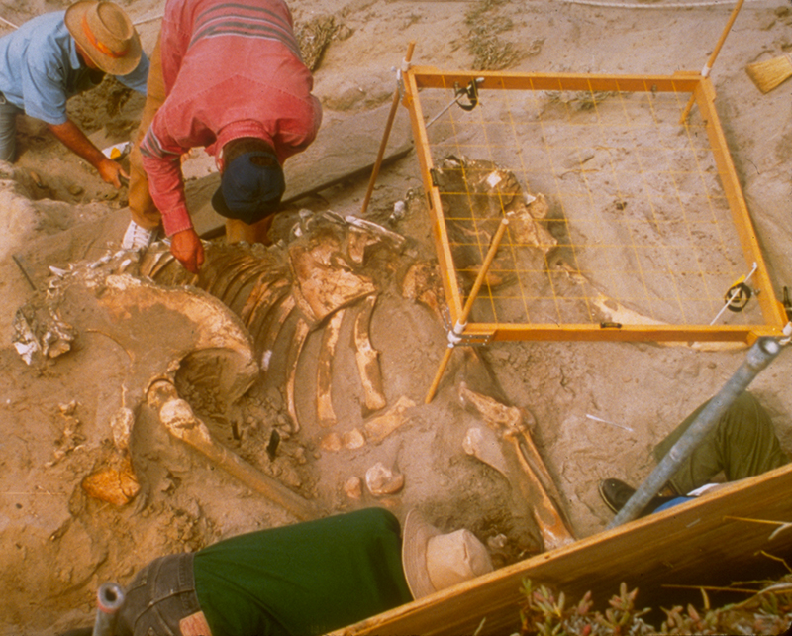
Figure 2.4
Vísindamenn geta aldursgreint kolefnisleifar sem eru yngri en um það bil 50,000 ára, eins og þennan dvergmammút, með kolefnisaldursgreiningu. (höfundarupplýsing: Bill Faulkner, NPS)
Notes:
Photo shows scientists unearthing a mammoth skeleton.

Slide 11
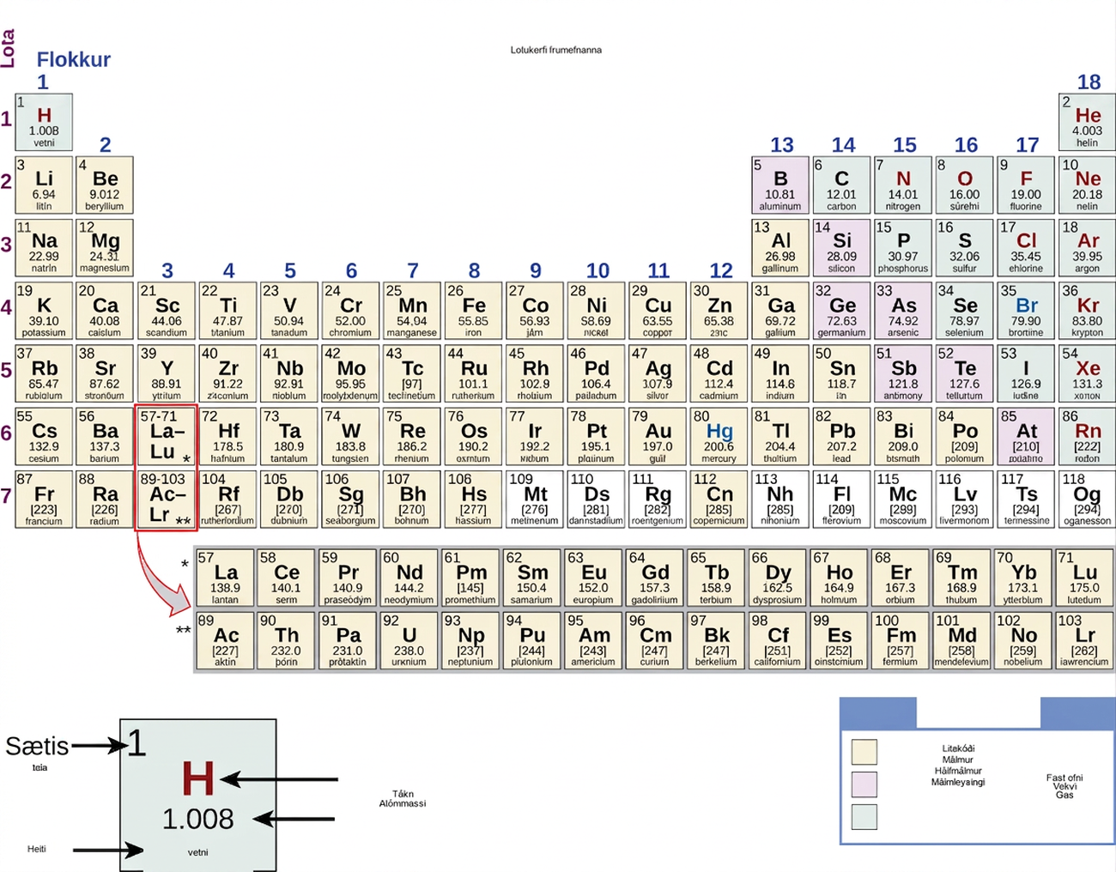
Figure 2.5
Lotukerfið sýnir atómmassa og sætistölu hvers frumefnis. Sætistalan birtist fyrir ofan tákn frumefnisins og áætlaður atómmassi fyrir neðan það.
Notes:
The periodic table consists of eighteen groups and seven periods. Each element has its own square. Within each square is the following information; the atomic number, the symbol, the relative atomic mass, and the name. For example, hydrogen's atomic number is 1, symbol is the letter H; relative atomic mass is 1.01, and name is hydrogen. Two additional rows of elements, known as the lanthanides and actinides, are placed beneath the main table. The lanthanides include elements 57 through 71 and belong in period seven between groups three and four. The actinides include elements 89 through 98 and belong in period eight between the same groups. These elements are placed separately to make the table more compact. For each element, the name, atomic symbol, atomic number, and atomic mass are provided. The atomic number is a whole number that represents the number of protons. The atomic mass, which is the average mass of different isotopes, is estimated to two decimal places. The elements are divided into three categories: metals, nonmetals and metalloids. These form a diagonal line from period two, group thirteen to period six, group seventeen. All elements to the left of the metalloids are metals, and all elements to the right are nonmetals.

Slide 12
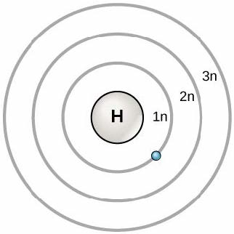
Figure 2.6
Árið 1913 þróaði Niels Bohr Bohr-líkanið, þar sem rafeindir eru á meginhvelum. Rafeind er venjulega á lægsta tiltæka orkuhveli, því sem er næst kjarnanum. Orka frá ljóseind getur lyft henni upp á hærra orkuhvel, en það ástand er óstöðugt og rafeindin fellur fljótt aftur í grunnástand. Í því ferli losar hún ljóseind.
Notes:
Three concentric circles around the nucleus of a hydrogen atom represent principal shells. These are named 1 n, 2 n, and 3 n in order of increasing distance from the nucleus. An electron orbits in the shell closest to the nucleus, 1 n. The nucleus is marked with an H for hydrogen.

Slide 13
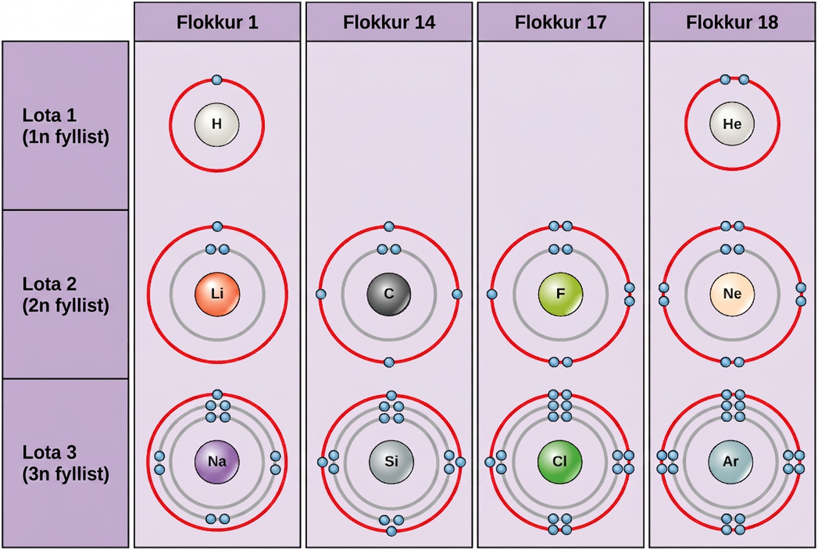
Figure 2.7
Bohr-teikningar sýna hve margar rafeindir fylla hvert meginhvel. Frumefni í flokki 18 (helín, neon og argon) hafa fullt ysta hvel, eða gildishvel. Fullt gildishvel er stöðugasta rafeindaskipan. Frumefni í öðrum flokkum hafa gildishvel sem eru aðeins að hluta fyllt og taka til sín eða missa rafeindir til að ná stöðugri rafeindaskipan.
Notes:
Bohr diagrams of elements from groups 1, 14, 17 and 18, and periods 1, 2 and 3 are shown. Period 1, in which the 1n shell is filling, contains hydrogen and helium. Hydrogen, in group 1, has one valence electron. Helium, in group 18, has two valence electrons. The 1n shell holds a maximum of two electrons, so the shell is full and the electron configuration is stable. Period 2, in which the 2n shell is filling, contains lithium, carbon, fluorine, and neon. Lithium, in group 1, has 1 valence electron. Carbon, in group 14, has 4 valence electrons. Fluorine, in group 17, has 7 valence electrons. Neon, in group 18, has 8 valence electrons, a full octet. Period 3, in which the 3n shell is filling, contains sodium, silicon, chlorine, and argon. Sodium, in group 1, has 1 valence electron. Silicon, in group 14, has 4 valence electrons. Chlorine, in group 17, has 7 valence electrons. Argon, in group 18, has 8 valence electrons, a full octet.

Slide 14
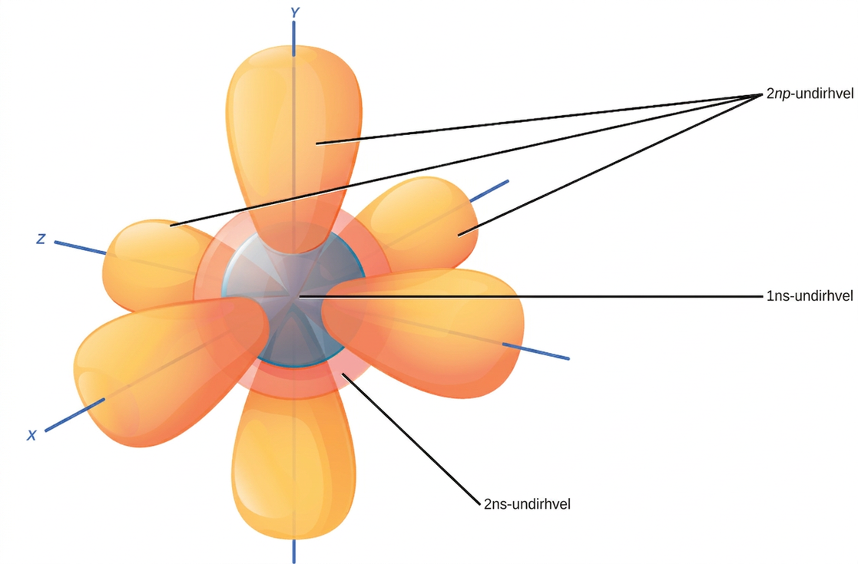
Figure 2.8
s-undirhvelin eru kúlulaga. Bæði 1n og 2n meginhvelin hafa s-svigrúm, en kúlan er stærri í 2n svigrúminu. Hver kúla er eitt svigrúm. Þrjú lóðlaga svigrúm mynda p-undirhvel. Meginhvel 2n hefur p-undirhvel, en hvel 1 hefur það ekki.
Notes:
Illustration shows 1 n s, 2 n s and 2 n p subshells. The 1 n s subshell and 2 n s subshells are both spheres, but the 2 n s sphere is larger than the 1 n s sphere. The 2 n p subshell is made up of three dumbbells that radiate out from the center of the atom along X, Y, and Z axes.

Slide 15
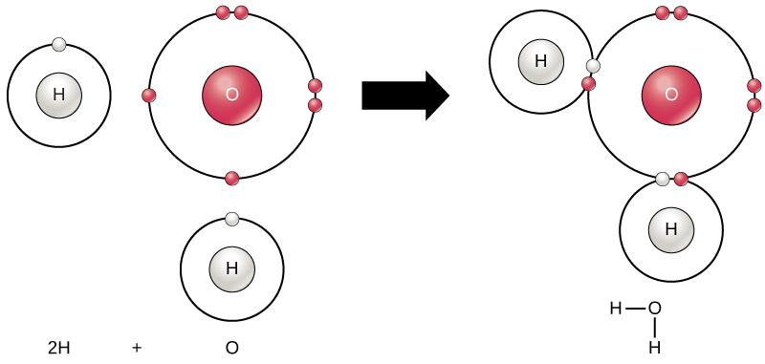
Figure 2.9
Tvö eða fleiri atóm geta tengst hvert öðru og myndað sameind. Þegar tvö vetnisatóm og eitt súrefnisatóm deila rafeindum með samgildum tengjum myndast vatnssameind.
Notes:
In the first image, an oxygen atom is shown with six valence electrons. Four of these valence electrons form pairs at the top and right sides of the valence shell. The other two electrons are alone on the bottom and left sides. A hydrogen atom sits next to each the lone electron of the oxygen. Each hydrogen has only one valence electron. An arrow indicates that a reaction takes place. After the reaction, in the second image, each unpaired electron in the oxygen joins an electron from one of the hydrogen atoms so that the valence rings are now connected together. The bond that forms between oxygen and hydrogen can also be represented by a dash.

Slide 16
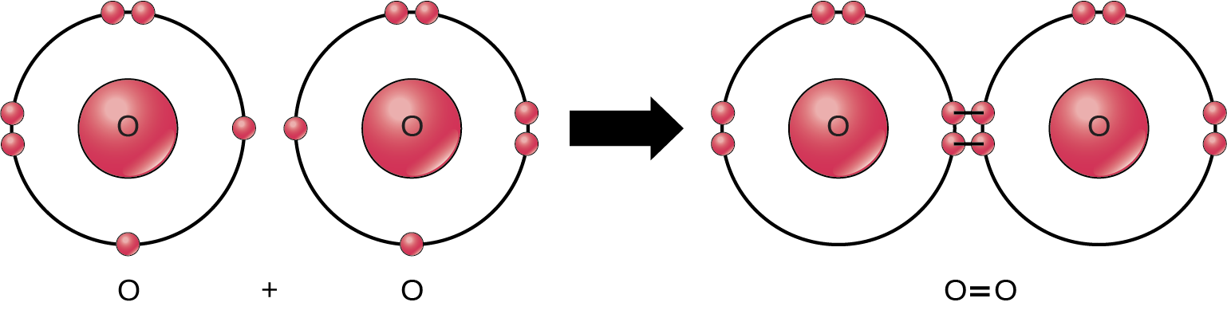
Figure 2.10
Tvítengi tengir súrefnisatómin í O2 sameind.
Notes:
Two oxygen atoms are shown side-by-side. Each has six valence electrons, two that are paired and two that are unpaired. An arrow indicates that a reaction takes place. After the reaction, the four unpaired electrons join to form a double bond. This double bond can also be depicted by an equal sign between two Os.

Slide 17
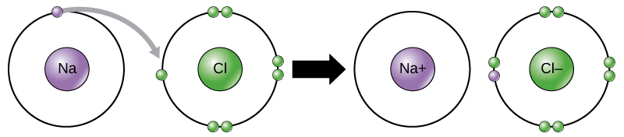
Figure 2.11
Við myndun jónasambands missa málmar rafeindir og málmleysingjar taka til sín rafeindir til að ná áttureglu.
Notes:
A sodium and a chlorine atom sit side by side. The sodium atom has one valence electron, and the chlorine atom has seven. Six of chlorines electrons form pairs at the top, bottom and right sides of the valence shell. The seventh electron sits alone on the left side. The sodium atom transfers its valence electron to chlorines valence shell, where it pairs with the unpaired left electron. An arrow indicates a reaction takes place. After the reaction takes place, the sodium becomes a cation with a charge of plus one and an empty valence shell, while the chlorine becomes an anion with a charge of minus one and a full valence shell containing eight electrons.

Slide 18
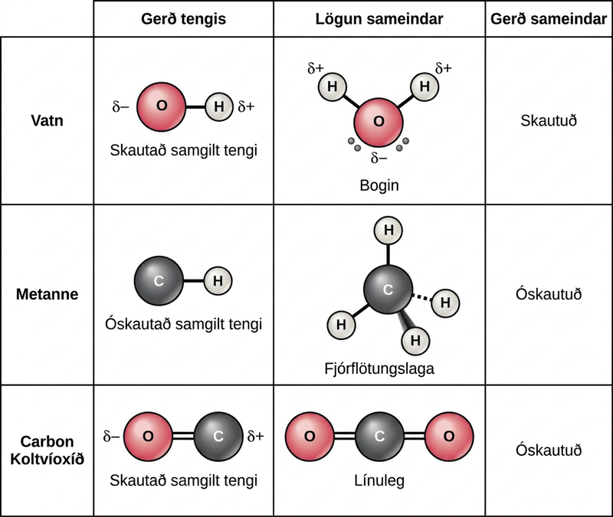
Figure 2.12
Hvort sameind er skautuð eða óskautuð fer bæði eftir gerð tengja og lögun sameindarinnar. Bæði vatn og koltvíoxíð hafa skautuð samgild tengi, en koltvíoxíð er línulegt og því vega hlutahleðslur sameindarinnar hver aðra upp.
Notes:
Table compares water, methane and carbon dioxide molecules. In water, oxygen has a stronger pull on electrons than hydrogen resulting in a polar covalent O-H bond. Likewise in carbon dioxide the oxygen has a stronger pull on electrons than carbon and the bond is polar covalent. However, water has a bent shape because two lone pairs of electrons push the hydrogen atoms together so the molecule is polar. By contrast carbon dioxide has two double bonds that repel each other, resulting in a linear shape. The polar bonds in carbon dioxide cancel each other out, resulting in a nonpolar molecule. In methane, the bond between carbon and hydrogen is nonpolar and the molecule is a symmetrical tetrahedron with hydrogens spaced as far apart as possible on the three-dimensional sphere. Since methane is symmetrical with nonpolar bonds, it is a nonpolar molecule.

Slide 19
2.2 Vatn
Markmið náms
Lýsa þeim eiginleikum vatns sem eru lífsnauðsynlegir
Útskýra hvers vegna vatn er framúrskarandi leysir
Nefna dæmi um samloðunar- og viðloðunareiginleika vatns
Fjalla um hlutverk sýra, basa og jafnalausna í jafnvægisstjórnun líkamans

Slide 20
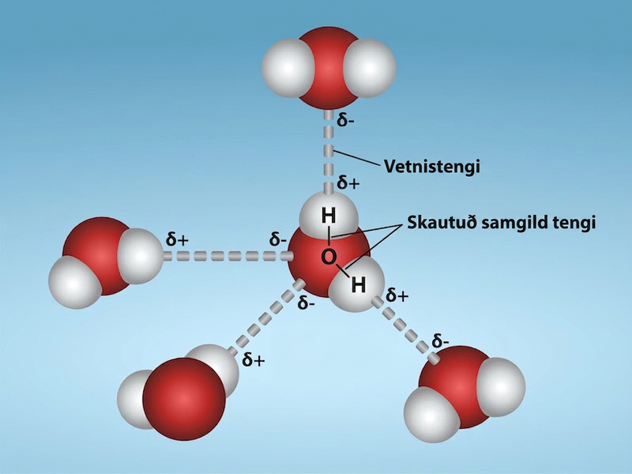
Figure 2.13
Skautun vatns. Skautun vatns stafar af mismunandi rafdrægni vetnis og súrefnis. Afleiðingin er sú að vetnistengi myndast þegar örlítið neikvætt súrefni í einni vatnssameind dregst að örlítið jákvæðu vetni í annarri vatnssameind. Höfundarupplýsing: Rao, A., Fletcher, S., Ryan, K., Tag, A. og Hawkins, A. Department of Biology, Texas A&M University
Notes:
Four water molecules are shown, with hydrogen bonds between them. The hydrogen bonds are dotted lines connecting the hydrogen atom from one molecule with an oxygen atom from another molecule.

Slide 21
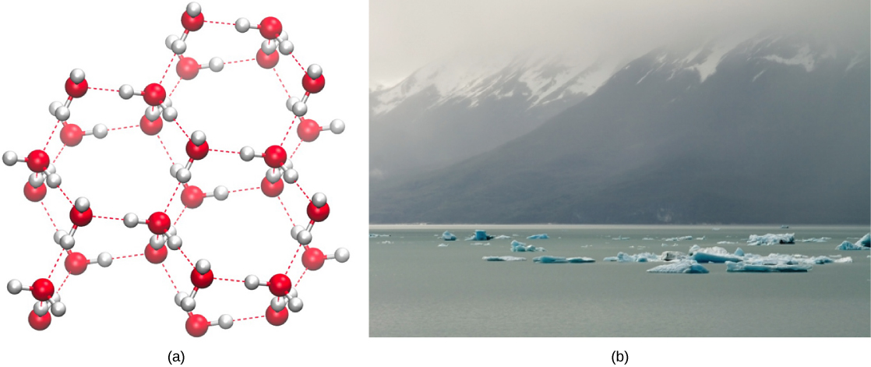
Figure 2.14
Vetnistengi gera ís eðlisléttari en fljótandi vatn. (a) Grindarbygging íss gerir hann eðlisléttari en frjálst flæðandi sameindir fljótandi vatns og gerir honum kleift að (b) fljóta á vatni. (höfundarupplýsing a: byggt á verki eftir Jane Whitney, mynd gerð með Visual Molecular Dynamics (VMD) software1; höfundarupplýsing b: byggt á verki eftir Carlos Ponte)
Notes:
Illustration A shows the molecular structure of ice. The water molecules are arranged in hexagons, and are bonded together with hydrogen bonds. The hexagonal arrangements have a good deal of space between them. Image B shows ice floes floating on ocean water near a mountain range that rises out of the water.

Slide 22
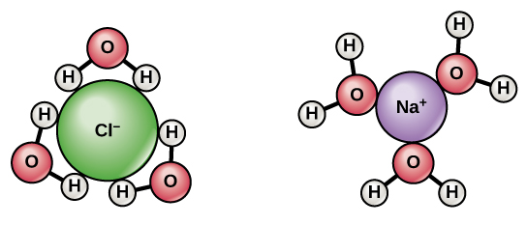
Figure 2.15
Þegar matarsalti (NaCl) er blandað í vatn myndast vatnshjúpar umhverfis jónirnar.
Notes:
When sodium chloride dissolves in water, the positively charged sodium ions interact with the oxygen of water, and the negatively charged chlorine ions interact with the hydrogen of water. A negatively charged chlorine ion is shown surrounded by water molecules whose hydrogen atoms are oriented inward toward the chlorine ion. A positively charged sodium ion is shown surrounded by water molecules whose oxygen atoms are oriented inward toward the sodium ion.chloride dissolves in water, the positively charged sodium ions interact with the oxygen of water, and the negatively charged chlorine ions interact with the hydrogen of water.

Slide 23
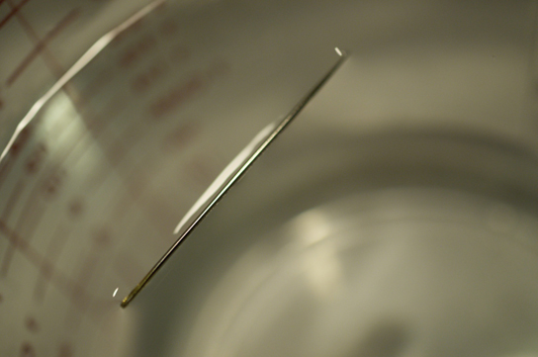
Figure 2.16
Þyngd nálarinnar togar yfirborðið niður. Á sama tíma togar yfirborðsspenna það upp, heldur nálinni á vatnsyfirborðinu og kemur í veg fyrir að hún sökkvi. Takið eftir dældinni í vatninu umhverfis nálina. (höfundarupplýsing: Cory Zanker)
Notes:
A photograph shows a needle floating at the surface of a glass of water. Though the needle floats, it appears to be slightly sinking below the surface.

Slide 24
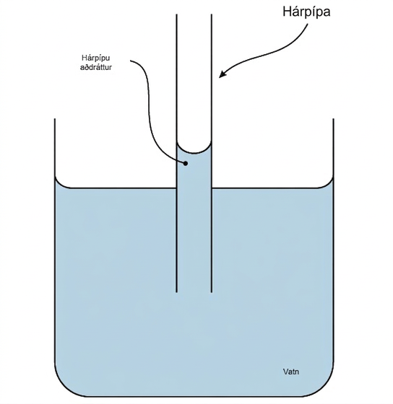
Figure 2.17
Hárpípukraftur í glerröri verður til þegar viðloðunarkraftar innra yfirborðs glersins eru meiri en samloðunarkraftarnir milli vatnssameindanna sjálfra. (höfundarupplýsing: byggt á verki eftir Pearson-Scott Foresman, gefið Wikimedia Foundation)
Notes:
A thin hollow tube sits in a beaker of water. The water level inside the tube is higher than the water level in the beaker due to capillary action.

Slide 25
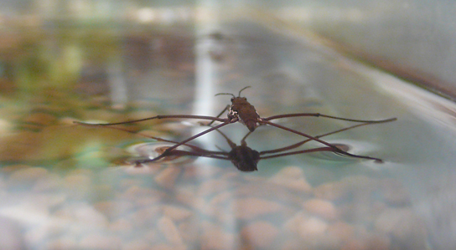
Figure 2.18
Samloðunar- og viðloðunareiginleikar vatns gera þessum vatnahlaupara (Gerris sp.) kleift að fljóta. (höfundarupplýsing: Tim Vickers)
Notes:
Photo shows an insect with long, thin legs standing on the surface of water.

Slide 26
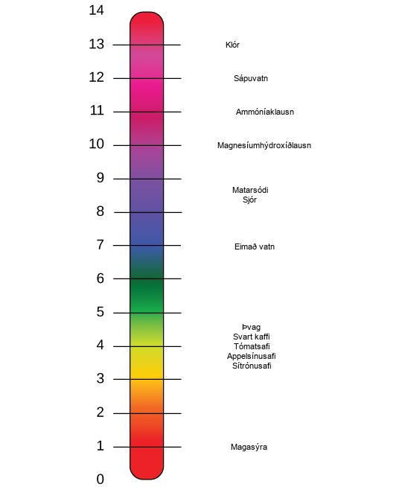
Figure 2.19
pH-kvarðinn mælir styrk vetnisjóna (H+) í lausn. (höfundarupplýsing: byggt á verki eftir Edward Stevens)
Notes:
The lower case p upper case H scale, which ranges from zero to 14, sits next to a bar with the colors of the rainbow. The p H of common substances are given. These include gastric acid with a p H around one, lemon juice with a p H around two, orange juice with a p H around three, tomato juice with a p H around four, black coffee with a p H around five, urine with a p H around six, distilled water with a p H around seven, sea water with a p H around eight, baking soda with a p H around nine, milk of magnesia with a p H around ten, ammonia solution with a p H around 11, soapy water with a p H around 12, and bleach with a p H around 13.

Slide 27

Figure 2.20
Þessi skýringarmynd sýnir hvernig líkaminn temprar pH-gildi blóðs með jafnalausnarkerfum. Bláu örvarnar sýna ferlið þar sem pH hækkar þegar meira CO2 myndast. Fjólubláu örvarnar sýna gagnstæða ferlið: pH lækkar þegar meira bíkarbónat myndast.
Notes:
An upper case H subscript 2 baseline upper case O molecule can combine with an upper case C upper case O subscript 2 baseline molecule to form H subscript 2 baseline C O subscript 3 baseline, or carbonic acid. A proton may dissociate from H subscript 2 baseline C O subscript 3 baseline, forming bicarbonate, or H C O subscript 3 baseline superscript negative, in the process. The reaction is reversible so that if acid is added protons combined with bicarbonate to form carbonic acid.

Slide 28
2.3 Kolefni
Markmið náms
Útskýra hvers vegna kolefni er mikilvægt fyrir líf
Lýsa hlutverki virkra hópa í líffræðilegum sameindum

Slide 29
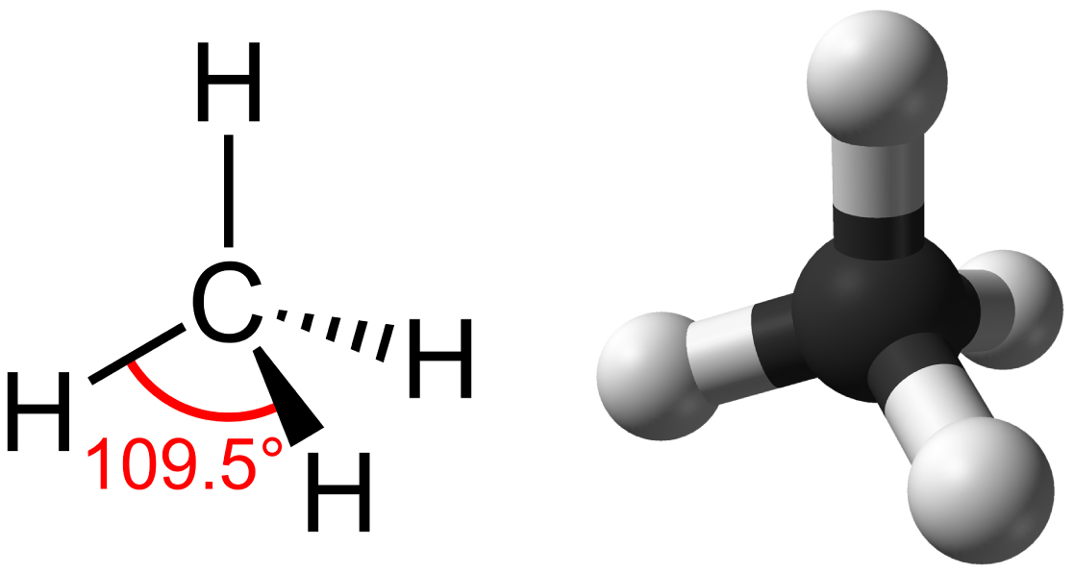
Figure 2.21
Metan hefur fjórflötungsbyggingu þar sem vetnisatómin fjögur eru hvert um sig í 109.5° fjarlægð frá hinum.
Notes:
Methane, the simplest hydrocarbon, is composed of four hydrogen atoms surrounding a central carbon. The bonds between the four hydrogen atoms and the central carbon are spaced as far apart as possible. The resulting shape is tetrahedral, with hydrogen atoms projecting upward and off to three sides around the central carbon.

Slide 30
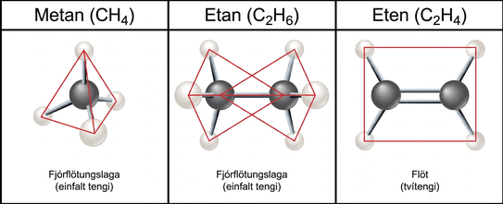
Figure 2.22
Þegar kolefni myndar eintengi við önnur atóm er lögunin fjórflötungslaga. Þegar tvö kolefnisatóm mynda tvítengi er lögunin flöt eða planlaga. Eintengi, eins og þau sem eru í etani, geta snúist. Tvítengi, eins og þau sem eru í eteni, geta ekki snúist og því haldast atómin sitt hvorum megin föst í stöðu sinni.
Notes:
Methane, the simplest hydrocarbon, is composed of four hydrogen atoms surrounding a central carbon. The bond between the four hydrogen atoms and the central carbon spaced as far apart as possible. This results in a tetrahedral shape with hydrogen atoms projecting upward and off to three sides around the central carbon. Ethane is composed of two carbons connected by a single bond. Each carbon also has three hydrogen atoms connected to it. The hydrogens are spaced as far apart from each other and from the other carbon so again the shape is tetrahedral. Ethene, like ethane, is composed of two carbon atoms, but in this case the carbons are connected by a double bond. Each carbon also has two hydrogen atoms connected to it, for a total of three bonds. The three bonds are spaced as far apart as possible around carbon, which means they are all on the same plane and pointing off in three directions. As a result, the molecule is planar, or flat.

Slide 31
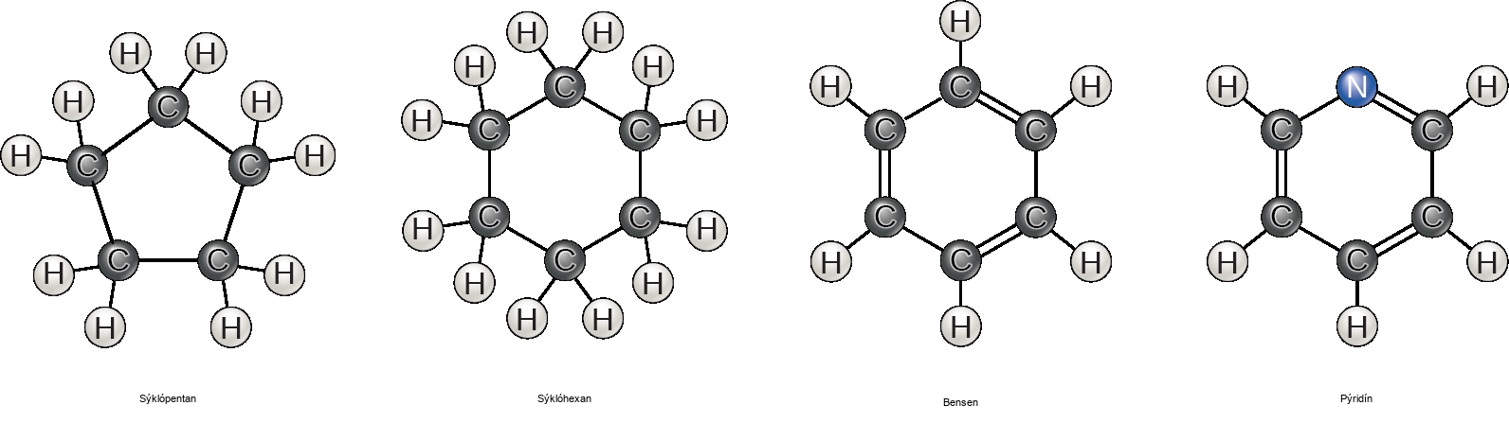
Figure 2.23
Kolefni getur myndað fimm og sex atóma hringi. Kolefnin í hringnum geta tengst með eintengjum eða tvítengjum og köfnunarefni getur komið í stað kolefnis.
Notes:
Four molecular structures are shown. Cyclopentane is a ring consisting of five carbons, each with two hydrogens attached. Cyclohexane is a ring of six carbons, each with two hydrogens attached. Benzene is a six-carbon ring with alternating double bonds. Each carbon has one hydrogen attached. Pyridine is the same as benzene, but a nitrogen is substituted for one of the carbons. No hydrogens are attached to the nitrogen.

Slide 32
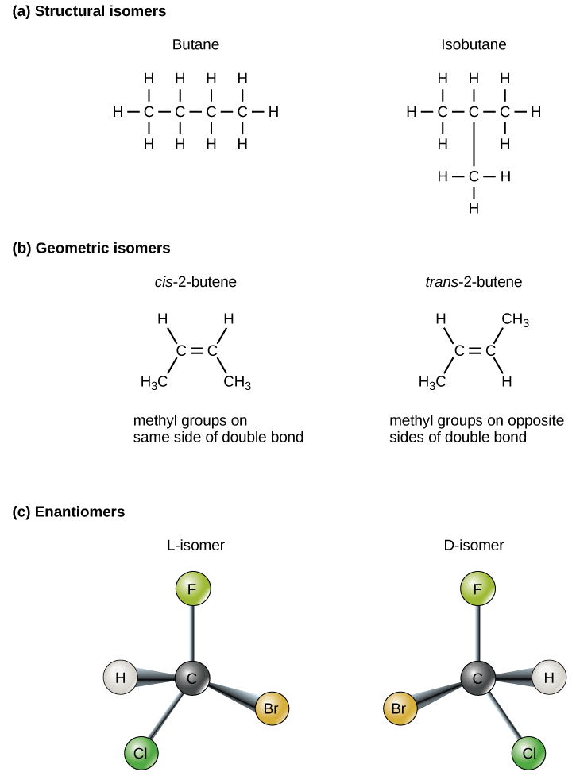
Figure 2.24
Sameindir sem hafa sama fjölda og sömu gerð atóma en ólíka uppröðun kallast hverfur. (a) Byggingarhverfur hafa ólíka samgilda uppröðun atóma. (b) Rúmhverfur hafa ólíka uppröðun atóma umhverfis tvítengi. (c) Hendnar hverfur eru spegilmyndir hvor af annarri.
Notes:
Part A shows butane and isobutane are structural isomers. Both molecules have four carbons and ten hydrogens, but in butane the carbons form a single chain, while in isobutane the carbons form a branched chain. Part B shows cis dash 2 butene and trans dash 2 butene each consist of a four-carbon chain. The two central carbons are connected by a double bond resulting in a planar, or flat shape. In the cis isomer, both terminal upper case C upper case H subscript 3 baseline groups are on the same side of the plane, and two hydrogen atoms are on the opposite side. Imagine a person with arms stretched out and upwards and legs spread apart, with a glove on the left hand and a sock on the left foot: this represents a cis configuration. In cis-butene the terminal upper C upper H subscript 3 baseline groups are on opposite sides of the plane. Now, imagine a person with outstretched arms and legs, but this time with a glove on the left hand and a sock on the right foot: this is what a trans configuration looks like. Part C shows two enantiomers, each with different arrangement of hydrogen, bromine, chlorine and fluorine around a central carbon. The molecules are mirror images of one another.

Slide 33
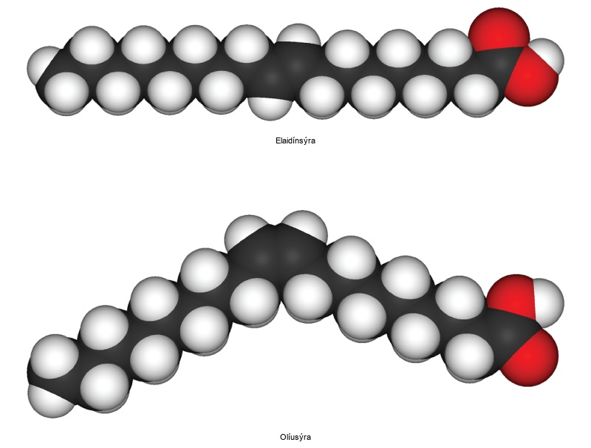
Figure 2.25
Þessi rúmfyllingarlíkön sýna cis-fitusýru (óleinsýru) og trans-fitusýru (elaidínsýru). Takið eftir sveigjunni í sameindinni sem stafar af cis-stillingunni.
Notes:
Oleic acid and eliadic acid both consist of a long carbon chain. In oleic acid the chain is kinked due to the presence of a double bond about half way down, while in eliadic acid the chain is straight.

Slide 34
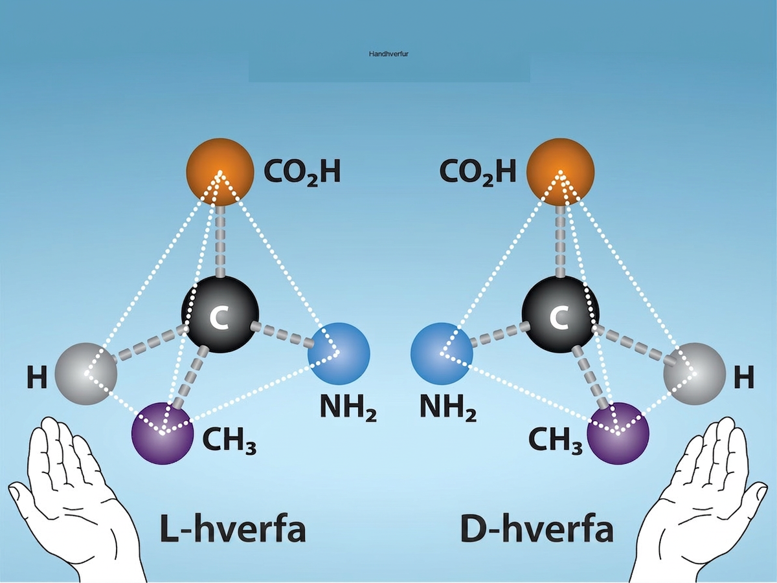
Figure 2.26
Hendnar hverfur eru sameindir sem eru spegilmyndir hvor af annarri og falla ekki saman við yfirlagningu. L/D-nafnakerfið er dregið af latnesku orðunum fyrir vinstri og hægri: laevus og dexter. Þetta dæmi sýnir L- og D-hverfur amínósýrunnar alaníns. Heimild: Rao, A., Hawkins, A., Fletcher, S. og Ryan K. Department of Biology, Texas A&M University.
Notes:
Molecular models of D-and L-alanine are shown. The two molecules, which contain the same number of carbon, oxygen, hydrogen, and nitrogen atoms, are mirror images of one another. Below the images, a left hand is shown near the L-isomer and the right hand is shown near the D-isomer.

Slide 35
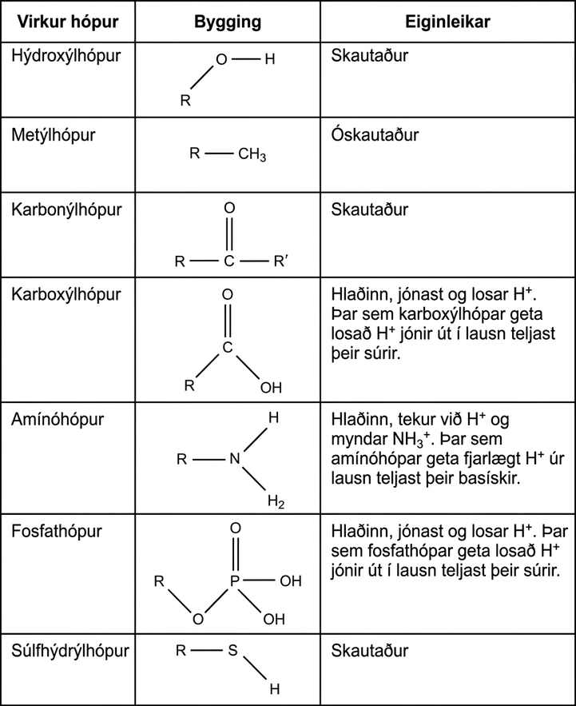
Figure 2.27
Þessir virku hópar koma fyrir í mörgum ólíkum líffræðilegum sameindum. R, einnig kallað R-hópur, er skammstöfun fyrir hvaða hóp sem er þar sem kolefnis- eða vetnisatóm tengist afgangi sameindarinnar.
Notes:
Table shows the structure and properties of different functional groups. Hydroxyl groups, which consist of upper case O upper case H attached to a carbon chain, are polar. Methyl groups, which consist of three hydrogens attached to a carbon chain, are nonpolar. Carbonyl groups, which consist of an oxygen double bonded to a carbon in the middle of a hydrocarbon chain, are polar. Carboxyl groups, which consist of a carbon with a double bonded oxygen and an upper O upper H group attached to a carbon chain, are able to ionize, releasing H positive ions into solution. Carboxyl groups are considered acidic. Amino groups, which consist of two hydrogens attached to a nitrogen, are able to accept H positive ions from solution, forming H subscript 3 baseline positive. Amino groups are considered basic. Phosphate groups consist of a phosphorous with one double bonded oxygen and two upper O upper H groups. Another oxygen forms a link from the phosphorous to a carbon chain. Both upper O upper H groups in phosphorous can lose an H positive ion, and phosphate groups are considered acidic. Sulfhydryl group has an upper-case S upper-case H group bonded to a carbon chain. The bond is polar due to the small difference in electronegativity of sulfur and hydrogen.

Slide 36
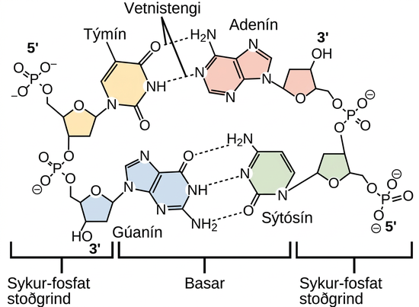
Figure 2.28
Vetnistengi tengja tvo DNA-þræði saman og mynda tvöfalda gormbyggingu.
Þetta OpenStax-viðbótarefni er © Rice University samkvæmt CC BY-NC-SA 4.0 International leyfi; heimilt er að fjölfalda það eða breyta því eingöngu í óviðskiptalegum tilgangi, en geta verður OpenStax, Rice University og allra breytinga sem gerðar eru. Öllum aðlögunum verður að deila samkvæmt sams konar leyfi.
Notes:
Molecular models show hydrogen bonding between thymine and adenine, and between cytosine and guanine. These four DNA bases are organic molecules containing carbon, nitrogen, oxygen, and hydrogen in complex ring structures. Hydrogen bonds between the bases hold them together.

