Slide 1

Biology 2e
Chapter 24 Fungi

Slide 2
Chapter outline
Characteristics of Fungi
Classifications of Fungi
Ecology of Fungi
Fungal Parasites and Pathogens
Importance of Fungi in Human Life

Slide 3
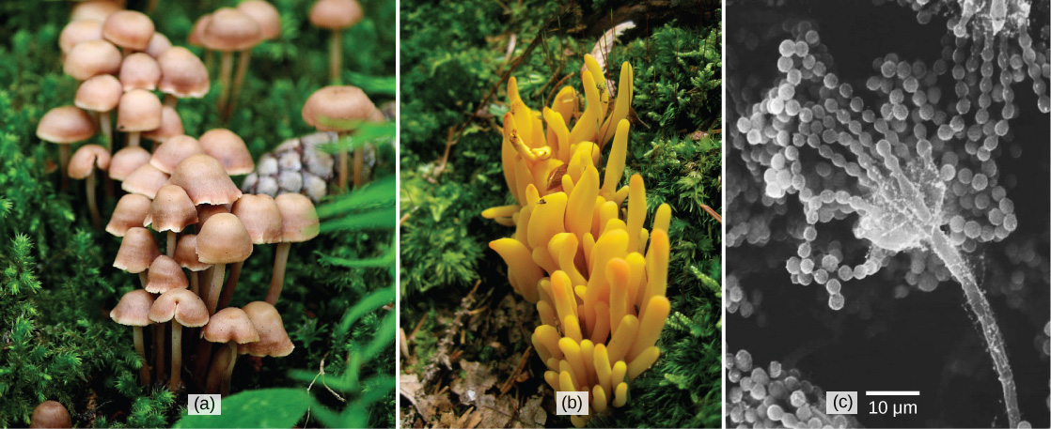
Figure 24.1
Many species of fungus produce the familiar mushroom (a) which is a reproductive structure. This (b) coral fungus displays brightly colored fruiting bodies. This electron micrograph shows (c) the spore-bearing structures of Aspergillus, a type of toxic fungus found mostly in soil and plants. (credit “mushroom”: modification of work by Chris Wee; credit “coral fungus”: modification of work by Cory Zanker; credit “Aspergillus”: modification of work by Janice Haney Carr, Robert Simmons, CDC; scale-bar data from Matt Russell)
Notes:
Left photo shows a cluster of mushrooms with bell-like domes attached to slender stalks. Middle photo shows a yellowish-orange fungus that grows in a cluster and is lobe-shaped. Right photo is a micrograph that shows a long, slender stalk that branches into long chains of spores that look like a string of beads.

Slide 4
24.1 Characteristics of Fungi
Learning Objectives
List the characteristics of fungi
Describe the composition of the mycelium
Describe the mode of nutrition of fungi
Explain sexual and asexual reproduction in fungi

Slide 5
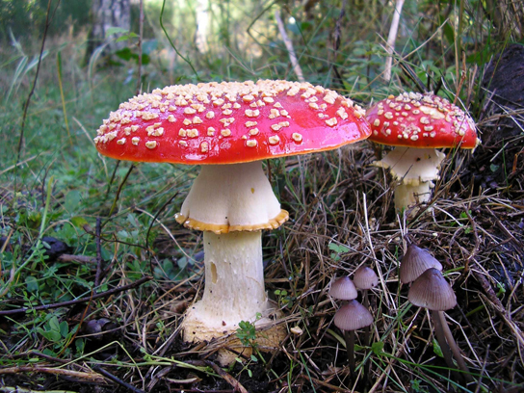
Figure 24.2
Amanita. The poisonous Amanita muscaria is native to temperate and boreal regions of North America. (credit: Christine Majul)
Notes:
Photo shows two large mushrooms, each with a wide white base and a bright red cap. The caps are dotted with small white protrusions.

Slide 6
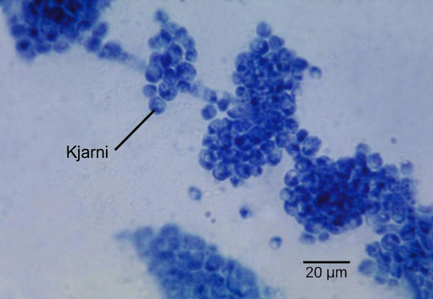
Figure 24.3
Candida albicans. Candida albicans is a yeast cell and the agent of candidiasis and thrush. This organism has a similar morphology to coccus bacteria; however, yeast is a eukaryotic organism (note the nucleus). (credit: modification of work by Dr. Godon Roberstad, CDC; scale-bar data from Matt Russell)
Notes:
Micrograph shows clumps of small blue spheres. Each sphere is about 5 microns across.

Slide 7
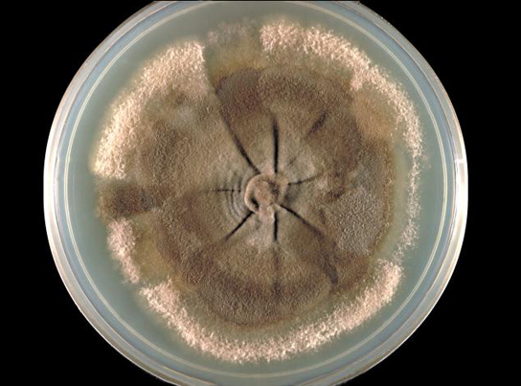
Figure 24.4
A fungal mycelium. The mycelium of the fungus Neotestudina rosati can be pathogenic to humans. The fungus enters through a cut or scrape and develops a mycetoma, a chronic subcutaneous infection. (credit: CDC)
Notes:
Photo depicts a light brown fungus growing in a Petri dish. The fungus has the appearance of wrinkled round skin surrounded by powdery residue. A hub-like indentation exists at the center of the fungus. Extending from this hub are folds that resemble spokes on a wheel.

Slide 8
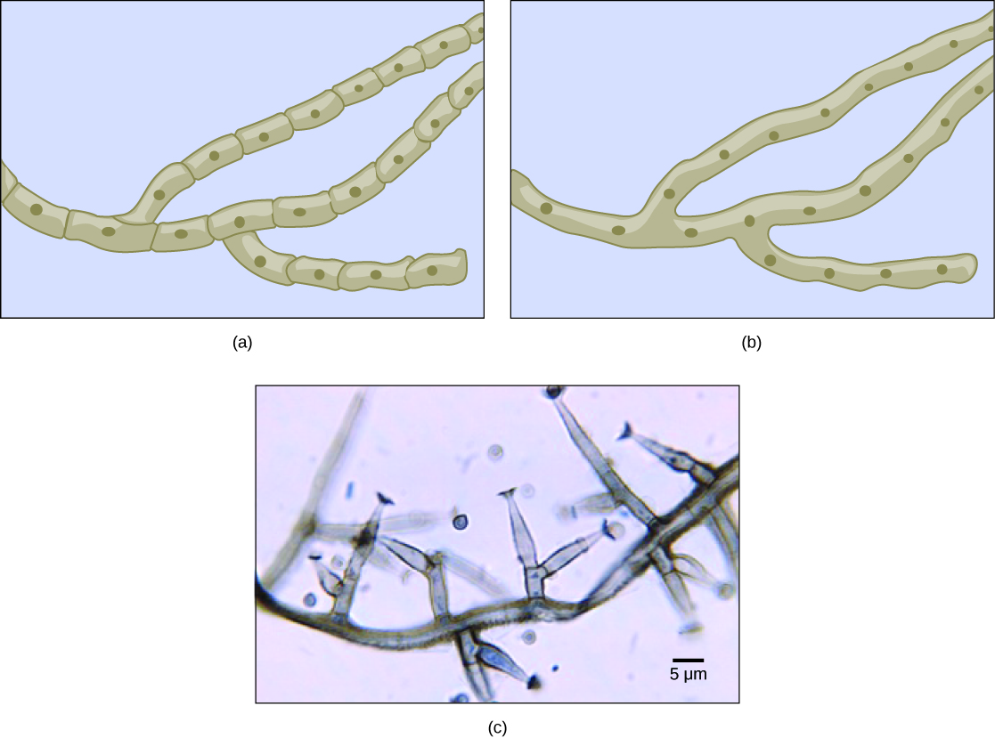
Figure 24.5
Fungal hyphae. Fungal hyphae may be (a) septated or (b) coenocytic (coeno- = "common"; -cytic = "cell") with many nuclei present in a single hypha. A bright field light micrograph of (c) Phialophora richardsiae shows septa that divide the hyphae. (credit c: modification of work by Dr. Lucille Georg, CDC; scale-bar data from Matt Russell)
Notes:
Part A is an illustration of septated hyphae. Cells within the septated hyphae are rectangular. Each cell has its own nucleus, and connects to other cells end to end in a long strand. Two branches occur in the hyphae. Part B is an illustration of coenocytic hyphae. Like the septated hyphae, the coenocytic hyphae consist of long, branched fibers. However, in coenocytic hyphae, there is no separation between the cells or nuclei. Part C is a light micrograph of septated hyphae from Phialophora richardsiae. The hyphae consists of a long chain of cells with multiple branches. Each branch is about 3 microns wide and varies from 3 to 20 microns in length.

Slide 9
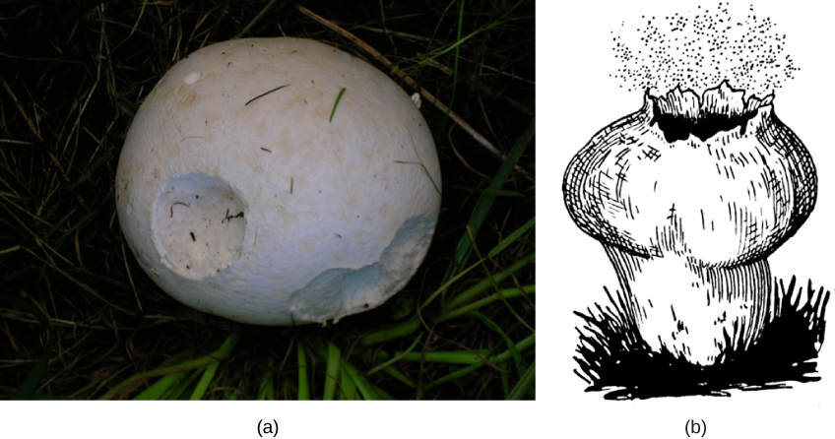
Figure 24.6
Puffball and spores. The (a) giant puffball mushroom releases (b) a cloud of spores when it reaches maturity. (credit a: modification of work by Roger Griffith; credit b: modification of work by Pearson Scott Foresman, donated to the Wikimedia Foundation)
Notes:
Part A is a photo of a puffball mushroom, which is round and white. Part B is an illustration of a puffball mushroom releasing spores through its exploded top.

Slide 10
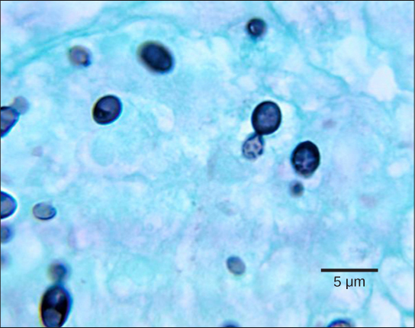
Figure 24.7
Budding in Histoplasma. The dark cells in this bright field light micrograph are the pathogenic yeast Histoplasma capsulatum, seen against a backdrop of light blue tissue. Histoplasma primarily infects lungs but can spread to other tissues, causing histoplasmosis, a potentially fatal disease. (credit: modification of work by Dr. Libero Ajello, CDC; scale-bar data from Matt Russell)
Notes:
Micrograph shows budding yeast cells. The parent cells are stained dark blue and round, with smaller, teardrop shaped cells budding from them. The cells are about 2 microns across and 3 microns long.

Slide 11
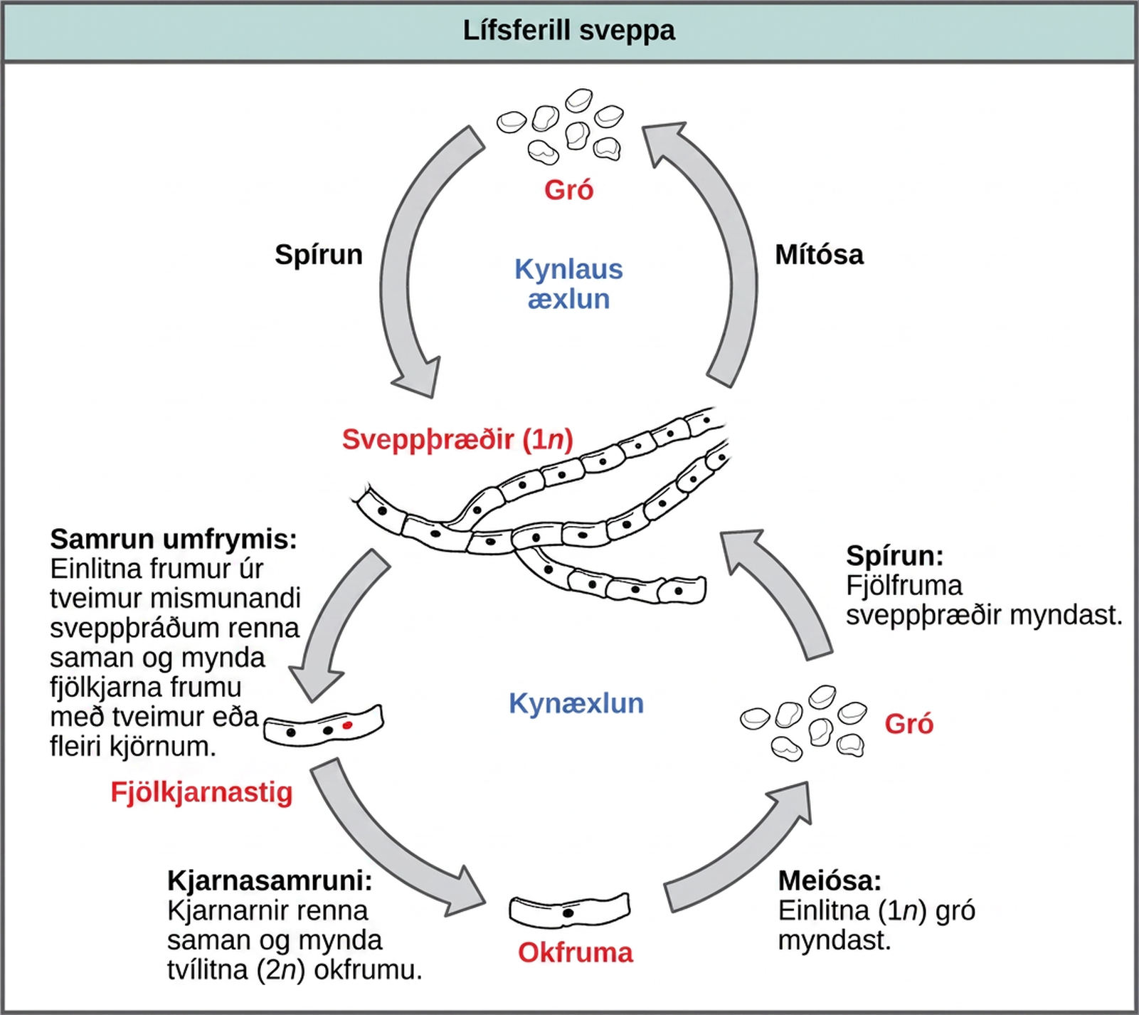
Figure 24.8
Generalized fungal life cycle. Fungi may have both asexual and sexual stages of reproduction.
Notes:
The asexual and sexual stages of reproduction of fungi are shown. In the asexual life cycle, a haploid (1n) mycelium undergoes mitosis to form spores. Germination of the spores results in the formation of more mycelia. In the sexual life cycle, the mycelium undergoes plasmogamy, a process in which haploid cells fuse to form a heterokaryon (a cell with two or more haploid nuclei). This is called the heterokaryotic stage. The dikaryotic cells (cells with two more more nuclei) undergo karyogamy, a process in which the nuclei fuse to form a diploid (2n) zygote. The zygote undergoes meiosis to form haploid (1n) spores. Germination of the spores results in the formation of a multicellular mycelium.

Slide 12
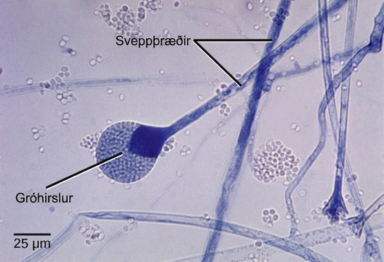
Figure 24.9
Sporangiospores. This bright field light micrograph shows the release of spores from a sporangium at the end of a hypha called a sporangiophore. The organism is a Mucor sp. fungus, a mold often found indoors. (credit: modification of work by Dr. Lucille Georg, CDC; scale-bar data from Matt Russell)
Notes:
Micrograph shows several long, thread-like hyphae stained blue. One hypha has a round sporangium, about 35 microns in diameter, at the tip. The sporangium is dark blue at the neck, and grainy white and blue elsewhere. Spores that have already been released appear as small white ovals.

Slide 13
24.2 Classifications of Fungi
Learning Objectives
Identify fungi and place them into the five major phyla according to current classification
Describe each phylum in terms of major representative species and patterns of reproduction

Slide 14
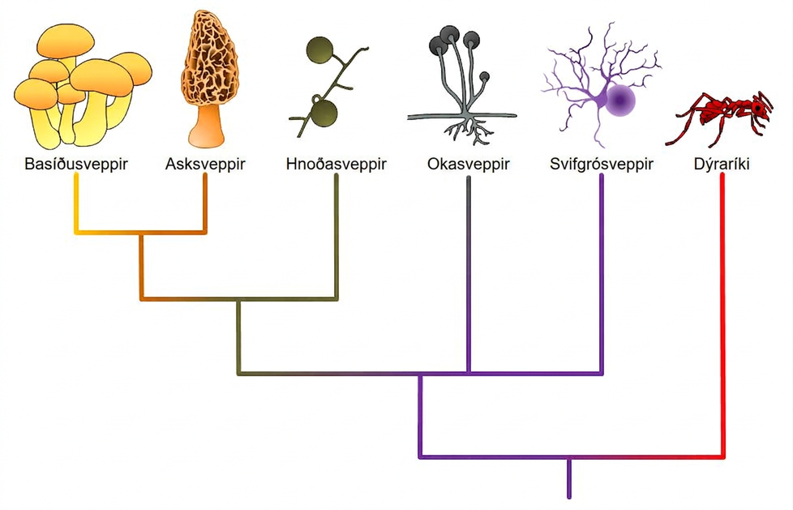
Figure 24.10
Fungal phyla. Note: “-mycota” is used to designate a phylum while “-mycetes” formally denotes a class or is used informally to refer to all members of the phylum.
Notes:
The image displays the phyologenetic tree for fungi. From a central source, branches include basidiomycota and ascomycota (which exist at the end of the same branch), glomeromycota, zygomycota, and chytridiomycota. Animalia are diplayed coming from a separate branch from the same source ancestor, but are not a part of the fungi.

Slide 15
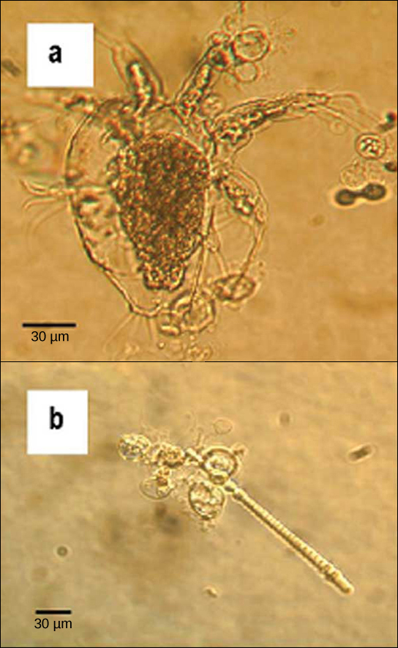
Figure 24.11
Chytrids. The chytrid Batrachochytrium dendrobatidis is seen in these light micrographs as transparent spheres growing on (a) a freshwater arthropod (water mite) and (b) algae. This chytrid causes skin diseases in many species of amphibians, resulting in species decline and extinction. (credit: modification of work by Johnson ML, Speare R., CDC)
Notes:
Micrograph A shows an arthropod, which is a teardrop-shaped transparent organism about 90 microns across and 120 microns long. Tentacle-like appendages jut out from the front, wide end of the organism, and clusters of cilia-like appendages jut out from either side and the back. Transparent oval organisms about 20 microns across cling to the arthropod. Micrograph B shows a similar oval transparent organisms clinging to rod-shaped algae about 5 microns across and 200 microns long.

Slide 16
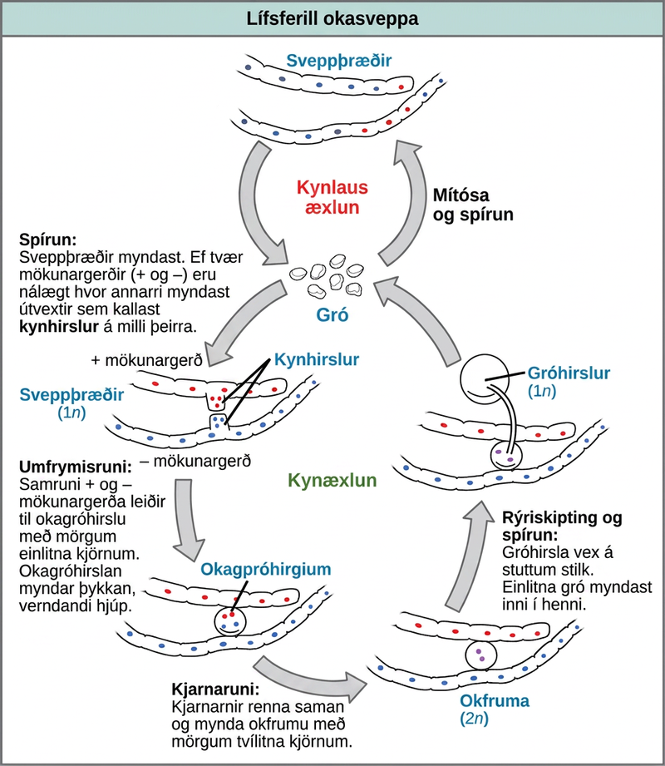
Figure 24.12
Zygomycete life cycle. Zygomycetes have asexual and sexual phases in their life cycles. In the asexual phase, spores are produced from haploid sporangia by mitosis (not shown). In the sexual phase, plus and minus haploid mating types conjugate to form a heterokaryotic zygosporangium. Karyogamy then produces a diploid zygote. Diploid cells in the zygote undergo meiosis and germinate to form a haploid sporangium, which releases the next generation of haploid spores.
Notes:
The asexual and sexual life cycles of zygomycetes are shown. In the asexual life cycle, 1n spores undergo mitosis to form long chains of cells called mycelia. Germination results in the formation of more spores. In the sexual life cycle, spores germinate to form mycelia with two different mating types: plus and minus. If the plus and minus mating types are in close proximity, extensions called gametangia form between them. In a process called plasmogamy, the gametangia fuse to form a zygosporangium with multiple haploid nuclei. A thick, protective coat forms around the zygosporangium. In a process called karyogamy, the nuclei fuse to form a zygote with multiple diploid (2n) nuclei. The zygote undergoes meiosis and germination. A sporangium grows on a short stalk. Haploid spores are formed inside. The spores germinate, ending the cycle.

Slide 17
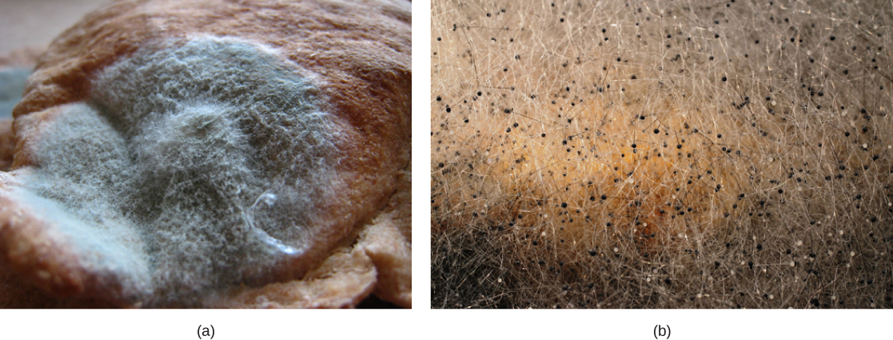
Figure 24.13
Rhizopus spores. Asexual sporangia grow at the end of stalks, which appear as (a) white fuzz seen on this bread mold, Rhizopus stolonifer. The black tips (b) of bread mold are the spore-containing sporangia. (credit b: modification of work by "polandeze"/Flickr)
Notes:
The photo in part A shows a thick layer of green mold growing on bread. Fuzzy white projections grow from the mold. Part B shows a photo of black tips in bread mold.

Slide 18
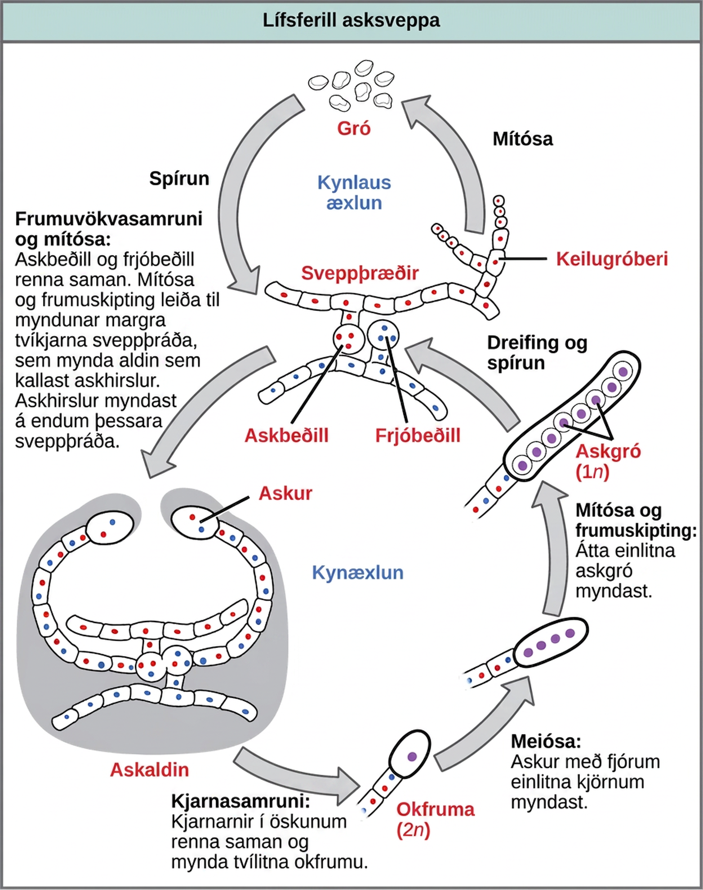
Figure 24.14
Ascomycete life cycle. The lifecycle of an ascomycete is characterized by the production of asci during the sexual phase. In each ascus, the four nuclei produced by meiosis divide once mitotically for a total of eight haploid ascospores. The haploid phase is the predominant phase of the life cycle in Ascomycetes.
Notes:
Ascomycetes have both sexual and asexual life cycles. In the asexual life cycle, the haploid (1n) mycelium branches into a chain of cells called the conidiophore. Spores bud from the end of the conidiophore and germinate to form more mycelia. In the sexual life cycle, a round structure called an antheridium buds from the male strain, and a similar structure called the ascogonium buds from the female strain. In a process called plasmogamy, the ascogonium and antheridium fuse to form a cell with multiple haploid nuclei. Mitosis and cell division result in the growth of many hyphae, which form a fruiting body called the ascocarp. The hyphae are dikaryotic, meaning they have two haploid nuclei. Asci form at the tips of these hyphae. In a process called karyogamy, the nuclei in the asci fuse to form a diploid (2n) zygote. The zygote undergoes meiosis without cell division, resulting in an ascus with four 1n nuclei arranged in a row. Each nucleus undergoes mitosis, resulting in eight ascospores, which are also arranged in a row at the tip of the hyphae. Dispersal and germination results in the growth of new mycelia.

Slide 19
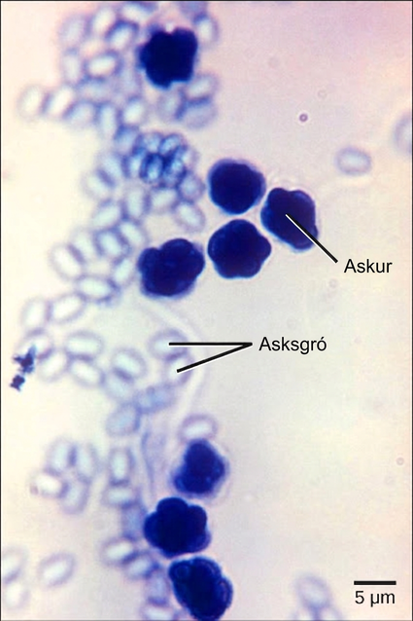
Figure 24.15
Ascospores. The bright field light micrograph shows ascospores being released from asci in the fungus Talaromyces flavus var. flavus. (credit: modification of work by Dr. Lucille Georg, CDC; scale-bar data from Matt Russell)
Notes:
Micrograph shows asci, which appear as multiple, sphere-like shapes fused together into a structure about 7 microns across, and ascospores, which are small, light blue ovals about two microns wide by three microns long released from the asci.

Slide 20
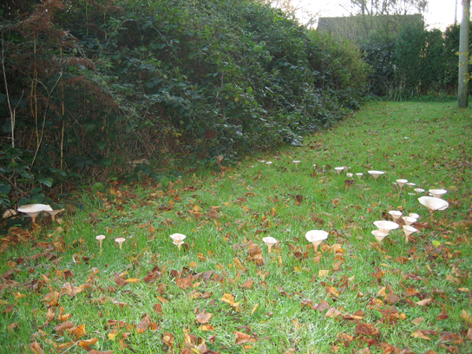
Figure 24.16
Fairy ring. The fruiting bodies of a basidiomycete form a ring in a meadow, commonly called “fairy ring.” The best-known fairy ring fungus has the scientific name Marasmius oreades. The body of this fungus, its mycelium, is underground and grows outward in a circle. As it grows, the mycelium depletes the soil of nitrogen, causing the mycelia to grow away from the center and leading to the “fairy ring” of fruiting bodies where there is adequate soil nitrogen. (Credit: "Cropcircles"/Wikipedia Commons)]
Notes:
Photo shows toadstool mushrooms growing on a lawn, and forming a large circle.

Slide 21
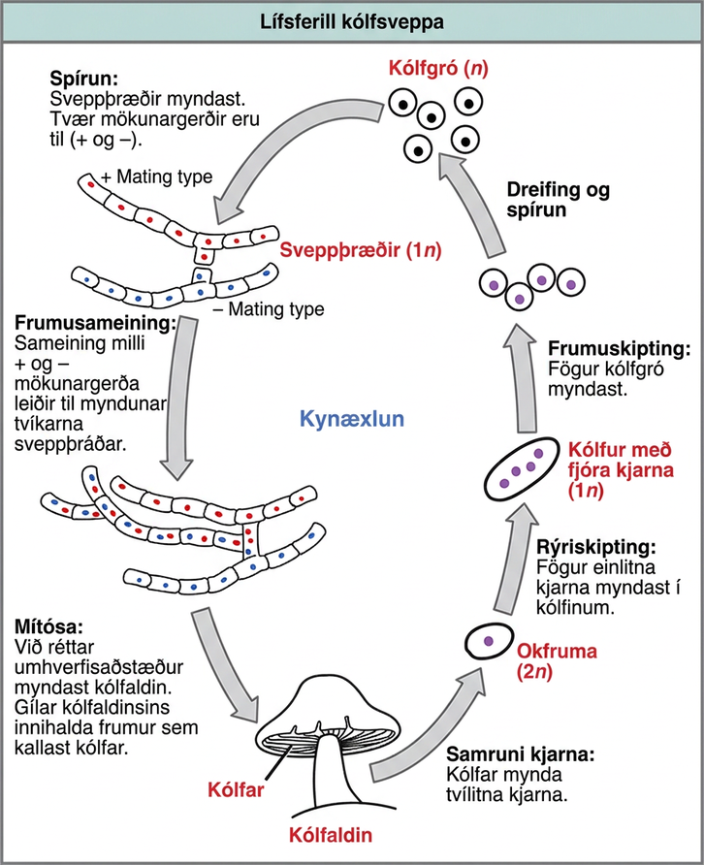
Figure 24.17
Basidiomycete life cycle. The lifecycle of a basidiomycete has sexual and asexual reproduction with haploid and dikaryotic mycelia. Haploid primary mycelia fuse to form a dikaryotic secondary mycelium, which is the dominant stage of the life cycle, and produces the basidiocarp.
Notes:
The life cycle of basidiomycetes, better known as mushrooms, is shown. Basidiomycetes have a sexual life cycle that begins with the germination of 1n basidiospores into mycelia with plus and minus mating types. In a process called plasmogamy, the plus and minus mycelia form a dikaryotic mycelium. Under the right conditions, the dikaryotic mycelium grows into a basdiocarp, or mushroom. Gills on the underside of the mushroom cap contain cells called basidia. The basidia undergo karyogamy to form a 2n zygote. The zygote undergoes meiosis to form cells with four haploid (1n) nuclei. Cell division results in four basidiospores. Dispersal and germination of basidiospores ends the cycle.

Slide 22
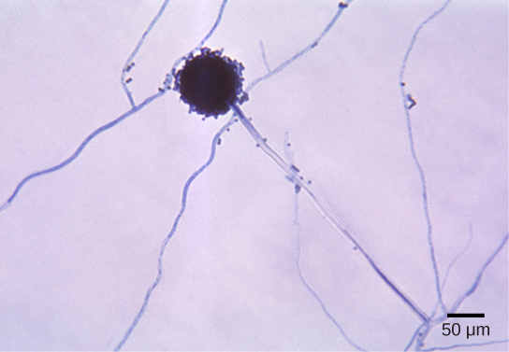
Figure 24.18
Aspergillus. Aspergillus niger is an asexually reproducing fungus (phylum Ascomycota) commonly found as a food contaminant. The spherical structure in this light micrograph is an asexual conidiophore. Molecular studies have placed Aspergillus with the ascomycetes and sexual cycles have been identified in some species. (credit: modification of work by Dr. Lucille Georg, CDC; scale-bar data from Matt Russell)
Notes:
Micrograph shows Aspergillus mycelia, which look like long threads, and a spherical conidiophore about 40 microns across.

Slide 23
24.3 Ecology of Fungi
Learning Objectives
Describe the role of fungi in various ecosystems
Describe mutualistic relationships of fungi with plant roots and photosynthetic organisms
Describe the beneficial relationship between some fungi and insects

Slide 24
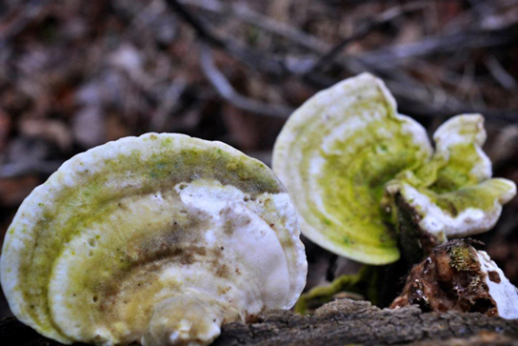
Figure 24.19
Bracket fungi. Fungi are an important part of ecosystem nutrient cycles. These bracket fungi growing on the side of a tree are the fruiting structures of a basidiomycete. They receive their nutrients through their hyphae, which invade and decay the tree trunk. (credit: Cory Zanker)
Notes:
Photo shows two shell-shaped mushrooms growing on decaying wood.

Slide 25
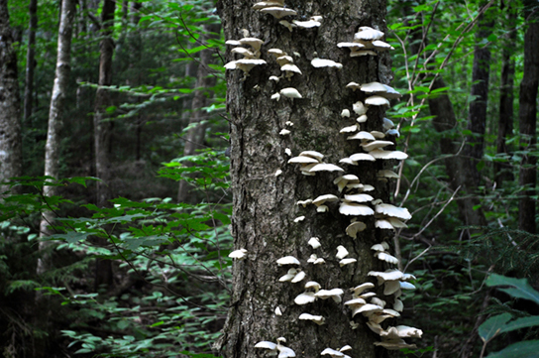
Figure 24.20
Shelf fungi. Shelf fungi, so called because they grow on trees in a stack, attack and digest the trunk or branches of a tree. While some shelf fungi are found only on dead trees, others can parasitize living trees and cause eventual death, so they are considered serious tree pathogens. (credit: Cory Zanker)
Notes:
Photo shows a shell-shaped shelf fungus growing up the trunk of a living tree.

Slide 26
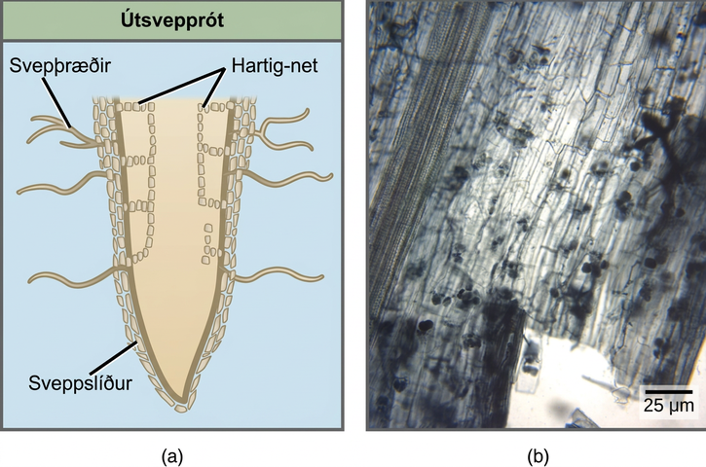
Figure 24.21
Two types of mycorrhizae. (a) Ectomycorrhizae and (b) arbuscular or endomycorrhizae have different mechanisms for interacting with the roots of plants. (credit b: MS Turmel, University of Manitoba, Plant Science Department)
Notes:
The figure compares two types of mycorrhizae: ectomycorrhiza and arbuscular mycorrhiza. Part A is an illustration of an ectomycorrhiza mycorrhiza. In ectomycorrhiza, fungal hyphae form a structure called a Hartig net inside the root. The Hartig net forms rows of cells that extend straight down, and branch toward the outside of the root. A fungal mantle surrounds the root. Mycelia extend from the fungal mantle. In arbuscular mycorrhiza, the fungi form finger-like clusters that are connected to mycelia that extend from the root into the soil. Part B is a micrograph of arbuscular mycorrhiza, which appear as grape-like clusters in a root tip.

Slide 27
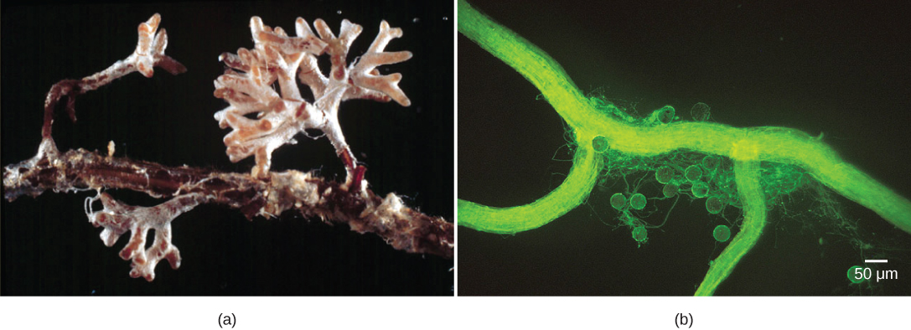
Figure 24.22
Mycorrhizae. The (a) infection of Pinus radiata (Monterey pine) roots by the hyphae of Amanita muscaria (fly amanita) causes the pine tree to produce many small, branched rootlets. The Amanita hyphae cover these small roots with a white mantle. (b) Spores (the round bodies) and hyphae (thread-like structures) are evident in this light micrograph of an arbuscular mycorrhiza by a fungus on the root of a corn plant. (credit a: modification of work by Randy Molina, USDA; credit b: modification of work by Sara Wright, USDA-ARS; scale-bar data from Matt Russell)
Notes:
Part A is a photograph showing a white fungal mantle that covers a tree-like structure that has grown from the side of a root. Part B is a micrograph showing ribbon-like hyphae surrounded by spores that are about 30 microns across.

Slide 28
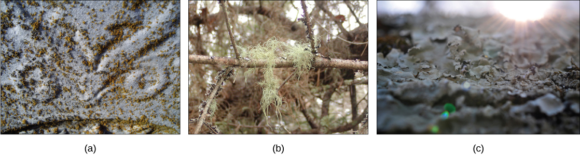
Figure 24.23
Lichens. Lichens have many forms. They may be (a) crust-like, (b) hair-like, or (c) leaf-like. (credit a: modification of work by Jo Naylor; credit b: modification of work by "djpmapleferryman"/Flickr; credit c: modification of work by Cory Zanker)
Notes:
Different lichens are shown. Part A shows a lichen that appears like brown flecks on gray rock. Part B shows a moss-like lichen hanging from a tree. Part C shows lichen that have a wide, flat, convoluted shape.

Slide 29
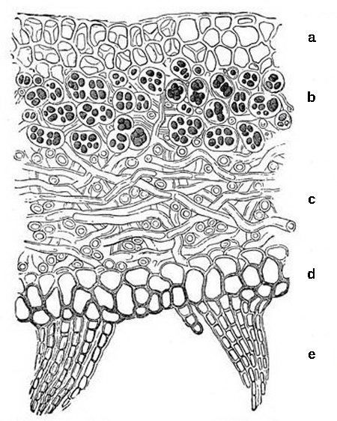
Figure 24.24
Structure of a lichen. This cross-section of a lichen thallus shows the (a) upper cortex of fungal hyphae, which provides protection; the (b) algal zone where photosynthesis occurs, the (c) medulla of fungal hyphae, and the (d) lower cortex, which also provides protection and may have (e) rhizines to anchor the thallus to the substrate.
Notes:
The lichen has multiple layers. The top layer, or upper cortex, is made up of compact fungal hyphae that provide protection to the lichen. Beneath this layer is the algal zone, where fungal hyphae wrap around the photosynthetic algal cells. Below the algal zone is a layer known as the medulla, which is comprised of more loosely arranged fungal hyphae. Beneath the medulla lies the lower cortex, which, like the upper cortex, is comprised of compact fungal hyphae that provide protection to the lichen. Projections beneath the lower cortex anchor the lichen to its substrate.

Slide 30
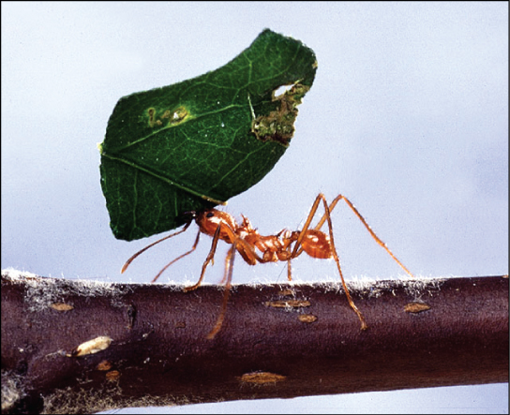
Figure 24.25
Leaf-cutter ant. A leaf-cutter ant transports a leaf that will feed a farmed fungus. (credit: Scott Bauer, USDA-ARS)
Notes:
Photo shows an ant carrying a leaf over its head.

Slide 31
24.4 Fungal Parasites and Pathogens
Learning Objectives
Describe some fungal parasites and pathogens of plants
Describe the different types of fungal infections in humans
Explain why antifungal therapy is hampered by the similarity between fungal and animal cells

Slide 32
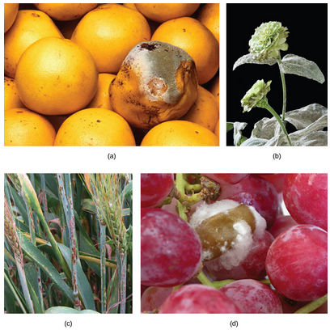
Figure 24.26
Fungal pathogens. Some fungal pathogens include (a) green mold on grapefruit, (b) powdery mildew on a zinnia, (c) stem rust on a sheaf of barley, and (d) grey rot on grapes. In wet conditions Botrytis cinerea, the fungus that causes grey rot, can destroy a grape crop. However, controlled infection of grapes by Botrytis results in noble rot, a condition that produces strong and much-prized dessert wines. (credit a: modification of work by Scott Bauer, USDA-ARS; credit b: modification of work by Stephen Ausmus, USDA-ARS; credit c: modification of work by David Marshall, USDA-ARS; credit d: modification of work by Joseph Smilanick, USDA-ARS)
Notes:
Image displays various plants and fruits infected with fungal pathogens. (a) green mold on grapefruit, (b) powdery mildew covering zinnia flower and leaves, (c) red-colored rust on barley, (d) grey rot on grapes, which appears as a fibrous, almost cotton-like substance.

Slide 33
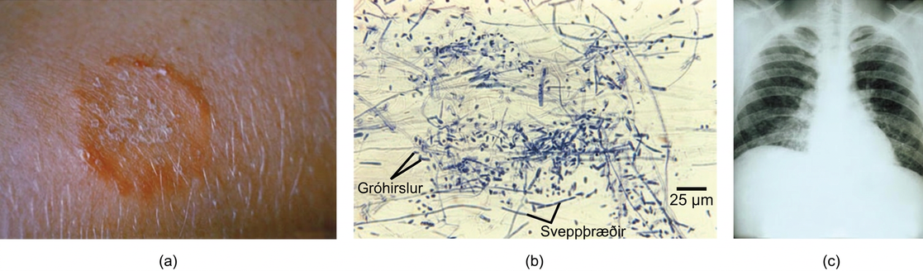
Figure 24.27
Fungal diseases of humans. (a) Ringworm presents as a red ring on skin; (b) Trichophyton violaceum, shown in this bright field light micrograph, causes superficial mycoses on the scalp; (c) Histoplasma capsulatum is an ascomycete that infects airways and causes symptoms similar to influenza. (credit a: modification of work by Dr. Lucille K. Georg, CDC; credit b: modification of work by Dr. Lucille K. Georg, CDC; credit c: modification of work by M. Renz, CDC; scale-bar data from Matt Russell)
Notes:
Part A is a photo of a red, ring-shaped skin lesion. Part B is a micrograph of long, thread-like mycelia and small, oval sporangia. Part C is a chest X-ray of a person with a fungal infection.

Slide 34
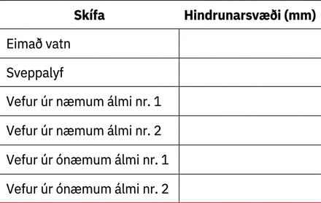
Table 24.1

Slide 35
24.5 Importance of Fungi in Human Life
Learning Objectives
Describe the importance of fungi to the balance of the environment
Summarize the role of fungi in agriculture and food and beverage preparation
Describe the importance of fungi in the chemical and pharmaceutical industries
Discuss the role of fungi as model organisms

Slide 36
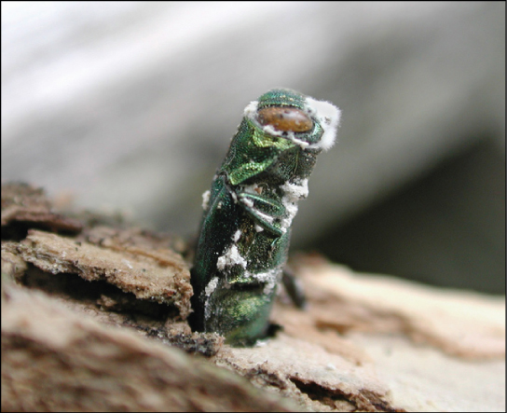
Figure 24.28
Fungal insect control. The emerald ash borer (Agrilus planipennis) is an insect that attacks ash trees. It is in turn parasitized by a pathogenic fungus (Beauveria bassiana) that holds promise as a biological insecticide. The parasitic fungus appears as white fuzz on the body of the insect. (credit: Houping Liu, USDA Agricultural Research Service)
Notes:
Photo shows a green, stump-shaped ash borer jutting from the bark of a tree with white fuzz (the parasitic fungus) on its body.

Slide 37
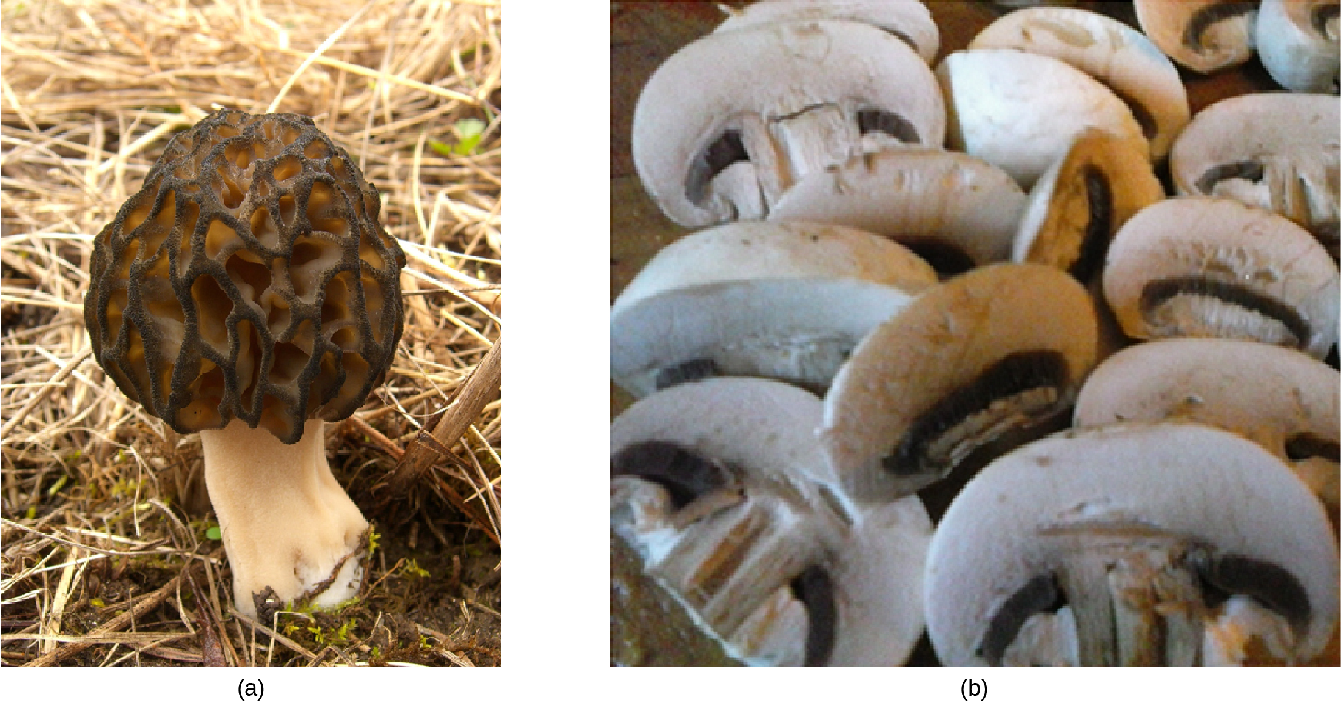
Figure 24.29
Edible fungi. (a) The morel mushroom is an ascomycete greatly appreciated for its delicate taste. (credit: Jason Hollinger). (b) Basidiocarps of Agaricus ready for an omelet (credit: Mary Anne Clark)
This OpenStax ancillary resource is © Rice University under a CC BY-NC-SA 4.0 International license; it may be reproduced or modified for noncommercial purposes only but must be attributed to OpenStax, Rice University and any changes must be noted. Any adaptation must be shared under the same type of license.
Notes:
Part a Photo shows a mushroom with a convoluted black cap. Part b shows a pile of sliced mushrooms similar to ones people would see in a food store.

