Slide 1

Biology 2e
Chapter 25 Seedless Plants

Slide 2
Chapter outline
Early Plant Life
Green Algae: Precursors of Land Plants
Bryophytes
Seedless Vascular Plants

Slide 3
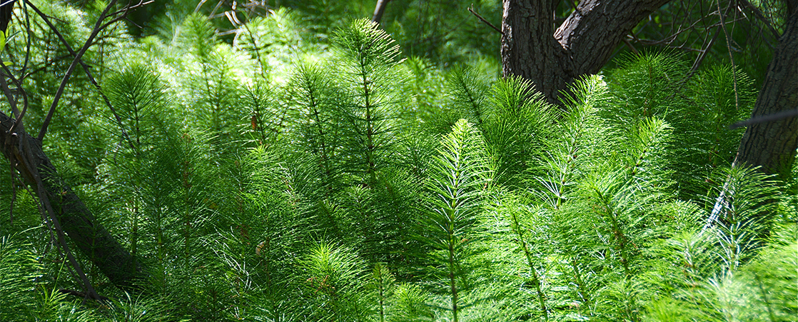
Figure 25.1
Seedless plants, like these horsetails (Equisetum sp.), thrive in damp, shaded environments under a tree canopy where dryness is rare. (credit: modification of work by Jerry Kirkhart)
Notes:
Photo shows a seedless plant growing under a large tree. The seedless plant has a long, slender stalk with thin, filamentous branches radiating out from it. The branches have no leaves.

Slide 4
25.1 Early Plant Life
Learning Objectives
Discuss the challenges to plant life on land
Describe the adaptations that allowed plants to colonize the land
Describe the timeline of plant evolution and the impact of land plants on other living things

Slide 5
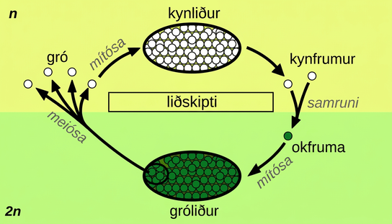
Figure 25.2
Alternation of generations between the 1n gametophyte and 2n sporophyte is shown. Mitosis occurs in both gametophyte and sporophyte generations. Diploid sporophytes produce haploid spores by meiosis, while haploid gametophytes produce gametes by mitosis. (credit: Peter Coxhead)
Notes:
The plant life cycle has haploid and diploid stages. The cycle begins when haploid (1n) spores undergo mitosis to form a multicellular gametophyte. The gametophyte produces gametes, two of which fuse to form a diploid zygote. The diploid (2n) zygote undergoes mitosis to form a multicellular sporophyte. Meiosis of cells in the sporophyte produces 1n spores, completing the cycle.

Slide 6
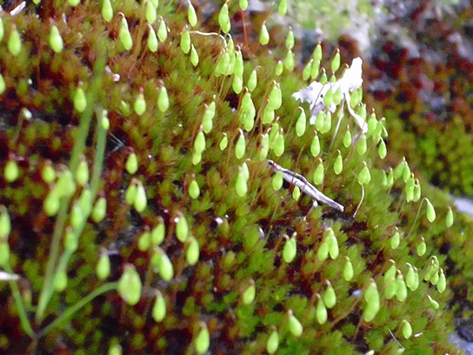
Figure 25.3
Sporangia. Spore-producing sacs called sporangia grow at the ends of long, thin stalks in this photo of the moss Bryum capillare. (credit: Javier Martin)
Notes:
Photo shows sporangia in seedless plant Bryum capillare.

Slide 7
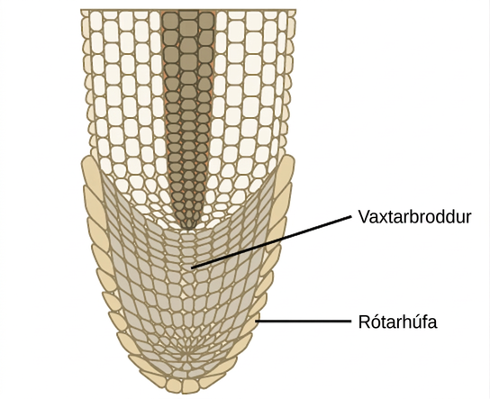
Figure 25.4
Apical meristem at a root tip. Addition of new cells in a root occurs at the apical meristem. Subsequent enlargement of these cells causes the organ to grow and elongate. The root cap protects the fragile apical meristem as the root tip is pushed through the soil by cell elongation.
Notes:
The illustration shows the tip of a root tapering to a rounded end. The entire inside of the rounded tip is the apical meristem, whose cells are smaller than the more mature cells further from the tip. The apical meristem is surrounded on the outside of the root by a single layer of cells called the root cap.

Slide 8
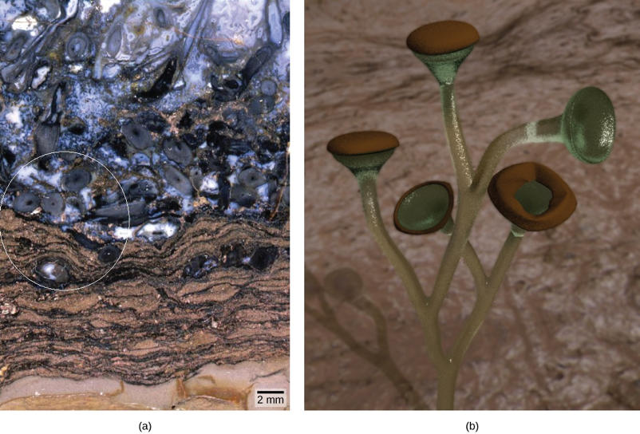
Figure 25.5
Early vascular plant fossils. This Rhynie chert (a) contains fossilized material from vascular plants. Reconstruction of Cooksonia (b), is shown based upon the fossilized remains inside the circle in (a). (credit b: modification of work by Peter Coxhead based on original image by “Smith609”/Wikimedia Commons; scale-bar data from Matt Russell)
Notes:
Part A is a photo of a rock marbled brown and black with multiple indentations and irregular, pockmarked features containing fossilized corms and rhizoids. A circle appears around a few large features to indicate the fossilized corms. Part B is a reconstruction of the fossilized remains that can be found in Part A, showing light green branches ending with larger brown bulbs.

Slide 9
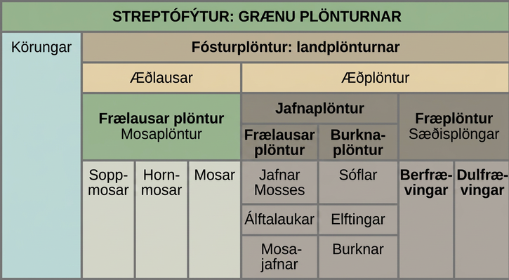
Figure 25.6
Streptophytes. This table shows the major divisions of green plants.
Notes:
Table shows the division of Streptophytes: the green plants. This group includes Charophytes and Embryophytes. Embryophytes are land plants, which are subdivided into vascular and nonvascular plants. Nonvascular plants are all seedless, and are in the Bryophyte group, which is subdivided into liverworts, hornworts, and mosses. Vascular plants are divided into seedless and seed plants. Seedless plants are subdivided into Lycophytes, which include club mosses, quillworts, and spike mosses, and monilophytes, which include whisk ferns, horsetails, and ferns. Seed plants are in the Spermatophyte group and consist of gymnosperms and angiosperms.

Slide 10
25.2 Green Algae: Precursors of Land Plants
Learning Objectives
Describe the traits shared by green algae and land plants
Explain why charophytes are considered the closest algal relative to land plants
Explain how current phylogenetic relationships are reshaped by comparative analysis of DNA sequences

Slide 11
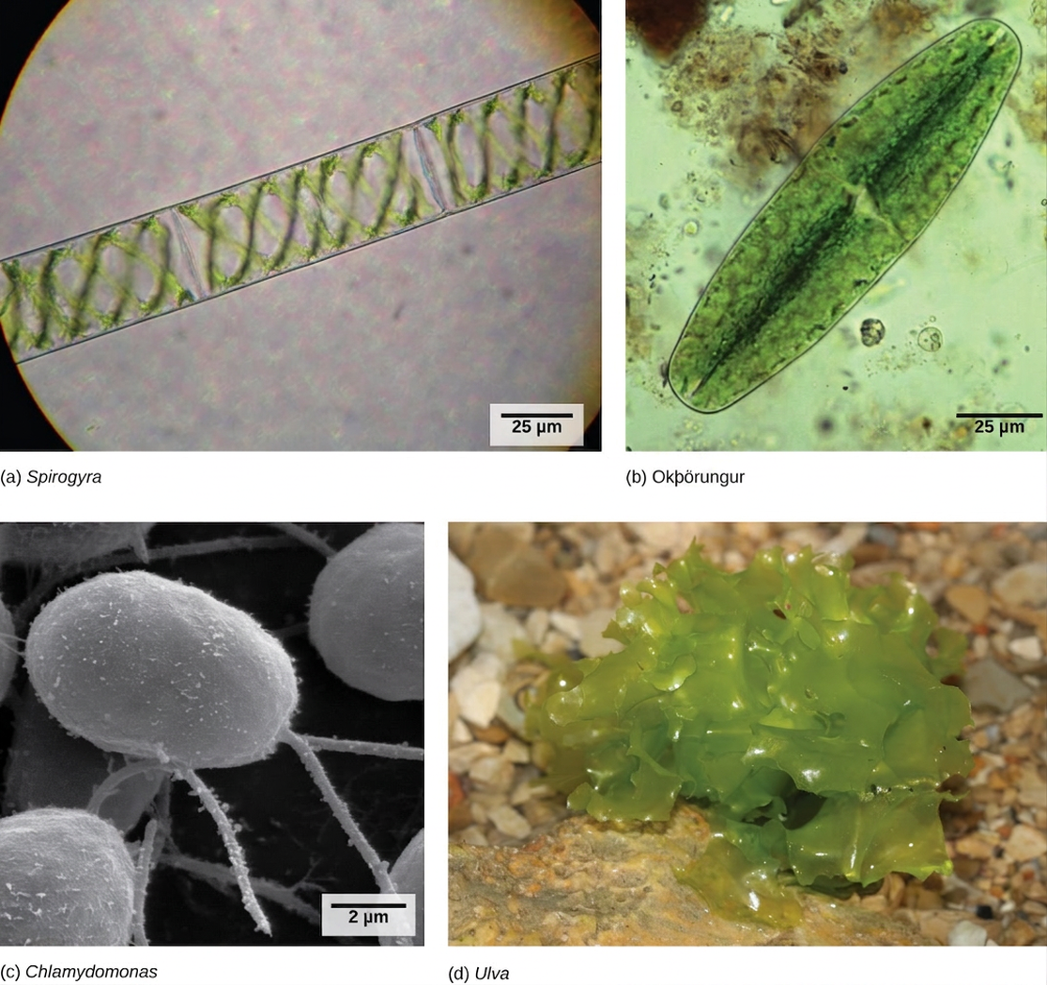
Figure 25.7
Green algae. Charophyta include (a) Spirogyra and (b) desmids. Chlorophyta include (c) Chlamydomonas, and (d) Ulva. Desmids and Chlamydomonas are single-celled organisms, Spirogyra forms chains of cells, and Ulva forms multicellular structures resembling leaves, although the cells are not differentiated as they are in higher plants (credit b: modification of work by Derek Keats; credit c: modification of work by Dartmouth Electron Microscope Facility, Dartmouth College; credit d: modification of work by Holger Krisp; scale-bar data from Matt Russell)
Notes:
Light micrograph A shows rectangular Spirogyra cells linked in a chain. Light micrograph B shows a oval green desmid cell. Electron micrograph C shows egg-shaped Chlamydomonas cells attached to thin stalks. Photo D shows a colony of Ulva that resembles leaf lettuce.

Slide 12
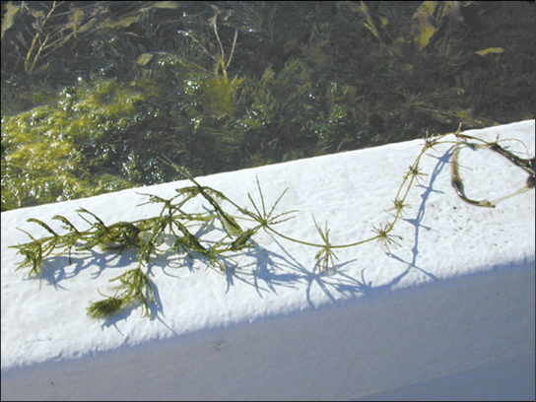
Figure 25.8
Chara. The representative alga, Chara, is a noxious weed in Florida, where it clogs waterways. (credit: South Florida Information Access, U.S. Geological Survey)
Notes:
Chara is a water plant with a long, flexible green stem. Whorls of slender stalks periodically radiate from the stem.

Slide 13
25.3 Bryophytes
Learning Objectives
Identify the main characteristics of bryophytes
Describe the distinguishing traits of liverworts, hornworts, and mosses
Chart the development of land adaptations in the bryophytes
Describe the events in the bryophyte lifecycle

Slide 14
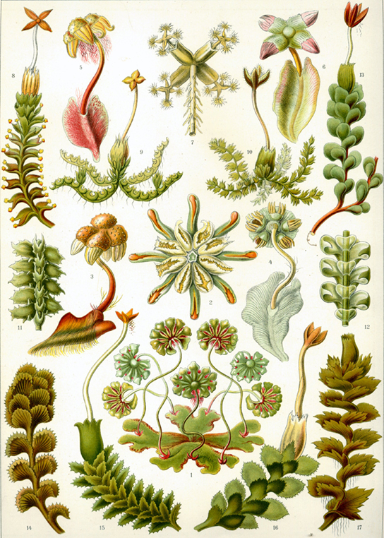
Figure 25.9
Liverworts. This 1904 drawing shows the variety of forms of Marchantiophyta.
Notes:
The illustration shows a variety of liverworts, which all share a branched, leafy structure.

Slide 15
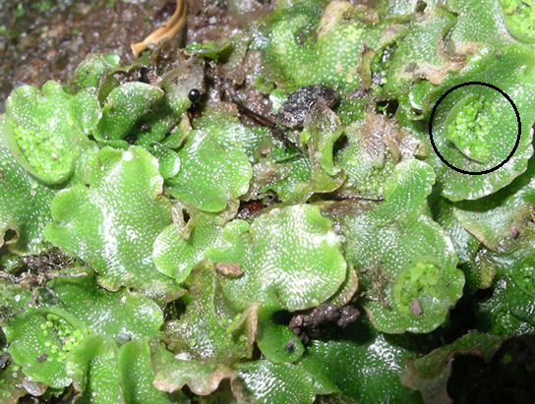
Figure 25.10
Liverwort gametophyte. A liverwort, Lunularia cruciata, displays its lobate, flat thallus. The organism in the photograph is in the gametophyte stage, but has not yet produced gametangia. Lunularia gametophytes produce crescent-shaped gemmae (circled), which contain asexual spores. The tiny white dots on the surface of the thallus are air pores.
Notes:
Photo shows a liverwort with lettuce-like leaves. The gemma cup, described in the paragraph and subsequent life-cycle diagram, is highlighted.

Slide 16
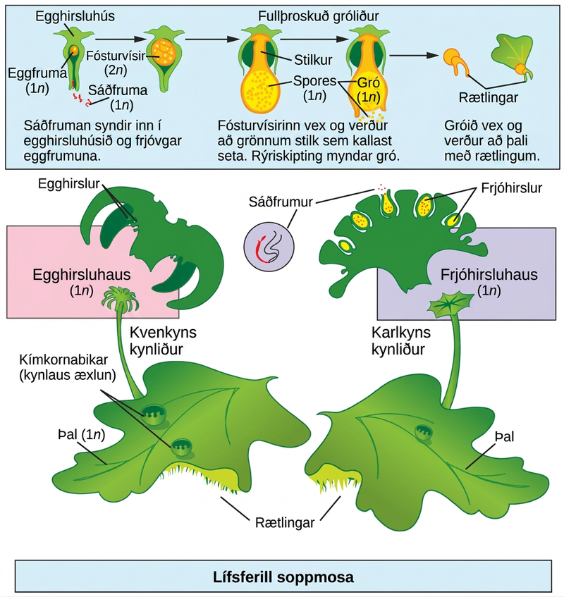
Figure 25.11
Reproductive cycle of liverworts. The life cycle of a typical lobate liverwort is shown. This image shows a liverwort in which antheridia and archegonia are produced on separate gametophytes. (credit: modification of work by Mariana Ruiz Villareal)
Notes:
The liverwort has a flat, leaf-like structure called a thallus, which is haploid (1n). Root-like rhizoids grow from the bottom of the thallus. Gemma cups used for asexual reproduction grow on top of the thallus. A slender stalk extends from the thallus, and a haploid (1n) archegonial head sits at its top. The archegonial head is the female gametophyte. The archegonial head has fronds, like a palm tree. The underside of the archegonial head contains protrusions called archegonia, which house the eggs. Another stalk extends from another thallus, and a haploid (1n) antheridial head sits at its top. The antheridial head is the male gametophyte. The outside of the antheridial head has antheridia which release sperm. The haploid (1n) sperm swim through a hole in the bottom of the archegonium and fertilize the haploid (1n) egg to produce a diploid (2n) embryo. The embryo grows into a stalk called a seta. Meiosis produces haploid (1n) spores in a sac at the tip of the stalk. The sac bursts open, releasing the spores. The spores sprout, producing a new thallus and rhizoids.

Slide 17
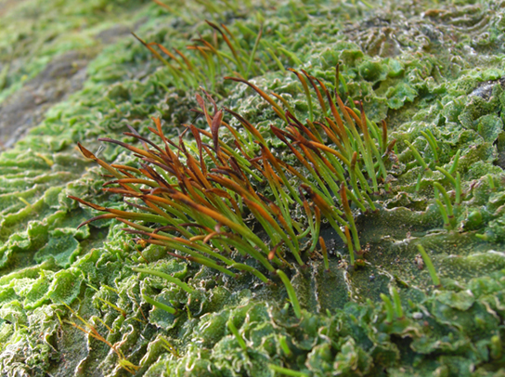
Figure 25.12
Hornwort sporophytes. Hornworts grow a tall and slender sporophyte. (credit: modification of work by Jason Hollinger)
Notes:
The base of the hornwort plant, called the thallus, has a wrinkled, leaf-like appearance. The sporophytes, a cluster of slender green stalks with brown tips, grow from this wrinkled mass.

Slide 18
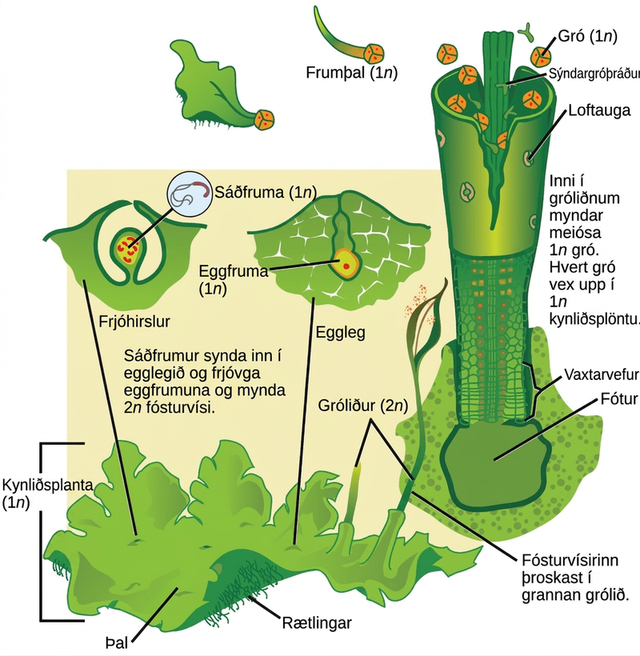
Figure 25.13
Reproductive cycle of hornworts. The alternation of generation in hornworts is shown. (credit: modification of work by “Smith609”/Wikimedia Commons based on original work by Mariana Ruiz Villareal)
Notes:
In hornworts, the gametophyte is a haploid 1 n leaf-like structure with slender stalks called rhizoids underneath. Male sex organs called antheridia produce sperm, and female sex organs called archegonia produce eggs. Both male and female sex organs form just beneath the surface of the gametophyte, and are exposed to the surface as the organs mature. The sperm swims to the egg or is propelled by water. When the egg is fertilized, the embryo grows into a hollow tube-like structure called a sporophyte. Meiosis inside the sporophyte produces haploid 1 n spores. The spores are ejected from the top of the tube. They grow into new gametophytes, completing the cycle.

Slide 19
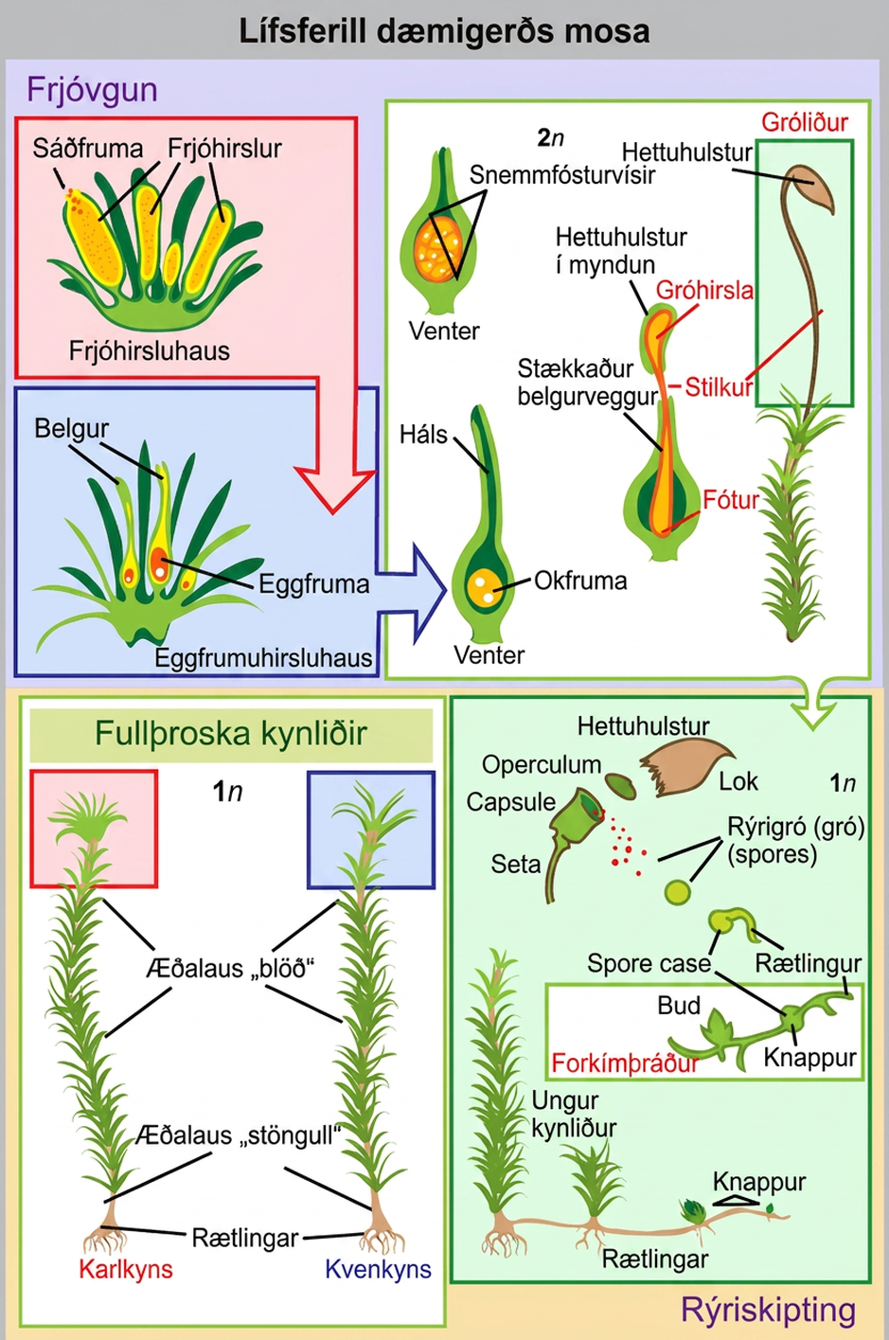
Figure 25.14
Reproductive cycle of mosses. This illustration shows the life cycle of mosses. (credit: modification of work by Mariana Ruiz Villareal)
Notes:
In mosses, the mature haploid (1n) gametophyte is a slender, nonvascular stem with fuzzy, non-vascular leaves. Root-like rhizoids grow from the bottom. Male antheridia and female archegonia grow at the tip of the stem. Sperm fertilize the eggs, producing a diploid (2n) zygote inside a vase-like structure called a venter inside the archegonial head. The embryo grows into a sporophyte that projects like a flower from the vase. The sporophyte undergoes meiosis to produce haploid (1n) spores that grow to produce mature gametophytes, completing the cycle.

Slide 20
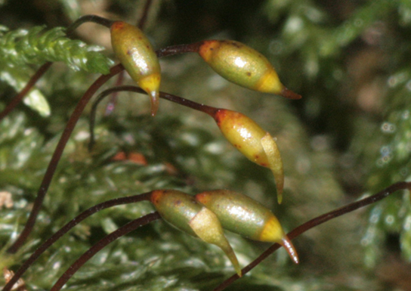
Figure 25.15
Moss sporophyte. This photograph shows the long slender stems, called setae, connected to capsules of the moss Thamnobryum alopecurum. The operculum and remnants of the calyptra are visible in some capsules. (credit: modification of work by Hermann Schachner)
Notes:
In the photo, setae appear as long, slender, bent stems with oval-shaped capsules at the tips.

Slide 21
25.4 Seedless Vascular Plants
Learning Objectives
Identify the new traits that first appear in seedless tracheophytes
Discuss how each trait is important for adaptation to life on land
Identify the classes of seedless tracheophytes
Describe the life cycle of a fern
Explain the role of seedless plants in the ecosystem

Slide 22
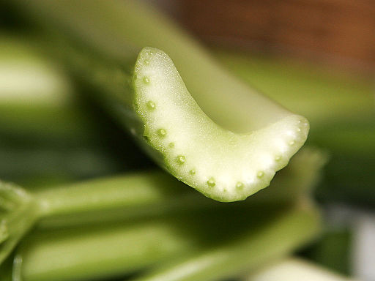
Figure 25.16
Vascular bundles in celery. This cross section of a celery stalk shows a number of vascular bundles. The xylem is on the inner part of each bundle. (credit: fir0002 | flagstaffotos.com.au [GFDL 1.2 (http://www.gnu.org/licenses/old-licenses/fdl-1.2.html)], via Wikimedia Commons. Image modified from source.)
Notes:
Photo shows a cross section of a celery stalk, depicting a number of vascular bundles.

Slide 23
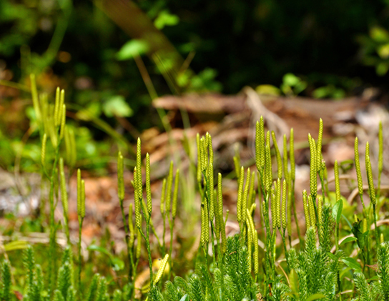
Figure 25.17
Lycopodium. In the club mosses such as Lycopodium clavatum, sporangia are arranged in clusters called strobili. The generic name means "wolf-foot" from the resemblance of the branched sporophyte to a paw. The specific epithet clavatum refers to the club-shaped strobilus, and reflects the common name of the phylum. (credit: Cory Zanker)
Notes:
In the photo, seed-like strobili are arranged around the slender stalks of a club moss.

Slide 24
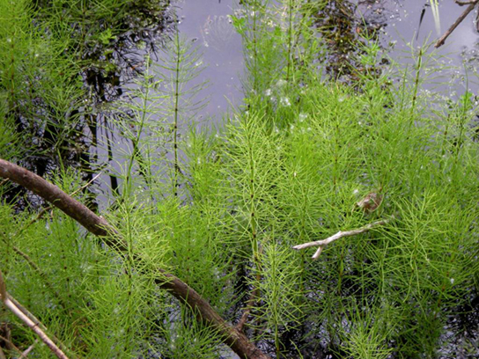
Figure 25.18
Horsetails. Horsetails, named for the brushy appearance of the sporophyte, thrive in a marsh. (credit: Myriam Feldman)
Notes:
In the photo, bushy horsetail plants grow in water.

Slide 25
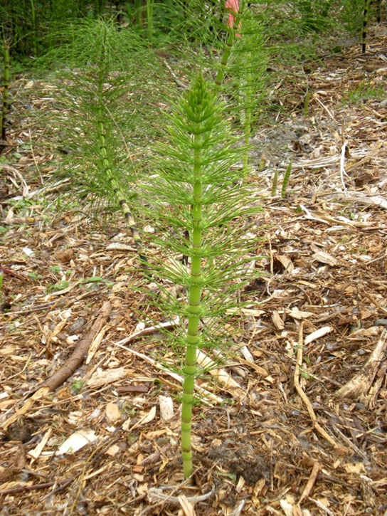
Figure 25.19
The jointed stem of a horsetail. Thin leaves originating at the joints are noticeable on the horsetail plant. Because silica deposited in the cell walls made these plants abrasive, horsetails were once used as scrubbing brushes and were nicknamed scouring rushes. (credit: Myriam Feldman)
Notes:
Photo shows a horsetail plant, which resembles a scrub brush, with a thick stem and whorls of thin leaves branching from the stem.

Slide 26
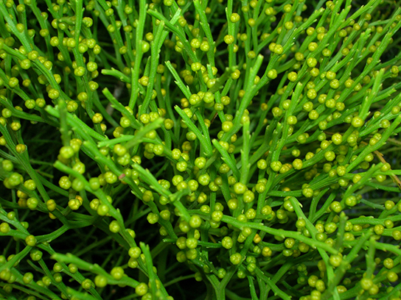
Figure 25.20
Psilotum. The whisk fern Psilotum nudum has conspicuous green stems with knob-shaped sporangia. (credit: Forest & Kim Starr)
Notes:
Photo shows a whisk fern with many green stems that have small knobs along their length.

Slide 27
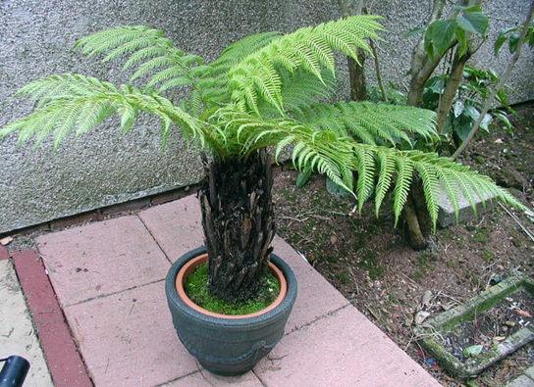
Figure 25.21
A tree fern. Some specimens of this short tree-fern species can grow very tall. (credit: Adrian Pingstone)
Notes:
Photo shows a potted tree fern.

Slide 28
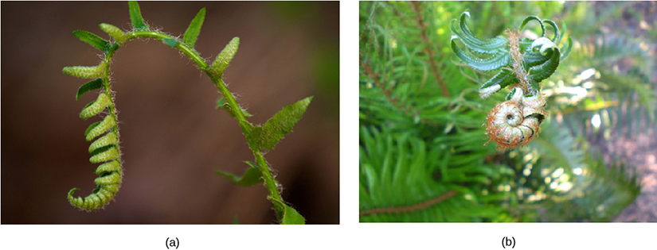
Figure 25.22
Fern fiddleheads. Croziers, or fiddleheads, are the tips of fern fronds. (credit a: modification of work by Cory Zanker; credit b: modification of work by Myriam Feldman)
Notes:
Fiddleheads at the top of a maturing fern curl into a structure that resembles their namesake.

Slide 29
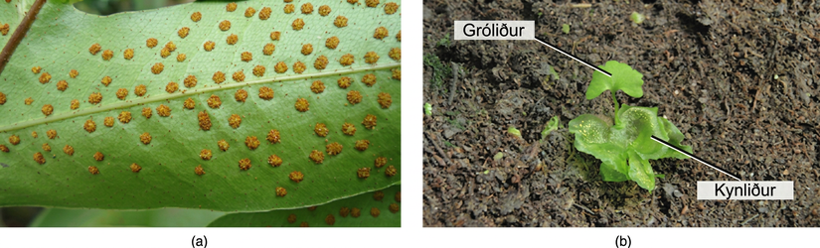
Figure 25.23
Fern reproductive stages. Sori (a) appear as small bumps on the underside of a fern frond. (credit: Myriam Feldman). (b) Fern gametophyte and young sporophyte. The sporophyte and gametophyte are labeled. (credit: modification of work by "Vlmastra"/Wikimedia Commons)
Notes:
Photo A shows small bumps called sori on the underside of a fern frond. Photo B shows a young sporophyte with a fan-shaped leaf growing from a lettuce-like gametophyte.

Slide 30
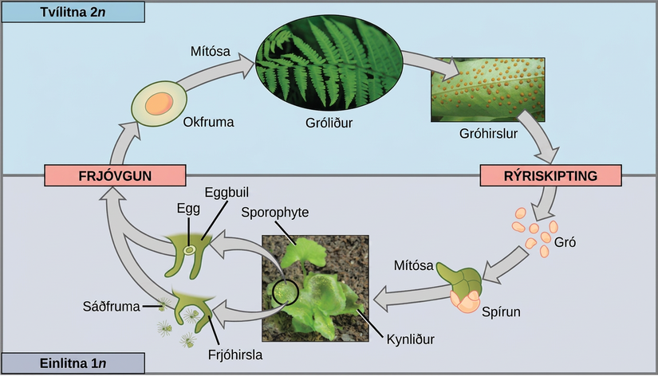
Figure 25.24
Reproductive cycle of a fern. This life cycle of a fern shows alternation of generations with a dominant sporophyte stage. (credit "fern": modification of work by Cory Zanker; credit "gametophyte": modification of work by "Vlmastra"/Wikimedia Commons)
Notes:
The fern life cycle begins with a diploid (2n) sporophyte, which is the fern plant. Sporangia are found on the bottom of the leaves. Sporangia undergo meiosis to form haploid (1n) spores. The spores germinate and grow into a haploid (1n) green gametophyte that resembles lettuce. The gametophyte contains antheridia that produce sperm, and archegonia that produce eggs. Inside the archegonium the sperm fertilizes the egg, forming a diploid (2n) zygote. The zygote undergoes mitosis to form a diploid (2n) sporophyte, ending the cycle.

Slide 31
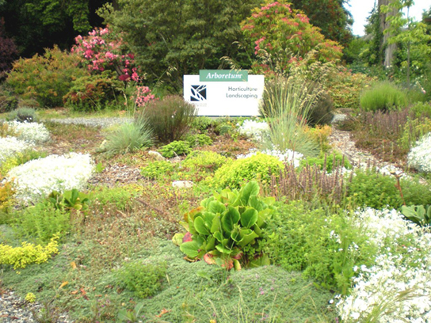
Figure 25.25
This landscaped border at a college campus was designed by students in the horticulture and landscaping department of the college. (credit: Myriam Feldman)
Notes:
Photo shows a landscaped garden with a variety of flowers and bushes.

Slide 32
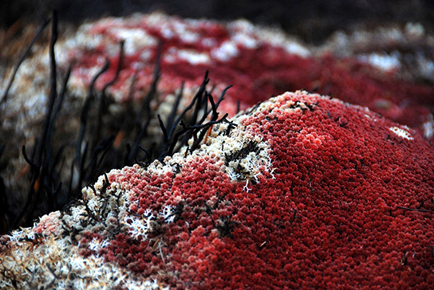
Figure 25.26
Sphagnum moss. Sphagnum acutifolium is dried peat moss and can be used as fuel. (credit: Ken Goulding)
This OpenStax ancillary resource is © Rice University under a CC BY-NC-SA 4.0 International license; it may be reproduced or modified for noncommercial purposes only but must be attributed to OpenStax, Rice University and any changes must be noted. Any adaptation must be shared under the same type of license.
Notes:
The Sphagnum in the photo has the appearance of a bumpy red carpet with protruding black stalks.

