Slide 1

Biology 2e
Chapter 23 Protists

Slide 2
Chapter outline
Eukaryotic Origins
Characteristics of Protists
Groups of Protists
Ecology of Protists

Slide 3
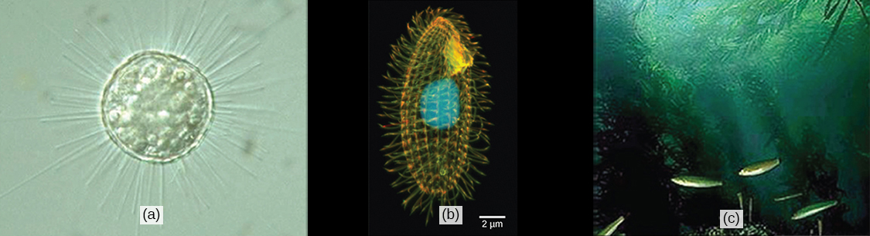
Figure 23.1
Protists range from the microscopic, single-celled (a) Acanthocystis turfacea and the (b) ciliate Tetrahymena thermophila, both visualized here using light microscopy, to the enormous, multicellular (c) kelps (Chromalveolata) that extend for hundreds of feet in underwater “forests.” (credit a: modification of work by Yuiuji Tsukii; credit b: modification of work by Richard Robinson, Public Library of Science; credit c: modification of work by Kip Evans, NOAA; scale-bar data from Matt Russell)
Notes:
Part a is a micrograph of a round, transparent single-celled organism with long thin spines. Part b is a micrograph of an oval, transparent organism with ridges running along its length. The nucleus is visible as a large, round sphere. Cilia extend from the surface of the organism. Part c is an underwater photo of a kelp forest growing from the seabed.

Slide 4
23.1 Eukaryotic Origins
Learning Objectives
List the unifying characteristics of eukaryotes
Describe what scientists know about the origins of eukaryotes based on the last common ancestor
Explain the endosymbiotic theory

Slide 5
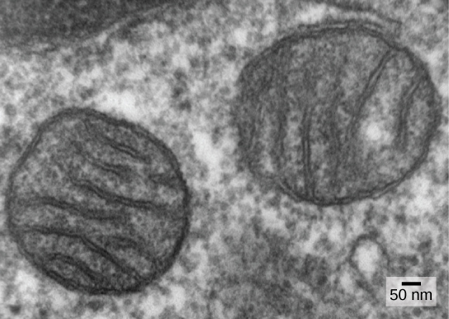
Figure 23.2
Mitochondria. In this transmission electron micrograph of mitochondria in a mammalian lung cell, the cristae, infoldings of the mitochondrial inner membrane, can be seen in cross-section. (credit: Louise Howard)
Notes:
This micrograph shows two round, membrane-bound organelles inside a cell. The organelles are about 400 nanometers (about 0.4 microns) across and have membranes running through the middle of them.

Slide 6
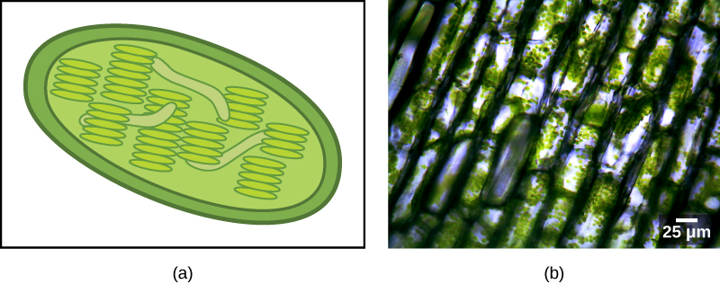
Figure 23.3
Chloroplasts. (a) This chloroplast cross-section illustrates its elaborate inner membrane organization. Stacks of thylakoid membranes compartmentalize photosynthetic enzymes and provide scaffolding for chloroplast DNA. (b) In this micrograph of Elodea sp., the chloroplasts can be seen as small green spheres. (credit b: modification of work by Brandon Zierer; scale-bar data from Matt Russell)
Notes:
The illustration A shows a green, oval chloroplast with an outer membrane and an inner membrane. Thylakoids are disk-shaped and stack together like poker chips. Image B is a micrograph showing rectangular shapes that have small green spheres within.

Slide 7
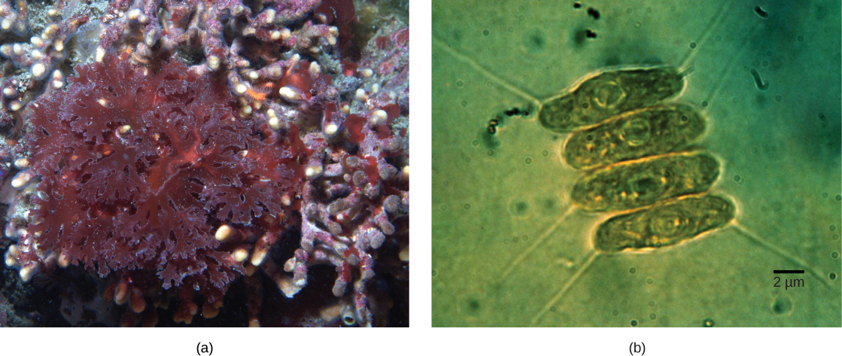
Figure 23.4
Algae. (a) Red algae and (b) green algae (seen here by light microscopy) share similar DNA sequences with photosynthetic cyanobacteria. Scientists speculate that, in a process called endosymbiosis, an ancestral prokaryote engulfed a photosynthetic cyanobacterium that evolved into modern-day chloroplasts. (credit a: modification of work by Ed Bierman; credit b: modification of work by G. Fahnenstiel, NOAA; scale-bar data from Matt Russell)
Notes:
Part a shows red algae with lettuce-like leaves. Part b shows four oval green algae cells stacked next to each other. The green algae cells are about 2 micrometers across and 10 micrometers long.

Slide 8
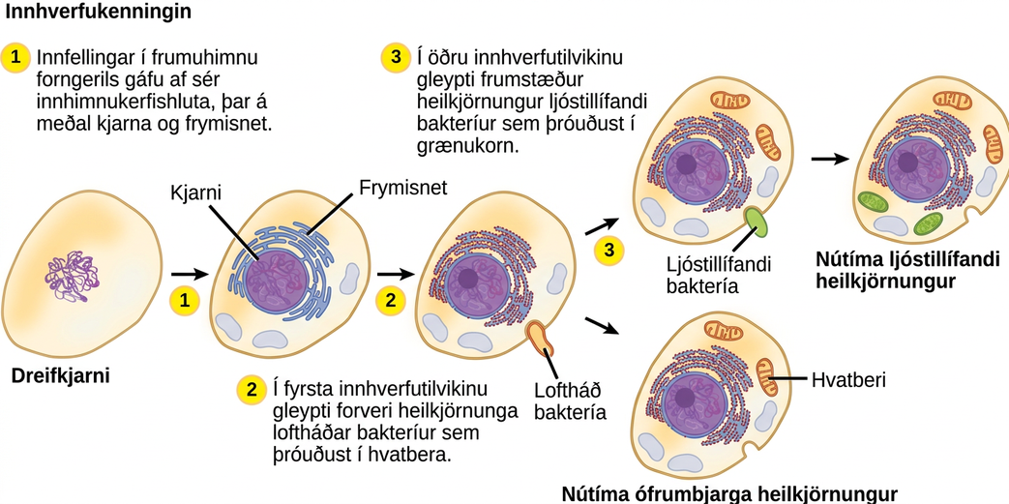
Figure 23.5
The Endosymbiotic Theory. The first eukaryote may have originated from an ancestral prokaryote that had undergone membrane proliferation, compartmentalization of cellular function (into a nucleus, lysosomes, and an endoplasmic reticulum), and the establishment of endosymbiotic relationships with an aerobic prokaryote, and, in some cases, a photosynthetic prokaryote, to form mitochondria and chloroplasts, respectively.
Notes:
The illustration shows steps that, according to the endosymbiotic theory, gave rise to eukaryotic organisms. In step 1, infoldings in the plasma membrane of an ancestral prokaryote gave rise to endomembrane components, including a nucleus and endoplasmic reticulum. In step 2, the first endosymbiotic event occurred: The ancestral eukaryote consumed aerobic bacteria that evolved into mitochondria. The results of step 2 branch in two directions. One direction led to modern heterotrophic eukaryotes with mitochondria but no chloroplasts. The other direction led to step 3, a second endosymbiotic event, where the early eukaryote consumed photosynthetic bacteria that evolved into chloroplasts. Step 3 led to modern photosynthetic eukaryotes with both mitochondria and chloroplasts.

Slide 9
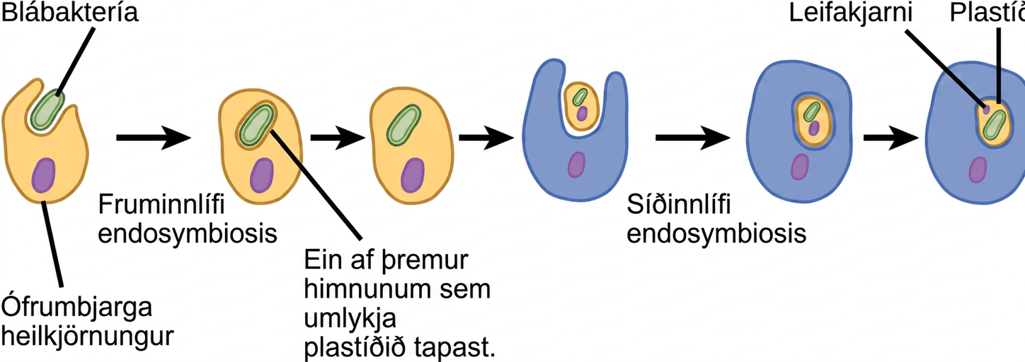
Figure 23.6
Secondary endosymbiosis. The hypothesized process of several endosymbiotic events leading to the evolution of chlorarachniophytes is shown. In a primary endosymbiotic event, a heterotrophic eukaryote consumed a cyanobacterium. In a secondary endosymbiotic event, the cell resulting from primary endosymbiosis was consumed by a second cell. The resulting organelle became a plastid in modern chlorarachniophytes.
Notes:
According to the secondary endosymbiosis theory, plastids in modern chlorarachniophytes arose via two endosymbiotic events. In the first event, a cyanobacterium was engulfed by a heterotrophic eukaryote. Cyanobacteria have two membranes and the endosymbiosis event gave rise to a third membrane. One of these membranes was lost. Then, in a second endosymbiotic event, the cell was engulfed by another cell. The first cell became a plastid, an organelle with a vestigial nucleus and an organelle membrane inside it; thus, the plastid has the appearance of a cell within a cell.

Slide 10
23.2 Characteristics of Protists
Learning Objectives
Describe the cell structure characteristics of protists
Describe the metabolic diversity of protists
Describe the life cycle diversity of protists

Slide 11
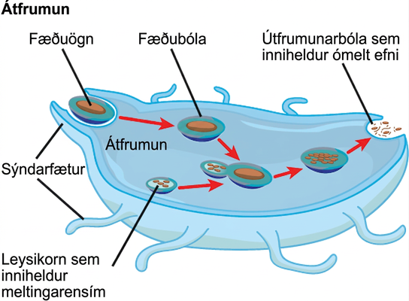
Figure 23.7
Phagocytosis. The stages of phagocytosis include the engulfment of a food particle, the digestion of the particle using hydrolytic enzymes contained within a lysosome, and the expulsion of undigested materials from the cell.
Notes:
In this illustration, a eukaryotic cell is shown consuming a food particle. As the food particle is consumed, it is encapsulated in a vacuole. The vacuole fuses with a lysosome, and proteins inside the lysosome digest the food particle. Indigestible waste material is ejected from the cell when an exocytic vesicle fuses with the plasma membrane.

Slide 12
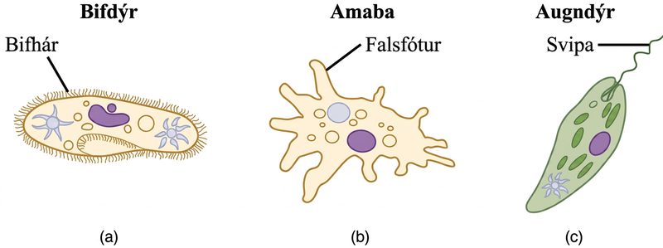
Figure 23.8
Locomotor organelles in protists. Protists use various methods for transportation. (a) Paramecium waves hair-like appendages called cilia to propel itself. (b) Amoeba uses lobe-like pseudopodia to anchor itself to a solid surface and pull itself forward. (c) Euglena uses a whip-like tail called a flagellum to propel itself.
Notes:
Part a shows a shoe-shaped Paramecium, which is covered with fine, hair-like cilia. Part b shows an Amoeba, which is irregular in shape with long extensions of cytoplasm jutting out from the main body. The extensions are called pseudopods. Part c shows an oval Euglena, which has a narrow front end. A long, whip-like flagellum protrudes from the back end.

Slide 13
23.3 Groups of Protists (1 of 2)
Learning Objectives
Describe representative protist organisms from each of the six presently recognized supergroups of eukaryotes
Identify the evolutionary relationships of plants, animals, and fungi within the six presently recognized supergroups of eukaryotes

Slide 14
23.3 Groups of Protists (2 of 2)
Learning Objectives
Identify defining features of protists in each of the six supergroups of eukaryotes.

Slide 15
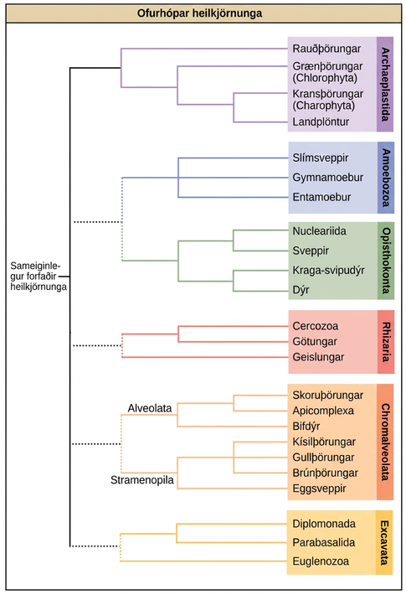
Figure 23.9
Eukaryotic supergroups. This diagram shows a proposed classification of the domain Eukarya. Currently, the domain Eukarya is divided into six supergroups. Within each supergroup are multiple kingdoms. Although each supergroup is believed to be monophyletic, the dotted lines suggest evolutionary relationships among the supergroups that continue to be debated.
Notes:
This image displays a proposed protist phylogeny. On the left, a common eukaryotic ancestor has one solid branch and other dotted branches connecting it to six supergroups. The solid branch leads to supergroup Archaeplastida. Within Archaeplastida, red algae branch off first, then Chlorophytes (a type of green algae), and finally Charophytes (another type of green algae) and land plants split. The first dotted branch splits into supergroups Amoebozoa and Opisthokonta. Amoebozoa includes slime molds, Gymnamoebas, and Entamoebas. Opisthokonta splits into one sub-branch containing fungi and Nucleariids, and another sub-branch containing Choanoflagellates and animals. The second dotted branch leads to supergroup Rhizaria, within which Radiolarians branch off first, and then forams and Cercozoans split. The third dotted branch leads to supergroup Chromalveolata, which is broken into two named sub-branches, the Alveolates and the Stramenopiles. Within the Alveolates sub-branch, Ciliates branch off first, then Dinoflagellates and Apicomplexans split. Within the Stramenopiles sub-branch, Oomycetes branch off first, then diatoms, golden algae, and brown algae split. The last dotted branch leads to supergroup Excavata, within which Euglenozoans branch off first, then Diplomonads and Parabasalids split.

Slide 16
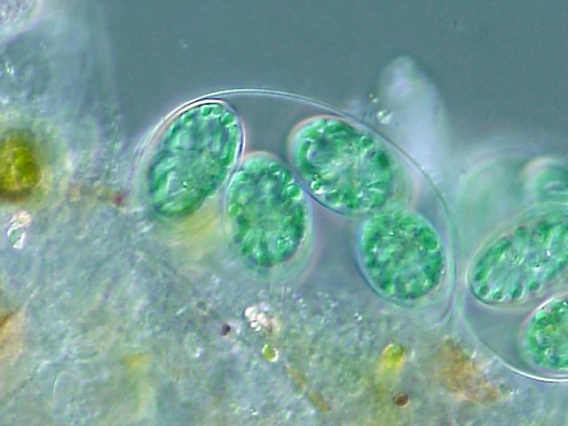
Figure 23.10
Glaucocystis. (credit: By ja:User:NEON / commons:User:NEON_ja - Own work, CC BY-SA 2.5, https://commons.wikimedia.org/w/index.php?curid=1706641)
Notes:
This light micrograph image shows Glaucocystis colonies comprised of green, oval-shaped cells loosely bound together by the extended cell wall of a prior generation.

Slide 17
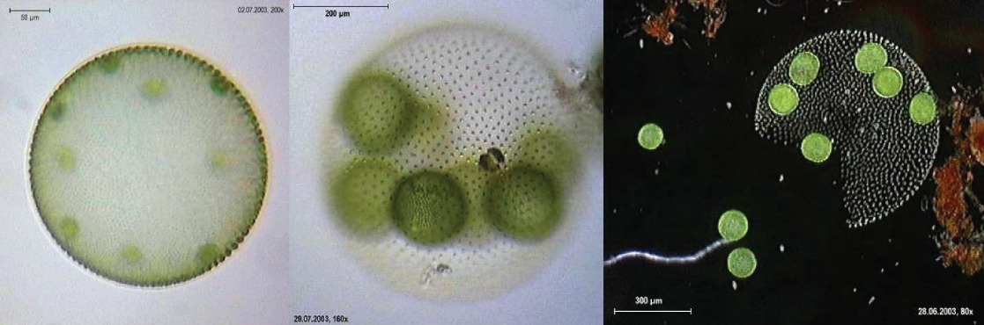
Figure 23.11
Volvox. Volvox aureus is a green alga in the supergroup Archaeplastida. This species exists as a colony, consisting of cells immersed in a gel-like matrix and intertwined with each other via hair-like cytoplasmic extensions. (credit: Dr. Ralf Wagner)
Notes:
The micrograph on the left shows a sphere about 400 microns across with round green cells about 50 microns across inside. The middle micrograph shows a similar view at higher magnification. The micrograph on the right shows a broken sphere that has released some of the cells, while other cells remain inside.

Slide 18
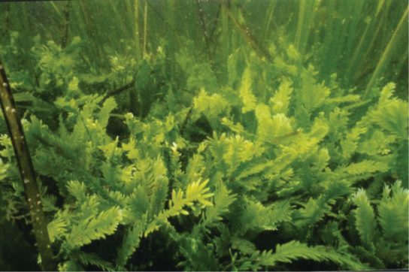
Figure 23.12
A multinucleate alga. Caulerpa taxifolia is a chlorophyte consisting of a single cell containing potentially thousands of nuclei. (credit: NOAA). An interesting question is how a single cell can produce such complex shapes.
Notes:
This underwater photo shows fern-like plants growing on the sea bottom.

Slide 19
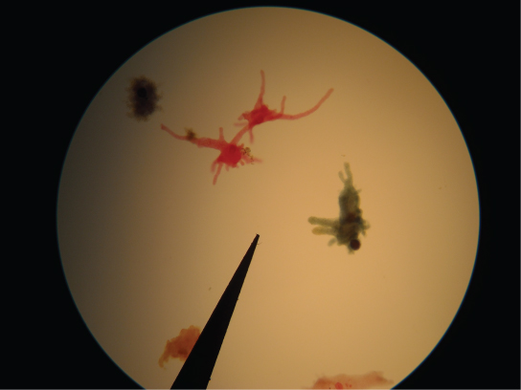
Figure 23.13
Amoeba. Amoebae with tubular and lobe-shaped pseudopodia are seen under a microscope. These isolates would be morphologically classified as amoebozoans.
Notes:
The micrograph shows amoebas with lobe-like pseudopodia.

Slide 20
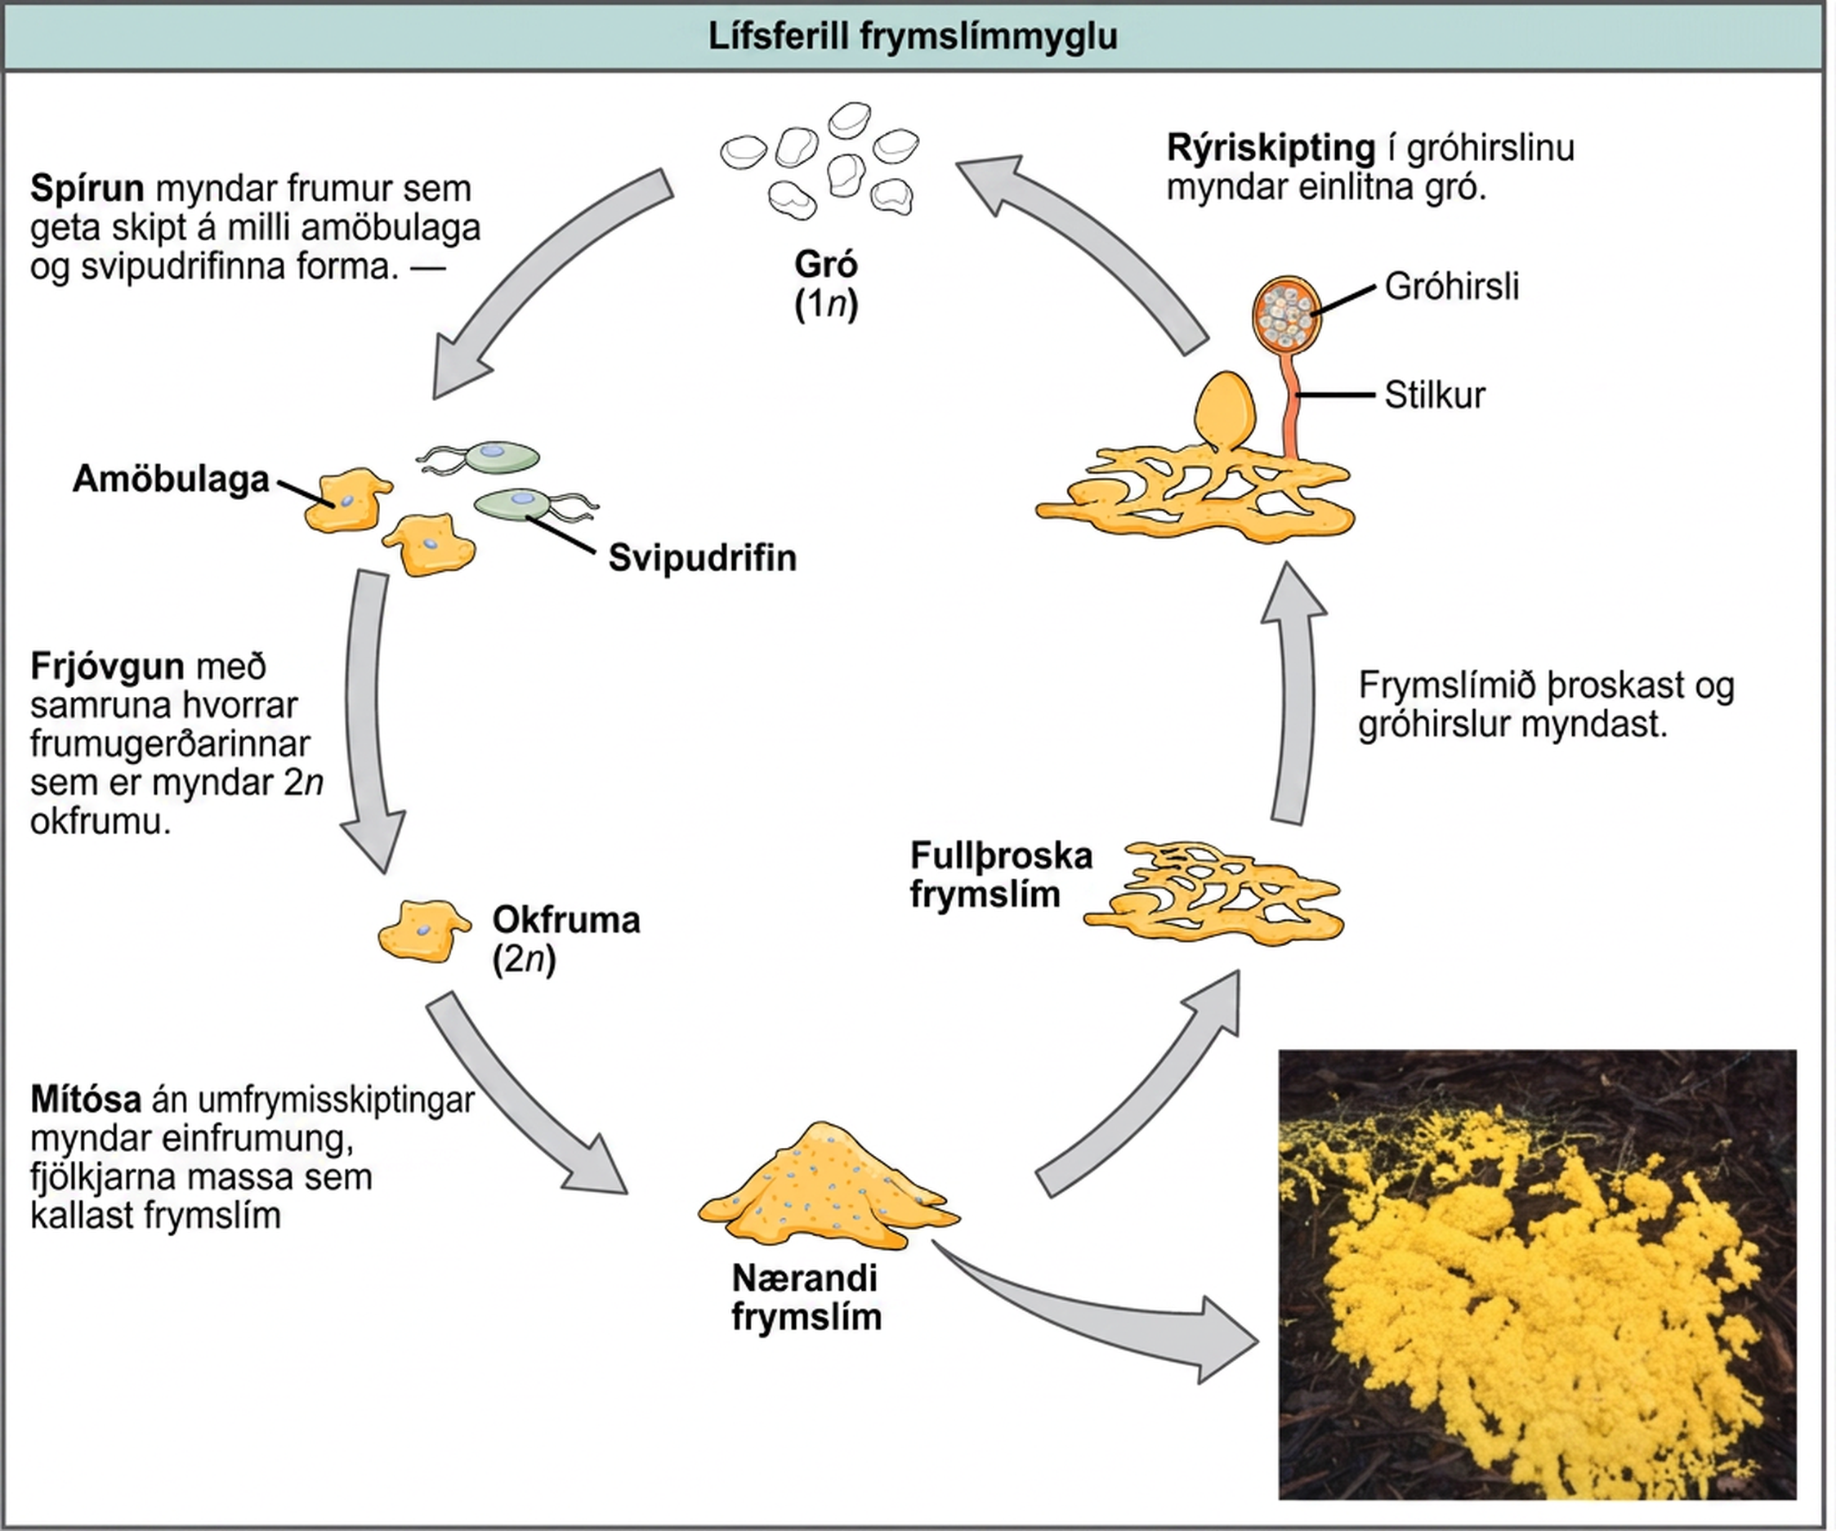
Figure 23.14
Plasmodial slime molds. The life cycle of the plasmodial slime mold is shown. The brightly colored plasmodium in the inset photo is a single-celled, multinucleate mass. (credit: modification of work by Dr. Jonatha Gott and the Center for RNA Molecular Biology, Case Western Reserve University)
Notes:
Illustration shows the plasmodium slime mold life cycle, which begins when 1n spores germinate, giving rise to cells that can convert between amoeboid and flagellated forms. Fertilization by fusion of either cell type results in a 2n zygote. The zygote undergoes mitosis without cytokinesis, resulting in a single-celled, multinucleate mass called a plasmodium, which is visible to the naked eye. A photo inset shows that the plasmodium is bright yellow and looks like vomit. As the plasmodium matures, holes form in the center of the mass. Stalks with bulb-shaped sporangia at the top grow up from the mass. Spores are released when the sporangia burst open, completing the cycle.

Slide 21
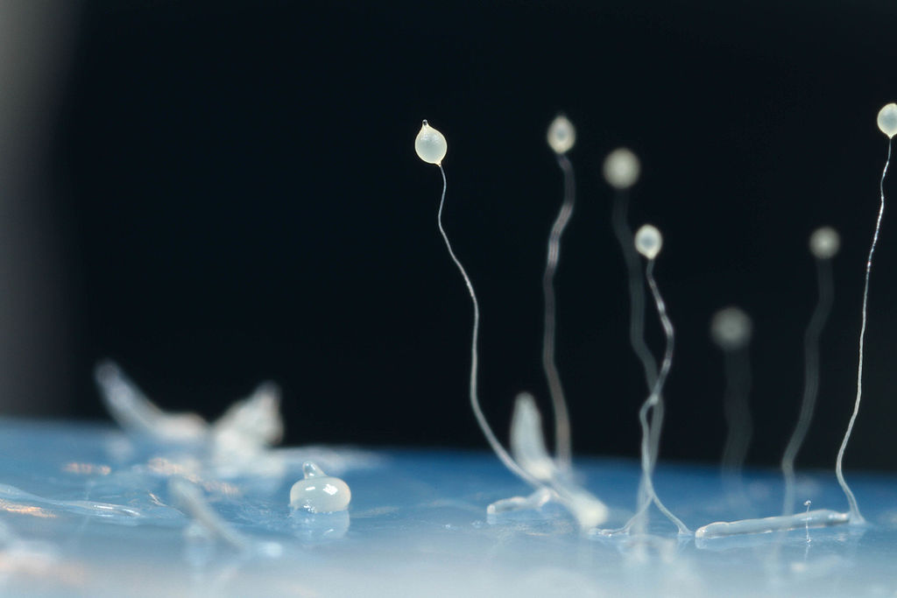
Figure 23.15
Cellular Slime Mold. The image shows several stages in the life cycle of Dictyostelium discoideum, including aggregated cells, mobile slugs and their transformation into fruiting bodies with a cluster of spores supported by a stalk. (credit: By Usman Bashir (Own work) [CC BY-SA 4.0 (http://creativecommons.org/licenses/by-sa/4.0)], via Wikimedia Commons)
Notes:
The image shows several stages in the life cycle of Dictyostelium discoideum. It appears as fibers or very thin stalks topped with circular structures

Slide 22
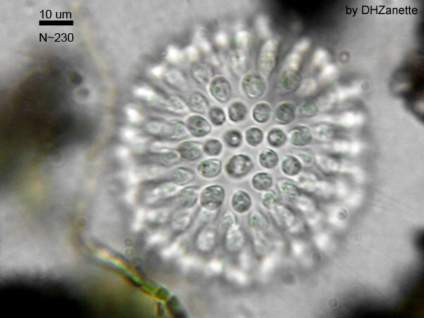
Figure 23.16
A Colonial Choanoflagellate. (credit: By Dhzanette (http://en.wikipedia.org/wiki/Choanoflagellate) [Public domain], via Wikimedia Commons)
Notes:
A micrograph shows a colonial Choanoflagellate. It appears to be a central structure with a series of circular cells on its surface.

Slide 23
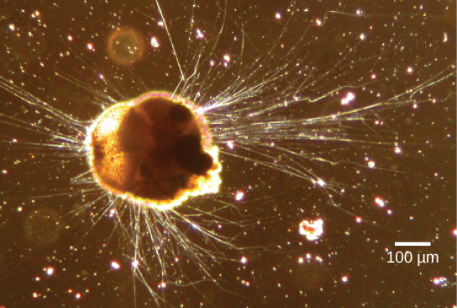
Figure 23.17
Rhizaria. Ammonia tepida, a Rhizaria species viewed here using phase contrast light microscopy, exhibits many threadlike pseudopodia. It also has a chambered calcium carbonate shell or test. (credit: modification of work by Scott Fay, UC Berkeley; scale-bar data from Matt Russell)
Notes:
The micrograph shows a semi-round cell with long, hair-like projections extending from it.

Slide 24
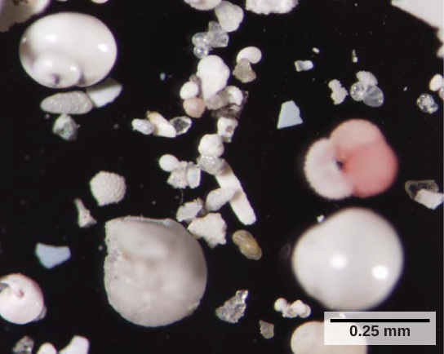
Figure 23.18
Foraminiferan Tests. These shells from foraminifera sank to the sea floor. (credit: Deep East 2001, NOAA/OER)
Notes:
The photo shows small, white shells that look like clamshells, and shell fragments. Each cell is about 0.25 m m across.

Slide 25
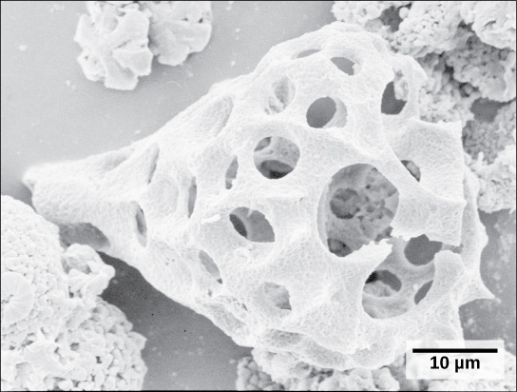
Figure 23.19
Radiolarian shell. This fossilized radiolarian shell was imaged using a scanning electron microscope. (credit: modification of work by Hannes Grobe, Alfred Wegener Institute; scale-bar data from Matt Russell)
Notes:
The micrograph shows a tear drop-shaped white structure reminiscent of a shell. The structure is hollow and perfused with circular holes.

Slide 26
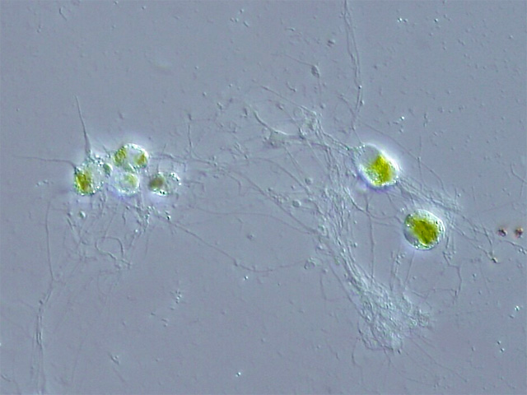
Figure 23.20
A Chlorarachniophyte. This rhizarian is mixotrophic, and can obtain nutrients both by photosynthesis and by trapping various microorganisms with its network of pseudopodia. (credit: By ja:User:NEON / commons:User:NEON_ja (Own work) [CC BY-SA 2.5 (http://creativecommons.org/licenses/by-sa/2.5) or CC BY-SA 2.5 (http://creativecommons.org/licenses/by-sa/2.5)], via Wikimedia Commons)
Notes:
Image is a Chlorarachniophyte. It appears as a series of green cells with what appear to be fibers surrounding and connecting them.

Slide 27
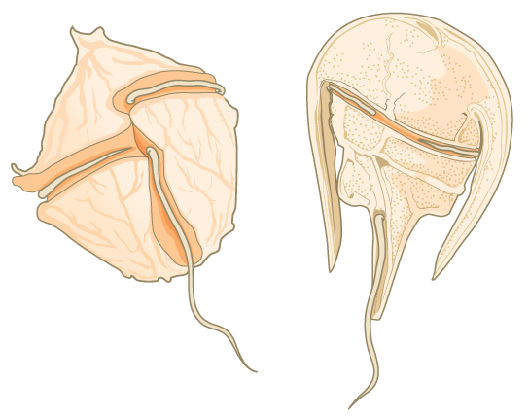
Figure 23.21
Dinoflagellates. The dinoflagellates exhibit great diversity in shape. Many are encased in cellulose armor and have two flagella that fit in grooves between the plates. Movement of these two perpendicular flagella causes a spinning motion.
Notes:
The illustration shows two dinoflagellates. The first is walnut-shaped, with a groove around the middle and another perpendicular groove that starts at the middle and extends back. Flagella fit in each groove. The second dinoflagellate is horseshoe-shaped, with the body extending from the wide part of the horseshoe toward the narrow end. Like the first dinoflagellate, this one has two perpendicular grooves, each containing a flagellum.

Slide 28
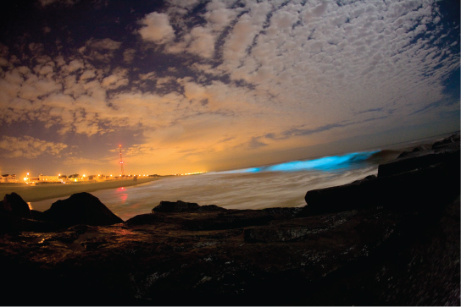
Figure 23.22
Dinoflagellate bioluminescence. Bioluminescence is emitted from dinoflagellates in a breaking wave, as seen from the New Jersey coast. (credit: “catalano82”/Flickr)
Notes:
The breaking wave in this photo is an iridescent blue color.

Slide 29
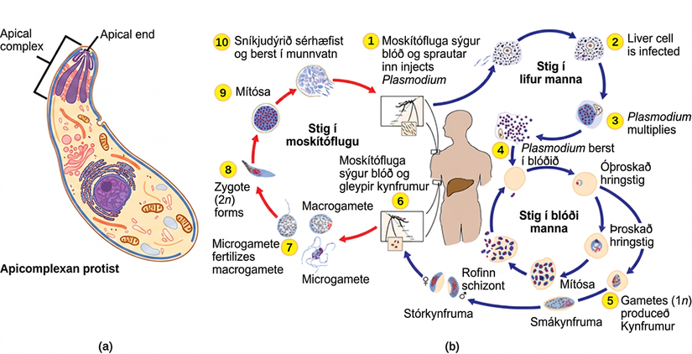
Figure 23.23
Apicomplexa. (a) Apicomplexans are parasitic protists. They have a characteristic apical complex that enables them to infect host cells. (b) Plasmodium, the causative agent of malaria, has a complex life cycle typical of apicomplexans. (credit b: modification of work by CDC)
Notes:
Illustration A shows an oval cell that has a narrow end and a wide end. The apical complex is located at the narrow end. The three branches of this complex narrow and join at the apical, or narrow, end of the cell. Illustration b shows the life cycle of Plasmodium, which causes malaria. The plasmodium life cycle begins when a mosquito takes a blood meal and injects Plasmodium into the bloodstream. The Plasmodium enters the liver where it multiplies, and eventually reenters the blood. In the blood it enters the ring stage, so called because the cell is curled into a ring shape. The Ring stage may multiply by mitosis or it may undergo meiosis, forming new 1n gametes of male or female sex types. When a mosquito takes a blood meal from an infected host the gametes are ingested. A smaller gamete sex type, called a microgamete, fertilizes a larger sex type, called a macrogamete, producting a 2n zygote. The zygote undergoes mitosis and differentiation. It enters the saliva where it can be injected into another host, completing the cycle.

Slide 30
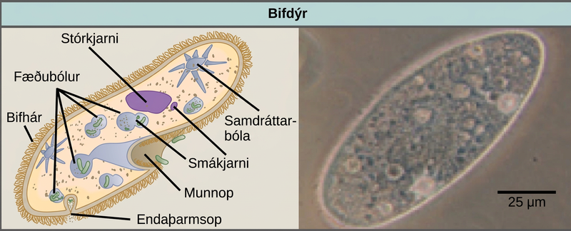
Figure 23.24
Paramecium. Paramecium has a primitive mouth (called an oral groove) to ingest food, and an anal pore to eliminate waste. Contractile vacuoles allow the organism to excrete excess water. Cilia enable the organism to move. (credit “paramecium micrograph”: modification of work by NIH; scale-bar data from Matt Russell)
Notes:
The illustration on the left shows a shoe-shaped Paramecium. Short, hair-like cilia cover the outside of the cell. Inside are food vacuoles, a large macronucleus, and a small micronucleus. The Paramecium has two star-shaped contractile vacuoles. The mouth pore is an indentation located just where the foot narrows. A small opening called the anal pore is located at the wide end of the cell. The micrograph on the right is a Paramecium, which is about 50 microns across and 150 microns long.

Slide 31
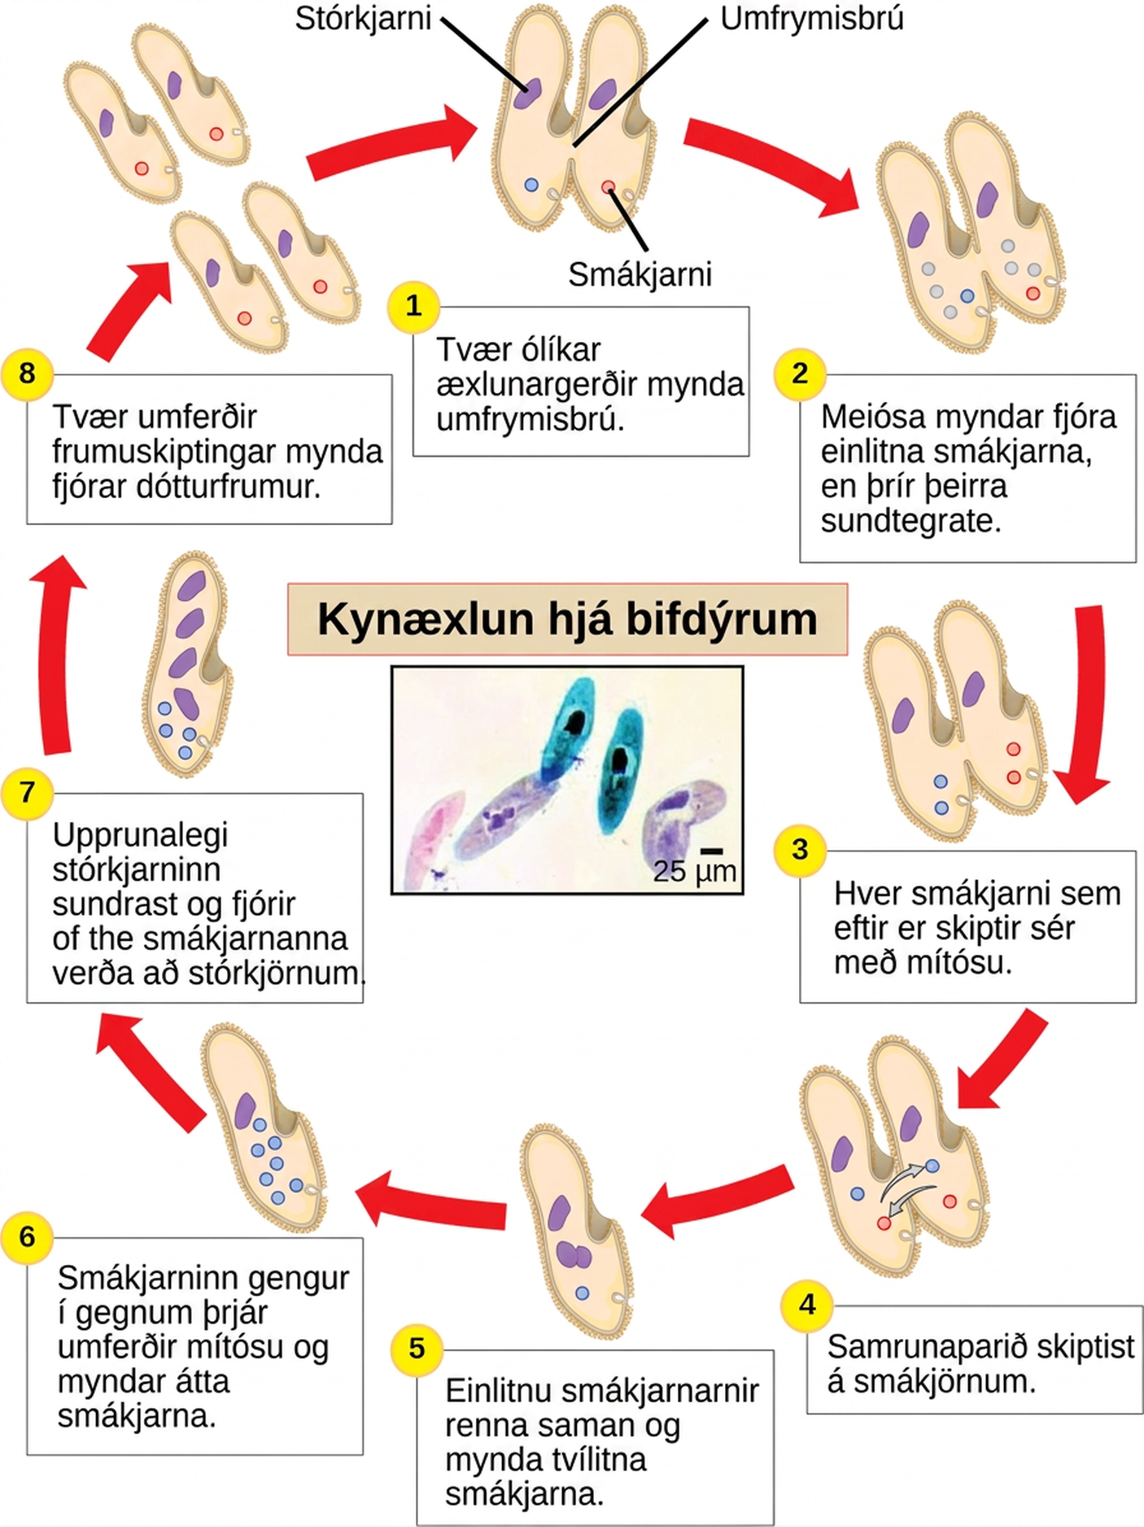
Figure 23.25
Conjugation in Paramecium. The complex process of sexual reproduction in Paramecium creates eight daughter cells from two original cells. Each cell has a macronucleus and a micronucleus. During sexual reproduction, the macronucleus dissolves and is replaced by a micronucleus. (credit “micrograph”: modification of work by Ian Sutton; scale-bar data from Matt Russell)
Notes:
The illustration shows the life cycle of Paramecium. The cycle begins (step 1) when two different mating types form a cytoplasmic bridge, becoming a conjugate pair. Each Paramecium has a macronucleus and a micronucleus. The micronuclei undergo meiosis (step 2), resulting in four haploid micronuclei in each parent cell. Three of these micronuclei disintegrate. The remaining micronuclei divide once by mitosis (step 3), resulting in two micronuclei per cell. The parent cells swap one of these micronuclei (step 4). The two haploid micronuclei then fuse, forming a diploid micronucleus (step 5). The micronucleus undergoes three rounds of mitosis (step 6), resulting in eight micronuclei. The original macronucleus dissolves, and four of the micronuclei become macronuclei (step 7). Two rounds of cell division (step 8) result in four daughter cells per each parent cell, each with one macronucleus and one micronucleus.

Slide 32
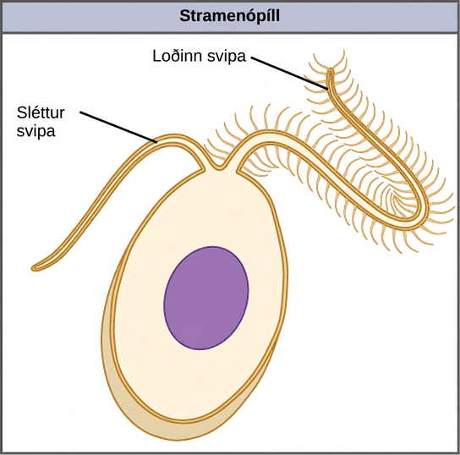
Figure 23.26
Stramenopile flagella. This stramenopile cell has a single hairy flagellum and a secondary smooth flagellum.
Notes:
The illustration shows an egg-shaped stramenopile cell. Protruding from the narrow end of the cell is one hairless flagellum and one hairy flagellum.

Slide 33
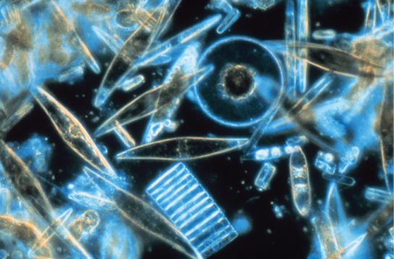
Figure 23.27
Diatoms. Assorted diatoms, visualized here using light microscopy, live among annual sea ice in McMurdo Sound, Antarctica. Diatoms range in size from 2 to 200 µm. (credit: Prof. Gordon T. Taylor, Stony Brook University, NSF, NOAA)
Notes:
This micrograph shows translucent blue diatoms, which range widely in size and shape. Many are tube- or diamond-shaped. One is disk-shaped with a visible hub. Another looks like a disk viewed from the end, with grooves in it.

Slide 34
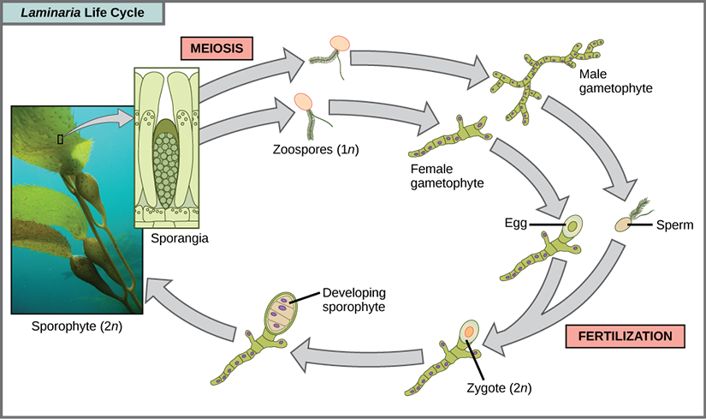
Figure 23.28
Alternation of generations in a brown alga. Several species of brown algae, such as the Laminaria shown here, have evolved life cycles in which both the haploid (gametophyte) and diploid (sporophyte) forms are multicellular. The gametophyte is different in structure than the sporophyte. (credit “laminaria photograph”: modification of work by Claire Fackler, CINMS, NOAA Photo Library)
Notes:
The life cycle of the brown algae, Laminaria, begins when sporangia undergo meiosis, producing 1 n zoospores. The zoospores undergo mitosis, producing multicellular male and female gametophytes. The female gametophyte produces eggs, and the male gametophyte produces sperm. The sperm fertilizes the egg, producing a 2 n zygote. The zygote undergoes mitosis, producing a multicellular sporophyte. The mature sporophyte produces sporangia, completing the cycle. A photo inset shows the sporophyte stage, which resembles a plant with long, flat blade-like leaves attached to green stalks via bladder like connections. Both the blade and stalks are submerged. Sporangia are associated with the leaf like structures.

Slide 35
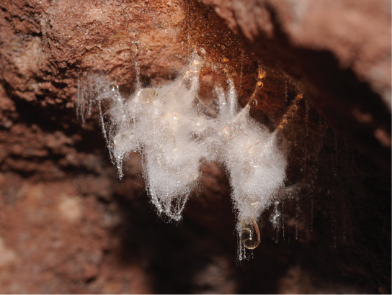
Figure 23.29
Oomycetes. A saprobic oomycete engulfs a dead insect. (credit: modification of work by Thomas Bresson)
Notes:
The photo shows a mucous-like mass, covered in white fuzz, hanging from a rock.

Slide 36
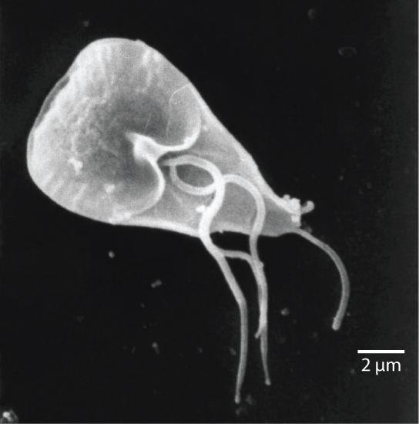
Figure 23.30
Giardia. The mammalian intestinal parasite Giardia lamblia, visualized here using scanning electron microscopy, is a waterborne protist that causes severe diarrhea when ingested. (credit: modification of work by Janice Carr, CDC; scale-bar data from Matt Russell)
Notes:
The micrograph shows Giardia, which is shaped like a corn kernel and about 12 to 15 microns in length. Three whip-like flagella protrude from the middle of the parasite, and a whip-like tail protrudes from the narrow back end.

Slide 37
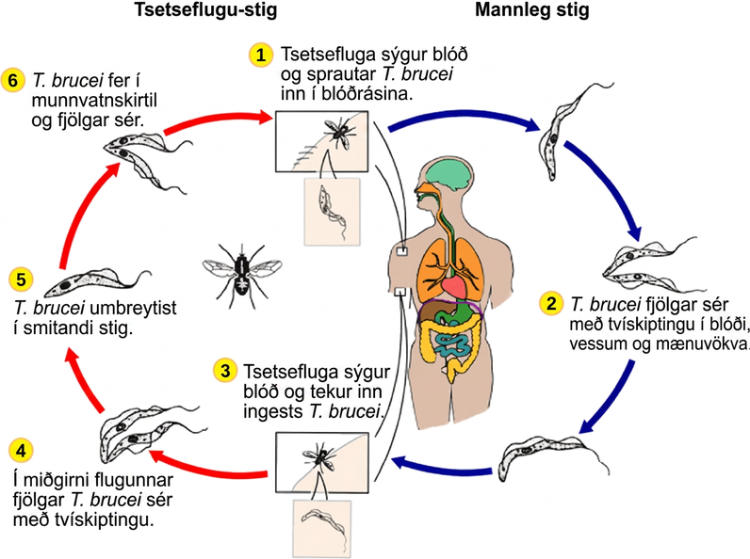
Figure 23.31
Sleeping sickness. Trypanosoma brucei, the causative agent of sleeping sickness, spends part of its life cycle in the tsetse fly and part in humans. (credit: modification of work by CDC)
Notes:
The life cycle of T brucei begins when the tsetse fly takes a blood meal from a human host, and injects the parasite into the bloodstream (step 1). T brucei multiplies by binary fission in blood, lymph and spinal fluid (step 2). When another tsetse fly bites the infected person, it takes up the pathogen (step 3), which then multiplies by binary fission in the fly's midgut (step 4). T brucei transforms into an infectious stage (step 5) and enters the salivary gland, where it multiplies (step 6). The cycle is completed when the fly takes a blood meal from another human.

Slide 38
23.4 Ecology of Protists
Learning Objectives
Describe the role that protists play in the ecosystem
Describe important pathogenic species of protists

Slide 39
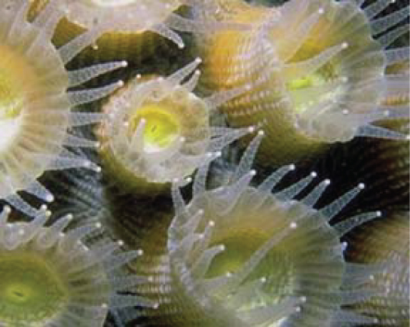
Figure 23.32
Coral with symbiotic dinoflagellates. Coral polyps obtain nutrition through a symbiotic relationship with dinoflagellates.
Notes:
This underwater photo shows coral polyps. Polyps are cup-shaped and have tentacles extending from the edge of the cup.

Slide 40
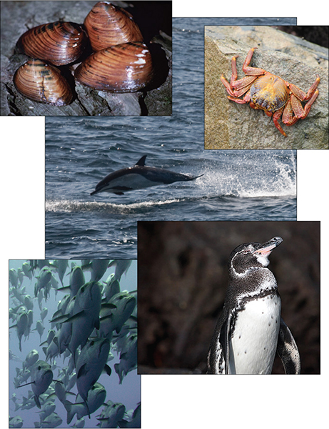
Figure 23.33
Protists contribute to the food chain. Virtually all aquatic organisms depend directly or indirectly on protists for food. (credit “mollusks”: modification of work by Craig Stihler, USFWS; credit “crab”: modification of work by David Berkowitz; credit “dolphin”: modification of work by Mike Baird; credit “fish”: modification of work by Tim Sheerman-Chase; credit “penguin”: modification of work by Aaron Logan)
Notes:
The photo collage shows mollusks, a crab, a dolphin, a penguin, and a school of fish.

Slide 41
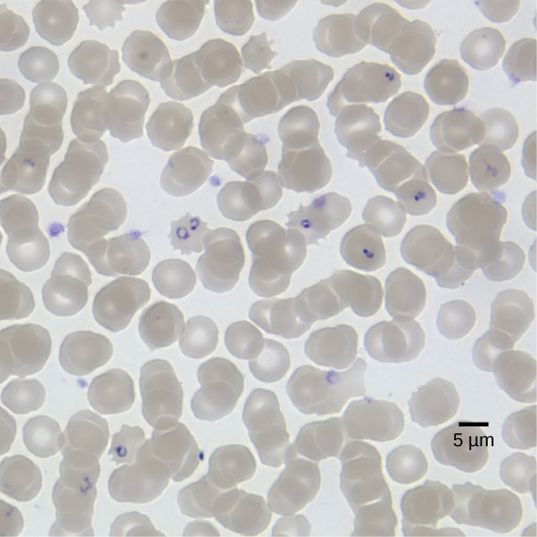
Figure 23.34
Malaria parasite. Red blood cells are shown to be infected with P. falciparum, the causative agent of malaria. In this light microscopic image taken using a 100× oil immersion lens, the ring-shaped P. falciparum stains purple. (credit: modification of work by Michael Zahniser; scale-bar data from Matt Russell)
Notes:
The micrograph shows round red blood cells, each about 8 microns across, infected with ring-shaped P falciparum.

Slide 42
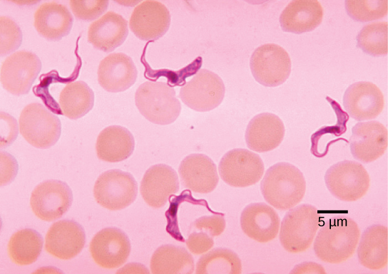
Figure 23.35
Trypanosomes. Trypanosomes are shown among red blood cells. (credit: modification of work by Dr. Myron G. Shultz; scale-bar data from Matt Russell)
Notes:
The micrograph shows round red blood cells, about 8 microns across. Swimming among the red blood cells are ribbon-like trypanosomes. The trypanosomes are about three times as long as the red blood cells are wide.

Slide 43
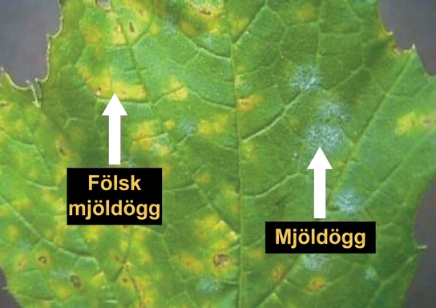
Figure 23.36
Protist plant infections. Both downy and powdery mildews on this grape leaf are caused by an infection of P. viticola. (credit: modification of work by USDA)
Notes:
The photo shows a leaf infected with downy mildew and powdery mildew. Where the leaf is infected with downy mildew, it is yellow instead of green. Powdery mildew appears as a white fuzz on the leaf.

Slide 44
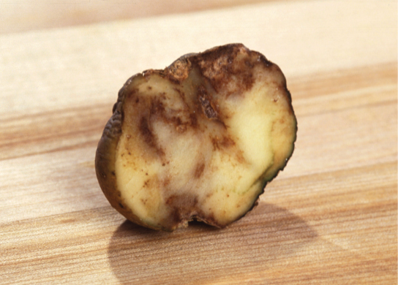
Figure 23.37
Potato blight. These unappetizing remnants result from an infection with P. infestans, the causative agent of potato late blight. (credit: USDA)
This OpenStax ancillary resource is © Rice University under a CC BY-NC-SA 4.0 International license; it may be reproduced or modified for noncommercial purposes only but must be attributed to OpenStax, Rice University and any changes must be noted. Any adaptation must be shared under the same type of license.
Notes:
The photo shows a slice of potato that has browned and appears rotten.

