Slide 1

Biology 2e
Chapter 4 Cell Structure

Slide 2
Yfirlit kafla
Rannsóknir á frumum
Dreifkjörnungafrumur
Heilkjörnungafrumur
Innhimnukerfið og prótein
Frumugrindin
Tengsl frumna og frumustarfsemi

Slide 3
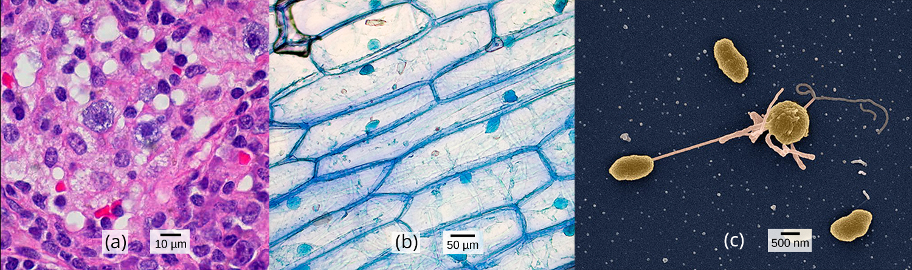
Figure 4.1
(a) Frumur úr nefholum (skoðaðar í ljóssmásjá), (b) laukfrumur (skoðaðar í ljóssmásjá) og (c) bakteríufrumur af tegundinni Vibrio tasmaniensis (skoðaðar í skanneindasmásjá) koma úr mjög ólíkum lífverum, en hafa þó allar tiltekna grundvallareiginleika í frumubyggingu. (credit a: modification of work by Ed Uthman, MD; credit b: modification of work by Umberto Salvagnin; credit c: modification of work by Anthony D'Onofrio, William H. Fowle, Eric J. Stewart, and Kim Lewis of the Lewis Lab at Northeastern University; scale-bar data from Matt Russell)
Notes:
Part a: Human cheek cells as viewed by light microscopy have an irregular round shape and a well-defined nucleus that takes up about one-half of the cell. Part b: Onion skin cells, also viewed by light microscopy, are long and thin with a rectangular shape defined by a cell wall. They are about as wide as a cheek cell, but at least five times as long. The cell wall and nucleus are well defined in the micrograph. The onion cell nucleus is about the same size as the cheek cell nucleus. Part c: In this scanning electron micrograph of bacterial cells, the cell surface has a three-dimensional shape. Three of the bacteria are oval in shape. The fourth is round and has protrusions called pili. One pilus connects this bacterium to another.

Slide 4
4.1 Studying Cells
Hæfniviðmið
Lýsa hlutverki frumna í lífverum
Bera saman ljóssmásjárskoðun og rafeindasmásjárskoðun
Taka saman meginatriði frumukenningarinnar

Slide 5
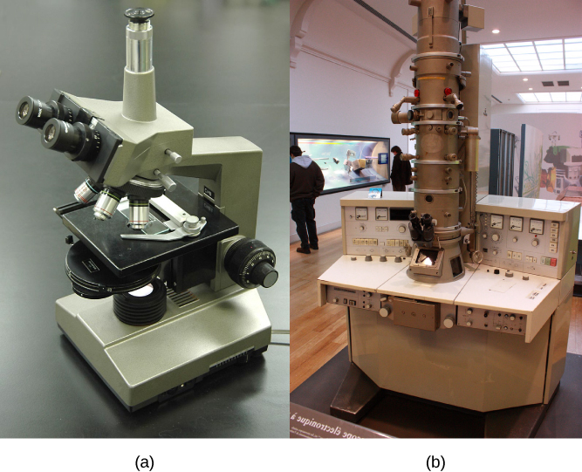
Figure 4.2
(a) Flestar ljóssmásjár í háskólakennslustofu í líffræði geta stækkað frumur allt að um það bil 400 sinnum og hafa um 200 nanómetra upplausn. (b) Rafeindasmásjár veita mun meiri stækkun, 100,000x, og hafa 50 píkómetra upplausn. (credit a: modification of work by "GcG"/Wikimedia Commons; credit b: modification of work by Evan Bench)
Notes:
Part a: This light microscope has binocular lenses and four objective lenses. The sample stage is directly beneath the objective lens. The light microscope sits on a tabletop and can be easily carried. Part b: The electron microscope shown here sits in a museum. It is about the size of a desk, and a person can sit in front of it to operate it. A column taller than a person rises from the center of the scope.

Slide 6
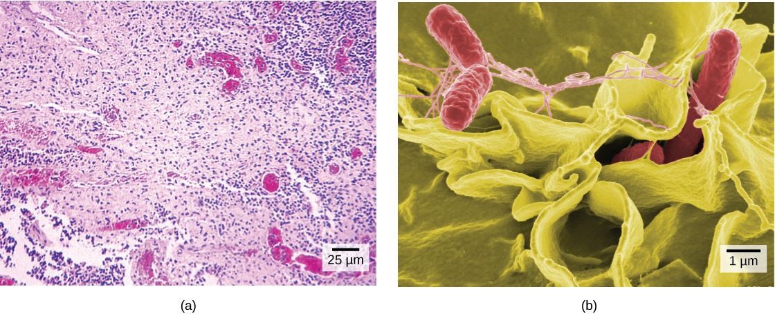
Figure 4.3
(a) Þessar Salmonella-bakteríur sjást sem örsmáir fjólubláir punktar þegar þær eru skoðaðar í ljóssmásjá. (b) Þessi skanneindasmásjármynd sýnir Salmonella-bakteríur (rauðar) ráðast inn í mannafrumur (gular). Þótt hluti (b) sýni annað Salmonella-sýni en hluti (a) má samt greina samanburðarlega aukningu í stækkun og smáatriðum. (credit a: modification of work by CDC/Armed Forces Institute of Pathology, Charles N. Farmer, Rocky Mountain Laboratories; credit b: modification of work by NIAID, NIH; scale-bar data from Matt Russell)
Notes:
Part a: Salmonella through a light microscope appear as tiny purple dots. Part b: In this scanning electron micrograph, bacteria appear as three-dimensional ovals. The human cells are much larger with a complex, folded appearance. Some of the bacteria lie on the surface of the human cells, and some are squeezed between them.

Slide 7
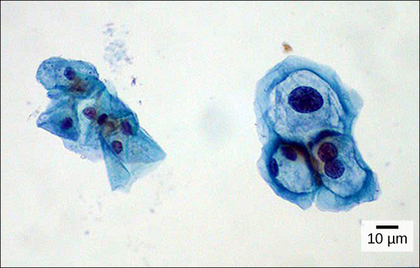
Figure 4.4
Þessar frumur úr leghálsi, skoðaðar í ljóssmásjá, eru úr Pap-stroki. Eðlilegar frumur eru til vinstri. Frumurnar til hægri eru sýktar af vörtuveiru manna (HPV). Takið eftir að sýktu frumurnar eru stærri. Auk þess hafa tvær þessara frumna tvo kjarna hvor, í stað eins kjarna eins og eðlilegt er. (credit: modification of work by Ed Uthman, MD; scale-bar data from Matt Russell)
Notes:
Both normal cells and cells infected with HPV have an irregular, round shape and a well-defined nucleus. Infected cells, however, are two to three times as large as uninfected cells, and some have two nuclei.

Slide 8
4.2 Prokaryotic Cells
Hæfniviðmið
Nefna dæmi um dreifkjörnunga og heilkjörnunga
Bera saman dreifkjörnungafrumur og heilkjörnungafrumur
Lýsa hlutfallslegri stærð mismunandi frumna
Útskýra hvers vegna frumur þurfa að vera smáar

Slide 9
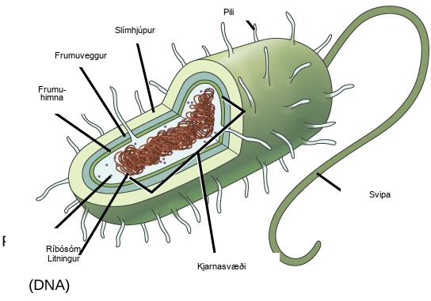
Figure 4.5
Þessi mynd sýnir almenna byggingu dreifkjörnungafrumu. Allir dreifkjörnungar hafa litninga-DNA staðsett í kjarnalíki, ríbósóm, frumuhimnu og frumuvegg. Aðrar byggingar sem sýndar eru finnast í sumum bakteríum en ekki öllum.
Notes:
In this illustration, the prokaryotic cell has an oval shape. The circular chromosome is concentrated in a region called the nucleoid. The fluid inside the cell is called the cytoplasm. Ribosomes, depicted as small circles, float in the cytoplasm. The cytoplasm is encased by a plasma membrane, which in turn is encased by a cell wall. A capsule surrounds the cell wall. The bacterium depicted has a flagellum protruding from one narrow end. Pili are small protrusions that project from the capsule in all directions.

Slide 10
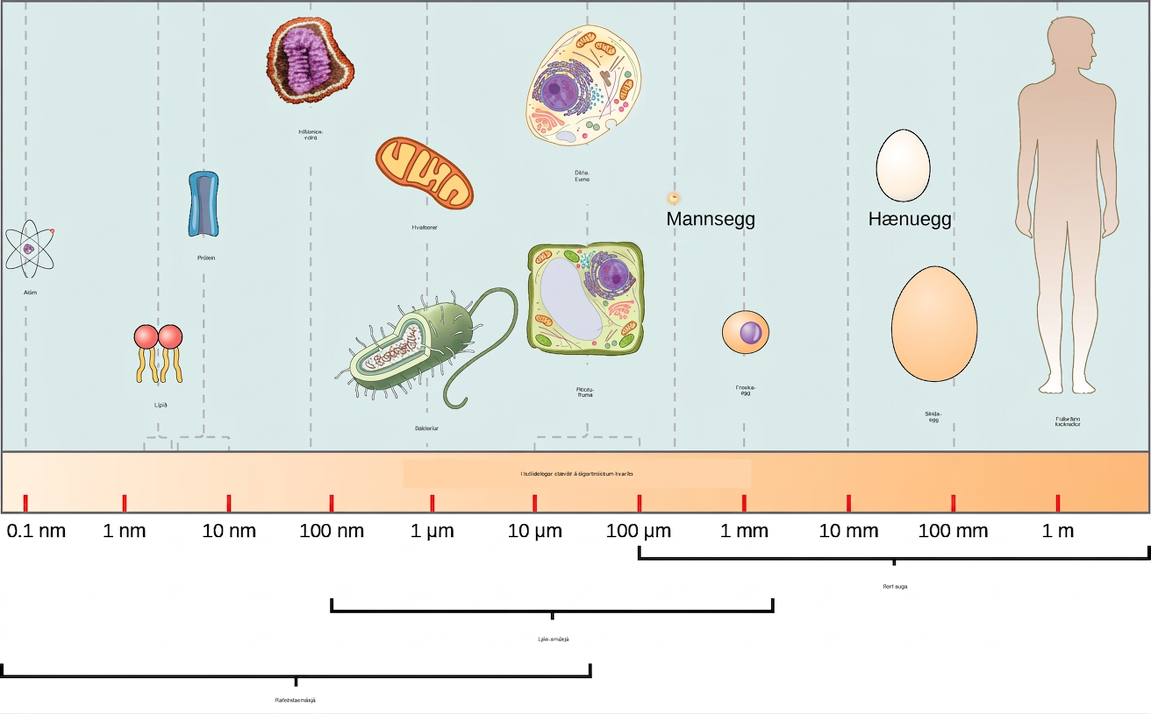
Figure 4.6
Þessi mynd sýnir hlutfallslega stærð örvera á lógaritmískum kvarða (munið að hver eining hækkunar á lógaritmískum kvarða samsvarar 10-faldri aukningu á þeirri stærð sem mæld er).
Notes:
Relative sizes on a logarithmic scale, from 0.1 n m to 1 m, are shown. Objects are shown from smallest to largest. The smallest object shown, an atom, is about .1 n m in size. The next largest objects shown are lipids and proteins; these molecules are between 1 and 10 n m. A flu virus is just under 100 n m. Bacteria and mitochondria are both about 1 greek mu m. Plant and animal cells are both between 10 and 100 greek mu m. A human egg is between 100 greek mu m and 1 m m. A frog egg is about 1 m m, A chicken egg and an ostrich egg are both between 10 and 100 m m, but an ostrich egg is larger. For comparison, a human is approximately 1 m tall. Appropriate instruments to view different size ranges are also shown. An electron microscope is used for things from less than .1 n m to almost 100 greek mu m. A light microscope is used for things from 100 n m to over 1 m m. The naked eye is used for things 100 greek mu m and up.

Slide 11
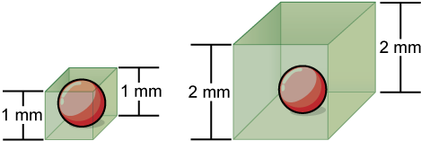
Figure 4.7
Takið eftir að þegar fruma stækkar lækkar hlutfall yfirborðsflatar og rúmmáls. Þegar yfirborðsflatarmál er ekki nægilegt til að styðja við aukið rúmmál frumu mun fruman annaðhvort skipta sér eða deyja. Teninglaga fruman til vinstri hefur rúmmálið 1 mm3 og yfirborðsflatarmálið 6 mm2, með hlutfall yfirborðsflatar og rúmmáls 6 á móti 1; teninglaga fruman til hægri hefur hins vegar rúmmálið 8 mm3 og yfirborðsflatarmálið 24 mm2, með hlutfall yfirborðsflatar og rúmmáls 3 á móti 1.
Notes:
On the left, a sphere 1 mm in diameter is encased in a box of the same width. On the right, the same sphere is encased in a box 2 mm in diameter.

Slide 12
4.3 Eukaryotic Cells
Hæfniviðmið
Lýsa byggingu heilkjörnungafrumna
Bera saman dýrafrumur og plöntufrumur
Greina frá hlutverki frumuhimnunnar
Taka saman hlutverk helstu frumulíffæra

Slide 13
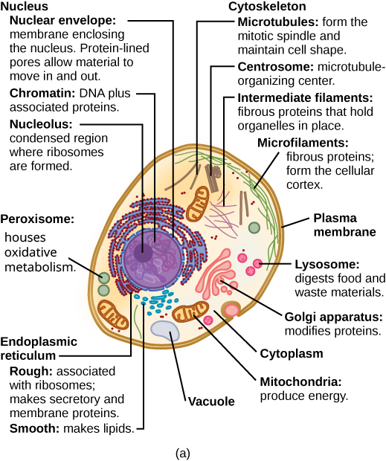
Figure 4.8
Þessar myndir sýna helstu frumulíffæri og aðra frumuhluta í (a) dæmigerðri dýrafrumu og (b) dæmigerðri heilkjörnungaplöntufrumu. Plöntufruman hefur frumuvegg, grænukorn, plastíð og miðlægt safabóluhólf, byggingar sem finnast ekki í dýrafrumum. Flestar frumur hafa hvorki leysikorn né deilikorn.
Notes:
Part a: This illustration shows a typical eukaryotic animal cell, which is egg shaped. The fluid inside the cell is called the cytoplasm, and the cell is surrounded by a cell membrane. The nucleus takes up about one-half the width of the cell. Inside the nucleus is the chromatin, which is composed of DNA and associated proteins. A region of the chromatin is condensed into the nucleolus, a structure where ribosomes are synthesized. The nucleus is encased in a nuclear envelope, which is perforated by protein-lined pores that allow entry of material into the nucleus. The nucleus is surrounded by the rough and smooth endoplasmic reticulum, or ER. The smooth ER is the site of lipid synthesis. The rough ER has embedded ribosomes that give it a bumpy appearance. It synthesizes membrane and secretory proteins. In addition to the ER, many other organelles float inside the cytoplasm. These include the Golgi apparatus, which modifies proteins and lipids synthesized in the ER. The Golgi apparatus is made of layers of flat membranes. Mitochondria, which produce food for the cell, have an outer membrane and a highly folded inner membrane. Other, smaller organelles include peroxisomes that house oxidative metabolism, lysosomes that digest food, and vacuoles. Ribosomes, responsible for protein synthesis, also float freely in the cytoplasm and are depicted as small dots. The last cellular component shown is the cytoskeleton, which has four different types of components: microfilaments, intermediate filaments, microtubules, and centrosomes. Microfilaments are fibrous proteins that line the cell membrane and make up the cellular cortex. Intermediate filaments are fibrous proteins that hold organelles in place. Microtubules form the mitotic spindle and maintain cell shape. Centrosomes are made of two tubular structures at right angles to one another. They form the microtubule-organizing center.

Slide 14
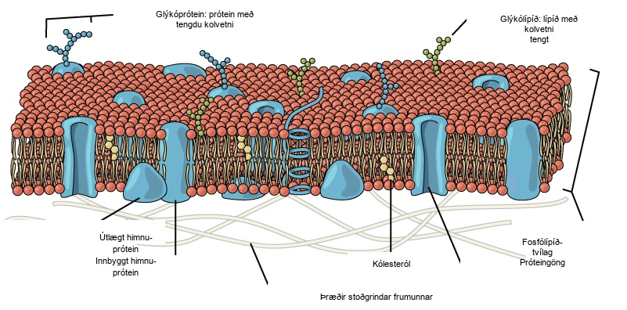
Figure 4.9
Frumuhimna heilkjörnunga er tvöfalt fosfólípíðlag með innfelldum próteinum og kólesteróli.
Notes:
The plasma membrane is composed of a phospholipid bilayer. In the bilayer, the two long hydrophobic tails of phospholipids face toward the center, and the hydrophilic head group faces the exterior. Integral membrane proteins and protein channels span the entire bilayer. Protein channels have a pore in the middle. Peripheral membrane proteins sit on the surface of the phospholipids, and are associated with the phospholipid head groups. On the exterior side of the membrane, carbohydrates are attached to certain proteins and lipids. Filaments of the cytoskeleton line the interior of the membrane.

Slide 15
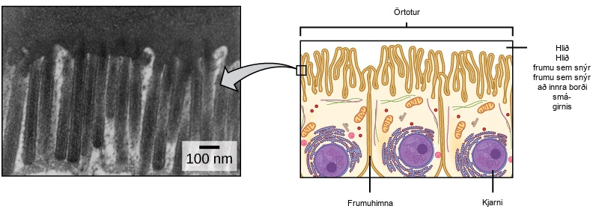
Figure 4.10
Örþarmar, eins og þeir sjást á frumum sem þekja smágirnið, auka það yfirborðsflatarmál sem er tiltækt til frásogs. Þessir örþarmar eru aðeins á þeim hluta frumuhimnunnar sem snýr að holrýminu þaðan sem efni verða frásoguð. (credit "micrograph": modification of work by Louisa Howard)
Notes:
The left part of this figure is a transmission electron micrograph of microvilli, which appear as long, slender stalks extending from the plasma membrane. The right side illustrates cells containing microvilli. The microvilli cover the surface of the cell facing the interior of the small intestine.

Slide 16
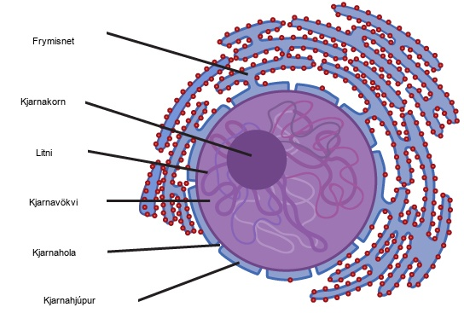
Figure 4.11
Kjarninn geymir litni (DNA ásamt próteinum) í hlaupkenndu efni sem kallast kjarnagrunnur. Kjarnakorn er þétt litnissvæði þar sem myndun ríbósóma fer fram. Afmörkun kjarnans kallast kjarnahjúpur. Hann samanstendur af tveimur tvöföldum fosfólípíðlögum: ytri og innri himnu. Kjarnahimnan er samfelld frymisnetinu. Kjarnagöt gera efnum kleift að fara inn í og út úr kjarnanum.
Notes:
The two-dimensional image depicts the nucleus of a cell as a circular object with two membranes; several gaps appear in the circle, representing nuclear pores. Surrounding the nucleus are membranous sacks representing the endoplasmic reticulum. Inside the nucleus is another circle, approximately ten percent of the total size of the nucleus, representing the nucleolus.

Slide 17
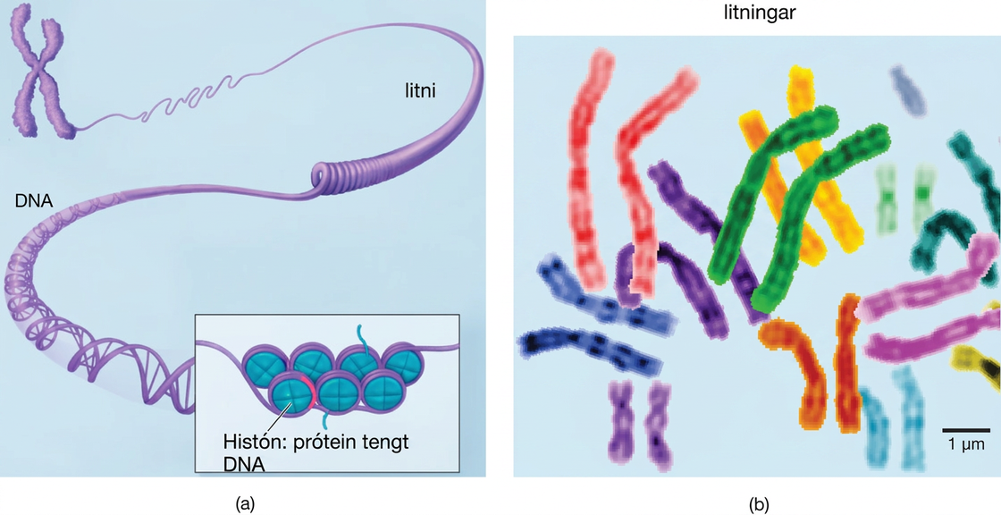
Figure 4.12
(a) Þessi mynd sýnir mismunandi stig í skipulagi litnis (DNA og prótein). (b) Þessi mynd sýnir paraða litninga. (credit b: modification of work by NIH; scale-bar data from Matt Russell)
Notes:
Part a: In this illustration, DNA tightly coiled into two thick cylinders is shown in the upper right. A close-up shows how the DNA is coiled around proteins called histones. Part b: This image shows paired chromosomes. The chromosomes are shown as a collection of slender tubes.

Slide 18
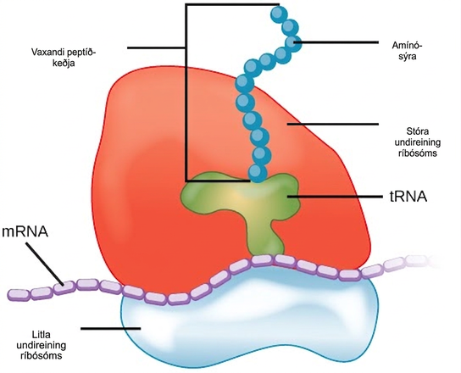
Figure 4.13
Ríbósóm eru gerð úr stórri undireiningu (efst) og lítilli undireiningu (neðst). Við próteinmyndun raða ríbósóm amínósýrum saman í prótein.
Notes:
The ribosome consists of a small subunit and a large subunit, which is about three times as big as the small one. The large subunit sits on top of the small one. A chain of m R N A threads between the large and small subunits. A protein chain extends from the top of the large subunit.

Slide 19
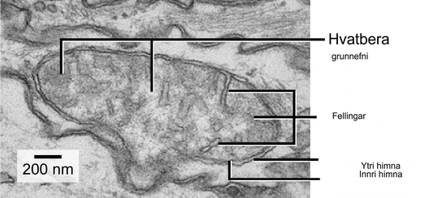
Figure 4.14
Þessi rafeindasmásjármynd sýnir hvatbera í rafeindasmásjá. Þetta frumulíffæri hefur ytri himnu og innri himnu. Innri himnan myndar fellingar, sem kallast hvatberakambar, og þær auka yfirborðsflatarmál hennar. Rýmið milli himnanna tveggja kallast millihimnurými og rýmið innan innri himnunnar kallast hvatberagrunnur. ATP-myndun fer fram á innri himnunni. (credit: modification of work by Matthew Britton; scale-bar data from Matt Russell)
Notes:
This transmission electron micrograph of a mitochondrion shows an oval outer membrane and an inner membrane with many folds called cristae. Inside the inner membrane is a space called the mitochondrial matrix.

Slide 20
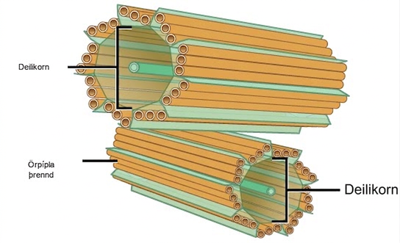
Figure 4.15
Deilikornamiðjan samanstendur af tveimur deilikornum sem liggja hornrétt hvort á annað. Hvert deilikorn er sívalningur gerður úr níu þrenndum örpípla. Prótein sem ekki eru túbúlín (sýnd með grænum línum) halda örpípluþrenndunum saman.
Notes:
The image depicts two tube-like structures, one on top of the other, at right angles. Each of the tubes is labeled as the centriole. Each tube is composed of smaller tubes grouped in threes; these are labeled 'microtubule triplet.' Each centriole tube is composed of nine triplets arranged to form the wall of the tube.

Slide 21
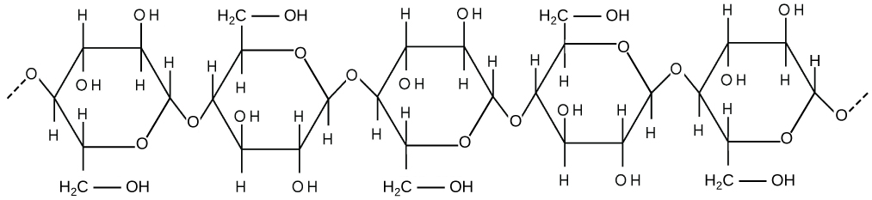
Figure 4.16
Sellulósi er löng keðja β-glúkósasameinda sem tengjast með 1-4 tengi. Brotalínurnar við hvorn enda myndarinnar tákna röð margra fleiri glúkósaeininga. Stærð síðunnar gerir ómögulegt að sýna heila sellulósasameind.
Notes:
This illustration shows three glucose subunits that are attached together. Dashed lines at each end indicate that many more subunits make up an entire cellulose fiber. Each glucose subunit is a closed ring composed of carbon, hydrogen, and oxygen atoms.

Slide 22
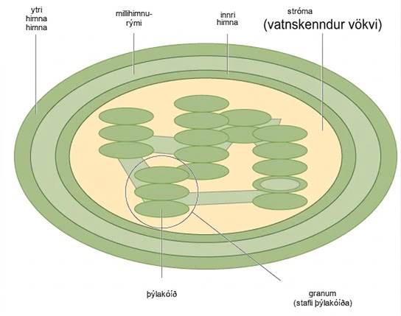
Figure 4.17
Grænukornið hefur ytri himnu, innri himnu og himnubyggingar, þ.e. þýlakóíða sem staflast í grana. Rýmið innan þýlakóíðhimnanna kallast þýlakóíðrými. Ljósföngunarhvörf fara fram í þýlakóíðhimnunum og sykurmyndun fer fram í vökvanum innan innri himnunnar, sem kallast stróma. Grænukorn hafa einnig eigið erfðamengi, sem er á einum hringlaga litningi.
Notes:
This illustration shows a chloroplast, which has an outer membrane and an inner membrane. The space between the outer and inner membranes is called the intermembrane space. Inside the inner membrane are flat, pancake-like structures called thylakoids. The thylakoids form stacks called grana. The liquid inside the inner membrane is called the stroma, and the space inside the thylakoids is called the thylakoid space.

Slide 23
4.4 Innhimnukerfið og prótein
Hæfniviðmið
Telja upp hluta innhimnukerfisins
Greina tengslin milli innhimnukerfisins og hlutverka þess

Slide 24
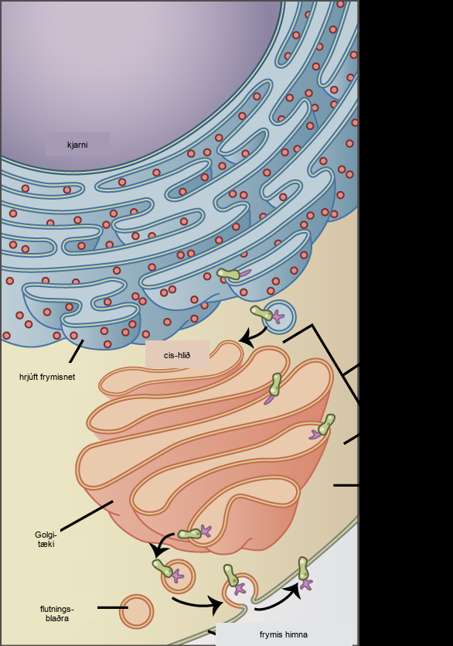
Figure 4.18
Himnuprótein og seytiprótein eru mynduð í hrjúfa frymisnetinu (RER). RER breytir einnig stundum próteinum. Á þessari mynd er (grænu) innbyggðu himnupróteini breytt með því að (fjólublátt) kolvetni tengist því í ER. Blöðrur með innbyggða próteininu brumast frá ER og renna saman við cis-hlið Golgikerfisins. Þegar próteinið fer eftir belgjum Golgikerfisins breytist það enn frekar við tengingu fleiri kolvetna. Þegar myndun þess er lokið fer það út sem innbyggt himnuprótein í blöðru sem brumast frá trans-hlið Golgikerfisins. Þegar blaðran rennur saman við frumuhimnuna verður próteinið innbyggður hluti þeirrar frumuhimnu. (credit: modification of work by Magnus Manske)
Notes:
The left part of this figure shows the rough E R with an integral membrane protein embedded in it. The part of the protein facing the inside of the E R has a carbohydrate attached to it. The protein is shown leaving the E R in a vesicle that fuses with the cis side of the Golgi apparatus. The Golgi apparatus consists of several layers of membranes, called cisternae. As the protein passes through the cisternae, it is further modified by the addition of more carbohydrates. Eventually, it leaves the trans face of the Golgi in a vesicle. The vesicle fuses with the cell membrane so that the carbohydrate that was on the inside of the vesicle now faces the outside of the membrane. At the same time, the contents of the vesicle are ejected from the cell.

Slide 25
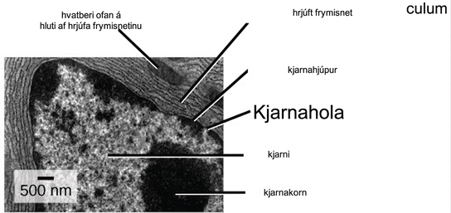
Figure 4.19
Þessi gegnumlýsingarrafeindasmásjármynd sýnir hrjúft frymisnet og önnur frumulíffæri í brisfrumu. (credit: modification of work by Louisa Howard)
Notes:
In this transmission electron micrograph, the nucleus is the most prominent feature. The nucleolus is a circular, dark region inside the nucleus. A nuclear pore can be seen in the nuclear envelope that surrounds the nucleus. The rough endoplasmic reticulum surrounds the nucleus, appearing as many layers of membranes. A mitochondrion sits between the layers of the E R membrane.

Slide 26
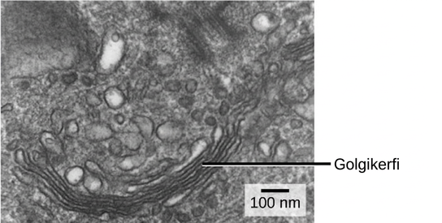
Figure 4.20
Golgikerfið í þessu hvíta blóðkorni sést sem stafli af hálfhringlaga, flötum hringjum neðarlega á myndinni. Nokkrar blöðrur sjást nálægt Golgikerfinu. (credit: modification of work by Louisa Howard)
Notes:
In this transmission electron micrograph, the Golgi apparatus appears as a stack of membranes surrounded by unnamed organelles.

Slide 27
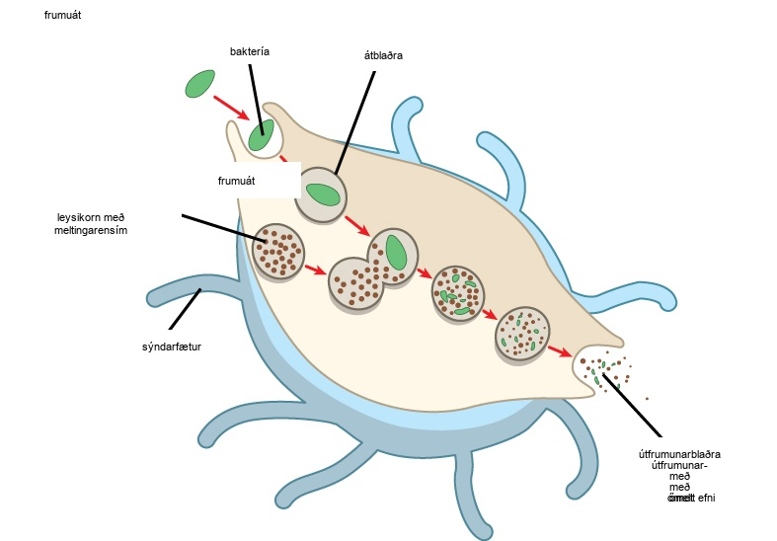
Figure 4.21
Átfruma hefur gleypt (frumuétið) bakteríu sem gæti verið sjúkdómsvaldandi og rennur síðan saman við leysikorn innan frumunnar til að eyða sýklinum. Önnur frumulíffæri eru til staðar í frumunni en eru ekki sýnd hér til einföldunar.
Notes:
In this illustration, a eukaryotic cell is shown consuming a bacterium. As the bacterium is consumed, it is encapsulated in a vesicle. The vesicle fuses with a lysosome, and proteins inside the lysosome digest the bacterium.

Slide 28
4.5 Frumugrindin
Hæfniviðmið
Lýsa frumugrindinni
Bera saman hlutverk örþráða, millistigsþráða og örpípla
Bera saman bifhár og svipur
Taka saman muninn á hlutum dreifkjörnungafrumna, dýrafrumna og plöntufrumna

Slide 29
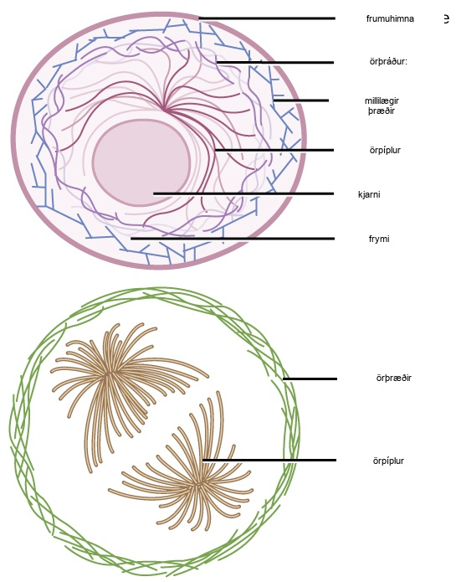
Figure 4.22
Örþræðir þykkja börkinn við innri jaðar frumunnar. Líkt og teygjur standast þeir togkrafta. Örpíplur eru inni í frumunni þar sem þær viðhalda lögun sinni með því að standast þrýstikrafta. Millistigsþræðir eru um alla frumuna og halda frumulíffærum á sínum stað.
Notes:
Microfilaments line the inside of the plasma membrane, whereas microtubules radiate out from the center of the cell. Intermediate filaments form a network throughout the cell that holds organelles in place.

Slide 30
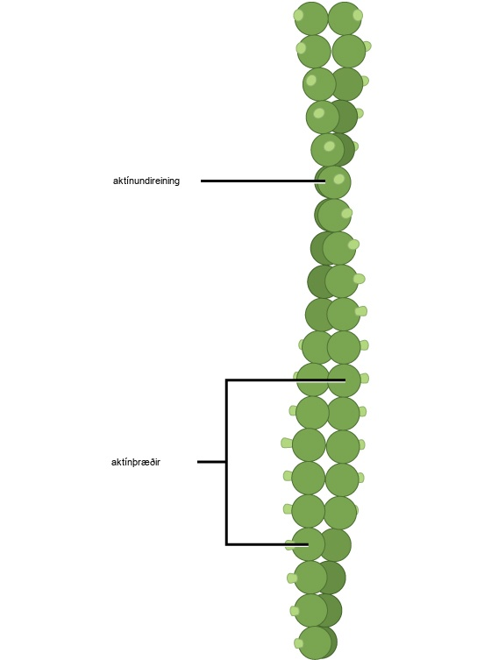
Figure 4.23
Örþræðir eru gerðir úr tveimur samofnum aktínþráðum.
Notes:
This illustration shows two actin filaments wound together. Each actin filament is composed of many actin subunits connected together to form a chain.

Slide 31
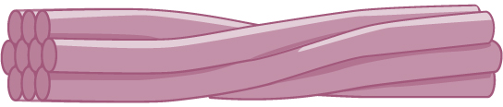
Figure 4.24
Millistigsþræðir samanstanda af nokkrum samofnum þráðum trefjapróteina.
Notes:
This illustration shows 10 intermediate filament fibers bundled together.

Slide 32
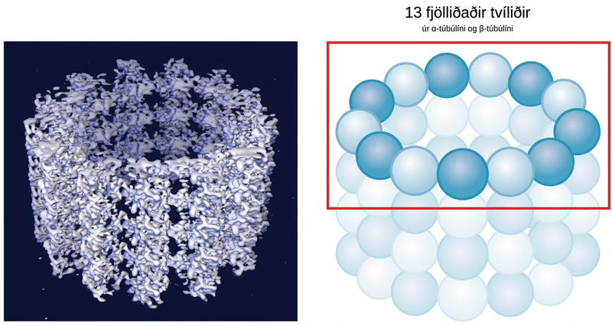
Figure 4.25
Örpíplur eru holar. Veggir þeirra samanstanda af 13 fjölliðuðum tvíliðum úr α-túbúlíni og β-túbúlíni (mynd til hægri). Myndin til vinstri sýnir sameindabyggingu pípunnar.
Notes:
The left part of this figure is a molecular model of 13 polymerized dimers of alpha- and beta-tubulin joined together to form a hollow tube. The right part of this image shows the tubulin structure as a ring of spheres connected together.

Slide 33
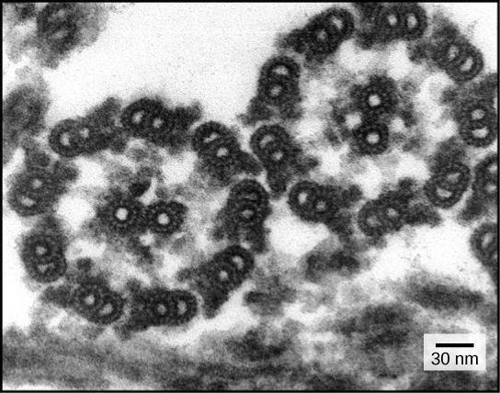
Figure 4.26
Þessi gegnumlýsingarrafeindasmásjármynd af tveimur svipum sýnir 9 + 2 uppröðun örpíplanna: níu örpíplutvenndir umlykja eina örpíplutvennd. (credit: modification of work by Dartmouth Electron Microscope Facility, Dartmouth College; scale-bar data from Matt Russell)
Notes:
This transmission electron micrograph shows a cross section of nine microtubule doublets that form a hollow tube. Another microtubule doublet sits in the center of the tube.

Slide 34
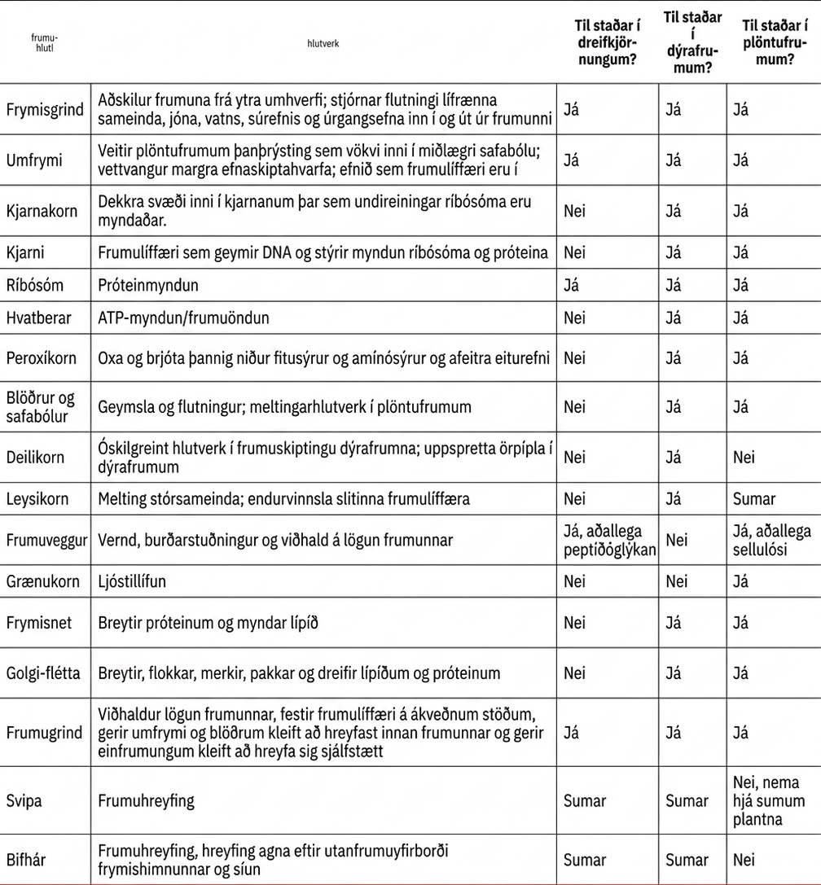
Table 4.1

Slide 35
4.6 Tengsl frumna og frumustarfsemi
Hæfniviðmið
Lýsa utanfrumuefninu
Nefndu dæmi um leiðir sem plöntufrumur og dýrafrumur nota til samskipta við aðlægar frumur
Dragðu saman hlutverk þéttitengja, desmosóma, glufutengja og plasmódesma

Slide 36
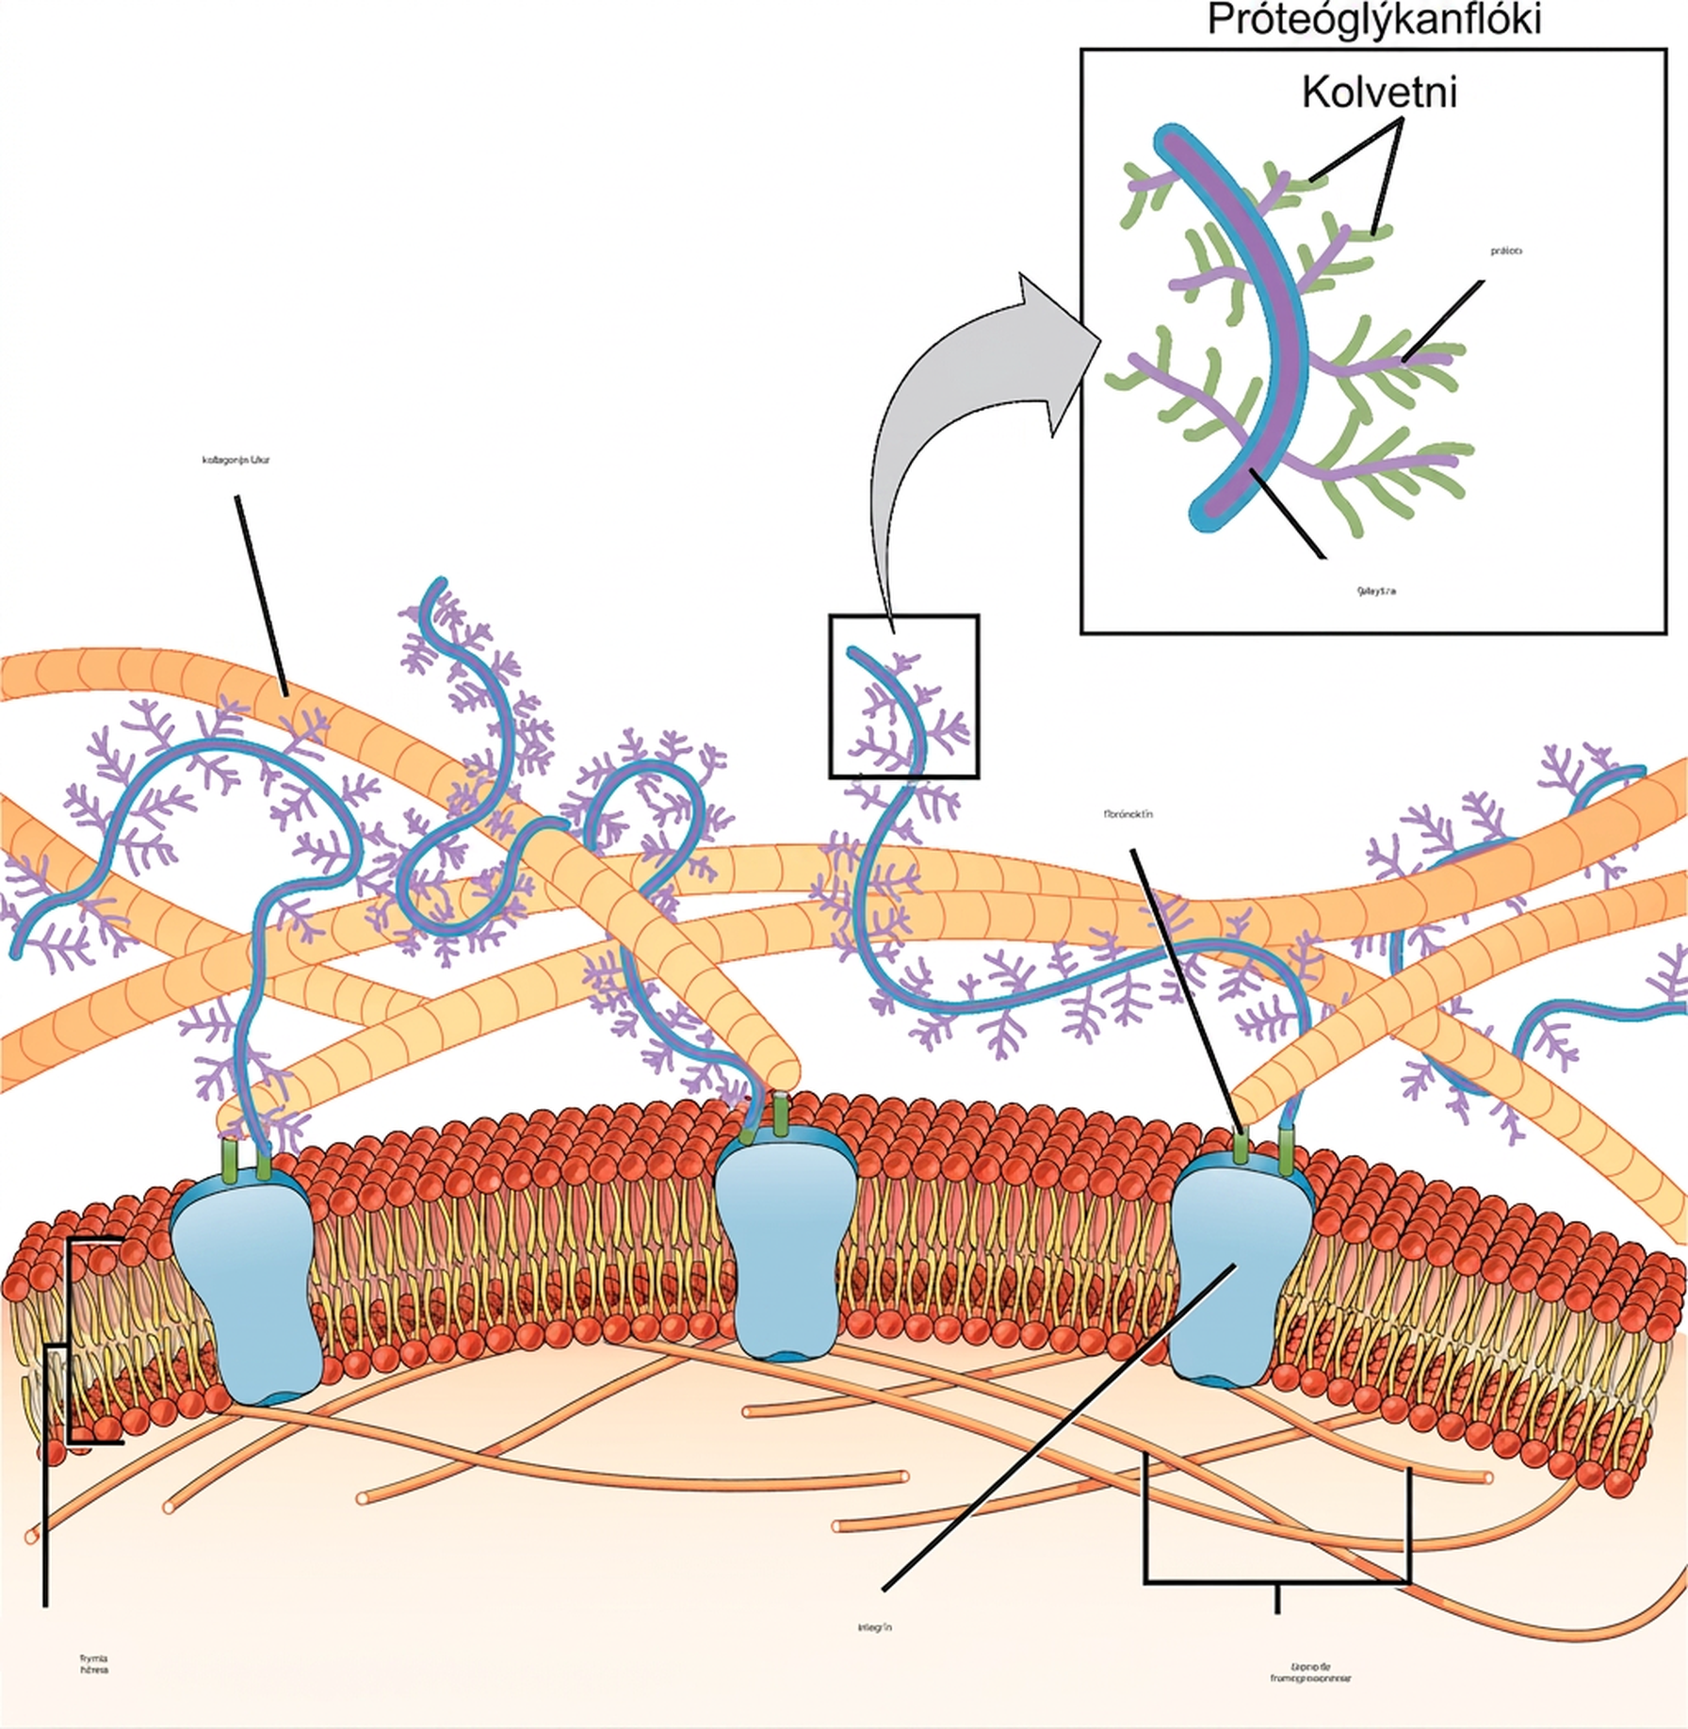
Figure 4.27
Millifrumuefnið er net próteina og kolvetna.
Notes:
This illustration shows the plasma membrane. Embedded in the plasma membrane are integral membrane proteins called integrins. On the exterior of the cell is a vast network of collagen fibers. The fibers are attached to the integrins via a protein called fibronectin. Proteoglycan complexes also extend from the plasma membrane to the extracellular matrix. A close-up view shows that each proteoglycan complex is composed of a polysaccharide core. Proteins branch from this core, and carbohydrates branch from the proteins. The inside of the cytoplasmic membrane is lined with microfilaments of the cytoskeleton.

Slide 37
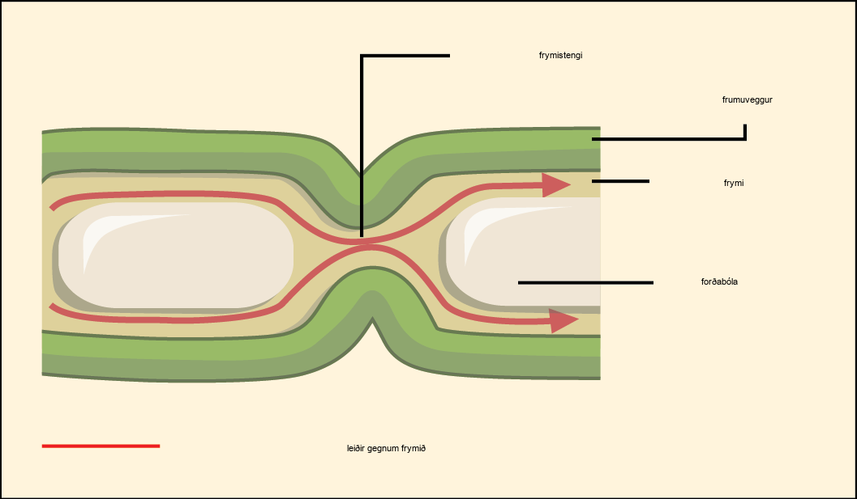
Figure 4.28
Plasmódesma er rás milli frumuveggja tveggja aðlægra plöntufrumna. Plasmódesma gera efnum kleift að berast úr umfrymi einnar plöntufrumu yfir í umfrymi aðlægrar frumu.
Notes:
This illustration shows two plant cells side-by-side. A gap in the cell wall, a plasmodesma, allows fluid and small molecules to pass from the cytoplasm of one cell to the cytoplasm of the other.

Slide 38
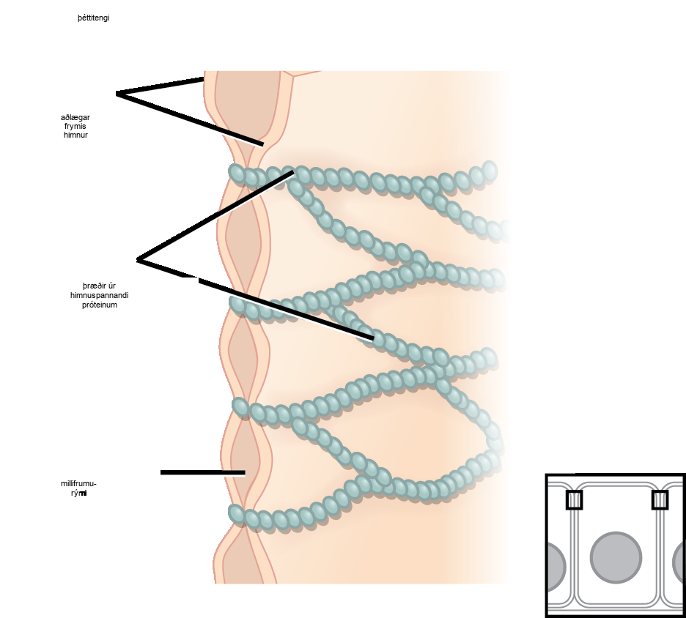
Figure 4.29
Þéttitengi mynda vatnsheld tengsl milli aðlægra dýrafrumna. Prótein sjá um viðloðunina í þéttitengjum. (mynd: byggt á verki Mariana Ruiz Villareal)
Notes:
This illustration shows two cell membranes joined together by a matrix of tight junctions.

Slide 39
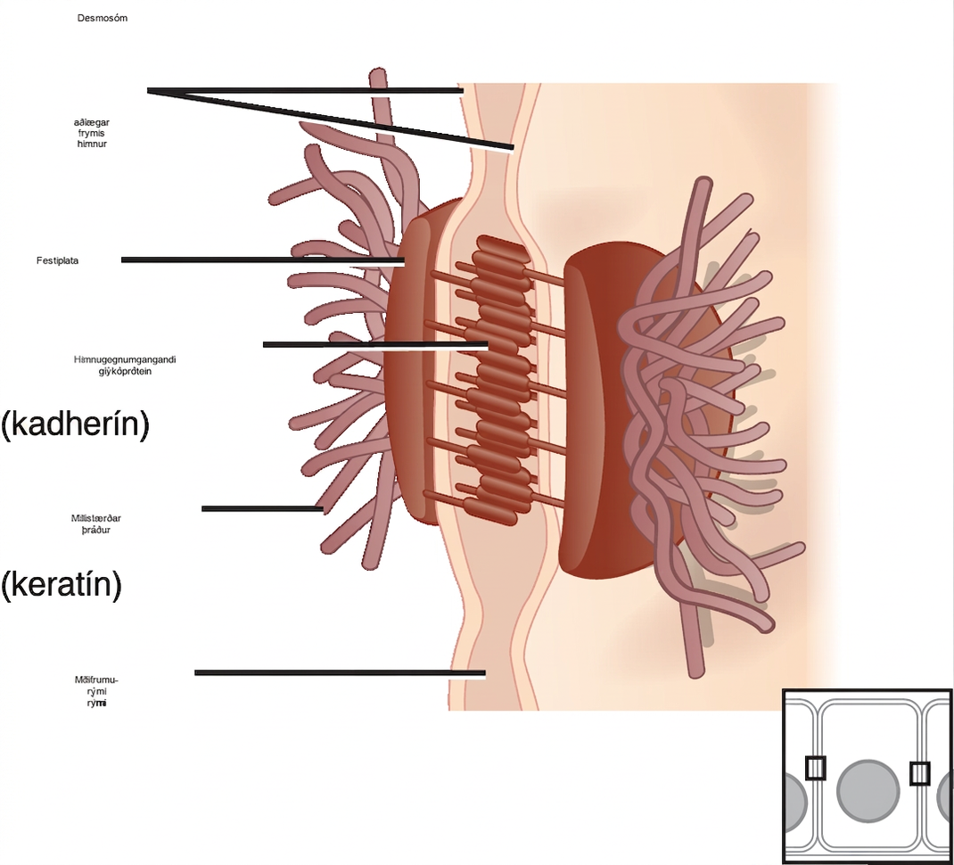
Figure 4.30
Desmosóm myndar mjög sterka punkttengingu milli frumna. Tengsl kadherína og milligrindaþráða mynda hana. (mynd: byggt á verki Mariana Ruiz Villareal)
Notes:
This illustration shows two cells fused together by a desmosome. Cadherins extend from each cell and join the two cells together. Intermediate filaments connect to cadherins on the inside of the cell.

Slide 40
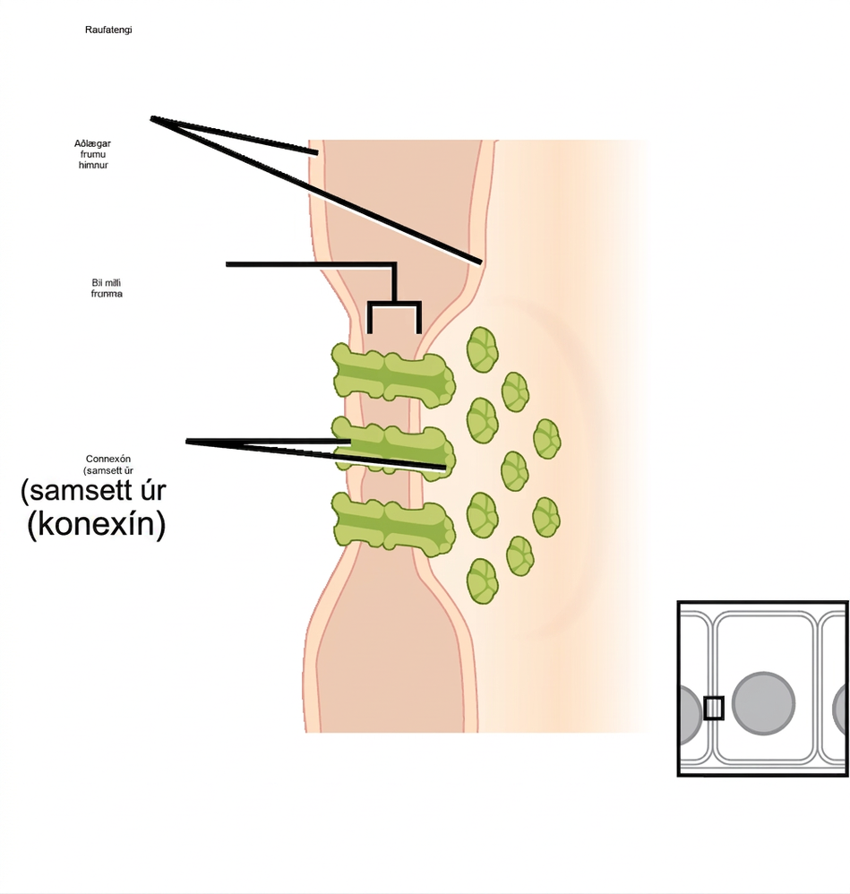
Figure 4.31
Glufutengi er próteinklætt op sem gerir vatni og litlum sameindum kleift að berast milli aðlægra dýrafrumna. (mynd: byggt á verki Mariana Ruiz Villareal)
Þetta OpenStax-viðbótarefni er © Rice University samkvæmt CC BY-NC-SA 4.0 International leyfi; það má fjölfalda eða breyta eingöngu í óviðskiptalegum tilgangi, en tilgreina verður OpenStax og Rice University sem rétthafa og taka fram allar breytingar. Öllum aðlögunum verður að deila með sams konar leyfi.
Notes:
This illustration shows two cells joined together with protein pores called gap junctions that allow water and small molecules to pass through.

