Slide 1
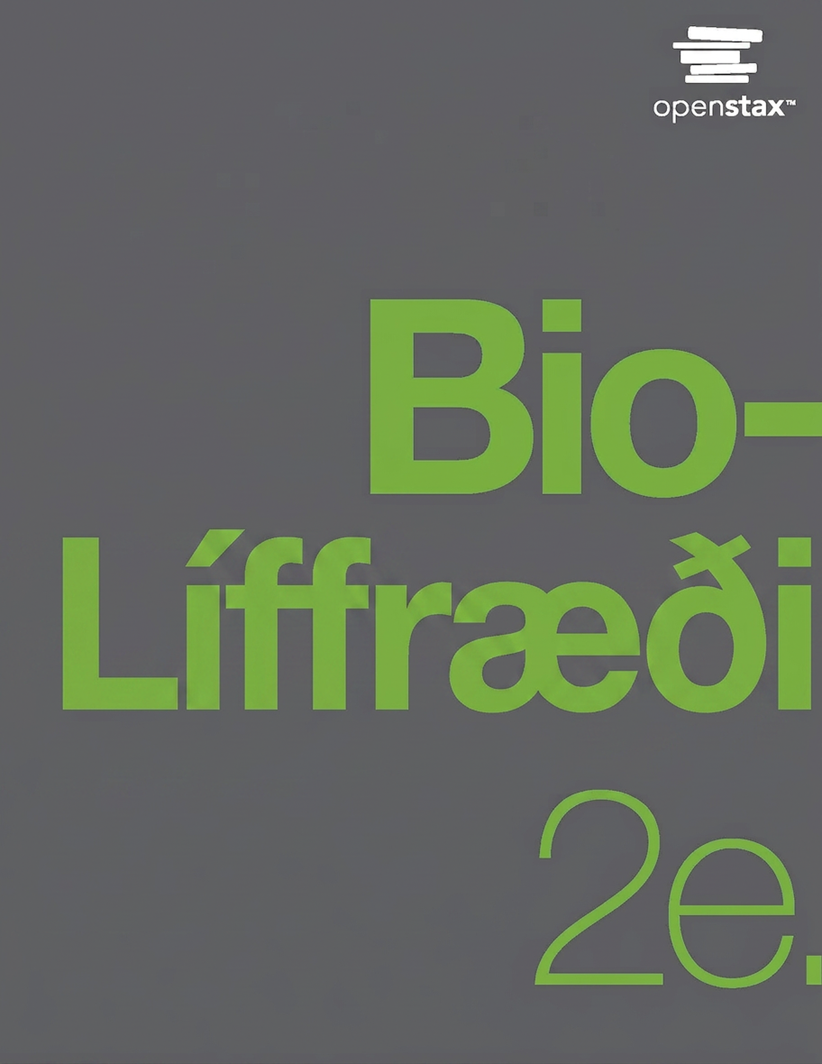
Biology 2e
Chapter 34 Animal Nutrition and the Digestive System

Slide 2
Chapter outline
Digestive Systems
Nutrition and Energy Production
Digestive System Processes
Digestive System Regulation

Slide 3
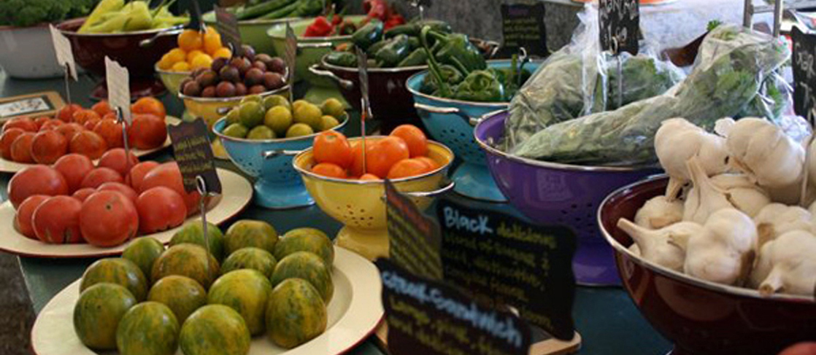
Figure 34.1
For humans, fruits and vegetables are important in maintaining a balanced diet. (credit: modification of work by Julie Rybarczyk)
Notes:
Photo shows a variety of fresh vegetables being sold at a market.

Slide 4
34.1 Digestive Systems
Learning Objectives
Explain the processes of digestion and absorption
Compare and contrast different types of digestive systems
Explain the specialized functions of the organs involved in processing food in the body
Describe the ways in which organs work together to digest food and absorb nutrients

Slide 5
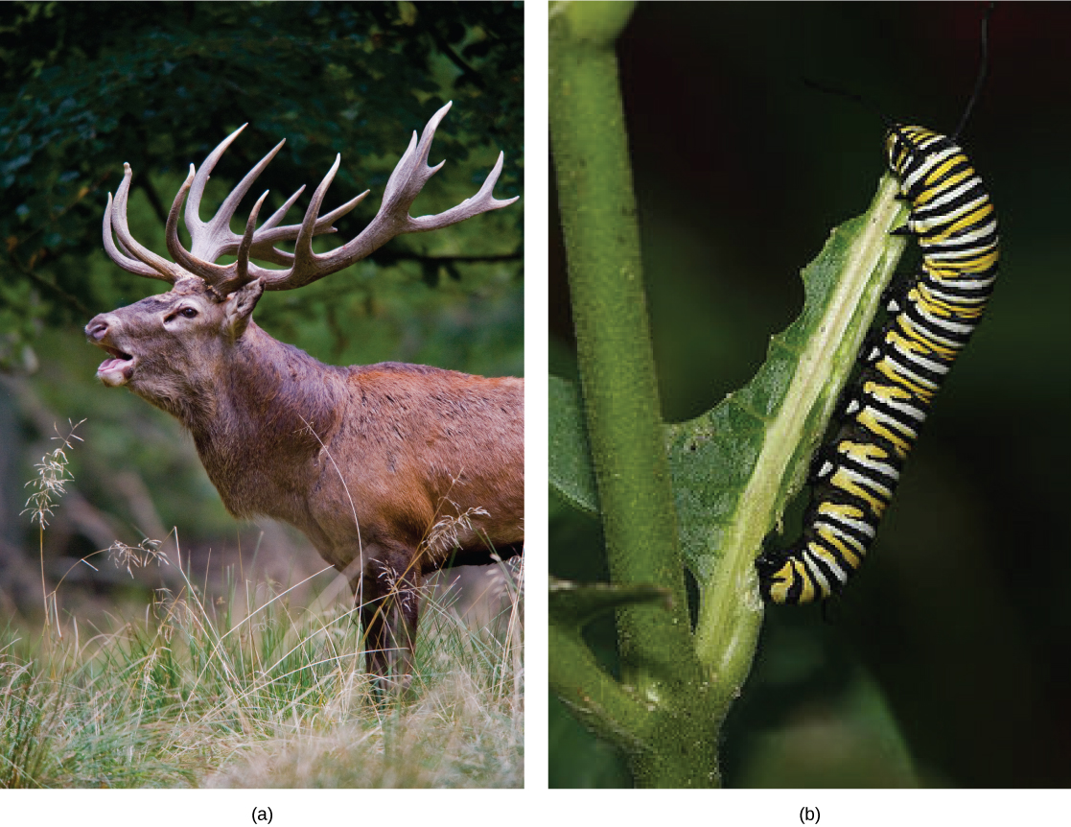
Figure 34.2
Herbivores, like this (a) mule deer and (b) monarch caterpillar, eat primarily plant material. (credit a: modification of work by Bill Ebbesen; credit b: modification of work by Doug Bowman)
Notes:
Left photo shows a buck with antlers. Right photo shows a black, yellow, and white striped caterpillar eating a leaf.

Slide 6
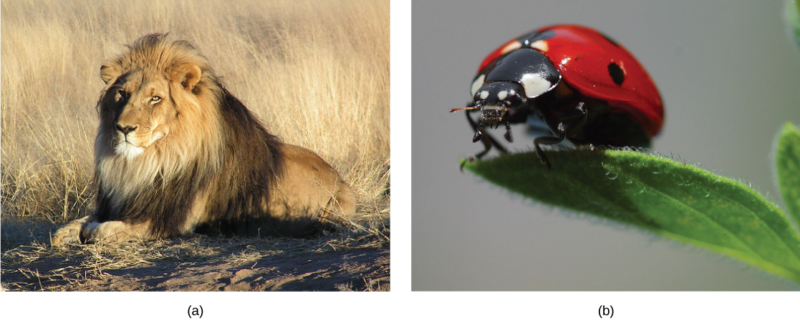
Figure 34.3
Carnivores like the (a) lion eat primarily meat. The (b) ladybug is also a carnivore that consumes small insects called aphids. (credit a: modification of work by Kevin Pluck; credit b: modification of work by Jon Sullivan)
Notes:
The first photo shows a lion. The next photo shows a ladybug.

Slide 7
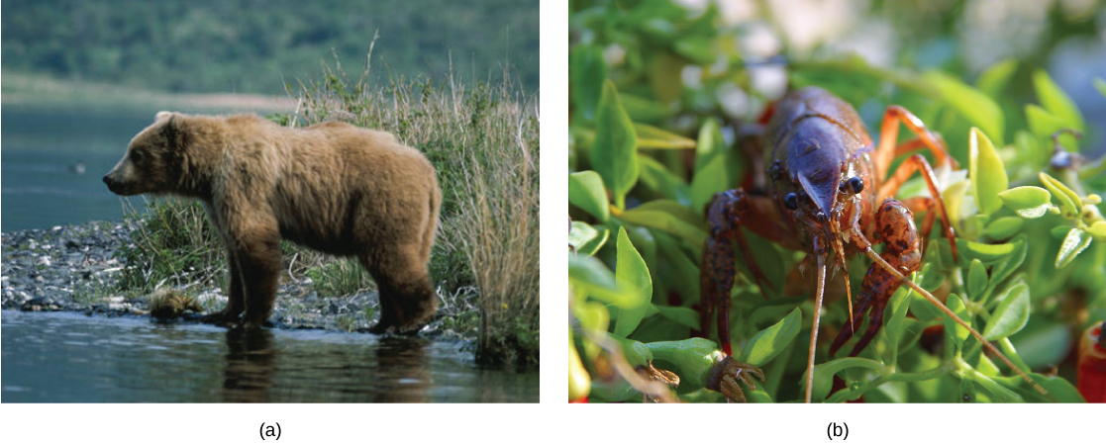
Figure 34.4
Omnivores like the (a) bear and (b) crayfish eat both plant and animal based food. (credit a: modification of work by Dave Menke; credit b: modification of work by Jon Sullivan)
Notes:
The first photo shows a bear. The next photo shows a crayfish.

Slide 8
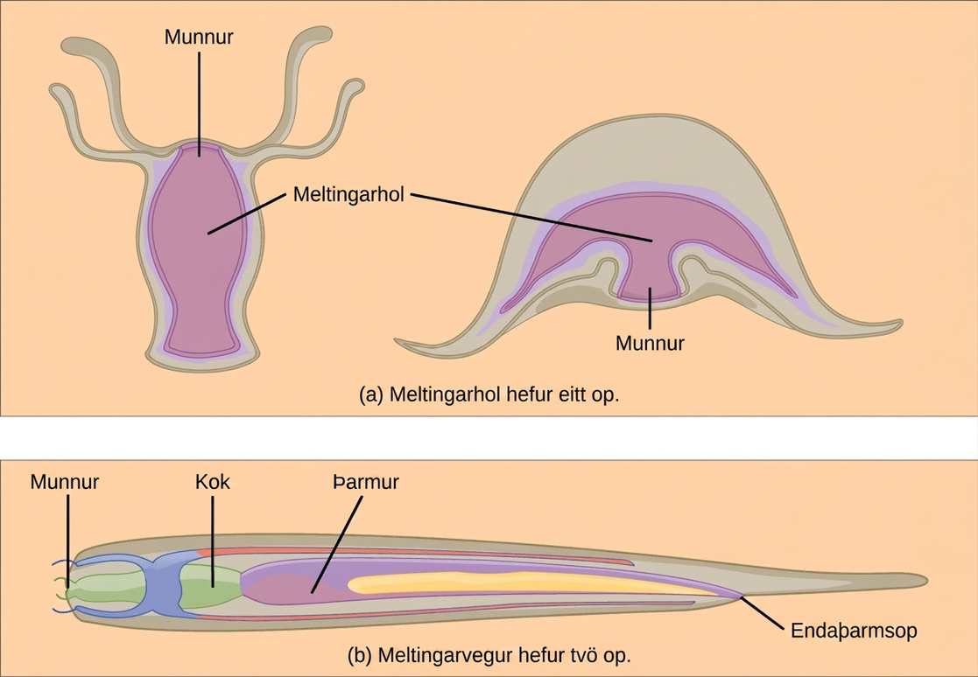
Figure 34.5
(a) A gastrovascular cavity has a single opening through which food is ingested and waste is excreted, as shown in this hydra and in this jellyfish medusa. (b) An alimentary canal has two openings: a mouth for ingesting food, and an anus for eliminating waste, as shown in this nematode.
Notes:
Part A shows a hydra, which has a vase-shaped body with tentacles around the rim. The hydras mouth is located between the tentacles, at the top of the vase shaped body. Next to the hydra is a jellyfish medusa, which is bell shaped with tentacles hanging down from the edge of the bell. The mouth, in the lower middle part of the body, opens into the gastrovascular cavity. Part B shows a nematode, which has a long, tube-like body that is wide at one end and tapers down to a tail at the other. The mouth is in the front of the wide end. It opens into an esophagus, then a pharynx. The pharynx empties into a long intestine, which ends at the anus a short distance before the tail.

Slide 9
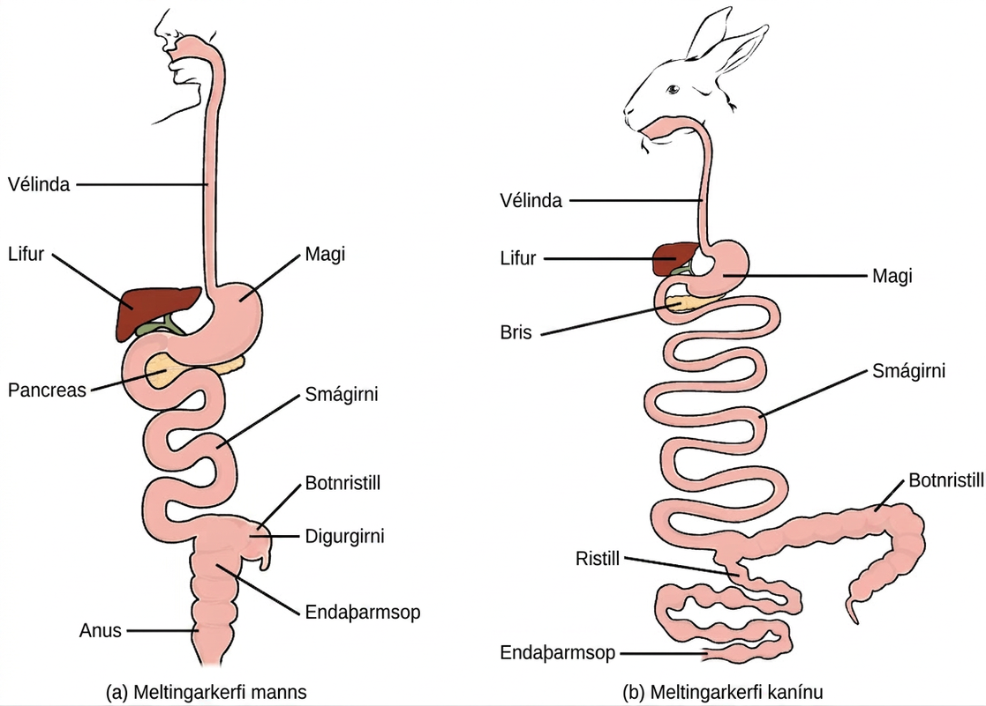
Figure 34.6
(a) Humans and herbivores, such as the (b) rabbit, have a monogastric digestive system. However, in the rabbit the small intestine and cecum are enlarged to allow more time to digest plant material. The enlarged organ provides more surface area for absorption of nutrients. Rabbits digest their food twice: the first time food passes through the digestive system, it collects in the cecum, and then it passes as soft feces called cecotrophes. The rabbit re-ingests these cecotrophes to further digest them.
Notes:
The basic components of the human and rabbit digestive system are the same: each begins at the mouth. Food is swallowed through the esophagus and into the kidney-shaped stomach. The liver is located on top of the stomach, and the pancreas is underneath. Food passes from the stomach to the long, winding small intestine. From there it enters the wide large intestine before passing out the anus. At the junction of the small and large intestine is a pouch called the cecum. The small and large intestines are much longer in rabbits than in humans, and the cecum is much longer as well.

Slide 10
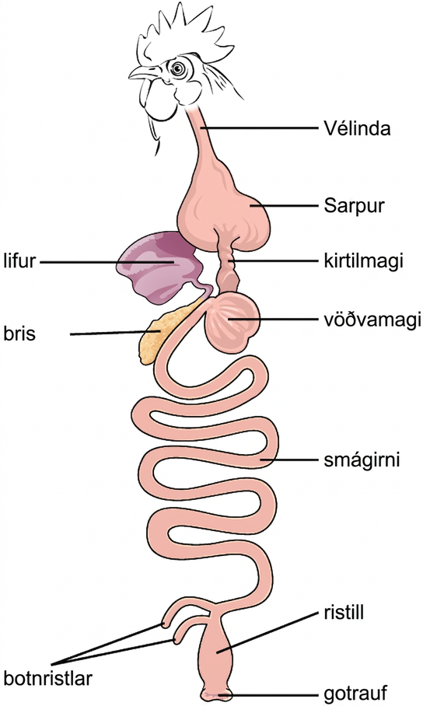
Figure 34.7
The avian esophagus has a pouch, called a crop, which stores food. Food passes from the crop to the first of two stomachs, called the proventriculus, which contains digestive juices that break down food. From the proventriculus, the food enters the second stomach, called the gizzard, which grinds food. Some birds swallow stones or grit, which are stored in the gizzard, to aid the grinding process. Birds do not have separate openings to excrete urine and feces. Instead, uric acid from the kidneys is secreted into the large intestine and combined with waste from the digestive process. This waste is excreted through an opening called the cloaca.
Notes:
Illustration shows an avian digestive system. Food is swallowed through the esophagus into the crop, which is shaped like an upside-down heart. From the bottom of the crop food enters a tubular proventriculus, which empties into a spherical gizzard. From the gizzard, food enters the small intestine, then the large intestine. Waste exits the body through the cloaca. The liver and pancreas are located between the crop and gizzard. Rather than a single cecum, birds have two caeca at the junction of the small and large intestine.

Slide 11
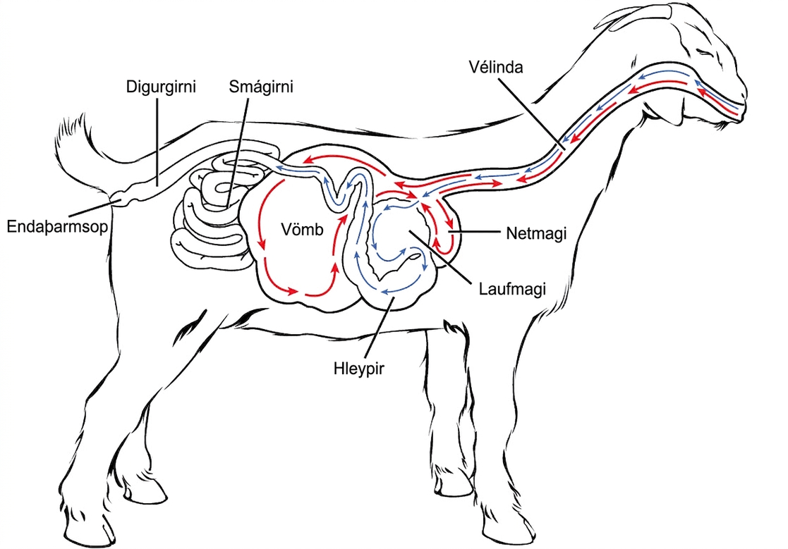
Figure 34.8
Ruminant animals, such as goats and cows, have four stomachs. The first two stomachs, the rumen and the reticulum, contain prokaryotes and protists that are able to digest cellulose fiber. The ruminant regurgitates cud from the reticulum, chews it, and swallows it into a third stomach, the omasum, which removes water. The cud then passes onto the fourth stomach, the abomasum, where it is digested by enzymes produced by the ruminant.
Notes:
Illustration shows the digestive system of a goat. Food passes from the mouth, through the esophagus and into the rumen. It circulates through the rumen, then moves forward, and down into the small, pouch-shaped reticulum. From the reticulum the food, which is now cud, is regurgitated. The animal chews the cud, and then swallows it into the coiled omasum, which sits between the reticulum and the rumen. After circulating through the omasum the food passes onto the fourth stomach, the abomasum, where it is digested by enzymes. The food then enters the small intestine, then the large intestine. Waste is excreted through the anus.

Slide 12
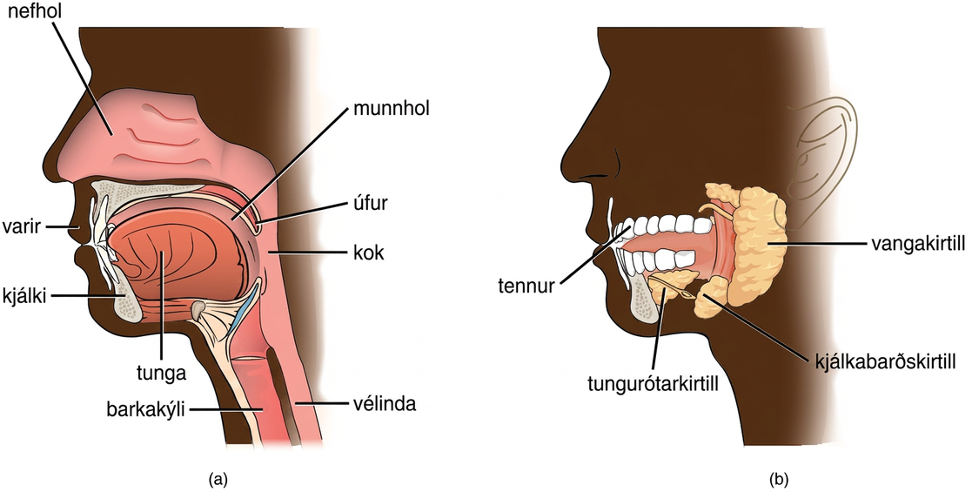
Figure 34.9
Digestion of food begins in the (a) oral cavity. Food is masticated by teeth and moistened by saliva secreted from the (b) salivary glands. Enzymes in the saliva begin to digest starches and fats. With the help of the tongue, the resulting bolus is moved into the esophagus by swallowing. (credit: modification of work by the National Cancer Institute)
Notes:
Illustration A shows the parts of the human oral cavity. The tongue rests in the lower part of the mouth. The flap that hangs from the back of the mouth is the uvula. The airway behind the uvula, called the pharynx, extends up to the nostrils and down to the esophagus, which begins in the neck. Illustration B shows the two salivary glands, which are located beneath the tongue, the sublingual and the submandibular. A third salivary gland, the parotid, is located behind the pharynx.

Slide 13
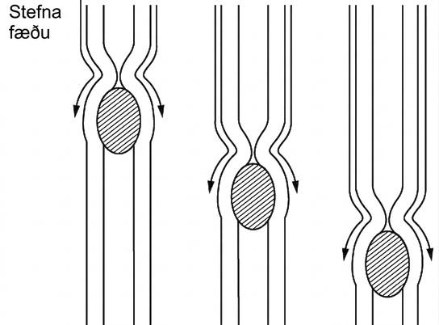
Figure 34.10
The esophagus transfers food from the mouth to the stomach through peristaltic movements.
Notes:
Photo shows food moving down the esophagus, which is a muscular tube. Muscles constrict behind the food. The constriction moves down, pushing the food ahead of it, from the mouth to the stomach.

Slide 14
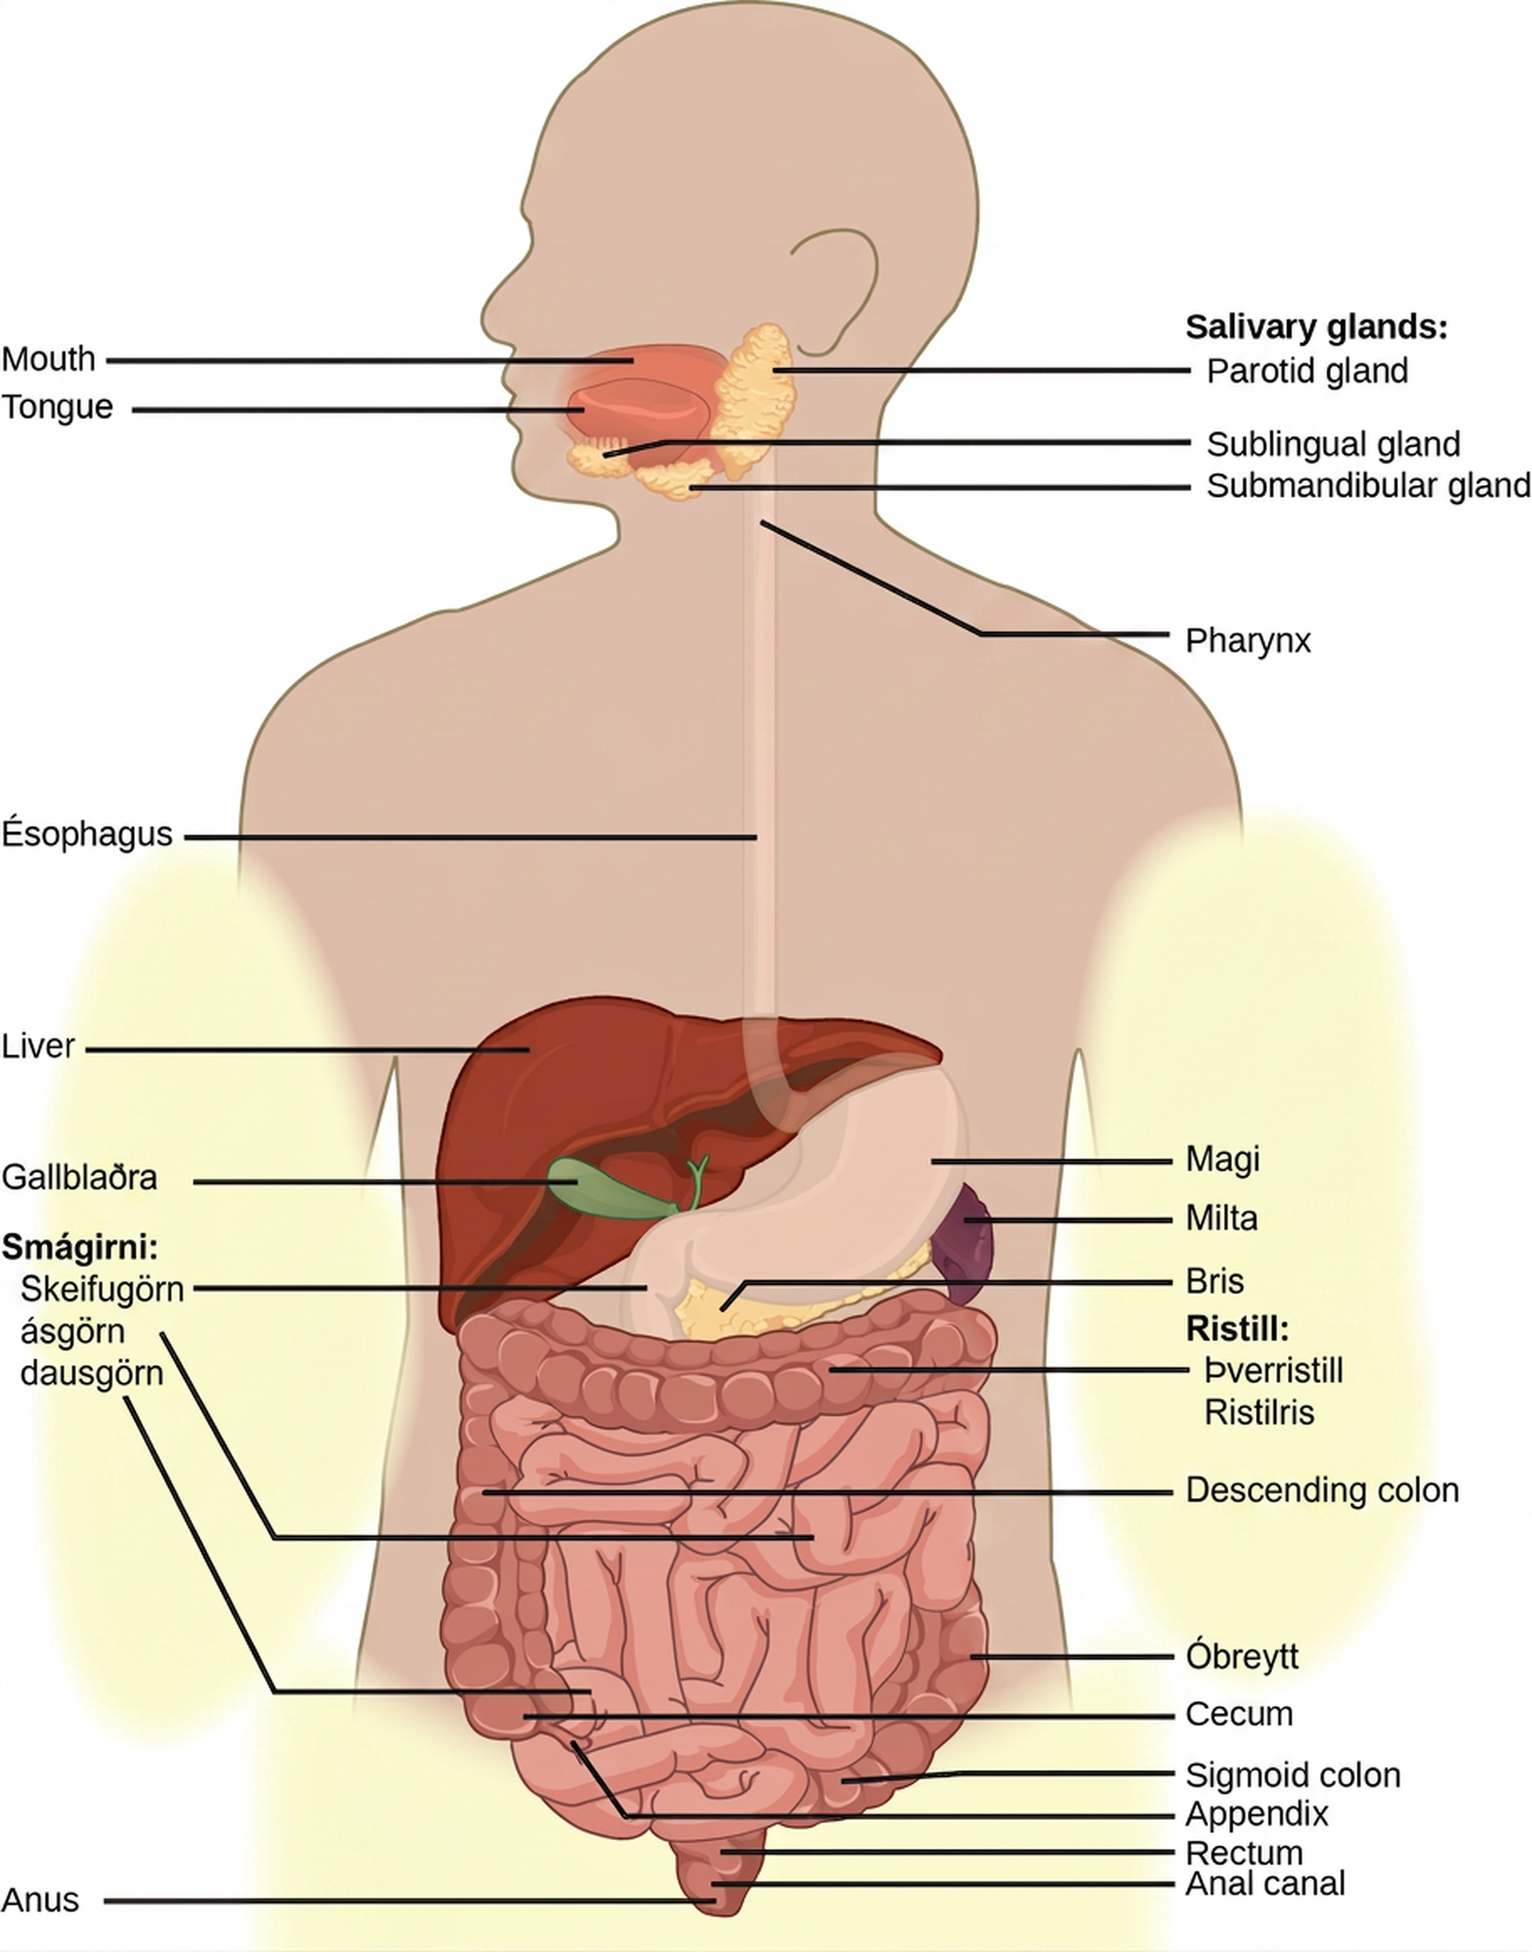
Figure 34.11
The human stomach has an extremely acidic environment where most of the protein gets digested. (credit: modification of work by Mariana Ruiz Villareal)
Notes:
Illustration shows the human lower digestive system, which begins with the stomach, a sac that lies above the large intestine. The stomach empties into the small intestine, which is a long, highly folded tube. The beginning of the small intestine is called the duodenum, the long middle part is called the jejunum, and the end is called the ileum. The ileum empties into the large intestine on the right side of the body. Beneath the junction of the small and large intestine is a small pouch called the cecum. The appendix is at the bottom end of the cecum. The large intestine travels up the left side of the body, across the top of the small intestine, then down the right side of the body. These parts of the large intestine are called the ascending colon, the transverse colon and the descending colon, respectively. The large intestine empties into the rectum, which is connected to the anus. The pancreas is sandwiched between the stomach and large intestine. The liver is a triangular organ that sits above and slightly to the right of the stomach. The gallbladder is a small bulb between the liver and stomach.

Slide 15
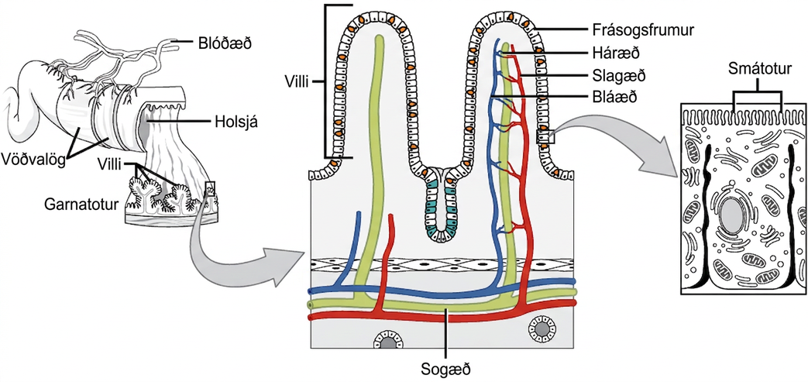
Figure 34.12
Villi are folds on the small intestine lining that increase the surface area to facilitate the absorption of nutrients.
Notes:
Illustration shows a cross section of the small intestine, the lumen, or inside of which has many fingerlike projections called villi. Muscle layers wrap around the outside of the intestine, and blood vessels interact with the muscle layer. A blowup shows that capillaries and lymphatic vessels travel up inside the villi. The surface of each villus is covered with hairlike microvilli.

Slide 16
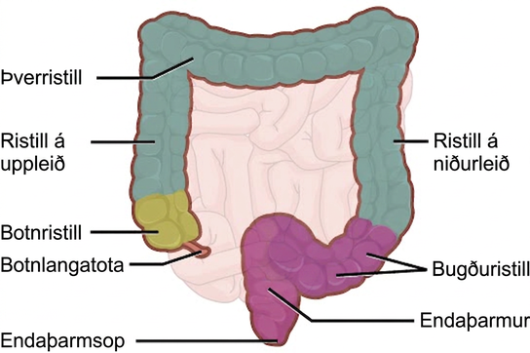
Figure 34.13
The large intestine reabsorbs water from undigested food and stores waste material until it is eliminated.
Notes:
Illustration shows the structure of the large intestine, which begins with the ascending colon. Below the ascending colon is the cecum. The vermiform appendix is a small projection at the bottom of the cecum. The ascending colon travels up the right side of the body, then turns into the transverse colon. On the left side of the body the large intestine turns again, into the descending colon. At the bottom, the descending colon curves up; this part of the intestine is called the sigmoid colon. The sigmoid colon empties into the rectum. The rectum travels straight down, to the anus.

Slide 17
34.2 Nutrition and Energy Production (1 of 2)
Learning Objectives
Explain why an animal’s diet should be balanced and meet the needs of the body
Define the primary components of food
Describe the essential nutrients required for cellular function that cannot be synthesized by the animal body

Slide 18
34.2 Nutrition and Energy Production (2 of 2)
Learning Objectives
Explain how energy is produced through diet and digestion
Describe how excess carbohydrates and energy are stored in the body

Slide 19
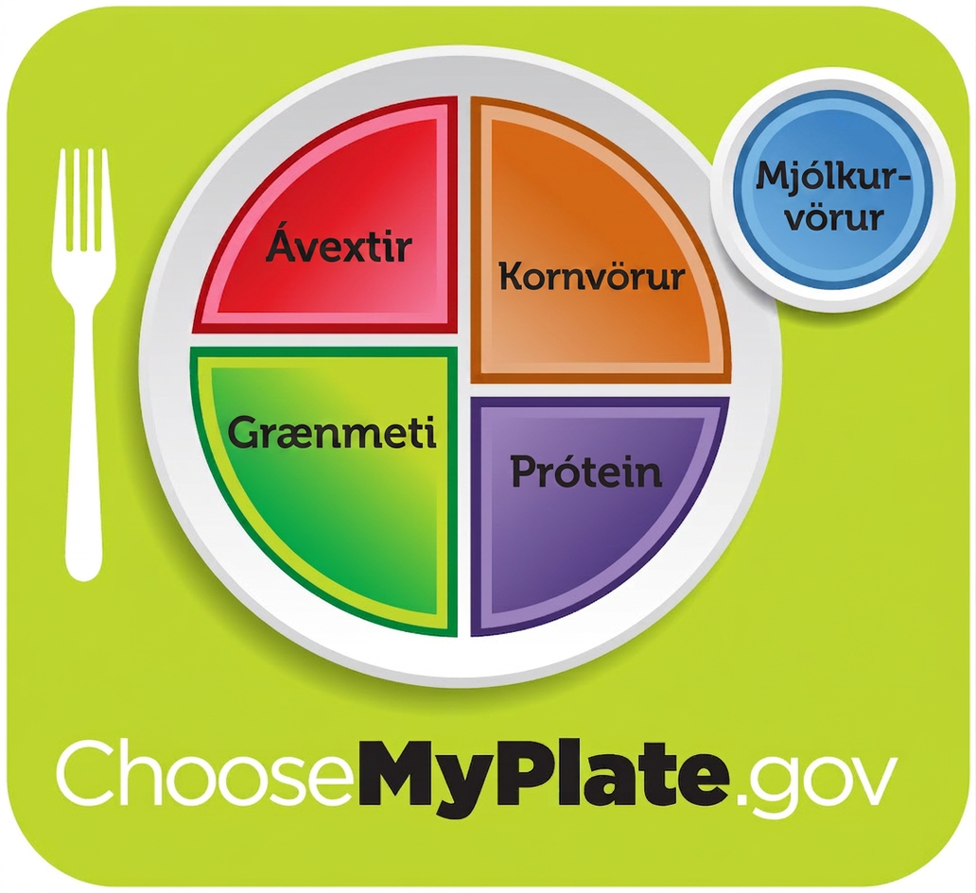
Figure 34.14
For humans, a balanced diet includes fruits, vegetables, grains, and protein. (credit: USDA)
Notes:
Healthy diet logo shows a plate divided into four sections, labeled fruits; vegetables; grains; and protein. The vegetables and grains sections are larger than the other two. A circle to the side of the plate is labeled dairy. Beneath the plate is the web address, which reads Choose My Plate dot gov.

Slide 20
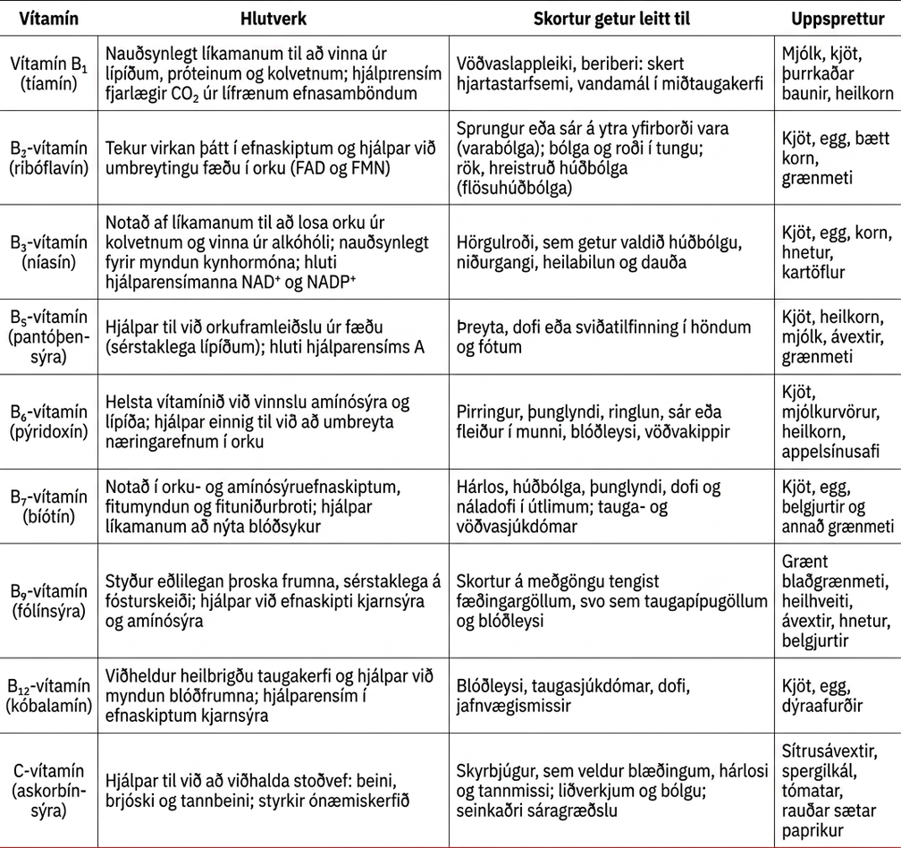
Table 34.1

Slide 21
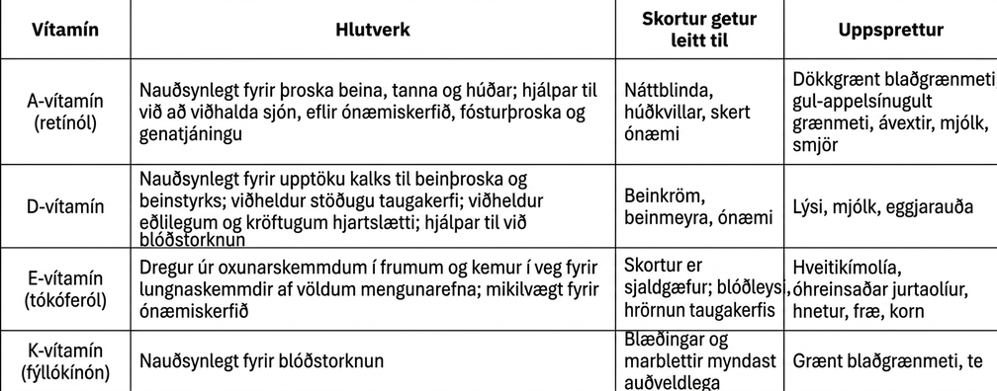
Table 34.2

Slide 22
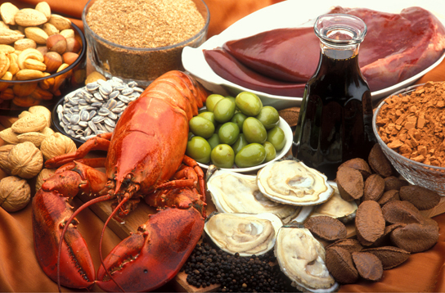
Figure 34.15
A healthy diet should include a variety of foods to ensure that needs for essential nutrients are met. (credit: Keith Weller, USDA ARS)
Notes:
Photo shows a variety of foods, including lobster, clams, nuts and liver.

Slide 23
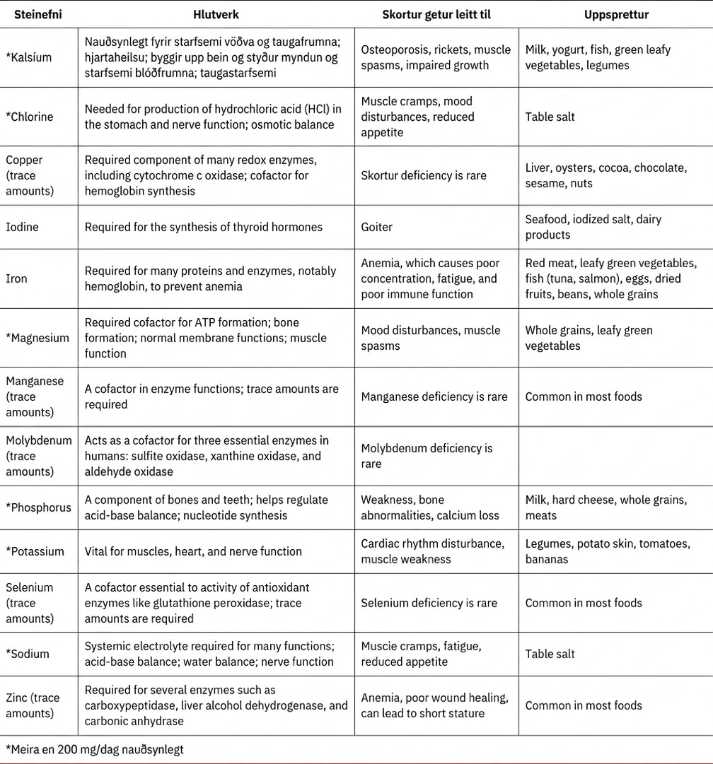
Table 34.3

Slide 24
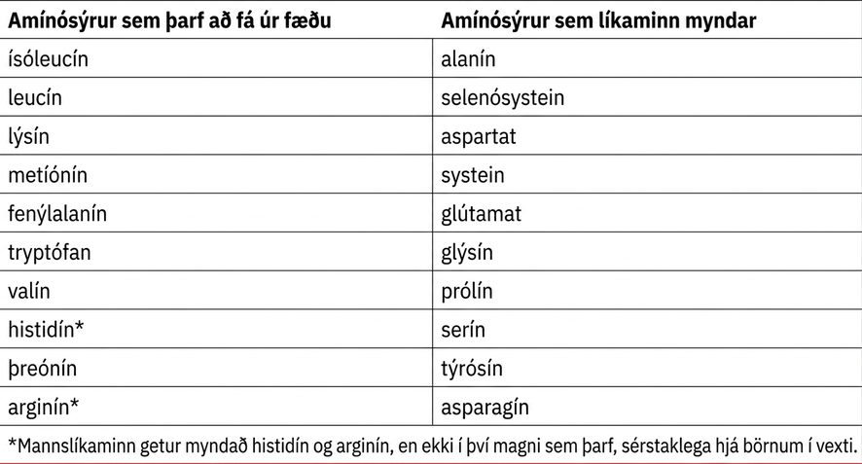
Table 34.4

Slide 25
34.3 Digestive System Processes
Learning Objectives
Describe the process of digestion
Detail the steps involved in digestion and absorption
Define elimination
Explain the role of both the small and large intestines in absorption

Slide 26
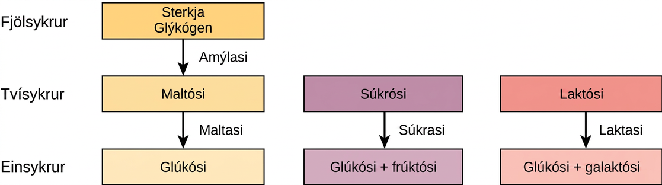
Figure 34.16
Digestion of carbohydrates is performed by several enzymes. Starch and glycogen are broken down into glucose by amylase and maltase. Sucrose (table sugar) and lactose (milk sugar) are broken down by sucrase and lactase, respectively.
Notes:
Pathways for the breakdown of starch and glycogen, sucrose, and lactose are shown. Starch and glycogen, which are both polysaccharides, are broken down by amylase into the disaccharide maltose. Maltose is then broken down by maltase into the monosaccharaide glucose. Sucrose, a disaccharide, is broken down by sucrase into the monosaccharides glucose and fructose. Lactose, also a disaccharide, is broken down by lactase into glucose and galactose.

Slide 27
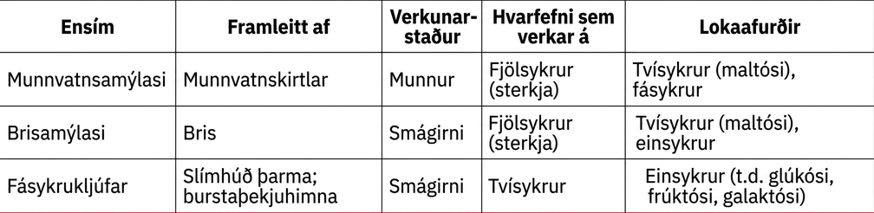
Table 34.5

Slide 28
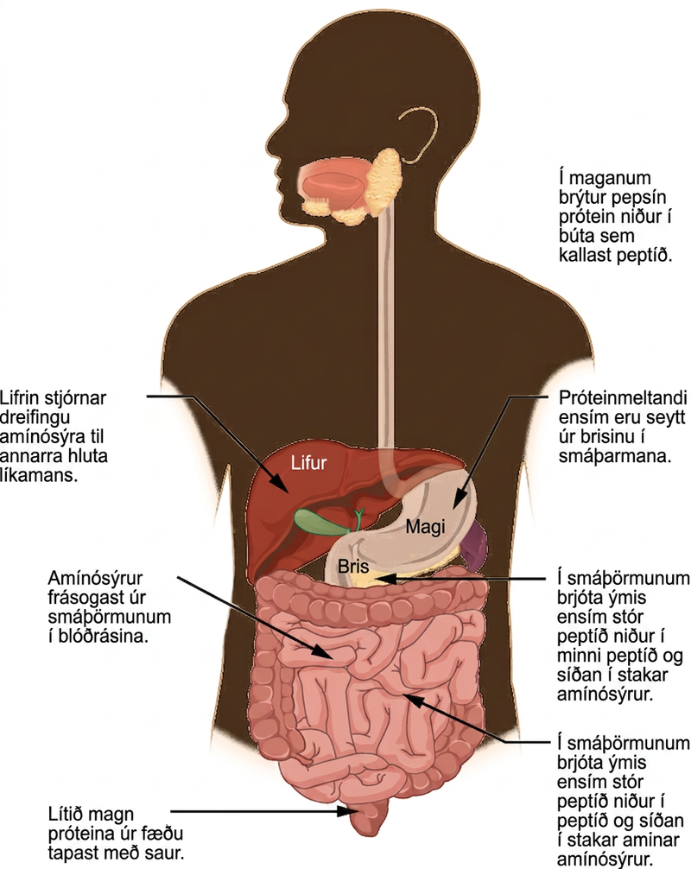
Figure 34.17
Protein digestion is a multistep process that begins in the stomach and continues through the intestines.
Notes:
Protein digestion begins in the stomach, where pepsin breaks proteins down into fragments, called peptides. Further digestion occurs in the small intestine, where a variety of enzymes break peptides down into smaller peptides, and then into individual amino acids. Several of the protein-digesting enzymes found in the small intestine are secreted from the pancreas. Amino acids are absorbed from the small intestine into the blood stream. The liver regulates the distribution of amino acids to the rest of the body. A small amount of dietary protein is lost in the feces.

Slide 29
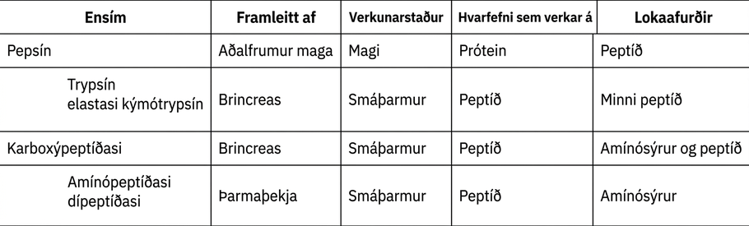
Table 34.6

Slide 30
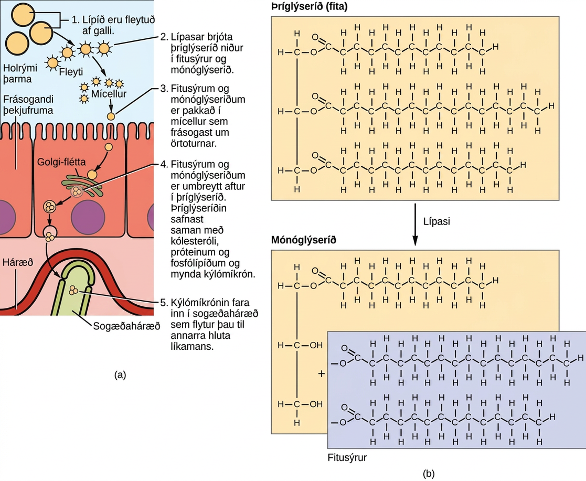
Figure 34.18
Lipids are digested and absorbed in the small intestine.
Notes:
Illustration shows a row of absorptive epithelial cells that line the intestinal lumen. Hair-like microvilli project into the lumen. On the other side of the epithelial cells are capillaries and lymphatic vessels. In the intestinal lumen, lipids are emulsified by the bile. Lipases breakdown fats, also known as triglycerides, into fatty acids and monoglycerides. Fats are made up of three fatty acids attached to a 3-carbon glycerol backbone. In monoglycerides, two of the fatty acids are removed. The emulsified lipids form small, spherical particles called micelles that are absorbed by the epithelial cells. Inside the epithelial cells the fatty acids and monoglyerides are reassembled into triglycerides. The triglycerides aggregate with cholesterol, proteins, and phospholipids to form spherical chylomicrons. The chylomicrons are moved into a lymph capillary, which transports them to the rest of the body.

Slide 31
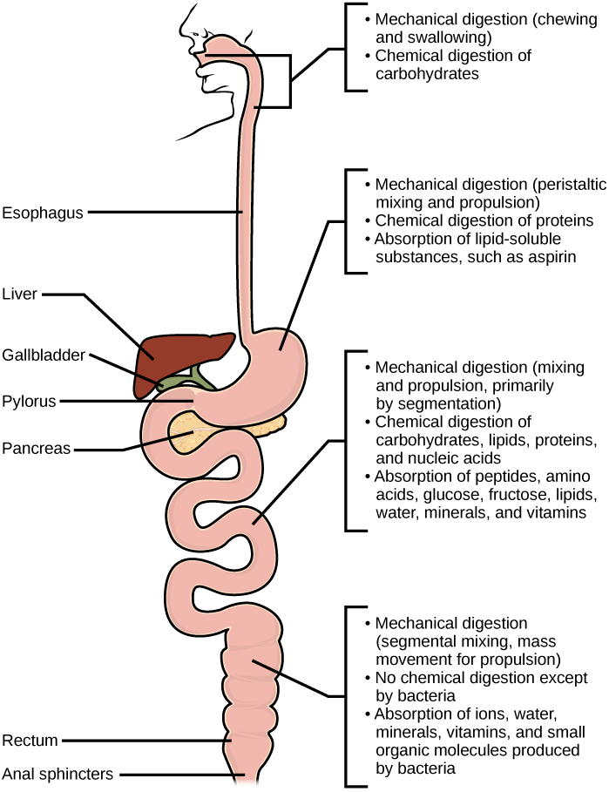
Figure 34.19
Mechanical and chemical digestion of food takes place in many steps, beginning in the mouth and ending in the rectum.
Notes:
Steps in mechanical and chemical digestion are shown. Digestion begins in the mouth, where chewing and swallowing mechanically breaks down food into smaller particles, and enzymes chemically digest carbohydrates. In the stomach, mechanical digestion includes peristaltic mixing and propulsion. Chemical digestion of proteins occurs, and lipid-soluble substances such as aspirin are absorbed. In the small intestine, mechanical digestion occurs through mixing and propulsion, primarily by segmentation. Chemical digestion of carbohydrates, lipids, proteins and nucleic acid occurs. Peptides, amino acids, glucose, fructose, lipids, water, vitamins, and minerals are absorbed into the bloodstream. In the large intestine, mechanical digestion occurs through segmental mixing and mass movement. No chemical digestion occurs except for digestion by bacteria. Water, ions, vitamins, minerals, and small organic molecules produced by bacteria are absorbed into the bloodstream.

Slide 32
34.4 Digestive System Regulation
Learning Objectives
Discuss the role of neural regulation in digestive processes
Explain how hormones regulate digestion

Slide 33
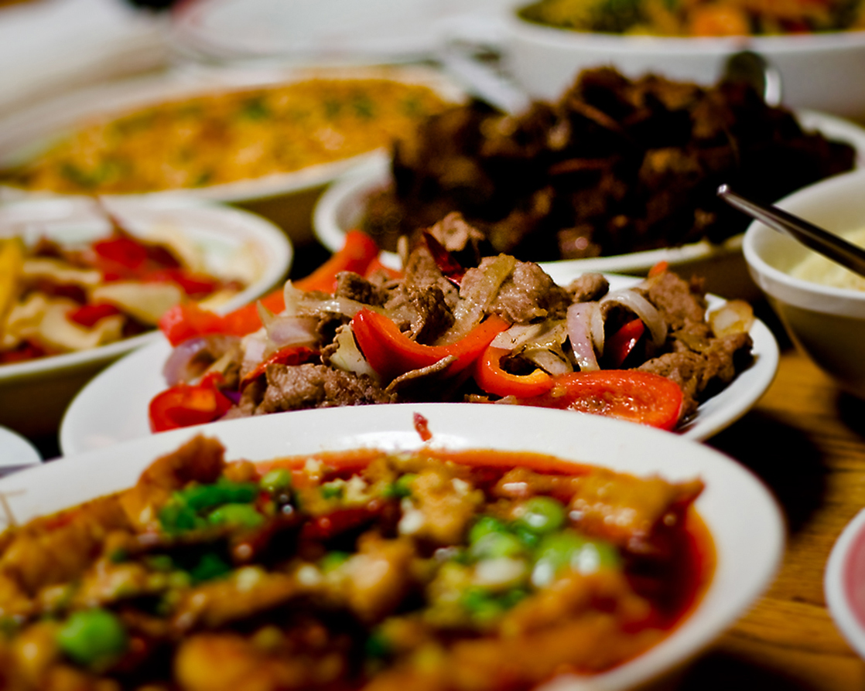
Figure 34.20
Seeing a plate of food triggers the secretion of saliva in the mouth and the production of HCL in the stomach. (credit: Kelly Bailey)
This OpenStax ancillary resource is © Rice University under a CC BY-NC-SA 4.0 International license; it may be reproduced or modified for noncommercial purposes only but must be attributed to OpenStax, Rice University and any changes must be noted. Any adaptation must be shared under the same type of license.
Notes:
Photo shows plates of food on a dinner table.

