Slide 1

Biology 2e
Chapter 13 Modern Understandings of Inheritance

Slide 2
Chapter outline
Chromosomal Theory and Genetic Linkage
Chromosomal Basis of Inherited Disorders

Slide 3
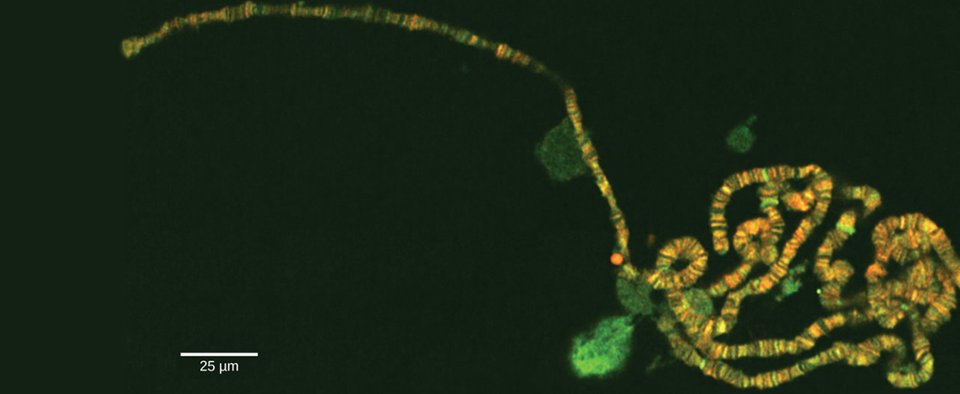
Figure 13.1
Chromosomes are threadlike nuclear structures consisting of DNA and proteins that serve as the repositories for genetic information. The chromosomes depicted here were isolated from a fruit fly’s salivary gland, stained with dye, and visualized under a microscope. Akin to miniature bar codes, chromosomes absorb different dyes to produce characteristic banding patterns, which allows for their routine identification. (credit: modification of work by “LPLT”/Wikimedia Commons; scale-bar data from Matt Russell)
Notes:
Electron micrograph shows a long, thin chromosome that has a banding pattern.

Slide 4
13.1 Chromosomal Theory and Genetic Linkage (1 of 2)
Learning Objectives
Discuss Sutton’s Chromosomal Theory of Inheritance
Describe genetic linkage
Explain the process of homologous recombination, or crossing over
Describe chromosome creation

Slide 5
13.1 Chromosomal Theory and Genetic Linkage (2 of 2)
Learning Objectives
Calculate the distances between three genes on a chromosome using a three-point test cross

Slide 6
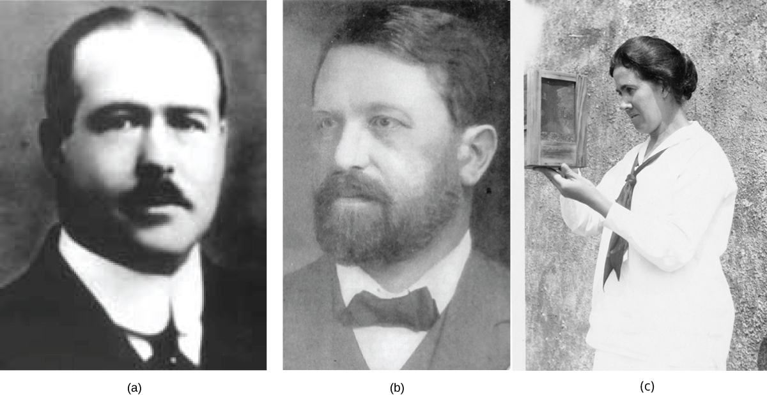
Figure 13.2
(a) Walter Sutton and (b) Theodor Boveri developed the Chromosomal Theory of Inheritance, which states that chromosomes carry the unit of heredity (genes). Eleanor Carothers (c), was the first to provide physical evidence supporting the theory.
Notes:
Part a is a photo of Walter Sutton. Part b is a photo of Theodor Boveri. Part c is a picture of Eleanor Carothers holding a grasshopper cage.

Slide 7
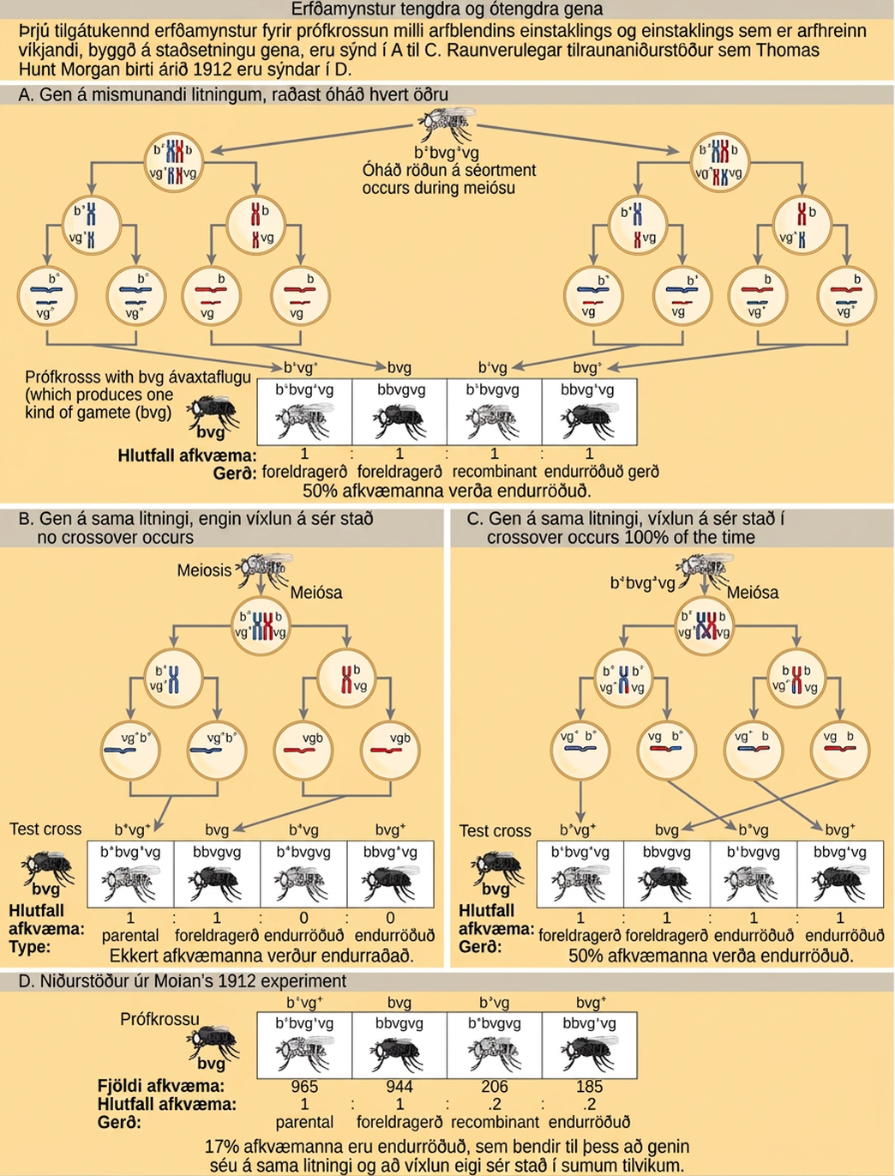
Figure 13.3
This figure shows unlinked and linked gene inheritance patterns. The example used includes fruit fly body color and wing length. Fruit flies may have a dominant gray color `b` +, or a recessive black color `b`. They may have dominant long wings vg+, or recessive short wings, vg. In (a), two genes are located on different chromosomes so independent assortment occurs during meiosis. The offspring have an equal chance of being the parental type (inheriting the same combination of traits as the parents) or a nonparental type (inheriting a different combination of traits than the parents). In (b), two genes are very close together on the same chromosome so that no crossing over occurs between them. Therefore, the genes are always inherited together and all the offspring are the parental type. In (c), two genes are far apart on the chromosome such that crossing over occurs during every meiotic event. The recombination frequency will be the same as if the genes were on separate chromosomes. (d) The actual recombination frequency of fruit fly wing length and body color that Thomas Morgan observed in 1912 was 17 percent. A crossover frequency between 0 percent and 50 percent indicates that the genes are on the same chromosome and crossover sometimes occurs.
Notes:
The illustration shows the possible inheritance patterns of linked and unlinked genes. The example used includes fruit fly body color and wing length. Fruit flies may have a dominant gray color lowercase b superscript +, or a recessive black color lowercase b. They may have dominant long wings lowercase v g superscript +, or recessive short wings, lowercase v g. Three hypothetical inheritance patterns for a test cross between a heterozygous and a recessive fruit fly are shown, based on gene placement. The actual experimental results published by Thomas Hunt Morgan in 1912 are also shown. In the first hypothetical inheritance pattern in part a, the genes for the two characteristics are on different chromosomes. Independent assortment occurs so that the ratio of genotypes in the offspring is 1 b + b v g + v g colon 1 b b v g v g colon 1 b + b v g v g colon 1 b b v g + v g, and 50% of the offspring are nonparental types. In the second hypothetical inheritance pattern in part b, the genes are close together on the same chromosome so that no crossover occurs between them. The ratio of genotypes is 1 b + b v g + v g colon 1. b b v g v g, and none of the offspring are recombinant. In the third hypothetical inheritance pattern in part c, the genes are far apart on the same chromosome so that crossing over occurs 100% of the time. The ratio of genotypes is the same as for genes on two different chromosomes, and 50% of the offspring are recombinant, nonparental types. Part d shows that the number of offspring that Thomas Hunt Morgan actually observed was 965 colon 944 colon 206 colon 185, which is b + b v g + v g colon b b v g v g colon b + b v g v g colon b b v g + v g. Seventeen percent of the offspring were recombinant, indicating that the genes are on the same chromosome and crossing over occurs between them some of the time.

Slide 8
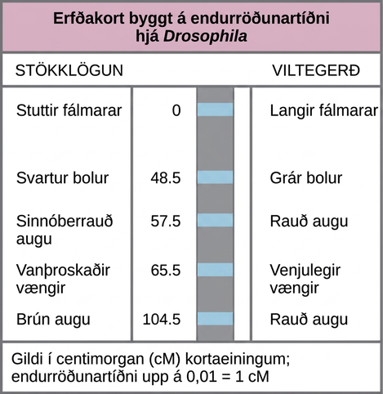
Figure 13.4
This genetic map orders Drosophila genes on the basis of recombination frequency.
Notes:
The illustration shows a Drosophila genetic map. The gene for aristae length occurs at 0 centimorgans, or lower case c upper case M. The gene for body color occurs at 48.5 lower c upper M. The gene for red versus cinnabar eye color occurs at 57.5 lower c upper M. The gene for wing length occurs at 65.5 lower c upper M, and the gene for red versus brown eye color occurs at 104.5 lower c upper M. One lower c upper M is equivalent to a recombination frequency of 0.01.

Slide 9
13.2 Chromosomal Basis of Inherited Disorders
Learning Objectives
Describe how a karyogram is created
Explain how nondisjunction leads to disorders in chromosome number
Compare disorders that aneuploidy causes
Describe how errors in chromosome structure occur through inversions and translocations

Slide 10
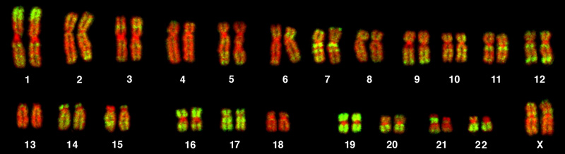
Figure 13.5
This karyotype is of a female human. Notice that homologous chromosomes are the same size, and have the same centromere positions and banding patterns. A human male would have an XY chromosome pair instead of the XX pair. (credit: Andreas Blozer et al)
Notes:
This is a karyotype of a human female. There are 22 homologous pairs of chromosomes and an XX chromosome pair.

Slide 11
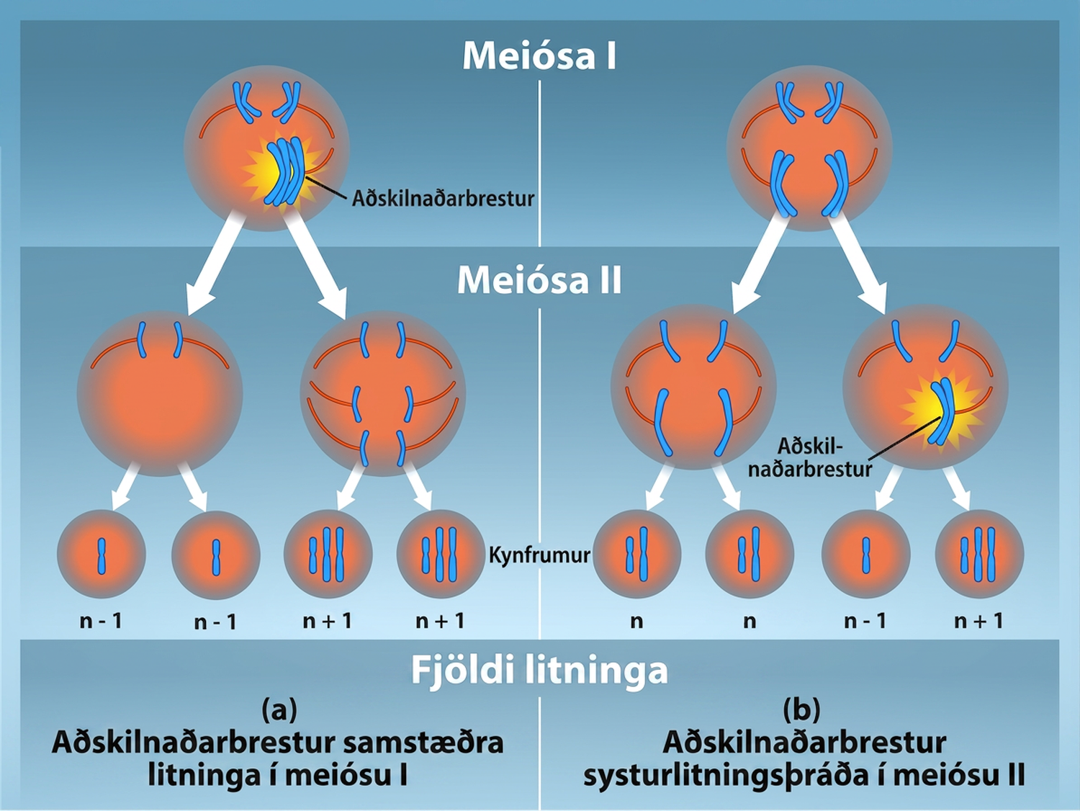
Figure 13.6
Nondisjunction occurs when homologous chromosomes or sister chromatids fail to separate during meiosis, resulting in an abnormal chromosome number. Nondisjunction may occur during meiosis I or meiosis II. Credit: Rao, A. and Tag, A. Department of Biology, Texas A&M University.
Notes:
This illustration shows nondisjunction that occurs during meiosis I. Nondisjunction during meiosis I occurs when a homologous pair fails to separate, and results in two gametes with n + 1 chromosomes, and two gametes with n minus 1 chromosomes. Nondisjunction during meiosis I I would occur when sister chromatids fail to separate, and results in one gamete with n + 1 chromosomes, one gamete with n minus 1 chromosomes, and two normal gametes.

Slide 12
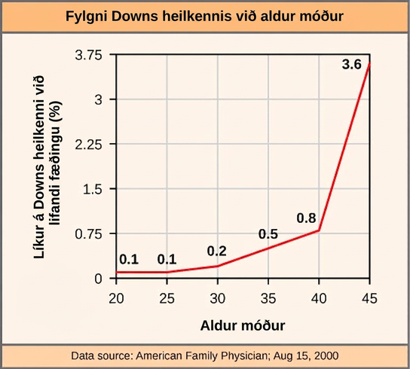
Figure 13.7
The incidence of having a fetus with trisomy 21 increases dramatically with maternal age.
Notes:
This graph shows the risk of Down syndrome in the fetus with increasing maternal age. Risk dramatically increases past a maternal age of 35.

Slide 13
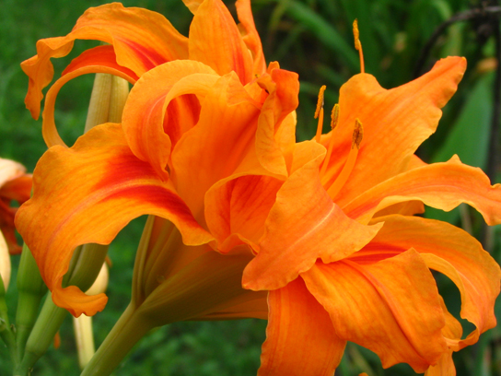
Figure 13.8
As with many polyploid plants, this triploid orange daylily (Hemerocallis fulva) is particularly large and robust, and grows flowers with triple the number of petals of its diploid counterparts. (credit: Steve Karg)
Notes:
Photo shows an orange day lily, which is a plant with a large flower; the flower looks like it is bursting with orange petals.

Slide 14
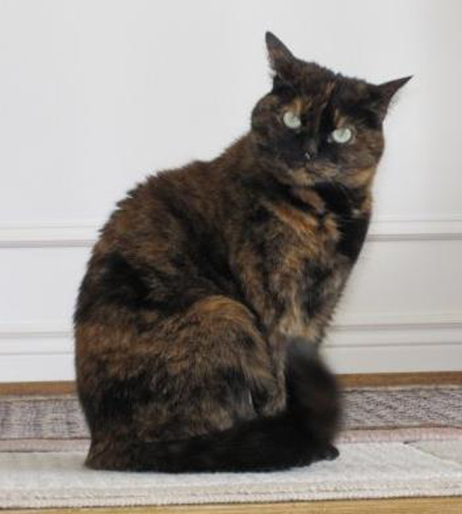
Figure 13.9
In cats, the gene for coat color is located on the X chromosome. In female cats' embryonic development, one of the two X chromosomes randomly inactivates in each cell, resulting in a tortoiseshell pattern if the cat has two different alleles for coat color. Male cats, having only one X chromosome, never exhibit a tortoiseshell coat color. (credit: Michael Bodega)
Notes:
Photo shows a tortoiseshell cat with orange and black fur.

Slide 15
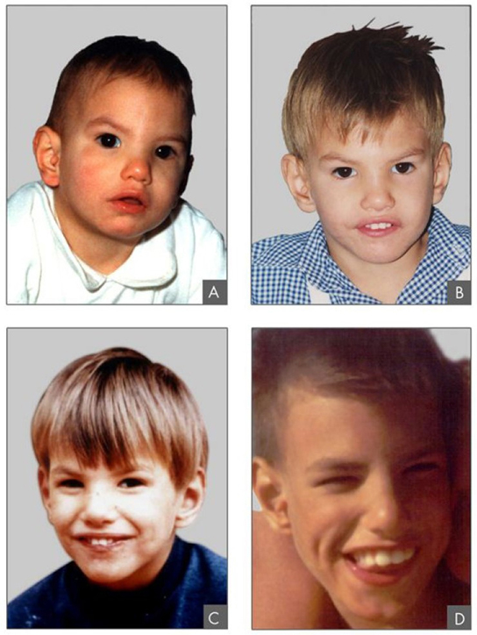
Figure 13.10
This figure shows an individual with cri-du-chat syndrome at two, four, nine, and 12 years of age. (credit: Paola Cerruti Mainardi)
Notes:
Photos show a boy with cri du chat syndrome. In parts a, b, c, and d of the image, he is two, four, nine, and 12 years of age, respectively.

Slide 16
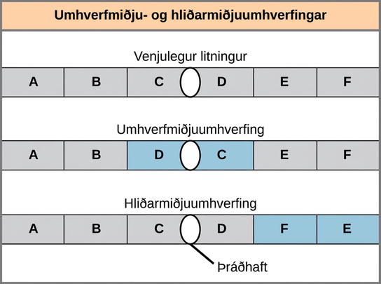
Figure 13.11
Pericentric inversions include the centromere, and paracentric inversions do not. A pericentric inversion can change the chromosome arms' relative lengths. A paracentric inversion cannot.
Notes:
Illustration shows pericentric and paracentric inversions. In this example, the order of genes in the normal chromosome is A B C D E F, with the centromere between genes C and D. In the pericentric inversion the order is A B D C E F. In the paracentric inversion example, the resulting gene order is A B C D F E.

Slide 17
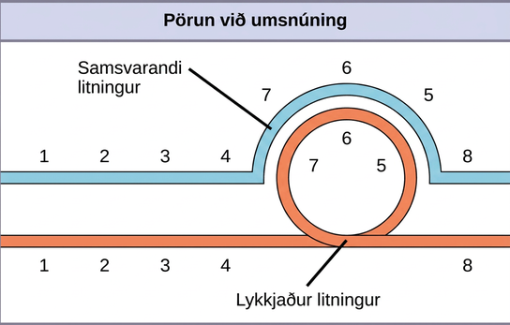
Figure 13.12
When one chromosome undergoes an inversion but the other does not, one chromosome must form an inverted loop to retain point-for-point interaction during synapsis. This inversion pairing is essential to maintaining gene alignment during meiosis and to allow for recombination.
Notes:
This illustration shows the inversion pairing that occurs when one chromosome undergoes inversion but the other does not. For chromosome alignment to occur during meiosis, one chromosome must form an inverted loop while the other conforms around it.

Slide 18
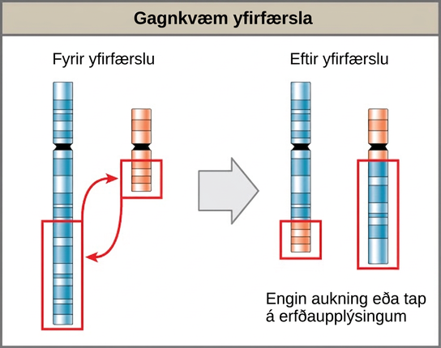
Figure 13.13
A reciprocal translocation occurs when a DNA segment transfers from one chromosome to another, nonhomologous chromosome. (credit: modification of work by National Human Genome Research/USA)
This OpenStax ancillary resource is © Rice University under a CC BY-NC-SA 4.0 International license; it may be reproduced or modified for noncommercial purposes only but must be attributed to OpenStax, Rice University and any changes must be noted. Any adaptation must be shared under the same type of license.
Notes:
Illustration shows a reciprocal translocation in which DNA is transferred from one chromosome to another. Some DNA is also transferred from the second chromosome back to the first. No genetic information is gained or lost in the process.

