Slide 1

Biology 2e
Chapter 35 The Nervous System

Slide 2
Chapter outline
Neurons and Glial Cells
How Neurons Communicate
The Central Nervous System
The Peripheral Nervous System
Nervous System Disorders

Slide 3

Figure 35.1
An athlete’s nervous system is hard at work during the planning and execution of a movement as precise as a high jump. Parts of the nervous system are involved in determining how hard to push off and when to turn, as well as controlling the muscles throughout the body that make this complicated movement possible without knocking the bar down—all in just a few seconds. (credit: Steven Pisano)
Notes:
Photo shows a woman, upside-down with an arched back, going over a horizontal bar at a track and field event.

Slide 4
35.1 Neurons and Glial Cells
Learning Objectives
List and describe the functions of the structural components of a neuron
List and describe the four main types of neurons
Compare the functions of different types of glial cells

Slide 5
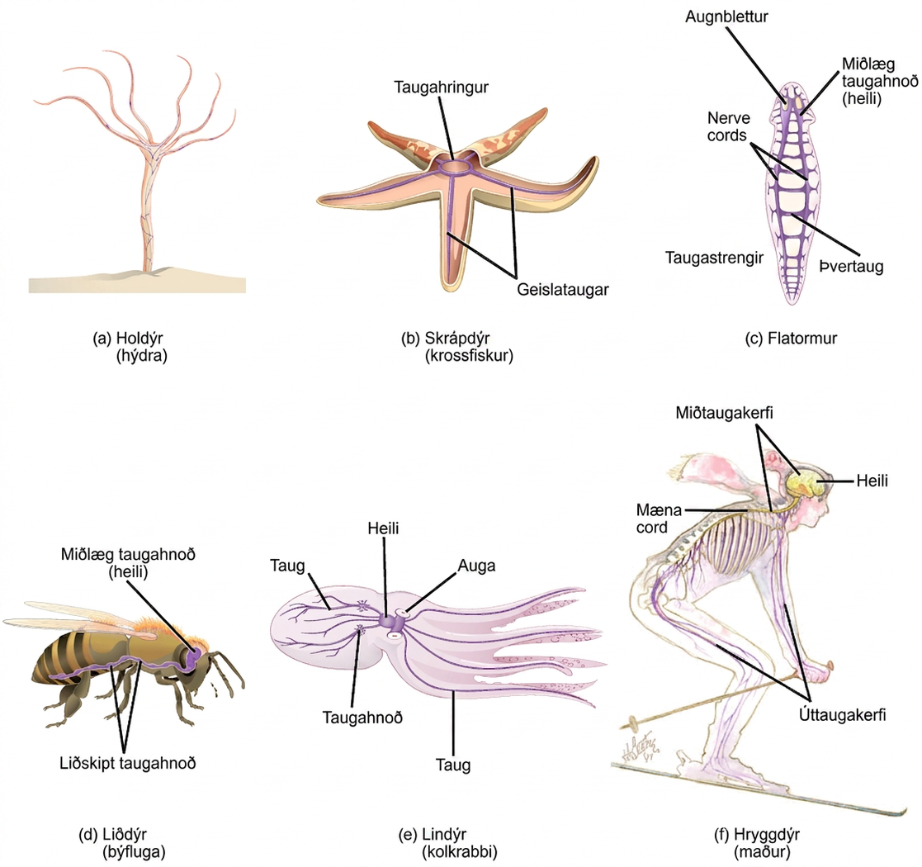
Figure 35.2
Nervous systems vary in structure and complexity. In (a) cnidarians, nerve cells form a decentralized nerve net. In (b) echinoderms, nerve cells are bundled into fibers called nerves. In animals exhibiting bilateral symmetry such as (c) planarians, neurons cluster into an anterior brain that processes information. In addition to a brain, (d) arthropods have clusters of nerve cell bodies, called peripheral ganglia, located along the ventral nerve cord. Mollusks such as squid and (e) octopi, which must hunt to survive, have complex brains containing millions of neurons. In (f) vertebrates, the brain and spinal cord comprise the central nervous system, while neurons extending into the rest of the body comprise the peripheral nervous system. (credit e: modification of work by Michael Vecchione, Clyde F.E. Roper, and Michael J. Sweeney, NOAA; credit f: modification of work by NIH)
Notes:
Illustration A shows the nerve net of a hydra, which resembles a fish net surrounding the body. The hydra is plant like, with a trunk and tentacle like extensions at the top of the trunk. Illustration B shows the nervous system of a sea star. A nerve ring is present in the center of the body. Radiating out from this ring into the five arms are radial nerves. Illustration C shows the nervous system of a planarian, or flatworm. The flatworm has centralized ganglia, or brains, around each eye in the anterior end, and two nerve cords that run along the sides of the body. Transverse nerves connect the nerve cords together. Illustration D shows the nervous system of a bee. The central ganglia, or brain, is located in the head. The ventral nerve cord runs along the lower part of the body. Bumps of nerve cell bodies, called peripheral ganglia, occur periodically along the nerve cord. Illustration E shows the nervous system of the octopus, which consists of a large brain located between the two eyes, and nerves that run into the body and arms. Two large ganglia exist in the nerves located in the body. Illustration F shows the nervous system of a human, which consists of a central nervous system composed of the brain and spinal cord, and a peripheral nervous system composed of the nerves running into the rest of the body.

Slide 6
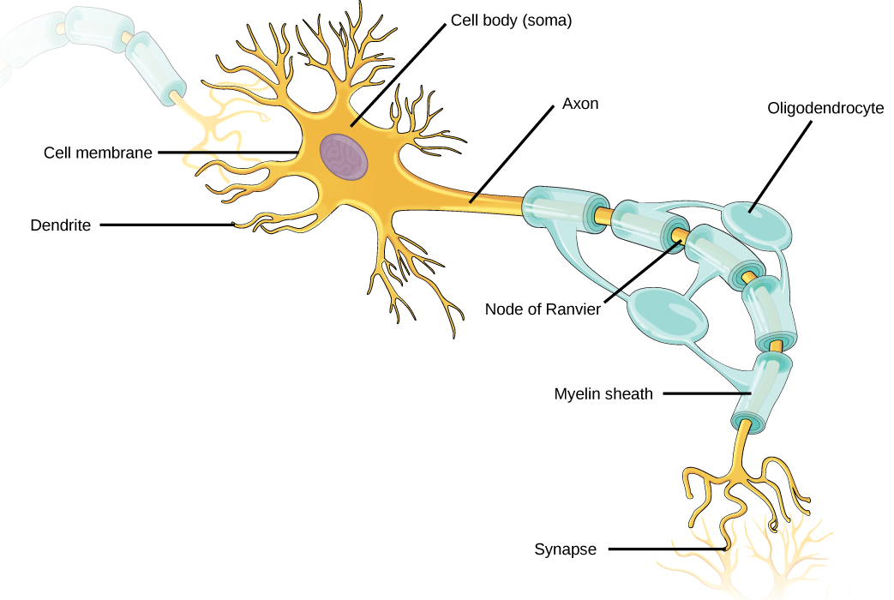
Figure 35.3
Neurons contain organelles common to many other cells, such as a nucleus and mitochondria. They also have more specialized structures, including dendrites and axons.
Notes:
Illustration shows a neuron. The main part of the cell body, called the soma, contains the nucleus. Branch-like dendrites project from three sides of the soma. A long, thin axon projects from the fourth side. The axon branches at the end. The tip of the axon is in close proximity to dendrites of an adjacent nerve cell. The narrow space between the axon and dendrites is called the synapse. Cells called oligodendrocytes are located next to the axon. Projections from the oligodendrocytes wrap around the axon, forming a myelin sheath. The myelin sheath is not continuous, and gaps where the axon is exposed are called nodes of Ranvier.

Slide 7
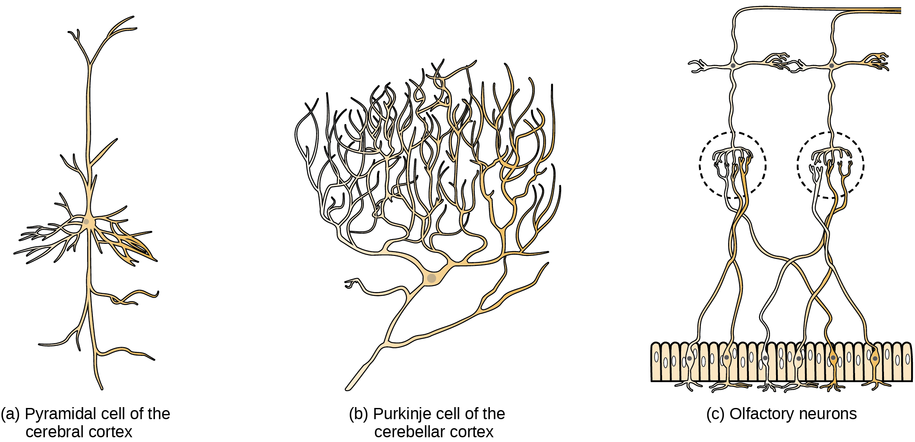
Figure 35.4
There is great diversity in the size and shape of neurons throughout the nervous system. Examples include (a) a pyramidal cell from the cerebral cortex, (b) a Purkinje cell from the cerebellar cortex, and (c) olfactory cells from the olfactory epithelium and olfactory bulb.
Notes:
Part A shows a pyramidal cell with two long, branched projections on either end of the soma. Dendrites branch from either side. Part B shows a Purkinje cell with highly branched dendrites opposite the axon. Part C shows cells with long, thin axons. The dendrites are less branched than in pyramidal or Purkinje cells.

Slide 8
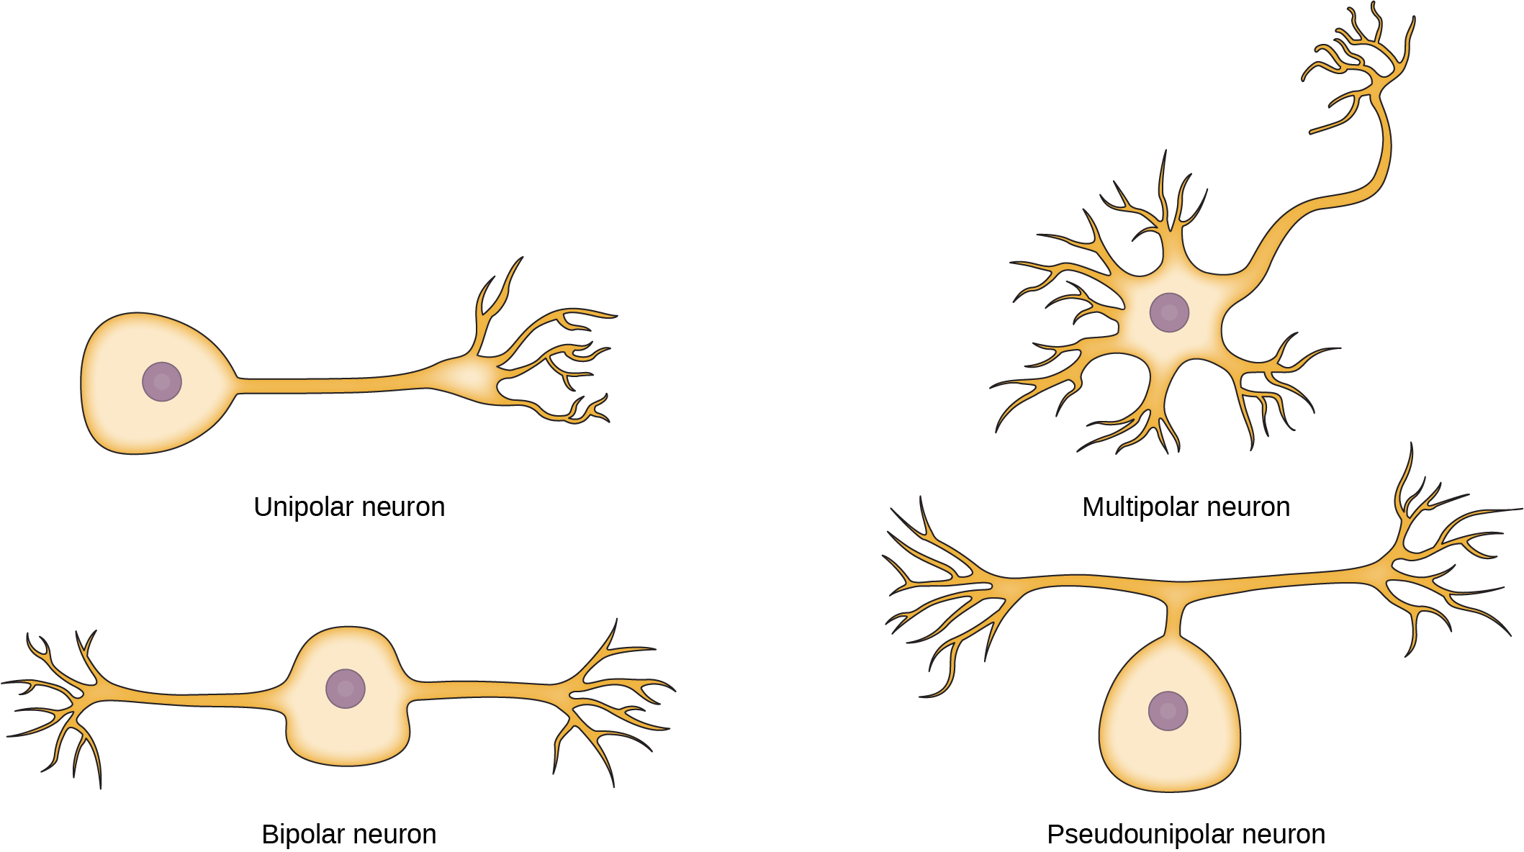
Figure 35.5
Neurons are broadly divided into four main types based on the number and placement of axons: (1) unipolar, (2) bipolar, (3) multipolar, and (4) pseudounipolar.
Notes:
The unipolar cell has a single, long axon extending from the cell body. The bipolar neuron has one axon and one dendrite projecting from opposite sides of the cell body. The multipolar neuron has one long axon and several short, highly branched dendrites extending in all directions. The pseudounipolar neuron has one axon that forms two branches a short distance from the cell body, each of which extends in a different direction.

Slide 9
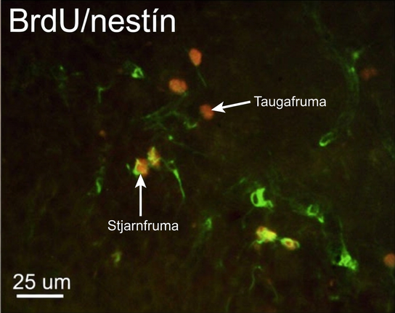
Figure 35.6
This micrograph shows fluorescently labeled new neurons in a rat hippocampus. Cells that are actively dividing have bromodeoxyuridine (BrdU) incorporated into their DNA and are labeled in red. Cells that express glial fibrillary acidic protein (GFAP) are labeled in green. Astrocytes, but not neurons, express GFAP. Thus, cells that are labeled both red and green are actively dividing astrocytes, whereas cells labeled red only are actively dividing neurons. (credit: modification of work by Dr. Maryam Faiz, et. al., University of Barcelona; scale-bar data from Matt Russell)
Notes:
In the micrograph, several cells are fluorescently shown as green only. Three cells are shown as red only, and four cells are shown as being both green and red. The cells shown as green and red are astrocytes, and the cells shown red are neurons. The neurons are oval and about ten microns long. Astrocytes are slightly larger and irregularly shaped.

Slide 10
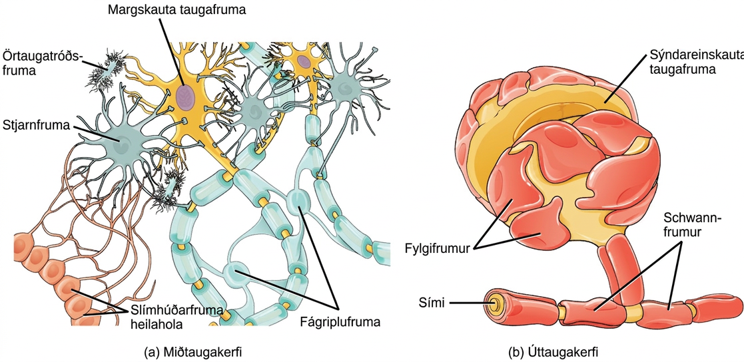
Figure 35.7
Glial cells support neurons and maintain their environment. Glial cells of the (a) central nervous system include oligodendrocytes, astrocytes, ependymal cells, and microglial cells. Oligodendrocytes form the myelin sheath around axons. Astrocytes provide nutrients to neurons, maintain their extracellular environment, and provide structural support. Microglia scavenge pathogens and dead cells. Ependymal cells produce cerebrospinal fluid that cushions the neurons. Glial cells of the (b) peripheral nervous system include Schwann cells, which form the myelin sheath, and satellite cells, which provide nutrients and structural support to neurons.
Notes:
Illustration A shows various types of glial cells surrounding a multipolar nerve of the central nervous system. Oligodendrocytes have an oval body and protrusions that wrap around the axon. Astrocytes are round and slightly larger than neurons, with many extensions projecting outward to neurons and other cells. Microglia are small and rectangular, with many fine projections. Ependymal cells have small, round bodies lined up in a row. Long extensions connect from the ependymal cells to an astrocyte. Illustration B shows a pseudounipolar cell of the peripheral nervous system. Schwann cells wrap around the branched axon, and satellite cells surround the neuron cell body.

Slide 11
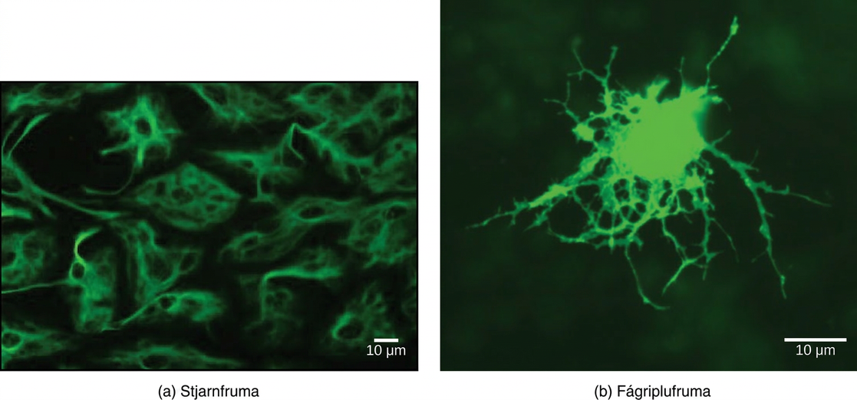
Figure 35.8
(a) Astrocytes and (b) oligodendrocytes are glial cells of the central nervous system. (credit a: modification of work by Uniformed Services University; credit b: modification of work by Jurjen Broeke; scale-bar data from Matt Russell)
Notes:
Astrocytes, fluorescently labeled green, are irregularly shaped with long extensions that provide support to nerve cells. Oligodendrocytes, also labeled green, are round with long, branched extensions that form the myelin sheath of nerve cells.

Slide 12
35.2 How Neurons Communicate
Learning Objectives
Describe the basis of the resting membrane potential
Explain the stages of an action potential and how action potentials are propagated
Explain the similarities and differences between chemical and electrical synapses
Describe long-term potentiation and long-term depression

Slide 13
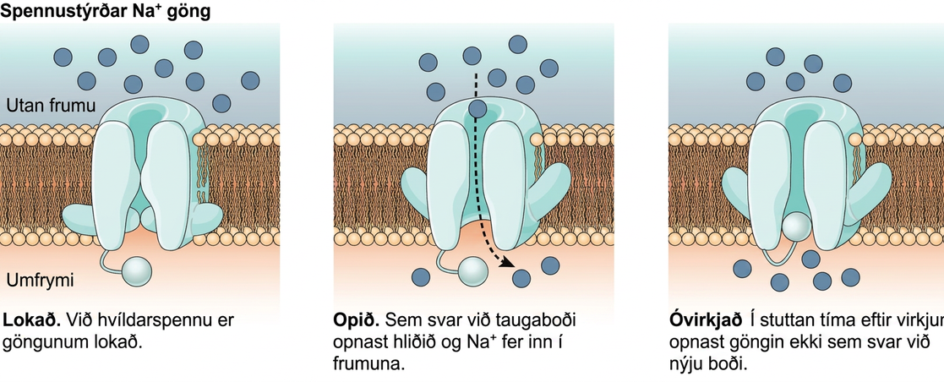
Figure 35.9
Voltage-gated ion channels open in response to changes in membrane voltage. After activation, they become inactivated for a brief period and will no longer open in response to a signal.
Notes:
The first image shows a voltage-gated sodium channel that is closed at the resting potential. In response to a nerve impulse the channel opens, allowing sodium to enter the cell. After the impulse the channel enters an inactive state. The channel closes by a different mechanism and, for a brief period does not reopen in response to a new nerve impulse.

Slide 14
Table 35.1
Ion | Extracellular concentration (mM) | Intracellular concentration (mM) | Ratio outside/inside
Na⁺ | 145 | 12 | 12
K+ | 4 | 155 | 0.026
Cl⁻ | 120 | 4 | 30
Organic anions (A−) | — | 100
The resting membrane potential is a result of different concentrations inside and outside the cell.

Slide 15
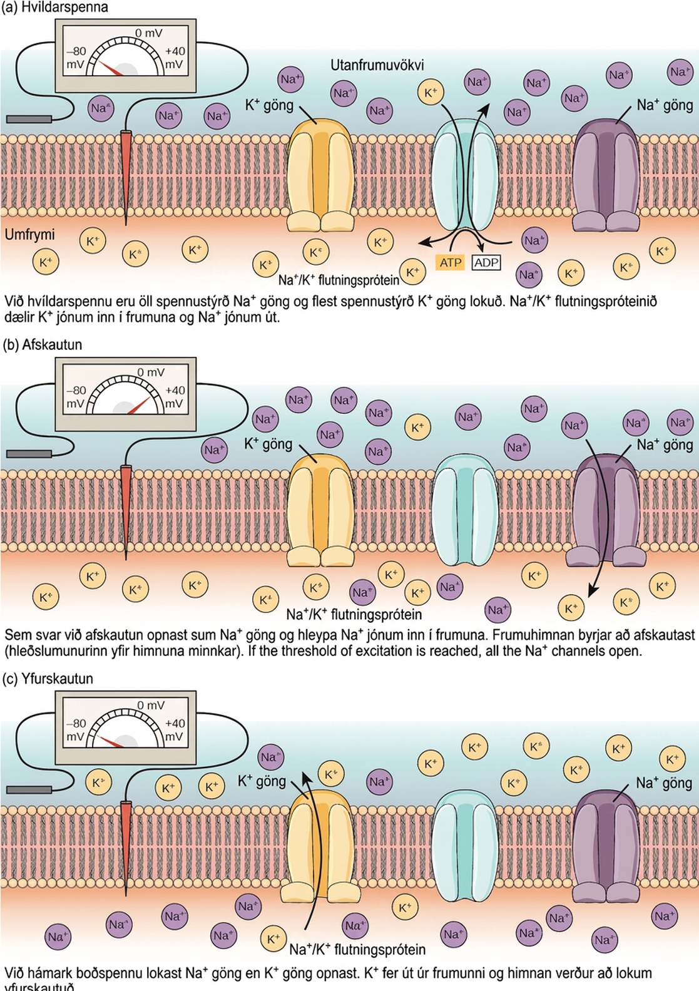
Figure 35.10
The (a) resting membrane potential is a result of different concentrations of Na+ and K+ ions inside and outside the cell. A nerve impulse causes Na+ to enter the cell, resulting in (b) depolarization. At the peak action potential, K+ channels open and the cell becomes (c) hyperpolarized.
Notes:
The resting membrane potential of minus seventy volts is maintained by a sodium/potassium transporter that transports sodium ions out of the cell and potassium ions in. Voltage gated sodium and potassium channels are closed. In response to a nerve impulse, some sodium channels open, allowing sodium ions to enter the cell. The membrane starts to depolarize; in other words, the charge across the membrane lessens. If the membrane potential increases to the threshold of excitation, all the sodium channels open. At the peak action potential, potassium channels open and potassium ions leave the cell. The membrane eventually becomes hyperpolarized.

Slide 16
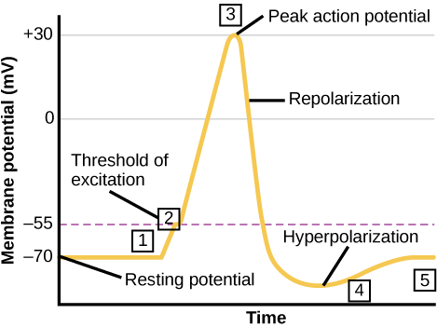
Figure 35.11
The formation of an action potential can be divided into five steps: (1) A stimulus from a sensory cell or another neuron causes the target cell to depolarize toward the threshold potential. (2) If the threshold of excitation is reached, all Na+ channels open and the membrane depolarizes. (3) At the peak action potential, K+ channels open and K+ begins to leave the cell. At the same time, Na+ channels close. (4) The membrane becomes hyperpolarized as K+ ions continue to leave the cell. The hyperpolarized membrane is in a refractory period and cannot fire. (5) The K+ channels close and the Na+/K+ transporter restores the resting potential.
Notes:
Graph plots membrane potential in millivolts versus time. The membrane remains at the resting potential of negative 70 millivolts until a nerve impulse occurs in step 1. Some sodium channels open, and the potential begins to rapidly climb past the threshold of excitation of negative 55 millivolts, at which point all the sodium channels open. At the peak action potential, the potential begins to rapidly drop as potassium channels open and sodium channels close. As a result, the membrane repolarizes past the resting membrane potential and becomes hyperpolarized. The membrane potential then gradually returns to normal.

Slide 17
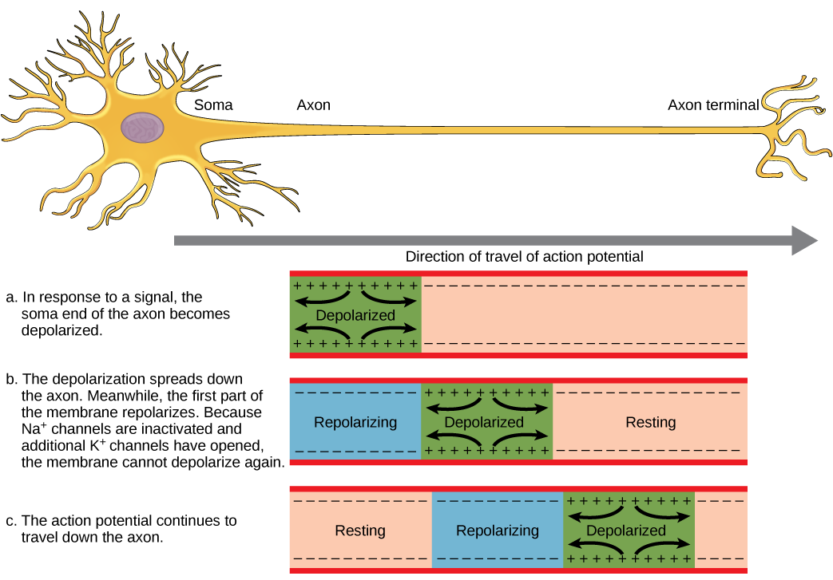
Figure 35.12
The action potential is conducted down the axon as the axon membrane depolarizes, then repolarizes.
Notes:
In image A, the action potential travels from the soma down the axon to the axon terminal. The action potential is initiated when a signal from the soma causes the soma-end of the axon membrane to depolarize. In image B, the depolarization spreads down the axon. Meanwhile, the membrane at the start of the axon repolarizes. Because potassium channels are open, the membrane cannot depolarize again. In image C, the action potential continues to spread down the axon this way.

Slide 18
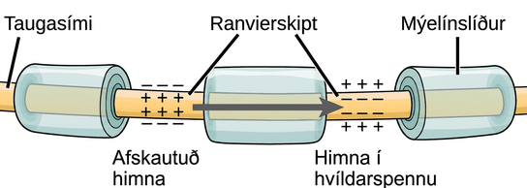
Figure 35.13
Nodes of Ranvier are gaps in myelin coverage along axons. Nodes contain voltage-gated K+ and Na+ channels. Action potentials travel down the axon by jumping from one node to the next.
Notes:
Illustration shows an axon covered in three bands of myelin sheath. Between the sheath coverings the axon is exposed. The uncovered parts of the axon are called nodes of Ranvier. In the illustration, the left node of Ranvier is depolarized such that the membrane potential is positive inside and negative outside. The right membrane of the right node is at the resting potential, negative inside and positive outside. An arrow indicates that the depolarization jumps from the left node to the right, so that the right node becomes depolarized.

Slide 19
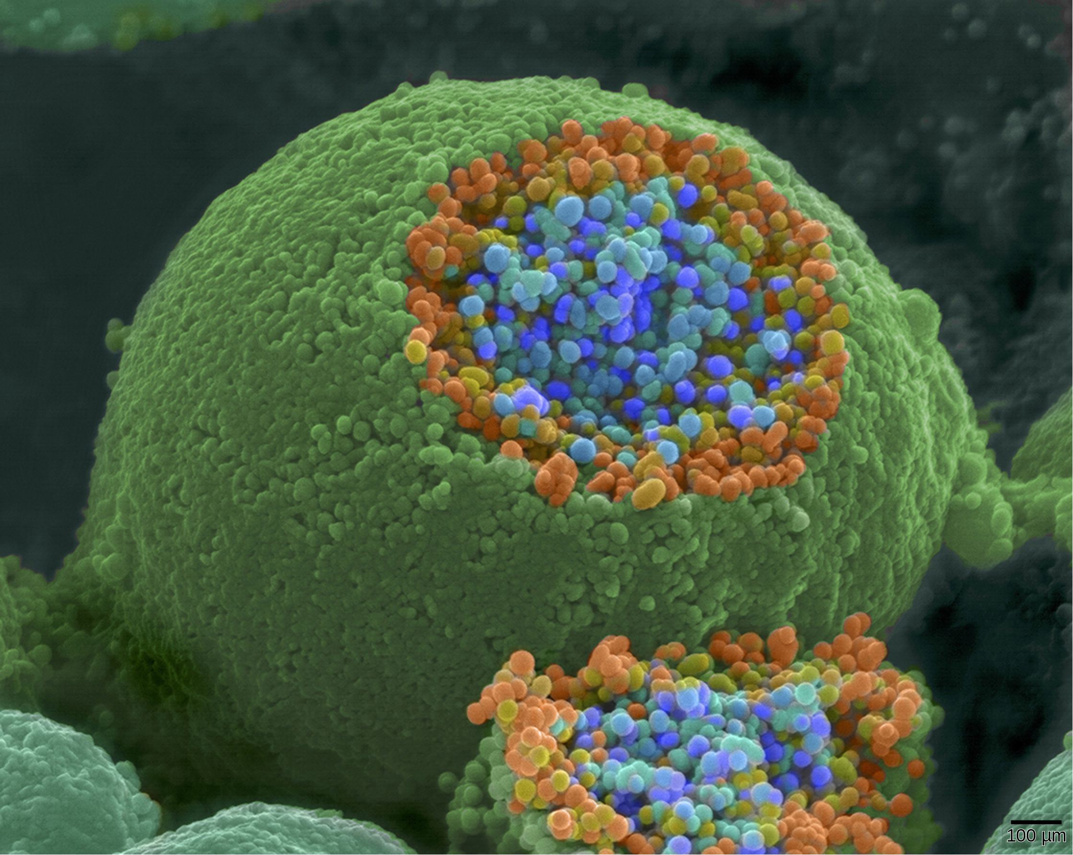
Figure 35.14
This pseudocolored image taken with a scanning electron microscope shows an axon terminal that was broken open to reveal synaptic vesicles (blue and orange) inside the neuron. (credit: modification of work by Tina Carvalho, NIH-NIGMS; scale-bar data from Matt Russell)
Notes:
The axon terminal is spherical. A section is sliced off, revealing small blue and orange vesicles just inside.

Slide 20
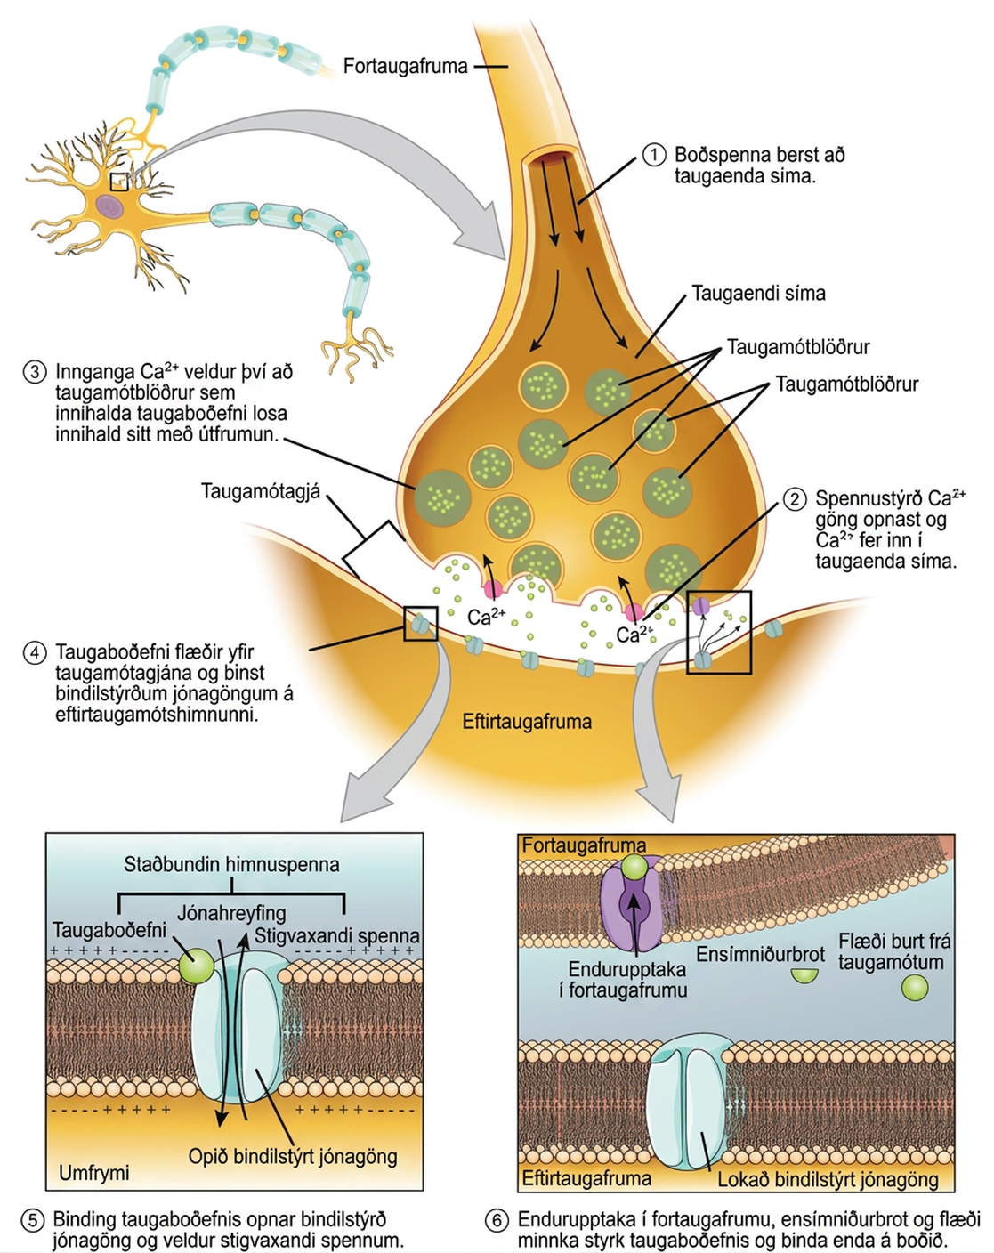
Figure 35.15
Communication at chemical synapses requires release of neurotransmitters. When the presynaptic membrane is depolarized, voltage-gated Ca2+ channels open and allow Ca2+ to enter the cell. The calcium entry causes synaptic vesicles to fuse with the membrane and release neurotransmitter molecules into the synaptic cleft. The neurotransmitter diffuses across the synaptic cleft and binds to ligand-gated ion channels in the postsynaptic membrane, resulting in a localized depolarization or hyperpolarization of the postsynaptic neuron.
Notes:
Illustration shows a narrow axon of a presynaptic cell widening into a bulb-like axon terminal. A narrow synaptic cleft separates the axon terminal of the presynaptic cell from the postsynaptic cell. In step 1, an action potential arrives at the axon terminal. In step 2, the action potential causes voltage-gated calcium channels in the axon terminal to open, allowing calcium to enter. In step 3, calcium influx causes neurotransmitter-containing synaptic vesicles to fuse with the plasma membrane. Contents of the vesicles are released into the synaptic cleft by exocytosis. In step 4, neurotransmitter diffuses across the synaptic cleft and binds ligand-gated ion channels on the postsynaptic membrane, causing the channels to open. In step 5, the open channels cause ion movement into or out of the cell, resulting in a localized change in membrane potential. In step 6, reuptake by the presynaptic neuron, enzymatic degradation and diffusion reduce neurotransmitter levels, terminating the signal.

Slide 21
Table 35.2
Neurotransmitter | Example | Location
Acetylcholine | — | CNS and/or PNS
Biogenic amine | Dopamine, serotonin, norepinephrine | CNS and/or PNS
Amino acid | Glycine, glutamate, aspartate, gamma aminobutyric acid | CNS
Neuropeptide | Substance P, endorphins | CNS and/or PNS

Slide 22
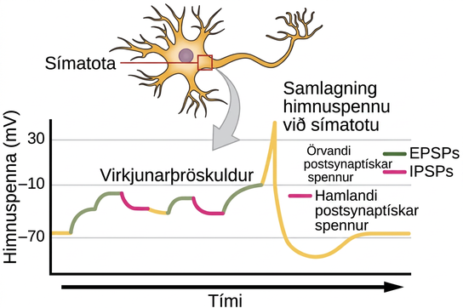
Figure 35.16
A single neuron can receive both excitatory and inhibitory inputs from multiple neurons, resulting in local membrane depolarization (EPSP input) and hyperpolarization (IPSP input). All these inputs are added together at the axon hillock. If the EPSPs are strong enough to overcome the IPSPs and reach the threshold of excitation, the neuron will fire.
Notes:
Illustration shows the location of the axon hillock, which is the area connecting the neuron body to the axon. A graph shows the summation of membrane potentials at the axon hillock, plotted as membrane potential in millivolts versus time. Initially, the membrane potential at the axon hillock is minus 70 millivolts. A series of E P S Ps and I P S Ps cause the potential to rise and fall. Eventually, the potential increases to the threshold of excitation. At this point the nerve fires, resulting in a sharp increase in membrane potential, followed by a rapid decrease. The hillock becomes hyperpolarized such that the membrane potential is lower than the resting potential. The hillock then gradually returns to the resting potential.

Slide 23
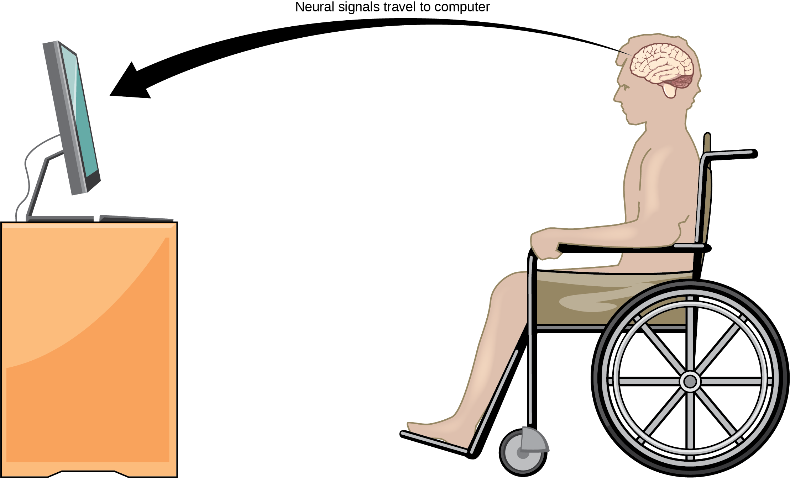
Figure 35.17
With brain-computer interface technology, neural signals from a paralyzed patient are collected, decoded, and then fed to a tool, such as a computer, a wheelchair, or a robotic arm.
Notes:
Illustration shows a person in a wheelchair, facing a computer screen. An arrow indicates that neural signals travel from the brain of the paralyzed person to the computer.

Slide 24
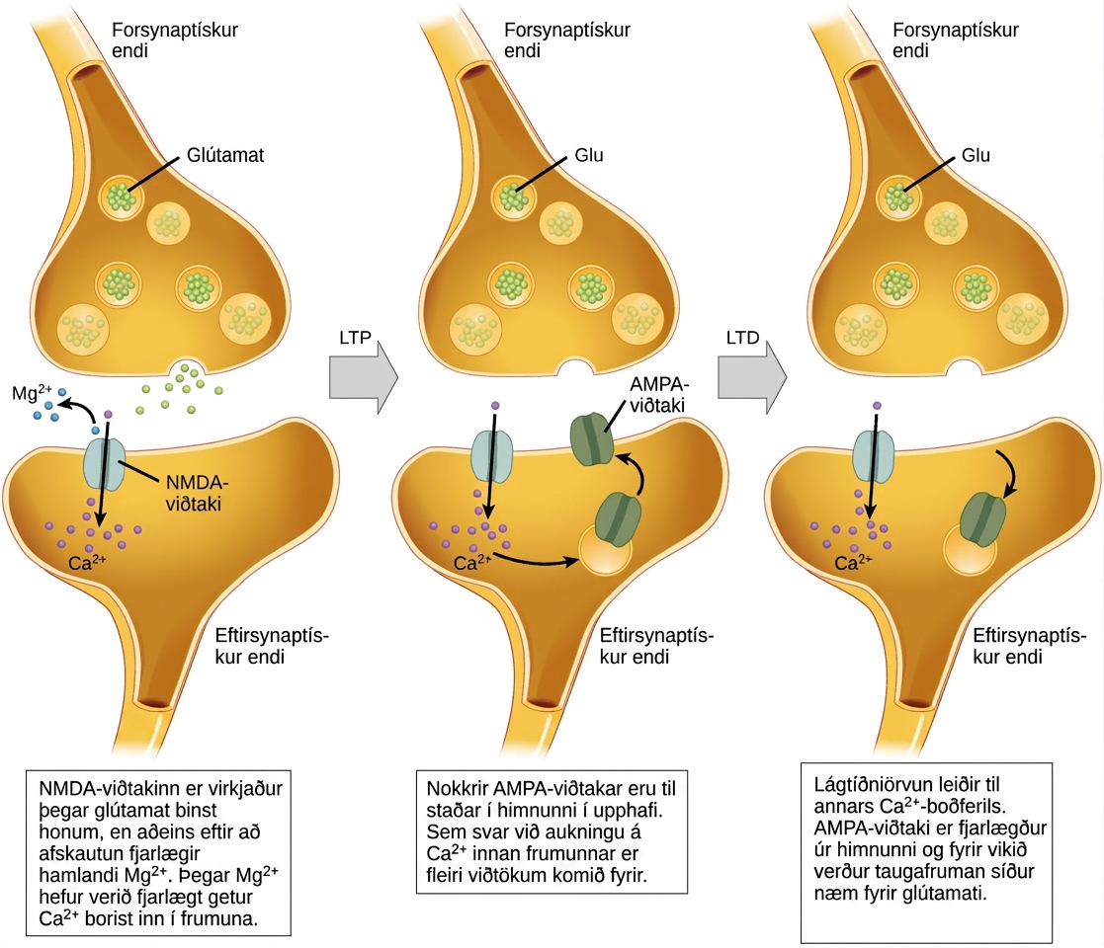
Figure 35.18
Calcium entry through postsynaptic NMDA receptors can initiate two different forms of synaptic plasticity: long-term potentiation (LTP) and long-term depression (LTD). LTP arises when a single synapse is repeatedly stimulated. This stimulation causes a calcium- and CaMKII-dependent cellular cascade, which results in the insertion of more AMPA receptors into the postsynaptic membrane. The next time glutamate is released from the presynaptic cell, it will bind to both NMDA and the newly inserted AMPA receptors, thus depolarizing the membrane more efficiently. LTD occurs when few glutamate molecules bind to NMDA receptors at a synapse (due to a low firing rate of the presynaptic neuron). The calcium that does flow through NMDA receptors initiates a different calcineurin and protein phosphatase 1-dependent cascade, which results in the endocytosis of AMPA receptors. This makes the postsynaptic neuron less responsive to glutamate released from the presynaptic neuron.
Notes:
Illustration shows the mechanism of L T P and L T D. Normally, the N M D A receptor in the postsynaptic neuron is activated by glutamate binding, but only after depolarization removes an inhibitory magnesium ion. Once the magnesium is removed, calcium can enter the cell. In response to an increase in intracellular calcium, A M P A receptors are inserted into the plasma membrane, which amplifies the signal resulting in L T P. L D P occurs when low-frequency stimulation results in the activation of a different calcium-signaling cascade that causes A M P A receptors to be removed from the plasma membrane. As a result, the nerve cell becomes less responsive to glutamate.

Slide 25
35.3 The Central Nervous System
Learning Objectives
Identify the spinal cord, cerebral lobes, and other brain areas on a diagram of the brain
Describe the basic functions of the spinal cord, cerebral lobes, and other brain areas

Slide 26
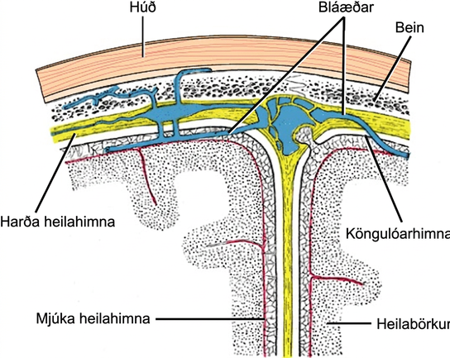
Figure 35.19
The cerebral cortex is covered by three layers of meninges: the dura, arachnoid, and pia maters. (credit: modification of work by Gray’s Anatomy)
Notes:
Illustration shows the three meninges that protect the brain. The outermost layer, just beneath the skull, is the dura mater. The dura mater is the thickest meninge, and blood vessels run through it. Beneath the dura mater is the arachnoid mater, and beneath this is the pia mater.

Slide 27
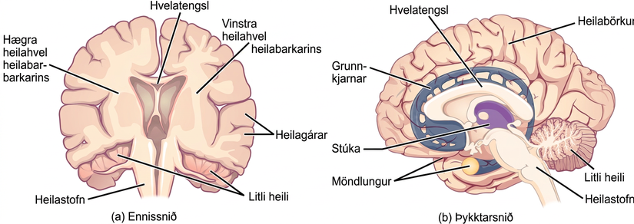
Figure 35.20
These illustrations show the (a) coronal and (b) sagittal sections of the human brain.
Notes:
Illustration shows coronal (front) and sagittal (side) sections of a human brain. In the coronal section, the large upper part of the brain, called the cerebral cortex, is divided into left and right hemispheres. A cavity resembling butterfly wings exists between the left and right cortex. The corpus callosum is a band that connects the two hemispheres together, just above this cavity. The surface of the cerebral cortex contains bumpy protrusions called gyri. The cerebral cortex is anchored by the brain stem, which connects with the spinal cord. On either side of the brainstem tucked beneath the cerebral cortex is the cerebellum. The surface of the cerebellum is bumpy, but not as bumpy as the cerebral cortex. The sagittal section reveals that the cerebral cortex makes up the front and top part of the brain, while the brainstem and cerebellum make up the lower back part. The oval thalamus sits in the cavity in the middle of the cerebral cortex. The corpus callosum wraps around the top part of the thalamus. The basal ganglia wraps around the corpus callosum, starting at the lower front part of the brain and continuing three-quarters of the way around so the back end almost meets the front end. The basal ganglia is separated into segments that are connected along the top and bottom. The amygdala is a spherical structure at the end of the basal ganglia.

Slide 28
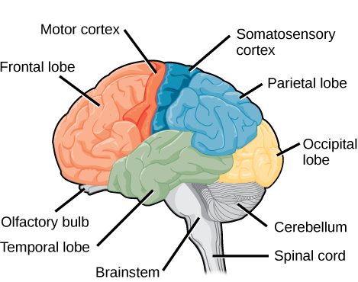
Figure 35.21
The human cerebral cortex includes the frontal, parietal, temporal, and occipital lobes.
Notes:
Sagittal, or side view of the human brain shows the different lobes of the cerebral cortex. The frontal lobe is at the front center of the brain. The parietal lobe is at the top back part of the brain. The occipital lobe is at the back of the brain, and the temporal lobe is at the bottom center of the brain. The motor cortex is the back of the frontal lobe, and the olfactory bulb is the bottom part. The somatosensory cortex is the front part of the parietal lobe. The brainstem is beneath the temporal lobe, and the cerebellum is beneath the occipital lobe.

Slide 29
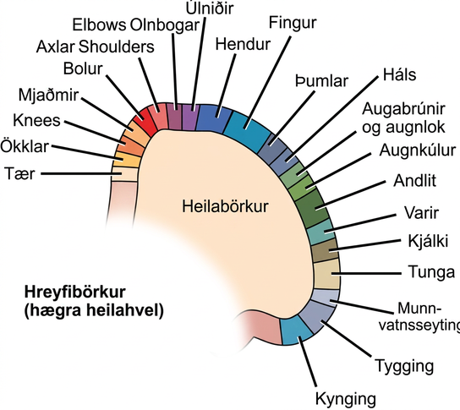
Figure 35.22
Different parts of the motor cortex control different muscle groups. Muscle groups that are neighbors in the body are generally controlled by neighboring regions of the motor cortex as well. For example, the neurons that control finger movement are near the neurons that control hand movement.
Notes:
Diagram shows the location of motor control for various muscle groups on the right hemisphere cerebral cortex. From the top middle of the motor cortex to the bottom right, the order of areas controlled is toes, ankles, knees, hips, trunk, shoulders, elbows, wrists, hands, fingers, thumbs, neck, eyebrows and eyelids, eyeballs, face, lips, jaw, tongue, salivation, chewing and swallowing.

Slide 30
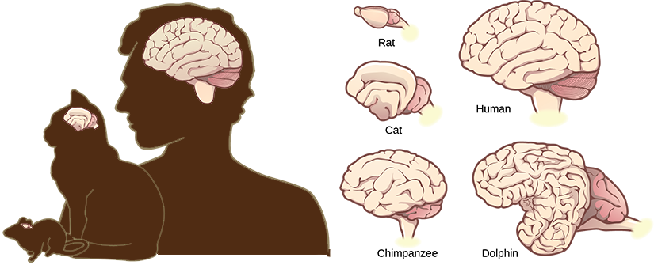
Figure 35.23
Mammals have larger brain-to-body ratios than other vertebrates. Within mammals, increased cortical folding and surface area is correlated with complex behavior.
Notes:
Illustrations shows that brains increase in size and amount of cortical folding from rat to cat to chimpanzee to human to dolphin.

Slide 31
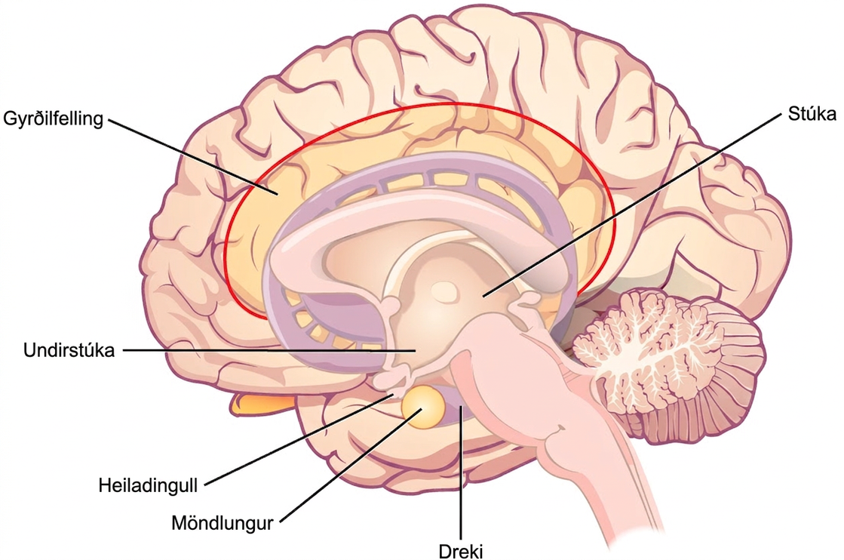
Figure 35.24
The limbic system regulates emotion and other behaviors. It includes parts of the cerebral cortex located near the center of the brain, including the cingulate gyrus and the hippocampus as well as the thalamus, hypothalamus, and amygdala.
Notes:
Illustration shows parts of the limbic system. The thalamus and hypothalamus are located in the cavity in the center of the cerebral cortex. The cingulate gyrus is part of the cerebral cortex that wraps around the upper part of the basal ganglia. The hippocampus is part of the cerebral cortex located beneath the thalamus. The amygdala is located at the end of the basal ganglia, and sits beside the pituitary.

Slide 32
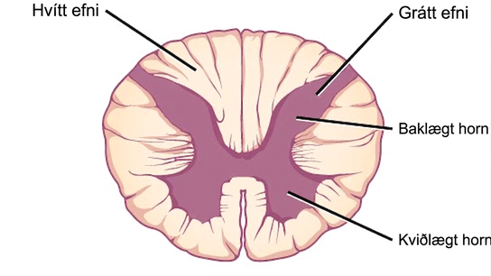
Figure 35.25
A cross-section of the spinal cord shows gray matter (containing cell bodies and interneurons) and white matter (containing axons).
Notes:
In the cross section the gray matter forms an X inside the oval white matter. The legs of the X are thicker than the arms. Each leg is called a ventral horn, and each arm is called a dorsal horn.

Slide 33
35.4 The Peripheral Nervous System
Learning Objectives
Describe the organization and functions of the sympathetic and parasympathetic nervous systems
Describe the organization and function of the sensory-somatic nervous system

Slide 34
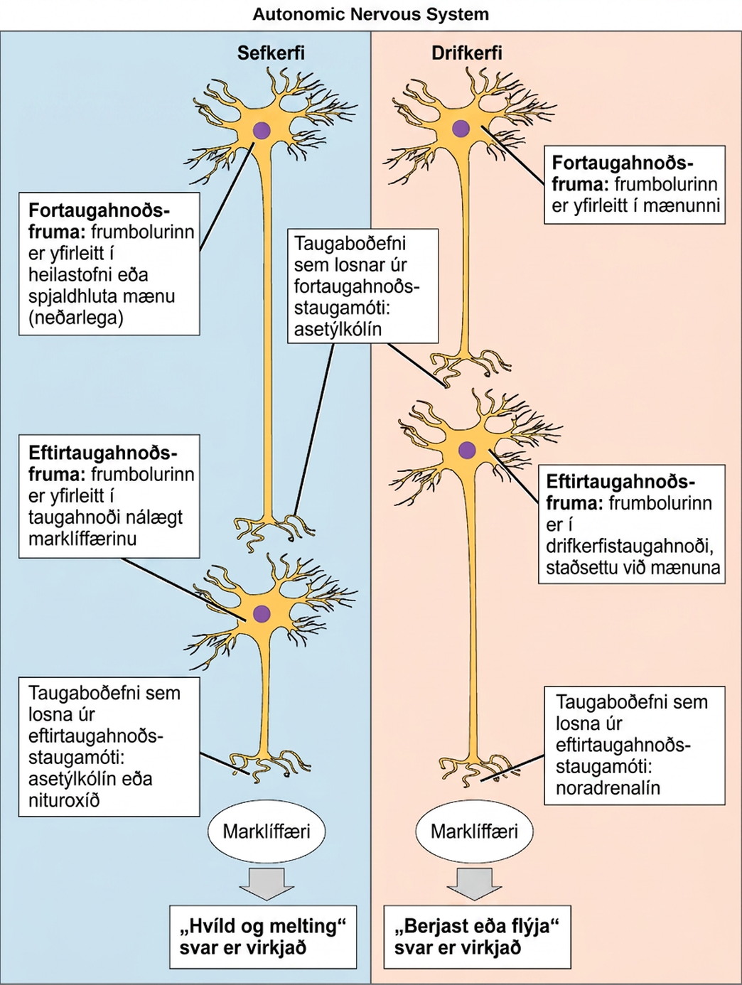
Figure 35.26
In the autonomic nervous system, a preganglionic neuron of the CNS synapses with a postganglionic neuron of the PNS. The postganglionic neuron, in turn, acts on a target organ. Autonomic responses are mediated by the sympathetic and the parasympathetic systems, which are antagonistic to one another. The sympathetic system activates the “fight or flight” response, while the parasympathetic system activates the “rest and digest” response.
Notes:
The autonomic nervous system is divided into sympathetic and parasympathetic systems. In the sympathetic system, the soma of the preganglionic neurons is usually located in the spine while in the parasympathetic system the soma is usually in the brainstem or sacral vertebrae, at the bottom of the spine. In both systems, the preganglionic neuron releases the neurotransmitter acetylcholine into the preganglionic synapse. Postganglionic neurons of the sympathetic system have somas in a sympathetic ganglion, located next to the spinal cord. Postganglionic neurons of the parasympathetic system have somas in ganglions near the target organ. Postganglionic neurons of the sympathetic system release norepinephrine into the postganglionic synapse, causing the fight or flight response to be activated in the target organ, while postganglionic neurons of the parasympathetic system release acetylcholine or nitric oxide into postganglionic synapse, causing the rest and digest response to be activated in the target organ.

Slide 35
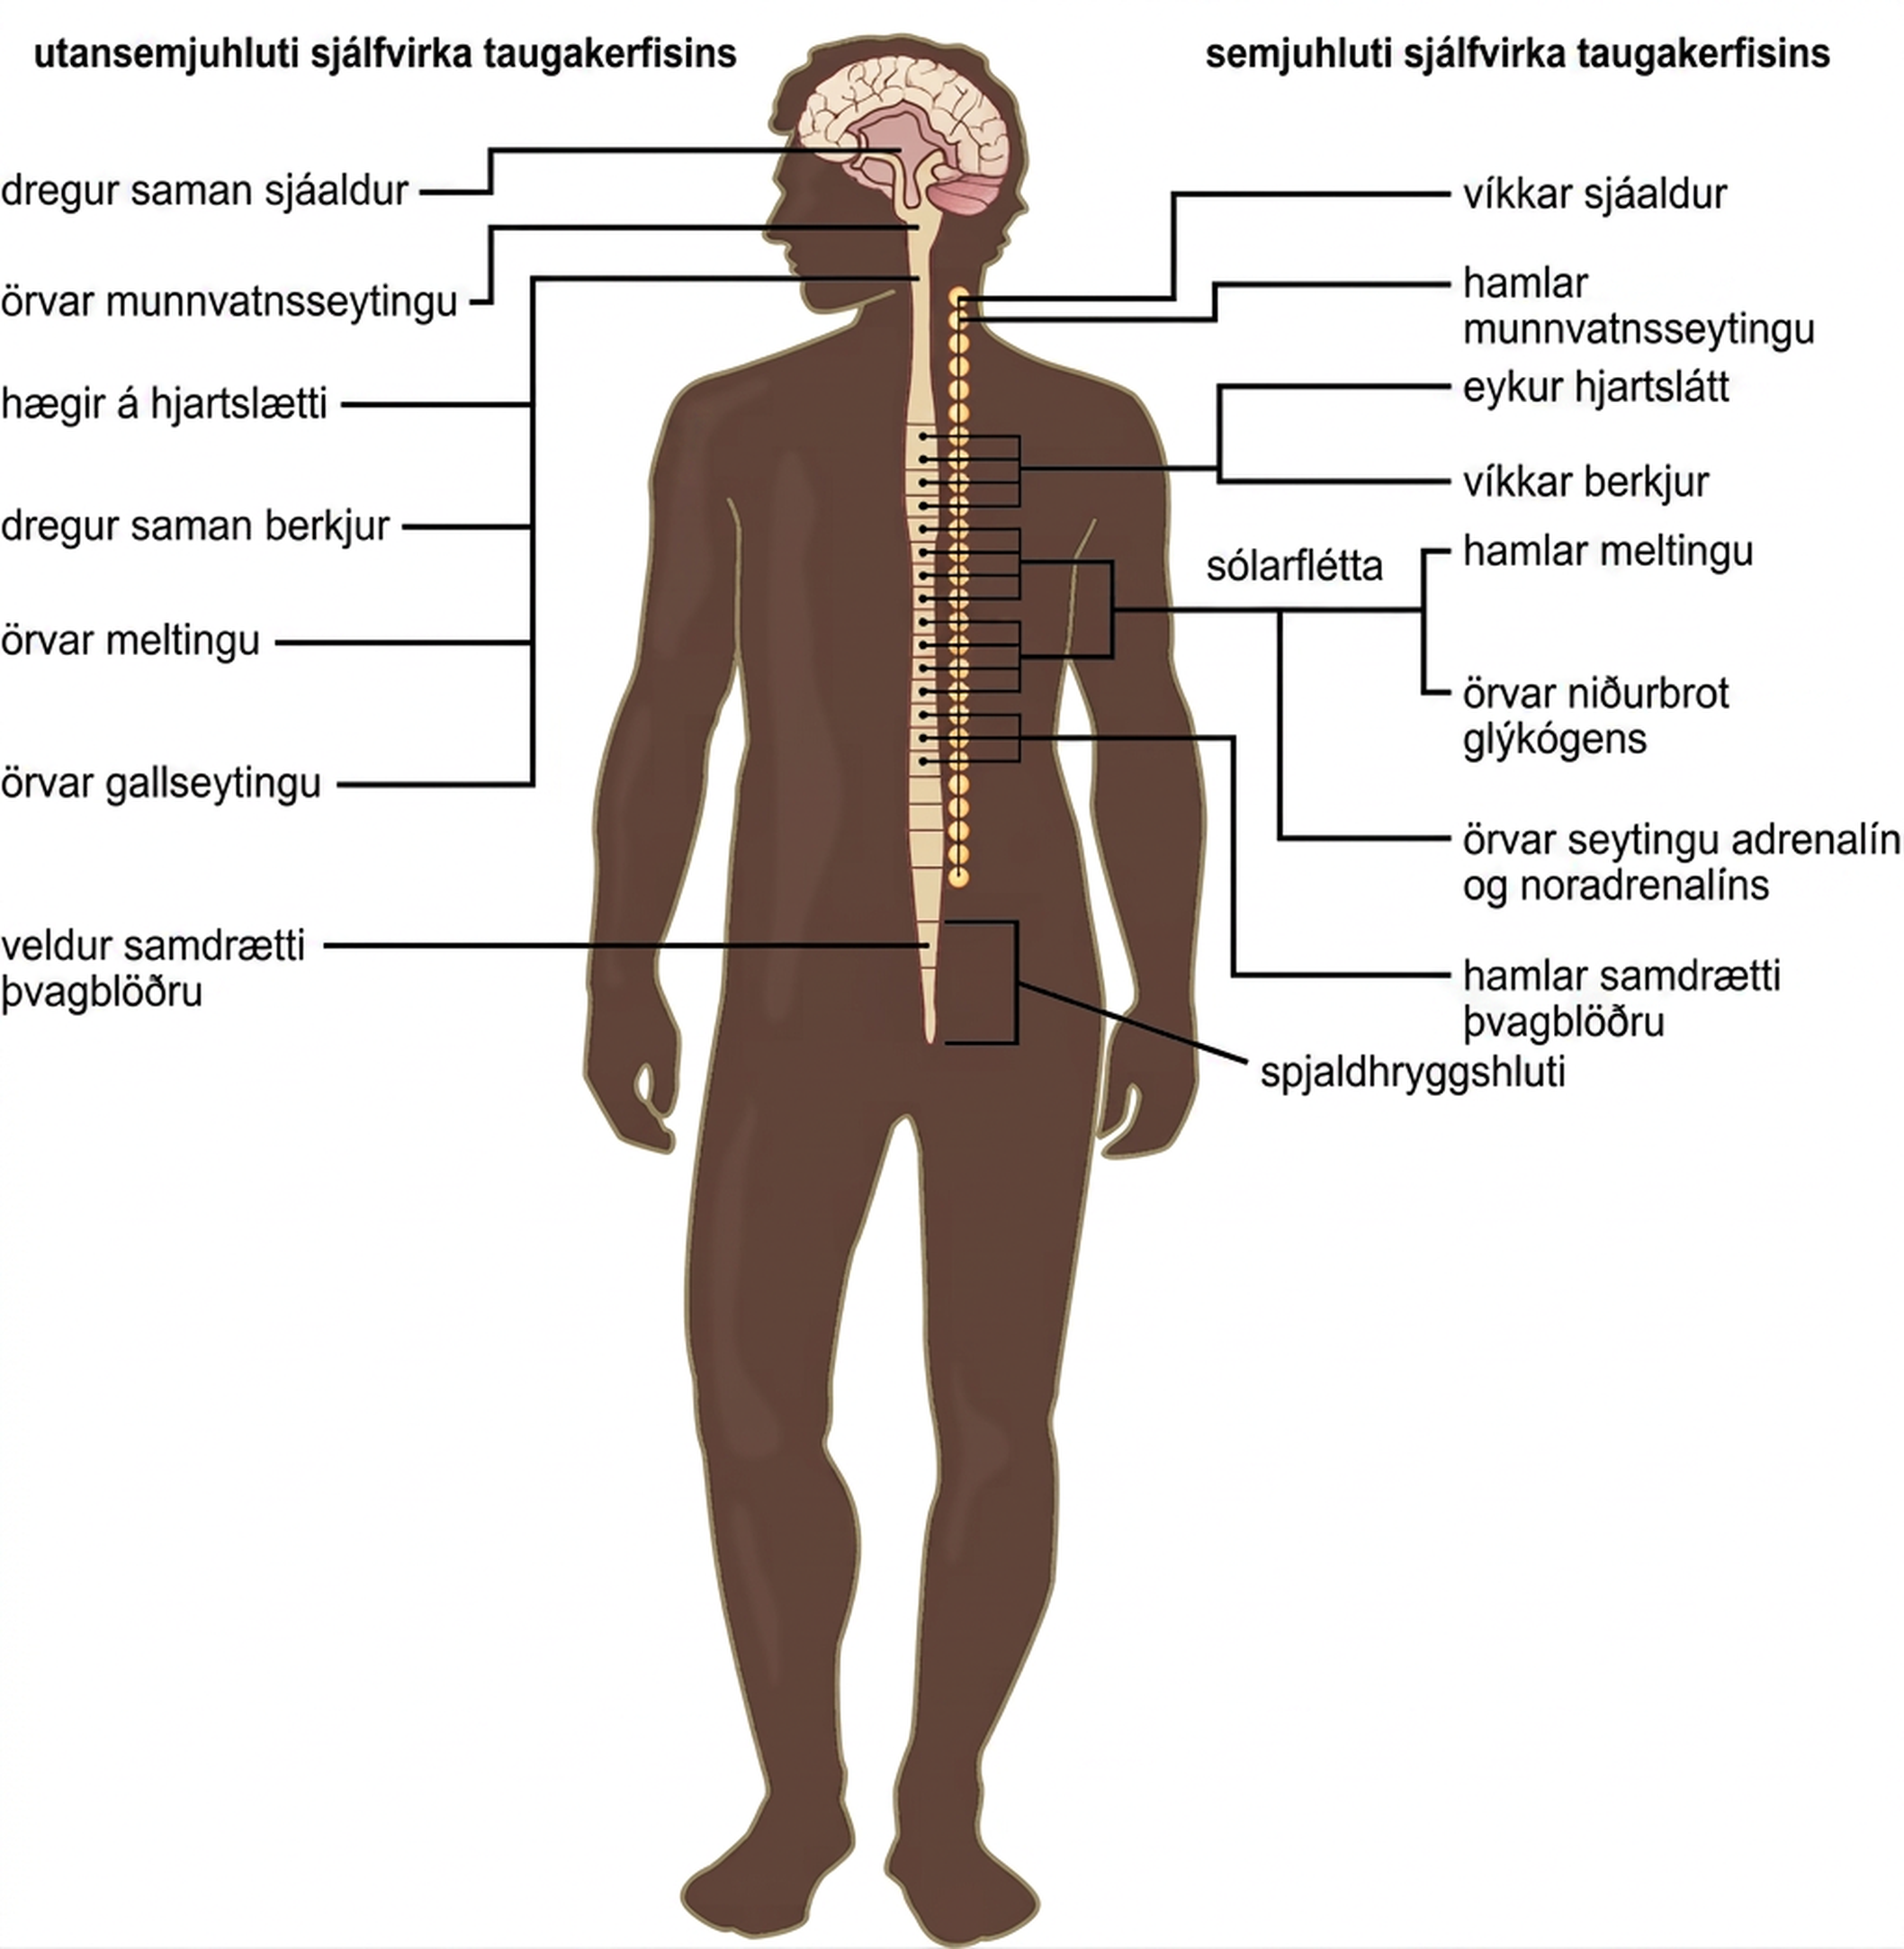
Figure 35.27
The sympathetic and parasympathetic nervous systems often have opposing effects on target organs.
Notes:
Illustration shows the effects of the sympathetic and parasympathetic systems on target organs, and the placement of the preganglionic neurons that mediate these effects. The parasympathetic system causes pupils and bronchi to constrict, slows the heart rate, and stimulates salivation, digestion, and bile secretion. Preganglionic neurons that mediate these effects are all located in the brain stem. Preganglionic neurons of the parasympathetic system that are located in the sacral cause the bladder to contract. The sympathetic system causes pupils and bronchi to dilate, increases heart rate, inhibits digestion, stimulates the breakdown of glycogen and the secretion of adrenaline and noradrenaline, and inhibits contraction of the bladder. The preganglionic neurons that mediate these effects are all located in the spine.

Slide 36
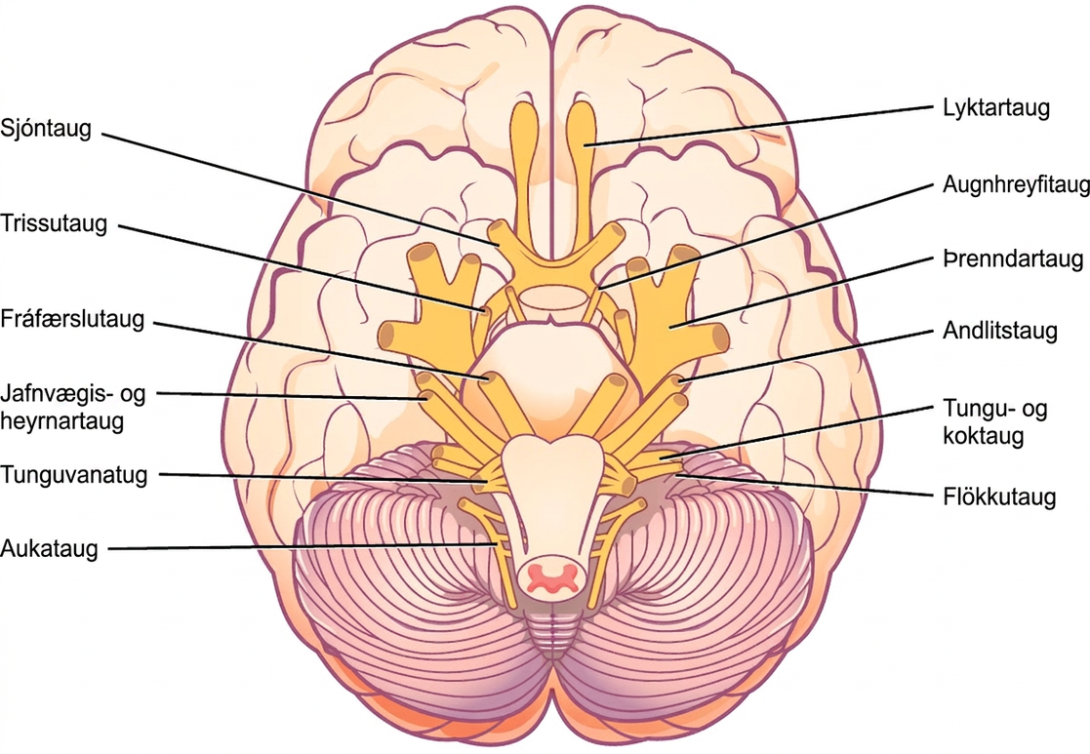
Figure 35.28
The human brain contains 12 cranial nerves that receive sensory input and control motor output for the head and neck.
Notes:
Illustration shows the underside of the brain. The twelve cranial nerves cluster around the brain stem, and are symmetrically located on each side. The olfactory nerve is short and lobe-like, and is located closest to the front. Directly behind this is the optic nerve, then the oculomotor nerve. All these nerves are located in front of the brain stem. The trigeminal nerve, which is the thickest, is located on either side of the brain stem. It forms three branches shortly after leaving the brain. The trochlear nerve is a small nerve in front of the trigeminal nerve. Behind the brain stem are the smaller facial, vestibulocochlear, glossopharyngeal and hypoglossal nerves. The nerve furthest back is the accessory nerve.

Slide 37
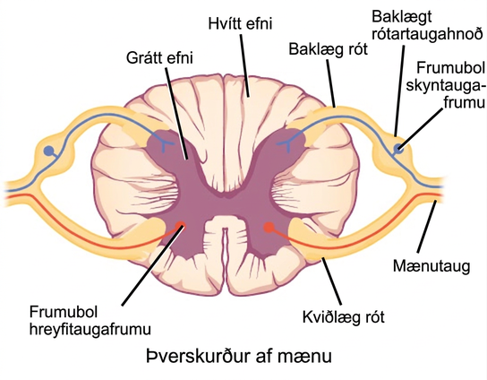
Figure 35.29
Spinal nerves contain both sensory and motor axons. The somas of sensory neurons are located in dorsal root ganglia. The somas of motor neurons are found in the ventral portion of the gray matter of the spinal cord.
Notes:
Illustration shows a cross section of the spinal cord. The gray matter forms an X inside the white matter. A spinal nerve extends from the left arm of the X, and another extends from the left leg of the X. The two nerves join together to the left of the spine. The right arm and leg of the X form a symmetrical nerve. The part of the nerve that exits from the leg of the X is called the ventral root, and the part that exits from the arm of the X is called the dorsal root. The ventral root is on the belly side, and the dorsal root is on the back side. The dorsal root ganglion is a bulge halfway between where the nerve leaves the spine and where the dorsal and ventral roots join. Sensory neuron somas cluster in the dorsal root. Motor neuron somas cluster in the gray matter in the leg of the X. Motor neuron axons are bundled in the ventral root.

Slide 38
35.5 Nervous System Disorders
Learning Objectives
Describe the symptoms, potential causes, and treatment of several examples of nervous system disorders

Slide 39
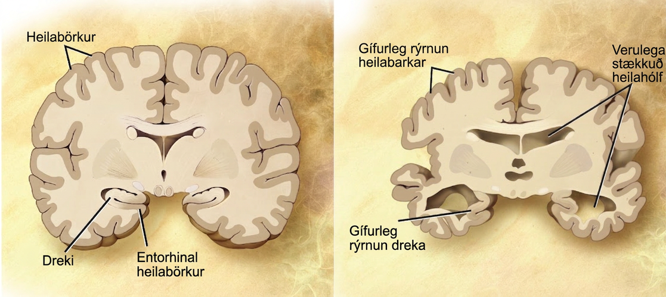
Figure 35.30
Compared to a normal brain (left), the brain from a patient with Alzheimer’s disease (right) shows a dramatic neurodegeneration, particularly within the ventricles and hippocampus. (credit: modification of work by “Garrando”/Wikimedia Commons based on original images by ADEAR: "Alzheimer's Disease Education and Referral Center, a service of the National Institute on Aging”)
Notes:
A cross section of a normal brain and the brain of an Alzheimers patient are compared. In the Alzheimers brain, the cerebral cortex is greatly shrunken in size as is the hippocampus. Ventricles, holes in the center and bottom right and left parts of the brain, are also enlarged.

Slide 40
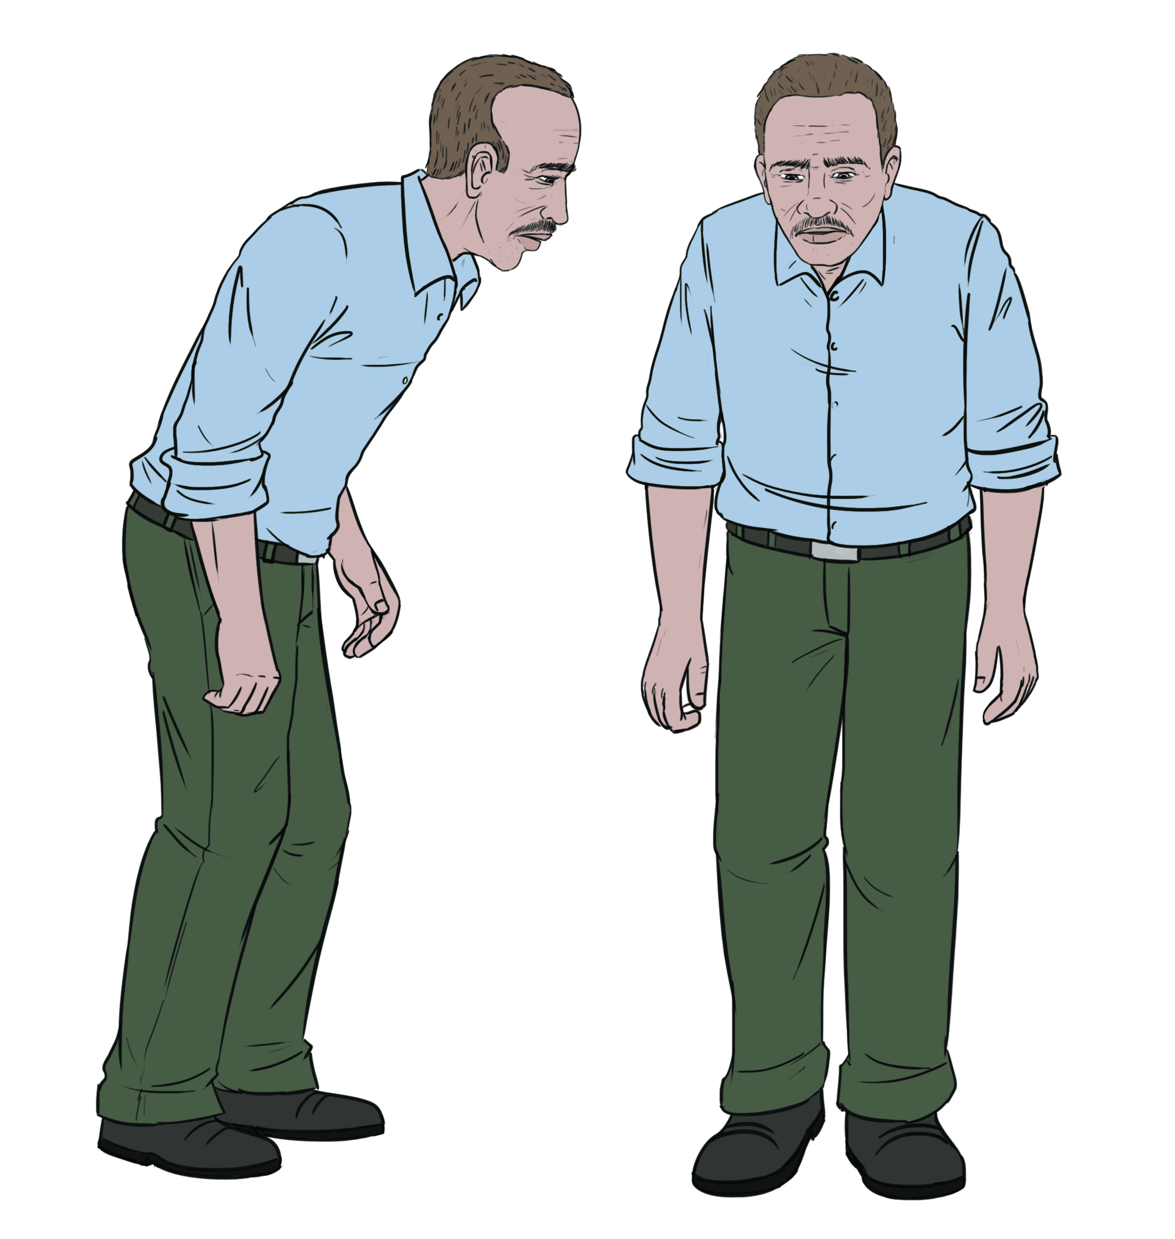
Figure 35.31
Parkinson’s patients often have a characteristic hunched walk.
Notes:
Illustration shows a hunched man with stiff arms and a shuffling walk.

Slide 41
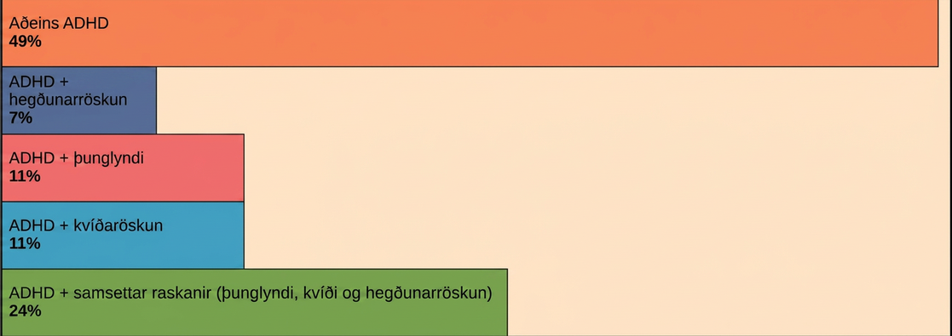
Figure 35.32
Many people with ADHD have one or more other neurological disorders. (credit “chart design and illustration”: modification of work by Leigh Coriale; credit “data”: Drs. Biederman and Faraone, Massachusetts General Hospital).
This OpenStax ancillary resource is © Rice University under a CC BY-NC-SA 4.0 International license; it may be reproduced or modified for noncommercial purposes only but must be attributed to OpenStax, Rice University and any changes must be noted. Any adaptation must be shared under the same type of license.
Notes:
Bar graph shows that 49% of ADHD patients suffer from ADHD alone. Seven percent have both ADHD and conduct disorder. Eleven percent have ADHD and depression. Eleven percent have ADHD and anxiety disorder. Twenty-four percent have ADHD and a combination of depression, anxiety disorder, and conduct disorder.

