Slide 1

Biology 2e
Chapter 15 Genes and Proteins

Slide 2
Chapter outline
The Genetic Code
Prokaryotic Transcription
Eukaryotic Transcription
RNA Processing in Eukaryotes
Ribosomes and Protein Synthesis

Slide 3
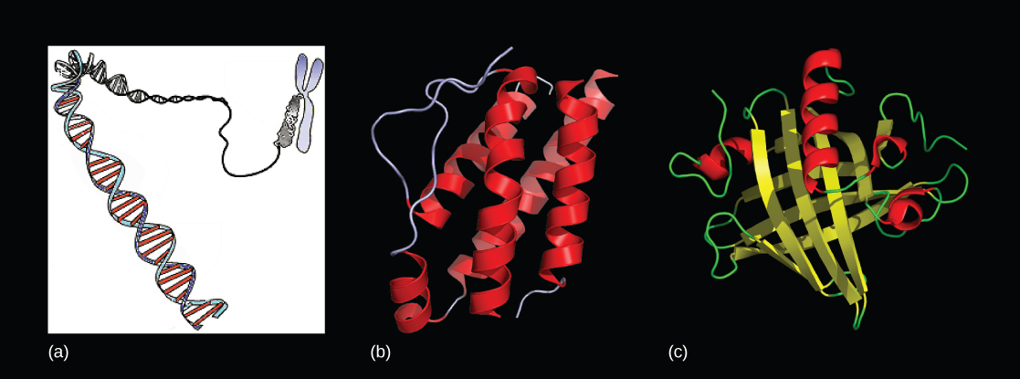
Figure 15.1
Genes, which are carried on (a) chromosomes, are linearly organized instructions for making the RNA and protein molecules that are necessary for all of the processes of life. The (b) interleukin-2 protein and (c) alpha-2u-globulin protein are just two examples of the array of different molecular structures that are encoded by genes. (credit “chromosome: National Human Genome Research Institute; credit “interleukin-2”: Ramin Herati/Created from PDB 1M47 and rendered with Pymol; credit “alpha-2u-globulin”: Darren Logan/rendered with AISMIG)
Notes:
Molecular models show a DNA double helix that is packed in a chromosome in Part a, and two proteins are shown in Parts b and c.

Slide 4
15.1 The Genetic Code
Learning Objectives
Explain the “central dogma” of DNA-protein synthesis
Describe the genetic code and how the nucleotide sequence prescribes the amino acid and the protein sequence

Slide 5
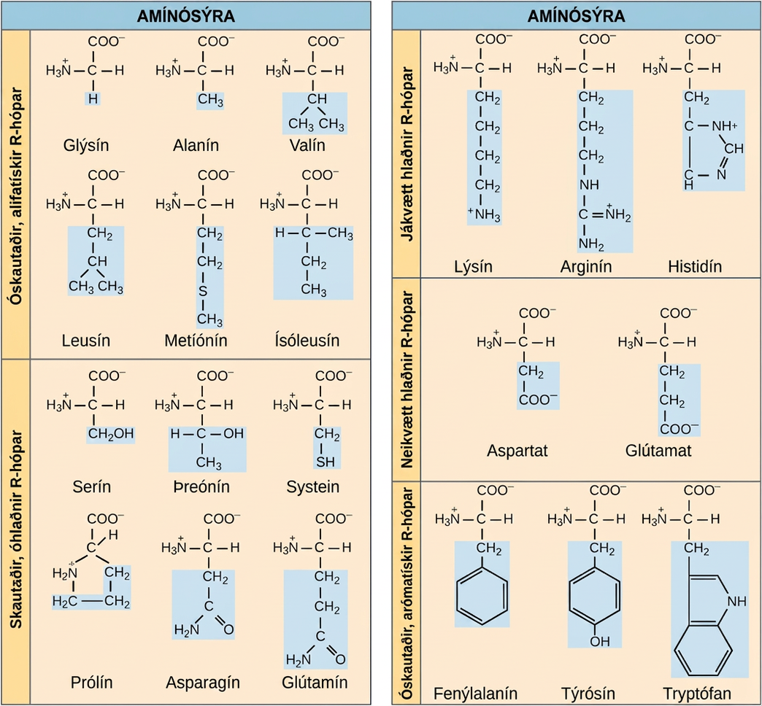
Figure 15.2
Structures of the 20 amino acids found in proteins are shown. Each amino acid is composed of an amino group ( N H 3 + ), a carboxyl group (COO-), and a side chain (blue). The side chain may be nonpolar, polar, or charged, as well as large or small. It is the variety of amino acid side chains that gives rise to the incredible variation of protein structure and function.
Notes:
Structures of the twenty amino acids are given. Six amino acids; glycine, alanine, valine, leucine, methionine, and isoleucine; have R groups that are non-polar and aliphatic, meaning they do not have a ring. Six amino acids; serine, threonine, cysteine, proline, asparagine, and glutamate; have R groups that are polar but uncharged. Three amino acids; lysine, arginine, and histidine; have R groups that are positively charged. Two amino acids, glutamate and aspartate, have R groups that are negatively charged. Three amino acids; phenylalanine, tyrosine, and tryptophan; have nonpolar and aromatic (meaning they have a ring) R groups.

Slide 6
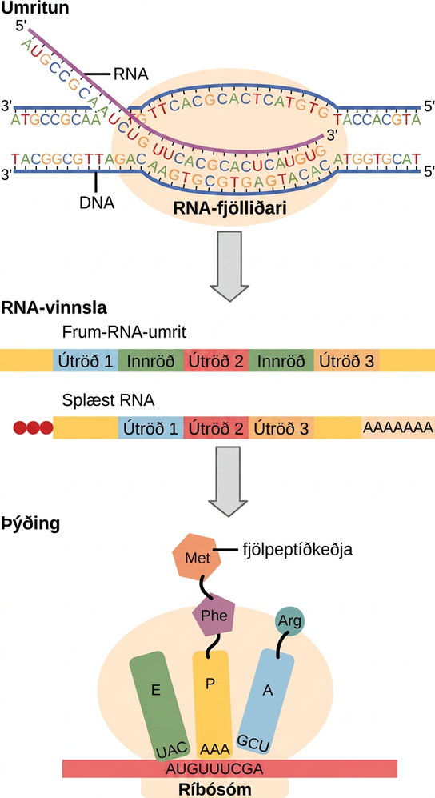
Figure 15.3
Instructions on DNA are transcribed onto messenger RNA. Ribosomes are able to read the genetic information inscribed on a strand of messenger RNA and use this information to string amino acids together into a protein.
Notes:
To make a protein, genetic information encoded by the D N A must be transcribed onto an m R N A molecule. The R N A is then processed by splicing to remove exons and by the addition of a 5 prime cap and a poly A tail. A ribosome then reads the sequence on the m R N A, and uses this information to string amino acids into a protein.

Slide 7
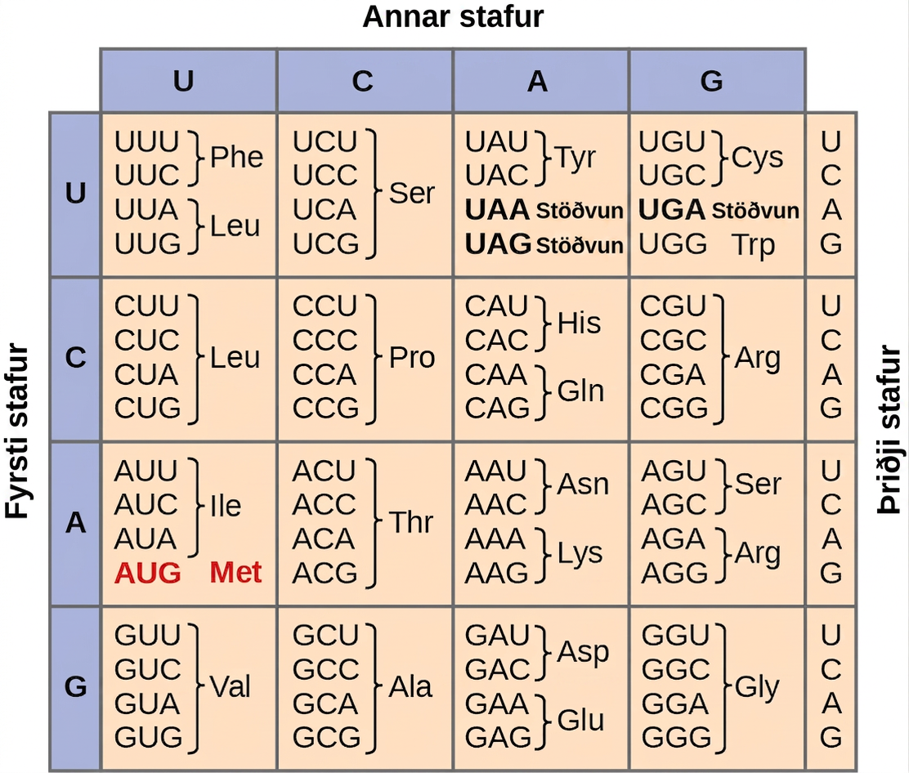
Figure 15.4
This figure shows the genetic code for translating each nucleotide triplet in mRNA into an amino acid or a termination signal in a protein. (credit: modification of work by NIH)
Notes:
Figure shows all 64 codons. Sixty-one of these code for amino acids, and three are stop codons.

Slide 8
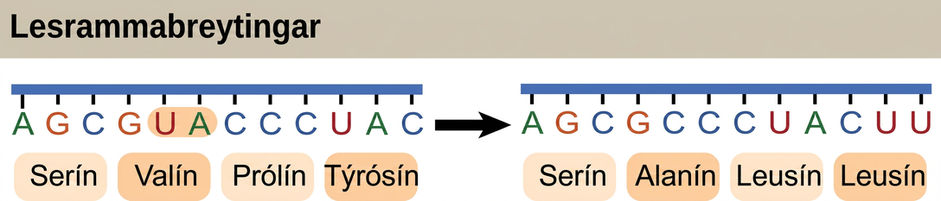
Figure 15.5
The deletion of two nucleotides shifts the reading frame of an mRNA and changes the entire protein message, creating a nonfunctional protein or terminating protein synthesis altogether.
Notes:
Illustration shows a frameshift mutation in which the reading frame is altered by the deletion of two amino acids.

Slide 9
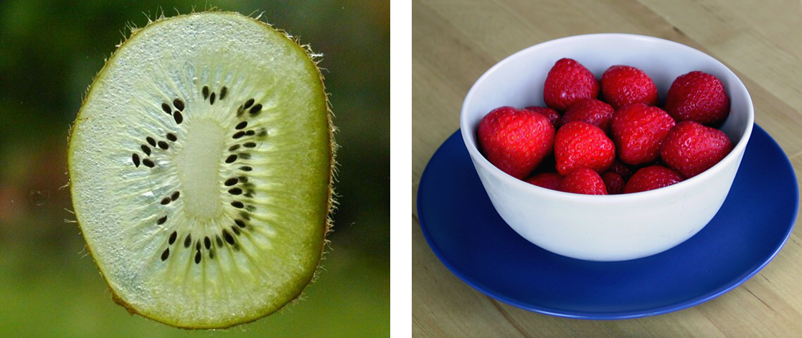
Figure 15.6
Do you think that a kiwi or a strawberry has more DNA per fruit? (credit “kiwi”: "Kelbv"/Flickr; credit: “strawberry”: Alisdair McDiarmid)
Notes:
Photographs show a thin slice of a green kiwi fruit and a bowl of strawberries.

Slide 10
15.2 Prokaryotic Transcription
Learning Objectives
List the different steps in prokaryotic transcription
Discuss the role of promoters in prokaryotic transcription
Describe how and when transcription is terminated

Slide 11
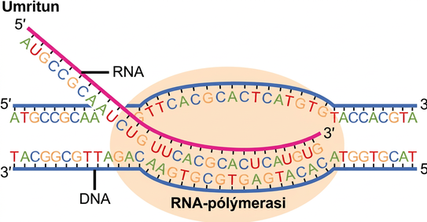
Figure 15.7
Messenger RNA is a copy of protein-coding information in the coding strand of DNA, with the substitution of U in the RNA for T in the coding sequence. However, new RNA nucleotides base pair with the nucleotides of the template strand. RNA is synthesized in its 5'-3' direction, using the enzyme RNA polymerase. As the template is read, the DNA unwinds ahead of the polymerase and then rewinds behind it.
Notes:
Illustration shows R N A synthesis by R N A polymerase. The R N A strand is synthesized in the 5 prime to 3 prime direction.

Slide 12
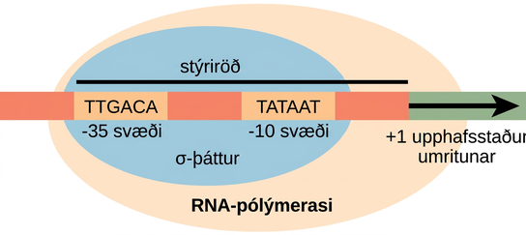
Figure 15.8
The σ subunit of prokaryotic RNA polymerase recognizes consensus sequences found in the promoter region upstream of the transcription start site. The σ subunit dissociates from the polymerase after transcription has been initiated.
Notes:
Illustration shows the sigma subunit of R N A polymerase bound to two consensus sequences that are 10 and 35 bases upstream of the transcription start site. R N A polymerase is bound to sigma.

Slide 13
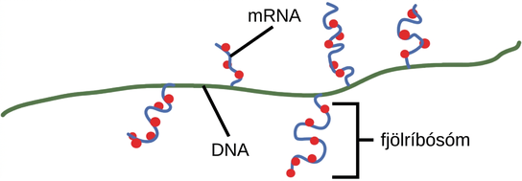
Figure 15.9
Multiple polymerases can transcribe a single bacterial gene while numerous ribosomes concurrently translate the mRNA transcripts into polypeptides. In this way, a specific protein can rapidly reach a high concentration in the bacterial cell.
Notes:
Illustration shows a portion of a D N A molecule. Multiple strands of m R N A hang off of the D N A at the locations where m R N A is being transcribed. Each m R N A strand has multiple ribosomes attached at different locations along its length, creating proteins. One m R N A strand with multiple ribosomes attached to it is labelled a polyribosome.

Slide 14
15.3 Eukaryotic Transcription
Learning Objectives
List the steps in eukaryotic transcription
Discuss the role of RNA polymerases in transcription
Compare and contrast the three RNA polymerases
Explain the significance of transcription factors

Slide 15
Table 15.1
RNA Polymerase | Cellular Compartment | Product of Transcription | α-Amanitin Sensitivity
I | Nucleolus | All rRNAs except 5S rRNA | Insensitive
II | Nucleus | All protein-coding nuclear pre-mRNAs | Extremely sensitive
III | Nucleus | 5S rRNA, tRNAs, and small nuclear RNAs | Moderately sensitive

Slide 16
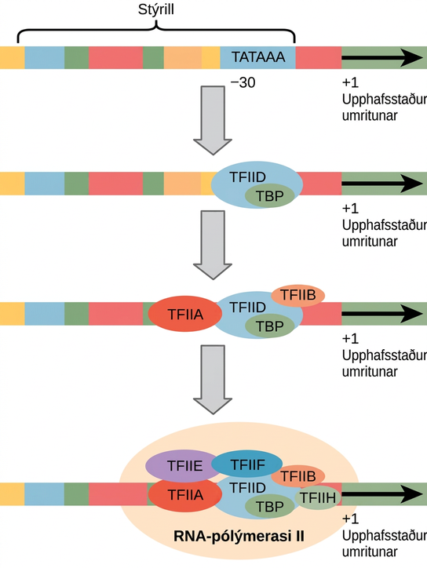
Figure 15.10
A generalized promoter of a gene transcribed by RNA polymerase II is shown. Transcription factors recognize the promoter. RNA polymerase II then binds and forms the transcription initiation complex.
Notes:
Illustration shows a series of transcription factors binding to the promoter, which is upstream of the gene. After all of the transcription factors are bound, R N A polymerase I I binds as well.

Slide 17
15.4 RNA Processing in Eukaryotes
Learning Objectives
Describe the different steps in RNA processing
Understand the significance of exons, introns, and splicing for mRNAs
Explain how tRNAs and rRNAs are processed

Slide 18
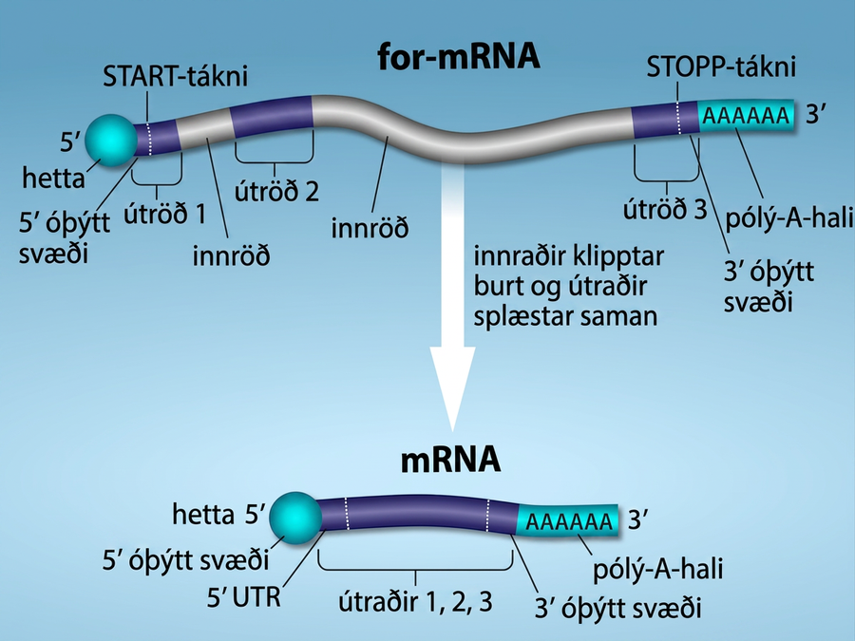
Figure 15.11
Eukaryotic pre-mRNA processing. In addition to 5’ Cap and 3’ Poly-A Tail addition, introns must be precisely removed and exons joined to generate a functional mRNA. Nucleotides upstream (towards the 5’cap) of the translation START codon are part of the 5’ untranslated region (5’ UTR). Nucleotides downstream (towards 3’end) of the STOP codon form the 3’ UTR. Both 5’ and 3’ UTRs are important for regulating translation initiation and mRNA stability. Credit: Rao, A., Ryan, K. Fletcher, S. and Tag, A. Department of Biology, Texas A&M University.
Notes:
An illustration shows that in Pre- m R N A processing, there is a primary R N A transcript including regions labeled, left to right, as exon 1, intron, exon 2, intron, and exon 3. The introns are cut and exons are spliced together to produce mRNA. After R N A processing, there is a spliced R N A with these parts, left to right are a 5 prime cap, a 5 prime untranslated region, exon 1, exon 2, exon 3, a 3 prime untranslated region, and a poly a tail. The 5 prime unstranslated region is not separate from exon 1, but is the beginning of exon 1. The 3 prime untranslated region is not separate from exon 3 but the final part of exon 3.

Slide 19
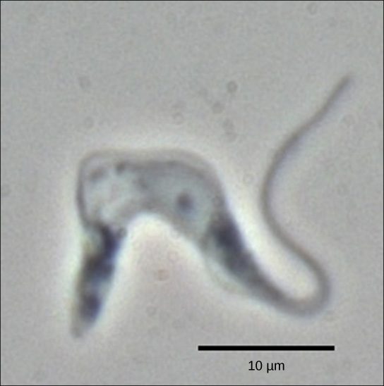
Figure 15.12
Trypanosoma brucei is the causative agent of sleeping sickness in humans. The mRNAs of this pathogen must be modified by the addition of nucleotides before protein synthesis can occur. (credit: modification of work by Torsten Ochsenreiter)
Notes:
Micrograph shows T. brucei, which has a u-shaped cell body and a long tail.

Slide 20
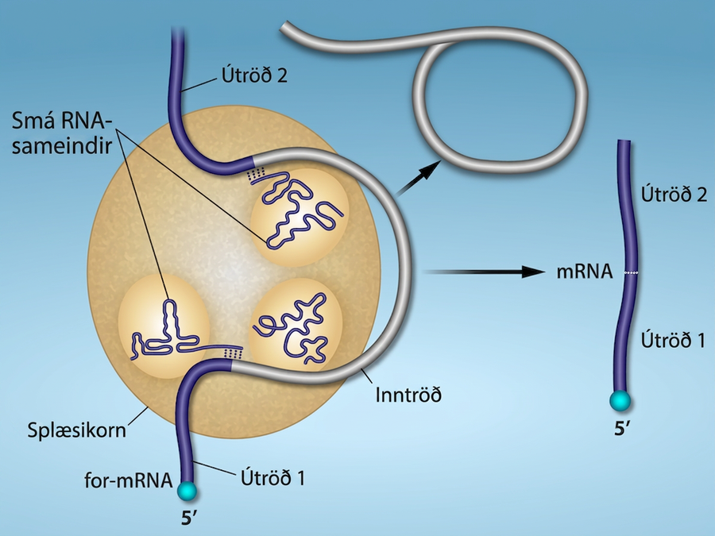
Figure 15.13
Pre-mRNA splicing involves the precise removal of introns from the primary RNA transcript. The splicing process is catalyzed by protein complexes called spliceosomes that are composed of proteins and RNA molecules called small nuclear RNAs (snRNAs). Spliceosomes recognize sequences at the 5' and 3' end of the intron. Rao, A. and Ryan, K. Department of Biology, Texas A&M University.
Notes:
Illustration shows a spliceosome bound to m R N A. An intron is wrapped around small R N As associated with the spliceosome. When the splice is complete, the exons on either side of the intron are fused together, and the intron forms a ring structure.

Slide 21
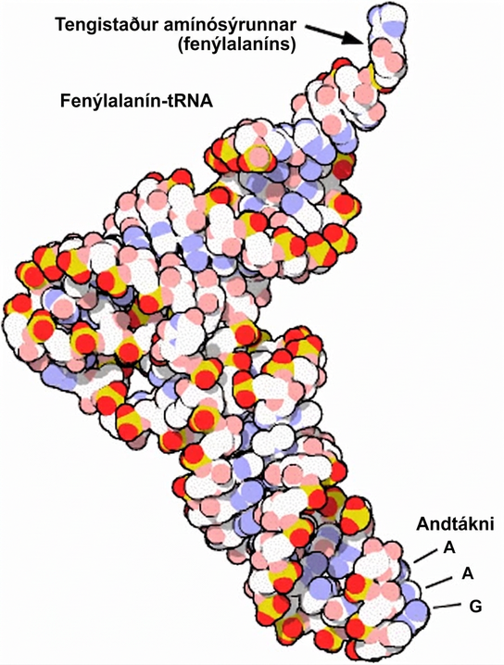
Figure 15.14
This is a space-filling model of a tRNA molecule that adds the amino acid phenylalanine to a growing polypeptide chain. The anticodon AAG binds the Codon UUC on the mRNA. The amino acid phenylalanine is attached to the other end of the tRNA.
Notes:
The molecular model of phenylalanine t R N A is L shaped. At one end is the anticodon A A G. At the other end is the attachment site for the amino acid phenylalanine.

Slide 22
15.5 Ribosomes and Protein Synthesis
Learning Objectives
Describe the different steps in protein synthesis
Discuss the role of ribosomes in protein synthesis

Slide 23
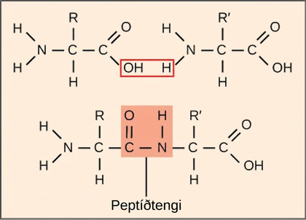
Figure 15.15
A peptide bond links the carboxyl end of one amino acid with the amino end of another, producing one water molecule during the process. For simplicity in this image, only the functional groups involved in the peptide bond are shown. The R and R' designations refer to the rest of each amino acid structure.
Notes:
Illustration shows two amino acids side-by-side. Each amino acid has an amino group, a carboxyl group, and a side chain labeled R or R prime. Upon formation of a peptide bond, the amino group is joined to the carboxyl group. A water molecule is released in the process.

Slide 24
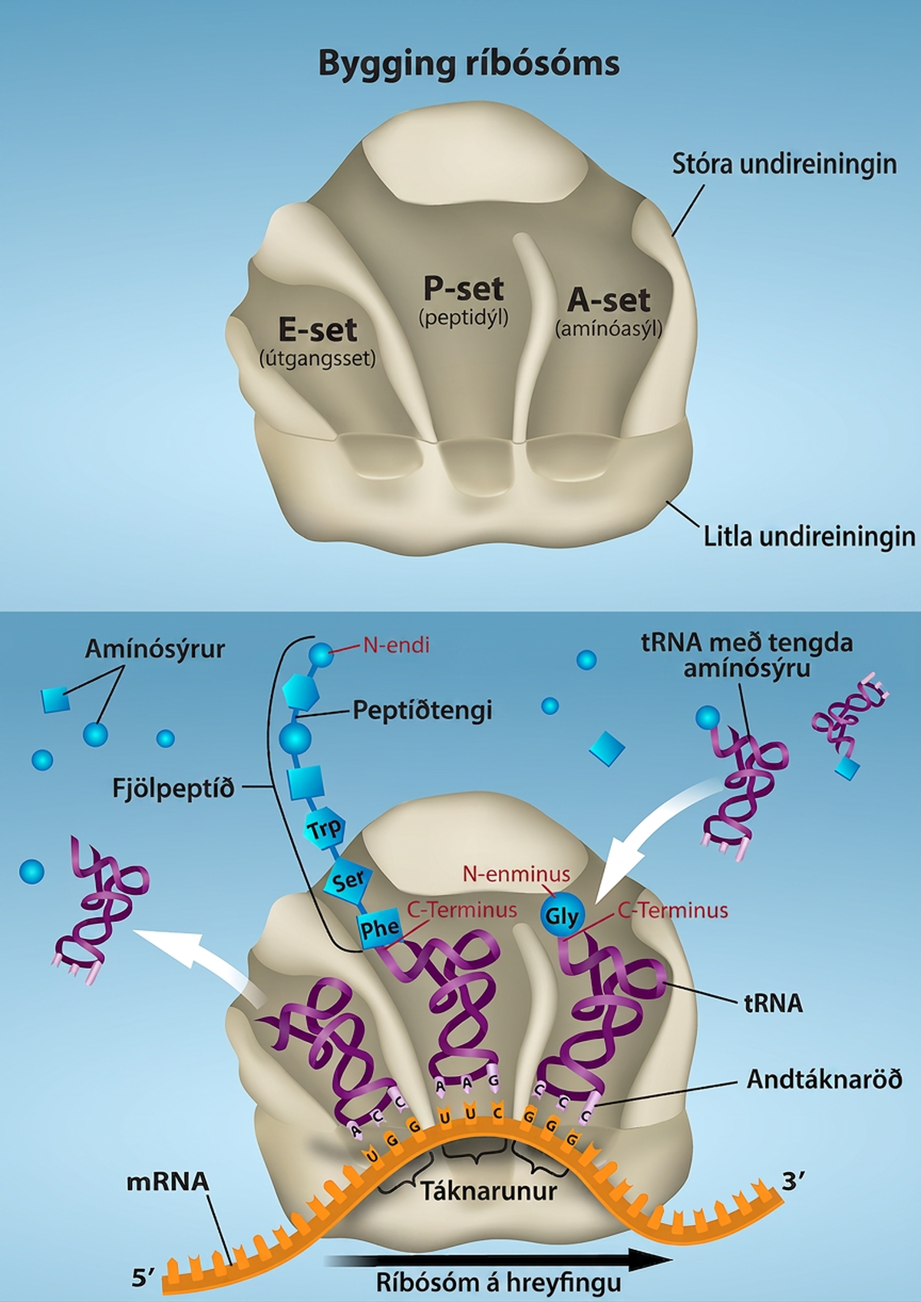
Figure 15.16
The ribosome and its function. The ribosome is responsible for translating the mRNA into protein. A. The ribosome consists of a large and small ribosomal subunit. Assembly of the subunits on the mRNA forms three tRNA binding sites. B. During translation, charged tRNAs enter the Acceptor site, and the anticodon on the tRNA base pairs with the codon in the mRNA. After the incoming amino acid forms a peptide bond with the growing polypeptide chain, the ribosome will move three nucleotides toward the 3’ end of the mRNA. This movement will transfer the tRNA with the growing polypeptide to the Peptidyl-tRNA binding site and allow the empty tRNA to exit at the Exit site. Credit: Rao, A., Ryan, K. and Fletcher, S. Department of Biology, Texas A&M University.
Notes:
Ribosome structure is shown with the E site, P site, and A site. The A site is labelled aminoacyl, the P site is labelled peptidyl, and the E site is labelled exit. As ribosomes move along m R N A, t R N As with amino acids attached bind to the A sites. The polypeptide is assembled at the P site, and the empty t R N A exits from the E site.

Slide 25
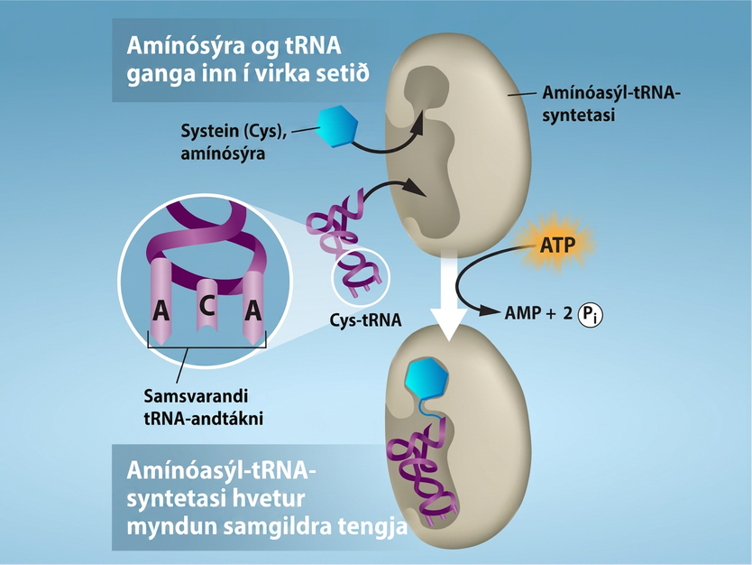
Figure 15.17
Charging of tRNAs with correct amino acids. Aminoacyl-tRNA synthetases catalyze covalent bond formation between the tRNA and the correct amino acid in preparation for translation. Because there are multiple amino acids, there are multiple different tRNA synthetases. All of the synthetases require energy, in the form of ATP, to make sure the correct amino acid is attached to the tRNA with the correct anticodon sequence. Credit: Rao, A., Ryan, K. and Tag, A. Department of Biology, Texas A&M University.
Notes:
Amino acid and t R N A enter the active site. In this case, the amino acid cysteine (abbreviated Cys) and Cys t R N A bind to the active site of aminoacyl t R N A synthetase. A T P is consumed, producing A M P and 2 inorganic phosphates. As a result, aminoacyl t R N A synthetase catalyzes covalent bonding of cysteine to Cys t R N A.

Slide 26
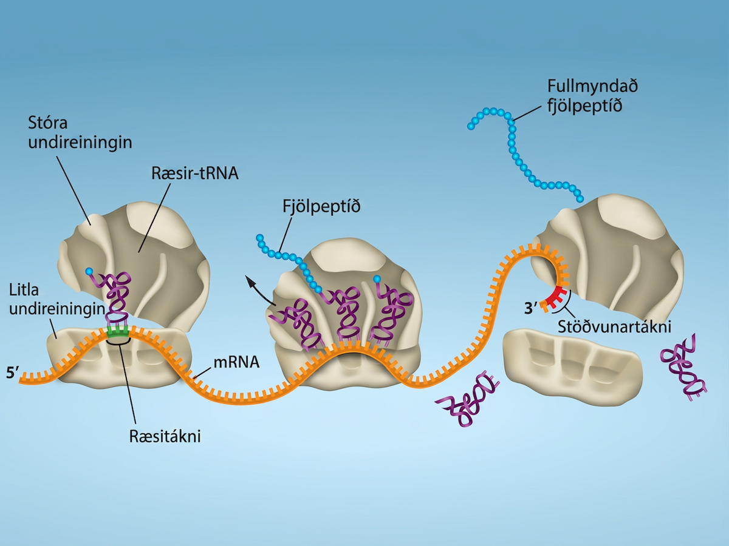
Figure 15.18
Translation begins when an initiator tRNA anticodon recognizes a start codon on mRNA bound to a small ribosomal subunit. The large ribosomal subunit joins the small subunit, and a second tRNA is recruited. As the mRNA moves relative to the ribosome, successive tRNAs move through the ribosome and the polypeptide chain is formed. Entry of a release factor into the A site terminates translation and the components dissociate.
Notes:
Illustration shows the steps of protein synthesis. First, the initiator tRNA recognizes the sequence AUG on an mRNA that is associated with the small ribosomal subunit. The large subunit then joins the complex. Next, a second tRNA is recruited at the A site. A peptide bond is formed between the first amino acid, which is at the P site, and the second amino acid, which is at the A site. The mRNA then shifts and the first tRNA is moved to the E site, where it dissociates from the ribosome. Another tRNA binds at the A site, and the process is repeated. Finally, entry of a release factor into the A site terminates translation and the components dissociate at the stop codon.

Slide 27
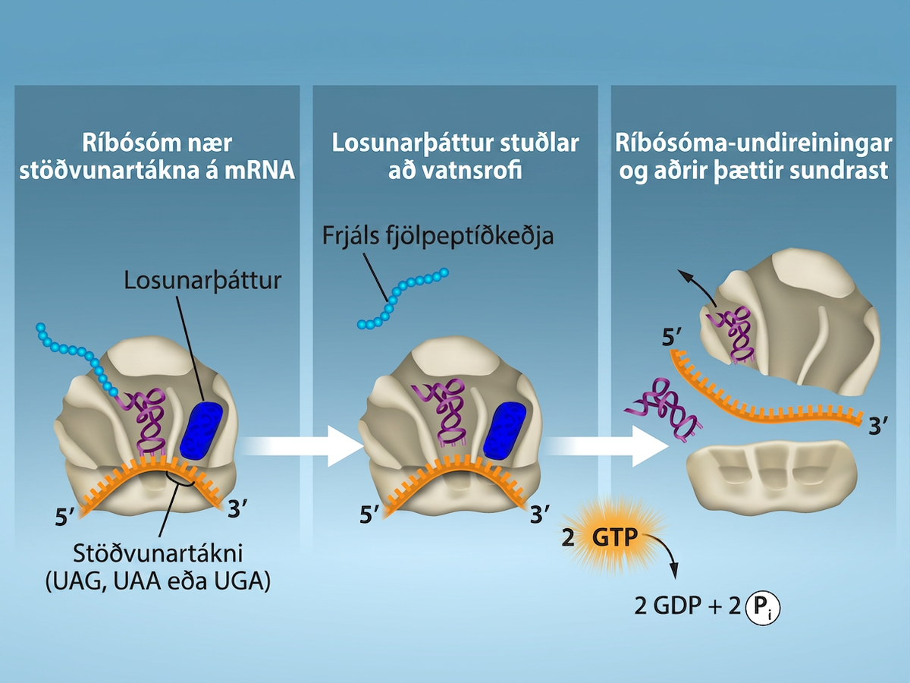
Figure 15.19
Translation Termination is Active. Translation is terminated when a STOP codon is in the A-site of the ribosome. Since there are no tRNAs corresponding to the STOP codons, the Release Factor protein enters and catalyzes the hydrolysis between the last amino acid and its tRNA. This hydrolysis releases the free carboxyl terminus (C-term) of the protein. Additional factors use the energy in GTP hydrolysis to disassemble the large and small ribosomal subunits and mRNA. Credit: Rao, A. and Ryan, K. Department of Biology, Texas A&M University.
Notes:
The first section shows a ribosome reaching a stop codon on m R N A. The stop codon reaches the A site of the ribosome, and a release factor interacts with the A site as well. The second section shows the polypeptide being released. 2 G T P molecules go through hydrolysis, leading to the third section. In the third section, the ribosome subunits are shown separating, and the RNA is no longer connected to it.

Slide 28
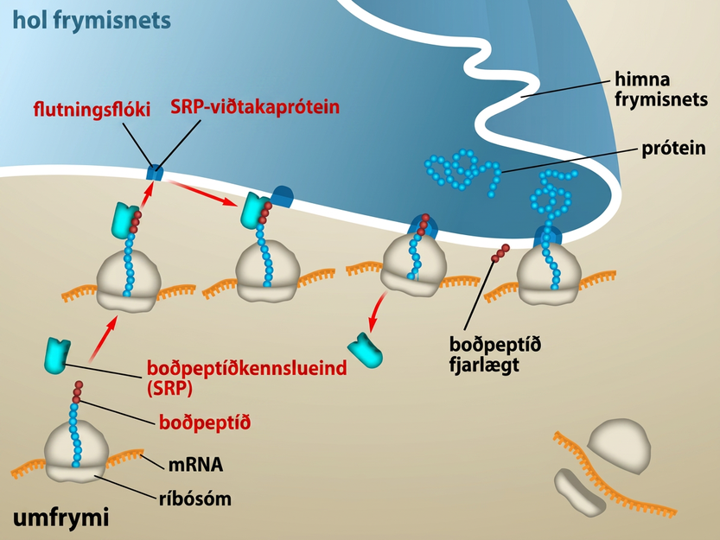
Figure 15.20
Proteins are co-translationally targeted into the ER for secretion. Proteins that will be secreted from the cell will contain a signal sequence at the N-terminus. The signal will be recognized by SRP as soon as the amino acids emerge from the ribosome, and the ribosome will be targeted to the translocation channel in the ER membrane. The rest of the protein will go directly from the ribosome, across the ER membrane and into the ER lumen. From the ER, proteins can be secreted from the cell via vesicle trafficking. Credit: Rao, A. and Ryan, K. Department of Biology, Texas A&M University.
This OpenStax ancillary resource is © Rice University under a CC BY-NC-SA 4.0 International license; it may be reproduced or modified for noncommercial purposes only but must be attributed to OpenStax, Rice University and any changes must be noted. Any adaptation must be shared under the same type of license.
Notes:
In the cytosol, the m R N A and Ribosome complex have a signal peptide that bonds with a signal recognition particle. Once combined, they interact with a translocation complex and signal recognition particle receptor protein in the E R Membrane. The protein is then removed from the ribosome complex and goes across the E R Membrane into the E R Lumen.

