Slide 1

Biology 2e
Chapter 43 Animal Reproduction and Development

Slide 2
Chapter outline
Reproduction Methods
Fertilization
Human Reproductive Anatomy and Gametogenesis
Hormonal Control of Human Reproduction
Human Pregnancy and Birth
Fertilization and Early Embryonic Development
Organogenesis and Vertebrate Axis Formation

Slide 3
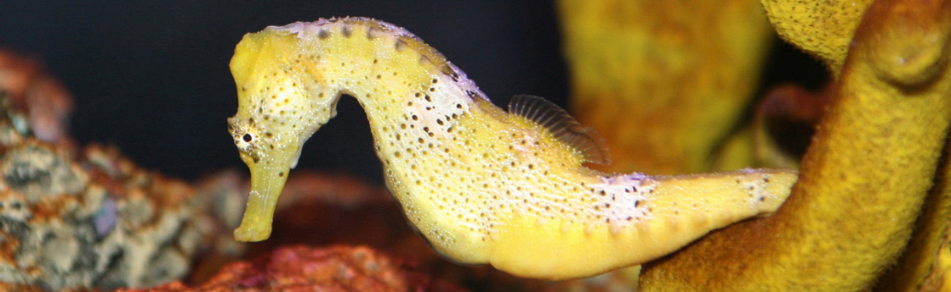
Figure 43.1
Female seahorses produce eggs for reproduction that are then fertilized by the male. Unlike almost all other animals, the male seahorse then gestates the young until birth. (credit: modification of work by "cliff1066"/Flickr)
Notes:
Photo shows a yellow seahorse with its tail curled around a fragment of coral.

Slide 4
43.1 Reproduction Methods
Learning Objectives
Describe advantages and disadvantages of asexual and sexual reproduction
Discuss asexual reproduction methods
Discuss sexual reproduction methods

Slide 5
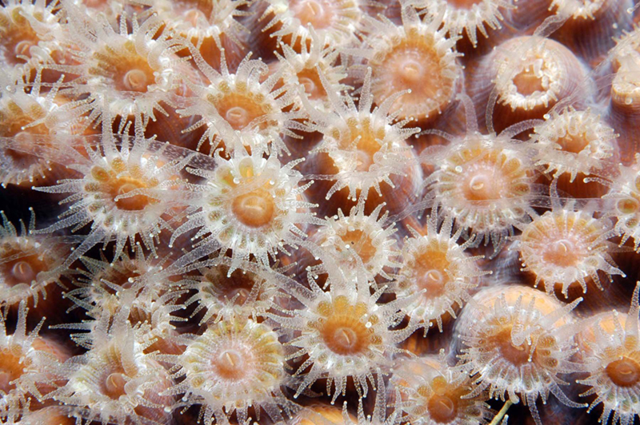
Figure 43.2
Coral polyps reproduce asexually by fission. (credit: G. P. Schmahl, NOAA FGBNMS Manager)
Notes:
Image shows many coral polyps clustered together. Each Polyp is cup-shaped, with tentacles radiating out from the rim.

Slide 6
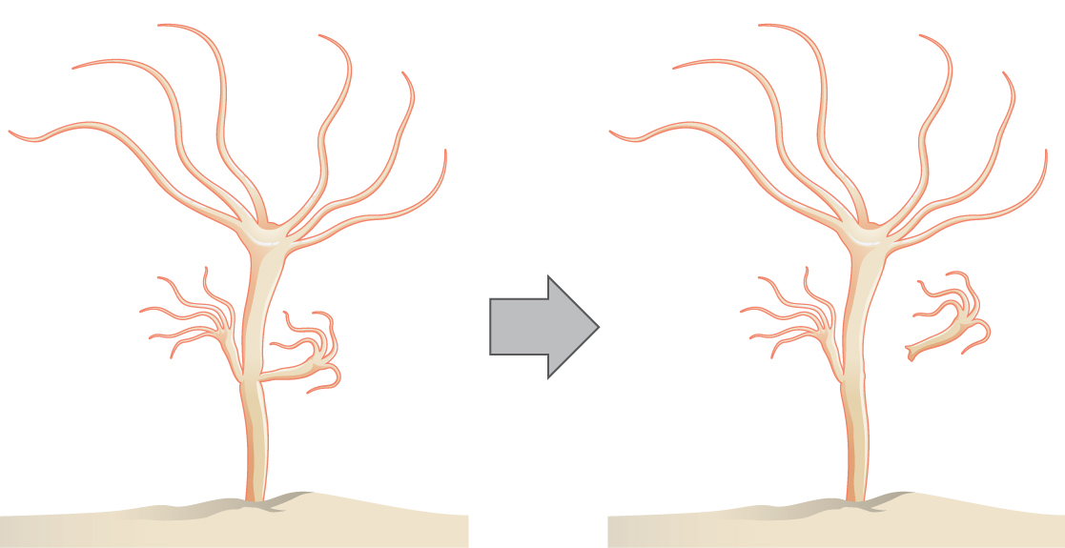
Figure 43.3
Hydra reproduce asexually through budding.
Notes:
Illustration shows a hydra, which has a stalk-like body with tentacles growing out the top. A smaller hydra is budding from the side of the stalk.

Slide 7
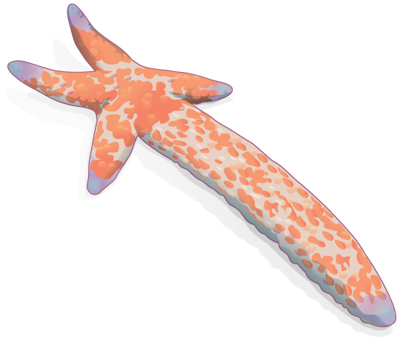
Figure 43.4
Sea stars can reproduce through fragmentation. The large arm, a fragment from another sea star, is developing into a new individual.
Notes:
Illustration shows a sea star with one long arm and four very short arms.

Slide 8
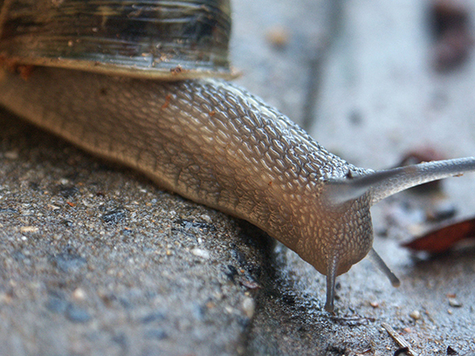
Figure 43.5
Many snails are hermaphrodites. When two individuals mate, they can produce up to one hundred eggs each. (credit: Assaf Shtilman)
Notes:
Photo shows a land snail.

Slide 9
43.2 Fertilization
Learning Objectives
Discuss internal and external methods of fertilization
Describe the methods used by animals for development of offspring during gestation
Describe the anatomical adaptations that occurred in animals to facilitate reproduction

Slide 10
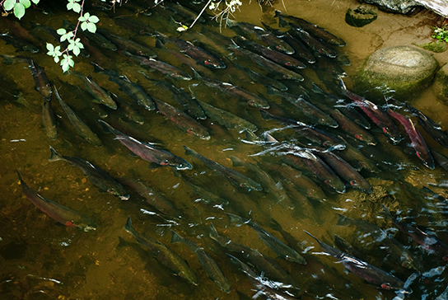
Figure 43.6
Salmon reproduce through spawning. (credit: Dan Bennett)
Notes:
Photo shows many salmon swimming up a shallow creek.

Slide 11
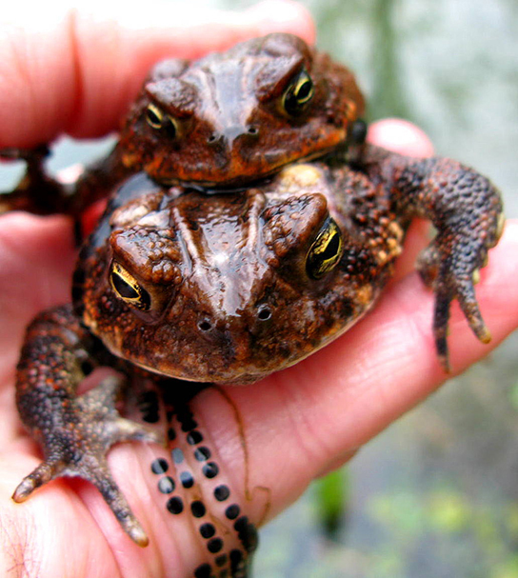
Figure 43.7
During sexual reproduction in toads, the male grasps the female from behind and externally fertilizes the eggs as they are deposited. (credit: "OakleyOriginals"/Flickr)
Notes:
Photo shows mating toads.

Slide 12
43.3 Human Reproductive Anatomy and Gametogenesis
Learning Objectives
Describe human male and female reproductive anatomies
Discuss the human sexual response
Describe spermatogenesis and oogenesis and discuss their differences and similarities

Slide 13
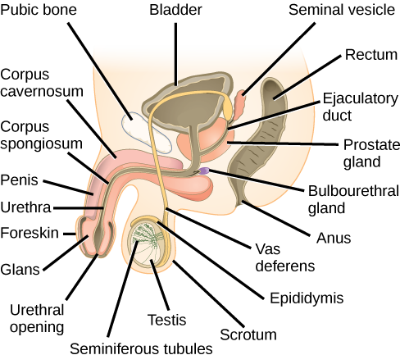
Figure 43.8
The reproductive structures of the human male are shown.
Notes:
Illustration shows a cross section of the penis and testes. The penis widens at the end, into the glans, which is surrounded by the foreskin. The urethra opens at the middle of the glans after running through the middle of the penis to the bladder. The tissue surrounding the urethra is the Corpus spongiosum, and above the Corpus spongiosum is the Corpus cavernosum. The testes, located immediately behind the penis, are covered by the scrotum. Seminiferous tubules are located in the testes. The epididymis partly surrounds the sac containing the seminiferous tubules. The Vas deferens is a tube connecting the seminiferous tubules to the ejaculatory duct, which begins in the prostate gland. The prostate gland is located behind and below the bladder. The seminal vesicle, located above the prostate, also connects to the ejaculatory duct. The bulbourethral gland connects to the urethra where the urethra enters the penis.

Slide 14
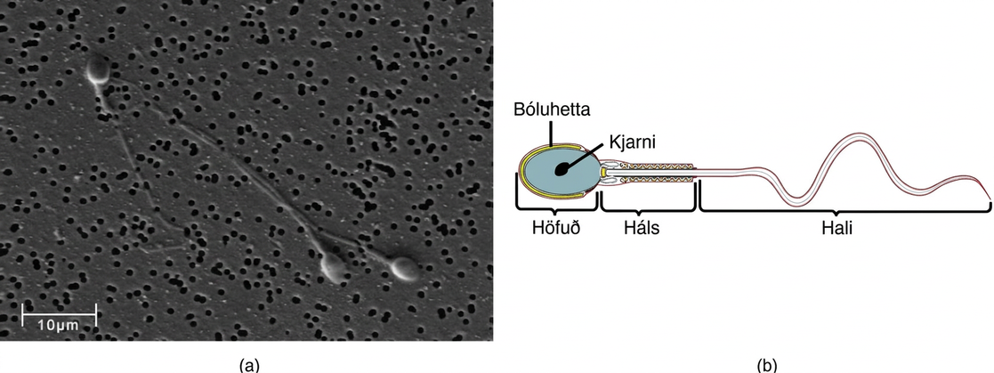
Figure 43.9
Human sperm, visualized using scanning electron microscopy, have a flagellum, neck, and head. (credit b: modification of work by Mariana Ruiz Villareal; scale-bar data from Matt Russell)
Notes:
Micrograph shows human sperm, which have an oval head about 3 microns across and a very long flagellum. Illustration shows that the head is surrounded by the acrosome. The part of the tail closest to the head, called the neck, is thicker than the rest.

Slide 15
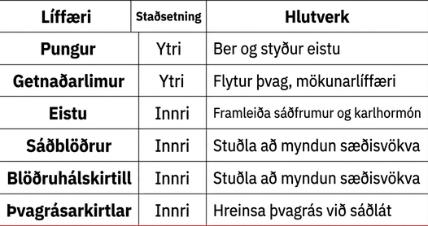
Table 43.1

Slide 16
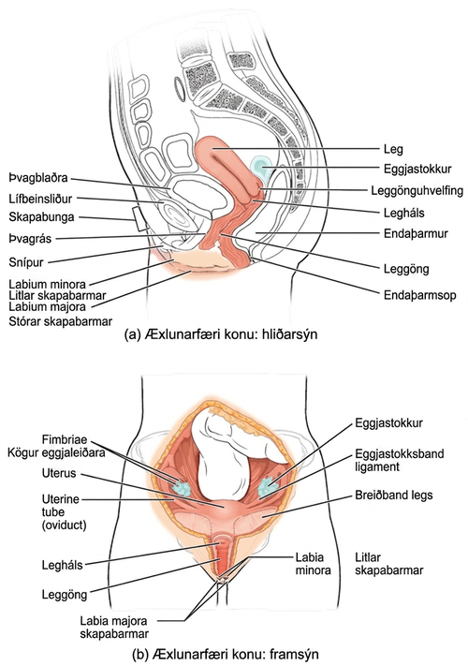
Figure 43.10
The reproductive structures of the human female are shown. (credit a: modification of work by Gray's Anatomy; credit b: modification of work by CDC)
Notes:
Side and front views of female reproductive organs are shown. The vagina is wide at the bottom, and narrows into the cervix. Above the cervix is the uterus, which is shaped like a triangle pointing down. Fallopian tubes extend from the top sides of the uterus. The Fallopian tubes curve back in toward the uterus, and end in fingerlike appendages called fimbriae. The ovaries are located between the fimbriae and the uterus. The urethra is located in front of the vagina, and the rectum is located behind. The clitoris is a structure located in front of the urethra. The labia minora and labia majora are folds of tissue on either side of the vagina.

Slide 17
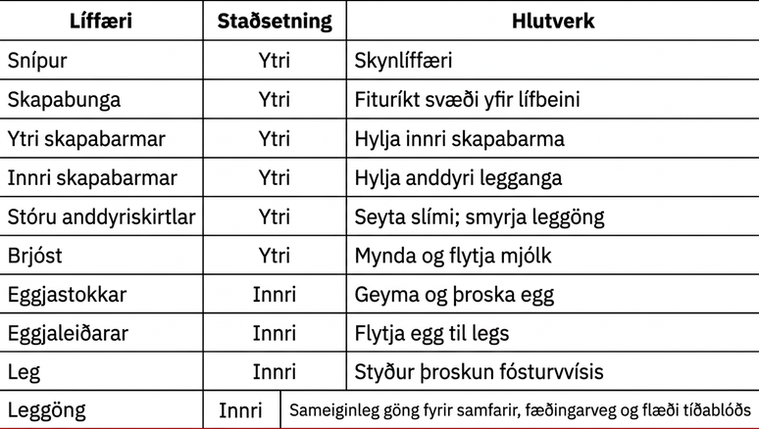
Table 43.2

Slide 18
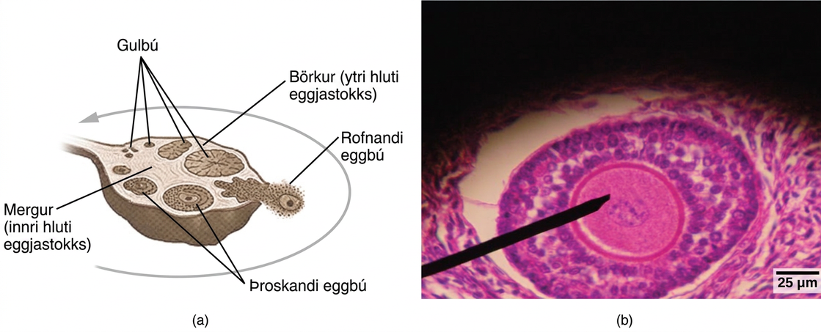
Figure 43.11
Oocytes develop in (a) follicles, located in the ovary. At the beginning of the menstrual cycle, the follicle matures. At ovulation, the follicle ruptures, releasing the egg. The follicle becomes a corpus luteum, which eventually degenerates. The (b) follicle in this light micrograph has an oocyte at its center. (credit a: modification of work by NIH; scale-bar data from Matt Russell)
Notes:
Illustration A shows a cross section of a human ovary, which is oval with a stem-like structure at one end that anchors it to the uterus. The central part of the ovary is the medulla, and the outer part is the cortex. Follicles exist in the cortex. Small, immature follicles are located near this stem-like structure. As a follicle matures, it grows and moves toward the edge of the ovary opposite the stem, it ruptures, releasing the egg. The follicle is now called a corpus luteum. The corpus luteum matures and moves back toward the stem, along the opposite edge of the ovary from which the follicle matured. The corpus luteum shrinks and eventually disintegrates. The light micrograph in illustration B shows an oval follicle with a large oocyte located at the center. Around the oocyte are much smaller cells.

Slide 19
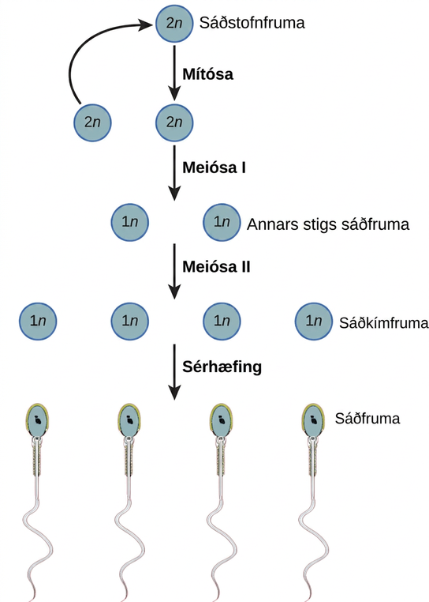
Figure 43.12
During spermatogenesis, four sperm result from each primary spermatocyte.
Notes:
Spermatogenesis begins when the 2 n spermatogonium undergoes mitosis, producing more spermatagonia. The spermatogonia undergo meiosis I, producing haploid 1 n secondary spermatocytes, and meiosis I I, producing spermatids. Differentiation of the spermatids results in mature sperm.

Slide 20
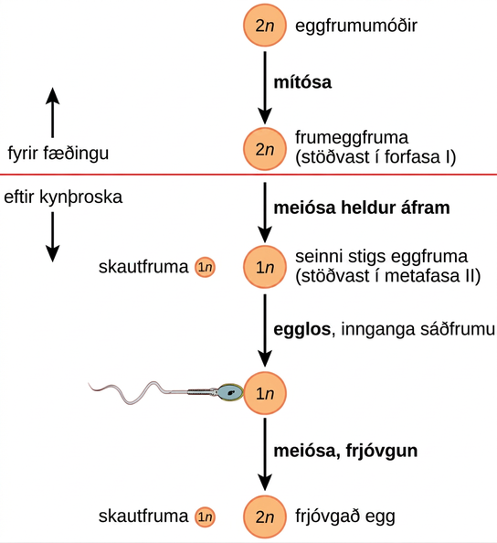
Figure 43.13
The process of oogenesis occurs in the ovary’s outermost layer.
Notes:
Oogenesis begins when the 2 n oogonium undergoes mitosis, producing a primary oocyte. The primary oocytes arrest in prophase I before birth. After puberty, meiosis of one oocyte per menstrual cycle continues, resulting in a 1 n secondary oocyte that arrests in metaphase I I and a polar body. Upon ovulation and sperm entry, meiosis is completed and fertilization occurs, resulting in a polar body, shown as 1 n, and a fertilized egg, 2 n.

Slide 21
43.4 Hormonal Control of Human Reproduction
Learning Objectives
Describe the roles of male and female reproductive hormones
Discuss the interplay of the ovarian and menstrual cycles
Describe the process of menopause

Slide 22
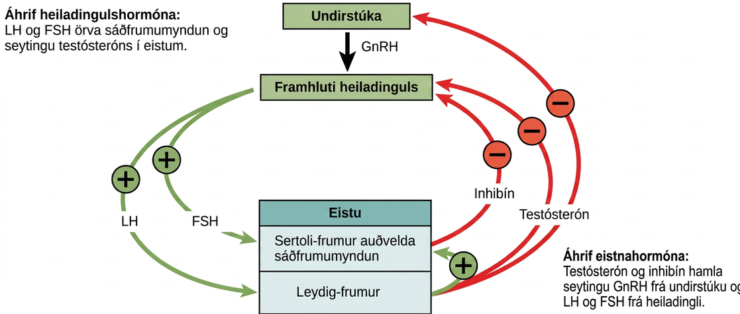
Figure 43.14
Hormones control sperm production in a negative feedback system.
Notes:
Hormonal control of the male reproductive system is mediated by the hypothalamus, anterior pituitary and testes. The hypothalamus releases GnRH, causing the anterior pituitary to release LH and FSH. FSH and LH both act on the testes. FSH stimulates the Sertoli cells in the testes to facilitate spermatogenesis and to secrete inhibin. LH causes the Leydig cells in the testes to secrete testosterone. Testosterone further stimulates spermatogenesis by the Sertoli cells, but inhibits GnRH, LH, and FSH production by the hypothalamus and anterior pituitary. Inhibin secreted by Sertoli cells also inhibits FSH and LH production by the anterior pituitary.

Slide 23
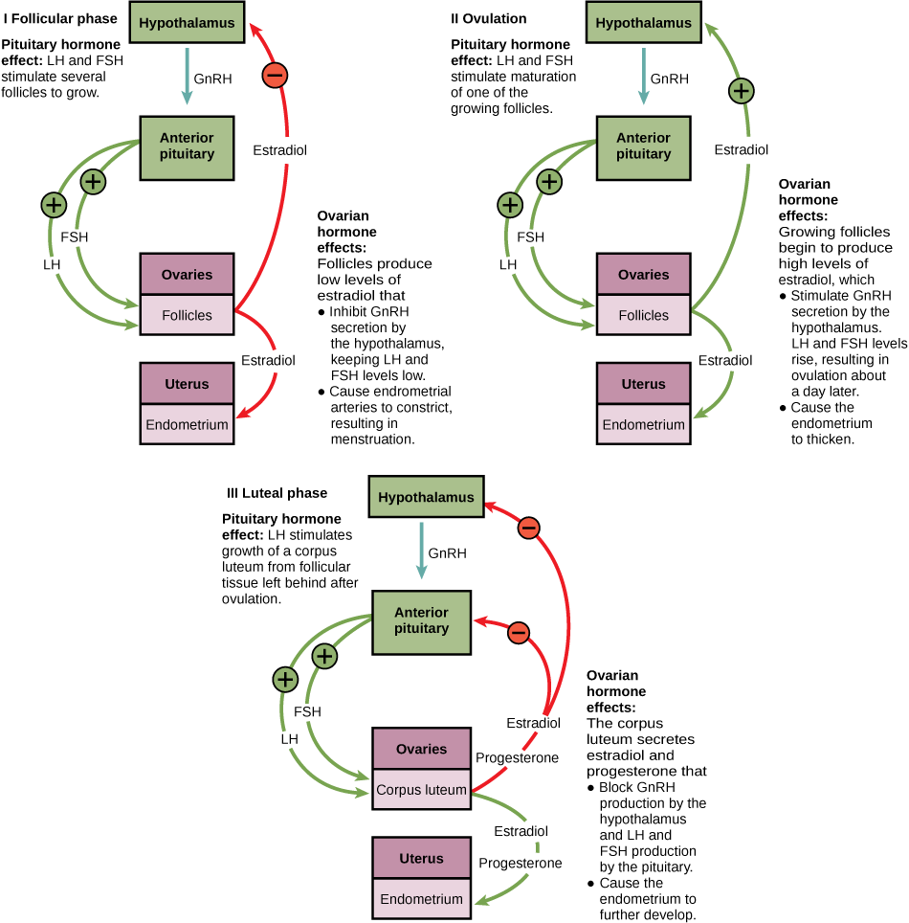
Figure 43.15
The ovarian and menstrual cycles of female reproduction are regulated by hormones produced by the hypothalamus, pituitary, and ovaries.
Notes:
Hormone levels during the follicular phase, ovulation, and the luteal phase are compared. During the follicular phase, L H and F S H secreted from the pituitary stimulate several follicles to grow. The follicles produce low levels of estradiol that inhibit G n R H secretion by the hypothalamus, keeping L H and F S H levels low. Low levels of estradiol also cause the endometrial arteries to constrict, resulting in menstruation. During the time leading up to ovulation, L H and F S H stimulate maturation of one of the follicles. The growing follicle begins to produce high levels of estradiol, which stimulates G n R H secretion by the hypothalamus. As a result, L H and F S H levels rise, resulting in ovulation about a day later. Estradiol also causes the endometrium to thicken. After ovulation, the ovarian cycle enters the luteal phase. L H from the pituitary stimulates growth of the corpus luteum from the ruptured follicle. The corpus luteum secretes estradiol and progesterone that block G n R H production by the hypothalamus and L H and F S H production by the pituitary. Estradiol and progesterone also cause the endometrium to further develop.

Slide 24
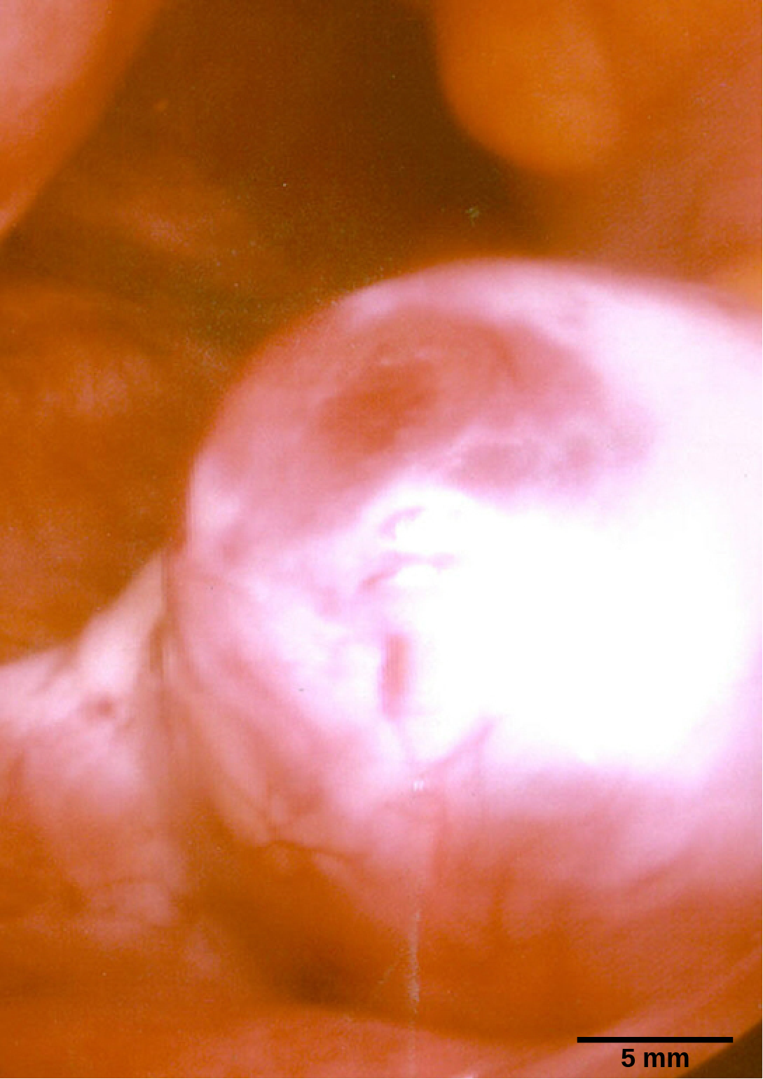
Figure 43.16
This mature egg follicle may rupture and release an egg. (credit: scale-bar data from Matt Russell)
Notes:
Micrograph shows a spherical egg growing on the surface of a tissue.

Slide 25
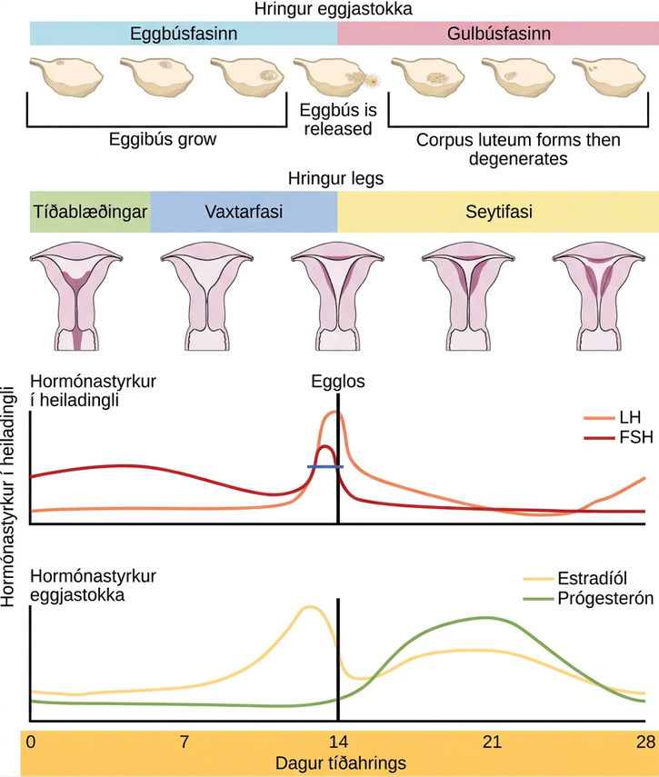
Figure 43.17
Rising and falling hormone levels result in progression of the ovarian and menstrual cycles. (credit: modification of work by Mikael Häggström)
Notes:
The menstrual cycle encompasses both an ovarian cycle and a uterine cycle. The uterine cycle is divided into menstrual flow, the proliferative phase and the secretory phase. The ovarian cycle is separated into follicular and luteal phases. At day zero the uterine cycle enters the menstrual phase and the ovarian cycle enters the follicular phase. Menstruation begins, and the follicle inside the uterus begins to grow. The level of the pituitary hormone F S H rises slightly, while L H levels remain low. The levels of ovarian hormones estradiol and progesterone remain low. After menses the uterine cycle enters the proliferative phase and the follicle continues to grow. The level of the ovarian hormone estradiol begins to rapidly rise. Toward the end of the proliferative phase, levels of the pituitary hormones F S H and L H rise as well. Around day fourteen, just after the levels of estrogen, progesterone and estradiol reach their peak, ovulation occurs. The follicle ruptures, releasing the oocyte. The ovarian cycle enters the luteal phase. The follicle grows into a corpus luteum and then degenerates. The uterus enters the secretory phase. Progesterone levels increase and estradiol levels, which had dropped after ovulation, increase as well. Toward the end of the secretory phase estrogen and progesterone levels decrease, reaching their baseline levels around day 28. At this point menstruation begins.

Slide 26
43.5 Human Pregnancy and Birth
Learning Objectives
Explain fetal development during the three trimesters of gestation
Describe labor and delivery
Compare the efficacy and duration of various types of contraception
Discuss causes of infertility and the therapeutic options available

Slide 27
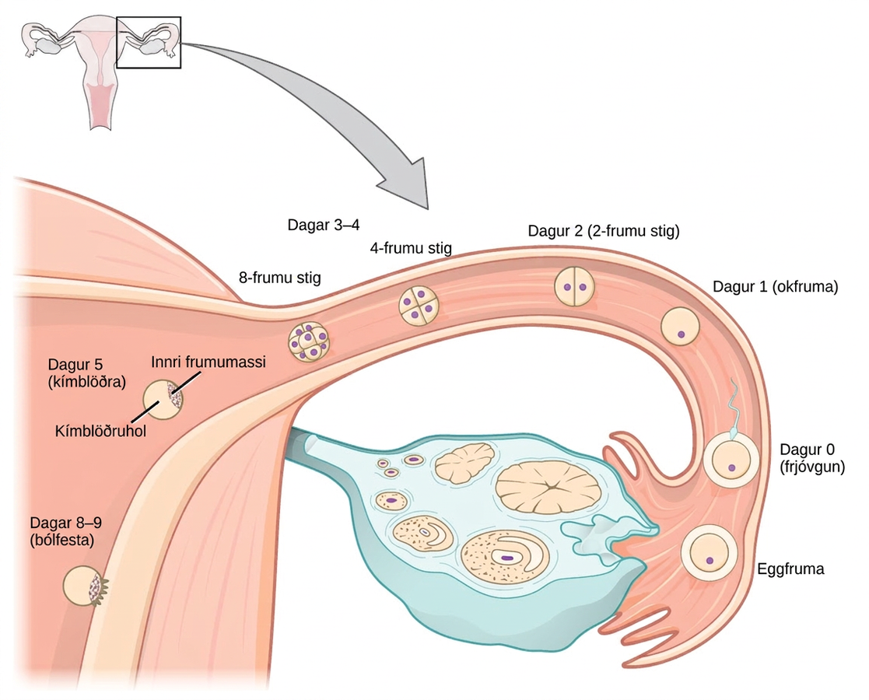
Figure 43.18
In humans, fertilization occurs soon after the oocyte leaves the ovary. Implantation occurs eight or nine days later. (credit: Ed Uthman)
Notes:
Upon ovulation, an oocyte is released from the ovary and enters the fallopian tubule. Fertilization by a sperm occurs at day zero, resulting in a single-celled zygote. Around day two, the zygote undergoes cell division. More cell divisions occur on the third and fourth day, resulting in four-cell and eight-cell stages. By this time the cell mass has traveled to the end of the fallopian tube. Around day five the cell mass enters the uterus and differentiates into a blastocyst that is hollow inside (a fluid-filled cavity called a blastocoel), with an inner cell mass off to one side. The layer of cells on the outside of the blastocyst is called the trophoblast. Around day eight or nine the blastocyst implants in the wall of the uterus, with the inner cell mass facing the wall.

Slide 28
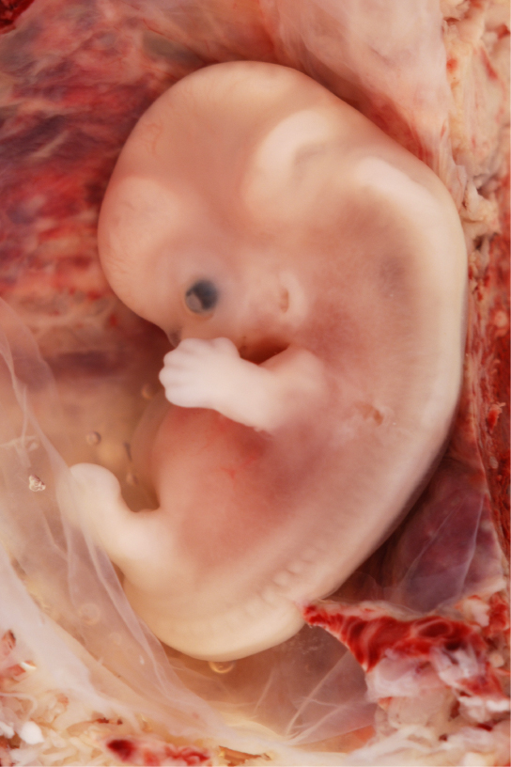
Figure 43.19
Fetal development is shown at nine weeks gestation. (credit: Ed Uthman)
Notes:
Photo shows a human fetus, with a large bent head and a dark eye, fingers on its arm and a leg bud. The spine is visible through the back, and the stomach protrudes out as far as the leg bud.

Slide 29
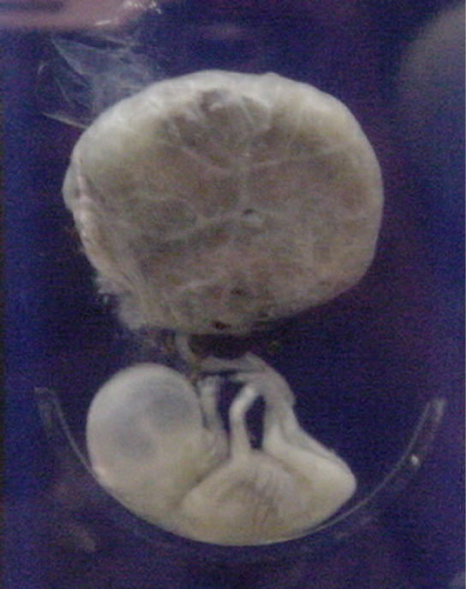
Figure 43.20
This fetus is just entering the second trimester, when the placenta takes over more of the functions performed as the baby develops. (credit: National Museum of Health and Medicine)
Notes:
The second trimester fetus has long arms and legs, and is attached to the placenta, which is round and larger than the fetus.

Slide 30
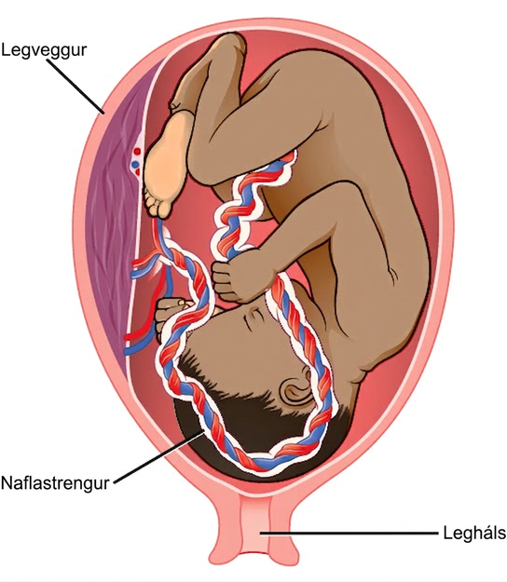
Figure 43.21
There is rapid fetal growth during the third trimester. (credit: modification of work by Gray’s Anatomy)
Notes:
Illustration shows a third trimester fetus, which is a fully developed baby. The fetus is up-side down and pressing on the cervix. The thick umbilical cord extends from the fetus' belly to the uterine wall.

Slide 31
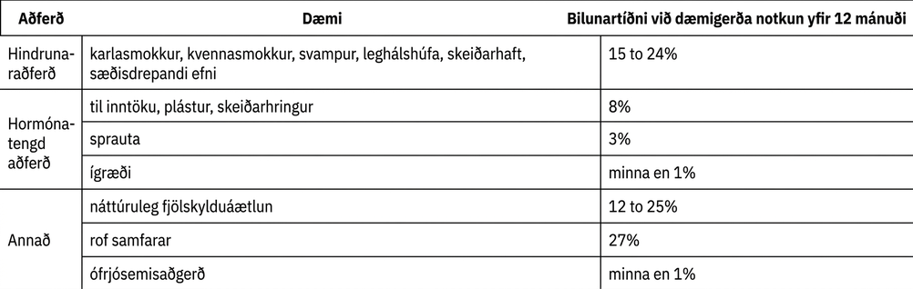
Table 43.3

Slide 32
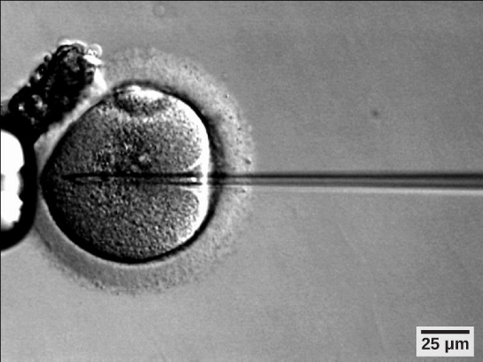
Figure 43.22
A sperm is inserted into an egg for fertilization during intracytoplasmic sperm injection (ICSI). (credit: scale-bar data from Matt Russell)
Notes:
Micrograph shows a needle injecting sperm into an egg.

Slide 33
43.6 Fertilization and Early Embryonic Development
Learning Objectives
Discuss how fertilization occurs
Explain how the embryo forms from the zygote
Discuss the role of cleavage and gastrulation in animal development

Slide 34
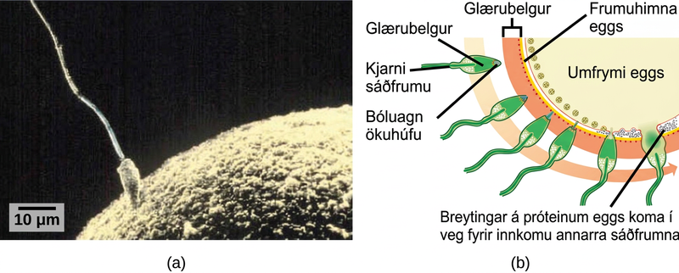
Figure 43.23
(a) Fertilization is the process in which sperm and egg fuse to form a zygote. (b) Acrosomal reactions help the sperm degrade the glycoprotein matrix protecting the egg and allow the sperm to transfer its nucleus. (credit: (b) modification of work by Mariana Ruiz Villareal; scale-bar data from Matt Russell)
Notes:
Part A is a micrograph that shows a sperm whose head is touching the surface of an egg. The egg is much larger than the sperm. Part B is an illustration that shows the surface of the egg, which is coated with a zona pellucida. The sperm penetrates the zona pellucida, then the egg plasma membrane and releases its D N A into the egg cytoplasm. At this point, changes in proteins just inside the egg's cell membrane occur, preventing entry of other sperm.

Slide 35
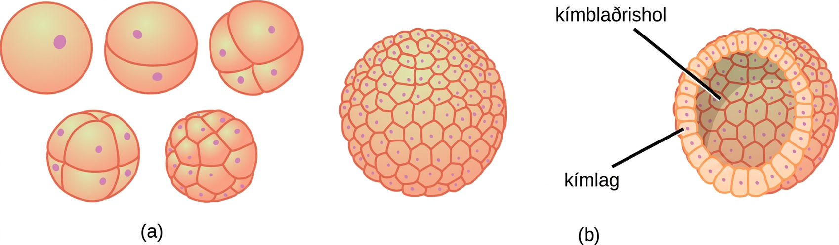
Figure 43.24
(a) During cleavage, the zygote rapidly divides into multiple cells without increasing in size. (b) The cells rearrange themselves to form a hollow ball with a fluid-filled or yolk-filled cavity called the blastula.
Notes:
Part A illustration shows a fertilized egg divided into two, four, eight, and sixteen cells. Part B shows a hollow ball of cells. The cells on the surface are called the blastoderm, and the hollow center is called the blastocoel.

Slide 36
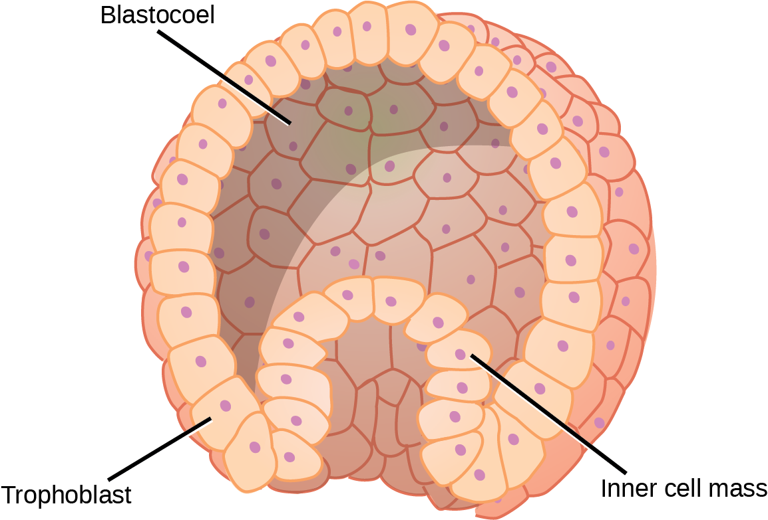
Figure 43.25
The rearrangement of the cells in the mammalian blastula to two layers—the inner cell mass and the trophoblast—results in the formation of the blastocyst.
Notes:
Illustration shows a hollow ball of cells with an inner cell mass clustered to one side. The exterior is called the trophoblast.

Slide 37
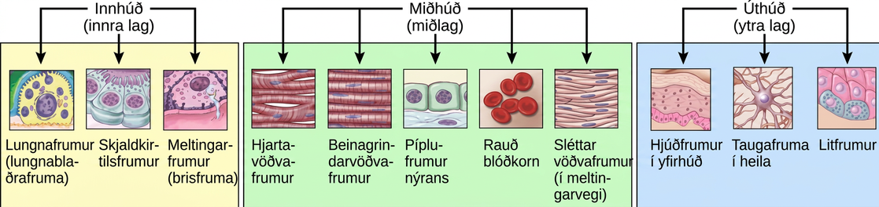
Figure 43.26
The three germ layers give rise to different cell types in the animal body. (credit: modification of work by NIH, NCBI)
Notes:
Illustration shows cells associated with the internal endoderm, the middle mesoderm, and the external ectoderm. Lung, thyroid and digestive tissues are associated with the endoderm. Muscle, kidney and blood cells are associated with the mesoderm. Skin, neurons, and pigment cells are associated with the ectoderm.

Slide 38
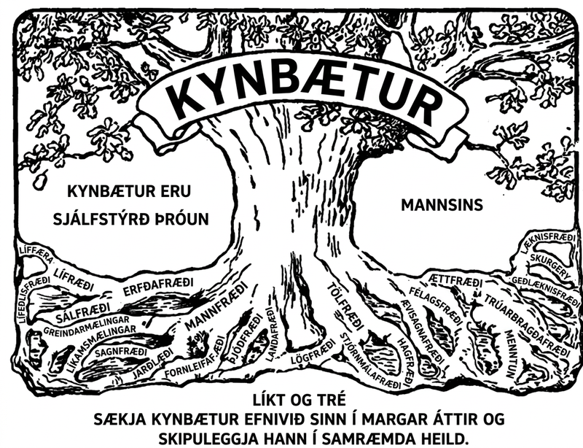
Figure 43.27
This logo from the Second International Eugenics Conference in New York City in September of 1921 shows how eugenics attempted to merge several fields of study with the goal of producing a genetically superior human race.
Notes:
Illustration shows a tree with words such as genetics, statistics, medicine, economics, and genealogy associated with the roots. The word eugenics is emblazoned across the upper trunk. To the side of the tree is the text that reads, Eugenics is the self-direction of human evolution.

Slide 39
43.7 Organogenesis and Vertebrate Axis Formation
Learning Objectives
Describe the process of organogenesis
Identify the anatomical axes formed in vertebrates

Slide 40
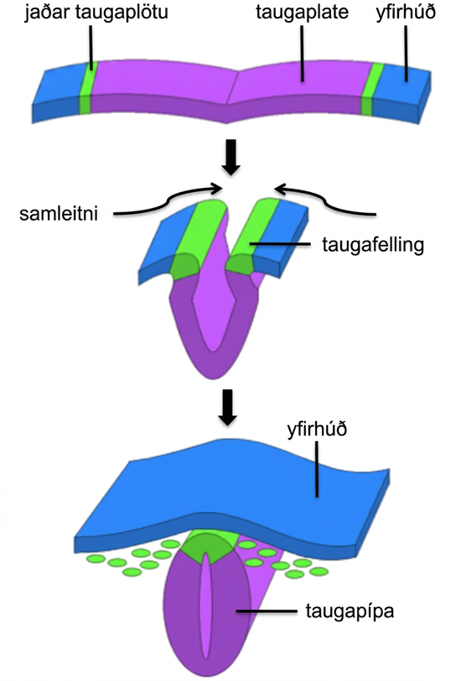
Figure 43.28
The central region of the ectoderm forms the neural tube, which gives rise to the brain and the spinal cord.
Notes:
Illustration shows a flat sheet. The middle of the sheet is the neural plate, and the epidermis is at either end. The neural plate border separates the neural plate from the epidermis. During convergence the plate folds, bringing the neural folds together. The neural folds fuse, forming the neural plate into a neural tube. The epidermis separates and folds around the outside.

Slide 41
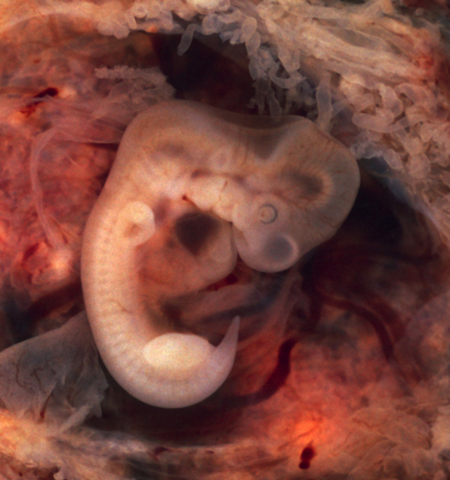
Figure 43.29
In this five-week old human embryo, somites are segments along the length of the body. (credit: modification of work by Ed Uthman)
Notes:
Embryo resembles a segmented earthworm with a bulging head.

Slide 42
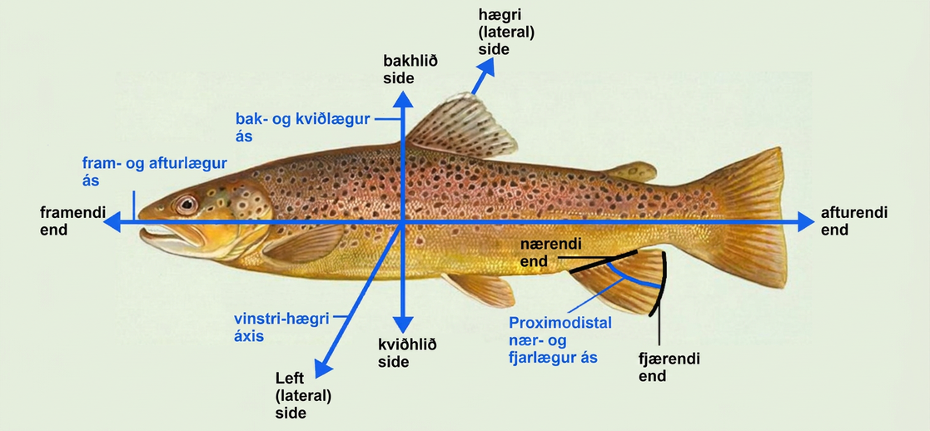
Figure 43.30
Animal bodies have three axes for symmetry. (credit: modification of work by NOAA)
This OpenStax ancillary resource is © Rice University under a CC BY-NC-SA 4.0 International license; it may be reproduced or modified for noncommercial purposes only but must be attributed to OpenStax, Rice University and any changes must be noted. Any adaptation must be shared under the same type of license.
Notes:
Illustration shows a fish dissected by lines into anterior (front) and posterior (rear) ends and dorsal (top) and ventral (bottom) surfaces. It also indicates that where the fish's fin contacts its body is the proximal end, and the outer edge of the fin is the distal end.

