Slide 1

Biology 2e
Chapter 14 DNA Structure and Function

Slide 2
Chapter outline
Historical Basis of Modern Understanding
DNA Structure and Sequencing
Basics of DNA Replication
DNA Replication in Prokaryotes
DNA Replication in Eukaryotes
DNA Repair

Slide 3
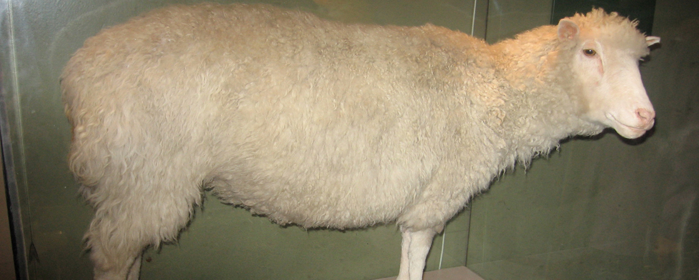
Figure 14.1
Dolly the sheep was the first large mammal to be cloned.
Notes:
Photo shows Dolly the sheep, which has been stuffed and placed in a glass case.

Slide 4
14.1 Historical Basis of Modern Understanding
Learning Objectives
Explain transformation of DNA
Describe the key experiments that helped identify that DNA is the genetic material
State and explain Chargaff’s rules

Slide 5
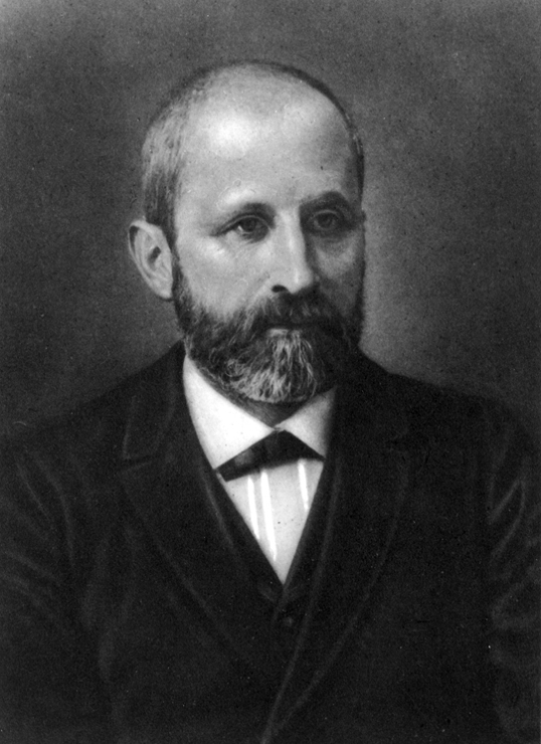
Figure 14.2
Friedrich Miescher (1844–1895) discovered nucleic acids.
Notes:
Photo of Friedrich Miescher.

Slide 6
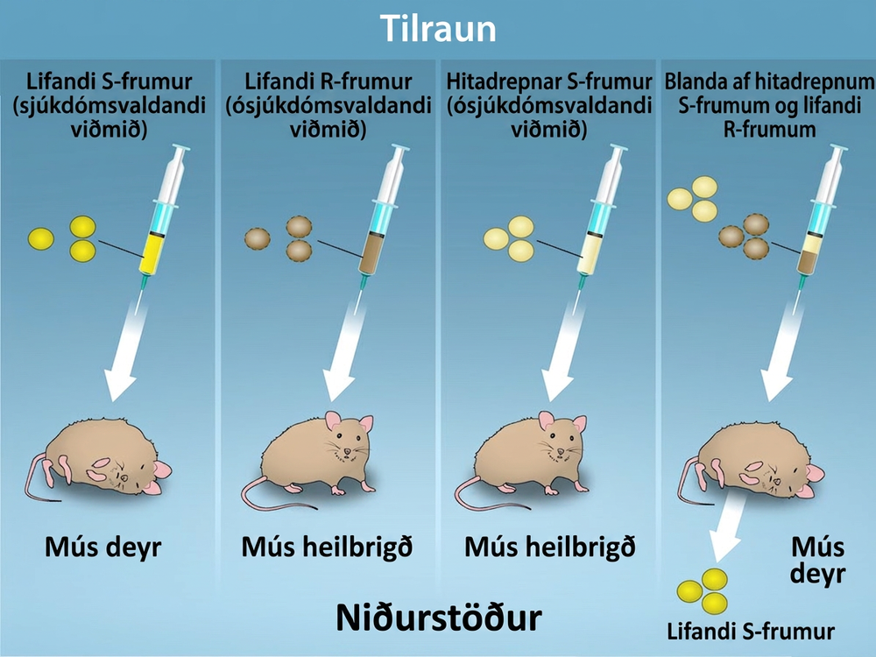
Figure 14.3
Two strains of S. pneumoniae were used in Griffith’s transformation experiments. The R strain is non-pathogenic, whereas the S strain is pathogenic and causes death. When Griffith injected a mouse with the heat-killed S strain and a live R strain, the mouse died. The S strain was recovered from the dead mouse. Griffith concluded that something had passed from the heat-killed S strain to the R strain, transforming the R strain into the S strain in the process. Credit: Rao, A., Ryan, K. and Tag, A. Department of Biology, Texas A&M University.
Notes:
Four scenarios in an experiment are shown. In the first, living S cells are injected, and the mouse dies. In the second, living R cells are injected, and the mouse is healthy. In the third, heat-killed S cells are injected, and the mouse is healthy. In the fourth, mixture of heat-killed S cells and Living R cells are injected, and the mouse dies and living S cells are recovered.

Slide 7
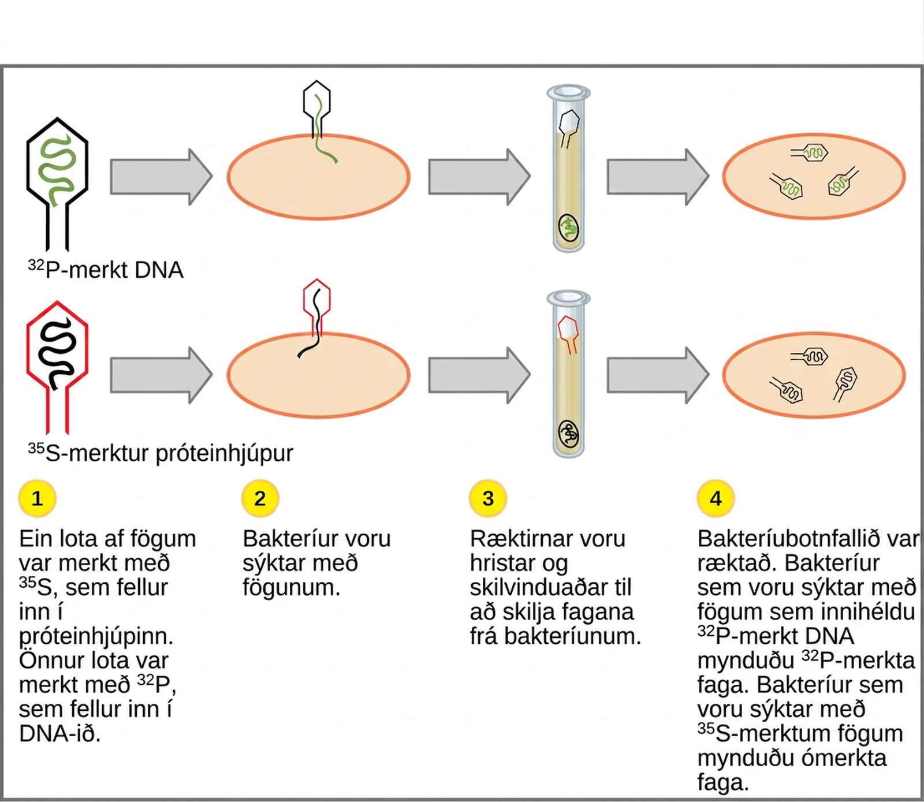
Figure 14.4
In Hershey and Chase's experiments, bacteria were infected with phage radiolabeled with either 35S, which labels protein, or 32P, which labels DNA. Only 32P entered the bacterial cells, indicating that DNA is the genetic material.
Notes:
Illustration shows bacteria being infected by phage labeled with superscript 35 baseline upper case S, which is incorporated into the protein coat, or superscript 32 baseline upper case P, which is incorporated into the D N A. Infected bacteria were separated from phage by centrifugation and cultured. The bacteria that had been infected with phage containing superscript 32 baseline upper P labeled D N A made radioactive phage. The bacteria that had been infected with superscript 35 baseline upper S labeled phage produced unlabeled phage. The results support the hypothesis that D N A, and not protein, is the genetic material.

Slide 8
14.2 DNA Structure and Sequencing
Learning Objectives
Describe the structure of DNA
Explain the Sanger method of DNA sequencing
Discuss the similarities and differences between eukaryotic and prokaryotic DNA

Slide 9
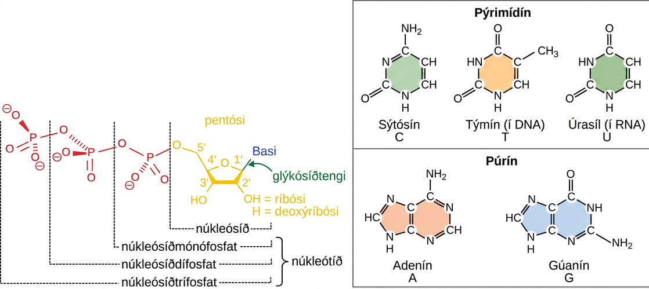
Figure 14.5
The purines have a double ring structure with a six-membered ring fused to a five-membered ring. Pyrimidines are smaller in size; they have a single six-membered ring structure.
Notes:
llustration depicts the structure of a nucleoside, which is made up of a pentose with a nitrogenous base attached at the 1 prime position. There are two kinds of nitrogenous bases: pyrimidines, which have one six-membered ring, and purines, which have a six-membered ring fused to a five-membered ring. Cytosine, thymine, and uracil are pyrimidines, and adenine and guanine are purines. A nucleoside with one phosphate attached at the 5 prime position is called a nucleoside monophosphate. A nucleoside with two or three phosphates attached is called a nucleoside diphosphate or nucleoside triphosphate, respectively.

Slide 10
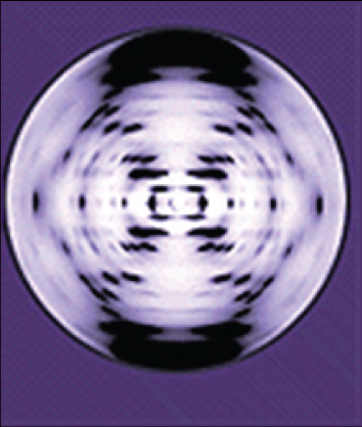
Figure 14.6
The X-ray diffraction pattern of DNA, which helped to elucidate its double-helix structure.
Notes:
The x-ray diffraction pattern is symmetrical, with dots in an x-shape

Slide 11
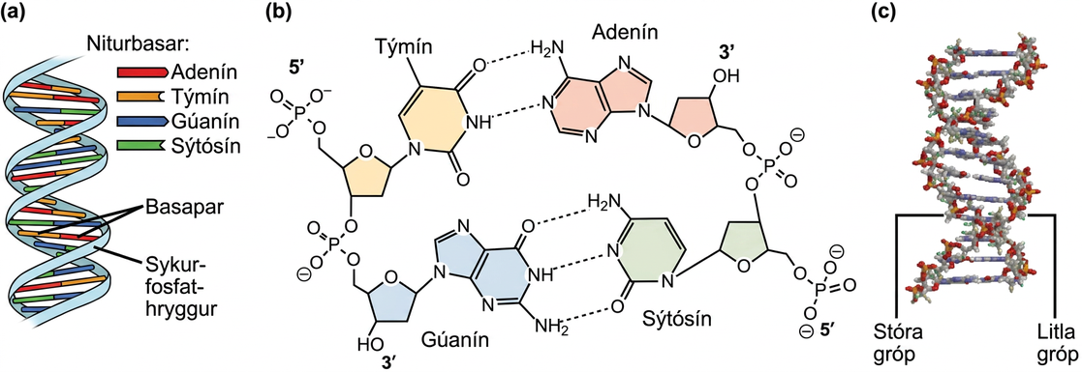
Figure 14.7
DNA has (a) a double helix structure and (b) phosphodiester bonds; the dotted lines between Thymine and Adenine and Guanine and Cytosine represent hydrogen bonds. The (c) major and minor grooves are binding sites for DNA binding proteins during processes such as transcription (the copying of RNA from DNA) and replication.
Notes:
Part A shows an illustration of a D N A double helix, which has a sugar phosphate backbone on the outside and nitrogenous base pairs on the inside. Part B shows base pairing between thymine and adenine, which form two hydrogen bonds, and between guanine and cytosine, which form three hydrogen bonds. Part C shows a molecular model of the D N A double helix. The outside of the helix alternates between wide gaps, called major grooves, and narrow gaps, called minor grooves.

Slide 12
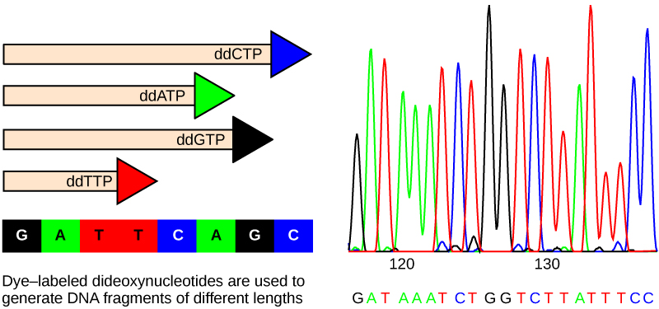
Figure 14.8
In Frederick Sanger's dideoxy chain termination method, dye-labeled dideoxynucleotides are used to generate DNA fragments that terminate at different points. The DNA is separated by capillary electrophoresis on the basis of size, and from the order of fragments formed, the DNA sequence can be read. The DNA sequence readout is shown on an electropherogram that is generated by a laser scanner.
Notes:
Part A shows a template D N A strand and newly synthesized strands that were generated in the presence of dideoxynucleotides that terminate the chain at different points to generate fragments of different sizes. Each dideoxynucleotide is labeled a different color. Part B shows a sequence readout that was generated after the D N A fragments were separated on the basis of size. The color of the fragment indicates the identity of the nucleotide at the end of a given fragment. By reading the colors in order, the D N A sequence can be determined.

Slide 13
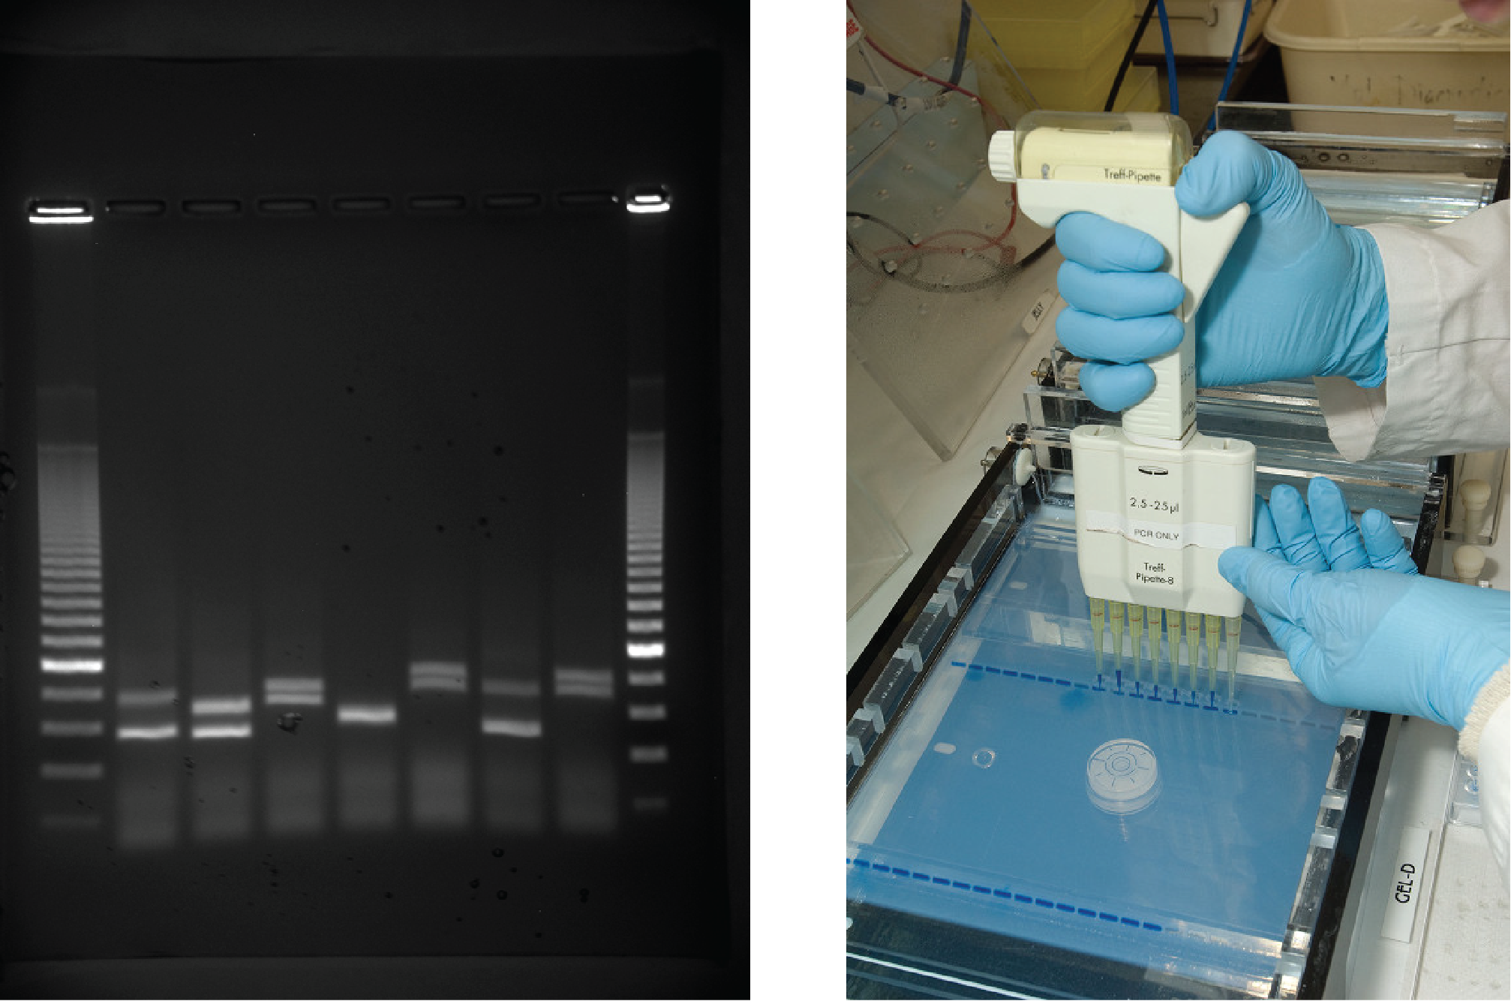
Figure 14.9
DNA can be separated on the basis of size using gel electrophoresis. (credit: James Jacob, Tompkins Cortland Community College)
Notes:
The first photo shows an agarose gel illuminated under UV light. The gel is nine lanes across. Each lane was loaded with a sample containing DNA fragments of differing size that have separated as they travel through the gel, from top to bottom. The DNA appears as thin, white bands on a black background. Lanes one and nine contain many bands from a DNA standard. These bands are closely spaced toward the top, and spaced farther apart further down the gel. Lanes two through eight contain one or two bands each. Some of these bands are identical in size and run the same distance into the gel. Others run a slightly different distance, indicating a small difference in size. The second image shows a person using a handheld device with eight pipettes holding DNA material. The person places the device's pipettes directly over a prepared gel inside an electrphoresis machine. The gel already contains several lines of material where the user has previouly loaded DNA material.

Slide 14
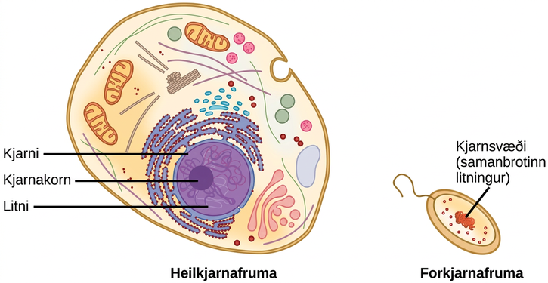
Figure 14.10
A eukaryote contains a well-defined nucleus, whereas in prokaryotes, the chromosome lies in the cytoplasm in an area called the nucleoid.
Notes:
Illustration shows a eukaryotic cell, which has a membrane-bound nucleus containing chromatin and a nucleolus, and a prokaryotic cell, which has DNA contained in an area of the cytoplasm called the nucleoid. The prokaryotic cell is much smaller than the eukaryotic cell.

Slide 15
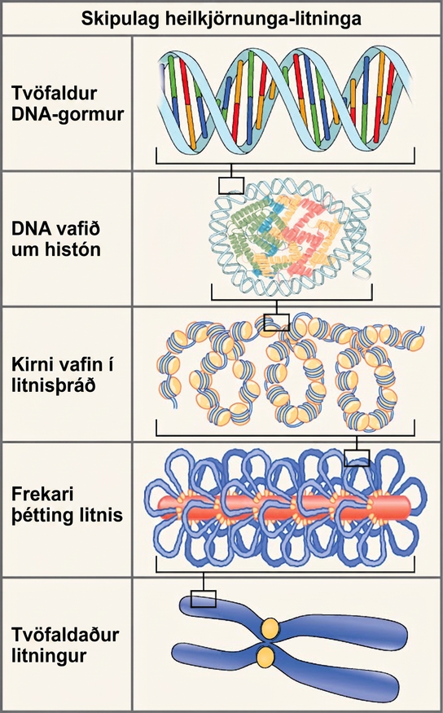
Figure 14.11
These figures illustrate the compaction of the eukaryotic chromosome.
Notes:
Illustration shows the levels of organization of eukaryotic chromosomes, starting with the D N A double helix, which wraps around histone proteins. The entire D N A molecule wraps around many clusters of histone proteins, forming a structure that looks like beads on a string, which are nucleosomes coiled into a chromatin fiber. The chromatin is further condensed by wrapping around a protein core. The result is a compact chromosome, shown in duplicated form, which is the shape of an x.

Slide 16
14.3 Basics of DNA Replication
Learning Objectives
Explain how the structure of DNA reveals the replication process
Describe the Meselson and Stahl experiments

Slide 17
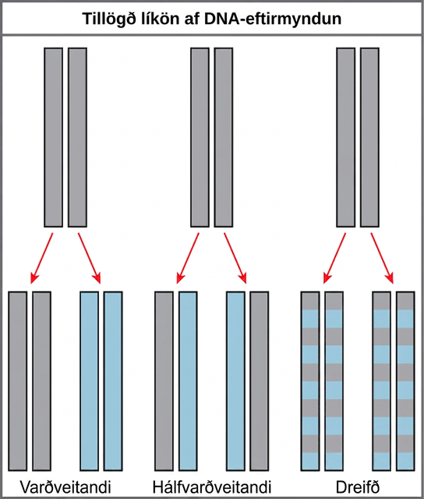
Figure 14.12
The three suggested models of DNA replication. Gray indicates the original DNA strands, and blue indicates newly synthesized DNA.
Notes:
Illustration shows the conservative, semi-conservative, and dispersive models of D N A synthesis. In the conservative model, the D N A is replicated and both newly synthesized strands are paired together. In the semi-conservative model, each newly synthesized strand pairs with a parent strand. In the dispersive model, newly synthesized D N A is interspersed with parent D N A within both D N A strands.

Slide 18
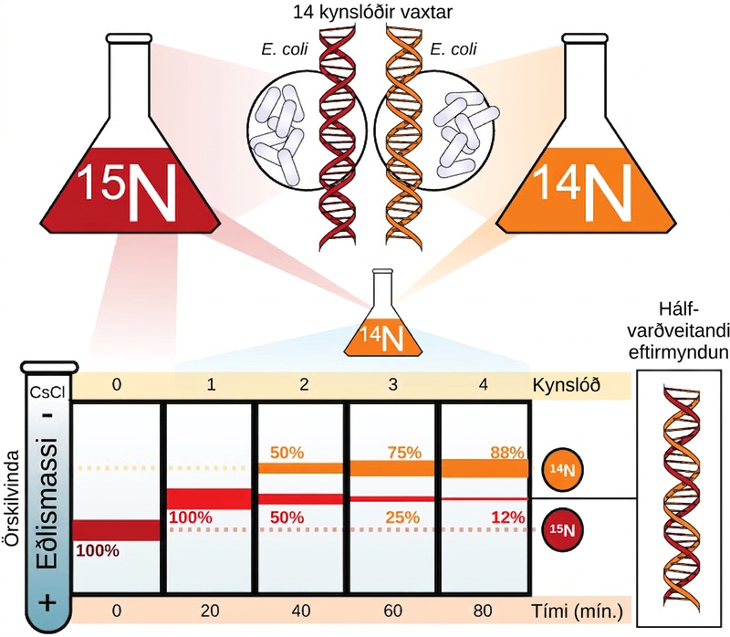
Figure 14.13
Meselson and Stahl experimented with E. coli grown first in heavy nitrogen (15N) then in 14N. DNA grown in 15N (red band) is heavier than DNA grown in 14N (orange band), and sediments to a lower level in cesium chloride solution in an ultracentrifuge. When DNA grown in 15N is switched to media containing 14N, after one round of cell division the DNA sediments halfway between the 15N and 14N levels, indicating that it now contains fifty percent 14N. In subsequent cell divisions, an increasing amount of DNA contains 14N only. These data support the semi-conservative replication model. (credit: modification of work by Mariana Ruiz Villareal)
Notes:
Illustration shows an experiment in which E coli was grown initially in media containing superscript 15 baseline upper case N nucleotides. When the D N A was extracted and run in an ultracentrifuge, a band of D N A appeared low in the tube. The culture was next placed in the superscript 14 baseline upper case N medium. After one generation, all of the D N A appeared in the middle of the tube, indicating that the D N A was a mixture of half superscript 14 baseline upper N and half superscript 15 baseline upper N, D N A. After two generations, half of the D N A appeared in the middle of the tube, and half appeared higher up, indicating that half the D N A contained 50% superscript 15 baseline upper N, and half contained superscript 14 baseline upper N only. In subsequent generations, more and more of the D N A appeared in the upper, superscript 14 baseline upper N band.

Slide 19
14.4 DNA Replication in Prokaryotes
Learning Objectives
Explain the process of DNA replication in prokaryotes
Discuss the role of different enzymes and proteins in supporting this process

Slide 20
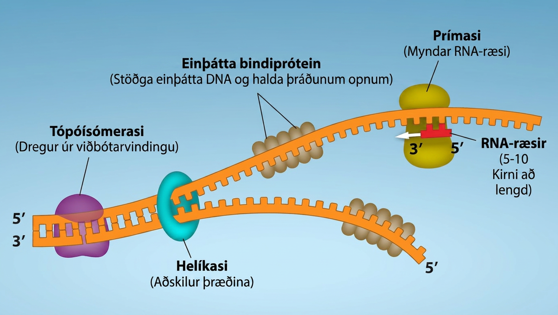
Figure 14.14
First Components of DNA Replication. As DNA replication begins, DNA Helicase, a large enzyme, separates the two strands of DNA so that they can act as templates for replication. Single-strand binding proteins bind to each strand to stabilize and prevent them from reforming the double helix. Primase, an RNA polymerase, binds to the single stranded DNA and synthesizes a short RNA primer in the 5’ to 3’ direction that is antiparallel to the parental strand. This RNA primer allows for DNA polymerase to begin replicating the DNA. Topoisomerase binds to the double helix upstream of the replication fork to prevent additional coiling by making small cuts in one of the DNA strands. Credit: Rao, A., Ryan, K. Fletcher, S. and Tag, A. Department of Biology, Texas A&M University.
Notes:
Topoisomerase binds to D N A to relieve additional coiling. Helicase separates or unzips the two strands. Single-strand binding proteins attach to each D N A strand, and stablize s s D N A and keeps the strands open. While the strands are separated, Primase makes R N A Primer, which is five to ten nucleotides long. The R N A Primer is attached to the s s D N A strand.

Slide 21
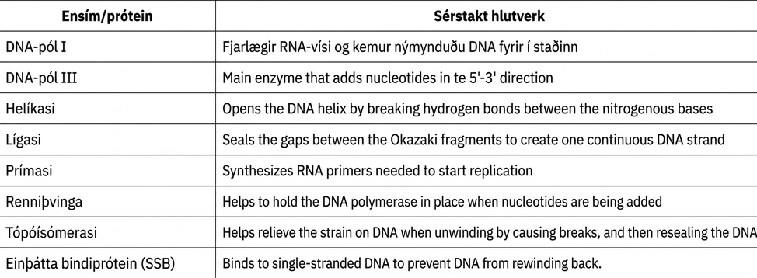
Table 14.1

Slide 22
14.5 DNA Replication in Eukaryotes
Learning Objectives
Discuss the similarities and differences between DNA replication in eukaryotes and prokaryotes
State the role of telomerase in DNA replication

Slide 23
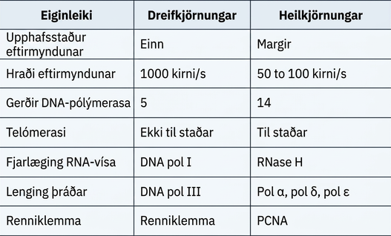
Table 14.2

Slide 24
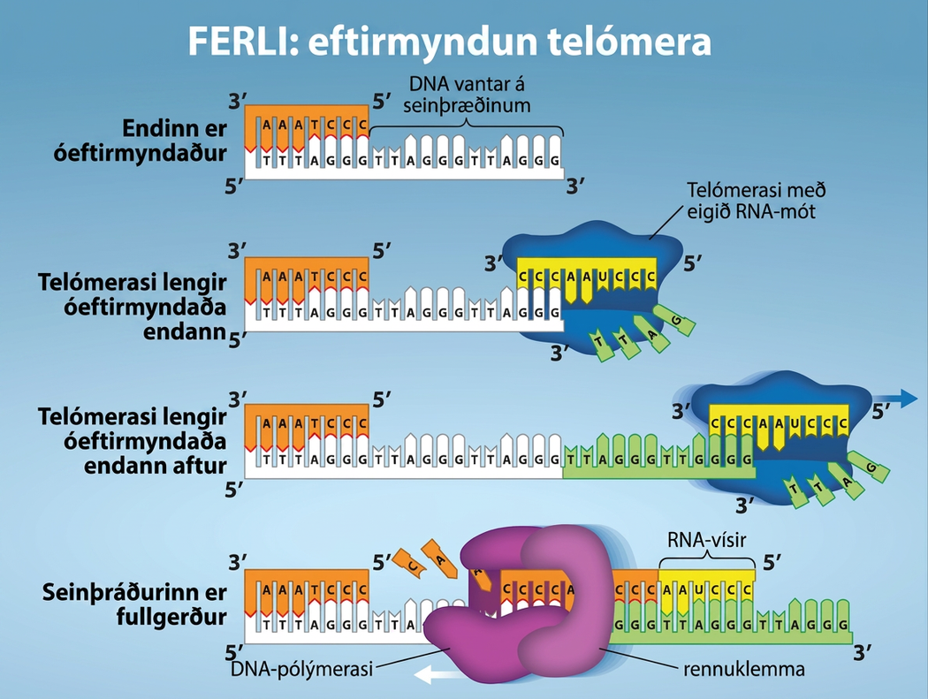
Figure 14.15
The ends of linear chromosomes are maintained by the action of the telomerase enzyme. Credit: Rao, A. and Fletcher, S. Department of Biology, Texas A&M University.
Notes:
The process of Telomere Replication is shown. The starting image has an unreplicated end, and is missing DNA on the lagging strang. Telomerase has an associated R N A that complements the 5 prime overhang at the end of the chromosome, creating an extension of the unreplicated end. The R N A template is used to synthesize the complementary strand, and telomerase again extends the unreplicated end. Telomerase then shifts, and the process is repeated. Next, primase and D N A polymerase synthesize the rest of the complementary strand. And the lagging strand is completed.

Slide 25
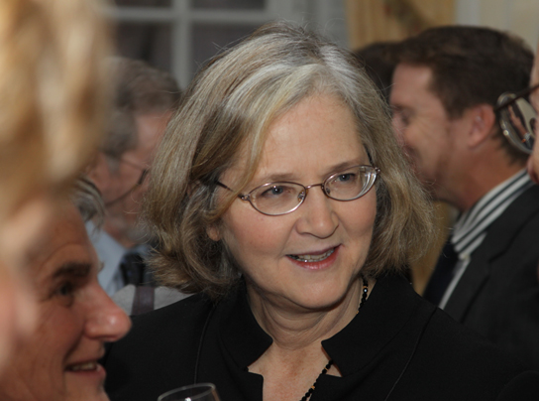
Figure 14.16
Elizabeth Blackburn, 2009 Nobel Laureate, is one of the scientists who discovered how telomerase works. (credit: US Embassy Sweden)
Notes:
Photo of Elizabeth Blackburn.

Slide 26
14.6 DNA Repair
Learning Objectives
Discuss the different types of mutations in DNA
Explain DNA repair mechanisms

Slide 27
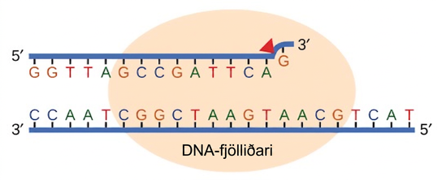
Figure 14.17
Proofreading by DNA polymerase corrects errors during replication.
Notes:
Illustration shows D N A polymerase replicating a strand of D N A. The enzyme has accidentally inserted G opposite A, resulting in a bulge. The enzyme backs up to fix the error.

Slide 28
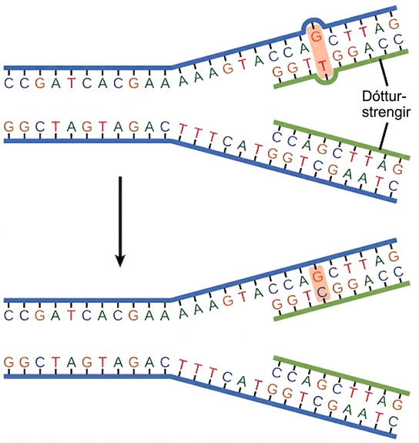
Figure 14.18
In mismatch repair, the incorrectly added base is detected after replication. The mismatch repair proteins detect this base and remove it from the newly synthesized strand by nuclease action. The gap is now filled with the correctly paired base.
Notes:
The top illustration shows a replicated D N A strand with G T base mismatch. The bottom illustration shows the repaired D N A, which has the correct G C base pairing.

Slide 29
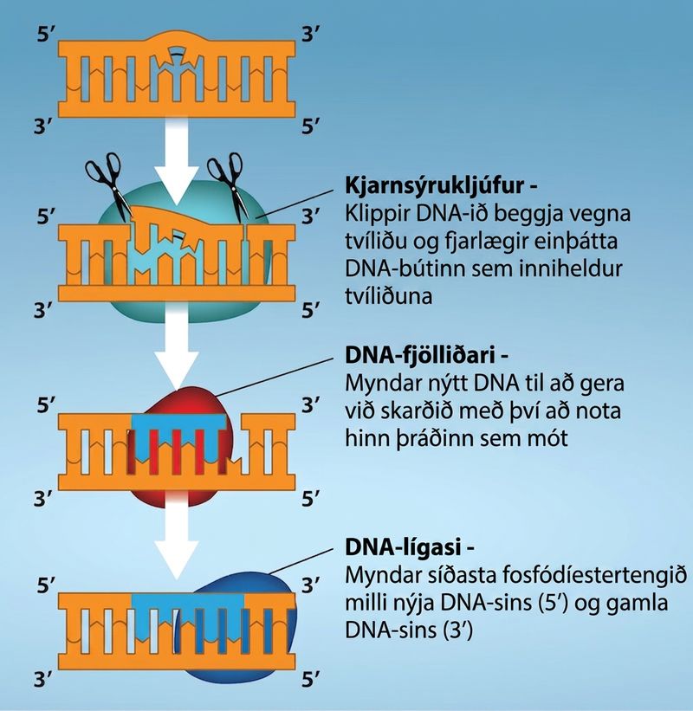
Figure 14.19
Nucleotide excision repairs thymine dimers. When exposed to UV light, thymines lying adjacent to each other can form thymine dimers. In normal cells, they are excised and replaced. Credit: Rao, A., Fletcher, S. and Tag, A. Department of Biology, Texas A&M University.
Notes:
Illustration shows a D N A strand in which a thymine dimer has formed. Excision repair enzyme cut out the section of D N A that contains the dimer so it can be replaced with normal base pairs. Nuclease cuts the D N A on each side of the dimer, and removes the single strand of D N A containing the dimer. DNA Polymerase synthesizes new D N A to repair the hole. D N A ligase forms the final phosphidiester bond between the new D N A and old D N A.

Slide 30
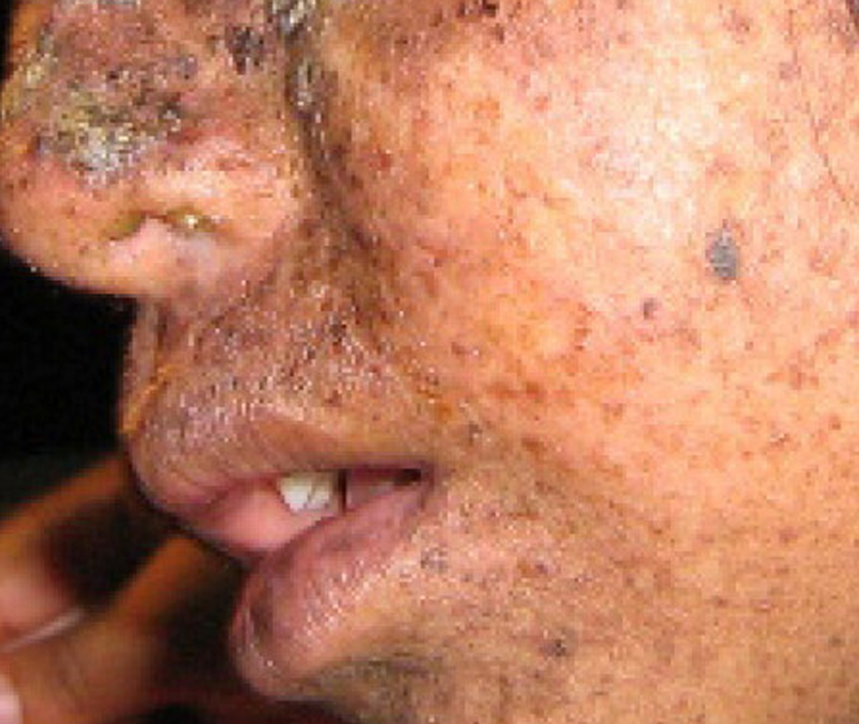
Figure 14.20
Xeroderma pigmentosa is a condition in which thymine dimerization from exposure to UV light is not repaired. Exposure to sunlight results in skin lesions. (credit: James Halpern et al.)
Notes:
Photo shows a person with mottled skin lesions that result from xermoderma pigmentosa.

Slide 31
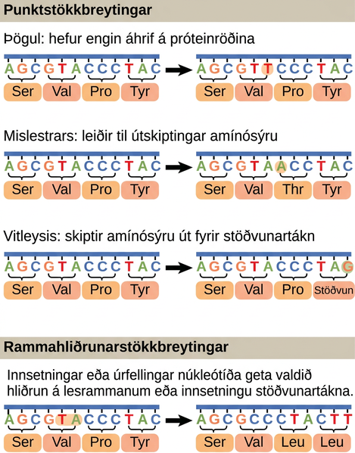
Figure 14.21
Mutations can lead to changes in the protein sequence encoded by the DNA.
This OpenStax ancillary resource is © Rice University under a CC BY-NC-SA 4.0 International license; it may be reproduced or modified for noncommercial purposes only but must be attributed to OpenStax, Rice University and any changes must be noted. Any adaptation must be shared under the same type of license.
Notes:
Illustration shows different types of point mutations that result from a single amino acid substitution. In a silent mutation, no change in the amino acid sequence occurs. In a missense mutation, one amino acid is substituted for another. In a nonsense mutation, a stop codon is substituted for an amino acid. In a frameshift mutation, one or more bases is added or deleted, resulting in a change in the reading frame.

