Slide 1
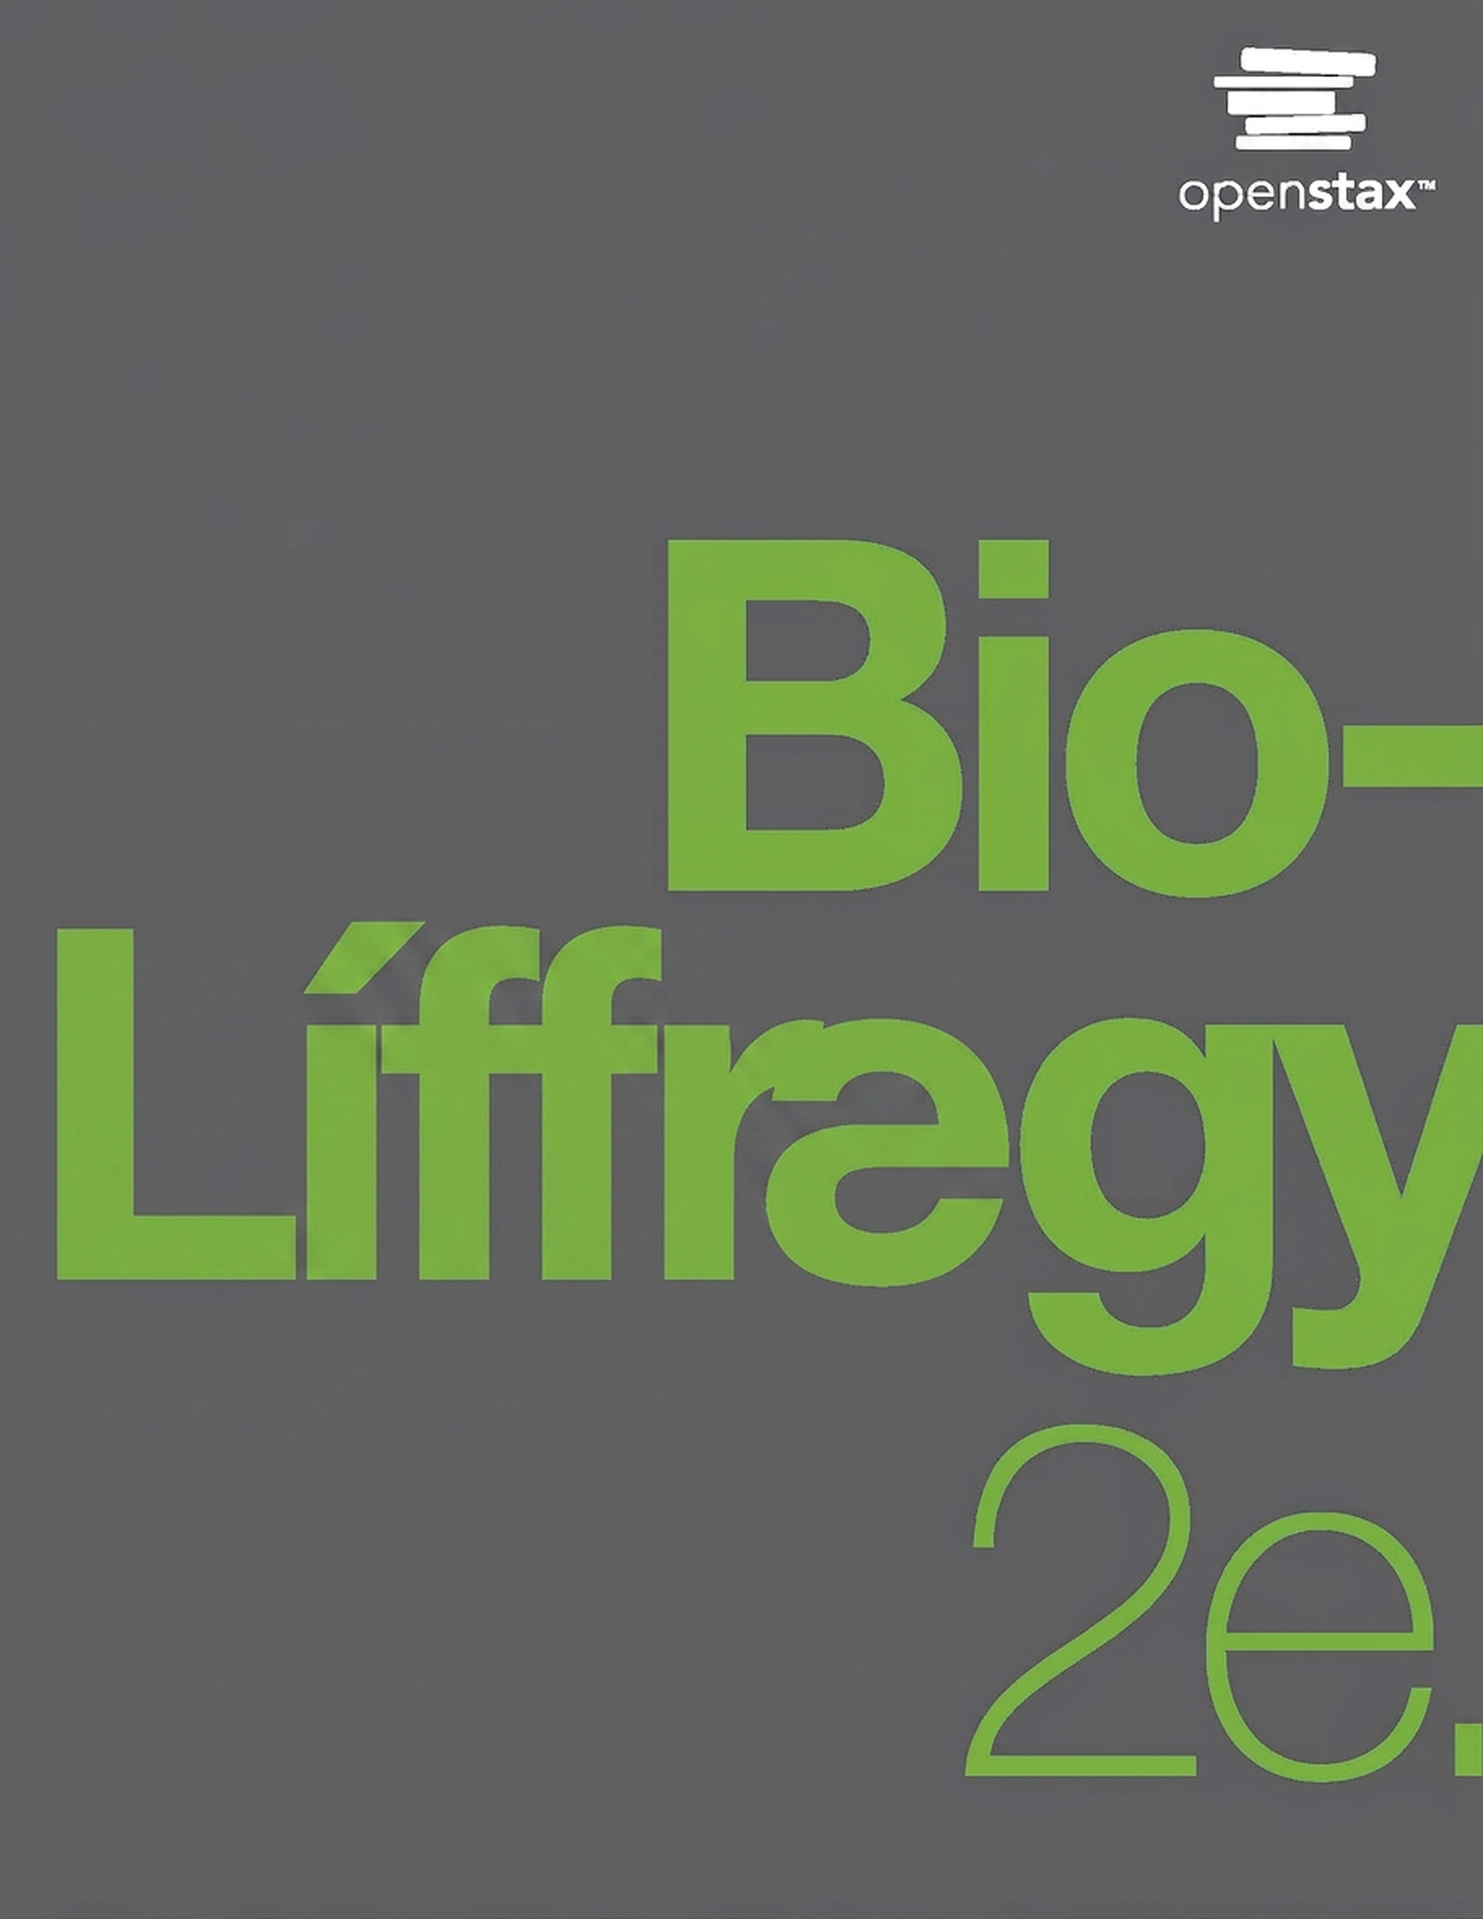
Biology 2e
Chapter 3 Biological Macromolecules

Slide 2
Yfirlit kafla
Nýmyndun líffræðilegra stórsameinda
Kolvetni
Lípíð
Prótein
Kjarnsýrur

Slide 3
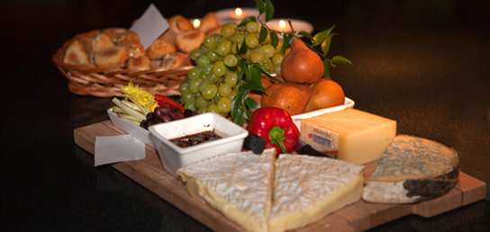
Figure 3.1
Matvæli á borð við brauð, ávexti og ost eru rík uppspretta líffræðilegra stórsameinda. (höfundur: byggt á verki eftir Bengt Nyman)
Notes:
Photo shows a variety of cheeses, fruits, and breads served on a tray.

Slide 4
3.1 Nýmyndun líffræðilegra stórsameinda
Markmið kaflans
Skilja nýmyndun stórsameinda
Útskýra afvötnunarhvörf (eða þéttihvörf) og vatnsrofshvörf

Slide 5
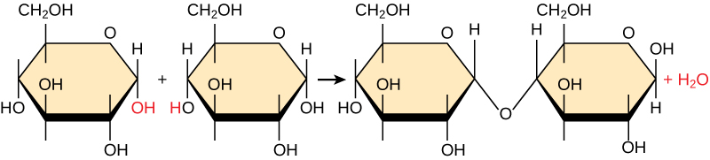
Figure 3.2
Í afvötnunarnýmyndunarhvarfinu hér að ofan tengjast tvær glúkósasameindir og mynda tvísykruna maltósa. Í ferlinu myndast vatnssameind.
Notes:
Shown is the reaction of two glucose monomers to form maltose. When maltose is formed, a water molecule is released. The components of the linkage are upper case O upper case H from one glucose molecule combining with one upper case H from the second glucose molecule.

Slide 6
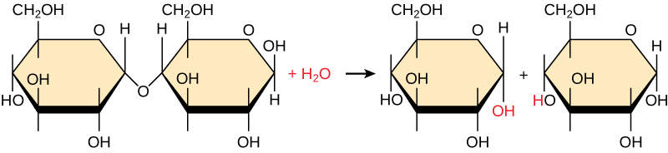
Figure 3.3
Í vatnsrofshvarfinu hér klofnar tvísykran maltósi í tvær glúkósaeiningar þegar vatnssameind er bætt við. Athugið að þetta hvarf er andhverfa nýmyndunarhvarfsins á mynd 3.2.
Notes:
Shown is the breakdown of maltose to form two glucose monomers. Water is a reactant. The water molecule, upper case H subscript 2 baseline upper case O, breaks apart, with upper O upper H obtained by one of the glucose molecules, and upper H obtained by the second glucose molecule.

Slide 7
3.2 Carbohydrates
Markmið kaflans
Fjalla um hlutverk kolvetna í frumum og í millifrumuefni dýra og plantna
Útskýra flokkun kolvetna
Telja upp algengar einsykrur, tvísykrur og fjölsykrur

Slide 8
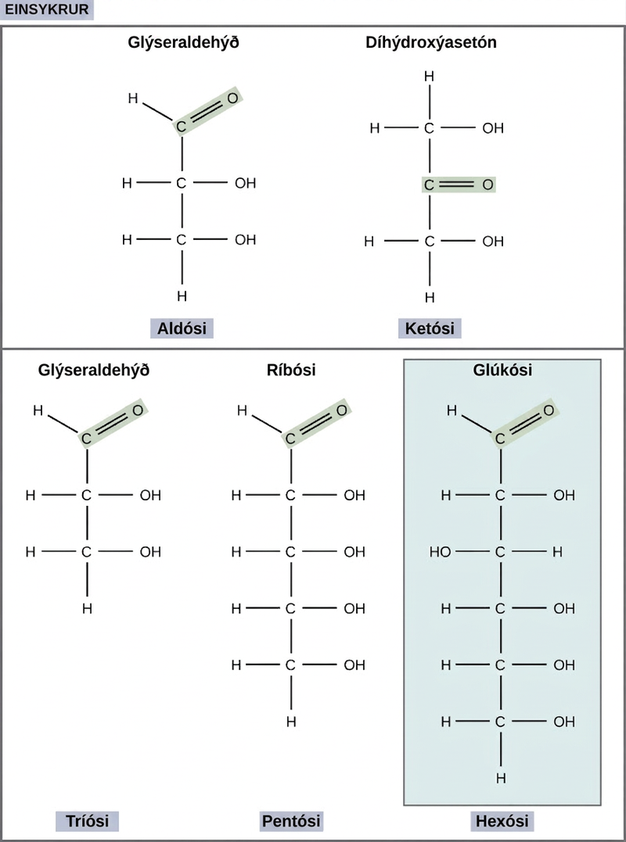
Figure 3.4
Vísindamenn flokka einsykrur eftir stöðu karbónýlhópsins og fjölda kolefnisatóma í grunngrindinni. Aldósar hafa karbónýlhóp (sýndan með grænu) við enda kolefniskeðjunnar og ketósar hafa karbónýlhóp í miðri kolefniskeðjunni. Tríósar, pentósar og hexósar hafa grunngrind með þremur, fimm og sex kolefnisatómum, í þessari röð.
Notes:
The molecular structures of glyceraldehyde, an aldose, and dihydroxyacetone, a ketose, are shown. Both sugars have a three-carbon backbone. Glyceraldehyde has a carbonyl group (c double bonded to O) at one end of the carbon chain with hydroxyl (OH) groups attached to the other carbons. Dihydroxyacetone has a carbonyl group in the middle of the chain and alcohol groups at each end. The molecular structures of linear forms of ribose, a pentose, and glucose, a hexose, are also shown. Both ribose and glucose are aldoses with a carbonyl group at the end of chain,and hydroxyl groups attached to the other carbons.

Slide 9
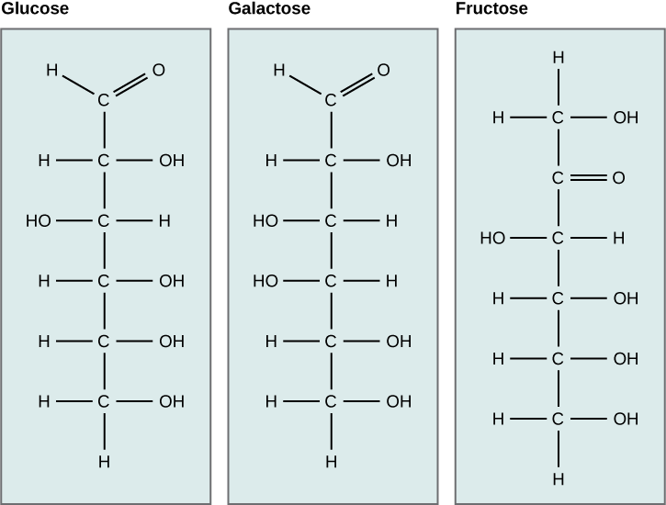
Figure 3.5
Glúkósi, galaktósi og frúktósi eru allir hexósar. Þeir eru byggingarhverfur, sem þýðir að þeir hafa sömu efnaformúlu (C6H12O6) en ólíka uppröðun atóma.
Notes:
The molecular structures of the linear forms of glucose, galactose, and fructose are shown. Glucose and galactose are both aldoses with a carbonyl group (carbon double-bonded to oxygen) at one end of the molecule. A hydroxyl (OH) group is attached to each of the other residues. In glucose, the hydroxyl group attached to the third carbon is on the left side of the molecular structure and all other hydroxyl groups are on the right. In galactose, the hydroxyl groups attached to the third and fourth carbons are on the left, and the hydroxyl groups attached to the second, fifth and sixth carbon are on the right. Fructose is a ketose with C doubled bonded to O at the second carbon. All other carbons have hydroxyl groups associated with them. The hydroxyl group associated with the third carbon is on the left, and all the other hydroxyl groups are on the right.

Slide 10
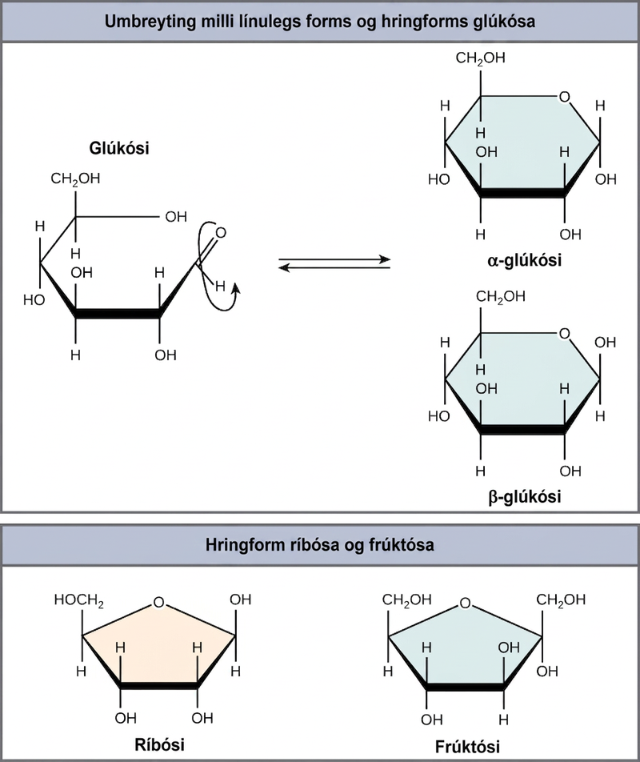
Figure 3.6
Einsykrur með fimm og sex kolefnisatóm eru í jafnvægi milli línulegs forms og hringforms. Þegar hringurinn myndast læsist hliðarkeðjan sem hann lokast við í α- eða β-stöðu. Frúktósi og ríbósi mynda einnig hringi, en þeir mynda fimmliða hringi, ólíkt sexliða hring glúkósa.
Notes:
The conversion of glucose between linear and ring forms is shown. The glucose ring has five carbons and an oxygen. In alpha glucose, the first hydroxyl group is locked in a down position, and in beta glucose, the ring is locked in an up position. Structures for ring forms of ribose and fructose are also shown. Both sugars have a ring with four carbons and an oxygen.

Slide 11
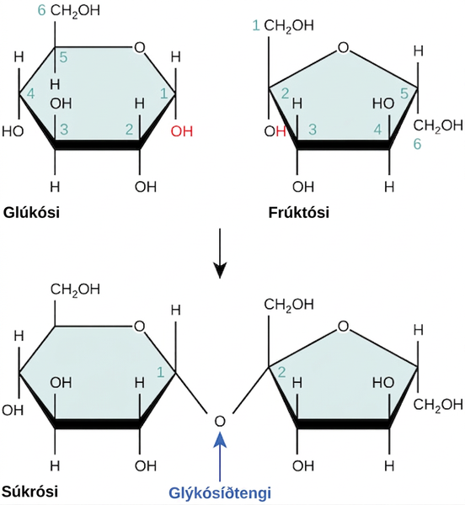
Figure 3.7
Súkrósi myndast þegar glúkósaeining og frúktósaeining tengjast í afvötnunarhvarfi og mynda glýkósíðtengi. Í ferlinu tapast vatnssameind. Samkvæmt venju eru kolefnisatómin í einsykru númeruð frá endakolefninu sem er næst karbónýlhópnum. Í súkrósa myndast glýkósíðtengi milli kolefnis 1 í glúkósa og kolefnis 2 í frúktósa.
Notes:
The formation of sucrose from glucose and fructose is shown. In sucrose, the number one carbon of the glucose ring is connected to the number two carbon of fructose via an oxygen.

Slide 12
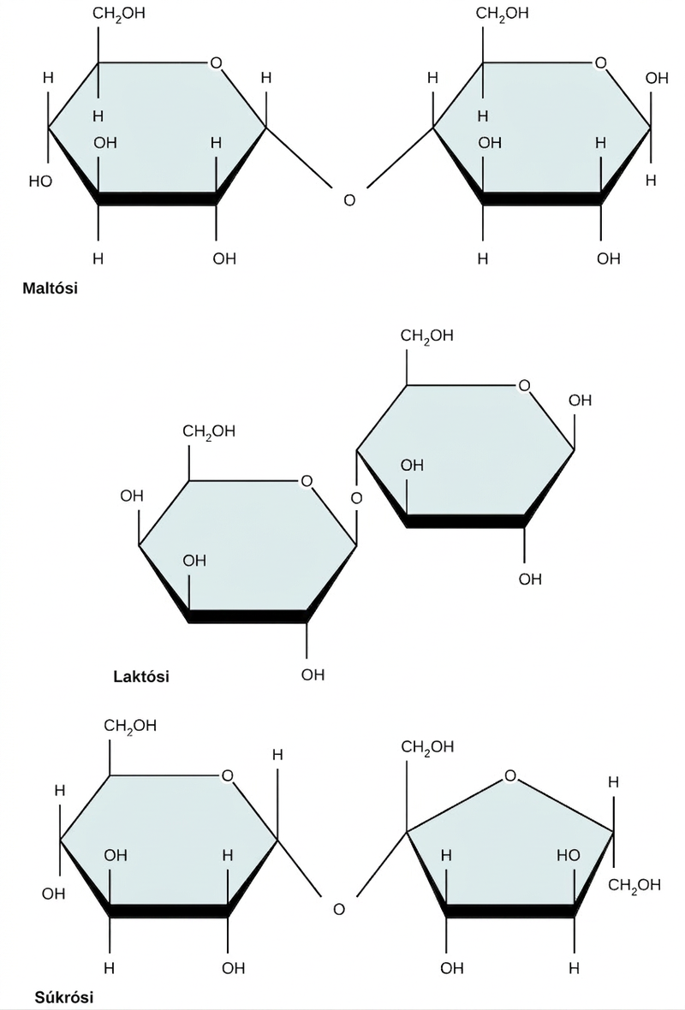
Figure 3.8
Algengar tvísykrur eru maltósi (maltsykur), laktósi (mjólkursykur) og súkrósi (borðsykur).
Notes:
The chemical structures of maltose, lactose, and sucrose are shown. Both maltose and lactose are made from two glucose monomers joined together in ring form. In maltose, the oxygen in the glycosidic bond points downward. In lactose, the oxygen in the glycosidic bond points upward. Sucrose is made from glucose and fructose monomers. The oxygen in the glycosidic bond points downward.

Slide 13
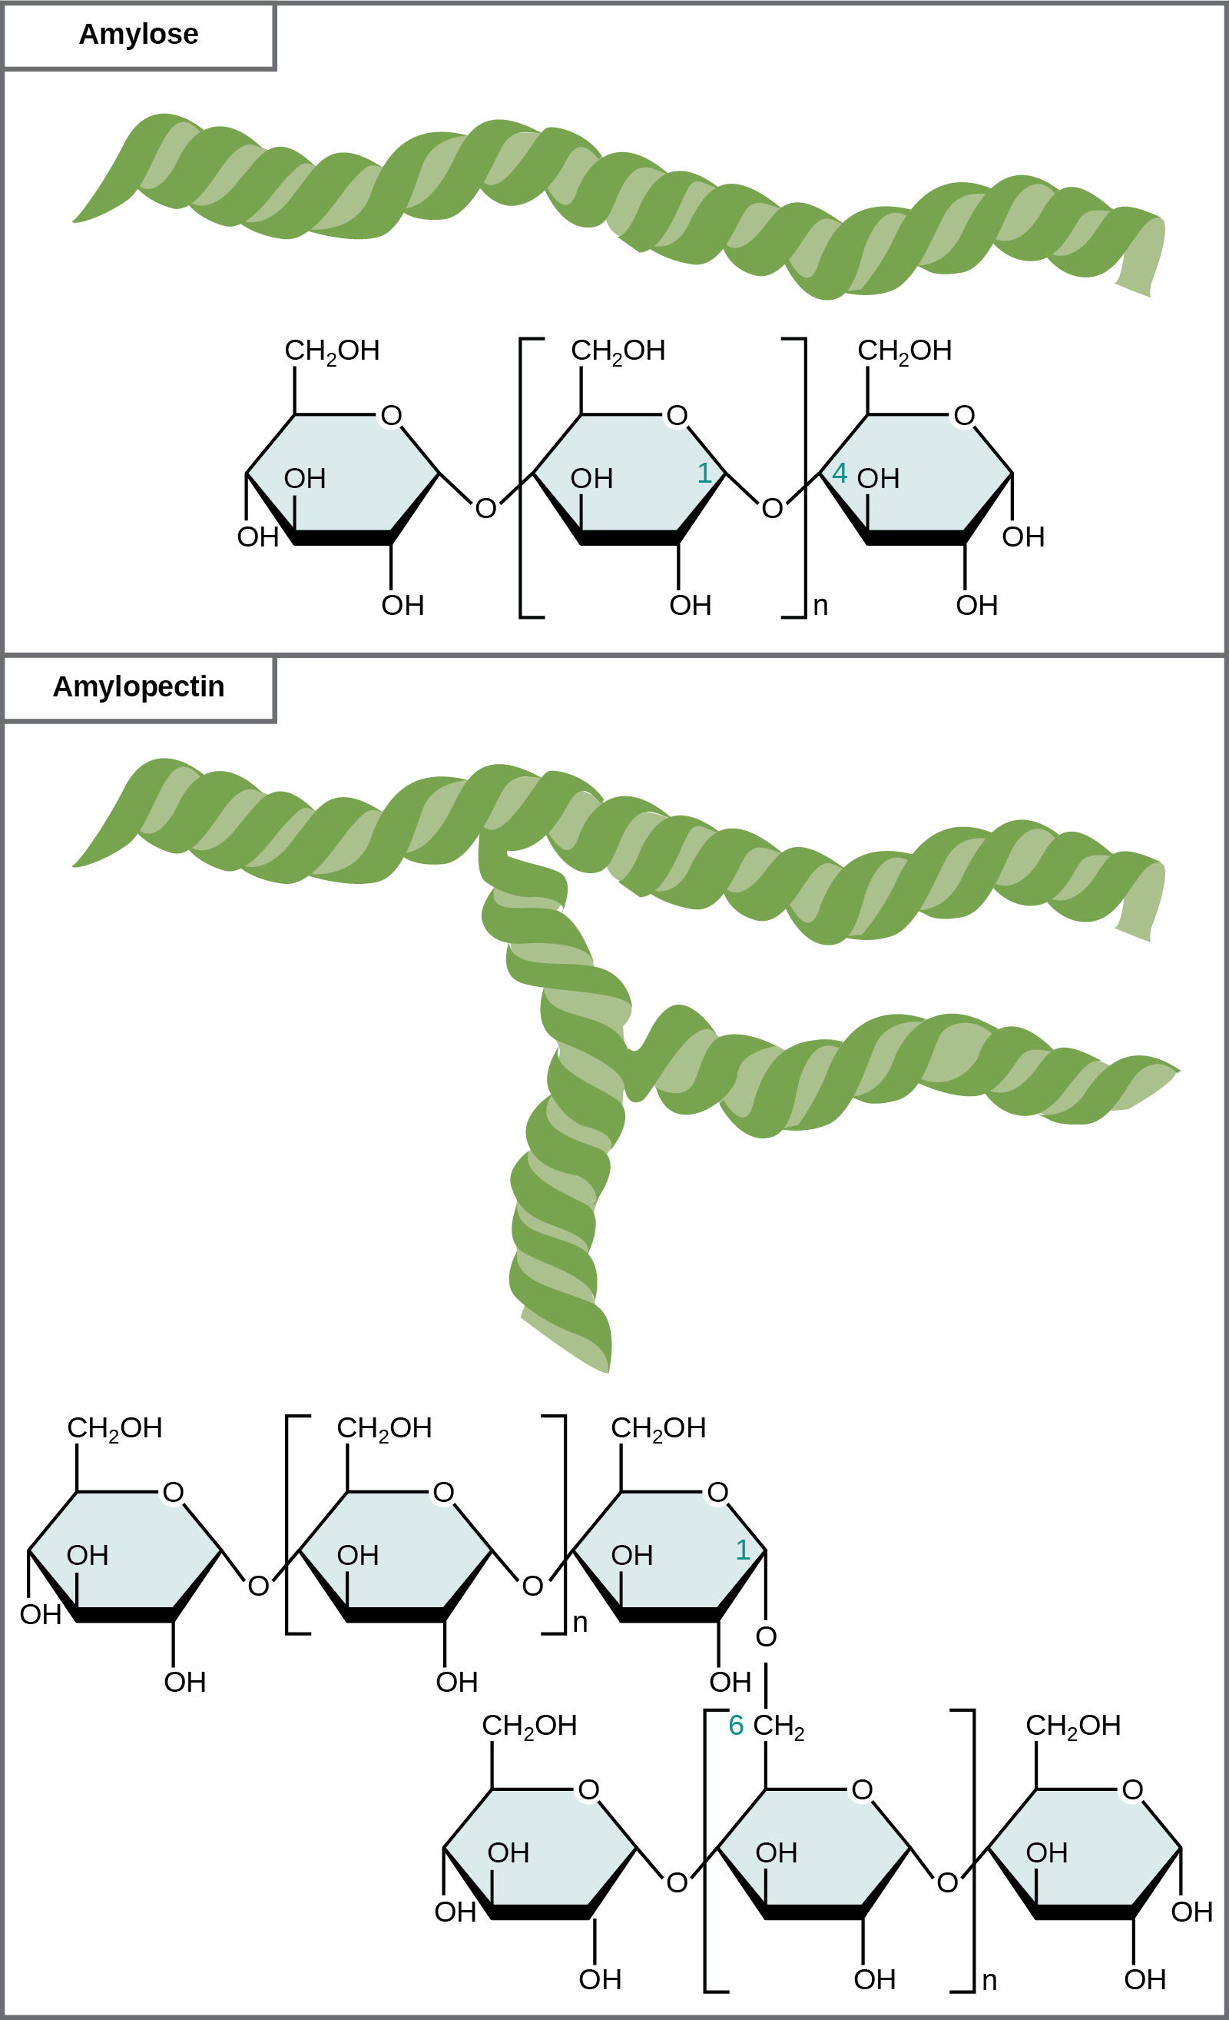
Figure 3.9
Amýlósi og amýlópektín eru tvö ólík form sterkju. Amýlósi er gerður úr ógreindum keðjum glúkósaeininga sem tengjast með α 1-4 glýkósíðtengjum. Amýlópektín er gert úr greinóttum keðjum glúkósaeininga sem tengjast með α 1-4 og α 1-6 glýkósíðtengjum. Vegna þess hvernig undireiningarnar tengjast hafa glúkósakeðjurnar gormlaga byggingu. Glýkógen (ekki sýnt) er svipað amýlópektíni að byggingu en er mun greinóttara.
Notes:
The chemical structures of amylose and amylopectin are shown. Amylose consists of unbranched chains of glucose subunits, and amylopectin consists of branched chains of glucose subunits.

Slide 14
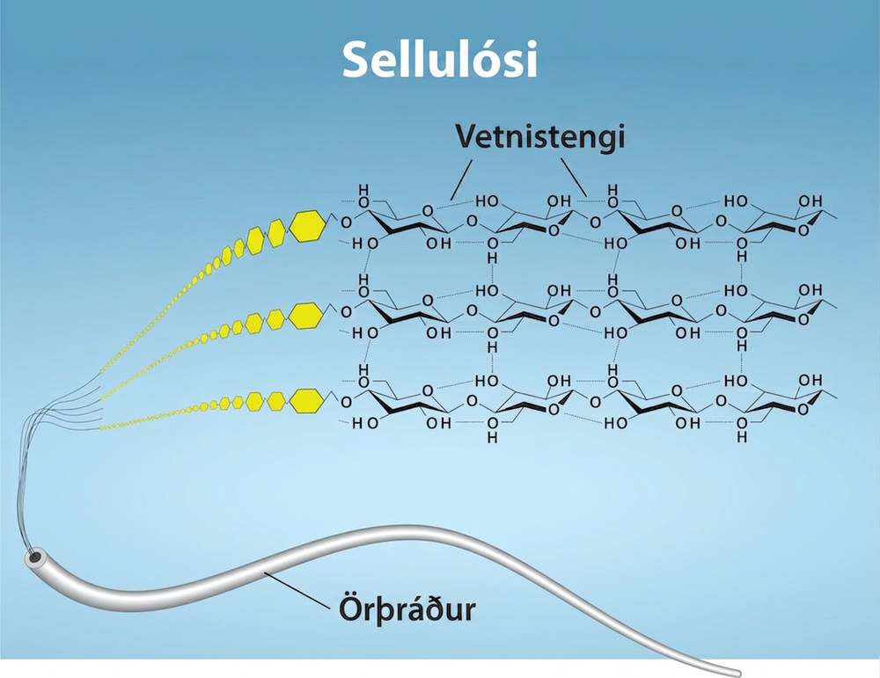
Figure 3.10
Sellulósi er lífrænt efnasamband sem samanstendur af línulegum keðjum hundruða til þúsunda samtengdra glúkósasameinda. Glúkósaeiningarnar mynda vetnistengi sem halda keðjunum þétt saman hlið við hlið og mynda sterkar örþræðir. Þessi stífleiki er mikilvægur byggingarþáttur í frumuveggjum plantna. Höfundar: Ryan, K. Rao, A. og Hawkins, A. Department of Biology, Texas A&M University.
Notes:
Three different magnifications of cellulose are shown. The microfibril is shown as a string-like tube. Further magnification shows that the microfibril is made up of chains of glucose molecules. Further magnification shows the structure of the glucose and that they are linked by hydrogen bonds.

Slide 15
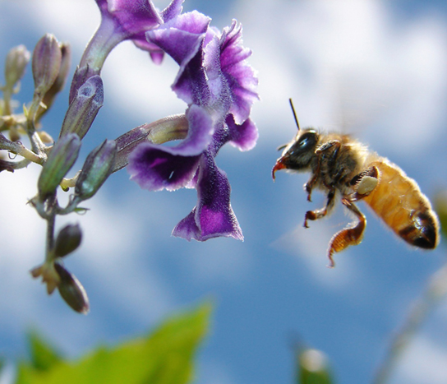
Figure 3.11
Skordýr hafa harða ytri stoðgrind úr kítíni, sem er tegund fjölsykru. (höfundur: Louise Docker)
Notes:
A photograph shows a bee in flight, getting nectar from a flower.

Slide 16
3.3 Lípíð (1 af 2)
Markmið kaflans
Lýsa fjórum megingerðum lípíða
Útskýra hlutverk fitu við orkugeymslu
Gera greinarmun á mettuðum og ómettuðum fitusýrum
Lýsa fosfólípíðum og hlutverki þeirra í frumum
Skilgreina grunnbyggingu stera og nokkur hlutverk stera

Slide 17
3.3 Lípíð (2 af 2)
Markmið kaflans
Útskýra hvernig kólesteról hjálpar til við að viðhalda fljótandi eiginleikum frumuhimnunnar

Slide 18
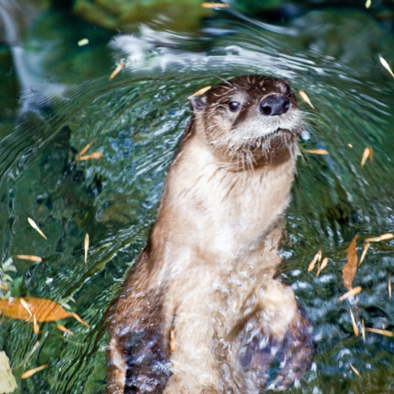
Figure 3.12
Vatnsfælin lípíð í feldi vatnaspendýra, eins og þessa áróturs, verja þau gegn umhverfisáhrifum. (höfundur: Ken Bosma)
Notes:
Photo shows a river otter swimming. The river otter has thick fur that is smooth and wet.

Slide 19
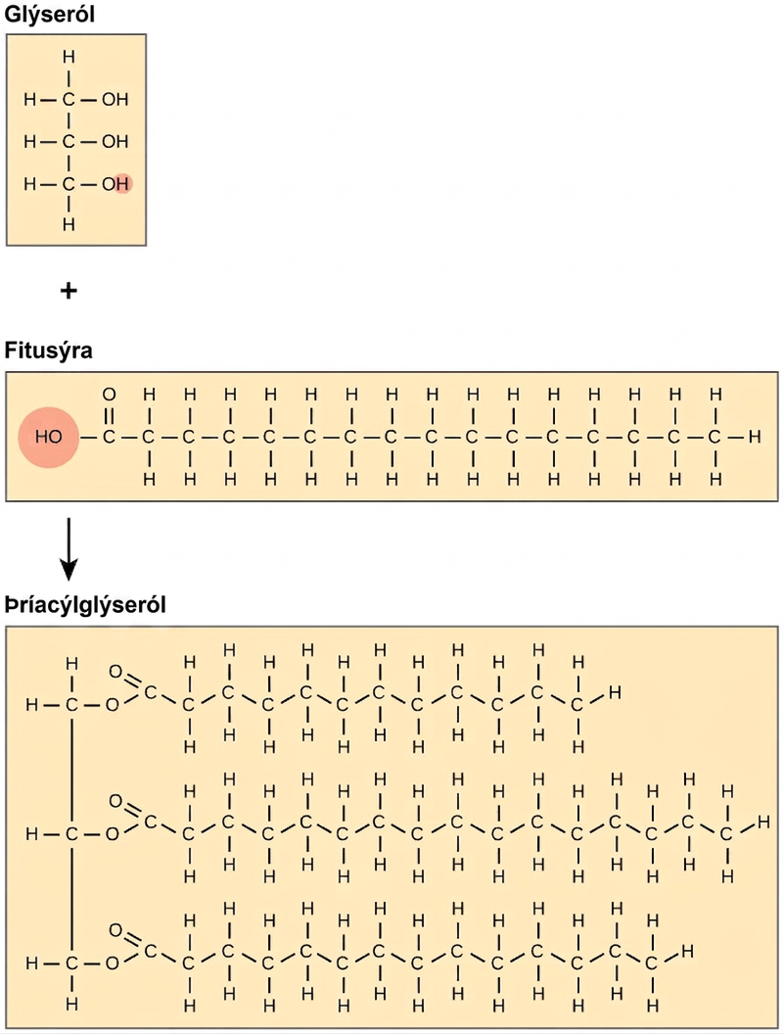
Figure 3.13
Þegar þrjár fitusýrur tengjast glýserólgrind í afvötnunarhvarfi myndast þríacýlglýseról. Þrjár vatnssameindir losna í ferlinu.
Notes:
The structures of glycerol, a fatty acid, and a triacylglycerol are shown. Glycerol is a chain of three carbons, with a hydroxyl (upper O upper H) group attached to each carbon. A fatty acid has an acetyl (upper C upper O upper O upper H) group attached to a long carbon chain. In triacylglycerol, a fatty acid is attached to each of glycerols three hydroxyl groups via the carboxyl group. A water molecule is lost in the reaction so the structure of the linkage is C dash O dash C, with an oxygen double bonded to the second carbon.

Slide 20
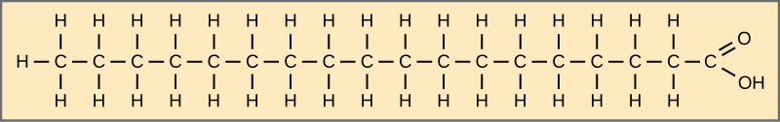
Figure 3.14
Sterínsýra er algeng mettuð fitusýra.
Notes:
The structure of stearic acid is shown. This fatty acid has a hydrocarbon chain seventeen residues long attached to an acetyl group. All bonds between the carbons are single bonds.

Slide 21
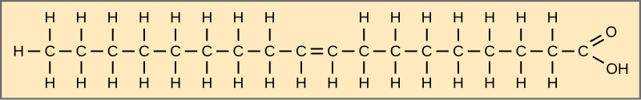
Figure 3.15
Olíusýra er algeng ómettuð fitusýra.
Notes:
The structure of oleic acid is shown. This fatty acid has a hydrocarbon chain seventeen residues long attached to an acetyl group. The bond between carbon eight and carbon nine is a double bond.

Slide 22
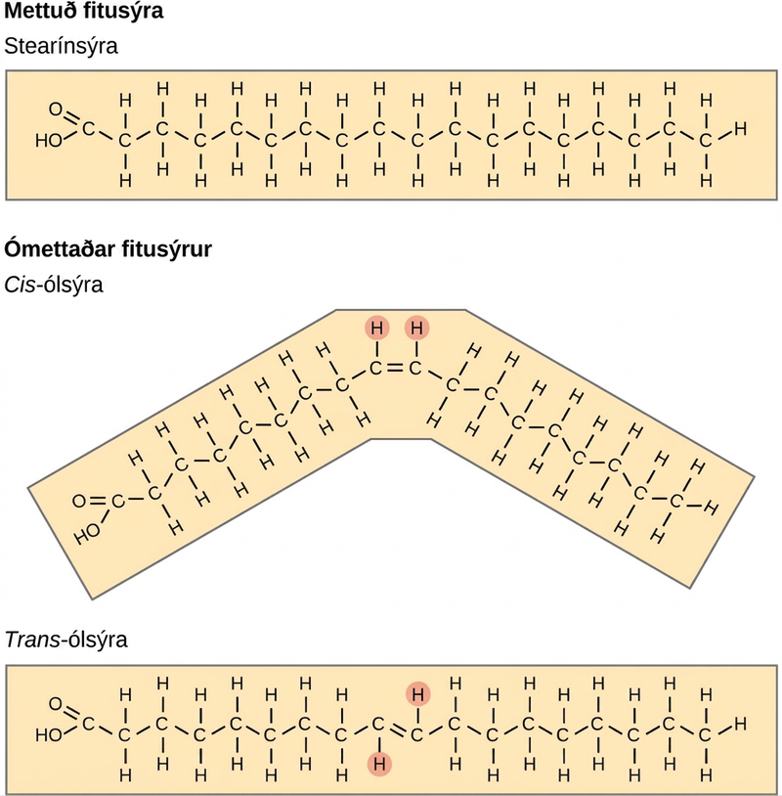
Figure 3.16
Mettaðar fitusýrur hafa kolvetniskeðjur þar sem atómin tengjast eingöngu með eintengjum. Ómettaðar fitusýrur hafa eitt eða fleiri tvítengi. Hvert tvítengi getur verið í cis- eða trans-stillingu. Í cis-stillingu eru bæði vetnisatómin sömu megin við kolvetniskeðjuna. Í trans-stillingu eru vetnisatómin sitt hvoru megin. Cis-tvítengi veldur beygju í keðjunni.
Notes:
A comparison of saturated and unsaturated fatty acids is shown. Stearic acid, a saturated fatty acid, has a hydrocarbon chain seventeen residues long attached to an acetyl group. Oleic acid also has a seventeen-residue hydrocarbon chain, but a double bond exists between the eighth and ninth carbon in the chain. In cis oleic acid, the hydrogens are on the same side of the double bond. In the cis oleic acid, the 2 hydrogens on the same side cause the chain to bend. In trans oleic acid, they are on opposite sides.

Slide 23
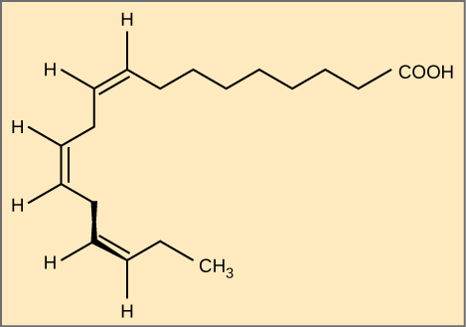
Figure 3.17
Alfa-línólensýra er dæmi um ómega-3-fitusýru. Hún hefur þrjú cis-tvítengi og er því bogadregin að lögun. Til skýrleika eru kolefnisatómin ekki sýnd á skýringarmyndinni. Hvert kolefnisatóm með eintengi hefur tvö tengd vetnisatóm, sem eru heldur ekki sýnd á myndinni.
Notes:
The molecular structures of alpha-linolenic acid, an omega-3 fatty acid is shown. Alpha-linolenic acid has three double bonds located eight, eleven, and fourteen residues from the acetyl group. It has a hooked shape.

Slide 24
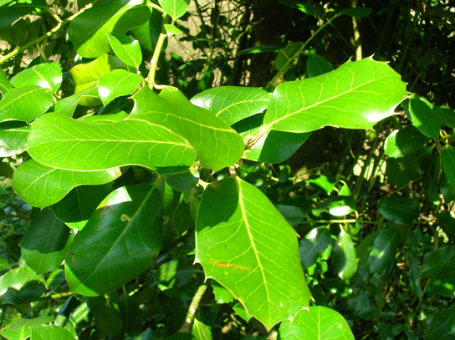
Figure 3.18
Lipids comprise waxy coverings on some leaves. (credit: Roger Griffith)
Notes:
The photo shows leaves on a plant; the leaves appear thick, shiny, and waxy.

Slide 25
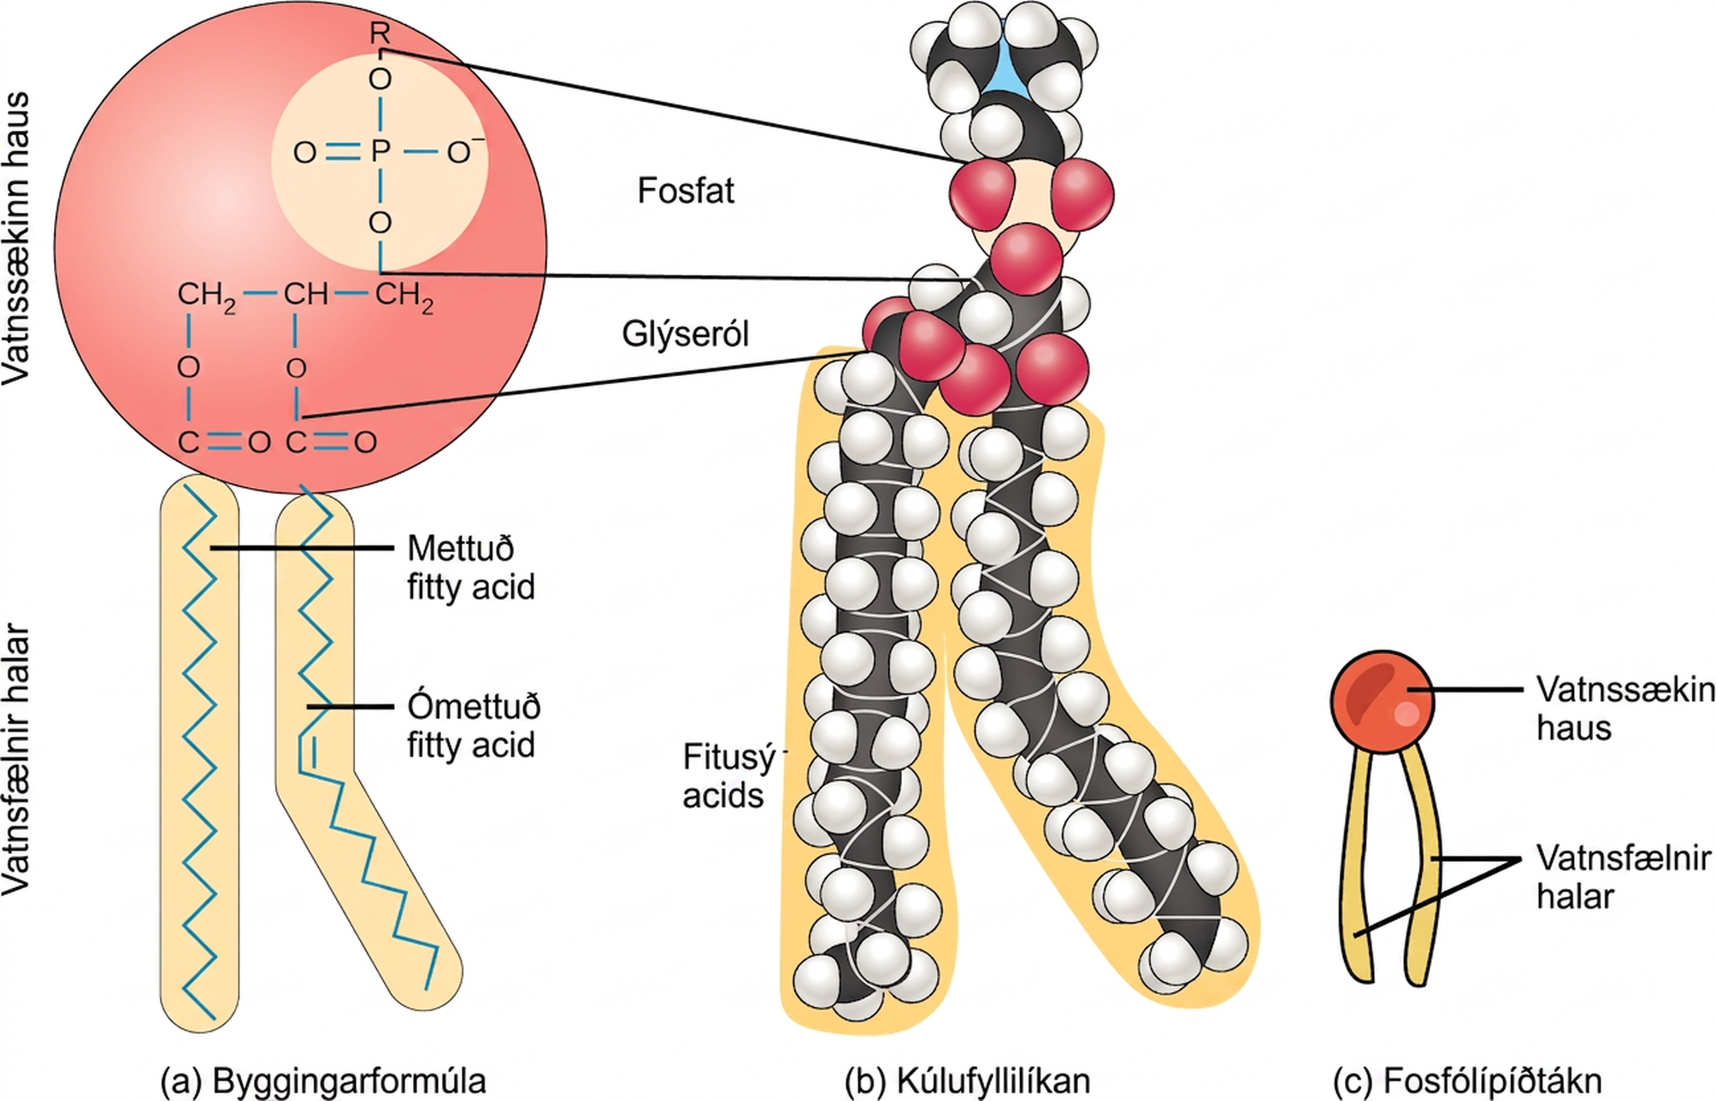
Figure 3.19
Fosfólípíð er sameind með tvær fitusýrur og breyttan fosfathóp tengdan við glýserólgrind. Fosfatið getur breyst þegar hlaðinn eða skautaður efnahópur bætist við.
Notes:
The molecular structure of a phospholipid is shown. It consists of two fatty acids attached to the first and second carbons in glycerol, and a phosphate group attached to the third position. In the illustration one of the fatty acids is saturated and straight, and the second is unsaturated and bent. Both are below the glycerol molecule. The phosphate group may be further modified by addition of another molecule to one of its oxygens indicated by upper-case R. Two molecules may modify the phosphate group, choline and serine. The glycerol and phosphate group make up the hydrophilic head of the molecule, while the fatty acids attached below make up the hydrophobic tails.

Slide 26
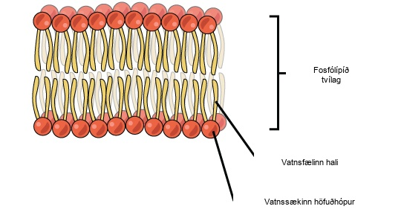
Figure 3.20
Fosfólípíðtvílagið er meginuppistaða allra frumuhimna. Vatnssæknir höfuðhópar fosfólípíðanna snúa að vatnslausninni. Vatnsfælnu halarnir eru einangraðir inni í miðju tvílaginu.
Notes:
An illustration of a phospholipids bilayer is shown. The phospholipids bilayer consists of two layers of phospholipids. The hydrophobic tails of the phospholipids face one another while the hydrophilic head groups face outward.

Slide 27
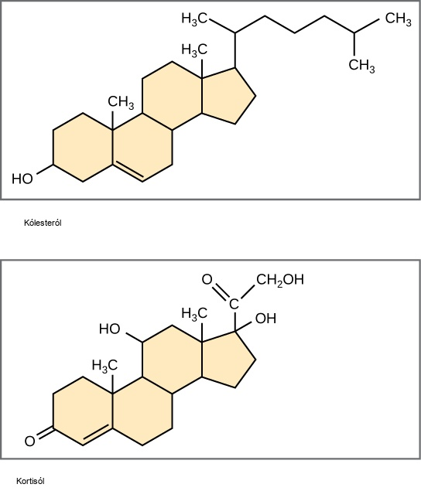
Figure 3.21
Sterar, svo sem kólesteról og kortisól, eru samsettir úr fjórum samrunnum kolvetnishringjum.
Notes:
The structures of cholesterol and cortisol are shown. Each of these molecules is composed of three six-carbon rings fused to a five-carbon ring. Cholesterol has a branched hydrocarbon attached to the five-carbon ring, and a hydroxyl group attached to the terminal six-carbon ring. Cortisol has a two-carbon chain modified with a double-bonded oxygen, a hydroxyl group attached to the five-carbon ring, and an oxygen double-bonded to the terminal six-carbon ring.

Slide 28
3.4 Proteins
Markmið kaflans
Lýsa hlutverkum próteina í frumum og vefjum
Fjalla um tengsl amínósýra og próteina
Útskýra fjögur byggingarstig próteina
Lýsa því hvernig lögun og starfsemi próteina tengjast

Slide 29
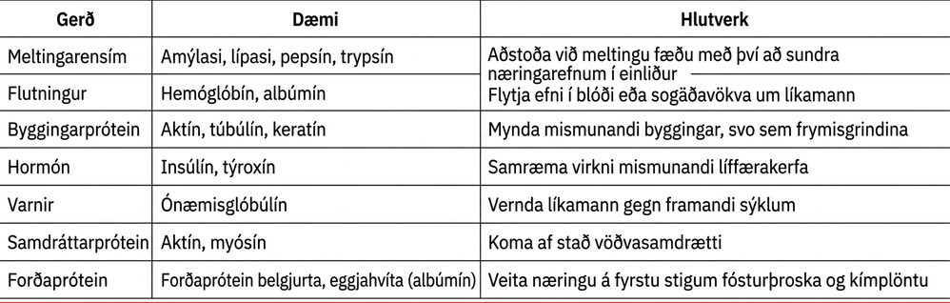
Table 3.1

Slide 30
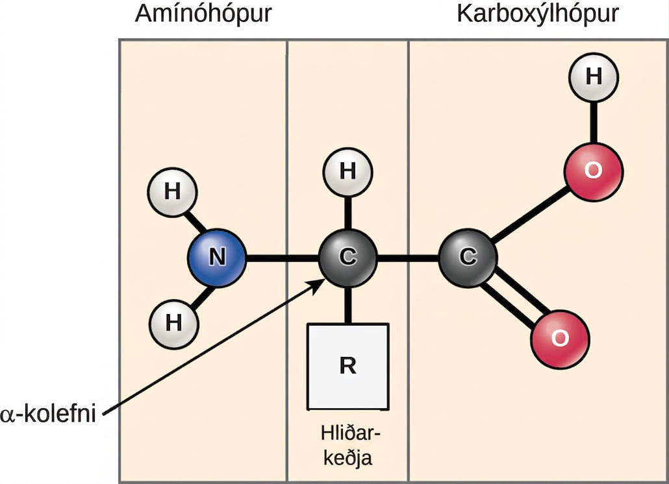
Figure 3.22
Amínósýrur hafa miðlægt ósamhverft kolefnisatóm sem amínóhópur, karboxýlhópur, vetnisatóm og hliðarkeðja (R-hópur) tengjast við.
Notes:
The molecular structure of an amino acid is given. An amino acid has an alpha carbon to which an amino group, a carboxyl group, a hydrogen, and a side chain are attached. The side chain varies for different amino acids, and is designated as the R - group.

Slide 31
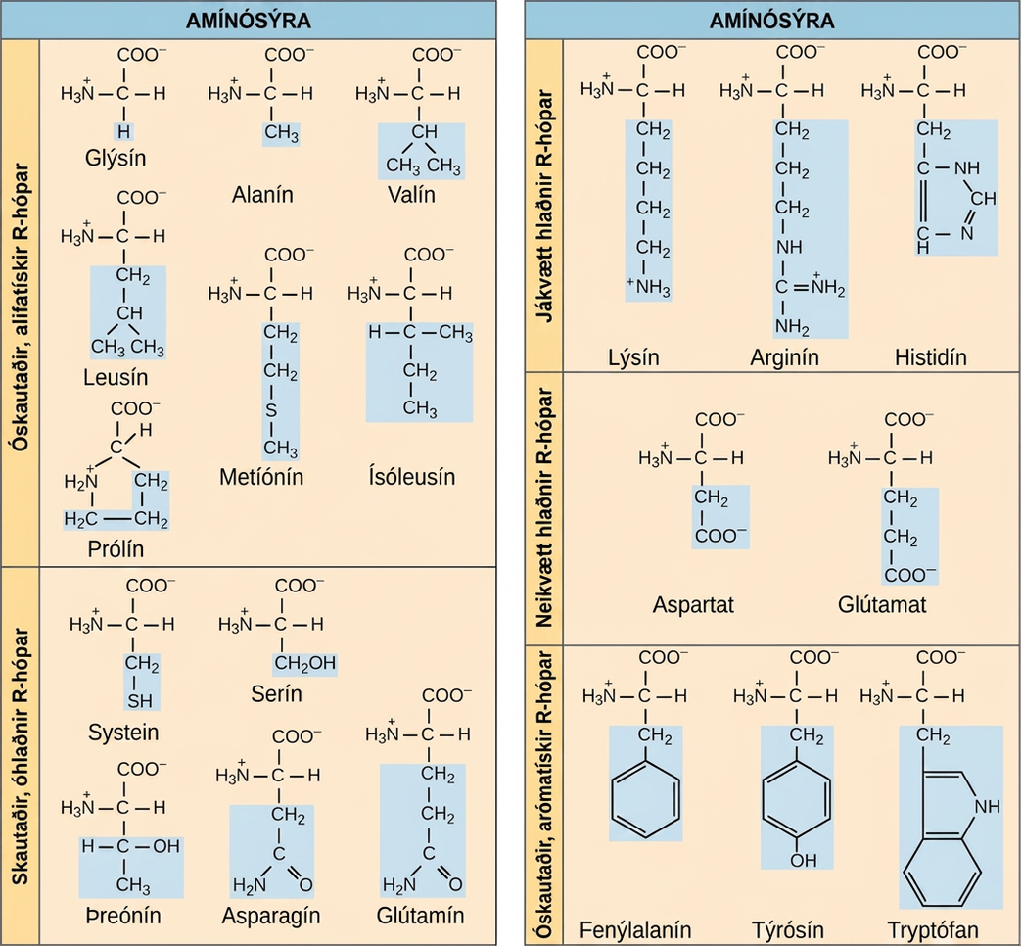
Figure 3.23
Í próteinum finnast almennt 20 algengar amínósýrur, hver með sinn R-hóp (breytilegan hóp) sem ákvarðar efnafræðilega eiginleika hennar.
Notes:
The molecular structures of the twenty amino acids commonly found in proteins are given. These are divided into five categories: nonpolar aliphatic, polar uncharged, positively charged, negatively charged, and aromatic. Nonpolar aliphatic amino acids include glycine, alanine, valine, leucine, methionine, isoleucine, and proline. Polar uncharged amino acids include serine, threonine, cysteine, asparagine, and glutamine. Positively charged amino acids include lysine, arginine, and histidine. Negatively charged amino acids include aspartate and glutamate. Aromatic amino acids include phenylalanine, tyrosine, and tryptophan. For example, in the amino acid glycine, the R group is a single hydrogen; but in alanine the R group is upper C upper H subscript 3 baseline.

Slide 32
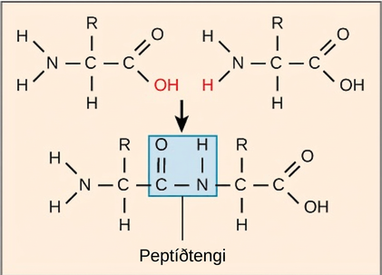
Figure 3.24
Myndun peptíðtengis er afvötnunarnýmyndunarhvarf. Karboxýlhópur einnar amínósýru tengist amínóhópi amínósýrunnar sem bætist við. Í ferlinu losnar vatnssameind.
Notes:
The formation of a peptide bond between two amino acids is shown. When the peptide bond forms, the carbon from the carbonyl group becomes attached to the nitrogen from the amino group. The upper O upper H from the carboxyl group and an upper H from the amino group form a molecule of water.

Slide 33
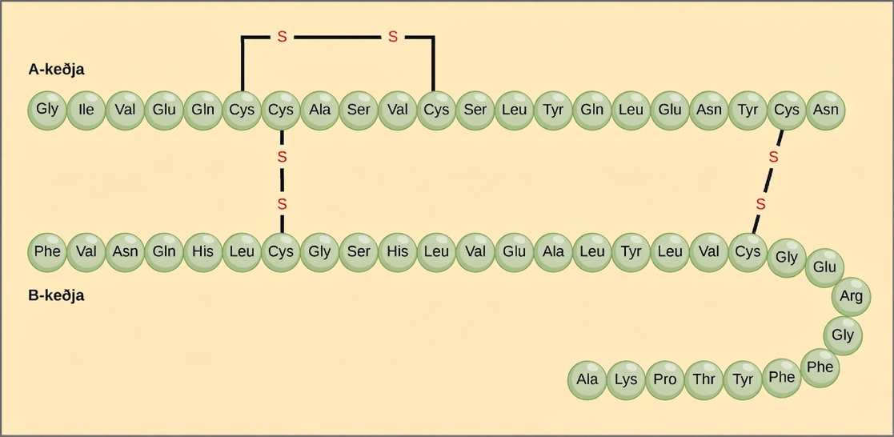
Figure 3.25
Insúlín úr nautgripasermi er próteinhormón sem samanstendur af tveimur peptíðkeðjum, A (21 amínósýra að lengd) og B (30 amínósýrur að lengd). Í hvorri keðju sýna þriggja stafa skammstafanir, sem standa fyrir heiti amínósýranna í þeirri röð sem þær koma fyrir, frumbyggingu próteinsins. Amínósýran cystein (cys) hefur súlfhýdrýlhóp (SH) sem hliðarkeðju. Tveir súlfhýdrýlhópar geta hvarfast í nærveru súrefnis og myndað tvísúlfíðtengi (S-S). Tvö tvísúlfíðtengi tengja A- og B-keðjurnar saman og það þriðja hjálpar A-keðjunni að fella sig í rétta lögun. Athugið að öll tvísúlfíðtengin eru jafn löng, en þau eru teiknuð í mismunandi stærðum til skýrleika.
Notes:
The amino acid sequences for the A chain and B chain of bovine insulin are shown. The A chain is 21 amino acids in length, and the B chain is 30 amino acids in length. One disulfide, or S S bond, connects two cysteine residues in the A chain. Two other disulfide linkages connect the A chain to the B chain.

Slide 34
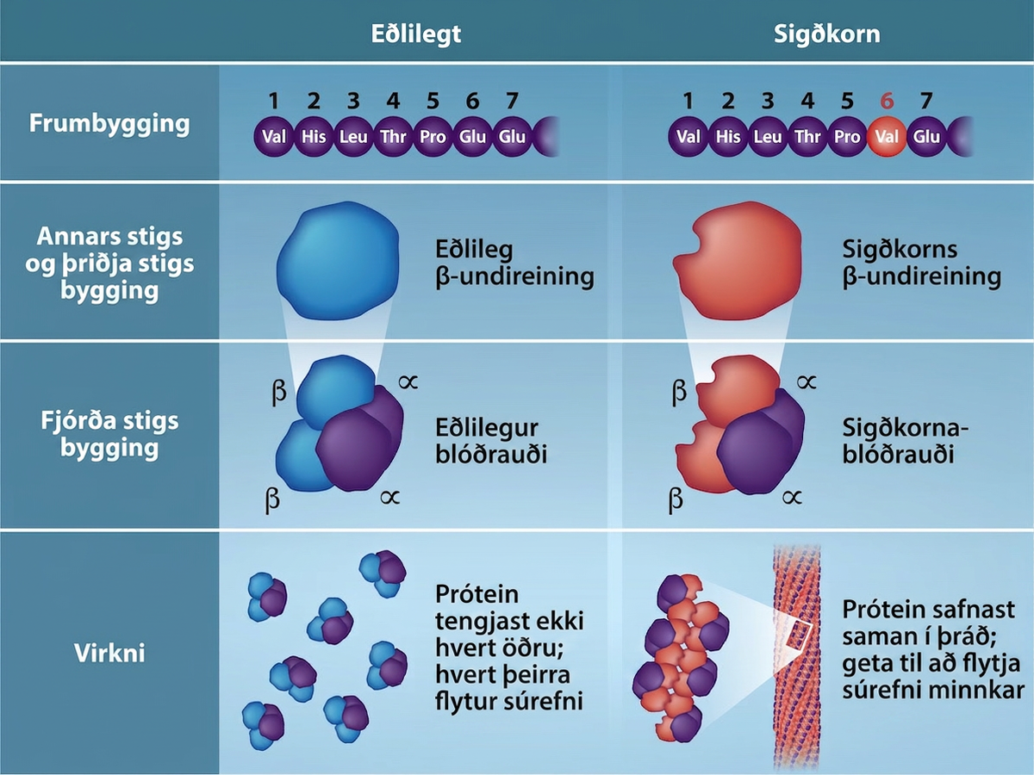
Figure 3.26
Vegna þessarar breytingar á einni amínósýru í keðjunni mynda blóðrauðasameindir langa þræði sem afmynda tvíholu, eða skífulaga, rauðu blóðkornin og valda því að þau taka á sig hálfmána- eða „sigðarlögun“, sem stíflar æðar (mynd 3.27). Beta (β)-keðja blóðrauða er 147 amínósýrur að lengd, en ein amínósýruskipting í frumröðinni leiðir til breytinga á annars stigs, þriðja stigs og fjórða stigs byggingu og veldur sigðkornablóðleysi. Í eðlilegum blóðrauða er amínósýran í stöðu sex glútamat. Í sigðkornablóðrauða kemur valín í stað glútamats. (höfundar: Rao, A., Tag, A. Ryan, K. og Fletcher, S. Department of Biology, Texas A&M University)
Notes:
Several representations of hemoglobin proteins are shown under normal and sickle cell conditions. In primary structure, the sixth amino acid is replaced by valine. In secondary and tertiary structures, the sickle cell is revealed by a misshapen molecule. As a result, in function, normal hemoglobins do not associate with each other, and each can carry oxygen. But in sickle cell conditions, the proteins aggregate into a fiber and oxygen carrying capacity is reduced.

Slide 35
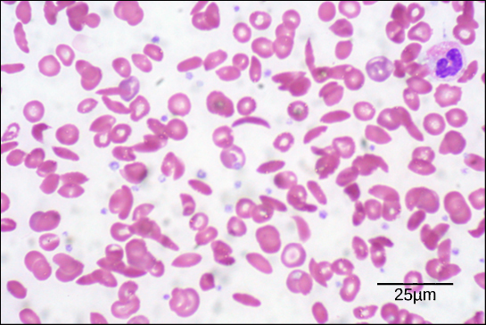
Figure 3.27
Í þessu blóðstroki, sem er sýnt í 535x stækkun með bjartsviðssmásjá, eru sigðkorn hálfmánalaga en eðlileg blóðkorn eru skífulaga. (höfundur: byggt á verki eftir Ed Uthman; gögn fyrir kvarðastrik frá Matt Russell)
Notes:
This electron micrograph shows red blood cells from a patient with sickle cell anemia. Most of the cells have a normal, disk shape, but about one in five has a sickle shape. A normal blood cell is eight microns across.

Slide 36
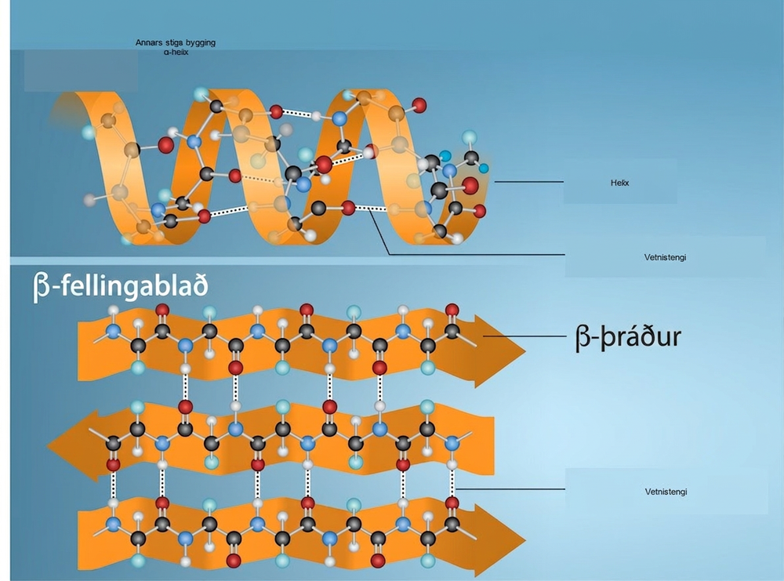
Figure 3.28
α-gormurinn og β-fellingablaðið eru annars stigs próteinbyggingar sem myndast þegar vetnistengi myndast milli karbónýlsúrefnis og amínóvetnis í peptíðgrindinni. Tilteknar amínósýrur hafa tilhneigingu til að mynda α-gorm en aðrar stuðla frekar að myndun β-fellingablaðs. Svart = kolefni, hvítt = vetni, blátt = nitur og rautt = súrefni. Höfundar: Rao, A., Ryan, K. Fletcher, S. og Tag, A. Department of Biology, Texas A&M University.
Notes:
The illustration shows an alpha helix protein structure, which coils like a spring, and a beta-pleated sheet structure, which forms flat sheets stacked together. In an alpha-helix, hydrogen bonding occurs between the carbonyl group of one amino acid and the amino group of the amino acid that occurs four residues later. In a beta-pleated sheet, hydrogen bonding occurs between two different lengths of peptide that are antiparallel to one another.

Slide 37
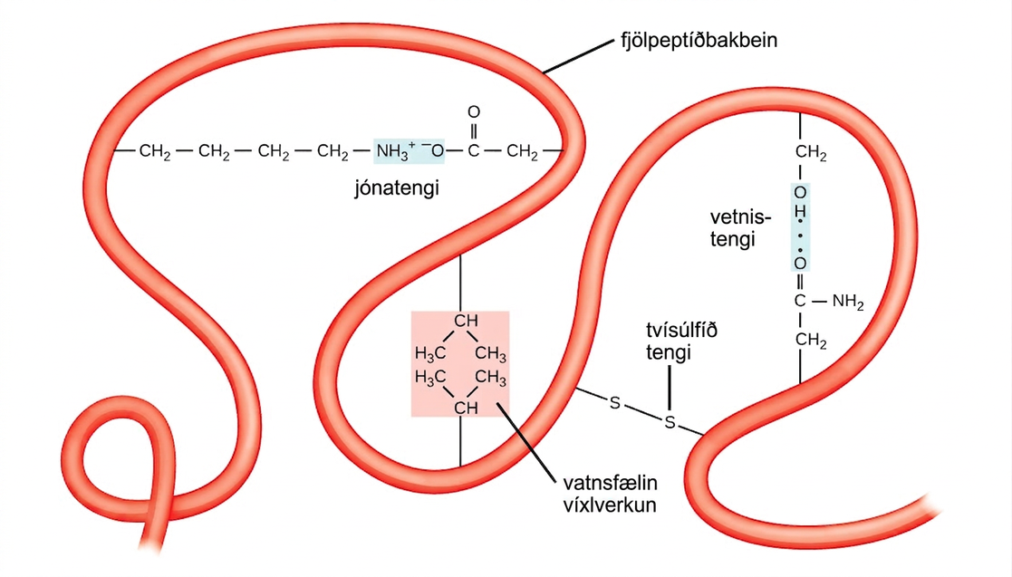
Figure 3.29
Ýmis efnafræðileg víxlverkun ákvarðar þriðja stigs byggingu próteina. Þar á meðal eru vatnsfælin víxlverkun, jónatengi, vetnistengi og tvísúlfíðtengi.
Notes:
This illustration shows a polypeptide backbone folded into a three-dimensional structure. Chemical interactions between amino acid side chains maintain its shape. These include an ionic bond between an amino group and a carboxyl group, hydrophobic interactions between two hydrophobic side chains, a hydrogen bond between a hydroxyl group and a carbonyl group, and a disulfide linkage.

Slide 38
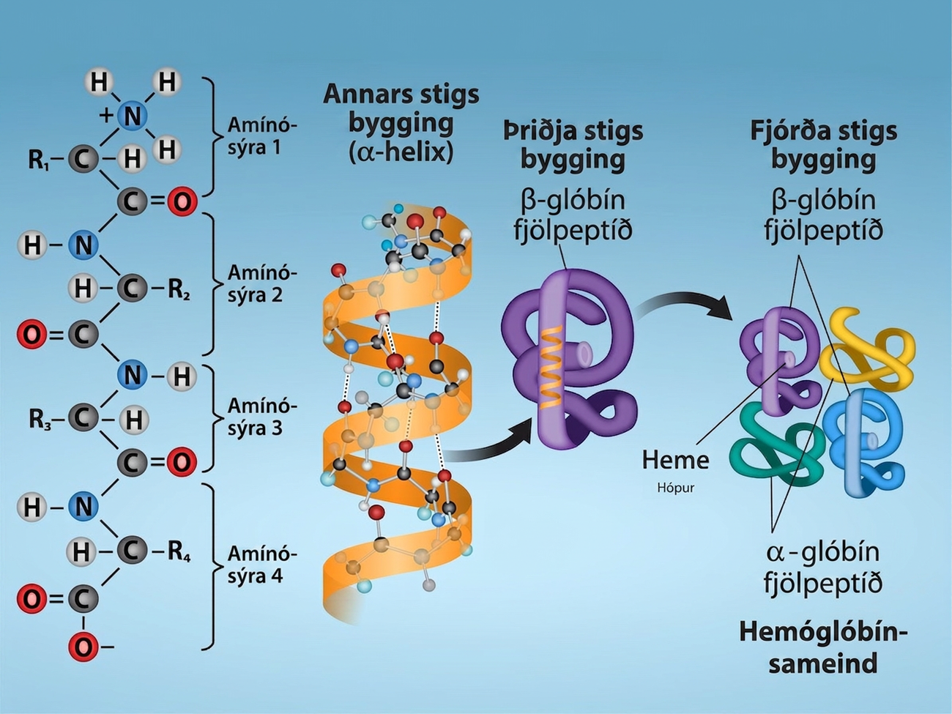
Figure 3.30
Skoðið fjögur byggingarstig próteina á þessum myndum. Höfundar: Rao, A. Ryan, K. og Tag, A. Department of Biology, Texas A&M University.
Notes:
Shown are the four levels of protein structure. The primary structure is the amino acid sequence. Secondary structure is a regular folding pattern due to hydrogen bonding. Tertiary structure is the three-dimensional folding pattern of the protein due to interactions between amino acid side chains. Quaternary structure is the interaction of two or more polypeptide chains.

Slide 39
3.5 Nucleic Acids
Markmið kaflans
Lýsa byggingu kjarnsýra og skilgreina tvær gerðir kjarnsýra
Útskýra byggingu og hlutverk DNA
Útskýra byggingu og hlutverk RNA

Slide 40
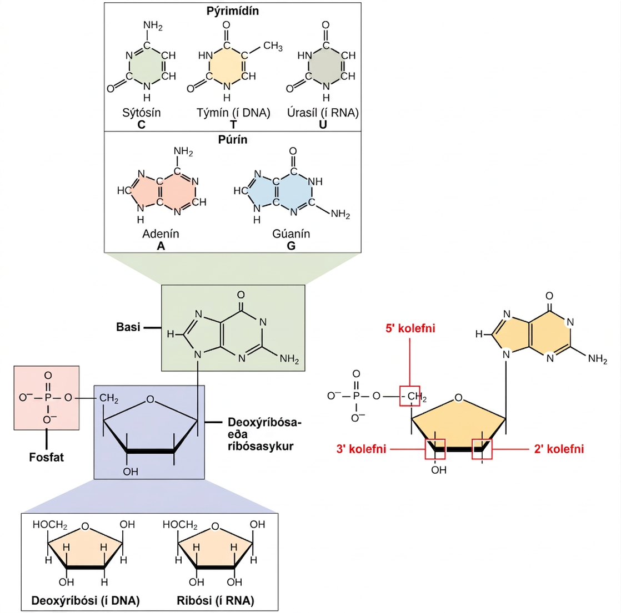
Figure 3.31
Núkleótíð er gert úr þremur þáttum: niturbasa, pentósasykri og einum eða fleiri fosfathópum. Kolefnisleifar í pentósanum eru númeraðar frá 1′ til 5′ (strikið greinir þessar leifar frá leifum í basanum, sem eru númeraðar án strikmerkingar). Basinn tengist 1′ stöðu ríbósans og fosfatið tengist 5′ stöðunni. Þegar fjölkirni myndast tengist 5′ fosfat aðkomandi núkleótíðs 3′ hýdroxýlhópnum á enda keðjunnar sem er að lengjast. Tvær gerðir pentósa eru í núkleótíðum, deoxýríbósi (finnst í DNA) og ríbósi (finnst í RNA). Deoxýríbósi er svipaður ríbósa að byggingu en hefur H í stað OH í 2′ stöðu. Hægt er að skipta bösum í tvo flokka: púrín og pýrimídín. Púrín hafa tvöfalda hringbyggingu en pýrimídín hafa einn hring.
Notes:
The molecular structure of a nucleotide is shown. The core of the nucleotide is a pentose whose carbon residues are numbered one prime through five prime. The base is attached to the one prime carbon, and the phosphate is attached to the five prime carbon. Two kinds of pentose are found in nucleotides: ribose and deoxyribose. Deoxyribose has an H instead of O H at the two prime position. Five kinds of base are found in nucleotides. Two of these, adenine and guanine, are purine bases with two rings fused together. The other three, cytosine, thymine and uracil, have one six-membered ring.

Slide 41
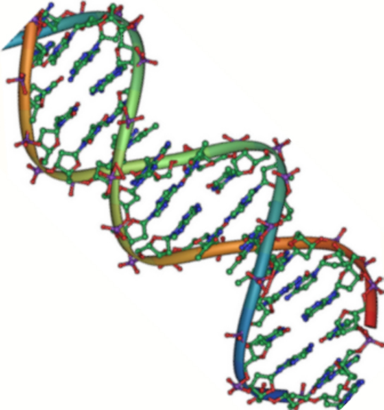
Figure 3.32
Náttúrulegt DNA er andsamsíða tvöfaldur gormur. Fosfatburðargrindin (sýnd með bugðóttu línunum) er utan á sameindinni og basarnir eru að innan. Hver basi á öðrum þræðinum víxlverkar með vetnistengjum við basa á gagnstæða þræðinum. (höfundaréttur: Jerome Walker/Dennis Myts)
Notes:
The molecular structure of D N A is shown. D N A consists of two antiparallel strands twisted in a double helix. The phosphate backbone is on the outside, and the nitrogenous bases face one another on the inside. The bases appear as strands between the phosphate backbone of the double helix.

Slide 42
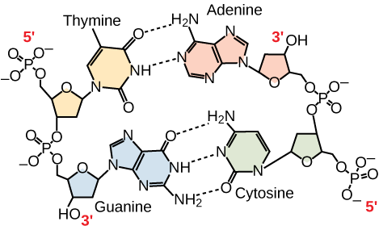
Figure 3.33
Í tvíþátta DNA sameind liggja þræðirnir tveir andsamsíða hvor öðrum þannig að annar þráðurinn liggur frá 5′ til 3′ en hinn frá 3′ til 5′. Fosfatburðargrindin er utan á sameindinni og basarnir eru í miðjunni. Adenín myndar vetnistengi (eða basapör) við týmín og gúanín myndar basapar við cýtósín.
Notes:
Hydrogen bonding between thymine and adenine and between guanine and cytosine is shown. Thymine forms two hydrogen bonds with adenine, and guanine forms three hydrogen bonds with cytosine. The phosphate backbones of each strand are on the outside and run in opposite directions.

Slide 43
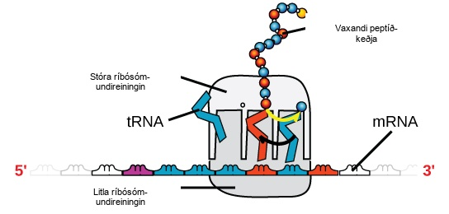
Figure 3.34
Ríbósóm er úr tveimur hlutum: stórri undireiningu og lítilli undireiningu. mRNA liggur á milli undireininganna tveggja. tRNA sameind þekkir táknröð á mRNA, binst henni með samstæðri basapörun og bætir réttri amínósýru við peptíðkeðjuna sem er að lengjast.
Notes:
An illustration of a ribosome is shown. m R N A sits between the large and small subunits. t R N A molecules bind the ribosome and add amino acids to the growing peptide chain.

Slide 44
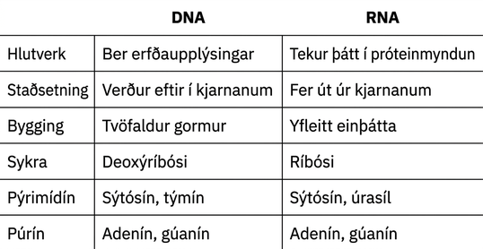
Table 3.2
Þetta stoðefni frá OpenStax er © Rice University samkvæmt CC BY-NC-SA 4.0 International leyfi. Heimilt er að endurgera það eða breyta því eingöngu í óviðskiptalegum tilgangi, en geta verður OpenStax og Rice University sem rétthafa og tilgreina allar breytingar. Sérhver aðlögun verður að vera deilt samkvæmt sams konar leyfi.

