Slide 1
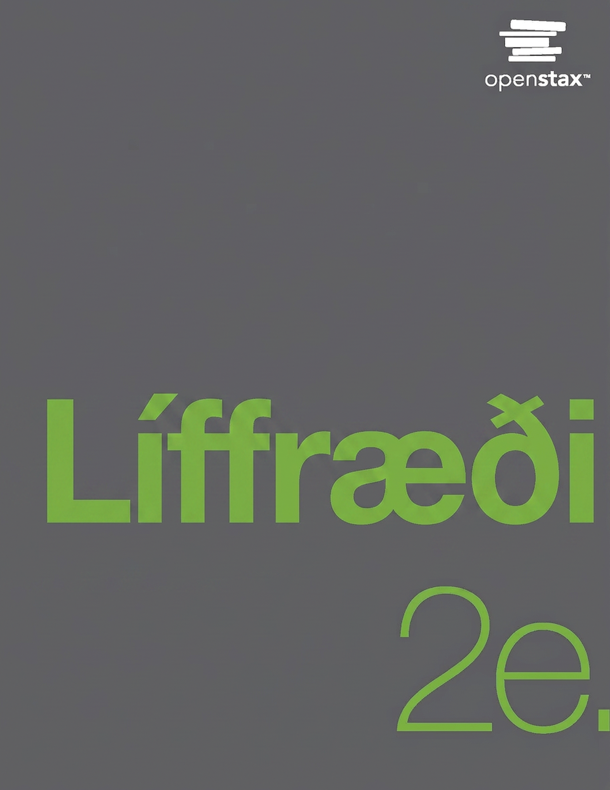
Biology 2e
Chapter 38 The Musculoskeletal System

Slide 2
Chapter outline
Types of Skeletal Systems
Bone
Joints and Skeletal Movement
Muscle Contraction and Locomotion

Slide 3
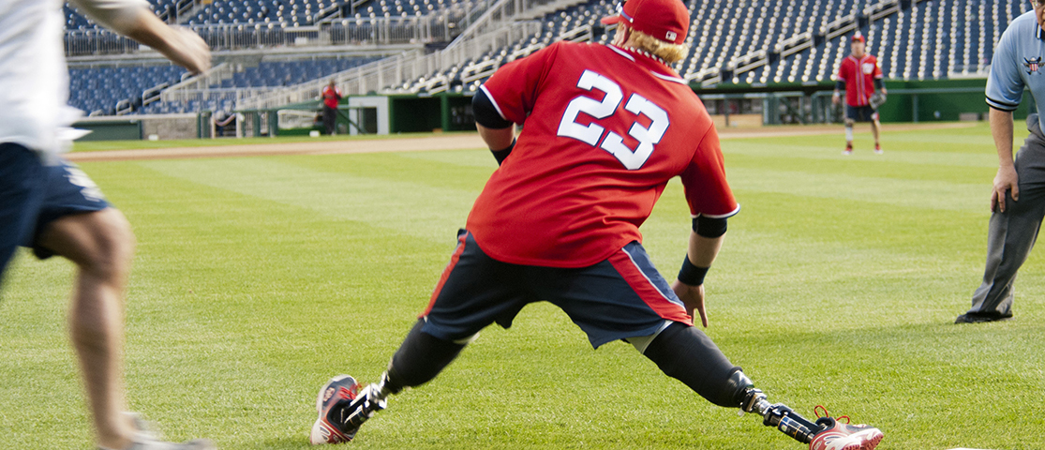
Figure 38.1
Improvements in the design of prostheses have allowed for a wider range of activities in recipients. (credit: modification of work by Stuart Grout)
Notes:
Photo shows a man with prosthetic legs stretching out while playing baseball.

Slide 4
38.1 Types of Skeletal Systems
Learning Objectives
Discuss the different types of skeletal systems
Explain the role of the human skeletal system
Compare and contrast different skeletal systems

Slide 5
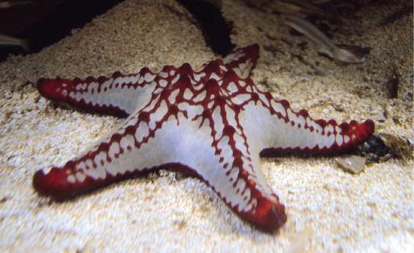
Figure 38.2
The skeleton of the red-knobbed sea star (Protoreaster linckii) is an example of a hydrostatic skeleton. (credit: “Amada44”/Wikimedia Commons)
Notes:
Photo shows a white sea star with red bumps along the tops and tips of its arms.

Slide 6
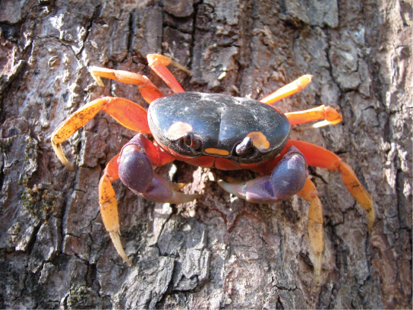
Figure 38.3
Muscles attached to the exoskeleton of the Halloween crab (Gecarcinus quadratus) allow it to move.
Notes:
Photo shows a crab with orange legs and a black body crawling on a tree.

Slide 7
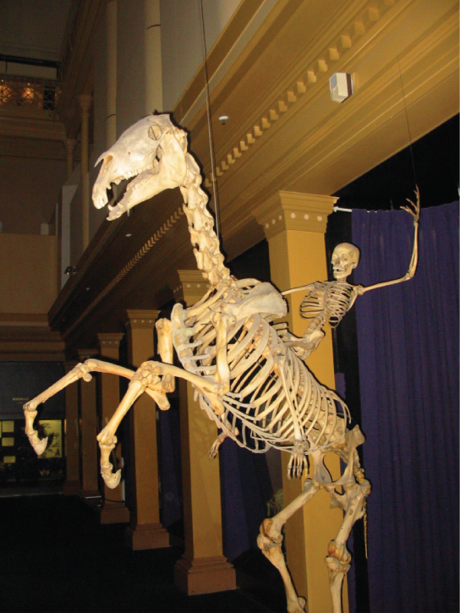
Figure 38.4
The skeletons of humans and horses are examples of endoskeletons. (credit: Ross Murphy)
Notes:
Photo shows a human skeleton riding a bucking horse skeleton.

Slide 8
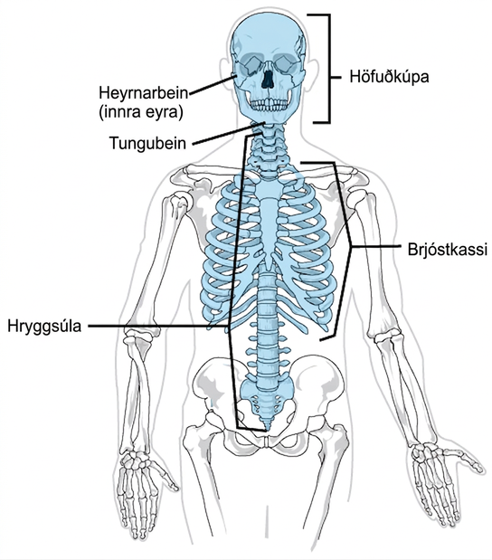
Figure 38.5
The axial skeleton consists of the bones of the skull, ossicles of the middle ear, hyoid bone, vertebral column, and rib cage. (credit: modification of work by Mariana Ruiz Villareal)
Notes:
On a human skeleton, the parts of the axial skeleton are highlighted, and include the skull, ossicles, or inner ear, the hyoid bone just below the jaw, the spinal or vertebral column, and the ribcage.

Slide 9
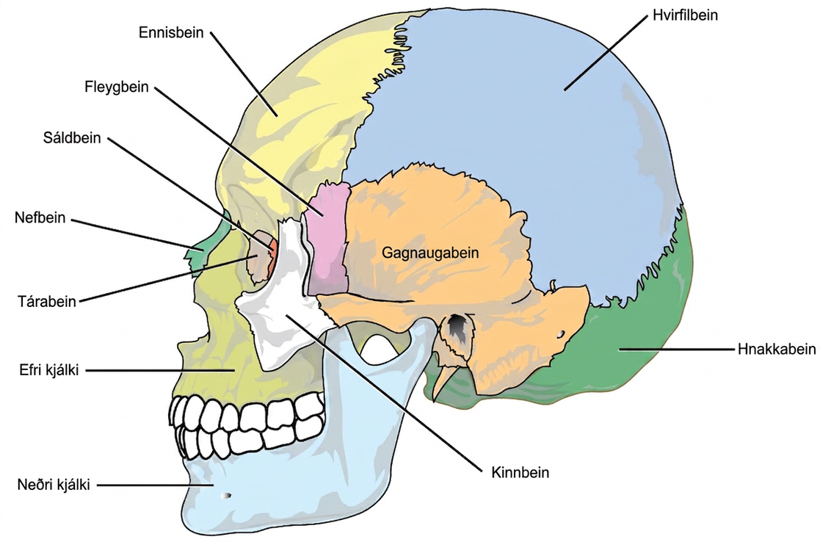
Figure 38.6
The bones of the skull support the structures of the face and protect the brain. (credit: modification of work by Mariana Ruiz Villareal)
Notes:
The bones of the skull are shown from the side. The mandible is the lower jaw bone. The maxilla is superior to the mandible, comprising the upper lip and side of the nasal region. The nasal bone is anterior. The lacrimal is on the inside of the eye socket. The ethmoid is posterior to the lacrimal. The frontal bone is large, and takes up the forehead region. The zygomatic, or cheekbone, is lateral to the eye socket. The sphenoid is just behind the zygomatic. The temporal bone makes up much of the side of the skull. The parietal is large, taking up much of the top and rear portions of the skull. The occipital bone makes up the lower back of the skull.

Slide 10
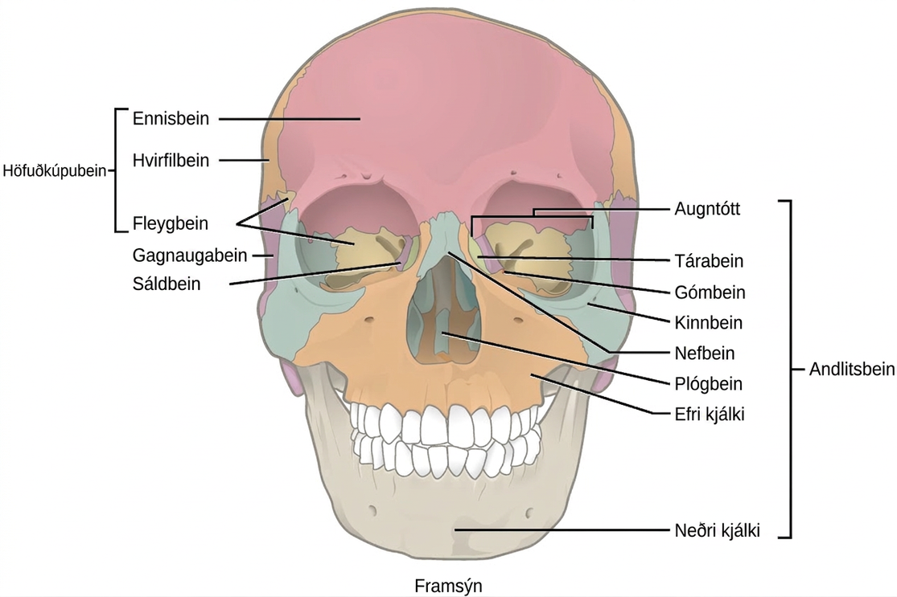
Figure 38.7
The cranial bones, including the frontal, parietal, ethmoid, and sphenoid bones, cover the top of the head. The facial bones of the skull form the face and provide cavities for the eyes, nose, and mouth.
Notes:
Illustration shows a front-end view of a skull. The frontal bone is the prominent bone that makes up most of the top of the skull. The parietal bones and sphenoid bone make up the side of the skull. Two nasal bones make up the bridge of the nose. The zygomatic bone is the cheek bone. The vomer is a single bone in the middle of the nose. The maxilla makes up the upper jaw, and the mandible is the lower jaw. The lacrimal is a bone on the inner center of the eye. The nasal conchae are bones inside the nose.

Slide 11
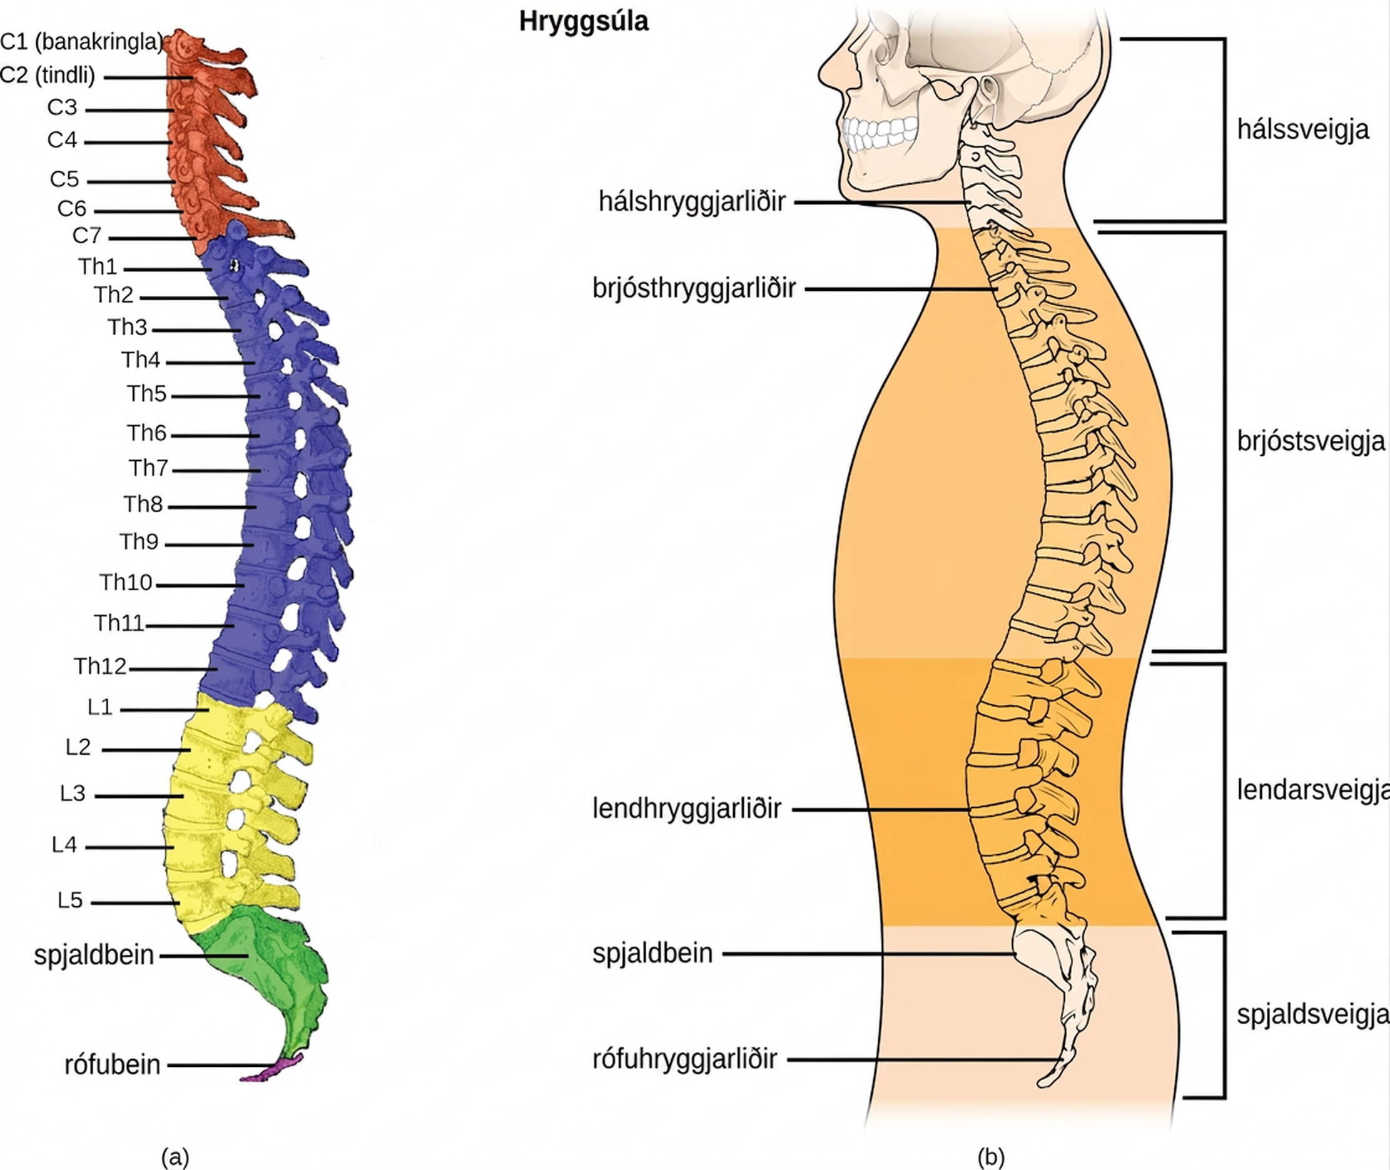
Figure 38.8
(a) The vertebral column consists of seven cervical vertebrae (C1–7) twelve thoracic vertebrae (Th1–12), five lumbar vertebrae (L1–5), the os sacrum, and the coccyx. (b) Spinal curves increase the strength and flexibility of the spine. (credit a: modification of work by Uwe Gille based on original work by Gray's Anatomy; credit b: modification of work by NCI, NIH)
Notes:
Illustration A shows all the vertebrae in a vertebral column. Illustration B shows that different sections of vertebrae curve in different directions. The cervical vertebrae in the neck curve toward the front of the body. The top cervical vertebrae is called the atlas, or c 1. The next bone down is the c 2, or axis. There are 7 cerebral vertebrae. Next are the thoracic vertebrae, which extend from the neck to the bottom of the rib cage, curve toward the back of the body. These are labeled as T h 1, which is the first thoracic vertebrae below the cervicals, to t h 12, which is the lowest of the thoracic vertebrae. Next are the lumbar vertebrae, which extend to the bottom of the back, curve toward the front again. These lumbar vertebrae are labeled L 1, which is the next vertebrae below the thoracics, thorugh L 5, which is the lowest lumbar vertebrae. The sacrum and the coccygeal vertebrae make up the sacral curve that curves toward the back. The sacrum is above the coccyx.

Slide 12
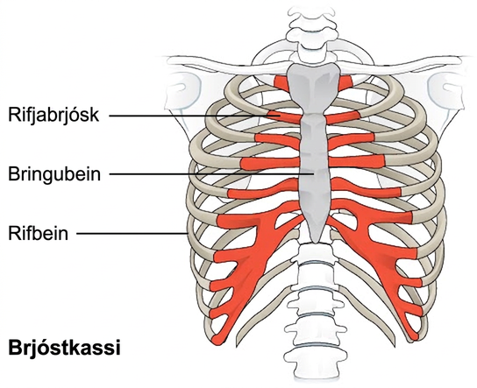
Figure 38.9
The thoracic cage, or rib cage, protects the heart and the lungs. (credit: modification of work by NCI, NIH)
Notes:
Illustration shows the rib cage and the sternum, which is the bone in the front and center of the upper body. The rib bones, which end about three quarters of the way around the body, do not connect directly to the sternum; instead, costal cartilage connects the rib bones to the sternum.

Slide 13
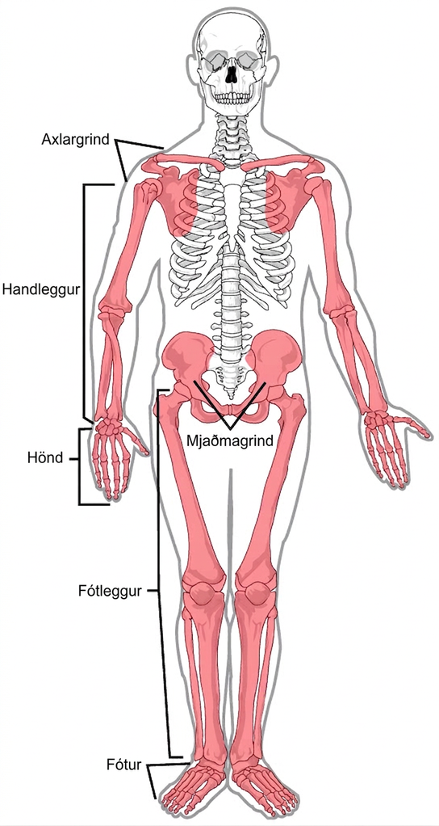
Figure 38.10
The appendicular skeleton is composed of the bones of the pectoral limbs (arm, forearm, hand), the pelvic limbs (thigh, leg, foot), the pectoral girdle, and the pelvic girdle. (credit: modification of work by Mariana Ruiz Villareal)
Notes:
Illustration shows the appendicular skeleton, which consists of arms, legs, shoulder bones, and the pelvic girdle.

Slide 14
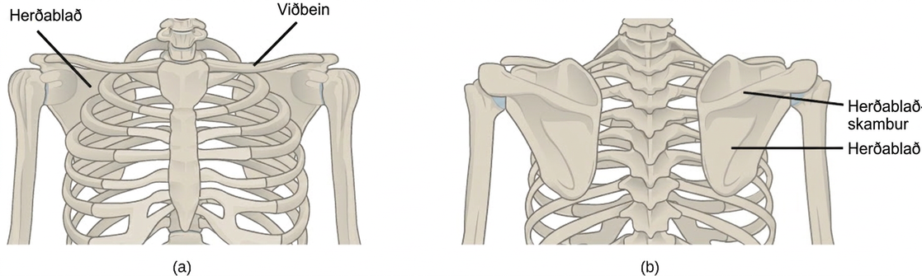
Figure 38.11
(a) The pectoral girdle in primates consists of the clavicles and scapulae. (b) The posterior view reveals the spine of the scapula to which muscle attaches.
Notes:
Illustration shows the pectoral girdles of the shoulder. Each girdle consists of a long, thin clavicle that runs from the sternum to the arm and a flat, triangular scapula that extends down from the clavicle. Viewed from the back, the upper part of the scapula has a prominent protrusion, called a spine.

Slide 15
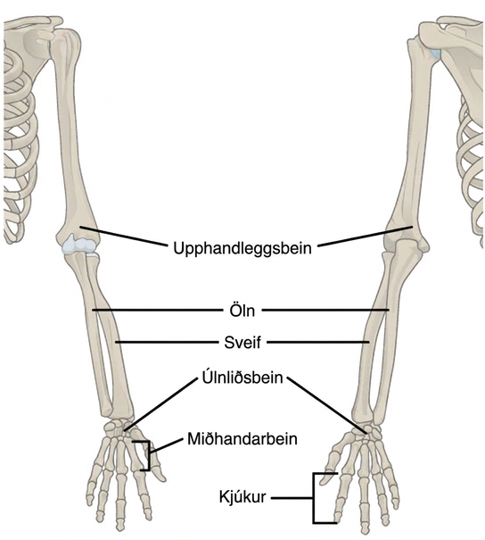
Figure 38.12
The upper limb consists of the humerus of the upper arm, the radius and ulna of the forearm, eight bones of the carpus, five bones of the metacarpus, and 14 bones of the phalanges.
Notes:
Illustration shows a skeletal human arm. The humerus is the bone of the upper arm. The radius is the thick bone in the forearm, on the side of the thumb and the ulna is the thin bone on the side of the pinkie finger. The carpals are the bones of the wrist, the metacarpals are bones of the hand, and phalanges are bones of the fingers.

Slide 16
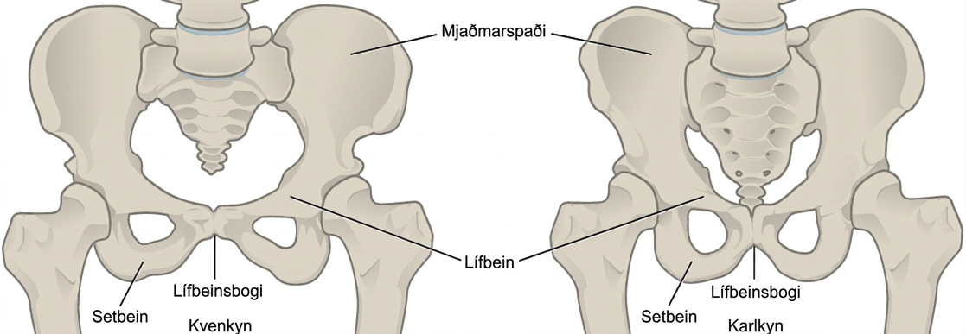
Figure 38.13
To adapt to reproductive fitness, the (a) female pelvis is lighter, wider, shallower, and has a broader angle between the pubic bones than (b) the male pelvis.
Notes:
Illustration compares male and female pelvic bones. In both males and females, a wide, rounded bone called the ilium attaches to each side of the spine. The ilium curves toward the front, where it narrows into the ischium. A loop-shaped bone extends down from the place where the ilium meets the ischium, and connects back to the ilium in the front center of the body; this area is the pubic arch. Females appear to have a wider pubic arch.

Slide 17
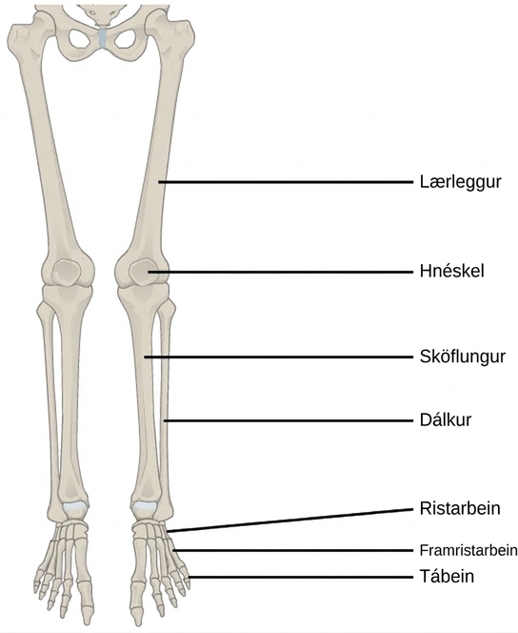
Figure 38.14
The lower limb consists of the thigh (femur), kneecap (patella), leg (tibia and fibula), ankle (tarsals), and foot (metatarsals and phalanges) bones.
Notes:
Illustration shows a leg. The bone of the upper leg is the femur. The tibia is the thicker, front bone of the lower leg, and the fibula is the rear bone. The tarsals are the bones of the ankle. The metatarsals are the bones of the foot, and the phalanges are the bones of the toes.

Slide 18
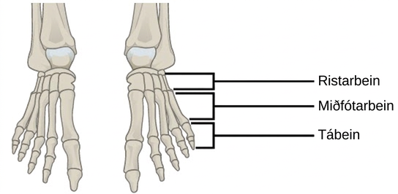
Figure 38.15
This drawing shows the bones of the human foot and ankle, including the metatarsals and the phalanges.
Notes:
Illustration shows a human foot. The metatarsals are five long, thin bones that connect to the phalanges.

Slide 19
38.2 Bone
Learning Objectives
Classify the different types of bones in the skeleton
Explain the role of the different cell types in bone
Explain how bone forms during development

Slide 20
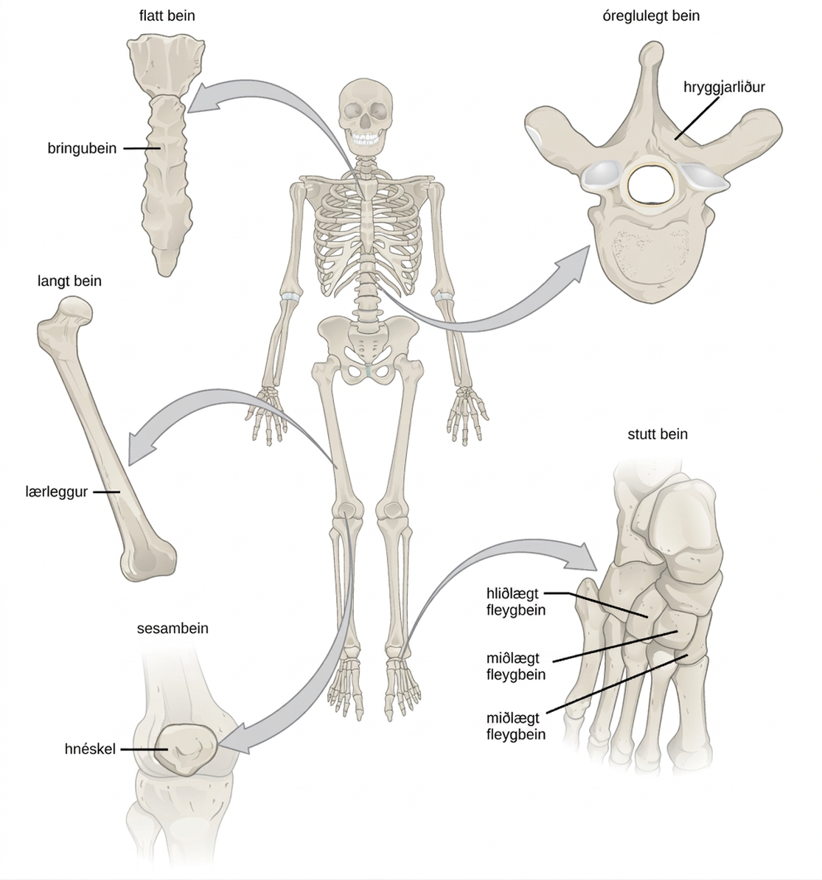
Figure 38.16
Shown are different types of bones: flat, irregular, long, short, and sesamoid.
Notes:
Illustration shows classification of different bone types. The sternum at the front, middle of the rib cage is a flat bone. The femur is a long bone. The patella is small and circular, and is called a sesamoid bone. The vertebrae are irregular bones, with holes in their centers and the bones of the foot are short bones, called lateral cuneiform, intermediate cuneiform, and medial cuneiform.

Slide 21
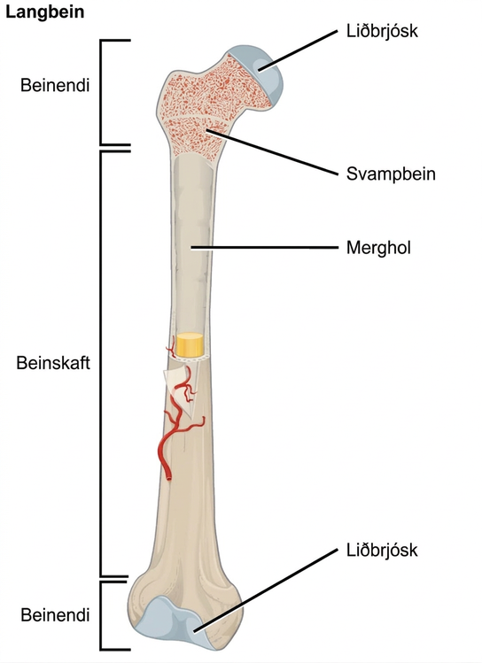
Figure 38.17
The long bone is covered by articular cartilage at either end and contains bone marrow (shown in yellow in this illustration) in the medullary cavity.
Notes:
Illustration shows a long bone, which is wide at both ends and narrow in the middle. The narrow middle is called the diaphysis and the long ends are called the epiphyses. The epiphyses are filled with spongy bone perforated with holes, and the ends are made up of articular cartilage. A hollow opening in the middle of the diaphysis is called the medullary cavity.

Slide 22
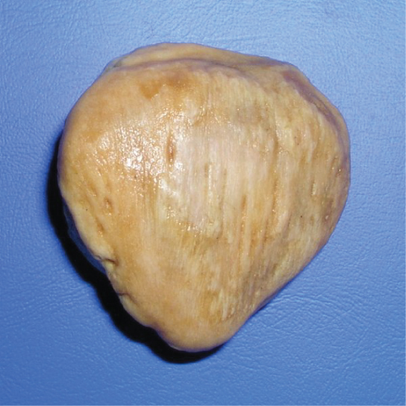
Figure 38.18
The patella of the knee is an example of a sesamoid bone.
Notes:
The patella is a flat, teardrop-shaped bone.

Slide 23
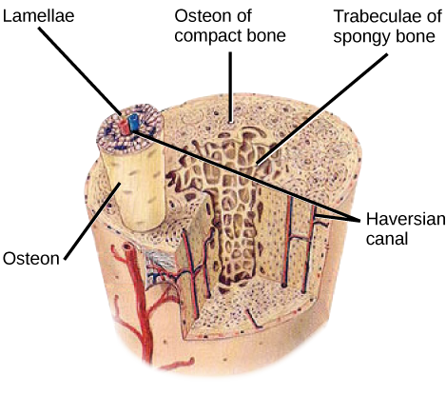
Figure 38.19
Compact bone tissue consists of osteons that are aligned parallel to the long axis of the bone, and the Haversian canal that contains the bone’s blood vessels and nerve fibers. The inner layer of bones consists of spongy bone tissue. The small dark ovals in the osteon represent the living osteocytes. (credit: modification of work by NCI, NIH)
Notes:
Illustration shows a cross-section of a bone. The compact outer part of the bone is made up of cylindrical osteons that run its length. Each osteon is made up of a matrix of lamellae that surround a central Haversian canal. Arteries, veins and nerve fibers run through the Haversian canals. The spongy inner bone consists of porous trabeculae.

Slide 24
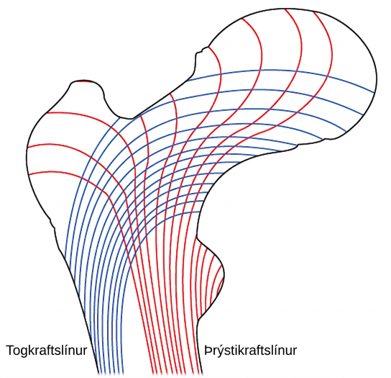
Figure 38.20
Trabeculae in spongy bone are arranged such that one side of the bone bears tension and the other withstands compression.
Notes:
Illustration shows tension lines in a long bone, which start out perpendicular to the epiphysis and then turn and run along the length of the bone. Compression lines run the length of the bone opposite the side of the tension lines.

Slide 25
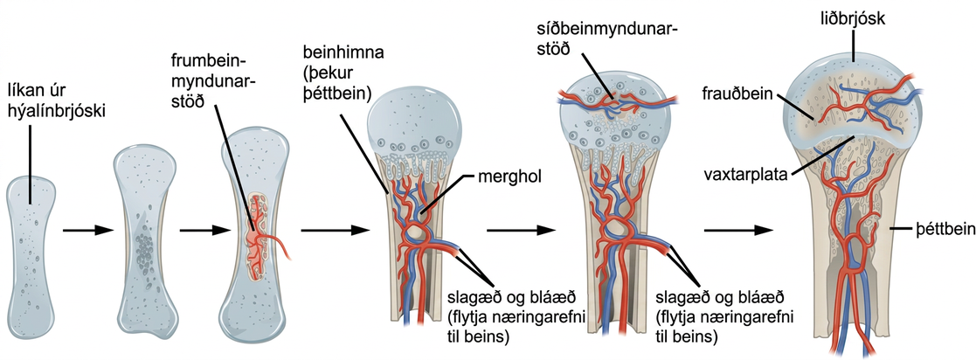
Figure 38.21
Endochondral ossification is the process of bone development from hyaline cartilage. The periosteum is the connective tissue on the outside of bone that acts as the interface between bone, blood vessels, tendons, and ligaments.
Notes:
Illustration shows bone growth, which begins with a hyaline cartilage model that has the appearance of a small bone. A primary ossification center forms in the center of the narrow part of the bone, and a bone collar forms around the outside. The periosteum forms around the outside of the bone. Next, blood vessels begin to form in the bone and secondary ossification centers form in the epiphyses. The primary ossification center hollows out to form the medullary cavity, and an epiphyseal plate grows, separating the epiphyses from the diaphysis.

Slide 26
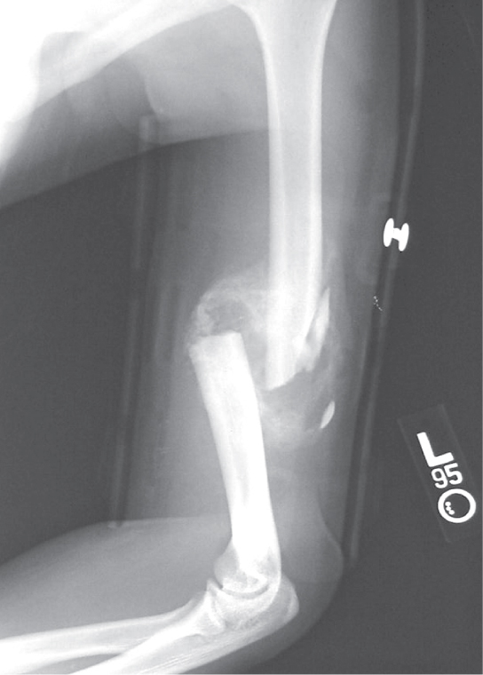
Figure 38.22
After this bone is set, a callus will knit the two ends together. (credit: Bill Rhodes)
Notes:
Photo shows an X-ray of a broken humerus—the bone in the upper arm.

Slide 27
38.3 Joints and Skeletal Movement
Learning Objectives
Classify the different types of joints on the basis of structure
Explain the role of joints in skeletal movement

Slide 28
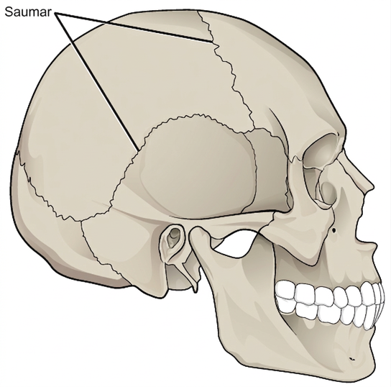
Figure 38.23
Sutures are fibrous joints found only in the skull.
Notes:
Illustration shows sutures that knit the back part of the skull together with the front and lower parts. These appear as lines, or cracks, between the bones of the skull.

Slide 29
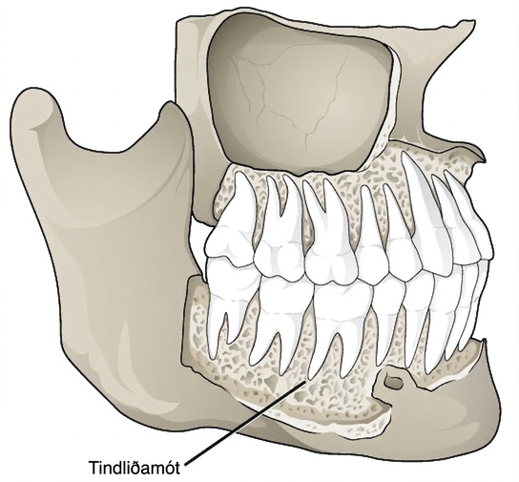
Figure 38.24
Gomphoses are fibrous joints between the teeth and their sockets. (credit: modification of work by Gray's Anatomy)
Notes:
Illustration shows a gomphosis connecting a tooth to the jaw. The gomphoses have a porous appearance.

Slide 30
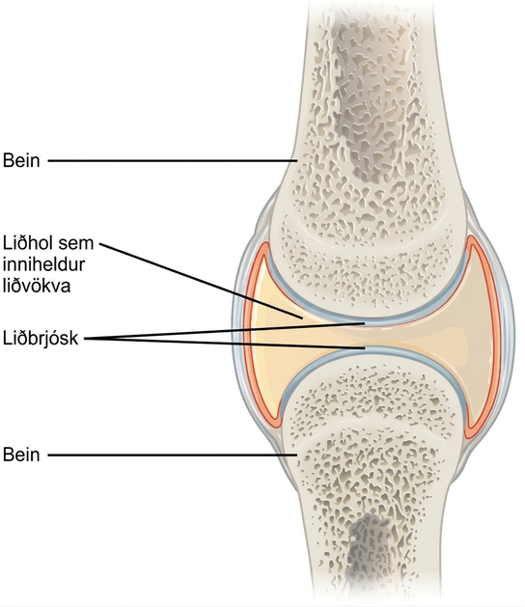
Figure 38.25
Synovial joints are the only joints that have a space or “synovial cavity” in the joint.
Notes:
Illustration shows a synovial joint between two bones. An I beam shaped synovial cavity exists between the bones, and articular cartilage wraps around the tips of the bones. The joint cavity contains synovial fluid. Ligaments connect the two bones together.

Slide 31
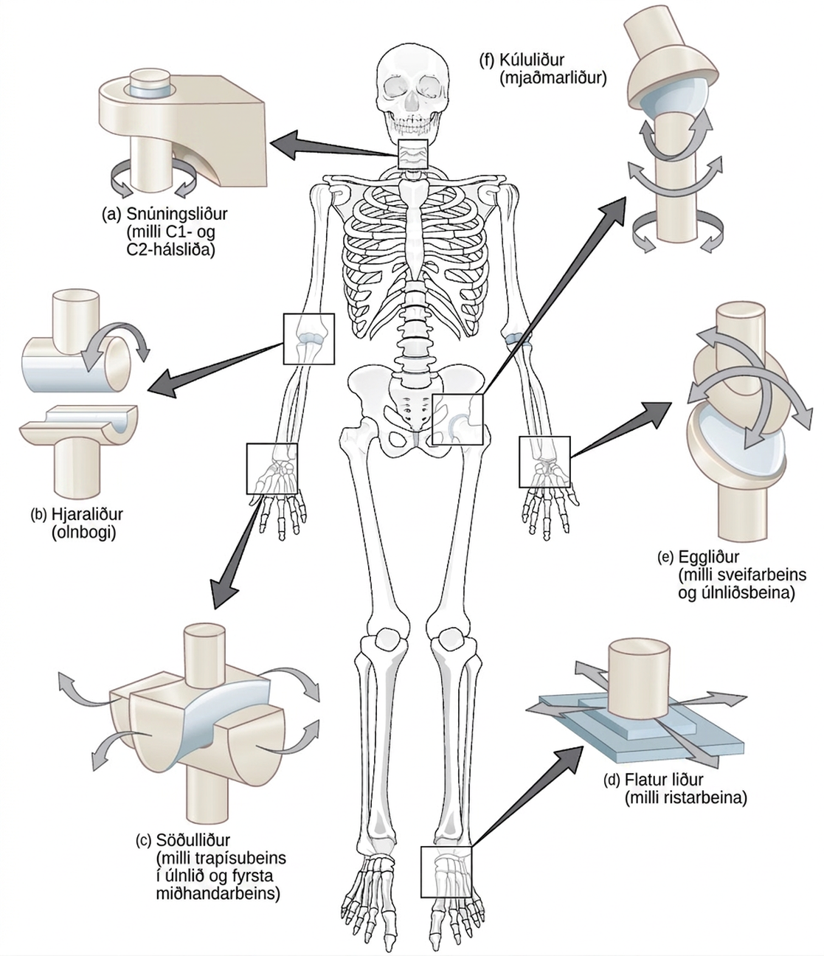
Figure 38.26
Different types of joints allow different types of movement. Planar, hinge, pivot, condyloid, saddle, and ball-and-socket are all types of synovial joints.
Notes:
Illustration shows joints of the body. The neck is a pivot joint that allows rotation. The hip is a ball-and-socket joint that allows a swiveling movement. The elbow is a hinge joint that allows movement in one direction. The wrist has a saddle joint to allow back-and forth-movement, and a condyloid joint to allow up-and-down movement. The tarsals of the foot have a plane joint that allows back-and-forth movement.

Slide 32
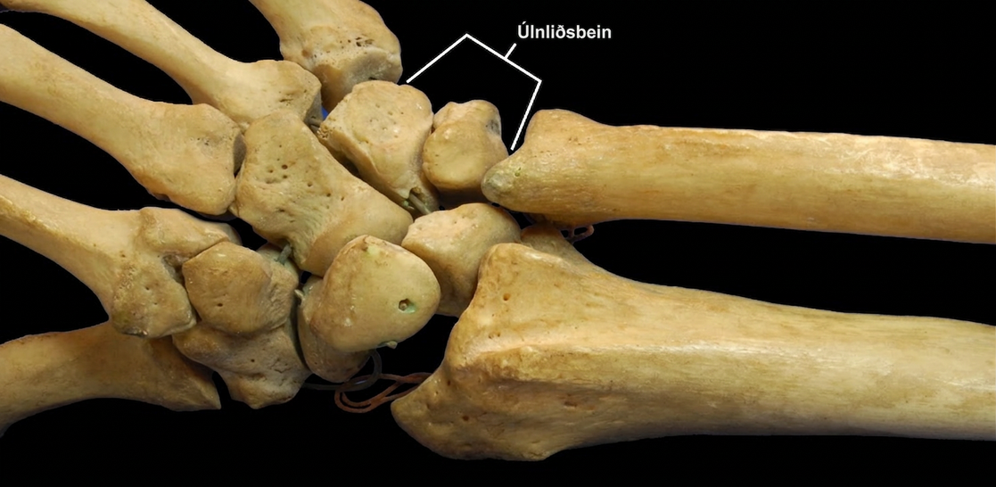
Figure 38.27
The joints of the carpal bones in the wrist are examples of planar joints. (credit: modification of work by Brian C. Goss)
Notes:
Photo shows a human hand skeleton. The radius and ulna of the forearm connect to several small, knobby bones in the wrist called carpals. Carpals, in turn, connect to bones in the hand.

Slide 33
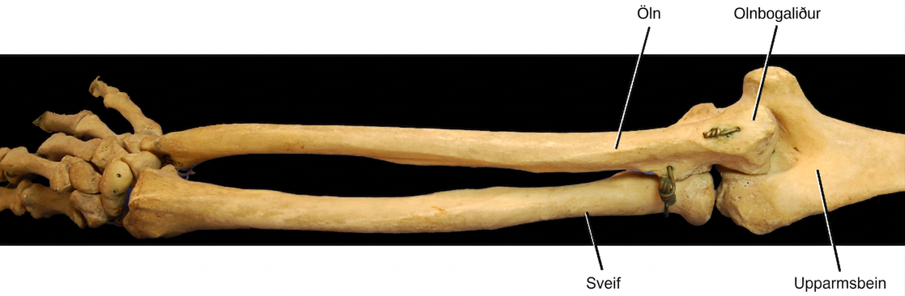
Figure 38.28
The elbow joint, where the radius articulates with the humerus, is an example of a hinge joint. (credit: modification of work by Brian C. Goss)
Notes:
Photo shows the skeleton of a human arm. The ulna of the lower arm fits in the groove of the humerus, forming the hinge-like elbow joint.

Slide 34
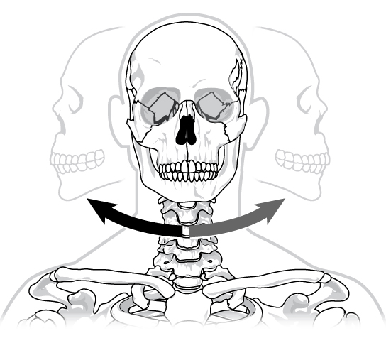
Figure 38.29
The joint in the neck that allows the head to move back and forth is an example of a pivot joint.
Notes:
Illustration shows a human skull twisting left and right on the neck in a pivot-like motion.

Slide 35
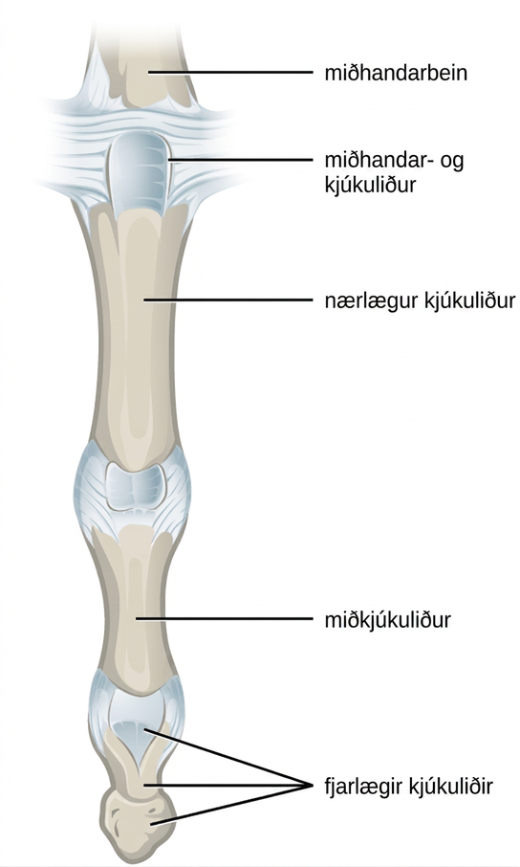
Figure 38.30
The metacarpophalangeal joint in the finger is an example of a condyloid joint. (credit: modification of work by Gray's Anatomy)
Notes:
Illustration shows the metacarpophalangeal joint that joins the metacarpal of the hand to a finger.

Slide 36
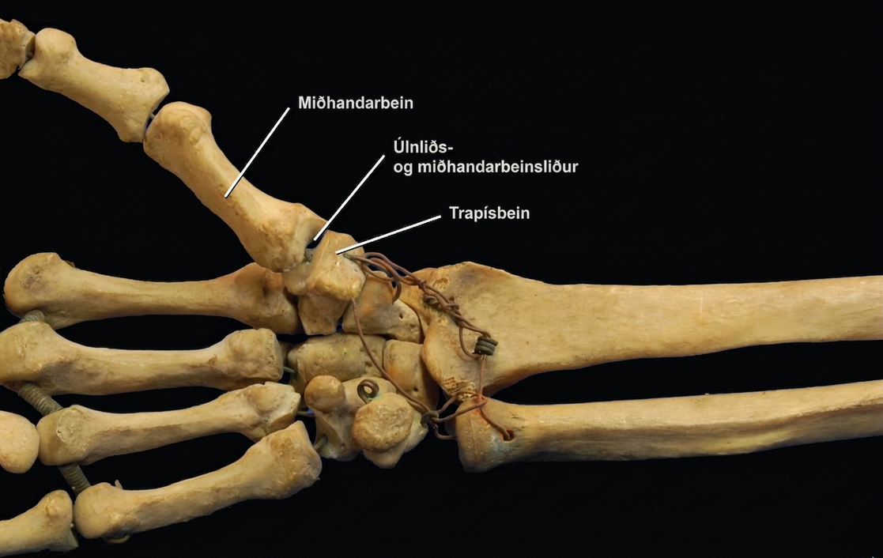
Figure 38.31
The carpometacarpal joints in the thumb are examples of saddle joints. (credit: modification of work by Brian C. Goss)
Notes:
Photo shows the carpometacarpal joint that connects the metacarpal of the thumb to the trapezium of the wrist. Each bone is saddle-shaped at the end.

Slide 37
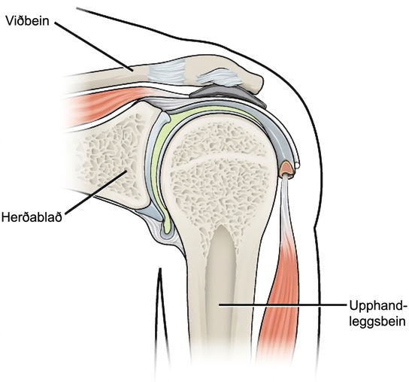
Figure 38.32
The shoulder joint is an example of a ball-and-socket joint.
Notes:
Illustration shows that the ball-shaped end of the humerus fits into the socket in the shoulder joint.

Slide 38
38.4 Muscle Contraction and Locomotion
Learning Objectives
Classify the different types of muscle tissue
Explain the role of muscles in locomotion

Slide 39
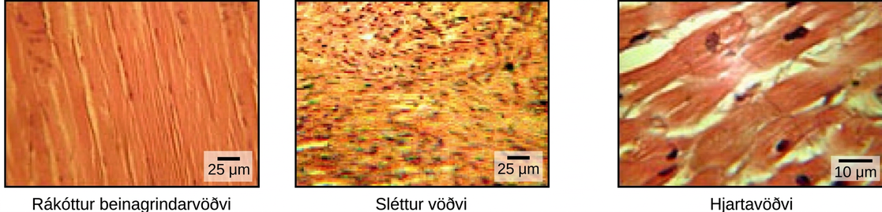
Figure 38.33
The body contains three types of muscle tissue: skeletal muscle, smooth muscle, and cardiac muscle, visualized here using light microscopy. Skeletal muscle cells are long, cylindrical cells with multiple nuclei. Smooth muscle cells are short, tapered at each end, and have only one plump nucleus in each. Cardiac muscle cells are branched and striated, but short. The cytoplasm may branch, and they have one nucleus in the center of the cell. (credit: modification of work by NCI, NIH; scale-bar data from Matt Russell)
Notes:
The skeletal muscle cells are long and arranged in parallel bands that give the appearance of striations. Each cell has multiple nuclei. Smooth muscle cells have no striations and only one nuclei per cell. Cardiac muscles are striated but have only one nucleus.

Slide 40
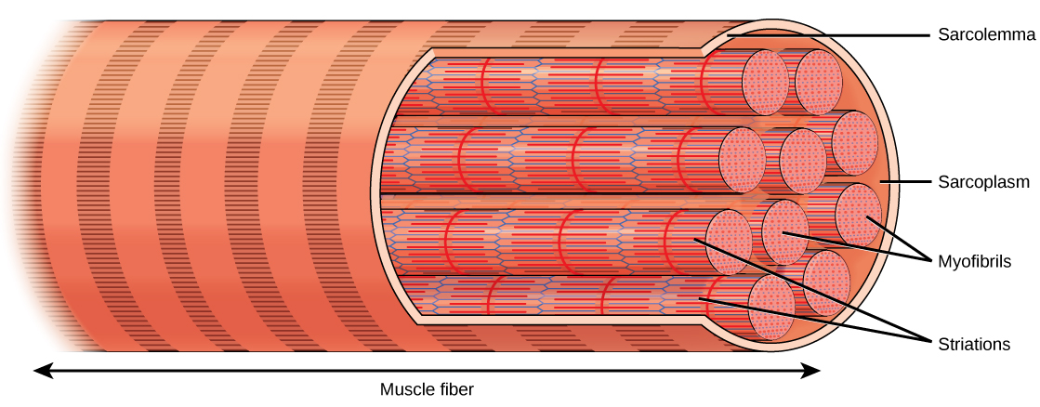
Figure 38.34
A skeletal muscle cell is surrounded by a plasma membrane called the sarcolemma with a cytoplasm called the sarcoplasm. A muscle fiber is composed of many fibrils, packaged into orderly units.
Notes:
Illustration shows a long, tubular skeletal muscle cell that runs the length of a muscle fiber. Long, cylindrical bundles called myofibrils run the length of the cell. The myofibrils have a banded appearance. A sarcoplasm exists around the myofibrils, and the sarcolemma surrounds everything.

Slide 41
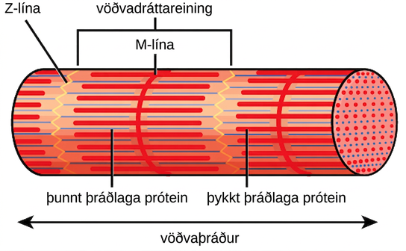
Figure 38.35
A sarcomere is the region from one Z line to the next Z line. Many sarcomeres are present in a myofibril, resulting in the striation pattern characteristic of skeletal muscle.
Notes:
Illustration shows part of a tubular myofibril, which consists of many sarcomeres. Zigzagging lines, called Z lines, run perpendicular to the fiber. Each sarcomere starts at one Z line and ends at the next. A straight perpendicular line, called an M line, exists halfway between each Z line. Thick filaments extend out from the M lines, parallel to the length of the myofibril. Thin filaments extend from the Z lines, and extend into the space between the thick filaments.

Slide 42
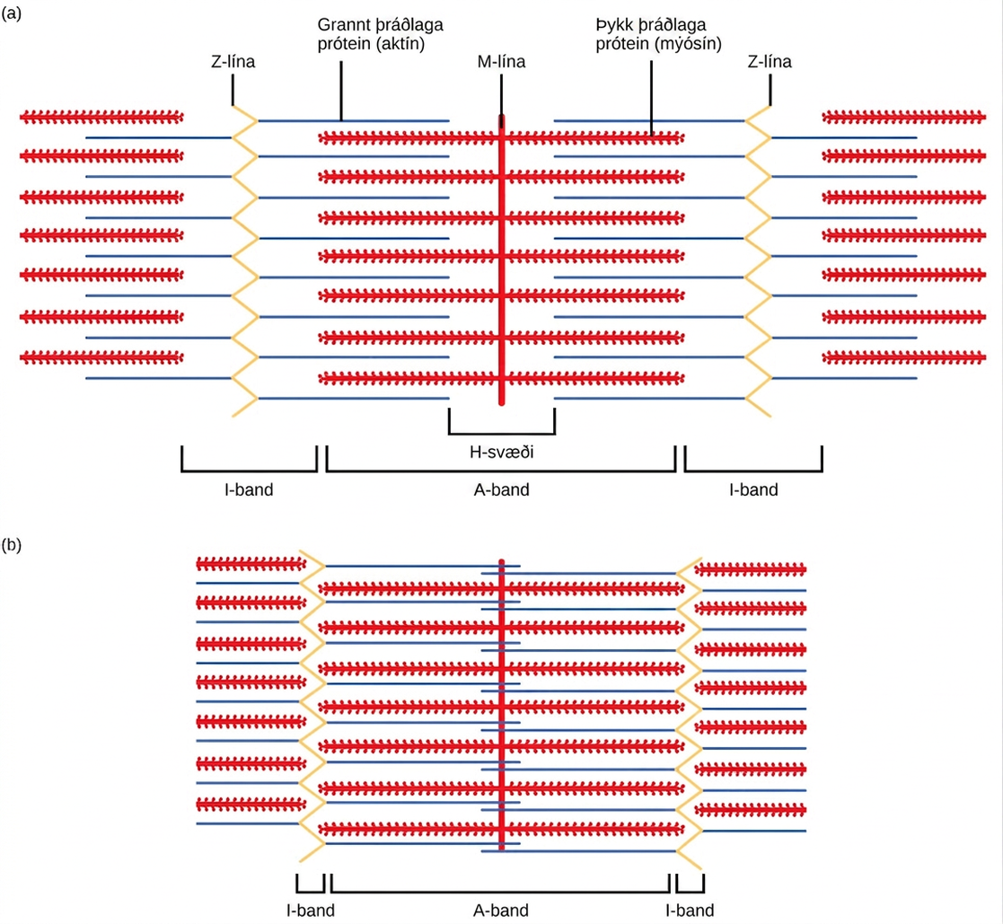
Figure 38.36
When (a) a sarcomere (b) contracts, the Z lines move closer together and the I band gets smaller. The A band stays the same width and, at full contraction, the thin filaments overlap.
Notes:
Part A of the illustration shows a relaxed muscle fiber. Two zigzagging Z lines extend from top to bottom. Thin actin filaments extend left and right from each Z line. Between the Z lines is a vertical M line. Thick myosin filaments extend left and right from the M line. The thick and thin filaments partially overlap. The A band represents the length that the thick filaments extend from both sides of the M line. The I band represents the part of the thin filaments that does not overlap with the thick filaments. Part B shows a contracted muscle fiber. In the contracted fiber, the thick and thin filaments completely overlap. The A band is the same length as in the uncontracted muscle, but the I band has shrunken to the width of the Z line.

Slide 43
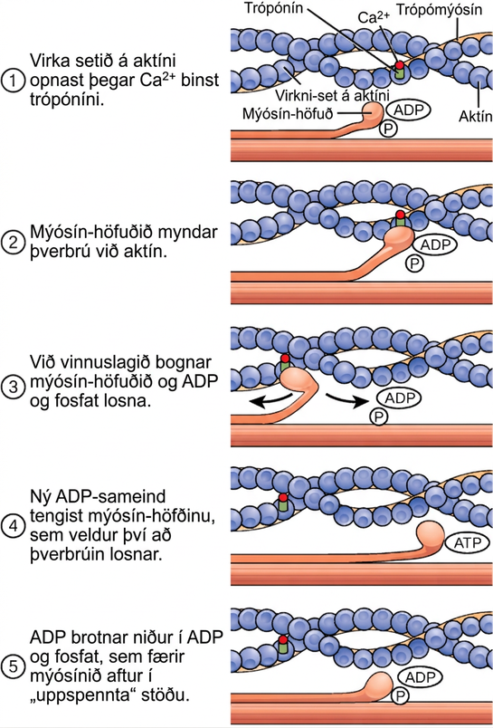
Figure 38.37
The cross-bridge muscle contraction cycle, which is triggered by Ca2+ binding to the actin active site, is shown. With each contraction cycle, actin moves relative to myosin.
Notes:
Illustration shows two actin filaments coiled with tropomyosin in a helix, sitting beside a myosin filament. Each actin filament is made of round actin subunits linked in a chain. A bulbous myosin head with A D P and phosphate attached sticks up from the myosin filament. The contraction cycle begins when calcium binds to the actin filament, allowing the myosin head to from a cross bridge. During the power stroke, the myosin head bends and A D P and phosphate are released. As a result, the actin filament moves relative to the myosin filament. A new molecule of A T P binds to the myosin head, causing it to detach. The A T P hydrolyzes to A D P and phosphate, returning the myosin head to the cocked position.

Slide 44
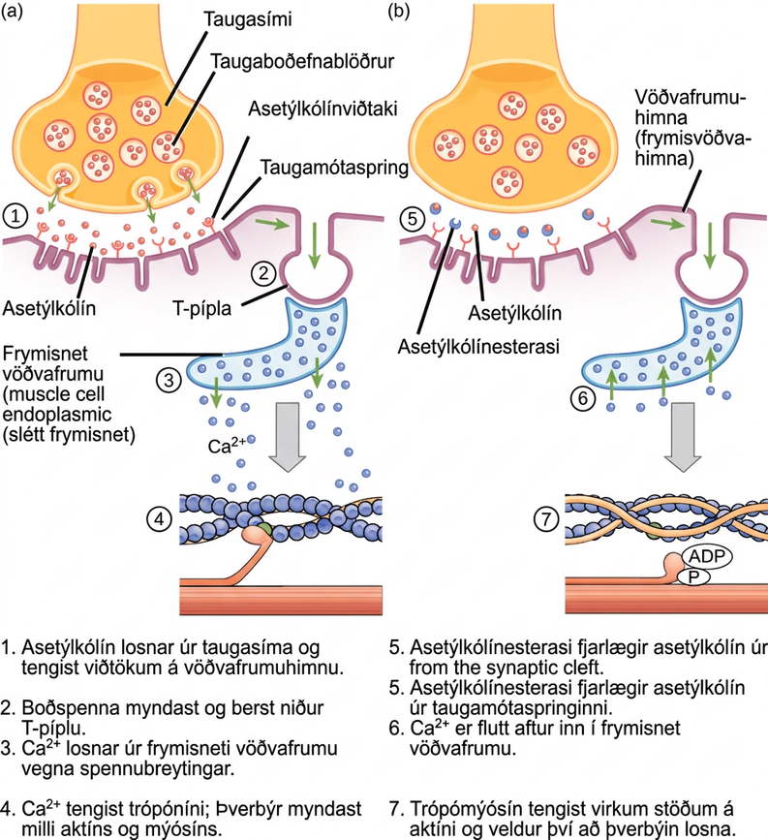
Figure 38.38
This diagram shows excitation-contraction coupling in a skeletal muscle contraction. The sarcoplasmic reticulum is a specialized endoplasmic reticulum found in muscle cells.
This OpenStax ancillary resource is © Rice University under a CC BY-NC-SA 4.0 International license; it may be reproduced or modified for noncommercial purposes only but must be attributed to OpenStax, Rice University and any changes must be noted. Any adaptation must be shared under the same type of license.
Notes:
There are four steps in the start of a muscle contraction. Step 1: Acetylcholine released from synaptic vesicles in the axon terminal binds to receptors on the muscle cell plasma membrane. Step 2: An action potential is initiated that travels down the T tubule. Step 3: Calcium ions are released from the sarcoplasmic reticulum in response to the change in voltage. Step 4: Calcium ions bind to troponin, exposing active sites on actin. Cross-bridge formation occurs and muscles contract. Three additional steps are part of the end of a muscle contraction. Step 5: Acetylcholine is removed from the synaptic cleft by acetylcholinesterase. Step 6: Calcium ions are transported back into the sarcoplasmic reticulum. Step 7: Tropomyosin covers active sites on actin preventing cross-bridge formation, so the muscle contraction ends.

