Slide 1

Biology 2e
Chapter 33 The Animal Body: Basic Form and Function

Slide 2
Chapter outline
Animal Form and Function
Animal Primary Tissues
Homeostasis

Slide 3
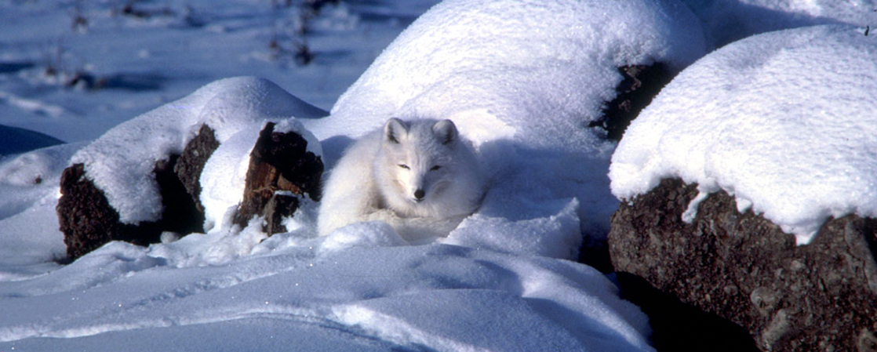
Figure 33.1
An arctic fox is a complex animal, well adapted to its environment. It changes coat color with the seasons, and has longer fur in winter to trap heat. (credit: modification of work by Keith Morehouse, USFWS)
Notes:
Photo shows a white arctic fox that blends in with the snow.

Slide 4
33.1 Animal Form and Function
Learning Objectives
Describe the various types of body plans that occur in animals
Describe limits on animal size and shape
Relate bioenergetics to body size, levels of activity, and the environment

Slide 5
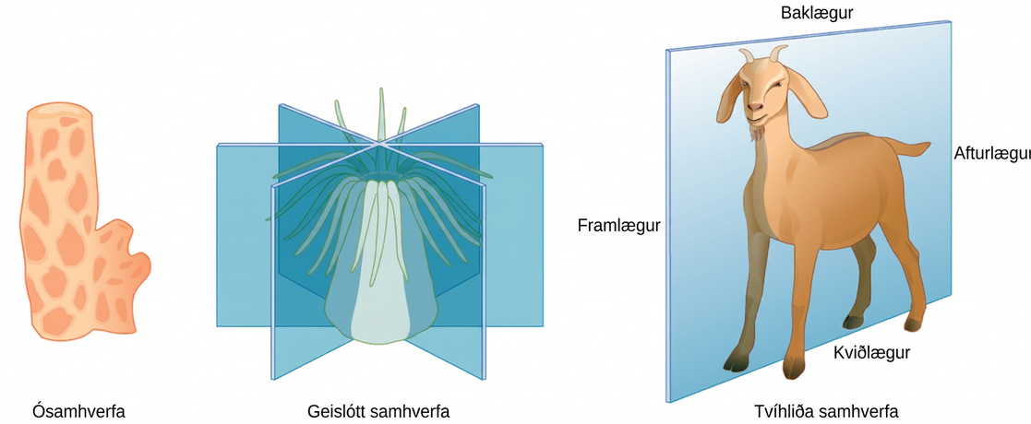
Figure 33.2
Animals exhibit different types of body symmetry. The sponge is asymmetrical, the sea anemone has radial symmetry, and the goat has bilateral symmetry.
Notes:
Illustration A shows an asymmetrical sponge with a tube-like body and a growth off to one side. Illustration B shows a sea anemone with a tube-like, radially symmetrical body. Tentacles grow from the top of the tube. Three vertical planes arranged 120 degrees apart dissect the body. The half of the body on one side of each plane is a mirror image of the body on the other side. Illustration C shows a goat with a bilaterally symmetrical body. A plane runs from front to back through the middle of the goat, dissecting the body into left and right halves, which are mirror images of each other. The top part of the goat is defined as dorsal, and the bottom part is defined as ventral. The front of the goat is defined as anterior, and the back is defined as posterior.

Slide 6
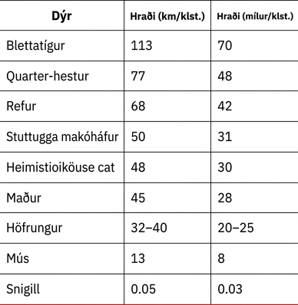
Table 33.1

Slide 7
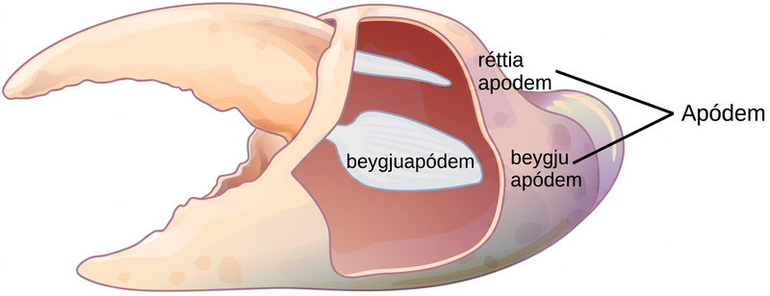
Figure 33.3
Apodemes are ingrowths on arthropod exoskeletons to which muscles attach. The apodemes on this crab leg are located above and below the fulcrum of the claw. Contraction of muscles attached to the apodemes pulls the claw closed.
Notes:
Illustration shows a crab claw with a small, upper portion that pivots relative to a large, lower portion. The apodemes are located on the large portion, above and below the pivot point.

Slide 8
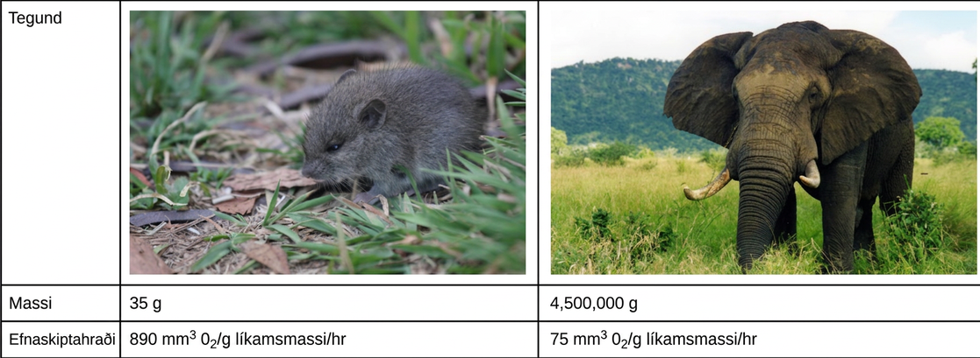
Figure 33.4
The mouse has a much higher metabolic rate than the elephant. (credit “mouse”: modification of work by Magnus Kjaergaard; credit “elephant”: modification of work by “TheLizardQueen”/Flickr)
Notes:
A mouse has an average mass of 35 grams and a metabolic rate of 890 millimeters cubed of oxygen per gram body mass per hour. The elephant has an average mass of 4,500 k g and a metabolic rate of 75 millimeters cubed of oxygen per gram body mass per hour.

Slide 9
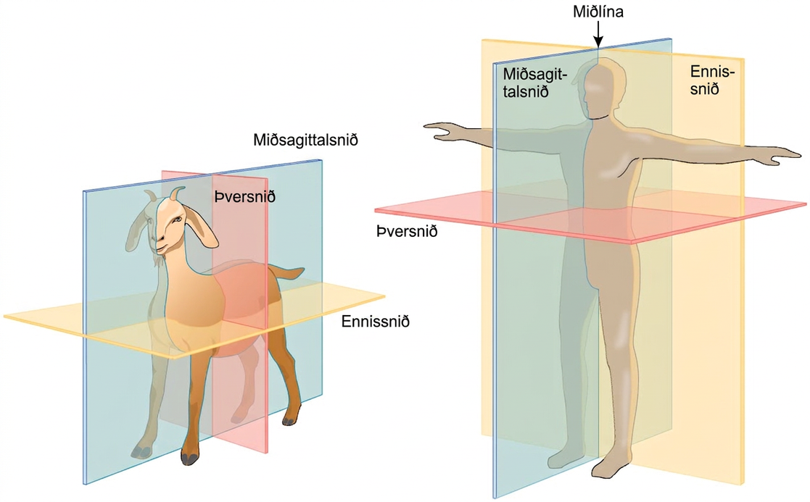
Figure 33.5
Shown are the planes of a quadrupedal goat and a bipedal human. The midsagittal plane divides the body exactly in half, into right and left portions. The frontal plane divides the front and back, and the transverse plane divides the body into upper and lower portions.
Notes:
Illustration A shows the planes of a goat body. The midsagittal plane runs through the middle of the goat from front to back, separating the right and left sides. The frontal plane also runs from front to back, but separates the upper half of the body from the lower half. The transverse plane runs across the middle of the goat, and separate the front and back halves of the body. Illustration B shows the planes of a human body. The midsagittal plane runs from top to bottom and separates the right and left halves of the body. The Frontal plane also runs from top to bottom and separates the front and back halves of the body. The Transverse plane dissects the middle of the body between the chest and abdomen, separating the top of the body from the bottom. The midline is an imaginary line running through the middle of the body, from top to bottom.

Slide 10
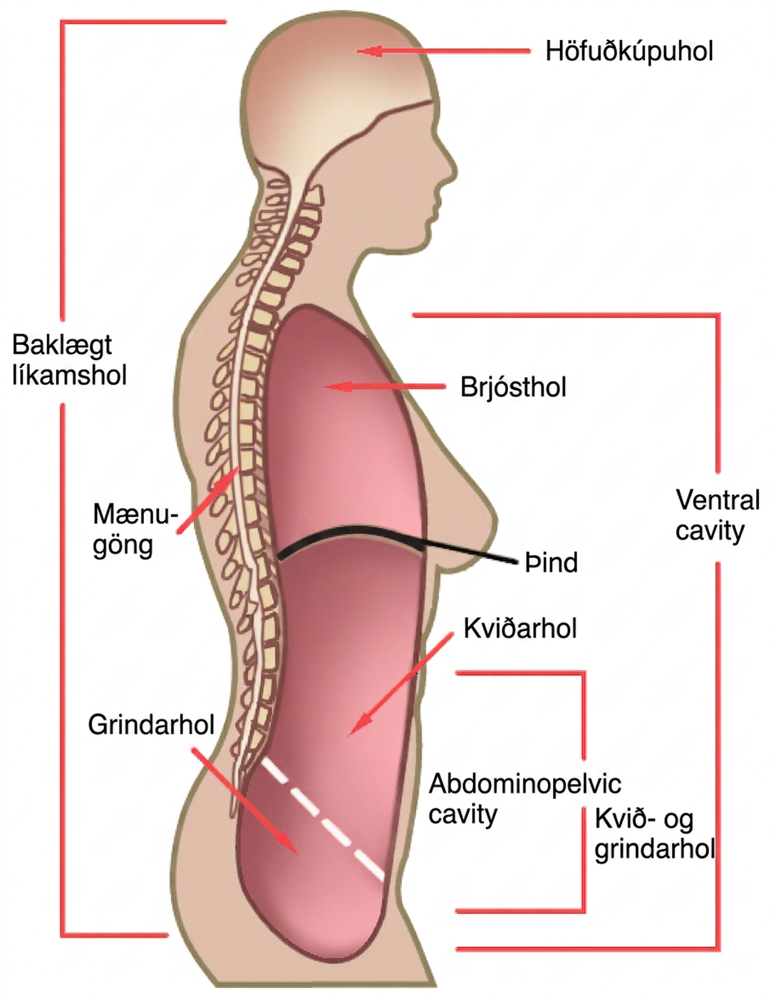
Figure 33.6
Vertebrate animals have two major body cavities. The dorsal cavity contains the cranial and the spinal cavity. The ventral cavity contains the thoracic cavity and the abdominopelvic cavity. The thoracic cavity is separated from the abdominopelvic cavity by the diaphragm. The abdominopelvic cavity is separated into the abdominal cavity and the pelvic cavity by an imaginary line parallel to the pelvis bones. (credit: modification of work by NCI)
Notes:
Illustration shows a cross-sectional side view of the upper part of a human body. The entire head region above the eyes and to the back of the head and a long thin strip from this region down the back is shaded to indicate the dorsal cavity. The head is labeled cranial cavity and the long thin region down the back is the spinal cavity. A large oblong area shaded at the front of the body indicates the ventral cavity. It is labeled from top to bottom as thoracic cavity, diaphragm (thin line separating regions), abdominal cavity, and pelvic cavity. The abdominal and pelvic cavities are separated by a thin dashed line and together they are labeled the abdominopelvic cavity.

Slide 11
33.2 Animal Primary Tissues
Learning Objectives
Describe epithelial tissues
Discuss the different types of connective tissues in animals
Describe three types of muscle tissues
Describe nervous tissue

Slide 12
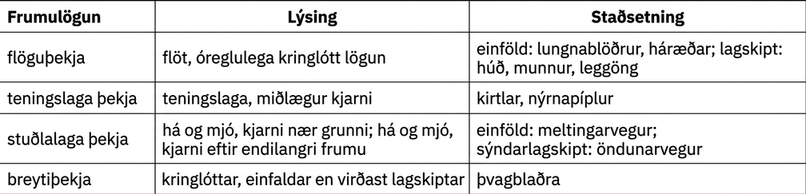
Table 33.2

Slide 13
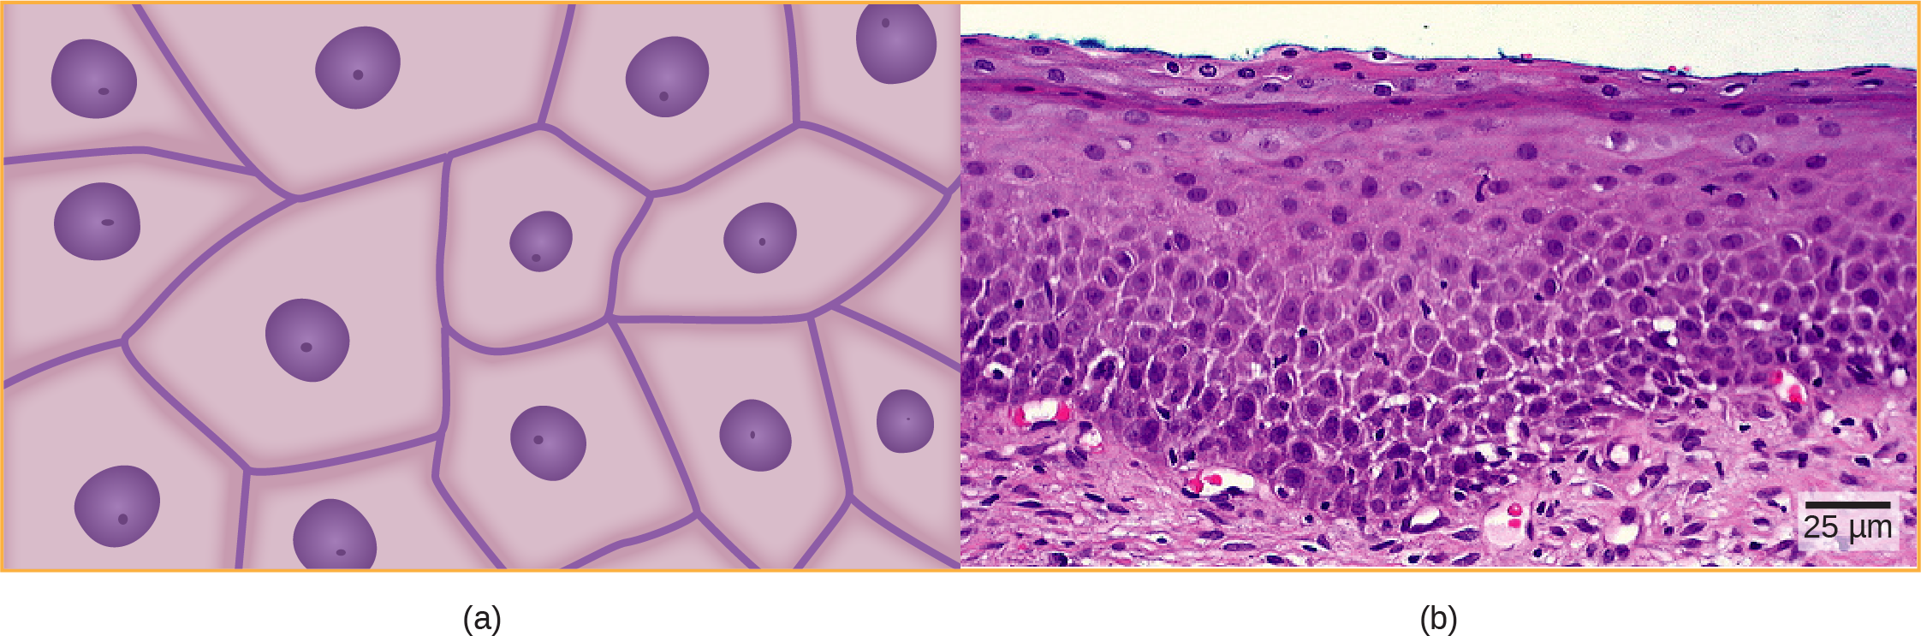
Figure 33.7
Squamous epithelia cells (a) have a slightly irregular shape, and a small, centrally located nucleus. These cells can be stratified into layers, as in (b) this human cervix specimen. (credit b: modification of work by Ed Uthman; scale-bar data from Matt Russell)
Notes:
Illustration A shows irregularly shaped cells with a central nucleus. Micrograph B shows a cross section of squamous cells from the human cervix. In the upper layer the cells appear to be tightly packed. In they middle layer they appear to be more loosely packed, and in the lower layer they are flatter and elongated.

Slide 14
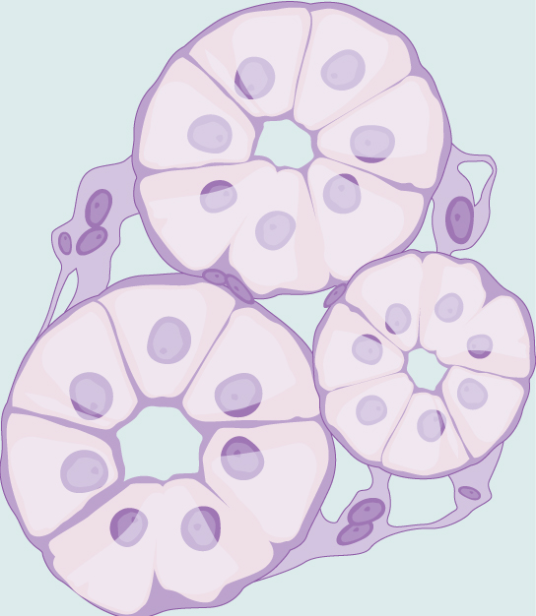
Figure 33.8
Simple cuboidal epithelial cells line tubules in the mammalian kidney, where they are involved in filtering the blood.
Notes:
Illustration shows cells, shaped like slices of pie, arranged in a circle. The hub of the circle is empty. Three of these circles of cells cluster together.

Slide 15
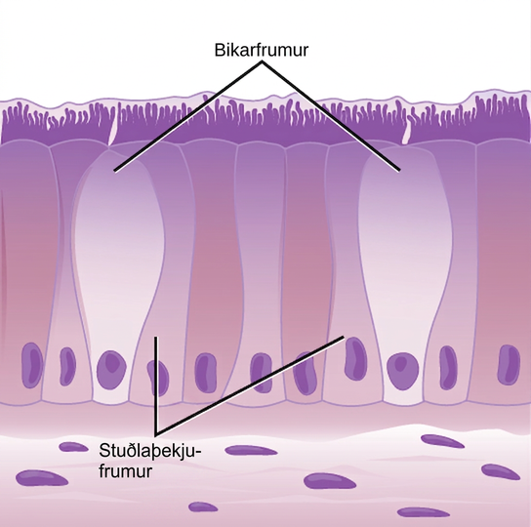
Figure 33.9
Simple columnar epithelial cells absorb material from the digestive tract. Goblet cells secrete mucus into the digestive tract lumen.
Notes:
Illustration shows tall, columnar cells arranged side-by-side. Each cell has a nucleus located near the bottom, and cilia extending from the top. Two oval goblet cells are interspersed among the columnar epithelial cells. The goblet cells, which are shorter than the columnar cells, are in direct contact with the intestinal lumen. Beneath the columnar cells is a layer of horizontal cells.

Slide 16
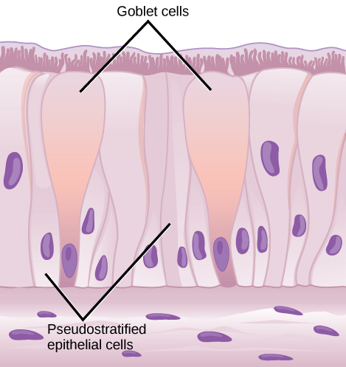
Figure 33.10
Pseudostratified columnar epithelia line the respiratory tract. They exist in one layer, but the arrangement of nuclei at different levels makes it appear that there is more than one layer. Goblet cells interspersed between the columnar epithelial cells secrete mucus into the respiratory tract.
Notes:
Illustration shows columnar cells arranged side-by-side. The cells are wide at the top, and thin at the bottom. Shorter columnar cells are interspersed between the lower, thin part of the tall columnar cells. Some of these cells extend to the surface of the epithelium, but they are very thin at the top. The nuclei of the tall columnar cells are located near the top, and the nuclei of the shorter columnar cells are located near the bottom, giving the appearance of two layers of cells. Cilia extend from the top of the tall columnar cells. Oval goblet cells are interspersed among the columnar epithelial cells. Beneath the columnar cells is a layer of horizontal cells.

Slide 17
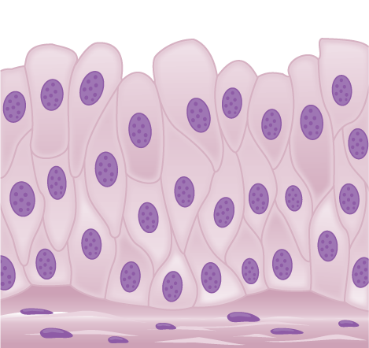
Figure 33.11
Transitional epithelia of the urinary bladder undergo changes in thickness depending on how full the bladder is.
Notes:
Illustration shows tall, diamond-shaped cells layered one on top of the other.

Slide 18
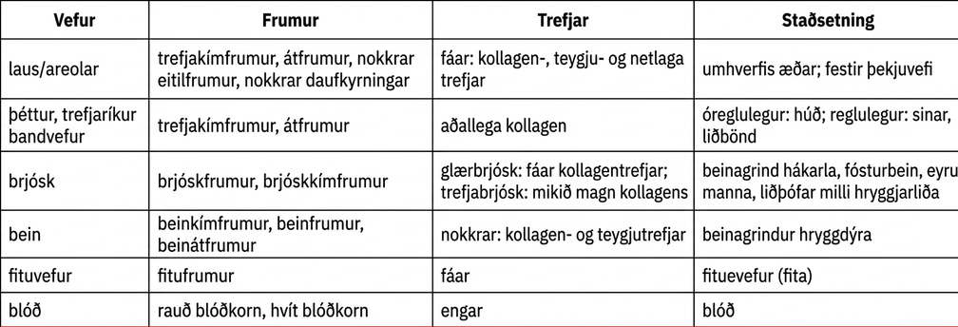
Table 33.3

Slide 19
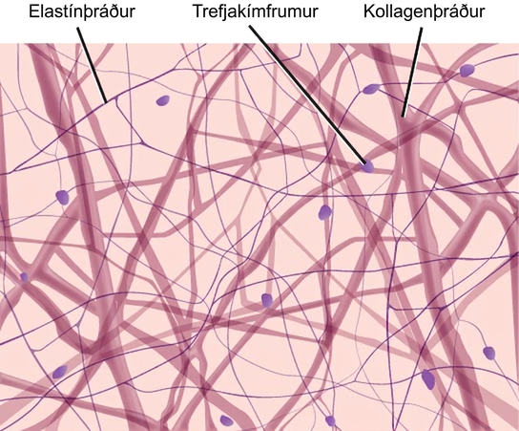
Figure 33.12
Loose connective tissue is composed of loosely woven collagen and elastic fibers. The fibers and other components of the connective tissue matrix are secreted by fibroblasts.
Notes:
Illustration shows thick collagen fibers and thin elastin fibers loosely woven together in an irregular network. Oval fibroblasts are interspersed among the fibers.

Slide 20
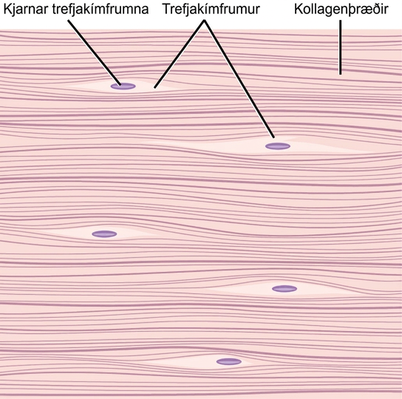
Figure 33.13
Fibrous connective tissue from the tendon has strands of collagen fibers lined up in parallel.
Notes:
Illustration shows parallel collagen fibers packed tightly together. Interspersed among the collagen fibers are long, thin fibroblasts.

Slide 21
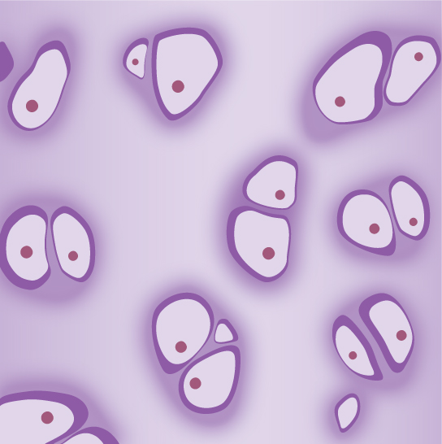
Figure 33.14
Hyaline cartilage consists of a matrix with cells called chondrocytes embedded in it. The chondrocytes exist in cavities in the matrix called lacunae.
Notes:
Illustration shows pairs of chondrocytes embedded in a matrix. The parts of the cells that face one another are flat, and the outer surfaces are rounded. Each cell has a small, rounded nucleus.

Slide 22
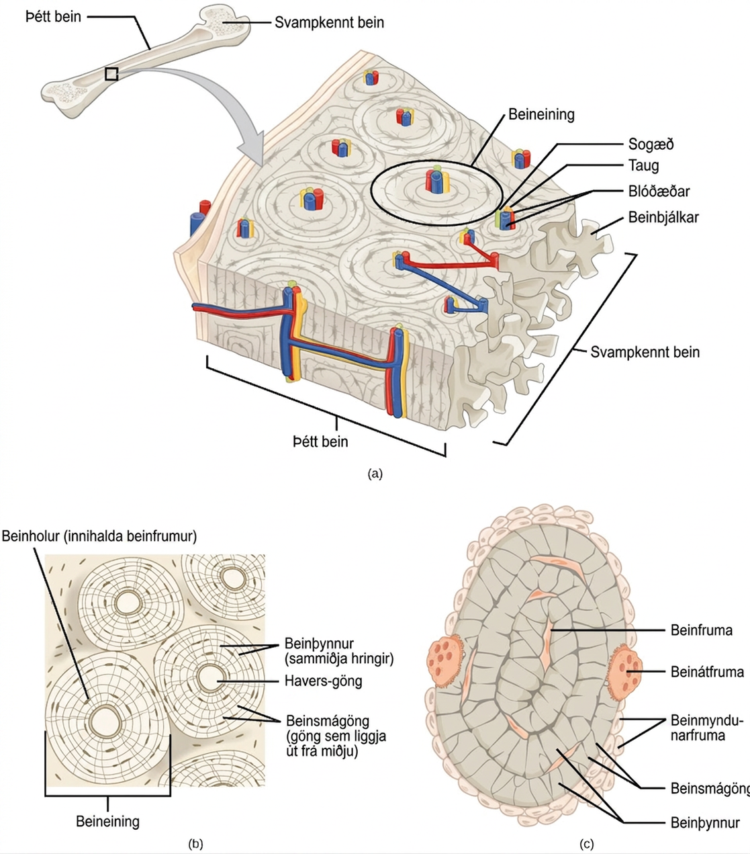
Figure 33.15
(a) Compact bone is a dense matrix on the outer surface of bone. Spongy bone, inside the compact bone, is porous with web-like trabeculae. (b) Compact bone is organized into rings called osteons. Blood vessels, nerves, and lymphatic vessels are found in the central Haversian canal. Rings of lamellae surround the Haversian canal. Between the lamellae are cavities called lacunae. Canaliculi are microchannels connecting the lacunae together. (c) Osteoblasts surround the exterior of the bone. Osteoclasts bore tunnels into the bone and osteocytes are found in the lacunae.
Notes:
Illustration A shows a cross section of a long bone with wide protrusions at either end. The outer part is compact bone. Inside the compact bone is porous spongy bone made of web-like trabreculae. The spongy bone fills the wide part at either end of the bone. In the middle, a hollow exists inside the spongy bone. Illustration B shows several circular osteons clustered together in compact bone. At the hub of each osteon is an opening called the Haversian canal filled with blood and lymph vessels and nerves. The lamellae surrounding the Haversian canal resemble concentric circles. Lacunae are wide spaces that contain osteocytes, in the rings between the lamellae. Microchannels called canaliculi radiate through the rings out from the central Haversian canal, connecting the lacunae together. Illustration C shows small osteoblasts surrounding the outside of bone. Larger osteoclasts are also on the outer surface, forming a hollow in the bone. Osteocytes are long, thin cells in the lacunae.

Slide 23
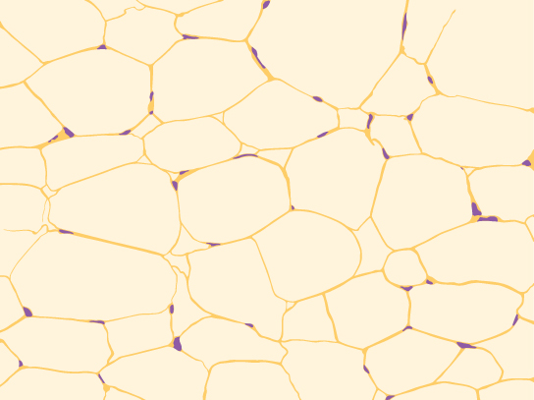
Figure 33.16
Adipose is a connective tissue made up of cells called adipocytes. Adipocytes have small nuclei localized at the cell edge.
Notes:
Illustration shows irregularly shaped cells with tiny nuclei clustered next to the cells’ outer membrane.

Slide 24
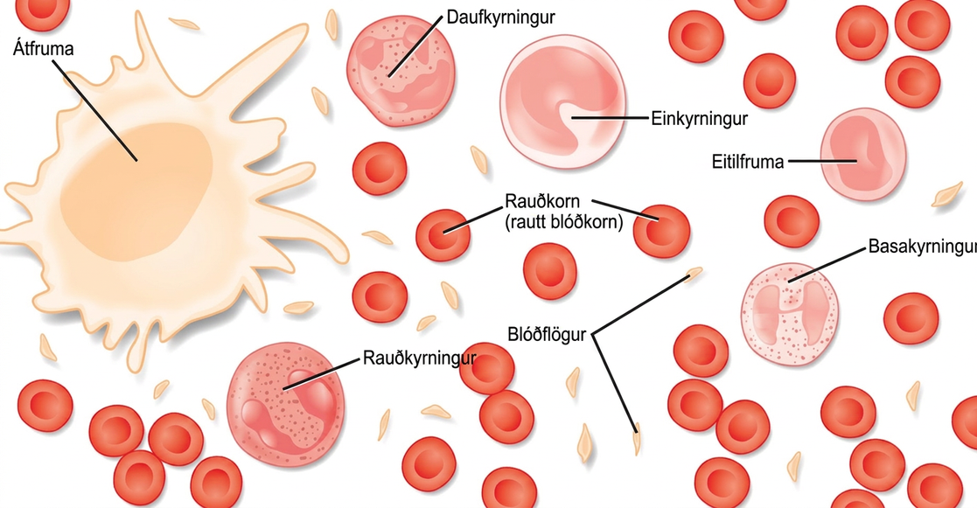
Figure 33.17
Blood is a connective tissue that has a fluid matrix, called plasma, and no fibers. Erythrocytes (red blood cells), the predominant cell type, are involved in the transport of oxygen and carbon dioxide. Also present are various leukocytes (white blood cells) involved in immune response.
Notes:
Different types of blood cells are shown. Red blood cells are disc-shaped, with a central indentation. Platelets are much smaller than red blood cells, narrow and long. Neutrophils, eosinophils, lymphocytes, monocytes and basophils are all about three times the diameter of a red blood cell and round. They differ in the shape of the nucleus, and in the presence or absence of granules in the cytoplasm. Macrophages, which are the largest cell type, have pseudopods which give them an irregular shape.

Slide 25
Table 33.4
Type of Muscle | Striations | Nuclei | Control | Location
smooth | no | single, in center | involuntary | visceral organs
skeletal | yes | many, at periphery | voluntary | skeletal muscles
cardiac | yes | single, in center | involuntary | heart

Slide 26
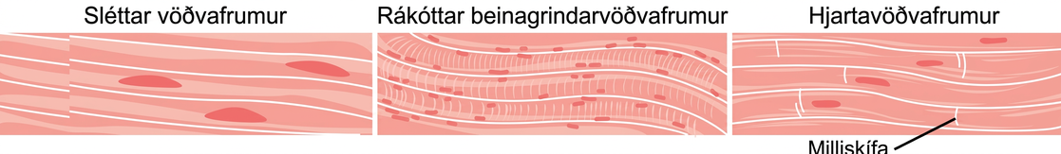
Figure 33.18
Smooth muscle cells do not have striations, while skeletal muscle cells do. Cardiac muscle cells have striations, but, unlike the multinucleate skeletal cells, they have only one nucleus. Cardiac muscle tissue also has intercalated discs, specialized regions running along the plasma membrane that join adjacent cardiac muscle cells and assist in passing an electrical impulse from cell to cell.
Notes:
The smooth muscle cells are long and arranged in parallel bands. Each cell has a long, narrow nucleus. Skeletal muscle cells are also long but have striations across them and many small nuclei per cell. Cardiac muscles are shorter than smooth or skeletal muscle cells, and each cell has one nucleus.

Slide 27
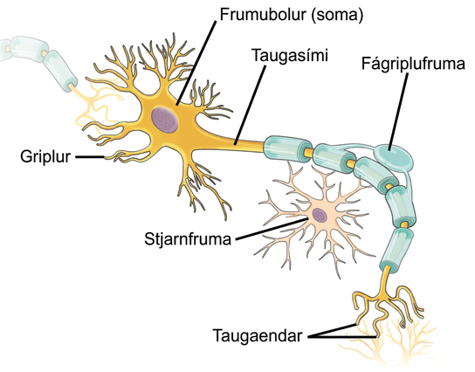
Figure 33.19
The neuron has projections called dendrites that receive signals and projections called axons that send signals. Also shown are two types of glial cells: astrocytes regulate the chemical environment of the nerve cell, and oligodendrocytes insulate the axon so the electrical nerve impulse is transferred more efficiently.
Notes:
Illustration shows a neuron which has an oval cell body, labeled as a soma. Branchlike dendrites extend from three sides of the body. A long, thin axon extends from the fourth side. At the end of the axon are branchlike terminals, called axon terminals. A cell called an oligodendrocyte grows alongside the axon. Projections from the oligodendrocyte wrap around the axon, forming a myelin sheath. Another cell called an astrocyte sits alongside the axon.

Slide 28
33.3 Homeostasis
Learning Objectives
Define homeostasis
Describe the factors affecting homeostasis
Discuss positive and negative feedback mechanisms used in homeostasis
Describe thermoregulation of endothermic and ectothermic animals

Slide 29
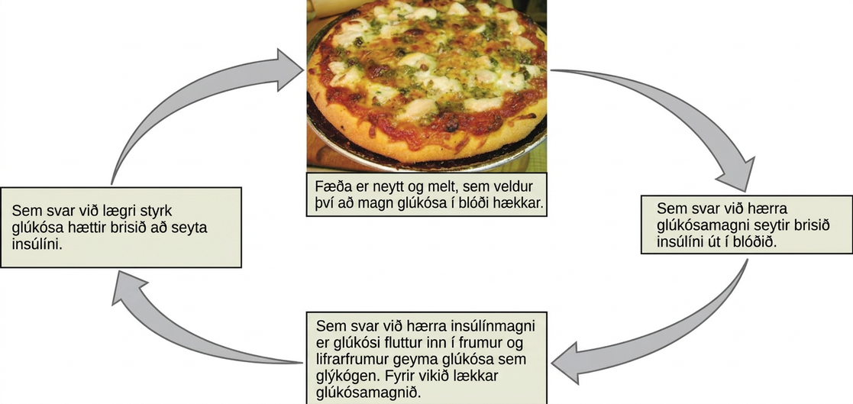
Figure 33.20
Blood sugar levels are controlled by a negative feedback loop. (credit: modification of work by Jon Sullivan)
Notes:
Illustration shows the response to consuming a meal. When food is consumed and digested, blood glucose levels rise. In response to the higher concentration of glucose, the pancreas secretes insulin into the blood. In response to the higher insulin levels in the blood, glucose is transported into many body cells. Liver cells store glucose as glycogen. As a result, glucose levels drop. In response to the lower concentration of glucose, the pancreas stops secreting insulin.

Slide 30
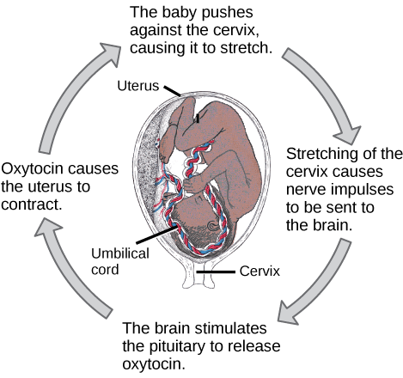
Figure 33.21
The birth of a human infant is the result of positive feedback.
Notes:
Prior to birth, the baby pushes against the cervix, causing it to stretch. Stretching of the cervix causes nerve impulses to be sent to the brain. As a result, the brain stimulates the pituitary to release oxytocin. Oxytocin causes the uterus to contract. As a result, the baby pushes against the cervix in a positive feedback loop.

Slide 31
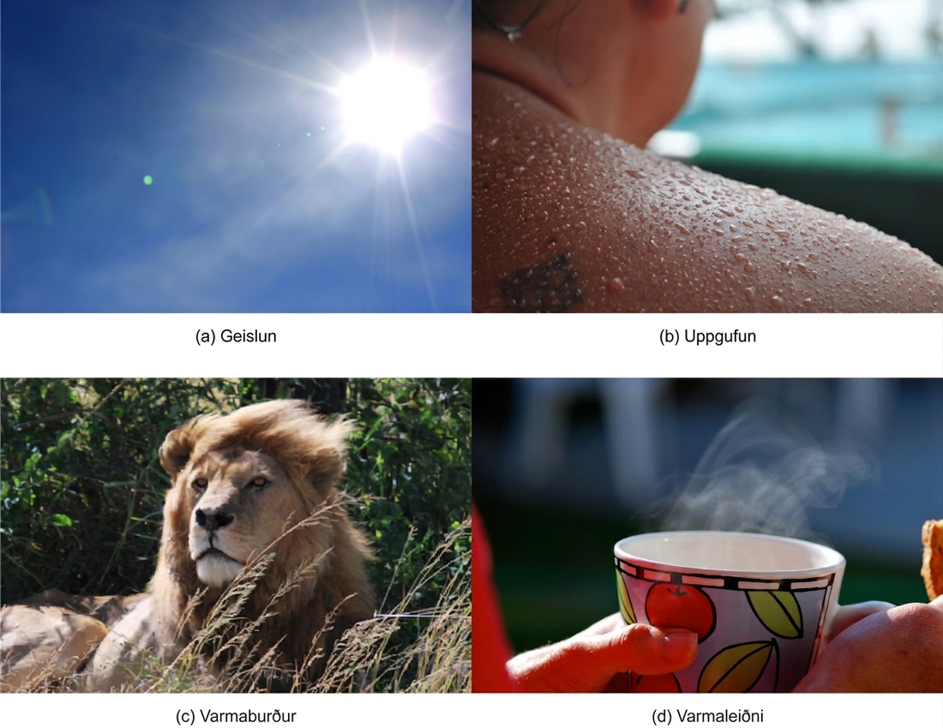
Figure 33.22
Heat can be exchanged by four mechanisms: (a) radiation, (b) evaporation, (c) convection, or (d) conduction. (credit b: modification of work by “Kullez”/Flickr; credit c: modification of work by Chad Rosenthal; credit d: modification of work by “stacey.d”/Flickr)
Notes:
Photo A shows the sun. Photo B shows a sweaty person. Photo C shows a lion with its mane blowing in the wind. Photo D shows a person holding a steaming hot drink.

Slide 32
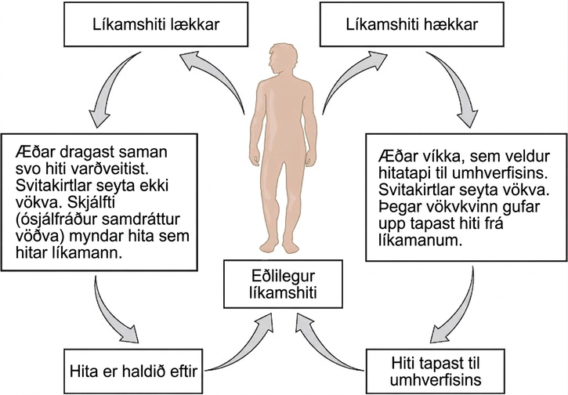
Figure 33.23
The body is able to regulate temperature in response to signals from the nervous system.
This OpenStax ancillary resource is © Rice University under a CC BY-NC-SA 4.0 International license; it may be reproduced or modified for noncommercial purposes only but must be attributed to OpenStax, Rice University and any changes must be noted. Any adaptation must be shared under the same type of license.
Notes:
Flow chart shows how normal body temperature is maintained. If the body temperature rises, blood vessels dilate, resulting in loss of heat to the environment. Sweat glands secrete fluid. As this fluid evaporates, heat is lost from the body. As a result, the body temperature falls to normal body temperature. If body temperature falls, blood vessels constrict so that heat is conserved. Sweat glands do not secrete fluid. Shivering (involuntary contraction of muscles) releases heat which warms the body. Heat is retained, and body temperature increases to normal.

