Slide 1

Biology 2e
Chapter 17 Biotechnology and Genomics

Slide 2
Chapter outline
Biotechnology
Mapping Genomes
Whole-Genome Sequencing
Applying Genomics
Genomics and Proteomics

Slide 3
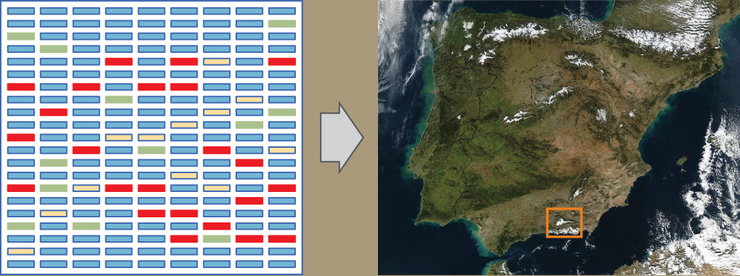
Figure 17.1
Genomics compares the DNA of different organisms, enabling scientists to create maps with which to navigate different organisms' DNA. (credit "map": modification of photo by NASA)
Notes:
The left part of this image is an illustration of a gene chip. The chip is a grid comprising nine columns and 21 rows. Most cells in the grid are blue, but some are green, yellow, or red. The green, yellow, or red color shows that D N A has hybridized with the chip, indicating the presence of a particular gene. The right part of the image is a satellite image of Spain, with a small region outlined in a square. This image is meant to reinforce the concept that, like regions of the world, D N A can be mapped.

Slide 4
17.1 Biotechnology
Learning Objectives
Describe gel electrophoresis
Explain molecular and reproductive cloning
Describe biotechnology uses in medicine and agriculture

Slide 5
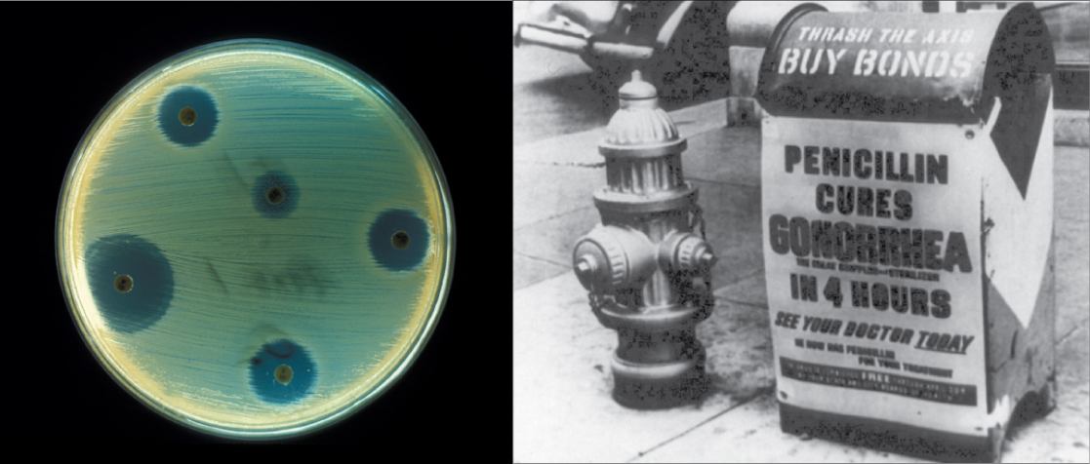
Figure 17.2
Fungi, bacteria, and other organisms that have antimicrobial properties produce antibiotics. The first antibiotic discovered was penicillin. Pharmaceutical companies now commercially produce and test antibiotics for their potential to inhibit bacterial growth. (credit "advertisement": modification of work by NIH; credit "test plate": modification of work by Don Stalons/CDC; scale-bar data from Matt Russell)
Notes:
The right side of this image is an old black and white photo of a mailbox plastered with an advertisement that says, Penicillin cures gonorrhea in four hours. See your doctor today. The left side of the image shows a petri dish streaked with bacteria. Bacteria grow everywhere on the plate except where discs containing antibiotic have been placed. These areas are completely devoid of bacterial growth.

Slide 6
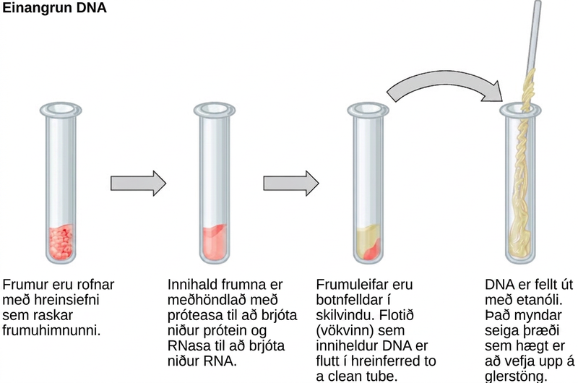
Figure 17.3
This diagram shows the basic method of DNA extraction.
Notes:
This illustration shows the four main steps of D N A extraction. In the first step, cells in a test tube are lysed using a detergent that disrupts the plasma membrane. In the second step, cell contents are treated with protease to destroy protein, and RNAase to destroy R N A. The resulting slurry is centrifuged to pellet the cell debris. The supernatant, or liquid, containing the D N A is then transferred to a clean test tube. The D N A is precipitated with ethanol. It forms viscous, mucous-like strands that can be spooled on a glass rod.

Slide 7
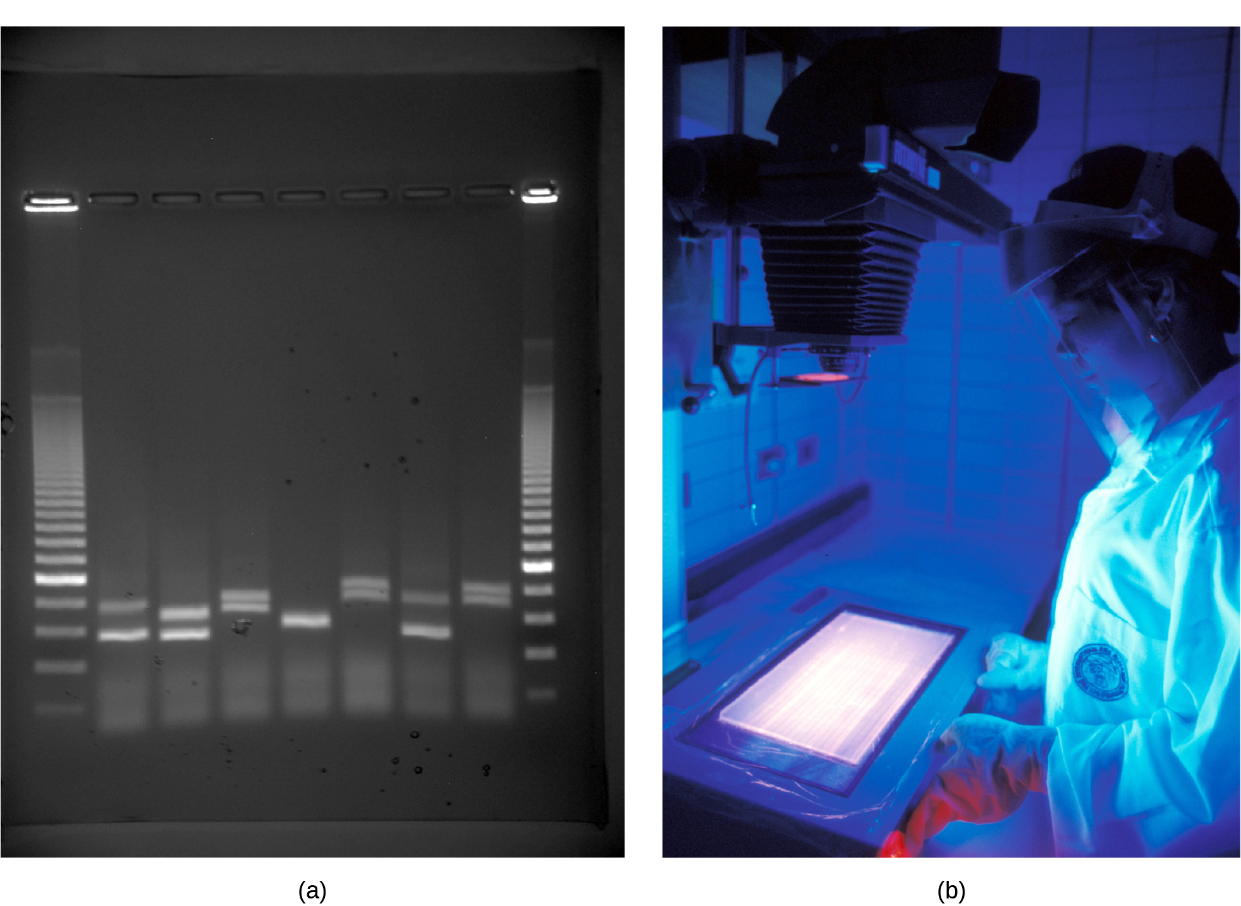
Figure 17.4
a) Shown are DNA fragments from seven samples run on a gel, stained with a fluorescent dye, and viewed under UV light; and b) a researcher from International Rice Research Institute, reviewing DNA profiles using UV light. (credit: a: James Jacob, Tompkins Cortland Community College b: International Rice Research Institute)
Notes:
Photo shows an agarose gel illuminated under U V light. The gel contains nine lanes from left to right. Each lane was loaded with a sample containing D N A fragments of differing size that separated as they travelled through the gel from top to bottom. The D N A appears as thin, white bands on a black background. Lanes one and nine contain many bands from a D N A standard. These bands are closely spaced toward the top, and spaced farther apart further down the gel. Lanes two through eight contain one or two bands each. Some of these bands are identical in size and run the same distance into the gel. Others run a slightly different distance, indicating a small difference in size. Image b shows a researcher working at a machine where she is observing D N A under ultraviolet light.

Slide 8
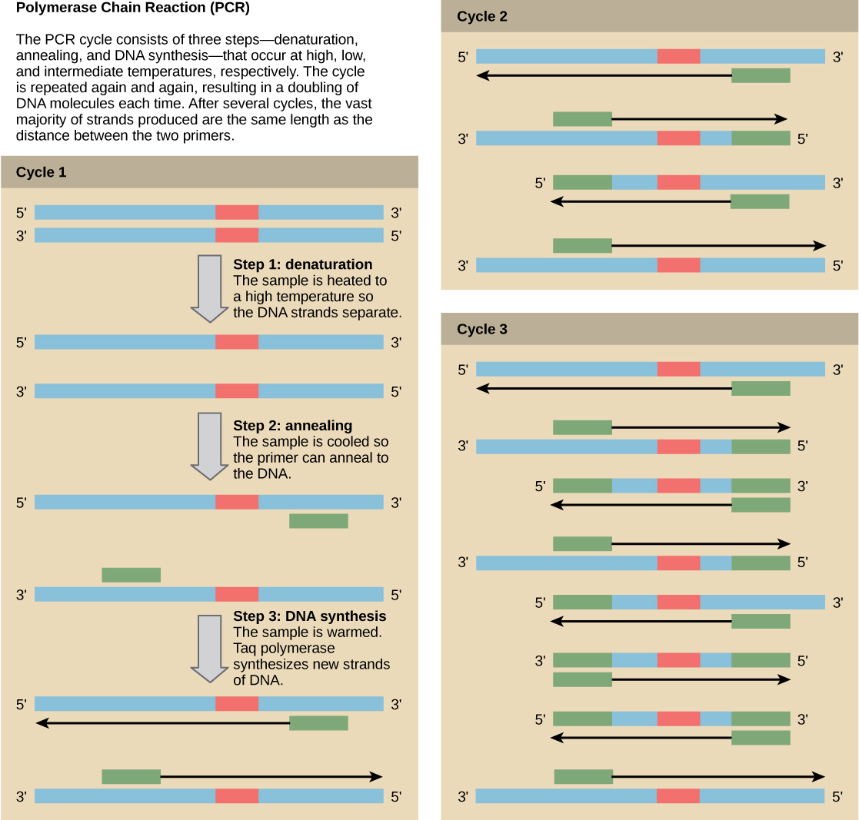
Figure 17.5
Scientists use polymerase chain reaction, or PCR, to amplify a specific DNA sequence. Primers—short pieces of DNA complementary to each end of the target sequence combine with genomic DNA, Taq polymerase, and deoxynucleotides. Taq polymerase is a DNA polymerase isolated from the thermostable bacterium Thermus aquaticus that is able to withstand the high temperatures that scientists use in PCR. Thermus aquaticus grows in the Lower Geyser Basin of Yellowstone National Park. Reverse transcriptase PCR (RT-PCR) is similar to PCR, but cDNA is made from an RNA template before PCR begins.
Notes:
Illustration shows the amplification of a D N A sequence by the polymerase chain reaction. P C R consists of three steps; denaturation, annealing, and D N A synthesis; that occur at high, low, and intermediate temperatures. In step 1, the denaturation step, the sample is heated to a high temperature so the D N A strands separate. In step 2, annealing, the sample is cooled so two primers can anneal to the two strands of D N A. The primers are spaced such that the sequence of interest between them will be amplified. In step 3, D N A synthesis, the sample is warmed to the optimal temperature for Taq polymerase, which synthesizes the complementary strand from the primer to the 3 prime end of the molecule. This cycle is repeated again and again. Each time, the newly synthesized strands serve as templates so that the amount of D N A doubles with each cycle. As the cycles continue, more and more strands are the size of the distance between the two primers; in the end, the vast majority of strands are this size.

Slide 9
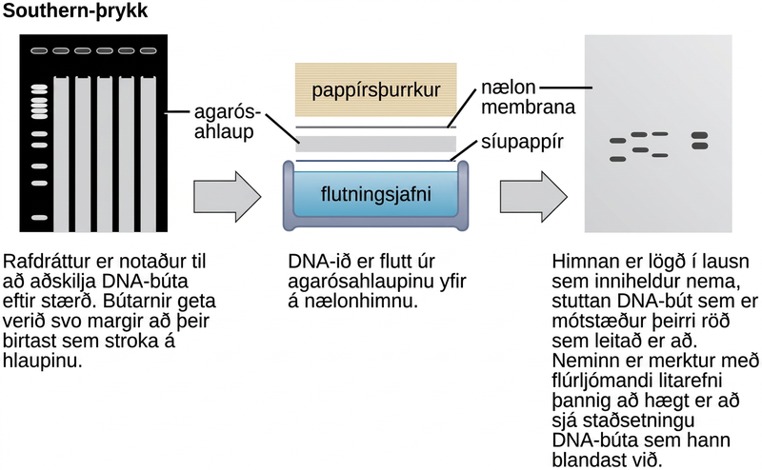
Figure 17.6
Scientists use Southern blotting to find a particular sequence in a DNA sample. Scientists separate DNA fragments on a gel, transfer them to a nylon membrane, and incubate them with a DNA probe complementary to the sequence of interest. Northern blotting is similar to Southern blotting, but scientists run RNA on the gel instead of DNA. In Western blotting, scientists run proteins on a gel and detect them using antibodies.
Notes:
In Southern blotting, D N A is separated on the basis of size by agarose gel electrophoresis. The fragments run through the gel from top to bottom. In the gel shown in this figure, there are so many D N A fragments they appear as a smear in each lane. The D N A from the gel is transferred to a nylon membrane. To do so, the gel is sandwiched between filter paper and the membrane and placed in transfer buffer. Paper towels above the gel wick up the moisture and assist in the transfer. The nylon membrane is then incubated with a radioactively or fluorescently labeled probe that is complementary to the sequence of interest. Discrete bands appear where the sequence of interest is located.

Slide 10
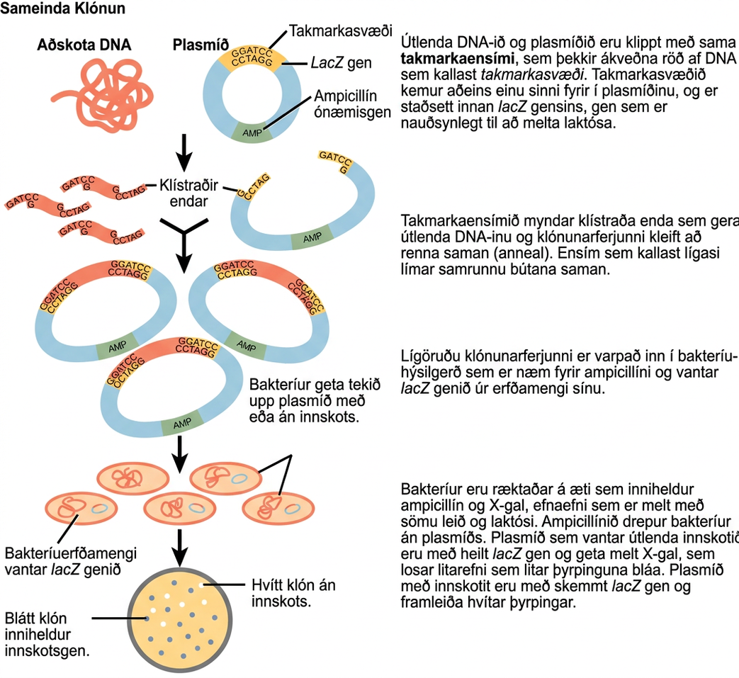
Figure 17.7
This diagram shows the steps involved in molecular cloning.
Notes:
This figure illustrates the steps in molecular cloning into a plasmid called a cloning vector. The vector has a lac Z gene, which is necessary for metabolizing lactose, and a gene for ampicillin resistance. Within the lac Z gene are restriction sites, sequences of D N A cut by a particular restriction enzyme. The D N A to be cloned and the plasmid are both cut by the same restriction enzyme. The restriction enzyme staggers the cuts on the two strands of D N A, such that each strand has an overhanging single-stranded bit of D N A. On one strand, the sequence of the overhang is G A T C, and on the other, the sequence is C T A G. These two sequences are complementary, and allow the fragment of foreign D N A to anneal with the plasmid. An enzyme called ligase joins the two pieces together. The ligated plasmid is then transformed into a bacterial strain that lacks the lac Z gene and is sensitive to the antibiotic ampicillin. The bacteria are plated on media containing ampicillin, so that only bacteria that have taking up the plasmid; which has an ampicillin resistance gene; will grow. The media also contains X gal, a chemical that is metabolized in the same way as lactose. Plasmids lacking the insert are able to metabolize X gal, releasing a dye from X gal that turns the colony blue. Plasmids with the insert have a disrupted lac Z gene and produce white colonies. Thus, colonies containing the cloned D N A can be selected on the basis of color.

Slide 11
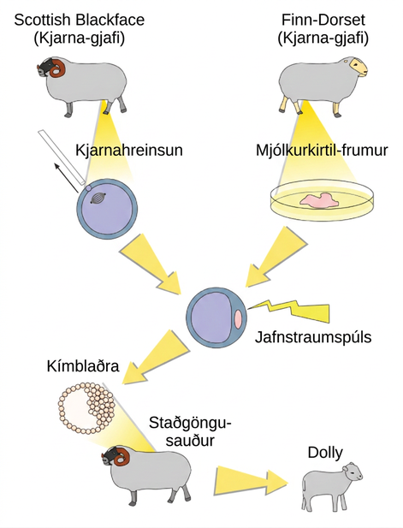
Figure 17.8
Dolly the sheep was the first mammal to be cloned. To create Dolly, they removed the nucleus from a donor egg cell. They then introduced the nucleus from a second sheep into the cell, which divided to the blastocyst stage before they implanted it in a surrogate mother. (credit: modification of work by "Squidonius"/Wikimedia Commons)
Notes:
To clone Dolly the sheep, a Scottish Blackface sheep was used as a cytoplasmic donor. Eggs from this sheep were extracted, and the nucleus removed. A Finn Dorset sheep was used as the nuclear donor. Nuclei were extracted from mammary cells, and direct electric current was used to fuse the nuclear D N A with the donor egg. The egg was then allowed to divide to the blastocyst stage, in which a sphere of cells contains a cluster of cells on one side. The blastocyst was implanted in a surrogate mother, resulting in Dolly the sheep.

Slide 12
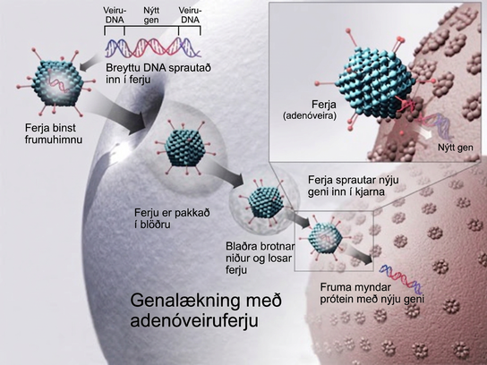
Figure 17.9
Gene therapy using an adenovirus vector can be used to cure certain genetic diseases in which a person has a defective gene. (credit: NIH)
Notes:
To cure disease using an adenovirus vector, a new gene intended to replace a defective one is packaged with the adenovirus genome. The genes that make the virus pathogenic are removed. The modified D N A is put inside the virus' capsid, or protein coat. The person to be cured is infected with the modified virus. Viral D N A enters the nucleus, where the modified gene can replace the defective one.

Slide 13
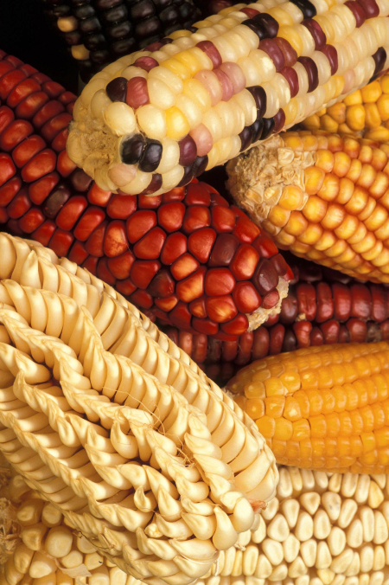
Figure 17.10
Corn, a major agricultural crop used to create products for a variety of industries, is often modified through plant biotechnology. (credit: Keith Weller, USDA)
Notes:
Photo shows corn cobs with different colors, including yellow, white, red, and a mixture of these colors.

Slide 14
17.2 Mapping Genomes
Learning Objectives
Define genomics
Describe genetic and physical maps
Describe genomic mapping methods

Slide 15
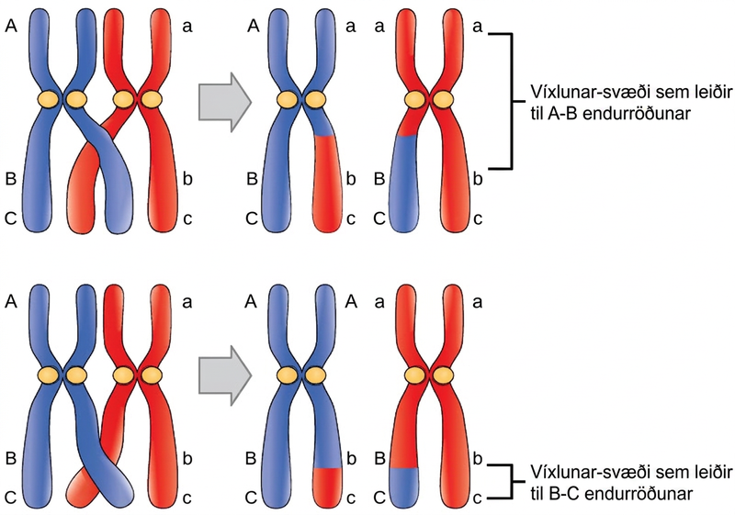
Figure 17.11
Crossover may occur at different locations on the chromosome. Recombination between genes A and B is more frequent than recombination between genes B and C because genes A and B are farther apart. Therefore, a crossover is more likely to occur between them.
Notes:
A homologous pair of chromosomes has three genes, named A, B, and C. Gene A is located near the top of the chromosome, and genes B and C are located close together near the bottom. Each chromosome has different A, B, and C alleles. The alleles may recombine if a crossover occurs between them, so that genetic material from one chromosome is swapped with another. Genes A and B are far apart on the chromosome such that a crossover event occurring almost anywhere in the chromosome will result in the recombination of alleles for these genes. Genes B and C are much closer together, so only crossovers occurring in a very narrow region will result in recombination of these genes.

Slide 16
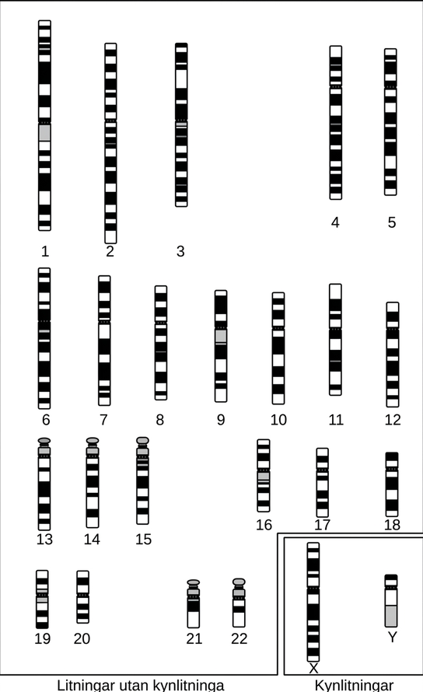
Figure 17.12
A cytogenetic map shows the appearance of a chromosome after scientists stain and exam it under a microscope. (credit: National Human Genome Research Institute)
Notes:
Cytogenetic maps of the 22 human autosomes and the X and Y chromosomes are shown. The map appears as a black, white, and gray banding pattern unique to each chromosome.

Slide 17
17.3 Whole-Genome Sequencing
Learning Objectives
Describe three types of sequencing
Define whole-genome sequencing

Slide 18
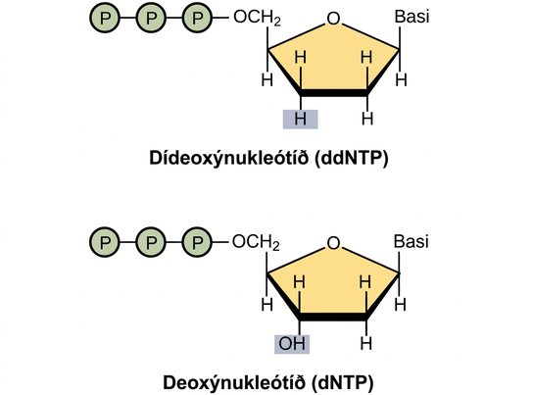
Figure 17.13
A dideoxynucleotide is similar in structure to a deoxynucleotide, but is missing the 3' hydroxyl group (indicated by the box). When a dideoxynucleotide is incorporated into a DNA strand, DNA synthesis stops.
Notes:
A deoxynucleotide consists of a deoxyribose sugar, a base, and three phosphate groups. Dideoxyribose is identical to deoxyribose except that the hydroxyl, upper case O upper case H, group at the 3 prime position is replaced by upper case H. A 3 prime hydroxyl is necessary for elongation of the D N A chain, and the chain therefore stops growing if a dideoxyribose instead of deoxyribose is incorporated into the growing chain.

Slide 19
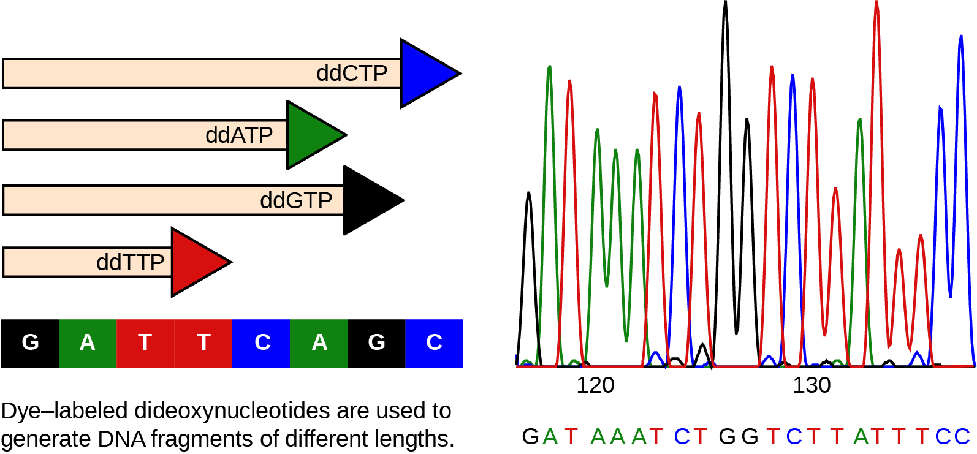
Figure 17.14
This figure illustrates Frederick Sanger's dideoxy chain termination method. Using dideoxynucleotides, the DNA fragment can terminate at different points. The DNA separates on the basis of size, and we can read these bands based on the fragments’ size.
Notes:
The left part of this illustration shows a parent strand of D N A with the sequence G A T T C A G C, and four daughter strands, each of which was made in the presence of a different dideoxynucleotide: lower case d lower case d upper case A upper case T upper case P, and lower case d lower case d upper case C upper case T upper case P, and lower d lower d upper G upper T upper P, or lower d lower d upper T upper T upper P. The growing chain terminates when a lower d lower d upper N T P is incorporated, resulting in daughter strands of different lengths. The right part of this image shows the separation of the D N A fragments on the basis of size. Each lower d lower d upper N T P is fluorescently labeled with a different color so that the sequence can be read by the size of each fragment and its color.

Slide 20
17.4 Applying Genomics
Learning Objectives
Explain pharmacogenomics
Define polygenic

Slide 21
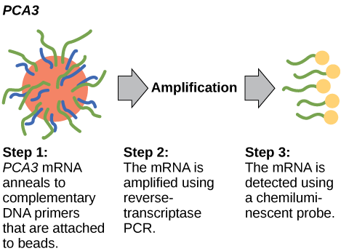
Figure 17.15
PCA3 is a gene that is expressed in prostate epithelial cells and overexpressed in cancerous cells. A high PCA3 concentration in urine is indicative of prostate cancer. The PCA3 test is a better indicator of cancer than the more well known PSA test, which measures the level of PSA (prostate-specific antigen) in the blood.
Notes:
The P C A 3 test occurs in three steps. In step one, P C A 3 m R N A anneals to complementary D N A primers that are attached to beads. In step two, the m R N A is amplified using reverse-transcriptase P C R. In step three, the m R N A is detected using a chemiluminescent probe.

Slide 22
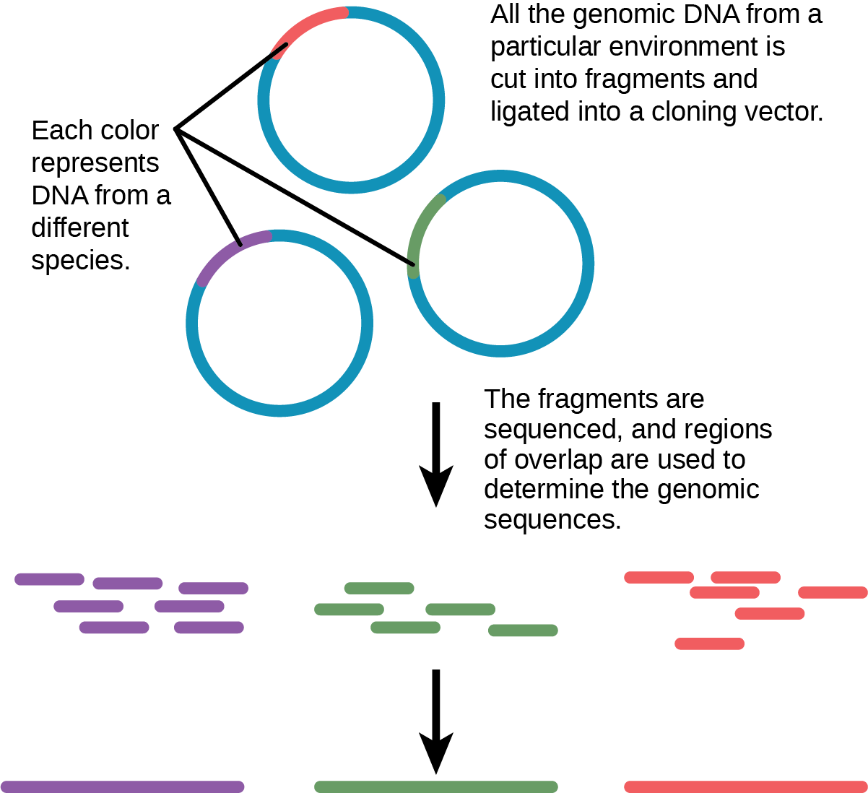
Figure 17.16
Metagenomics involves isolating DNA from multiple species within an environmental niche.
Notes:
In metagenomics, all of the genomic DNA from a particular environment is cut into fragments and ligated into a cloning vector. The fragments, which may be from several different species, are sequenced. Regions of overlap indicate that two fragments came from the same species. Thus, the genome of each species present can be determined.

Slide 23
17.5 Genomics and Proteomics
Learning Objectives
Explain systems biology
Describe a proteome
Define protein signature

Slide 24
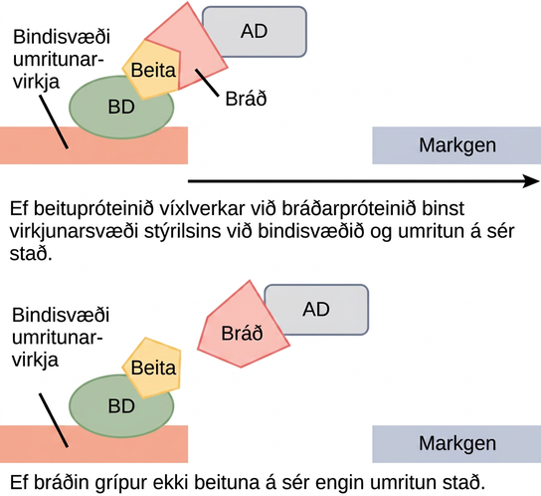
Figure 17.17
Scientists use two-hybrid screening to determine whether two proteins interact. In this method, a transcription factor splits into a DNA-binding domain (BD) and an activator domain (AD). The binding domain is able to bind the promoter in the activator domain's absence, but it does not turn on transcription. The bait protein attaches to the BD, and the prey protein attaches to the AD. Transcription occurs only if the prey “catches” the bait.
This OpenStax ancillary resource is © Rice University under a CC BY-NC-SA 4.0 International license; it may be reproduced or modified for noncommercial purposes only but must be attributed to OpenStax, Rice University and any changes must be noted. Any adaptation must be shared under the same type of license.
Notes:
In two-hybrid screening, the binding domain of a transcription factor is separated from the activator domain. A bait protein is attached to the D N A binding domain of a transcription factor, and a prey protein is attached to the activator domain. If the prey catches the bait, in other words, binds to it, transcription of a reporter gene occurs. If the prey does not catch the bait, no transcription occurs. Scientists use this transcriptional activation to determine if interaction between the bait and prey has occurred.

