Slide 1

Biology 2e
Chapter 27 Introduction to Animal Diversity

Slide 2
Chapter outline
Features of the Animal Kingdom
Features Used to Classify Animals
Animal Phylogeny
The Evolutionary History of the Animal Kingdom

Slide 3
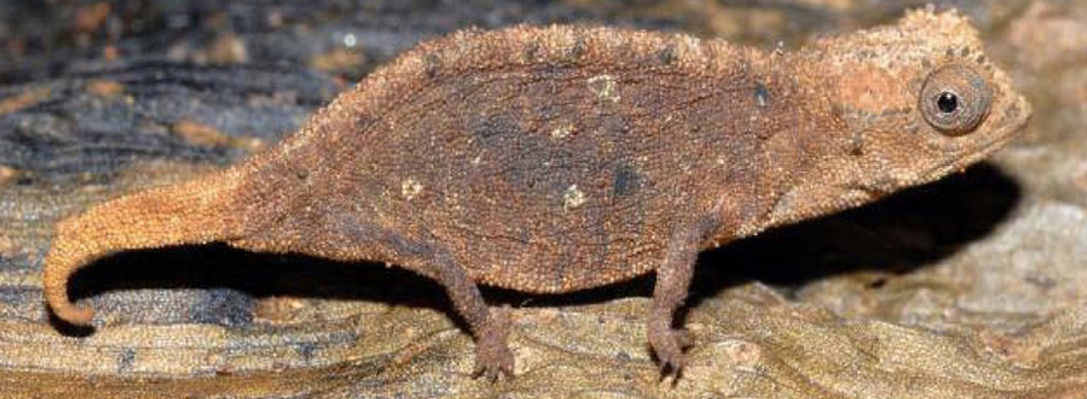
Figure 27.1
The leaf chameleon (Brookesia micra) was discovered in northern Madagascar in 2012. At just over one inch long, it is the smallest known chameleon. (credit: modification of work by Frank Glaw, et al., PLOS)
Notes:
Photo shows a mottled brown chameleon that blends into the leaf it sits on.

Slide 4
27.1 Features of the Animal Kingdom
Learning Objectives
List the features that distinguish the kingdom Animalia from other kingdoms
Explain the processes of animal reproduction and embryonic development
Describe the roles that Hox genes play in development

Slide 5
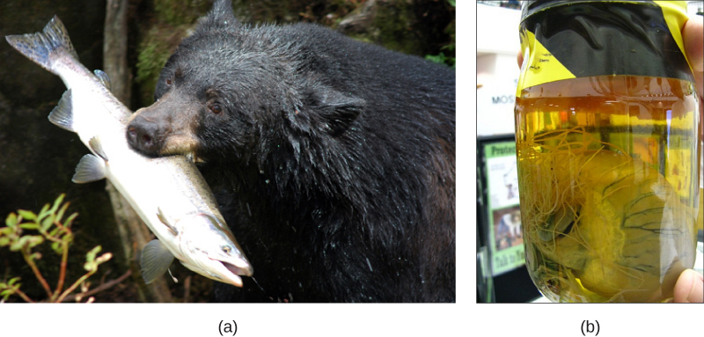
Figure 27.2
Heterotrophy. All animals are heterotrophs and thus derive energy from a variety of food sources. The (a) black bear is an omnivore, eating both plants and animals. The (b) heartworm Dirofilaria immitis is a parasite that derives energy from its hosts. It spends its larval stage in mosquitoes and its adult stage infesting the heart of dogs and other mammals, as shown here. (credit a: modification of work by USDA Forest Service; credit b: modification of work by Clyde Robinson)
Notes:
Part a shows a bear with a large fish in its mouth. Part b shows a heart in a jar. Long, threadlike worms extend from the heart.

Slide 6
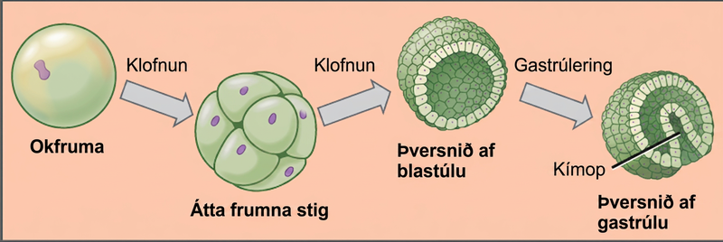
Figure 27.3
Development of a simple embryo. During embryonic development, the zygote undergoes a series of mitotic cell divisions, or cleavages, that subdivide the egg into smaller and smaller blastomeres. Note that the 8-cell stage and the blastula are about the same size as the original zygote. In many invertebrates, the blastula consists of a single layer of cells around a hollow space. During a process called gastrulation, the cells from the blastula move inward on one side to form an inner cavity. This inner cavity becomes the primitive gut (archenteron) of the gastrula ("little gut") stage. The opening into this cavity is called the blastopore, and in some invertebrates it is destined to form the mouth.
Notes:
The left part of the illustration shows a single-celled zygote. The initial cleavage, or cell division, results in a ball of cells, called the eight-cell stage. The cells do not grow during cleavage, so the eight-cell stage ball is about the same diameter as the zygote. Further cleavage results in a hollow ball of cells called a blastula. Upon gastrulation, part of the ball of cells invaginates, forming a cavity called a blastopore.

Slide 7
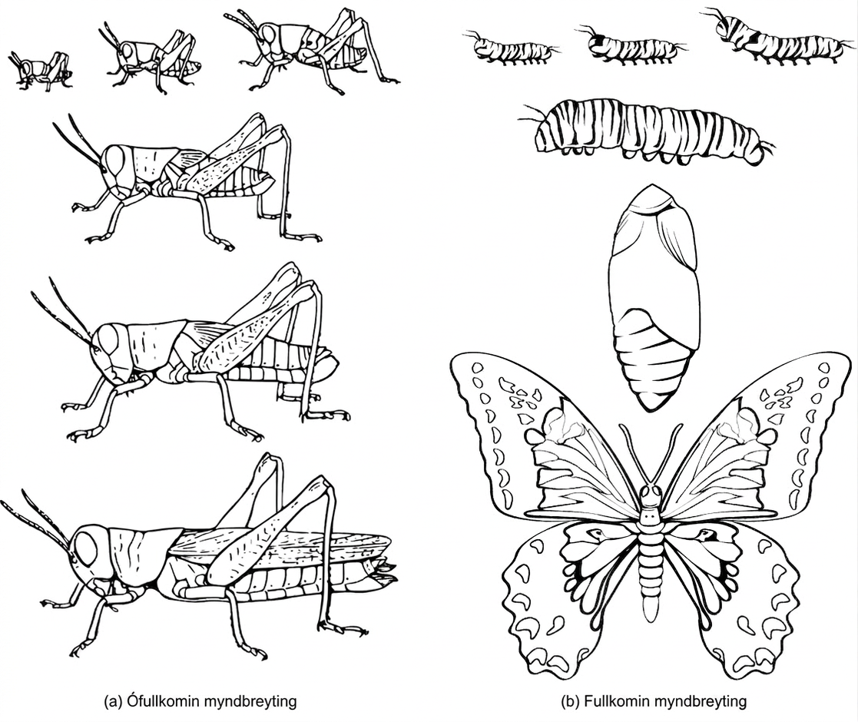
Figure 27.4
Insect metamorphosis. (a) The grasshopper undergoes incomplete metamorphosis. (b) The butterfly undergoes complete metamorphosis. (credit: S.E. Snodgrass, USDA)
Notes:
Illustration A shows the egg, nymph and adult stages of a grasshopper. The nymph stages are similar in appearance to the adult stage, but smaller. Illustration B shows the egg, larvae, pupa and adult stages of a butterfly. The pupa is a cocoon the butterfly makes when transforming from the larval to adult stages. The winged adult butterfly looks nothing like the caterpillar larva.

Slide 8
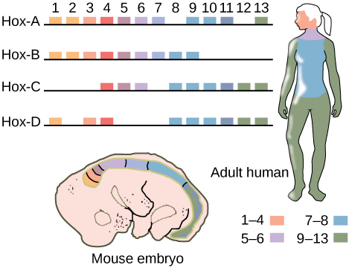
Figure 27.5
Hox genes. Hox genes are highly conserved genes encoding transcription factors that determine the course of embryonic development in animals. In vertebrates, the genes have been duplicated into four clusters on different chromosomes: Hox-A, Hox-B, Hox-C, and Hox-D. Genes within these clusters are expressed in certain body segments at certain stages of development. Shown here is the homology between Hox genes in mice and humans. Note how Hox gene expression, as indicated with orange, pink, blue, and green shading, occurs in the same body segments in both the mouse and the human. While at least one copy of each Hox gene is present in humans and other vertebrates, some Hox genes are missing in some chromosomal sets.
Notes:
This illustration shows the four clusters of Hox genes found in vertebrates: Hox A, Hox B, Hox C, and Hox D. There are 13 Hox genes, but not all of them are found in each cluster. In both mice and humans, genes 1 through 4 regulate the development of the head. Genes 5 and 6 regulate the development of the neck. Genes 7 and 8 regulate the development of the torso, and genes 9 through 13 regulate the development of the arms and legs.

Slide 9
27.2 Features Used to Classify Animals
Learning Objectives
Explain the differences in animal body plans that support basic animal classification
Compare and contrast the embryonic development of protostomes and deuterostomes

Slide 10
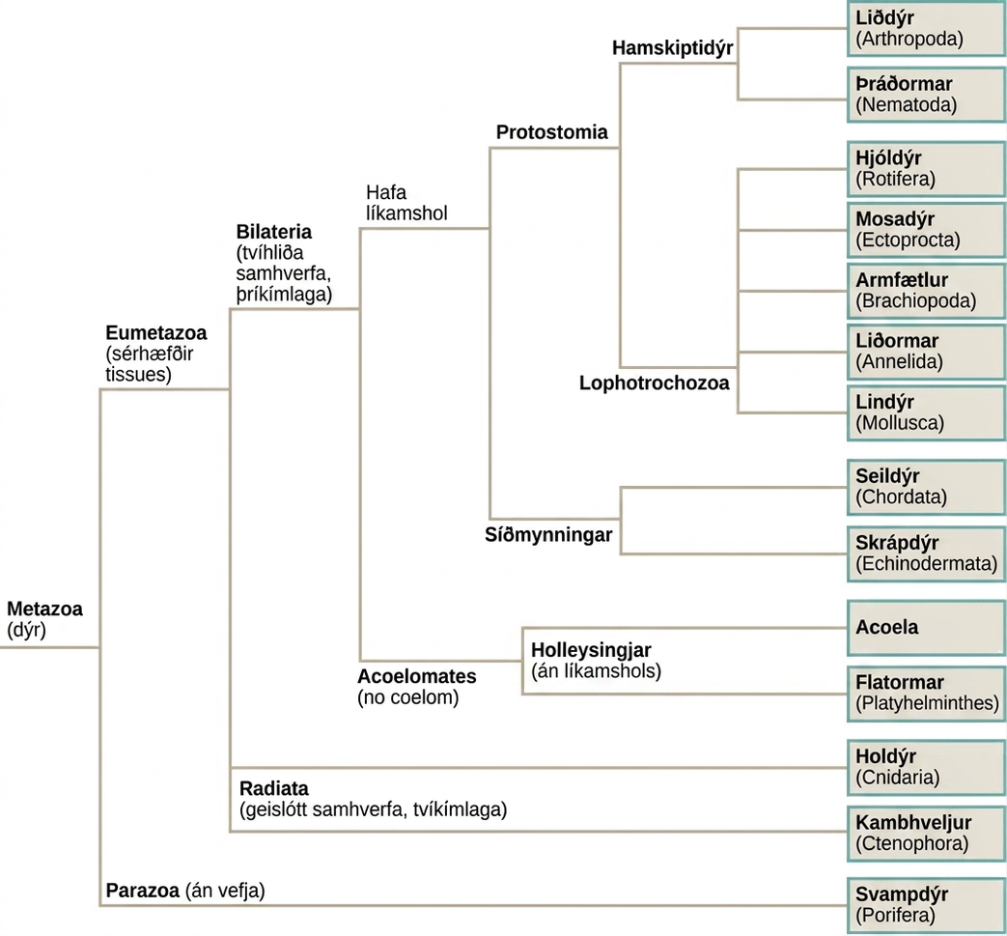
Figure 27.6
Animal phylogeny. The phylogenetic tree of animals is based on morphological, fossil, and genetic evidence. The Ctenophora and Porifera are both considered to be basal because of the absence of Hox genes in this group, but how they are related to the “Parahoxozoa” (Placozoa + Eumetazoa) or to each other, continues to be a matter of debate. The represented tree is one of several proposed relationships based on genetic and other data.
Notes:
The phylogenetic tree of metazoans, or animals, branches into parazoans with no tissues (sponges) together with Ctenophora as sister branches, and Parahoxozoa which branches into Placozoa and Eumetazoans with specialized tissues. Eumetazoans branch into Radiata, diploblastic animals with radial symmetry, and Bilateria, triploblastic animals with bilateral symmetry. Radiata includes cnidarians. Bilateria branches into Acoela, which have no body cavity, and Protostomia and Deuterostomia, which possess a body cavity. Deuterostomes include chordates and echinoderms. Protostomia branches into Lophotrochozoa and Ecdysozoa. Ecdysozoa includes arthropods and nematodes, or roundworms. Lophotrochozoa includes Mollusca, Annelida, Brachopoda, Ectoprocta, Rotifera, and Platyhelminthes.

Slide 11
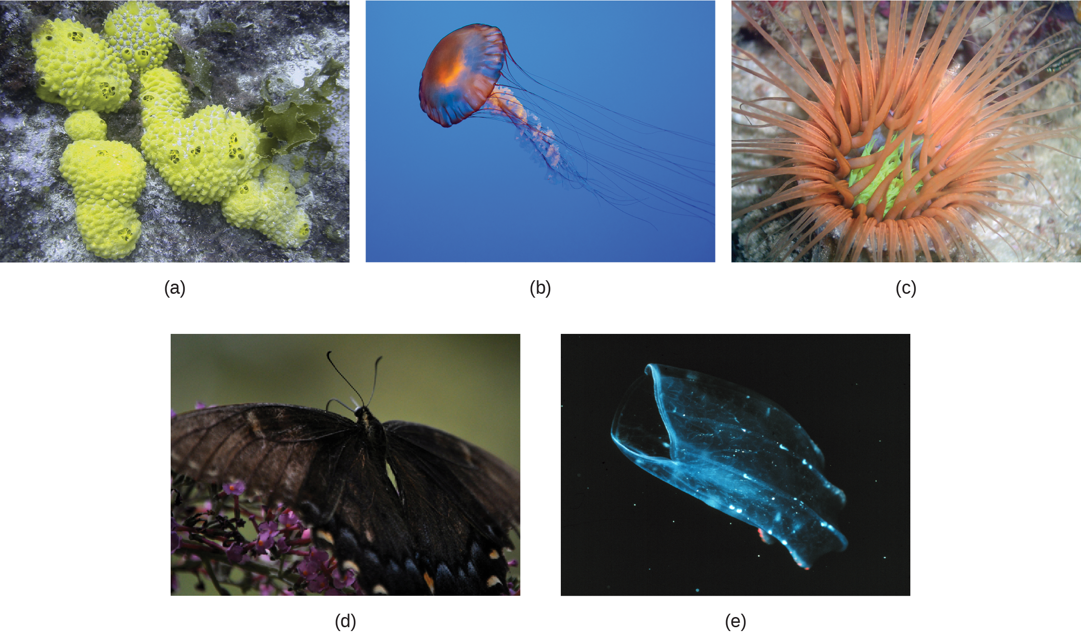
Figure 27.7
Symmetry in animals. The (a) sponge is asymmetrical. The (b) jellyfish and (c) anemone are radially symmetrical, the (d) butterfly is bilaterally symmetrical. Rotational symmetry (e) is seen in the ctenophore Beroe, shown swimming open-mouthed. (credit a: modification of work by Andrew Turner; credit b: modification of work by Robert Freiburger; credit c: modification of work by Samuel Chow; credit d: modification of work by Cory Zanker; credit e: modification of work by NOAA)
Notes:
Part a shows several sponges, which form irregular, bumpy blobs on the sea floor. Part b shows a jellyfish with long, slender tentacles, radiating from a flexible, disc-shaped body. Part c shows an anemone sitting on the sea floor with thick tentacles, radiating up from a cup-shaped body. Part d shows a black butterfly with two symmetrical wings. Part e shows a beroe, which is a type of jelly fish, semi-transparent with more solid ribs and a visible opening at one end.

Slide 12
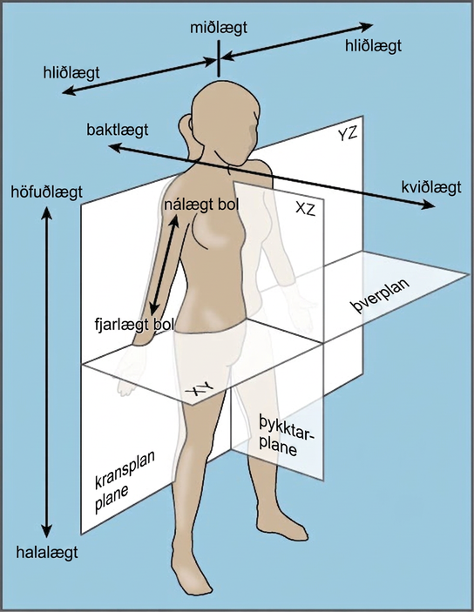
Figure 27.8
Bilateral symmetry. The bilaterally symmetrical human body can be divided by several planes.
Notes:
The illustration shows a woman's body dissected into planes. The coronal plane separates the front from the back. The front of the body is the ventral side, and the back of the body is the dorsal side. The transverse plane separates the upper body from the lower body, running parallel to the ground. The upper body is defined as cranial, and the lower body is defined as caudal. The sagittal plane dissects the body from side to side. The medial line goes through the center of the body. The areas to the left and right of the medial line are defined as lateral. Parts of the body close to the medial line are proximal, and those further away are distal.

Slide 13
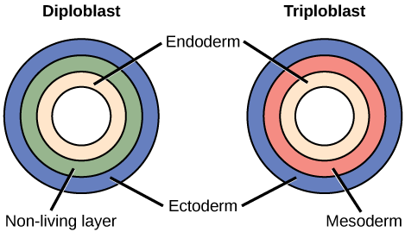
Figure 27.9
Diploblastic and triploblastic embryos. During embryogenesis, diploblasts develop two embryonic germ layers: an ectoderm and an endoderm or mesendoderm. Triploblasts develop a third layer—the mesoderm—which arises from mesendoderm and resides between the endoderm and ectoderm.
Notes:
The left illustration shows the two embryonic germ layers of a diploblast. The inner layer is the endoderm, and the outer layer is the ectoderm. Sandwiched between the endoderm and the ectoderm is a non-living layer. Right illustration shows the three embryonic germ layers of a triploblast. Like the diploblast, the triploblast has an inner endoderm and an outer ectoderm. Sandwiched between these two layers is a living mesoderm.

Slide 14
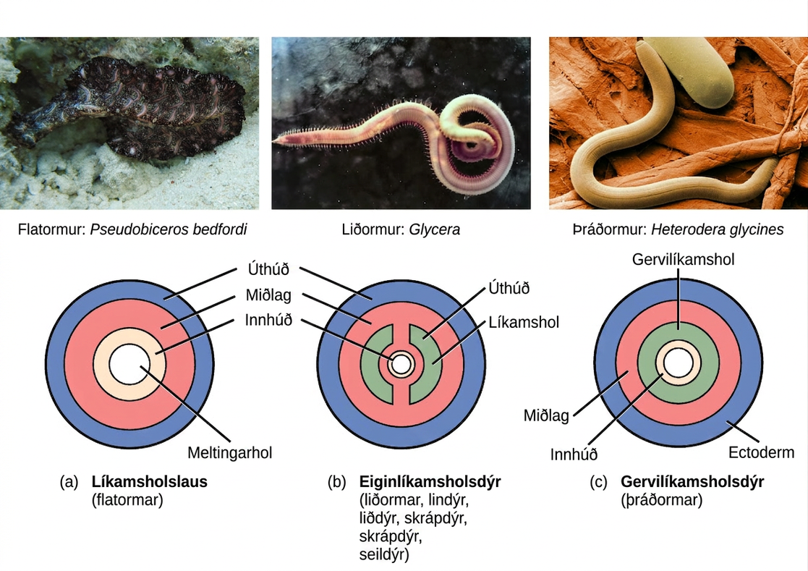
Figure 27.10
Body cavities. Triploblasts may be (a) acoelomates, (b) eucoelomates, or (c) pseudocoelomates. Acoelomates have no body cavity. Eucoelomates have a body cavity within the mesoderm, called a coelom, in which both the gut and the body wall are lined with mesoderm. Pseudocoelomates also have a body cavity, but only the body wall is lined with mesoderm. (credit a: modification of work by Jan Derk; credit b: modification of work by NOAA; credit c: modification of work by USDA, ARS)
Notes:
Part a shows the body plan of acoelomates, including flatworms. Acoelomates have a central digestive cavity. Outside this digestive cavity are three tissue layers: an inner endoderm, a central mesoderm, and an outer ectoderm. The photo shows a swimming flatworm, which has the appearance of a frilly black and pink ribbon. Part b shows the body plan of eucoelomates, which include annelids, mollusks, arthropods, echinoderms, and chordates. Eucoelomates have the same tissue layers as acoelomates, but a cavity called a coelom exists within the mesoderm. The coelom is divided into two symmetrical parts that are separated by two spokes of mesoderm. The photo shows a swimming annelid known as a bloodworm. The bloodworm has a tubular body that tapers at each end. Numerous appendages radiate from either side. Part c shows the body plan of pseudocoelomates, which include roundworms. Like the acoelomates and eucoelomates, the pseudocoelomates have an endoderm, a mesoderm, and an ectoderm. However, in pseudocoelomates, a pseudocoelum separates the endoderm from the mesoderm. The photo shows a roundworm, or nematode, which has a tubular body.

Slide 15
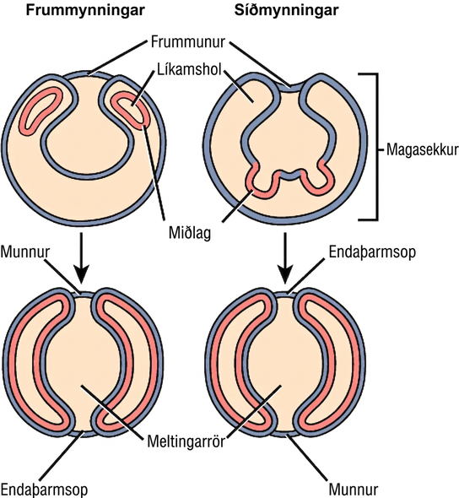
Figure 27.11
Protostomes and deuterostomes. Eucoelomates can be divided into two groups based on their early embryonic development. In protostomes, the mouth forms at or near the site of the blastopore and the body cavity forms by splitting the mesodermal mass during the process of schizocoely. In deuterostomes, the mouth forms at a site opposite the blastopore end of the embryo and the mesoderm pinches off to form the coelom during the process of enterocoely.
Notes:
The illustration compares the development of protostomes and deuterostomes. In both protostomes and deuterostomes, the gastrula, which resembles a hollow ball of cells, contains an indentation called a blastopore. In protostomes, two circular layers of mesoderm form inside the gastrula, containing the coelom cavity. As the protostome develops, the mesoderm grows and fuses with the gastrula cell layer. The blastopore becomes the mouth, and a second opening forms opposite the mouth, which becomes the anus. In deuterostomes, two groups of gastrula cells in the blastopore grow inward to form the mesoderm. As the deuterostome develops, the mesoderm pinches off and fuses, forming a second body cavity. The body plan of the deuterostome at this stage looks very similar to that of the protostome, but the blastopore becomes the anus, and the second opening becomes the mouth.

Slide 16
27.3 Animal Phylogeny (1 of 2)
Learning Objectives
Interpret the metazoan phylogenetic tree
Describe the types of data that scientists use to construct and revise animal phylogeny

Slide 17
27.3 Animal Phylogeny (2 of 2)
Learning Objectives
List some of the relationships within the modern phylogenetic tree that have been discovered as a result of modern molecular data

Slide 18
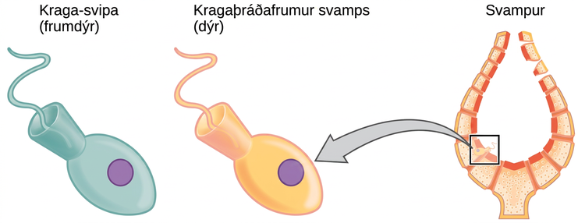
Figure 27.12
Choanoflagellates and choanocytes. Cells of the protist choanoflagellate clade closely resemble sponge choanocyte cells. Beating of choanocyte flagella draws water through the sponge so that nutrients can be extracted and waste removed.
Notes:
The image on the left shows a choanoflagellate, which is a single-celled protest. The image on the right shows a sponge choanocyte cell that lines the inside of a sponge. The two cells appear identical. Both are egg shaped with a cone at the back end. A flagellum juts out from the wide part of the cone.

Slide 19
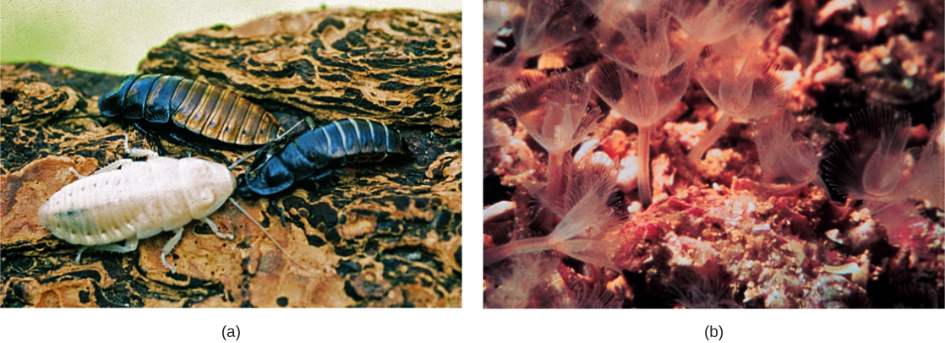
Figure 27.13
Ecdysozoa. Animals that molt their exoskeletons, such as these (a) Madagascar hissing cockroaches, are in the clade Ecdysozoa. (b) Phoronids are in the clade Lophotrochozoa. The tentacles are part of a feeding structure called a lophophore. (credit a: modification of work by Whitney Cranshaw, Colorado State University, Bugwood.org; credit b: modification of work by NOAA)
Notes:
Part a shows cockroaches. Part b shows phoronids, whose body is a slender stalk anchored to the ocean floor. Fine tentacles radiate from the top of the stalk. The tentacles and stalk resemble a flower.

Slide 20
27.4 The Evolutionary History of the Animal Kingdom (1 of 2)
Learning Objectives
Describe the features that characterized the earliest animals and approximately when they appeared on earth
Explain the significance of the Cambrian period for animal evolution and the changes in animal diversity that took place during that time

Slide 21
27.4 The Evolutionary History of the Animal Kingdom (2 of 2)
Learning Objectives
Describe some of the unresolved questions surrounding the Cambrian explosion
Discuss the implications of mass animal extinctions that have occurred in evolutionary history

Slide 22
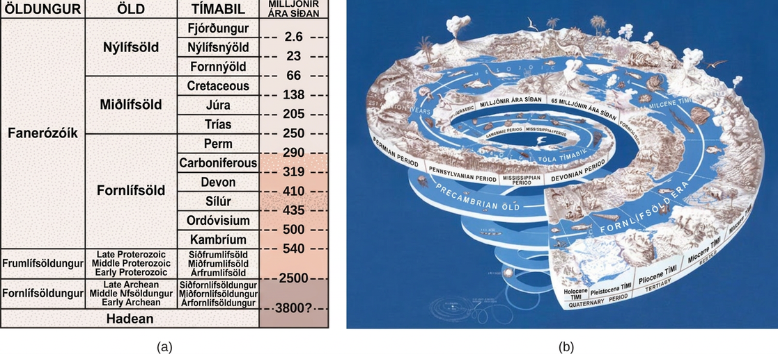
Figure 27.14
An evolutionary timeline. (a) Earth’s history is divided into eons, eras, and periods. Note that the Ediacaran period starts in the Proterozoic eon and ends at the start of the Cambrian period of the Phanerozoic eon. (b) Stages on the geological time scale are represented as a spiral. (credit: modification of work by USGS)
Notes:
Table A describes eras in earth's history associated with evolution of plant groups. In the first column earth's history is divided into four eons, the Pre Archean- Hadean, Archaean, Proterozoic, Phanerozoic. The oldest eon, the Pre Archean, spans the beginning of earth's history to about 3.8 billion years ago. The Archean eon spans 2.5 to 3.8 billion years ago, and the Proterozoic spans 540 million to 2.5 billion years ago. The second column lists the eras within each eon. The Phanerozoic eon, from 540 million years ago to present time, is sub divided into the Paleozoic, Mesozoic and Cenozoic eras. The third column lists the periods within each. The Paleozoic era, from 250 to 540 million years ago, is further divided into seven periods: the Cambrian from 500 to 540 million years ago, the Ordovician from 435 to 500 million years ago, the Silurian from 410 to 435 million years ago, the Devonian from 319 to 410 million years ago, the Carboniferous from 290 to 290 million years ago, and the Permian from 250 to 290 million years ago. The Mesozoic era, from 66 to 250 million years ago, is divided into three periods, the Triassic from 205 to 250 million years ago, the Jurassic from 138 to 205 million years ago, and the Cretaceous, from 66 to 138 million years ago. The Cenozoic era, from 66 million years ago to modern times, is divided into three eras, the Paleogene from 23 to 66 million years ago, Neogene from 2.6 to 23 million years ago, and the Quaternary from present to 2.8 million years. The last column indicates the time periods in millions of years. Illustration B shows geological periods in a spiral starting with the beginning of earth's history at the bottom and ending with modern times at the top. The diversity and complexity of life increases toward the top of the spiral.

Slide 23
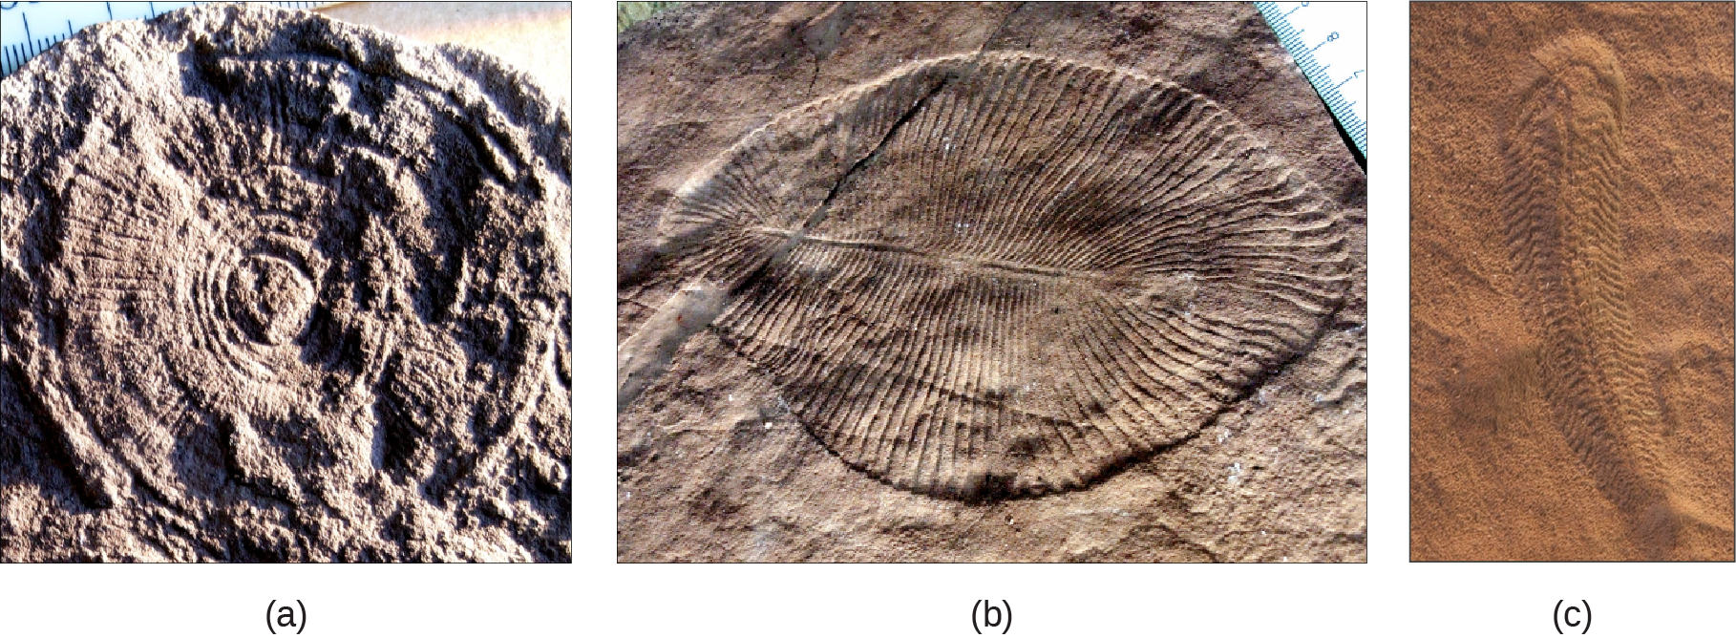
Figure 27.15
Ediacaran fauna. Fossils of (a) Cyclomedusa (up to 20 cm), (b) Dickinsonia (up to 1.4 m), and (c) Spriggina (up to 5 cm) date to the Ediacaran period (543-635 MYA). (credit: modification of work by “Smith609”/Wikimedia Commons)
Notes:
Part a shows a fossil that resembles a wheel, with spokes radiating out from the center, imprinted on a rock. Part b shows a fossil that resembles a teardrop shaped leaf, with grooves radiating out from a central rib. Part c shows a fossil that is much longer than it is wide, with many small ribs and a tail.

Slide 24
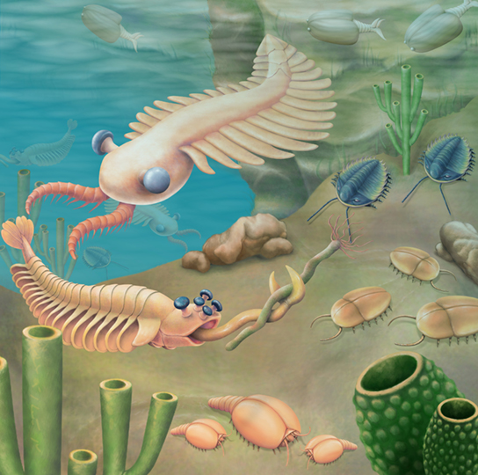
Figure 27.16
Fauna of the Burgess Shale. An artist’s rendition depicts some organisms from the Cambrian period. Anomalocaris is seen in the upper left quadrant of the picture.
Notes:
The illustration shows a sea bed abundant with odd organisms, including tube-shaped worms anchored to the sea floor and animals that resemble cockroaches crawling along it. Swimming creatures somewhat resemble modern insects.

Slide 25
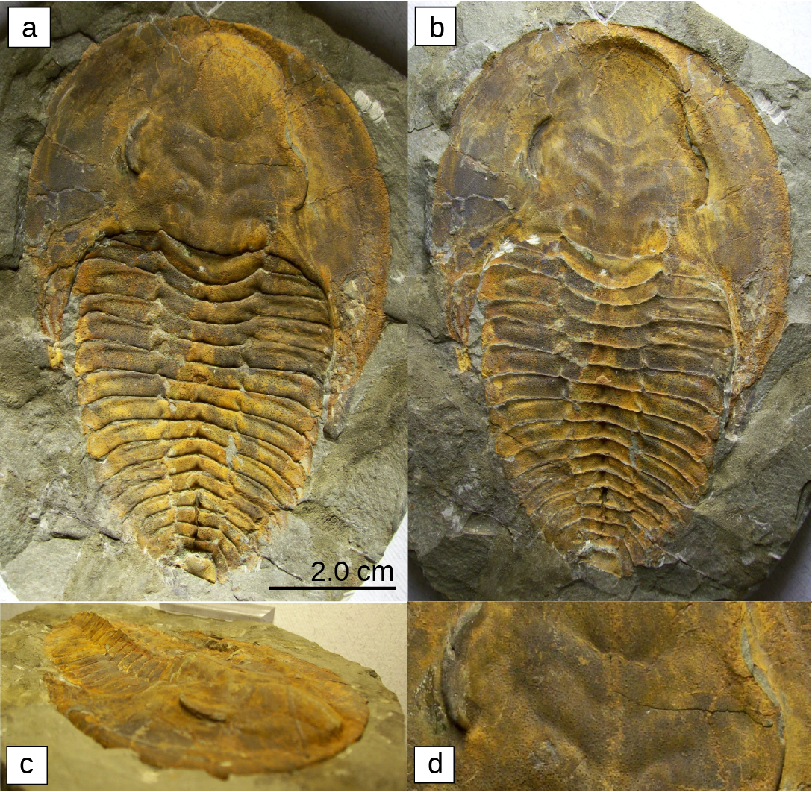
Figure 27.17
Trilobites. These fossils (a–d) belong to trilobites, extinct arthropods that appeared in the early Cambrian period, 525 million years ago, and disappeared from the fossil record during a mass extinction at the end of the Permian period, about 250 million years ago.
Notes:
Photos a, b, c, d show four trilobite fossils. All are teardrop shaped, with a smooth wide end. About one-third of the way down, the body is segmented into horizontal ridges.

Slide 26
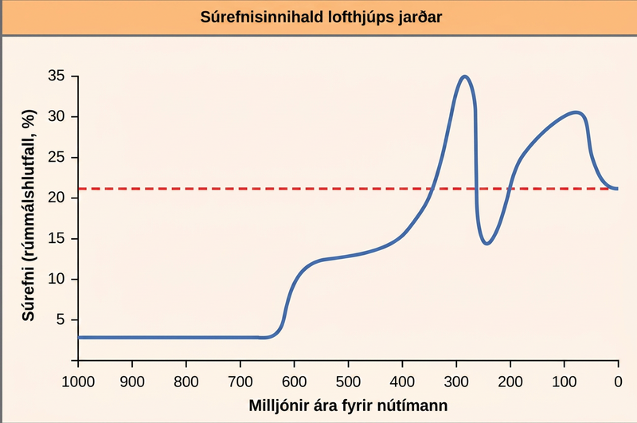
Figure 27.18
Atmospheric oxygen over time. The oxygen concentration in Earth’s atmosphere rose sharply around 300 million years ago.
Notes:
The chart shows the percent oxygen by volume in the Earth’s atmosphere. Until 625 million years ago, there was virtually no oxygen. Oxygen levels began to rapidly climb around this time, and peaked around 275 million years ago, at about 35 percent. Between 275 and 225 million years ago, oxygen levels dropped precipitously to about 15 percent, and then climbed again and dropped to the modern-day concentration of 22 percent.

Slide 27
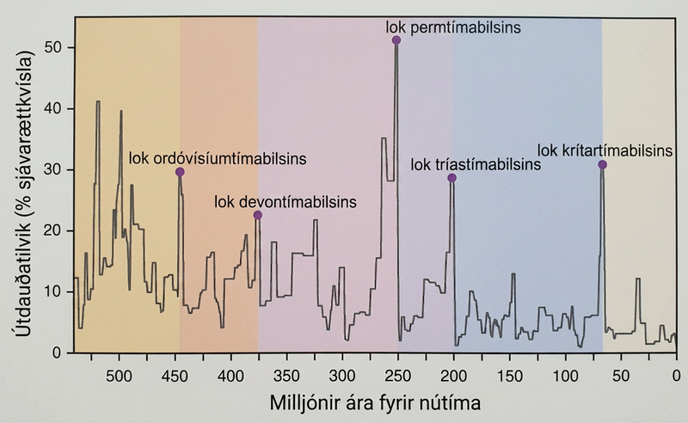
Figure 27.19
Extinctions. Mass extinctions have occurred repeatedly over geological time.
This OpenStax ancillary resource is © Rice University under a CC BY-NC-SA 4.0 International license; it may be reproduced or modified for noncommercial purposes only but must be attributed to OpenStax, Rice University and any changes must be noted. Any adaptation must be shared under the same type of license.
Notes:
The chart shows percent extinction intensity of eliminated marine genera versus time in millions of years before present. Extinction intensity spikes at boundaries between periods, including the end of the Ordovician which had 30 percent extinction occurrences of marine genera approximately 450 million years ago. The late Devonian had approximately 25 percent extinction occurrences of marine genera at roughly 375 million years ago. The end of the Permian had 50 percent extinction occurrences of marine genera approximately 250 million years ago. The end of the Triassic had roughly 30 percent extinction occurrences of marine genera 200 million years ago. And the end of the Cretaceous periods had over 30 percent extinction occurrences of marine genera roughly 70 million years ago.

