Slide 1

Biology 2e
Chapter 44 Ecology and the Biosphere

Slide 2
Chapter outline
The Scope of Ecology
Biogeography
Terrestrial Biomes
Aquatic Biomes
Climate and the Effects of Global Climate Change

Slide 3
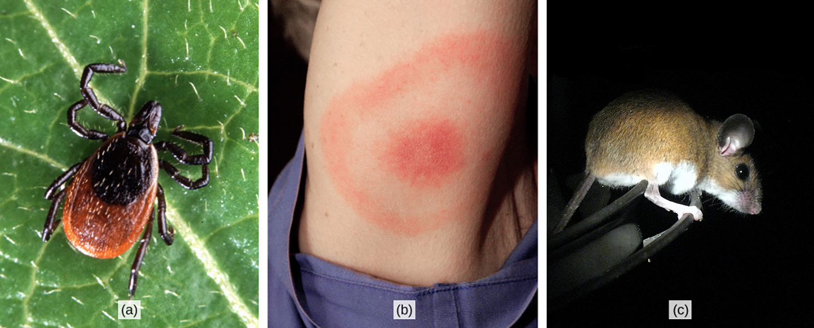
Figure 44.1
The (a) deer tick carries the bacterium that produces Lyme disease in humans, often evident in (b) a symptomatic bull’s eye rash. The (c) white-footed mouse is one well-known host to deer ticks carrying the Lyme disease bacterium. (credit a: modification of work by Scott Bauer, USDA ARS; credit b: modification of work by James Gathany, CDC; credit c: modification of work by Rob Ireton)
Notes:
Photo (a) shows a deer tick on a leaf. The tick has a brown oval body with a smaller, round oval toward the front. The head and legs are black. Photo (b) shows an arm with a red, circular rash enclosed in a ring-like rash. Photo (c) shows a brown mouse with a white belly and legs and large, round ears.

Slide 4
44.1 The Scope of Ecology (1 of 2)
Learning Objectives
Define ecology and the four basic levels of ecological research
Describe examples of the ways in which ecology requires the integration of different scientific disciplines
Distinguish between abiotic and biotic components of the environment

Slide 5
44.1 The Scope of Ecology (2 of 2)
Learning Objectives
Recognize the relationship between abiotic and biotic components of the environment

Slide 6
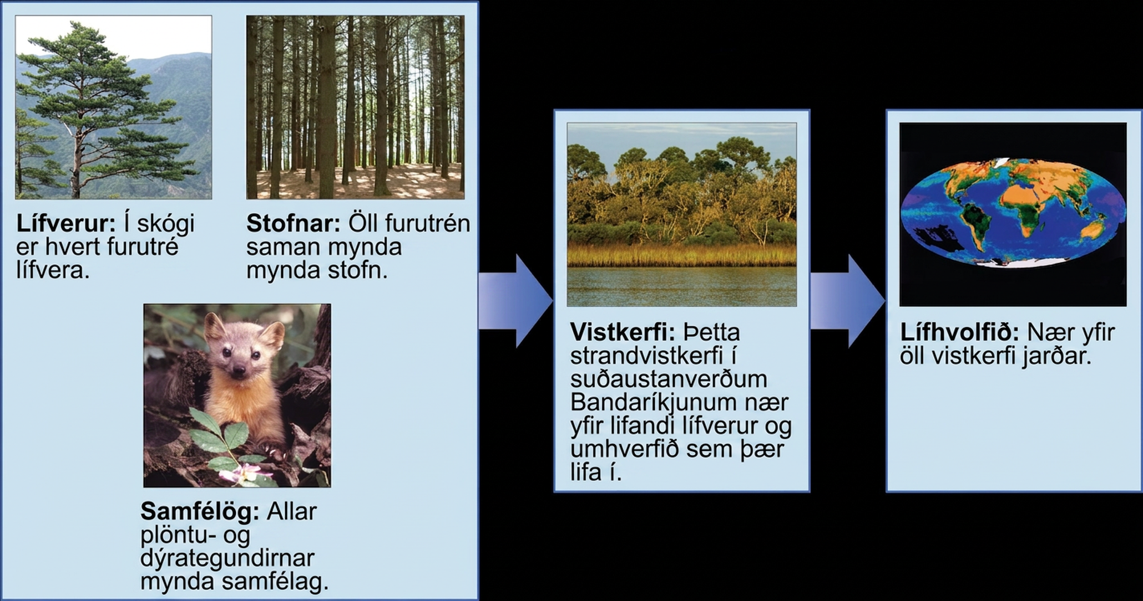
Figure 44.2
Ecologists study within several biological levels of organization. (credit “organisms”: modification of work by yeowatzup”/Flickr; credit “populations”: modification of work by "Crystl"/Flickr; credit “communities”: modification of work by US Fish and Wildlife Service; credit “ecosystems”: modification of work by Tom Carlisle, US Fish and Wildlife Service Headquarters; credit “biosphere”: NASA)
Notes:
The figure gives an overview of some biological levels of organization with example photos. Each individual pine tree (pictured) in a forest is an organism. Together, all the pine trees in a forest (pictured) make up a population. All the plant and animal species comprise a community, pictured as a marmot on a forest floor. Those three levels are grouped in a box with an arrow to the larger level of an ecosystem, which includes living organisms and the environment they live in. An example is a coastal ecosystem in the southeastern United states, pictured as a body of water, behind which is a stand of tall grasses developing into more dense vegetation and trees as distance from the water increases. A final arrow points to the level of a biosphere, encompassing all ecosystems on Earth and pictured as a map of the Earth showing vegetation patterns.

Slide 7
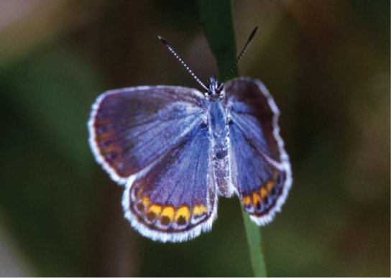
Figure 44.3
The Karner blue butterfly (Lycaeides melissa samuelis) is a rare butterfly that lives only in open areas with few trees or shrubs, such as pine barrens and oak savannas. It can only lay its eggs on lupine plants. (credit: modification of work by J & K Hollingsworth, USFWS)
Notes:
Photo depicts a Karner blue butterfly, which has light blue wings with gold ovals and black dots around the edges.

Slide 8
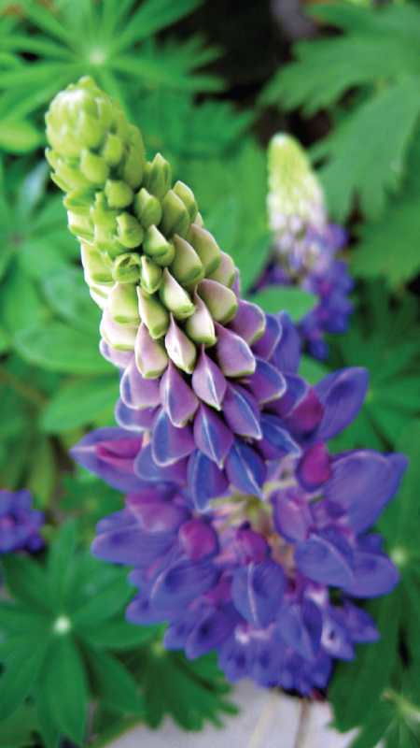
Figure 44.4
The wild lupine (Lupinus perennis) is the only known host plant for the Karner blue butterfly.
Notes:
This photo depicts a wild lupine flower, which is long and thin with clam-shaped petals radiating out from the center. The bottom third of the flower is blue, the middle is pink and blue, and the top is green.

Slide 9
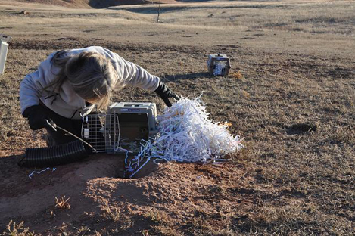
Figure 44.5
This landscape ecologist is releasing a black-footed ferret into its native habitat as part of a study. (credit: USFWS Mountain Prairie Region, NPS)
Notes:
This photo shows a woman looking into a small cage with its door open. The cage sits on short prairie grass, next to a hole with dirt around the rim. In the background sits a second, closed cage.

Slide 10
44.2 Biogeography (1 of 2)
Learning Objectives
Define biogeography
List and describe abiotic factors that affect the global distribution of plant and animal species
Compare the impact of abiotic forces on aquatic and terrestrial environments

Slide 11
44.2 Biogeography (2 of 2)
Learning Objectives
Summarize the effects of abiotic factors on net primary productivity

Slide 12
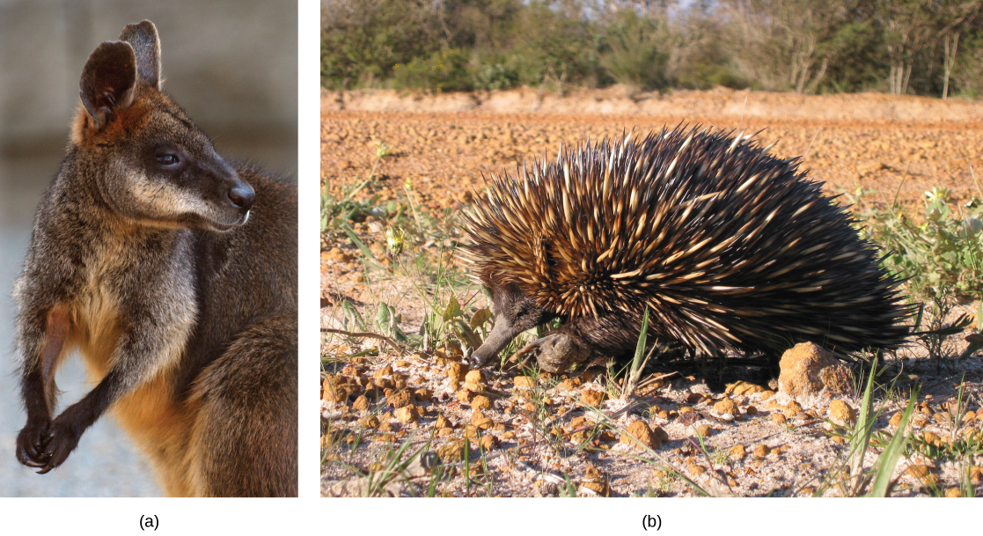
Figure 44.6
Australia is home to many endemic species. The (a) wallaby (Wallabia bicolor), a medium-sized member of the kangaroo family, is a pouched mammal, or marsupial. The (b) echidna (Tachyglossus aculeatus) is an egg-laying mammal. (credit a: modification of work by Derrick Coetzee; credit b: modification of work by Allan Whittome)
Notes:
Photo (a) depicts a wallaby, a member of the kangaroo family. The wallaby is brown with white flecks on its fur and a light brown underbelly. Its hands are clasped together. Photo (b) shows an echidna. Like a porcupine, the echidna has a compact body covered with brown and white quills. It has a long, slender snout.

Slide 13
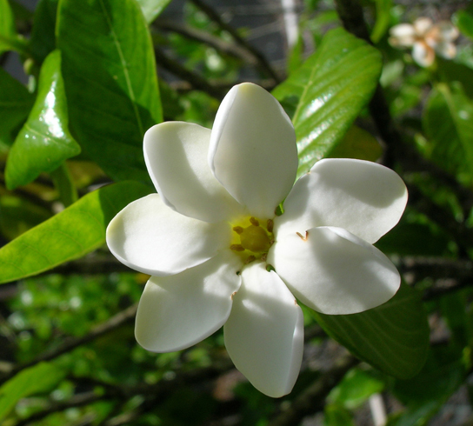
Figure 44.7
Listed as federally endangered, the forest gardenia is a small tree with distinctive flowers. It is found only in five of the Hawaiian Islands in small populations consisting of a few individual specimens. (credit: Forest & Kim Starr)
Notes:
The photo shows a white flower with seven smooth, diamond-shaped petals radiating out from a yellow center. The flower is surrounded by waxy green leaves.

Slide 14
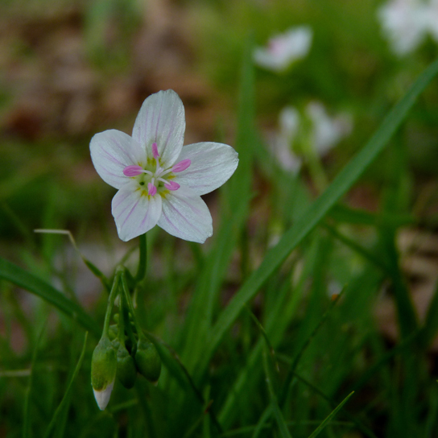
Figure 44.8
The spring beauty is an ephemeral spring plant that flowers early in the spring to avoid competing with larger forest trees for sunlight. (credit: John Beetham)
Notes:
This photo shows a white flower with five diamond-shaped petals radiating out from a green center. Faint purple lines radiate out from the center of each petal toward the tip. Five stalk-like stamens with pink-tipped anthers extend from the flower’s green center.

Slide 15
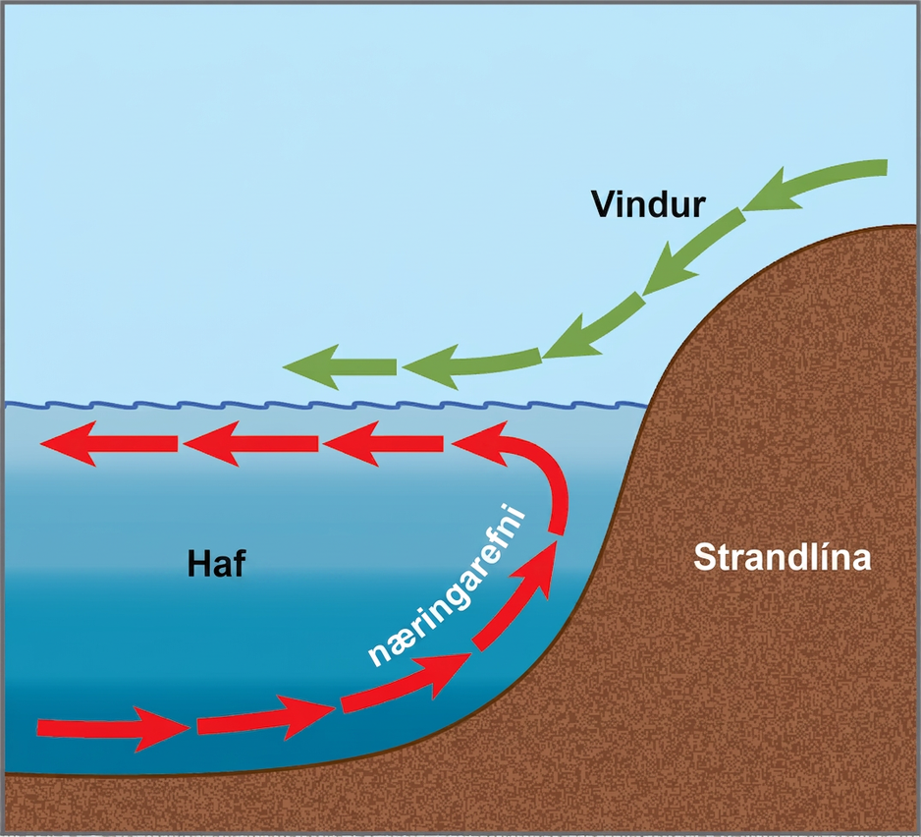
Figure 44.9
Ocean upwelling is an important process that recycles nutrients and energy in the ocean. As wind (green arrows) pushes offshore, it causes water from the ocean bottom (red arrows) to move to the surface, bringing up nutrients from the ocean depths.
Notes:
Arrows in the illustration indicate that the prevailing wind direction is from the coastline toward the open ocean. The wind pushes the surface water away from shore, inducing a current in this direction. A counter-current flows from the depths toward shore, where it meets the surface current. The counter-current brings nutrients from the depths up toward the surface near the shoreline.

Slide 16
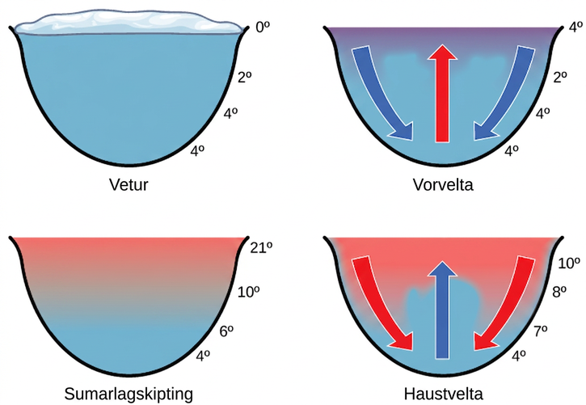
Figure 44.10
The spring and fall turnovers are important processes in freshwater lakes that act to move the nutrients and oxygen at the bottom of deep lakes to the top. Turnover occurs because water has a maximum density at 4 °C. Surface water temperature changes as the seasons progress, and denser water sinks.
Notes:
The illustration shows a cross-section of a lake in four different seasons. In winter, the surface of the lake is frozen with a temperature of 0 degrees upper case C. The temperature at the bottom of the lake is 4 degrees upper case C, and the temperature just beneath the surface is 2 degrees C. During the spring turnover, the surface ice melts and warms to 4 degrees C. At this temperature, the surface water is denser than the 2 degree C water beneath; therefore, it sinks. In summertime, the surface of the lake is 21 degrees C, and the temperature decreases with depth, to 4 degrees C at the bottom. During the fall turnover, the warm surface water cools to about 10 degrees C; thus, it becomes denser and sinks.

Slide 17
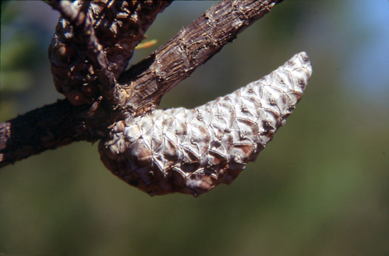
Figure 44.11
The mature cones of the jack pine (Pinus banksiana) open only when exposed to high temperatures, such as during a forest fire. A fire is likely to kill most vegetation, so a seedling that germinates after a fire is more likely to receive ample sunlight than one that germinates under normal conditions. (credit: USDA)
Notes:
Photo shows two pine cones that are tightly closed and attached to a branch.

Slide 18
44.3 Terrestrial Biomes
Learning Objectives
Identify the two major abiotic factors that determine terrestrial biomes
Recognize distinguishing characteristics of each of the eight major terrestrial biomes

Slide 19
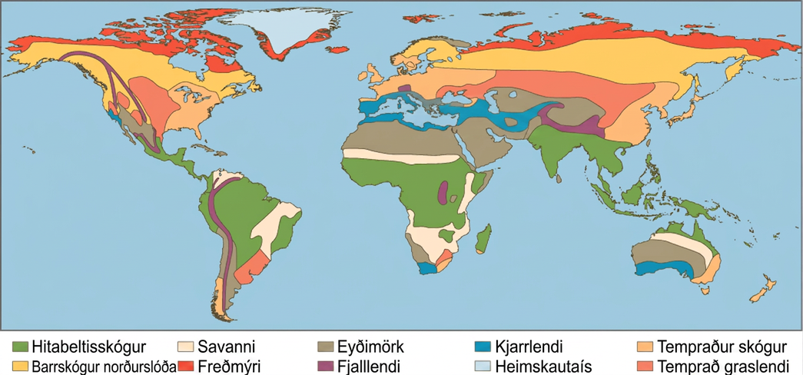
Figure 44.12
Each of the world’s major biomes is distinguished by characteristic temperatures and amounts of precipitation. Polar ice and mountains are also shown.
Notes:
This world map shows the eight major biomes, polar ice, and mountains. Tropical forests, deserts and savannas are found primarily in South America, Africa, and Australia. Tropical forests also dominate Southeast Asia. Deserts dominate the Middle East and are found in the southwestern United States. Chaparral is found all around the Mediterranean Sea, in southern Australia, on the southern tip of Africa, and in California in southwestern North America. Temperate forests dominate the eastern United States, Europe, and Eastern Asia. Temperate grasslands dominate the midwestern United States and parts of Asia, and are also found in South America. The boreal forest is found in northern Canada, Europe, and Asia, and tundra exists to the north of the boreal forest in each of these regions. Mountainous regions run the length of North and South America, and are found in northern India, Africa, and parts of Europe. Polar ice covers Greenland.

Slide 20
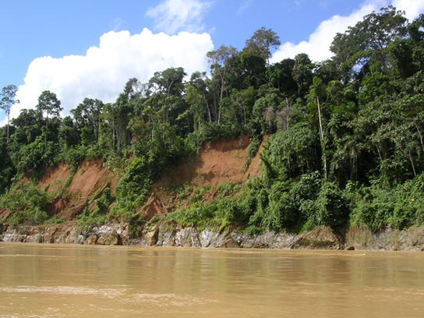
Figure 44.13
Tropical wet forests, such as these forests along the Madre de Dios river, Peru, near the Amazon River, have high species diversity. (credit: Roosevelt Garcia)
Notes:
This photo depicts a section of the Madre de Dios River, which is brown with mud. Trees line the edge of the river.

Slide 21
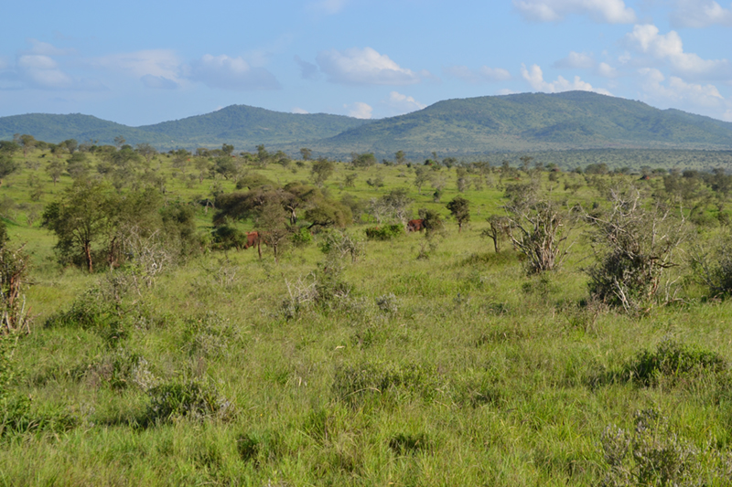
Figure 44.14
Savannas, like this one in Taita Hills Wildlife Sanctuary in Kenya, are dominated by grasses. (credit: Christopher T. Cooper)
Notes:
A grassy slope plain is covered in vegetation, whether it be grass, small bushes, or small trees.

Slide 22
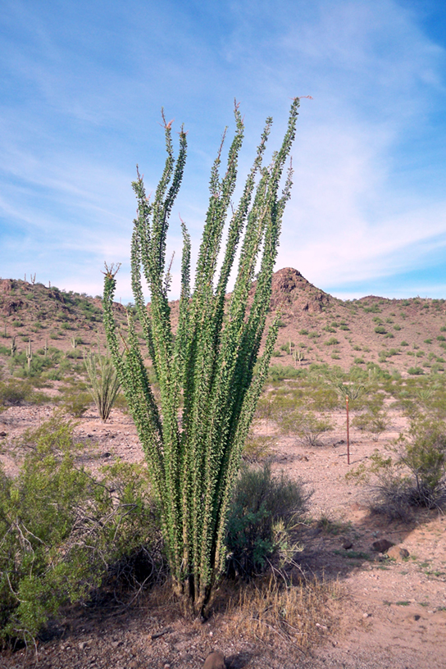
Figure 44.15
To reduce water loss, many desert plants have tiny leaves or no leaves at all. The leaves of ocotillo (Fouquieria splendens), shown here in the Sonora Desert near Gila Bend, Arizona, appear only after rainfall, and then are shed.
Notes:
This photo shows a sandy desert dotted with scrubby bushes. An ocotillo plant dominates the picture. It has long, thin unbranched stems that grow straight up from the base of the plant and radiate out slightly. The plant has no leaves.

Slide 23
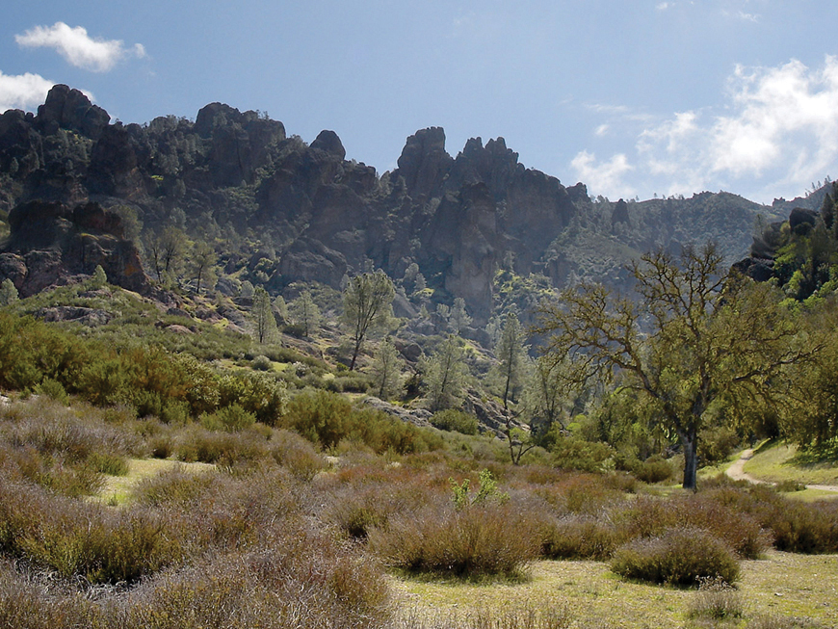
Figure 44.16
The chaparral is dominated by shrubs. (credit: Miguel Vieira)
Notes:
Photo depicts a landscape with many shrubs, dormant grass, a few trees, and mountains in the background.

Slide 24
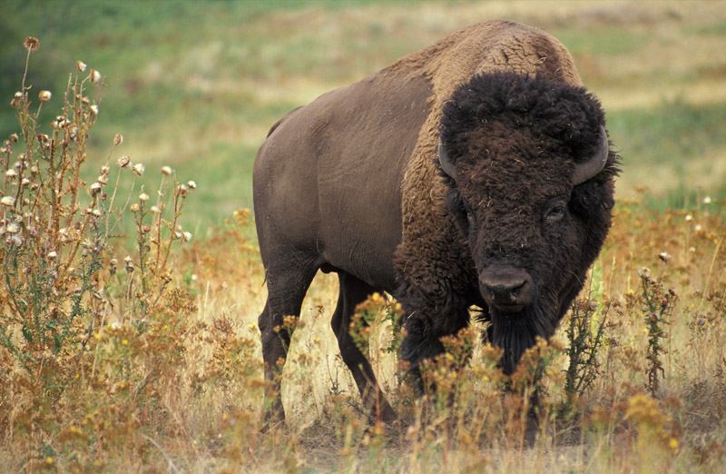
Figure 44.17
The American bison (Bison bison), more commonly called the buffalo, is a grazing mammal that once populated American prairies in huge numbers. (credit: Jack Dykinga, USDA Agricultural Research Service)
Notes:
This photo shows a bison, which is dark brown in color with an even darker head. The hind part of the animal has short fur, and the front of the animal has longer, curly fur.

Slide 25
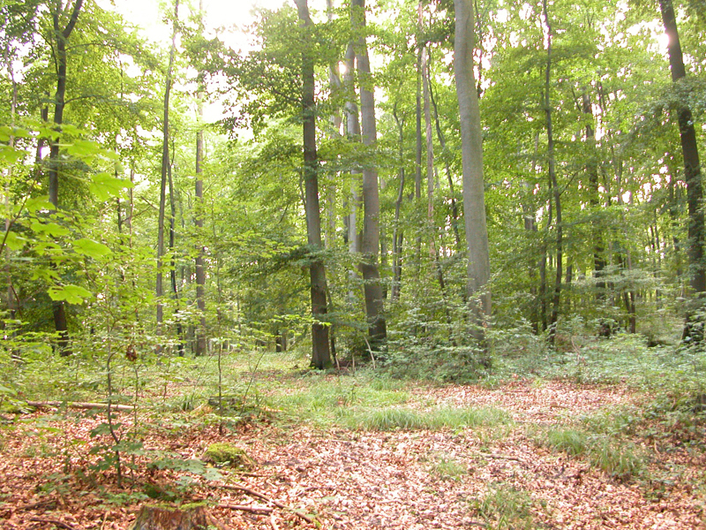
Figure 44.18
Deciduous trees are the dominant plant in the temperate forest. (credit: Oliver Herold)
Notes:
Photo shows a deciduous forest with many tall trees, some smaller trees and grass, and lots of dead leaves on the forest floor. Sunlight filters down to the forest floor.

Slide 26
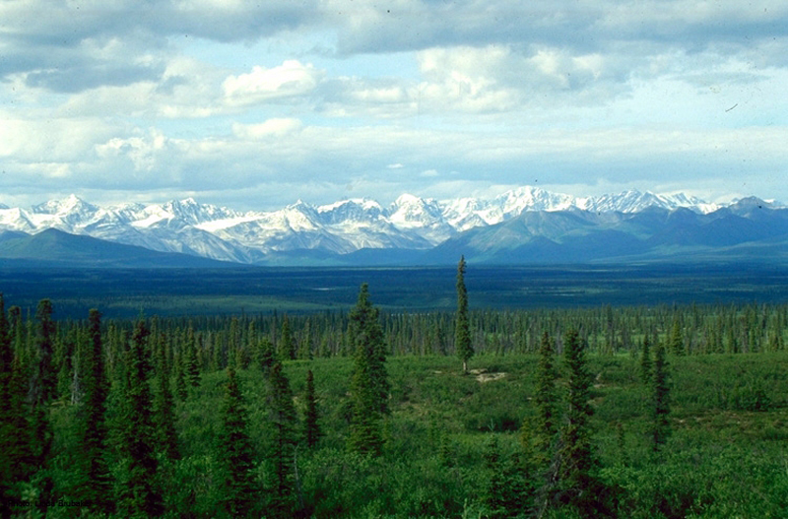
Figure 44.19
The boreal forest (taiga) has low lying plants and conifer trees. (credit: L.B. Brubaker)
Notes:
The photo shows a boreal forest with a uniform low layer of plants and tall conifers scattered throughout the landscape. The snowcapped mountains of the Alaska Range are in the background.

Slide 27
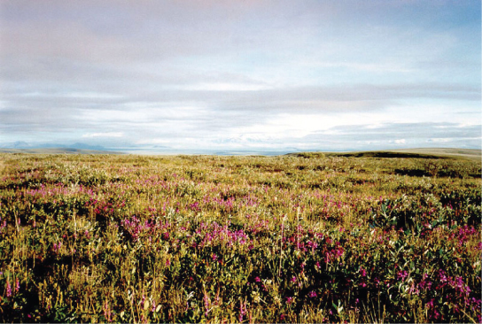
Figure 44.20
Low-growing plants such as shrub willow dominate the tundra landscape, shown here in the Arctic National Wildlife Refuge. (credit: USFWS Arctic National Wildlife Refuge)
Notes:
This photo shows a flat plain covered with shrub. Many of the shrubs are covered in pink flowers.

Slide 28
44.4 Aquatic Biomes
Learning Objectives
Describe the effects of abiotic factors on the composition of plant and animal communities in aquatic biomes
Compare and contrast the characteristics of the ocean zones
Summarize the characteristics of standing water and flowing water freshwater biomes

Slide 29
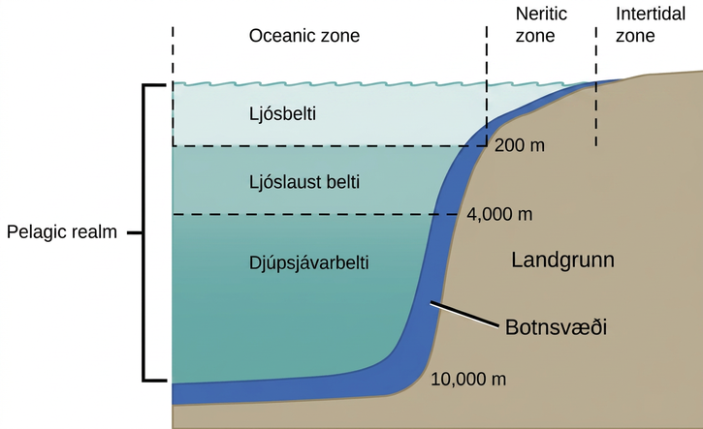
Figure 44.21
The ocean is divided into different zones based on water depth and distance from the shoreline.
Notes:
The illustration divides the ocean into different zones based on depth. The top layer, called the photic zone, extends from the surface to 200 m. The aphotic zone extends from 200 to 4,000 m. The abyssal zone extends from 4,000 m to the ocean bottom. The ocean is also divided into zones based on distance from the shore. The intertidal zone extends from high to low tide. The neritic zone extends from the intertidal zone to the point at which ocean depth is about 200 m. At about this depth, the continental shelf ends in a steep slope to the ocean bottom. The oceanic zone is the area of open ocean. The entire ocean bottom is the benthic zone. It extends from the shore, along the bottom of shallow water, and continues along the bottom down to the greatest ocean depths. All of the ocean's open water, above the entire benthic realm, including the photic, aphotic, and abyssal zones, is referred to as the pelagic realm.

Slide 30
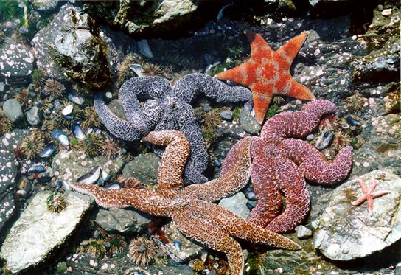
Figure 44.22
Sea urchins, mussel shells, and starfish are often found in the intertidal zone, shown here in Kachemak Bay, Alaska. (credit: NOAA)
Notes:
Photo shows sea urchins, mussel shells, and starfish in a rocky intertidal zone.

Slide 31
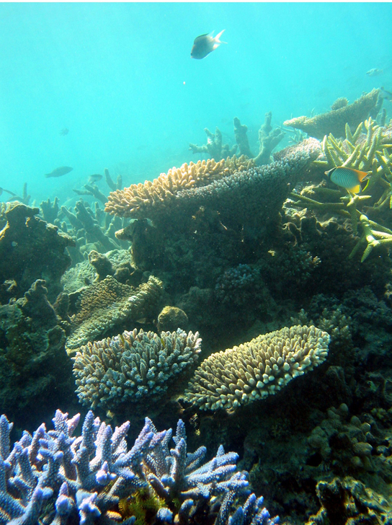
Figure 44.23
Coral reefs are formed by the calcium carbonate skeletons of coral organisms, which are marine invertebrates in the phylum Cnidaria. (credit: Terry Hughes)
Notes:
In this photo, several fish are swimming among coral. The coral at the front of the photo is blue with branched arms. Further back are anvil-shaped corals.

Slide 32
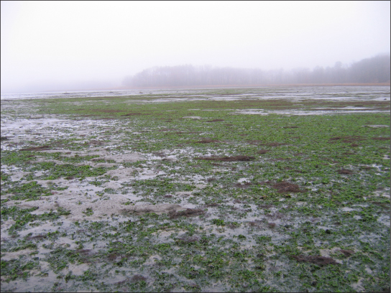
Figure 44.24
The uncontrolled growth of algae in this lake has resulted in an algal bloom. (credit: Jeremy Nettleton)
Notes:
This photo shows a body of water whose surface is mostly covered with thick, green algae, appearing as a mossy, fuzzy substance.

Slide 33
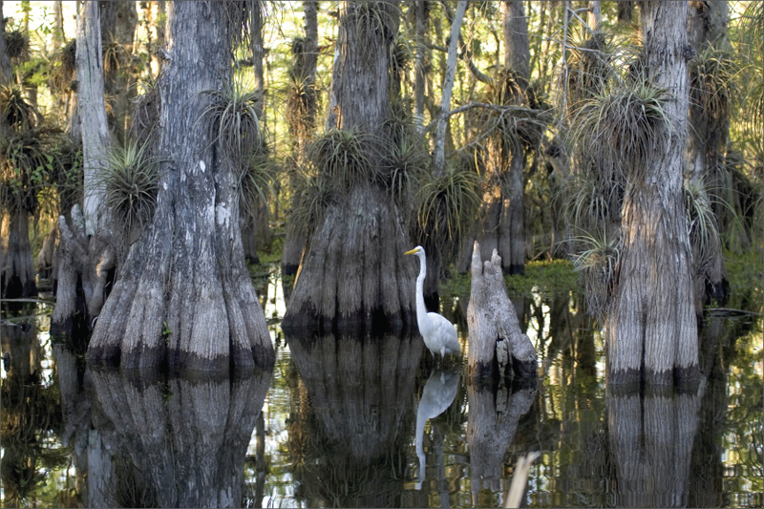
Figure 44.25
Located in southern Florida, Everglades National Park is vast array of wetland environments, including sawgrass marshes, cypress swamps, and estuarine mangrove forests. Here, a great egret walks among cypress trees. (credit: NPS)
Notes:
This photo shows mangrove trees growing in black water. The trunks of the mangroves widen and split toward the bottom. A white bird stands in the water among the trees.

Slide 34
44.5 Climate and the Effects of Global Climate Change (1 of 2)
Learning Objectives
Define global climate change
Summarize the effects of the Industrial Revolution on global atmospheric carbon dioxide concentration
Describe three natural factors affecting long-term global climate

Slide 35
44.5 Climate and the Effects of Global Climate Change (2 of 2)
Learning Objectives
List two or more greenhouse gases and describe their role in the greenhouse effect

Slide 36
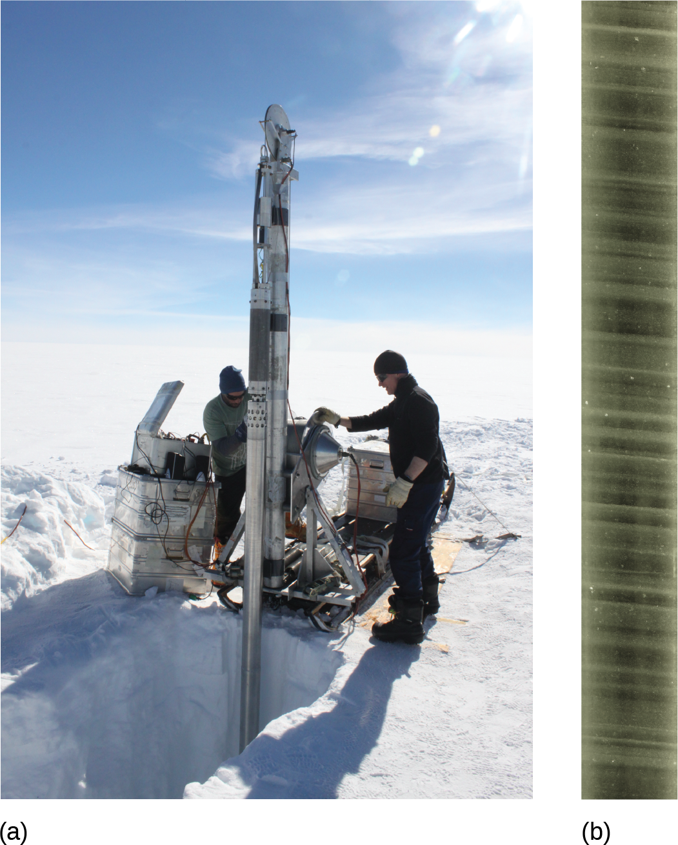
Figure 44.26
Scientists drill for ice cores in polar regions. The ice contains air bubbles and biological substances that provide important information for researchers. (credit: a: Helle Astrid Kjær; b: National Ice Core Laboratory, USGS)
Notes:
In the first image, a group of scientists uses a drill to extract an ice core in a polar environment. In the second, an ice core is displayed, showing air bubbles trapped within.

Slide 37
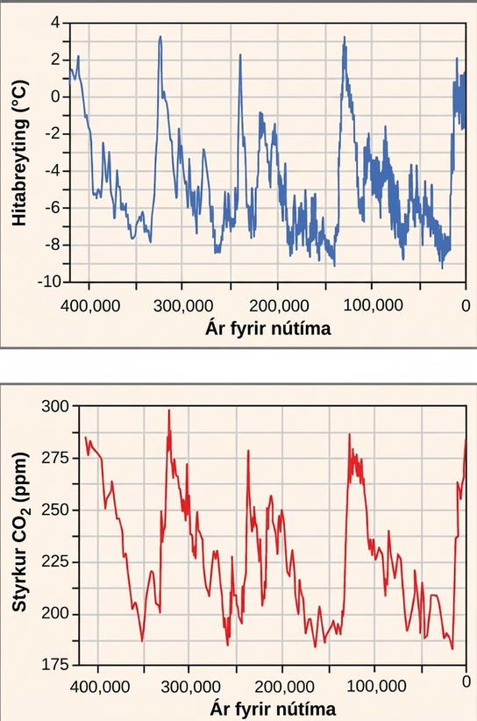
Figure 44.27
Ice at the Russian Vostok station in East Antarctica was laid down over the course of 420,000 years and reached a depth of over 3,000 m. By measuring the amount of CO2 trapped in the ice, scientists have determined past atmospheric CO2 concentrations. Temperatures relative to modern day were determined from the amount of deuterium (a nonradioactive isotope of hydrogen) present.
Notes:
Top graph plots temperature change in degrees Celsius versus years before present, beginning 400,000 years ago. Temperature shows a cyclical variation, from about 2 degrees Celsius above todays average temperature, to about 8 degrees below. Carbon dioxide levels also show a cyclical variation. The graph shows that the current trend is the carbon dioxide levels are rising. In the past, it cycled between 180 and 300 parts per million. The temperature and carbon dioxide cycles, which repeat at about a hundred thousand year scale, closely mirror one another.

Slide 38
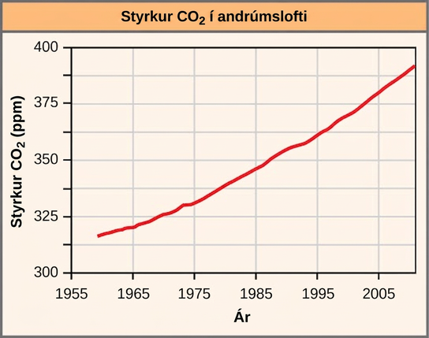
Figure 44.28
The atmospheric concentration of CO2 has risen steadily since the beginning of industrialization.
Notes:
Atmospheric carbon dioxide concentration (ppm) is plotted against year, from 19 60 to 20 10. Carbon dioxide concentration has steadily risen in the timeframe shown, from an approximate concentration of 320 in the year 19 55, to a concentration of 365 in the year 19 95, and close to 400 in the year 2005.

Slide 39
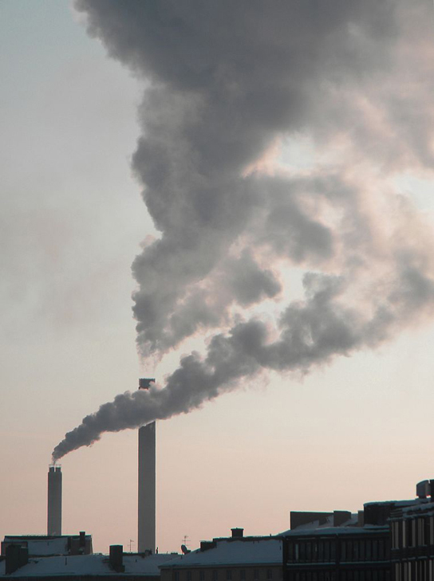
Figure 44.29
The burning of fossil fuels in industry and by vehicles releases carbon dioxide and other greenhouse gases into the atmosphere. (credit: “Pöllö”/Wikimedia Commons)
Notes:
This photo shows a smokestack from a factory churning gray smoke into the air.

Slide 40
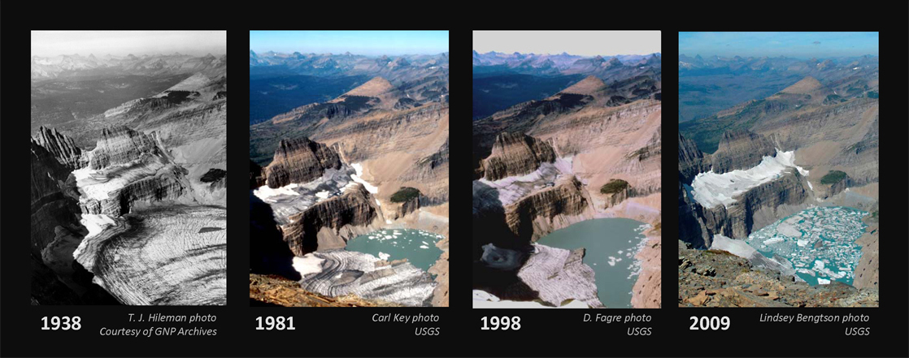
Figure 44.30
The effect of global warming can be seen in the continuing retreat of Grinnel Glacier. The mean annual temperature in the park has increased 1.33 °C since 1900. The loss of a glacier results in the loss of summer meltwaters, sharply reducing seasonal water supplies and severely affecting local ecosystems. (credit: modification of work by USGS)
This OpenStax ancillary resource is © Rice University under a CC BY-NC-SA 4.0 International license; it may be reproduced or modified for noncommercial purposes only but must be attributed to OpenStax, Rice University and any changes must be noted. Any adaptation must be shared under the same type of license.
Notes:
A series of photos shows the Grinnel Glacier in the years 19 38, 19 81, 19 98 and 2009. In 19 38, the lake beneath the glacier was completely frozen. In 19 81, about one-third of the lake was thawed. In 19 98, two-thirds of the lake was thawed. In 2009, it was covered with chunks of ice, but otherwise it was completely thawed. At the same time, the glacier itself has steadily receded.

