Slide 1

Biology 2e
Chapter 37 The Endocrine System

Slide 2
Chapter outline
Types of Hormones
How Hormones Work
Regulation of Body Processes
Regulation of Hormone Production
Endocrine Glands

Slide 3
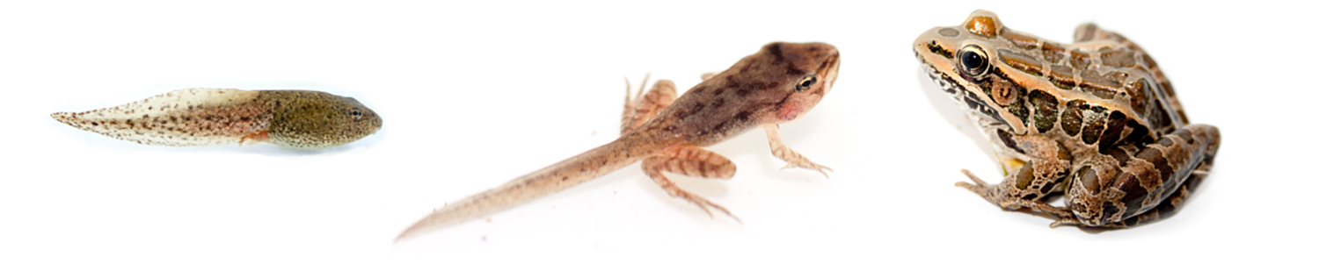
Figure 37.1
The process of amphibian metamorphosis, as seen in the tadpole-to-frog stages shown here, is driven by hormones. (credit "tadpole": modification of work by Brian Gratwicke)
Notes:
Photo A shows a tadpole. Photo b shows a frog that has developed legs but still has the tail of a tadpole. Photo C shows a fully grown frog.

Slide 4
37.1 Types of Hormones
Learning Objectives
List the different types of hormones
Explain their role in maintaining homeostasis

Slide 5
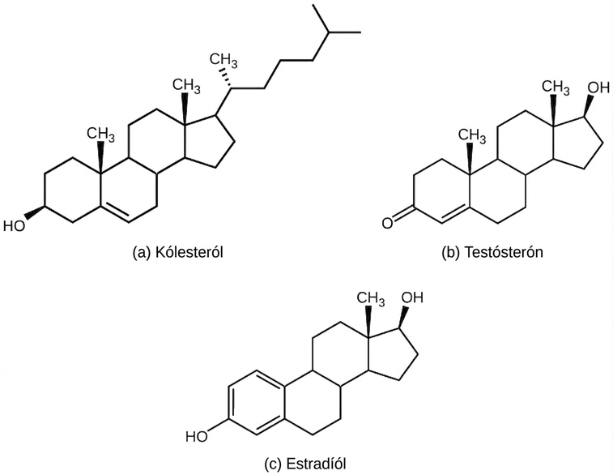
Figure 37.2
The structures shown here represent (a) cholesterol, plus the steroid hormones (b) testosterone and (c) estradiol.
Notes:
Part A shows the molecular structure of cholesterol, which has three six-carbon rings attached to a five-carbon ring. A hydroxyl group is attached to the first six-membered ring, and a branched carbon chain is attached to the five-membered ring. Two methyl groups are attached each to a carbon that links the rings together. Part B shows the molecular structure of testosterone, which has a hydroxyl group in place of the branched carbon chain found on cholesterol. A ketone instead of a hydroxyl group is attached to the six-membered ring. Part C shows the molecular structure of estradiol, which, like testosterone, has a hydroxyl group in place of cholesterol’s branched carbon chain. Estradiol also lacks one of the methyl groups found in cholesterol.

Slide 6
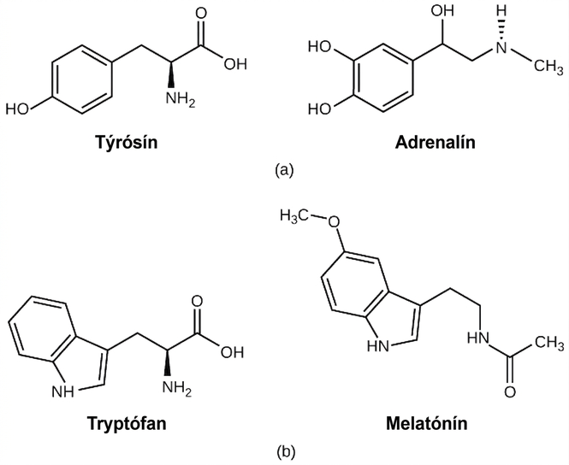
Figure 37.3
(a) The hormone epinephrine, which triggers the fight-or-flight response, is derived from the amino acid tyrosine. (b) The hormone melatonin, which regulates circadian rhythms, is derived from the amino acid tryptophan.
Notes:
Part A shows the amino acid tyrosine on the left and epinephrine on the right. Epinephrine is similar in structure to tyrosine, with minor modifications. Part B shows the amino acid tryptophan on the left and the structurally similar melatonin on the right.

Slide 7
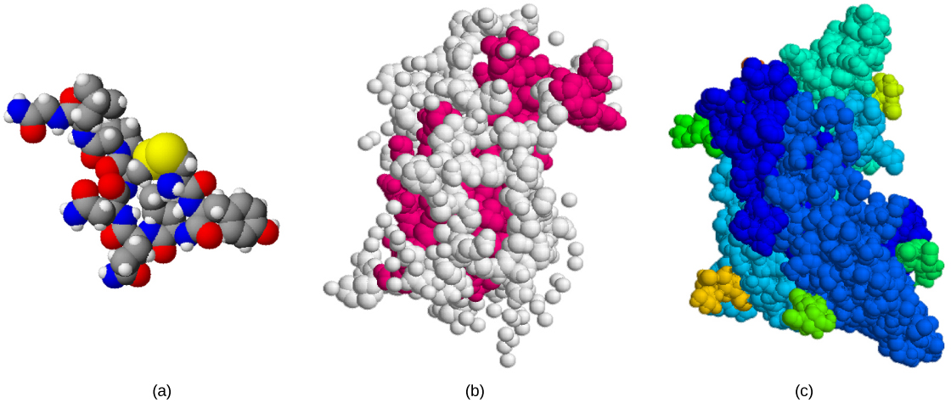
Figure 37.4
The structures of peptide hormones (a) oxytocin, (b) growth hormone, and (c) follicle-stimulating hormone are shown. These peptide hormones are much larger than those derived from cholesterol or amino acids.
Notes:
Oxytocin, growth hormone, and follicle stimulating hormone are all large, with complex three-dimensional structures.

Slide 8
37.2 How Hormones Work
Learning Objectives
Explain how hormones work
Discuss the role of different types of hormone receptors

Slide 9
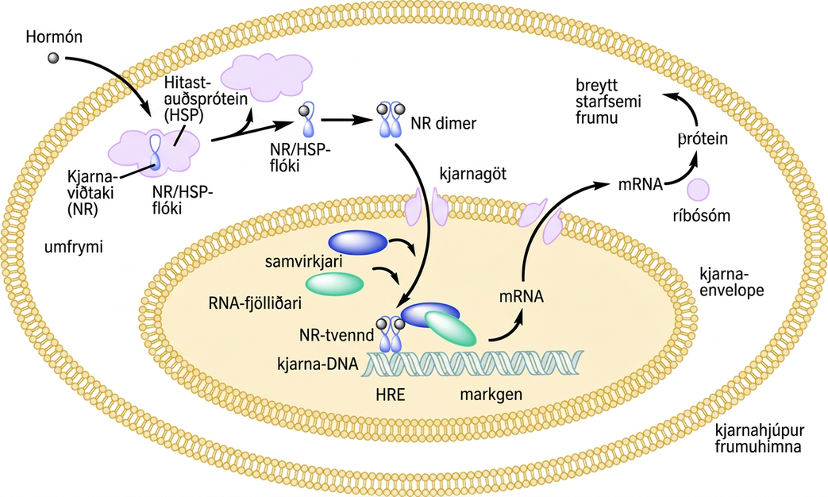
Figure 37.5
An intracellular nuclear receptor (NR) is located in the cytoplasm bound to a heat shock protein (HSP). Upon hormone binding, the receptor dissociates from the heat shock protein and translocates to the nucleus. In the nucleus, the hormone-receptor complex binds to a DNA sequence called a hormone response element (HRE), which triggers gene transcription and translation. The corresponding protein product can then mediate changes in cell function.
Notes:
Illustration shows a hormone crossing the cellular membrane and attaching to the N R slash H S P complex. The complex dissociates, releasing the heat shock protein and a N R slash hormone complex. The complex dimerizes, enters the nucleus, and attaches to an H R E element on D N A, triggering transcription of certain genes.

Slide 10
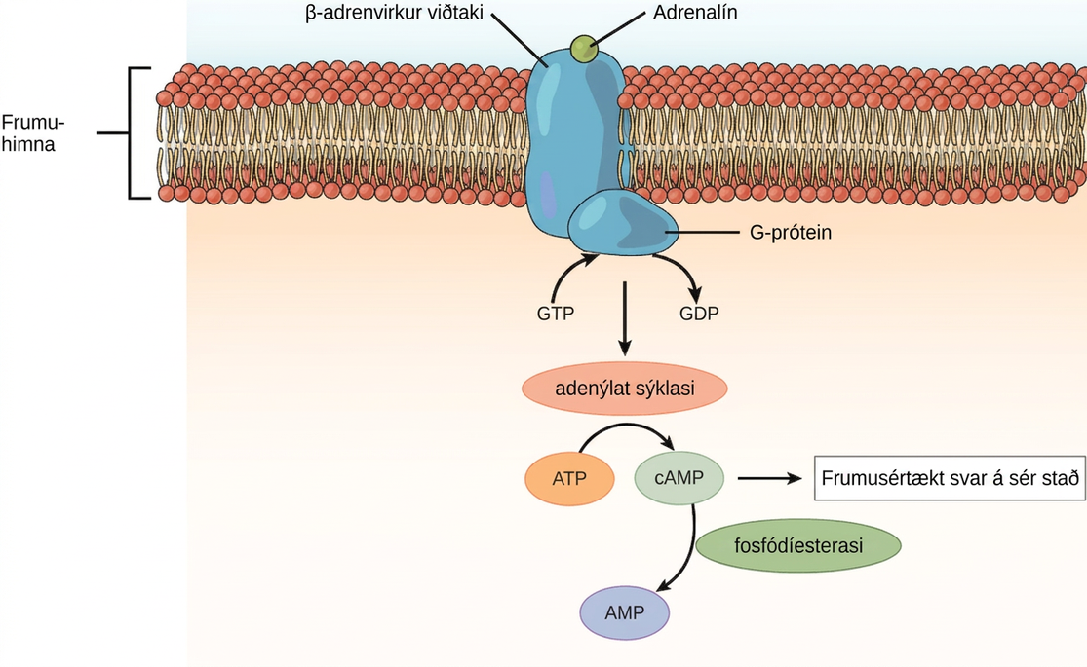
Figure 37.6
The amino acid-derived hormones epinephrine and norepinephrine bind to beta-adrenergic receptors on the plasma membrane of cells. Hormone binding to receptor activates a G-protein, which in turn activates adenylyl cyclase, converting ATP to cAMP. cAMP is a second messenger that mediates a cell-specific response. An enzyme called phosphodiesterase breaks down cAMP, terminating the signal.
Notes:
Illustration shows epinephrine bound to the extracellular surface of a beta-adrenergic receptor. A G-protein associated with the intracellular surface of the receptor is activated when the G D P associated with it is replaced with G T P. The G protein activates the enzyme adenylyl cyclase, which converts A T P to lower case c upper case A M P, triggering a cellular response.

Slide 11
37.3 Regulation of Body Processes
Learning Objectives
Explain how hormones regulate the excretory system
Discuss the role of hormones in the reproductive system
Describe how hormones regulate metabolism
Explain the role of hormones in different diseases

Slide 12
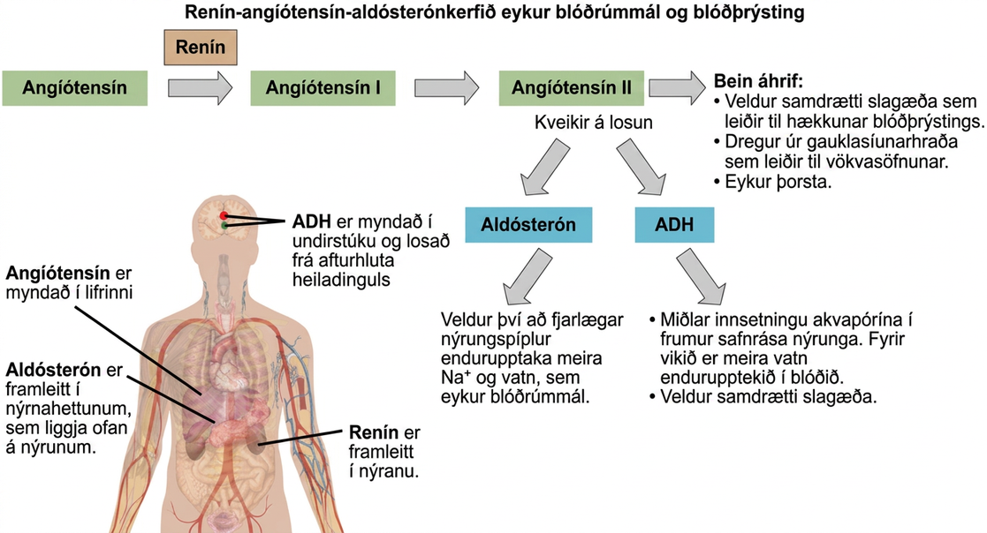
Figure 37.7
ADH and aldosterone increase blood pressure and volume. Angiotensin II stimulates release of these hormones. Angiotensin II, in turn, is formed when renin cleaves angiotensinogen. (credit: modification of work by Mikael Häggström)
Notes:
The Renin-angiotensin-aldosterone pathway involves four hormones: renin, which is made in the kidney, angiotensinogen, which is made in the liver, aldosterone, which is made in the adrenal glands, and A D H, which is made in the hypothalamus and secreted by the posterior pituitary. The adrenal glands are located on top of the kidneys, and the hypothalamus and pituitary are in the brain. The pathway begins when renin converts angiotensinogen into angiotensin I. Angiotensin I is the converted into angiotensin I I. Angiotensin I I has several direct effects. These include arterial constriction, which increases blood pressure, decreasing the glomerular filtration rate, which results in water retention, and increasing thirst. Angiotensin I I also triggers the release of two other hormones, aldosterone and A D H. Aldosterone causes nephron distal tubules to reabsorb more sodium and water, which increases blood volume. A D H mediates the insertion of aquaporins into the nephridial collecting ducts. As a result, more water is reabsorbed by the blood. A D H also causes arteries to constrict.

Slide 13

Figure 37.8
Professional baseball player Jason Giambi publically admitted to, and apologized for, his use of anabolic steroids supplied by a trainer. (credit: Bryce Edwards)
Notes:
Photo shows baseball player Jason Giambi at a game.

Slide 14
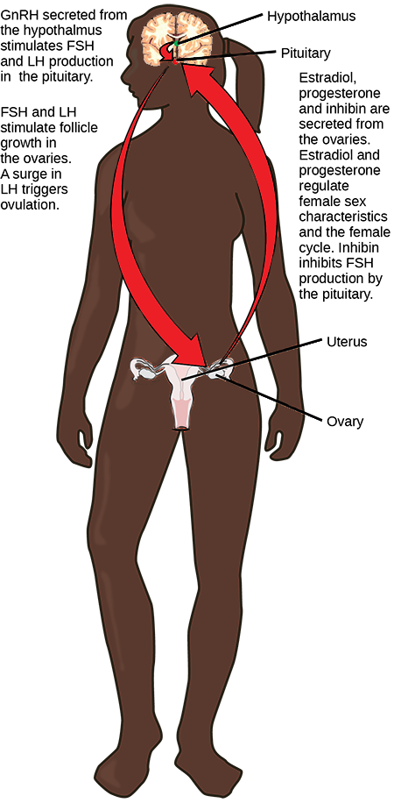
Figure 37.9
Hormonal regulation of the ovarian reproductive system involves hormones from the hypothalamus, pituitary, and ovaries.
Notes:
The hypothalamus secretes upper case G lower case n upper case R upper case H, which stimulates secretion of F S H and L H from the pituitary. The hypothalamus and pituitary are both found in the brain. F S H and L H stimulate follicle growth in the ovaries, and a surge in L H triggers ovulation. The two ovaries, which are located on either side of the uterus, secrete estradiol, progesterone, and inhibin. Estrodiol and progesterone regulate female sex characteristics and the menstrual cycle. Inhibin inhibits F S H production by the pituitary in a negative feedback loop.

Slide 15
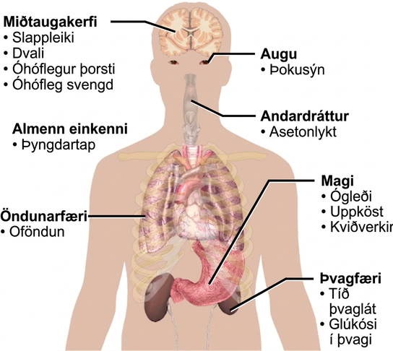
Figure 37.10
The main symptoms of diabetes are shown. (credit: modification of work by Mikael Häggström)
Notes:
Symptoms of diabetes that affect the central nervous system include excessive thirst, excessive hunger, lethargy and stupor. It affects the eyes via blurred vision. A systemic issue is weight loss. It causes breath that smells like acetone, and affects the respiratory system through hyperventilation. Some of the gastric issues caused are nausea, vomiting, and abdominal pain. The urinary issues caused include frequent urination, and glucose in the urine.

Slide 16
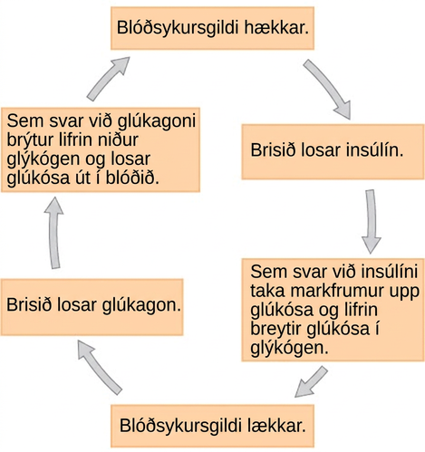
Figure 37.11
Insulin and glucagon regulate blood glucose levels.
Notes:
When blood glucose levels fall, the pancreas secretes the hormone glucagon. Glucagon causes the liver to break down glycogen, releasing glucose into the blood. As a result, blood glucose levels rise. In response to high glucose levels, the pancreas releases insulin. In response to insulin, target cells take up glucose, and the liver converts glucose to glycogen. As a result, blood glucose levels fall.

Slide 17
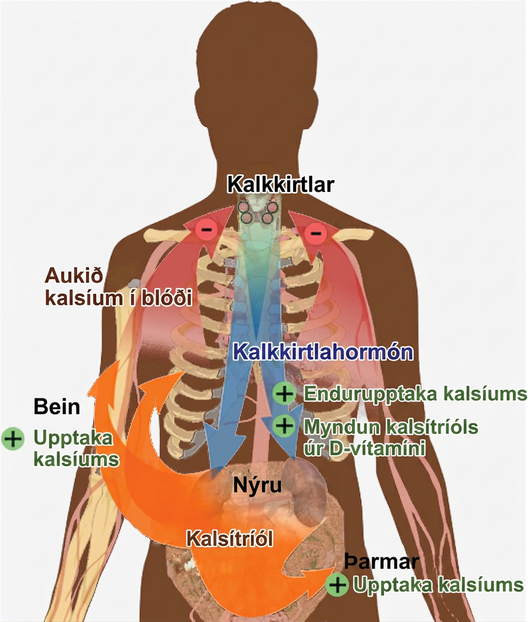
Figure 37.12
Parathyroid hormone (PTH) is released in response to low blood calcium levels. It increases blood calcium levels by targeting the skeleton, the kidneys, and the intestine. (credit: modification of work by Mikael Häggström)
Notes:
The parathyroid glands, which are located in the neck, release parathyroid hormone, or P T H. P T H causes the release of calcium from bone and triggers the reabsorption of calcium from the urine in the kidneys. P T H also triggers the formation of calcitriol from vitamin D. Calcitriol causes the intestines to absorb more calcium. The result is increased calcium in the blood.

Slide 18
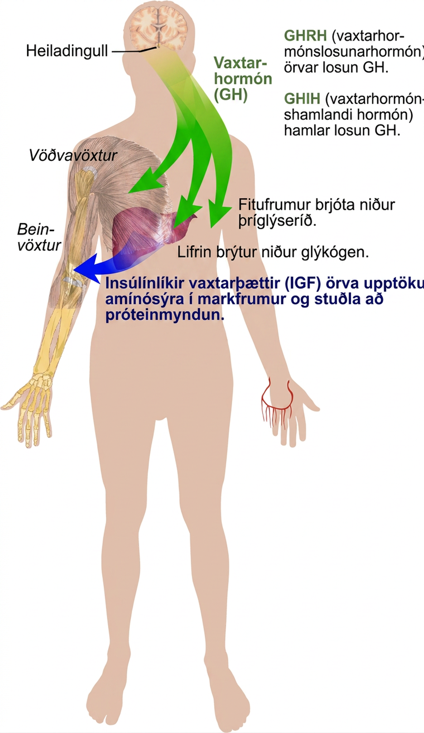
Figure 37.13
Growth hormone directly accelerates the rate of protein synthesis in skeletal muscle and bones. Insulin-like growth factor 1 (IGF-1) is activated by growth hormone and also allows formation of new proteins in muscle cells and bone. (credit: modification of work by Mikael Häggström)
Notes:
Growth hormone, or G H, is released from the pituitary gland and stimulates bone and muscle growth. It also stimulates fat breakdown by adipocytes and glycogen breakdown by the liver. The liver releases insulin-like growth factors, or I G Fs, which cause target cells to take up amino acids, promoting protein synthesis. G H releasing hormone stimulates the release of G H, and G H inhibiting hormone inhibits the release of G H.

Slide 19
37.4 Regulation of Hormone Production
Learning Objectives
Explain how hormone production is regulated
Discuss the different stimuli that control hormone levels in the body

Slide 20
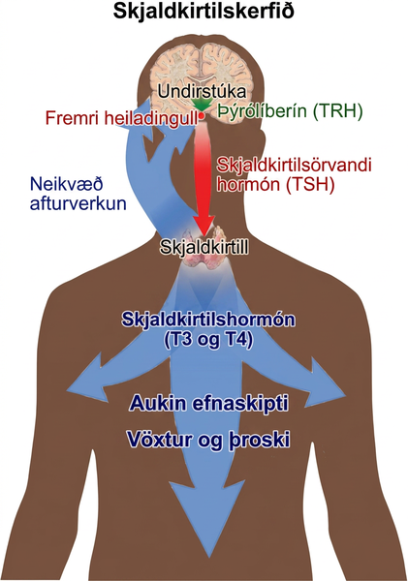
Figure 37.14
The anterior pituitary stimulates the thyroid gland to release thyroid hormones T3 and T4. Increasing levels of these hormones in the blood results in feedback to the hypothalamus and anterior pituitary to inhibit further signaling to the thyroid gland. (credit: modification of work by Mikael Häggström)
Notes:
The hypothalamus secretes thyrotropin-releasing hormone, which causes the anterior pituitary gland to secrete thyroid-stimulating hormone, or T S H. Thyroid-stimulating hormone causes the thyroid gland to secrete the thyroid hormones T 3 and T 4, which increase metabolism, resulting in growth and development. In a negative feedback loop, T 3 and T 4 inhibit hormone secretion by the hypothalamus and pituitary, terminating the signal.

Slide 21
37.5 Endocrine Glands
Learning Objectives
Describe the role of different glands in the endocrine system
Explain how the different glands work together to maintain homeostasis

Slide 22
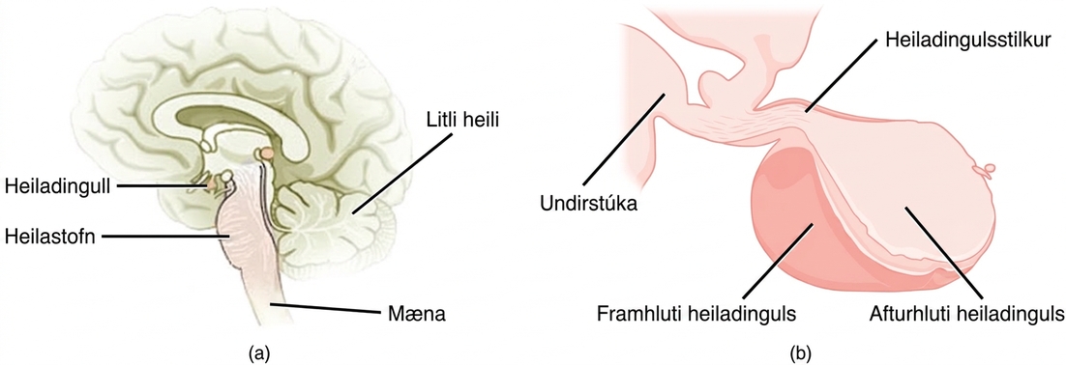
Figure 37.15
The pituitary gland is located at (a) the base of the brain and (b) connected to the hypothalamus by the pituitary stalk. (credit a: modification of work by NCI; credit b: modification of work by Gray’s Anatomy)
Notes:
The pituitary gland sits at the base of the brain, just above the brain stem. It is lobe-shaped and hangs down from the hypothalamus, to which it is connected to via a narrow stalk. The anterior part of the pituitary is toward the front, and the posterior end is toward the back.

Slide 23
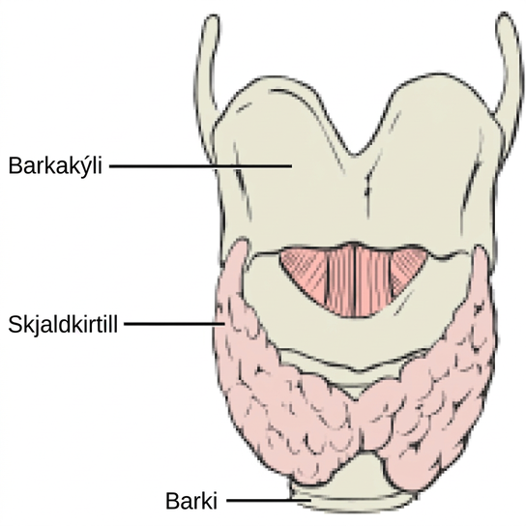
Figure 37.16
This illustration shows the location of the thyroid gland.
Notes:
The thyroid is located in the neck beneath the larynx and in front of the trachea. It consists of right and left lobes.

Slide 24
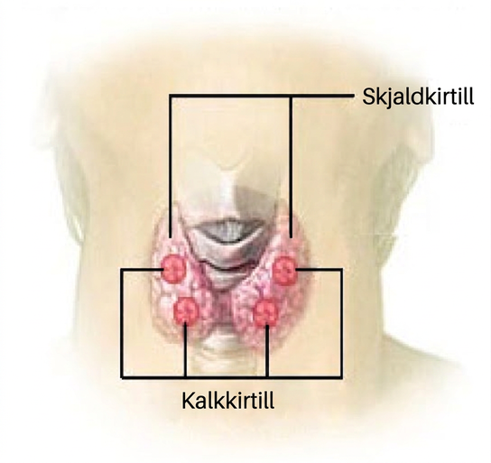
Figure 37.17
The parathyroid glands are located on the posterior of the thyroid gland. (credit: modification of work by NCI)
Notes:
The parathyroid glands are round structures located on the surface of the right and left lobes of the thyroid gland. In the illustration shown, there are two parathyroid glands on each side, and one is located above the other.

Slide 25
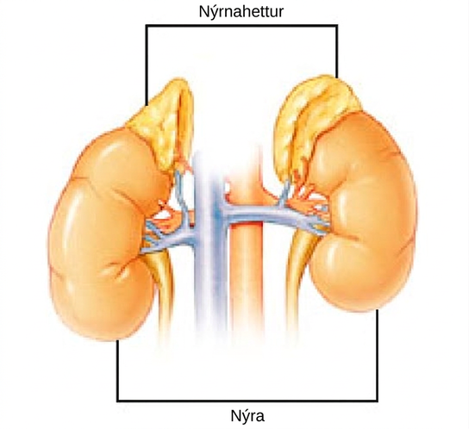
Figure 37.18
The location of the adrenal glands on top of the kidneys is shown. (credit: modification of work by NCI)
Notes:
The adrenal glands are lumpy, irregular structures located on top of the kidneys.

Slide 26
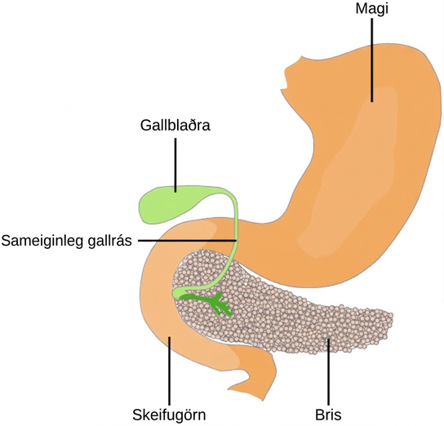
Figure 37.19
The pancreas is found underneath the stomach and points toward the spleen. (credit: modification of work by NCI)
Notes:
The pancreas is a grainy, teardrop-shaped organ tucked between the stomach and intestine. A common bile duct extends from the pancreas to a small pouch like structure called a gall bladder.

Slide 27
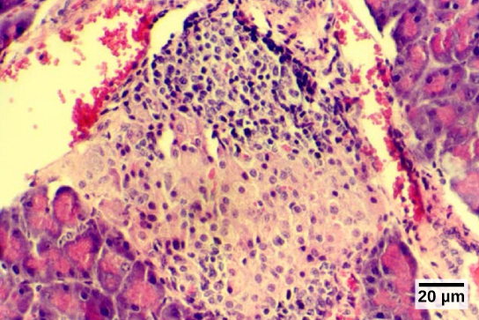
Figure 37.20
The islets of Langerhans are clusters of endocrine cells found in the pancreas; they stain lighter than surrounding cells. (credit: modification of work by Muhammad T. Tabiin, Christopher P. White, Grant Morahan, and Bernard E. Tuch; scale-bar data from Matt Russell)
Notes:
Micrograph shows purple-stained cells in a white tissue. The white tissue is surrounded by tissue that stains pink.

Slide 28
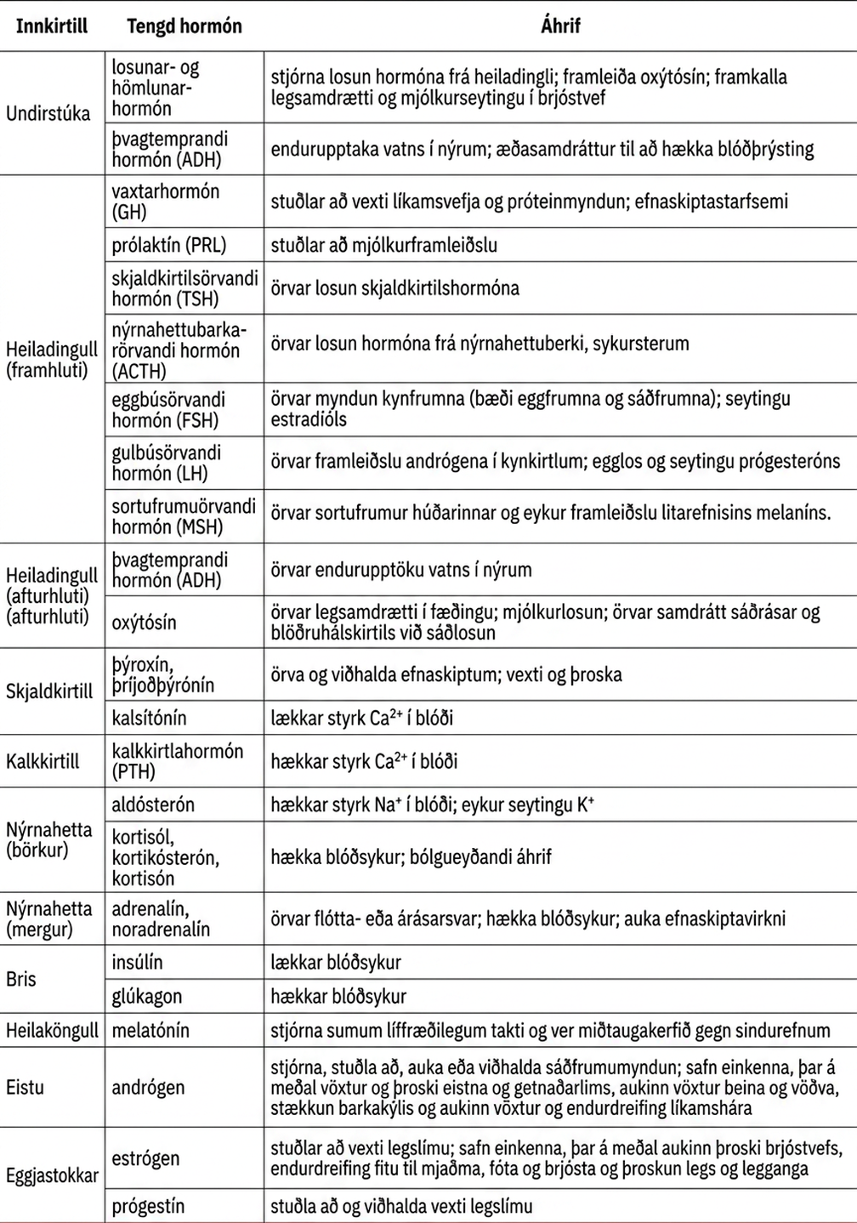
Table 37.1
This OpenStax ancillary resource is © Rice University under a CC BY-NC-SA 4.0 International license; it may be reproduced or modified for noncommercial purposes only but must be attributed to OpenStax, Rice University and any changes must be noted. Any adaptation must be shared under the same type of license.

