Slide 1

Biology 2e
Chapter 31 Soil and Plant Nutrition

Slide 2
Chapter outline
Nutritional Requirements of Plants
The Soil
Nutritional Adaptations of Plants

Slide 3
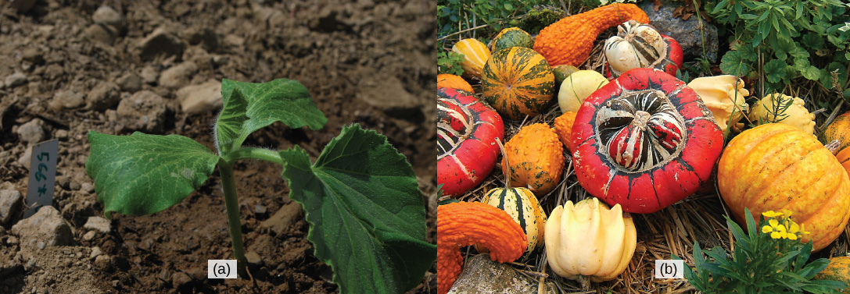
Figure 31.1
For this (a) squash seedling (Cucurbita maxima) to develop into a mature plant bearing its (b) fruit, numerous nutritional requirements must be met. (credit a: modification of work by Julian Colton; credit b: modification of work by "Wildfeuer"/Wikimedia Commons)
Notes:
Left photo shows a dark green seedling with three leaves. The seedling is growing on a plot of dark-brown soil. Right photo shows a variety of red, orange, green and yellow squashes.

Slide 4
31.1 Nutritional Requirements of Plants
Learning Objectives
Describe how plants obtain nutrients
List the elements and compounds required for proper plant nutrition
Describe an essential nutrient

Slide 5
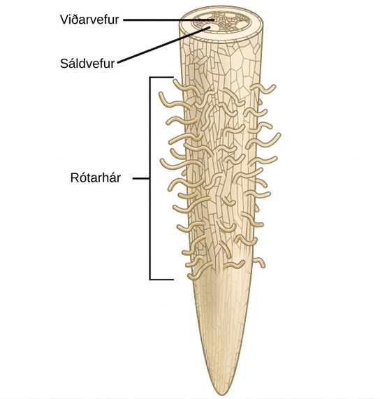
Figure 31.2
Water is absorbed through the root hairs and moves up the xylem to the leaves.
Notes:
Illustration shows a root tip. The tip of the root is bare, and hairs grow further up. A cross section at the top of the root reveals xylem tissue interspersed by four ovals containing phloem at the periphery.

Slide 6
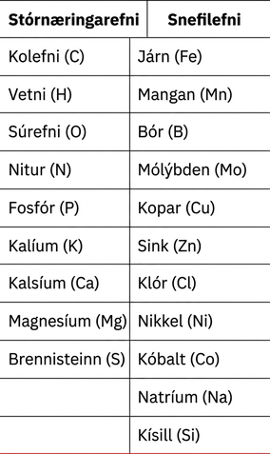
Table 31.1

Slide 7
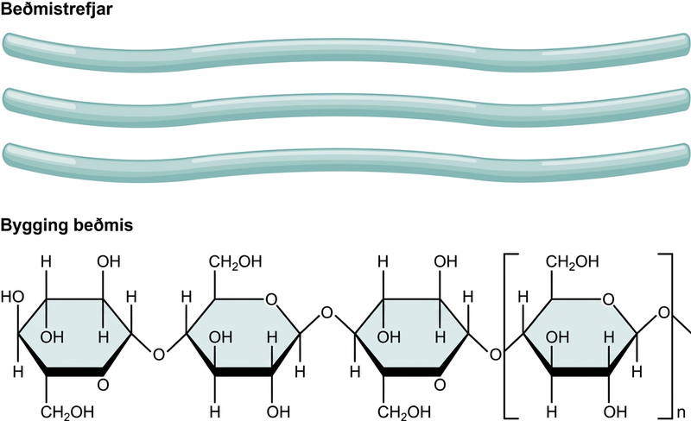
Figure 31.3
Cellulose, the main structural component of the plant cell wall, makes up over thirty percent of plant matter. It is the most abundant organic compound on earth.
Notes:
Three cellulose fibers and the chemical structure of cellulose is shown. Cellulose consists of unbranched chains of glucose subunits that form long, straight fibers.

Slide 8
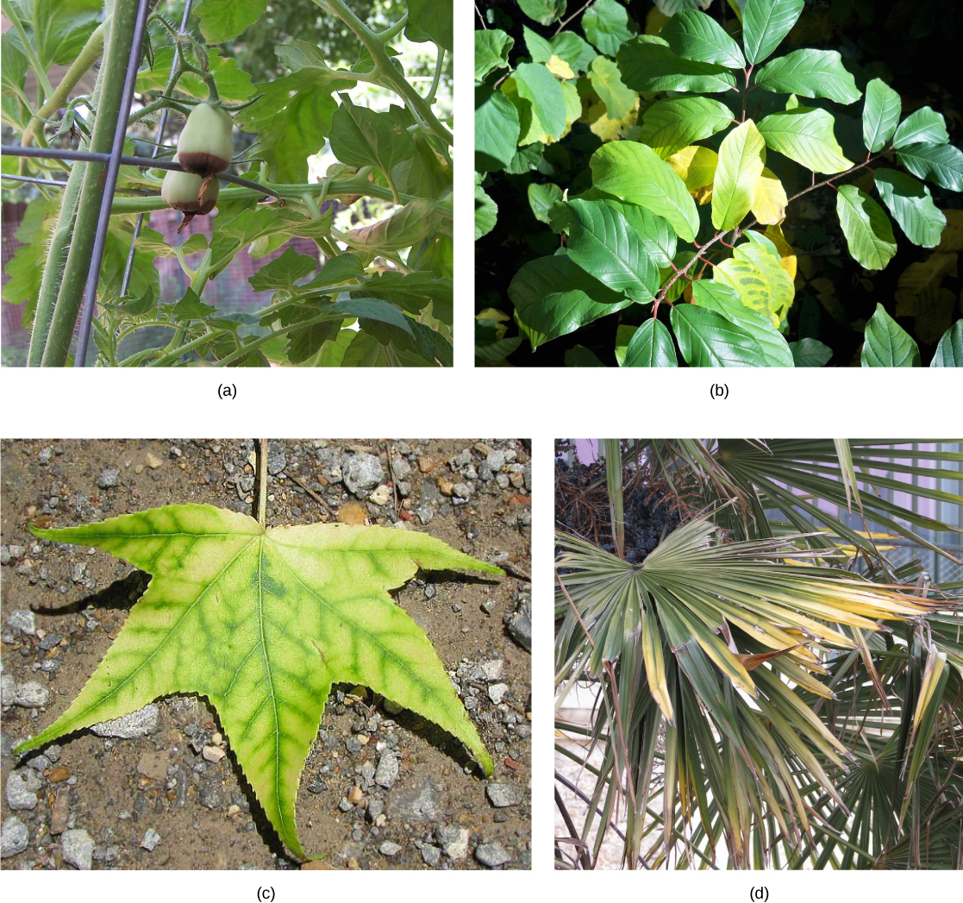
Figure 31.4
Nutrient deficiency is evident in the symptoms these plants show. This (a) grape tomato suffers from blossom end rot caused by calcium deficiency. The yellowing in this (b) Frangula alnus results from magnesium deficiency. Inadequate magnesium also leads to (c) interveinal chlorosis, seen here in a sweetgum leaf. This (d) palm is affected by potassium deficiency. (credit c: modification of work by Jim Conrad; credit d: modification of work by Malcolm Manners)
Notes:
Photo (a) shows a tomato plant with two green tomato fruits. The fruits have turned dark brown on the bottom. Photo (b) shows a plant with green leaves; some of the leaves have turned yellow. Photo (c) shows a five-lobed leaf that is yellow with greenish veins. Photo (d) shows green palm leaves with yellow tips.

Slide 9
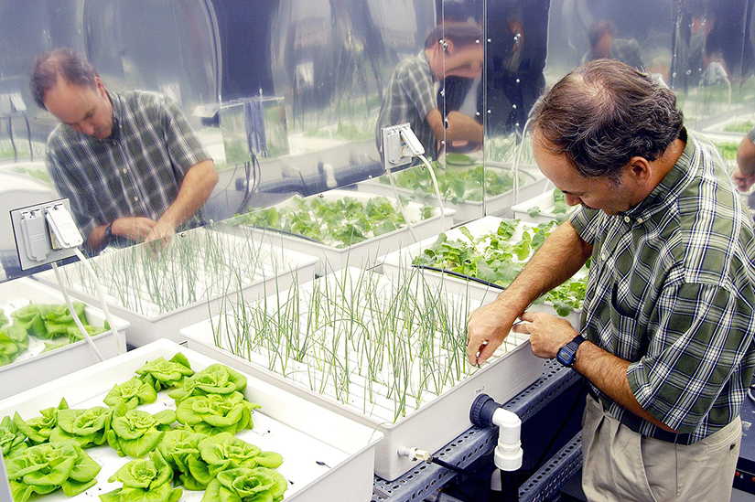
Figure 31.5
Plant physiologist Ray Wheeler checks onions being grown using hydroponic techniques. The other plants are Bibb lettuce (left) and radishes (right). Credit: NASA
Notes:
This photo shows a NASA researcher examining a hydroponic array, including several types of plants. The onions grow in a tray with long, thin openings from which emerge their grass-like leaves. Next to the onions are lettuces in a try appearing to have holes from which their larger leaves can emerge.

Slide 10
31.2 The Soil
Learning Objectives
Describe how soils are formed
Explain soil composition
Describe a soil profile

Slide 11
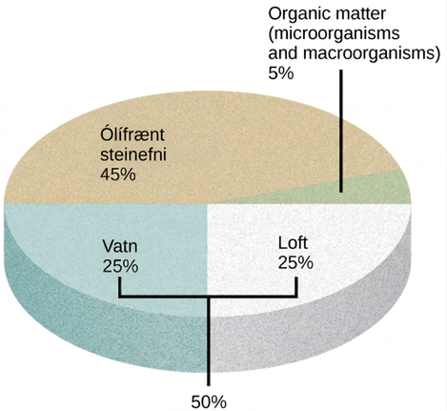
Figure 31.6
The four major components of soil are shown: inorganic minerals, organic matter, water, and air.
Notes:
Illustration shows a pie graph that outlines the composition of soil. Forty-five percent is inorganic mineral matter, 25 percent is water, 25 percent is air, and 5 percent is organic matter, including microorganisms and macroorganisms.

Slide 12
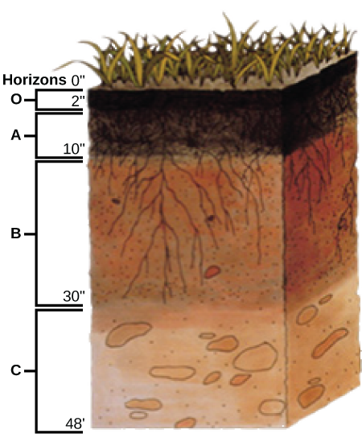
Figure 31.7
This soil profile shows the different soil layers (O horizon, A horizon, B horizon, and C horizon) found in typical soils. (credit: modification of work by USDA)
Notes:
Illustration shows a cross-section of soil layers, or horizons. The top layer, from zero to two inches, is the O horizon. The O horizon is a rich, deep brown color. From two to ten inches is the A horizon. This layer is slightly lighter in color than the O horizon, and extensive root systems are visible. From ten to thirty inches is the B horizon. The B horizon is reddish brown. Longer roots extend to the bottom of this layer. The C horizon extends from 30 to 48 inches. This layer is rocky and devoid of roots.

Slide 13
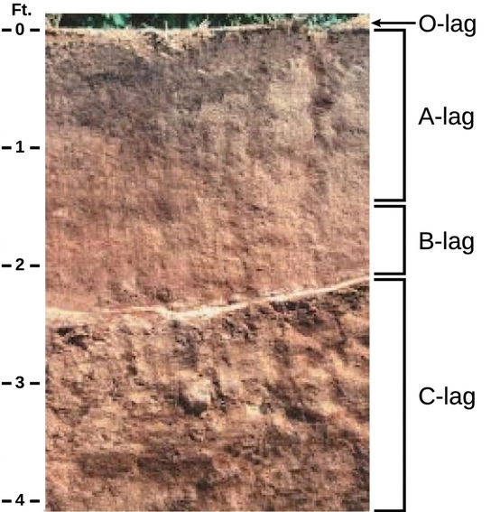
Figure 31.8
The San Joaquin soil profile has an O horizon, A horizon, B horizon, and C horizon. (credit: modification of work by USDA)
Notes:
In the photo, soil has been cut away to reveal the soil profile. The O horizon is at the soil surface and is a rich black color. The brown A horizon starts beneath the O horizon and extends to about two-and-a-half feet beneath the surface. The B horizon is reddish brown and extends from the bottom of the A horizon to about two feet deep. The C horizon extends from the bottom of the B horizon to the bottom of the photo at a depth of four feet. The C horizon is light brown and has a coarser consistency than the A or B horizons.

Slide 14
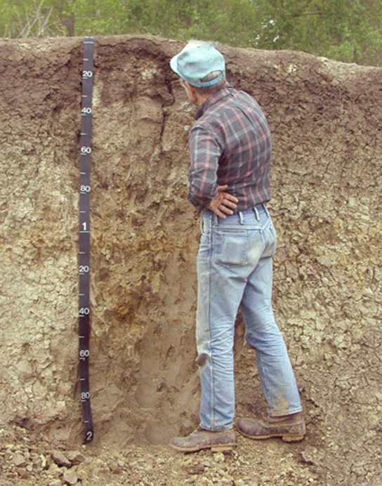
Figure 31.9
This soil scientist is studying the horizons and composition of soil at a research site. (credit: USDA)
Notes:
Photo shows a man standing next to a wall of soil in a pit that is as deep as he is tall.

Slide 15
31.3 Nutritional Adaptations of Plants
Learning Objectives
Understand the nutritional adaptations of plants
Describe mycorrhizae
Explain nitrogen fixation

Slide 16
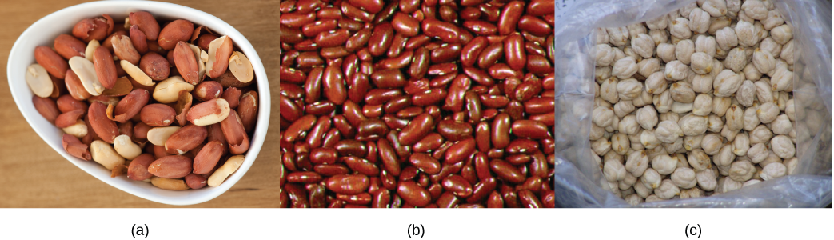
Figure 31.10
Some common edible legumes—like (a) peanuts, (b) beans, and (c) chickpeas—are able to interact symbiotically with soil bacteria that fix nitrogen. (credit a: modification of work by Jules Clancy; credit b: modification of work by USDA)
Notes:
Top photo shows a bowl of shelled peanuts. Middle photo shows red kidney beans. Bottom photo shows white, bumpy, round chickpeas.

Slide 17
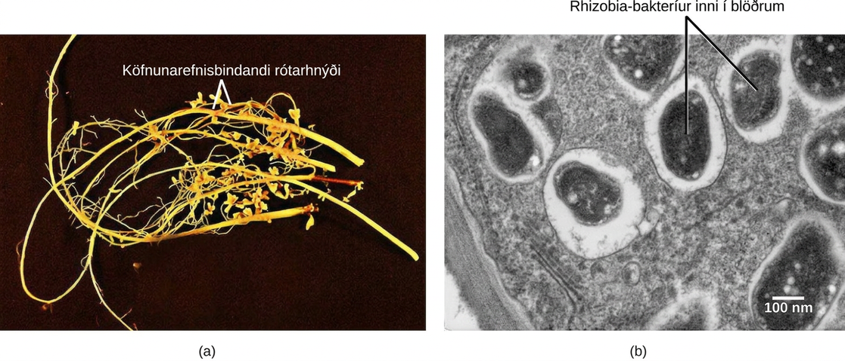
Figure 31.11
Soybean roots contain (a) nitrogen-fixing nodules. Cells within the nodules are infected with Bradyrhyzobium japonicum, a rhizobia or “root-loving” bacterium. The bacteria are encased in (b) vesicles inside the cell, as can be seen in this transmission electron micrograph. (credit a: modification of work by USDA; credit b: modification of work by Louisa Howard, Dartmouth Electron Microscope Facility; scale-bar data from Matt Russell)
Notes:
Part A is a photo of legume roots, which are long and thin with hair-like appendages. Nodules are bulbous protrusions extending from the root. Part B is a transmission electron micrograph of a nodule cell cross section. Black oval-shaped vesicles containing rhizobia are visible. The vesicles are surrounded by a white layer and are scattered unevenly throughout the cell, which is gray.

Slide 18
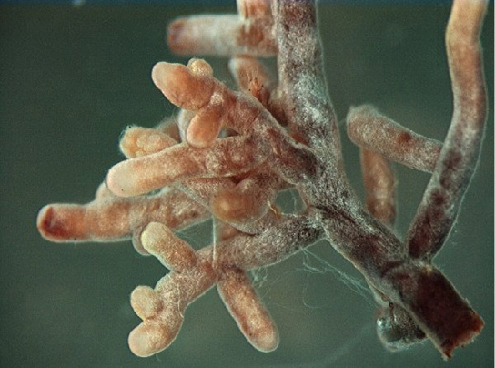
Figure 31.12
Root tips proliferate in the presence of mycorrhizal infection, which appears as off-white fuzz in this image. (credit: modification of work by Nilsson et al., BMC Bioinformatics 2005)
Notes:
Photo shows a root with many branching tips. The surface of the root is fuzzy in appearance.

Slide 19
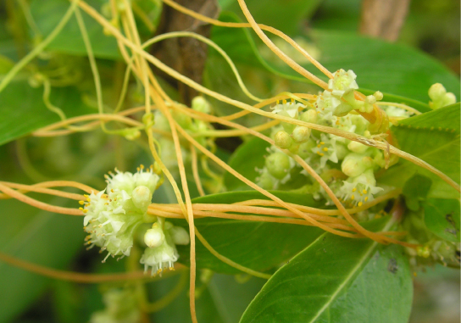
Figure 31.13
The dodder is a holoparasite that penetrates the host’s vascular tissue and diverts nutrients for its own growth. Note that the vines of the dodder, which has white flowers, are beige. The dodder has no chlorophyll and cannot produce its own food. (credit: "Lalithamba"/Flickr)
Notes:
Photo shows a beige vine with small white flowers. The vine is wrapped around a woody stem of a plant with green leaves.

Slide 20
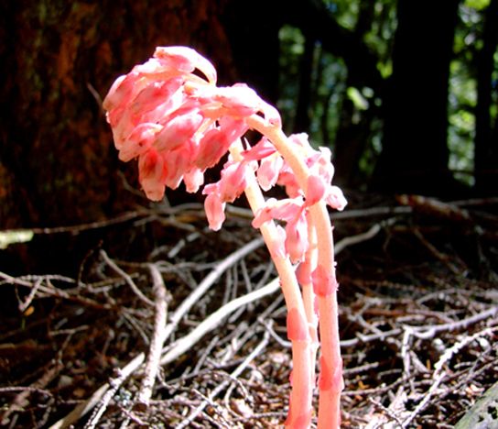
Figure 31.14
Saprophytes, like this Dutchmen’s pipe (Monotropa hypopitys), obtain their food from dead matter and do not have chlorophyll. (credit: modification of work by Iwona Erskine-Kellie)
Notes:
Photo shows a plant with light pink stems reminiscent of asparagus. Bud-like appendages grow from the tips of the stems.

Slide 21
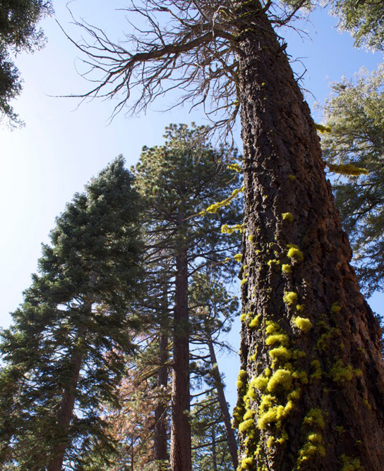
Figure 31.15
Lichens, covered in Ecology of Fungi, which often have symbiotic relationships with other plants, can sometimes be found growing on trees. (credit: "benketaro"/Flickr)
Notes:
Photo shows a tall pine tree covered with green lichen.

Slide 22
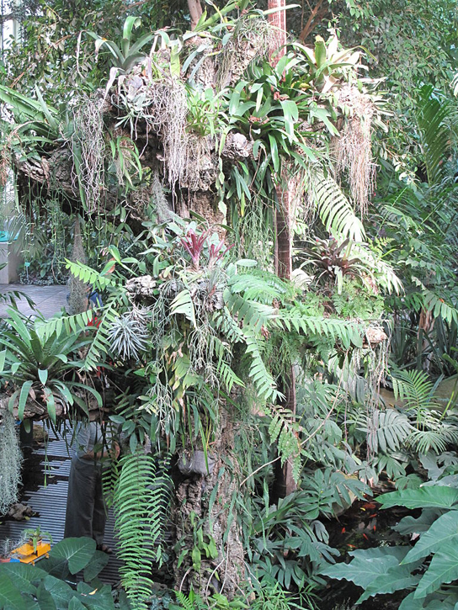
Figure 31.16
These epiphyte plants grow in the main greenhouse of the Jardin des Plantes in Paris.
Notes:
Photo shows a tree trunk covered with epiphytes, which look like ferns growing on the trunk of a tree. There are so many epiphytes the trunk is nearly obscured.

Slide 23
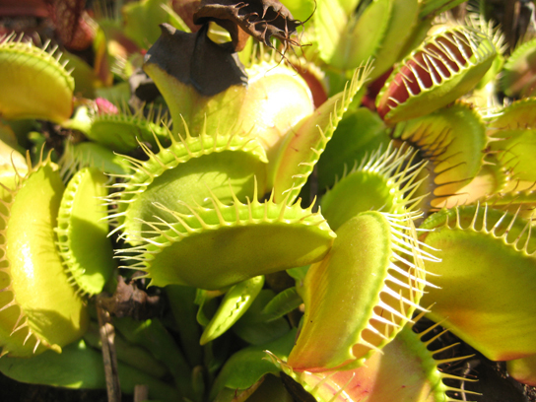
Figure 31.17
A Venus flytrap has specialized leaves to trap insects. (credit: "Selena N. B. H."/Flickr)
This OpenStax ancillary resource is © Rice University under a CC BY-NC-SA 4.0 International license; it may be reproduced or modified for noncommercial purposes only but must be attributed to OpenStax, Rice University and any changes must be noted. Any adaptation must be shared under the same type of license.
Notes:
Photo shows a Venus flytrap. Pairs of modified leaves of this plant have the appearance of a mouth. White, hair-like appendages at the opening of the mouth have the appearance of teeth. The mouth can close on unwary insects, trapping them in the teeth.

