Slide 1

Biology 2e
Chapter 41 Osmotic Regulation and Excretion

Slide 2
Chapter outline
Osmoregulation and Osmotic Balance
The Kidneys and Osmoregulatory Organs
Excretion Systems
Nitrogenous Wastes
Hormonal Control of Osmoregulatory Functions

Slide 3
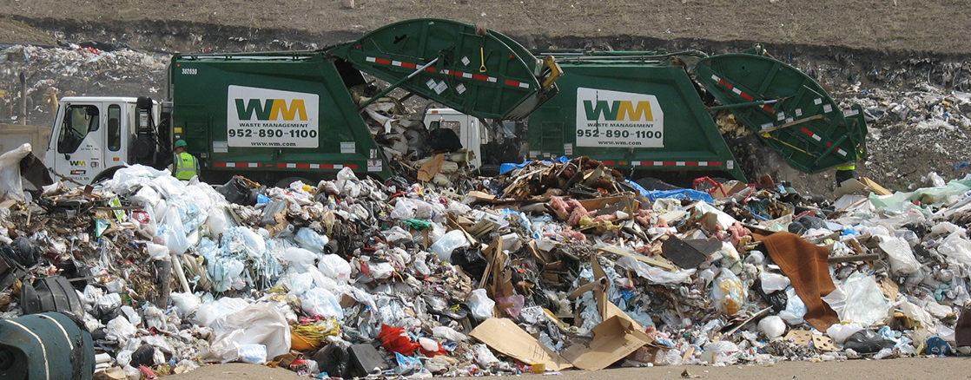
Figure 41.1
Just as humans recycle what we can and dump the remains into landfills, our bodies use and recycle what they can and excrete the remaining waste products. Our bodies’ complex systems have developed ways to treat waste and maintain a balanced internal environment. (credit: modification of work by Redwin Law)
Notes:
Photo shows two garbage trucks dumping their contents into a landfill.

Slide 4
41.1 Osmoregulation and Osmotic Balance (1 of 2)
Learning Objectives
Define osmosis and explain its role within the body
Explain why osmoregulation and osmotic balance are important body functions
Describe active transport mechanisms
Explain osmolarity and the way in which it is measured

Slide 5
41.1 Osmoregulation and Osmotic Balance (2 of 2)
Learning Objectives
Describe osmoregulators or osmoconformers and how these tools allow animals to adapt to different environments

Slide 6
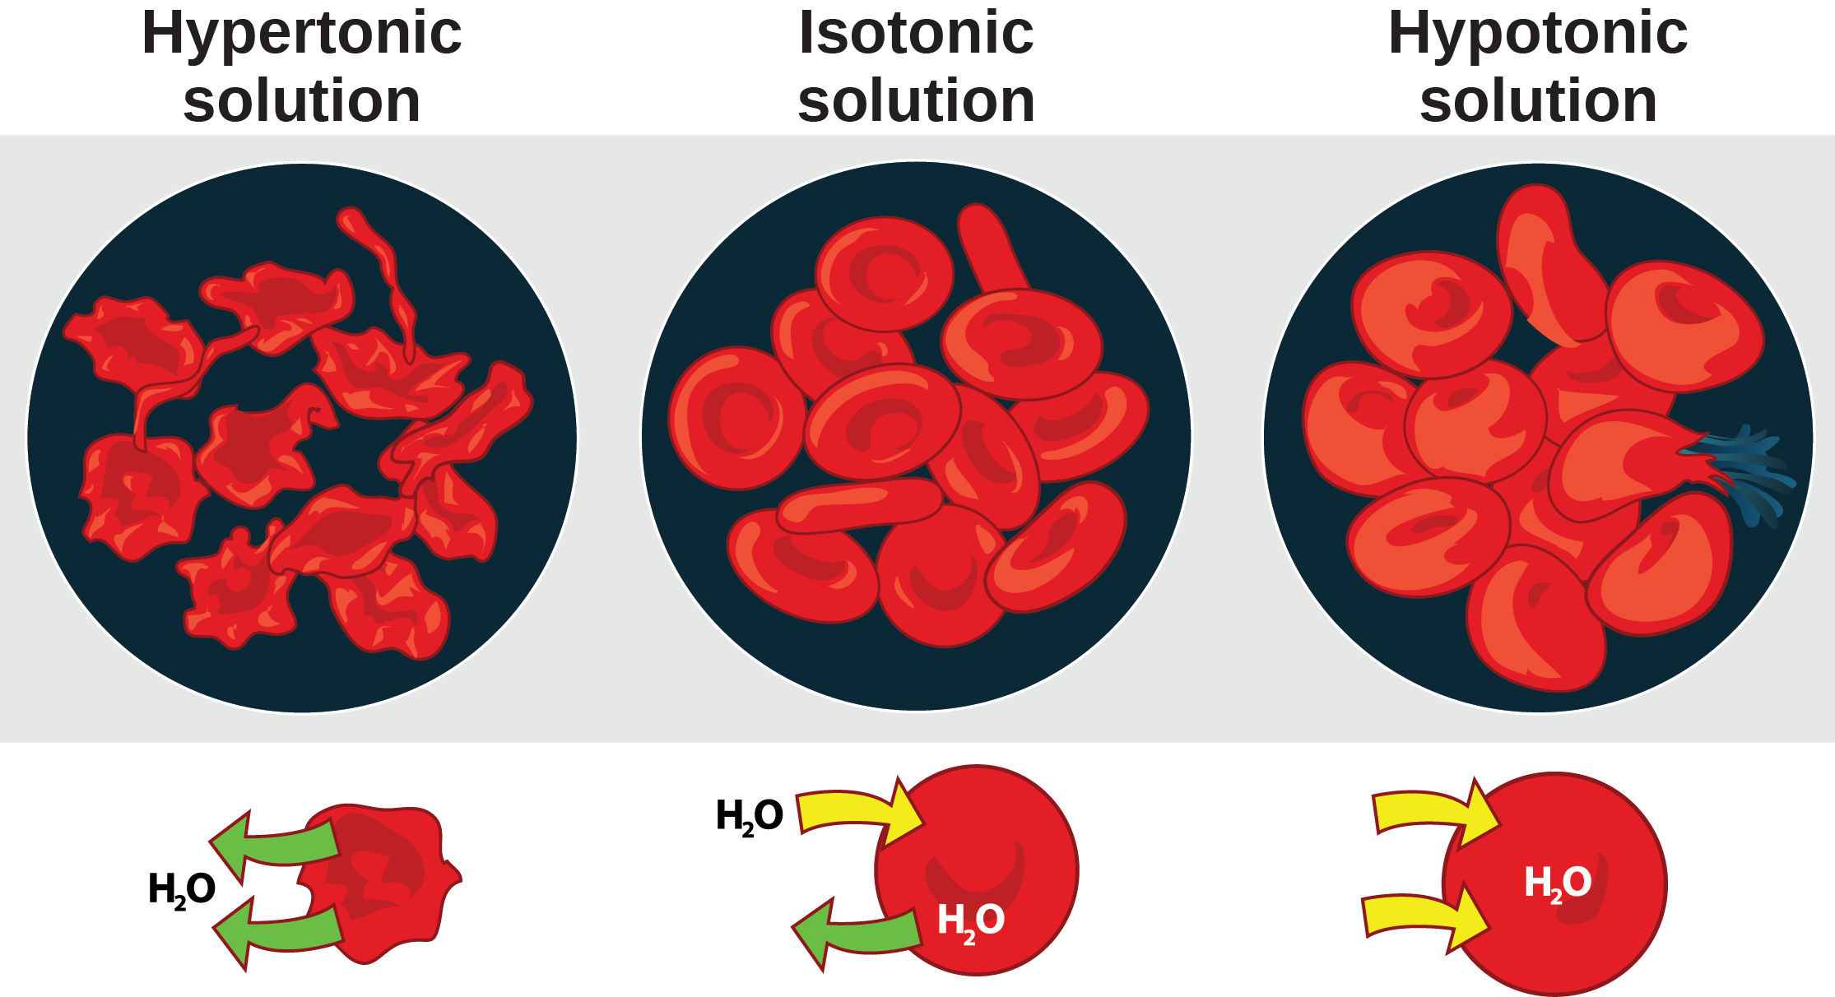
Figure 41.2
Cells placed in a hypertonic environment tend to shrink due to loss of water. In a hypotonic environment, cells tend to swell due to intake of water. The blood maintains an isotonic environment so that cells neither shrink nor swell. (credit: Mariana Ruiz Villareal)
Notes:
The left part of this illustration shows shriveled red blood cells bathed in a hypertonic solution. Below this, a diagram shows that upper case H subscript 2 baseline upper case O is leaving the red blood cell. The middle part shows healthy red blood cells bathed in an isotonic solution. A diagram below this shows upper H subscript 2 baseline upper O both entering and exiting the cell. And the right part shows bloated red blood cells bathed in a hypotonic solution. One of the bloated cells in the hypotonic solution bursts. A diagram below this shows upper H subscript 2 baseline upper O entering the cell.

Slide 7
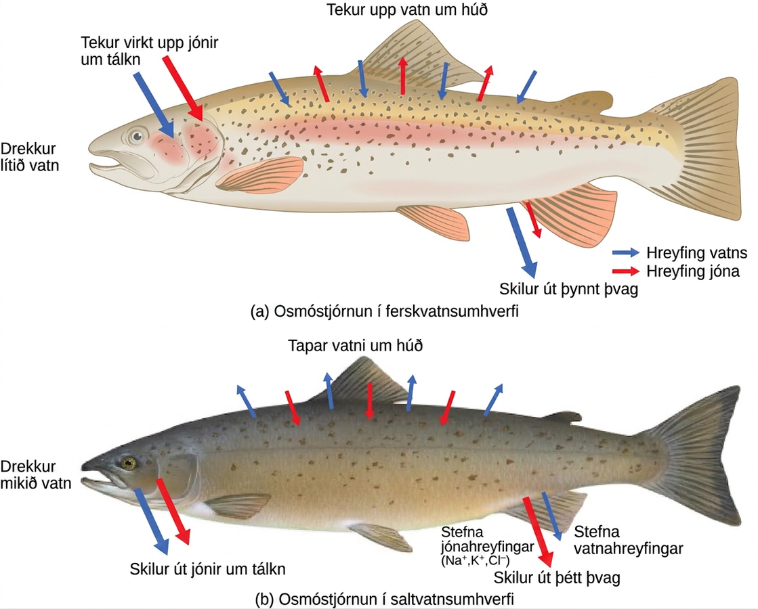
Figure 41.3
Fish are osmoregulators, but must use different mechanisms to survive in (a) freshwater or (b) saltwater environments. (credit: modification of work by Duane Raver, NOAA)
Notes:
Illustration A shows a fish in a freshwater environment, where water is absorbed through the skin. To compensate, the fish drinks little water and excretes dilute urine. Sodium, potassium and chlorine ions are lost through the skin, and the fish actively transports these same ions into its gills to compensate for this loss. Illustration B shows a fish in a saltwater environment, where water is lost through the skin. To compensate, the fish drinks ample water and excretes concentrated urine. It absorbs sodium, potassium, and chlorine ions through its skin, and excretes them through its gills.

Slide 8
41.2 The Kidneys and Osmoregulatory Organs (1 of 2)
Learning Objectives
Explain how the kidneys serve as the main osmoregulatory organs in mammalian systems
Describe the structure of the kidneys and the functions of the parts of the kidney
Describe how the nephron is the functional unit of the kidney and explain how it actively filters blood and generates urine

Slide 9
41.2 The Kidneys and Osmoregulatory Organs (2 of 2)
Learning Objectives
Detail the three steps in the formation of urine: glomerular filtration, tubular reabsorption, and tubular secretion

Slide 10
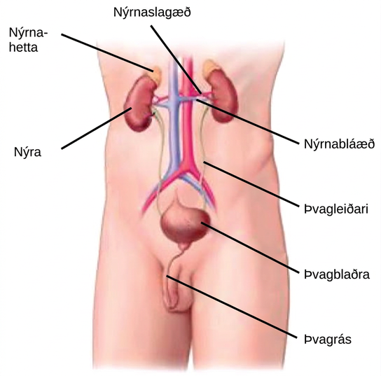
Figure 41.4
Kidneys filter the blood, producing urine that is stored in the bladder prior to elimination through the urethra. (credit: modification of work by NCI)
Notes:
Illustration shows the placement of the kidneys and bladder in a human man. The two kidneys face one another and are located on the posterior side, about halfway up the back. A renal artery and a renal vein extend from the inside middle of each kidney, toward a major blood vessel that runs up the middle of the body. A ureter runs down from each kidney to the bladder, a sac that sits just above the pelvis. The urethra runs down from the bottom of the bladder and through the penis. The adrenal glands are lumpy masses that sit on top of the kidneys.

Slide 11
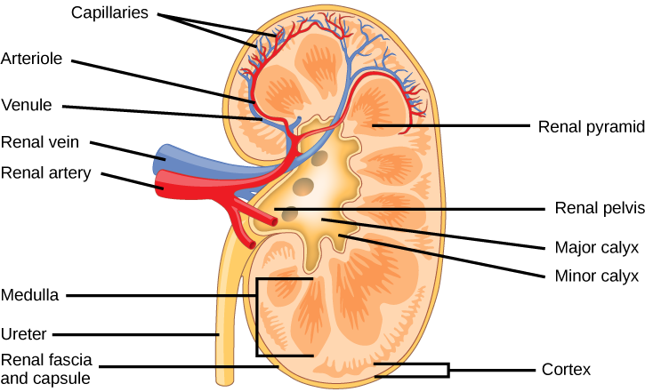
Figure 41.5
The internal structure of the kidney is shown. (credit: modification of work by NCI)
Notes:
The kidney is shaped like a kidney bean standing on end. Two layers, the outer renal fascia and an inner capsule, cover the outside of the kidney. The inside of the kidney consists of three layers: the outer cortex, the middle medulla and the inner renal pelvis. The renal pelvis is flush with the concave side of the kidney, and empties into the ureter, a tube that runs down outside the concave side of the kidney. Eight renal pyramids are embedded in the medulla, which is the thickest kidney layer. Each renal pyramid is teardrop-shaped, with the narrow end facing the renal pelvis. The renal artery and renal vein enter the concave part of the kidney, just above the ureter. The renal artery and renal vein branch into arterioles and venuoles, respectively, which extend into the kidney and branch into capillaries in the cortex.

Slide 12
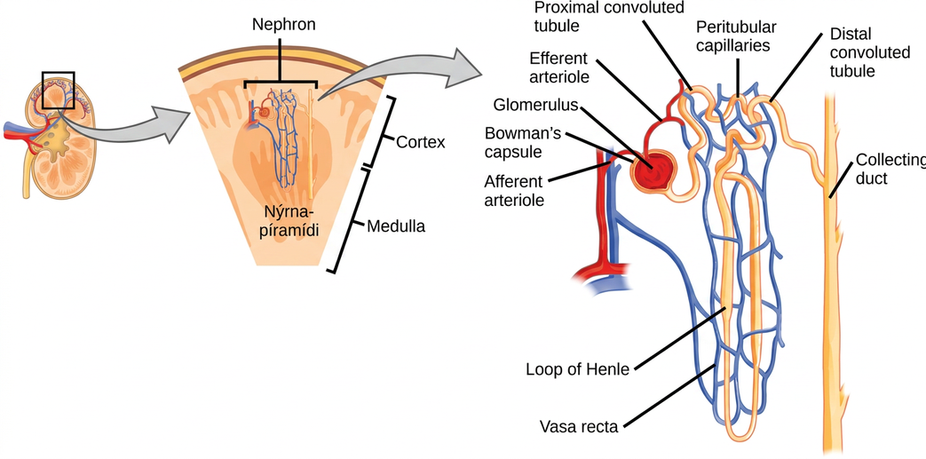
Figure 41.6
The nephron is the functional unit of the kidney. The glomerulus and convoluted tubules are located in the kidney cortex, while collecting ducts are located in the pyramids of the medulla. (credit: modification of work by NIDDK)
Notes:
Illustration shows the nephron, a tube-like structure that begins in the kidney cortex. Here, arterioles converge in a bulb-like structure called the glomerulus, which is partly surrounded by a Bowman's capsule. Afferent arterioles enter the glomerulus, and efferent arterioles leave. The glomerulus empties into the proximal convoluted tubule. A long loop, called the loop of Henle, extends from the proximal convoluted tubule to the inner medulla of the kidney, and then back out to the cortex. There, the loop of Henle joins a distal convoluted tubule. The distal convoluted tubule joins a collecting duct, which travels from the cortex back into the medulla, toward the center of the kidney. Eventually, the contents of the renal pyramid empty into the renal pelvis, and then the ureter.

Slide 13
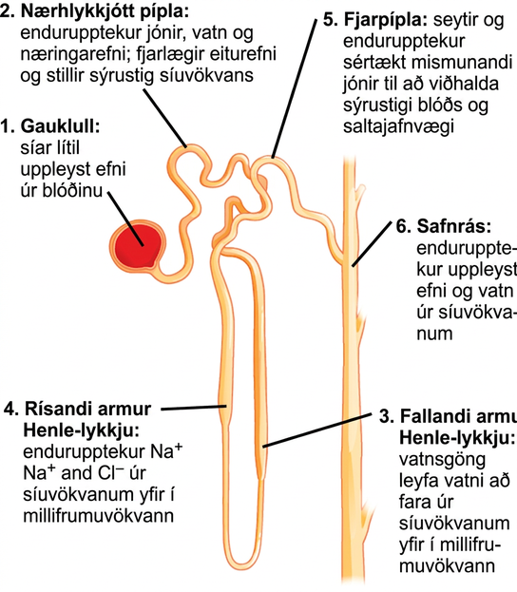
Figure 41.7
Each part of the nephron performs a different function in filtering waste and maintaining homeostatic balance. (1) The glomerulus forces small solutes out of the blood by pressure. (2) The proximal convoluted tubule reabsorbs ions, water, and nutrients from the filtrate into the interstitial fluid, and actively transports toxins and drugs from the interstitial fluid into the filtrate. The proximal convoluted tubule also adjusts blood pH by selectively secreting ammonia (NH3) into the filtrate, where it reacts with H+ to form NH4+. The more acidic the filtrate, the more ammonia is secreted. (3) The descending loop of Henle is lined with cells containing aquaporins that allow water to pass from the filtrate into the interstitial fluid. (4) In the thin part of the ascending loop of Henle, Na+ and Cl- ions diffuse into the interstitial fluid. In the thick part, these same ions are actively transported into the interstitial fluid. Because salt but not water is lost, the filtrate becomes more dilute as it travels up the limb. (5) In the distal convoluted tubule, K+ and H+ ions are selectively secreted into the filtrate, while Na+, Cl-, and HCO3- ions are reabsorbed to maintain pH and electrolyte balance in the blood. (6) The collecting duct reabsorbs solutes and water from the filtrate, forming dilute urine. (credit: modification of work by NIDDK)
Notes:
Illustration labels parts of a nephron and their function. The nephron begins at the glomerulus, a spherical structure that filters small solutes from the blood. The filtrate then enters a winding proximal convoluted tubule, which reabsorbs ions, water, and nutrients, and removes toxins and adjusts the filtrate p H. The proximal convoluted tubule empties into the descending loop of Henle. Aquaporins in the descending loop allow water to pass from the filtrate to the interstitial fluid. The descending loop of Henle turns into the ascending loop of Henle. Both the descending loop and ascending loop are thin at the bottom, and turn thick about a third of the way up. In the ascending loop of Henle, sodium and chlorine ions are reabsorbed from the filtrate into the interstitial fluid. The ascending loop of Henle empties into the distal convoluted tubule, which selectively secretes and absorbs ions to maintain blood p H and electrolyte balance. The distal convoluted tubule empties into a collecting duct, which reabsorbs water and solutes from the filtrate. The collecting duct travels down, toward the middle of the kidney.

Slide 14
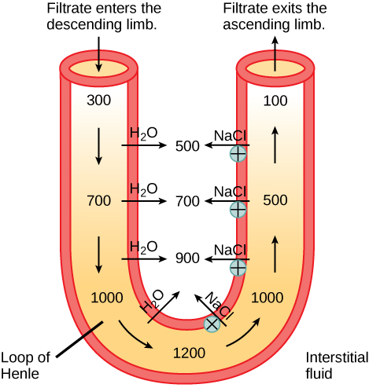
Figure 41.8
The loop of Henle acts as a countercurrent multiplier that uses energy to create concentration gradients. The descending limb is water permeable. Water flows from the filtrate to the interstitial fluid, so osmolality inside the limb increases as it descends into the renal medulla. At the bottom, the osmolality is higher inside the loop than in the interstitial fluid. Thus, as filtrate enters the ascending limb, Na+ and Cl- ions exit through ion channels present in the cell membrane. Further up, Na+ is actively transported out of the filtrate and Cl- follows. Osmolarity is given in units of milliosmoles per liter (mOsm/L).
Notes:
A U-shaped tube represents the loop of Henle. Filtrate enters the descending limb, and exits the ascending limb. The descending limb is water-permeable, and water travels from the limb to the interstitial space. As a consequence, the osmolality of the filtrate inside the limb increases from 300 milliosmoles per liter at the top to 1200 milliosmoles per liter at the bottom. The ascending limb is permeable to sodium and chloride ions. Because the osmolality inside bottom part of the limb is higher than the interstitial fluid, these ions diffuse out of the ascending limb. Higher up, sodium is actively transported out of the limb, and chloride follows. At the top of the ascending limb, the filtrate is 100 milliosmoles.

Slide 15
41.3 Excretion Systems
Learning Objectives
Explain how vacuoles, present in microorganisms, work to excrete waste
Describe the way in which flame cells and nephridia in worms perform excretory functions and maintain osmotic balance
Explain how insects use Malpighian tubules to excrete wastes and maintain osmotic balance

Slide 16
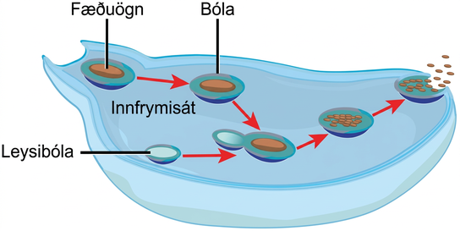
Figure 41.9
Some unicellular organisms, such as the amoeba, ingest food by endocytosis. The food vesicle fuses with a lysosome, which digests the food. Waste is excreted by exocytosis.
Notes:
In this illustration, a cell extends a pseudopod to consume a food particle. The consumed particle is encapsulated in a vesicle. The vesicle fuses with a lysosome, and proteins inside the lysosome digest the food particle. After the food is digested, the vesicle fuses with the cell membrane, and undigested remains are excreted.

Slide 17
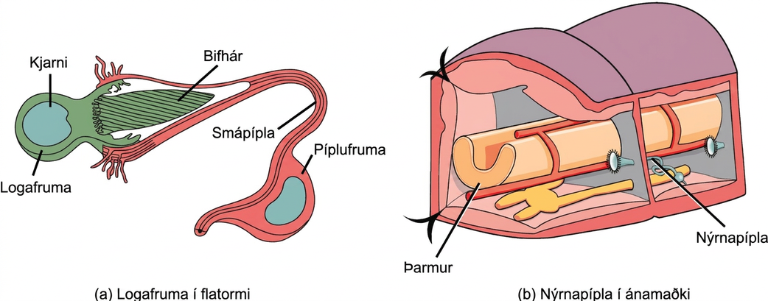
Figure 41.10
In the excretory system of the (a) planaria, cilia of flame cells propel waste through a tubule formed by a tube cell. Tubules are connected into branched structures that lead to pores located all along the sides of the body. The filtrate is secreted through these pores. In (b) annelids such as earthworms, nephridia filter fluid from the coelom, or body cavity. Beating cilia at the opening of the nephridium draw water from the coelom into a tubule. As the filtrate passes down the tubules, nutrients and other solutes are reabsorbed by capillaries. Filtered fluid containing nitrogenous and other wastes is stored in a bladder and then secreted through a pore in the side of the body.
Notes:
Illustration A shows a flame cell, which is bulb-shaped with cilia projecting from one end. The cilia form a point, like the tip of a paintbrush, inside a wide opening at the end of a tube cell. The tube cell narrows into a tubule, then widens into a body where the nucleus is located. The tubule continues past the cell body. Illustration B shows a cross section of an earthworm, which is segmented with walls separating each segment. The trumpet-like opening of a nephridium sticks out of the wall. Cilia surround the opening. Beyond the wall, the nephridium forms a tube that winds down to the ventral surface, where it connects with an opening to the exterior. Just above the opening the tube widens into a bladder.

Slide 18
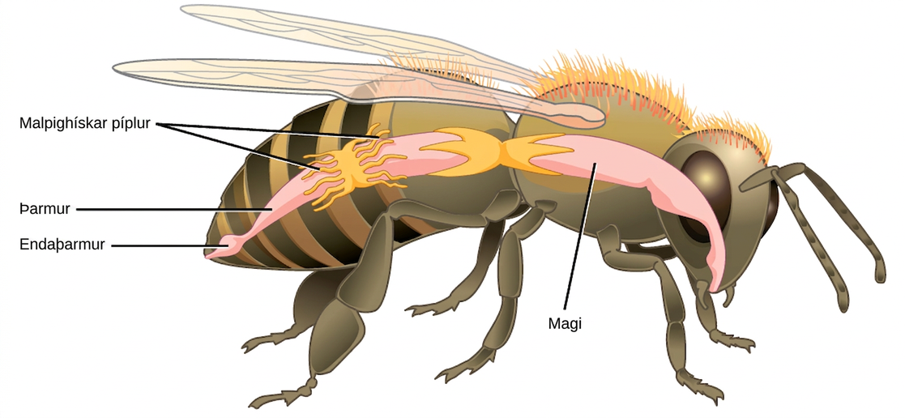
Figure 41.11
Malpighian tubules of insects and other terrestrial arthropods remove nitrogenous wastes and other solutes from the hemolymph. Na+ and/or K+ ions are actively transported into the lumen of the tubules. Water then enters the tubules via osmosis, forming urine. The urine passes through the intestine, and into the rectum. There, nutrients diffuse back into the hemolymph. Na+ and/or K+ ions are pumped into the hemolymph, and water follows. The concentrated waste is then excreted.
Notes:
Illustration shows the digestive tract of a bee. Food enters the mouth, and then goes through the stomach to the intestine. The Malpighian tubules are wormlike protrusions that form a band around the intestine. After the intestine, food enters a bulge called the rectum, and exits through the anus.

Slide 19
41.4 Nitrogenous Wastes
Learning Objectives
Compare and contrast the way in which aquatic animals and terrestrial animals can eliminate toxic ammonia from their systems
Compare the major byproduct of ammonia metabolism in vertebrate animals to that of birds, insects, and reptiles

Slide 20
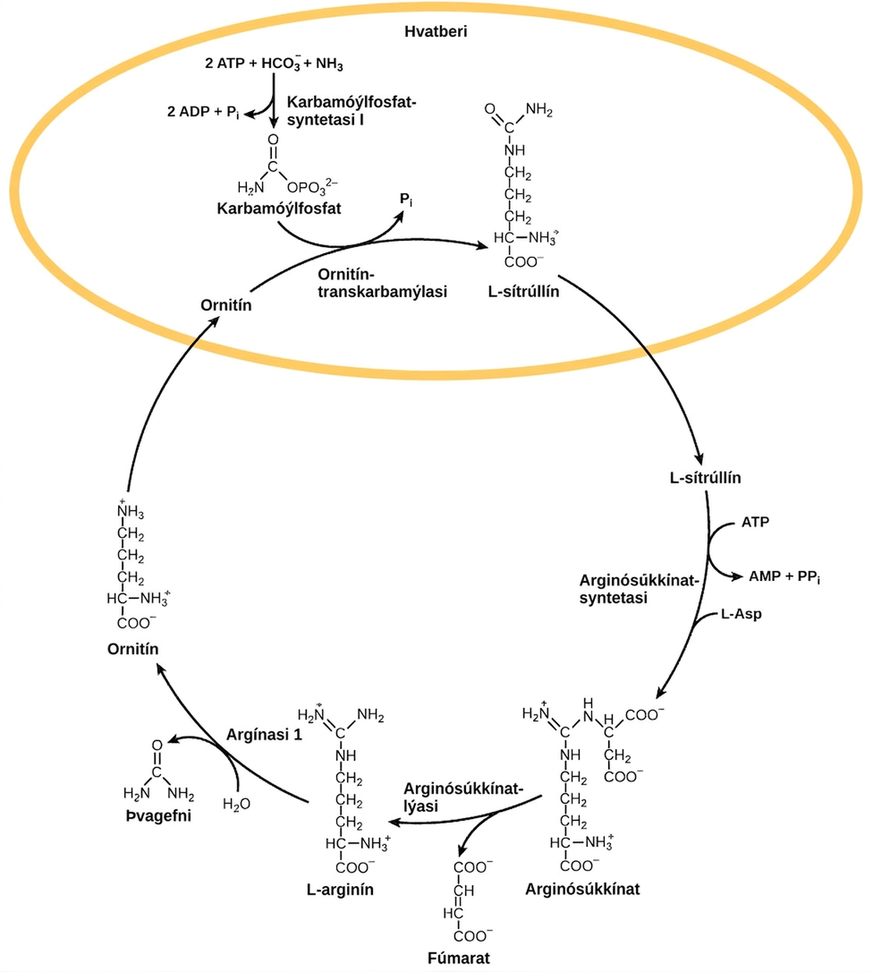
Figure 41.12
The urea cycle converts ammonia to urea.
Notes:
The urea cycle begins in the mitochondrion, where bicarbonate, shown as upper case H upper case C upper case O subscript 3 baseline is combined with ammonia, shown as upper case N upper case H subscript 3 baseline to make carbamoyl phosphate. Two A T P are used in the process. Ornithine transcarbamylase adds the carbamoyl phosphate to a five-carbon amino acid called ornithine to make L citrulline. L citrulline leaves the mitochondrion, and an enzyme called arginosuccinate synthetase adds a four carbon amino acid called L aspartate to it to make arginosuccinate. In the process, one A T P is converted to A M P and upper case P upper case P lower case i. Arginosuccinate lyase removes a four carbon fumarate molecule from the arginosuccinate, forming the six carbon amino acid L arginine. Arginase 1 removes a urea molecule from the L arginine, forming ornithine in the process. Urea has a single carbon double bonded to an oxygen and single bonded to two ammonia groups. Ornithine enters the mitochondrion, completing the cycle.

Slide 21
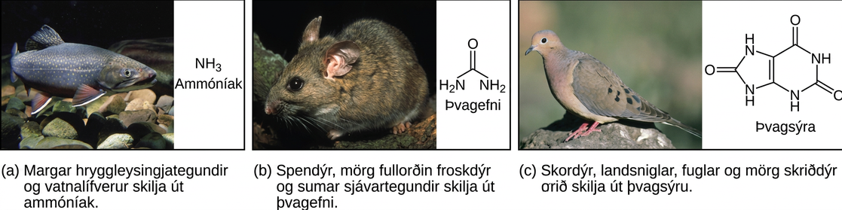
Figure 41.13
Nitrogenous waste is excreted in different forms by different species. These include (a) ammonia, (b) urea, and (c) uric acid. (credit a: modification of work by Eric Engbretson, USFWS; credit b: modification of work by B."Moose" Peterson, USFWS; credit c: modification of work by Dave Menke, USFWS)
Notes:
Part A shows a photo of a freshwater fish and states that many invertebrates and aquatic species excrete ammonia. The chemical structure of ammonia is upper case N upper case H subscript 3 baseline. Part B shows a photo of a wood rat and states that mammals, many adult amphibians, and some marine species excrete urea. The chemical structure of urea is shown. Urea has two upper N upper H subscript 2 baseline groups attached to a central carbon. An oxygen is also double-bonded to this central carbon. Part C shows a photo of a pigeon and states that insects, land snails, birds, and many reptiles excrete uric acid. The chemical structure of uric acid is shown. Uric acid has a six-membered carbon ring attached to a five-membered ring. Each ring has two upper N upper H groups embedded in it. An oxygen is double-bonded to each ring.

Slide 22
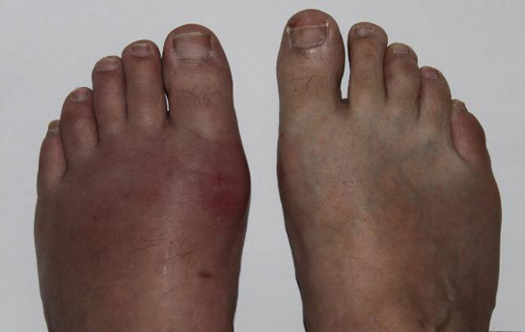
Figure 41.14
Gout causes the inflammation visible in this person’s left big toe joint. (credit: "Gonzosft"/Wikimedia Commons)
Notes:
Photo shows a person's feet. One foot is swollen and red, while the other appears normal.

Slide 23
41.5 Hormonal Control of Osmoregulatory Functions (1 of 2)
Learning Objectives
Explain how hormonal cues help the kidneys synchronize the osmotic needs of the body

Slide 24
41.5 Hormonal Control of Osmoregulatory Functions (2 of 2)
Learning Objectives
Describe how hormones like epinephrine, norepinephrine, renin-angiotensin, aldosterone, anti-diuretic hormone, and atrial natriuretic peptide help regulate waste elimination, maintain correct osmolarity, and perform other osmoregulatory functions

Slide 25
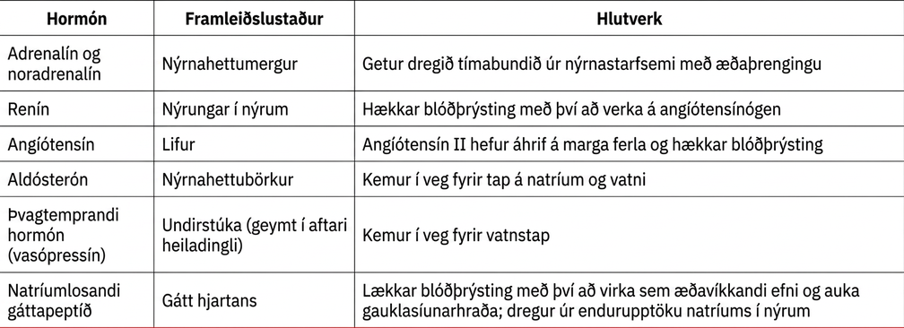
Table 41.1

Slide 26
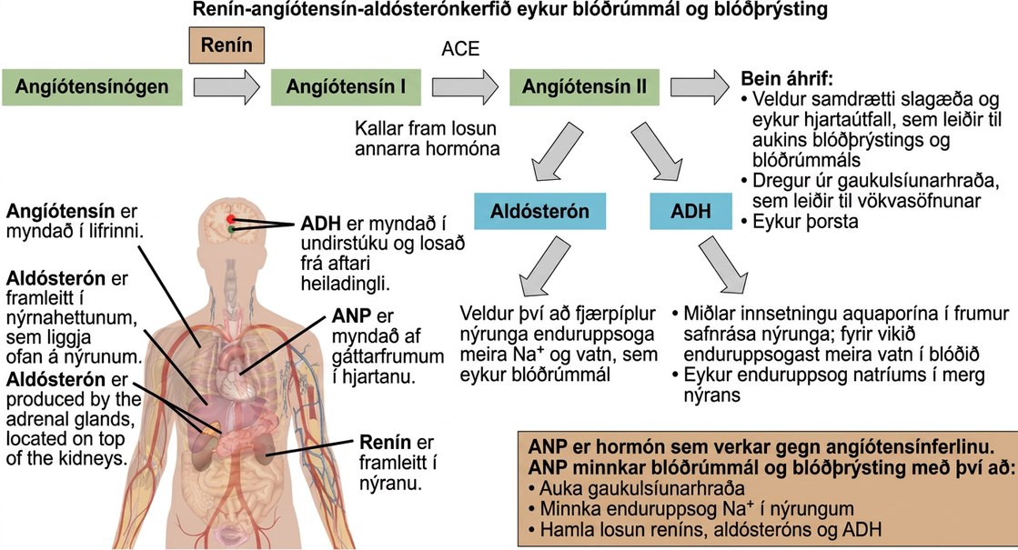
Figure 41.15
The renin-angiotensin-aldosterone system increases blood pressure and volume. The hormone ANP has antagonistic effects. (credit: modification of work by Mikael Häggström)
This OpenStax ancillary resource is © Rice University under a CC BY-NC-SA 4.0 International license; it may be reproduced or modified for noncommercial purposes only but must be attributed to OpenStax, Rice University and any changes must be noted. Any adaptation must be shared under the same type of license.
Notes:
The renin-angiotensin-aldosterone pathway involves four hormones: renin, which is made in the kidney, angiotensin, which is made in the liver, aldosterone, which is made in the adrenal glands, and A D H, which is made in the hypothalamus and secreted by the posterior pituitary. The adrenal glands are located on top of the kidneys, and the hypothalamus and pituitary are in the brain. The pathway begins when renin converts angiotensinogen into angiotensin I. An enzyme called A C E then converts angiotensin I into angiotensin I I. Angiotensin I I has several direct effects. These include arterial constriction, which increases blood pressure, decreasing the glomerular filtration rate, which results in water retention, and increasing thirst. Angiotensin I I also triggers the release of two other hormones, aldosterone and A D H. Aldosterone causes nephron distal tubules to reabsorb more sodium and water, which increases blood volume. A D H mediates the insertion of aquaporins into the nephridial collecting ducts. As a result, more water is reabsorbed by the blood. A D H also causes arteries to constrict. The hormone A N P is antagonistic to the angiotensin pathway. A N P decreases blood pressure and volume by increasing the glomerulus filtration rate, decreasing reabsorption of sodium ions by the nephron, and by inhibiting the release of renin from the kidney and aldosterone from the adrenal gland.

