Slide 1

Biology 2e
Chapter 42 The Immune System

Slide 2
Chapter outline
Innate Immune Response
Adaptive Immune Response
Antibodies
Disruptions in the Immune System

Slide 3
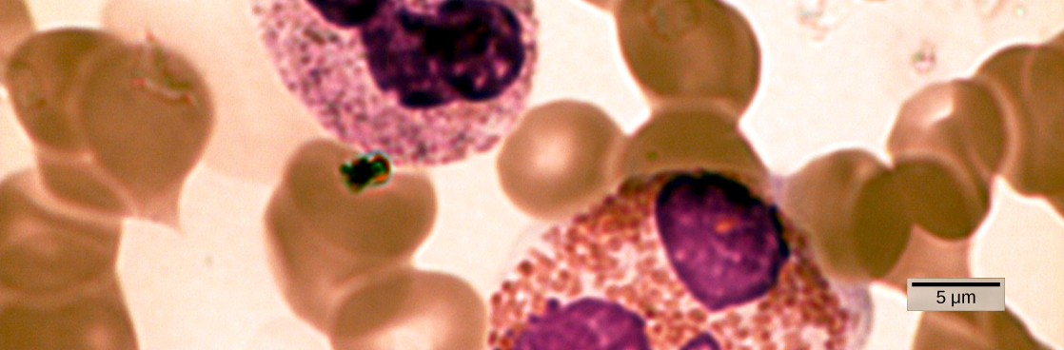
Figure 42.1
In this compound light micrograph purple-stained neutrophil (upper left) and eosinophil (lower right) are white blood cells that float among red blood cells in this blood smear. Neutrophils provide an early, rapid, and nonspecific defense against invading pathogens. Eosinophils play a variety of roles in the immune response. Red blood cells are about 7–8 µm in diameter, and a neutrophil is about 10–12µm. (credit: modification of work by Dr. David Csaba)
Notes:
Micrograph shows a blood smear. The neutrophil and eosinophil are similar in structure, but the eosinophil is larger. Both are filled with granular structures, and have three purple-stained nuclei. These white blood cells are surrounded with donut-shaped red blood cells.

Slide 4
42.1 Innate Immune Response (1 of 2)
Learning Objectives
Describe physical and chemical immune barriers
Explain immediate and induced innate immune responses
Discuss natural killer cells
Describe major histocompatibility complex I molecules

Slide 5
42.1 Innate Immune Response (2 of 2)
Learning Objectives
Summarize how the proteins in a complement system function to destroy extracellular pathogens

Slide 6
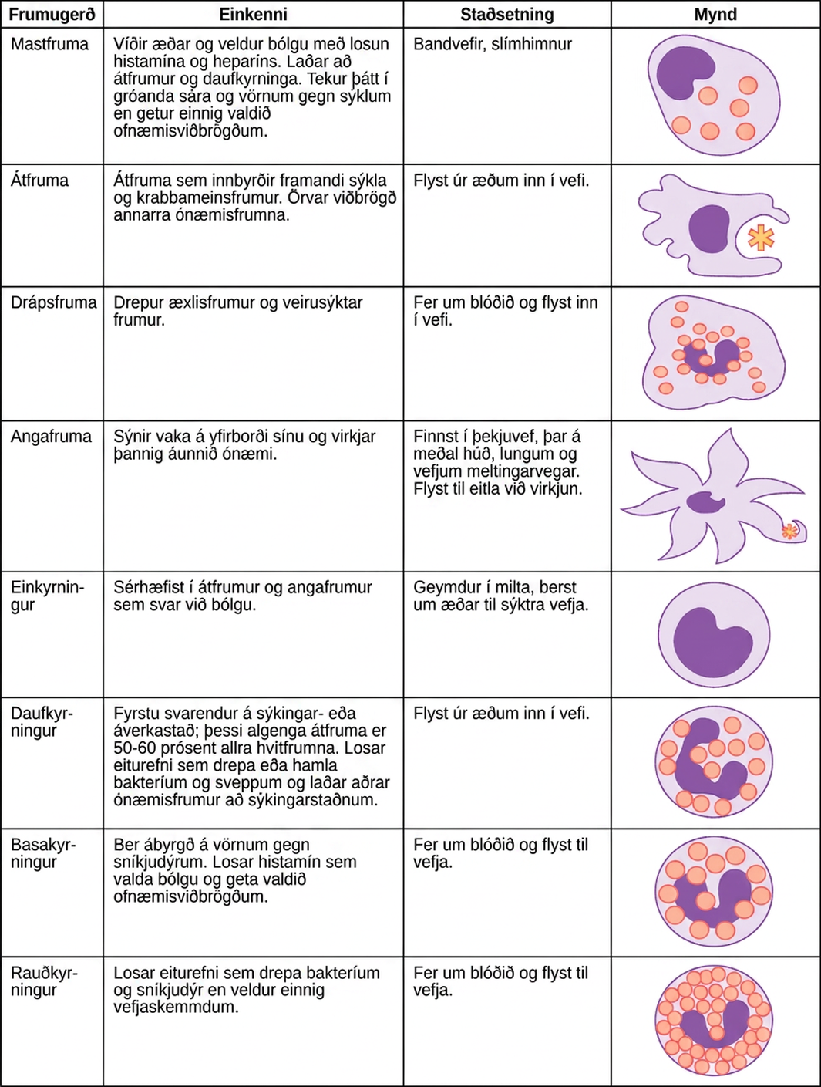
Figure 42.2
The characteristics and location of cells involved in the innate immune system are described. (credit: modification of work by NIH)
Notes:
Table shows various types of white blood cells and describes their function. Mast cells, natural killer cells, neutrophils, basophils and eosinophils are all filled with granules and have a horseshoe-shaped nucleus. Monocytes are similar in overal horseshoe-shape but without the granules inside. Macrophages are irregular in shape, with a round nucleus. Dendrites have star-like projections and a small horseshoe shaped nucleus. Mast cells dilate blood vessels and induce inflammation through release of histamines and heparin. They also recruit macrophages and neutrophils, and are involved in wound healing and defense against pathogens, but can also be responsible for allergic reactions. They are found in connective tissue and mucous membranes. Macrophages are phagocytic cells that consume foreign pathogens and cancer cells. They stimulate response of other immune cells and migrate from blood vessels into tissues. Natural killer cells kill tumor cells and virus-infected cells. They circulate in blood and migrate into tissues. Dendritic cells present antigens on their surface, thereby triggering adaptive immunity. They are present in tissues in epithelial tissue, including skin, lung and tissues of the digestive tract. They migrate to lymph nodes upon activation. Monocytes differentiate into macrophages and dendritic cells in response to inflammation. They are stored in spleen, and move through blood vessels to infected tissues. Neutrophils are first responders at the site of infection or trauma. These abundant phagocytic cell represent 50-60% of all leukocytes. They release toxins that kill or inhibit bacteria and fungi and recruit other immune cells to the site of infection. They migrate from blood vessels into tissues. Basophils are responsible for defense against parasites. They release histamines that cause inflammation and may be responsible for allergic reactions. They circulate in blood and migrate to tissues. Eosinophils release toxins that kill bacteria and parasites but also cause tissue damage. They circulate in blood and migrate to tissues.

Slide 7
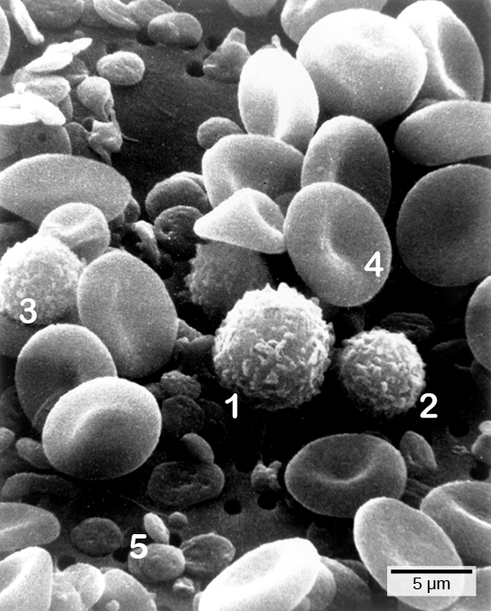
Figure 42.3
Cells of the blood include (1) monocytes, (2) lymphocytes, (3) neutrophils, (4) red blood cells, and (5) platelets. Note the very similar morphologies of the leukocytes (1, 2, 3). (credit: modification of work by Bruce Wetzel, Harry Schaefer, NCI; scale-bar data from Matt Russell)
Notes:
Micrograph shows a blood smear. Red blood cells are disk-shaped, and pinched together in the center. Monocytes, lymphocytes and neutrophils are all ball-shaped and fuzzy. Platelets are small, flat disks.

Slide 8
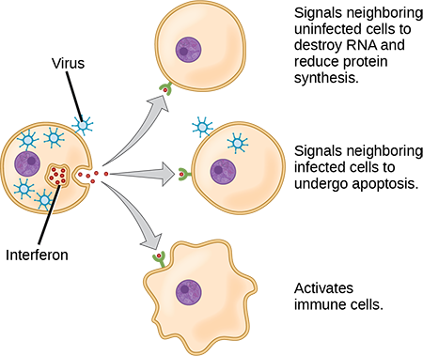
Figure 42.4
Interferons are cytokines that are released by a cell infected with a virus. Response of neighboring cells to interferon helps stem the infection.
Notes:
Illustration shows a virus-infected cell secreting interferon, which binds to receptors of neighboring cells. Interferon signals neighboring uninfected cells to destroy R N A and reduce protein synthesis, thus making it more difficult for virus to infect the cell. It signals neighboring infected cells to undergo apoptosis. It also activates nearby immune cells.

Slide 9
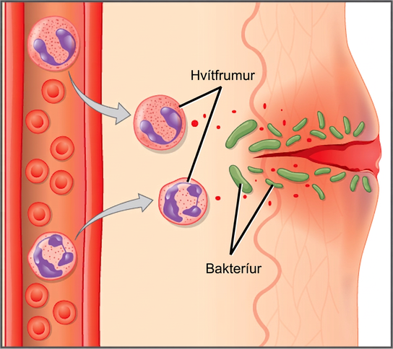
Figure 42.5
In response to a cut, mast cells secrete histamines that cause nearby capillaries to dilate. Neutrophils and monocytes leave the capillaries. Monocytes mature into macrophages. Neutrophils, dendritic cells, and macrophages release chemicals to stimulate the inflammatory response. Neutrophils and macrophages also consume invading bacteria by phagocytosis.
Notes:
Illustration shows a capillary near the surface of skin that has a cut in it. Bacteria have penetrated the skin around the cut. In response, mast cells in the lower part of the skin tissue release histamines, and dendritic cells release cytokines. The histamines cause the capillary to become permeable. Neutrophils and monocytes exit the capillary into the damaged skin. Both the neutrophil and macrophage release cytokines and consume bacteria by phagocytosis.

Slide 10
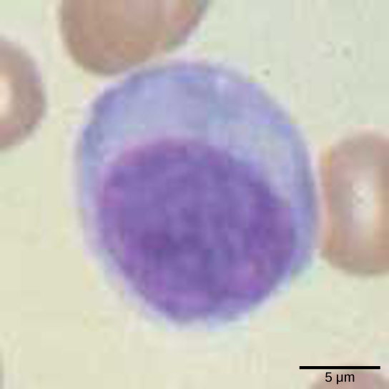
Figure 42.6
Lymphocytes, such as NK cells, are characterized by their large nuclei that actively absorb Wright stain and therefore appear dark colored under a microscope.
Notes:
Micrograph shows a round cell with a large nucleus.

Slide 11
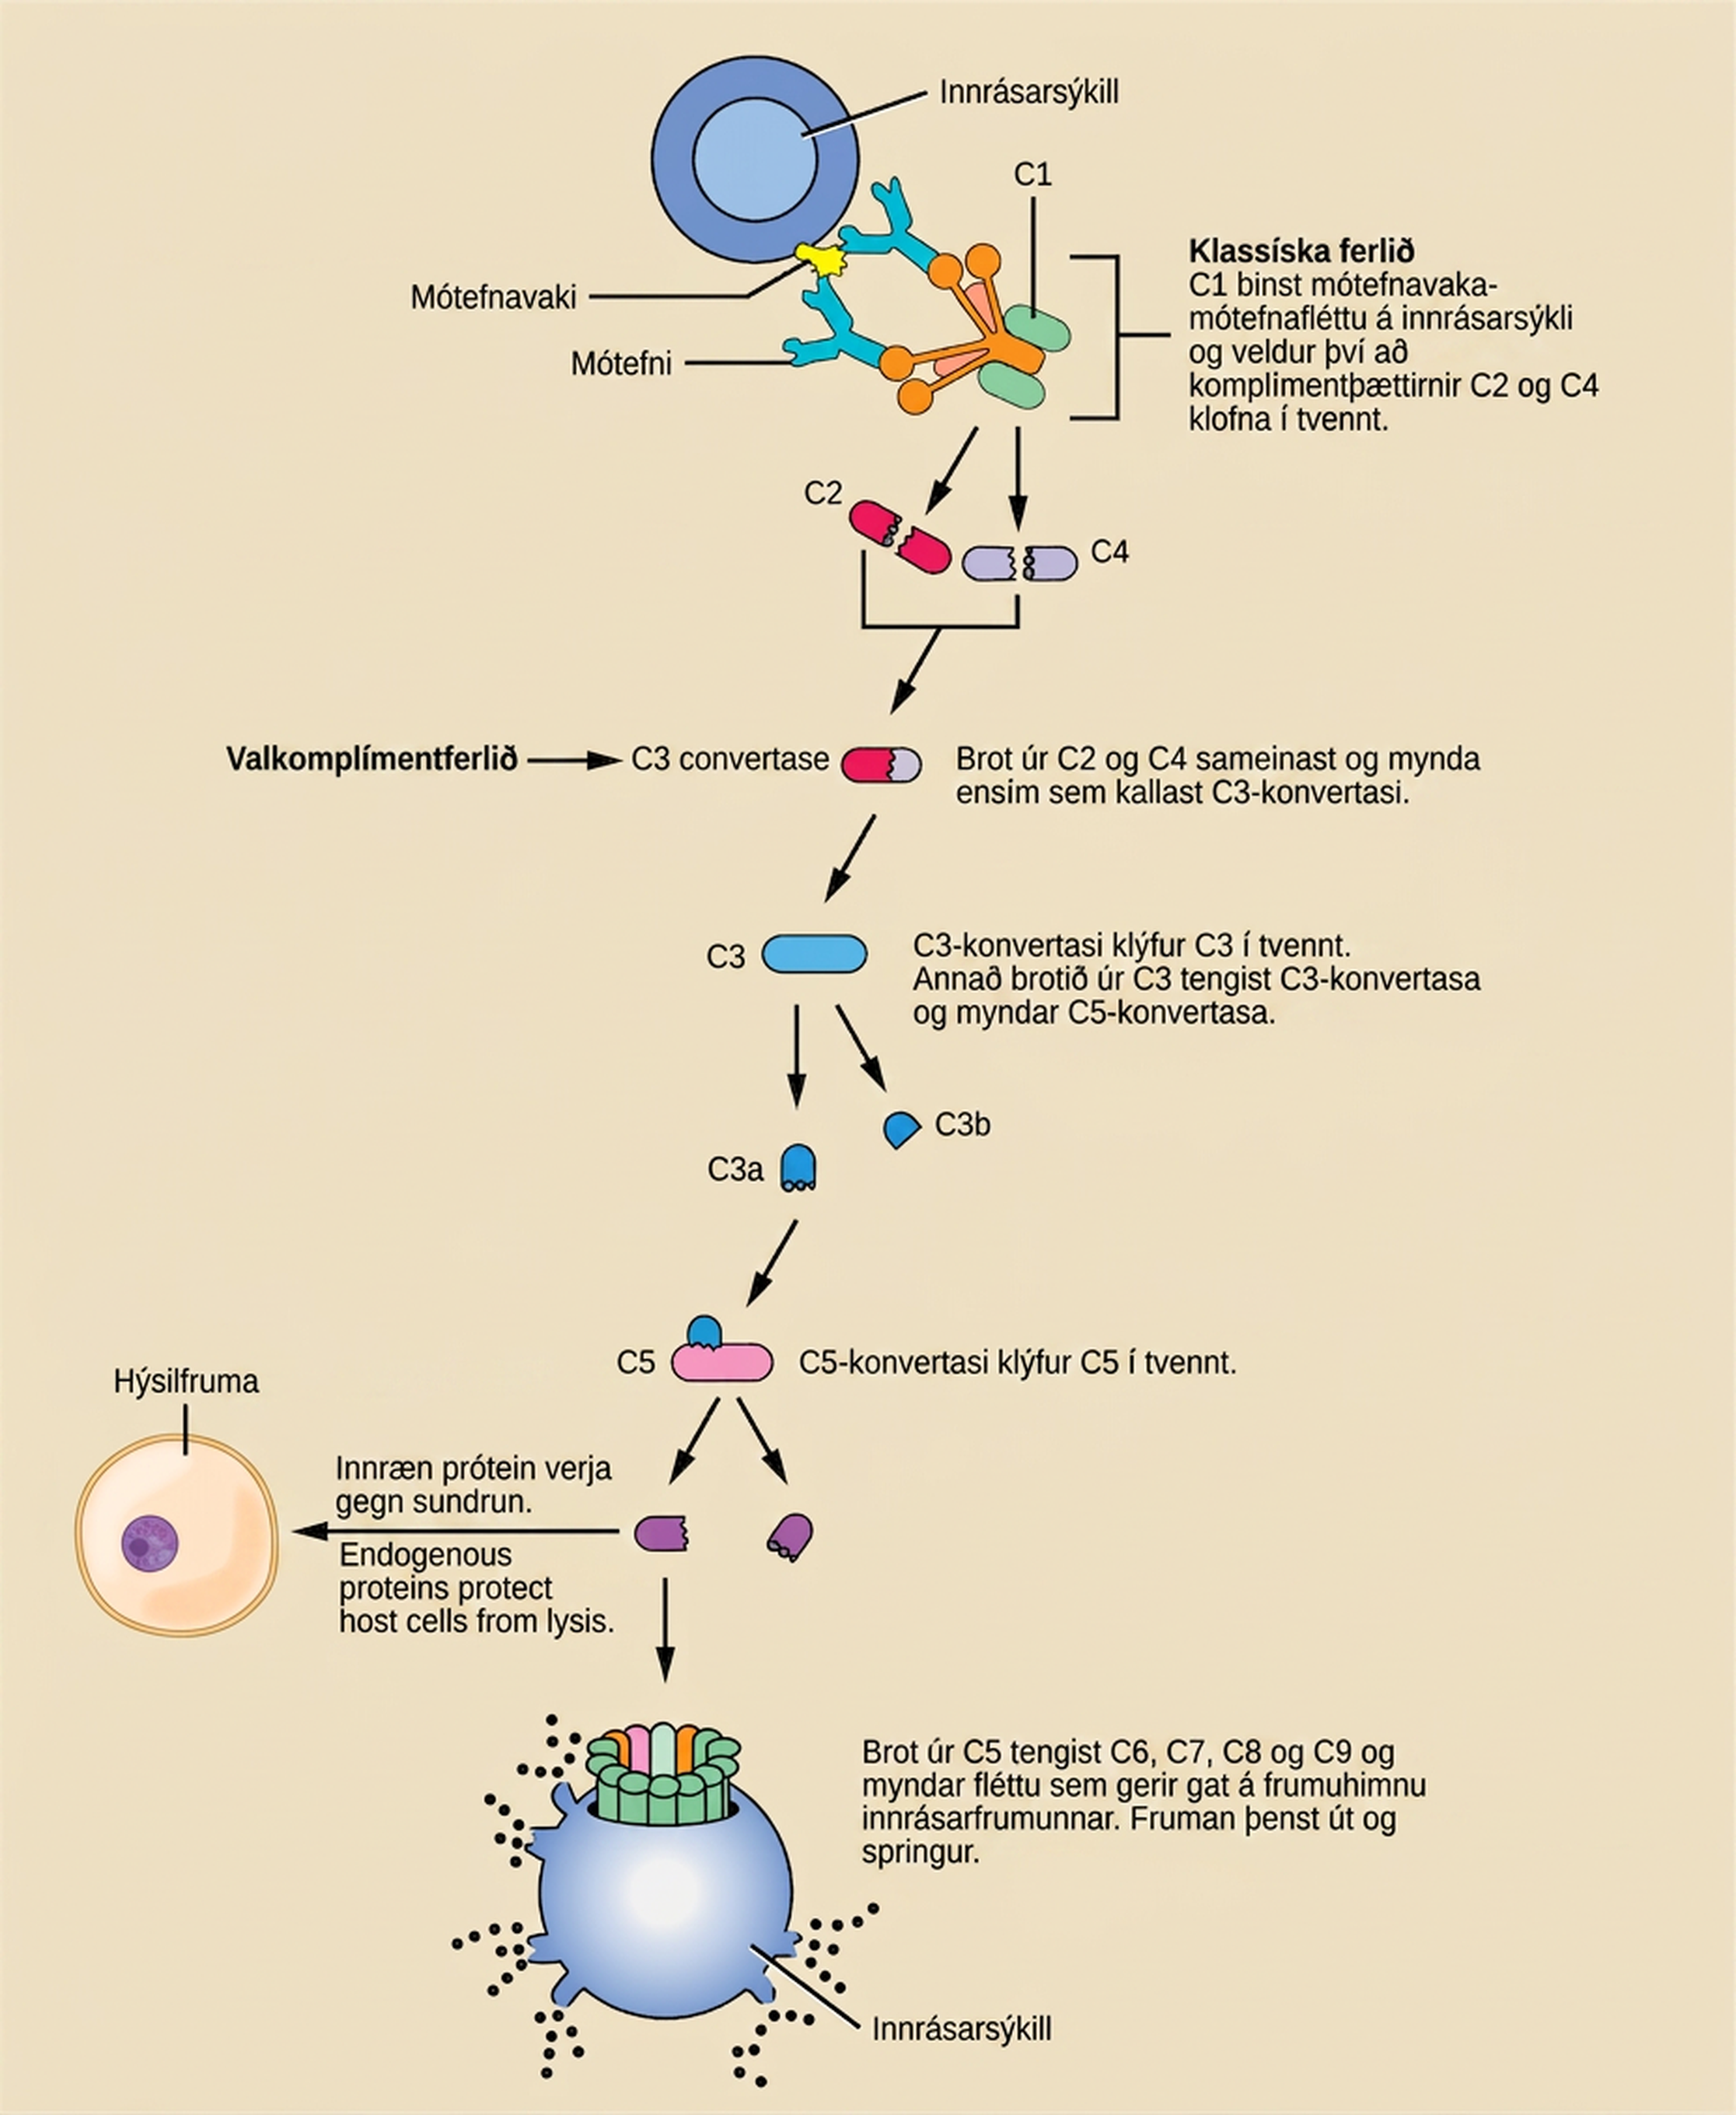
Figure 42.7
The classic pathway for the complement cascade involves the attachment of several initial complement proteins to an antibody-bound pathogen followed by rapid activation and binding of many more complement proteins and the creation of destructive pores in the microbial cell envelope and cell wall. The alternate pathway does not involve antibody activation. Rather, C3 convertase spontaneously breaks down C3. Endogenous regulatory proteins prevent the complement complex from binding to host cells. Pathogens lacking these regulatory proteins are lysed. (credit: modification of work by NIH)
Notes:
Illustration shows an invading pathogen with an antigen on its surface. In the classic pathway for complement activation, host antibodies bind the antigen, and C 1 binds the antibody. The C 1-antibody complex causes C 2 and C 4 each to split in two. Fragments from C 2 and C 4 each joins together to form an enzyme called C 3 convertase. C 3 convertase splits C 3 in two. One of the fragments from C 3 joins C 3 convertase to form C 5 convertase. C 5 convertase splits C 5 in two. A fragment from C 5 joins C 6, C 7, C 8, and C 9 to form a complex that makes a hole in the plasma membrane for the invading cell. The cell swells and bursts. In the alternative pathway, C 3 convertase spontaneously splits C 3 in two and the rest of the pathway proceeds the same as the classic pathway. Host cells are protected from complement by the presence of endogenous proteins.

Slide 12
42.2 Adaptive Immune Response
Learning Objectives
Explain adaptive immunity
Compare and contrast adaptive and innate immunity
Describe cell-mediated immune response and humoral immune response
Describe immune tolerance

Slide 13
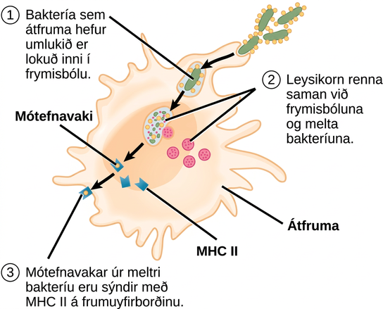
Figure 42.8
An APC, such as a macrophage, engulfs and digests a foreign bacterium. An antigen from the bacterium is presented on the cell surface in conjunction with an MHC II molecule. Lymphocytes of the adaptive immune response interact with antigen-embedded MHC II molecules to mature into functional immune cells.
Notes:
Illustration shows a bacterium being engulfed by a macrophage. Lysosomes fuse with the vacuole containing the bacteria. The bacterium is digested. Antigens from the bacterium are attached to a M H C I I molecule and presented on the cell surface.

Slide 14
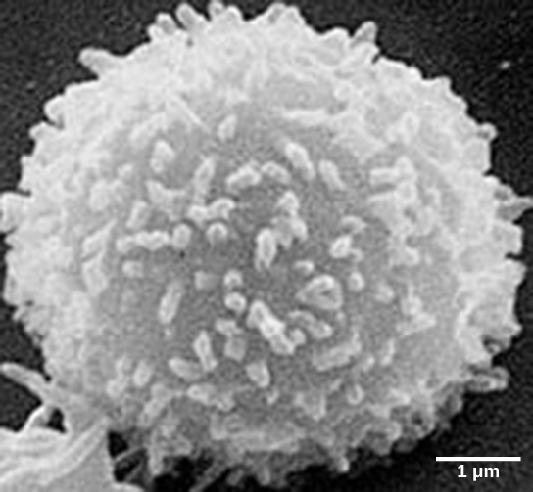
Figure 42.9
This scanning electron micrograph shows a T lymphocyte, which is responsible for the cell-mediated immune response. T cells are able to recognize antigens. (credit: modification of work by NCI; scale-bar data from Matt Russell)
Notes:
Micrograph shows a cell that looks like a fuzzy snowball.

Slide 15
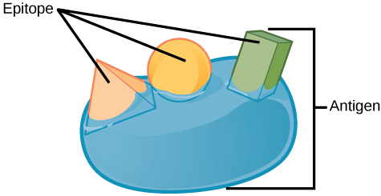
Figure 42.10
An antigen is a macromolecule that reacts with components of the immune system. A given antigen may contain several motifs that are recognized by immune cells. Each motif is an epitope. In this figure, the entire structure is an antigen, and the orange, salmon and green components projecting from it represent potential epitopes.
Notes:
Illustration shows an antigen with three epitopes, each with a unique shape; one spherical, one rectangular prism, and one pyramid.

Slide 16
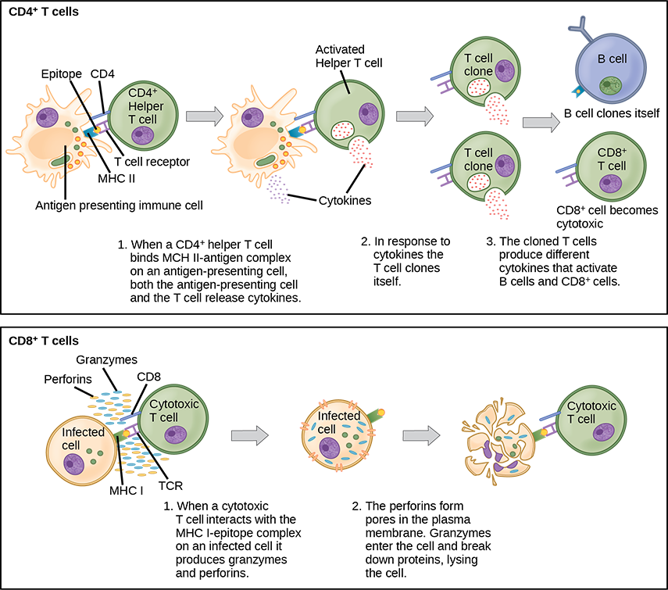
Figure 42.11
Naïve CD4+ T cells engage MHC II molecules on antigen-presenting cells (APCs) and become activated. Clones of the activated helper T cell, in turn, activate B cells and CD8+ T cells, which become cytotoxic T cells. Cytotoxic T cells kill infected cells.
Notes:
Illustration shows activation of a C D 4 plus helper T cell. An antigen-presenting cell digests a pathogen. Epitopes from this pathogen are presented in conjunction with M H C I I molecules on the cell surface. A T cell receptor and a C D 8 receptor, both on the surface of the T cell, bind the M H C I I epitope complex. As a result, the helper T cell becomes activated and both the helper T cell and antigen-presenting cell release cytokines. The cytokines induce the helper T cell to clone itself. The cloned helper T cells release different cytokines that activate B cells and C D 8 plus T cells, turning them into cytotoxic T cells. The cytotoxic T cell binds the M H C I epitope complex on an infected cell. The cytotoxic T cell then releases perforin molecules, which form a pore in the plasma membrane, and granzymes, which break down proteins, killing the cell.

Slide 17
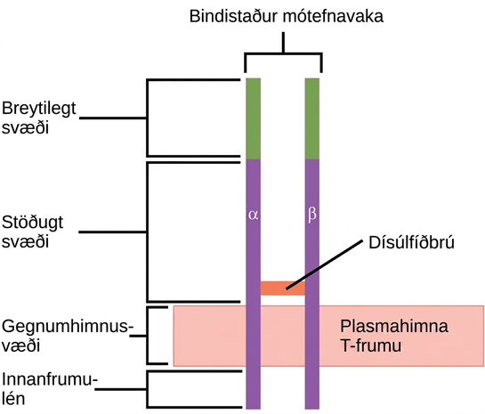
Figure 42.12
A T cell receptor spans the membrane and projects variable binding regions into the extracellular space to bind processed antigens via MHC molecules on APCs.
Notes:
Illustration shows a T cell receptor, which has two column-like subunits that project from the plasma membrane. The subunits, named alpha and beta, are connected by a disulfide bridge. The upper third of the extracellular portion of each column is called the variable region, and the lower two-thirds is called the constant region. The region that spans the membrane is called the transmembrane region. Beneath the transmembrane region is a short, intracellular region.

Slide 18
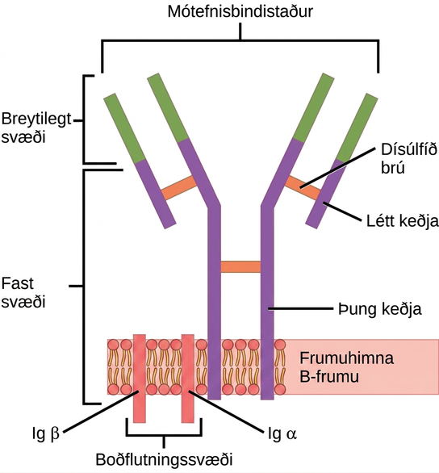
Figure 42.13
B cell receptors are embedded in the membranes of B cells and bind a variety of antigens through their variable regions. The signal transduction region transfers the signal into the cell.
Notes:
Illustration shows a B cell receptor that has two column-like subunits, called heavy chains, projecting up from the plasma membrane. Each column bends away from the other about halfway up, resulting in a Y-shaped structure. Two shorter subunits, called light chains, join the heavy chains after the bend. The upper portion of both the light and heavy chains is the variable region that makes up the antigen binding site. The bottom of both light and heavy chains forms the constant region. The signal transduction region consists of two proteins, I g beta and I g alpha, embedded in the plasma membrane, with projections on the cytoplasmic side.

Slide 19
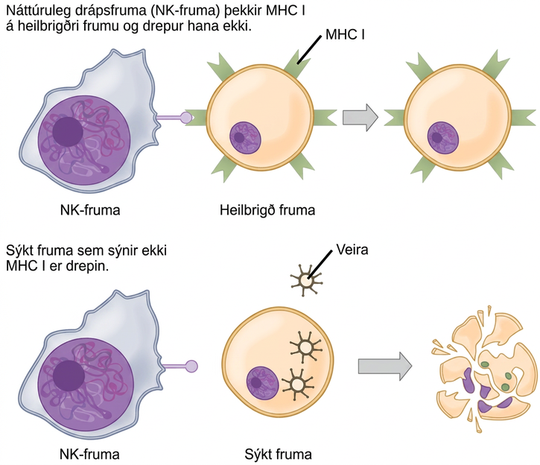
Figure 42.14
Natural killer (NK) cells recognize the MHC I receptor on healthy cells. If MHC I is absent, the cell is lysed.
Notes:
Healthy, uninfected cells present M H C I on their surface. A natural killer cell recognizes the M H C I and does not kill the cell. An infected cell that does not produce M H C I is killed.

Slide 20
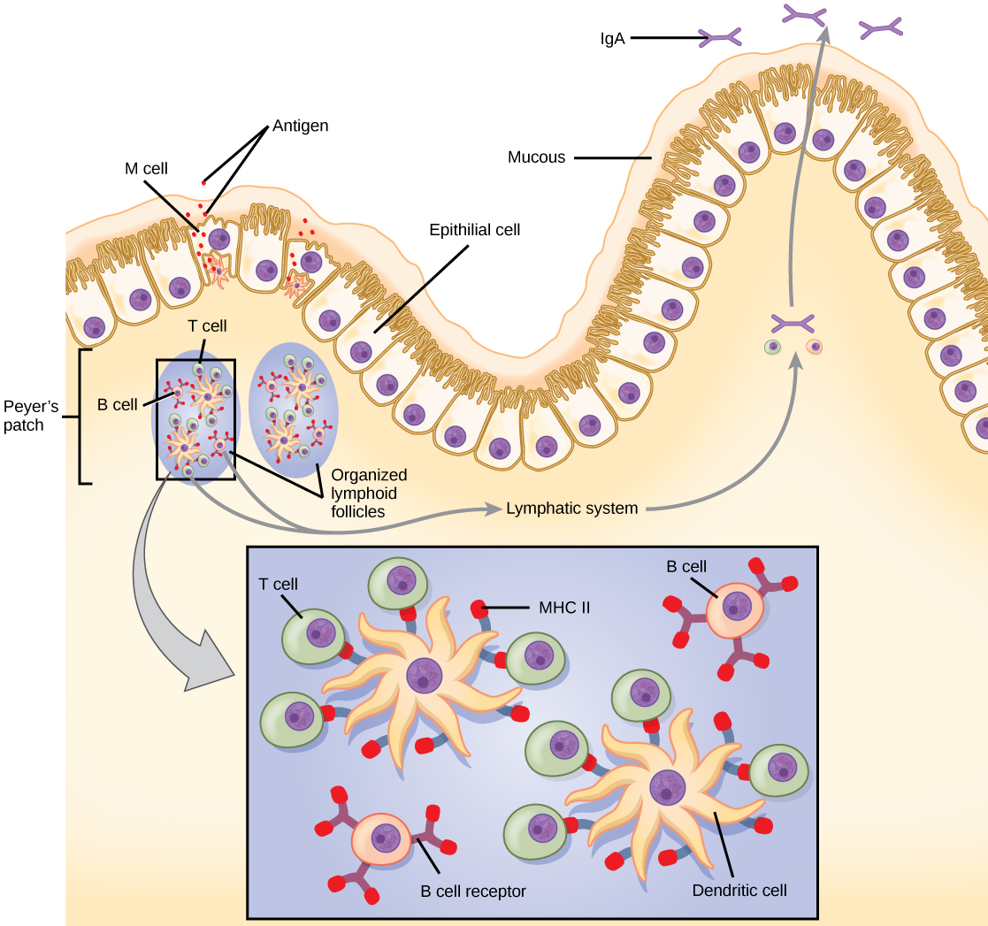
Figure 42.15
The topology and function of intestinal MALT is shown. Pathogens are taken up by M cells in the intestinal epithelium and excreted into a pocket formed by the inner surface of the cell. The pocket contains antigen-presenting cells such as dendritic cells, which engulf the antigens, then present them with MHC II molecules on the cell surface. The dendritic cells migrate to an underlying tissue called a Peyer’s patch. Antigen-presenting cells, T cells, and B cells aggregate within the Peyer’s patch, forming organized lymphoid follicles. There, some T cells and B cells are activated. Other antigen-loaded dendritic cells migrate through the lymphatic system where they activate B cells, T cells, and plasma cells in the lymph nodes. The activated cells then return to MALT tissue effector sites. IgA and other antibodies are secreted into the intestinal lumen.
Notes:
The intestine is lined with epithelial cells with hair-like cilia extending into the intestinal lumen. M cells are sandwiched between these epithelial cells, in bump-like projections in the intestinal lining. The M cells are shaped like an upside-down U, with the U forming a pocket on the interior surface. Antigens are taken up from the intestinal lumen by the M cells, and excreted into this U-shaped pocket. Dendritic cells in the pocket ingest the antigen, then migrate to an area below of the intestinal lining called a Peyer's patch. The dendritic cells, T cells and B cells aggregate to form clumps of cells called organized lymphoid follicles. There, some T cells interact with antigen associated with M H C I I on the surface of the dendritic cells. Some B cells are activated by free antigen. Some antigen-presenting dendritic cells enter the lymphatic system, where more B and T cells are activated in the lymph nodes. The B cells and T cells return to bigger bumps in the intestinal epithelium called MALT effector sites. Antibodies are secreted into the intestinal lumen.

Slide 21
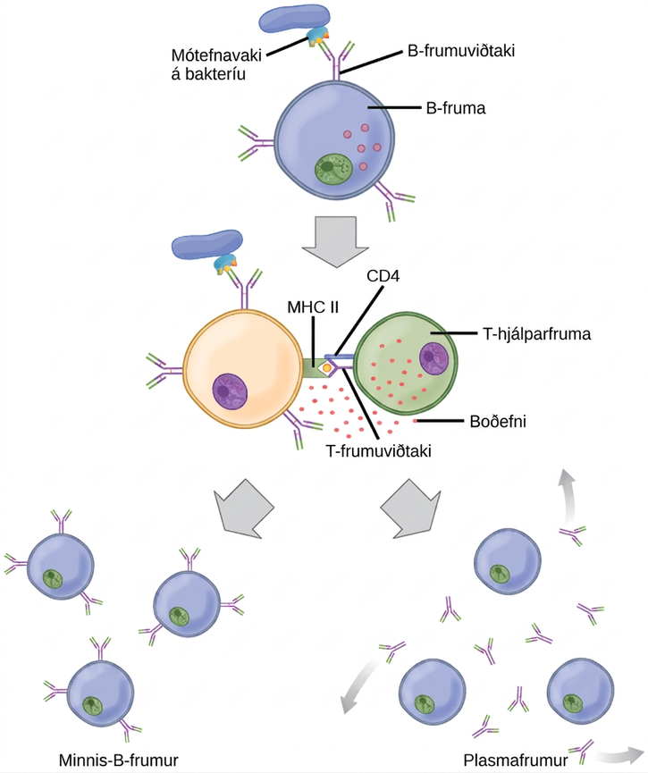
Figure 42.16
After initially binding an antigen to the B cell receptor (BCR), a B cell internalizes the antigen and presents it on MHC II. A helper T cell recognizes the MHC II–antigen complex and activates the B cell. As a result, memory B cells and plasma cells are made.
Notes:
llustration shows activation of a B cell. An antigen on the surface of a bacterium binds the B cell receptor. The b cell engulfs the antigen, and presents an epitope on its surface in conjunction with a M H C I I receptor. A T cell receptor and C D 4 molecule on the surface of a helper T cell recognize the epitopes M H C I I complex and activates the B cell. The B cell divides and turns into memory B cells and plasma cells. Memory B cells detect the antigen that had activated their parent B cell (memory B cells and their parent B cells share the same BCR, thus they detect the same antigen) and can initiate rapid division and strong response if the same antigen is detected after infection at a different time. Plasma B cells secrete antibodies.

Slide 22
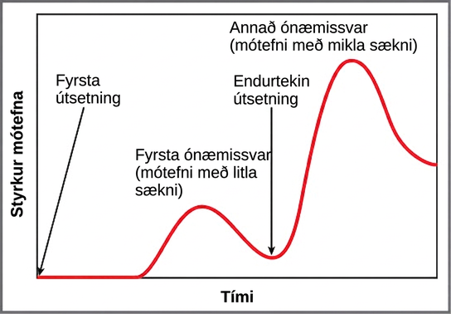
Figure 42.17
In the primary response to infection, antibodies are secreted first from plasma cells. Upon reexposure to the same pathogen, memory cells differentiate into antibody-secreting plasma cells that output a greater amount of antibody for a longer period of time.
Notes:
A graph plots antibody concentration over time during primary and secondary immune response. During the primary immune response, a low concentration of antibody is produced. Antibody is only produced after a delay from the time of the initial exposure. During the secondary immune response, about three times as much antibody is produced, and production begins much more quickly after the secondary exposure.

Slide 23
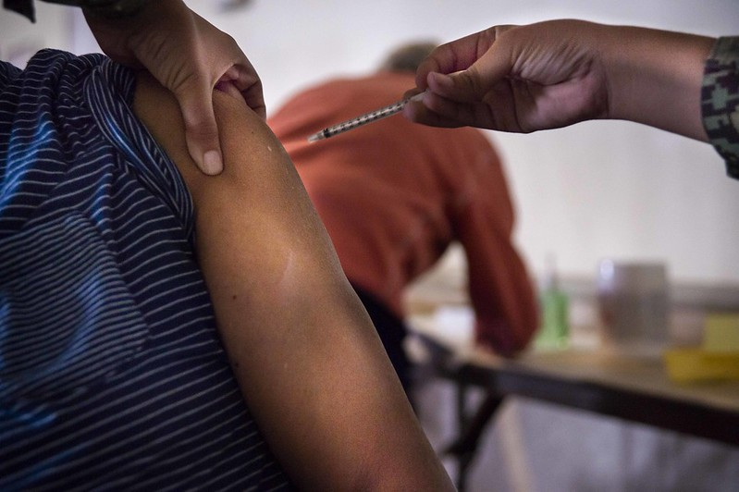
Figure 42.18
Vaccines are often delivered by injection into the arm. (credit: Navy Medicine)
Notes:
Photo shows a person receiving an injection in the arm.

Slide 24
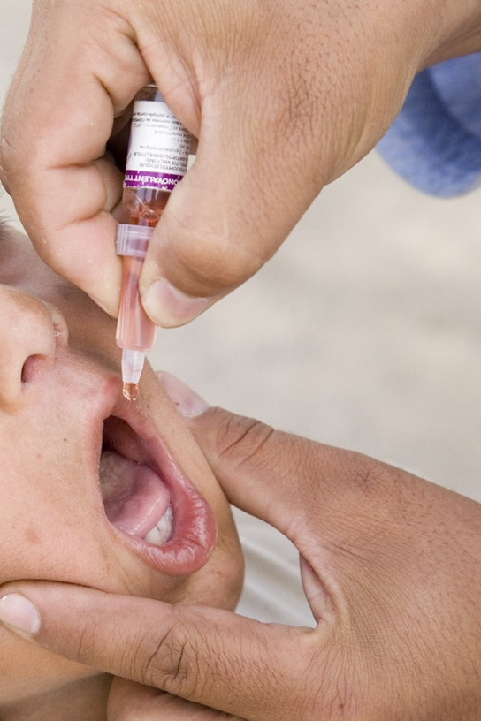
Figure 42.19
The polio vaccine can be administered orally. (credit: modification of work by UNICEF Sverige)
Notes:
Photo shows a child receiving an oral vaccination from a dropper.

Slide 25
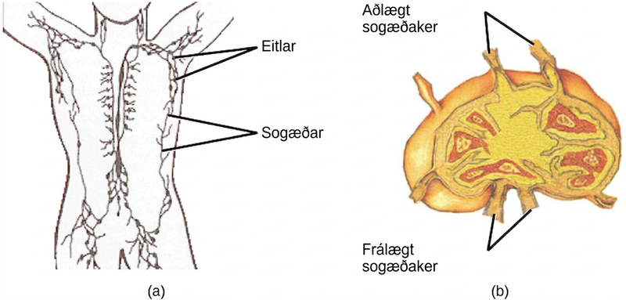
Figure 42.20
(a) Lymphatic vessels carry a clear fluid called lymph throughout the body. The liquid enters (b) lymph nodes through afferent vessels. Lymph nodes are filled with lymphocytes that purge infecting cells. The lymph then exits through efferent vessels. (credit: modification of work by NIH, NCI)
Notes:
Part A shows the location of the lymph nodes and lymph vessels in the human body. Lymph vessels run down the spine and along the sides of the body and into the arms and legs and neck. Lymph nodes are clustered in the upper arms and legs, and in the lower back. Part B shows a lymph node, which is kidney shaped. Afferent lymphatic vessels are located along the outer curve, and efferent vessels are located along the inner curve.

Slide 26
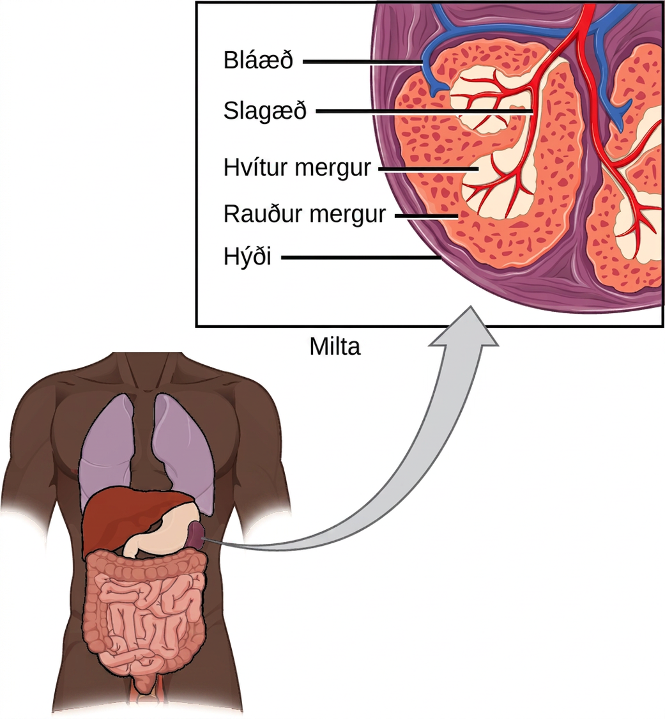
Figure 42.21
The spleen is similar to a lymph node but is much larger and filters blood instead of lymph. Blood enters the spleen through arteries and exits through veins. The spleen contains two types of tissue: red pulp and white pulp. Red pulp consists of cavities that store blood. Within the red pulp, damaged red blood cells are removed and replaced by new ones. White pulp is rich in lymphocytes that remove antigen-coated bacteria from the blood. (credit: modification of work by NCI)
Notes:
Illustration shows a cross section of a part of a spleen, which is located the upper left part of the abdomen. The spleen is divided into oval quadrants. At the center of these quadrants is white pulp, and at the periphery is red pulp. Arteries extend into the white pulp. Veins connect to the red pulp. The spleen is surrounded by a membrane called a capsule.

Slide 27
42.3 Antibodies
Learning Objectives
Explain cross-reactivity
Describe the structure and function of antibodies
Discuss antibody production

Slide 28
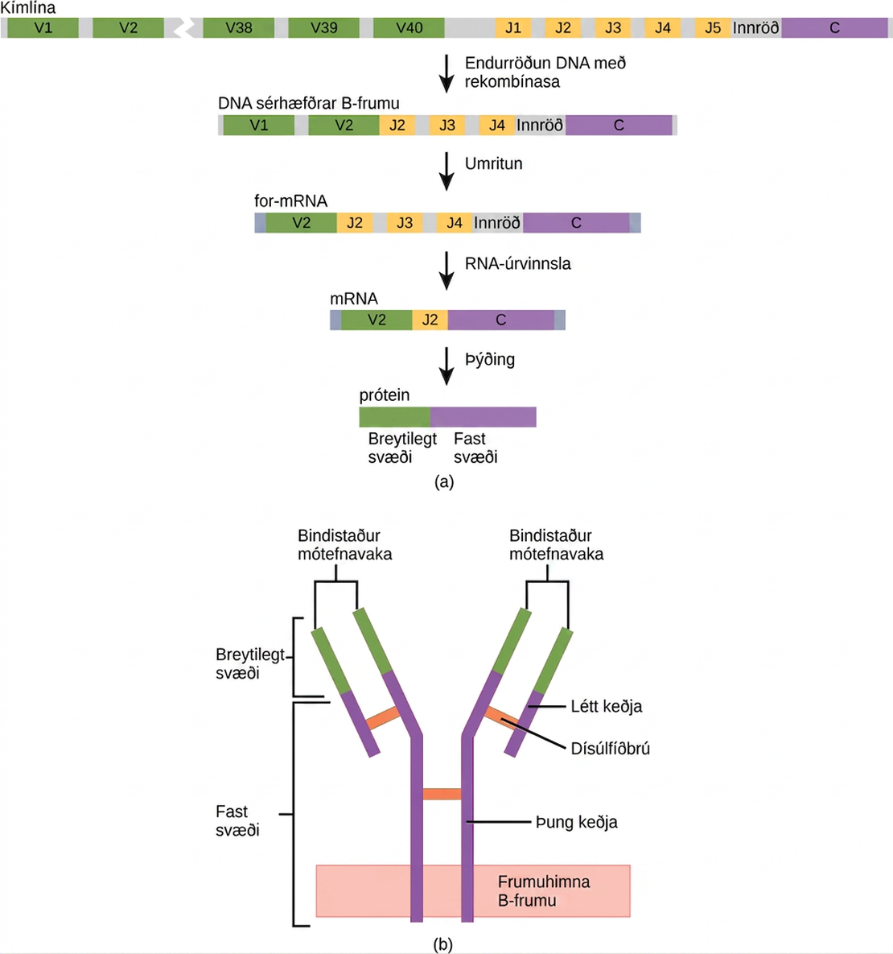
Figure 42.22
(a) As a germ-line B cell matures, an enzyme called DNA recombinase randomly excises V and J segments from the light chain gene. Splicing at the mRNA level results in further gene rearrangement. As a result, (b) each antibody has a unique variable region capable of binding a different antigen.
Notes:
Part A shows the arrangement of gene segments encoding antibody light chains in a germ line B cell. The segment contains forty consecutive V regions, named V 1 through V 40, five consecutive J regions named J 1 through J 5, and a constant region. J5 and the constant region are separated by an intron. D N A recombinase splices out the portion of D N A containing segments V 3 through J 1, resulting in a differentiated B cell where the V 2 region is joined to the J 2 region. The gene is transcribed into pre R N A. R N A processing splices out all but the V 2, J 2 and C regions. Translation results in a protein with a variable region formed from the V 2 and J 2 segments, and a constant region formed from the C region. In part B, the light chain joins the heavy chain to form a Y shaped antibody.

Slide 29
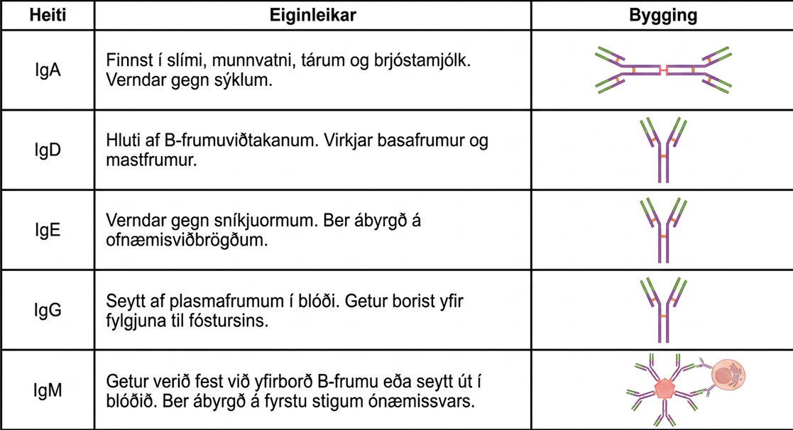
Figure 42.23
Immunoglobulins have different functions, but all are composed of light and heavy chains that form a Y-shaped structure.
Notes:
Table shows the structure and function of the five types of immunoglobulins: upper case I lower case g upper case A, and upper I lower g upper D, and upper I lower g upper E, and upper I lower g upper G and upper I lower g upper M. I g D, and I g E and I g G all have a Y shaped structure. I g D is part of the B cell receptor, and activates basophils and mast cells. I g E protects against parasitic worms, and is responsible for allergic reactions. I g G is secreted by plasma cells in the blood, and is able to cross the placenta into the fetus. I g A consist of two Y shaped structures connected at their trunk. It is found in mucous, saliva, tears and breast milk, and protects against pathogens. I g M consists of five Y shaped structures connected to a pentagram, with the top of the Ys facing out. It may be attached to the surface of B cells or secreted in the blood, and is responsible for the early stages of immunity.

Slide 30
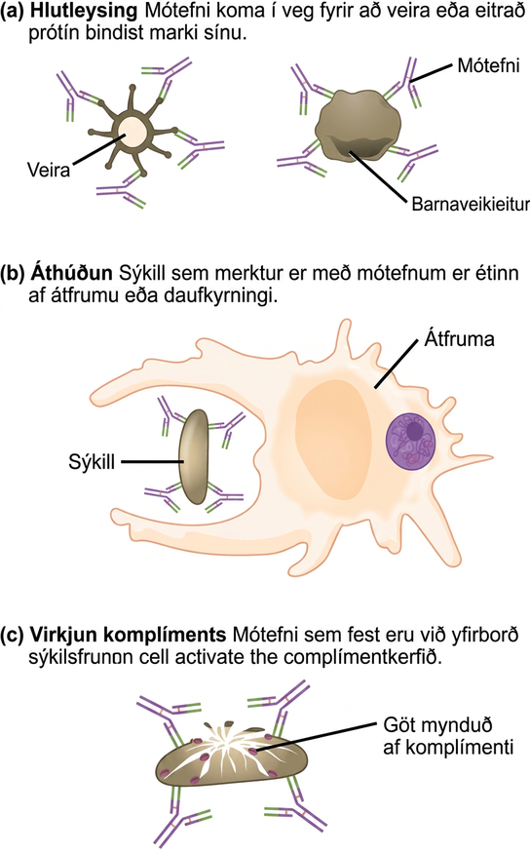
Figure 42.24
Antibodies may inhibit infection by (a) preventing the antigen from binding its target, (b) tagging a pathogen for destruction by macrophages or neutrophils, or (c) activating the complement cascade.
Notes:
Part A shows antibody neutralization. Antibodies coat the surface of a virus or toxic protein, such as the diphtheria toxin, and prevent them from binding to their target. Part B shows opsonization, a process by which a pathogen coated with antigens is consumed by a macrophage or neutrophil. Part C shows complement activation. Antibodies attached to the surface of a pathogen cell activate the complement system. Pores are formed in the cell membrane, destroying the cell.

Slide 31
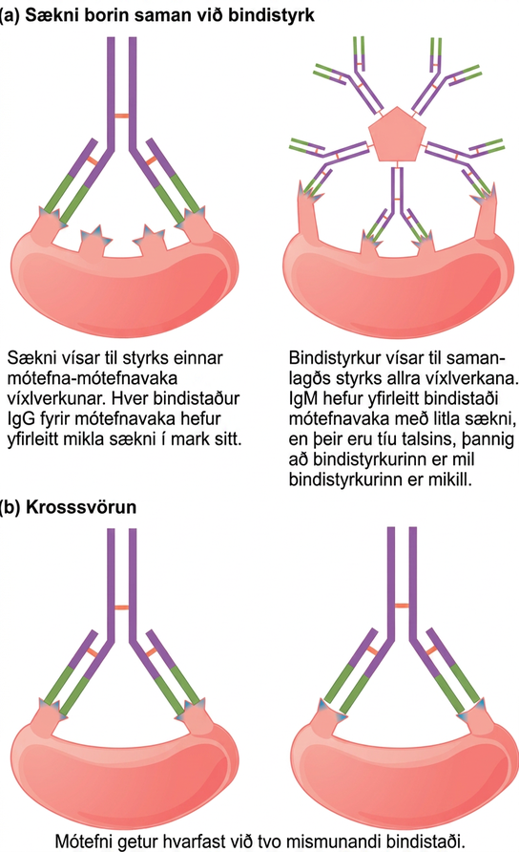
Figure 42.25
(a) Affinity refers to the strength of single interaction between antigen and antibody, while avidity refers to the strength of all interactions combined. (b) An antibody may cross react with different epitopes.
Notes:
Part A compares affinity and avidity. Affinity refers to the strength of a single antibody antigen interaction. Each I g G antigen-binding site typically has high affinity for its target. Avidity refers to the strength of all interactions combined, I g M typically has low affinity antigen binding sites, but there are ten of them so avidity is high. Part B describes cross reactivity, a situation in which an antibody reacts with two different epitopes.

Slide 32
42.4 Disruptions in the Immune System
Learning Objectives
Describe hypersensitivity
Define autoimmunity

Slide 33
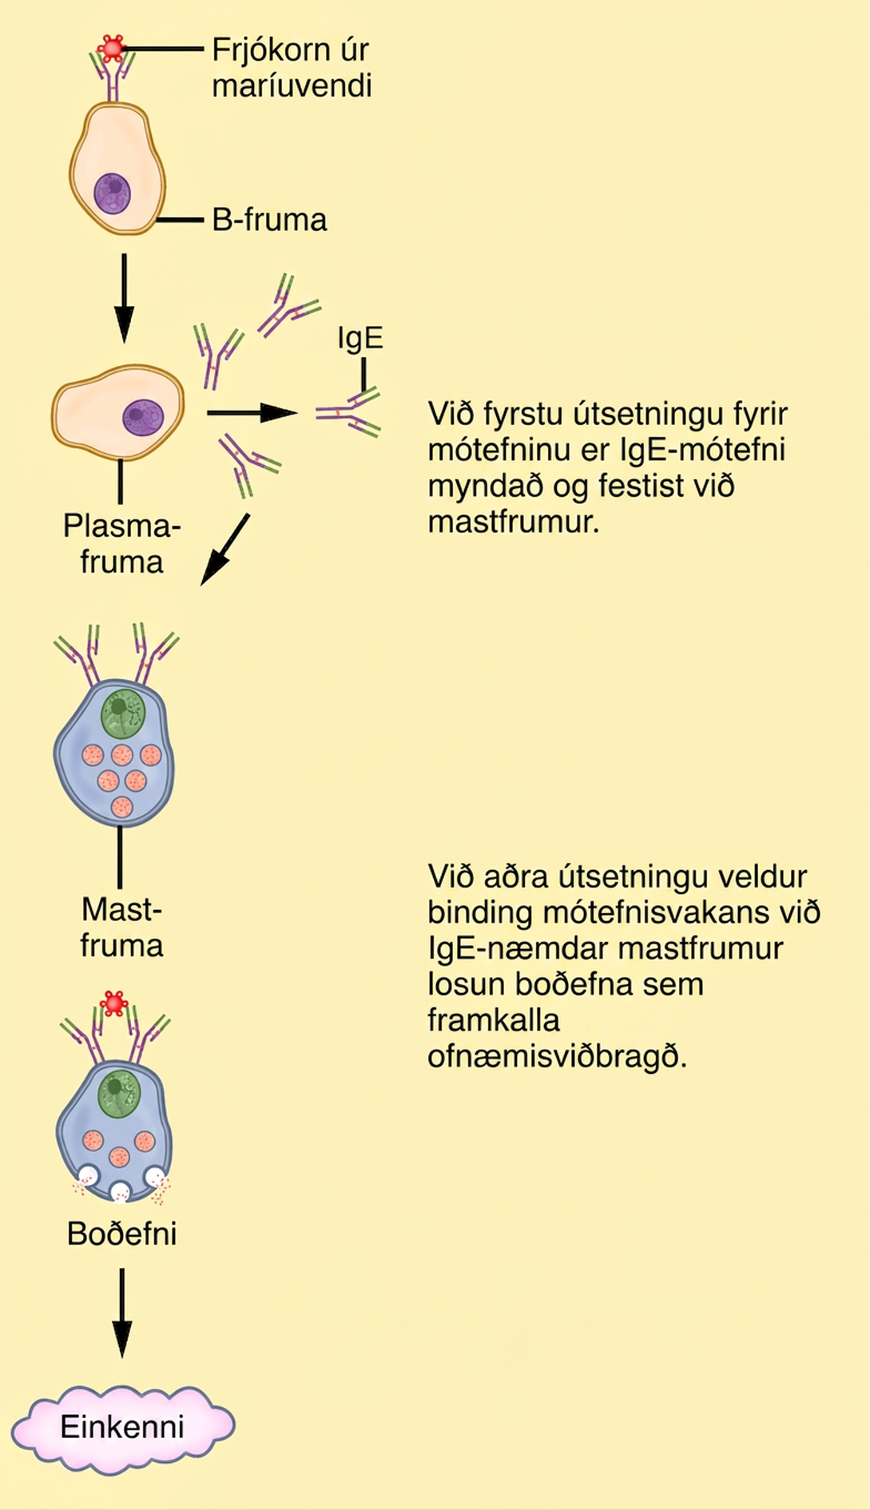
Figure 42.26
On first exposure to an allergen, an IgE antibody is synthesized by plasma cells in response to a harmless antigen. The IgE molecules bind to mast cells, and on secondary exposure, the mast cells release histamines and other modulators that affect the symptoms of allergy. (credit: modification of work by NIH)
Notes:
Illustration shows ragweed pollen attached to the surface of a B cell. The B cell is activated, producing plasma cells that release I g E. The I g E is presented on the surface of a mast cell. Upon a second exposure, binding of the antigen to the I g E primed mast cells causes the release of chemical mediators that elicit an allergic reaction.

Slide 34
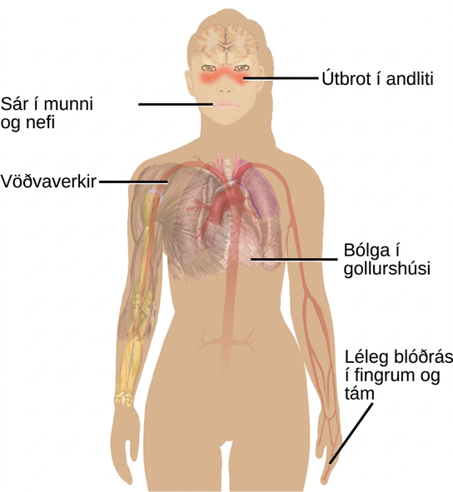
Figure 42.27
Systemic lupus erythematosus is characterized by autoimmunity to the individual’s own DNA and/or proteins, which leads to varied dysfunction of the organs. (credit: modification of work by Mikael Häggström)
This OpenStax ancillary resource is © Rice University under a CC BY-NC-SA 4.0 International license; it may be reproduced or modified for noncommercial purposes only but must be attributed to OpenStax, Rice University and any changes must be noted. Any adaptation must be shared under the same type of license.
Notes:
Illustration shows the symptoms of lupus, which include a face rash, ulcers in the mouth and nose, muscle aches, inflammation of the pericardium and poor circulation in the fingers and toes.

