Slide 1

Stærðfræðigreining, 1. bindi
4. kafli: Notkun afleiða

Slide 2
Yfirlit kaflans (1 af 2)
Tengdir breytingarhraðar
Línulegar nálganir og deildi
Hágildi og lággildi
Meðalgildissetningin
Afleiður og lögun grafs
Markgildi þegar x stefnir á óendanlegt og aðfellur
Hagnýt bestunarverkefni
Regla l’Hôpital
Aðferð Newtons

Slide 3
Yfirlit kaflans (2 af 2)
Stofnföll

Slide 4
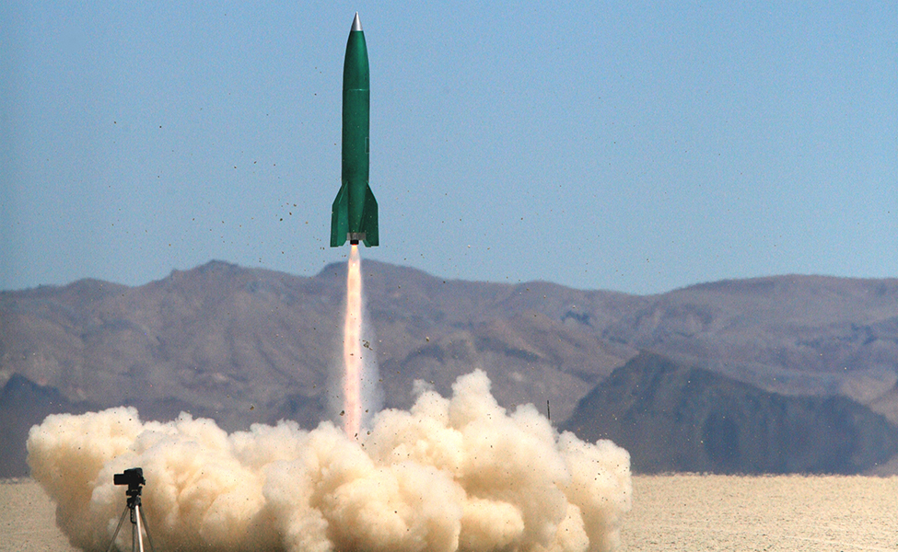
Mynd 4.1
Þegar eldflaug er skotið á loft, hversu hratt þarf horn myndbandsupptökuvélar að breytast svo unnt sé að fylgjast áfram með eldflauginni? (mynd: aðlagað verk eftir Steve Jurvetson, Wikimedia Commons)
Notes:
A photo of a rocket lifting off.

Slide 5
4.1 Tengdir breytingarhraðar
Námsmarkmið
Setja breytilegar stærðir fram með afleiðum.
Finna tengsl milli afleiða í tilteknu verkefni.
Nota keðjuregluna til að finna breytingarhraða stærðar sem er háður breytingarhraða annarra stærða.

Slide 6
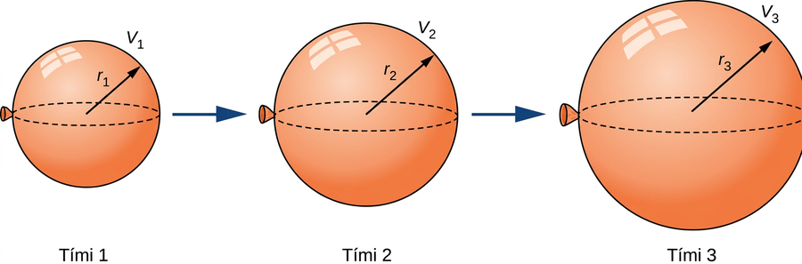
Mynd 4.2
Þegar lofti er dælt í blöðruna aukast bæði radíus hennar og rúmmál með tíma.
Notes:
Three balloons are shown at Times 1, 2, and 3. These balloons increase in volume and radius as time increases.

Slide 7
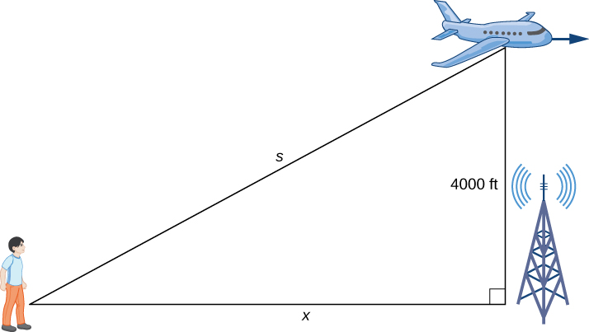
Mynd 4.3
Flugvél flýgur í fastri hæð, 4000 ft. Bæði fjarlægðin frá manneskjunni að flugvélinni og fjarlægðin frá manneskjunni að staðnum á jörðu beint undir vélinni breytast. Við táknum þessar stærðir með breytunum s og x, í sömu röð.
Notes:
A right triangle is made with a person on the ground, an airplane in the air, and a radio tower at the right angle on the ground. The hypotenuse is s, the distance on the ground between the person and the radio tower is x, and the side opposite the person (that is, the height from the ground to the airplane) is 4000 ft.

Slide 8
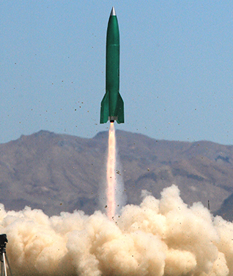
Mynd 4.4
(mynd: aðlagað verk eftir Steve Jurvetson, Wikimedia Commons)
Notes:
A photo of a rocket lifting off.

Slide 9
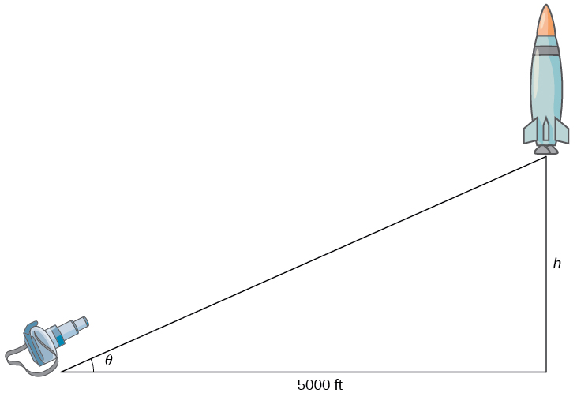
Mynd 4.5
Myndavél er staðsett 5000 ft frá skotpalli eldflaugarinnar. Hæð eldflaugarinnar og horn myndavélarinnar breytast með tíma. Við táknum þessar stærðir með breytunum h og θ, í sömu röð.
Notes:
A right triangle is formed with a camera at one of the nonright angles and a rocket at the other nonright angle. The angle with the camera has measure θ. The distance from the rocket to the ground is h; note that this is the side opposite the angle with measure θ. The side adjacent to the angle with measure θ is 5000 ft.

Slide 10
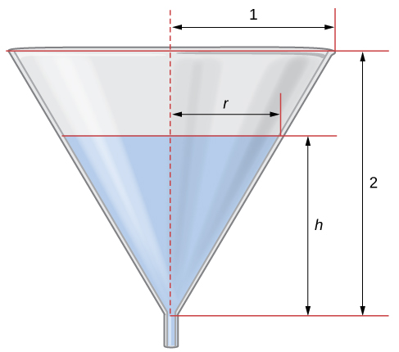
Mynd 4.6
Vatn rennur úr trekt sem er 2 ft á hæð og hefur radíusinn 1 ft. Hæð vatnsins og radíus vatnsflatarins breytast með tíma. Við táknum þessar stærðir með breytunum h og r, í sömu röð.
Notes:
A funnel is shown with height 2 and radius 1 at its top. The funnel has water to height h, at which point the radius is r.

Slide 11
4.2 Línulegar nálganir og deildi (1 af 2)
Námsmarkmið
Lýsa línulegri nálgun falls í punkti.
Setja fram línugervingu tiltekins falls.
Teikna graf sem sýnir hvernig nota má deildi til að nálga breytingu á stærð.

Slide 12
4.2 Línulegar nálganir og deildi (2 af 2)
Námsmarkmið
Reikna hlutfallsskekkju og prósentuskekkju við nálgun með deildi.

Slide 13
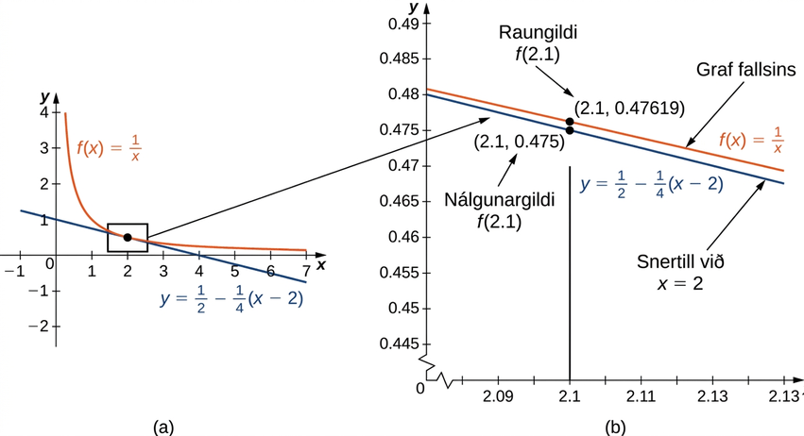
Mynd 4.7
(a) Snertillinn við f(x)=1/x í x=2 gefur góða nálgun á f þegar x er nálægt 2. (b) Þegar x=2.1 er gildi y á snertlinum við f(x)=1/x jafnt 0.475. Raungildi f(2.1) er 1/2.1, sem er um það bil 0.47619.
Notes:
This figure has two parts a and b. In figure a, the line f(x) = 1/x is shown with its tangent line at x = 2. In figure b, the area near the tangent point is blown up to show how good of an approximation the tangent is near x = 2.

Slide 14
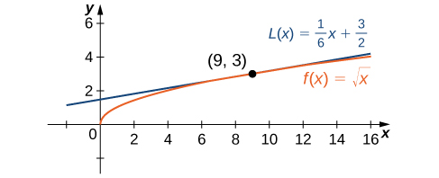
Mynd 4.8
Staðbundin línuleg nálgun við fallið f(x)=√x í x=9 gefur nálgun á f þegar x er nálægt 9.
Notes:
The function f(x) = the square root of x is shown with its tangent at (9, 3). The tangent appears to be a very good approximation from x = 6 to x = 12.

Slide 15
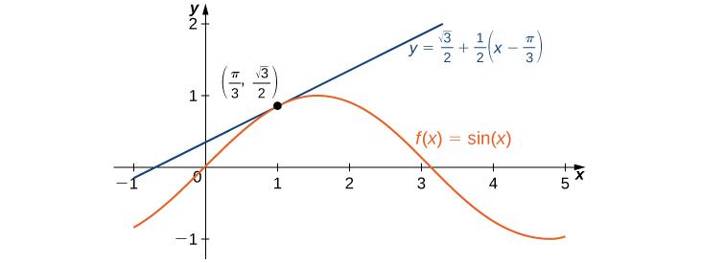
Mynd 4.9
Línulega nálgunin við f(x)=sin x í x=π/3 gefur nálgun á sin x þegar x er nálægt π/3.
Notes:
The function f(x) = sin x is shown with its tangent at (π/3, square root of 3 / 2). The tangent appears to be a very good approximation for x near π / 3.

Slide 16
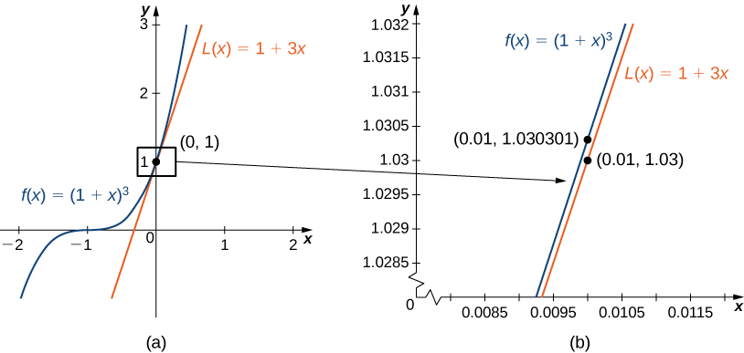
Mynd 4.10
(a) Línulega nálgunin við f(x) í x=0 er L(x). (b) Raungildi 1.01³ er 1.030301. Línulega nálgunin við f(x) í x=0 gefur matið 1.03 fyrir 1.01³.
Notes:
This figure has two parts a and b. In figure a, the line f(x) = (1 + x)3 is shown with its tangent line at (0, 1). In figure b, the area near the tangent point is blown up to show how good of an approximation the tangent is near (0, 1).

Slide 17
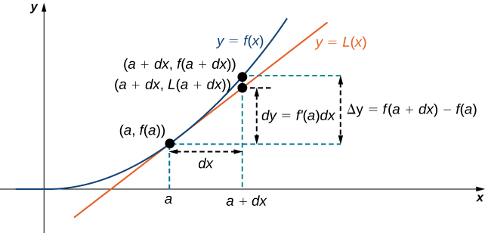
Mynd 4.11
Deildið dy=f′(a)dx er notað til að nálga raunverulega breytingu á y þegar x vex úr a í a+dx.
Notes:
A function y = f(x) is shown along with its tangent line at (a, f(a)). The tangent line is denoted L(x). The x axis is marked with a and a + dx, with a dashed line showing the distance between a and a + dx as dx. The points (a + dx, f(a + dx)) and (a + dx, L(a + dx)) are marked on the curves for y = f(x) and y = L(x), respectively. The distance between f(a) and L(a + dx) is marked as dy = f’(a) dx, and the distance between f(a) and f(a + dx) is marked as Δy = f(a + dx) – f(a).

Slide 18
4.3 Hágildi og lággildi
Námsmarkmið
Skilgreina algild útgildi.
Skilgreina staðbundin útgildi.
Útskýra hvernig finna má markpunkta falls á lokuðu bili.
Lýsa hvernig nota má markpunkta til að finna algild útgildi á lokuðu bili.

Slide 19
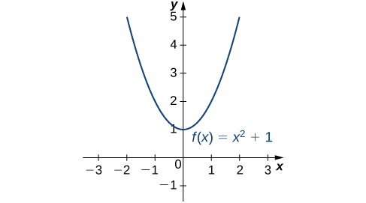
Mynd 4.12
Fallið hefur algilt lággildi, 1, í x=0. Það hefur ekkert algilt hágildi.
Notes:
The function f(x) = x2 + 1 is graphed, and its minimum of 1 is seen to be at x = 0.

Slide 20
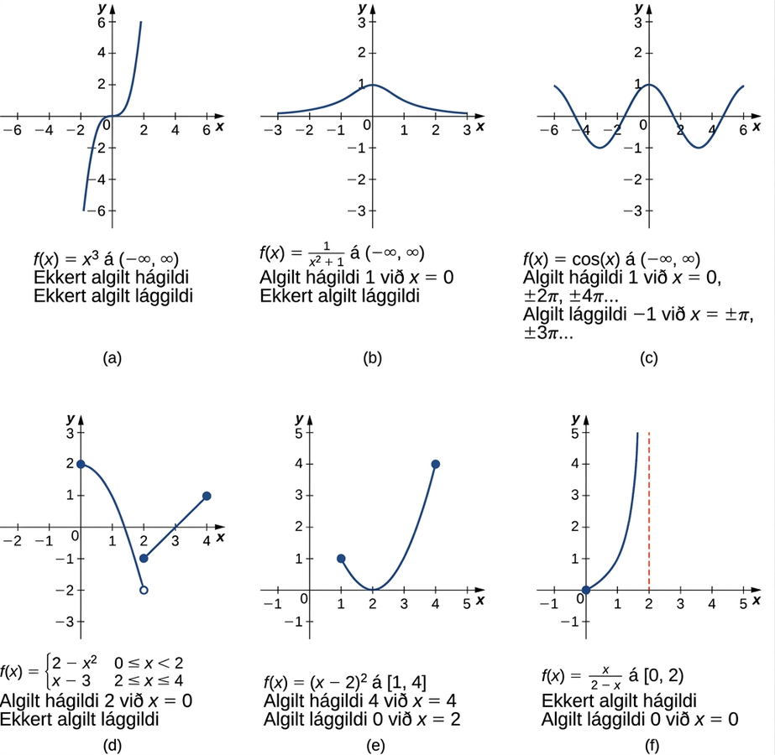
Mynd 4.13
Gröfin (a), (b) og (c) sýna nokkra möguleika á algildum útgildum falla með skilgreiningarmengið (−∞,∞). Gröfin (d), (e) og (f) sýna nokkra möguleika á algildum útgildum falla sem hafa afmarkað bil sem skilgreiningarmengi.
Notes:
This figure has six parts a, b, c, d, e, and f. In figure a, the line f(x) = x3 is shown, and it is noted that it has no absolute minimum and no absolute maximum. In figure b, the line f(x) = 1/(x2 + 1) is shown, which is near 0 for most of its length and rises to a bump at (0, 1); it has no absolute minimum, but does have an absolute maximum of 1 at x = 0. In figure c, the line f(x) = cos x is shown, which has absolute minimums of −1 at ±π, ±3π, … and absolute maximums of 1 at 0, ±2π, ±4π, …. In figure d, the piecewise function f(x) = 2 – x2 for 0 ≤ x < 2 and x – 3 for 2 ≤ x ≤ 4 is shown, with absolute maximum of 2 at x = 0 and no absolute minimum. In figure e, the function f(x) = (x – 2)2 is shown on [1, 4], which has absolute maximum of 4 at x = 4 and absolute minimum of 0 at x = 2. In figure f, the function f(x) = x/(2 − x) is shown on [0, 2), with absolute minimum of 0 at x = 0 and no absolute maximum.

Slide 21
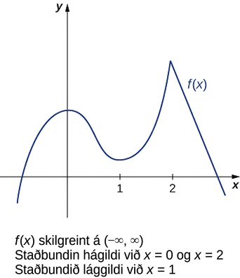
Mynd 4.14
Fallið f hefur tvö staðbundin hágildi og eitt staðbundið lággildi. Staðbundna hágildið við x=2 er jafnframt algilda hágildið.
Notes:
The function f(x) is shown, which curves upward from quadrant III, slows down in quadrant II, achieves a local maximum on the y-axis, decreases to achieve a local minimum in quadrant I at x = 1, increases to a local maximum at x = 2 that is greater than the other local maximum, and then decreases rapidly through quadrant IV.

Slide 22
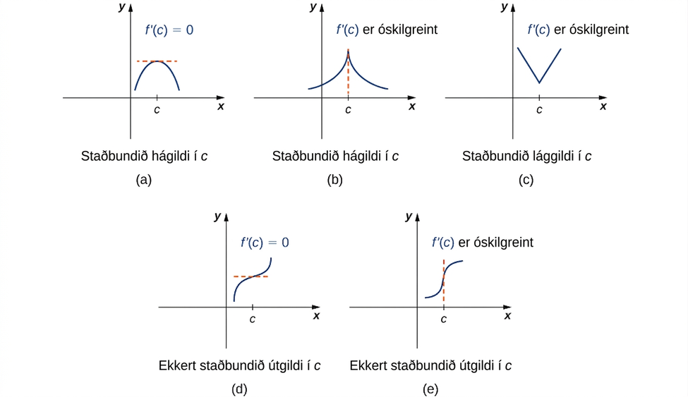
Mynd 4.15
(a–e) Fall f hefur markpunkt í c ef f′(c)=0 eða f′(c) er óskilgreint. Fall getur haft staðbundið útgildi í markpunkti, en þarf ekki að hafa það.
Notes:
This figure has five parts a, b, c, d, and e. In figure a, a parabola is shown facing down in quadrant I; there is a horizontal tangent line at the local maximum marked f’(c) = 0. In figure b, there is a function drawn with an asymptote at c, meaning that the function increases toward infinity on both sides of c; it is noted that f’(c) is undefined. In figure c, a version of the absolute value graph is shown that has been shifted so that its minimum is in quadrant I with x = c. It is noted that f’(c) is undefined. In figure d, a version of the function f(x) = x3 is shown that has been shifted so that its inflection point is in quadrant I with x = c. Its inflection point at (c, f(c)) has a horizontal line through it, and it is noted that f’(c) = 0. In figure e, a version of the function f(x) = x1/3 is shown that has been shifted so that its inflection point is in quadrant I with x = c. Its inflection point at (c, f(c)) has a vertical line through it, and it is noted that f’(c) is undefined.

Slide 23
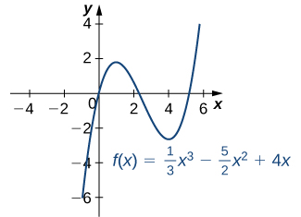
Mynd 4.16
Þetta fall hefur staðbundið hágildi og staðbundið lággildi.
Notes:
The function f(x) = (1/3) x3 – (5/2) x2 + 4x is graphed. The function has local maximum at x = 1 and local minimum at x = 4.

Slide 24
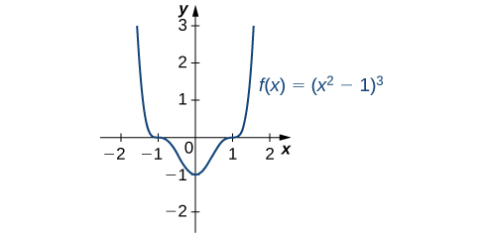
Mynd 4.17
Þetta fall hefur þrjá markpunkta: x=0, x=1 og x=−1. Fallið hefur staðbundið (og algilt) lággildi við x=0 en engin útgildi í hinum markpunktunum tveimur.
Notes:
The function f(x) = (x2 − 1)3 is graphed. The function has local minimum at x = 0, and inflection points at x = ±1.

Slide 25
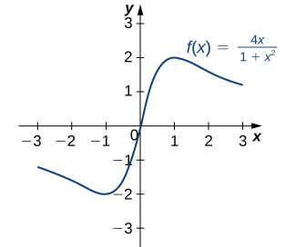
Mynd 4.18
Þetta fall hefur algilt hágildi og algilt lággildi.
Notes:
The function f(x) = 4x/(1 + x2) is graphed. The function has local/absolute maximum at x = 1 and local/absolute minimum at x = −1.

Slide 26
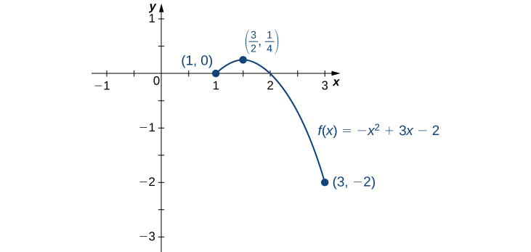
Mynd 4.19
Þetta fall hefur bæði algilt hágildi og algilt lággildi.
Notes:
The function f(x) = – x2 + 3x – 2 is graphed from (1, 0) to (3, −2), with its maximum marked at (3/2, 1/4).

Slide 27
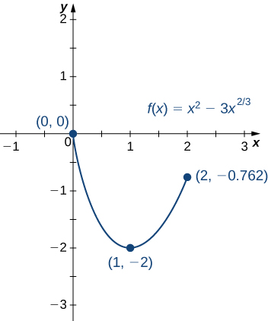
Mynd 4.20
Þetta fall hefur algilt hágildi í öðrum endapunkti bilsins.
Notes:
The function f(x) = x2 – 3x2/3 is graphed from (0, 0) to (2, −0.762), with its minimum marked at (1, −2).

Slide 28
4.4 Meðalgildissetningin
Námsmarkmið
Útskýra merkingu setningar Rolles.
Lýsa mikilvægi meðalgildissetningarinnar.
Setja fram þrjár mikilvægar afleiðingar meðalgildissetningarinnar.

Slide 29
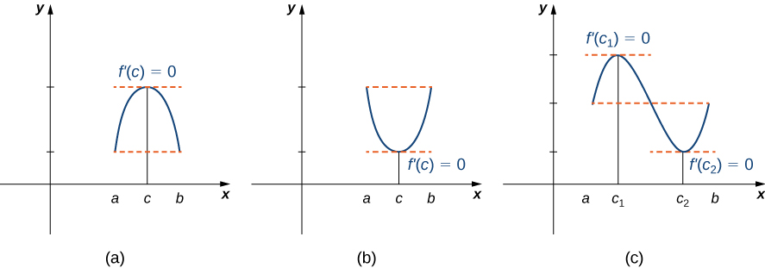
Mynd 4.21
Ef deildanlegt fall f uppfyllir f(a)=f(b), hlýtur afleiða þess að vera núll í að minnsta kosti einum punkti milli a og b.
Notes:
The figure is divided into three parts labeled a, b, and c. Figure a shows the first quadrant with values a, c, and b marked on the x-axis. A downward-facing parabola is drawn such that its values at a and b are the same. The point c is the global maximum, and it is noted that f’(c) = 0. Figure b shows the first quadrant with values a, c, and b marked on the x-axis. An upward-facing parabola is drawn such that its values at a and b are the same. The point c is the global minimum, and it is noted that f’(c) = 0. Figure c shows the first quadrant with points a, c1, c2, and b marked on the x-axis. One period of a sine wave is drawn such that its values at a and b are equal. The point c1 is the global maximum, and it is noted that f’(c1) = 0. The point c2 is the global minimum, and it is noted that f’(c2) = 0.

Slide 30
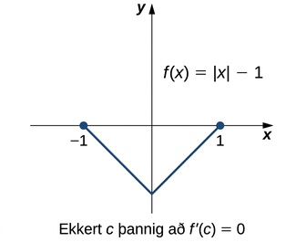
Mynd 4.22
Þar sem f(x)=|x|−1 er ekki deildanlegt við x=0 eru skilyrði setningar Rolles ekki uppfyllt. Niðurstaða setningarinnar gildir því ekki hér; ekkert c∈(−1,1) uppfyllir f′(c)=0.
Notes:
The function f(x) = |x| − 1 is graphed. It is shown that f(1) = f(−1), but it is noted that there is no c such that f’(c) = 0.

Slide 31
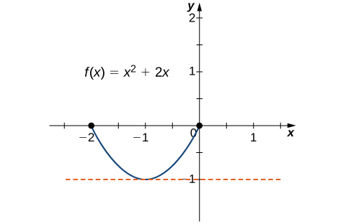
Mynd 4.23
Þetta fall er samfellt og deildanlegt á [−2,0] og f′(c)=0 þegar c=−1.
Notes:
The function f(x) = x2 +2x is graphed. It is shown that f(0) = f(−2), and a dashed horizontal line is drawn at the absolute minimum at (−1, −1).

Slide 32
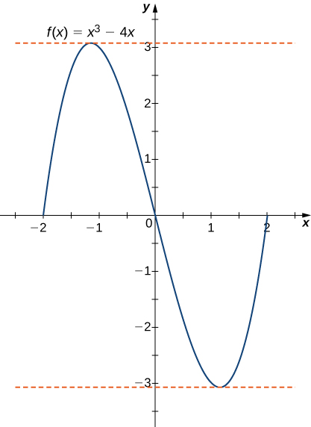
Mynd 4.24
Fyrir þessa margliðu á [−2,2] er f′(c)=0 við x=±2/3.
Notes:
The function f(x) = x3 – 4x is graphed. It is obvious that f(2) = f(−2) = f(0). Dashed horizontal lines are drawn at x = ±2/square root of 3, which are the local maximum and minimum.

Slide 33
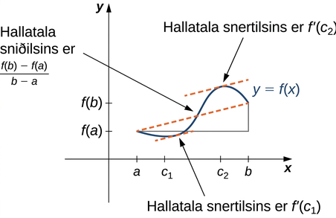
Mynd 4.25
Meðalgildissetningin segir að fyrir fall sem uppfyllir skilyrði hennar sé til punktur þar sem snertillinn hefur sömu hallatölu og sniðillinn milli endapunktanna. Fyrir þetta fall eru til tvö gildi, c1 og c2, þannig að snertlar við f í c1 og c2 hafa sömu hallatölu og sniðillinn.
Notes:
A vaguely sinusoidal function y = f(x) is drawn. On the x-axis, a, c1, c2, and b are marked. On the y-axis, f(a) and f(b) are marked. The function f(x) starts at (a, f(a)), decreases to c1, increases to c2, and then decreases to (b, f(b)). A secant line is drawn between (a, f(a)) and (b, f(b)), and it is noted that this line has slope (f(b) – f(a))/(b − a). The tangent lines at c1 and c2 are drawn, and these lines are parallel to the secant line. It is noted that the slopes of these tangent lines are f’(c1) and f’(c2), respectively.

Slide 34
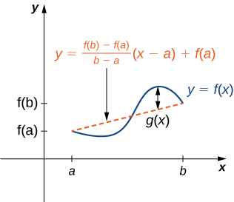
Mynd 4.26
Gildið g(x) er lóðrétti munurinn á punktinum (x,f(x)) og punktinum (x,y) á sniðlinum sem tengir (a,f(a)) og (b,f(b)).
Notes:
A vaguely sinusoidal function y = f(x) is drawn. On the x-axis, a and b are marked. On the y-axis, f(a) and f(b) are marked. The function f(x) starts at (a, f(a)), decreases, then increases, and then decreases to (b, f(b)). A secant line is drawn between (a, f(a)) and (b, f(b)), and it is noted that this line has equation y = ((f(b) – f(a))/(b − a)) (x − a) + f(a). A line is drawn between the maximum of f(x) and the secant line and it is marked g(x).

Slide 35
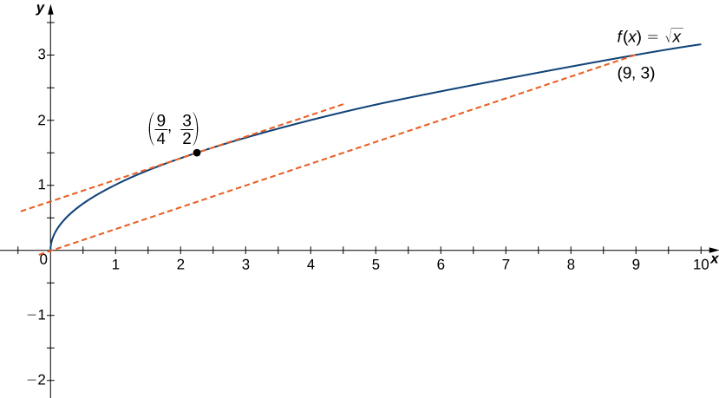
Mynd 4.27
Hallatala snertilsins við c=9/4 er sú sama og hallatala línustriksins sem tengir (0,0) og (9,3).
Notes:
The function f(x) = the square root of x is graphed from (0, 0) to (9, 3). There is a secant line drawn from (0, 0) to (9, 3). At point (9/4, 3/2), there is a tangent line that is drawn, and this line is parallel to the secant line.

Slide 36
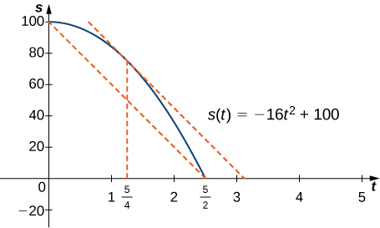
Mynd 4.28
Við tímann t=5/4 sec er hraði steinsins jafn meðalhraða hans frá því honum er sleppt þar til hann lendir á jörðinni.
Notes:
The function s(t) = −16t2 + 100 is graphed from (0, 100) to (5/2, 0). There is a secant line drawn from (0, 100) to (5/2, 0). At the point corresponding to t = 5/4, there is a tangent line that is drawn, and this line is parallel to the secant line.

Slide 37
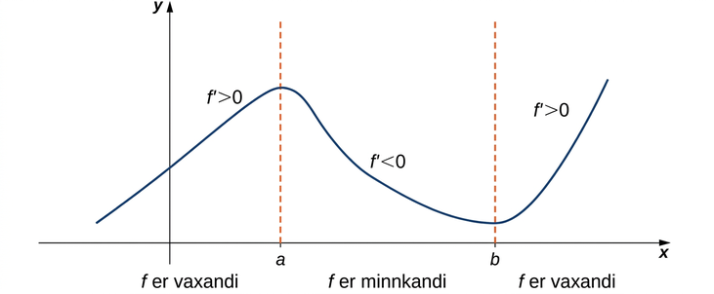
Mynd 4.29
Ef afleiða falls er jákvæð á bili I er fallið vaxandi á I; ef afleiðan er neikvæð á bili I er fallið minnkandi á I.
Notes:
A vaguely sinusoidal function f(x) is graphed. It increases from somewhere in the second quadrant to (a, f(a)). In this section it is noted that f’ > 0. Then in decreases from (a, f(a)) to (b, f(b)). In this section it is noted that f’ < 0. Finally, it increases to the right of (b, f(b)) and it is noted in this section that f’ > 0.

Slide 38
4.5 Afleiður og lögun grafs (1 af 3)
Námsmarkmið
Útskýra hvernig formerki fyrstu afleiðu hefur áhrif á lögun grafs falls.
Setja fram prófið með fyrstu afleiðu fyrir markpunkta.

Slide 39
4.5 Afleiður og lögun grafs (2 af 3)
Námsmarkmið
Nota sveigju og beygjuskil til að útskýra hvernig formerki annarrar afleiðu hefur áhrif á lögun grafs falls.
Útskýra sveigjuprófið fyrir fall á opnu bili.

Slide 40
4.5 Afleiður og lögun grafs (3 af 3)
Námsmarkmið
Útskýra samband falls við fyrstu og aðra afleiðu þess.
Setja fram prófið með annarri afleiðu fyrir staðbundin útgildi.

Slide 41
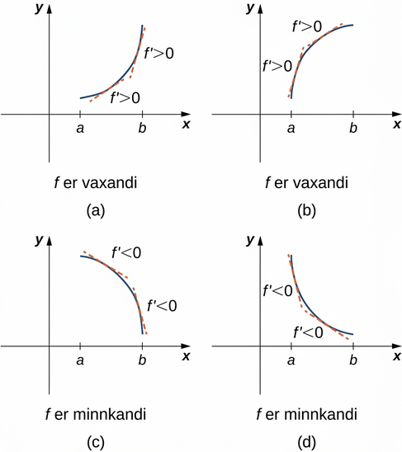
Mynd 4.30
Bæði föllin eru vaxandi á bilinu (a,b). Í sérhverjum punkti x er f′(x)>0. Bæði föllin eru minnkandi á bilinu (a,b). Í sérhverjum punkti x er f′(x)<0.
Notes:
This figure is broken into four figures labeled a, b, c, and d. Figure a shows a function increasing convexly from (a, f(a)) to (b, f(b)). At two points the derivative is taken and it is noted that at both f’ > 0. In other words, f is increasing. Figure b shows a function increasing concavely from (a, f(a)) to (b, f(b)). At two points the derivative is taken and it is noted that at both f’ > 0. In other words, f is increasing. Figure c shows a function decreasing concavely from (a, f(a)) to (b, f(b)). At two points the derivative is taken and it is noted that at both f’ < 0. In other words, f is decreasing. Figure d shows a function decreasing convexly from (a, f(a)) to (b, f(b)). At two points the derivative is taken and it is noted that at both f’ < 0. In other words, f is decreasing.

Slide 42
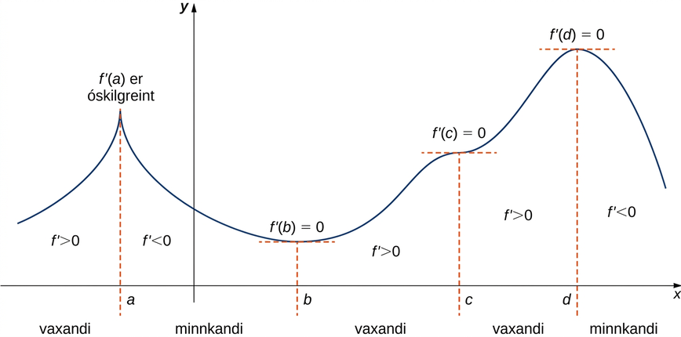
Mynd 4.31
Fallið f hefur fjóra markpunkta: a, b, c og d. Fallið f hefur staðbundin hágildi í a og d og staðbundið lággildi í b. Fallið f hefur ekki staðbundið útgildi í c. Formerki f′ breytist við öll staðbundin útgildi.
Notes:
A function f(x) is graphed. It starts in the second quadrant and increases to x = a, which is too sharp and hence f’(a) is undefined. In this section f’ > 0. Then, f decreases from x = a to x = b (so f’ < 0 here), before increasing at x = b. It is noted that f’(b) = 0. While increasing from x = b to x = c, f’ > 0. The function has an inversion point at c, and it is marked f’(c) = 0. The function increases some more to d (so f’ > 0), which is the global maximum. It is marked that f’(d) = 0. Then the function decreases and it is marked that f’ > 0.

Slide 43
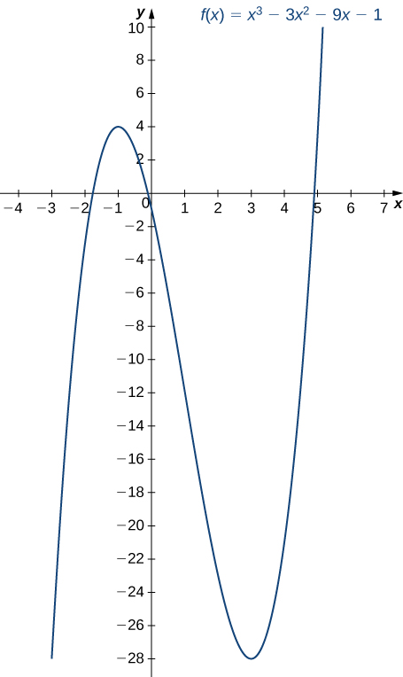
Mynd 4.32
Fallið f hefur hágildi við x=−1 og lággildi við x=3.
Notes:
The function f(x) = x3 – 3x2 – 9x – 1 is graphed. It has a maximum at x = −1 and a minimum at x = 3. The function is increasing before x = −1, decreasing until x = 3, and then increasing after that.

Slide 44
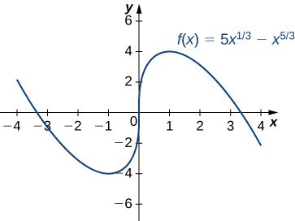
Mynd 4.33
Fallið f hefur staðbundið lággildi við x=−1 og staðbundið hágildi við x=1.
Notes:
The function f(x) = 5x1/3 – x5/3 is graphed. It decreases to its local minimum at x = −1, increases to x = 1, and then decreases after that.

Slide 45
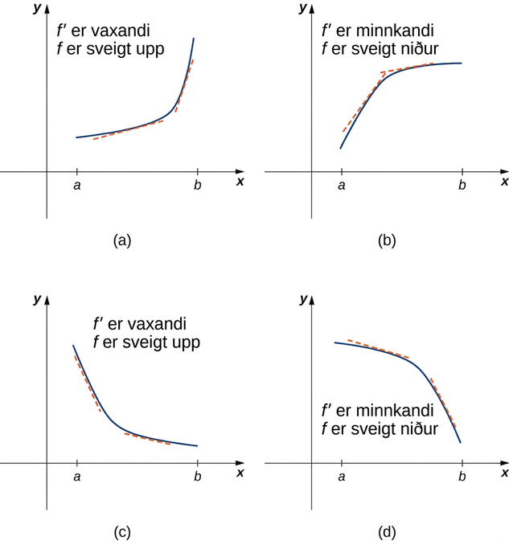
Mynd 4.34
(a), (c) Þar sem f′ er vaxandi á bilinu (a,b) segjum við að f sé sveigt upp á (a,b). (b), (d) Þar sem f′ er minnkandi á bilinu (a,b) segjum við að f sé sveigt niður á (a,b).
Notes:
This figure is broken into four figures labeled a, b, c, and d. Figure a shows a function increasing convexly from (a, f(a)) to (b, f(b)). At two points the derivative is taken and both are increasing, but the one taken further to the right is increasing more. It is noted that f’ is increasing and f is concave up. Figure b shows a function increasing concavely from (a, f(a)) to (b, f(b)). At two points the derivative is taken and both are increasing, but the one taken further to the right is increasing less. It is noted that f’ is decreasing and f is concave down. Figure c shows a function decreasing concavely from (a, f(a)) to (b, f(b)). At two points the derivative is taken and both are decreasing, but the one taken further to the right is decreasing less. It is noted that f’ is increasing and f is concave up. Figure d shows a function decreasing convexly from (a, f(a)) to (b, f(b)). At two points the derivative is taken and both are decreasing, but the one taken further to the right is decreasing more. It is noted that f’ is decreasing and f is concave down.

Slide 46
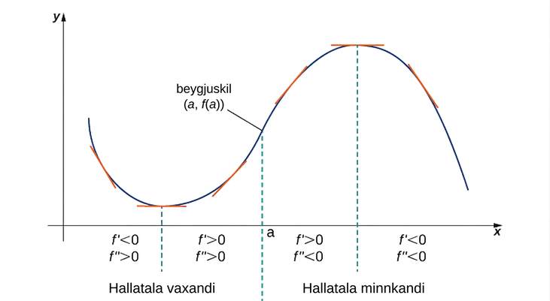
Mynd 4.35
Þar sem f″(x)>0 þegar x<a er fallið f sveigt upp á bilinu (−∞,a). Þar sem f″(x)<0 þegar x>a er fallið f sveigt niður á bilinu (a,∞). Punkturinn (a,f(a)) er beygjuskil fallsins f.
Notes:
A sinusoidal function is shown that has been shifted into the first quadrant. The function starts decreasing, so f’ < 0 and f’’ > 0. The function reaches the local minimum and starts increasing, so f’ > 0 and f’’ > 0. It is noted that the slope is increasing for these two intervals. The function then reaches an inflection point (a, f(a)) and from here the slop is decreasing even though the function continues to increase, so f’ > 0 and f’’ < 0. The function reaches the maximum and then starts decreasing, so f’ < 0 and f’’ < 0.

Slide 47
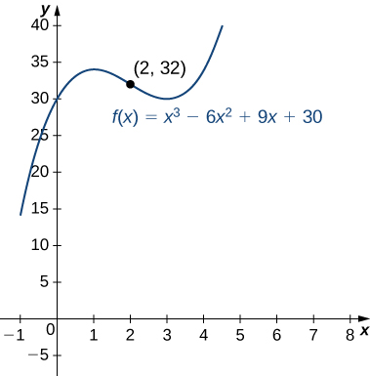
Mynd 4.36
Fallið hefur beygjuskilapunkt í (2,32), þar sem kúptni grafsins breytist.
Notes:
The function f(x) = x3 – 6x2 + 9x + 30 is graphed. The inflection point (2, 32) is marked, and it is roughly equidistant from the two local extrema.

Slide 48
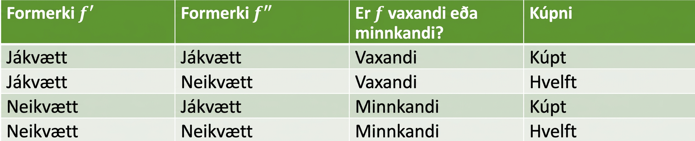
Tafla 4.1 Upplýsingar sem afleiður veita um gröf
Formerki $f′$ | Formerki $f^{″}$ | Er $f$ vaxandi eða minnkandi? | Kúptni
Jákvætt | Jákvætt | Vaxandi | Kúpt upp á við
Jákvætt | Neikvætt | Vaxandi | Kúpt niður á við
Neikvætt | Jákvætt | Minnkandi | Kúpt upp á við
Neikvætt | Neikvætt | Minnkandi | Kúpt niður á við

Slide 49
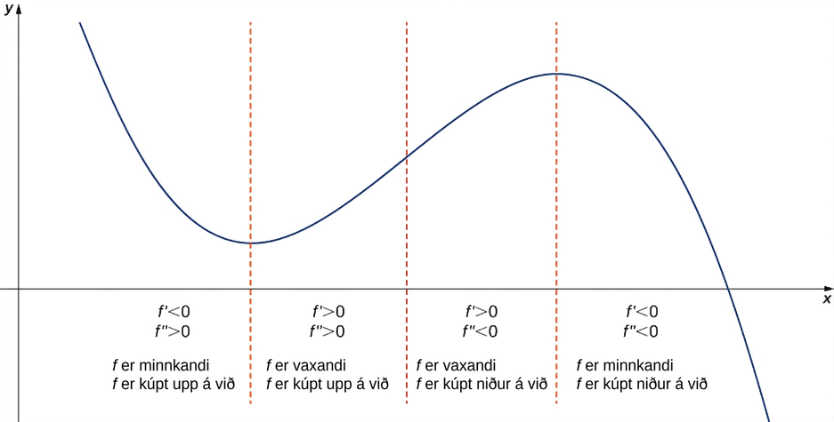
Mynd 4.37
Lítum á fall f sem er tvisvar deildanlegt á opnu bili I. Ef f′(x)>0 fyrir öll x∈I er fallið vaxandi á I. Ef f′(x)<0 fyrir öll x∈I er fallið minnkandi á I. Ef f″(x)>0 fyrir öll x∈I er fallið kúpt upp á við. Ef f″(x)<0 fyrir öll x∈I er fallið kúpt niður á við á I.
Notes:
A function is graphed in the first quadrant. It is broken up into four sections, with the breaks coming at the local minimum, inflection point, and local maximum, respectively. The first section is decreasing and concave up; here, f’ < 0 and f’’ > 0. The second section is increasing and concave up; here, f’ > 0 and f’’ > 0. The third section is increasing and concave down; here, f’ > 0 and f’’ < 0. The fourth section is increasing and concave down; here, f’ < 0 and f’’ < 0.

Slide 50
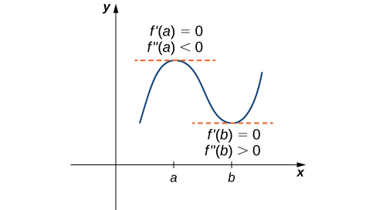
Mynd 4.38
Lítum á tvisvar deildanlegt fall f þannig að f″ sé samfellt. Þar sem f′(a)=0 og f″(a)<0 er til bil I sem inniheldur a og þannig að fyrir öll x í I er f vaxandi þegar x<a en minnkandi þegar x>a. Því hefur f staðbundið hágildi við x=a. Þar sem f′(b)=0 og f″(b)>0 er til bil I sem inniheldur b og þannig að fyrir öll x í I er f minnkandi þegar x<b en vaxandi þegar x>b. Því hefur f staðbundið lággildi við x=b.
Notes:
A function f(x) is graphed in the first quadrant with a and b marked on the x-axis. The function is vaguely sinusoidal, increasing first to x = a, then decreasing to x = b, and increasing again. At (a, f(a)), the tangent is marked, and it is noted that f’(a) = 0 and f’’(a) < 0. At (b, f(b)), the tangent is marked, and it is noted f’(b) = 0 and f’’(b) > 0.

Slide 51
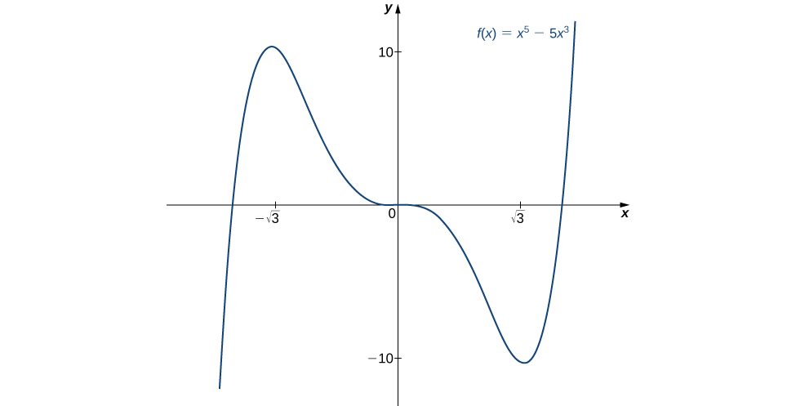
Mynd 4.39
Fallið f hefur staðbundið hágildi við x=−3 og staðbundið lággildi við x=3
Notes:
The function f(x) = x5 – 5x3 is graphed. The function increases to (negative square root of 3, 10), then decreases to an inflection point at 0, continues decreasing to (square root of 3, −10), and then increases.

Slide 52
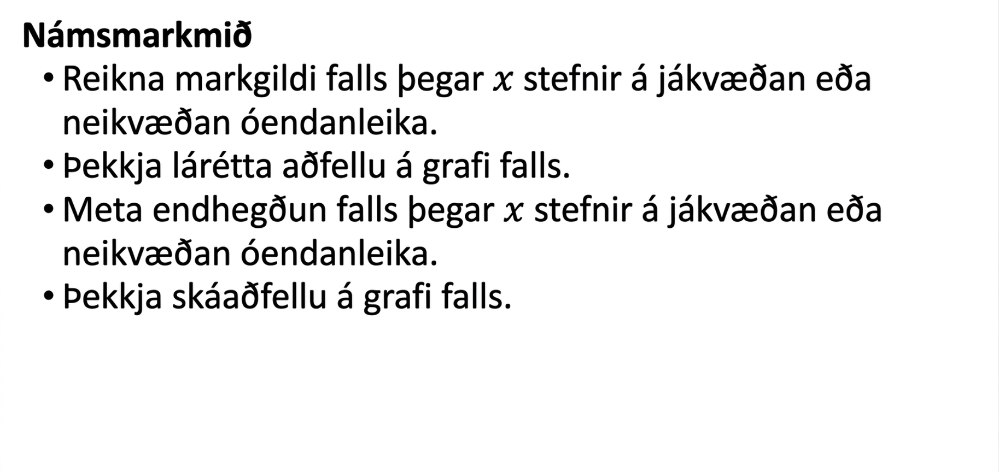
4.6 Markgildi þegar x stefnir á óendanlegt og aðfellur (1 af 2)
Námsmarkmið
Reikna markgildi falls þegar $x$ stefnir á jákvæðan eða neikvæðan óendanleika.
Þekkja lárétta aðfellu á grafi falls.
Meta endhegðun falls þegar $x$ stefnir á jákvæðan eða neikvæðan óendanleika.
Þekkja skáaðfellu á grafi falls.

Slide 53
4.6 Markgildi þegar x stefnir á óendanlegt og aðfellur (2 af 2)
Námsmarkmið
Greina fall og afleiður þess til að teikna graf fallsins.

Slide 54
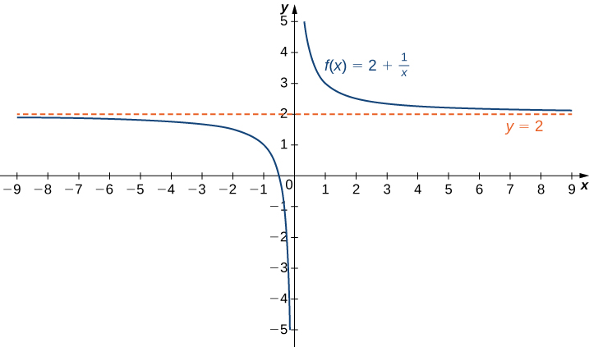
Mynd 4.40
Fallið nálgast aðfelluna y=2 þegar x stefnir á ±∞.
Notes:
The function f(x) 2 + 1/x is graphed. The function starts negative near y = 2 but then decreases to −∞ near x = 0. The function then decreases from ∞ near x = 0 and gets nearer to y = 2 as x increases. There is a horizontal line denoting the asymptote y = 2.

Slide 55
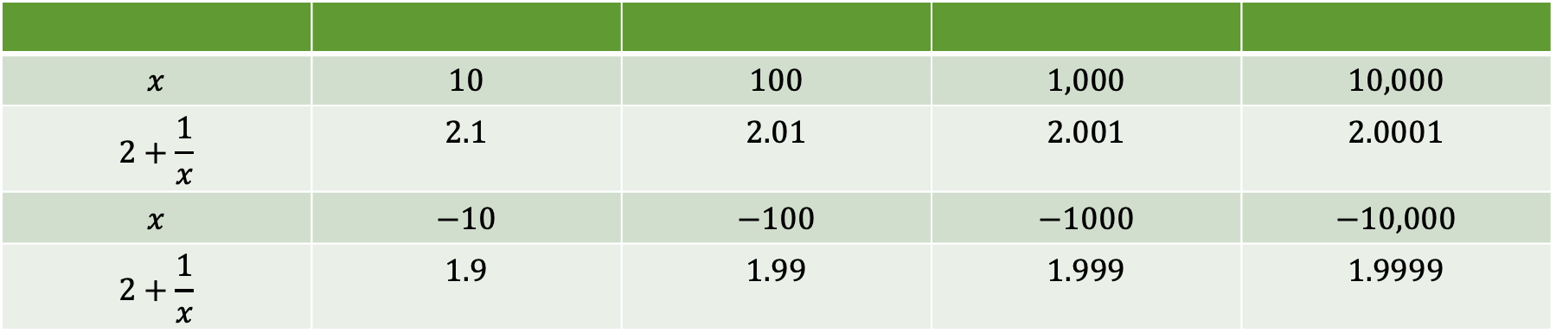
Tafla 4.2 Gildi falls $f$ þegar $x→\text{±}∞$
$$x$$ | $$10$$ | $$100$$ | $$1,000$$ | $$10,000$$
$$2+\frac{1}{x}$$ | $$2.1$$ | $$2.01$$ | $$2.001$$ | $$2.0001$$
$$x$$ | $$−10$$ | $$−100$$ | $$−1000$$ | $$−10,000$$
$$2+\frac{1}{x}$$ | $$1.9$$ | $$1.99$$ | $$1.999$$ | $$1.9999$$

Slide 56
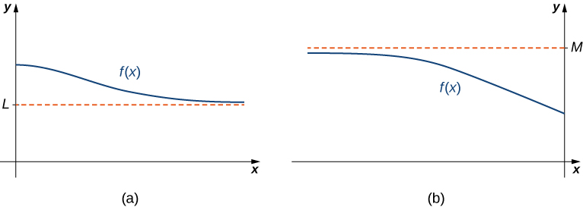
Mynd 4.41
(a) Þegar x→∞ komast gildi f eins nálægt L og vera skal. Línan y=L er lárétt aðfella fallsins f. (b) Þegar x→−∞ komast gildi f eins nálægt M og vera skal. Línan y=M er lárétt aðfella fallsins f.
Notes:
The figure is broken up into two figures labeled a and b. Figure a shows a function f(x) approaching but never touching a horizontal dashed line labeled L from above. Figure b shows a function f(x) approaching but never a horizontal dashed line labeled M from below.

Slide 57
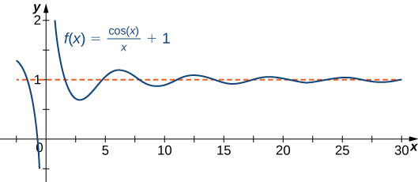
Mynd 4.42
Graf fallsins f(x)=cos(x)/x+1 sker láréttu aðfelluna y=1 óendanlega oft.
Notes:
The function f(x) = (cos x)/x + 1 is shown. It decreases from (0, ∞) and then proceeds to oscillate around y = 1 with decreasing amplitude.

Slide 58
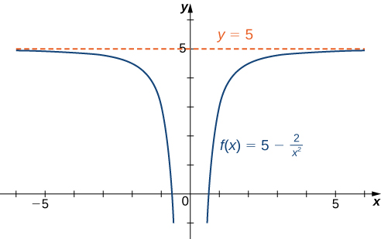
Mynd 4.43
Fallið nálgast lárétta aðfellu þegar x→±∞.
Notes:
The function f(x) = 5 – 2/x2 is graphed. The function approaches the horizontal asymptote y = 5 as x approaches ±∞.

Slide 59
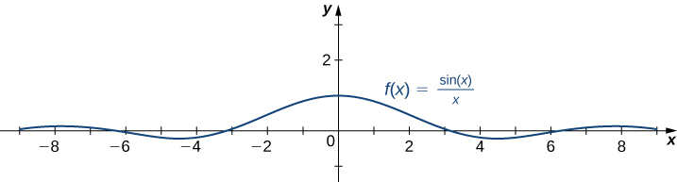
Mynd 4.44
Fallið sker láréttu aðfelluna margsinnis.
Notes:
The function f(x) = (sin x)/x is shown. It has a global maximum at (0, 1) and then proceeds to oscillate around y = 0 with decreasing amplitude.

Slide 60
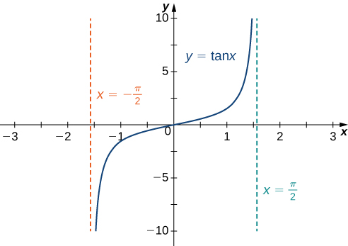
Mynd 4.45
Graf fallsins tan x hefur lóðréttar aðfellur við x=±π/2.
Notes:
The function f(x) = tan x is shown. It increases from (−π/2, −∞), passes through the origin, and then increases toward (π/2, ∞). There are vertical dashed lines marking x = ±π/2.

Slide 61
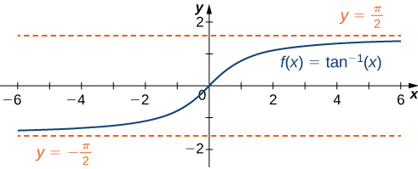
Mynd 4.46
Fallið hefur tvær láréttar aðfellur.
Notes:
The function f(x) = tan−1 x is shown. It increases from (−∞, −π/2), passes through the origin, and then increases toward (∞, π/2). There are horizontal dashed lines marking y = ±π/2.

Slide 62
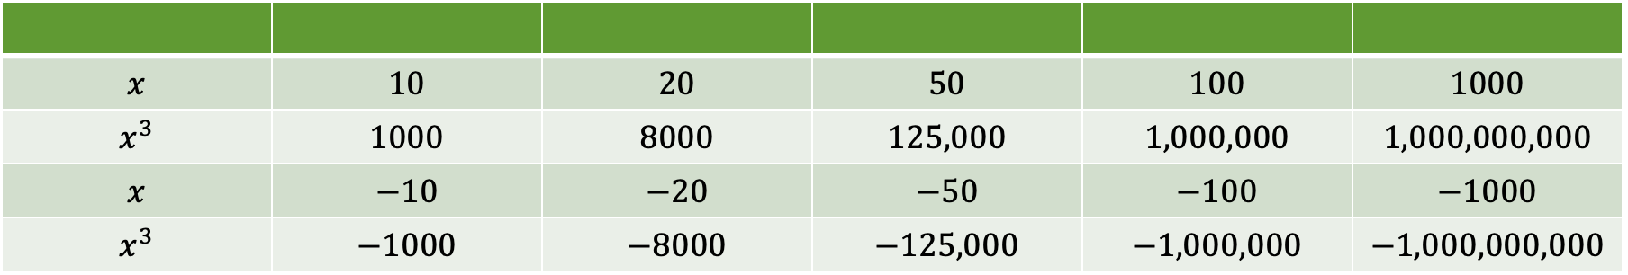
Tafla 4.3 Gildi veldisfalls þegar $x→\text{±}∞$
$$x$$ | $$10$$ | $$20$$ | $$50$$ | $$100$$ | $$1000$$
$$x^{3}$$ | $$1000$$ | $$8000$$ | $$125,000$$ | $$1,000,000$$ | $$1,000,000,000$$
$$x$$ | $$−10$$ | $$−20$$ | $$−50$$ | $$−100$$ | $$−1000$$
$$x^{3}$$ | $$−1000$$ | $$−8000$$ | $$−125,000$$ | $$−1,000,000$$ | $$−1,000,000,000$$

Slide 63

Mynd 4.47
Fyrir þetta fall stefna fallgildin á óendanlegt þegar x→±∞.
Notes:
The function f(x) = x3 is graphed. It is apparent that this function rapidly approaches infinity as x approaches infinity.

Slide 64

Mynd 4.48
Ef fall hefur markgildi í óendanleika gildir |f(x)−L|<ε fyrir öll x>N.
Notes:
The function f(x) is graphed, and it has a horizontal asymptote at L. L is marked on the y axis, as is L + ॉ and L – ॉ. On the x axis, N is marked as the value of x such that f(x) = L + ॉ.

Slide 65

Mynd 4.49
Ef fall hefur óendanlegt markgildi í óendanleika gildir f(x)>M fyrir öll x>N.
Notes:
The function f(x) is graphed. It continues to increase rapidly after x = N, and f(N) = M.

Slide 66

Mynd 4.50
Fyrir veldisföll með sléttan veldisvísi n gildir lim(x→∞) xⁿ = lim(x→−∞) xⁿ = ∞.
Notes:
The functions x2, x4, and x6 are graphed, and it is apparent that as the exponent grows the functions increase more quickly.

Slide 67

Mynd 4.51
Fyrir veldisföll með oddatölu sem veldisvísi n gildir lim(x→∞) xⁿ = ∞ og lim(x→−∞) xⁿ = −∞.
Notes:
The functions x, x3, and x5 are graphed, and it is apparent that as the exponent grows the functions increase more quickly.

Slide 68

Mynd 4.52
Endahegðun margliðu ræðst af hegðun liðarins með hæsta veldið.
Notes:
Both functions f(x) = 5x3 – 3x2 + 4 and g(x) = 5x3 are plotted. Their behavior for large positive and large negative numbers converges.

Slide 69

Tafla 4.4 Endahegðun margliðu ræðst af liðnum með hæsta veldið.
$$x$$ | $$10$$ | $$100$$ | $$1000$$
$$f\left(x\right)=5x^{3}−3x^{2}+4$$ | $$4704$$ | $$4,970,004$$ | $$4,997,000,004$$
$$g\left(x\right)=5x^{3}$$ | $$5000$$ | $$5,000,000$$ | $$5,000,000,000$$
$$x$$ | $$−10$$ | $$−100$$ | $$−1000$$
$$f\left(x\right)=5x^{3}−3x^{2}+4$$ | $$−5296$$ | $$−5,029,996$$ | $$−5,002,999,996$$
$$g\left(x\right)=5x^{3}$$ | $$−5000$$ | $$−5,000,000$$ | $$−5,000,000,000$$

Slide 70

Mynd 4.53
Graf fallsins nálgast lárétta aðfellu þegar x→±∞.
Notes:
The function f(x) = (3x - 1)/(2x + 5) is plotted as is its horizontal asymptote at y = 3/2.

Slide 71

Mynd 4.54
Graf fallsins nálgast láréttu aðfelluna y=0 þegar x→±∞.
Notes:
The function f(x) = (3x2 + 2x)/(4x2 – 5x + 7) is plotted as is its horizontal asymptote at y = 0.

Slide 72

Mynd 4.55
Þegar x→∞ gildir f(x)→∞. Þegar x→−∞ gildir f(x)→−∞.
Notes:
The function f(x) = (3x2 + 4x)/(x + 2) is plotted. It appears to have a diagonal asymptote as well as a vertical asymptote at x = −2.

Slide 73

Mynd 4.56
Graf fallsins f(x)=(3x²+4x)/(x+2) nálgast skáaðfelluna y=3x−2 þegar x→±∞.
Notes:
The function f(x) = (3x2 + 4x)/(x + 2) is plotted as is its diagonal asymptote y = 3x – 2.

Slide 74

Mynd 4.57
Þetta fall hefur tvær láréttar aðfellur og graf þess sker aðra þeirra.
Notes:
The function f(x) = (3x − 2)/(the square root of the quantity (4x2 + 5)) is plotted. It has two horizontal asymptotes at y = ±3/2, and it crosses y = −3/2 before converging toward it from below.

Slide 75

Mynd 4.58
Fallið f(x)=sin x sveiflast milli −1 og 1 þegar x→±∞.
Notes:
The function f(x) = sin x is graphed.

Slide 76

Mynd 4.59
Fallið f(x)=tan x stefnir hvorki á endanlegt markgildi né á ±∞ þegar x→±∞.
Notes:
The function f(x) = tan x is graphed.

Slide 77

Tafla 4.5 Endahegðun náttúrulega vísisfallsins
$$x$$ | $$−5$$ | $$−2$$ | $$0$$ | $$2$$ | $$5$$
$$e^{x}$$ | $$0.00674$$ | $$0.135$$ | $$1$$ | $$7.389$$ | $$148.413$$

Slide 78

Mynd 4.60
Vísisfallið stefnir á núll þegar x→−∞ og á ∞ þegar x→∞.
Notes:
The function f(x) = ex is graphed.

Slide 79

Tafla 4.6 Endahegðun náttúrulega lografallsins
$$x$$ | $$0.01$$ | $$0.1$$ | $$1$$ | $$10$$ | $$100$$
$$\text{ln}\left(x\right)$$ | $$−4.605$$ | $$−2.303$$ | $$0$$ | $$2.303$$ | $$4.605$$

Slide 80

Mynd 4.61
Náttúrulega lografallið stefnir á ∞ þegar x→∞.
Notes:
The function f(x) = ln(x) is graphed.

Slide 81
4.7 Hagnýt bestunarverkefni
Námsmarkmið
Setja upp og leysa bestunarverkefni á ýmsum hagnýtum sviðum.

Slide 82

Mynd 4.62
Við viljum ákvarða málin x og y þannig að 100 ft af girðingu afmarki garð með stærsta mögulega flatarmáli.
Notes:
A drawing of a garden has x and y written on the vertical and horizontal sides, respectively. There is a rock wall running along the entire bottom horizontal length of the drawing.

Slide 83

Mynd 4.63
Til að hámarka flatarmál garðsins þurfum við að finna hágildi fallsins A(x)=100x−2x².
Notes:
The function A(x) = 100x – 2x is graphed. At its maximum there is an intersection of two dashed lines and text that reads “Maximum area is 1250 square feet when x = 25 feet.”

Slide 84

Mynd 4.64
Ferningur með hliðarlengdina x tommur er skorinn úr hverju horni pappaspjaldsins. Fliparnir sem eftir standa eru brotnir upp og mynda opinn kassa.
Notes:
There are two figures for this figure. The first one is a rectangle with sides 24 in and 36 in, with each corner having a square of side length x taken out of it. In the second picture, there is a box with side lengths x in, 24 – 2x in, and 36 – 2x in.

Slide 85

Mynd 4.65
Til að hámarka rúmmál kassans þarf að finna hágildi þriðja stigs margliðu.
Notes:
The function V(x) = 4x3 – 120x2 + 864x is graphed. At its maximum there is an intersection of two dashed lines and text that reads “Maximum volume is approximately 1825 cubic inches when x ≈ 4.7 inches.”

Slide 86

Mynd 4.66
Hvernig veljum við x og y þannig að ferðatíminn frá kofanum til eyjarinnar verði sem stystur?
Notes:
The cabin is x miles from the shore. From that point on the shore, the island is y miles away. If you were to continue the line from the cabin to the shore (the x miles one) and if you were to draw a line from the island parallel to the shore, then the lines would extend 2 miles from the island and 6 miles from the cabin before intersecting.

Slide 87

Mynd 4.67
Til að hámarka tekjurnar þarf bílaleiga að vega leiguverðið á móti fjölda bíla sem verða leigðir á því verði.
Notes:
The function R(p) is graphed. At its maximum there is an intersection of two dashed lines and text that reads “Maximum revenue is $50,000 per day when the price charged per car is $100 per day.”

Slide 88

Mynd 4.68
Við viljum hámarka flatarmál rétthyrnings sem er innritaður í sporbaug.
Notes:
The ellipse x2/4 + y2 = 1 is drawn with its x intercepts being ±2 and its y intercepts being ±1. There is a rectangle inscribed in the ellipse with length L (in the x-direction) and width W.

Slide 89

Mynd 4.69
Við viljum lágmarka yfirborðsflatarmál kassa með ferningslaga botn og gefið rúmmál.
Notes:
A box with square base is shown. The base has side length x, and the height is y.

Slide 90

Mynd 4.70
Nota má graf til að ákvarða stærðir kassa með gefið rúmmál og minnsta yfirborðsflatarmál.
Notes:
The function S(x) = 864/x + x2 is graphed. At its minimum there is a dashed line and text that reads “Minimum surface area is 108 times the cube root of 4 square inches when x = 6 times the cube root of 2 inches.”

Slide 91
4.8 Regla l’Hôpital
Námsmarkmið
Greina hvenær beita á reglu l’Hôpital.
Greina óákveðin form sem koma fram í kvótum, margfeldum, mismunum og veldum og beita reglu l’Hôpital í hverju tilviki.
Lýsa innbyrðis vaxtarhraða falla.

Slide 92

Mynd 4.71
Ef lim(x→a) f(x)=lim(x→a) g(x), þá er hlutfallið f(x)/g(x) um það bil jafnt hlutfalli línulegra nálgana fallanna nálægt a.
Notes:
Two functions y = f(x) and y = g(x) are drawn such that they cross at a point above x = a. The linear approximations of these two functions y = f(a) + f’(a)(x – a) and y = g(a) + g’(a)(x – a) are also drawn.

Slide 93

Mynd 4.72
Markgildi fallsins f(x)=x ln x þegar x→0 fundið.
Notes:
The function y = x ln(x) is graphed for values x ≥ 0. At x = 0, the value of the function is 0.

Slide 94

Tafla 4.7 Samanburður á vaxtarhraða $x^{2}$ og $x^{3}$
$$x$$ | $$10$$ | $$100$$ | $$1000$$ | $$10,000$$
$$f\left(x\right)=x^{2}$$ | $$100$$ | $$10,000$$ | $$1,000,000$$ | $$100,000,000$$
$$g\left(x\right)=x^{3}$$ | $$1000$$ | $$1,000,000$$ | $$1,000,000,000$$ | $$1,000,000,000,000$$

Slide 95

Tafla 4.8 Samanburður á vaxtarhraða $x^{2}$ og $3x^{2}+4x+1$
$$x$$ | $$10$$ | $$100$$ | $$1000$$ | $$10,000$$
$$f\left(x\right)=x^{2}$$ | $$100$$ | $$10,000$$ | $$1,000,000$$ | $$100,000,000$$
$$g\left(x\right)=3x^{2}+4x+1$$ | $$341$$ | $$30,401$$ | $$3,004,001$$ | $$300,040,001$$

Slide 96

Mynd 4.73
Vísisfall vex hraðar en veldisfall.
Notes:
The functions g(x) = ex and f(x) = x2 are graphed. It is obvious that g(x) increases much more quickly than f(x).

Slide 97

Tafla 4.9 Vaxtarhraði veldisfalls og vísisfalls
$$x$$ | $$5$$ | $$10$$ | $$15$$ | $$20$$
$$x^{2}$$ | $$25$$ | $$100$$ | $$225$$ | $$400$$
$$e^{x}$$ | $$148$$ | $$22,026$$ | $$3,269,017$$ | $$485,165,195$$

Slide 98

Mynd 4.74
Veldisfall vex hraðar en lografall.
Notes:
The functions g(x) = x2 and f(x) = ln(x) are graphed. It is obvious that g(x) increases much more quickly than f(x).

Slide 99

Tafla 4.10 Vaxtarhraði veldisfalls og lografalls
$$x$$ | $$10$$ | $$100$$ | $$1000$$ | $$10,000$$
$$\text{ln}\left(x\right)$$ | $$2.303$$ | $$4.605$$ | $$6.908$$ | $$9.210$$
$$x^{2}$$ | $$100$$ | $$10,000$$ | $$1,000,000$$ | $$100,000,000$$

Slide 100

Mynd 4.75
Vísisfallið eˣ vex hraðar en xᵖ fyrir sérhvert p>0. (a) Samanburður á eˣ og x³. (b) Samanburður á eˣ og x⁴.
Notes:
This figure has two figures marked a and b. In figure a, the functions y = ex and y = x3 are graphed. It is obvious that ex increases more quickly than x3. In figure b, the functions y = ex and y = x4 are graphed. It is obvious that ex increases much more quickly than x4, but the point at which that happens is further to the right than it was for x3.

Slide 101

Tafla 4.11 Vísisfall vex hraðar en sérhvert veldisfall
$$x$$ | $$5$$ | $$10$$ | $$15$$ | $$20$$
$$x^{3}$$ | $$125$$ | $$1000$$ | $$3375$$ | $$8000$$
$$x^{4}$$ | $$625$$ | $$10,000$$ | $$50,625$$ | $$160,000$$
$$e^{x}$$ | $$148$$ | $$22,026$$ | $$3,269,017$$ | $$485,165,195$$

Slide 102

Mynd 4.76
Fallið y=ln x vex hægar en xᵖ fyrir sérhvert p>0 þegar x→∞.
Notes:
This figure shows y = the square root of x, y = the cube root of x, and y = ln(x). It is apparent that y = ln(x) grows more slowly than either of these functions.

Slide 103

Tafla 4.12 Lografall vex hægar en sérhvert rótarfall
$$x$$ | $$10$$ | $$100$$ | $$1000$$ | $$10,000$$
$$\text{ln}\left(x\right)$$ | $$2.303$$ | $$4.605$$ | $$6.908$$ | $$9.210$$
$$\sqrt[3]{x}$$ | $$2.154$$ | $$4.642$$ | $$10$$ | $$21.544$$
$$\sqrt{x}$$ | $$3.162$$ | $$10$$ | $$31.623$$ | $$100$$

Slide 104
4.9 Aðferð Newtons
Námsmarkmið
Lýsa skrefum aðferðar Newtons.
Útskýra hvað ítrekunarferli felur í sér.
Greina hvenær aðferð Newtons virkar ekki.
Beita ítrekunarferlum við ýmsar aðstæður.

Slide 105

Mynd 4.77
Nálganirnar x₀,x₁,x₂,… stefna á rótina x*. Þær fást með því að skoða snertla við graf fallsins f.
Notes:
This function f(x) is drawn with points (x0, f(x0)), (x1, f(x1)), and (x2, f(x2)) marked on the function. From (x0, f(x0)), a tangent line is drawn, and it strikes the x axis at x1. From (x0, f(x0)), a tangent line is drawn, and it strikes the x axis at x2. If a tangent line were drawn from (x2, f(x2)), it appears that it would come very close to x*, which is the actual root. Each tangent line drawn in this order appears to get closer and closer to x*.

Slide 106

Mynd 4.78
Fallið f(x)=x³−3x+1 hefur eina rót á bilinu [1,2].
Notes:
The function f(x) = x3 – 3x + 1 is drawn. It has roots between −2 and −1, 0 and 1, and 1 and 2.

Slide 107

Mynd 4.79
Við getum notað aðferð Newtons til að finna √2.
Notes:
The function y = x2 – 2 is drawn. A dashed line comes up from x0 = 2, and a tangent line is drawn down from there. It touches x1 = 1.5, which is near x* = the square root of 2.

Slide 108

Mynd 4.80
Ef upphafsgildið x₀ er of langt frá rótinni sem leitað er að geta nálganirnar stefnt á aðra rót.
Notes:
A function is drawn with two roots, labeled root sought and root found. A point x0 is chosen such that when the tangent of x0 is taken, even though it is nearer to the root sought, the tangent points to the root found.

Slide 109

Mynd 4.81
Nálganirnar halda áfram að skiptast á milli 0 og 1 og stefna aldrei á rót fallsins f.
Notes:
The function f(x) = x3 – 2x + 2 is drawn, which has a root between −2 and −1. The tangent from x = 0 goes to x = 1, and the tangent from x = 1 goes to x = 0.

Slide 110

Mynd 4.82
Þetta ítrekunarferli stefnir á gildið x*=8.
Notes:
The function F(x) = (1/2)x + 4 is graphed along with y = x. From x0, which appears to be at the origin, a line is drawn to the function F(x) at x1 = F(x0). Then a line is drawn to the right from here to the line y = x, at which point a line is drawn up to x2 = F(x1). Then a line is drawn to the right from here to the line y = x, at which point a line is drawn up to x3 = F(x2). Continuing this process would converge on the two lines’ intersection point at x* = 8.

Slide 111

Mynd 4.83
Mandelbrot-mengið er þekkt dæmi um punktamengi sem myndast við ítrekaða óreiðukennda hegðun tiltölulega einfalds falls.
Notes:
A very complicated and organic looking fractal.

Slide 112

Mynd 4.84
Hér er sýnt köngulóarvefsrit fyrir f(x)=3,55x(1−x). Gildarunan myndar 8-lotu.
Notes:
In the first quadrant, f(x) = 3.55x(1 – x) is graphed as is y = x. From some point on the x axis, a line is drawn up to the line y = x, at which point it turns to be horizontal and continues until it touches the outside edge of f(x), at which point it turns again to be vertical until it each the line y = x. This process continues a number of times and creates an interesting series of boxes.

Slide 113
4.10 Stofnföll
Námsmarkmið
Finna almennt stofnfall gefins falls.
Útskýra hugtök og rithátt óákveðins heildis.
Setjið fram veldisregluna fyrir heildun.
Notið stofnföll til að leysa einföld upphafsgildisverkefni.

Slide 114

Mynd 4.85
Stofnföllin fyrir 2x eru öll föll af gerðinni x²+C, þar sem C er hvaða rauntala sem er.
Notes:
The graphs for y = x2 + 2, y = x2 + 1, y = x2, y = x2 − 1, and y = x2 − 2 are shown.

Slide 115

Tafla 4.13 Heildunarformúlur
Notes:
Table 4.13 Integration Formulas; Columns: Differentiation Formula, Indefinite Integral; Row 1: ddx(k)=0, ∫kdx=∫kx0dx=kx+C; Row 2: ddx(xn)=nxn−1, ∫xndx=xn+1n+1+C for n≠−1; Row 3: ddx(ln|x|)=1x, ∫1xdx=ln|x|+C; Row 4: ddx(ex)=ex, ∫exdx=ex+C; Row 5: ddx(sinx)=cosx, ∫cosxdx=sinx+C; Row 6: ddx(cosx)=−sinx, ∫sinxdx=−cosx+C; Row 7: ddx(tanx)=sec2x, ∫sec2xdx=tanx+C; Row 8: ddx(cscx)=−cscxcotx, ∫cscxcotxdx=−cscx+C; Row 9: ddx(secx)=secxtanx, ∫secxtanxdx=secx+C; Row 10: ddx(cotx)=−csc2x, ∫csc2xdx=−cotx+C; Row 11: ddx(sin−1x)=11−x2, ∫11−x2dx=sin−1x+C; Row 12: ddx(tan−1x)=11+x2, ∫11+x2dx=tan−1x+C; Row 13: ddx(sec−1x)=1xx2−1, ∫1xx2−1dx=sec−1x+C

Slide 116

Mynd 4.86
Nokkrir lausnarferlar deildajöfnunnar dy/dx=6x² eru sýndir. Fallið y=2x³+3 uppfyllir deildajöfnuna og upphafsskilyrðið y(1)=5.
Notes:
The graphs for y = 2x3 + 6, y = 2x3 + 3, y = 2x3, and y = 2x3 − 3 are shown.

Slide 117
Notkunarleyfi
Þetta viðbótarefni frá OpenStax er © Rice University og gefið út samkvæmt alþjóðlega notkunarleyfinu CC BY-NC-SA 4.0. Aðeins er heimilt að afrita eða breyta efninu í tilgangi sem ekki er viðskiptalegs eðlis, enda sé OpenStax og Rice University getið sem rétthafa og allar breytingar tilgreindar. Öllum aðlögunum skal miðla samkvæmt sams konar notkunarleyfi.

