Slide 1

Stærðfræðigreining, 1. bindi
3. kafli: Afleiður

Slide 2
Yfirlit kaflans
Skilgreining afleiðunnar
Afleiðan sem fall
Deildunarreglur
Afleiður sem breytingarhraðar
Afleiður hornafalla
Keðjureglan
Afleiður andhverfra falla
Fólgin deildun
Afleiður vísis- og lografalla

Slide 3
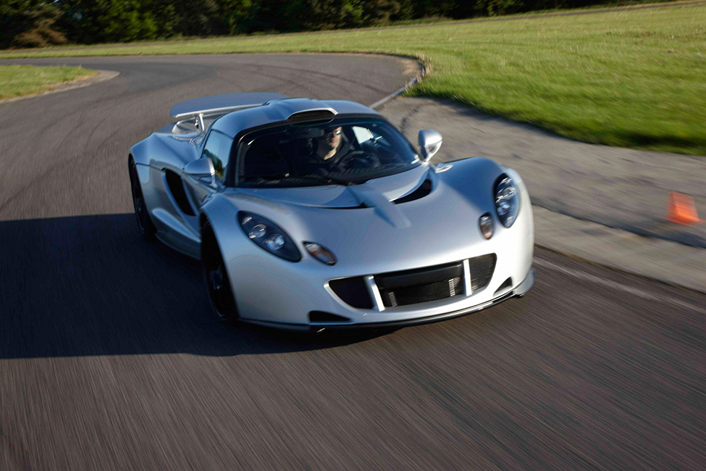
Mynd 3.1
Hennessey Venom GT kemst úr 0 í 200 mph á 14,51 sekúndu. (mynd: breytt útgáfa af verki Codex41, Flickr)
Notes:
A photo of a Hennessey Venom GT sports car speeding along a winding road.

Slide 4
3.1 Skilgreining afleiðunnar (1 af 2)
Námsmarkmið
Skilja merkingu snertils við feril í punkti.
Reikna hallatölu snertils.
Skilgreina afleiðuna sem markgildi mismunakvóta.
Reikna afleiðu gefins falls í punkti.
Lýsa hraða sem breytingarhraða.

Slide 5
3.1 Skilgreining afleiðunnar (2 af 2)
Námsmarkmið
Útskýra muninn á meðalhraða og augnablikshraða.
Áætla afleiðuna út frá gildistöflu.

Slide 6
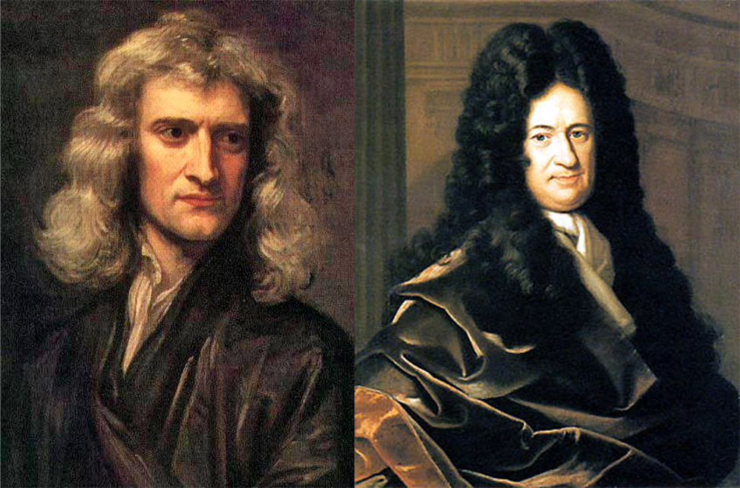
Mynd 3.2
Newton og Leibniz eru taldir hafa þróað stærðfræðigreiningu hvor í sínu lagi.
Notes:
Photos of Newton and Leibniz.

Slide 7
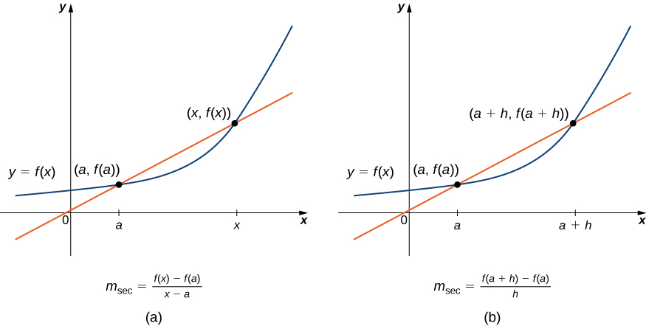
Mynd 3.3
Reikna má hallatölu sniðils á tvo vegu.
Notes:
This figure consists of two graphs labeled a and b. Figure a shows the Cartesian coordinate plane with 0, a, and x marked on the x-axis. There is a curve labeled y = f(x) with points marked (a, f(a)) and (x, f(x)). There is also a straight line that crosses these two points (a, f(a)) and (x, f(x)). At the bottom of the graph, the equation msec = (f(x) - f(a))/(x - a) is given. Figure b shows a similar graph, but this time a + h is marked on the x-axis instead of x. Consequently, the curve labeled y = f(x) passes through (a, f(a)) and (a + h, f(a + h)) as does the straight line. At the bottom of the graph, the equation msec = (f(a + h) - f(a))/h is given.

Slide 8
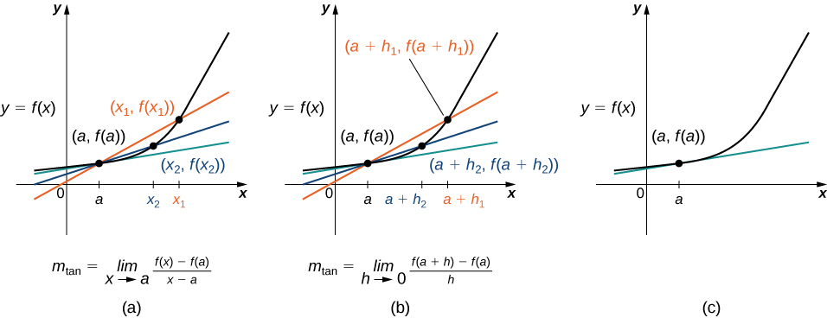
Mynd 3.4
Sniðlarnir nálgast snertilinn (sýndan með grænu) þegar síðari punkturinn nálgast þann fyrri.
Notes:
This figure consists of three graphs labeled a, b, and c. Figure a shows the Cartesian coordinate plane with 0, a, x2, and x1 marked in order on the x-axis. There is a curve labeled y = f(x) with points marked (a, f(a)), (x2, f(x2)), and (x1, f(x1)). There are three straight lines: the first crosses (a, f(a)) and (x1, f(x1)); the second crosses (a, f(a)) and (x2, f(x2)); and the third only touches (a, f(a)), making it the tangent. At the bottom of the graph, the equation mtan = limx → a (f(x) - f(a))/(x - a) is given. Figure b shows a similar graph, but this time a + h2 and a + h1 are marked on the x-axis instead of x2 and x1. Consequently, the curve labeled y = f(x) passes through (a, f(a)), (a + h2, f(a + h2)), and (a + h1, f(a + h1)) and the straight lines similarly cross the graph as in Figure a. At the bottom of the graph, the equation mtan = limh → 0 (f(a + h) - f(a))/h is given. Figure c shows only the curve labeled y = f(x) and its tangent at point (a, f(a)).

Slide 9
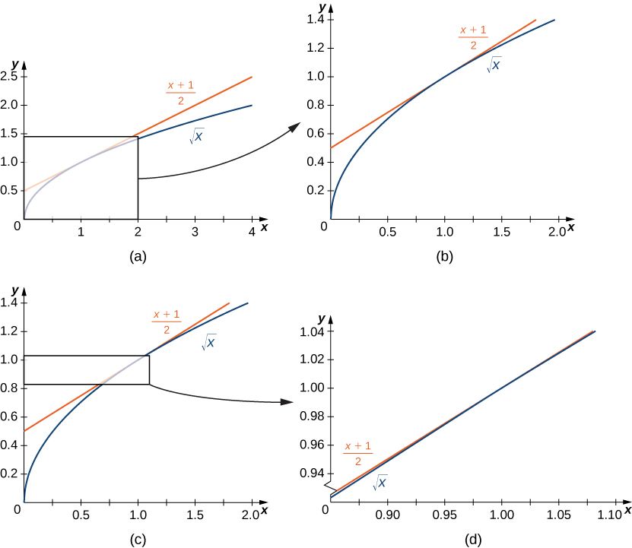
Mynd 3.5
Þegar x er nálægt 1 virðast graf fallsins f(x)=√x og snertill þess falla saman.
Notes:
This figure consists of four graphs labeled a, b, c, and d. Figure a shows the graphs of the square root of x and the equation y = (x + 1)/2 with the x-axis going from 0 to 4 and the y-axis going from 0 to 2.5. The graphs of these two functions look very close near 1; there is a box around where these graphs look close. Figure b shows a close up of these same two functions in the area of the box from Figure a, specifically x going from 0 to 2 and y going from 0 to 1.4. Figure c is the same graph as Figure b, but this one has a box from 0 to 1.1 in the x coordinate and 0.8 and 1 on the y coordinate. There is an arrow indicating that this is blown up in Figure d. Figure d shows a very close picture of the box from Figure c, and the two functions appear to be touching for almost the entire length of the graph.

Slide 10
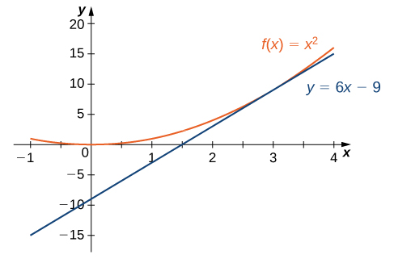
Mynd 3.6
Snertill við f(x) þar sem x=3.
Notes:
This figure consists of the graphs of f(x) = x squared and y = 6x - 9. The graphs of these functions appear to touch at x = 3.

Slide 11
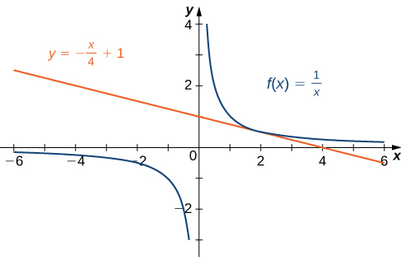
Mynd 3.7
Línan er snertill við f(x) þar sem x=2.
Notes:
This figure consists of the graphs of f(x) = 1/x and y = -x/4 + 1. The part of the graph f(x) = 1/x in the first quadrant appears to touch the other function’s graph at x = 2.

Slide 12
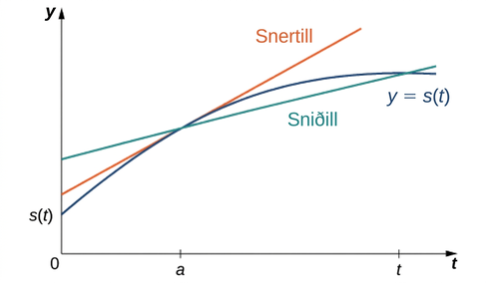
Mynd 3.8
Hallatala sniðilsins er meðalhraðinn á bilinu [a,t]. Hallatala snertilsins er augnablikshraðinn.
Notes:
This figure consists of the Cartesian coordinate plane with 0, a, and t1 marked on the t-axis. The function y = s(t) is graphed in the first quadrant along with two lines marked tangent and secant. The tangent line touches y = s(t) at only one point, (a, s(a)). The secant line touches y = s(t) at two points: (a, s(a)) and (t1, s(t1)).

Slide 13
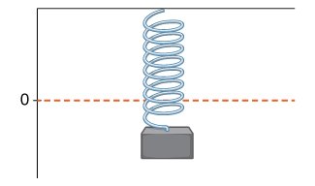
Mynd 3.9
Blýlóð hangir í gormi og sveiflast lóðrétt.
Notes:
A picture of a spring hanging down with a weight at the end. There is a horizontal dashed line marked 0 a little bit above the weight.

Slide 14
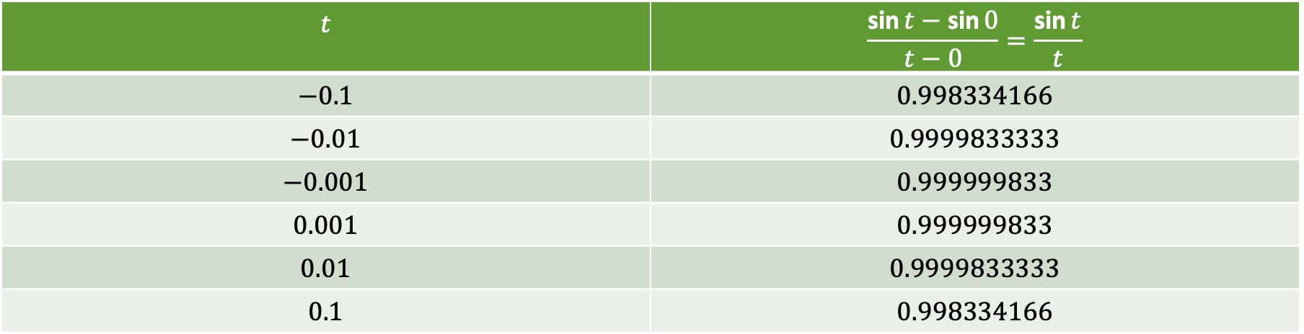
Tafla 3.1 Meðalhraði reiknaður með gildum á t sem nálgast 0
$$t$$ | $$\frac{\text{sin} t−\text{sin} 0}{t−0}=\frac{\text{sin} t}{t}$$
$$−0.1$$ | $$0.998334166$$
$$−0.01$$ | $$0.9999833333$$
$$−0.001$$ | $$0.999999833$$
$$0.001$$ | $$0.999999833$$
$$0.01$$ | $$0.9999833333$$
$$0.1$$ | $$0.998334166$$

Slide 15

Mynd 3.10
(mynd: breytt útgáfa af verki Codex41, Flickr)
Notes:
The same sports car speeding along a winding road from the beginning of the chapter.

Slide 16

Tafla 3.2 $v\left(t\right)$ fyrir mismunandi gildi á t
$$t$$ | $$v\left(t\right)$$
$$0$$ | $$0$$
$$3.05$$ | $$88$$
$$5.88$$ | $$146.67$$
$$14.51$$ | $$293.33$$
$$19.96$$ | $$337.19$$

Slide 17
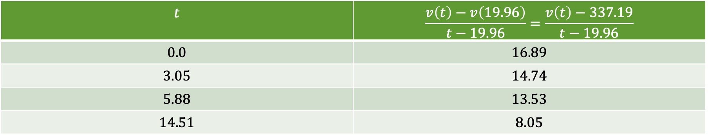
Tafla 3.3 Meðalhröðun
$$t$$ | $$\frac{v\left(t\right)−v\left(19.96\right)}{t−19.96}=\frac{v\left(t\right)−337.19}{t−19.96}$$
$$0.0$$ | $$16.89$$
$$3.05$$ | $$14.74$$
$$5.88$$ | $$13.53$$
$$14.51$$ | $$8.05$$

Slide 18
3.2 Afleiðan sem fall
Námsmarkmið
Skilgreina afleiðufall gefins falls.
Teikna graf afleiðufalls út frá grafi gefins falls.
Lýsa tengslum afleiða og samfelldni.
Lýsa þremur tilvikum þar sem fall hefur ekki afleiðu.
Útskýra merkingu afleiðu af hærra stigi.

Slide 19
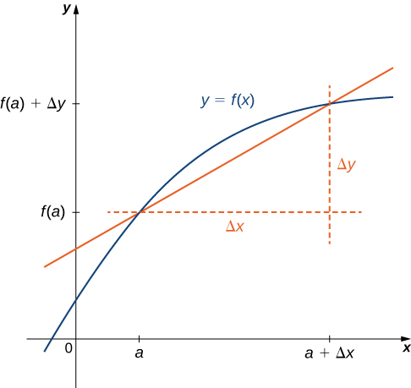
Mynd 3.11
Afleiðan er táknuð með dy/dx = lim(Δx→0) Δy/Δx.
Notes:
The function y = f(x) is graphed and it shows up as a curve in the first quadrant. The x-axis is marked with 0, a, and a + Δx. The y-axis is marked with 0, f(a), and f(a) + Δy. There is a straight line crossing y = f(x) at (a, f(a)) and (a + Δx, f(a) + Δy). From the point (a, f(a)), a horizontal line is drawn; from the point (a + Δx, f(a) + Δy), a vertical line is drawn. The distance from (a, f(a)) to (a + Δx, f(a)) is denoted Δx; the distance from (a + Δx, f(a) + Δy) to (a + Δx, f(a)) is denoted Δy.

Slide 20
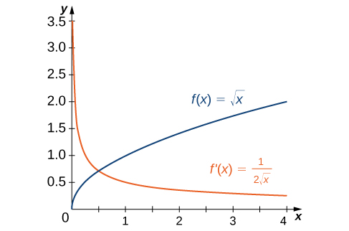
Mynd 3.12
Afleiðan f′(x) er alls staðar jákvæð þar sem fallið f(x) er vaxandi.
Notes:
The function f(x) = the square root of x is graphed as is its derivative f’(x) = 1/(2 times the square root of x).

Slide 21
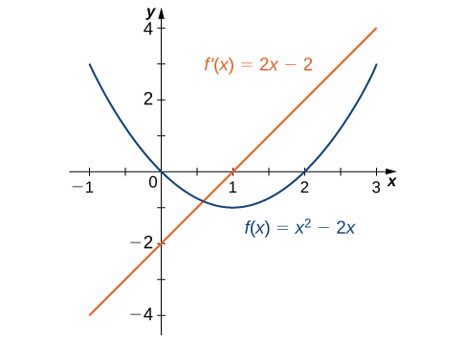
Mynd 3.13
Afleiðan f′(x)<0 þar sem fallið f(x) er minnkandi og f′(x)>0 þar sem f(x) er vaxandi. Afleiðan er núll þar sem fallið hefur láréttan snertil.
Notes:
The function f(x) = x squared – 2x is graphed as is its derivative f’(x) = 2x − 2.

Slide 22
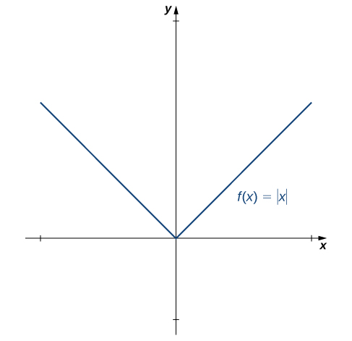
Mynd 3.14
Fallið f(x)=|x| er samfellt í 0 en ekki deildanlegt þar.
Notes:
The function f(x) = the absolute value of x is graphed. It consists of two straight line segments: the first follows the equation y = −x and ends at the origin; the second follows the equation y = x and starts at the origin.

Slide 23
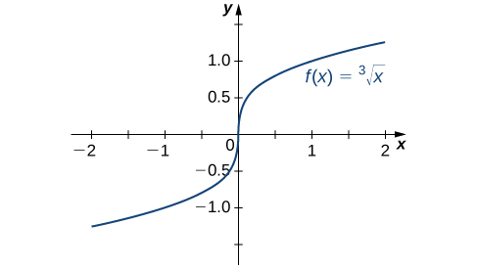
Mynd 3.15
Fallið f(x)=∛x hefur lóðréttan snertil við x=0. Það er samfellt í 0 en ekki deildanlegt þar.
Notes:
The function f(x) = the cube root of x is graphed. It has a vertical tangent at x = 0.

Slide 24
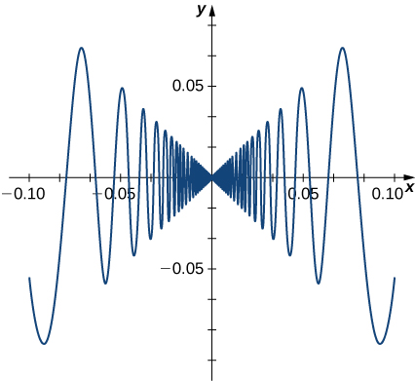
Mynd 3.16
Fallið f(x), skilgreint með f(x)=x sin(1/x) þegar x≠0 og f(0)=0, er ekki deildanlegt í 0.
Notes:
The function f(x) = x sin (1/2) if x does not equal 0 and f(x) = 0 if x = 0 is graphed. It looks like a rapidly oscillating sinusoidal function with amplitude decreasing to 0 at the origin.

Slide 25
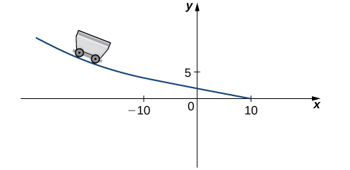
Mynd 3.17
Til að bíllinn hreyfist mjúklega eftir brautinni þarf fallið að vera bæði samfellt og deildanlegt.
Notes:
A cart is drawn on a line that curves through (−10, 5) to (10, 0) with y-intercept roughly (0, 2).

Slide 26
3.3 Deildunarreglur (1 af 2)
Námsmarkmið
Setja fram fastaregluna, fastamargföldunarregluna og veldisregluna.
Beita summu- og mismunareglunum til að sameina afleiður.
Nota margfeldisregluna til að finna afleiðu margfeldis falla.
Nota kvótaregluna til að finna afleiðu kvóta falla.

Slide 27
3.3 Deildunarreglur (2 af 2)
Námsmarkmið
Útvíkka veldisregluna yfir á föll með neikvæða veldisvísa.
Sameina deildunarreglurnar til að finna afleiðu margliðufalls eða ræðs falls.

Slide 28
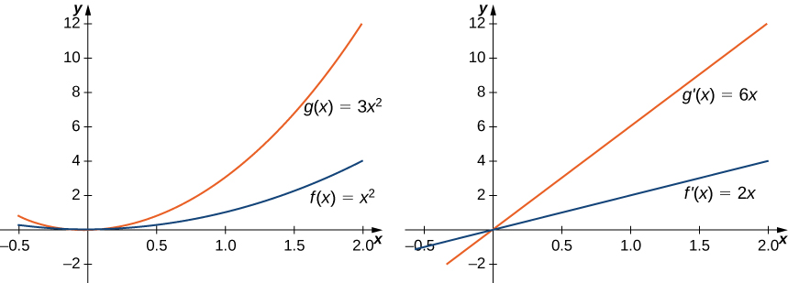
Mynd 3.18
Afleiða g(x) er þreföld afleiða f(x).
Notes:
Two graphs are shown. The first graph shows g(x) = 3x2 and f(x) = x squared. The second graph shows g’(x) = 6x and f’(x) = 2x. In the first graph, g(x) increases three times more quickly than f(x). In the second graph, g’(x) increases three times more quickly than f’(x).

Slide 29
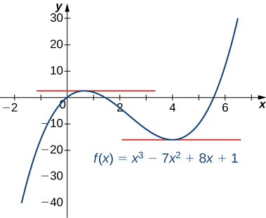
Mynd 3.19
Þetta fall hefur lárétta snertla við x = 2/3 og x = 4.
Notes:
The graph shows f(x) = x3 – 7x2 + 8x + 1, and the tangent lines are shown as x = 2/3 and x = 4.

Slide 30
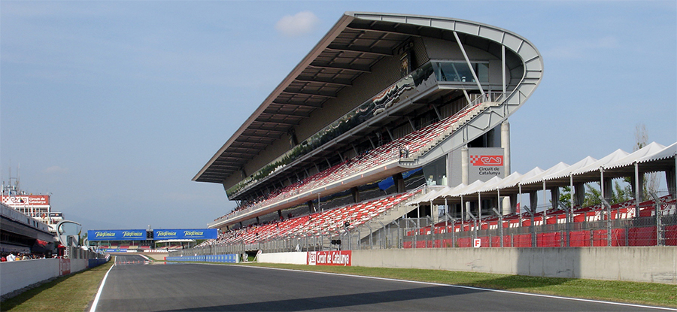
Mynd 3.20
Áhorfendastúkan við beinan kafla Circuit de Barcelona-Catalunya-kappakstursbrautarinnar er staðsett þar sem áhorfendum stafar ekki hætta af.
Notes:
A photo of a grandstand next to a straightaway of a race track.

Slide 31
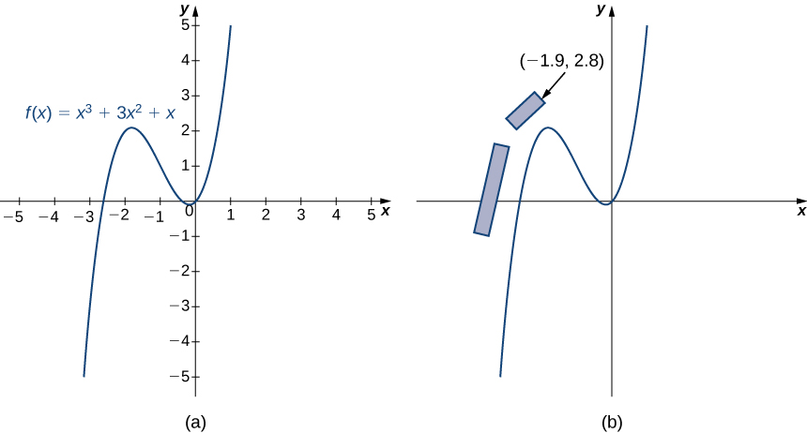
Mynd 3.21
(a) Lýsa má einum kafla kappakstursbrautarinnar með fallinu f(x)=x³+3x²+x. (b) Fremra horn áhorfendastúkunnar er í punktinum (−1,9; 2,8).
Notes:
This figure has two parts labeled a and b. Figure a shows the graph of f(x) = x3 + 3x2 + x. Figure b shows the same graph but this time with two boxes on it. The first box appears along the left-hand side of the graph straddling the x-axis roughly parallel to f(x). The second box appears a little higher, also roughly parallel to f(x), with its front corner located at (−1.9, 2.8). Note that this corner is roughly in line with the direct path of the track before it started to turn.

Slide 32
3.4 Afleiður sem breytingarhraðar (1 af 2)
Námsmarkmið
Ákvarða nýtt gildi stærðar út frá fyrra gildi hennar og breytingunni.
Reikna meðalbreytingarhraða og útskýra muninn á honum og augnabliksbreytingarhraða.

Slide 33
3.4 Afleiður sem breytingarhraðar (2 af 2)
Námsmarkmið
Beita breytingarhraða á færslu, hraða og hröðun hlutar sem hreyfist eftir beinni línu.
Spá fyrir um framtíðarmannfjölda út frá núverandi mannfjölda og vaxtarhraða hans.
Nota afleiður til að reikna jaðarkostnað og jaðartekjur í rekstri.

Slide 34
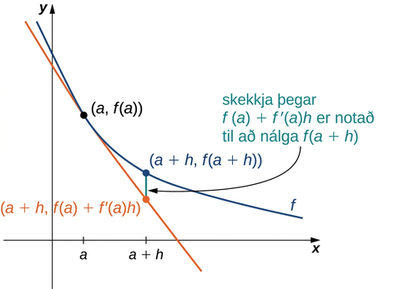
Mynd 3.22
Nýtt gildi breyttrar stærðar er jafnt upphaflega gildinu að viðbættum breytingarhraðanum margfölduðum með breytingarbilinu: f(a+h)≈f(a)+f′(a)h.
Notes:
On the Cartesian coordinate plane with a and a + h marked on the x axis, the function f is graphed. It passes through (a, f(a)) and (a + h, f(a + h)). A straight line is drawn through (a, f(a)) with its slope being the derivative at that point. This straight line passes through (a + h, f(a) + f’(a)h). There is a line segment connecting (a + h, f(a + h)) and (a + h, f(a) + f’(a)h), and it is marked that this is the error in using f(a) + f’(a)h to estimate f(a + h).

Slide 35

Mynd 3.23
Formerki v(t) ákvarðar hreyfistefnu eindarinnar.
Notes:
A number line marked with 0, 2, and 4. Between 0 and 2, there is a plus sign. Above 2, there is a 0. Between 2 and 4 there is a negative sign. Above 4 there is a 0. After 4 there is a plus sign and v(t).

Slide 36
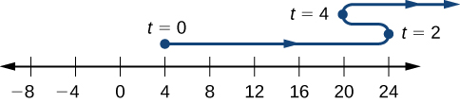
Mynd 3.24
Ákvarða má feril eindarinnar með því að greina v(t).
Notes:
A number line is given and above it a line snakes, starting at t = 0 above 4 on the number line. Then the line at t = 2 is above 24 on the number line. Then the line decreases at t = 4 to be above 20 on the number line, at which point the line reverses direction again and increases indefinitely.

Slide 37
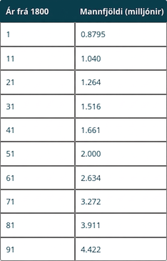
Tafla 3.4 Mannfjöldi í London
Heimild: http://en.wikipedia.org/wiki/Demographics_of_London.

Slide 38
Tafla 3.5 Stofnstærð snjóhéra og gaupa
Stofnstærð snjóhéra (þúsundir) | Stofnstærð gaupa (hundruð)
20 | 10
55 | 15
65 | 55
95 | 60
Heimild: http://www.biotopics.co.uk/newgcse/predatorprey.html.

Slide 39
3.5 Afleiður hornafalla
Námsmarkmið
Finna afleiður sínus- og kósínusfallsins.
Finna afleiður helstu hornafallanna.
Reikna afleiður af hærri stigum af sínus- og kósínusfallinu.

Slide 40
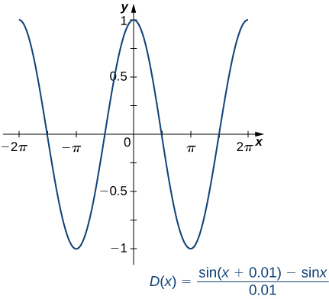
Mynd 3.25
Graf fallsins D(x) líkist mjög kósínusferli.
Notes:
The function D(x) = (sin(x + 0.01) − sin x)/0.01 is graphed. It looks a lot like a cosine curve.

Slide 41
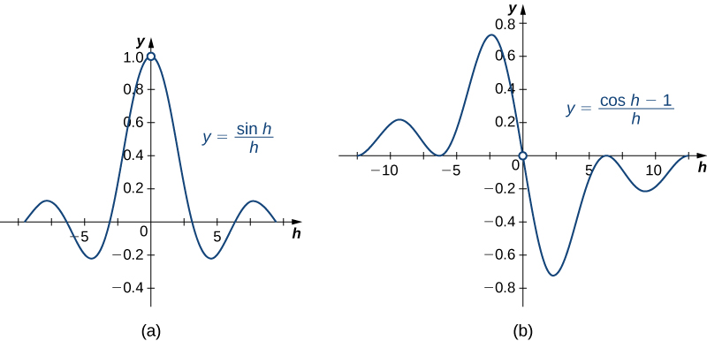
Mynd 3.26
Þessi gröf sýna tvö mikilvæg markgildi sem þarf til að sanna afleiðuformúlur sínus- og kósínusfallanna.
Notes:
The function y = (sin h)/h and y = (cos h – 1)/h are graphed. They both have discontinuities on the y-axis.

Slide 42
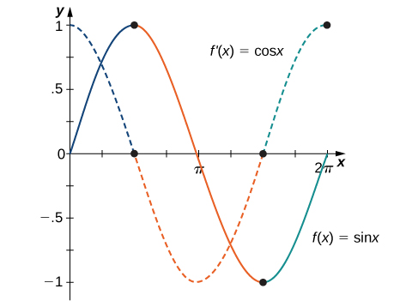
Mynd 3.27
Þar sem f(x) hefur hágildi eða lággildi er f′(x)=0; með öðrum orðum er f′(x)=0 þar sem f(x) hefur láréttan snertil. Þessir punktar eru merktir með punktum á gröfunum.
Notes:
The functions f(x) = sin x and f’(x) = cos x are graphed. It is apparent that when f(x) has a maximum or a minimum that f’(x) = 0.

Slide 43
3.6 Keðjureglan (1 af 2)
Námsmarkmið
Setja fram keðjuregluna fyrir samsetningu tveggja falla.
Beita keðjureglunni ásamt veldisreglunni.
Beita keðjureglunni ásamt margfeldisreglunni eða kvótareglunni þegar þess er þörf.

Slide 44
3.6 Keðjureglan (2 af 2)
Námsmarkmið
Þekkja keðjuregluna fyrir samsetningu þriggja eða fleiri falla.
Lýsa sönnun keðjureglunnar.

Slide 45
3.7 Afleiður andhverfra falla
Námsmarkmið
Reikna afleiðu andhverfs falls.
Þekkja afleiður helstu andhverfu hornafallanna.

Slide 46
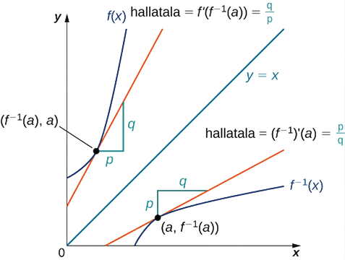
Mynd 3.28
Snertlar falls og andhverfu þess tengjast innbyrðis og hið sama gildir um afleiður fallanna.
Notes:
This graph shows a function f(x) and its inverse f−1(x). These functions are symmetric about the line y = x. The tangent line of the function f(x) at the point (f−1(a), a) and the tangent line of the function f−1(x) at (a, f−1(a)) are also symmetric about the line y = x. Specifically, if the slope of one were p/q, then the slope of the other would be q/p. Lastly, their derivatives are also symmetric about the line y = x.

Slide 47
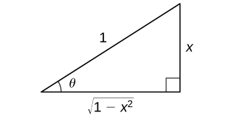
Mynd 3.29
Með rétthyrndum þríhyrningi þar sem hvassa hornið er θ, langhliðin hefur lengdina 1 og mótlæga hliðin við θ hefur lengdina x sjáum við að cos(sin⁻¹ x)=cos θ=√(1−x²).
Notes:
A right triangle with angle θ, opposite side x, hypotenuse 1, and adjacent side equal to the square root of the quantity (1 – x2).

Slide 48
3.8 Fólgin deildun
Námsmarkmið
Finna afleiðu flókins falls með fólginni deildun.
Nota fólgna deildun til að ákvarða jöfnu snertils.

Slide 49
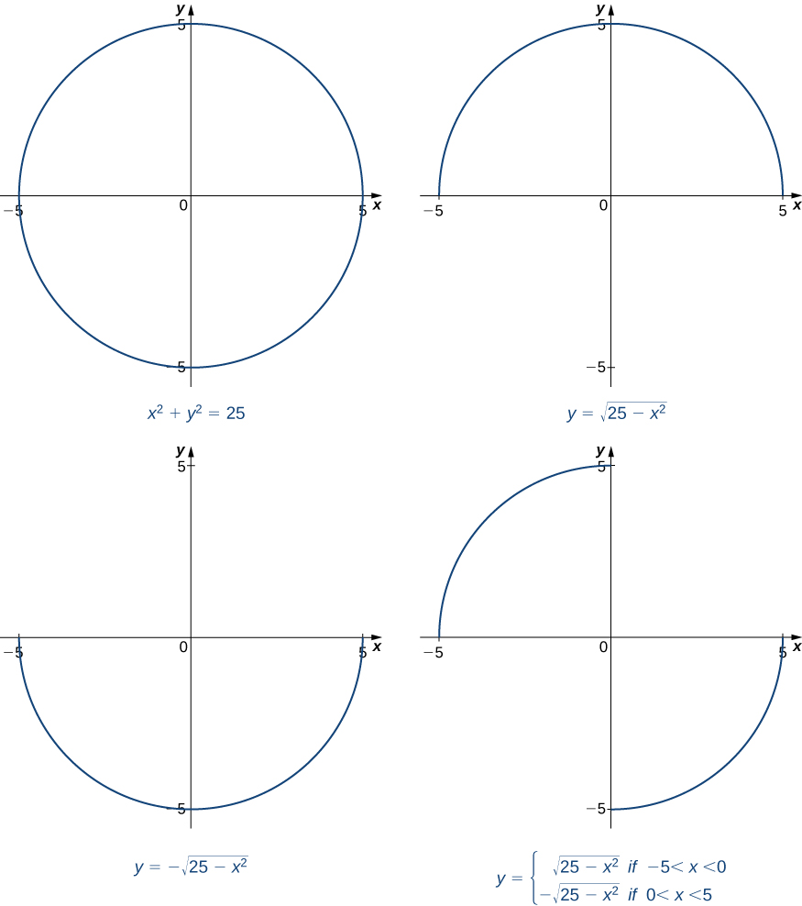
Mynd 3.30
Jafnan x²+y²=25 skilgreinir mörg föll með fólginum hætti.
Notes:
The circle with radius 5 and center at the origin is graphed fully in one picture. Then, only its segments in quadrants I and II are graphed. Then, only its segments in quadrants III and IV are graphed. Lastly, only its segments in quadrants II and IV are graphed.

Slide 50
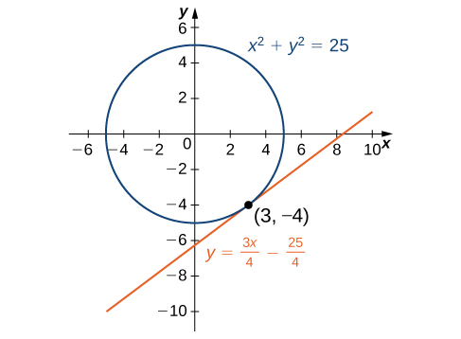
Mynd 3.31
Línan y=3x/4−25/4 er snertill við x²+y²=25 í punktinum (3, −4).
Notes:
The circle with radius 5 and center at the origin is graphed. A tangent line is drawn through the point (3, −4).

Slide 51
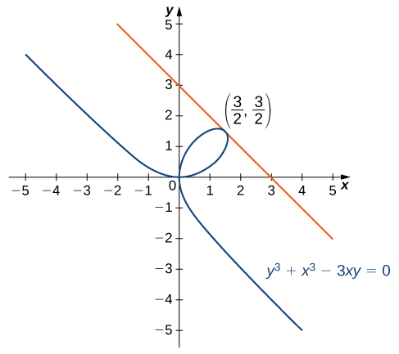
Mynd 3.32
Snertill við lauf Descartes í punktinum (3/2, 3/2) fundinn.
Notes:
A folium is shown, which is a line that creates a loop that crosses over itself. In this graph, it crosses over itself at (0, 0). Its tangent line from (3/2, 3/2) is shown.

Slide 52
3.9 Afleiður vísis- og lografalla
Námsmarkmið
Finna afleiður vísisfalla.
Finna afleiður lografalla.
Beita logradeildun til að ákvarða afleiðu falls.

Slide 53
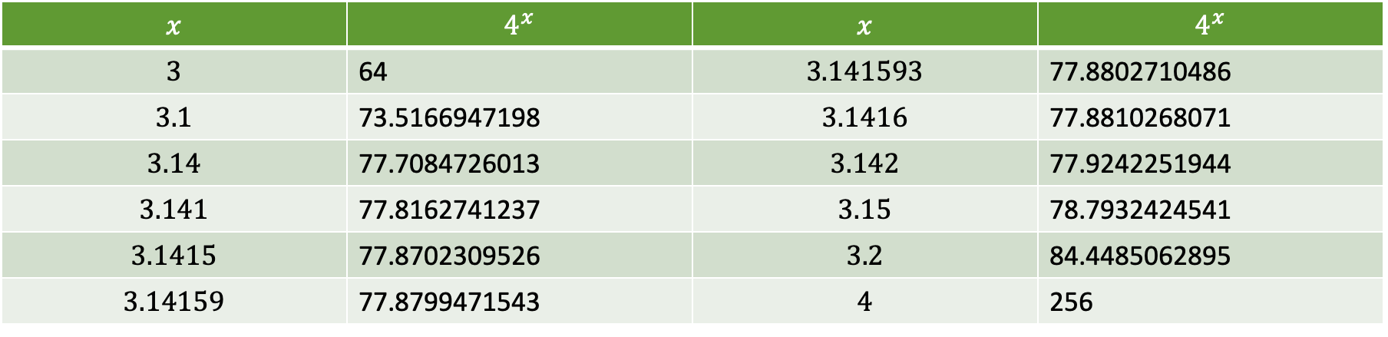
Tafla 3.6 Nálgun á gildi $4^{π}$
$$x$$ | $$4^{x}$$ | $$x$$ | $$4^{x}$$
$$3$$ | 64 | $$3.141593$$ | 77.8802710486
$$3.1$$ | 73.5166947198 | $$3.1416$$ | 77.8810268071
$$3.14$$ | 77.7084726013 | $$3.142$$ | 77.9242251944
$$3.141$$ | 77.8162741237 | $$3.15$$ | 78.7932424541
$$3.1415$$ | 77.8702309526 | $$3.2$$ | 84.4485062895
$$3.14159$$ | 77.8799471543 | $$4$$ | 256

Slide 54
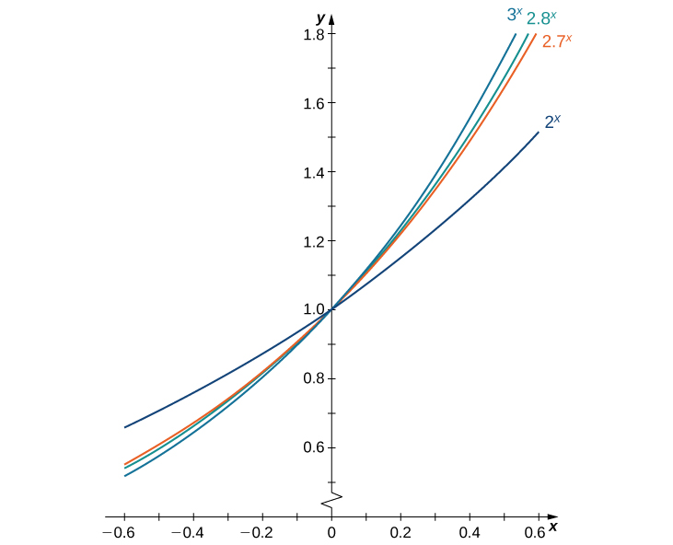
Mynd 3.33
Graf fallsins E(x)=eˣ liggur á milli grafanna y=2ˣ og y=3ˣ.
Notes:
The graphs of 3x, 2.8x, 2.7x, and 2x are shown. In quadrant I, their order from least to greatest is 2x, 2.7x, 2.8x, and 3x. In quadrant II, this order is reversed. All cross the y-axis at (0, 1).

Slide 55
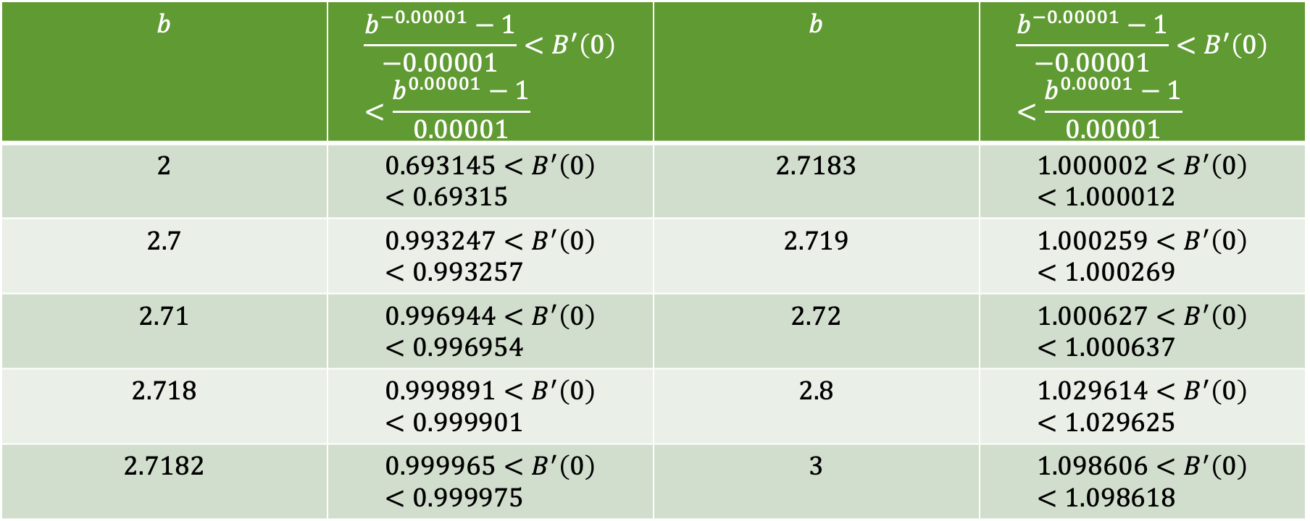
Tafla 3.7 Mat á gildi $e$
$$b$$ | $$\frac{b^{−0.00001}−1}{−0.00001}<B^{′}\left(0\right)<\frac{b^{0.00001}−1}{0.00001}$$ | $$b$$ | $$\frac{b^{−0.00001}−1}{−0.00001}<B^{′}\left(0\right)<\frac{b^{0.00001}−1}{0.00001}$$
$$2$$ | $$0.693145<B^{′}\left(0\right)<0.69315$$ | $$2.7183$$ | $$1.000002<B^{′}\left(0\right)<1.000012$$
$$2.7$$ | $$0.993247<B^{′}\left(0\right)<0.993257$$ | $$2.719$$ | $$1.000259<B^{′}\left(0\right)<1.000269$$
$$2.71$$ | $$0.996944<B^{′}\left(0\right)<0.996954$$ | $$2.72$$ | $$1.000627<B^{′}\left(0\right)<1.000637$$
$$2.718$$ | $$0.999891<B^{′}\left(0\right)<0.999901$$ | $$2.8$$ | $$1.029614<B^{′}\left(0\right)<1.029625$$
$$2.7182$$ | $$0.999965<B^{′}\left(0\right)<0.999975$$ | $$3$$ | $$1.098606<B^{′}\left(0\right)<1.098618$$

Slide 56
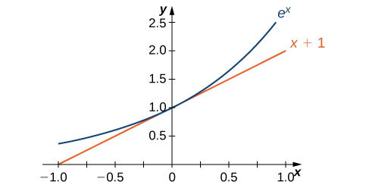
Mynd 3.34
Snertill við E(x)=eˣ í x=0 hefur hallatöluna 1.
Notes:
Graph of the function ex along with its tangent at (0, 1), x + 1.

Slide 57
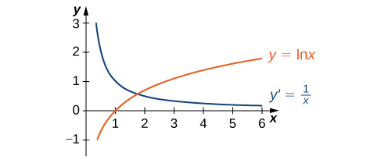
Mynd 3.35
Fallið y=ln x er vaxandi á (0,+∞). Afleiða þess y′=1/x er jákvæð á (0,+∞).
Notes:
Graph of the function ln x along with its derivative 1/x. The function ln x is increasing on (0, + ∞). Its derivative is decreasing but greater than 0 on (0, + ∞).

Slide 58
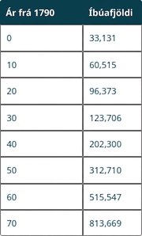
Tafla 3.8 Íbúafjöldi New York-borgar eftir árum
Heimild: http://en.wikipedia.org/wiki/Largest_cities_in_the_United_States _by_population_by_decade.

Slide 59
Notkunarleyfi
Þetta ítarefni frá OpenStax er © Rice University og gefið út samkvæmt alþjóðlega leyfinu CC BY-NC-SA 4.0. Aðeins má afrita það eða breyta því í óviðskiptalegum tilgangi, enda sé OpenStax og Rice University getið og allar breytingar tilgreindar. Öll aðlöguð verk skulu gefin út með sams konar leyfi.

