Slide 1

Stærðfræðigreining, 1. bindi
2. kafli Markgildi

Slide 2
Yfirlit kaflans
Innsýn í stærðfræðigreiningu
Markgildi falls
Reiknireglur fyrir markgildi
Samfelldni
Nákvæm skilgreining á markgildi

Slide 3
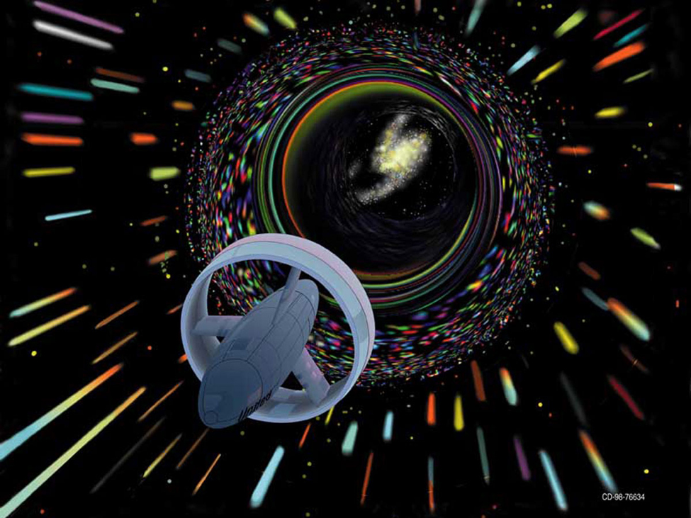
Mynd 2.1
Framtíðarsýn Bandarísku geimferðastofnunarinnar (NASA) um könnunarferðir manna til fjarlægra hluta alheimsins lýsir hugmyndinni um geimferðir á miklum hraða. En eru takmörk fyrir því hversu hratt geimfar getur farið? (mynd: NASA)
Notes:
A picture of a futuristic spaceship speeding through deep space.

Slide 4
2.1 Innsýn í stærðfræðigreiningu (1 af 3)
Námsmarkmið
Lýsa snertilvandamálinu og hvernig það leiddi til hugmyndarinnar um afleiðu.
Útskýra hvernig hugmyndin um markgildi nýtist við lausn snertilvandamálsins.
Skilja snertil við feril í punkti sem markstöðu sniðla.
Skilgreina augnablikshraða sem markgildi meðalhraða á stuttu tímabili.

Slide 5
2.1 Innsýn í stærðfræðigreiningu (2 af 3)
Námsmarkmið
Lýsa flatarmálsvandamálinu og hvernig það var leyst með heildi.
Útskýra hvernig hugmyndin um markgildi nýtist við lausn flatarmálsvandamálsins.

Slide 6
2.1 Innsýn í stærðfræðigreiningu (3 af 3)
Námsmarkmið
Skilja hvernig hugmyndirnar um markgildi, afleiðu og heildi leiddu til rannsókna á óendanlegum röðum og stærðfræðigreiningu margra breytistærða.

Slide 7
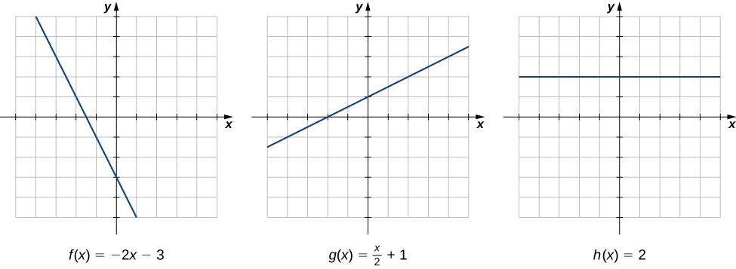
Mynd 2.2
Breytingarhraði línulegs falls er fastur í öllum þremur gröfunum og ákvarðast af hallatölunni.
Notes:
Three graphs of different linear functions are shown. The first is f(x) = -2x – 3, with slope of -2 and y intercept of -3. The second is g(x) = x / 2 + 1, with slope of 1/2 and y intercept of 1. The third is h(x) = 2, with slope of 0 and y intercept of 2. The rate of change of each is constant, as determined by the slope.

Slide 8
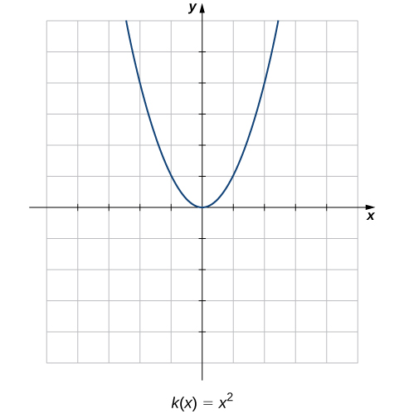
Mynd 2.3
Fallið k(x)=x² hefur ekki fastan breytingarhraða.
Notes:
A graph of the parabola k(x) = x^2, which opens up and has its vertex at the origin.

Slide 9
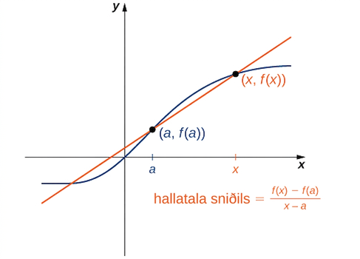
Mynd 2.4
Hallatala sniðils gegnum punktinn (a,f(a)) nálgar breytingarhraða fallsins í punktinum (a,f(a)).
Notes:
A graph showing a generic curved function going through the points (0,0), (a, fa.), and (x, f(x)). A straight line called the secant line is drawn through the points (a, fa.), and (x, f(x)), going below the curved function between a and x and going above the curved function at values greater than x or less than a. The curved function and the secant line cross once more at some point in the third quadrant. The slope of the secant line is ( f(x) – fa. ) / (x – a).

Slide 10
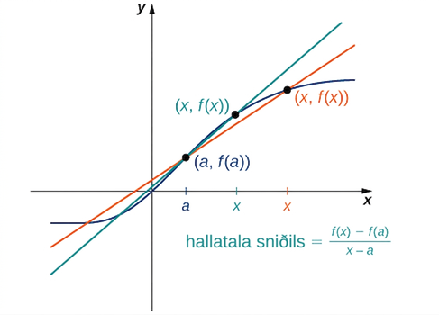
Mynd 2.5
Þegar x nálgast a verður hallatala sniðilsins æ betri nálgun á breytingarhraða fallsins f(x) í a.
Notes:
This graph is the same as the previous secant line and generic curved function graph. However, another point x is added, this time plotted closer to a on the x-axis. As such, another secant line is drawn through the points (a, fa.) and the new, closer (x, f(x)). The line stays much closer to the generic curved function around (a, fa.). The slope of this secant line has become a better approximation of the rate of change of the generic function.

Slide 11
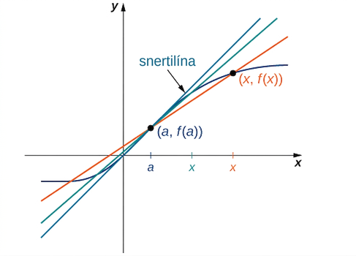
Mynd 2.6
Lausn snertilvandamálsins: Þegar x nálgast a nálgast sniðlarnir snertilinn.
Notes:
This graph is a continuation of the previous two. This time, the graph contains the curved function, the two secant lines, and a tangent line. As x approaches a, the secant lines approach the tangent line.

Slide 12
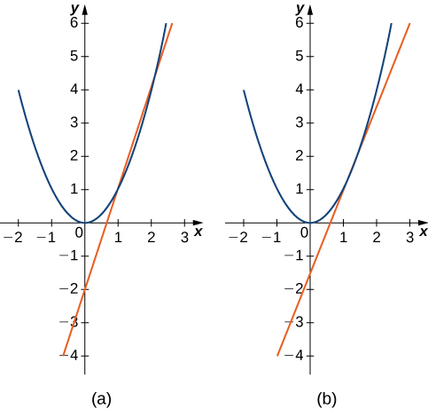
Mynd 2.7
Sniðlarnir við f(x)=x² í (1,1), sem liggja um (a) (2,4) og (b) (3/2,9/4), nálgast snertilinn við f(x)=x² í (1,1) sífellt betur.
Notes:
Two graphs of the parabola f(x) = x^2 are shown. The first has a secant line drawn, intersecting the parabola at (1,1) and (2,4). The second has a secant line drawn, intersecting the parabola at (1,1) and (3/2, 9/4). These lines provide successively closer approximations to the tangent line to the function at (1,1).

Slide 13
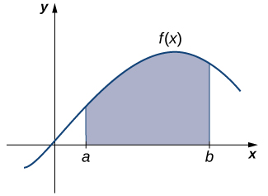
Mynd 2.8
Flatarmálsvandamálið: Hvernig finnum við flatarmál skyggða svæðisins?
Notes:
A graph is shown of a generic curved function f(x) shaped like a hill in quadrant one. An area under the function is shaded above the x-axis and between x=a and x=b.

Slide 14
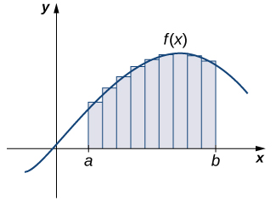
Mynd 2.9
Flatarmál svæðisins undir ferlinum er nálgað með því að leggja saman flatarmál mjórra rétthyrninga.
Notes:
The graph is the same as the previous image, with one difference. Instead of the area completely shaded under the curved function, the interval [a, b] is divided into smaller intervals in the shape of rectangles. The rectangles have the same small width. The height of each rectangle is the height of the function at the midpoint of the base of that specific rectangle.

Slide 15
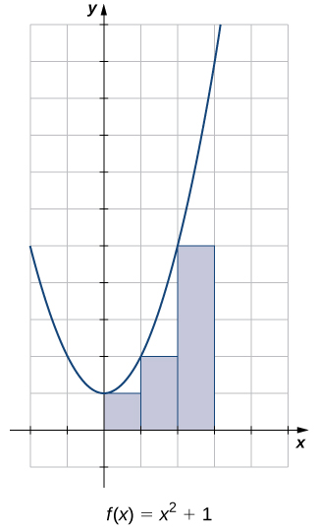
Mynd 2.10
Nálga má flatarmál svæðisins undir ferli f(x)=x²+1 með rétthyrningum.
Notes:
A graph of the parabola f(x) – x^2 + 1 drawn on graph paper with all units shown. The rectangles completely contained under the function and above the x-axis in the interval [0,3] are shaded. This strategy sets the heights of the rectangles as the smaller of the two corners that could intersect with the function. As such, the rectangles are shorter than the height of the function.

Slide 16
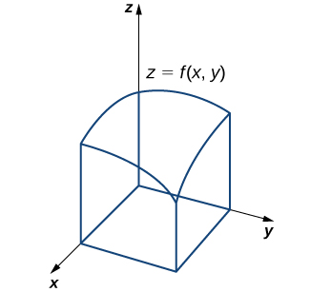
Mynd 2.11
Nota má stærðfræðigreiningu margra breytistærða til að finna rúmmálið milli flatar, sem skilgreindur er með falli af tveimur breytistærðum, og sléttu.
Notes:
A diagram in three dimensional space, over the x, y, and z axis where z = f(x,y). The base is the x,y axis, and the height is the z axis. The base is a rectangle contained in the x,y axis plane. The top is a surface of changing height with corners located directly above those of the rectangle in the x,y plane.. The highest point is above the corner at x=0, y=0. The lowest point is at the corner somewhere in the first quadrant of the x, y plane. The other two points are roughly the same height and located above the corners on the x axis and y axis. Lines are drawn connecting the corners of the rectangle to those of the surface.

Slide 17
2.2 Markgildi falls (1 af 2)
Námsmarkmið
Lýsa markgildi falls með réttum rithætti.
Nota gildistöflu til að meta markgildi falls eða ákvarða hvenær markgildið er ekki til.

Slide 18
2.2 Markgildi falls (2 af 2)
Námsmarkmið
Nota graf til að meta markgildi falls eða ákvarða hvenær markgildið er ekki til.
Skilgreina einhliða markgildi og gefa dæmi.
Útskýra tengsl einhliða og tvíhliða markgilda.
Lýsa óendanlegu markgildi með réttum rithætti.
Skilgreina lóðfellu.

Slide 19
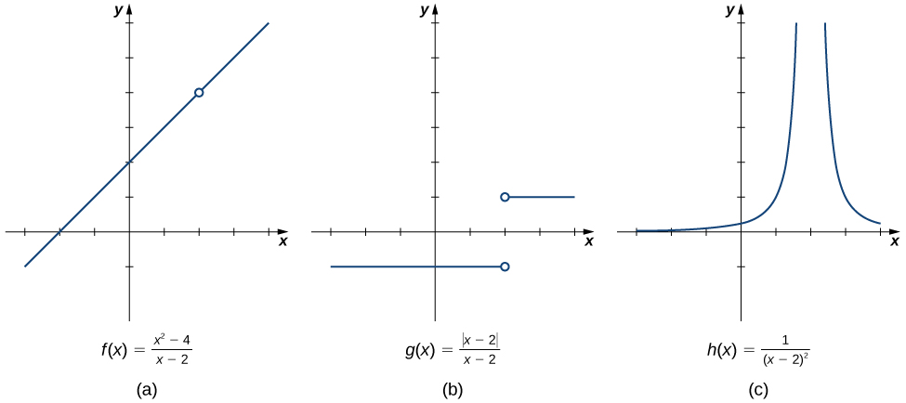
Mynd 2.12
Gröfin sýna hegðun þriggja mismunandi falla í grennd við x=2.
Notes:
Three graphs of functions. The first is f(s) = (x^2 – 4) / (x-2), which is a line of slope, x intercept (-2,0), and open circle at (2,4). The second is g(x) = |x – 2 | / (x-2), which contains two lines: x=1 for x>2 and x= -1 for x < 2. There are open circles at both endpoints (2, 1) and (-2, 1). The third is h(x) = 1 / (x-2)^2, in which the function curves asymptotically towards y=0 and x=2 in quadrants one and two.

Slide 20
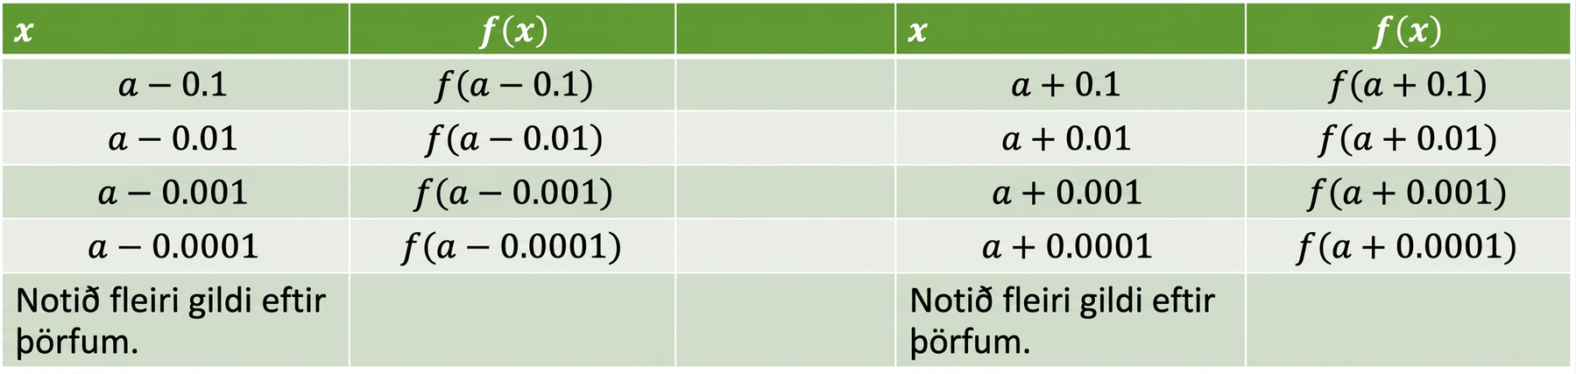
Tafla 2.1: Fallgildi fyrir lim(x→a) f(x)
x | $$f\left(x\right)$$ |  | x | $$f\left(x\right)$$
$$a−0.1$$ | $$f\left(a−0.1\right)$$ |  | $$a+0.1$$ | $$f\left(a+0.1\right)$$
$$a−0.01$$ | $$f\left(a−0.01\right)$$ |  | $$a+0.01$$ | $$f\left(a+0.01\right)$$
$$a−0.001$$ | $$f\left(a−0.001\right)$$ |  | $$a+0.001$$ | $$f\left(a+0.001\right)$$
$$a−0.0001$$ | $$f\left(a−0.0001\right)$$ |  | $$a+0.0001$$ | $$f\left(a+0.0001\right)$$
Notið fleiri gildi eftir þörfum. |  |  | Notið fleiri gildi eftir þörfum.

Slide 21
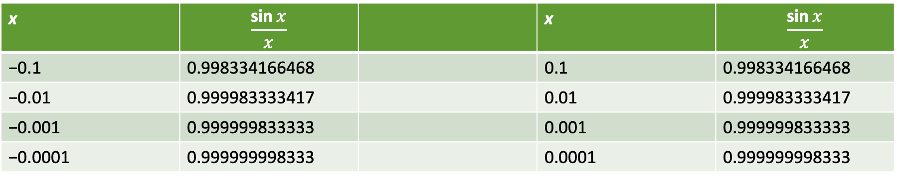
Tafla 2.2: Fallgildi fyrir lim(x→0) sin(x)/x
x | $$\frac{\text{sin} x}{x}$$ |  | x | $$\frac{\text{sin} x}{x}$$
−0.1 | 0.998334166468 |  | 0.1 | 0.998334166468
−0.01 | 0.999983333417 |  | 0.01 | 0.999983333417
−0.001 | 0.999999833333 |  | 0.001 | 0.999999833333
−0.0001 | 0.999999998333 |  | 0.0001 | 0.999999998333

Slide 22
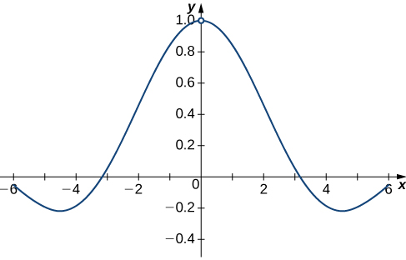
Mynd 2.13
Línurit fallsins f(x)=(sinx)/x staðfestir matið í töflu 2.2.
Notes:
A graph of f(x) = sin(x)/x over the interval [-6, 6]. The curving function has a y intercept at x=0 and x intercepts at y=pi and y=-pi.

Slide 23
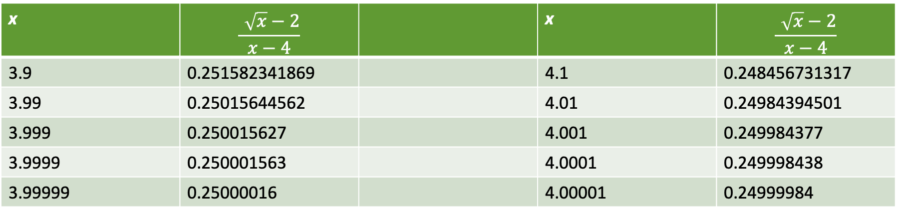
Tafla 2.3: Fallgildi fyrir lim(x→4) (√x−2)/(x−4)
x | $$\frac{\sqrt{x}−2}{x−4}$$ |  | x | $$\frac{\sqrt{x}−2}{x−4}$$
3.9 | 0.251582341869 |  | 4.1 | 0.248456731317
3.99 | 0.25015644562 |  | 4.01 | 0.24984394501
3.999 | 0.250015627 |  | 4.001 | 0.249984377
3.9999 | 0.250001563 |  | 4.0001 | 0.249998438
3.99999 | 0.25000016 |  | 4.00001 | 0.24999984

Slide 24
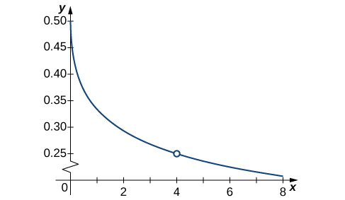
Mynd 2.14
Línurit fallsins f(x)=(√x−2)/(x−4) staðfestir matið í töflu 2.3.
Notes:
A graph of the function f(x) = (sqrt(x) – 2 ) / (x-4) over the interval [0,8]. There is an open circle on the function at x=4. The function curves asymptotically towards the x axis and y axis in quadrant one.

Slide 25
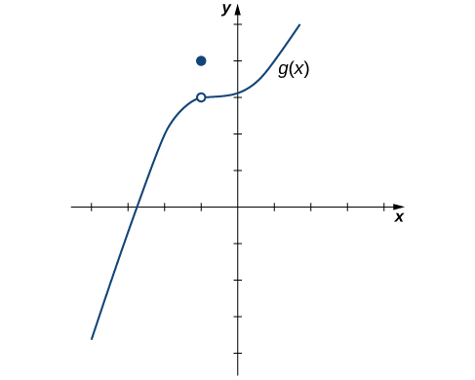
Mynd 2.15
Á línuriti g(x) er eitt gildi sem liggur ekki á slétta ferlinum.
Notes:
The graph of a generic curving function g(x). In quadrant two, there is an open circle on the function at (-1,3) and a closed circle one unit up at (-1, 4).

Slide 26
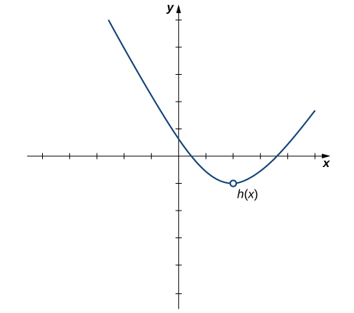
Mynd 2.16
Notes:
A graph of the function h(x), which is a parabola graphed over [-2.5, 5]. There is an open circle where the vertex should be at the point (2,-1).

Slide 27
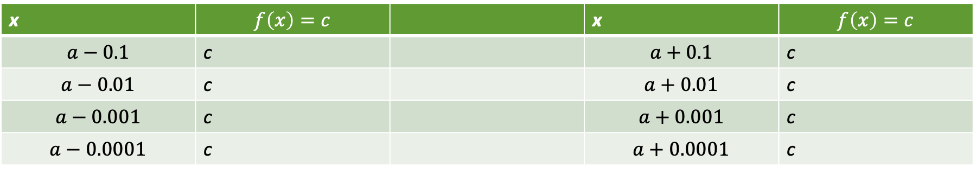
Tafla 2.4: Fallgildi fyrir lim(x→a) c = c
x | $$f\left(x\right)=c$$ |  | x | $$f\left(x\right)=c$$
$$a−0.1$$ | c |  | $$a+0.1$$ | c
$$a−0.01$$ | c |  | $$a+0.01$$ | c
$$a−0.001$$ | c |  | $$a+0.001$$ | c
$$a−0.0001$$ | c |  | $$a+0.0001$$ | c

Slide 28
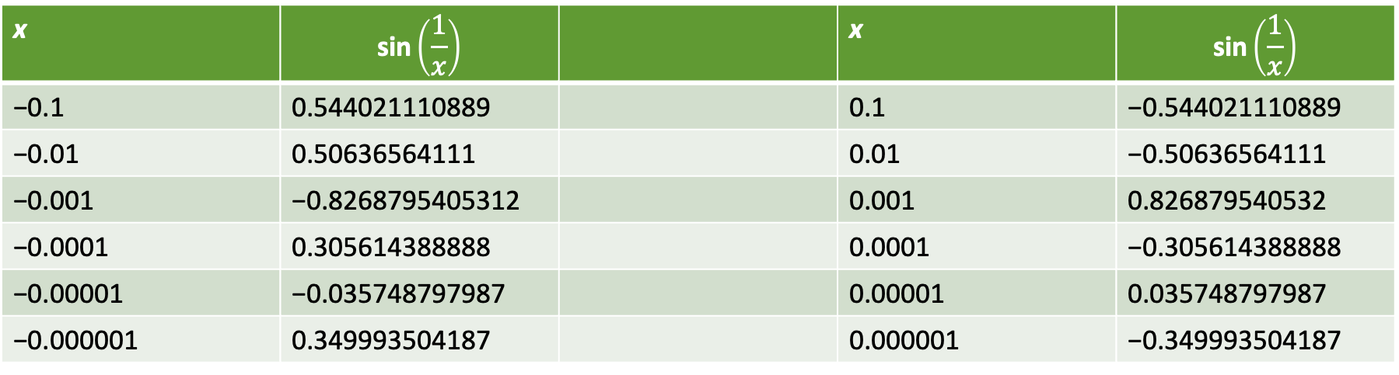
Tafla 2.5: Fallgildi fyrir lim(x→0) sin(1/x)
x | $$\text{sin}\left(\frac{1}{x}\right)$$ |  | x | $$\text{sin}\left(\frac{1}{x}\right)$$
−0.1 | 0.544021110889 |  | 0.1 | −0.544021110889
−0.01 | 0.50636564111 |  | 0.01 | −0.50636564111
−0.001 | −0.8268795405312 |  | 0.001 | 0.826879540532
−0.0001 | 0.305614388888 |  | 0.0001 | −0.305614388888
−0.00001 | −0.035748797987 |  | 0.00001 | 0.035748797987
−0.000001 | 0.349993504187 |  | 0.000001 | −0.349993504187

Slide 29
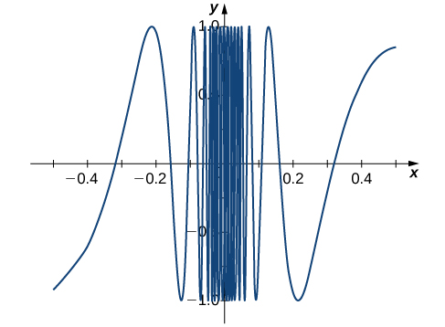
Mynd 2.17
Línurit fallsins f(x)=sin(1/x) sveiflast hratt á milli −1 og 1 þegar x stefnir á 0.
Notes:
The graph of the function f(x) = sin(1/x), which oscillates rapidly between -1 and 1 as x approaches 0. The oscillations are less frequent as the function moves away from 0 on the x axis.

Slide 30
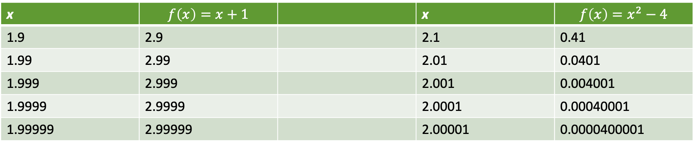
Tafla 2.6: Fallgildi fyrir
f(x)=x+1 ef x<2; f(x)=x²−4 ef x≥2
x | $$f\left(x\right)=x+1$$ |  | x | $$f\left(x\right)=x^{2}−4$$
1.9 | 2.9 |  | 2.1 | 0.41
1.99 | 2.99 |  | 2.01 | 0.0401
1.999 | 2.999 |  | 2.001 | 0.004001
1.9999 | 2.9999 |  | 2.0001 | 0.00040001
1.99999 | 2.99999 |  | 2.00001 | 0.0000400001

Slide 31
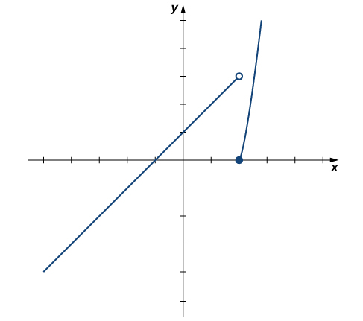
Mynd 2.18
Fallið f(x)=x+1 fyrir x<2 og f(x)=x²−4 fyrir x≥2 er ósamfellt við x=2.
Notes:
The graph of the given piecewise function. The first piece is f(x) = x+1 if x < 2. The second piece is x^2 – 4 if x >= 2. The first piece is a line with x intercept at (-1, 0) and y intercept at (0,1). There is an open circle at (2,3), where the endpoint would be. The second piece is the right half of a parabola opening upward. The vertex at (2,0) is a solid circle.

Slide 32
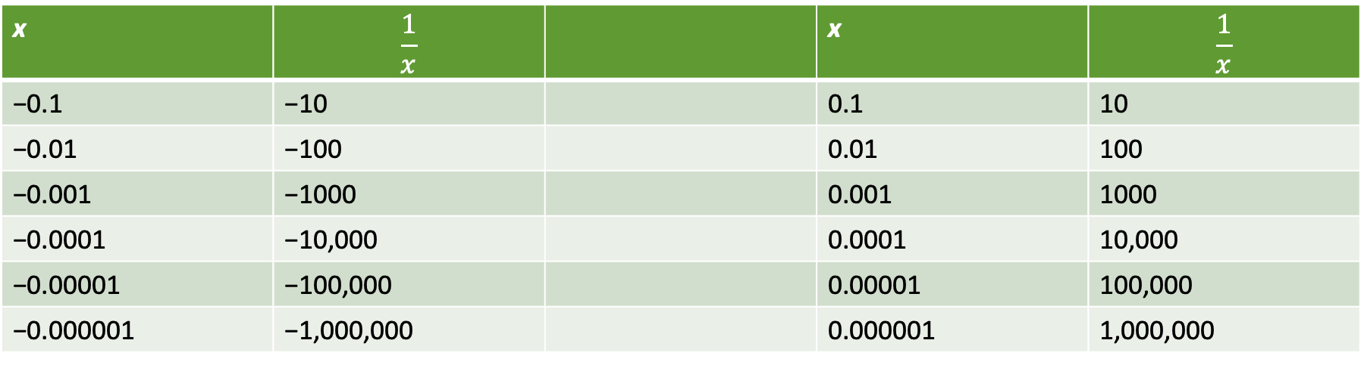
Tafla 2.7: Fallgildi fyrir f(x)=1/x
x | $$\frac{1}{x}$$ |  | x | $$\frac{1}{x}$$
−0.1 | −10 |  | 0.1 | 10
−0.01 | −100 |  | 0.01 | 100
−0.001 | −1000 |  | 0.001 | 1000
−0.0001 | −10,000 |  | 0.0001 | 10,000
−0.00001 | −100,000 |  | 0.00001 | 100,000
−0.000001 | −1,000,000 |  | 0.000001 | 1,000,000

Slide 33
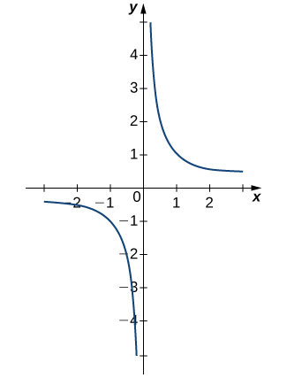
Mynd 2.19
Línurit fallsins f(x)=1/x staðfestir að markgildið þegar x stefnir á 0 er ekki til.
Notes:
The graph of the function f(x) = 1/x. The function curves asymptotically towards x=0 and y=0 in quadrants one and three.

Slide 34
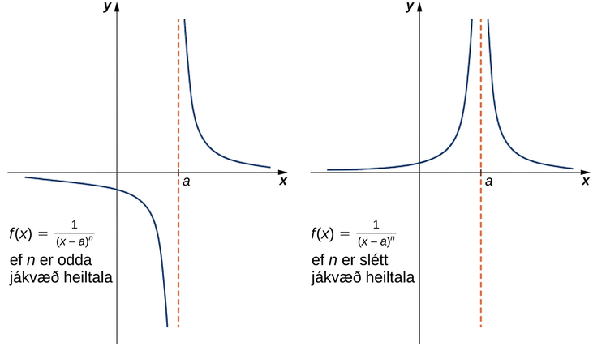
Mynd 2.20
Fallið f(x)=1/(x−a)^n hefur óendanleg markgildi þegar x nálgast a.
Notes:
Two graphs side by side of f(x) = 1 / (x-a)^n. The first graph shows the case where n is an odd positive integer, and the second shows the case where n is an even positive integer. In the first, the graph has two segments. Each curve asymptotically towards the x axis, also known as y=0, and x=a. The segment to the left of x=a is below the x axis, and the segment to the right of x=a is above the x axis. In the second graph, both segments are above the x axis.

Slide 35
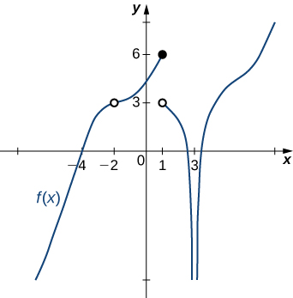
Mynd 2.21
Línuritið sýnir f(x).
Notes:
The graph of a function f(x) described by the above limits and values. There is a smooth curve for values below x=-2; at (-2, 3), there is an open circle. There is a smooth curve between (-2, 1] with a closed circle at (1,6). There is an open circle at (1,3), and a smooth curve stretching from there down asymptotically to negative infinity along x=3. The function also curves asymptotically along x=3 on the other side, also stretching to negative infinity. The function then changes concavity in the first quadrant around y=4.5 and continues up.

Slide 36

Mynd 2.22
(mynd: NASA)
Notes:
A picture of a futuristic spaceship speeding through deep space.

Slide 37
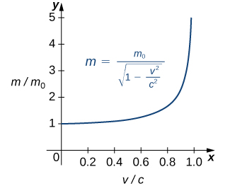
Mynd 2.23
Línuritið sýnir massahlutfallið sem fall af hraðahlutfallinu í jöfnu Einsteins fyrir massa hlutar á hreyfingu.
Notes:
A graph showing the ratio of masses as a function of the ratio of speed in Einstein’s equation for the mass of a moving object. The x axis is the ratio of the speeds, v/c. The y axis is the ratio of the masses, m/m0. The equation of the function is m = m0 / sqrt(1 – v2 / c2 ). The graph is only in quadrant 1. It starts at (0,1) and curves up gently until about 0.8, where it increases seemingly exponentially; there is a vertical asymptote at v/c (or x) = 1.

Slide 38
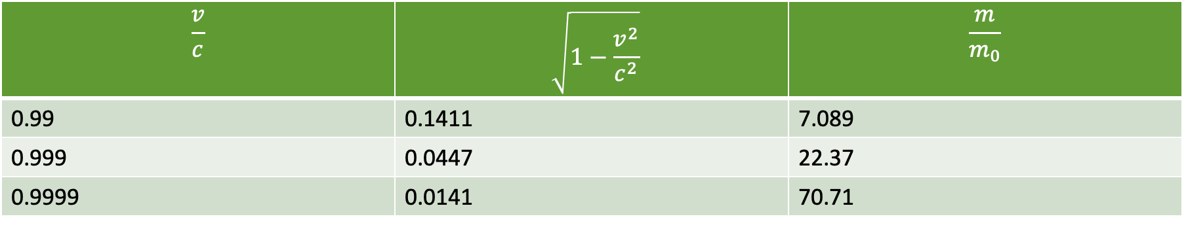
Tafla 2.8 Hlutföll massa og hraða hlutar á hreyfingu
$$\frac{v}{c}$$ | $$\sqrt{1−\frac{v^{2}}{c^{2}}}$$ | $$\frac{m}{m_{0}}$$
0.99 | 0.1411 | 7.089
0.999 | 0.0447 | 22.37
0.9999 | 0.0141 | 70.71

Slide 39
2.3 Reiknireglur fyrir markgildi (1 af 2)
Námsmarkmið
Þekkja helstu reiknireglur um markgildi.
Nota reiknireglur um markgildi til að reikna markgildi falls.
Reikna markgildi falls með þáttun.
Nota reiknireglur um markgildi til að reikna markgildi margliðu eða ræðs falls.
Reikna markgildi falls með þáttun eða samokum.

Slide 40
2.3 Reiknireglur fyrir markgildi (2 af 2)
Námsmarkmið
Reikna markgildi falls með klemmusetningunni.

Slide 41
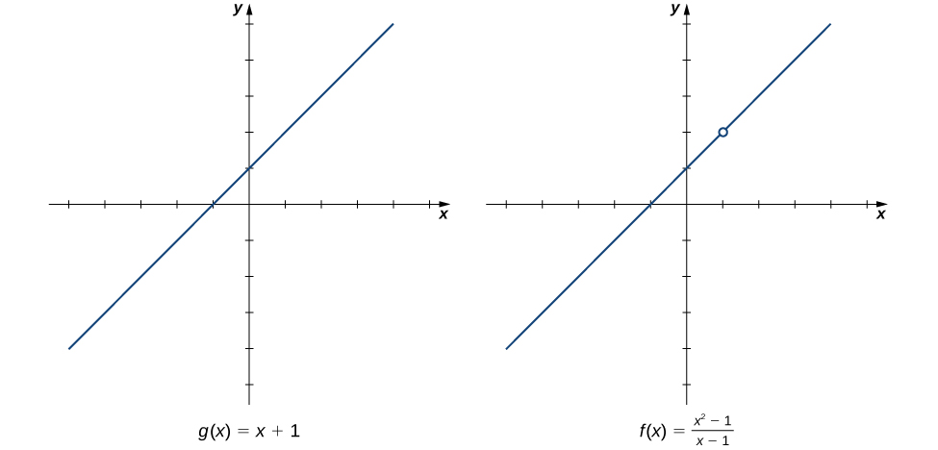
Mynd 2.24
Gröf f(x) og g(x) eru eins fyrir öll x≠1. Markgildi fallanna í 1 eru jöfn.
Notes:
Two graphs side by side. The first is a graph of g(x) = x + 1, a linear function with y intercept at (0,1) and x intercept at (-1,0). The second is a graph of f(x) = (x^2 – 1) / (x – 1). This graph is identical to the first for all x not equal to 1, as there is an open circle at (1,2) in the second graph.

Slide 42
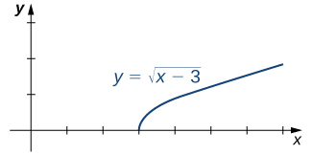
Mynd 2.25
Grafið sýnir fallið f(x)=x−3.
Notes:
A graph of the function f(x) = sqrt(x-3). Visually, the function looks like the top half of a parabola opening to the right with vertex at (3,0).

Slide 43
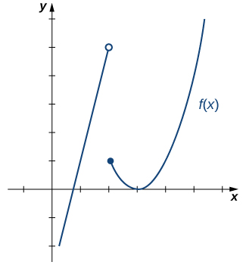
Mynd 2.26
Grafið sýnir fallið f(x).
Notes:
The graph of a piecewise function with two segments. For x<2, the function is linear with the equation 4x-3. There is an open circle at (2,5). The second segment is a parabola and exists for x>=2, with the equation (x-3)^2. There is a closed circle at (2,1). The vertex of the parabola is at (3,0).

Slide 44
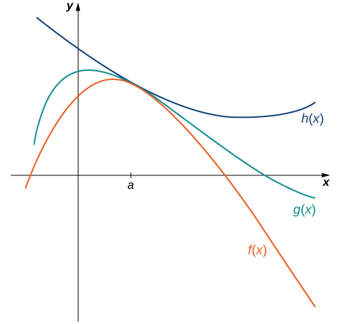
Mynd 2.27
Klemmusetningin gildir ef f(x)≤g(x)≤h(x) og markgildi f og h eru jöfn þegar x nálgast a.
Notes:
A graph of three functions over a small interval. All three functions curve. Over this interval, the function g(x) is trapped between the functions h(x), which gives greater y values for the same x values, and f(x), which gives smaller y values for the same x values. The functions all approach the same limit when x=a.

Slide 45
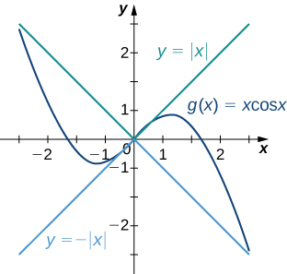
Mynd 2.28
Gröf f(x),g(x) og h(x) eru sýnd í grennd við punktinn x=0.
Notes:
The graph of three functions: h(x) = x, f(x) = -x, and g(x) = xcos(x). The first, h(x) = x, is a linear function with slope of 1 going through the origin. The second, f(x), is also a linear function with slope of −1; going through the origin. The third, g(x) = xcos(x), curves between the two and goes through the origin. It opens upward for x>0 and downward for x>0.

Slide 46
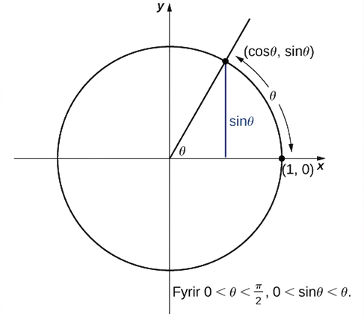
Mynd 2.29
Sínusfallið er sýnt sem línustrik við einingarhringinn.
Notes:
A diagram of the unit circle in the x,y plane – it is a circle with radius 1 and center at the origin. A specific point (cos(theta), sin(theta)) is labeled in quadrant 1 on the edge of the circle. This point is one vertex of a right triangle inside the circle, with other vertices at the origin and (cos(theta), 0). As such, the lengths of the sides are cos(theta) for the base and sin(theta) for the height, where theta is the angle created by the hypotenuse and base. The radian measure of angle theta is the length of the arc it subtends on the unit circle. The diagram shows that for 0 < theta < pi/2, 0 < sin(theta) < theta.

Slide 47
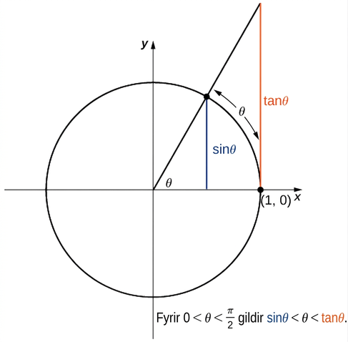
Mynd 2.30
Sínus- og tangensföllin eru sýnd sem línustrik við einingarhringinn.
Notes:
The same diagram as the previous one. However, the triangle is expanded. The base is now from the origin to (1,0). The height goes from (1,0) to (1, tan(theta)). The hypotenuse goes from the origin to (1, tan(theta)). As such, the height is now tan(theta). It shows that for 0 < theta < pi/2, sin(theta) < theta < tan(theta).

Slide 48
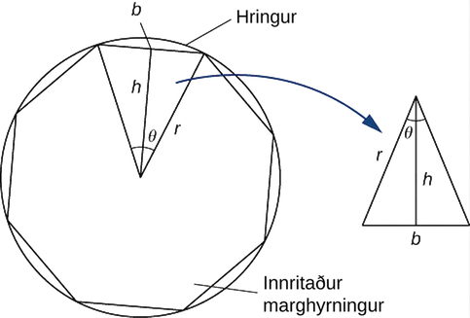
Mynd 2.31
Notes:
A diagram of a circle with an inscribed polygon – namely, an octagon. An isosceles triangle is drawn with one of the sides of the octagon as the base and center of the circle/octagon as the top vertex. The height h goes from the center of the base b to the center, and each of the legs is also radii r of the circle. The angle created by the height h and one of the legs r is labeled as theta.

Slide 49
2.4 Samfelldni
Námsmarkmið
Útskýra skilyrðin þrjú fyrir samfelldni í punkti.
Lýsa þremur gerðum ósamfelldni.
Skilgreina samfelldni á bili.
Setja fram setninguna um markgildi samsettra falla.
Nefna dæmi um milligildissetninguna.

Slide 50
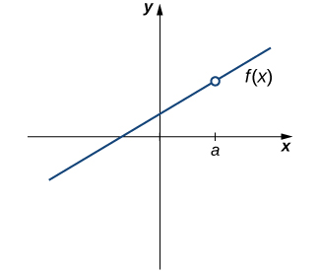
Mynd 2.32
Fallið f(x) er ekki samfellt í a því f(a) er óskilgreint.
Notes:
A graph of an increasing linear function f(x) which crosses the x axis from quadrant three to quadrant two and which crosses the y axis from quadrant two to quadrant one. A point a greater than zero is marked on the x axis. The point on the function f(x) above a is an open circle; the function is not defined at a.

Slide 51
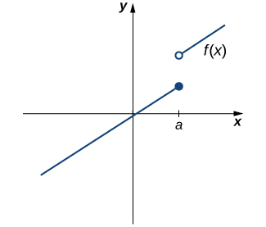
Mynd 2.33
Fallið f(x) er ekki samfellt í a því markgildið þegar x nálgast a er ekki til.
Notes:
The graph of a piecewise function f(x) with two parts. The first part is an increasing linear function that crosses from quadrant three to quadrant one at the origin. A point a greater than zero is marked on the x axis. At fa. on this segment, there is a solid circle. The other segment is also an increasing linear function. It exists in quadrant one for values of x greater than a. At x=a, this segment has an open circle.

Slide 52
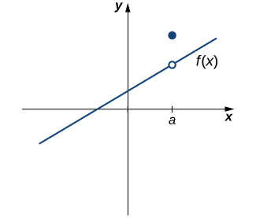
Mynd 2.34
Fallið f(x) er ekki samfellt í a því markgildið þegar x nálgast a er ekki jafnt f(a).
Notes:
The graph of a piecewise function with two parts. The first part is an increasing linear function that crosses the x axis from quadrant three to quadrant two and which crosses the y axis from quadrant two to quadrant one. A point a greater than zero is marked on the x axis. At this point, there is an open circle on the linear function. The second part is a point at x=a above the line.

Slide 53
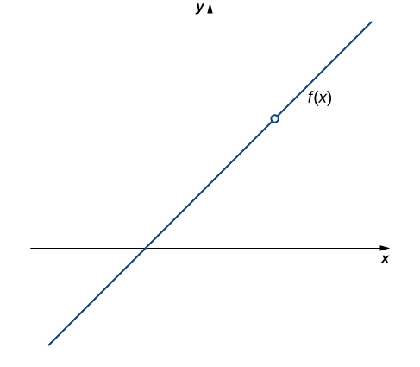
Mynd 2.35
Fallið f(x) er ósamfellt í 2 því f(2) er óskilgreint.
Notes:
A graph of the given function. There is a line which crosses the x axis from quadrant three to quadrant two and which crosses the y axis from quadrant two to quadrant one. At a point in quadrant one, there is an open circle where the function is not defined.

Slide 54
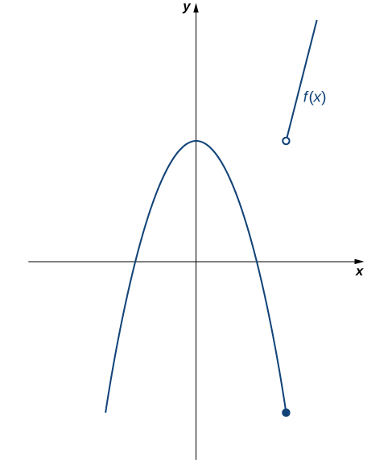
Mynd 2.36
Fallið f(x) er ekki samfellt í 3 því markgildið þegar x nálgast 3 er ekki til.
Notes:
A graph of the given piecewise function, which has two parts. The first is a downward opening parabola which is symmetric about the y axis. Its vertex is on the y axis, greater than zero. There is a closed circle on the parabola for x=3. The second part is an increasing linear function in the first quadrant, which exists for values of x > 3. There is an open circle at the end of the line where x would be 3.

Slide 55
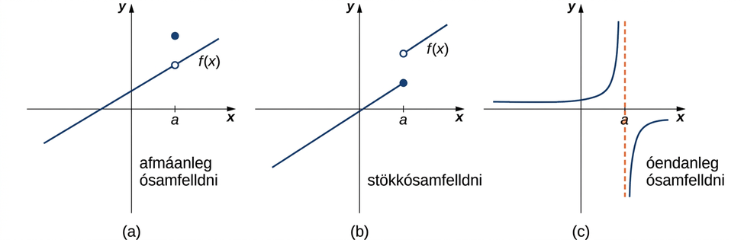
Mynd 2.37
Ósamfelldni flokkast í (a) afmáanlega ósamfelldni, (b) stökkósamfelldni og (c) óendanlega ósamfelldni.
Notes:
Three graphs, each showing a different discontinuity. The first is removable discontinuity. Here, the given function is a line with positive slope. At a point x=a, where a>0, there is an open circle on the line and a closed circle a few units above the line. The second is a jump discontinuity. Here, there are two lines with positive slope. The first line exists for x<=a, and the second exists for x>a, where a>0. The first line ends at a solid circle where x=a, and the second begins a few units up with an open circle at x=a. The third discontinuity type is infinite discontinuity. Here, the function has two parts separated by an asymptote x=a. The first segment is a curve stretching along the x axis to 0 as x goes to negative infinity and along the y axis to infinity as x goes to zero. The second segment is a curve stretching along the y axis to negative infinity as x goes to zero and along the x axis to 0 as x goes to infinity.

Slide 56
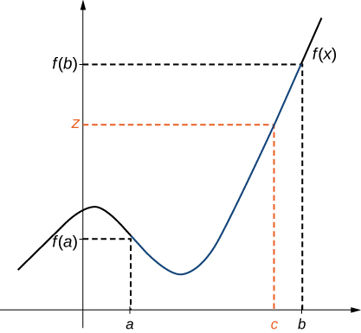
Mynd 2.38
Til er tala c∈[a,b] sem uppfyllir f(c)=z.
Notes:
A diagram illustrating the intermediate value theorem. There is a generic continuous curved function shown over the interval [a,b]. The points fa. and fb. are marked, and dotted lines are drawn from a, b, fa., and fb. to the points (a, fa.) and (b, fb.). A third point, c, is plotted between a and b. Since the function is continuous, there is a value for fc. along the curve, and a line is drawn from c to (c, fc.) and from (c, fc.) to fc., which is labeled as z on the y axis.

Slide 57
2.5 Nákvæm skilgreining á markgildi
Námsmarkmið
Lýsa epsílon-delta-skilgreiningu markgildis.
Beita epsílon-delta-skilgreiningunni til að finna markgildi falls.
Lýsa epsílon-delta-skilgreiningum einhliða og óendanlegra markgilda.
Nota epsílon-delta-skilgreininguna til að sanna reiknireglur um markgildi.

Slide 58
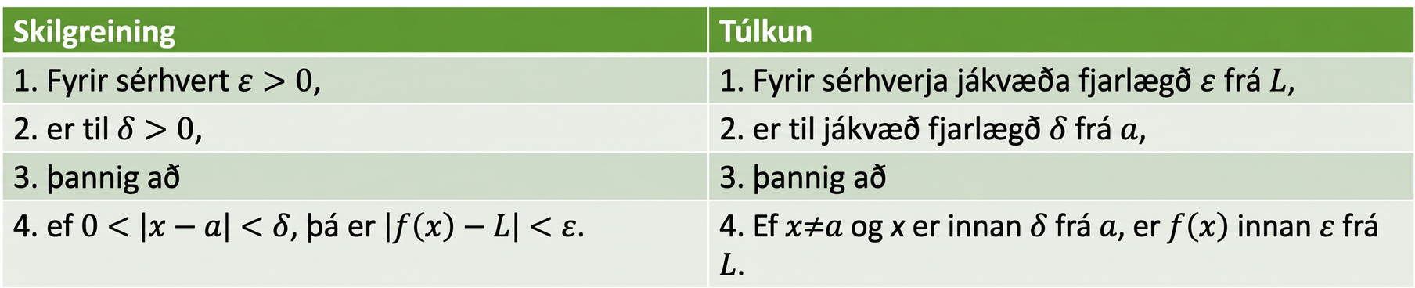
Tafla 2.9 Túlkun epsílon-delta-skilgreiningar markgildis
Skilgreining | Túlkun
1. Fyrir sérhvert $ε>0,$ | 1. Fyrir sérhverja jákvæða fjarlægð ε frá L,
2. er til $δ>0,$ | 2. Til er jákvæð fjarlægð $δ$ frá a,
3. þannig að | 3. þannig að
4. ef $0<\left|x−a\right|<δ,$ þá $\left|f\left(x\right)−L\right|<ε.$ | 4. ef x er í minni fjarlægð en $δ$ frá a og $x≠a,$ þá $f\left(x\right)$ er í minni fjarlægð en ε frá L.

Slide 59
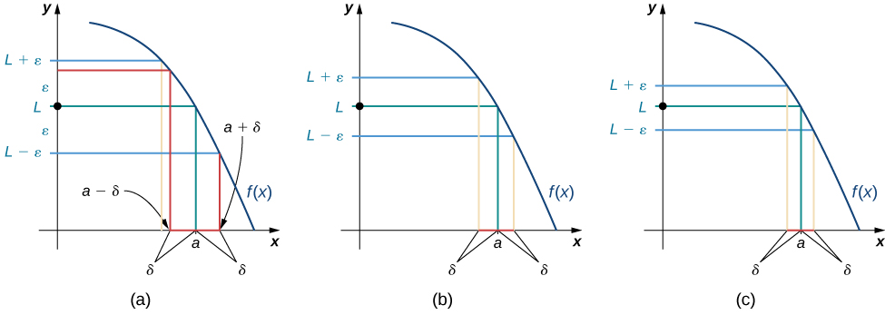
Mynd 2.39
Gröfin sýna möguleg gildi δ þegar ε er valið sífellt minna.
Notes:
There are three graphs side by side showing possible values of delta, given successively smaller choices of epsilon. Each graph has a decreasing, concave down curve in quadrant one. Each graph has the point (a, L) marked on the curve, where L is the limit of the function at the point where x=a. On either side of L on the y axis, a distance epsilon is marked off - namely, a line is drawn through the function at y = L + epsilon and L – epsilon. As smaller values of epsilon are chosen going from graph one to graph three, smaller values of delta to the left and right of point a can be found so that if we have chosen an x value within delta of a, then the value of f(x) is within epsilon of the limit L.

Slide 60
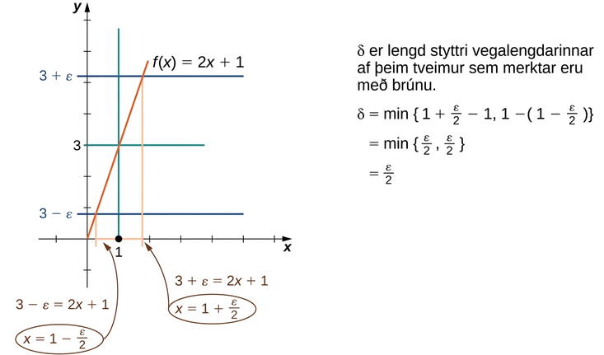
Mynd 2.40
Grafið sýnir hvernig δ er fundið með rúmfræðilegri aðferð.
Notes:
This graph shows how to find delta geometrically. The function 2x + 1 is drawn in red from x=0 to 2. A straight line is drawn at y=3 in green, which intersects the function at (1,3). Two blues lines are drawn at 3 + epsilon and 3 – epsilon, which are graphed here between 5 and 6 and between 0 and 1, respectively. Finally, two pink lines are drawn down from the points of intersection of the function and the blue lines – the taller between 1 and 2, and the shorter between 0 and 1. Since the blue lines and the function intersect, we can solve for x. For the shorter, corresponding to the line y = 3 – epsilon, we have 3 – epsilon = 2x + 1, which simplifies to x = 1 – epsilon / 2. For the taller, corresponding to the line y = 3 + epsilon, we have 3 + epsilon = 2x + 1, which simplifies to x = 1 + epsilon / 2. Delta is the smaller of the two distances between 1 and where the pink lines intersect with the x axis. We have delta is the min of 1 + epsilon / 2 -1 and 1 – (1 – epsilon / 2), which is the min of epsilon / 2 and epsilon / 2, which is simply epsilon / 2.

Slide 61
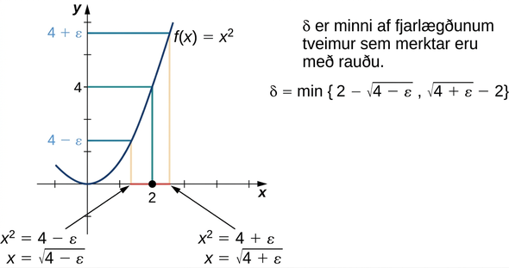
Mynd 2.41
Grafið sýnir hvernig δ er fundið með rúmfræðilegri aðferð fyrir gefið ε í sönnuninni í dæmi 2.41.
Notes:
This graph shows how to find delta geometrically for a given epsilon for the above proof. First, the function f(x) = x^2 is drawn from [-1, 3]. On the y axis, the proposed limit 4 is marked, and the line y=4 is drawn to intersect with the function at (2,4). For a given epsilon, point 4 + epsilon and 4 – epsilon are marked on the y axis above and below 4. Blue lines are drawn from these points to intersect with the function, where pink lines are drawn from the point of intersection to the x axis. These lines land on either side of x=2. Next, we solve for these x values, which have to be positive here. The first is x^2 = 4 – epsilon, which simplifies to x = sqrt(4-epsilon). The next is x^2 = 4 + epsilon, which simplifies to x = sqrt(4 + epsilon). Delta is the smaller of the two distances, so it is the min of (2 – sqrt(4 – epsilon) and sqrt(4 + epsilon) – 2).

Slide 62
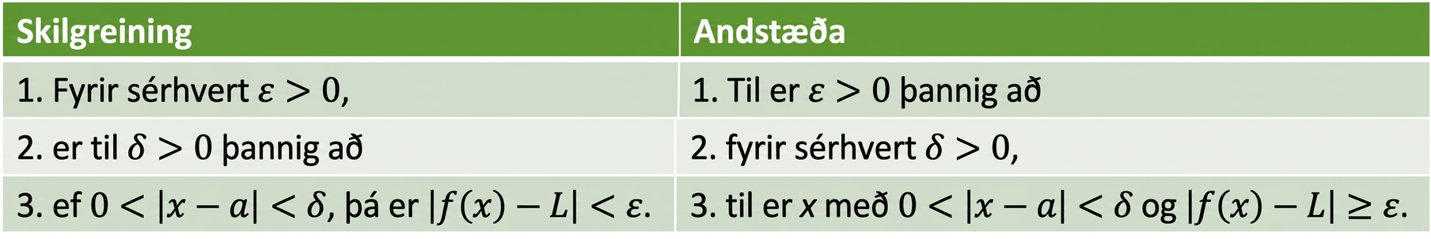
Tafla 2.10: Túlkun lim(x→a) f(x)=L og andstæða hennar
Skilgreining | Andstæða
1. Fyrir sérhvert $ε>0,$ | 1. Til er $ε>0$ þannig að
2. til er $δ>0,$ þannig að | 2. fyrir sérhvert $δ>0,$
3. ef $0<\left|x−a\right|<δ,$ þá $\left|f\left(x\right)−L\right|<ε.$ | 3. Til er x sem uppfyllir $0<\left|x−a\right|<δ$ þannig að $\left|f\left(x\right)−L\right|≥ε.$

Slide 63

Mynd 2.42
Grafið sýnir hvernig δ er fundið fyrir sönnunina í dæmi 2.44.
Notes:
A graph showing how to find delta for the above proof. The function f(x) = sqrt(x-4) is drawn for x > 4. Since the proposed limit is 0, lines y = 0 + epsilon and y = 0 – epsilon are drawn in blue. Since only the top blue line corresponding to y = 0 + epsilon intersects the function, one red line is drawn from the point of intersection to the x axis. This x value is found by solving sqrt(x-4) = epsilon, or x = epsilon squared + 4. Delta is then the distance between this point and 4, which is epsilon squared.

Slide 64

Mynd 2.43
Á gröfunum eru gildi δ teiknuð fyrir M til að sýna að f(x) stefnir á +∞ þegar x nálgast a.
Notes:
Two graphs side by side. Each graph contains two curves above the x axis separated by an asymptote at x=a. The curves on the left go to infinity as x goes to a and to 0 as x goes to negative infinity. The curves on the right go to infinity as x goes to a and to 0 as x goes to infinity. The first graph has a value M greater than zero marked on the y axis and a horizontal line drawn from there (y=M) to intersect with both curves. Lines are drawn down from the points of intersection to the x axis. Delta is the smaller of the distances between point a and these new spots on the x axis. The same lines are drawn on the second graph, but this M is larger, and the distances from the x axis intersections to point a are smaller.

Slide 65
Notkunarleyfi
Þetta viðbótarefni frá OpenStax er © Rice University og gefið út samkvæmt alþjóðlega CC BY-NC-SA 4.0-notkunarleyfinu. Aðeins má afrita það eða breyta því í óviðskiptalegum tilgangi, en geta verður OpenStax og Rice University sem rétthafa og tilgreina allar breytingar. Sérhverja aðlögun verður að birta með sams konar notkunarleyfi.

