Slide 1

Stærðfræðigreining, 1. bindi
1. kafli: Föll og gröf

Slide 2
Yfirlit kaflans
Upprifjun á föllum
Helstu flokkar falla
Hornaföll
Andhverf föll
Vísisföll og lograföll

Slide 3
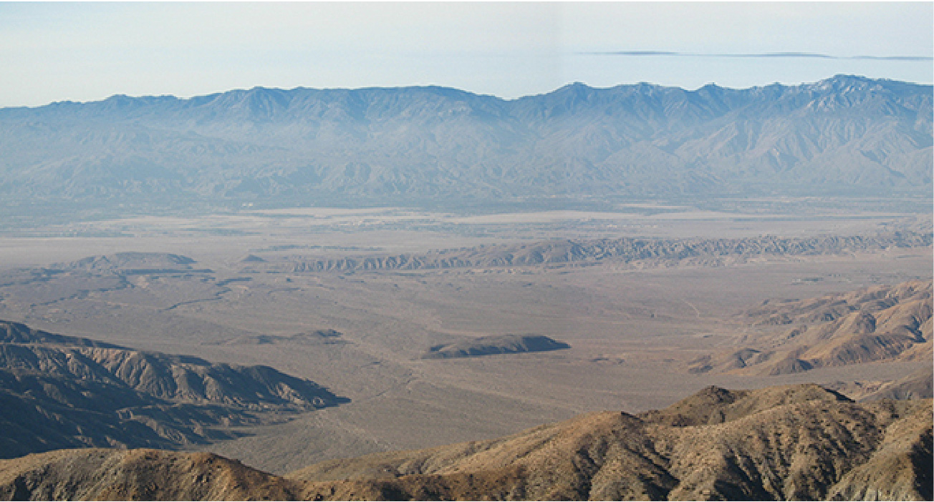
Mynd 1.1
Hluti San Andreas-misgengisins í Kaliforníu. Við stór misgengi af þessu tagi verða flestir öflugustu jarðskjálftar sem mælst hafa. (mynd: breytt útgáfa af verki Robb Hannawacker, NPS)
Notes:
A photograph of an earthquake fault.

Slide 4
1.1 Upprifjun á föllum (1 af 2)
Hæfniviðmið
Nota fallatáknun til að reikna gildi falls.
Ákvarða skilgreiningarmengi og myndmengi falls.
Teikna graf falls.
Finna núllstöðvar falls.
Þekkja fall út frá gildatöflu.
Mynda ný föll úr tveimur eða fleiri gefnum föllum.

Slide 5
1.1 Upprifjun á föllum (2 af 2)
Hæfniviðmið
Lýsa samhverfueiginleikum falls.

Slide 6
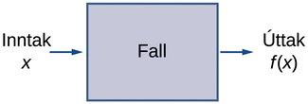
Mynd 1.2
Lýsa má falli sem inntaks- og úttakstæki.
Notes:
An image with three items. The first item is text that reads “Input, x”. An arrow points from the first item to the second item, which is a box with the label “function”. An arrow points from the second item to the third item, which is text that reads “Output, f(x)”.

Slide 7
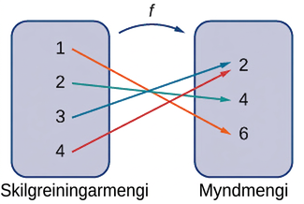
Mynd 1.3
Fall varpar hverju staki skilgreiningarmengisins á nákvæmlega eitt stak í myndmenginu. Þótt hvert inntak geti aðeins samsvarað einu úttaki geta tvö ólík inntök samsvarað sama úttaki.
Notes:
An image with two items. The first item is a bubble labeled domain. Within the bubble are the numbers 1, 2, 3, and 4. An arrow with the label “f” points from the first item to the second item, which is a bubble labeled “range”. Within this bubble are the numbers 2, 4, and 6. An arrow points from the 1 in the domain bubble to the 6 in the range bubble. An arrow points from the 1 in the domain bubble to the 6 in the range bubble. An arrow points from the 2 in the domain bubble to the 4 in the range bubble. An arrow points from the 3 in the domain bubble to the 2 in the range bubble. An arrow points from the 4 in the domain bubble to the 2 in the range bubble.

Slide 8
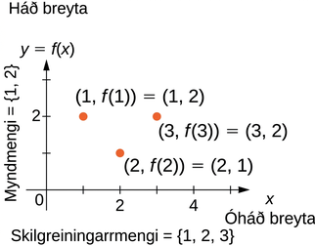
Mynd 1.4
Í þessu tilviki hefur graf fallsins f skilgreiningarmengið {1,2,3} og myndmengið {1,2}. Óháða breytan er x og háða breytan er y.
Notes:
An image of a graph. The y axis runs from 0 to 3 and has the label “dependent variable, y = f(x)”. The x axis runs from 0 to 5 and has the label “independent variable, x”. There are three points on the graph. The first point is at (1, 2) and has the label “(1, f(1)) = (1, 2)”. The second point is at (2, 1) and has the label “(2, f(2))=(2,1)”. The third point is at (3, 2) and has the label “(3, f(3)) = (3,2)”. There is text along the y axis that reads “range = {1, 2}” and text along the x axis that reads “domain = {1,2,3}”.

Slide 9
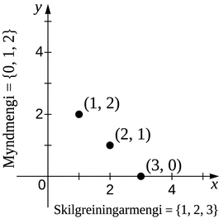
Mynd 1.5
Hér sést graf fallsins f með skilgreiningarmengið {1,2,3} og regluna f(x)=3−x. Grafið samanstendur af punktunum (x,f(x)) fyrir öll x í skilgreiningarmenginu.
Notes:
An image of a graph. The y axis runs from 0 to 5. The x axis runs from 0 to 5. There are three points on the graph at (1, 2), (2, 1), and (3, 0). There is text along the y axis that reads “range = {0,1,2}” and text along the x axis that reads “domain = {1,2,3}”.

Slide 10
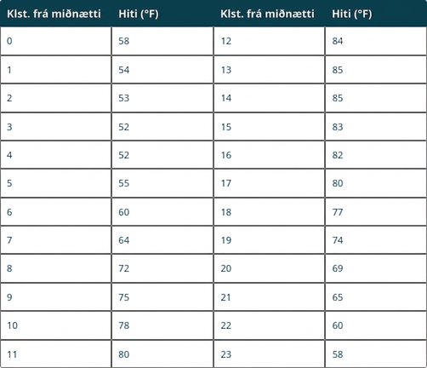
Tafla 1.1 Hitastig sem fall af tíma dags
Notes:
Table 1.1 Temperature as a Function of Time of Day; Columns: Hours after Midnight, Temperature (°F), Hours after Midnight, Temperature (°F); Row 1: 0, 58, 12, 84; Row 2: 1, 54, 13, 85; Row 3: 2, 53, 14, 85; Row 4: 3, 52, 15, 83; Row 5: 4, 52, 16, 82; Row 6: 5, 55, 17, 80; Row 7: 6, 60, 18, 77; Row 8: 7, 64, 19, 74; Row 9: 8, 72, 20, 69; Row 10: 9, 75, 21, 65; Row 11: 10, 78, 22, 60; Row 12: 11, 80, 23, 58

Slide 11
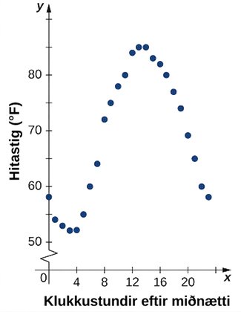
Mynd 1.6
Graf gagnanna í töflu 1.1 sýnir hitastig sem fall af tíma.
Notes:
An image of a graph. The y axis runs from 0 to 90 and has the label “Temperature in Fahrenheit”. The x axis runs from 0 to 24 and has the label “hours after midnight”. There are 24 points on the graph, one at each increment of 1 on the x-axis. The first point is at (0, 58) and the function decreases until x = 4, where the point is (4, 52) and is the minimum value of the function. After x=4, the function increases until x = 13, where the point is (13, 85) and is the maximum of the function along with the point (14, 85). After x = 14, the function decreases until the last point on the graph, which is (23, 58).

Slide 12
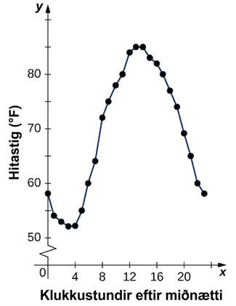
Mynd 1.7
Þegar punktarnir á mynd 1.6 eru tengdir kemur almennt mynstur gagnanna í ljós.
Notes:
An image of a graph. The y axis runs from 0 to 90 and has the label “Temperature in Fahrenheit”. The x axis runs from 0 to 24 and has the label “hours after midnight”. There are 24 points on the graph, one at each increment of 1 on the x-axis. The first point is at (0, 58) and the function decreases until x = 4, where the point is (4, 52) and is the minimum value of the function. After x=4, the function increases until x = 13, where the point is (13, 85) and is the maximum of the function along with the point (14, 85). After x = 14, the function decreases until the last point on the graph, which is (23, 58). A line connects all the points on the graph.

Slide 13
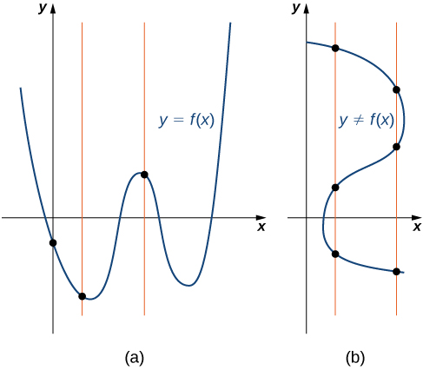
Mynd 1.8
(a) Punktasafnið er graf falls því sérhver lóðrétt lína sker það í mesta lagi einu sinni. (b) Punktasafnið er ekki graf falls því sumar lóðréttar línur skera það oftar en einu sinni.
Notes:
An image of two graphs. The first graph is labeled “a” and is of the function “y = f(x)”. Three vertical lines run through 3 points on the function, each vertical line only passing through the function once. The second graph is labeled “b” and is of the relation “y not equal to f(x)”. Two vertical lines run through the relation, one line intercepting the relation at 3 points and the other line intercepting the relation at 3 different points.

Slide 14
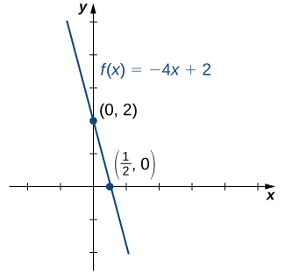
Mynd 1.9
Graf fallsins f(x)=−4x+2 er lína með x-skurðpunktinn (1/2,0) og y-skurðpunktinn (0,2).
Notes:
An image of a graph. The y axis runs from -2 to 5 and the x axis runs from -2 to 5. The graph is of the function “f(x) = -4x + 2”, which is a decreasing straight line. There are two points plotted on the function at (0, 2) and (1/2, 0).

Slide 15

Tafla 1.2
$$x$$ | $$−3$$ | $$−2$$ | $$1$$
$$f\left(x\right)$$ | $$1$$ | $$2$$ | $$3$$

Slide 16
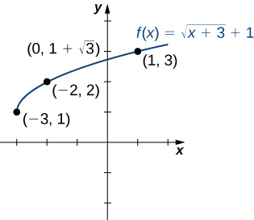
Mynd 1.10
Graf fallsins f(x)=√(x+3)+1 hefur y-skurðpunkt en enga x-skurðpunkta.
Notes:
An image of a graph. The y axis runs from -2 to 4 and the x axis runs from -3 to 2. The graph is of the function “f(x) = (square root of x + 3) + 1”, which is an increasing curved function that starts at the point (-3, 1). There are 3 points plotted on the function at (-3, 1), (-2, 2), and (1, 3). The function has a y intercept at (0, 1 + square root of 3).

Slide 17
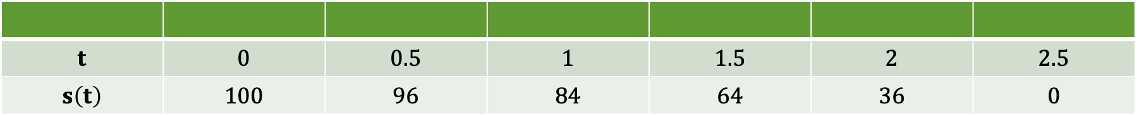
Tafla 1.3 Hæð $s$ sem fall af tíma $t$
$$t$$ | $$0$$ | $$0.5$$ | $$1$$ | $$1.5$$ | $$2$$ | $$2.5$$
$$s\left(t\right)$$ | $$100$$ | $$96$$ | $$84$$ | $$64$$ | $$36$$ | $$0$$

Slide 18
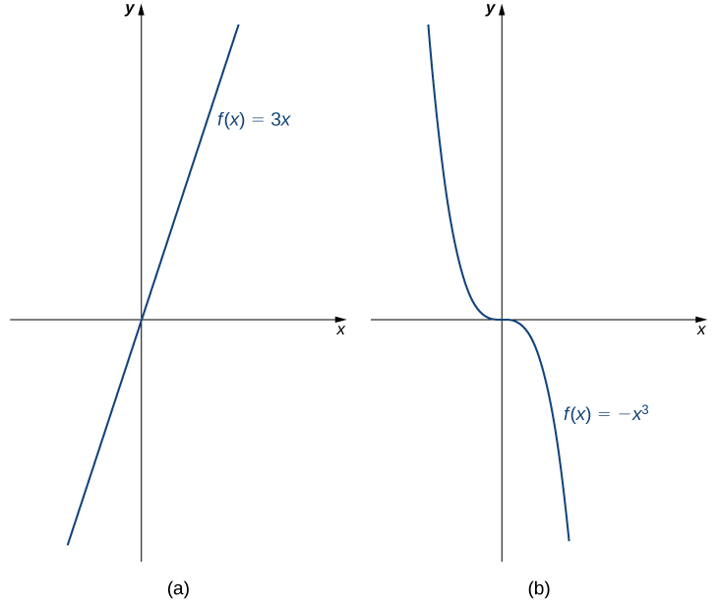
Mynd 1.11
(a) Fallið f(x)=3x er vaxandi á bilinu (−∞,∞). (b) Fallið f(x)=−x³ er minnkandi á bilinu (−∞,∞).
Notes:
An image of two graphs. The first graph is labeled “a” and is of the function “f(x) = 3x”, which is an increasing straight line that passes through the origin. The second graph is labeled “b” and is of the function “f(x) = -x cubed”, which is curved function that decreases until the function hits the origin where it becomes level, then decreases again after the origin.

Slide 19
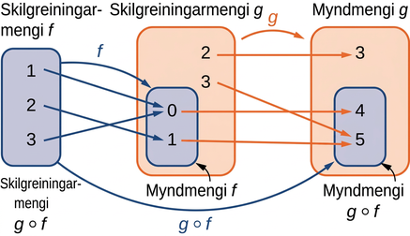
Mynd 1.12
Fyrir samsetta fallið g∘f gildir (g∘f)(1)=4, (g∘f)(2)=5 og (g∘f)(3)=4.
Notes:
An image with three items. The first item is a blue bubble that has two labels: “domain of f” and “domain of g of f”. This item contains the numbers 1, 2, and 3. The second item is two bubbles: an orange bubble labeled “domain of g” and a blue bubble that is completely contained within the orange bubble and is labeled “range of f”. The blue bubble contains the numbers 0 and 1, which are thus also contained within the larger orange bubble. The orange bubble contains two numbers not contained within the smaller blue bubble, which are 2 and 3. The third item is two bubbles: an orange bubble labeled “range of g” and a blue bubble that is completely contained within the orange bubble and is labeled “range of g of f”. The blue bubble contains the numbers 4 and 5, which are thus also contained within the larger orange bubble. The orange bubble contains one number not contained within the smaller blue bubble, which is the number 3. The first item points has a blue arrow with the label “f” that points to the blue bubble in the second item. The orange bubble in the second item has an orange arrow labeled “g” that points the orange bubble in the third item. The first item has a blue arrow labeled “g of f” which points to the blue bubble in the third item. There are three blue arrows pointing from numbers in the first item to the numbers contained in the blue bubble of the second item. The first blue arrow points from the 1 to the 0, the second blue arrow points from the 2 to the 1, and the third blue arrow points from the 3 to the 0. There are 4 orange arrows pointing from the numbers contained in the orange bubble in the second item, including those also contained in the blue bubble of the second item, to the numbers contained in the orange bubble of the third item, including the numbers in the blue bubble of the third item. The first orange arrow points from 2 to 3, the second orange arrow points from 3 to 5, the third orange arrow points from 0 to 4, and the fourth orange arrow points from 1 to 5.

Slide 20
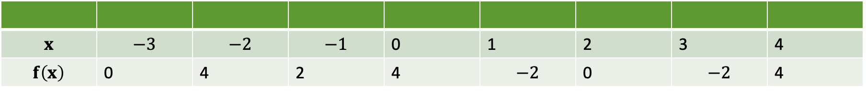
Tafla 1.4
$$x$$ | $$−3$$ | $$−2$$ | $$−1$$ | 0 | 1 | 2 | 3 | 4
$$f\left(x\right)$$ | 0 | 4 | 2 | 4 | $$−2$$ | 0 | $$−2$$ | 4

Slide 21
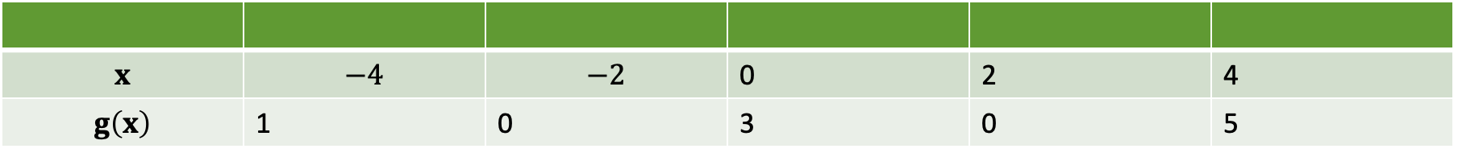
Tafla 1.5
$$x$$ | $$−4$$ | $$−2$$ | 0 | 2 | 4
$$g\left(x\right)$$ | 1 | 0 | 3 | 0 | 5

Slide 22
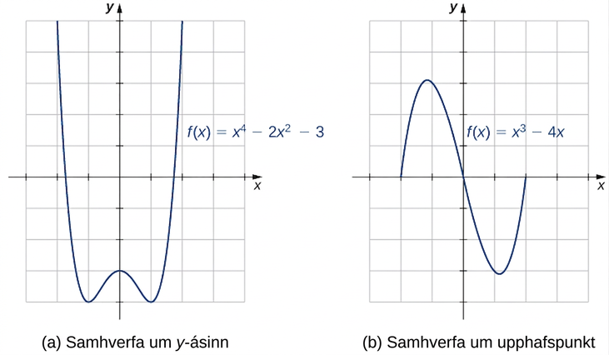
Mynd 1.13
(a) Graf sem er samhverft um y-ásinn. (b) Graf sem er samhverft um upphafspunkt hnitakerfisins.
Notes:
An image of two graphs. The first graph is labeled “(a), symmetry about the y-axis” and is of the curved function “f(x) = (x to the 4th) - 2(x squared) - 3”. The x axis runs from -3 to 4 and the y axis runs from -4 to 5. This function decreases until it hits the point (-1, -4), which is minimum of the function. Then the graph increases to the point (0,3), which is a local maximum. Then the the graph decreases until it hits the point (1, -4), before it increases again. The second graph is labeled “(b), symmetry about the origin” and is of the curved function “f(x) = x cubed - 4x”. The x axis runs from -3 to 4 and the y axis runs from -4 to 5. The graph of the function starts at the x intercept at (-2, 0) and increases until the approximate point of (-1.2, 3.1). The function then decreases, passing through the origin, until it hits the approximate point of (1.2, -3.1). The function then begins to increase again and has another x intercept at (2, 0).

Slide 23
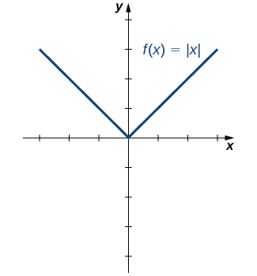
Mynd 1.14
Graf fallsins f(x)=|x| er samhverft um y-ásinn.
Notes:
An image of a graph. The x axis runs from -3 to 3 and the y axis runs from -4 to 4. The graph is of the function “f(x) = absolute value of x”. The graph starts at the point (-3, 3) and decreases in a straight line until it hits the origin. Then the graph increases in a straight line until it hits the point (3, 3).

Slide 24
1.2 Helstu flokkar falla (1 af 3)
Hæfniviðmið
Reikna hallatölu línulegs falls og túlka merkingu hennar.
Ákvarða stig margliðu.
Finna rætur annars stigs margliðu.
Lýsa gröfum einfaldra oddstæðra og jafnstæðra margliðufalla.
Þekkja rætt fall.
Lýsa gröfum veldisfalla og rótarfalla.

Slide 25
1.2 Helstu flokkar falla (2 af 3)
Hæfniviðmið
Útskýra muninn á algebruföllum og yfirskilvitlegum föllum.
Teikna graf kaflaskilgreinds falls.

Slide 26
1.2 Helstu flokkar falla (3 af 3)
Hæfniviðmið
Skissa graf falls sem hefur verið hliðrað, teygt eða speglað miðað við upphaflega stöðu grafsins.

Slide 27
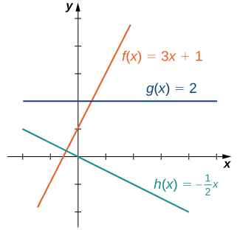
Mynd 1.15
Þessi línulegu föll eru vaxandi eða minnkandi á (-∞, ∞), en eitt fallið er lárétt lína.
Notes:
An image of a graph. The y axis runs from -2 to 5 and the x axis runs from -2 to 5. The graph is of the 3 functions. The first function is “f(x) = 3x + 1”, which is an increasing straight line with an x intercept at ((-1/3), 0) and a y intercept at (0, 1). The second function is “g(x) = 2”, which is a horizontal line with a y intercept at (0, 2) and no x intercept. The third function is “h(x) = (-1/2)x”, which is a decreasing straight line with an x intercept and y intercept both at the origin. The function f(x) is increasing at a higher rate than the function h(x) is decreasing.

Slide 28
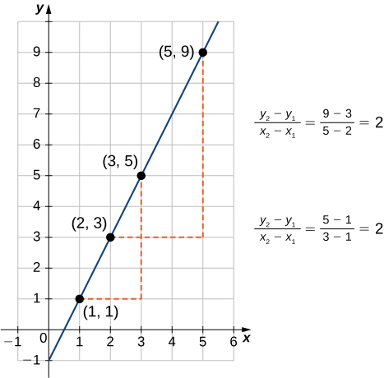
Mynd 1.16
Fyrir sérhvert línulegt fall er hallatalan (y2−y1)/(x2−x1) óháð því hvaða punktar (x1,y1) og (x2,y2) eru valdir á línunni.
Notes:
An image of a graph. The y axis runs from -1 to 10 and the x axis runs from -1 to 6. The graph is of a function that is an increasing straight line. There are four points labeled on the function at (1, 1), (2, 3), (3, 5), and (5, 9). There is a dotted horizontal line from the labeled function point (1, 1) to the unlabeled point (3, 1) which is not on the function, and then dotted vertical line from the unlabeled point (3, 1), which is not on the function, to the labeled function point (3, 5). These two dotted have the label “(y2 - y1)/(x2 - x1) = (5 -1)/(3 - 1) = 2”. There is a dotted horizontal line from the labeled function point (2, 3) to the unlabeled point (5, 3) which is not on the function, and then dotted vertical line from the unlabeled point (5, 3), which is not on the function, to the labeled function point (5, 9). These two dotted have the label “(y2 - y1)/(x2 - x1) = (9 -3)/(5 - 2) = 2”.

Slide 29
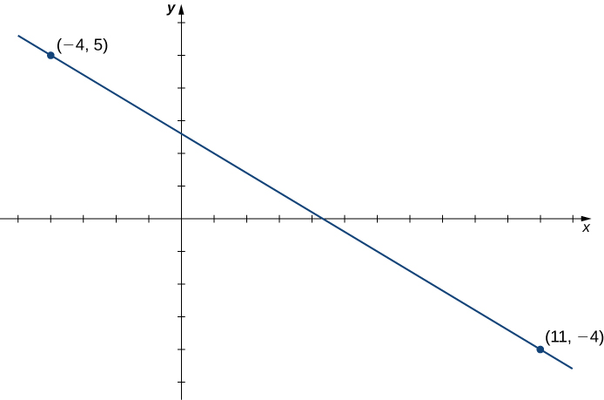
Mynd 1.17
Jafna línulegs falls fundin þegar graf þess er línan gegnum tvo gefna punkta.
Notes:
An image of a graph. The x axis runs from -5 to 12 and the y axis runs from -5 to 6. The graph is of the function that is a decreasing straight line. The function has two points plotted, at (-4, 5) and (11, 4).

Slide 30
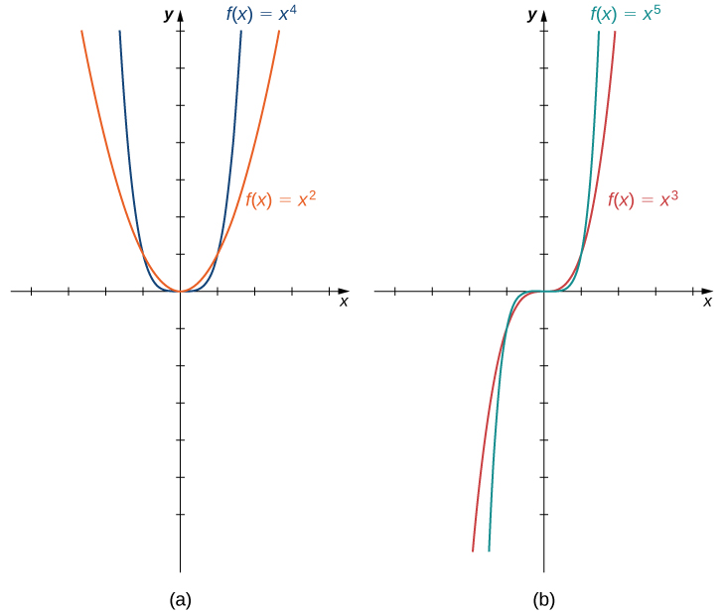
Mynd 1.18
(a) Fyrir sérhverja slétta heiltölu n er f(x)=axⁿ jafnstætt fall. (b) Fyrir sérhverja oddatölu n er f(x)=axⁿ oddstætt fall.
Notes:
An image of two graphs. Both graphs have an x axis that runs from -4 to 4 and a y axis that runs from -6 to 7. The first graph is labeled “a” and is of two functions. The first function is “f(x) = x to the 4th”, which is a parabola that decreases until the origin and then increases again after the origin. The second function is “f(x) = x squared”, which is a parabola that decreases until the origin and then increases again after the origin, but increases and decreases at a slower rate than the first function. The second graph is labeled “b” and is of two functions. The first function is “f(x) = x to the 5th”, which is a curved function that increases until the origin, becomes even at the origin, and then increases again after the origin. The second function is “f(x) = x cubed”, which is a curved function that increases until the origin, becomes even at the origin, and then increases again after the origin, but increases at a slower rate than the first function.

Slide 31
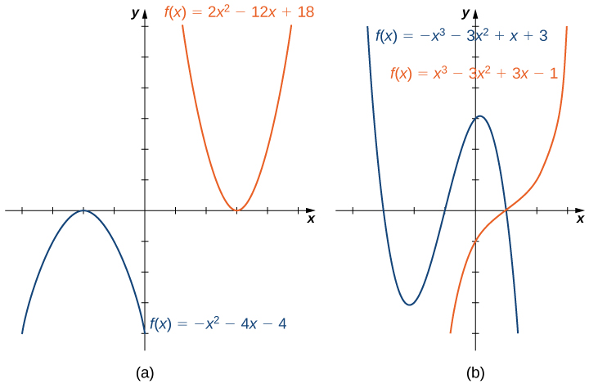
Mynd 1.19
(a) Fyrir annars stigs fall opnast fleygboginn upp ef forystustuðullinn a>0. Ef a<0 opnast fleygboginn niður. (b) Fyrir þriðja stigs fall f gildir að ef forystustuðullinn a>0, þá stefnir f(x)→∞ þegar x→∞ og f(x)→−∞ þegar x→−∞. Ef forystustuðullinn a<0 gildir hið gagnstæða.
Notes:
An image of two graphs. The first graph is labeled “a” and has an x axis that runs from -4 to 5 and a y axis that runs from -4 to 6. The graph contains two functions. The first function is “f(x) = -(x squared) - 4x -4”, which is a parabola. The function increasing until it hits the maximum at the point (-2, 0) and then begins decreasing. The x intercept is at (-2, 0) and the y intercept is at (0, -4). The second function is “f(x) = 2(x squared) -12x + 16”, which is a parabola. The function decreases until it hits the minimum point at (3, -2) and then begins increasing. The x intercepts are at (2, 0) and (4, 0) and the y intercept is not shown. The second graph is labeled “b” and has an x axis that runs from -4 to 3 and a y axis that runs from -4 to 6. The graph contains two functions. The first function is “f(x) = -(x cubed) - 3(x squared) + x + 3”. The graph decreases until the approximate point at (-2.2, -3.1), then increases until the approximate point at (0.2, 3.1), then begins decreasing again. The x intercepts are at (-3, 0), (-1, 0), and (1, 0). The y intercept is at (0, 3). The second function is “f(x) = (x cubed) -3(x squared) + 3x - 1”. It is a curved function that increases until the point (1, 0), where it levels out. After this point, the function begins increasing again. It has an x intercept at (1, 0) and a y intercept at (0, -1).

Slide 32

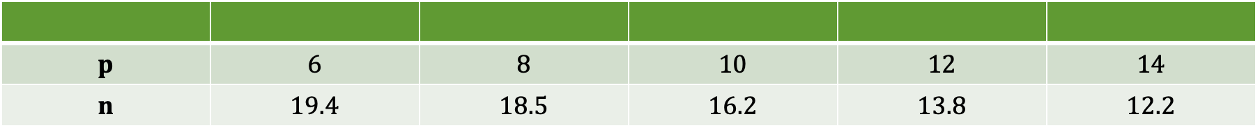
Tafla 1.6 Fjöldi seldra eininga $n$ (í þúsundum) sem fall af verði á einingu $p$ (í dollurum)
$$p$$ | $$6$$ | $$8$$ | $$10$$ | $$12$$ | $$14$$
$$n$$ | $$19.4$$ | $$18.5$$ | $$16.2$$ | $$13.8$$ | $$12.2$$

Slide 33
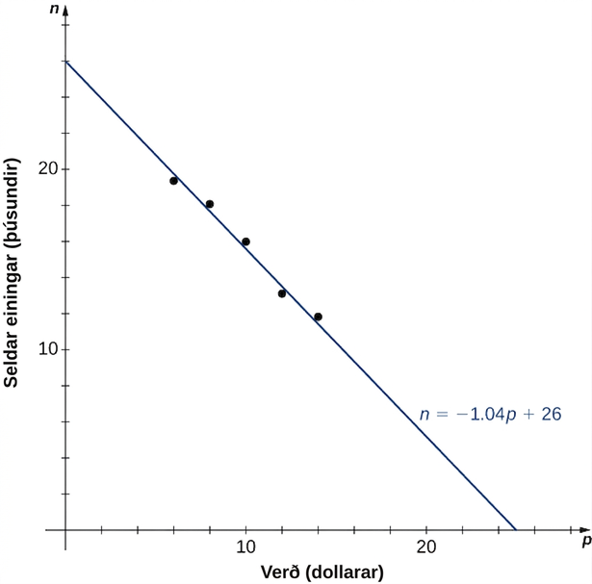
Mynd 1.20
Gögnin um fjölda seldra eininga sem fall af verði sýna nokkurn veginn línulegt samband. Við notum línulega fallið n=−1.04p+26 til að nálga þetta samband.
Notes:
An image of a graph. The y axis runs from 0 to 28 and is labeled “n, units sold in thousands”. The x axis runs from 0 to 28 and is labeled “p, price in dollars”. The graph is of the function “n = -1.04p + 26”, which is a decreasing line function that starts at the y intercept point (0, 26). There are 5 points plotted on the graph at (6, 19.4), (8, 18.5), (10, 16.2), (12, 13.8), and (14, 12.2). The points are not on the graph of the function line, but are very close to it. The function has an x intercept at the point (25, 0).

Slide 34
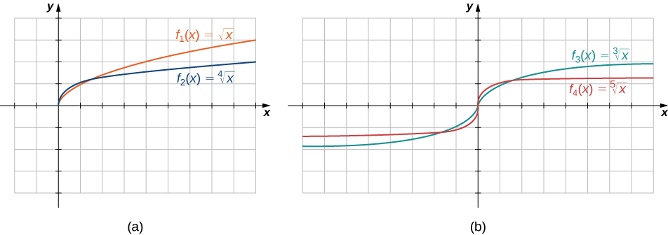
Mynd 1.21
(a) Ef n er slétt tala er skilgreiningarmengi f(x)=x^(1/n) jafnt [0,∞). (b) Ef n er oddatala er skilgreiningarmengi f(x)=x^(1/n) jafnt (−∞,∞) og fallið er oddstætt.
Notes:
An image of two graphs. The first graph is labeled “a” and has an x axis that runs from -2 to 9 and a y axis that runs from -4 to 4. The first graph is of two functions. The first function is “f(x) = square root of x”, which is a curved function that begins at the origin and increases. The second function is “f(x) = x to the 4th root”, which is a curved function that begins at the origin and increases, but increases at a slower rate than the first function. The second graph is labeled “b” and has an x axis that runs from -8 to 8 and a y axis that runs from -4 to 4. The second graph is of two functions. The first function is “f(x) = cube root of x”, which is a curved function that increases until the origin, becomes vertical at the origin, and then increases again after the origin. The second function is “f(x) = x to the 5th root”, which is a curved function that increases until the origin, becomes vertical at the origin, and then increases again after the origin, but increases at a slower rate than the first function.

Slide 35
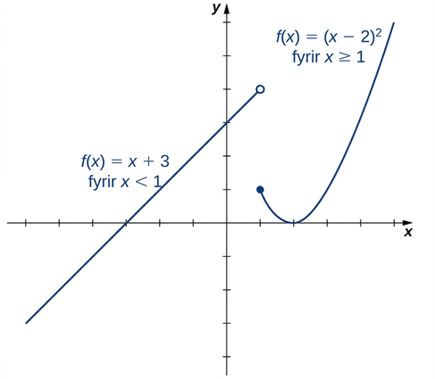
Mynd 1.22
Þetta kaflaskilgreinda fall er línulegt þegar x<1 og annars stigs fall þegar x≥1.
Notes:
An image of a graph. The x axis runs from -7 to 5 and the y axis runs from -4 to 6. The graph is of a function that has two pieces. The first piece is an increasing line that ends at the open circle point (1, 4) and has the label “f(x) = x + 3, for x < 1”. The second piece is parabolic and begins at the closed circle point (1, 1). After the point (1, 1), the piece begins to decrease until the point (2, 0) then begins to increase. This piece has the label “f(x) = (x - 2) squared, for x >= 1”.The function has x intercepts at (-3, 0) and (2, 0) and a y intercept at (0, 3).

Slide 36
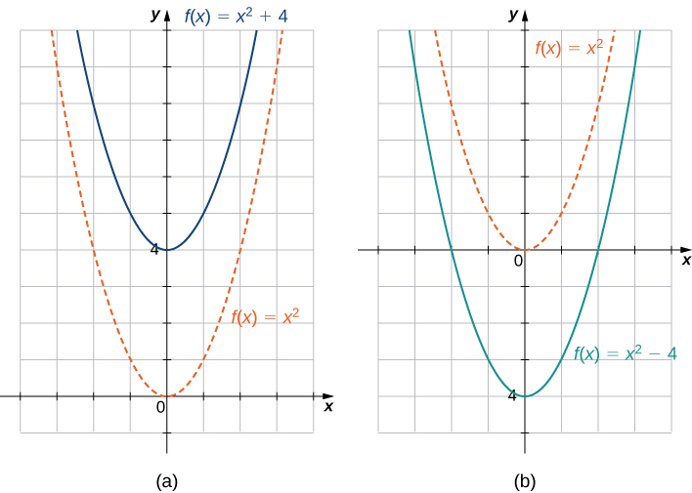
Mynd 1.23
(a) Ef c>0 fæst graf y=f(x)+c með því að hliðra grafi y=f(x) lóðrétt upp um c einingar. (b) Ef c>0 fæst graf y=f(x)−c með því að hliðra grafi y=f(x) lóðrétt niður um c einingar.
Notes:
An image of two graphs. The first graph is labeled “a” and has an x axis that runs from -4 to 4 and a y axis that runs from -1 to 10. The graph is of two functions. The first function is “f(x) = x squared”, which is a parabola that decreases until the origin and then increases again after the origin. The second function is “f(x) = (x squared) + 4”, which is a parabola that decreases until the point (0, 4) and then increases again after the origin. The two functions are the same in shape, but the second function is shifted up 4 units. The second graph is labeled “b” and has an x axis that runs from -4 to 4 and a y axis that runs from -5 to 6. The graph is of two functions. The first function is “f(x) = x squared”, which is a parabola that decreases until the origin and then increases again after the origin. The second function is “f(x) = (x squared) - 4”, which is a parabola that decreases until the point (0, -4) and then increases again after the origin. The two functions are the same in shape, but the second function is shifted down 4 units.

Slide 37
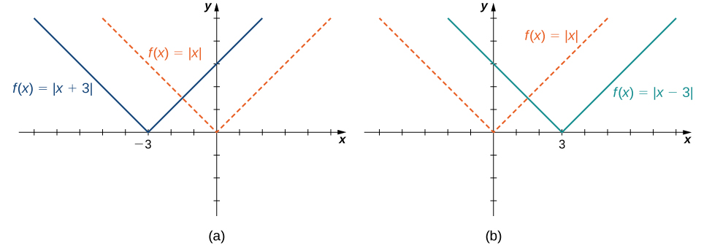
Mynd 1.24
(a) Ef c>0 fæst graf y=f(x+c) með því að hliðra grafi y=f(x) lárétt til vinstri um c einingar. (b) Ef c>0 fæst graf y=f(x−c) með því að hliðra grafi y=f(x) lárétt til hægri um c einingar.
Notes:
An image of two graphs. The first graph is labeled “a” and has an x axis that runs from -8 to 5 and a y axis that runs from -3 to 5. The graph is of two functions. The first function is “f(x) = absolute value of x”, which decreases in a straight line until the origin and then increases in a straight line again after the origin. The second function is “f(x) = absolute value of (x + 3)”, which decreases in a straight line until the point (-3, 0) and then increases in a straight line again after the point (-3, 0). The two functions are the same in shape, but the second function is shifted left 3 units. The second graph is labeled “b” and has an x axis that runs from -5 to 8 and a y axis that runs from -3 to 5. The graph is of two functions. The first function is “f(x) = absolute value of x”, which decreases in a straight line until the origin and then increases in a straight line again after the origin. The second function is “f(x) = absolute value of (x - 3)”, which decreases in a straight line until the point (3, 0) and then increases in a straight line again after the point (3, 0). The two functions are the same in shape, but the second function is shifted right 3 units.

Slide 38
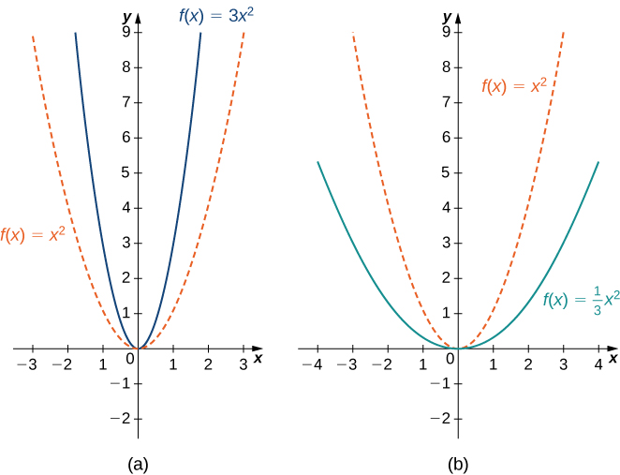
Mynd 1.25
(a) Ef c>1 fæst graf y=cf(x) með því að teygja graf y=f(x) lóðrétt. (b) Ef 0<c<1 fæst graf y=cf(x) með því að þjappa grafi y=f(x) lóðrétt.
Notes:
An image of two graphs. The first graph is labeled “a” and has an x axis that runs from -3 to 3 and a y axis that runs from -2 to 9. The graph is of two functions. The first function is “f(x) = x squared”, which is a parabola that decreases until the origin and then increases again after the origin. The second function is “f(x) = 3(x squared)”, which is a parabola that decreases until the origin and then increases again after the origin, but is vertically stretched and thus increases at a quicker rate than the first function. The second graph is labeled “b” and has an x axis that runs from -4 to 4 and a y axis that runs from -2 to 9. The graph is of two functions. The first function is “f(x) = x squared”, which is a parabola that decreases until the origin and then increases again after the origin. The second function is “f(x) = (1/3)(x squared)”, which is a parabola that decreases until the origin and then increases again after the origin, but is vertically compressed and thus increases at a slower rate than the first function.

Slide 39
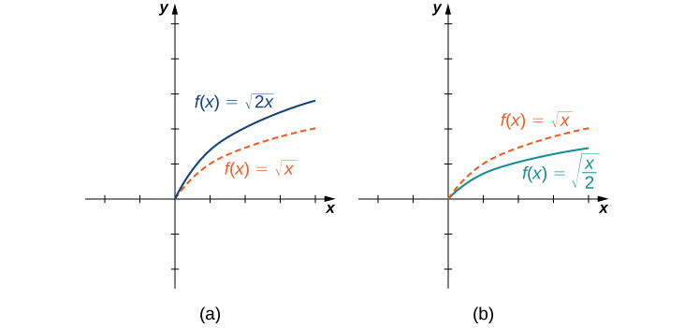
Mynd 1.26
(a) Ef c>1 fæst graf y=f(cx) með því að þjappa grafi y=f(x) lárétt. (b) Ef 0<c<1 fæst graf y=f(cx) með því að teygja graf y=f(x) lárétt.
Notes:
An image of two graphs. Both graphs have an x axis that runs from -2 to 4 and a y axis that runs from -2 to 5. The first graph is labeled “a” and is of two functions. The first graph is of two functions. The first function is “f(x) = square root of x”, which is a curved function that begins at the origin and increases. The second function is “f(x) = square root of 2x”, which is a curved function that begins at the origin and increases, but increases at a faster rate than the first function. The second graph is labeled “b” and is of two functions. The first function is “f(x) = square root of x”, which is a curved function that begins at the origin and increases. The second function is “f(x) = square root of (x/2)”, which is a curved function that begins at the origin and increases, but increases at a slower rate than the first function.

Slide 40
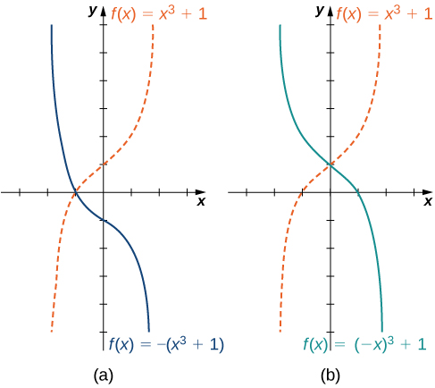
Mynd 1.27
(a) Graf y=−f(x) fæst með því að spegla graf y=f(x) um x-ásinn. (b) Graf y=f(−x) fæst með því að spegla graf y=f(x) um y-ásinn.
Notes:
An image of two graphs. Both graphs have an x axis that runs from -3 to 3 and a y axis that runs from -5 to 6. The first graph is labeled “a” and is of two functions. The first graph is of two functions. The first function is “f(x) = x cubed + 1”, which is a curved increasing function that has an x intercept at (-1, 0) and a y intercept at (0, 1). The second function is “f(x) = -(x cubed + 1)”, which is a curved decreasing function that has an x intercept at (-1, 0) and a y intercept at (0, -1). The second graph is labeled “b” and is of two functions. The first function is “f(x) = x cubed + 1”, which is a curved increasing function that has an x intercept at (-1, 0) and a y intercept at (0, 1). The second function is “f(x) = (-x) cubed + 1”, which is a curved decreasing function that has an x intercept at (1, 0) and a y intercept at (0, 1). The first function increases at the same rate the second function decreases for the same values of x.

Slide 41
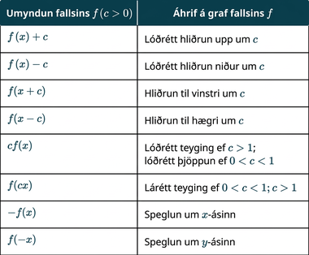
Tafla 1.7 Ummyndanir falla
Notes:
Table 1.7 Transformations of Functions; Columns: Transformation of f(c>0), Effect on the graph of f; Row 1: f(x)+c, Vertical shift up c units; Row 2: f(x)−c, Vertical shift down c units; Row 3: f(x+c), Shift left by c units; Row 4: f(x−c), Shift right by c units; Row 5: cf(x), Vertical stretch if c>1;vertical compression if 0<c<1; Row 6: f(cx), Horizontal stretch if 0<c<1; horizontal compression if c>1; Row 7: −f(x), Reflection about the x-axis; Row 8: f(−x), Reflection about the y-axis

Slide 42
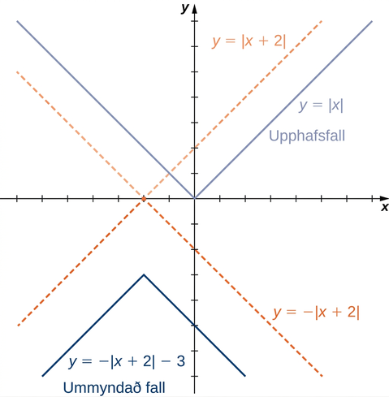
Mynd 1.28
Líta má á fallið f(x)=−|x+2|−3 sem röð þriggja ummyndana á fallinu y=|x|.
Notes:
An image of a graph. The x axis runs from -7 to 7 and a y axis runs from -7 to 7. The graph contains four functions. The first function is “f(x) = absolute value of x” and is labeled starting function. It decreases in a straight line until the origin and then increases in a straight line again after the origin. The second function is “f(x) = absolute value of (x + 2)”, which decreases in a straight line until the point (-2, 0) and then increases in a straight line again after the point (-2, 0). The second function is the same shape as the first function, but is shifted left 2 units. The third function is “f(x) = -(absolute value of (x + 2))”, which increases in a straight line until the point (-2, 0) and then decreases in a straight line again after the point (-2, 0). The third function is the second function reflected about the x axis. The fourth function is “f(x) = -(absolute value of (x + 2)) - 3” and is labeled “transformed function”. It increases in a straight line until the point (-2, -3) and then decreases in a straight line again after the point (-2, -3). The fourth function is the third function shifted down 3 units.

Slide 43
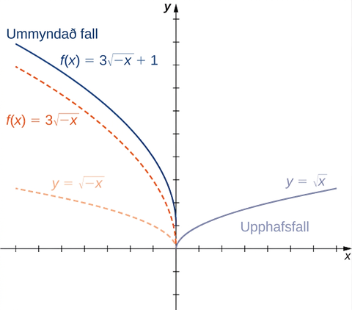
Mynd 1.29
Líta má á fallið f(x)=3√(−x)+1 sem röð þriggja ummyndana á fallinu y=√x.
Notes:
An image of a graph. The x axis runs from -7 to 7 and a y axis runs from -2 to 10. The graph contains four functions. The first function is “f(x) = square root of x” and is labeled starting function. It is a curved function that begins at the origin and increases. The second function is “f(x) = square root of -x”, which is a curved function that decreases until it reaches the origin, where it stops. The second function is the first function reflected about the y axis. The third function is “f(x) = 3(square root of -x)”, which is a curved function that decreases until it reaches the origin, where it stops. The third function decreases at a quicker rate than the second function. The fourth function is “f(x) = 3(square root of -x) + 1” and is labeled “transformed function”. Itis a curved function that decreases until it reaches the point (0, 1), where it stops. The fourth function is the third function shifted up 1 unit.

Slide 44
1.3 Hornaföll (1 af 2)
Hæfniviðmið
Umreikna hornamál milli gráða og radíana.
Þekkja skilgreiningar grunnhornafallanna út frá þríhyrningi og hring.
Rita helstu hornafallajöfnurnar.
Þekkja gröf og lotur hornafallanna.

Slide 45
1.3 Hornaföll (2 af 2)
Hæfniviðmið
Lýsa hliðrun grafs sínus- eða kósínusfalls út frá jöfnu fallsins.

Slide 46
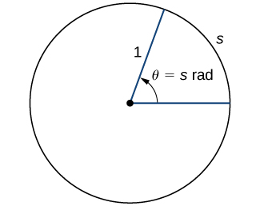
Mynd 1.30
Radíanamál hornsins θ er bogalengdin s á samsvarandi boga einingarhringsins.
Notes:
An image of a circle. At the exact center of the circle there is a point. From this point, there is one line segment that extends horizontally to the right a point on the edge of the circle and another line segment that extends diagonally upwards and to the right to another point on the edge of the circle. These line segments have a length of 1 unit. The curved segment on the edge of the circle that connects the two points at the end of the line segments is labeled “s”. Inside the circle, there is an arrow that points from the horizontal line segment to the diagonal line segment. This arrow has the label “theta = s radians”.

Slide 47
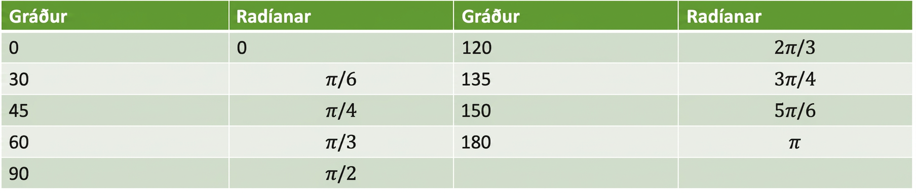
Tafla 1.8 Algeng horn gefin upp í gráðum og radíönum
Gráður | Radíanar | Gráður | Radíanar
0 | 0 | 120 | $$2π\text{/}3$$
30 | $$π\text{/}6$$ | 135 | $$3π\text{/}4$$
45 | $$π\text{/}4$$ | 150 | $$5π\text{/}6$$
60 | $$π\text{/}3$$ | 180 | $$π$$
90 | $$π\text{/}2$$

Slide 48
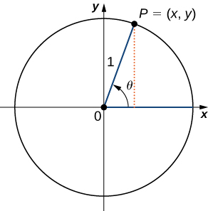
Mynd 1.31
Hornið θ er í staðalstöðu. Gildi hornafallanna fyrir θ eru skilgreind út frá hnitunum x og y.
Notes:
An image of a graph. The graph has a circle plotted on it, with the center of the circle at the origin, where there is a point. From this point, there is one line segment that extends horizontally along the x axis to the right to a point on the edge of the circle. There is another line segment that extends diagonally upwards and to the right to another point on the edge of the circle. This point is labeled “P = (x, y)”. These line segments have a length of 1 unit. From the point “P”, there is a dotted vertical line that extends downwards until it hits the x axis and thus the horizontal line segment. Inside the circle, there is an arrow that points from the horizontal line segment to the diagonal line segment. This arrow has the label “theta”.

Slide 49
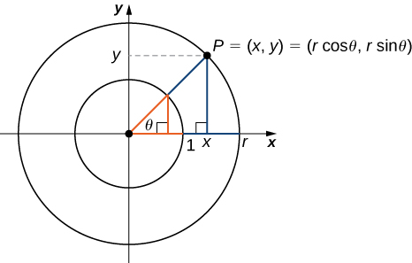
Mynd 1.32
Fyrir punktinn P=(x,y) á hring með radíus r gilda jöfnurnar x=rcosθ og y=rsinθ um hnitin x og y.
Notes:
An image of a graph. The graph has a circle plotted on it, with the center of the circle at the origin, where there is a point. From this point, there is one blue line segment that extends horizontally along the x axis to the right to a point on the edge of the circle. There is another blue line segment that extends diagonally upwards and to the right to another point on the edge of the circle. This point is labeled “P = (x, y)”. These line segments have a length of “r” units. Between these line segments within the circle is the label “theta”, representing the angle between the segments. From the point “P”, there is a blue vertical line that extends downwards until it hits the x axis and thus hits the horizontal line segment, at a point labeled “x”. At the intersection horizontal line segment and vertical line segment at the point x, there is a right triangle symbol. From the point “P”, there is a dotted horizontal line segment that extends left until it hits the y axis at a point labeled “y”.

Slide 50
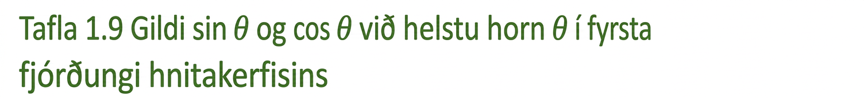
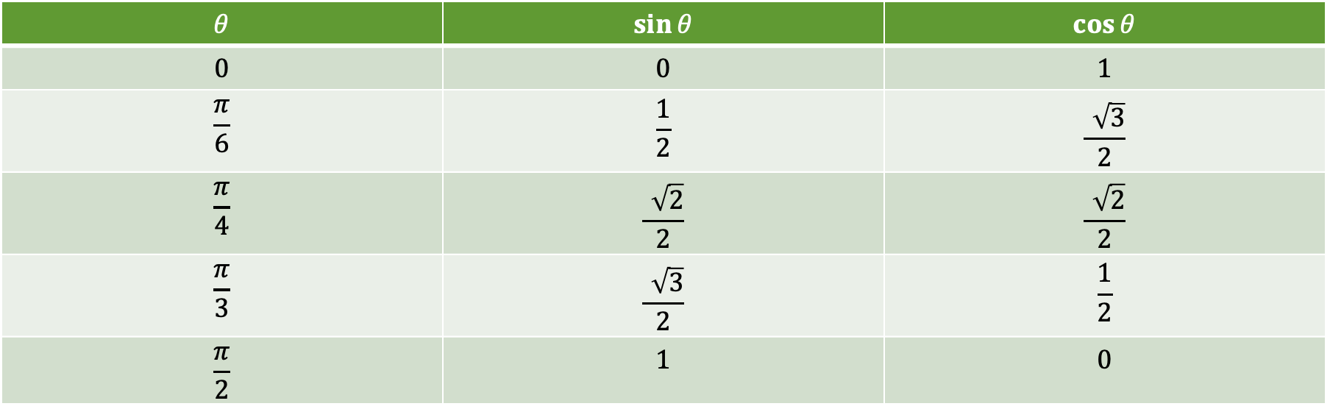
Tafla 1.9 Gildi $\text{sin} θ$ og $\text{cos} θ$ við helstu horn $θ$ í fyrsta fjórðungi
$$θ$$ | $$sin θ$$ | $$cos θ$$
$$0$$ | $$0$$ | $$1$$
$$\frac{π}{6}$$ | $$\frac{1}{2}$$ | $$\frac{\sqrt{3}}{2}$$
$$\frac{π}{4}$$ | $$\frac{\sqrt{2}}{2}$$ | $$\frac{\sqrt{2}}{2}$$
$$\frac{π}{3}$$ | $$\frac{\sqrt{3}}{2}$$ | $$\frac{1}{2}$$
$$\frac{π}{2}$$ | $$1$$ | $$0$$

Slide 51
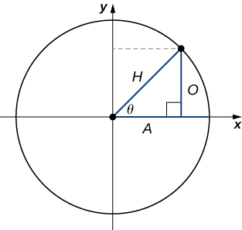
Mynd 1.33
Með því að innrita rétthyrndan þríhyrning í hring má setja hlutföll hliðarlengdanna fram með gildum hornafallanna við θ.
Notes:
An image of a graph. The graph has a circle plotted on it, with the center of the circle at the origin, where there is a point. From this point, there is one line segment that extends horizontally along the x axis to the right to a point on the edge of the circle. There is another line segment with length labeled “H” that extends diagonally upwards and to the right to another point on the edge of the circle. From the point, there is vertical line with a length labeled “O” that extends downwards until it hits the x axis and thus the horizontal line segment at a point with a right triangle symbol. The distance from this point to the center of the circle is labeled “A”. Inside the circle, there is an arrow that points from the horizontal line segment to the diagonal line segment. This arrow has the label “theta”.

Slide 52
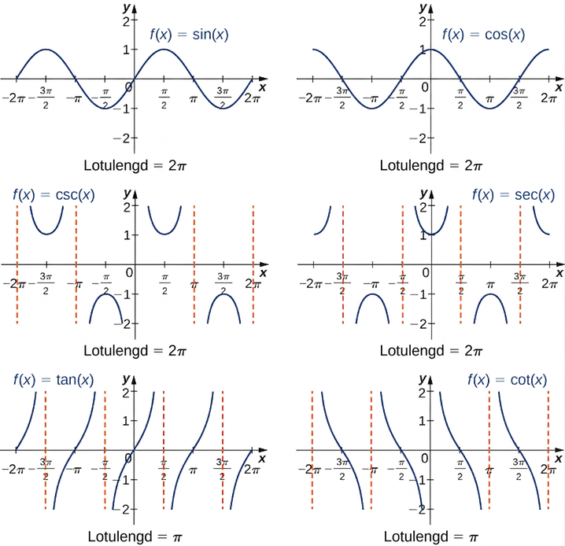
Mynd 1.34
Hornaföllin sex eru lotubundin.
Notes:
An image of six graphs. Each graph has an x axis that runs from -2 pi to 2 pi and a y axis that runs from -2 to 2. The first graph is of the function “f(x) = sin(x)”, which is a curved wave function. The graph of the function starts at the point (-2 pi, 0) and increases until the point (-((3 pi)/2), 1). After this point, the function decreases until the point (-(pi/2), -1). After this point, the function increases until the point ((pi/2), 1). After this point, the function decreases until the point (((3 pi)/2), -1). After this point, the function begins to increase again. The x intercepts shown on the graph are at the points (-2 pi, 0), (-pi, 0), (0, 0), (pi, 0), and (2 pi, 0). The y intercept is at the origin. The second graph is of the function “f(x) = cos(x)”, which is a curved wave function. The graph of the function starts at the point (-2 pi, 1) and decreases until the point (-pi, -1). After this point, the function increases until the point (0, 1). After this point, the function decreases until the point (pi, -1). After this point, the function increases again. The x intercepts shown on the graph are at the points (-((3 pi)/2), 0), (-(pi/2), 0), ((pi/2), 0), and (((3 pi)/2), 0). The y intercept is at the point (0, 1). The graph of cos(x) is the same as the graph of sin(x), except it is shifted to the left by a distance of (pi/2). On the next four graphs there are dotted vertical lines which are not a part of the function, but act as boundaries for the function, boundaries the function will never touch. They are known as vertical asymptotes. There are infinite vertical asymptotes for all of these functions, but these graphs only show a few. The third graph is of the function “f(x) = csc(x)”. The vertical asymptotes for “f(x) = csc(x)” on this graph occur at “x = -2 pi”, “x = -pi”, “x = 0”, “x = pi”, and “x = 2 pi”. Between the “x = -2 pi” and “x = -pi” asymptotes, the function looks like an upward facing “U”, with a minimum at the point (-((3 pi)/2), 1). Between the “x = -pi” and “x = 0” asymptotes, the function looks like an downward facing “U”, with a maximum at the point (-(pi/2), -1). Between the “x = 0” and “x = pi” asymptotes, the function looks like an upward facing “U”, with a minimum at the point ((pi/2), 1). Between the “x = pi” and “x = 2 pi” asymptotes, the function looks like an downward facing “U”, with a maximum at the point (((3 pi)/2), -1). The fourth graph is of the function “f(x) = sec(x)”. The vertical asymptotes for this function on this graph are at “x = -((3 pi)/2)”, “x = -(pi/2)”, “x = (pi/2)”, and “x = ((3 pi)/2)”. Between the “x = -((3 pi)/2)” and “x = -(pi/2)” asymptotes, the function looks like an downward facing “U”, with a maximum at the point (-pi, -1). Between the “x = -(pi/2)” and “x = (pi/2)” asymptotes, the function looks like an upward facing “U”, with a minimum at the point (0, 1). Between the “x = (pi/2)” and “x = (3pi/2)” asymptotes, the function looks like an downward facing “U”, with a maximum at the point (pi, -1). The graph of sec(x) is the same as the graph of csc(x), except it is shifted to the left by a distance of (pi/2). The fifth graph is of the function “f(x) = tan(x)”. The vertical asymptotes of this function on this graph occur at “x = -((3 pi)/2)”, “x = -(pi/2)”, “x = (pi/2)”, and “x = ((3 pi)/2)”. In between all of the vertical asymptotes, the function is always increasing but it never touches the asymptotes. The x intercepts on this graph occur at the points (-2 pi, 0), (-pi, 0), (0, 0), (pi, 0), and (2 pi, 0). The y intercept is at the origin. The sixth graph is of the function “f(x) = cot(x)”. The vertical asymptotes of this function on this graph occur at “x = -2 pi”, “x = -pi”, “x = 0”, “x = pi”, and “x = 2 pi”. In between all of the vertical asymptotes, the function is always decreasing but it never touches the asymptotes. The x intercepts on this graph occur at the points (-((3 pi)/2), 0), (-(pi/2), 0), ((pi/2), 0), and (((3 pi)/2), 0) and there is no y intercept.

Slide 53
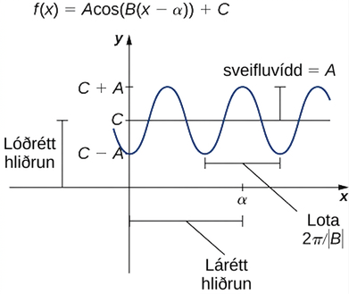
Mynd 1.35
Graf almenns kósínusfalls.
Notes:
An image of a graph. The graph is of the function “f(x) = Acos(B(x - alpha)) + C”. Along the y axis, there are 3 hash marks: starting from the bottom and moving up, the hash marks are at the values “C - A”, “C”, and “C + A”. The distance from the origin to “C” is labeled “vertical shift”. The distance from “C - A” to “A” and the distance from “A” to “C + A” is “A”, which is labeled “amplitude”. On the x axis is a hash mark at the value “alpha” and the distance between the origin and “alpha” is labeled “horizontal shift”. The distance between two successive minimum values of the function (in other words, the distance between two bottom parts of the wave that are next to each other) is “(2 pi)/(absolute value of B)” is labeled the period. The period is also the distance between two successive maximum values of the function.

Slide 54
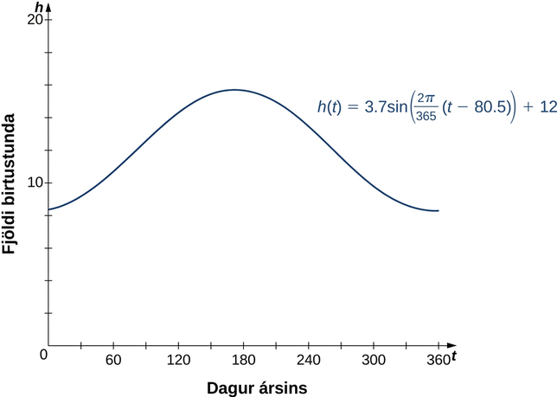
Mynd 1.36
Lýsa má fjölda birtustunda sem falli af degi ársins með hliðruðum sínusferli.
Notes:
An image of a graph. The x axis runs from 0 to 365 and is labeled “t, day of the year”. The y axis runs from 0 to 20 and is labeled “h, number of daylight hours”. The graph is of the function “h(t) = 3.7sin(((2 pi)/365)(t - 80.5)) + 12”, which is a curved wave function. The function starts at the approximate point (0, 8.4) and begins increasing until the approximate point (171.8, 15.7). After this point, the function decreases until the approximate point (354.3, 8.3). After this point, the function begins increasing again.

Slide 55
1.4 Andhverf föll
Hæfniviðmið
Ákvarða skilyrðin fyrir því að fall eigi sér andhverfu.
Nota lárétta línuprófið til að ákvarða hvenær fall er eintækt.
Finna andhverfu gefins falls.
Teikna graf andhverfs falls.
Reikna gildi andhverfra hornafalla.

Slide 56
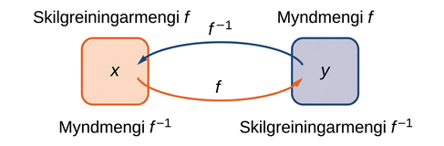
Mynd 1.37
Fyrir fall f og andhverfu þess f⁻¹ gildir f⁻¹(y)=x þá og því aðeins að f(x)=y. Myndmengi f verður skilgreiningarmengi f⁻¹ og skilgreiningarmengi f verður myndmengi f⁻¹.
Notes:
An image of two bubbles. The first bubble is orange and has two labels: the top label is “Domain of f” and the bottom label is “Range of f inverse”. Within this bubble is the variable “x”. An orange arrow with the label “f” points from this bubble to the second bubble. The second bubble is blue and has two labels: the top label is “range of f” and the bottom label is “domain of f inverse”. Within this bubble is the variable “y”. A blue arrow with the label “f inverse” points from this bubble to the first bubble.

Slide 57
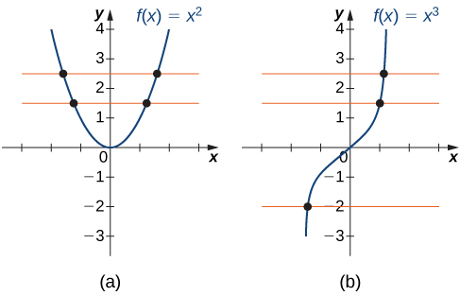
Mynd 1.38
(a) Fallið f(x)=x² er ekki eintækt því það stenst ekki lárétta línuprófið. (b) Fallið f(x)=x³ er eintækt því það stenst lárétta línuprófið.
Notes:
An image of two graphs. Both graphs have an x axis that runs from -3 to 3 and a y axis that runs from -3 to 4. The first graph is of the function “f(x) = x squared”, which is a parabola. The function decreases until it hits the origin, where it begins to increase. The x intercept and y intercept are both at the origin. There are two orange horizontal lines also plotted on the graph, both of which run through the function at two points each. The second graph is of the function “f(x) = x cubed”, which is an increasing curved function. The x intercept and y intercept are both at the origin. There are three orange lines also plotted on the graph, each of which only intersects the function at one point.

Slide 58
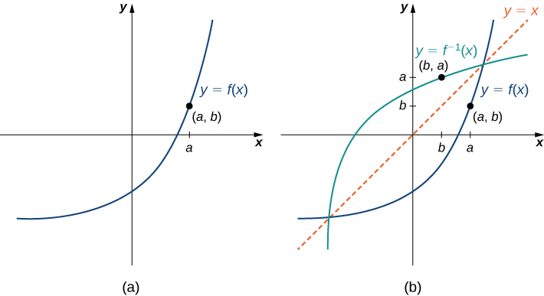
Mynd 1.39
(a) Punkturinn (a,b) liggur á grafi fallsins f. (b) Þar sem (a,b) liggur á grafi f liggur punkturinn (b,a) á grafi f−1. Graf f−1 er speglun grafs f um línuna y=x.
Notes:
An image of two graphs. The first graph is of “y = f(x)”, which is a curved increasing function, that increases at a faster rate as x increases. The point (a, b) is on the graph of the function in the first quadrant. The second graph also graphs “y = f(x)” with the point (a, b), but also graphs the function “y = f inverse (x)”, an increasing curved function, that increases at a slower rate as x increases. This function includes the point (b, a). In addition to the two functions, there is a diagonal dotted line potted with the equation “y =x”, which shows that “f(x)” and “f inverse (x)” are mirror images about the line “y =x”.

Slide 59
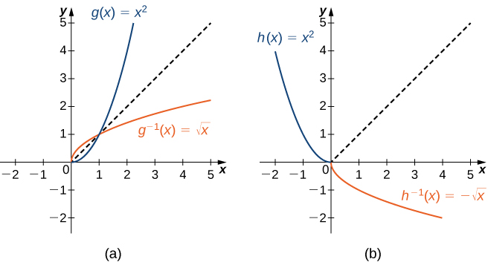
Mynd 1.40
(a) Þegar g(x)=x² er einskorðað við [0,∞) er g⁻¹(x)=√x. (b) Þegar h(x)=x² er einskorðað við (−∞,0] er h⁻¹(x)=−√x.
Notes:
An image of two graphs. Both graphs have an x axis that runs from -2 to 5 and a y axis that runs from -2 to 5. The first graph is of two functions. The first function is “g(x) = x squared”, an increasing curved function that starts at the point (0, 0). This function increases at a faster rate for larger values of x. The second function is “g inverse (x) = square root of x”, an increasing curved function that starts at the point (0, 0). This function increases at a slower rate for larger values of x. The first function is “h(x) = x squared”, a decreasing curved function that ends at the point (0, 0). This function decreases at a slower rate for larger values of x. The second function is “h inverse (x) = -(square root of x)”, an increasing curved function that starts at the point (0, 0). This function decreases at a slower rate for larger values of x. In addition to the two functions, there is a diagonal dotted line potted with the equation “y =x”, which shows that “f(x)” and “f inverse (x)” are mirror images about the line “y =x”.

Slide 60
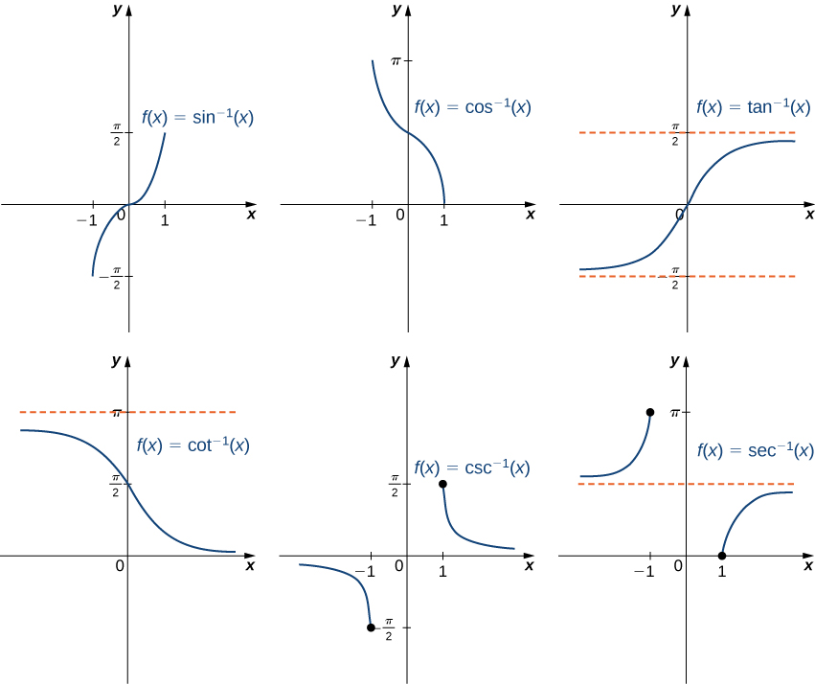
Mynd 1.41
Graf hvers andhverfs hornafalls fæst með því að spegla graf samsvarandi einskorðaðs hornafalls um línuna y=x.
Notes:
An image of six graphs. The first graph is of the function “f(x) = sin inverse(x)”, which is an increasing curve function. The function starts at the point (-1, -(pi/2)) and increases until it ends at the point (1, (pi/2)). The x intercept and y intercept are at the origin. The second graph is of the function “f(x) = cos inverse (x)”, which is a decreasing curved function. The function starts at the point (-1, pi) and decreases until it ends at the point (1, 0). The x intercept is at the point (1, 0). The y intercept is at the point (0, (pi/2)). The third graph is of the function f(x) = tan inverse (x)”, which is an increasing curve function. The function starts close to the horizontal line “y = -(pi/2)” and increases until it comes close the “y = (pi/2)”. The function never intersects either of these lines, it always stays between them - they are horizontal asymptotes. The x intercept and y intercept are both at the origin. The fourth graph is of the function “f(x) = cot inverse (x)”, which is a decreasing curved function. The function starts slightly below the horizontal line “y = pi” and decreases until it gets close the x axis. The function never intersects either of these lines, it always stays between them - they are horizontal asymptotes. The fifth graph is of the function “f(x) = csc inverse (x)”, a decreasing curved function. The function starts slightly below the x axis, then decreases until it hits a closed circle point at (-1, -(pi/2)). The function then picks up again at the point (1, (pi/2)), where is begins to decrease and approach the x axis, without ever touching the x axis. There is a horizontal asymptote at the x axis. The sixth graph is of the function “f(x) = sec inverse (x)”, an increasing curved function. The function starts slightly above the horizontal line “y = (pi/2)”, then increases until it hits a closed circle point at (-1, pi). The function then picks up again at the point (1, 0), where is begins to increase and approach the horizontal line “y = (pi/2)”, without ever touching the line. There is a horizontal asymptote at the “y = (pi/2)”.

Slide 61

Mynd 1.42
Graf fallsins y=sinx+cosx.
Notes:
An image of a graph. The x axis runs from -4 to 4 and the y axis runs from -4 to 4. The graph is of the function “y = sin(x) + cos(x)”, a curved wave function. The graph of the function decreases until it hits the approximate point (-(3pi/4), -1.4), where it increases until the approximate point ((pi/4), 1.4), where it begins to decrease again. The x intercepts shown on this graph of the function are at (-(5pi/4), 0), (-(pi/4), 0), and ((3pi/4), 0). The y intercept is at (0, 1).

Slide 62

1.5 Vísisföll og lograföll (1 af 2)
Námsmarkmið
Þekkja form vísisfalls.
Útskýra muninn á gröfum $x^{b}$ og $b^{x}.$
Gera sér grein fyrir mikilvægi tölunnar $e.$
Þekkja form lografalls.
Útskýra samband vísisfalla og lografalla.

Slide 63
1.5 Vísisföll og lograföll (2 af 2)
Námsmarkmið
Lýsa hvernig reikna má logra með öðrum grunni.
Þekkja breiðbogaföllin, gröf þeirra og helstu samsemdir.

Slide 64

Tafla 1.10 Gildi $x^{2}$ og $2^{x}$
$$x$$ | $$−3$$ | $$−2$$ | $$−1$$ | $$0$$ | $$1$$ | $$2$$ | $$3$$ | $$4$$ | $$5$$ | $$6$$
$$x^{2}$$ | $$9$$ | $$4$$ | $$1$$ | $$0$$ | $$1$$ | $$4$$ | $$9$$ | $$16$$ | $$25$$ | $$36$$
$$2^{x}$$ | $$1\text{/}8$$ | $$1\text{/}4$$ | $$1\text{/}2$$ | $$1$$ | $$2$$ | $$4$$ | $$8$$ | $$16$$ | $$32$$ | $$64$$

Slide 65

Mynd 1.43
Bæði 2ˣ og x² stefna á óendanlegt þegar x→∞, en 2ˣ vex hraðar en x². Þegar x→−∞ stefnir x² á óendanlegt, en 2ˣ→0.
Notes:
An image of a graph. The x axis runs from -10 to 10 and the y axis runs from 0 to 50. The graph is of two functions. The first function is “y = x squared”, which is a parabola. The function decreases until it hits the origin and then begins increasing. The second function is “y = 2 to the power of x”, which starts slightly above the x axis, and begins increasing very rapidly, more rapidly than the first function.

Slide 66


Tafla 1.11 Gildi $2^{x}$ fyrir runu ræðra talna sem nálgast $\sqrt{2}$
$$x$$ | $$1.4$$ | $$1.41$$ | $$1.414$$ | $$1.4142$$ | $$1.41421$$ | $$1.414213$$
$$2^{x}$$ | $$2.639$$ | $$2.65737$$ | $$2.66475$$ | $$2.665119$$ | $$2.665138$$ | $$2.665143$$

Slide 67

Mynd 1.44
Ef b>1 er bˣ vaxandi á (−∞,∞). Ef 0<b<1 er bˣ minnkandi á (−∞,∞).
Notes:
An image of a graph. The x axis runs from -3 to 3 and the y axis runs from 0 to 4. The graph is of four functions. The first function is “f(x) = 2 to the power of x”, an increasing curved function, which starts slightly above the x axis and begins increasing. The second function is “f(x) = 4 to the power of x”, an increasing curved function, which starts slightly above the x axis and begins increasing rapidly, more rapidly than the first function. The third function is “f(x) = (1/2) to the power of x”, a decreasing curved function with decreases until it gets close to the x axis without touching it. The third function is “f(x) = (1/4) to the power of x”, a decreasing curved function with decreases until it gets close to the x axis without touching it. It decreases at a faster rate than the third function.

Slide 68

Tafla 1.12 Gildi ${\left(1+\frac{1}{m}\right)}^{m}$ þegar $m→∞$
$$m$$ | $$10$$ | $$100$$ | $$1000$$ | $$10,000$$ | $$100,000$$ | $$1,000,000$$
$${\left(1+\frac{1}{m}\right)}^{m}$$ | $$2.5937$$ | $$2.7048$$ | $$2.71692$$ | $$2.71815$$ | $$2.718268$$ | $$2.718280$$

Slide 69

Mynd 1.45
Graf fallsins f(x)=eˣ hefur snertil með hallatöluna 1 þegar x=0.
Notes:
An image of a graph. The x axis runs from -3 to 3 and the y axis runs from 0 to 4. The graph is of the function “f(x) = e to power of x”, an increasing curved function that starts slightly above the x axis. The y intercept is at the point (0, 1). At this point, a line is drawn tangent to the function. This line has the label “slope = 1”.

Slide 70

Mynd 1.46
Föllin y=eˣ og y=ln(x) eru andhverf hvort öðru og því eru gröf þeirra samhverf um línuna y=x.
Notes:
An image of a graph. The x axis runs from -3 to 3 and the y axis runs from -3 to 4. The graph is of two functions. The first function is “f(x) = e to power of x”, an increasing curved function that starts slightly above the x axis. The y intercept is at the point (0, 1) and there is no x intercept. The second function is “f(x) = ln(x)”, an increasing curved function. The x intercept is at the point (1, 0) and there is no y intercept. A dotted line with label “y = x” is also plotted on the graph, to show that the functions are mirror images over this line.

Slide 71

Mynd 1.47
Gröf y=log_b(x) eru sýnd fyrir b=2,e,10.
Notes:
An image of a graph. The x axis runs from -3 to 3 and the y axis runs from 0 to 4. The graph is of three functions. All three functions a log functions that are increasing curved functions that start slightly to the right of the y axis and have an x intercept at (1, 0). The first function is “y = log base 10 (x)”, the second function is “f(x) = ln(x)”, and the third function is “y = log base 2 (x)”. The third function increases the most rapidly, the second function increases next most rapidly, and the third function increases the slowest.

Slide 72

Mynd 1.48
(mynd: breytt útgáfa af verki Robb Hannawacker, NPS)
Notes:
A photograph of an earthquake fault.

Slide 73

Mynd 1.49
Lýsa má lögun silkþráðar í köngulóarvef með breiðbogafalli. Keðja eða strengur sem hangir milli tveggja festipunkta og verður aðeins fyrir eigin þunga hefur sömu lögun. (mynd: „Mtpaley“, Wikimedia Commons)
Notes:
A photograph of a spider web collecting dew drops.

Slide 74

Mynd 1.50
Einingarbreiðboginn uppfyllir cosh²(t)−sinh²(t)=1.
Notes:
An image of a graph. The x axis runs from -1 to 3 and the y axis runs from -3 to 3. The graph is of the relation “(x squared) - (y squared) -1”. The left most point of the relation is at the x intercept, which is at the point (1, 0). From this point the relation both increases and decreases in curves as x increases. This relation is known as a hyperbola and it resembles a sideways “U” shape. There is a point plotted on the graph of the relation labeled “(cosh(1), sinh(1))”, which is at the approximate point (1.5, 1.2).

Slide 75

Mynd 1.51
Breiðbogaföllin byggjast á formúlum með eˣ og e⁻ˣ.
Notes:
An image of six graphs. Each graph has an x axis that runs from -3 to 3 and a y axis that runs from -4 to 4. The first graph is of the function “y = cosh(x)”, which is a hyperbola. The function decreases until it hits the point (0, 1), where it begins to increase. There are also two functions that serve as a boundary for this function. The first of these functions is “y = (1/2)(e to power of -x)”, a decreasing curved function and the second of these functions is “y = (1/2)(e to power of x)”, an increasing curved function. The function “y = cosh(x)” is always above these two functions without ever touching them. The second graph is of the function “y = sinh(x)”, which is an increasing curved function. There are also two functions that serve as a boundary for this function. The first of these functions is “y = (1/2)(e to power of x)”, an increasing curved function and the second of these functions is “y = -(1/2)(e to power of -x)”, an increasing curved function that approaches the x axis without touching it. The function “y = sinh(x)” is always between these two functions without ever touching them. The third graph is of the function “y = sech(x)”, which increases until the point (0, 1), where it begins to decrease. The graph of the function has a hump. The fourth graph is of the function “y = csch(x)”. On the left side of the y axis, the function starts slightly below the x axis and decreases until it approaches the y axis, which it never touches. On the right side of the y axis, the function starts slightly to the right of the y axis and decreases until it approaches the x axis, which it never touches. The fifth graph is of the function “y = tanh(x)”, an increasing curved function. There are also two functions that serve as a boundary for this function. The first of these functions is “y = 1”, a horizontal line function and the second of these functions is “y = -1”, another horizontal line function. The function “y = tanh(x)” is always between these two functions without ever touching them. The sixth graph is of the function “y = coth(x)”. On the left side of the y axis, the function starts slightly below the boundary line “y = 1” and decreases until it approaches the y axis, which it never touches. On the right side of the y axis, the function starts slightly to the right of the y axis and decreases until it approaches the boundary line “y = -1”, which it never touches.

Slide 76
Notkunarleyfi
Þetta viðbótarefni OpenStax er © Rice University og gefið út samkvæmt alþjóðlega CC BY-NC-SA 4.0-notkunarleyfinu. Heimilt er að afrita það eða breyta því eingöngu í óviðskiptalegum tilgangi, en geta verður OpenStax og Rice University sem rétthafa og tilgreina allar breytingar. Sérhver breytt útgáfa skal gefin út með sams konar notkunarleyfi.

