Slide 1
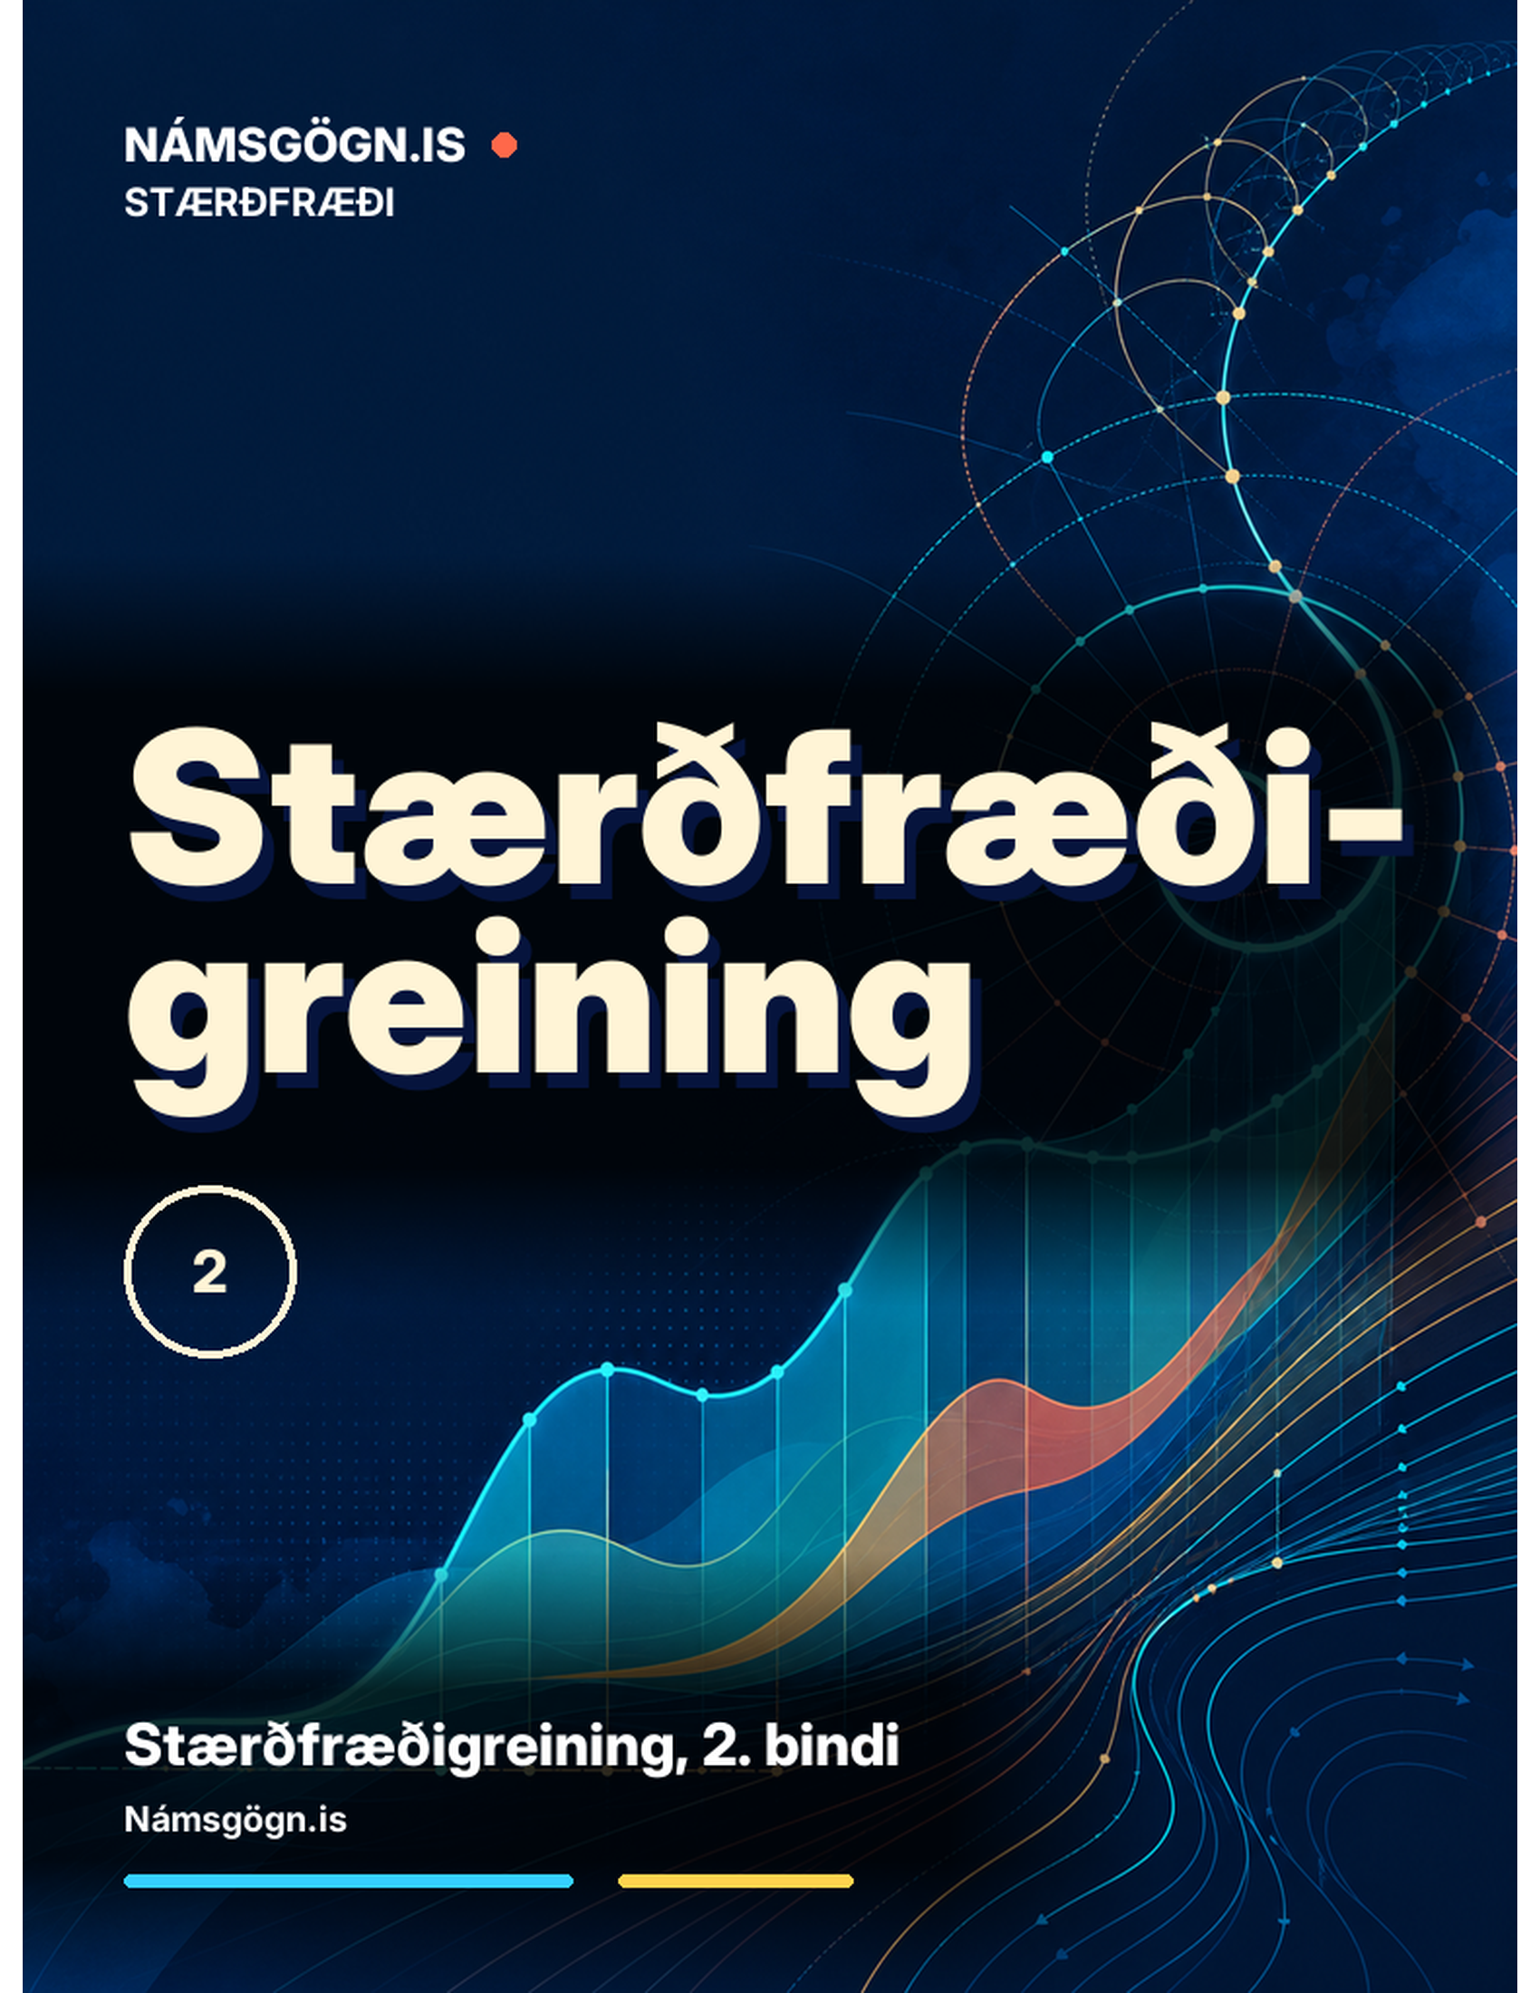
Stærðfræðigreining, 2. bindi
7. kafli Stikajöfnur og skauthnit

Slide 2
Yfirlit kaflans
Stikajöfnur
Stærðfræðigreining stikaðra ferla
Skauthnit
Flatarmál og bogalengd í skauthnitum
Keilusnið

Slide 3
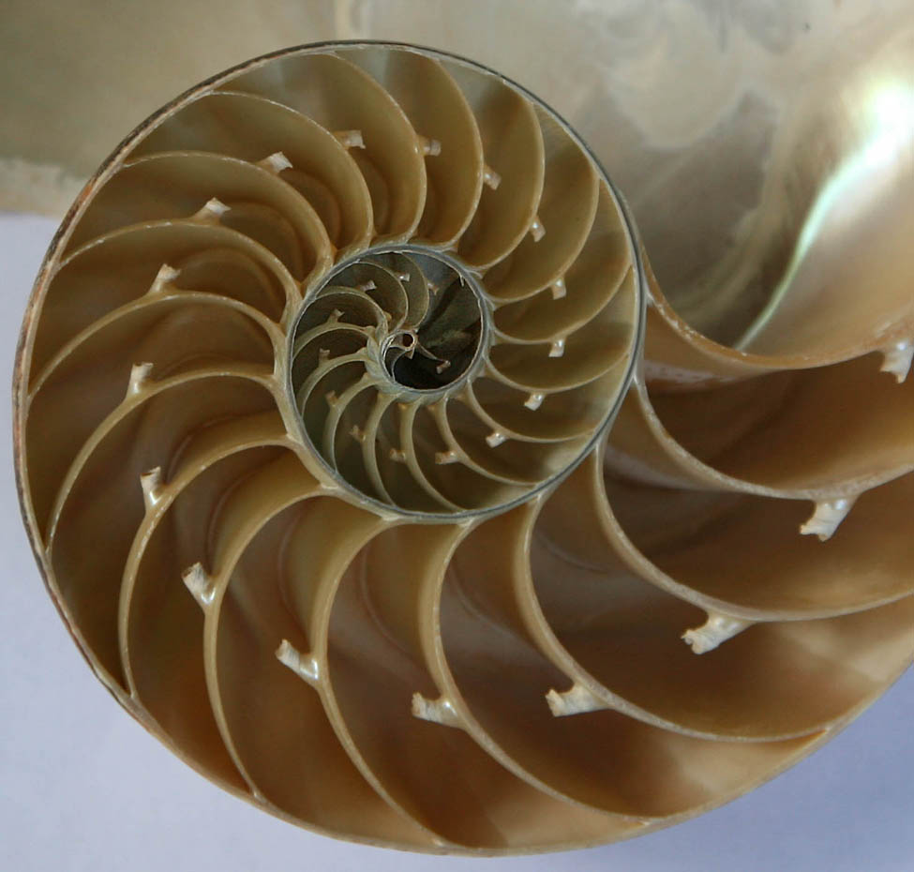
Mynd 7.1
Hólfaður perlusnekkill er sjávardýr sem lifir í hitabeltishluta Kyrrahafsins. Vísindamenn telja að tegundin hafi haldist að mestu óbreytt í um 500 milljónir ára. (mynd: breytt útgáfa af verki Jitze Couperus, Flickr)
Notes:
A photo of a cross section of a seashell that spirals from big chambers to smaller and smaller ones.

Slide 4
7.1 Stikajöfnur
Námsmarkmið
Teikna feril sem lýst er með stikuðum jöfnum.
Umrita stikajöfnur ferils þannig að y sé fall af x.$y=f\left(x\right).$
Þekkja stikajöfnur grunnferla, svo sem línu og hrings.
Þekkja stikajöfnur hjólboga.

Slide 5
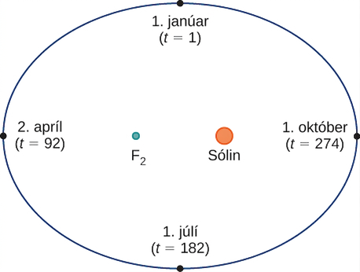
Mynd 7.2
Braut jarðar um sólina á einu ári.
Notes:
An ellipse with January 1 (t = 1) at the top, April 2 (t = 92) on the left, July 1 (t = 182) on the bottom, and October 1 (t = 274) on the right. The focal points of the ellipse have F2 on the left and the Sun on the right.

Slide 6
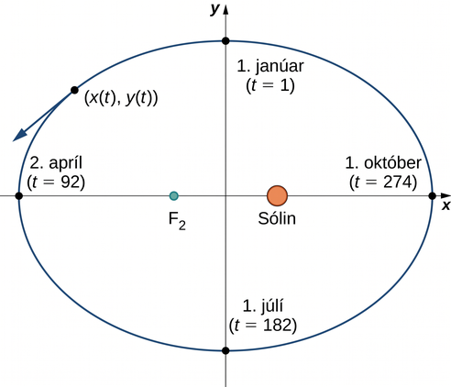
Mynd 7.3
Hnitaásar lagðir yfir braut jarðar.
Notes:
An ellipse with January 1 (t = 1) at the top, April 2 (t = 92) on the left, July 1 (t = 182) on the bottom, and October 1 (t = 274) on the right. The focal points of the ellipse have F2 on the left and the Sun on the right. There is a line going from t = 1 to t = 182. There is also a line going from t = 92 to t = 274 that passes through F2 and the Sun. On the upper left side, there is a point marked (x(t), y(t)) with a tangent line pointing down and to the left.

Slide 7
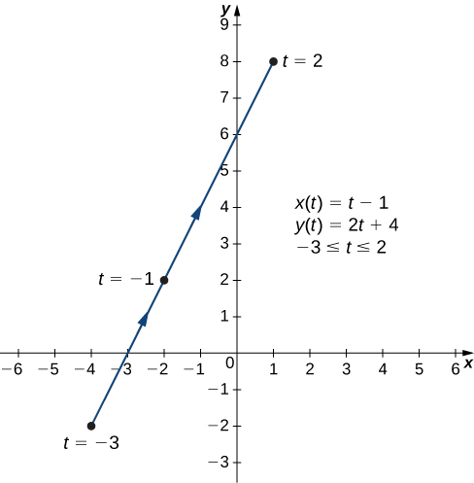
Mynd 7.4
Graf planferilsins sem stikuðu jöfnurnar í a-lið lýsa.
Notes:
A straight line going from (−4, −2) through (−3, 0), (−2, 2), and (0, 6) to (1, 8) with arrow pointed up and to the right. The point (−4, −2) is marked t = −3, the point (−2, 2) is marked t = −1, and the point (1, 8) is marked t = 2. On the graph there are also written three equations: x(t) = t −1, y(t) = 2t + 4, and −3 ≤ t ≤ 2.

Slide 8
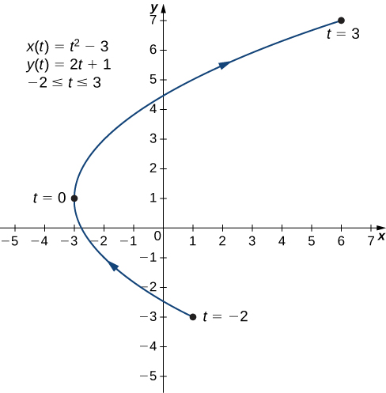
Mynd 7.5
Graf planferilsins sem stikuðu jöfnurnar í b-lið lýsa.
Notes:
A curved line going from (1, −3) through (−3, 1) to (6, 7) with arrow pointing in that order. The point (1, −3) is marked t = −2, the point (−3, 1) is marked t = 0, and the point (6, 7) is marked t = 3. On the graph there are also written three equations: x(t) = t2 − 3, y(t) = 2t + 1, and −2 ≤ t ≤ 3.

Slide 9
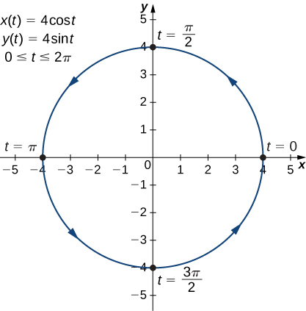
Mynd 7.6
Graf planferilsins sem stikuðu jöfnurnar í c-lið lýsa.
Notes:
A circle with radius 4 centered at the origin is graphed with arrow going counterclockwise. The point (4, 0) is marked t = 0, the point (0, 4) is marked t = π/2, the point (−4, 0) is marked t = π, and the point (0, −4) is marked t = 3π/2. On the graph there are also written three equations: x(t) = 4 cos(t), y(t) = 4 sin(t), and 0 ≤ t ≤ 2π.

Slide 10
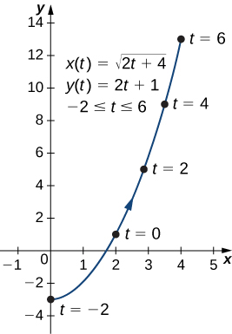
Mynd 7.7
Graf planferilsins sem stikuðu jöfnurnar í a-lið lýsa.
Notes:
A curved line going from (−3, 0) through (2, 1) to (4, 13) with arrow going in that order. The point (−3, 0) is marked t = −2, the point (2, 1) is marked t = 0, the point (2 times the square root of 2, 5) is marked t = 2, the point (3 times the square root of 2, 9) is marked t = 4, and the point (4, 13) is marked t = 6. On the graph there are also written three equations: x(t) = square root of the quantity (2t + 4), y(t) = 2t + 1, and −2 ≤ t ≤ 6.

Slide 11
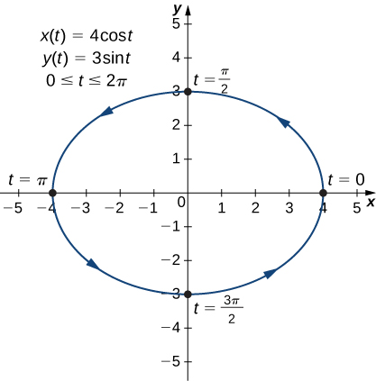
Mynd 7.8
Graf planferilsins sem stikuðu jöfnurnar í b-lið lýsa.
Notes:
An ellipse with major axis horizontal and of length 8 and with minor radius vertical and of length 6 that is centered at the origin with arrow going counterclockwise. The point (4, 0) is marked t = 0, the point (0, 3) is marked t = π/2, the point (−4, 0) is marked t = π, and the point (0, −3) is marked t = 3π/2. On the graph there are also written three equations: x(t) = 4 cos(t), y(t) = 3 sin(t), and 0 ≤ t ≤ 2π.

Slide 12
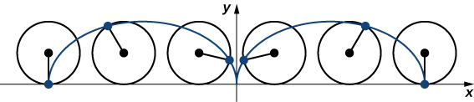
Mynd 7.9
Hjól rúllar eftir vegi án þess að renna; punktur á jaðri hjólsins fer eftir hjólboga.
Notes:
A series of circles with center marked and a point on the circle drawing out a curve as if the circle was rolling along a plane. The shape made seems to be half an ellipse with height the diameter of the original circle and with major axis the circumference of the circle.

Slide 13
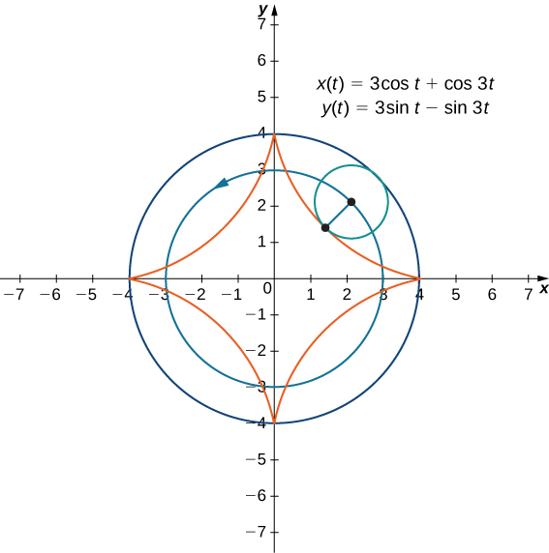
Mynd 7.10
Graf innhjólbogans sem stikuðu jöfnurnar á myndinni lýsa.
Notes:
Two circles are drawn both with center at the origin and with radii 3 and 4, respectively; the circle with radius 3 has an arrow pointing in the counterclockwise direction. There is a third circle drawn with center on the circle with radius 3 and touching the circle with radius 4 at one point. That is, this third circle has radius 1. A point is drawn on this third circle, and if it were to roll along the other two circles, it would draw out a four pointed star with points at (4, 0), (0, 4), (−4, 0), and (0, −4). On the graph there are also written two equations: x(t) = 3 cos(t) + cos(3t) and y(t) = 3 sin(t) – sin(3t).

Slide 14
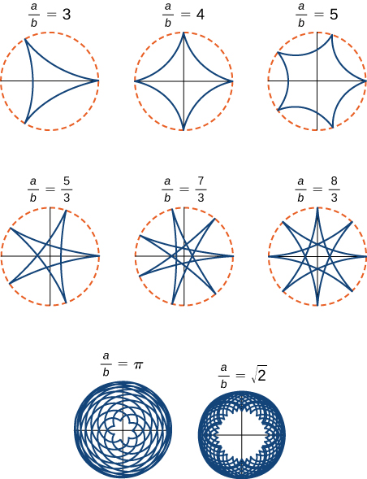
Mynd 7.11
Gröf mismunandi innhjólboga fyrir ólík gildi á a/b.
Notes:
A series of hypocycloids is given. The first is a three pointed star marked a/b = 3. The second is a four pointed star marked a/b = 4. The third is a five pointed star marked a/b = 5. None of these first three figures has lines that cross each other. The fourth figure is a five pointed star but this one has lines which cross each other and looks like the star that children first learn to draw; it is marked a/b = 5/3. A similar sort of star with seven points is next and is marked a/b = 7/3. Then a similar star with eight points is next and is marked a/b = 8/3. The next figure is a complicated series of curves that ultimately creates a small rosette in the middle; this is marked a/b = π. Lastly, there is an even more complicated series of curves that creates a large rosette with sharper florets marked a/b = the square root of 2.

Slide 15
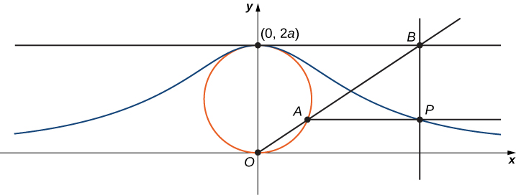
Mynd 7.12
Þegar punkturinn A færist eftir hringnum fer punkturinn P eftir Agnesi-ferli hringsins.
Notes:
A circle with bottom at point O (the origin) and top at point (0, 2a) is drawn. The x axis is drawn from point O, and the y axis is drawn up from point O through (0, 2a). Parallel to the x axis is a line drawn from (0, 2a); it has point B marked to the right. A line from point B to point O passes through the circle at point A. A line is drawn parallel to the x axis from point A, and it forms a right angle with a line drawn down from point B; these lines intersect at point P. There is a curve that is symmetric about the y axis that passes through the point P. This curve has its maximum at (0, 2a) and gently decreases through the point P.

Slide 16
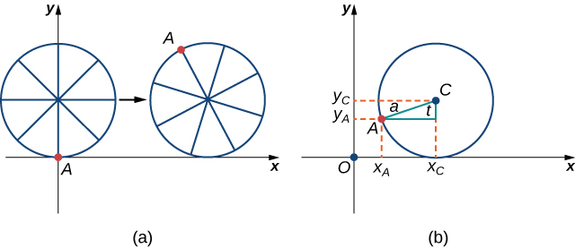
Mynd 7.13
(a) Maurinn heldur sér í jaðar reiðhjóladekksins meðan það rúllar eftir jörðinni. (b) Rúmfræði notuð til að ákvarða staðsetningu maursins eftir að dekkið hefur snúist um hornið t.
Notes:
There are two figures marked (a) and (b). Figure a has a circle with point A on the circle at the origin. The circle has “spokes,” with point A being at the end of one of these spokes. The circle appears to be travelling to the right on the x axis, with point A being up above the x axis in a second image of the circle drawn slightly to the right. Figure b has a circle in the first quadrant with center C. It touches the x axis at xc. A point A is drawn on the circle and a right triangle is made from this point and point C. The hypotenuse is marked a and the angle at C between A and xc is marked t. Lines are drawn to give the x and y values of A as xA and yA, respectively. Similarly, a line is drawn to give the y value of C as yC.

Slide 17
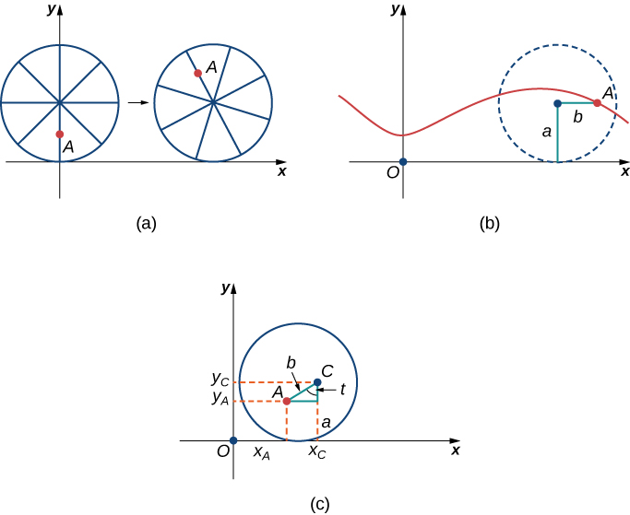
Mynd 7.14
(a) Maurinn skríður eftir einum teininum í átt að miðju hjólsins. (b) Ferill maursins eftir að hann hefur færst nær miðju hjólsins. Hann kallast styttur hjólbogi. (c) Ný uppsetning eftir að maurinn hefur færst nær miðju hjólsins.
Notes:
There are three figures marked (a), (b), and (c). Figure a has a circle with “spokes,” where point A is in the middle of one of these spokes. The circle is tangent to the x axis at the origin. The circle appears to be travelling to the right on the x axis, with point A being higher up in a second image of the circle drawn slightly to the right. Figure b shows the curve that point A would trace out, as the circle travels to the right. It is vaguely sinusoidal. Figure c has a circle in the first quadrant with center C. It touches the x axis at xc. A point A is drawn inside the circle and a right triangle is made from this point and point C. The hypotenuse is marked b, the angle at C between A and xc is marked t, and the distance from C to xc is marked a. Lines are drawn to give the x and y values of A as xA and yA, respectively. Similarly, a line is drawn to give the y value of C as yC.

Slide 18
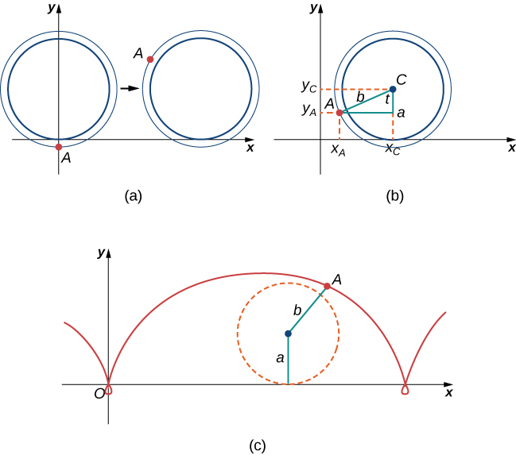
Mynd 7.15
(a) Maurinn heldur sér í flans lestarhjólsins. (b) Ný uppsetning eftir að maurinn hefur stokkið yfir á lestarhjólið. (c) Maurinn fer eftir lengdum hjólboga.
Notes:
There are three figures marked (a), (b), and (c). Figure a has a circle and a point A that is outside the circle on the y axis (below the origin). The circle is tangent to the x axis at the origin. The circle appears to be travelling to the right on the x axis, with point A being above the x axis in a second image of the circle drawn slightly to the right. Figure b has a circle in the first quadrant with center C. It touches the x axis at xc. A point A is drawn outside the circle and a right triangle is made from this point and point C. The hypotenuse is marked b, the angle at C between A and xc is marked t, and the distance from C to xc is marked a. Lines are drawn to give the x and y values of A as xA and yA, respectively. Similarly, a line is drawn to give the y value of C as yC. Figure c shows the curve that point A would trace out, as the circle travels to the right. It is vaguely sinusoidal with an extra loop at the bottom once per revolution.

Slide 19
7.2 Stærðfræðigreining stikaðra ferla
Námsmarkmið
Ákvarða afleiður og jöfnur snertla við stikaferla.
Finna flatarmálið undir stikaferli.
Nota jöfnuna fyrir bogalengd stikaferils.
Beita formúlunni fyrir yfirborðsflatarmál á snúð sem myndaður er af stikaferli.

Slide 20
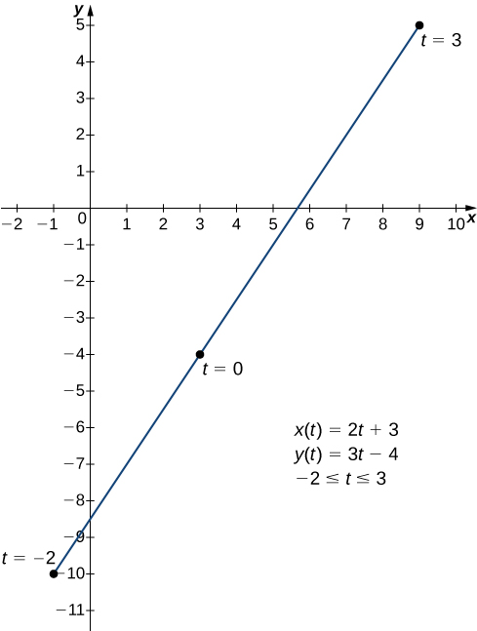
Mynd 7.16
Graf línustriksins sem gefnu stikuðu jöfnurnar lýsa.
Notes:
A straight line from (−1, −10) to (9, 5). The point (−1, −10) is marked t = −2, the point (3, −4) is marked t = 0, and the point (9, 5) is marked t = 3. There are three equations marked: x(t) = 2t + 3, y(t) = 3t – 4, and −2 ≤ t ≤ 3

Slide 21
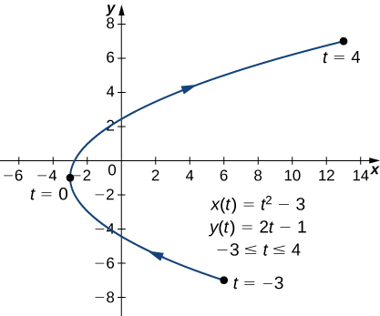
Mynd 7.17
Graf fleygbogans sem stikuðu jöfnurnar í a-lið lýsa.
Notes:
A curved line going from (6, −7) through (−3, −1) to (13, 7) with arrow pointing in that order. The point (6, −7) is marked t = −3, the point (−3, −1) is marked t = 0, and the point (13, 7) is marked t = 4. On the graph there are also written three equations: x(t) = t2 − 3, y(t) = 2t − 1, and −3 ≤ t ≤ 4.

Slide 22
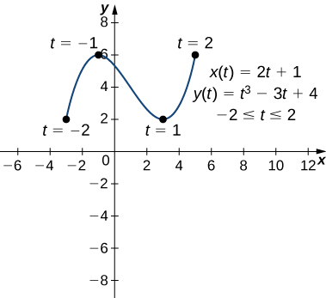
Mynd 7.18
Graf ferilsins sem stikuðu jöfnurnar í b-lið lýsa.
Notes:
A vaguely sinusoidal curve going from (−3, 2) through (−1, 6) and (3, 2) to (5, 6). The point (−3, 2) is marked t = −2, the point (−1, 6) is marked t = −1, the point (3, 2) is marked t = 1, and the point (5, 6) is marked t = 2. On the graph there are also written three equations: x(t) = 2t + 1, y(t) = t3 – 3t + 4, and −2 ≤ t ≤ 2.

Slide 23
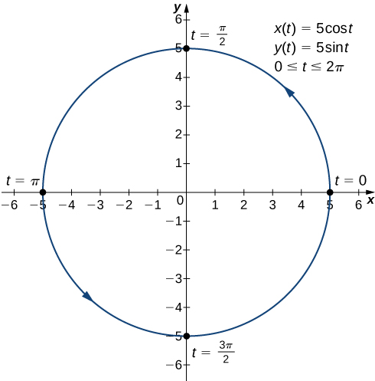
Mynd 7.19
Graf ferilsins sem stikuðu jöfnurnar í c-lið lýsa.
Notes:
A circle with radius 5 centered at the origin is graphed with arrow going counterclockwise. The point (5, 0) is marked t = 0, the point (0, 5) is marked t = π/2, the point (−5, 0) is marked t = π, and the point (0, −5) is marked t = 3π/2. On the graph there are also written three equations: x(t) = 5 cos(t), y(t) = 5 sin(t), and 0 ≤ t ≤ 2π.

Slide 24
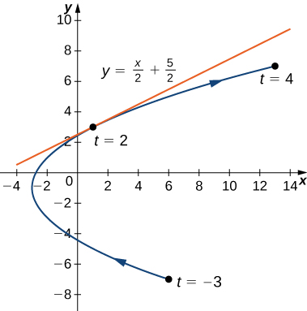
Mynd 7.20
Snertill við fleygbogann sem gefinn er með stikum þegar t=2.
Notes:
A curved line going from (6, −7) through (−3, −1) to (13, 7) with arrow pointing in that order. The point (6, −7) is marked t = −3, the point (−3, −1) is marked t = 0, and the point (13, 7) is marked t = 4. On the graph there are also written three equations: x(t) = t2 − 3, y(t) = 2t − 1, and −3 ≤ t ≤ 4. At the point (1, 3), which is marked t = 2, there is a tangent line with equation y = x/2 + 5/2.

Slide 25
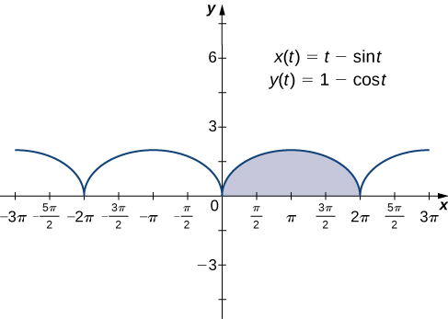
Mynd 7.21
Graf hjólferils þar sem boginn yfir [0,2π] er auðkenndur.
Notes:
A series of half circles drawn above the x axis with x intercepts being multiples of 2π. The half circle between 0 and 2π is highlighted. On the graph there are also written two equations: x(t) = t – sin(t) and y(t) = 1 – cos(t).

Slide 26
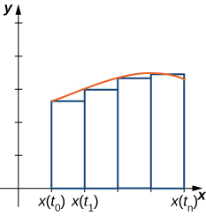
Mynd 7.22
Nálgun á flatarmálinu undir ferli sem gefinn er með stikum.
Notes:
A curved line is drawn in the first quadrant. Below it are a series of rectangles marked that begin at the x axis and reach up to the curved line; the rectangle’s height is determined by the location of the curved line at the leftmost point of the rectangle. These lines are noted as x(t0), x(t1), …, x(tn).

Slide 27
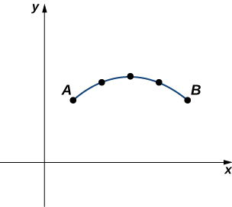
Mynd 7.23
Ferill nálgaður með línustrikum.
Notes:
A curved line in the first quadrant with points marked for x = 1, 2, 3, 4, and 5. These points have values roughly 2.1, 2.7, 3, 2.7, and 2.1, respectively. The points for x = 1 and 5 are marked A and B, respectively.

Slide 28
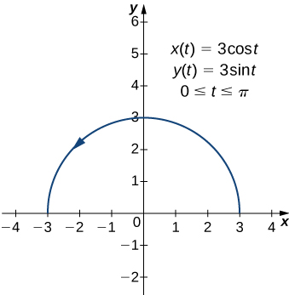
Mynd 7.24
Bogalengd hálfhringsins er jöfn margfeldi geisla hans og π.
Notes:
A semicircle is drawn with radius 3. There is an arrow pointing counterclockwise. On the graph there are also written three equations: x(t) = 3 cos(t), y(t) = 3 sin(t), and 0 ≤ t ≤ π.

Slide 29
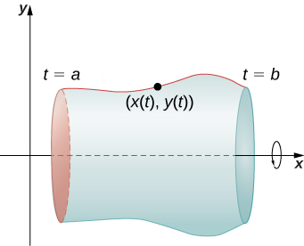
Mynd 7.25
Snúningsflötur myndaður af ferli sem gefinn er með stikum.
Notes:
A curve is drawn in the first quadrant with endpoints marked t = a and t = b. On this curve, there is a point marked (x(t), y(t)). There is a circle with an arrow drawn around the x axis that seems to indicate a rotation about the x axis, and there is a shape that accompanies that curve that seems to be what you would obtain if you rotated the curve about the x axis.

Slide 30
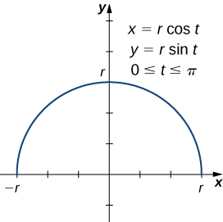
Mynd 7.26
Hálfhringur myndaður með stikajöfnum.
Notes:
A semicircle is drawn with radius r. On the graph there are also written three equations: x(t) = r cos(t), y(t) = r sin(t), and 0 ≤ t ≤ π.

Slide 31
7.3 Skauthnit
Námsmarkmið
Ákvarða staðsetningu punkta í plani með skauthnitum.
Umrita hnit punkta milli rétthyrndra hnita og skauthnita.
Teikna skautferla út frá gefnum jöfnum.
Umrita jöfnur milli rétthyrndra hnita og skauthnita.
Greina samhverfu í skautferlum og jöfnum þeirra.

Slide 32
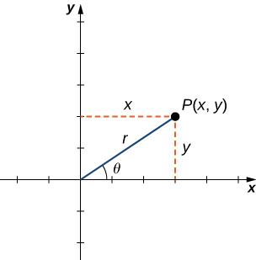
Mynd 7.27
Frjáls punktur í kartesíska planinu.
Notes:
A point P(x, y) is given in the first quadrant with lines drawn to indicate its x and y values. There is a line from the origin to P(x, y) marked r and this line make an angle θ with the x axis.

Slide 33
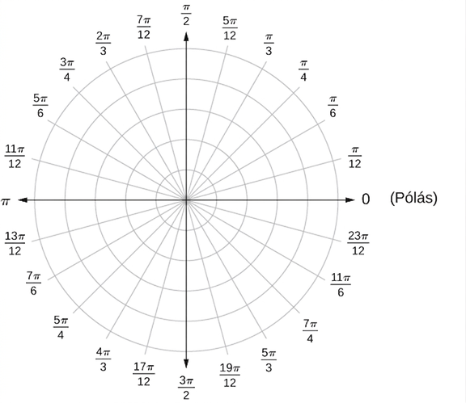
Mynd 7.28
Skauthnitakerfið.
Notes:
A series of concentric circles is drawn with spokes indicating different values between 0 and 2π in increments of π/12. The first quadrant starts with 0 where the x axis would be, then the next spoke is marked π/12, then π/6, π/4, π/3, 5π/12, π/2, and so on into the second, third, and fourth quadrants. The polar axis is noted near the former x axis line.

Slide 34
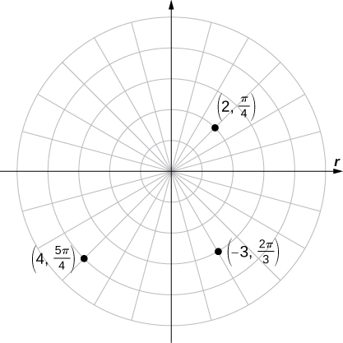
Mynd 7.29
Þrír punktar teiknaðir í skauthnitakerfinu.
Notes:
Three points are marked on a polar coordinate plane, specifically (2, π/4) in the first quadrant, (4, 5π/4) in the third quadrant, and (−3, 2π/3) in the fourth quadrant.

Slide 35
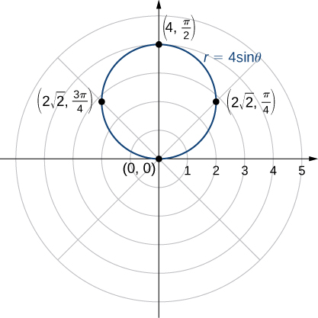
Mynd 7.30
Graf fallsins r=4sinθ er hringur.
Notes:
On the polar coordinate plane, a circle is drawn with radius 2. It touches the origin, (2 times the square root of 2, π/4), (4, π/2), and (2 times the square root of 2, 3π/4).

Slide 36
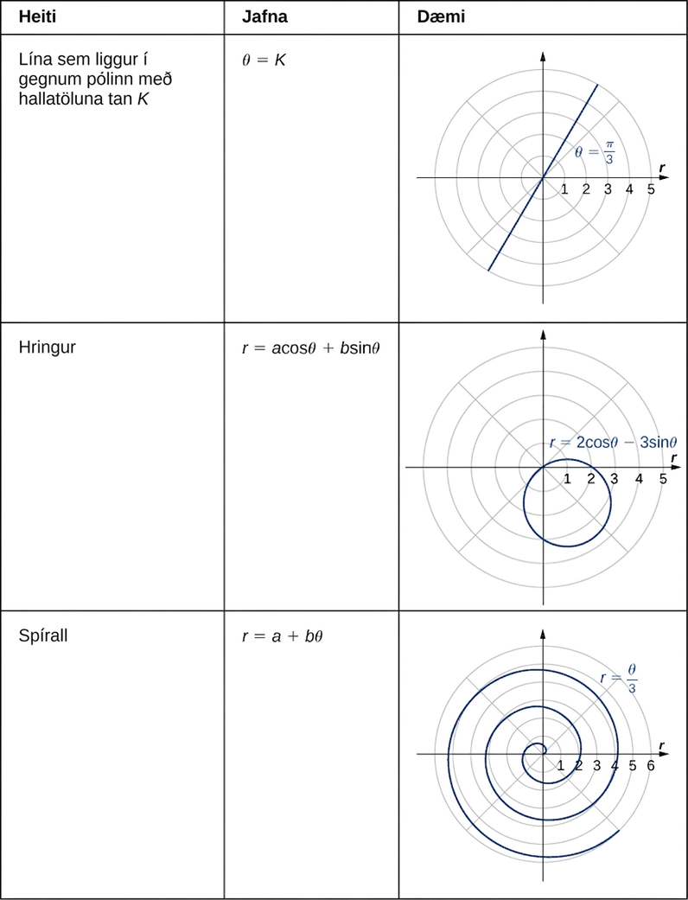
Mynd 7.31
Notes:
This table has three columns and 3 rows. The first row is a header row and is given from left to right as name, equation, and example. The second row is Line passing through the pole with slope tan K; θ = K; and a picture of a straight line on the polar coordinate plane with θ = π/3. The third row is Circle; r = a cosθ + b sinθ; and a picture of a circle on the polar coordinate plane with equation r = 2 cos(θ) – 3 sin(θ): the circle touches the origin but has center in the third quadrant.

Slide 37
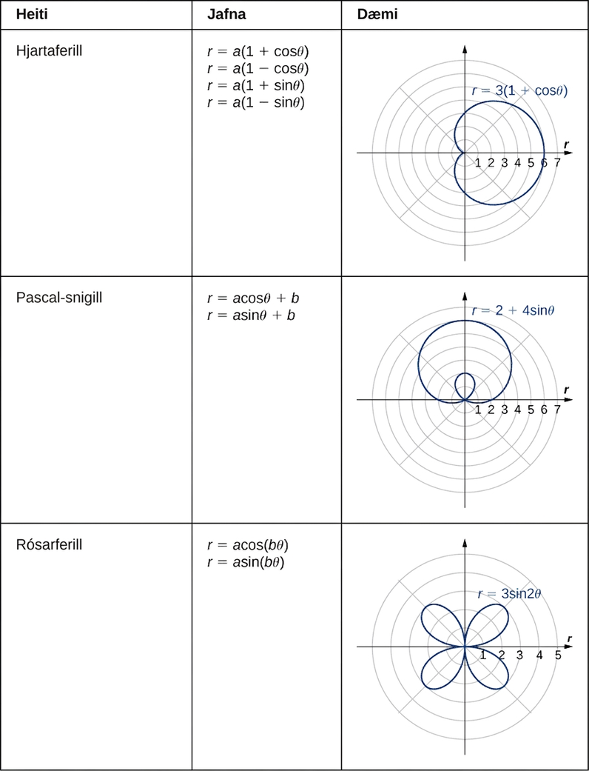
Mynd 7.32
Notes:
This table has three columns and 3 rows. The first row is Spiral; r = a + bθ; and a picture of a spiral starting at the origin with equation r = θ/3. The second row is Cardioid; r = a(1 + cosθ), r = a(1 – cosθ), r = a(1 + sinθ), r = a(1 – sinθ); and a picture of a cardioid with equation r = 3(1 + cosθ): the cardioid looks like a heart turned on its side with a rounded bottom instead of a pointed one. The third row is Limaçon; r = a cosθ + b, r = a sinθ + b; and a picture of a limaçon with equation r = 2 + 4 sinθ: the figure looks like a deformed circle with a loop inside of it. The seventh row is Rose; r = a cos(bθ), r = a sin(bθ); and a picture of a rose with equation r = 3 sin(2θ): the rose looks like a flower with four petals, one petal in each quadrant, each with length 3 and reaching to the origin between each petal.

Slide 38
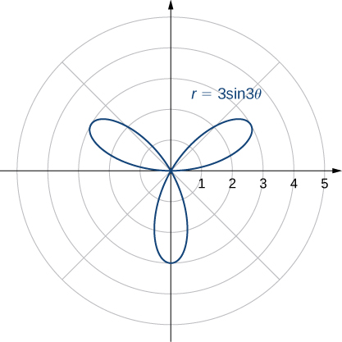
Mynd 7.33
Graf jöfnunnar r=3sin3θ.
Notes:
A rose with three petals, one in the first quadrant, another in the second quadrant, and the third in both the third and fourth quadrants, each with length 3. Each petal starts and ends at the origin.

Slide 39
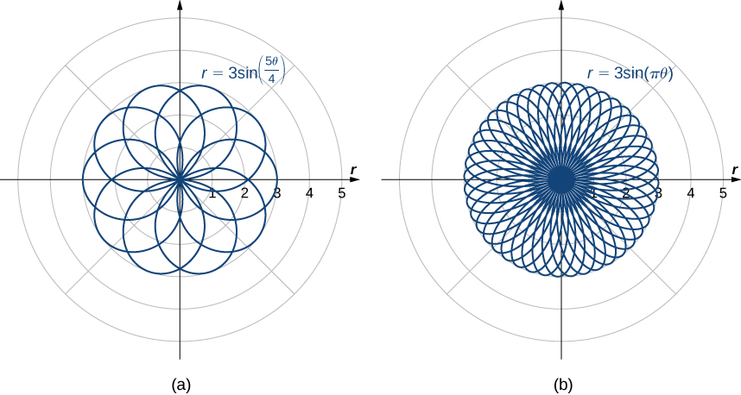
Mynd 7.34
Gröf skautarósa fyrir föll með (a) ræðum stuðli og (b) óræðum stuðli. Athugið að rósin í (b) fyllir ekki skífuna með geisla 3 og miðju í upphafspunkti þótt svo virðist. Á sérhverjum föstum geisla frá upphafspunkti eru aðeins teljanlega mörg gildi á θ sem gefa punkt á grafinu eftir geislanum. Hins vegar eru, fyrir sérhvern punkt í skífunni, punktar á grafinu sem liggja eins nálægt honum og óskað er.
Notes:
This figure has two figures. The first is a rose with so many overlapping petals that there are a few patterns that develop, starting with a sharp 10 pointed star in the center and moving out to an increasingly rounded set of petals. The second figure is a rose with even more overlapping petals, so many so that it is impossible to tell what is happening in the center, but on the outer edges are a number of sharply rounded petals.

Slide 40
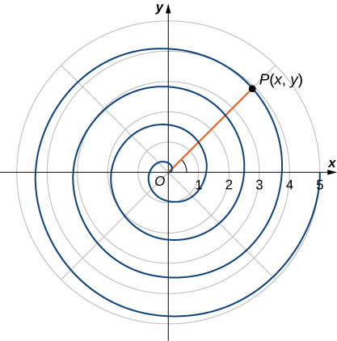
Mynd 7.35
Hvernig má lýsa spíralferli stærðfræðilega?
Notes:
A spiral starting at the origin and continually increasing its radius to a point P(x, y).

Slide 41
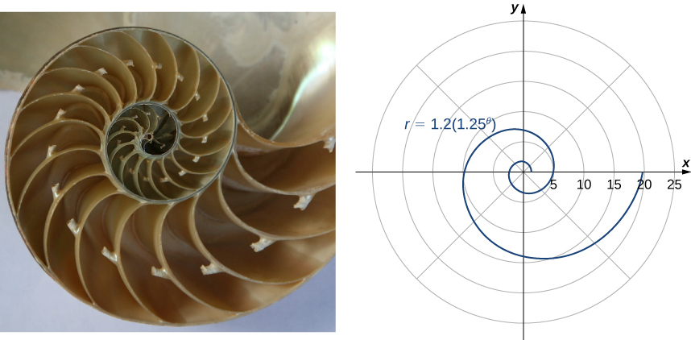
Mynd 7.36
Lograrspírall líkist lögun hólfaðrar perlusnekkjuskeljar. (mynd: breytt útgáfa af verki Jitze Couperus, Flickr)
Notes:
This figure has two figures. The first is a shell with many chambers that increase in size from the center out. The second is a spiral with equation r = 1.2(1.25θ).

Slide 42
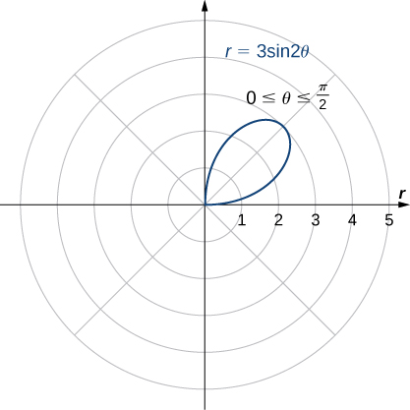
Mynd 7.37
Graf jöfnunnar frá θ=0 til θ=π/2.
Notes:
A single petal is graphed with equation r = 3 sin(2θ) for 0 ≤ θ ≤ π/2. It starts at the origin and reaches a maximum distance from the origin of 3.

Slide 43
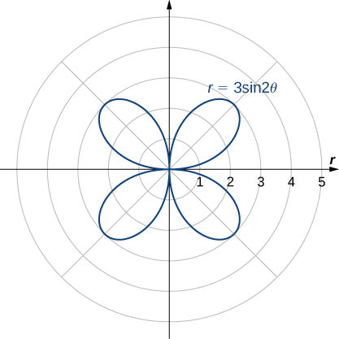
Mynd 7.38
Allt graf jöfnunnar kallast fjögurra blaða rós.
Notes:
A four-petaled rose is graphed with equation r = 3 sin(2θ). Each petal starts at the origin and reaches a maximum distance from the origin of 3.

Slide 44
7.4 Flatarmál og bogalengd í skauthnitum
Námsmarkmið
Beita formúlunni fyrir flatarmál svæðis í skauthnitum.
Ákvarða bogalengd skautferils.

Slide 45
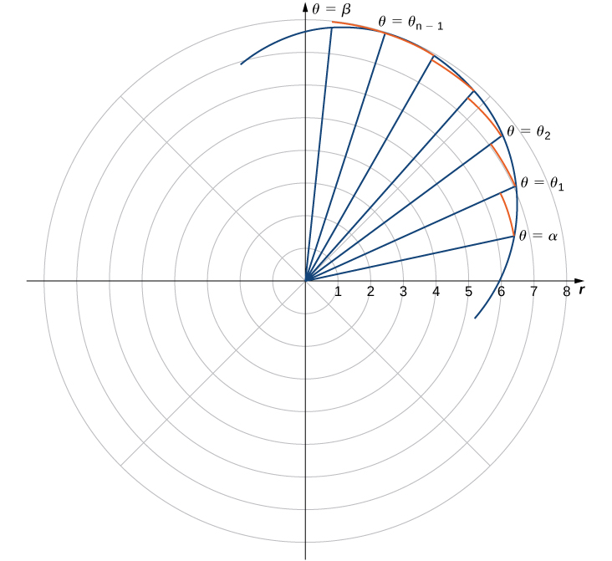
Mynd 7.39
Skipting dæmigerðs ferils í skauthnitum.
Notes:
On the polar coordinate plane, a curve is drawn in the first quadrant, and there are rays from the origin that intersect this curve at a regular interval. Every time one of these rays intersects the curve, a perpendicular arc is made from the ray to the next ray. The first instance of a ray-curve intersection is labeled θ = α; the last instance is labeled θ = β. The intervening ones are marked θ1, θ2, …, θn−1.

Slide 46
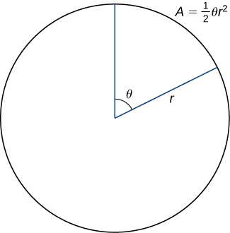
Mynd 7.40
Flatarmál hringgeira er A = ½θr².
Notes:
A circle is drawn with radius r and a sector of angle θ. It is noted that A = (1/2) θ r2.

Slide 47
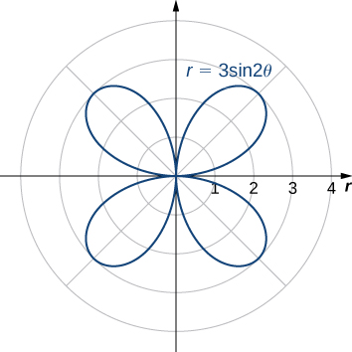
Mynd 7.41
Graf jöfnunnar r=3sin(2θ).
Notes:
A four-petaled rose with furthest extent 3 from the origin at π/4, 3π/4, 5π/4, and 7π/4.

Slide 48
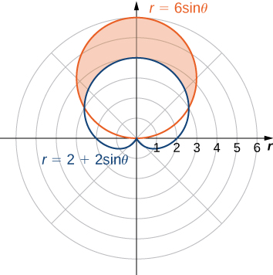
Mynd 7.42
Svæðið milli ferlanna r=2+2sinθ og r=6sinθ.
Notes:
A cardioid with equation r = 2 + 2 sinθ is shown, so it has its upper heart part at the origin and the rest of the cardioid is pointed up. There is a circle with radius 6 centered at (3, π/2). The area above the cardioid but below the circle is shaded orange.

Slide 49
7.5 Keilusnið (1 af 2)
Námsmarkmið
Finna jöfnu fleygboga á staðalformi út frá gefnum brennipunkti og stýrilínu.
Finna jöfnu sporbaugs á staðalformi út frá gefnum brennipunktum.
Finna jöfnu breiðboga á staðalformi út frá gefnum brennipunktum.
Greina fleygboga, sporbaug eða breiðboga út frá miðskekkju hans.

Slide 50
7.5 Keilusnið (2 af 2)
Námsmarkmið
Rita jöfnu keilusniðs í skauthnitum með miðskekkju e$e$.
Ákvarða hvenær almenn annars stigs jafna lýsir fleygboga, sporbaug eða breiðboga.

Slide 51
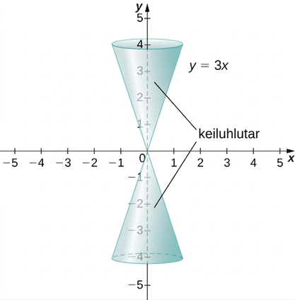
Mynd 7.43
Keila mynduð með því að snúa línunni y=3x um y-ásinn.
Notes:
The line y = 3x is drawn and then rotated around the y axis to create two nappes, that is, a cone that is both above and below the x axis.

Slide 52
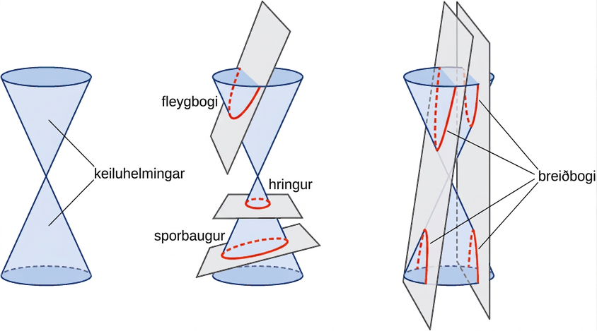
Mynd 7.44
Keilusniðin fjögur. Hvert keilusnið ákvarðast af horninu milli skurðsléttunnar og áss keilunnar.
Notes:
This figure has three figures. The first figure shows a plain cone with two nappes. The second figure shows a cone with a plane through one nappes and the circle at the top, which creates a parabola. There is also a circle, which occurs when a plane intersects one of the nappes while parallel to the circular bases. There is also an ellipse, which occurs when a plane insects one of the nappes while not parallel to one of the circular bases. Note that the circle and the ellipse are bounded by the edges of the cone on all sides. The last figure shows a hyperbola, which is obtained when a plane intersects both nappes.

Slide 53
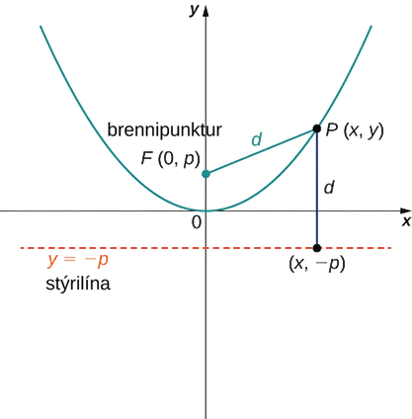
Mynd 7.45
Dæmigerður fleygbogi þar sem breytan p táknar fjarlægðina frá brennipunktinum að topppunktinum.
Notes:
A parabola is drawn with vertex at the origin and opening up. A focus is drawn as F at (0, p). A point P is marked on the line at coordinates (x, y), and the distance from the focus to P is marked d. A line marked the directrix is drawn, and it is y = − p. The distance from P to the directrix at (x, −p) is marked d.

Slide 54
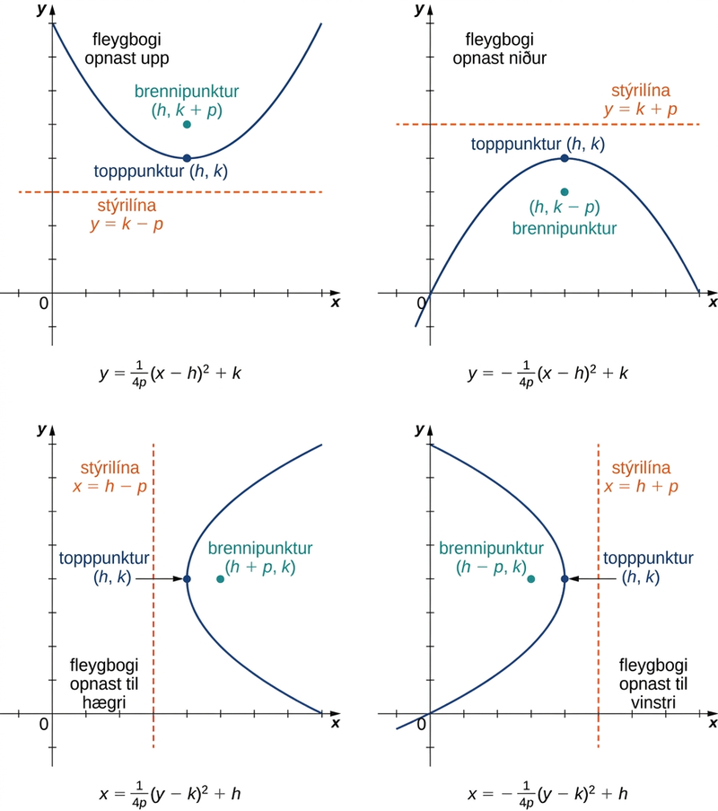
Mynd 7.46
Fjórir fleygbogar sem opnast í ólíkar áttir ásamt jöfnum þeirra á stöðluðu formi.
Notes:
This figure has four figures, each a parabola facing a different way. In the first figure, a parabola is drawn opening up with equation y = (1/(4p))(x − h)2 + k. The vertex is given as (h, k), the focus is drawn at (h, k + p), and the directrix is drawn as y = k − p. In the second figure, a parabola is drawn opening down with equation y = −(1/(4p))(x − h)2 + k. The vertex is given as (h, k), the focus is drawn at (h, k − p), and the directrix is drawn as y = k + p. In the third figure, a parabola is drawn opening to the right with equation x = (1/(4p))(y − k)2 + h. The vertex is given as (h, k), the focus is drawn at (h + p, k), and the directrix is drawn as x = h − p. In the fourth figure, a parabola is drawn opening left with equation x = −(1/(4p))(y − k)2 + h. The vertex is given as (h, k), the focus is drawn at (h – p, k), and the directrix is drawn as x = h + p.

Slide 55
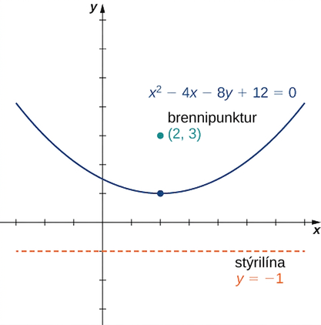
Mynd 7.47
Fleygboginn í dæmi 7.19.
Notes:
A parabola is drawn with vertex at (2, 1) and opening up with equation x2 – 4x – 8y + 12 = 0. The focus is drawn at (1, 3). The directrix is drawn at y = − 1.

Slide 56
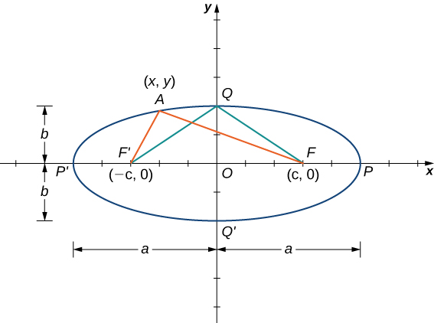
Mynd 7.48
Dæmigerður sporbaugur þar sem summa fjarlægðanna frá sérhverjum punkti á sporbauginum að brennipunktunum er föst.
Notes:
An ellipse is drawn with center at the origin O, focal point F’ being (−c, 0) and focal point F being (c, 0). The ellipse has points P and P’ on the x axis and points Q and Q’ on the y axis. There are lines drawn from F’ to Q and F to Q. There are also lines drawn from F’ and F to a point A on the ellipse marked (x, y). The distance from O to Q and O to Q’ is marked b, and the distance from P to O and O to P’ is marked a.

Slide 57
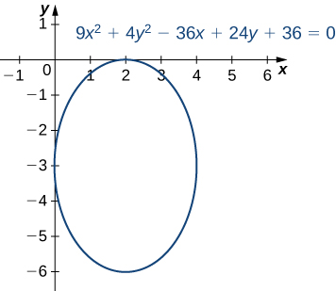
Mynd 7.49
Sporbaugurinn í dæmi 7.20.
Notes:
An ellipse is drawn with equation 9x2 + 4y2 – 36x + 24y + 36 = 0. It has center at (2, −3), touches the x axis at (2, 0), and touches the y axis at (0, −3).

Slide 58

Mynd 7.50
(a) Braut jarðar um sólina er sporbaugur og sólin er í öðrum brennipunktinum. (b) Statuary Hall í þinghúsi Bandaríkjanna er hvíslhvelfing með sporöskjulaga þversnið.
Notes:
There are two figures labeled a and b. In figure a, the earth is drawn orbiting the sun, with January and July marked. The distance from the sun to the earth marked January is 147 million km, while the distance from the sun to the earth marked July is 152 million miles. In figure b, a room is shown with curved walls.

Slide 59

Mynd 7.51
Dæmigerður breiðbogi þar sem mismunur fjarlægðanna frá sérhverjum punkti á breiðboganum að brennipunktunum er fastur. Meginásinn er einnig kallaður langás og þverásinn einnig skammás.
Notes:
A hyperbola is drawn with center at the origin. The vertices are at (a, 0) and (−a, 0); the foci are labeled F1 and F2 and are at (c, 0) and (−c, 0). The asymptotes are drawn, and lines are drawn from the vertices to the asymptotes; the intersections of these lines are connected by other lines to make a rectangle; the shorter axis is called the conjugate axis and the larger axis is called the transverse axis. The distance from the x axis to either line forming the rectangle is b.

Slide 60

Mynd 7.52
Graf breiðbogans í dæmi 7.21.
Notes:
A hyperbola is drawn with equation 9x2 − 16y2 + 36x + 32y – 124 = 0. It has center at (−2, 1), and the hyperbolas are open to the left and right.

Slide 61

Mynd 7.53
Breiðbogaspegill sem safnar ljósi frá fjarlægum stjörnum.
Notes:
A hyperbola is drawn that is open to the right and left. There is a ray pointing to a point on the right hyperbola marked “Light from star.” It hits a “Mirror surface” and bounces to the focus on the other side of the hyperbola. There is dashed line from where the point hits the mirror surface to the focus on that side of the hyperbola.

Slide 62

Mynd 7.54
Keilusniðin þrjú ásamt brennipunktum sínum og stýrilínum.
Notes:
This figure has three figures. In the first is an ellipse, with center at the origin, foci at (c, 0) and (−c, 0), half of its vertical height being b, half of its horizontal length being a, and directrix x = ±a2/c. The second figure is a parabola with vertex at the origin, focus (c, 0), and directrix x = −a. The third figure is a hyperbola with center at the origin, foci at (c, 0) and (−c, 0), vertices at (a, 0) and (−a, 0), and directices at x = ±a2/c.

Slide 63

Tafla 7.1 Miðskekkjur og brennistik keilusniðanna
Keilusnið | e | p
Sporbaugur | $$0<e<1$$ | $$\frac{a^{2}−c^{2}}{c}=\frac{a\left(1−e^{2}\right)}{e}$$
Fleygbogi | $$e=1$$ | $$2a$$
Breiðbogi | $$e>1$$ | $$\frac{c^{2}−a^{2}}{c}=\frac{a\left(e^{2}−1\right)}{e}$$

Slide 64

Mynd 7.55
Graf breiðbogans sem lýst er í dæmi 7.23.
Notes:
Graph of a hyperbola with equation r = 3/(1 + 2 cosθ), center at (2, 0), and vertices at (1, 0) and (3, 0).

Slide 65

Mynd 7.56
Graf jöfnunnar xy=1; rauðu línurnar sýna snúnu ásana.
Notes:
Graph of xy = 1, which has asymptotes at the x and y axes. This hyperbola is relegated to the first and third quadrants, and the graph also has red dashed lines along y = x and y = −x.

Slide 66

Mynd 7.57
Graf sporbaugsins sem jafnan 13x² − 6√3xy + 7y² − 256 = 0 lýsir. Ásunum hefur verið snúið um 60°. Rauðu strikalínurnar sýna snúnu ásana.
Notes:
Graph of an ellipse with equation 13x2 – 6 times the square root of 3 times xy + 7y2 – 256 = 0. The center is at the origin, and the ellipse appears to be skewed 60 degrees. There are dashed red lines along the major and minor axes.

Slide 67
Notkunarleyfi
Þetta ítarefni frá OpenStax er © Rice University og gefið út samkvæmt alþjóðlega notkunarleyfinu CC BY-NC-SA 4.0. Einungis má afrita það eða breyta því í óhagnaðarskyni, en geta verður OpenStax og Rice University sem rétthafa og tilgreina allar breytingar. Öllum aðlögunum verður að deila samkvæmt sams konar notkunarleyfi.

