Slide 1

Stærðfræðigreining, 2. bindi
2. kafli Hagnýting heildunar

Slide 2
Efnisyfirlit kaflans
Flatarmál milli ferla
Rúmmál reiknað með sneiðum
Rúmmál snúða: Sívalningshylki
Bogalengd ferils og yfirborðsflatarmál
Hagnýting í eðlisfræði
Vægi og massamiðjur
Heildi, vísisföll og lograr
Vísisvöxtur og -hnignun
Stærðfræðigreining breiðbogafalla

Slide 3
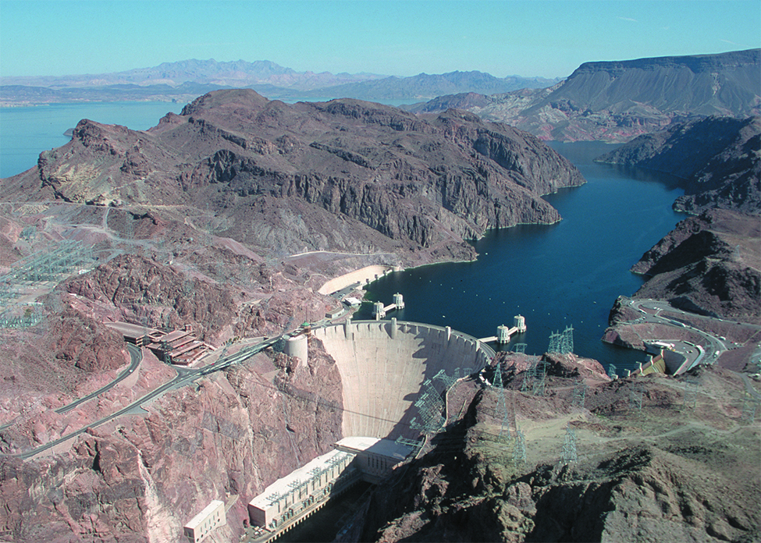
Mynd 2.1
Hoover-stíflan er eitt þekktasta kennileiti Bandaríkjanna og sér milljónum íbúa í suðvesturhluta landsins fyrir áveituvatni og vatnsaflsrafmagni. (heimild: aðlagað verk eftir Lynn Betts, Wikimedia)
Notes:
This is a picture of the Hoover Dam. The picture has the dam in the background and flowing water in the foreground below the dam.

Slide 4
2.1 Flatarmál milli ferla
Námsmarkmið
Ákvarða flatarmál svæðis milli tveggja ferla með heildun með tilliti til óháðu breytunnar.
Finna flatarmál samsetts svæðis.
Ákvarða flatarmál svæðis milli tveggja ferla með heildun með tilliti til háðu breytunnar.

Slide 5
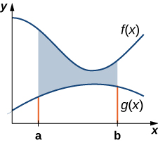
Mynd 2.2
Flatarmálið milli grafa fallanna f(x) og g(x) á bilinu [a,b].
Notes:
This figure is a graph in the first quadrant. There are two curves on the graph. The higher curve is labeled “f(x)” and the lower curve is labeled “g(x)”. There are two boundaries on the x-axis labeled a and b. There is shaded area between the two curves bounded by lines at x=a and x=b.

Slide 6
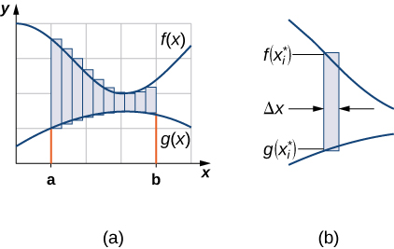
Mynd 2.3
(a) Við getum nálgað flatarmálið milli grafa fallanna f(x) og g(x) með rétthyrningum. (b) Dæmigerður rétthyrningur nær frá öðrum ferlinum að hinum.
Notes:
This figure has three graphs. The first graph has two curves, one over the other. In between the curves is a rectangle. The top of the rectangle is on the upper curve labeled “f(x*)” and the bottom of the rectangle is on the lower curve and labeled “g(x*)”. The second graph, labeled “(a)”, has two curves on the graph. The higher curve is labeled “f(x)” and the lower curve is labeled “g(x)”. There are two boundaries on the x-axis labeled a and b. There is shaded area between the two curves bounded by lines at x=a and x=b. The third graph, labeled “(b)” has two curves one over the other. The first curve is labeled “f(x*)” and the lower curve is labeled “g(x*)”. There is a shaded rectangle between the two. The width of the rectangle is labeled as “delta x”.

Slide 7
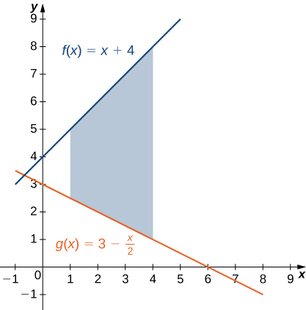
Mynd 2.4
Sýnt er svæði milli tveggja ferla þar sem annar ferillinn liggur alls staðar ofan við hinn.
Notes:
This figure is has two linear graphs in the first quadrant. They are the functions f(x) = x+4 and g(x)= 3-x/2. In between these lines is a shaded region, bounded above by f(x) and below by g(x). The shaded area is between x=1 and x=4.

Slide 8
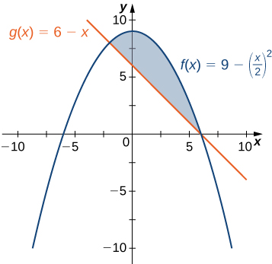
Mynd 2.5
Myndritið sýnir svæðið neðan við graf f(x) og ofan við graf g(x).
Notes:
This figure is has two graphs in the first quadrant. They are the functions f(x) = 9-(x/2)^2 and g(x)= 6-x. In between these graphs, an upside down parabola and a line, is a shaded region, bounded above by f(x) and below by g(x).

Slide 9
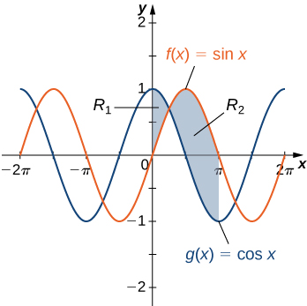
Mynd 2.6
Skipta má svæðinu milli ferlanna í tvö undirsvæði.
Notes:
This figure is has two graphs. They are the functions f(x) = sinx and g(x)= cosx. They are both periodic functions that resemble waves. There are two shaded areas between the graphs. The first shaded area is labeled “R1” and has g(x) above f(x). This region begins at the y-axis and stops where the curves intersect. The second region is labeled “R2” and begins at the intersection with f(x) above g(x). The shaded region stops at x=pi.

Slide 10
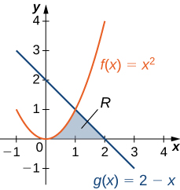
Mynd 2.7
Nota þarf tvö heildi til að reikna flatarmál svæðisins.
Notes:
This figure is has two graphs in the first quadrant. They are the functions f(x) = x^2 and g(x)= 2-x. In between these graphs is a shaded region, bounded to the left by f(x) and to the right by g(x). All of which is above the x-axis. The region is labeled R. The shaded area is between x=0 and x=2.

Slide 11
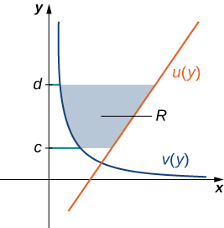
Mynd 2.8
Við getum fundið flatarmálið milli grafa fallanna u(y) og v(y).
Notes:
This figure is has two graphs in the first quadrant. They are the functions v(y) and u(y). In between these graphs is a shaded region, bounded to the left by v(y) and to the right by u(y). The region is labeled R. The shaded area is between the horizontal boundaries of y=c and y=d.

Slide 12
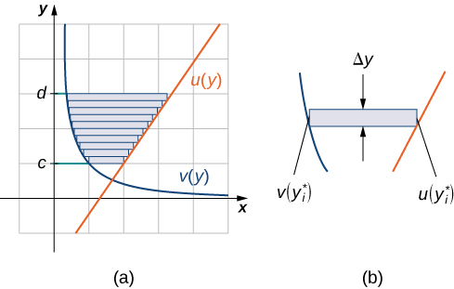
Mynd 2.9
(a) Flatarmálið milli grafa fallanna u(y) og v(y) nálgað með rétthyrningum. (b) Flatarmál dæmigerðs rétthyrnings.
Notes:
This figure is has three graphs. The first figure has two curves. They are the functions v(y*) and u(y*). In between these curves is a horizontal rectangle. The second figure labeled “(a)”, is a shaded region, bounded to the left by v(y) and to the right by u(y). The shaded area is between the horizontal boundaries of y=c and y=d. This shaded area is broken into rectangles between the curves. The third figure, labeled “(b)”, is the two curves v(y*) and u(y*). In between the curves is a horizontal rectangle with width delta y.

Slide 13

Mynd 2.10
Reikna má flatarmál svæðisins R með einu heildi ef ferlarnir eru settir fram sem föll af y.
Notes:
This figure is has two graphs in the first quadrant. They are the functions f(x) = x^2 and g(x)= 2-x. In between these graphs is a shaded region, bounded to the left by f(x) and to the right by g(x). All of which is above the x-axis. The region is labeled R. The shaded area is between x=0 and x=2.

Slide 14
2.2 Rúmmál reiknað með sneiðum
Námsmarkmið
Ákvarða rúmmál rúmhlutar með því að heilda flatarmál þversniða (sneiðaaðferðin).
Finna rúmmál snúðs með skífuaðferðinni.
Finna rúmmál snúðs með holrúmi með hringkragaaðferðinni.

Slide 15
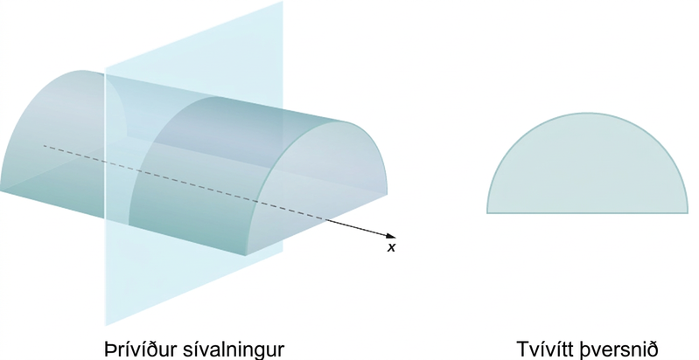
Mynd 2.11
Öll þversnið tiltekins sívalnings eru eins.
Notes:
This graphic has two figures. The first figure is half of a cylinder, on the flat portion. The cylinder has a line through the center labeled “x”. Vertically cutting through the cylinder, perpendicular to the line is a plane. The second figure is a two dimensional cross section of the cylinder intersecting with the plane. It is a semi-circle.

Slide 16
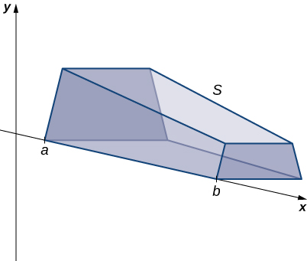
Mynd 2.12
Rúmhlutur með breytilegu þversniði.
Notes:
This figure is a graph of a 3-dimensional solid. It has one edge along the x-axis. The x-axis is part of the 2-dimensional coordinate system with the y-axis labeled. The edge of the solid along the x-axis starts at a point labeled “a” and stops at a point labeled “b”.

Slide 17
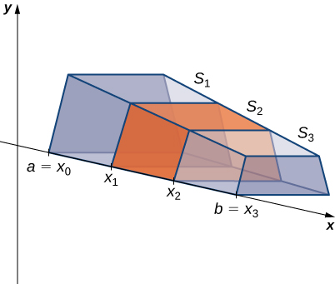
Mynd 2.13
Rúmhlutnum S hefur verið skipt í þrjár sneiðar hornrétt á x-ásinn.
Notes:
This figure is a graph of a 3-dimensional solid. It has one edge along the x-axis. The x-axis is part of the 2-dimensional coordinate system with the y-axis labeled. The edge of the solid along the x-axis starts at a point labeled “a=xsub0”. The solid is divided up into smaller solids with slices at xsub1, xsub2, and stops at a point labeled “b=xsub3”. These smaller solids are labeled Ssub1, Ssub2, and Ssub3. They are also shaded.

Slide 18
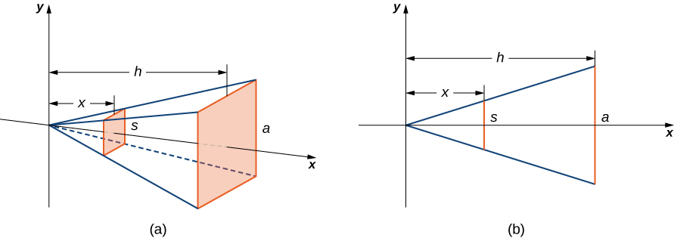
Mynd 2.14
(a) Pýramída með ferningslaga grunnfleti er komið fyrir eftir x-ásnum. (b) Tvívíð hliðarmynd af pýramídanum.
Notes:
This figure has two graphs. The first graph, labeled “a”, is a pyramid on its side. The x-axis goes through the middle of the pyramid. The point of the top of the pyramid is at the origin of the x y coordinate system. The base of the pyramid is shaded and labeled “a”. Inside of the pyramid is a shaded rectangle labeled “s”. The distance from the y-axis to the base of the pyramid is labeled “h”. the distance the rectangle inside of the pyramid to the y-axis is labeled “x”. The second figure is a cross section of the pyramid with the x and y axes labeled. The cross section is a triangle with one side labeled “a”, perpendicular to the x-axis. The distance a is from the y-axis is h. There is another perpendicular line to the x-axis inside of the triangle. It is labeled “s”. It is x units from the y-axis.

Slide 19
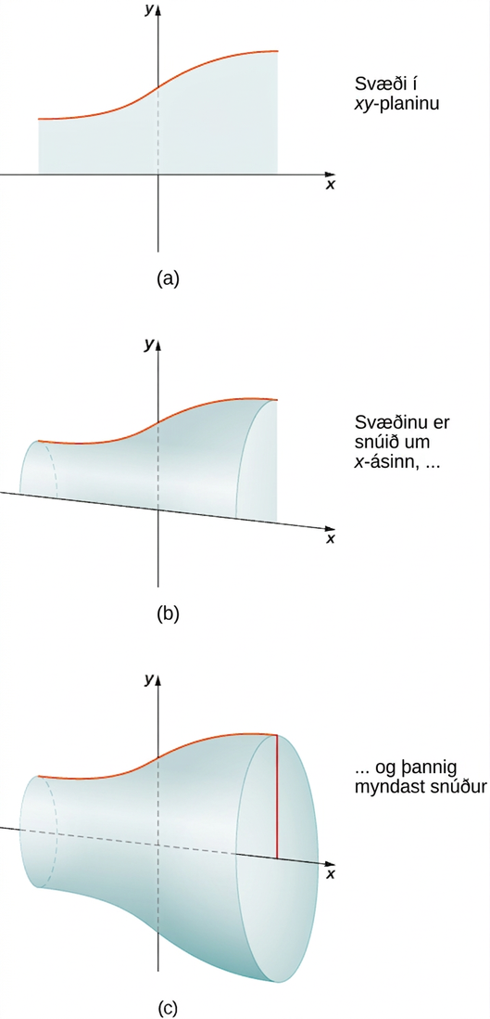
Mynd 2.15
(a) Þetta svæði er snúið um x-ásinn. (b) Þegar svæðið snýst um ásinn myndar það snúð. (c) Hér sést rúmhluturinn þegar snúningnum er lokið.
Notes:
This figure has three graphs. The first graph, labeled “a” is a region in the x y plane. The region is created by a curve above the x-axis and the x-axis. The second graph, labeled “b” is the same region as in “a”, but it shows the region beginning to rotate around the x-axis. The third graph, labeled “c” is the solid formed by rotating the region from “a” completely around the x-axis, forming a solid.

Slide 20
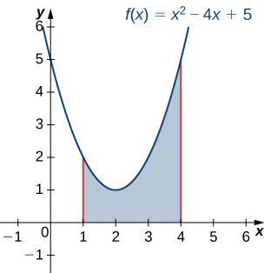
Mynd 2.16
Svæði sem notað er til að mynda snúð.
Notes:
This figure is a graph of the parabola f(x)=x^2-4x+5. The parabola is the top of a shaded region above the x-axis. The region is bounded to the left by a line at x=1 and to the right by a line at x=4.

Slide 21
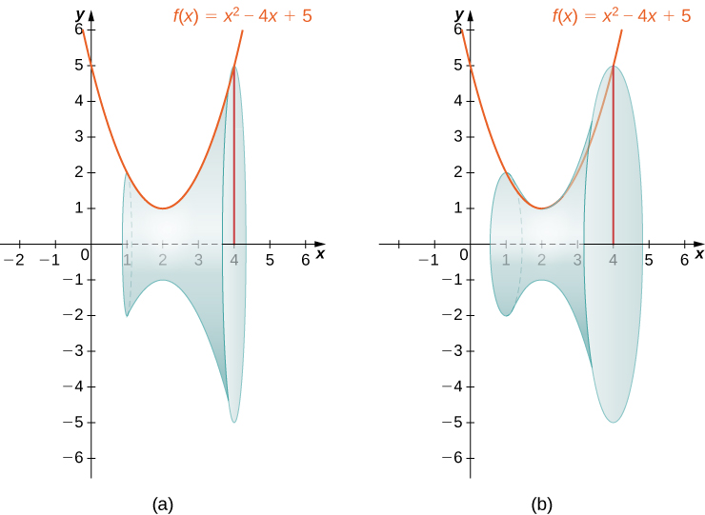
Mynd 2.17
Tvær myndir, (a) og (b), af snúðnum sem myndast þegar svæðinu á mynd 2.16 er snúið um x-ásinn.
Notes:
This figure has two graphs of the parabola f(x)=x^2-4x+5. The parabola is the top of a shaded region above the x-axis. The region is bounded to the left by a line at x=1 and to the right by a line at x=4. The first graph has a shaded solid below the parabola. This solid has been formed by rotating the parabola around the x-axis. The second graph is the same as the first, with the solid being rotated to show the solid.

Slide 22
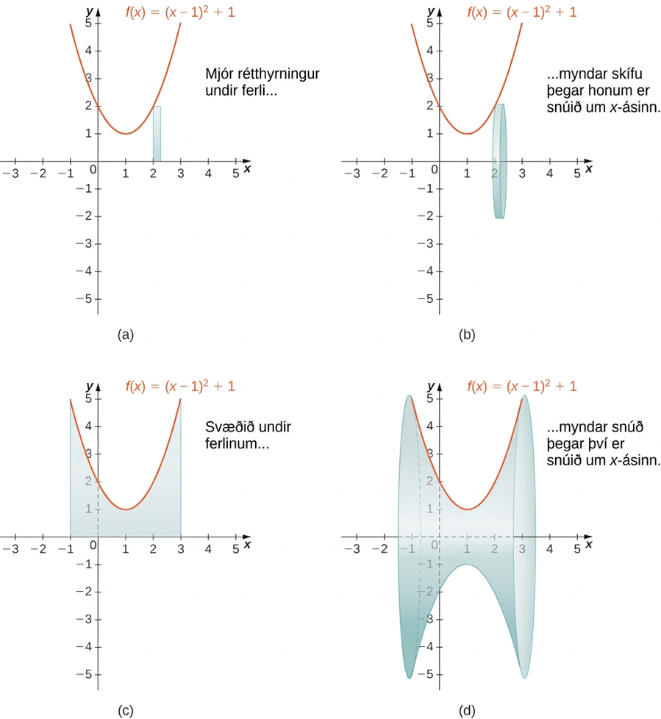
Mynd 2.18
(a) Mjór rétthyrningur sem notaður er til að nálga flatarmálið undir ferli. (b) Dæmigerð skífa sem myndast þegar rétthyrningnum er snúið um x-ásinn. (c) Svæðinu undir ferlinum er snúið um x-ásinn og þannig myndast (d) snúðurinn.
Notes:
This figure has four graphs. The first graph, labeled “a” is a parabola f(x)=(x-1)^2+1. The curve is above the x-axis and intersects the y-axis at y=2. Under the curve in the first quadrant is a vertical rectangle starting at the x-axis and stopping at the curve. The second graph, labeled “b” is the same parabola as in the first graph. The rectangle under the parabola from the first graph has been rotated around the x-axis forming a solid disk. The third graph labeled “c” is the same parabola as the first graph. There is a shaded region bounded above by the parabola, to the left by the line x=-1 and to the right by the line x=3, and below by the x-axis. The fourth graph labeled “d” is the same parabola as the first graph. The region from the third graph has been revolved around the x-axis to form a solid.

Slide 23
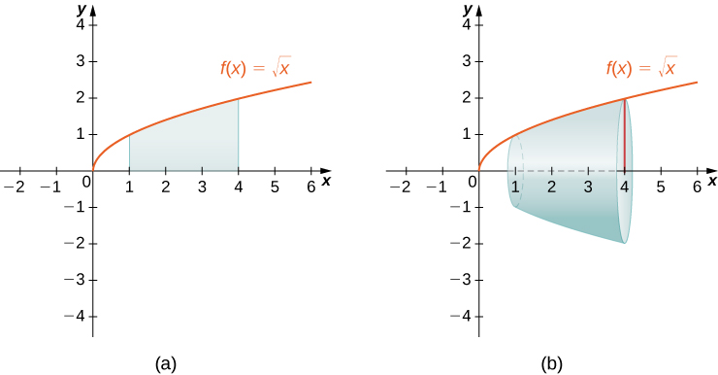
Mynd 2.19
(a) Fallið f(x)=x á bilinu [1,4]. (b) Snúðurinn sem fæst þegar svæðinu undir grafi f(x) er snúið um x-ásinn.
Notes:
This figure has two graphs. The first graph labeled “a” is the curve f(x) = squareroot(x). It is an increasing curve above the x-axis. The curve is in the first quadrant. Under the curve is a region bounded by x=1 and x=4. The bottom of the region is the x-axis. The second graph labeled “b” is the same curve as the first graph. The solid region from the first graph has been rotated around the x-axis to form a solid region.

Slide 24
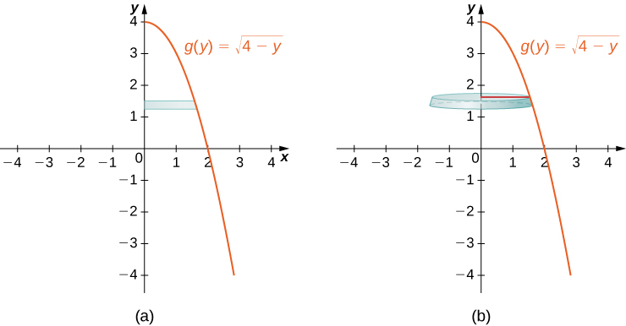
Mynd 2.20
(a) Sýndur er grannur rétthyrningur milli ferils fallsins g(y)=4−y og y-ássins. (b) Þegar rétthyrningnum er snúið um y-ásinn myndar hann dæmigerða skífu.
Notes:
This figure has two graphs. The first graph labeled “a” is the curve g(y) = squareroot(4-y). It is a decreasing curve starting on the y-axis at y=4. Between the curve and the y-axis is a horizontal rectangle. The rectangle starts at the y-axis and stops at the curve. The second graph labeled “b” is the same curve as the first graph. The rectangle from the first graph has been rotated around the y-axis to form a horizontal disk.

Slide 25
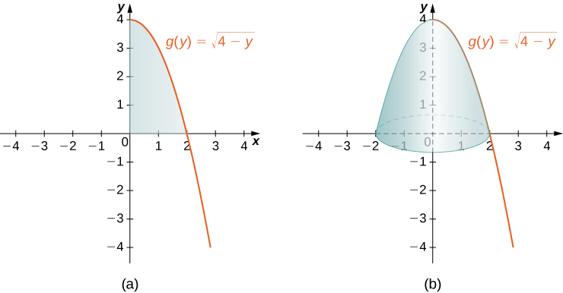
Mynd 2.21
(a) Svæðið vinstra megin við feril fallsins g(y)=4−y á bilinu [0,4] á y-ásnum. (b) Snúðurinn sem myndast þegar svæðinu er snúið um y-ásinn.
Notes:
This figure has two graphs. The first graph labeled “a” is the curve g(y) = squareroot(4-y). It is a decreasing curve starting on the y-axis at y=4. The region formed by the x-axis, the y-axis, and the curve is shaded. This region is in the first quadrant. The second graph labeled “b” is the same curve as the first graph. The region from the first graph has been rotated around the y-axis to form a solid.

Slide 26
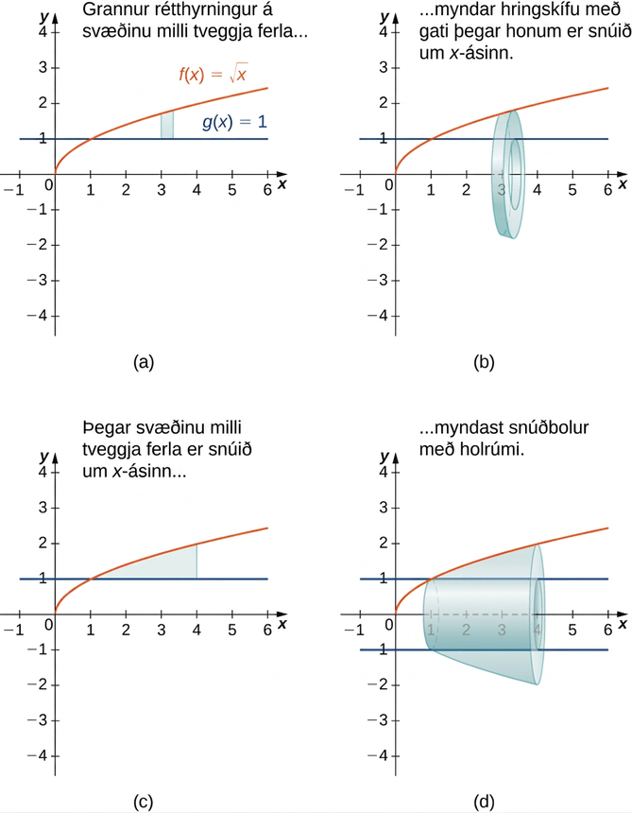
Mynd 2.22
(a) Grannur rétthyrningur á svæðinu milli tveggja ferla. (b) Dæmigerður hringkragi sem myndast þegar rétthyrningnum er snúið um x-ásinn. (c) Svæðið milli ferlanna á gefna bilinu. (d) Snúðurinn sem myndast.
Notes:
This figure has four graphs. The first graph is labeled “a” and has the two functions f(x)=squareroot(x) and g(x)=1 graphed in the first quadrant. f(x) is an increasing curve starting at the origin and g(x) is a horizontal line at y=1. The curves intersect at the ordered pair (1,1). In between the curves is a shaded rectangle with the bottom on g(x) and the top at f(x). The second graph labeled “b” is the same two curves as the first graph. The shaded rectangle between the curves from the first graph has been rotated around the x-axis to form an open disk or washer. The third graph labeled “a” has the same two curves as the first graph. There is a shaded region between the two curves between where they intersect and a line at x=4. The fourth graph is the same two curves as the first with the region from the third graph rotated around the x-axis forming a solid region with a hollow center. The hollow center is represented on the graph with broken horizontal lines at y=1 and y=-1.

Slide 27
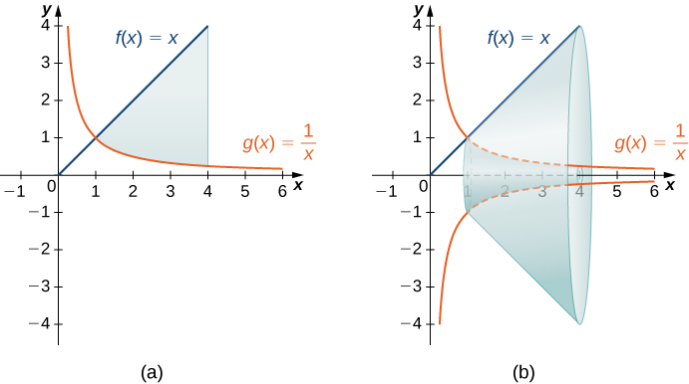
Mynd 2.23
(a) Svæðið milli grafa fallanna f(x)=x og g(x)=1/x á bilinu [1,4]. (b) Þegar svæðinu er snúið um x-ásinn myndast snúður með holrúmi í miðjunni.
Notes:
This figure has two graphs. The first graph is labeled “a” and has the two curves f(x)=x and g(x)=1/x. They are graphed only in the first quadrant. f(x) is a diagonal line starting at the origin and g(x) is a decreasing curve with the y-axis as a vertical asymptote and the x-axis as a horizontal asymptote. The graphs intersect at (1,1). There is a shaded region between the graphs, bounded to the right by a line at x=4. The second graph is the same two curves. There is a solid formed by rotating the shaded region from the first graph around the x-axis.

Slide 28
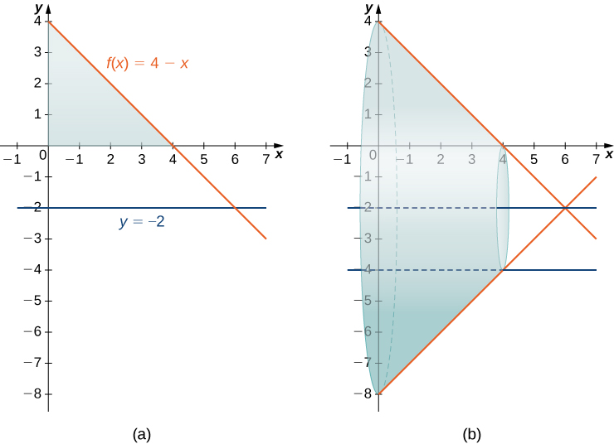
Mynd 2.24
(a) Svæðið milli grafs fallsins f(x)=4−x og x-ássins á bilinu [0,4]. (b) Þegar svæðinu er snúið um línuna y=−2 myndast snúður með sívalningslaga gati í gegnum miðjuna.
Notes:
This figure has two graphs. The first graph is labeled “a” and has the two curves f(x)=4-x and -2. There is a shaded region making a triangle bounded by the decreasing line f(x), the y-axis and the x-axis. The second graph is the same two curves. There is a solid formed by rotating the shaded region from the first graph around the line y=-2. There is a hollow cylinder inside of the solid represented by the lines y=-2 and y=-4.

Slide 29
2.3 Rúmmál snúða: Sívalningshylki
Námsmarkmið
Reikna rúmmál snúðs með hylkjaaðferðinni.
Bera saman mismunandi aðferðir við að reikna rúmmál snúðs.

Slide 30
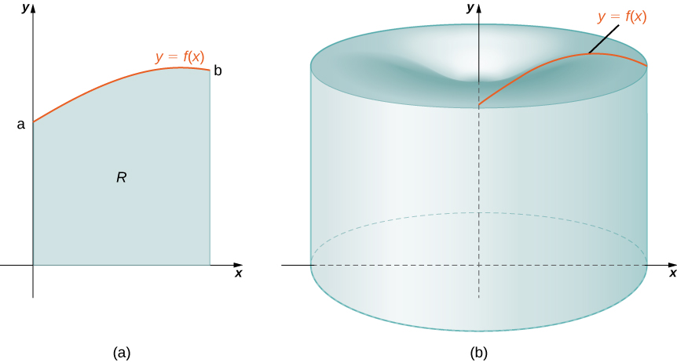
Mynd 2.25
(a) Svæði afmarkað af grafi falls af x. (b) Snúðurinn sem myndast þegar svæðinu er snúið um y-ásinn.
Notes:
This figure has two graphs. The first graph is labeled “a” and is an increasing curve in the first quadrant. The curve is labeled “y=f(x)”. The curve starts on the y-axis at y=a. Under the curve, above the x-axis is a shaded region labeled “R”. The shaded region is bounded on the right by the line x=b. The second graph is a three dimensional solid. It has been created by rotating the shaded region from “a” around the y-axis.

Slide 31
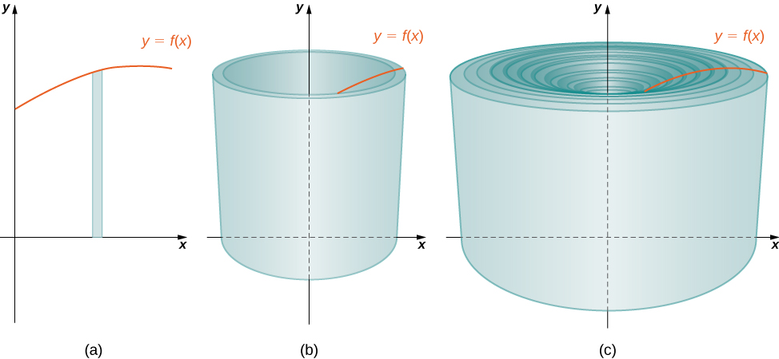
Mynd 2.26
(a) Dæmigerður rétthyrningur. (b) Þegar rétthyrningnum er snúið um y-ásinn myndast sívalningshylki. (c) Þegar öllum hylkjunum er raðað saman fæst nálgun á upphaflega rúmhlutann.
Notes:
This figure has two images. The first is a cylindrical shell, hollow in the middle. It has a vertical axis in the center. There is also a curve that meets the top of the cylinder. The second image is a set of concentric cylinders, one inside of the other forming a nesting of cylinders.

Slide 32
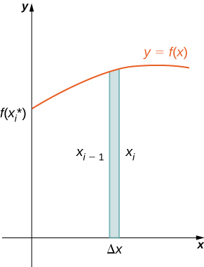
Mynd 2.27
Rúmmál hylkisins reiknað.
Notes:
This figure is a graph in the first quadrant. The curve is increasing and labeled “y=f(x)”. The curve starts on the y-axis at f(x*). Below the curve is a shaded rectangle. The rectangle starts on the x-axis. The width of the rectangle is delta x. The two sides of the rectangle are labeled “xsub(i-1)” and “xsubi”.

Slide 33
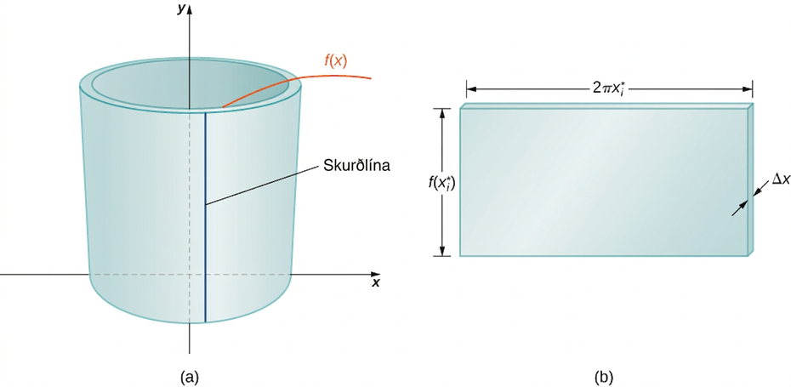
Mynd 2.28
(a) Skerið dæmigert hylki lóðrétt. (b) Flettið hylkinu út svo það myndi flata plötu.
Notes:
This figure has two images. The first is labeled “a” and is of a hollow cylinder around the y-axis. On the front of this cylinder is a vertical line labeled “cut line”. The height of the cylinder is “y=f(x)”. The second figure is labeled “b” and is a shaded rectangular block. The height of the rectangle is “f(x*), the width of the rectangle is “2pix*”, and the thickness of the rectangle is “delta x”.

Slide 34
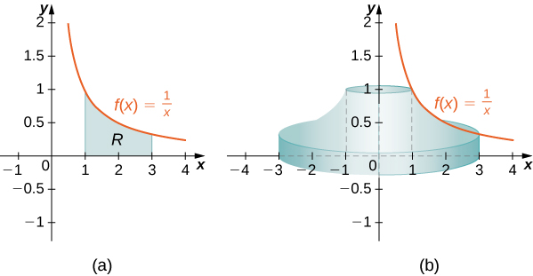
Mynd 2.29
(a) Svæðið R undir grafi f(x)=1/x á bilinu [1,3]. (b) Snúðurinn sem myndast þegar R er snúið um y-ásinn.
Notes:
This figure has three images. The first is a solid that has been formed by rotating the curve y=1/x about the y-axis. The solid begins on the x-axis and stops where y=1. The second image is labeled “a” and is the graph of y=1/x in the first quadrant. Under the curve is a shaded region labeled “R”. The region is bounded by the curve, the x-axis, to the left at x=1 and to the right at x=3. The third image is labeled “b” and is half of the solid formed by rotating the shaded region about the y-axis.

Slide 35
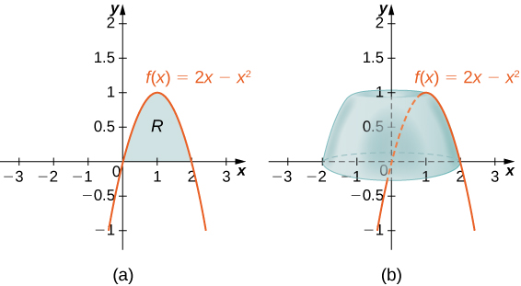
Mynd 2.30
(a) Svæðið R undir grafi f(x)=2x−x² á bilinu [0,2]. (b) Snúðurinn sem fæst þegar R er snúið um y-ásinn.
Notes:
This figure has two graphs. The first graph is labeled “a” and is the curve f(x)=2x-x^2. It is an upside down parabola intersecting the x-axis at the origin ant at x=2. Under the curve the region in the first quadrant is shaded and is labeled “R”. The second figure is a graph of the same curve. On the graph is a solid that is formed by rotation the region from “a” about the y-axis.

Slide 36
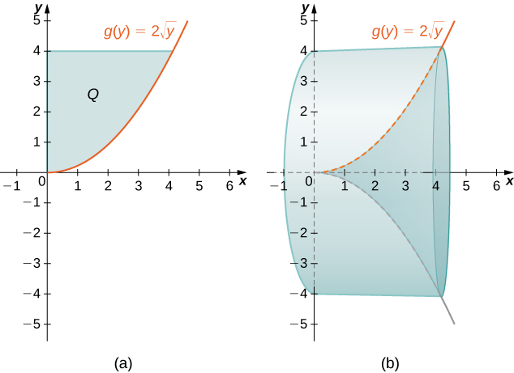
Mynd 2.31
(a) Svæðið Q vinstra megin við feril fallsins g(y) á bilinu [0,4]. (b) Snúðurinn sem myndast þegar Q er snúið um x-ásinn.
Notes:
This figure has two graphs. The first graph is labeled “a” and is the curve g(y)=2squareroot(y). It is an increasing curve in the first quadrant beginning at the origin. Between the y-axis and the curve, there is a shaded region labeled “Q”. The shaded region is bounded above by the line y=4. The second graph is the same curve in “a” and labeled “b”. It also has a solid region that has been formed by rotating the curve in “a” about the x-axis. The solid starts at the y-axis and stops at x=4.

Slide 37
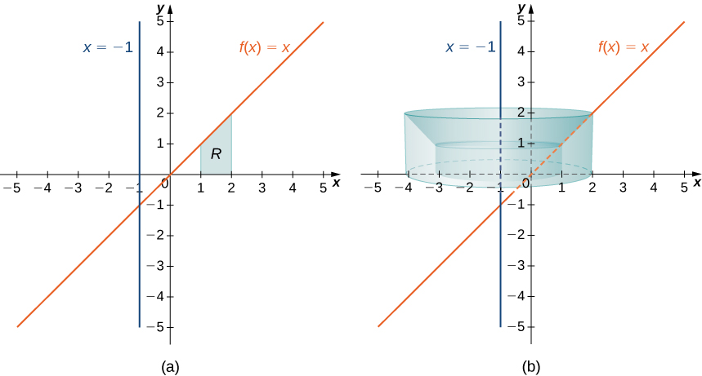
Mynd 2.32
(a) Svæðið R milli grafs f(x) og x-ássins á bilinu [1,2]. (b) Snúðurinn sem myndast þegar R er snúið um línuna x=−1.
Notes:
This figure has two graphs. The first graph is labeled “a” and is the line f(x)=x, a diagonal line through the origin. There is a shaded region above the x-axis under the line labeled “R”. This region is bounded to the left by the line x=1 and to the right by the line x=2. There is also the vertical line x=-1 on the graph. The second figure has the same graphs as “a” and is labeled “b”. Also on the graph is a solid formed by rotating the region “R” from the first graph about the line x=-1.

Slide 38
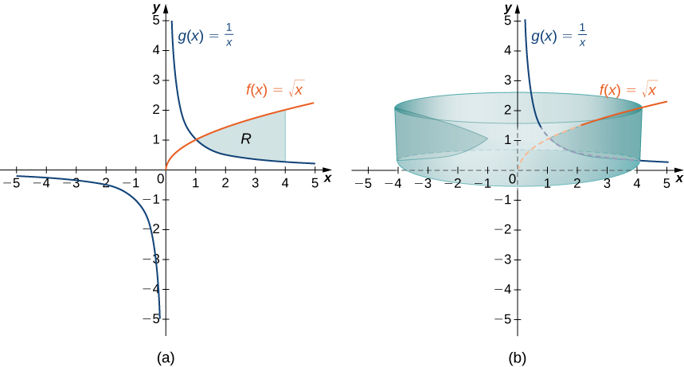
Mynd 2.33
(a) Svæðið R milli grafa f(x) og g(x) á bilinu [1,4]. (b) Snúðurinn sem myndast þegar R er snúið um y-ásinn.
Notes:
This figure has two graphs. The first graph is labeled “a” and has two curves. The curves are the graphs of f(x)=squareroot(x) and g(x)=1/x. In the first quadrant the curves intersect at (1,1). In between the curves in the first quadrant there is a shaded region labeled “R”, bounded to the right by the line x=4. The second graph is labeled “b” and is the same as the graphs in “a”. Also on this graph is a solid that has been formed by rotating the region “R” from the figure “a” about the y-axis.

Slide 39
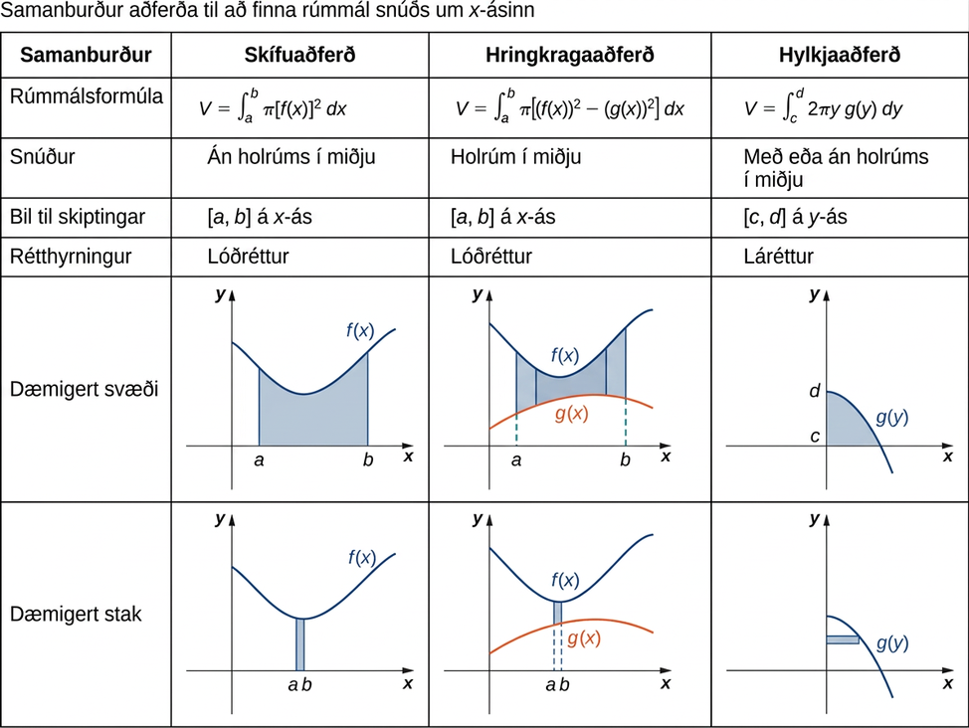
Mynd 2.34
Notes:
This figure is a table comparing the different methods for finding volumes of solids of revolution. The columns in the table are labeled “comparison”, “disk method”, “washer method”, and “shell method”. The rows are labeled “volume formula”, “solid”, “interval to partition”, “rectangles”, “typical region”, and “rectangle”. In the disk method column, the formula is given as the definite integral from a to b of pi times [f(x)]^2. The solid has no cavity in the center, the partition is [a,b], rectangles are vertical, and the typical region is a shaded region above the x-axis and below the curve of f(x). In the washer method column, the formula is given as the definite integral from a to b of pi times [f(x)]^2-[g(x)]^2. The solid has a cavity in the center, the partition is [a,b], rectangles are vertical, and the typical region is a shaded region above the curve of g(x) and below the curve of f(x). In the shell method column, the formula is given as the definite integral from c to d of 2pi times yg(y). The solid is with or without a cavity in the center, the partition is [c,d] rectangles are horizontal, and the typical region is a shaded region above the x-axis and below the curve of g(y).

Slide 40
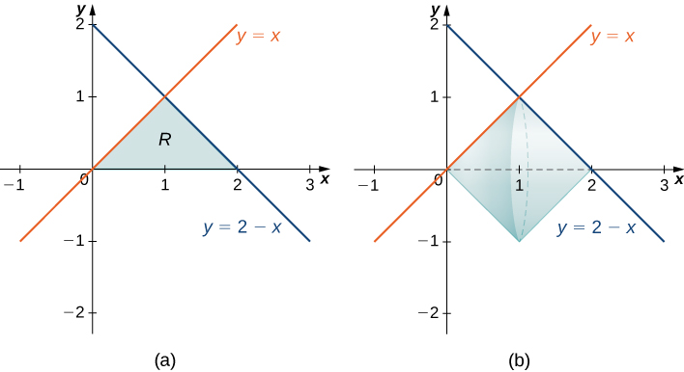
Mynd 2.35
(a) Svæðið R, sem afmarkast af tveimur línum og x-ásnum. (b) Snúðurinn sem myndast þegar R er snúið um x-ásinn.
Notes:
This figure has two graphs. The first graph is labeled “a” and has two lines y=x and y=2-x drawn in the first quadrant. The lines intersect at (1,1) and form a triangle above the x-axis. The region that is the triangle is shaded. The second graph is labeled “b” and is the same graphs as “a”. The shaded triangular region in “a” has been rotated around the x-axis to form a solid on the second graph.

Slide 41
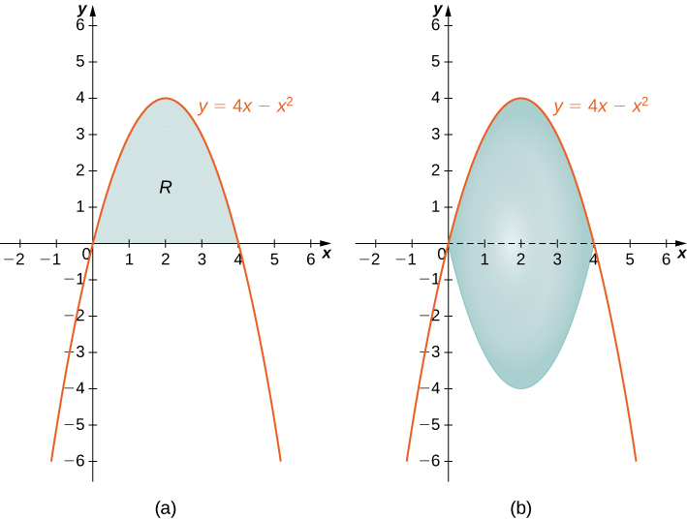
Mynd 2.36
(a) Svæðið R milli ferilsins og x-ássins. (b) Snúðurinn sem myndast þegar R er snúið um x-ásinn.
Notes:
This figure has two graphs. The first graph is labeled “a” and is the curve y=4x-x^2. It is an upside down parabola intersecting the x-axis at the origin and at x=4. The region above the x-axis and below the curve is shaded and labeled “R”. The second graph labeled “b” is the same as in “a”. On this graph the shaded region “R” has been rotated around the x-axis to form a solid.

Slide 42
2.4 Bogalengd ferils og yfirborðsflatarmál
Námsmarkmið
Ákvarða lengd ferilsins y=f(x) milli tveggja punkta.
Ákvarða lengd ferilsins x=g(y) milli tveggja punkta.
Finna yfirborðsflatarmál snúðs.

Slide 43
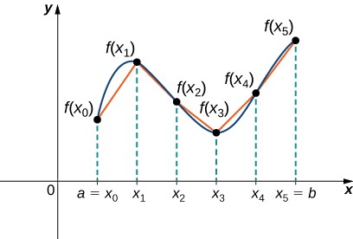
Mynd 2.37
Nálga má lengd ferils með því að leggja saman lengdir línustrika.
Notes:
This figure is a graph in the first quadrant. The curve increases and decreases. It is divided into parts at the points a=xsub0, xsub1, xsub2, xsub3, xsub4, and xsub5=b. Also, there are line segments between the points on the curve.

Slide 44
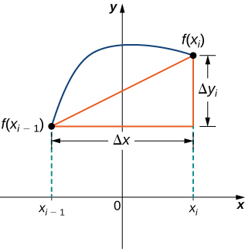
Mynd 2.38
Dæmigert línustrik nálgar ferilinn á bilinu [xi−1,xi].
Notes:
This figure is a graph. It is a curve above the x-axis beginning at the point f(xsubi-1). The curve ends in the first quadrant at the point f(xsubi). Between the two points on the curve is a line segment. A right triangle is formed with this line segment as the hypotenuse, a horizontal segment with length delta x, and a vertical line segment with length delta y.

Slide 45
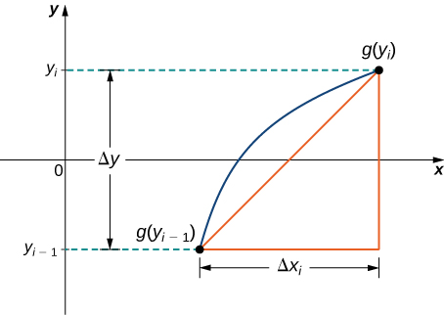
Mynd 2.39
Dæmigert línustrik á bilinu [yi−1,yi].
Notes:
This figure is a graph. It is a curve to the right of the y-axis beginning at the point g(ysubi-1). The curve ends in the first quadrant at the point g(ysubi). Between the two points on the curve is a line segment. A right triangle is formed with this line segment as the hypotenuse, a horizontal segment with length delta x, and a vertical line segment with length delta y.

Slide 46
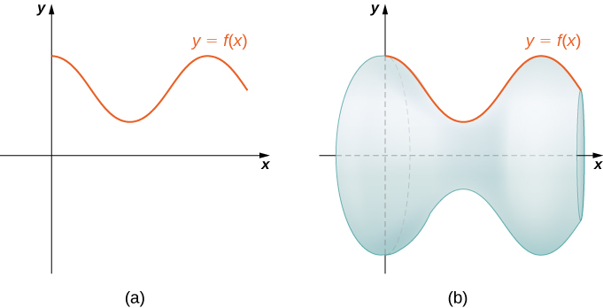
Mynd 2.40
(a) Ferill sem sýnir fallið f(x). (b) Snúðflöturinn sem myndast þegar grafi f(x) er snúið um x-ásinn.
Notes:
This figure has two graphs. The first graph is labeled “a” and is a curve in the first quadrant beginning at the y-axis. The curve is y=f(x). The second graph is labeled “b” and has the same curve y=f(x). There is also a solid surface formed by rotating the curve about the x-axis.

Slide 47
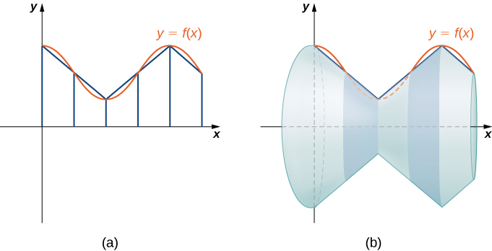
Mynd 2.41
(a) Fallið f(x) nálgað með línustrikum. (b) Snúðflöturinn sem myndast þegar línustrikunum er snúið um x-ásinn.
Notes:
This figure has two graphs. The first graph is labeled “a” and is a curve in the first quadrant beginning at the y-axis. The curve is y=f(x). The area under the curve above the x-axis has been divided into regions with vertical lines. The second graph is labeled “b” and has the same curve y=f(x). There is also a solid surface formed by rotating the curve about the x-axis.

Slide 48
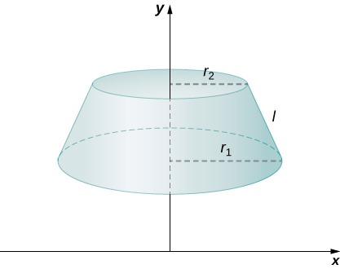
Mynd 2.42
Keilustúfur getur nálgað lítinn hluta yfirborðsflatar.
Notes:
This figure is a graph. It is a frustum of a cone above the x-axis with the y-axis in the center. The radius of the bottom of the frustum is rsub1 and the radius of the top is rsub2. The length of the side is labeled “l”.

Slide 49
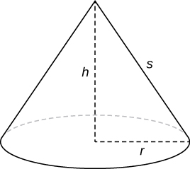
Mynd 2.43
Hliðarflatarmál keilunnar er gefið með πrs.
Notes:
This figure is a cone. The cone has radius r, height h, and length of side s.

Slide 50
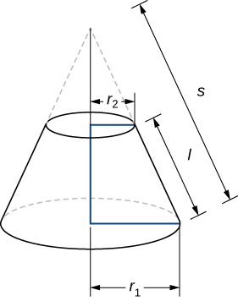
Mynd 2.44
Útreikningur á hliðarflatarmáli keilustúfs.
Notes:
This figure is a graph. It is a frustum of a cone. The radius of the bottom of the frustum is rsub1 and the radius of the top is rsub2. The length of the side is labeled “l”. There is also the top of a cone with broken lines above the frustum. It has length of side s.

Slide 51
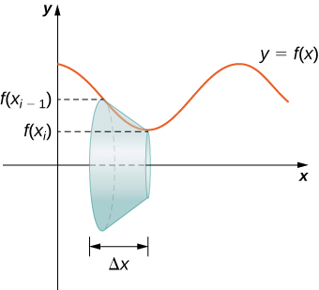
Mynd 2.45
Dæmigerð ræma sem notuð er til að ákvarða yfirborðsflatarmál.
Notes:
This figure has two graphics. The first is a curve in the first quadrant. Around the x-axis is a frustum of a cone. The edge of the frustum is against the curve. The edge begins at f(xsubi-1) and ends at f(xsubi). The second image is the same curve with the same frustum. the height of the frustum is delta x and the curve is labeled y=f(x).

Slide 52
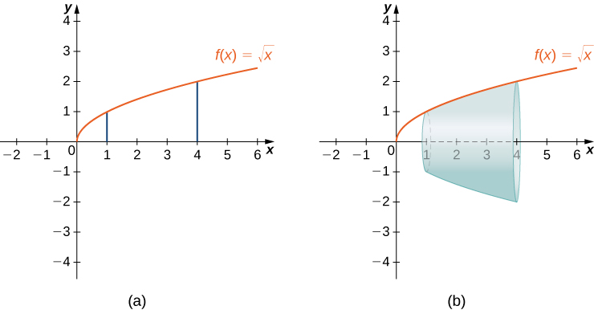
Mynd 2.46
(a) Graf f(x). (b) Snúðflöturinn.
Notes:
This figure has two graphs. The first is the curve f(x)=squareroot(x). The curve is increasing and begins at the origin. Also on the graph are the vertical lines x=1 and x=4. The second graph is the same function as the first graph. The region between f(x) and the x-axis, bounded by x=1 and x=4 has been rotated around the x-axis to form a surface.

Slide 53
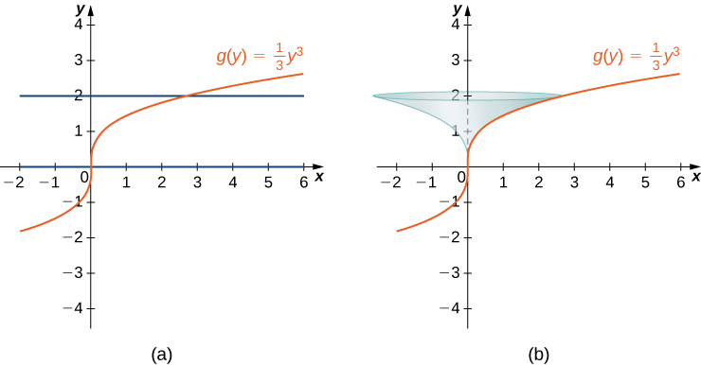
Mynd 2.47
(a) Graf g(y). (b) Snúðflöturinn.
Notes:
This figure has two graphs. The first is the curve g(y)=1/3y^3. The curve is increasing and begins at the origin. Also on the graph are the horizontal lines y=0 and y=2. The second graph is the same function as the first graph. The region between g(y) and the y-axis, bounded by y=0 and y=2 has been rotated around the y-axis to form a surface.

Slide 54
2.5 Hagnýting í eðlisfræði (1 af 2)
Námsmarkmið
Ákvarða massa einvíðs hlutar út frá línulegu þéttleikafalli hans.
Ákvarða massa tvívíðs hringskífulaga hlutar út frá geislaþéttleikafalli hans.
Reikna vinnu breytilegs krafts sem verkar eftir línu.

Slide 55
2.5 Hagnýting í eðlisfræði (2 af 2)
Námsmarkmið
Reikna vinnuna við að dæla vökva úr einni hæð í aðra.
Finna vökvaþrýstikraftinn á lóðrétta plötu á kafi.

Slide 56
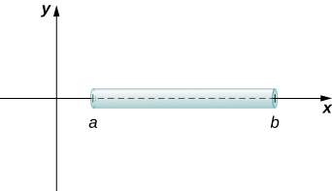
Mynd 2.48
Reikna má massa þunnrar stangar sem liggur eftir x-ásnum með því að heilda þéttleikafall hennar.
Notes:
This figure has the x and y axes. On the x-axis is a cylinder, beginning at x=a and ending at x=b.

Slide 57
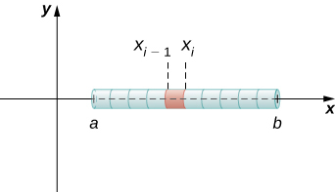
Mynd 2.49
Dæmigert stangarbrot.
Notes:
This figure has the x and y axes. On the x-axis is a cylinder, beginning at x=a and ending at x=b. The cylinder has been divided into segments. One segment in the middle begins at xsub(i-1) and ends at xsubi.

Slide 58
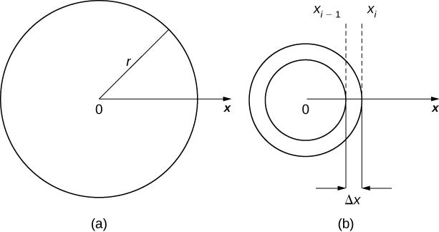
Mynd 2.50
(a) Þunn hringskífa í xy-planinu. (b) Dæmigerður hringkragi.
Notes:
This figure has two images. The first is labeled “a” and is a circle with radius r. The center of the circle is labeled 0. The circle also has the positive x-axis beginning at 0, extending through the circle. The second figure is labeled “b”. It has two concentric circles with center at 0 and the x-axis extending out from 0. The concentric circles form a washer. The width of the washer is from xsub(i-1) to xsubi and is labeled delta x.

Slide 59
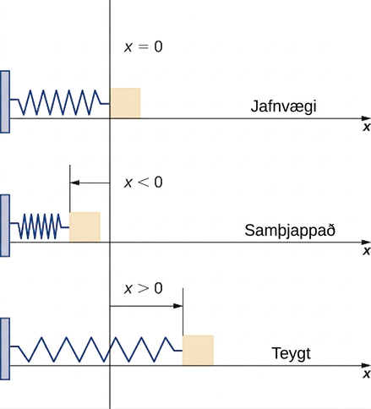
Mynd 2.51
Kubbur festur við láréttan gorm í jafnvægisstöðu, þegar gormurinn er þjappaður og þegar hann er teygður.
Notes:
This figure has three images. The first is the x-axis. On the left is a vertical block. Attached to the block is a spring that ends at the y-axis and has the label x=0. The image is labeled equilibrium. The second image is the same spring that ends before the y-axis. It has x<0 and is labeled compressed. The third image is the same spring that is beyond the y-axis. It has x>0 and is labeled stretched.

Slide 60

Mynd 2.52
Hve mikla vinnu þarf til að tæma tank sem er að hluta fylltur vatni?
Notes:
This figure is a right circular cylinder that is vertical. It represents a tank of water. The radius of the cylinder is 4 m, the height of the cylinder is 10 m. The height of the water inside the cylinder is 8 m. There is also a horizontal line on top of the tank representing the x=0. A line is drawn vertical beside the cylinder with a downward arrow labeled x.

Slide 61

Mynd 2.53
Dæmigert vatnslag.
Notes:
This figure is a right circular cylinder representing a tank of water. Inside of the cylinder is a layer of water with thickness delta x. The thickness begins at xsub(i-1) and ends at xsubi.

Slide 62

Mynd 2.54
Vatnstankur í laginu eins og keila á hvolfi.
Notes:
This figure is an upside-down cone. The cone has an axis through the center. The top of the cone on the axis is labeled x=0.

Slide 63

Mynd 2.55
Einslaga þríhyrningar notaðir til að setja fram geisla vatnsskífu.
Notes:
This figure has two images. The first has the x-axis. Below the axis, on a slant is a line segment extending up to the x-axis. Beside the line segment is a horizontal right circular cylinder. The second image has a triangle. The right triangle mirrors the first image with the hypotenuse the line segment in the first image. The top of the triangle is 4 units. the length of the vertical side is 12 units. The vertical side is also divided into two parts; the first is xsubi, the second is 12-xsubi. It is divided at the level where the first image has the cylinder.

Slide 64

Mynd 2.56
Lárétt plata á kafi í vatni.
Notes:
This image has a circular plate submerged in water. The plate is labeled A and the depth of the water is labeled s.

Slide 65

Mynd 2.57
Þunn lóðrétt plata á kafi í vatni.
Notes:
This image is the overhead view of a submerged circular plate. The x-axis is to the side of the plate. The plate’s diameter goes from x=a to x=b. There is a strip in the middle of the plate with thickness of delta x. On the axis this thickness begins at x=xsub(i-1) and ends at x=xsubi. The length of the strip in the plate is labeled w(csubi).

Slide 66

Mynd 2.58
(a) Vatnsrenna með þríhyrningslaga þversnið. (b) Mál annars enda vatnsrennunnar.
Notes:
This figure has two images. The first is a water trough with rectangular sides. The length of the trough is 15 feet, the depth is 3 feet, and the width is 8 feet. The second image is a cross section of the trough. It is a triangle. The top has length of 8 feet and the sides have length 5 feet. The altitude is labeled with 3 feet.

Slide 67

Mynd 2.59
Einfaldað líkan af Hoover-stíflunni með gefnum áætluðum málum.
Notes:
This figure is a trapezoid with the longer side on top. There is a smaller trapezoid inside the first with height labeled 530 feet. It is also 10 feet below the top of the larger trapezoid.

Slide 68

Mynd 2.60
Fyrst veljum við viðmiðunarkerfi.
Notes:
This figure is a trapezoid with the longer side on top. There is a smaller trapezoid inside the first with height labeled s(x)=x-10. It represents the depth of the water. It is also 10 feet below the top of the larger trapezoid. The top of the larger trapezoid is at x=0.

Slide 69

Mynd 2.61
Við notum einslaga þríhyrninga til að ákvarða fall fyrir breidd stíflunnar. (a) Áætluð mál stíflunnar; (b) einslaga þríhyrningarnir auðkenndir.
Notes:
This figure has two images. The first is a trapezoid with larger side on the top. The length of the top is divided into 3 measures. The first measure is 250 feet, the second is 750 feet, and the third is 250 feet. The height of the trapezoid is 750 feet. The length of the bottom is 750 feet. Inside of the trapezoid the width is labeled w(x). Inside if one of the triangular sides is the width r. The second image is the same trapezoid. It has the height labeled as 750 feet. Inside the trapezoid it has the height divided into two segments. The first is labeled x, and the second is labeled 750-x. On the side of the trapezoid a triangle has been formed by a vertical line from the bottom side to the top. Inside of the triangle is a horizontal line segment labeled r.

Slide 70
2.6 Vægi og massamiðjur
Námsmarkmið
Finna massamiðju hluta sem dreifast eftir línu.
Ákvarða massamiðju þunnrar plötu.
Nota samhverfu til að ákvarða þungamiðju þunnrar plötu.
Beita rúmmálssetningu Pappusar.

Slide 71

Mynd 2.62
(a) Þunn stöng hvílir á vogarási. (b) Massar eru settir á stöngina.
Notes:
This figure has two images. The first image is a horizontal line on top of an equilateral triangle. It represents a rod on a fulcrum. The second image is the same as the first with two squares on the line. They are labeled msub1 and msub2. The distance from msub1 to the fulcrum is dsub1. The distance from msub2 to the fulcrum is dsub2.

Slide 72

Mynd 2.63
Massamiðjan x– er jafnvægispunktur kerfisins.
Notes:
This figure is an image of the x-axis. On the axis there is a point labeled x bar. Also on the axis there is a point xsub1 with a square above it. Inside of the square is the label msub1. There is also a point xsub2 on the axis. Above this point there is a square. Inside of the square is the label msub2.

Slide 73

Mynd 2.64
Punktmassinn m1 er í punktinum (x1,y1) í planinu.
Notes:
This figure has the x and y axes labeled. There is a point in the first quadrant at (xsub1, ysub1). This point is labeled msub1.

Slide 74

Mynd 2.65
Svæði í planinu sem táknar þunna plötu.
Notes:
This image is a graph of y=f(x). It is in the first quadrant. Under the curve is a shaded region labeled “R”. The shaded region is bounded to the left at x=a and to the right at x=b.

Slide 75

Mynd 2.66
Dæmigert rétthyrningssvæði þynnunnar.
Notes:
This figure is a graph of the curve labeled f(x). It is in the first quadrant. Under the curve and above the x-axis there is a vertical shaded rectangle. the height of the rectangle is labeled f(xsubi). Also, xsubi = xsubi – 1 + xsubi/2.

Slide 76

Mynd 2.67
Massamiðja þynnu fundin.
Notes:
This figure is the graph of the curve f(x)=squareroot(x). It is an increasing curve in the first quadrant. Under the curve above the x-axis there is a shaded region. It starts at x=0 and is bounded to the right at x=4.

Slide 77

Mynd 2.68
Svæði milli grafa tveggja falla.
Notes:
This figure is a graph of the first quadrant. It has two curves. They are labeled f(x) and g(x). f(x) is above g(x). In between the curves is a shaded region labeled “R”. The shaded region is bounded to the left by x=a and to the right by x=b.

Slide 78

Mynd 2.69
Dæmigert rétthyrningssvæði á svæðinu milli grafa tveggja falla.
Notes:
This figure is a graph of the first quadrant. It has two curves. They are labeled f(x) and g(x). f(x) is above g(x). In between the curves is a shaded rectangle.

Slide 79

Mynd 2.70
Þungamiðja svæðis milli tveggja ferla fundin.
Notes:
This figure is a graph. It has two curves. They are labeled f(x)=1-x^2 and g(x)=x-1. In between the curves is a shaded region. The shaded region is bounded to the left by x=a and to the right by x=b.

Slide 80

Mynd 2.71
Nota má samhverfuregluna til að finna þungamiðju samhverfs svæðis.
Notes:
This figure is a graph of the function f(x)=4-x^2. It is an upside-down parabola. The region under the parabola above the x-axis is shaded. The curve intersects the x-axis at x=-2 and x=2.

Slide 81

Mynd 2.72
Frá Grand Canyon Skywalk er stórbrotið útsýni yfir gljúfrið. (mynd: 10da_ralta, Wikimedia Commons)
Notes:
This figure is a picture of the Grand Canyon skywalk. It is a building at the edge of the canyon with a walkway extending out over the canyon

Slide 82

Mynd 2.73
Skywalk er líkt eftir með þremur undirsvæðum.
Notes:
This figure is a sketch of the Grand Canyon walkway. It is on the xy coordinate system. The walkway is upside-down “u” shaped. It has been divided into three regions. The first region at the top is labeled “Rsub1”. It is a semi-circle with outer radius of 35 feet and inner radius of 25 feet. The second region is labeled “Rsub2”. It has two rectangles with width of 10 feet each and height of 35 feet. The third region is labeled “Rsub3” and is two rectangles. They have a width of 10 feet and height of 48 feet. These represent the part of the walkway inside of the visitor center.

Slide 83

Mynd 2.74
Rúmmál hringsnúðs ákvarðað með setningu Pappusar. (a) Hringskífulaga svæði R í sléttunni; (b) hringsnúðurinn sem myndast þegar R er snúið um y-ásinn.
Notes:
This figure has two graphs. The first is the x y coordinate system with a circle centered on the x-axis at x=4. The radius is 2. The second figure is the x y coordinate system. The circle from the first image has been revolved about the y-axis to form a torus.

Slide 84
2.7 Heildi, vísisföll og lograr (1 af 2)
Námsmarkmið
Setja fram skilgreiningu náttúrlega lograns með heildi.
Þekkja afleiðu náttúrlega lograns.
Heilda föll sem fela í sér náttúrlega logrann.
Skilgreina töluna e með heildi.
Þekkja afleiðu og heildi vísisfallsins.

Slide 85
2.7 Heildi, vísisföll og lograr (2 af 2)
Námsmarkmið
Sanna eiginleika logra og vísisfalla með heildum.
Setja fram almenn lograföll og vísisföll með hjálp náttúrlega lograns og náttúrlega vísisfallsins.

Slide 86

Mynd 2.75
(a) Þegar x>1 er náttúrlegi logrinn flatarmálið undir ferlinum y=1/t frá 1 til x. (b) Þegar x<1 er náttúrlegi logrinn neikvætt gildi flatarmálsins undir ferlinum frá x til 1.
Notes:
This figure has two graphs. The first is the curve y=1/t. It is decreasing and in the first quadrant. Under the curve is a shaded area. The area is bounded to the left at x=1. The area is labeled “area=lnx”. The second graph is the same curve y=1/t. It has shaded area under the curve bounded to the right by x=1. It is labeled “area=-lnx”.

Slide 87

Mynd 2.76
Graf f(x)=ln x sýnir að fallið er samfellt.
Notes:
This figure is a graph. It is an increasing curve labeled f(x)=lnx. The curve is increasing with the y-axis as an asymptote. The curve intersects the x-axis at x=1.

Slide 88

Mynd 2.77
Flatarmálið undir ferlinum frá 1 til e er jafnt einum.
Notes:
This figure is a graph. It is the curve y=1/t. It is decreasing and in the first quadrant. Under the curve is a shaded area. The area is bounded to the left at x=1 and to the right at x=e. The area is labeled “area=1”.

Slide 89

Mynd 2.78
Gröf fallanna ln x og exp x.
Notes:
This figure is a graph. It has three curves. The first curve is labeled exp x. It is an increasing curve with the x-axis as a horizontal asymptote. It intersects the y-axis at y=1. The second curve is a diagonal line through the origin. The third curve is labeled lnx. It is an increasing curve with the y-axis as an vertical axis. It intersects the x-axis at x=1.

Slide 90
2.8 Vísisvöxtur og -hnignun (1 af 2)
Námsmarkmið
Beita líkani um veldisvöxt, meðal annars við fólksfjölgun og vaxtavexti.
Útskýra hugtakið tvöföldunartími.

Slide 91
2.8 Vísisvöxtur og -hnignun (2 af 2)
Námsmarkmið
Beita líkani um veldishnignun, meðal annars við geislavirka hrörnun og kólnunarlögmál Newtons.
Útskýra hugtakið helmingunartími.

Slide 92

Mynd 2.79
Dæmi um veldisvöxt bakteríustofns.
Notes:
This figure is a graph. It is the exponential curve for y=200e^0.02t. It is in the first quadrant and an increasing function. It begins on the y-axis.

Slide 93

Tafla 2.1 Veldisvöxtur bakteríustofns
Notes:
Table 2.1 Exponential Growth of a Bacterial Population; Columns: Time (min), Population Size (no. of bacteria); Row 1: 10, 244; Row 2: 20, 298; Row 3: 30, 364; Row 4: 40, 445; Row 5: 50, 544; Row 6: 60, 664; Row 7: 70, 811; Row 8: 80, 991; Row 9: 90, 1210; Row 10: 100, 1478; Row 11: 110, 1805; Row 12: 120, 2205

Slide 94

Mynd 2.80
Dæmi um veldishnignun.
Notes:
This figure is a graph in the first quadrant. It is a decreasing exponential curve. It begins on the y-axis at 2000 and decreases towards the t-axis.

Slide 95
2.9 Stærðfræðigreining breiðbogafalla
Námsmarkmið
Beita formúlum fyrir afleiður og heildi breiðbogafalla.
Beita formúlum fyrir afleiður andhverfra breiðbogafalla og samsvarandi heildi.
Lýsa algengum aðstæðum þar sem keðjulína kemur fyrir.

Slide 96

Mynd 2.81
Gröf breiðbogafallanna.
Notes:
This figure has six graphs. The first graph labeled “a” is of the function y=sinh(x). It is an increasing function from the 3rd quadrant, through the origin to the first quadrant. The second graph is labeled “b” and is of the function y=cosh(x). It decreases in the second quadrant to the intercept y=1, then becomes an increasing function. The third graph labeled “c” is of the function y=tanh(x). It is an increasing function from the third quadrant, through the origin, to the first quadrant. The fourth graph is labeled “d” and is of the function y=coth(x). It has two pieces, one in the third quadrant and one in the first quadrant with a vertical asymptote at the y-axis. The fifth graph is labeled “e” and is of the function y=sech(x). It is a curve above the x-axis, increasing in the second quadrant, to the y-axis at y=1 and then decreases. The sixth graph is labeled “f” and is of the function y=csch(x). It has two pieces, one in the third quadrant and one in the first quadrant with a vertical asymptote at the y-axis.

Slide 97

Tafla 2.2 Afleiður breiðbogafallanna
f(x) | d f(x) / dx
sinh x | cosh x
cosh x | sinh x
tanh x | sech² x
coth x | −csch² x
sech x | −sech x · tanh x
csch x | −csch x · coth x

Slide 98

Tafla 2.3 Skilgreiningarmengi og myndmengi andhverfu breiðbogafallanna
Fall | Skilgreiningarmengi | Myndmengi
sinh⁻¹ x | (−∞, ∞) | (−∞, ∞)
cosh⁻¹ x | [1, ∞) | [0, ∞)
tanh⁻¹ x | (−1, 1) | (−∞, ∞)
coth⁻¹ x | (−∞, −1) ∪ (1, ∞) | (−∞, 0) ∪ (0, ∞)
sech⁻¹ x | (0, 1] | [0, ∞)
csch⁻¹ x | (−∞, 0) ∪ (0, ∞) | (−∞, 0) ∪ (0, ∞)

Slide 99

Mynd 2.82
Gröf andhverfu breiðbogafallanna.
Notes:
This figure has six graphs. The first graph labeled “a” is of the function y=sinh^-1(x). It is an increasing function from the 3rd quadrant, through the origin to the first quadrant. The second graph is labeled “b” and is of the function y=cosh^-1(x). It is in the first quadrant, beginning on the x-axis at 2 and increasing. The third graph labeled “c” is of the function y=tanh^-1(x). It is an increasing function from the third quadrant, through the origin, to the first quadrant. The fourth graph is labeled “d” and is of the function y=coth^-1(x). It has two pieces, one in the third quadrant and one in the first quadrant with a vertical asymptote at the y-axis. The fifth graph is labeled “e” and is of the function y=sech^-1(x). It is a curve decreasing in the first quadrant and stopping on the x-axis at x=1. The sixth graph is labeled “f” and is of the function y=csch^-1(x). It has two pieces, one in the third quadrant and one in the first quadrant with a vertical asymptote at the y-axis.

Slide 100

Tafla 2.4 Afleiður andhverfu breiðbogafallanna
f(x) | d f(x) / dx
sinh⁻¹ x | 1 / √(1 + x²)
cosh⁻¹ x | 1 / √(x² − 1)
tanh⁻¹ x | 1 / (1 − x²)
coth⁻¹ x | 1 / (1 − x²)
sech⁻¹ x | −1 / (x√(1 − x²))
csch⁻¹ x | −1 / (|x|√(1 + x²))

Slide 101

Mynd 2.83
Keðjurnar milli þessara staura mynda keðjulínu. (höfundarupplýsingar: aðlagað verk eftir OKFoundryCompany, Flickr)
Notes:
An image of chains hanging between posts that all take the shape of a catenary.

Slide 102

Mynd 2.84
Breiðbogakósínusfall myndar keðjulínu.
Notes:
This figure is a graph. It is of the function f(x)=2cosh(x/2). The curve decreases in the second quadrant to the y-axis. It intersects the y-axis at y=2. Then the curve becomes increasing.

Slide 103
Notkunarleyfi
Þetta ítarefni frá OpenStax er © Rice University og gefið út samkvæmt alþjóðlega CC BY-NC-SA 4.0 leyfinu. Heimilt er að afrita það eða breyta því, en eingöngu í tilgangi sem ekki er rekinn í hagnaðarskyni. Tilgreina verður OpenStax og Rice University sem rétthafa og geta skal allra breytinga. Öllum aðlögunum verður að deila með sama leyfisskilmáta.

