Slide 1

Stærðfræðigreining, 2. bindi
4. kafli: Inngangur að deildajöfnum

Slide 2
Efnisyfirlit kaflans
Grunnatriði deildajafna
Stefnuvið og tölulegar aðferðir
Aðgreinanlegar deildajöfnur
Lógistíska jafnan
Fyrsta stigs línulegar deildajöfnur

Slide 3
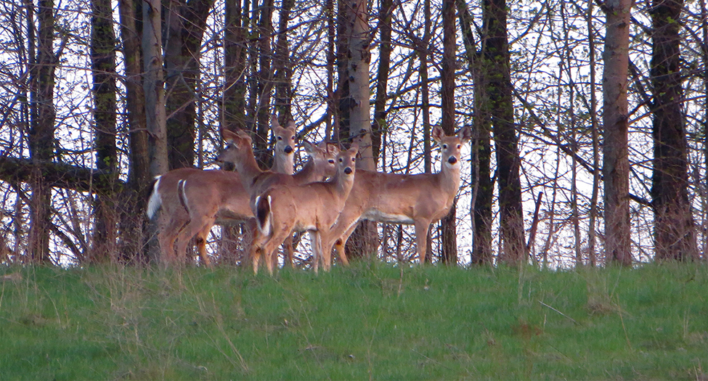
Mynd 4.1
Hvítstirtla (Odocoileus virginianus) í austurhluta Bandaríkjanna. Nota má deildajöfnur til að rannsaka dýrastofna. (mynd: aðlagað eftir verki Rachel Kramer, Flickr)
Notes:
This is a photograph of a deer.

Slide 4
4.1 Grunnatriði deildajafna (1 af 2)
Námsmarkmið
Ákvarða stig deildajöfnu.
Útskýra hvað átt er við með lausn deildajöfnu.
Greina á milli almennrar lausnar og sérlausnar deildajöfnu.
Þekkja upphafsgildisverkefni.

Slide 5
4.1 Grunnatriði deildajafna (2 af 2)
Námsmarkmið
Ákvarða hvort tiltekið fall sé lausn deildajöfnu eða upphafsgildisverkefnis.

Slide 6
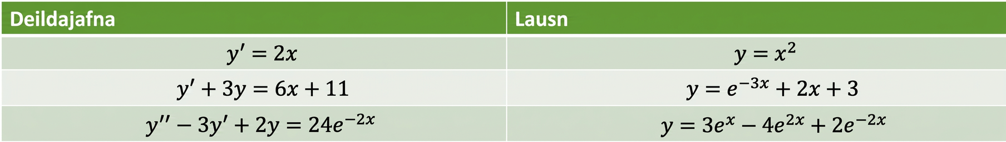
Tafla 4.1 Dæmi um deildajöfnur og lausnir þeirra
Jafna | Lausn
y′ = 2x | y = x²
y′ + 3y = 6x + 11 | y = e^(−3x) + 2x + 3
y″ − 3y′ + 2y = 24e^(−2x) | y = 3e^x − 4e^(2x) + 2e^(−2x)

Slide 7
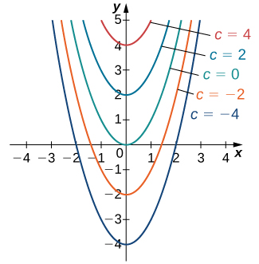
Mynd 4.2
Lausnafjölskylda deildajöfnunnar y′=2x.
Notes:
A graph of a family of solutions to the differential equation y’ = 2 x, which are of the form y = x ^ 2 + C. Parabolas are drawn for values of C: -4, -2, 0, 2, and 4.

Slide 8
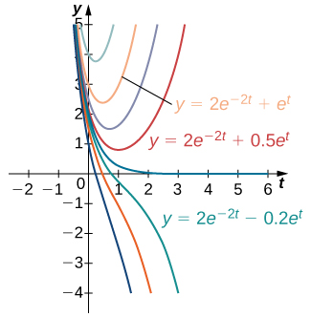
Mynd 4.3
Lausnafjölskylda deildajöfnunnar y′ + 2y = 3eᵗ. Sérlausnin y = 2e⁻²ᵗ + eᵗ er merkt inn á myndina.
Notes:
A graph of a family of solutions to the differential equation y’ + 2 y = 3 e ^ t, which are of the form y = 2 e ^ (-2 t) + C e ^ t. The versions with C = 1, 0.5, and -0.2 are shown, among others not labeled. For all values of C, the function increases rapidly for t < 0 as t goes to negative infinity. For C > 0, the function changes direction and increases in a gentle curve as t goes to infinity. Larger values of C have a tighter curve closer to the y axis and at a higher y value. For C = 0, the function goes to 0 as t goes to infinity. For C < 0, the function continues to decrease as t goes to infinity.

Slide 9
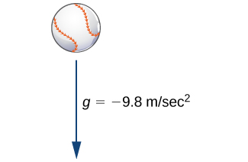
Mynd 4.4
Þegar hafnabolti fellur í lofti er þyngdarkrafturinn eini krafturinn sem verkar á hann, ef loftmótstaða er vanrækt.
Notes:
A picture of a baseball with an arrow underneath it pointing down. The arrow is labeled g = -9.8 m/sec ^ 2.

Slide 10
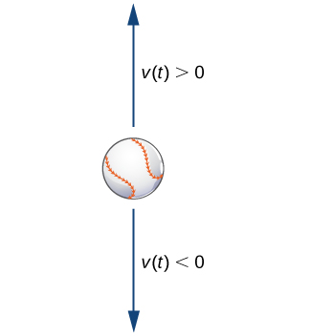
Mynd 4.5
Mögulegur hraði hafnaboltans á upp- og niðurleið.
Notes:
A picture of a baseball with an arrow above it pointing up and an arrow below it pointing down. The arrow pointing up is labeled v(t) > 0, and the arrow pointing down is labeled v(t) < 0.

Slide 11
4.2 Stefnuvið og tölulegar aðferðir
Námsmarkmið
Teikna stefnuvið tiltekinnar deildajöfnu af fyrsta stigi.
Nota stefnuvið til að teikna lausnarferil deildajöfnu af fyrsta stigi.
Nota aðferð Eulers til að nálga lausn deildajöfnu af fyrsta stigi.

Slide 12
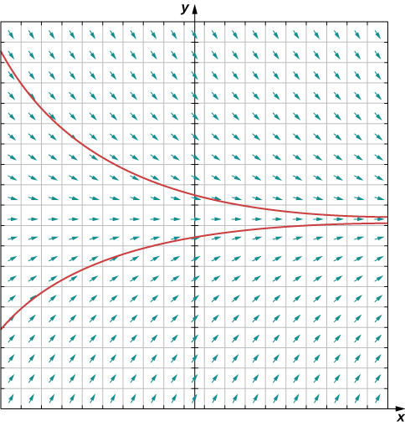
Mynd 4.6
Stefnuvið deildajöfnunnar T′(t)=−0.4(T−72). Tvær lausnir eru teiknaðar: önnur hefur upphafshita undir 72°F en hin upphafshita yfir 72°F.
Notes:
A graph of a direction field for the given differential equation in quadrants one and two. The arrows are pointing directly to the right at y = 72. Below that line, the arrows have increasingly positive slope as y becomes smaller. Above that line, the arrows have increasingly negative slope as y becomes larger. The arrows point to convergence at y = 72. Two solutions are drawn: one for initial temperature less than 72, and one for initial temperatures larger than 72. The upper solution is a decreasing concave up curve, approaching y = 72 as t goes to infinity. The lower solution is an increasing concave down curve, approaching y = 72 as t goes to infinity.

Slide 13
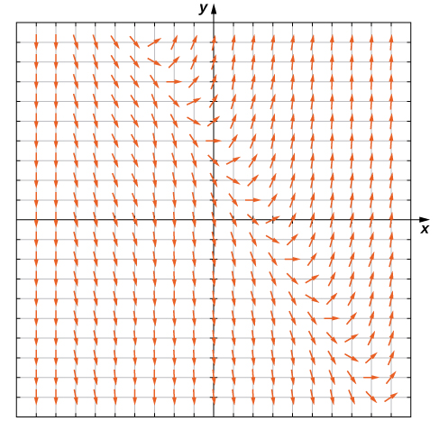
Mynd 4.7
Stefnuvið deildajöfnunnar y′=3x+2y−4.
Notes:
A graph of the direction field for the differential equation y’ = 3 x + 2 y – 4 in all four quadrants. In quadrants two and three, the arrows point down and slightly to the right. On a diagonal line, roughly y = -x + 2, the arrows point further and further to the right, curve, and then point up above that line.

Slide 14
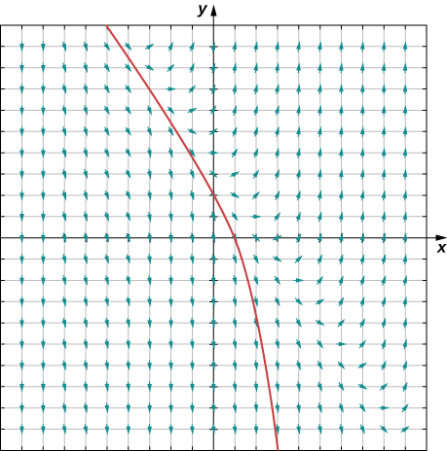
Mynd 4.8
Stefnuvið deildajöfnunnar y′=3x+2y−4 ásamt lausninni sem liggur í gegnum punktinn (0,1).
Notes:
A graph of the direction field for the differential equation y’ = 3 x + 2 y – 4 in all four quadrants. In quadrants two and three, the arrows point down and slightly to the right. On a diagonal line, roughly y = -x + 2, the arrows point further and further to the right, curve, and then point up above that line. The solution passing through the point (0, 1) is shown. It curves down through (-5, 10), (0, 2), (1, 0), and (3, -10).

Slide 15
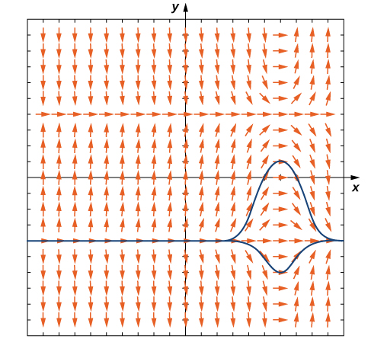
Mynd 4.9
Stefnuvið deildajöfnunnar y′ = (x − 3)(y² − 4) ásamt tveimur lausnum. Lausnirnar liggja mjög þétt saman, en önnur er rétt ofan við jafnvægislausnina y = −2 og hin rétt neðan við sömu jafnvægislausn.
Notes:
A direction field for the given differential equation. The arrows are horizontal and pointing to the right at y = -4, y = 4, and x = 6. The closer the arrows are to x = 6, the more horizontal the arrows become. The further away, the more vertical they are. The arrows point down for y > 4 and x < 4, -4 < y < 4 and x > 6, and y < -4 and x < 6. In all other areas, the arrows are pointing up.

Slide 16
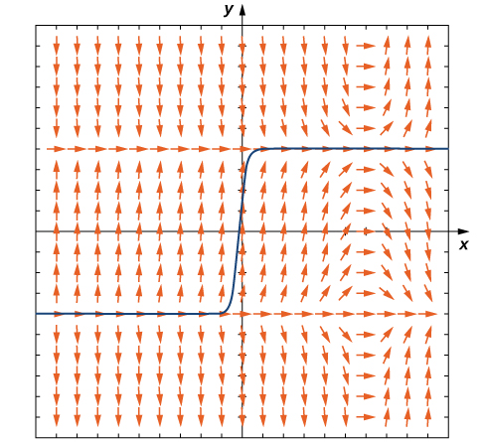
Mynd 4.10
Stefnuvið upphafsgildisverkefnisins y′ = (x − 3)(y² − 4), y(0) = 0,5.
Notes:
A direction field for the given differential equation. The arrows are horizontal and pointing to the right at y = -4, y = 4, and x = 6. The closer the arrows are to x = 6, the more horizontal the arrows become. The further away, the more vertical they are. The arrows point down for y > 4 and x < 4, -4 < y < 4 and x > 6, and y < -4 and x < 6. In all other areas, the arrows are pointing up. A solution is graphed that goes through (0, 0.5). It begins along y = -4 in quadrant three, increases from -4 to 4 between x = -1 and 1, and ends going along y = 4 in quadrant 1.

Slide 17
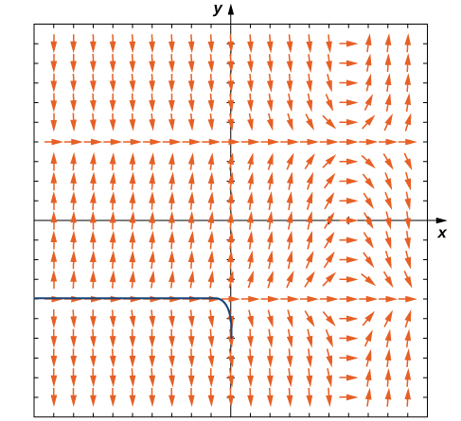
Mynd 4.11
Stefnuvið upphafsgildisverkefnisins y′ = (x − 3)(y² − 4), y(0) = −3.
Notes:
A direction field for the given differential equation. The arrows are horizontal and pointing to the right at y = -4, y = 4, and x = 6. The closer the arrows are to x = 6, the more horizontal the arrows become. The further away, the more vertical they are. The arrows point down for y > 4 and x < 4, -4 < y < 4 and x > 6, and y < -4 and x < 6. In all other areas, the arrows are pointing up. A solution is graphed that goes along y = -4 in quadrant 3 and curves between x = -1 and x = 0 to go to negative infinity along the y axis.

Slide 18
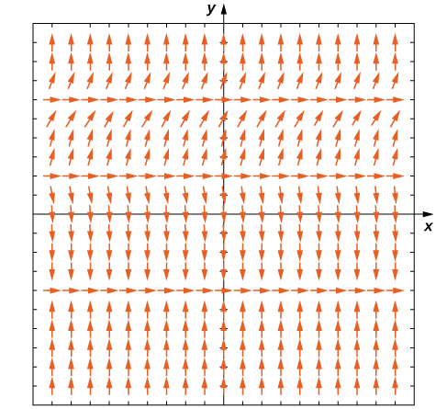
Mynd 4.12
Stefnuvið deildajöfnunnar y′ = (y − 3)²(y² + y − 2).
Notes:
A graph of a direction field with arrows pointing to the right at y = -4, y = 2, and y = 6. For y < -4, the arrows point up. For -4 < y < 2, the arrows point down. For 2 < y <6, the arrows point up, becoming flatter and flatter as they approach y = 6. For y > 6, the arrows point up and become more and more vertical the further they get from y = 6.

Slide 19
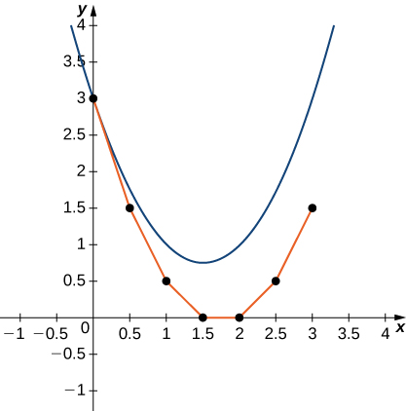
Mynd 4.13
Aðferð Eulers fyrir upphafsgildisverkefnið y′=2x−3,y(0)=3.
Notes:
A graph over the range [-1,4] for x and y. The given upward opening parabola is drawn with vertex at (1.5, 0.75). Individual points are plotted at (0, 3), (0.5, 1.5), (1, 0.5), (1.5, 0), (2, 0), (2.5, 0.5), and (3, 1.5) with line segments connecting them.

Slide 20
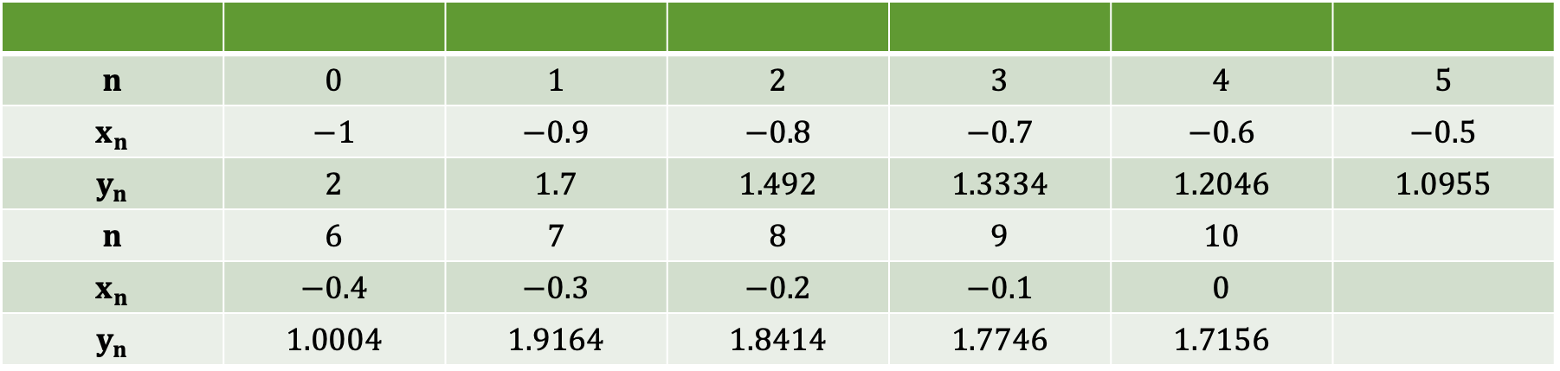
Tafla 4.2 Aðferð Eulers notuð til að nálga lausnir deildajöfnu
n | 0 | 1 | 2 | 3 | 4 | 5
xₙ | -1 | -0.9 | -0.8 | -0.7 | -0.6 | -0.5
yₙ | 2 | 1.7 | 1.492 | 1.3334 | 1.2046 | 1.0955
n | 6 | 7 | 8 | 9 | 10
xₙ | -0.4 | -0.3 | -0.2 | -0.1 | 0
yₙ | 1.0004 | 1.9164 | 1.8414 | 1.7746 | 1.7156

Slide 21
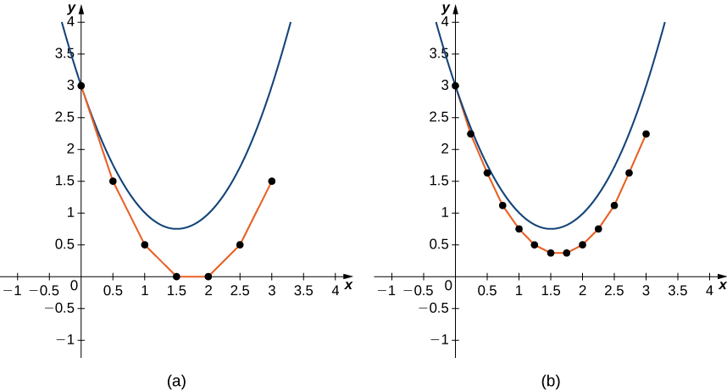
Mynd 4.14
Aðferð Eulers fyrir upphafsgildisverkefnið y′=2x−3,y(0)=3 með (a) skrefstærð h=0.5 og (b) skrefstærð h=0.25.
Notes:
Two graphs of the same parabola, y = x ^ 2 – 3 x + 3. The first shows Euler’s method for the given initial-value problem with a step size of h = 0.05, and the second shows Euler’s method with a step size of h = 0.25. The first then has the points (0, 3), (.5, 1.5), (1, 0.5), (1.5, 0), (2, 0), (2.5, 0.5), and (3, 1.5) plotted with line segments connecting them. The second has the points (0, 3), (0.25, 2.25), (0.5, 1.625), (0.75, 1.125), (1, 0.75), (1.25, 0.5), (1.5, 0.375), (2, 0.5), (2.25, 0.75), (2.5, 1.125), (2.75, 1.625), and (3, 2.25) plotted with line segments connecting them.

Slide 22
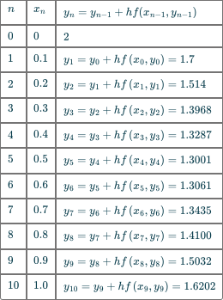
Tafla 4.3 Aðferð Eulers notuð til að nálga lausnir deildajöfnu
Notes:
Table 4.3 Using Euler’s Method to Approximate Solutions to a Differential Equation; Row 1: n, xn, yn=yn−1+hf(xn−1,yn−1); Row 2: 0, 0, 2; Row 3: 1, 0.1, y1=y0+hf(x0,y0)=1.7; Row 4: 2, 0.2, y2=y1+hf(x1,y1)=1.514; Row 5: 3, 0.3, y3=y2+hf(x2,y2)=1.3968; Row 6: 4, 0.4, y4=y3+hf(x3,y3)=1.3287; Row 7: 5, 0.5, y5=y4+hf(x4,y4)=1.3001; Row 8: 6, 0.6, y6=y5+hf(x5,y5)=1.3061; Row 9: 7, 0.7, y7=y6+hf(x6,y6)=1.3435; Row 10: 8, 0.8, y8=y7+hf(x7,y7)=1.4100; Row 11: 9, 0.9, y9=y8+hf(x8,y8)=1.5032; Row 12: 10, 1.0, y10=y9+hf(x9,y9)=1.6202

Slide 23
4.3 Aðgreinanlegar deildajöfnur
Námsmarkmið
Leysa deildajöfnu með aðskilnaði breyta.
Leysa hagnýt verkefni með aðskilnaði breyta.

Slide 24
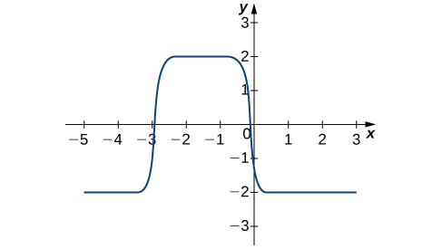
Mynd 4.15
Graf lausnar upphafsgildisverkefnisins y′ = (2x + 3)(y² − 4), y(0) = −1.
Notes:
A graph of the solution over [-5, 3] for x and [-3, 2] for y. It begins as a horizontal line at y = -2 from x = -5 to just before -3, almost immediately steps up to y = 2 from just after x = -3 to just before x = 0, and almost immediately steps back down to y = -2 just after x = 0 to x = 3.

Slide 25
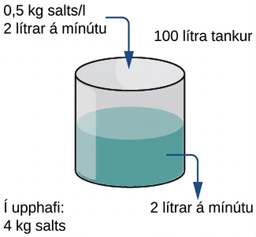
Mynd 4.16
Í saltvatnstanki er tiltekið magn saltlausnar í upphafi. Lausn streymir inn í tankinn og út úr honum. Hvernig breytist saltmagnið með tíma?
Notes:
A diagram of a cylinder filled with water with input and output. It is a 100 liter tank which initially contains 4 kg of salt. The input is 0.5 kg salt / liter and 2 liters / minute. The output is 2 liters / minute.

Slide 26
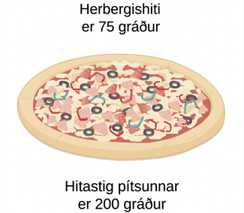
Mynd 4.17
Samkvæmt kólnunarlögmáli Newtons: Ef pítsan kólnar um 10°F á 1 mínútu, hve langur tími líður þar til hún hefur kólnað niður í 150°F?
Notes:
An image of a pizza is shown. Above the pizza is labeled “Room temperature is 75 degrees” and below the pizza is labeled “Pizza temperature is 200 degrees”.

Slide 27
4.4 Lógistíska jafnan
Námsmarkmið
Lýsa burðargetu umhverfis í lógistísku líkani af stofnvexti.
Teikna stefnuvið fyrir lógistíska jöfnu og túlka lausnarferlana.
Leysa lógistíska jöfnu og túlka niðurstöðurnar.

Slide 28
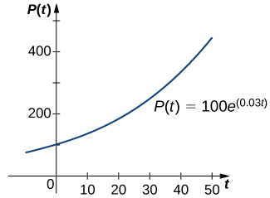
Mynd 4.18
Veldisvaxtarlíkan fyrir stofn.
Notes:
A graph of an exponential function p(t) = 100 e ^ (0.03 t). It is an increasing concave up function starting in quadrant 2, crosses the y axis at (0, 100), and increases in quadrant 1.

Slide 29

Mynd 4.19
Fasalína fyrir deildajöfnuna dP/dt = rP(1 − P/K).
Notes:
A diagram of the phase line for the given differential equation. A vertical blue line with arrows on either end has two points marked, at P = K and P = 0, with K > 0. Red arrows point up between 0 and K and down below zero and above K.

Slide 30
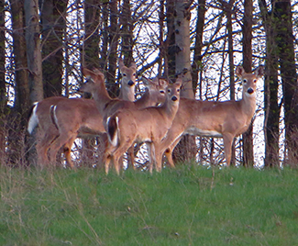
Mynd 4.20
(mynd: verk Rachel Kramer á Flickr, aðlagað)
Notes:
This is a photograph of a deer.

Slide 31
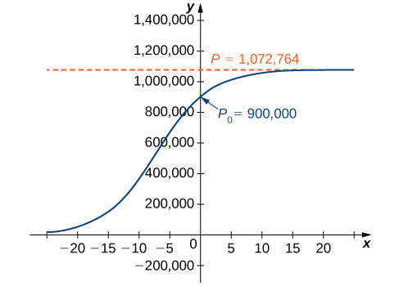
Mynd 4.21
Lógistískur ferill fyrir dýrastofn sem telur 900.000 dýr í upphafi.
Notes:
A graph of a logistic curve for the deer population with an initial population P_0 of 900,000. The graph begins as an increasing concave up function in quadrant two, changes to an increasing concave down function, crosses the x axis at (0, 900,000), and asymptotically approaches P = 1,072,764 as x goes to infinity.

Slide 32
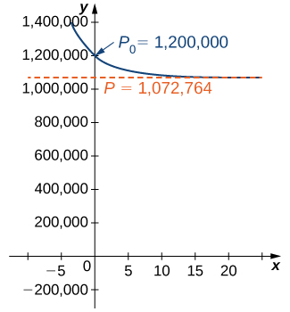
Mynd 4.22
Lógistískur ferill fyrir dýrastofn sem telur 1.200.000 dýr í upphafi.
Notes:
A graph of the logistic curve for an initial population of 1,200,000 deer. The graph is a decreasing concave up function which begins in quadrant two, crosses the y axis at (0, 1,200,000), and asymptotically approaches P = 1,072,764 as x goes to infinity.

Slide 33
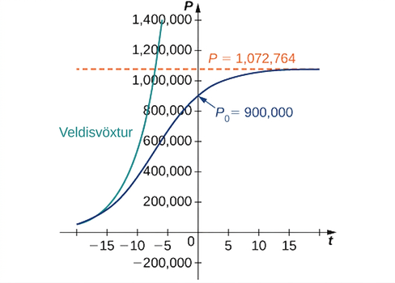
Mynd 4.23
Samanburður á veldisvexti og lógistískum vexti þegar upphafsstofninn er 900.000 lífverur og vaxtarhraðinn 23,11%.
Notes:
A graph showing exponential and logistic growth for the same initial population of 900,000 organisms and growth rate of 23.11%. Both begin in quadrant two close to the x axis as increasing concave up curves. The exponential growth curve continues to grow, passing P = 1,072,764 while still in quadrant two. The logistic growth curve changes concavity, crosses the x axis at P_0 = 900,000, and asymptotically approaches P = 1,072,764.

Slide 34
4.5 Fyrsta stigs línulegar deildajöfnur
Námsmarkmið
Rita línulega deildajöfnu af fyrsta stigi á stöðluðu formi.
Finna heildunarstuðul og nota hann til að leysa línulega deildajöfnu af fyrsta stigi.
Leysa hagnýt verkefni sem fela í sér línulegar deildajöfnur af fyrsta stigi.

Slide 35
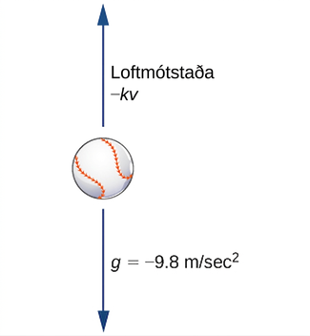
Mynd 4.24
Kraftar sem verka á hafnabolta á hreyfingu: Þyngdarkrafturinn verkar niður á við en loftmótstaðan gegn hreyfistefnunni.
Notes:
A diagram of a baseball with an arrow above it pointing up and an arrow below it pointing down. The upper arrow is labeled “air resistance –kv” and the lower arrow is labeled “g = -9.8 m/sec ^ 2.”

Slide 36
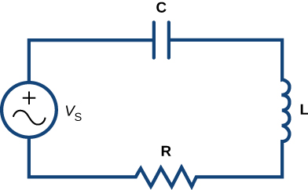
Mynd 4.25
Dæmigerð rafrás með spennugjafa (VS), þétti (C), spólu (L) og viðnámi (R).
Notes:
A diagram of an electric circuit in a rectangle. The top has a capacitor C, the left has a voltage generator Vs, the bottom was a resistor R, and the right has an inductor L.

Slide 37
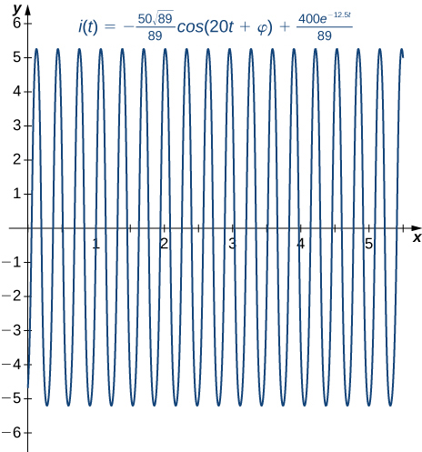
Mynd 4.26
Notes:
A graph of the given solution over [0, 6] on the x axis. It is an oscillating function, rapidly going from just below -5 to just above 5.

Slide 38
Notkunarleyfi
Þetta ítarefni frá OpenStax er © Rice University og gefið út samkvæmt alþjóðlega notkunarleyfinu CC BY-NC-SA 4.0. Heimilt er að afrita það eða breyta því, en aðeins í tilgangi sem ekki er viðskiptalegs eðlis. Geta verður OpenStax og Rice University sem rétthafa og tilgreina allar breytingar. Öll aðlöguð útgáfa verður að vera gefin út með sams konar notkunarleyfi.

