Slide 1

Stærðfræðigreining, 2. bindi
5. kafli: Runur og raðir

Slide 2
Yfirlit kaflans
Runur
Óendanlegar raðir
Sundurleitniprófið og heildisprófið
Samanburðarpróf
Víxlmerkjaraðir
Kvóta- og rótarpróf

Slide 3
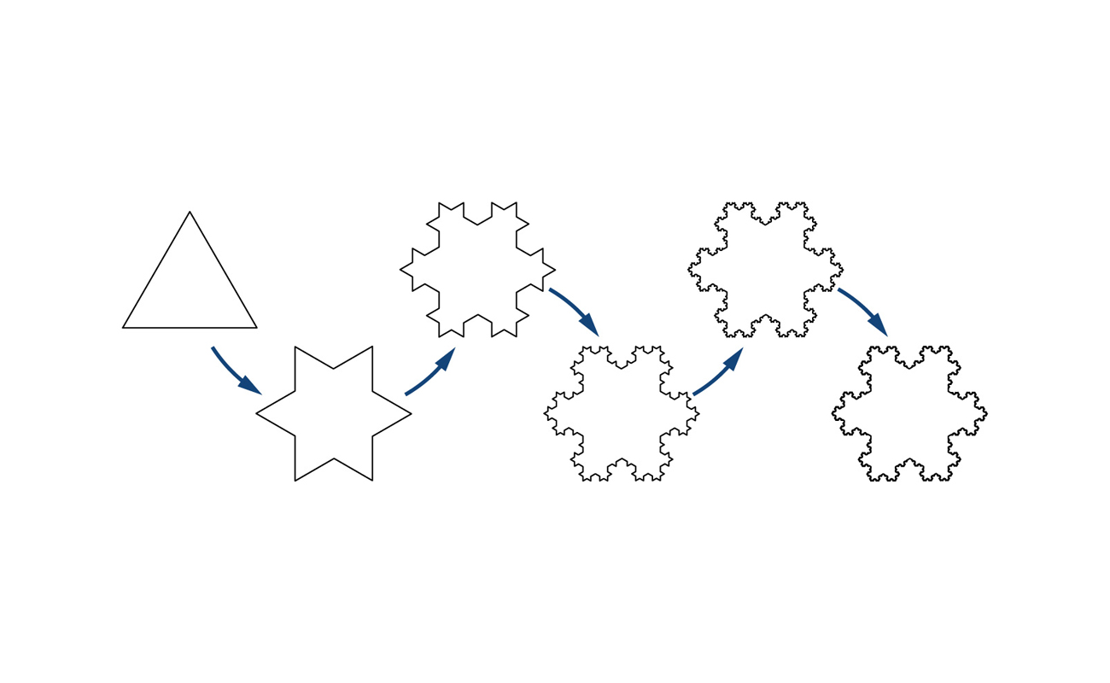
Mynd 5.1
Koch-snjókornið er myndað með ítrun. Byrjað er á jafnhliða þríhyrningi. Í hverju skrefi er miðþriðjungur hvers línustriks fjarlægður og í stað hans settur jafnhliða þríhyrningur sem vísar út á við.
Notes:
This is a diagram of several iterations of the Koch snowflake, which is created through an interative process. The first case is an equilateral triangle. Five times, the middle third of each line segment is replaced with an equilateral triangle pointing outward.

Slide 4
5.1 Runur
Námsmarkmið
Finna formúlu fyrir almenna lið runu.
Reikna markgildi runu ef það er til.
Ákvarða hvort tiltekin runa sé samleitin eða ósamleitin.

Slide 5
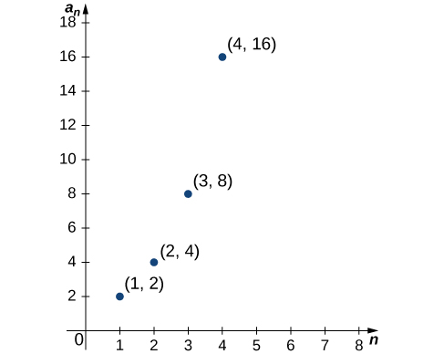
Mynd 5.2
Punktarnir sem sýndir eru mynda graf rununnar {2ⁿ}.
Notes:
A graph in quadrant one containing the following points: (1, 2), (2, 4), (3, 8), (4, 16).

Slide 6
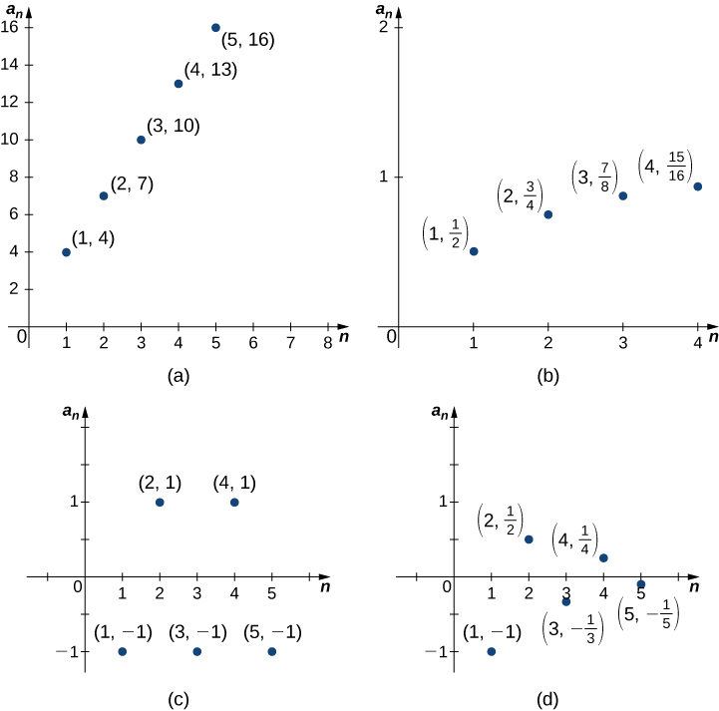
Mynd 5.3
(a) Liðir rununnar verða ótakmarkað stórir þegar n→∞. (b) Liðir rununnar stefna á 1 þegar n→∞. (c) Liðir rununnar skiptast á að vera 1 og −1 þegar n→∞. (d) Liðir rununnar skiptast á að vera jákvæðir og neikvæðir en stefna á 0 þegar n→∞.
Notes:
Four graphs in quadrants 1 and 4, labeled a through d. The horizontal axis is for the value of n and the vertical axis is for the value of the term a _n. Graph a has points (1, 4), (2, 7), (3, 10), (4, 13), and (5, 16). Graph b has points (1, 1/2), (2, 3/4), (3, 7/8), and (4, 15/16). Graph c has points (1, -1), (2, 1), (3, -1), (4, 1), and (5, -1). Graph d has points (1, -1), (2, 1/2), (3, -1/3), (4, 1/4), and (5, -1/5).

Slide 7
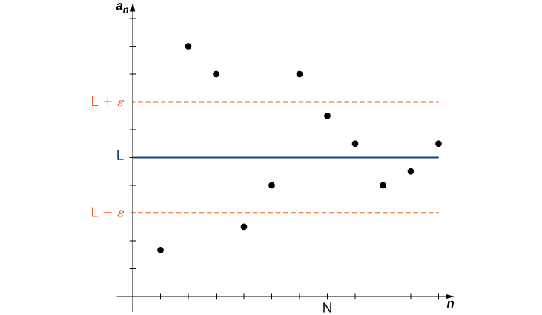
Mynd 5.4
Þegar n stækkar nálgast liðirnir an töluna L. Fyrir n≥N er fjarlægðin milli sérhvers punkts (n,an) og línunnar y=L minni en ε.
Notes:
A graph in quadrant 1 with axes labeled n and a_n instead of x and y, respectively. A positive point N is marked on the n axis. From smallest to largest, points L – epsilon, L, and L + epsilon are marked on the a_n axis, with the same interval epsilon between L and the other two. A blue line y = L is drawn, as are red dotted ones for y = L + epsilon and L – epsilon. Points in quadrant 1 are plotted above and below these lines for x < N. However, past N, the points remain inside the lines y = L + epsilon and L – epsilon, converging on L.

Slide 8
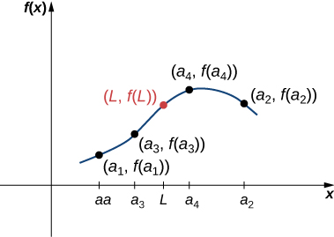
Mynd 5.5
Þar sem f er samfellt fall og inntaksgildin a1,a2,a3,… stefna á L, stefna úttaksgildin f(a1),f(a2),f(a3),… á f(L).
Notes:
A graph in quadrant 1 with points (a_1, f(a_1)), (a_3, f(a_3)), (L, f(L)), (a_4, f(a_4)), and (a_2, f(a_2)) connected by smooth curves.

Slide 9
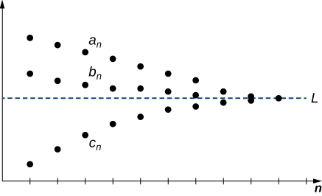
Mynd 5.6
Sérhver liður bn uppfyllir an≤bn≤cn. Þar sem runurnar {an} og {cn} stefna á sama markgildi hlýtur runan {bn} einnig að stefna á það markgildi.
Notes:
A graph in quadrant 1 with the line y = L and the x axis labeled as the n axis. Points are plotted above and below the line, converging to L as n goes to infinity. Points a_n, b_n, and c_n are plotted at the same n-value. A_n and b_n are above y = L, and c_n is below it.

Slide 10
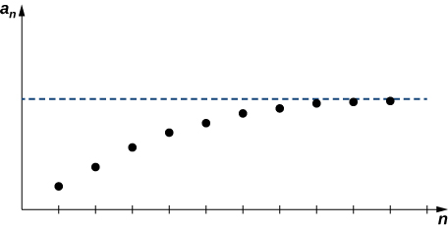
Mynd 5.7
Þar sem runan {an} er vaxandi og takmörkuð að ofan hlýtur hún að vera samleitin.
Notes:
A graph in quadrant 1 with the x and y axes labeled n and a_n, respectively. A dotted horizontal is drawn from the a_n axis into quadrant 1. Many points are plotted under the dotted line, increasing in a_n value and converging to the dotted line.

Slide 11
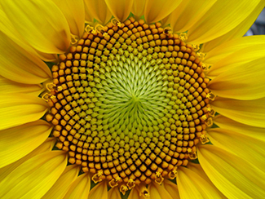
Mynd 5.8
Fræ sólblóms mynda spíralmynstur sem sveigjast til vinstri og hægri. Fjöldi spírala í hvora átt er alltaf Fibonacci-tala—undantekningarlaust. (mynd: aðlagað verk eftir Esdras Calderan, Wikimedia Commons)
Notes:
This is a photo of a sunflower, particularly the curves of the seeds at its middle. The number of spirals in each direction is always a Fibonacci number.

Slide 12
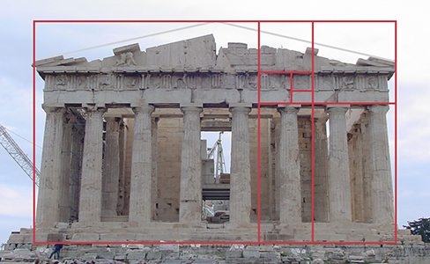
Mynd 5.9
Hlutföll gullinsniðsins koma fyrir í mörgum þekktum listaverkum og byggingum. Forngríska musterið Parþenon virðist hafa þessi hlutföll og gullinsniðið kemur einnig fram í mörgum smærri atriðum byggingarinnar. (mynd: aðlagað verk eftir TravelingOtter, Flickr)
Notes:
This is a photo of the Parthenon, an ancient Greek temple that was designed with the proportions of the Golden Rule. The entire temple’s front side fits perfectly into a rectangle with those proportions, as do the columns, the level between the columns and the roof, and a portion of the trim below the roof.

Slide 13
5.2 Óendanlegar raðir
Námsmarkmið
Útskýra hvað summa óendanlegrar raðar merkir.
Reikna summu kvótaraðar.
Reikna summu styttiraðar.

Slide 14
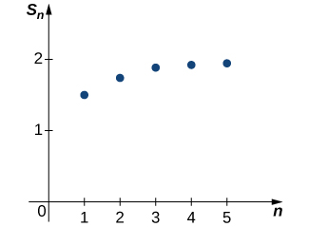
Mynd 5.10
Grafið sýnir runu hlutsummanna {Sk}. Runan virðist stefna á gildið 2.
Notes:
This is a graph in quadrant 1with the x and y axes labeled n and S_n, respectively. From 1 to 5, points are plotted. They increase and seem to converge to 2 and n goes to infinity.

Slide 15
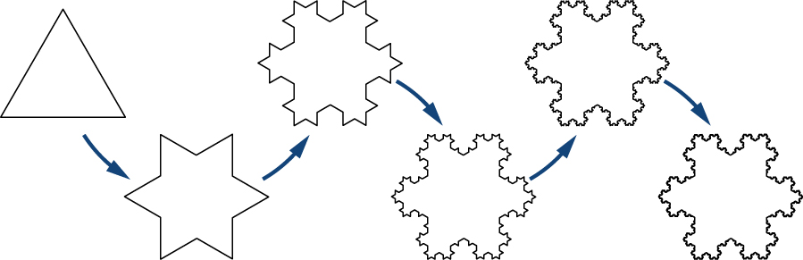
Mynd 5.11
Fyrstu fjögur stigin, F0, F1, F2 og F3, í myndun Koch-snjókornsins.
Notes:
This is a diagram of the Koch snowflake, which it created through iterations. The base case is an equilateral triangle. In each iteration, the middle third of each line segment is replaced with another equilateral triangle pointing outward.

Slide 16
5.3 Sundurleitniprófið og heildisprófið
Námsmarkmið
Nota sundurleitniprófið til að sýna að röð sé ósamleitin.
Nota heildispróf til að ákvarða hvort röð sé samleitin.
Áætla summu raðar með því að finna efri og neðri mörk fyrir afgang hennar.

Slide 17
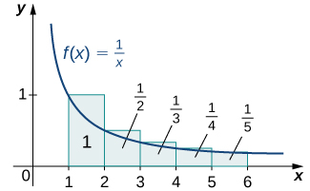
Mynd 5.12
Summa flatarmála rétthyrninganna er meiri en flatarmálið milli ferilsins f(x)=1/x og x-ássins fyrir x≥1. Þar sem svæðið undir ferlinum hefur óendanlegt flatarmál, eins og óeiginlegt heildi sýnir, er summa flatarmála rétthyrninganna einnig óendanleg.
Notes:
This is a graph in quadrant 1 of a decreasing concave up curve approaching the x axis – f(x) = 1/x. Five rectangles are drawn with base 1 over the interval [1, 6]. The height of each rectangle is determined by the value of the function at the left endpoint of the rectangle’s base. The areas for each are marked: 1, 1/2, 1/3, 1/4, and 1/5.

Slide 18
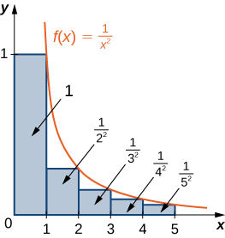
Mynd 5.13
Summa flatarmála rétthyrninganna er minni en samanlagt flatarmál fyrsta rétthyrningsins og svæðisins milli ferilsins f(x)=1/x² og x-ássins fyrir x≥1. Þar sem svæðið undir ferlinum hefur endanlegt flatarmál er summa flatarmála rétthyrninganna einnig endanleg.
Notes:
This is a graph in quadrant 1 of the decreasing concave up curve f(x) = 1/(x^2), which approaches the x axis. Rectangles of base 1 are drawn over the interval [0, 5]. The height of each rectangle is determined by the value of the function at the right endpoint of its base. The areas of each are marked: 1, 1/(2^2), 1/(3^2), 1/(4^2) and 1/(5^2).

Slide 19
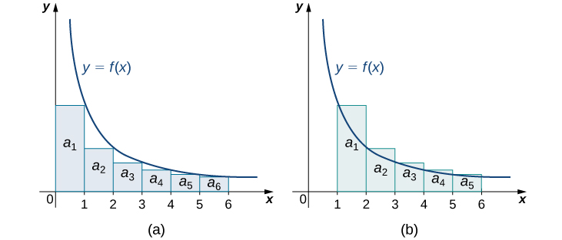
Mynd 5.14
(a) Ef unnt er að innrita rétthyrninga í svæðið sem afmarkast af ferlinum y=f(x) og x-ásnum og flatarmál svæðisins fyrir x≥1 er endanlegt, þá er summa flatarmála rétthyrninganna einnig endanleg. (b) Ef rétthyrningar eru umritaðir um svæðið sem afmarkast af y=f(x) og x-ásnum fyrir x≥1 og svæðið hefur óendanlegt flatarmál, þá er summa flatarmála rétthyrninganna einnig óendanleg.
Notes:
This shows two graphs side by side of the same function y = f(x), a decreasing concave up curve approaching the x axis. Rectangles are drawn with base 1 over the intervals [0, 6] and [1, 6]. For the graph on the left, the height of each rectangle is determined by the value of the function at the right endpoint of its base. For the graph on the right, the height of each rectangle is determined by the value of the function at the left endpoint of its base. Areas a_1 through a_6 are marked in the graph on the left, and the same for a_1 to a_5 on the right.

Slide 20
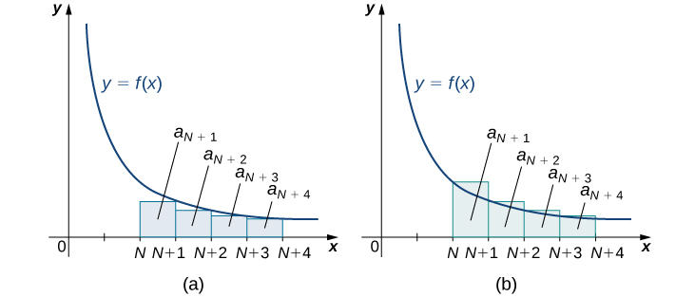
Mynd 5.15
Látum f vera samfellt, jákvætt og minnkandi fall og a_n=f(n) fyrir n≥1. Þá gilda (a) a_{N+1}+a_{N+2}+⋯ < ∫_N^∞ f(x)dx og (b) a_{N+1}+a_{N+2}+⋯ > ∫_{N+1}^∞ f(x)dx. Heildið gefur þannig efri og neðri mörk fyrir afgang raðarinnar.
Notes:
This shows two graphs side by side of the same decreasing concave up function y = f(x) that approaches the x axis in quadrant 1. Rectangles are drawn with a base of 1 over the intervals N through N + 4. The heights of the rectangles in the first graph are determined by the value of the function at the right endpoints of the bases, and those in the second graph are determined by the value at the left endpoints of the bases. The areas of the rectangles are marked: a_(N + 1), a_(N + 2), through a_(N + 4).

Slide 21
5.4 Samanburðarpróf
Námsmarkmið
Nota samanburðarpróf til að kanna samleitni raðar.
Nota markgildissamanburðarpróf til að ákvarða samleitni raðar.

Slide 22
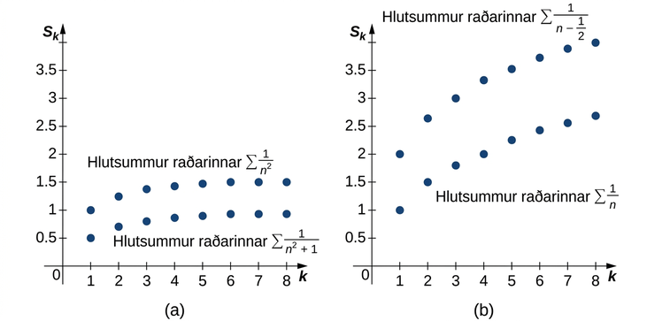
Mynd 5.16
(a) Sérhver hlutsumma gefnu raðarinnar er minni en samsvarandi hlutsumma samleitnu p−raðarinnar. (b) Sérhver hlutsumma gefnu raðarinnar er stærri en samsvarandi hlutsumma ósamleitnu harmónísku raðarinnar.
Notes:
This shows two graphs side by side. The first shows plotted points for the partial sums for the sum of 1/n^2 and the sum 1/(n^2 + 1). Each of the partial sums for the latter is less than the corresponding partial sum for the former. The second shows plotted points for the partial sums for the sum of 1/(n - 0.5) and the sum 1/n. Each of the partial sums for the latter is less than the corresponding partial sum for the former.

Slide 23
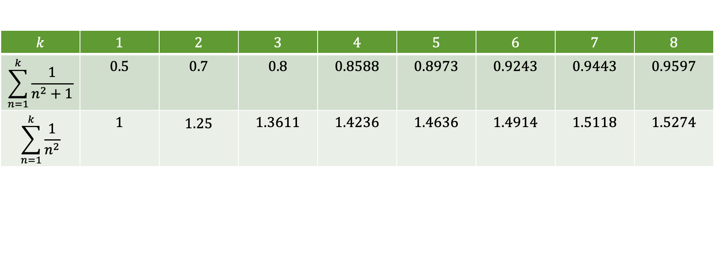
Tafla 5.1 Samanburður raðar við p-röð (p = 2)
$$k$$ | $$1$$ | $$2$$ | $$3$$ | $$4$$ | $$5$$ | $$6$$ | $$7$$ | $$8$$
$$\sum_{n=1}^{k}{\frac{1}{n^{2}+1}}$$ | $$0.5$$ | $$0.7$$ | $$0.8$$ | $$0.8588$$ | $$0.8973$$ | $$0.9243$$ | $$0.9443$$ | $$0.9597$$
$$\sum_{n=1}^{k}{\frac{1}{n^{2}}}$$ | $$1$$ | $$\begin{matrix}1.25\end{matrix}$$ | $$1.3611$$ | $$1.4236$$ | $$1.4636$$ | $$1.4914$$ | $$1.5118$$ | $$1.5274$$

Slide 24
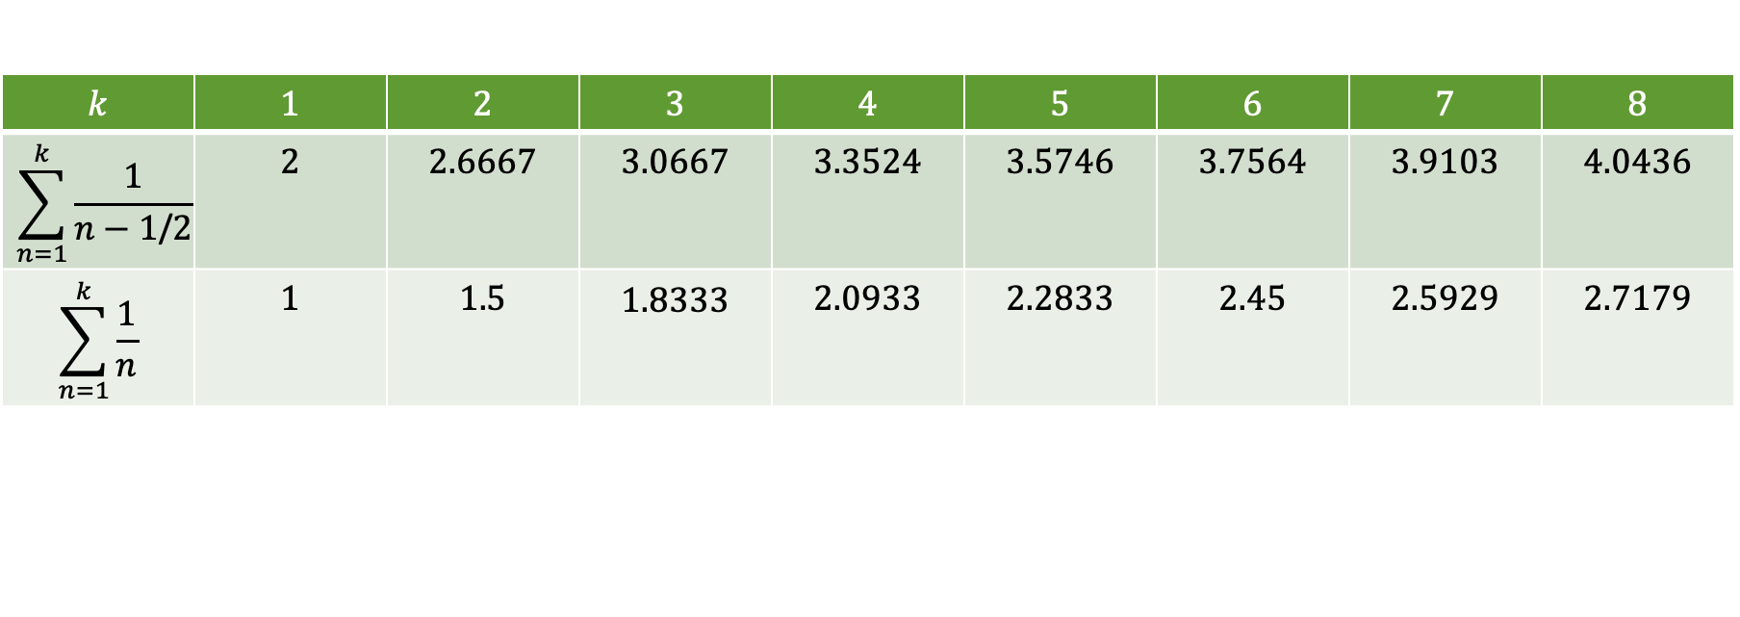
Tafla 5.2 Samanburður raðar við harmónísku röðina
$$k$$ | $$1$$ | $$2$$ | $$3$$ | $$4$$ | $$5$$ | $$6$$ | $$7$$ | $$8$$
$$\sum_{n=1}^{k}{\frac{1}{n−1\text{/}2}}$$ | $$2$$ | $$2.6667$$ | $$3.0667$$ | $$3.3524$$ | $$3.5746$$ | $$3.7564$$ | $$3.9103$$ | $$4.0436$$
$$\sum_{n=1}^{k}{\frac{1}{n}}$$ | $$1$$ | $$1.5$$ | $$\begin{matrix}1.8333\end{matrix}$$ | $$2.0933$$ | $$2.2833$$ | $$2.45$$ | $$2.5929$$ | $$2.7179$$

Slide 25
5.5 Víxlmerkjaraðir
Námsmarkmið
Nota víxlmerkjaraðaprófið til að kanna samleitni víxlmerkjaraðar.
Áætla summu víxlmerkjaraðar.
Útskýra hvað algild samleitni og skilyrt samleitni merkja.

Slide 26
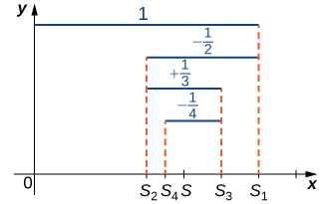
Mynd 5.17
Í víxlmerktu harmónísku röðinni mynda oddatöluliðirnir S2k+1 í runu hlutsummanna minnkandi runu sem er takmörkuð að neðan. Sléttutöluliðirnir S2k mynda vaxandi runu sem er takmörkuð að ofan.
Notes:
This graph demonstrates the alternating hamanic series in the first quadrant. The highest line 1 is drawn to S1, the next line -1/2 is drawn to S2, the next line +1/3 is drawn to S3, the line -1/4 is drawn to S4, and the last line +1/5 is drawn to S5. The odd terms are decreasing and bounded below, and the even terms are increasing and bounded above. It seems to be converging to S, which is in the middle of S2, S4 and S5, S3, S1.

Slide 27
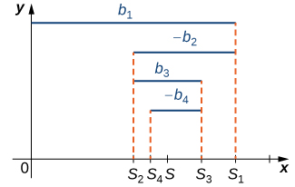
Mynd 5.18
Fyrir víxlmerkjaröðina b1−b2+b3−⋯, þar sem b1>b2>b3>⋯, mynda oddatöluliðirnir S2k+1 í runu hlutsummanna minnkandi runu sem er takmörkuð að neðan. Sléttutöluliðirnir S2k mynda vaxandi runu sem er takmörkuð að ofan.
Notes:
This diagram illustrates an alternating series in quadrant 1. The highest line b1 is drawn out to S1, the next line –b2 is drawn back to S2, the next line b3 is drawn out to S3, the next line –b4 is drawn back to S4, and the last line is drawn out to S5. It seems to be converging to S, which is in between S2, S4 and S5, S3, and S1. The odd terms are decreasing and bounded below. The even terms are increasing and bounded above.

Slide 28
5.6 Kvóta- og rótarpróf
Námsmarkmið
Nota kvótaprófið til að ákvarða algilda samleitni raðar.
Nota rótarprófið til að ákvarða algilda samleitni raðar.
Lýsa aðferð til að kanna samleitni tiltekinnar raðar.

Slide 29
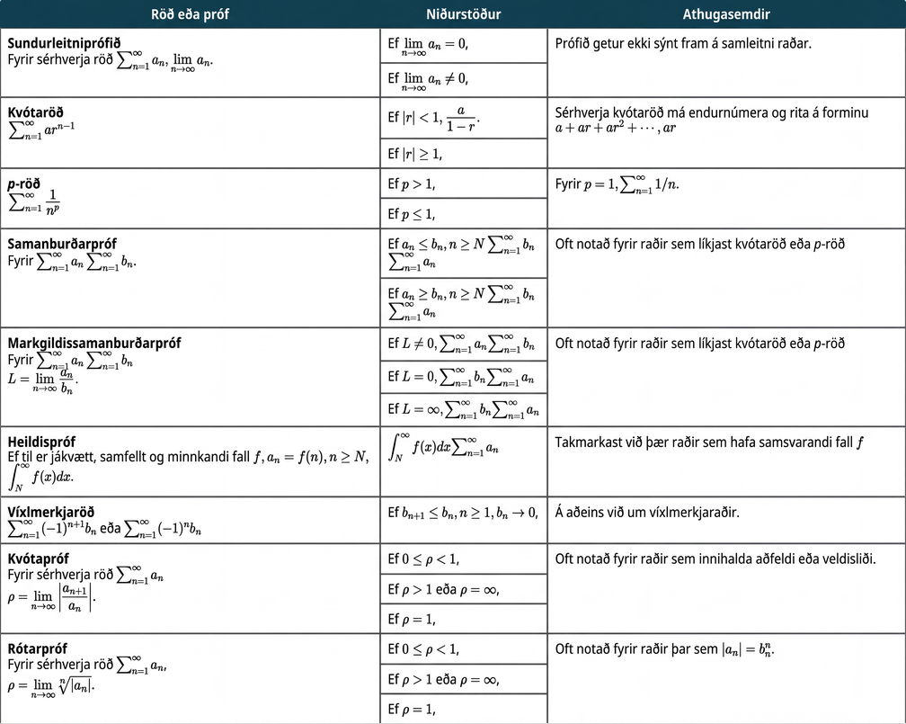
Tafla 5.3 Yfirlit yfir samleitnipróf
Notes:
Table 5.3 Summary of Convergence Tests; Columns: Series or Test, Conclusions, Comments; Row 1: Divergence Test
For any series ∑n=1∞an, evaluate limn→∞an., If limn→∞an=0, the test is inconclusive., This test cannot prove convergence of a series.; Row 2: If limn→∞an≠0, the series diverges.; Row 3: Geometric Series
∑n=1∞arn−1, If |r|<1, the series converges to
a/(1−r)., Any geometric series can be reindexed to be written in the form a+ar+ar2+⋯, where a is the initial term and r is the ratio.; Row 4: If |r|≥1, the series diverges.; Row 5: p-Series
∑n=1∞1np, If p>1, the series converges., For p=1, we have the harmonic series ∑n=1∞1/n.; Row 6: If p≤1, the series diverges.; Row 7: Comparison Test
For ∑n=1∞an with nonnegative terms, compare with a known series ∑n=1∞bn., If an≤bn for all n≥N and ∑n=1∞bn converges, then ∑n=1∞an converges., Typically used for a series similar to a geometric or p-series. It can sometimes be difficult to find an appropriate series.; Row 8: If an≥bn for all n≥N and ∑n=1∞bn diverges, then ∑n=1∞an diverges.; Row 9: Limit Comparison Test
For ∑n=1∞an with positive terms, compare with a series ∑n=1∞bn by evaluating
L=limn→∞anbn., If L is a real number and L≠0, then ∑n=1∞an and ∑n=1∞bn both converge or both diverge., Typically used for a series similar to a geometric or p-series. Often easier to apply than the comparison test.; Row 10: If L=0 and ∑n=1∞bn converges, then ∑n=1∞an converges.; Row 11: If L=∞ and ∑n=1∞bn diverges, then ∑n=1∞an diverges.; Row 12: Integral Test
If there exists a positive, continuous, decreasing function f such that an=f(n) for all n≥N, evaluate ∫N∞f(x)dx., ∫N∞f(x)dx and ∑n=1∞an both converge or both diverge., Limited to those series for which the corresponding function f can be easily integrated.; Row 13: Alternating Series
∑n=1∞(−1)n+1bnor∑n=1∞(−1)nbn, If bn+1≤bn for all n≥1 and bn→0, then the series converges., Only applies to alternating series.; Row 14: Ratio Test
For any series ∑n=1∞an with nonzero terms, let
ρ=limn→∞|an+1an|., If 0≤ρ<1, the series converges absolutely., Often used for series involving factorials or exponentials.; Row 15: If ρ>1orρ=∞, the series diverges.; Row 16: If ρ=1, the test is inconclusive.; Row 17: Root Test
For any series ∑n=1∞an, let
ρ=limn→∞|an|n., If 0≤ρ<1, the series converges absolutely., Often used for series where |an|=bnn.; Row 18: If ρ>1orρ=∞, the series diverges.; Row 19: If ρ=1, the test is inconclusive.

Slide 30
Notkunarleyfi
Þetta viðbótarefni frá OpenStax er © Rice University og gefið út samkvæmt alþjóðlega notkunarleyfinu CC BY-NC-SA 4.0. Aðeins má afrita það eða breyta því í óviðskiptalegum tilgangi, en geta skal OpenStax og Rice University sem höfunda og tilgreina allar breytingar. Sérhverja aðlögun verður að birta með sams konar notkunarleyfi.

