Slide 1

Stærðfræðigreining, 2. bindi
3. kafli Heildunaraðferðir

Slide 2
Yfirlit kaflans
Hlutheildun
Heildi hornafalla
Innsetning með hornaföllum
Stofnbrotaliðun
Aðrar heildunaraðferðir
Töluleg heildun
Óeiginleg heildi

Slide 3
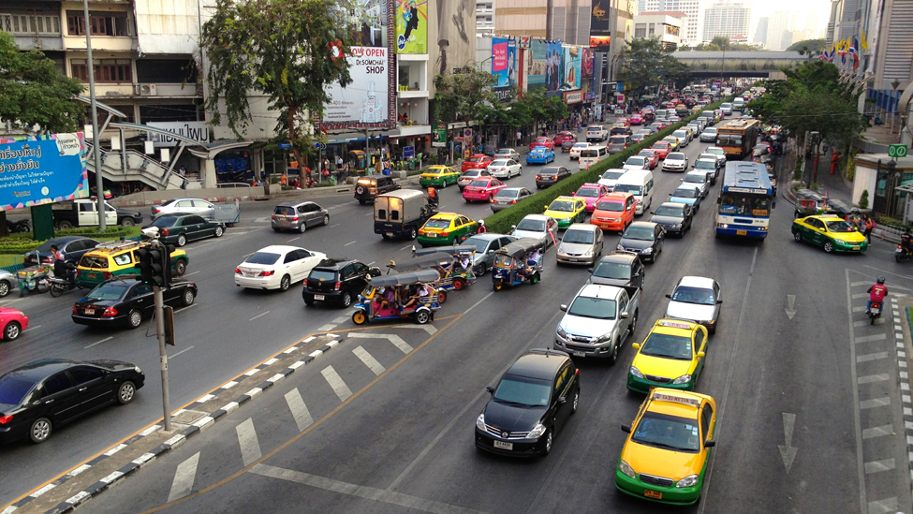
Mynd 3.1
Vandleg skipulagning umferðarljósa getur komið í veg fyrir slys eða fækkað þeim á fjölförnum gatnamótum. (mynd: aðlagað verk eftir David McKelvey, Flickr)
Notes:
This is a picture of a city street with a traffic signal. The picture has very busy lanes of traffic in both directions.

Slide 4
3.1 Hlutheildun
Námsmarkmið
Átta sig á hvenær beita á hlutheildun.
Nota hlutheildunarformúluna til að leysa heildunarverkefni.
Nota hlutheildunarformúluna fyrir ákveðin heildi.

Slide 5
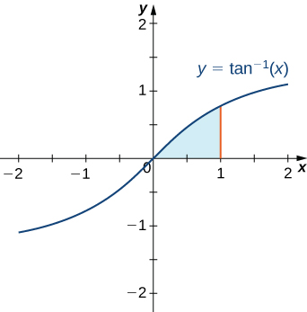
Mynd 3.2
Til að finna flatarmál skyggða svæðisins þurfum við að beita hlutheildun.
Notes:
This figure is the graph of the inverse tangent function. It is an increasing function that passes through the origin. In the first quadrant there is a shaded region under the graph, above the x-axis. The shaded area is bounded to the right at x = 1.

Slide 6
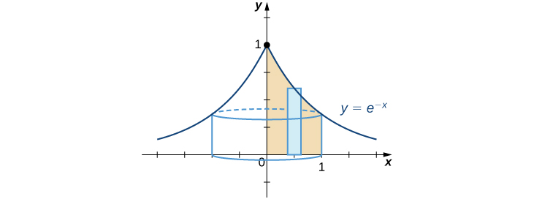
Mynd 3.3
Við getum notað skeljuaðferðina til að finna snúningsrúmmál.
Notes:
This figure is the graph of the function e^-x. It is an increasing function on the left side of the y-axis and decreasing on the right side of the y-axis. The curve also comes to a point on the y-axis at y=1. Under the curve there is a shaded rectangle in the first quadrant. There is also a cylinder under the graph, formed by revolving the rectangle around the y-axis.

Slide 7
3.2 Heildi hornafalla
Námsmarkmið
Leysa heildunarverkefni með margfeldum og veldum sin x og cos x.
Leysa heildunarverkefni með margfeldum og veldum tan x og sec x.
Nota lækkunarformúlur til að reikna heildi hornafalla.

Slide 8
3.3 Innsetning með hornaföllum
Námsmarkmið
Leysa heildunarverkefni sem fela í sér kvaðratrót af summu eða mismun tveggja ferninga.

Slide 9
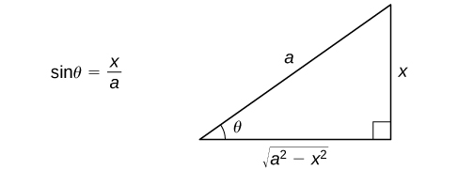
Mynd 3.4
Viðmiðunarþríhyrningur auðveldar að rita gildi hornafallanna við θ sem föll af x.
Notes:
This figure is a right triangle. It has an angle labeled theta. This angle is opposite the vertical side. The hypotenuse is labeled a, the vertical leg is labeled x, and the horizontal leg is labeled as the square root of (a^2 – x^2). To the left of the triangle is the equation sin(theta) = x/a.

Slide 10

Mynd 3.5
Teikna má viðmiðunarþríhyrning fyrir dæmi 3.21.
Notes:
This figure is a right triangle. It has an angle labeled theta. This angle is opposite the vertical side. The hypotenuse is labeled 3, the vertical leg is labeled x, and the horizontal leg is labeled as the square root of (9 – x^2). To the left of the triangle is the equation sin(theta) = x/3.

Slide 11
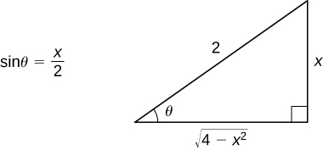
Mynd 3.6
Teikna má viðmiðunarþríhyrning fyrir dæmi 3.22.
Notes:
This figure is a right triangle. It has an angle labeled theta. This angle is opposite the vertical side. The vertical leg is labeled x, and the horizontal leg is labeled as the square root of (4 – x^2). To the left of the triangle is the equation sin(theta) = x/2.

Slide 12
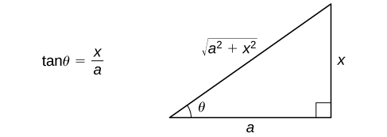
Mynd 3.7
Teikna má viðmiðunarþríhyrning til að rita gildi hornafallanna við θ sem föll af x.
Notes:
This figure is a right triangle. It has an angle labeled theta. This angle is opposite the vertical side. The hypotenuse is labeled the square root of (a^2+x^2), the vertical leg is labeled x, and the horizontal leg is labeled a. To the left of the triangle is the equation tan(theta) = x/a.

Slide 13
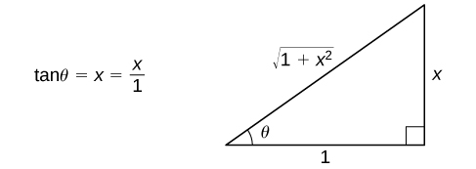
Mynd 3.8
Viðmiðunarþríhyrningurinn fyrir dæmi 3.24.
Notes:
This figure is a right triangle. It has an angle labeled theta. This angle is opposite the vertical side. The hypotenuse is labeled the square root of (1+x^2), the vertical leg is labeled x, and the horizontal leg is labeled 1. To the left of the triangle is the equation tan(theta) = x/1.

Slide 14
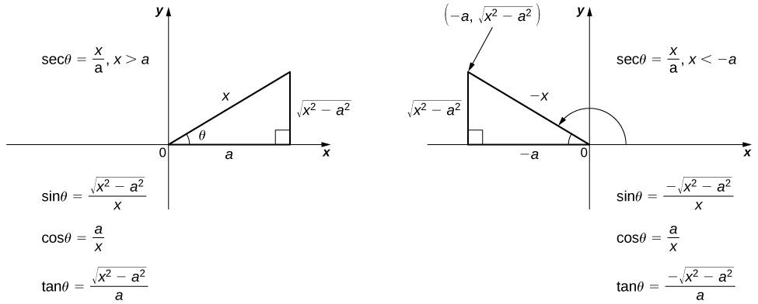
Mynd 3.9
Notið viðeigandi viðmiðunarþríhyrning til að rita gildi hornafallanna við θ sem föll af x.
Notes:
This figure has two right triangles. The first triangle is in the first quadrant of the xy coordinate system and has an angle labeled theta. This angle is opposite the vertical side. The hypotenuse is labeled x, the vertical leg is labeled the square root of (x^2-a^2), and the horizontal leg is labeled a. The horizontal leg is on the x-axis. To the left of the triangle is the equation sec(theta) = x/a, x>a. There are also the equations sin(theta)= the square root of (x^2-a^2)/x, cos(theta) = a/x, and tan(theta) = the square root of (x^2-a^2)/a. The second triangle is in the second quadrant, with the hypotenuse labeled –x. The horizontal leg is labeled –a and is on the negative x-axis. The vertical leg is labeled the square root of (x^2-a^2). To the right of the triangle is the equation sec(theta) = x/a, x<-a. There are also the equations sin(theta)= the negative square root of (x^2-a^2)/x, cos(theta) = a/x, and tan(theta) = the negative square root of (x^2-a^2)/a.

Slide 15
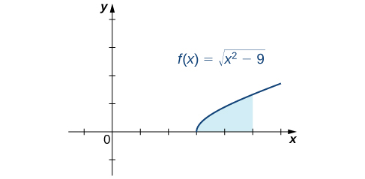
Mynd 3.10
Til að reikna flatarmál skyggða svæðisins þarf að reikna heildi með hornafallainnsetningu.
Notes:
This figure is the graph of the function f(x) = the square root of (x^2-9). It is an increasing curve that starts on the x-axis at 3 and is in the first quadrant. Under the curve above the x-axis is a shaded region bounded to the right at x = 5.

Slide 16
3.4 Stofnbrotaliðun
Námsmarkmið
Heilda rætt fall með liðun í stofnbrot.
Þekkja einfalda línulega þætti í ræðu falli.
Þekkja endurtekna línulega þætti í ræðu falli.
Þekkja annars stigs þætti í ræðu falli.

Slide 17
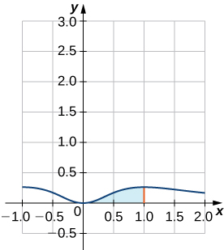
Mynd 3.11
Við getum notað skeljuaðferðina til að finna snúningsrúmmálið sem fæst þegar sýnda svæðinu er snúið um y-ásinn.
Notes:
This figure is the graph of the function f(x) = x^2/(x^2+1)^2. It is a curve above the x-axis. It is decreasing in the second quadrant, intersects at the origin, and increases in the first quadrant. Between x = 0 and x = 1, there is shaded area under the curve.

Slide 18
3.5 Aðrar heildunaraðferðir
Námsmarkmið
Nota heildatöflu til að leysa heildunarverkefni.
Nota tölvualgebrukerfi (CAS) til að leysa heildunarverkefni.

Slide 19
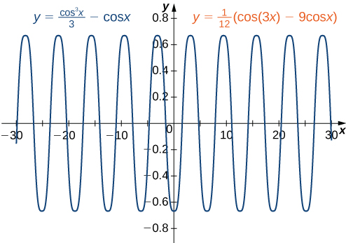
Mynd 3.12
Gröf fallanna y = cos³(x)/3 − cos(x) og y = (cos(3x) − 9 cos(x))/12 eru eins.
Notes:
This is the graph of a periodic function. The waves have an amplitude of approximately 0.7 and a period of approximately 10. The graph represents the functions y = cos^3(x)/3 – cos(x) and y = 1/12(cos(3x)-9cos(x). The graph is the same for both functions.

Slide 20
3.6 Töluleg heildun (1 af 2)
Námsmarkmið
Nálga gildi ákveðins heildis með miðpunktsreglunni og trapisureglunni.
Ákvarða algilda og hlutfallslega skekkju við notkun tölulegrar heildunaraðferðar.
Meta algilda og hlutfallslega skekkju með formúlu fyrir skekkjumörk.

Slide 21
3.6 Töluleg heildun (2 af 2)
Námsmarkmið
Greina hvenær miðpunktsreglan og trapisureglan ofmeta eða vanmeta raunverulegt gildi heildis.
Nota Simpsons-reglu til að nálga gildi ákveðins heildis með tiltekinni nákvæmni.

Slide 22
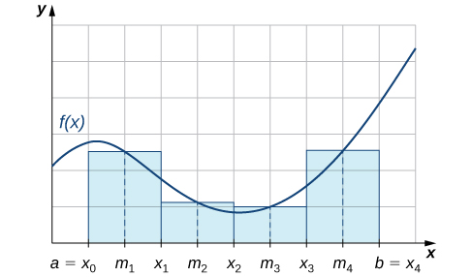
Mynd 3.13
Miðpunktsreglan nálgar flatarmálið milli grafs f(x) og x-ássins með því að leggja saman flatarmál rétthyrninga sem hafa miðpunkta á grafi f(x).
Notes:
This figure is a graph of a non-negative function in the first quadrant. The function increases and decreases. The quadrant is divided into a grid. Beginning on the x-axis at the point labeled a = x sub 0, there are rectangles shaded whose heights are approximately the height of the curve. The x-axis is scaled by increments of msub1, x sub 1, m sub 2, x sub 2, m sub 3, x sub 3, m sub 4 and b = x sub 4.

Slide 23
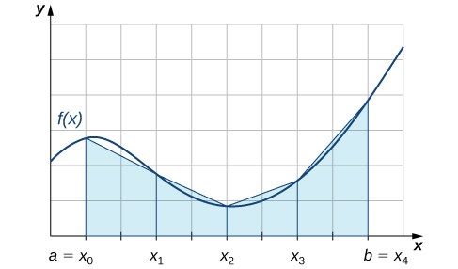
Mynd 3.14
Nota má trapisur til að nálga flatarmálið undir ferli og þar með gildi ákveðna heildisins.
Notes:
This figure is a graph of a non-negative function in the first quadrant. The function increases and decreases. The quadrant is divided into a grid. Beginning on the x-axis at the point labeled a = x sub 0, there are trapezoids shaded whose heights are approximately the height of the curve. The x-axis is scaled by increments of a = x sub 0, x sub 1, x sub 2, x sub 3, and b = x sub 4.

Slide 24
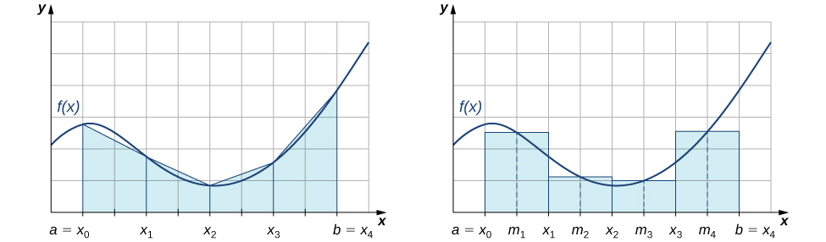
Mynd 3.15
Trapisureglan er yfirleitt ónákvæmari en miðpunktsreglan.
Notes:
This figure has two graphs, both of the same non-negative function in the first quadrant. The function increases and decreases. The quadrant is divided into a grid. The first graph, beginning on the x-axis at the point labeled a = x sub 0, there are trapezoids shaded whose heights are approximately the height of the curve. The x-axis is scaled by increments of a = x sub 0, xsub1, x sub 2, x sub 3, and b = x sub 4. The second graph has on the x-axis at the point labeled a = x sub 0. There are rectangles shaded whose heights are approximately the height of the curve. The x-axis is scaled by increments of m sub 1, x sub 1, m sub 2, x sub 2, m sub 3, x sub 3, m sub 4 and b = x sub 4.

Slide 25
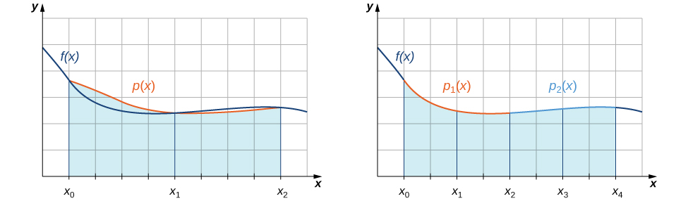
Mynd 3.16
Með Simpsons-reglu nálgum við ákveðið heildi með því að heilda kaflaskipt annars stigs fall.
Notes:
This figure has two graphs, both of the same non-negative function in the first quadrant. The function increases and decreases. The quadrant is divided into a grid. The first graph, beginning on the x-axis at the point labeled x sub 0, there are trapezoids shaded whose heights are represented by the function p(x), which is a curve following an approximate path of the original graph. The x-axis is scaled by increments of x sub 0, x sub 1, x sub 2. The second graph has on the x-axis at the point labeled x sub 0. There are shaded regions under the curve, divided by x sub 0, x sub 1, x sub 2, x sub 3, and x sub 4. The curve is sectioned into two different parts above the shaded areas. These two parts are labeled p sub 1(x) and p sub 2(x).

Slide 26
3.7 Óeiginleg heildi
Námsmarkmið
Reikna heildi yfir óendanlegt bil.
Reikna heildi yfir lokað bil þar sem fallið hefur óendanlega ósamfellu innan bilsins.
Nota samanburðarsetninguna til að ákvarða hvort ákveðið heildi sé samleitið.

Slide 27
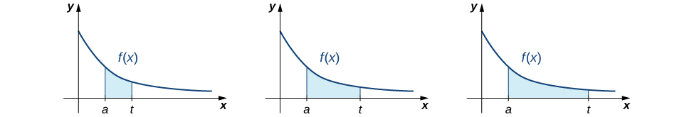
Mynd 3.17
Til að heilda fall yfir óendanlegt bil skoðum við markgildi heildisins þegar efri heildismörkin stefna á óendanlegt.
Notes:
This figure has three graphs. All the graphs have the same curve, which is f(x). The curve is non-negative, only in the first quadrant, and decreasing. Under all three curves is a shaded region bounded by a on the x-axis an t on the x-axis. The region in the first curve is small, and progressively gets wider under the second and third graph as t moves further to the right away from a on the x-axis.

Slide 28
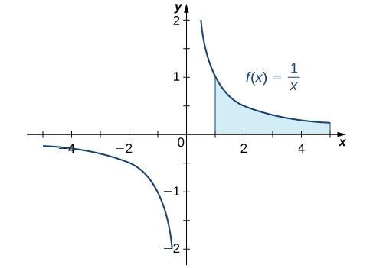
Mynd 3.18
Við getum fundið flatarmálið milli ferilsins f(x)=1/x og x-ássins yfir óendanlegu bili.
Notes:
This figure is the graph of the function y = 1/x. It is a decreasing function with a vertical asymptote at the y-axis. In the first quadrant there is a shaded region under the curve bounded by x = 1 and x = 4.

Slide 29
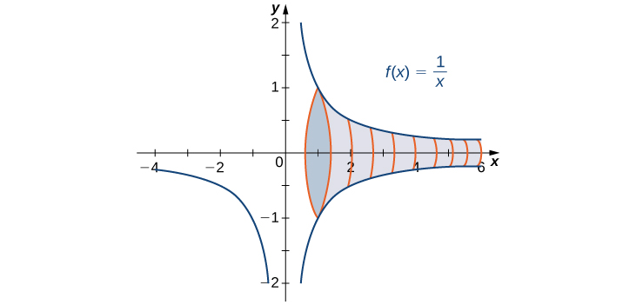
Mynd 3.19
Snúningshluturinn fæst með því að snúa óendanlegu flatarmáli um x-ásinn.
Notes:
This figure is the graph of the function y = 1/x. It is a decreasing function with a vertical asymptote at the y-axis. The graph shows a solid that has been generated by rotating the curve in the first quadrant around the x-axis.

Slide 30

Mynd 3.20
(mynd: aðlagað eftir verki David McKelvey, Flickr)
Notes:
This is a picture of a city street with a traffic signal. The picture has very busy lanes of traffic in both directions.

Slide 31
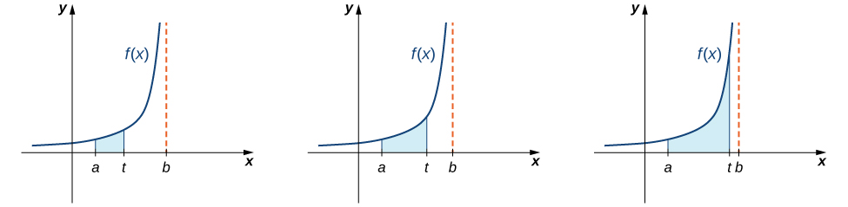
Mynd 3.21
Þegar t stefnir á b frá vinstri stefnir flatarmálið frá a til t á flatarmálið frá a til b.
Notes:
This figure has three graphs. All the graphs have the same curve, which is f(x). The curve is non-negative, only in the first quadrant, and increasing. Under all three curves is a shaded region bounded by a on the x-axis an t on the x-axis. There is also a vertical asymptote at x = b. The region in the first curve is small, and progressively gets wider under the second and third graph as t gets further from a, and closer to b on the x-axis.

Slide 32
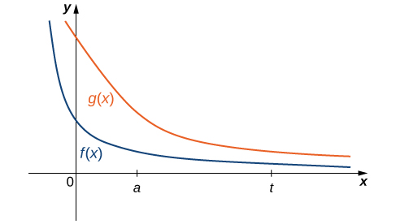
Mynd 3.22
Ef 0 ≤ f(x) ≤ g(x) fyrir x ≥ a, þá gildir ∫ₐᵗ f(x) dx ≤ ∫ₐᵗ g(x) dx fyrir t ≥ a.
Notes:
This figure has two graphs. The graphs are f(x) and g(x). The first graph f(x) is a decreasing, non-negative function with a horizontal asymptote at the x-axis. It has a sharper bend in the curve compared to g(x). The graph of g(x) is a decreasing, non-negative function with a horizontal asymptote at the x-axis.

Slide 33
Notkunarleyfi
Þetta viðbótarefni frá OpenStax er © Rice University og gefið út samkvæmt alþjóðlega notkunarleyfinu CC BY-NC-SA 4.0. Aðeins má afrita það eða breyta því í óviðskiptalegum tilgangi, enda sé OpenStax og Rice University getið og allar breytingar tilgreindar. Öllum aðlögunum skal deilt með sams konar notkunarleyfi.

