Slide 1

Grunnalgebra 2e
4. kafli: Gröf

Slide 2
Yfirlit kaflans
Notkun rétthyrnds hnitakerfis
Teikning grafa línulegra jafna með tveimur breytum
Teikning grafa með skurðpunktum við ása
Halli línu
Notkun hallatöluforms jöfnu línu
Ákvörðun jöfnu línu
Gröf línulegra ójafna

Slide 3
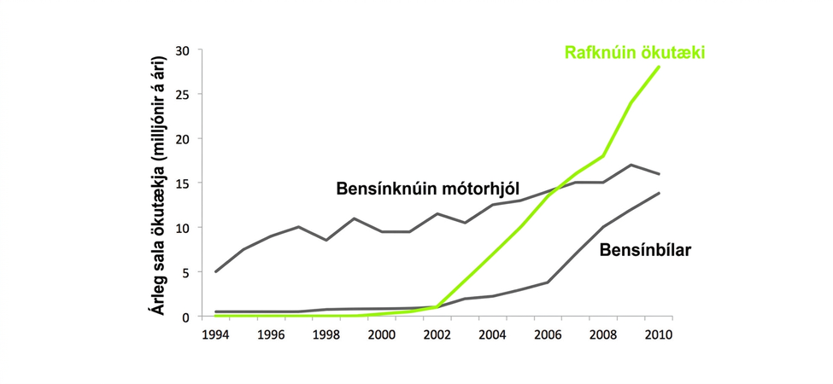
Mynd 4.1
Grafið sýnir árlega sölu bensínknúinna mótorhjóla, bensínbíla og rafknúinna ökutækja frá 1994 til 2010. Þetta er línurit með x- og y-ásum, ein algengasta tegund grafa. (mynd: Steve Jurvetson, Flickr)
Notes:
This is a drawing of a graph. The x-axis ranges from 1994 through 2010 in two-year increments. The y-axis is labeled 0 to 30 million in increments of 5 millon per year. The y-axis is labeled “Annual Vehicle Sales (MM/year)” There are three line graphs. The first shows the annual sale of gas motorcyles from 5 million in 1994 to about 15 million in 2010. The next line is a green line labled EV for electric vehicles. It shows sales were null from 1994 through 2002, but they quickly rose to more than 25 million in sales per year. The last line is labeled gas cars and starts at 0 in 1994 and slowly rises from 2002 to 2010 to just over 10 million.

Slide 4
4.1 Notkun rétthyrnds hnitakerfis
Hæfniviðmið
Teikna punkta í rétthyrnt hnitakerfi
Sannreyna lausnir jöfnu með tveimur breytum
Ljúka við lausnatöflu línulegrar jöfnu
Finna lausnir línulegrar jöfnu með tveimur breytum

Slide 5
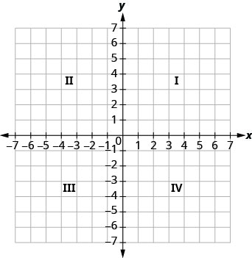
Mynd 4.2
Enska orðið „quadrant“ er dregið af orðstofninum „quad“, sem merkir „fjórir“.
Notes:
The graph shows the x y-coordinate plane. The x- and y-axes each run from negative 7 to 7. The top-right portion of the plane is labeled "I", the top-left portion of the plane is labeled "II", the bottom-left portion of the plane is labeled "III" and the bottom-right portion of the plane is labeled "IV".

Slide 6
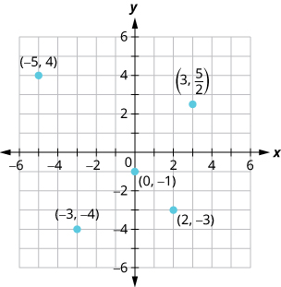
Mynd 4.3
Myndin sýnir punkta í xy-hnitakerfi. Bæði x- og y-ásinn ná frá −6 til 6. Eftirfarandi punktar eru merktir: (3, 5/2), (−5, 4), (−3, −4), (0, −1) og (2, −3).
Notes:
This figure shows points plotted on the x y-coordinate plane. The x and y axes run from negative 6 to 6. The following points are labeled: (3, 5 divided by 2), negative 5, 4), (negative 3, negative 4), (0, negative 1), and (2, negative 3).

Slide 7
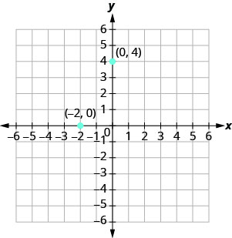
Mynd 4.4
Grafið sýnir xy-hnitakerfi. Bæði x- og y-ásinn ná frá −6 til 6. Punktarnir (0, 4) og (−2, 0) eru teiknaðir inn og merktir.
Notes:
The graph shows the x y-coordinate plane. The x- and y-axes each run from negative 6 to 6. Points (0, 4) and (negative 2, 0) are plotted and labeled.

Slide 8
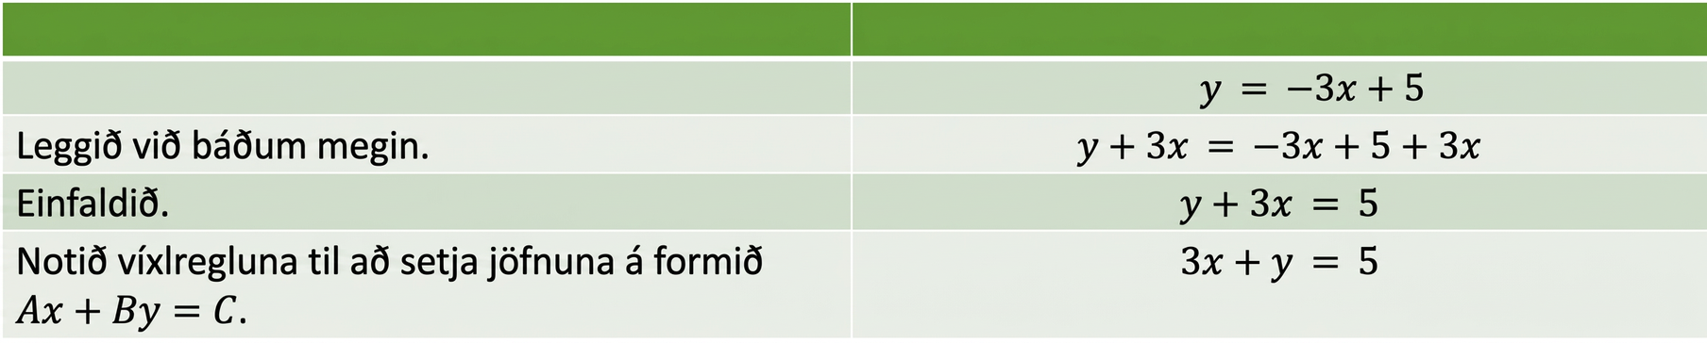
Tafla 4.1
 | $$y = −3x+5$$
Leggið við báðar hliðar. | $$y+3x = −3x+5+3x$$
Einfaldið. | $$y+3x = 5$$
Notið víxlregluna til að færa jöfnuna á formið $Ax+By=C$. | $$3x+y = 5$$
Sýnir skref fyrir skref hvernig línuleg jafna er færð úr hallatöluformi yfir á staðalform.

Slide 9
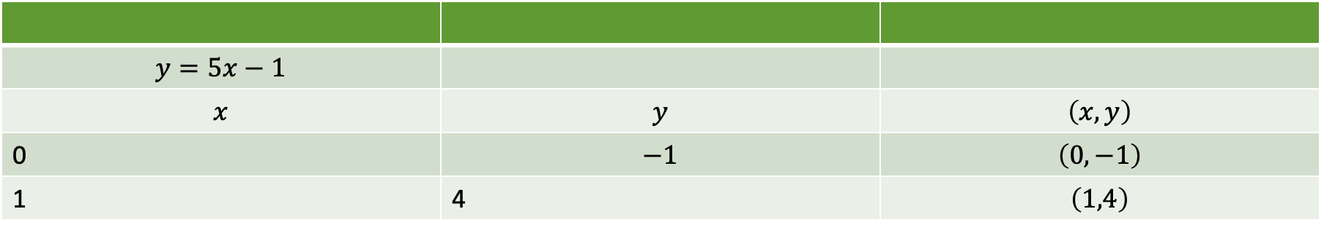
Tafla 4.2
$$y=5x−1$$
$$x$$ | $$y$$ | $$\left(x,y\right)$$
0 | $$−1$$ | $$\left(0,−1\right)$$
1 | 4 | $$\left(1,4\right)$$

Slide 10
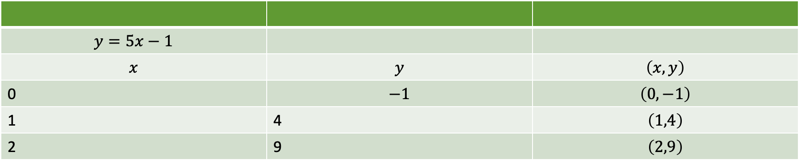
Tafla 4.3
$$y=5x−1$$
$$x$$ | $$y$$ | $$\left(x,y\right)$$
0 | $$−1$$ | $$\left(0,−1\right)$$
1 | 4 | $$\left(1,4\right)$$
2 | 9 | $$\left(2,9\right)$$

Slide 11
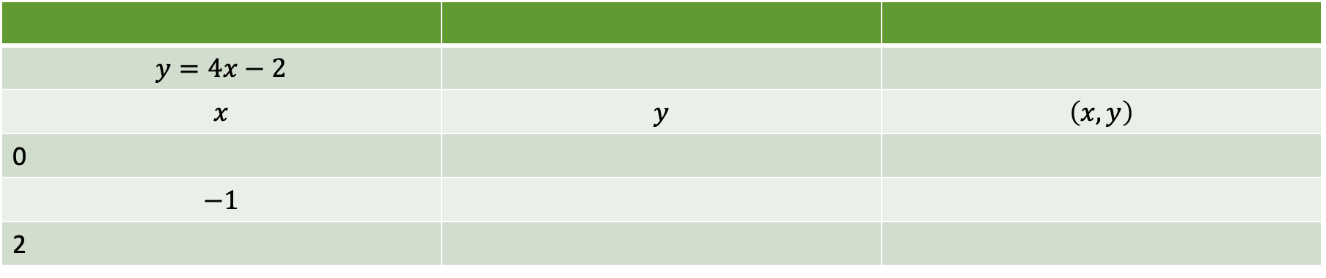
Tafla 4.4
$$y=4x−2$$
$$x$$ | $$y$$ | $$\left(x,y\right)$$
0
$$−1$$
2

Slide 12
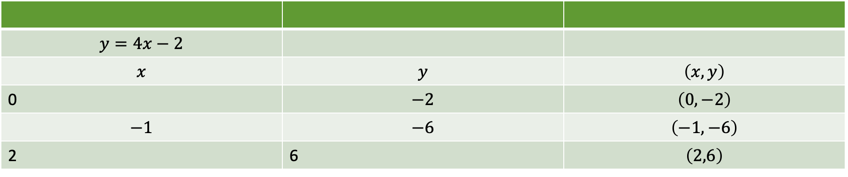
Tafla 4.5
$$y=4x−2$$
$$x$$ | $$y$$ | $$\left(x,y\right)$$
0 | $$−2$$ | $$\left(0,−2\right)$$
$$−1$$ | $$−6$$ | $$\left(−1,−6\right)$$
2 | 6 | $$\left(2,6\right)$$

Slide 13
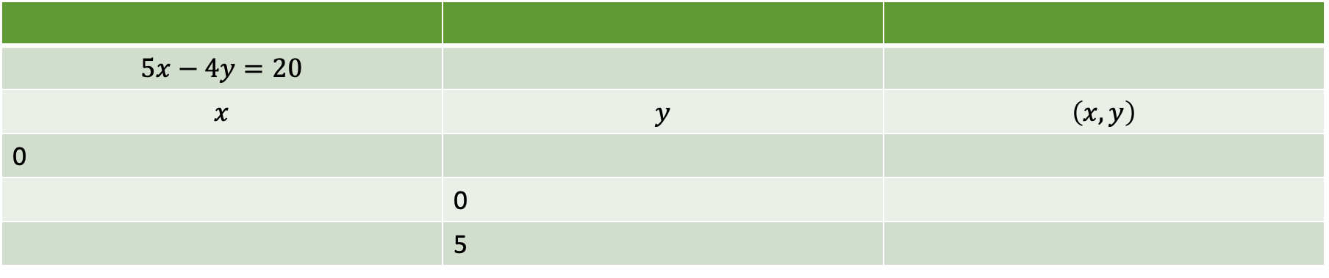
Tafla 4.6
$$5x−4y=20$$
$$x$$ | $$y$$ | $$\left(x,y\right)$$
0
 | 0
 | 5

Slide 14
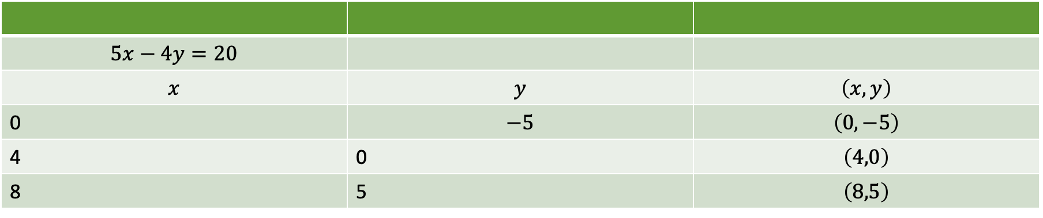
Tafla 4.7
$$5x−4y=20$$
$$x$$ | $$y$$ | $$\left(x,y\right)$$
0 | $$−5$$ | $$\left(0,−5\right)$$
4 | 0 | $$\left(4,0\right)$$
8 | 5 | $$\left(8,5\right)$$

Slide 15
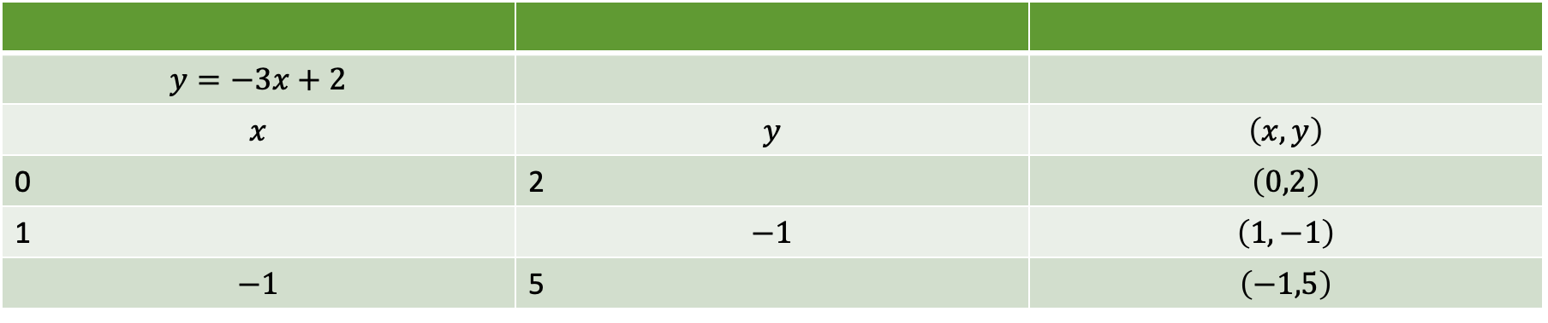
Tafla 4.8
$$y=−3x+2$$
$$x$$ | $$y$$ | $$\left(x,y\right)$$
0 | 2 | $$\left(0,2\right)$$
1 | $$−1$$ | $$\left(1,−1\right)$$
$$−1$$ | 5 | $$\left(−1,5\right)$$

Slide 16
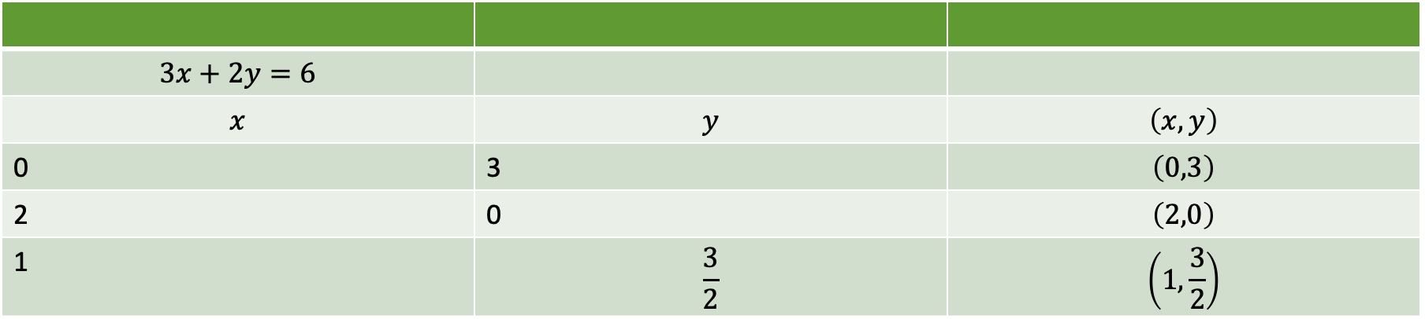
Tafla 4.9
$$3x+2y=6$$
$$x$$ | $$y$$ | $$\left(x,y\right)$$
0 | 3 | $$\left(0,3\right)$$
2 | 0 | $$\left(2,0\right)$$
1 | $$\frac{3}{2}$$ | $$\left(1,\frac{3}{2}\right)$$

Slide 17
4.2 Teikna gröf línulegra jafna með tveimur breytum
Námsmarkmið
Greina sambandið milli lausna jöfnu og grafs hennar
Teikna graf línulegrar jöfnu með því að merkja inn punkta
Teikna lóðréttar og láréttar línur

Slide 18
Tafla 4.10
$$3x+2y=6$$
$$x$$ | $$y$$ | $$\left(x,y\right)$$
0 | 3 | $$\left(0,3\right)$$
2 | 0 | $$\left(2,0\right)$$
1 | $$\frac{3}{2}$$ | $$\left(1,\frac{3}{2}\right)$$

Slide 19
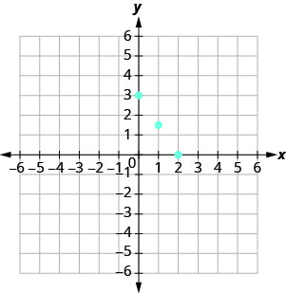
Mynd 4.5
Myndin sýnir fjóra punkta á xy-hnitafleti. x-ásinn nær frá −7 til 7 og y-ásinn frá −7 til 7. Punktarnir eru við (0, 3), (1, þrjá helminga), (2, 0) og (4, −3). Punktarnir fjórir virðast liggja á sömu beinu línunni.
Notes:
The figure shows four points on the x y-coordinate plane. The x-axis of the plane runs from negative 7 to 7. The y-axis of the plane runs from negative 7 to 7. Dots mark off the four points at (0, 3), (1, three halves), (2, 0), and (4, negative 3). The four points appear to line up along a straight line.

Slide 20
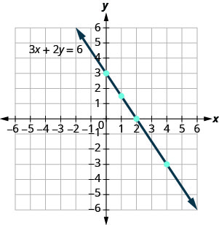
Mynd 4.6
Myndin sýnir beina línu gegnum fjóra punkta á xy-hnitafleti. x-ásinn nær frá −7 til 7 og y-ásinn frá −7 til 7. Punktarnir eru við (0, 3), (1, þrjá helminga), (2, 0) og (4, −3). Bein lína með neikvæða hallatölu liggur gegnum alla punktana fjóra. Örvar á báðum endum línunnar vísa að jaðri myndarinnar. Línan er merkt með jöfnunni 3x + 2y = 6.
Notes:
The figure shows a straight line drawn through four points on the x y-coordinate plane. The x-axis of the plane runs from negative 7 to 7. The y-axis of the plane runs from negative 7 to 7. Dots mark off the four points at (0, 3), (1, three halves), (2, 0), and (4, negative 3). A straight line with a negative slope goes through all four points. The line has arrows on both ends pointing to the edge of the figure. The line is labeled with the equation 3x plus 2y equals 6.

Slide 21
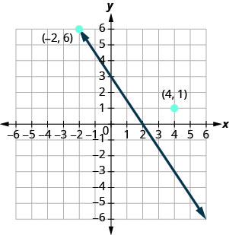
Mynd 4.7
Myndin sýnir beina línu og tvo punkta á xy-hnitafleti. x-ásinn nær frá −7 til 7 og y-ásinn frá −7 til 7. Punktarnir tveir eru merktir með hnitunum „(−2, 6)“ og „(4, 1)“. Beina línan liggur gegnum punktinn (−2, 6) en ekki punktinn (4, 1).
Notes:
The figure shows a straight line and two points and on the x y-coordinate plane. The x-axis of the plane runs from negative 7 to 7. The y-axis of the plane runs from negative 7 to 7. Dots mark off the two points and are labeled by the coordinates “(negative 2, 6)” and “(4, 1)”. The straight line goes through the point (negative 2, 6) but does not go through the point (4, 1).

Slide 22
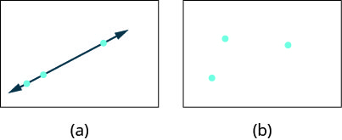
Mynd 4.8
Mynd a sýnir þrjá punkta sem bein lína liggur gegnum. Mynd b sýnir þrjá punkta sem liggja ekki á sömu línu.
Notes:
Figure a shows three points with a straight line going through them. Figure b shows three points that do not lie on the same line.

Slide 23
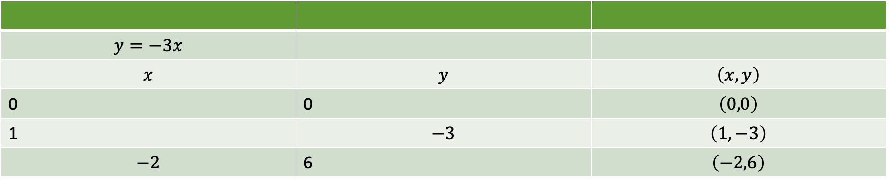
Tafla 4.11
$$y=−3x$$
$$x$$ | $$y$$ | $$\left(x,y\right)$$
0 | 0 | $$\left(0,0\right)$$
1 | $$−3$$ | $$\left(1,−3\right)$$
$$−2$$ | 6 | $$\left(−2,6\right)$$

Slide 24
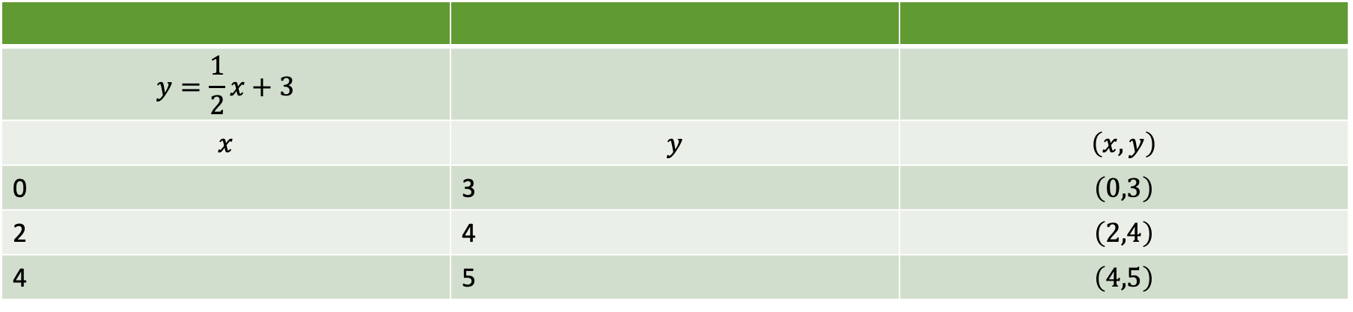
Tafla 4.12
$$y=\frac{1}{2}x+3$$
$$x$$ | $$y$$ | $$\left(x,y\right)$$
0 | 3 | $$\left(0,3\right)$$
2 | 4 | $$\left(2,4\right)$$
4 | 5 | $$\left(4,5\right)$$

Slide 25
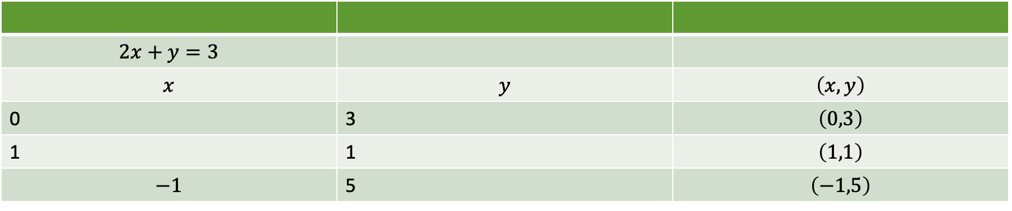
Tafla 4.13
$$2x+y=3$$
$$x$$ | $$y$$ | $$\left(x,y\right)$$
0 | 3 | $$\left(0,3\right)$$
1 | 1 | $$\left(1,1\right)$$
$$−1$$ | 5 | $$\left(−1,5\right)$$

Slide 26
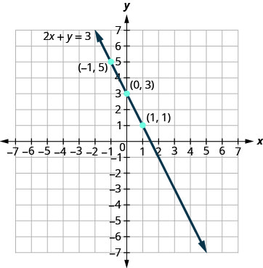
Mynd 4.9
Myndin sýnir beina línu gegnum þrjá punkta á xy-hnitafleti. x-ásinn nær frá −7 til 7 og y-ásinn frá −7 til 7. Punktarnir þrír eru merktir með röðuðu tvenndunum (−1, 5), (0, 3) og (1, 1). Bein lína liggur gegnum alla punktana þrjá. Örvar á báðum endum línunnar vísa út fyrir myndina. Línan er merkt með jöfnunni 2x + y = 3.
Notes:
The figure shows a straight line drawn through three points on the x y-coordinate plane. The x-axis of the plane runs from negative 7 to 7. The y-axis of the plane runs from negative 7 to 7. Dots mark off the three points which are labeled by their ordered pairs (negative 1, 5), (0, 3), and (1, 1). A straight line goes through all three points. The line has arrows on both ends pointing to the outside of the figure. The line is labeled with the equation 2x plus y equals 3.

Slide 27
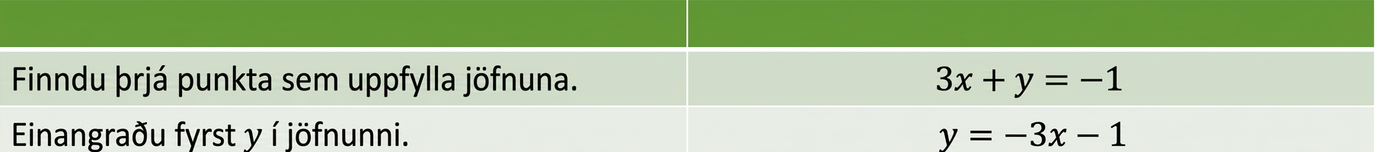
Tafla 4.14
Finnið þrjá punkta sem eru lausnir jöfnunnar. | $$3x+y = −1$$
Einangrið fyrst $y$. | $$y = −3x−1$$
Taflan sýnir skrefin við að einangra y í línulegu jöfnunni 3x + y = −1.

Slide 28
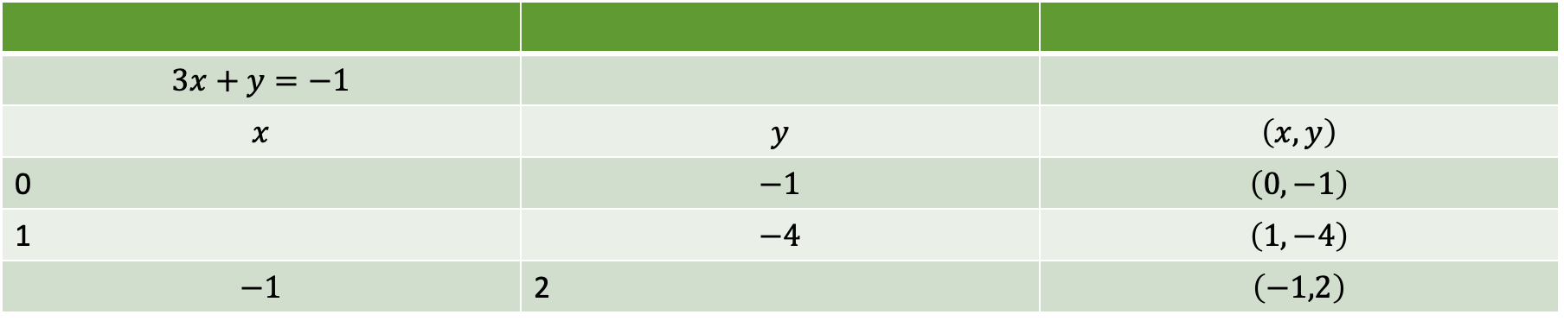
Tafla 4.15
$$3x+y=−1$$
$$x$$ | $$y$$ | $$\left(x,y\right)$$
0 | $$−1$$ | $$\left(0,−1\right)$$
1 | $$−4$$ | $$\left(1,−4\right)$$
$$−1$$ | 2 | $$\left(−1,2\right)$$

Slide 29
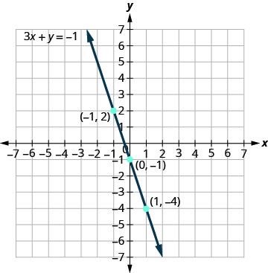
Mynd 4.10
Myndin sýnir beina línu gegnum þrjá punkta á xy-hnitafleti. x-ásinn nær frá −7 til 7 og y-ásinn frá −7 til 7. Punktarnir þrír eru merktir með röðuðu tvenndunum (−1, 2), (0, −1) og (1, −4). Bein lína liggur gegnum alla punktana þrjá. Örvar á báðum endum línunnar vísa út fyrir myndina. Línan er merkt með jöfnunni 3x + y = −1.
Notes:
The figure shows a straight line drawn through three points on the x y-coordinate plane. The x-axis of the plane runs from negative 7 to 7. The y-axis of the plane runs from negative 7 to 7. Dots mark off the three points which are labeled by their ordered pairs (negative 1, 2), (0, negative 1), and (1, negative 4). A straight line goes through all three points. The line has arrows on both ends pointing to the outside of the figure. The line is labeled with the equation 3x plus y equals negative 1.

Slide 30
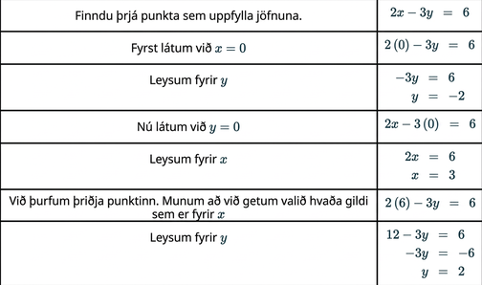
Tafla 4.16
Lausn skref fyrir skref sem sýnir hvernig finna má þrjá punkta sem uppfylla línulegu jöfnuna 2x − 3y = 6 með því að setja inn gildi fyrir x og y.

Slide 31
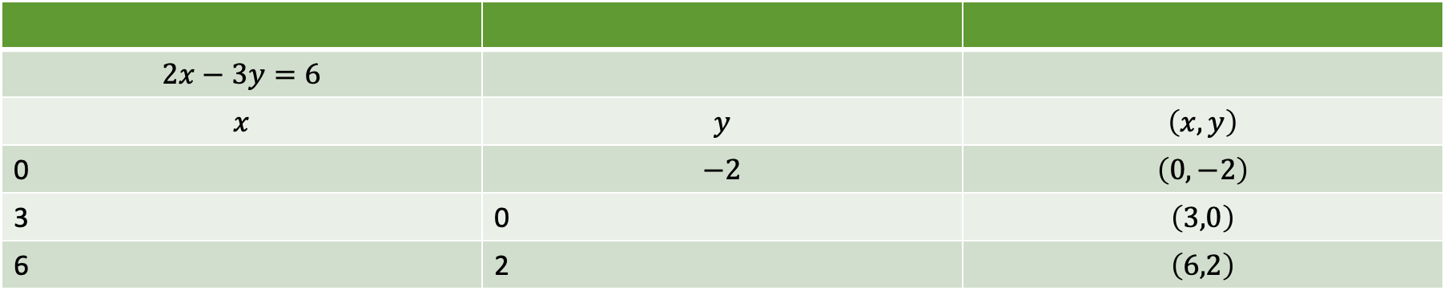
Tafla 4.17
$$2x−3y=6$$
$$x$$ | $$y$$ | $$\left(x,y\right)$$
0 | $$−2$$ | $$\left(0,−2\right)$$
3 | 0 | $$\left(3,0\right)$$
6 | 2 | $$\left(6,2\right)$$

Slide 32
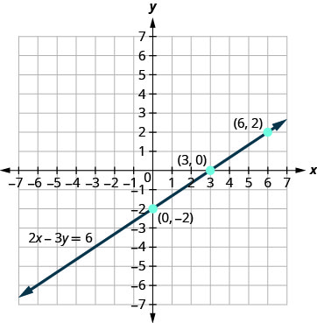
Mynd 4.11
Myndin sýnir beina línu sem liggur í gegnum þrjá punkta í xy-hnitakerfi. Bæði x-ásinn og y-ásinn ná frá −7 til 7. Punktarnir þrír eru merktir með tvenndunum (0, −2), (3, 0) og (6, 2). Bein lína liggur í gegnum alla punktana og örvar á báðum endum hennar vísa út úr myndinni. Línan er merkt með jöfnunni 2x − 3y = 6.
Notes:
The figure shows a straight line drawn through three points on the x y-coordinate plane. The x-axis of the plane runs from negative 7 to 7. The y-axis of the plane runs from negative 7 to 7. Dots mark off the three points which are labeled by their ordered pairs (0, negative 2), (3, 0), and (6, 2). A straight line goes through all three points. The line has arrows on both ends pointing to the outside of the figure. The line is labeled with the equation 2x minus 3y equals 6.

Slide 33
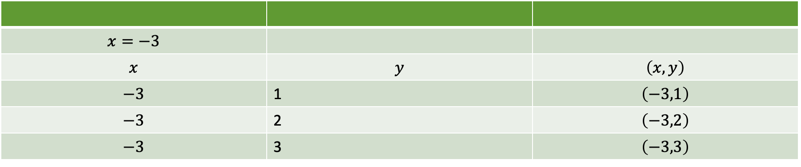
Tafla 4.18
$$x=−3$$
$$x$$ | $$y$$ | $$\left(x,y\right)$$
$$−3$$ | 1 | $$\left(−3,1\right)$$
$$−3$$ | 2 | $$\left(−3,2\right)$$
$$−3$$ | 3 | $$\left(−3,3\right)$$

Slide 34
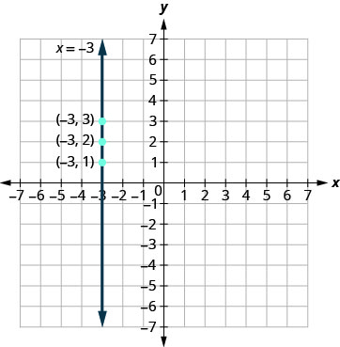
Mynd 4.12
Myndin sýnir lóðrétta beina línu sem liggur í gegnum þrjá punkta í xy-hnitakerfi. Bæði x-ásinn og y-ásinn ná frá −7 til 7. Punktarnir þrír eru merktir með tvenndunum (−3, 1), (−3, 2) og (−3, 3). Lóðrétt bein lína liggur í gegnum alla punktana og örvar á báðum endum hennar vísa út úr myndinni. Línan er merkt með jöfnunni x = −3.
Notes:
The figure shows a vertical straight line drawn through three points on the x y-coordinate plane. The x-axis of the plane runs from negative 7 to 7. The y-axis of the plane runs from negative 7 to 7. Dots mark off the three points which are labeled by their ordered pairs (negative 3, 1), (negative 3, 2), and (negative 3, 3). A vertical straight line goes through all three points. The line has arrows on both ends pointing to the outside of the figure. The line is labeled with the equation x equals negative 3.

Slide 35
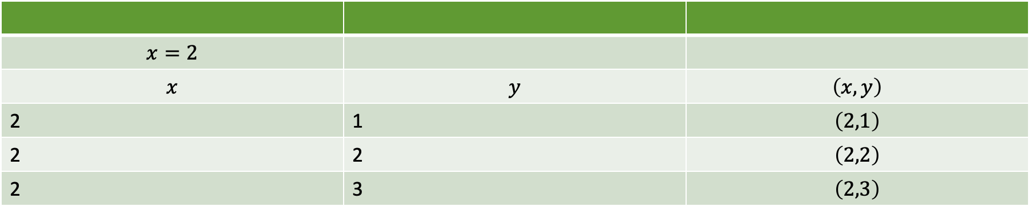
Tafla 4.19
$$x=2$$
$$x$$ | $$y$$ | $$\left(x,y\right)$$
2 | 1 | $$\left(2,1\right)$$
2 | 2 | $$\left(2,2\right)$$
2 | 3 | $$\left(2,3\right)$$

Slide 36
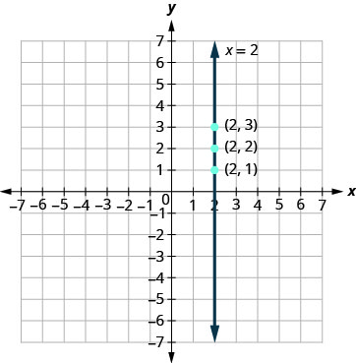
Mynd 4.13
Myndin sýnir lóðrétta beina línu sem liggur í gegnum þrjá punkta í xy-hnitakerfi. Bæði x-ásinn og y-ásinn ná frá −7 til 7. Punktarnir þrír eru merktir með tvenndunum (2, 1), (2, 2) og (2, 3). Lóðrétt bein lína liggur í gegnum alla punktana og örvar á báðum endum hennar vísa út úr myndinni. Línan er merkt með jöfnunni x = 2.
Notes:
The figure shows a straight vertical line drawn through three points on the x y-coordinate plane. The x-axis of the plane runs from negative 7 to 7. The y-axis of the plane runs from negative 7 to 7. Dots mark off the three points which are labeled by their ordered pairs (2, 1), (2, 2), and (2, 3). A vertical straight line goes through all three points. The line has arrows on both ends pointing to the outside of the figure. The line is labeled with the equation x equals 2.

Slide 37
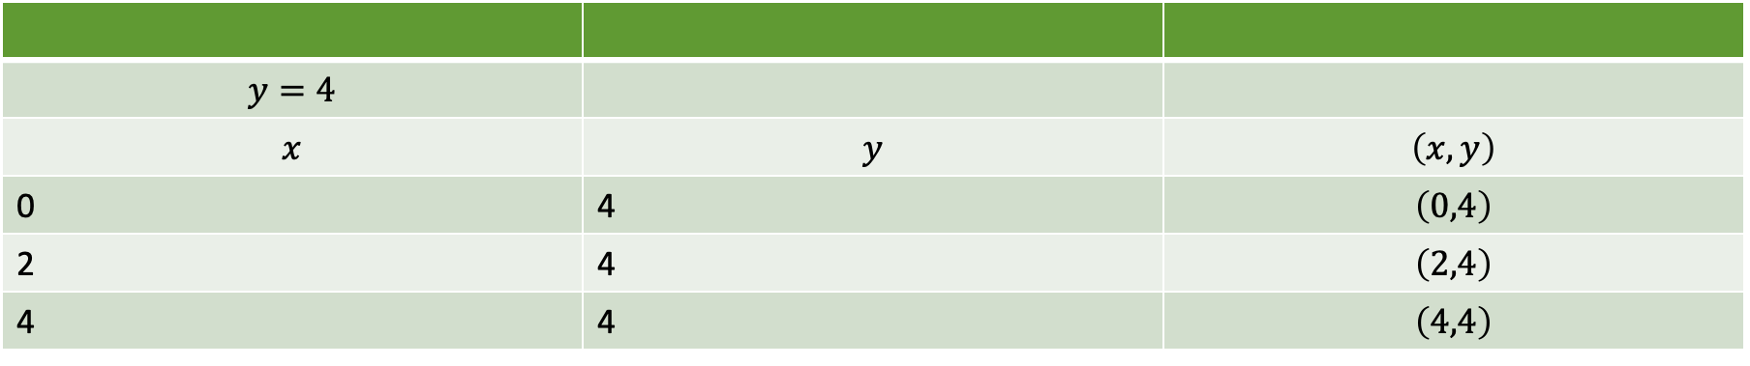
Tafla 4.20
$$y=4$$
$$x$$ | $$y$$ | $$\left(x,y\right)$$
0 | 4 | $$\left(0,4\right)$$
2 | 4 | $$\left(2,4\right)$$
4 | 4 | $$\left(4,4\right)$$

Slide 38
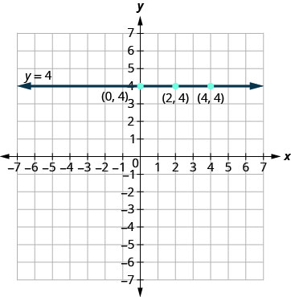
Mynd 4.14
Myndin sýnir lárétta beina línu sem liggur í gegnum þrjá punkta í xy-hnitakerfi. Bæði x-ásinn og y-ásinn ná frá −7 til 7. Punktarnir þrír eru merktir með tvenndunum (0, 4), (2, 4) og (4, 4). Lárétt bein lína liggur í gegnum alla punktana og örvar á báðum endum hennar vísa út úr myndinni. Línan er merkt með jöfnunni y = 4.
Notes:
The figure shows a straight horizontal line drawn through three points on the x y-coordinate plane. The x-axis of the plane runs from negative 7 to 7. The y-axis of the plane runs from negative 7 to 7. Dots mark off the three points which are labeled by their ordered pairs (0, 4), (2, 4), and (4, 4). A straight horizontal line goes through all three points. The line has arrows on both ends pointing to the outside of the figure. The line is labeled with the equation y equals 4.

Slide 39
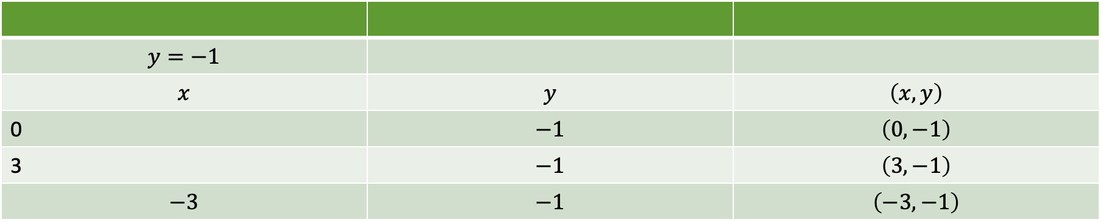
Tafla 4.21
$$y=−1$$
$$x$$ | $$y$$ | $$\left(x,y\right)$$
0 | $$−1$$ | $$\left(0,−1\right)$$
3 | $$−1$$ | $$\left(3,−1\right)$$
$$−3$$ | $$−1$$ | $$\left(−3,−1\right)$$

Slide 40
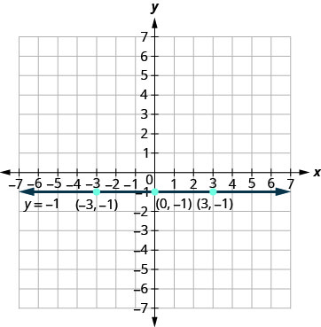
Mynd 4.15
Myndin sýnir lárétta beina línu sem liggur í gegnum þrjá punkta í xy-hnitakerfi. Bæði x-ásinn og y-ásinn ná frá −7 til 7. Punktarnir þrír eru merktir með tvenndunum (−3, −1), (0, −1) og (3, −1). Lárétt bein lína liggur í gegnum alla punktana og örvar á báðum endum hennar vísa út úr myndinni. Línan er merkt með jöfnunni y = −1.
Notes:
The figure shows a straight horizontal line drawn through three points on the x y-coordinate plane. The x-axis of the plane runs from negative 7 to 7. The y-axis of the plane runs from negative 7 to 7. Dots mark off the three points which are labeled by their ordered pairs (negative 3, negative 1), (0, negative 1), and (3, negative 1). A straight horizontal line goes through all three points. The line has arrows on both ends pointing to the outside of the figure. The line is labeled with the equation y equals negative 1.

Slide 41
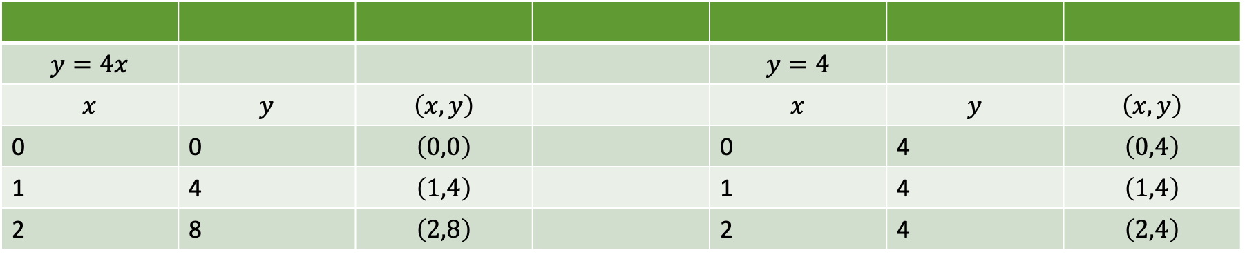
Tafla 4.22
$$y=4x$$ |  |  |  | $$y=4$$
$$x$$ | $$y$$ | $$\left(x,y\right)$$ |  | $$x$$ | $$y$$ | $$\left(x,y\right)$$
0 | 0 | $$\left(0,0\right)$$ |  | 0 | 4 | $$\left(0,4\right)$$
1 | 4 | $$\left(1,4\right)$$ |  | 1 | 4 | $$\left(1,4\right)$$
2 | 8 | $$\left(2,8\right)$$ |  | 2 | 4 | $$\left(2,4\right)$$

Slide 42
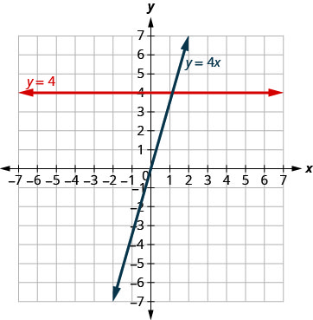
Mynd 4.16
Myndin sýnir tvær beinar línur í sama xy-hnitakerfi. Bæði x-ásinn og y-ásinn ná frá −7 til 7. Önnur línan er lárétt og merkt með jöfnunni y = 4. Hin línan er hallandi og merkt með jöfnunni y = 4x.
Notes:
The figure shows a two straight lines drawn on the same x y-coordinate plane. The x-axis of the plane runs from negative 7 to 7. The y-axis of the plane runs from negative 7 to 7. One line is a straight horizontal line labeled with the equation y equals 4. The other line is a slanted line labeled with the equation y equals 4x.

Slide 43
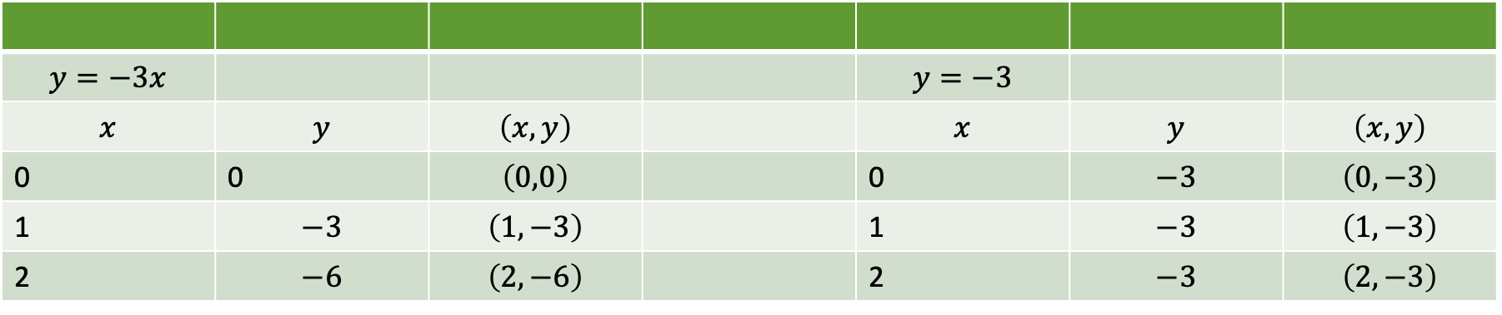
Tafla 4.23
$$y=−3x$$ |  |  |  | $$y=−3$$
$$x$$ | $$y$$ | $$\left(x,y\right)$$ |  | $$x$$ | $$y$$ | $$\left(x,y\right)$$
0 | 0 | $$\left(0,0\right)$$ |  | 0 | $$−3$$ | $$\left(0,−3\right)$$
1 | $$−3$$ | $$\left(1,−3\right)$$ |  | 1 | $$−3$$ | $$\left(1,−3\right)$$
2 | $$−6$$ | $$\left(2,−6\right)$$ |  | 2 | $$−3$$ | $$\left(2,−3\right)$$

Slide 44
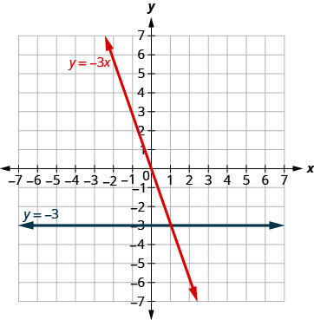
Mynd 4.17
Myndin sýnir tvær beinar línur í sama xy-hnitakerfi. Bæði x-ásinn og y-ásinn ná frá −7 til 7. Önnur línan er lárétt og merkt með jöfnunni y = −3. Hin línan er hallandi og merkt með jöfnunni y = −3x.
Notes:
The figure shows a two straight lines drawn on the same x y-coordinate plane. The x-axis of the plane runs from negative 7 to 7. The y-axis of the plane runs from negative 7 to 7. One line is a straight horizontal line labeled with the equation y equals negative 3. The other line is a slanted line labeled with the equation y equals negative 3x.

Slide 45
4.3 Teikna línu út frá skurðpunktum við ása
Námsmarkmið
Þekkja skurðpunkta grafs við x- og y-ás
Finna skurðpunkta línu við x- og y-ás út frá jöfnu hennar
Teikna línu út frá skurðpunktum hennar við ásana

Slide 46
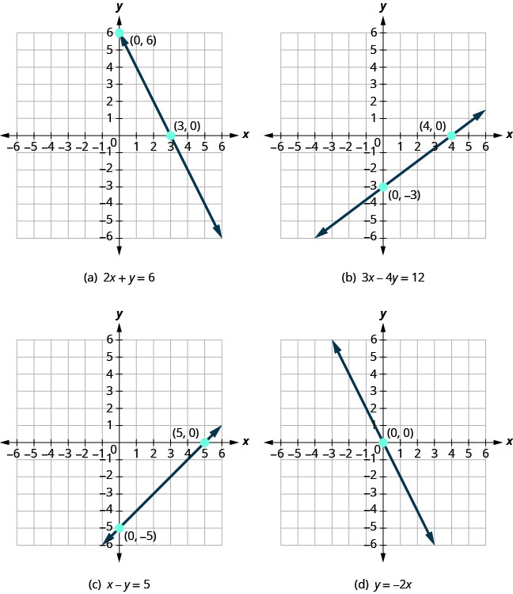
Mynd 4.18
Dæmi um gröf sem skera x-ásinn.
Notes:
Four figures, each showing a different straight line on the x y- coordinate plane. The x- axis of the planes runs from negative 7 to 7. The y- axis of the planes runs from negative 7 to 7. Figure a shows a straight line crossing the x- axis at the point (3, 0) and crossing the y- axis at the point (0, 6). The graph is labeled with the equation 2x plus y equals 6. Figure b shows a straight line crossing the x- axis at the point (4, 0) and crossing the y- axis at the point (0, negative 3). The graph is labeled with the equation 3x minus 4y equals 12. Figure c shows a straight line crossing the x- axis at the point (5, 0) and crossing the y- axis at the point (0, negative 5). The graph is labeled with the equation x minus y equals 5. Figure d shows a straight line crossing the x- axis and y- axis at the point (0, 0). The graph is labeled with the equation y equals negative 2x.

Slide 47
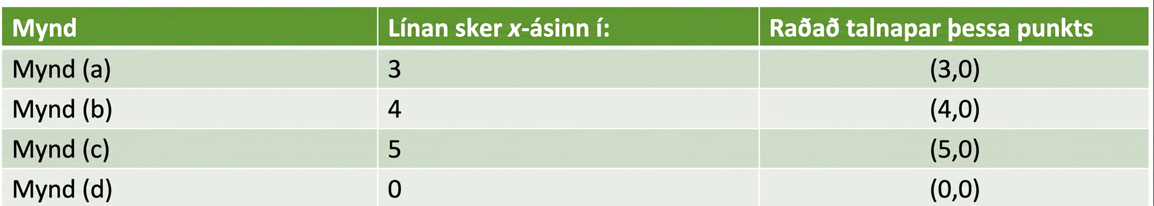
Tafla 4.24
Mynd | Línan sker x-ásinn í: | Raðtvennd punktsins
Mynd (a) | 3 | $$\left(3,0\right)$$
Mynd (b) | 4 | $$\left(4,0\right)$$
Mynd (c) | 5 | $$\left(5,0\right)$$
Mynd (d) | 0 | $$\left(0,0\right)$$

Slide 48
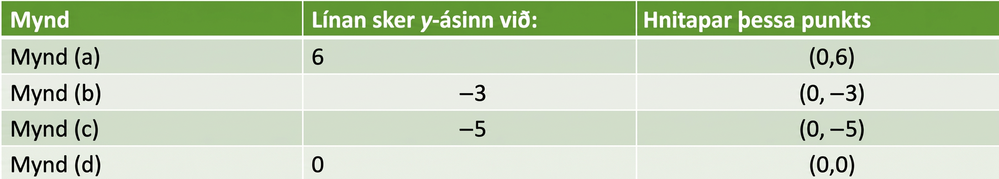
Tafla 4.25
Mynd | Línan sker y-ásinn í: | Raðtvennd punktsins
Mynd (a) | 6 | $$\left(0,6\right)$$
Mynd (b) | $$−3$$ | $$\left(0,−3\right)$$
Mynd (c) | $$−5$$ | $$\left(0,−5\right)$$
Mynd (d) | 0 | $$\left(0,0\right)$$

Slide 49
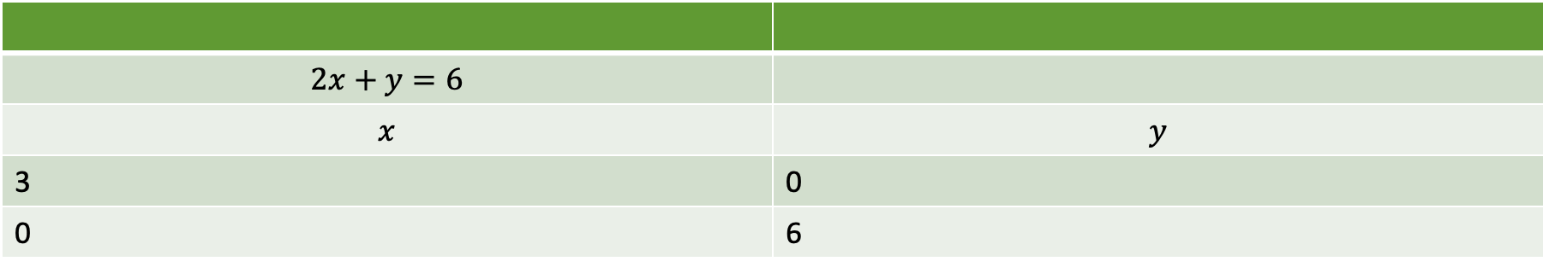
Tafla 4.26
$$2x+y=6$$
$$x$$ | $$y$$
3 | 0
0 | 6

Slide 50
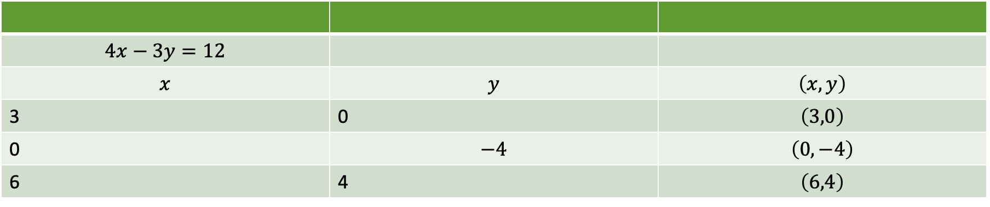
Tafla 4.27
$$4x−3y=12$$
$$x$$ | $$y$$ | $$\left(x,y\right)$$
3 | 0 | $$\left(3,0\right)$$
0 | $$−4$$ | $$\left(0,−4\right)$$
6 | 4 | $$\left(6,4\right)$$

Slide 51
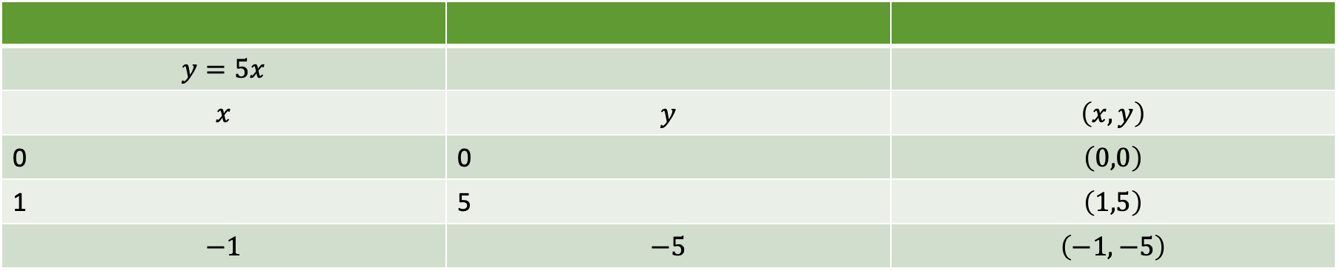
Tafla 4.28
$$y=5x$$
$$x$$ | $$y$$ | $$\left(x,y\right)$$
0 | 0 | $$\left(0,0\right)$$
1 | 5 | $$\left(1,5\right)$$
$$−1$$ | $$−5$$ | $$\left(−1,−5\right)$$

Slide 52
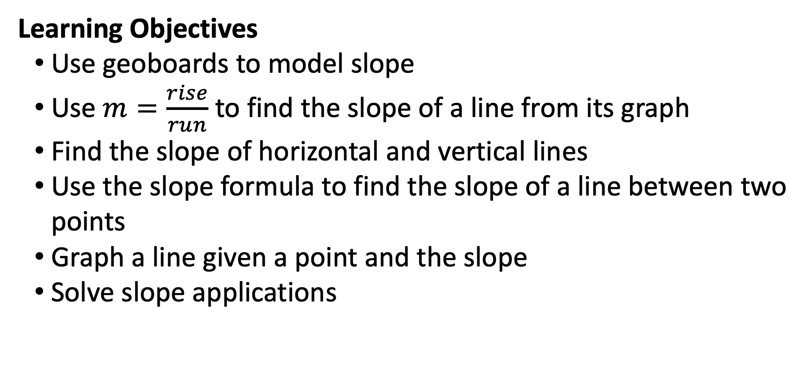
4.4 Skilningur á hallatölu línu
Námsmarkmið
Nota pinnabretti til að sýna hallatölu
Nota $m=\frac{rise}{run}$ til að finna hallatölu línu út frá grafi hennar
Finna hallatölu láréttra og lóðréttra lína
Nota hallatöluformúluna til að finna hallatölu línu milli tveggja punkta
Teikna graf línu út frá punkti og hallatölu
Leysa hagnýt verkefni um hallatölu

Slide 53
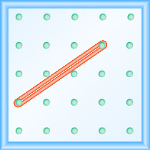
Mynd 4.19
Myndin sýnir jafnt dreift pinnanet með 5 dálkum og 5 röðum. Teygja liggur milli pinnans í dálki 1, röð 4 og pinnans í dálki 4, röð 2 og myndar línu.
Notes:
The figure shows a grid of evenly spaced pegs. There are 5 columns and 5 rows of pegs. A rubber band is stretched between the peg in column 1, row 4 and the peg in column 4, row 2, forming a line.

Slide 54
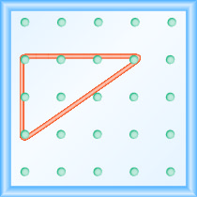
Mynd 4.20
Myndin sýnir jafnt dreift pinnanet með 5 dálkum og 5 röðum. Teygja liggur milli pinnanna í dálki 1, röð 2, dálki 1, röð 4 og dálki 4, röð 2 og myndar rétthyrndan þríhyrning. Pinninn í dálki 1, röð 2 er hornpunktur 90 gráðu hornsins en línan milli pinnanna í dálki 1, röð 4 og dálki 4, röð 2 myndar langhlið þríhyrningsins.
Notes:
The figure shows a grid of evenly spaced pegs. There are 5 columns and 5 rows of pegs. A rubber band is stretched between the peg in column 1, row 2, the peg in column 1, row 4, and the peg in column 4, row 2, forming a right triangle. The 1, 2 peg is the vertex of the 90 degree angle, while the line between the 1, 4 and 4, 2 pegs forms the hypotenuse of the triangle.

Slide 55
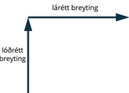
Mynd 4.21
Myndin sýnir tvær hornréttar línur með örvum. Fyrri línan vísar beint upp og er merkt „lóðrétt breyting“. Seinni örin vísar beint til hægri og er merkt „lárétt breyting“.
Notes:
In this illustration, there are two perpendicular lines with arrows. The first line extends straight upward and is labeled “rise”. The second arrow extends straight rightward and is labeled “run”.

Slide 56
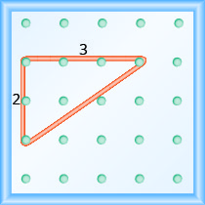
Mynd 4.22
Lóðrétta breytingin á pinnabrettinu er 2 þar sem teygjan hækkar um tvær einingar.
Notes:
The figure shows a grid of evenly spaced pegs. There are 5 columns and 5 rows of pegs. A rubber band is stretched between the peg in column 1, row 2, the peg in column 1, row 4, and the peg in column 4, row 2, forming a right triangle where the 1, 2 peg is the vertex of the 90 degree angle and the line between the 1, 4 peg and the 4, 2 peg forms the hypotenuse. The line between the 1, 2 peg and the 1, 4 peg is labeled “2”. The line between the 1, 2 peg and the 4, 2 peg is labeled “3”.

Slide 57

Tafla 4.29
Lóðrétta breytingin er 3. | $$m=\frac{3}{\text{run}}$$
Lárétta breytingin er 4. | $$m=\frac{3}{4}$$
 | Hallatalan er $\frac{3}{4}$.
Taflan sýnir hvernig hallatala línu (m) er reiknuð út frá lóðréttri og láréttri breytingu.

Slide 58

Tafla 4.30
Lóðrétta breytingin er −1. | $$=\frac{−1}{\text{run}}$$
Lárétta breytingin er 3. | $$\begin{matrix}m=\frac{−1}{3} \\ m=−\frac{1}{3}\end{matrix}$$
 | Hallatalan er $−\frac{1}{3}$.
Taflan sýnir skref fyrir skref hvernig hallatalan (m) er reiknuð út frá gefinni lóðréttri og láréttri breytingu. Niðurstaðan er m = -1/3.

Slide 59

Mynd 4.23
Myndin sýnir tvö pinnabretti með jöfnu bili milli pinna, merkt (a) og (b). Á hvoru bretti eru 5 dálkar og 5 raðir af pinnum. Á bretti (a) er teygja strengd milli pinnans í 1. dálki og 5. röð og pinnans í 5. dálki og 2. röð þannig að hún myndar línu. Undir brettinu er hallatala línunnar gefin sem m = 3/4. Á bretti (b) er teygja strengd milli pinnans í 1. dálki og 3. röð og pinnans í 4. dálki og 4. röð þannig að hún myndar línu. Undir brettinu er hallatala línunnar gefin sem m = −1/3.
Notes:
The figure shows two grids of evenly spaced pegs, one labeled (a) and one labeled (b). There are 5 columns and 5 rows of pegs in each grid. In the (a) grid, a rubber band is stretched between the peg in column 1, row 5 and the peg in column 5, row 2, forming a line. Below this grid is the slope of a line defined as m equals 3 fourths. In the (b) grid, a rubber band is stretched between the peg in column 1, row 3 and the peg in column 4, row 4, forming a line. Below this grid is the slope of a line defined as m equals negative 1 third.

Slide 60

Tafla 4.31
Notið hallatöluformúluna. | $$m=\frac{\text{rise}}{\text{run}}$$
Skiptið $m$ út fyrir $\frac{1}{2}$. | $$\frac{1}{2}=\frac{\text{rise}}{\text{run}}$$
Sýnir skrefin við notkun hallatöluformúlunnar ásamt aðgerðinni og stærðfræðilegri niðurstöðu hvers skrefs.

Slide 61

Tafla 4.32
Notið hallatöluformúluna. | $$m=\frac{\text{rise}}{\text{run}}$$
Skiptið $m$ út fyrir $\frac{−1}{4}$. | $$\frac{−1}{4}=\frac{\text{rise}}{\text{run}}$$
Skrefin við notkun hallatöluformúlunnar og samsvarandi stærðfræðilegar segðir.

Slide 62

Tafla 4.33
Teljið lóðréttu breytinguna. | Lóðrétta breytingin er $−3$.
Teljið láréttu breytinguna. Hún liggur frá hægri til vinstri og er því neikvæð. | Lárétta breytingin er $−5$.
Notið hallatöluformúluna. | $$m=\frac{\text{rise}}{\text{run}}$$
Setjið gildi lóðréttu og láréttu breytingarinnar inn í formúluna. | $$m=\frac{−3}{−5}$$
 | Hallatala línunnar er $\frac{−3}{−5}$.
Ítarleg skref til að reikna hallatölu línu (m) sem hlutfall lóðréttrar og láréttrar breytingar, ásamt aðgerðum og tölulegum niðurstöðum þeirra.

Slide 63

Tafla 4.34
Hver er lóðrétta breytingin? | Lóðrétta breytingin er $0$.
Teljið láréttu breytinguna. | Lárétta breytingin er $3$.
Hver er hallatalan? | $$\begin{matrix}m=\frac{\text{rise}}{\text{run}} \\ m=\frac{0}{3} \\ m=0\end{matrix}$$
 | Hallatala láréttu línunnar $y=4$ er $0$.
Hallatala láréttu línunnar (y=4) er reiknuð með því að ákvarða lóðréttu breytinguna (0) og láréttu breytinguna (3). Niðurstaðan sýnir að hallatalan er 0.

Slide 64

Tafla 4.35
Hver er lóðrétta breytingin? | Lóðrétta breytingin er $2$.
Teljið láréttu breytinguna. | Lárétta breytingin er $0$.
Hver er hallatalan? | $$\begin{matrix}m=\frac{\text{rise}}{\text{run}} \\ m=\frac{2}{0}\end{matrix}$$
Sýnir útreikning hallatölu þegar lárétta breytingin er núll og niðurstaðan því óskilgreind.

Slide 65

Tafla 4.36
Við táknum $\left(1,2\right)$ punkt nr. 1 og $\left(4,5\right)$ punkt nr. 2. | $$\left(\overset{x_{1},y_{1}}{1,2}\right) {\left(\overset{x_{2},y_{2}}{4,5}\right)}_{​}$$
Notið hallatöluformúluna. | $m=\frac{y_{2}−y_{1}}{x_{2}−x_{1}}$.
Setjið gildin inn.
$y$ seinni punkts að frádregnu $y$ fyrri punkts | $m=\frac{5−2}{x_{2}−x_{1}}$.
$x$ seinni punkts að frádregnu $x$ fyrri punkts | $m=\frac{5−2}{4−1}$.
Einfaldið teljarann og nefnarann. | $m=\frac{3}{3}$.
Einfaldið. | $m=1$.
Hallatala línunnar milli punktanna (1,2) og (4,5) reiknuð skref fyrir skref með hallatöluformúlunni.

Slide 66

Tafla 4.37
Við köllum $\left(−2,−3\right)$ punkt nr. 1 og $\left(−7,4\right)$ punkt nr. 2. | $$\left(\overset{x_{1},y_{1}}{−2,−3}\right) {\left(\overset{x_{2},y_{2}}{−7,4}\right)}_{​}$$
Notið hallatöluformúluna. | $m=\frac{y_{2}−y_{1}}{x_{2}−x_{1}}$.
Setjið gildin inn.
$y$ seinni punkts að frádregnu $y$ fyrri punkts | $m=\frac{4−\left(−3\right)}{x_{2}−x_{1}}$.
$x$ seinni punkts að frádregnu $x$ fyrri punkts | $m=\frac{4−\left(−3\right)}{−7−\left(−2\right)}$.
Einfaldið. | $$\begin{matrix}m=\frac{7}{−5} \\ m=−\frac{7}{5}\end{matrix}$$
Taflan sýnir skref fyrir skref hvernig hallatalan milli punktanna (-2,-3) og (-7,4) er reiknuð og hvaða stærðfræðisegðir eru notaðar.

Slide 67

Tafla 4.38
Ákvarðið lóðréttu og láréttu breytinguna. | $$m=−\frac{2}{3}$$
 | $$\frac{\text{rise}}{\text{run}}=\frac{−2}{3}$$
 | $$\text{rise}=−2$$
 | $$\text{run}=3$$
Taflan sýnir hvernig lóðrétt og lárétt breyting eru ákvörðuð út frá gefinni hallatölu (m) með því að greina teljara og nefnara brotsins.

Slide 68

Tafla 4.39
Ákvarðið lóðréttu og láréttu breytinguna. | $$m=4$$
Skrifið 4 sem brot. | $$\frac{\text{rise}}{\text{run}}=\frac{4}{1}$$
 | $$\text{rise}=4,\text{run}=1$$
Skref sem sýna hvernig lóðrétt og lárétt breyting eru ákvörðuð út frá hallatölunni m þegar hún er gefin sem heiltala.

Slide 69

Tafla 4.40
Notið hallatöluformúluna. | $$m=\frac{\text{rise}}{\text{run}}$$
Setjið inn gildin fyrir lóðréttu og láréttu breytinguna. | $$m=\frac{9}{18}$$
Einfaldið. | $$m=\frac{1}{2}$$
Halli þaksins er $\frac{1}{2}$.
 | Þakið hækkar um 1 fet fyrir hver 2 fet í lárétta stefnu.
Taflan sýnir skref fyrir skref hvernig halli þaks er reiknaður og túlkaður.

Slide 70
4.5 Notkun hallatöluforms jöfnu línu (1 af 2)
Námsmarkmið
Átta sig á tengslunum milli grafs og hallatöluforms jöfnu línu
Finna halla og y-skurðpunkt út frá jöfnu línu
Teikna graf línu út frá halla hennar og skurðpunkti

Slide 71
4.5 Notkun hallatöluforms jöfnu línu (2 af 2)
Námsmarkmið
Velja hentugustu aðferðina til að teikna graf línu
Teikna gröf og túlka hagnýt verkefni með hallatöluformi
Nota halla til að bera kennsl á samsíða línur
Nota halla til að bera kennsl á hornréttar línur

Slide 72

Mynd 4.24
Myndin sýnir línu á xy-hnitafleti. x-ás flatarins nær frá −8 til 8 og y-ásinn frá −8 til 8. Línan er merkt með jöfnunni y = 1/2x + 3. Punktarnir (0, 3), (2, 4) og (4, 5) eru einnig merktir. Rauður lóðréttur strikbútur liggur frá punktinum (2, 4) og eina einingu upp og er merktur „Lóðrétt breyting = 1“. Rauður láréttur strikbútur liggur þaðan að punktinum (4, 5) og er merktur „Lárétt breyting = 2“. Rauðu strikbútarnir mynda rétthyrndan þríhyrning þar sem línan y = 1/2x + 3 er langhliðin.
Notes:
This figure shows a line graphed on the x y-coordinate plane. The x-axis of the plane runs from negative 8 to 8. The y-axis of the plane runs from negative 8 to 8. The line is labeled with the equation y equals one half x, plus 3. The points (0, 3), (2, 4) and (4, 5) are labeled also. A red vertical line begins at the point (2, 4) and ends one unit above the point. It is labeled “Rise equals 1”. A red horizontal line begins at the end of the vertical line and ends at the point (4, 5). It is labeled “Run equals 2. The red lines create a right triangle with the line y equals one half x, plus 3 as the hypotenuse.

Slide 73

Mynd 4.25
Taflan hefur tvær raðir og fjóra dálka. Fyrsta röðin nær yfir alla fjóra dálkana og er fyrirsagnarröð. Fyrirsögnin er „Aðferðir til að teikna gröf lína“. Önnur röðin skiptist í fjóra dálka. Fyrsti dálkurinn ber heitið „Punktar merktir inn“ og sýnir minni töflu með fjórum röðum og tveimur dálkum. Fyrsta röðin er fyrirsagnarröð þar sem fyrri dálkurinn er merktur „x“ og sá síðari „y“. Aðrir reitir töflunnar eru auðir. Undir töflunni stendur: „Finnið þrjá punkta. Merkið punktana inn, gangið úr skugga um að þeir liggi á sömu línu og dragið síðan línuna.“ Annar dálkurinn ber heitið „Hallatöluform“ og sýnir jöfnuna y = mx + b. Undir jöfnunni stendur: „Finnið hallann og y-skurðpunktinn. Byrjið í y-skurðpunktinum og notið síðan hallann til að finna annan punkt.“ Þriðji dálkurinn ber heitið „Skurðpunktar“ og sýnir minni töflu með fjórum röðum og tveimur dálkum. Fyrsta röðin er fyrirsagnarröð þar sem fyrri dálkurinn er merktur „x“ og sá síðari „y“. Í næstu röð er 0 í x-dálkinum en y-reiturinn er auður. Í þar næstu röð er x-reiturinn auður en 0 er í y-dálkinum. Síðasta röðin er auð. Undir töflunni stendur: „Finnið skurðpunktana og þriðja punktinn. Merkið punktana inn, gangið úr skugga um að þeir liggi á sömu línu og dragið síðan línuna.“ Fjórði dálkurinn ber heitið „Bera kennsl á lóðréttar og láréttar línur“. Þar fyrir neðan stendur: „Jafnan hefur aðeins eina breytu.“ Jafnan x = a lýsir lóðréttri línu og jafnan y = b lýsir láréttri línu.
Notes:
The table has two rows and four columns. The first row spans all four columns and is a header row. The header is “Methods to Graph Lines”. The second row is made up of four columns. The first column is labeled “Plotting Points” and shows a smaller table with four rows and two columns. The first row is a header row with the first column labeled “x” and the second labeled “y”. The rest of the table is blank. Below the table it reads “Find three points. Plot the points, make sure they line up, then draw the line.” The Second column is labeled “Slope–Intercept” and shows the equation y equals m x, plus b. Below the equation it reads “Find the slope and y-intercept. Start at the y-intercept, then count the slope to get a second point.” The third column is labeled “Intercepts” and shows a smaller table with four rows and two columns. The first row is a header row with the first column labeled “x” and the second labeled “y”. The second row has a 0 in the “x” column and the “y” column is blank. The second row is blank in the “x” column and has a 0 in the “y” column. The third row is blank. Below the table it reads “Find the intercepts and a third point. Plot the points, make sure they line up, then draw the line.” The fourth column is labeled “Recognize Vertical and Horizontal Lines”. Below that it reads “The equation has only one variable.” The equation x equals a is a vertical line and the equation y equals b is a horizontal line.

Slide 74

Tafla 4.41
ⓐ Finnið hitastigið á Fahrenheit-kvarða þegar hitastigið á Celsíus-kvarða er 0. Finnið $F$ þegar $C=0$. Einfaldið. | $$\begin{matrix}F=\frac{9}{5}C+32 \\ F=\frac{9}{5}\left(0\right)+32 \\ F=32\end{matrix}$$
ⓑ Finnið hitastigið á Fahrenheit-kvarða þegar hitastigið á Celsíus-kvarða er 20. Finnið $F$ þegar $C=20$. Einfaldið. Einfaldið. | $$\begin{matrix}F=\frac{9}{5}C+32 \\ F=\frac{9}{5}\left(20\right)+32 \\ F=36+32 \\ F=68\end{matrix}$$
Dæmi um umreikning hitastigs af Celsíus-kvarða yfir á Fahrenheit-kvarða ásamt verkefnalýsingum og útreikningum skref fyrir skref.

Slide 75

Mynd 4.26
Enginn myndlýsingartexti
Notes:
No Alt Text

Slide 76

Mynd 4.27
Staðfestið að báðar línurnar hafi sama hallann, m=25, en ólíka y-skurðpunkta.
Notes:
The figure shows two lines graphed on the x y-coordinate plane. The x-axis of the plane runs from negative 8 to 8. The y-axis of the plane runs from negative 8 to 8. One line goes through the points (negative 5,1) and (5,5). The other line goes through the points (negative 5, negative 4) and (5,0).

Slide 77

Mynd 4.28
Lóðréttar línur með ólíka x-skurðpunkta eru samsíða.
Notes:
The figure shows two vertical lines graphed on the x y-coordinate plane. The x-axis of the plane runs from negative 8 to 8. The y-axis of the plane runs from negative 8 to 8. One line goes through the points (2,1) and (2,5). The other line goes through the points (5, negative 4) and (5,0).

Slide 78

Tafla 4.42
Tvær línulegar jöfnur eru greindar skref fyrir skref og sýnt hvernig finna má halla þeirra og y-skurðpunkta með því að færa þær á hallatöluform.

Slide 79

Tafla 4.43
 | $$\begin{matrix}y=−4 \\ y=0x−4\end{matrix}$$ | og | $$\begin{matrix}y=3 \\ y=0x+3\end{matrix}$$
Skrifið hvora jöfnu á hallatöluformi. | $$y=0x−4$$ |  | $$y=0x+3$$
Þar sem enginn $x$-liður er til staðar skrifum við $0x$. | $$y=mx+b$$ |  | $$y=mx+b$$
Finnið halla og $y$-skurðpunkt beggja línanna. | $$m=0$$ |  | $$m=0$$
 | $$y\text{−}\text{intercept} \text{is}\text{ (0, 4)}$$ |  | $$y\text{−}\text{intercept} \text{is}\text{ (0, 3)}$$
Taflan sýnir hvernig jöfnur láréttu línanna (y = -4 og y = 3) eru færðar á hallatöluform og hvernig hallar þeirra og y-skurðpunktar eru fundnir.

Slide 80

Tafla 4.44
Skref sem sýna að y=2x-3 og -6x+3y=-9 eru jafngildar jöfnur með því að færa þær á hallatöluform og bera saman eiginleika þeirra.

Slide 81

Mynd 4.29
Myndin sýnir tvær línur á xy-hnitafleti. x-ás flatarins nær frá −8 til 8 og y-ásinn frá −8 til 8. Önnur línan er merkt með jöfnunni y = −4x + 2 og liggur í gegnum punktana (0, 2) og (1, −2). Hin línan er merkt með jöfnunni y = 1/4x − 1 og liggur í gegnum punktana (0, −1) og (4, 0).
Notes:
The figure shows two lines graphed on the x y-coordinate plane. The x-axis of the plane runs from negative 8 to 8. The y-axis of the plane runs from negative 8 to 8. One line is labeled with the equation y equals negative 4x plus 2 and goes through the points (0,2) and (1, negative 2). The other line is labeled with the equation y equals one fourth x minus 1 and goes through the points (0, negative 1) and (4,0).

Slide 82

Tafla 4.45
Einangrið $y$. | $$\begin{matrix} 7x+2y & = & 3 & \\ 2y & = & −7x+3 & \\ \frac{2y}{2} & = & \frac{−7x+3}{2} & \\ y & = & −\frac{7}{2}x+\frac{3}{2} & \end{matrix}$$ | $$\begin{matrix}2x+7y & = & 5 \\ 7y & = & −2x+5 \\ \frac{7y}{7} & = & \frac{−2x+5}{7} \\ y & = & −\frac{2}{7}x+\frac{5}{7}\end{matrix}$$
Finnið halla hvorrar línu. | $$\begin{matrix}y & = & mx+b \\ m_{1} & = & −\frac{7}{2}\end{matrix}$$ | $$\begin{matrix}y & = & mx+b \\ m_{2} & = & −\frac{2}{7}\end{matrix}$$
Taflan sýnir skref fyrir skref hvernig tvær línulegar jöfnur eru leystar með tilliti til y og hallatala þeirra fundin.

Slide 83

4.6 Finna jöfnu línu
Námsmarkmið
Finna jöfnu línu út frá hallatölu og $y$-skurðpunkti
Finna jöfnu línu út frá hallatölu og punkti
Finna jöfnu línu út frá tveimur punktum
Finna jöfnu línu sem er samsíða gefinni línu
Finna jöfnu línu sem er hornrétt á gefna línu

Slide 84

Tafla 4.46
 | $$m=\frac{y−y_{1}}{x−x_{1}}$$
Margfaldaðu báðar hliðar jöfnunnar með $x−x_{1}$. | $$\begin{matrix} m\left(x−x_{1}\right) & = & \left(\frac{y−y_{1}}{x−x_{1}}\right)\left(x−x_{1}\right)\end{matrix}$$
Einfaldaðu. | $$\begin{matrix} m\left(x−x_{1}\right) & = & y−y_{1}\end{matrix}$$
Umritaðu jöfnuna þannig að $y$-liðirnir séu vinstra megin. | $$\begin{matrix} y−y_{1} & = & m\left(x−x_{1}\right)\end{matrix}$$
Sýnir skref fyrir skref hvernig punkthallaform línulegrar jöfnu er leitt út frá hallatöluformúlunni.

Slide 85

Tafla 4.47
Að skrifa jöfnu línu
Ef gefið er: | Notaðu: | Form:
Hallatala og y-skurðpunktur | hallatöluform | $$y=mx+b$$
Hallatala og punktur | punkthallaform | $$y−y_{1}=m\left(x−x_{1}\right)$$
Tveir punktar | punkthallaform | $$y−y_{1}=m\left(x−x_{1}\right)$$

Slide 86
4.7 Gröf línulegra ójafna
Námsmarkmið
Sannreyna lausnir ójöfnu með tveimur breytum
Greina tengslin milli lausna ójöfnu og grafs hennar
Teikna gröf línulegra ójafna

Slide 87
Mynd 4.30
Myndin sýnir talnalínu frá −5 til 5. Svigi er við 3 og ör liggur þaðan í átt að jákvæðu óendanlegu.
Notes:
The figure shows a number line extending from negative 5 to 5. A parenthesis is shown at positive 3 and an arrow extends form positive 3 to positive infinity.

Slide 88

Mynd 4.31
Myndin sýnir talnalínu frá −5 til 5. Svigi er við 3 og ör liggur þaðan í átt að jákvæðu óendanlegu. Fyrir ofan talnalínuna liggur ör frá 3 til vinstri og er merkt „tölur minni en 3“. Önnur ör liggur frá 3 til hægri og er merkt „tölur stærri en 3“.
Notes:
The figure shows a number line extending from negative 5 to 5. A parenthesis is shown at positive 3 and an arrow extends form positive 3 to positive infinity. An arrow above the number line extends from 3 and points to the left. It is labeled “numbers less than 3.” An arrow above the number line extends from 3 and points to the right. It is labeled “numbers greater than 3.”

Slide 89

Tafla 4.48
$$Ax+By<C$$ | $$Ax+By≤C$$
$$Ax+By>C$$ | $$Ax+By≥C$$
Markalínan tilheyrir ekki lausninni. | Markalínan tilheyrir lausninni.
Markalínan er strikalína. | Markalínan er heil lína.

Slide 90

Mynd 4.32
Grafið sýnir xy-hnitaflöt. Bæði x- og y-ásinn ná frá −10 til 10. Línan y = x + 4 er teiknuð með ör frá neðra vinstra horni til efra hægra horns. Punktarnir (−8, 12), (1, 6), (2, 6), (0, 0) og (−5, −15) eru merktir inn á grafið.
Notes:
The graph shows the x y-coordinate plane. The x- and y-axes each run from negative 10 to 10. The line y equals x plus 4 is plotted as an arrow extending from the bottom left toward the upper right. The following points are plotted and labeled (negative 8, 12), (1, 6), (2, 6), (0, 0), and (negative 5, negative 15).

Slide 91

Mynd 4.33
Grafið sýnir xy-hnitaflöt. Bæði x- og y-ásinn ná frá −10 til 10. Línan y = x + 4 er teiknuð með ör frá neðra vinstra horni til efra hægra horns. Punktarnir (−8, 12), (1, 6), (2, 6), (0, 0) og (−5, −15) eru merktir inn á grafið. Efra megin og vinstra við línuna er ójafnan y > x + 4. Hægra megin við línuna er ójafnan y < x + 4.
Notes:
The graph shows the x y-coordinate plane. The x- and y-axes each run from negative 10 to 10. The line y equals x plus 4 is plotted as an arrow extending from the bottom left toward the upper right. The following points are plotted and labeled (negative 8, 12), (1, 6), (2, 6), (0, 0), and (negative 5, negative 15). To the upper left of the line is the inequality y is greater than x plus 4. To the right of the line is the inequality y is less than x plus 4.

Slide 92

Mynd 4.34
Graf ójöfnunnar y > x + 4.
Notes:
The graph shows the x y-coordinate plane. The x- and y-axes each run from negative 10 to 10. The line y equals x plus 4 is plotted as a dashed arrow extending from the bottom left toward the upper right. The coordinate plane to the upper left of the line is shaded.

Slide 93

Mynd 4.35
Grafið sýnir xy-hnitaflöt. Bæði x- og y-ásinn ná frá −10 til 10. Línan y = −4x er teiknuð sem óslitin lína með ör frá efra vinstra horni niður að neðra hægra horni. Punkturinn (1, 0) er merktur inn á grafið en er án heitis. Svæðið vinstra megin við línuna er skyggt.
Notes:
The graph shows the x y-coordinate plane. The x- and y-axes each run from negative 10 to 10. The line y equals negative 4 x is plotted as a solid arrow extending from the top left toward the bottom right. The point (1, 0) is plotted, but not labeled. The region to the left of the line is shaded.

Slide 94
Notkunarleyfi
Þetta ítarefni frá OpenStax er © Rice University og gefið út samkvæmt alþjóðlega CC BY-NC-SA 4.0 notkunarleyfinu. Heimilt er að afrita það eða breyta því, en aðeins í tilgangi sem er ekki viðskiptalegs eðlis. Geta verður OpenStax og Rice University sem höfunda og taka skal fram allar breytingar. Öllum aðlöguðum útgáfum verður að deila með sama notkunarleyfi.

