Slide 1


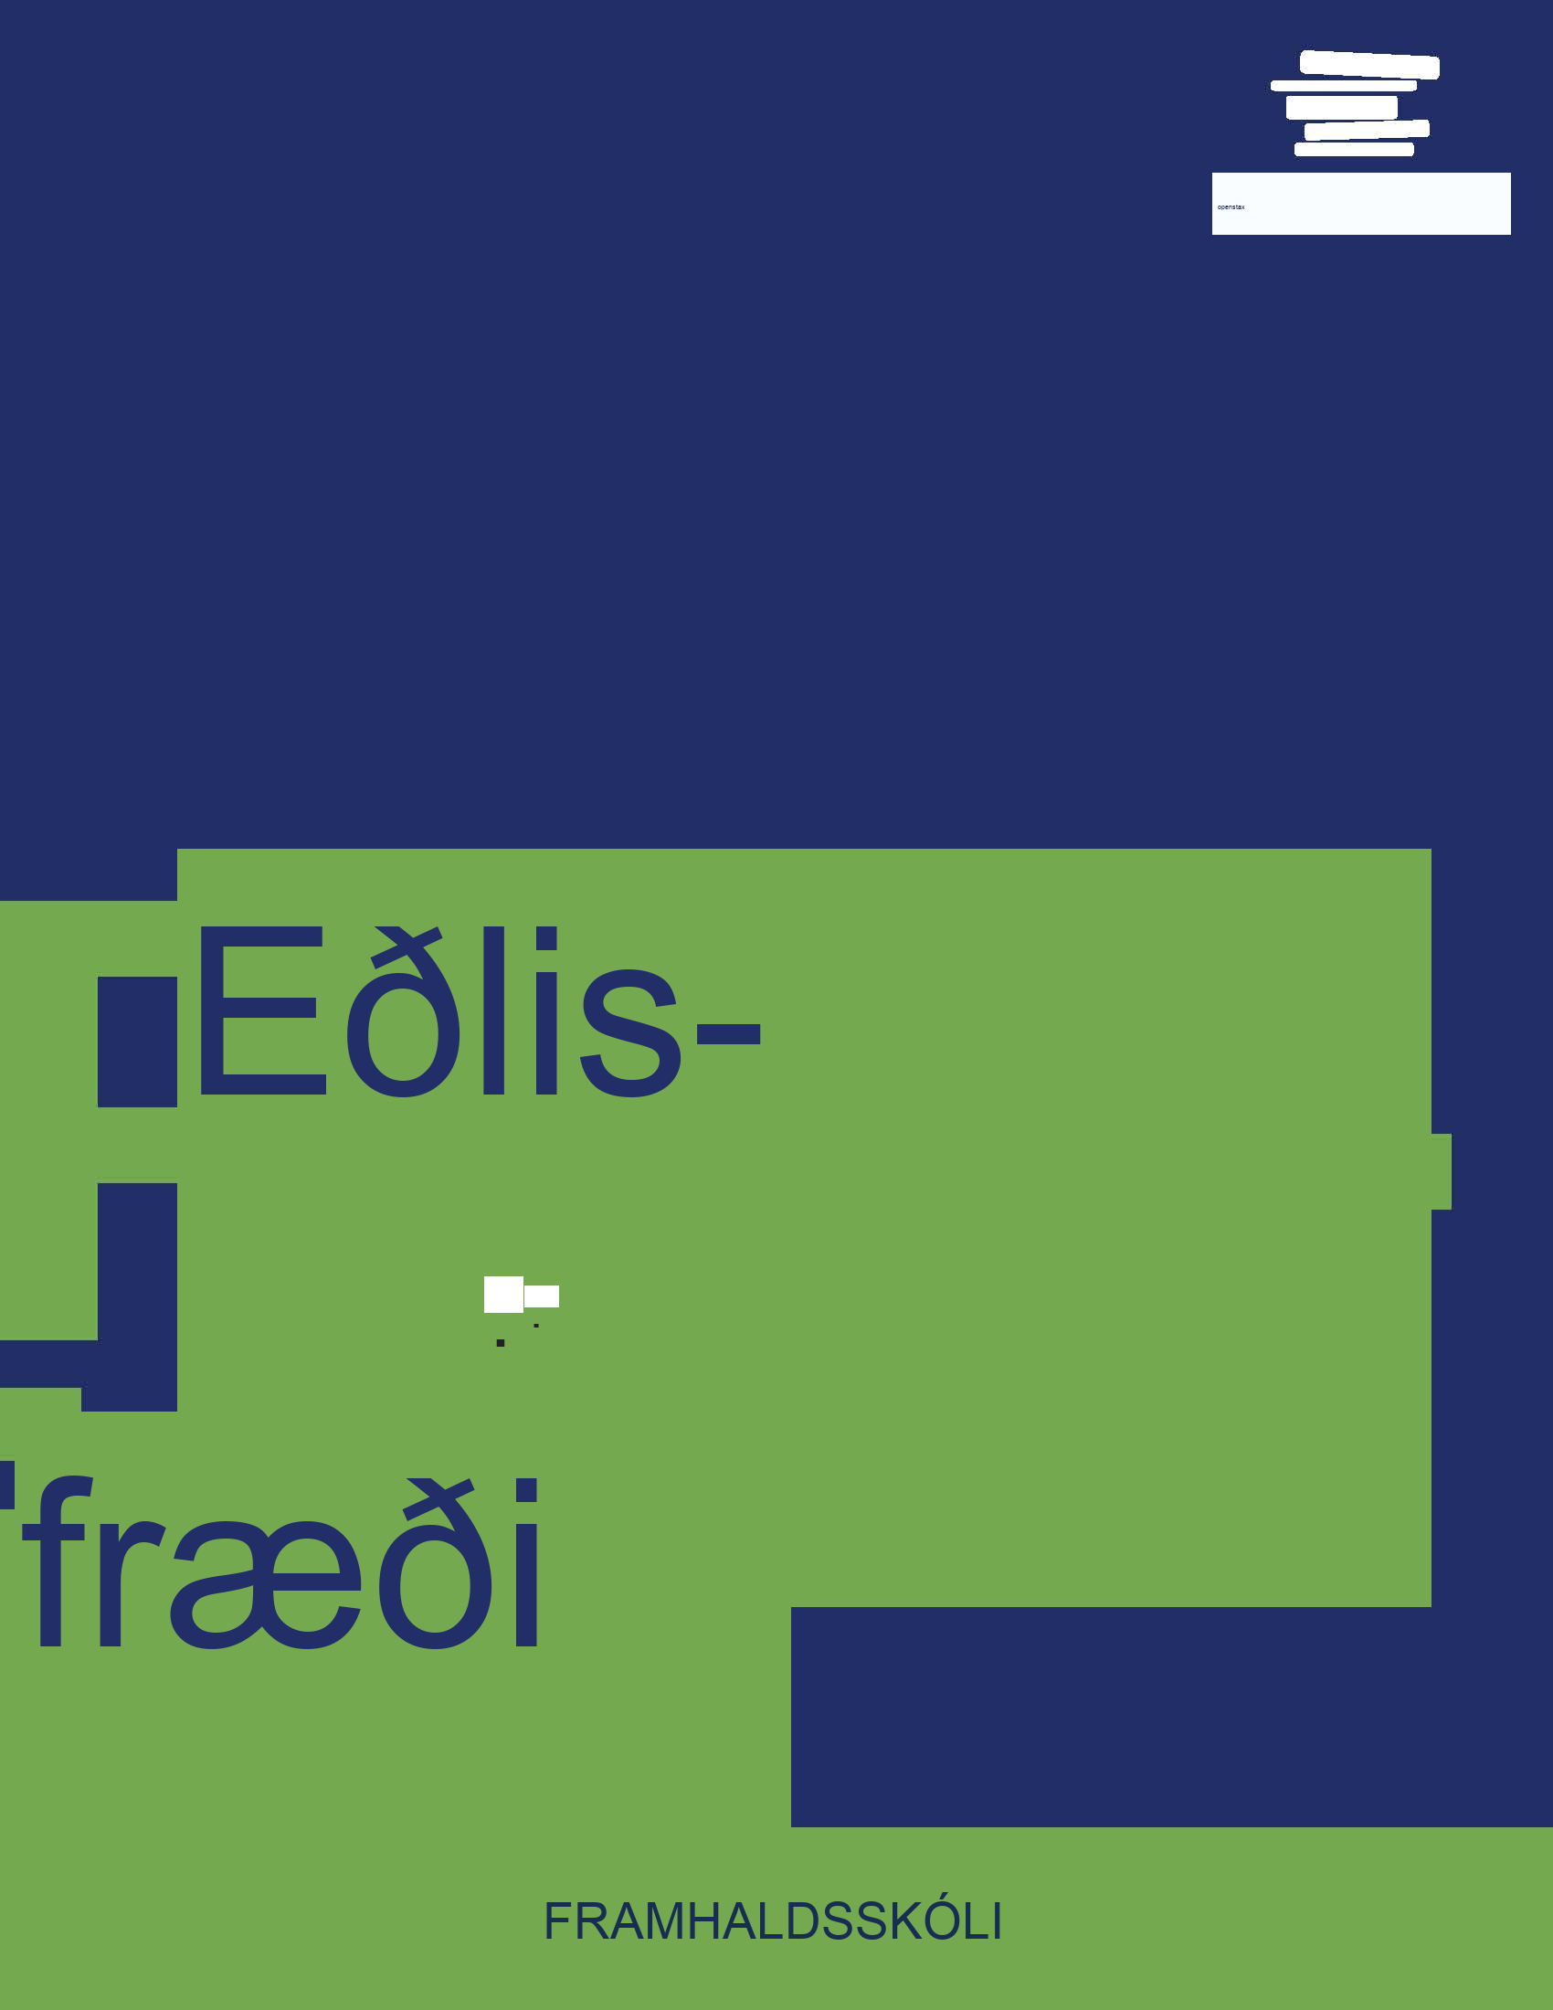


Eðlisfræði
Kafli 5 Hreyfing í tveimur víddum

Slide 2
Yfirlit kafla
Samlagning og frádráttur vigra: Myndrænar aðferðir
Samlagning og frádráttur vigra: Greinandi aðferðir
Kasthreyfing
Skáfletir
Einföld sveifluhreyfing

Slide 3
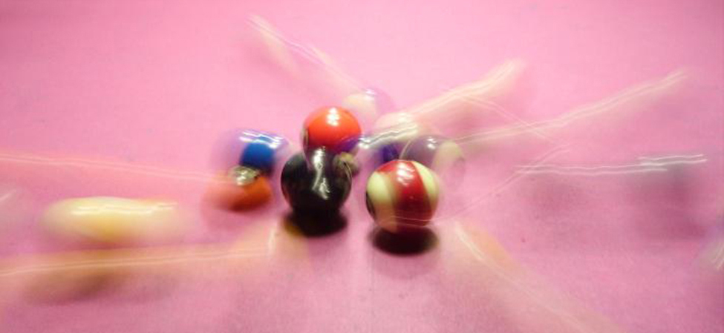

Mynd 5.1
Bíljardkúlur á bíljardborði eru á hreyfingu eftir að hafa verið slegnar með kjuða. (Popperipopp, Wikimedia Commons)
Notes:
Billiard balls in two-dimensional motion after the initial shot.

Slide 4
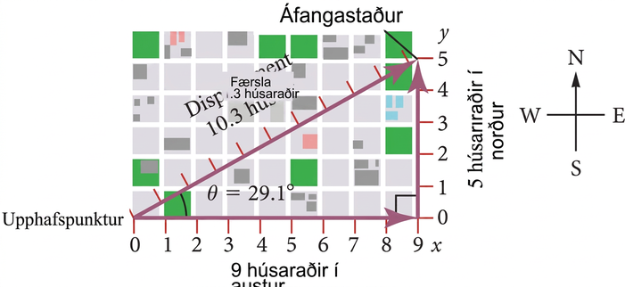
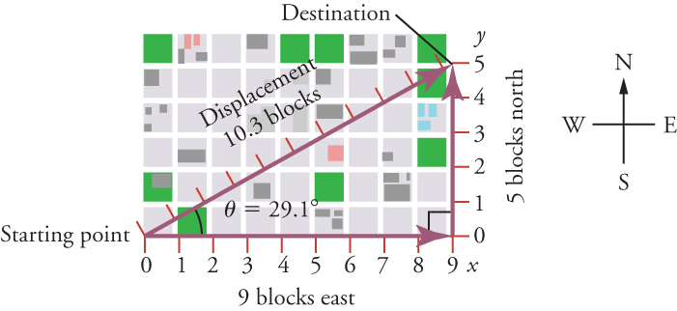
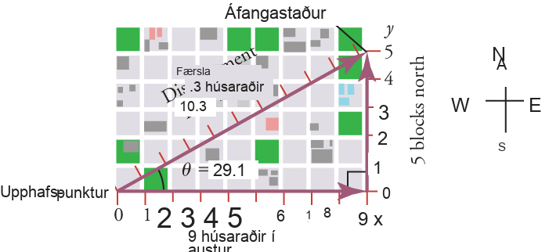
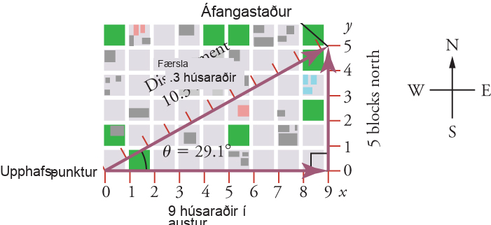
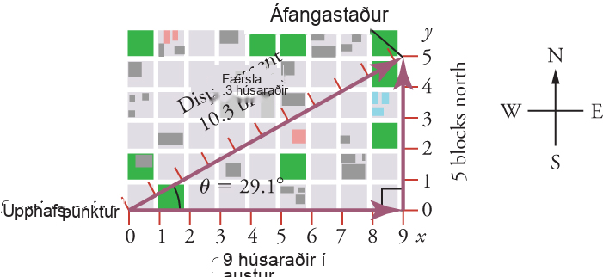
Mynd 5.2
Einstaklingur gengur níu húsaraðir í austur og fimm húsaraðir í norður. Færslan er 10.3 húsaraðir við hornið 29.1 ∘ norður af austur.
Notes:
A map is shown over top x and y-axes. The origin is labeled Starting Point. The x-axis represents east and has a scale from zero to nine in increments of one. The y-axis represents north and has a scale from zero to five in increments of one. Lines show that a person walks nine blocks east and five blocks north. A displacement vector is plotted from the origin to the destination of nine, five on the axes.

Slide 5
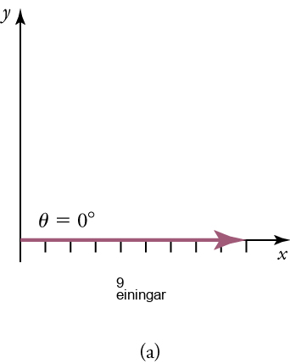
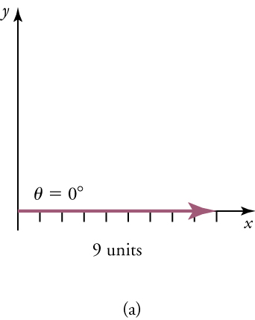
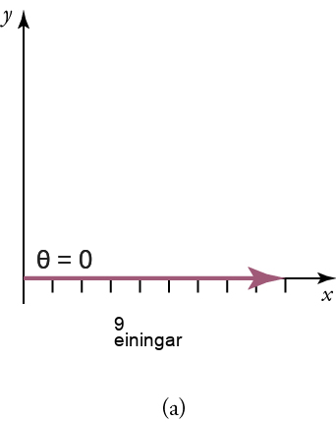
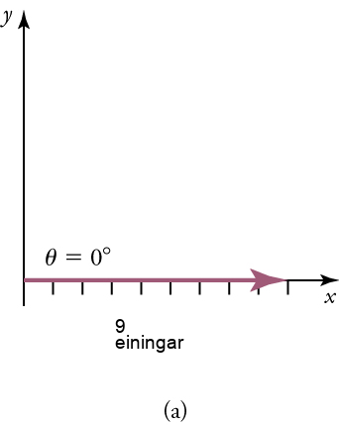
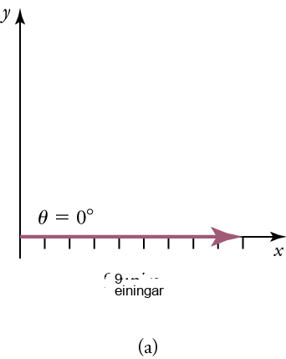
Mynd 5.3
Skýringarmyndin sýnir vigur með stærðina níu einingar og stefnuna 0°.
Notes:
The diagram shows a vector along an x-axis with a magnitude of nine units and a direction of 0°. An unlabeled y-axis is also shown.

Slide 6
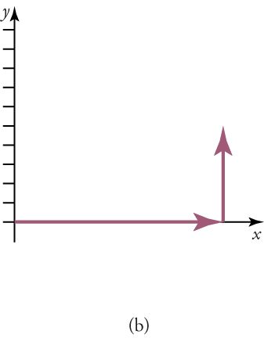

Mynd 5.4
Lóðréttum vigri er bætt við.
Notes:
The diagram shows a vector along an x-axis with a magnitude of nine units and a direction of 0°. A vertical vector is also shown at nine units with a height of five units. A y-axis is also shown with ten tick marks.

Slide 7
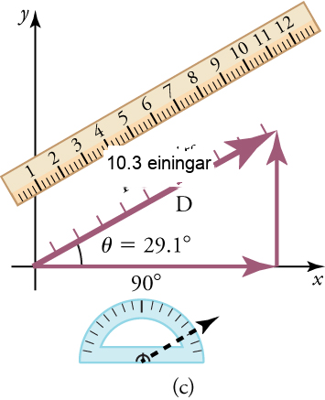
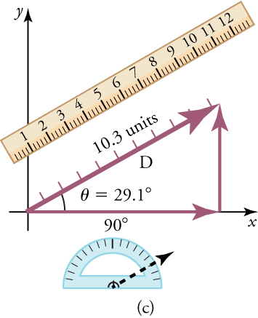
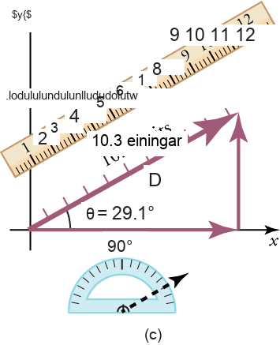
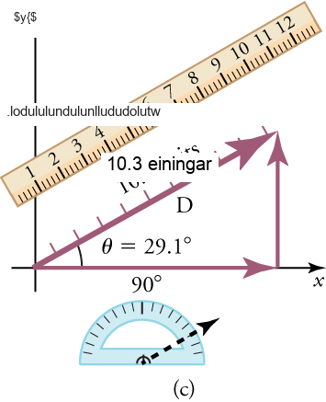

Mynd 5.5
Myndin sýnir summuvigurinn, reglustiku og gráðuboga.
Notes:
The diagram shows a vector along an x-axis with a magnitude of nine units and a direction of 0°. A vertical vector is also shown at nine units with a height of five units. A y-axis is shown with ten tick marks. A resultant vector is drawn, forming a right triangle with the other two vectors. This vector is labeled D, has a magnitude of ten point three units, and forms a twenty-nine point one degree angle with the x-axis.

Slide 8
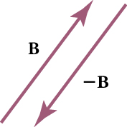

Mynd 5.6
Myndin sýnir vigur, B, og mótvigur hans, –B.
Notes:
Two vectors are shown. Vector B points upward at an angle. Vector negative B is parallel to vector B and points downward.

Slide 9
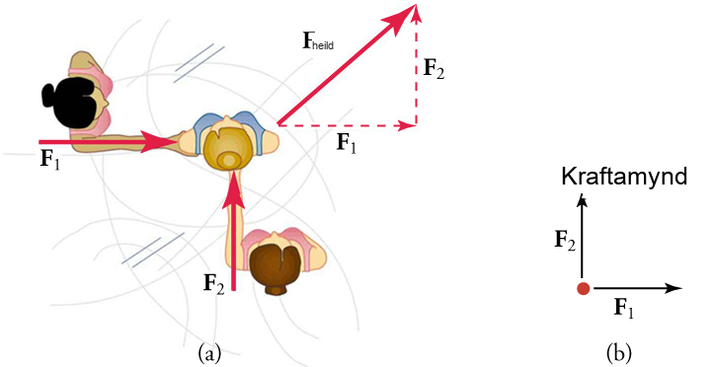
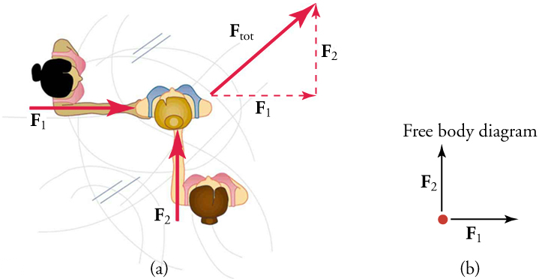
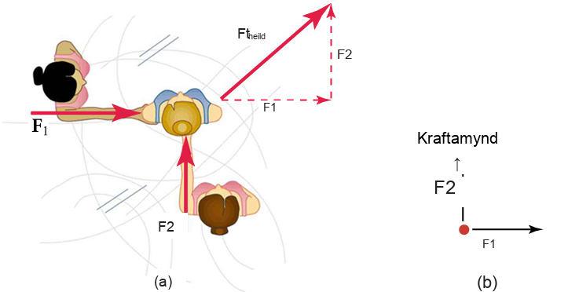
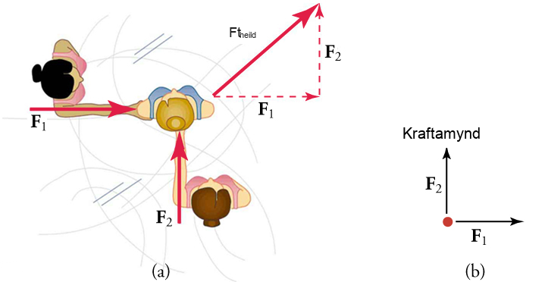

Mynd 5.7
Hluti (a) sýnir ofanálíkan af tveimur skautamönnum sem ýta á þann þriðja. Kraftar eru vigrar og leggjast saman eins og vigrar, þannig að heildarkrafturinn á þriðja skautamanninn er í þá átt sem sýnd er. Í hluta (b) sjáum við kraftamynd sem sýnir kraftana sem verka á þriðja skautamanninn.
Notes:
Two diagrams are shown. Diagram a is an overhead view of two skaters, one on the left and one below, pushing on a third skater in the center. A force vector is shown on each of the pushing skaters pointing from the skater's shoulder to the skater in the center. A right triangle is drawn using the force vectors, with F tot as the hypotenuse, F one as the bottom leg, and F two as the right leg. Diagram b is a free body diagram with F one pointing to the right and F two pointing up. Both vectors have the same magnitude.

Slide 10
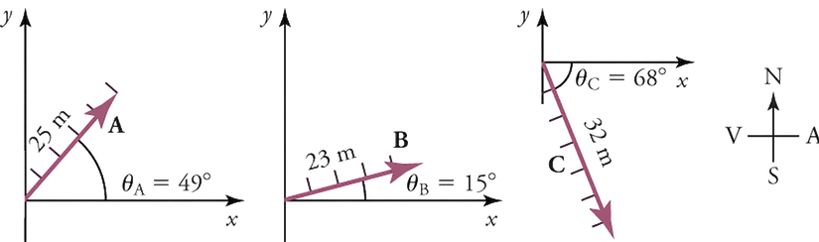

Mynd 5.8
Færsluvigrarnir þrír eru teiknaðir fyrst.
Notes:
Three displacement vectors are drawn on separate x-y axes. Vector A points upward from the origin and is twenty-five meters with an angle of forty-nine degrees. Vector B points upward from the origin and is twenty-three meters with an angle of fifteen degrees. Vector C points downward from the origin and is thirty-two meters with an angle of sixty-eight degrees.

Slide 11
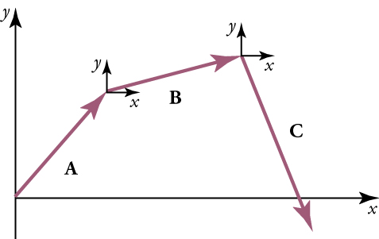

Mynd 5.9
Því næst eru vigrarnir settir saman, endi við upphaf.
Notes:
Three vectors, A, B, and C are shown. They form three sides of a polygon, with an x-axis forming the fourth side. The arrow of vector A touches the end of vector B and has an x-y-axis shown at the touching point. The arrow of vector B touches the end of vector C and has an x-y-axis shown at the touching point.

Slide 12
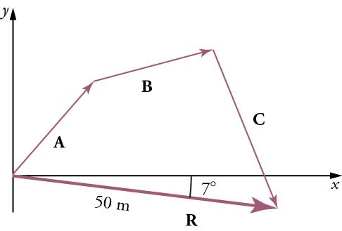

Mynd 5.10
Samlagningarvigurinn er teiknaður.
Notes:
Vectors A, B, C, and R form a four-sided figure, with vector R intersecting an x-axis. The magnitude of vector R is fifty meters and vector R forms a seven degree angle with the x-axis.

Slide 13
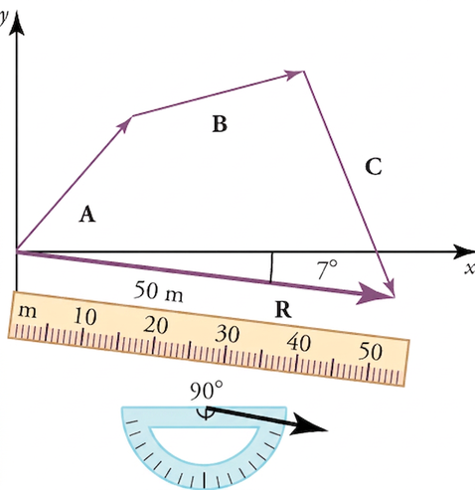
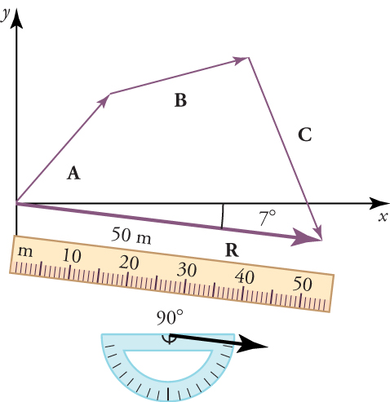
Mynd 5.11
Reglustika er notuð til að mæla stærð R og gráðubogi er notaður til að mæla stefnu R.
Notes:
Vectors A, B, C, and R form a four-sided figure, with vector R intersecting an x-axis. A ruler and a protractor are pictured below the figure. The magnitude of vector R is fifty meters and the direction of vector R is ninety degrees.

Slide 14
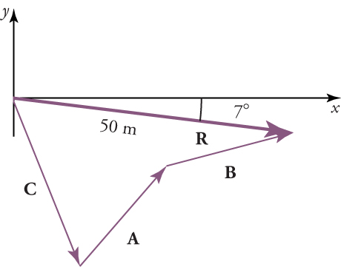

Mynd 5.12
Hægt er að leggja vigra saman í hvaða röð sem er til að fá sömu niðurstöðu.
Notes:
Vectors A, B, C, and R are shown. Angle CR is against the origin of x and y-axes and vector R has a length of 50 centimeters. Vector R forms a seven degree angle with the x-axis. Vectors C and A form an angle, and vectors B and R form an angle.

Slide 15
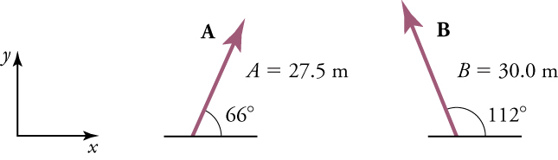

Mynd 5.13
Á myndinni er fyrsti áfangi ferðarinnar táknaður með vigri A og annar áfanginn er táknaður með vigri B.
Notes:
An x-y axis is shown for reference. Vector A points upward from the x-axis is twenty-seven point five meters, and has an angle of sixty-six degrees. Vector B points upward from the x-axis is thirty meters, and has an angle of one hundred twelve degrees.

Slide 16
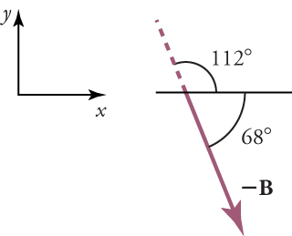

Mynd 5.14
Vigur –B táknar ferð í gagnstæða átt við vigur B.
Notes:
An x-y-axis is shown on the left for reference. On the right, vector negative B points downward and intersects the x-axis, forming an angle that measures sixty-eight degrees and a supplementary angle that measures one hundred twelve degrees.

Slide 17
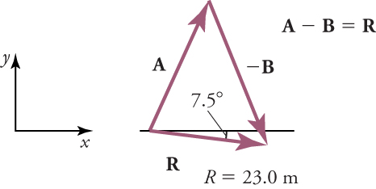

Mynd 5.15
Vigrarnir eru lagðir oddur við upphaf.
Notes:
An x-y axis is shown on the left. On the right, vectors A, negative B, and R form a triangle. R and the x-axis form an angle with a measure of seven point five degrees. A minus B equals R and R equals twenty-three meters.

Slide 18
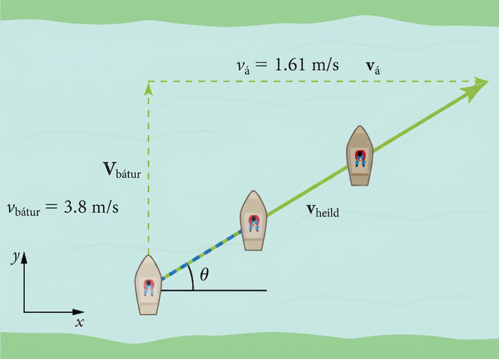
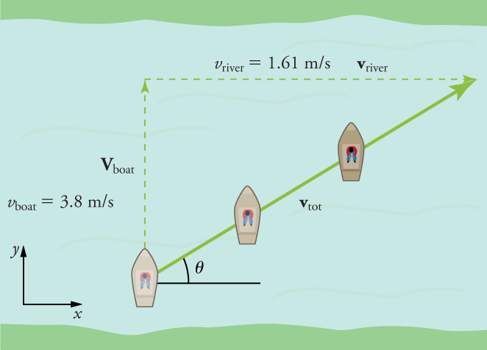
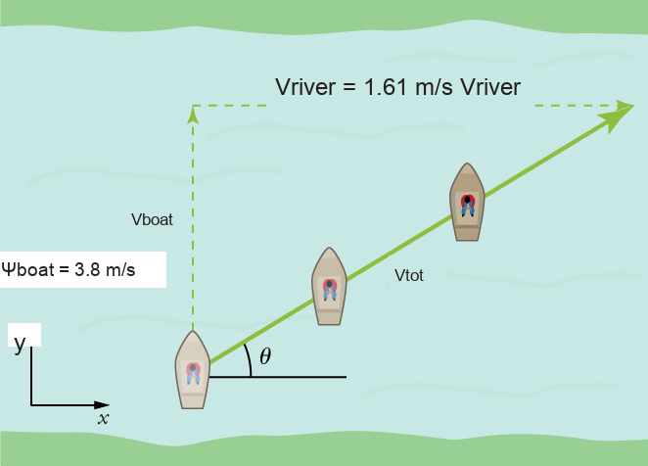

Mynd 5.16
Bátur reynir að sigla yfir á. Hver er heildarhraði og stefna bátsins?
Notes:
A river is shown with a boat traveling across it. Three images of the boat are shown to indicate the boat's motion in diagonal path across the river from the bottom left to the upper right corner. Three vectors are drawn to form a right triangle. The hypotenuse intersects the path of the boat and is labeled V tot. The left leg of the triangle is labeled V boat, three point eight meters per second. The upper leg of the triangle is labeled V river at one point six one meters per second. An x-y axis is in the bottom left corner for reference.

Slide 19
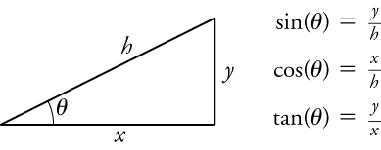
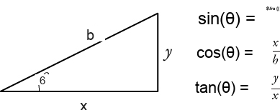

Mynd 5.17
Fyrir rétthyrndan þríhyrning eru sínus, kósínus og tangens af θ skilgreind út frá aðlægri skammhlið, mótlægri skammhlið eða langhlið. Á þessari mynd er x aðlæga skammhliðin, y er mótlæga skammhliðin og h er langhliðin.
Notes:
A right triangle is shown. The hypotenuse is labeled h, the vertical leg is labeled Y, and the horizontal leg is labeled X. The right angle is labeled with the angle symbol. The following formulas appear next to the triangle: sine angle equals y over h, cosine angle equals x over h, and tangent angle equals y over x.

Slide 20
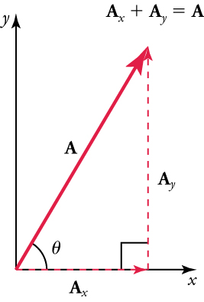
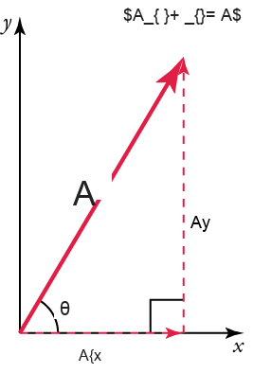
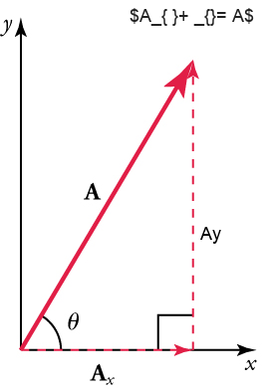
Mynd 5.18
Vigurinn A, með upphafspunkt í upphafi x-y hnitakerfis, er sýndur ásamt x- og y-þáttum sínum, A x og A y. Þessir vigrar mynda rétthyrndan þríhyrning.
Notes:
Vectors A, Ax, and Ay are shown. The vector A, with its tail at the origin of an x, y-coordinate system, is shown together with its x- and y-components, Ax and Ay. These vectors form a right triangle. The formula Ax plus Ay equals A is shown above the vectors.

Slide 21
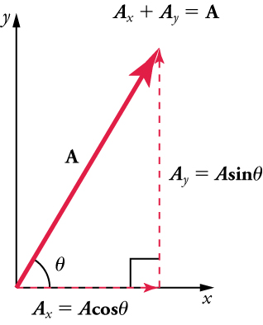

Mynd 5.19
Hægt er að tengja stærðir vigurþáttanna A x og A y við heildarvigurinn A og hornið θ með hornaföllum. Hér sjáum við að A x =Acosθ og A y =Asinθ.
Notes:
Vectors A x and A y form the legs of a right triangle and vector A forms the hypotenuse. Vector Ax is along an x-axis and vector Y is vertical and dashed. A x equals A times cosine angle. A y equals A times sine angle. A x plus A y equals A.

Slide 22
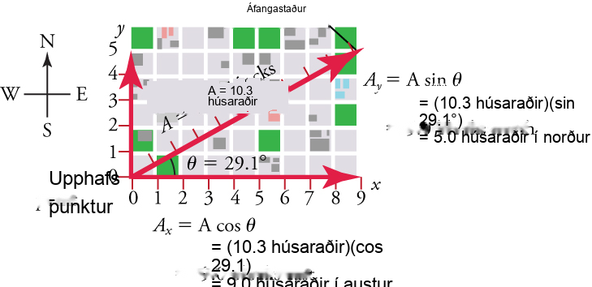
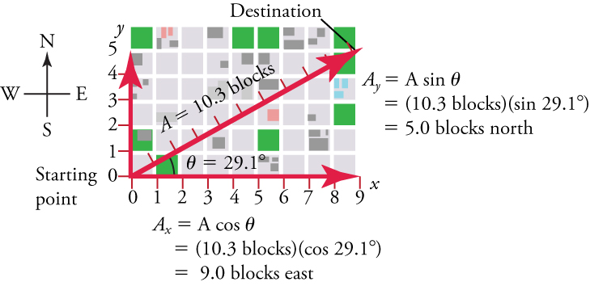
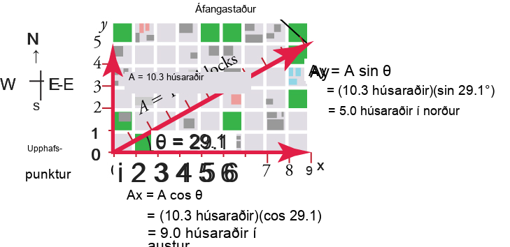
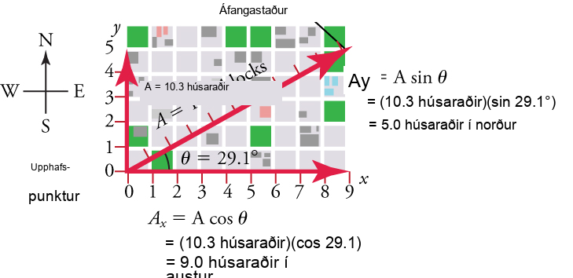

Mynd 5.20
Við getum notað samböndin A x =Acosθ og A y =Asinθ til að ákvarða stærð láréttra og lóðréttra þáttavigra í þessu dæmi.
Notes:
A map is shown over top x and y-axes. The origin is labeled Starting Point. The x-axis represents east and has a scale from zero to nine in increments of one. The y-axis represents north and has a scale from zero to five in increments of one. Lines show that a person walks nine blocks east and five blocks north. A displacement vector is plotted from the origin to the destination of nine, five on the axes. The following label is next to the y-axis: A y equals A times sine angle, equals ten point three blocks times sine twenty-nine point one, equals five blocks north. The following label is next to the x-axis: A x equals A cosine angle, equals ten point three blocks times sine twenty-nine point one, equals nine blocks east.

Slide 23
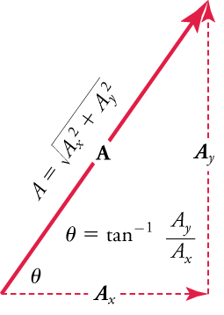
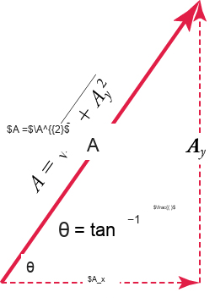
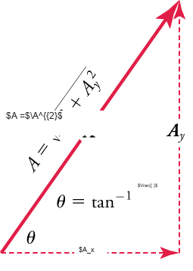
Mynd 5.21
Hægt er að ákvarða stærð og stefnu summuvigursins A þegar láréttu þættirnir A x og A y hafa verið ákvarðaðir.
Notes:
Vectors Ax and Ay form the legs of a right triangle and vector A forms the hypotenuse. Vectors Ax and Ay are dashed. The formula angle equals inverse tangent times Ay over Ax is inside the triangle. Vector A is labeled A equals the square root of Ax squared plus Ay squared.

Slide 24
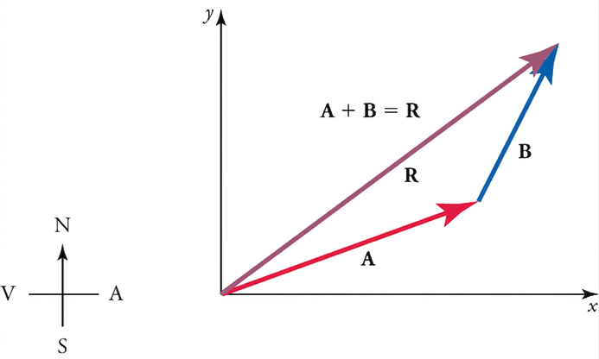
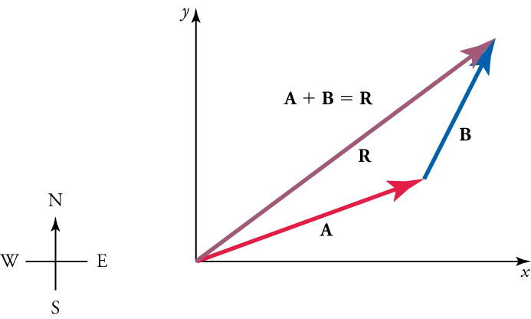
Mynd 5.22
Vigrarnir A og B eru tveir leggir göngu og R er summa þeirra eða heildarfærsla. Hægt er að nota greinandi aðferðir til að ákvarða stærð og stefnu R.
Notes:
A compass is shown on the left. On the right, vectors A, B, and R form a triangle, with the vertex of AR at the origin of an x-y axis. The formula A plus B equals R is above the triangle.

Slide 25
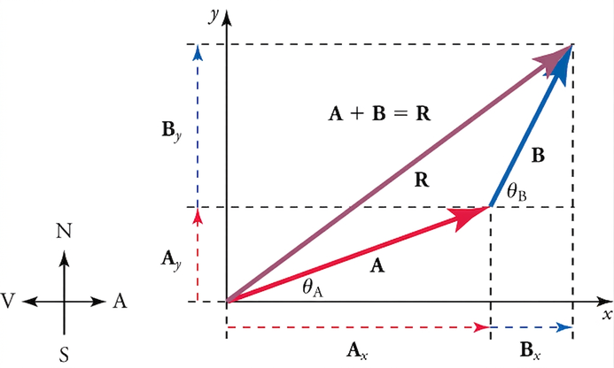



Mynd 5.23
Til að leggja saman vigrana A og B skal fyrst ákvarða lárétta og lóðrétta þætti hvers vigurs. Þetta eru punktalínuvigrarnir A x , A y B y sem sýndir eru á myndinni.
Notes:
A compass is shown on the left. On the right, vectors A, B, and R form a triangle, with the vertex of AR at the origin of an x-y axis. The formula A plus B equals R is above the triangle. Dashed lines indicate vertical and horizontal components of each vector. Labels indicate locations for angle A and angle B.

Slide 26


Mynd 5.24
Vigrarnir A x og B x leggjast saman og gefa stærð summuvigursins í láréttri stefnu, R x . Sömuleiðis leggjast vigrarnir A y og B y saman og gefa stærð summuvigursins í lóðréttri stefnu, R y .
Notes:
A compass is shown on the left. On the right, vectors A, B, and R form a triangle, with the vertex of AR at the origin of an x-y axis. The formula A plus B equals R is above the triangle. Dashed lines indicate vertical and horizontal components of each vector. Labels indicate locations for angle A and angle B. The formula Rx equals Ax plus Bx is below the x-axis. The formula Ry equals Ay plus By is next to the y-axis.

Slide 27


Mynd 5.25
Hægt er að nota greinandi líkön til að leggja saman vigra.
Notes:
Vectors A, B, and R form a triangle with vertex RA at the origin of an x y-axis. The following labels are included: angle (where R and A form an angle) equals thirty-six point six degrees, angle A equals twenty degrees, angle B equals sixty-three degrees, A equals fifty-three meters, B equals thirty-four meters, and A plus B equals R. A compass is shown in the bottom corner for reference.

Slide 28





Mynd 5.26
Þessi mynd sýnir Bert Foord í sjónvarpsveðurfréttum frá bresku veðurstofunni árið 1963. (BBC TV)
Notes:
A black and white photograph of a meteorologist is shown. The meteorologist is standing in front of a weather map with a television camera pointing at him.

Slide 29


Mynd 5.27
Skýringarmyndin sýnir kastferil fallbyssukúlu sem skotið er í lárétta stefnu samanborið við aðra sem er sleppt án lárétts hraða. Takið eftir að báðar fallbyssukúlurnar hafa sömu lóðréttu stöðu miðað við tíma.
Notes:
A cannonball is sitting on a flat surface. Dotted lines show the projectile motion of a cannon ball. Dotted line A shows the ball dropping vertically. Dotted line B shows a curved path. Dotted line C shows the ball moving horizontally.

Slide 30


Mynd 5.28
Drengur sparkar í bolta undir horninu θ og hann færist um vegalengdina s eftir ferli sínum.
Notes:
A boy is kicking a soccer ball. A curved line shows the ball's motion. A right triangle is drawn with vectors using an x-y axis. The hypotenuse is labeled d, the vertical leg is labeled y and the horizontal leg is labeled x.

Slide 31

Tafla 5.1 Samantekt á hreyfijöfnum (fast a)
$x=x_{0}+v_{avg}t$ (when $a\text{=}\text{constant}$ )
$v_{avg}=\frac{v_{0}+v}{2}$ (when $a\text{=}0$ )
$$v=v_{0}+at$$
$$x=x_{0}+v_{0}t+\frac{1}{2}at^{2}$$
$$v^{2}=v_{0}^{2}+2a\left(x−x_{0}\right)$$

Slide 32



Mynd 5.29
(a) Við greinum tvívíða kastahreyfingu með því að skipta henni í tvær óháðar einvíðar hreyfingar eftir lóðréttum og láréttum ásum. (b) Lárétta hreyfingin er einföld, vegna þess að a x =0 og v x er því fasti. (c) Hraðinn í lóðrétta stefnu byrjar að minnka þegar hluturinn rís; í hæsta punkti er lóðrétti hraðinn núll. Þegar hluturinn fellur aftur til jarðar eykst lóðrétti hraðinn aftur að stærð en stefnir í gagnstæða átt við upphaflega lóðrétta hraðann. (d) Hreyfingarnar í x- og y-stefnu eru sameinaðar aftur til að gefa heildarhraðann í hvaða punkti sem er á ferlinum.
Notes:
Four related diagrams of projectile motion are show, a, b, c, and d. Diagram a shows two-dimensional curved motion, vx and vy, along an x-y axis and includes the formulas V y equals negative V oy and angle equals negative angle o. Diagram b shows horizontal motion, vx. Diagram c shows upward and downward vertical velocity, vy. And diagram d shows the combination of vx, vy, and v, forming a right triangle.

Slide 33


Mynd 5.30
Myndin sýnir feril flugeldakúlu.
Notes:
The diagram shows the trajectory of a fireworks shell. An x-axis is labeled x, a y-axis is labeled h, and a vector, labeled V o, points upward from the axis origin. An angle is formed by the vector and the x-axis with a measure of seventy-five degrees.

Slide 34


Mynd 5.31
Myndin sýnir kasthreyfingu stórs steins úr eldfjalli.
Notes:
A volcano is shown with labels illustrating the projectile motion of rock shooting out of the volcano. Vector v o equals twenty-five meters per second and points from the volcano opening upward. Vector v curves downward to the ground and forms an angle of thirty-five degrees with a horizontal plane at the height of the volcano opening. The distance between the horizontal plane and the ground is labeled as negative twenty meters.

Slide 35


Mynd 5.32
Ferlar skotfæra á jafnsléttu. (a) Því meiri sem upphafshraðinn v 0 er, því meiri er drægnin fyrir tiltekið upphafshorn. (b) Áhrif upphafshorns θ 0 á drægni skotfæris með tilteknum upphafshraða. Athugið að allar samsetningar ferla sem gefa samtals 90 gráður munu hafa sömu drægni ef loftmótstaða er ekki til staðar, þó að hámarkshæð þessara ferla sé mismunandi.
Notes:
Two trajectory diagrams are shown. Diagram a shows three trajectories that curve upward then downward. They are labeled as follows: thirty meters per second and ninety-eight point one meters; forty meters per second and one hundred sixty-three meters; fifty meters per second and two hundred fifty-five meters. Diagram b shows three trajectories that curve upward then downward. They are labeled as follows: fifteen degrees and one hundred twenty-eight meters; forty-five degrees and two hundred fifty-five meters; seventy-five degrees and one hundred twenty-eight meters. The diagram also includes the formula v o equals fifty meters per second.

Slide 36



Mynd 5.33
Núningskraftar, eins og f, vinna alltaf gegn hreyfingu eða tilraun til hreyfingar milli hluta sem snertast. Núningur stafar að hluta til af hrjúfleika flötanna sem snertast, eins og sjá má á stækkuðu myndinni.
Notes:
A box is shown sitting on a floor. A vector labeled f points to the left from the area where the bottom of the box meets the floor. A zoom-in diagram shows the bottom surface of the box and the surface of the floor as rough.

Slide 37


Mynd 5.34
Skýringarmyndin sýnir hornrétta og lárétta þætti þyngdarkrafts á skáplani.
Notes:
A diagram shows perpendicular and horizontal components of weight. The weight is on an inclined plane that slopes downward to the right.

Slide 38





Mynd 5.35
Notaðu skýringarmyndina til að finna hreyfinúningsstuðul skíðamannsins.
Notes:
A skier is moving down a slope with an angle measure of twenty-five degrees to the ground. Force vectors are shown: N points upward from the skier, f points to the right of the skis, w points at a downward left angle from the skiers' feet, forming an angle with vector w that has a measure of twenty-five degrees. A free-body diagram illustrates the right triangle formed by these vectors.

Slide 39




Mynd 5.36
Notaðu nú skýringarmyndina til að finna hröðun skíðamannsins ef núningur er hverfandi og ef núningskrafturinn er 45.0 N.
Notes:
A skier is moving down a slope with an angle measure of twenty-five degrees to the ground. Force vectors are shown: N points upward from the skier, f points to the right of the skis, w points at a downward left angle from the skiers' feet, forming an angle with vector w that has a measure of twenty-five degrees. A free-body diagram illustrates the right triangle formed by these vectors.

Slide 40




Mynd 5.37
Reglustiku er hliðrað frá jafnvægisstöðu sinni.
Notes:
A drawing is shown of hands holding and flicking an upright ruler. A double-ended arrow is shown over the ruler and a label Equilibrium position points to the upright position of the ruler.

Slide 41




Mynd 5.38
(a) Plaststikunni hefur verið sleppt og endurheimtarkrafturinn færir stikuna aftur í jafnvægisstöðu sína. (b) Heildarkrafturinn er núll í jafnvægisstöðunni, en stikan hefur skriðþunga og heldur áfram að hreyfast til hægri. (c) Endurheimtarkrafturinn er í gagnstæða átt. Hann stöðvar stikuna og færir hana aftur í átt að jafnvægi. (d) Nú hefur stikan skriðþunga til vinstri. (e) Ef engin dempun er til staðar (af völdum núningskrafta) nær stikan upprunalegri stöðu sinni. Þaðan mun hreyfingin endurtaka sig.
Notes:
Four diagrams are shown, side-by-side, labeled a, b, c, d, and e. They show the sideways motion of a ruler that has been flicked. The vertical position of the ruler is labeled equilibrium position. A right-pointing force vector is shown on diagram a. A right-facing velocity vector and F equals zero is shown on b. A left-pointing force vector is shown on diagram c. A left-facing velocity vector and F equals zero is shown on d. A right-pointing force vector is shown on diagram e.

Slide 42




Mynd 5.39
Hlutur sem er festur við gorm og rennur á núningslausum fleti er einfaldur sveifluvaki. Þegar hluturinn er færður úr jafnvægisstöðu framkvæmir hann einfalda sveiflhreyfingu með sveifluvíddina X og sveiflutímann T. Mesti hraði hlutarins næst þegar hann fer í gegnum jafnvægisstöðuna. Því stífari sem gormurinn er, því styttri er sveiflutíminn T. Því meiri sem massi hlutarins er, því lengri er sveiflutíminn T.
Notes:
Five diagrams, a, b, c, d, and e are shown. They show an object attached to a spring sliding on a frictionless surface. Diagram a shows a left-pointing force vector and the following labels: v equals zero, x equals zero, x equals x, k. Diagram b has the following labels: F equals zero, negative v max, x equals zero. Diagram c shows a right-pointing force vector and the following labels: v equals zero, x equals zero, x equals negative x. Diagram d has the following labels: F equals zero, positive v max, x equals zero. Diagram e shows a left-pointing force vector and the following labels: v equals zero, x equals zero, x equals x. Free-body diagrams illustrate the forces acting on each system.

Slide 43



Mynd 5.40
Einfaldur pendúll samanstendur af kúlu með litlu þvermáli og bandi sem hefur mjög lítinn massa en er nægilega sterkt til að teygjast ekki. Línuleg færsla frá jafnvægisstöðu er s, lengd bogans. Einnig eru sýndir kraftarnir sem verka á kúluna, sem skila heildarkraftinum −mg sinθ í átt að jafnvægisstöðunni — það er að segja, endurheimtarkrafti.
Notes:
A pendulum is shown with a small-diameter bob and a string that has a very small mass but is strong enough not to stretch. The linear displacement from equilibrium is labeled s, the length of the arc. Also shown are the forces on the bob, which result in a net force of negative m times g sine angle toward the equilibrium position.

Slide 44


Mynd 5.41
Bíll á bílastæði. (exfordy, Flickr)
Þetta OpenStax viðbótarefni er © Rice University undir CC BY-NC-SA 4.0 alþjóðlegu leyfi; það má afrita eða breyta því eingöngu í óviðskiptalegum tilgangi, en eigna verður OpenStax og Rice University og taka skal fram allar breytingar. Öllum aðlögunum skal deila undir sams konar leyfi.
Notes:
A side view of the back end of a blue compact car is shown. The car is sitting on black asphalt.

