Slide 1





Eðlisfræði
Kafli 18 Stöðurafmagn

Slide 2
Yfirlit kafla
Rafhleðslur, varðveisla hleðslu og flutningur hleðslu
Lögmál Coulombs
Rafsvið
Rafmætti
Þéttar og rafsvarar

Slide 3
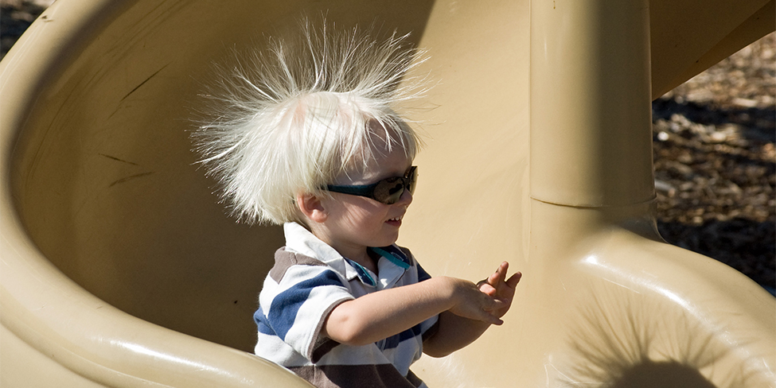

Mynd 18.1
Hár þessa barns inniheldur ójafnvægi í rafhleðslu (oft kallað stöðurafmagn), sem veldur því að það stendur út í loftið. Rennihreyfingin reif rafeindir burt frá líkama barnsins og skildi hann eftir með umframmagn af jákvæðum hleðslum, sem hrinda hver annarri frá sér eftir hverju hárstrái. (mynd: Ken Bosma, Wikimedia Commons)
Notes:
A photo shows a child sliding down a spiral-shaped slide, with his straight hair standing on end.

Slide 4
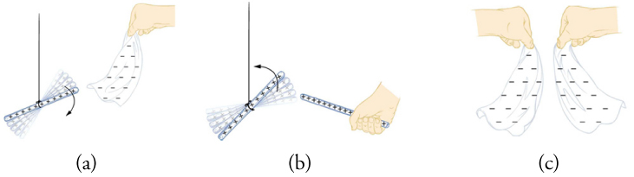

Mynd 18.2
Glerstöng verður jákvætt hlaðin þegar henni er nuddað við silki, en silkið verður neikvætt hlaðið. (a) Glerstöngin dregst að silkinu vegna þess að hleðslur þeirra eru andstæðar. (b) Tvær eins hlaðnar glerstangir hrinda hvor annarri frá sér. (c) Tvö eins hlaðin silkistykki hrinda hvoru öðru frá sér.
Notes:
This figure has three parts. Part a: It shows a glass rod suspended from its middle by a string and a nearby silk cloth held from its upper edge by a hand. The glass rod has a series of plus signs, and the silk cloth has many minus signs. There are several faded images of the glass rod and a downward pointing arrow, suggesting the rod's movement toward the cloth. The lower edge of the cloth bends toward the rod. Part b: It shows two glass rods near each other, each with a series of plus signs. One rod is held from one end by a hand, and the other rod is suspended from its middle by a string. There are several faded images of the suspended rod and an upward pointing arrow, suggesting its movement away from the handheld rod. Part c: It shows two silk cloths held by hand near each other, each with a number of minus signs. The lower edges of the cloths curve away from each other.

Slide 5
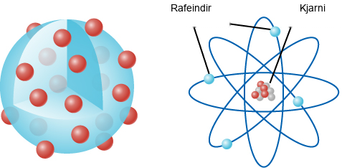
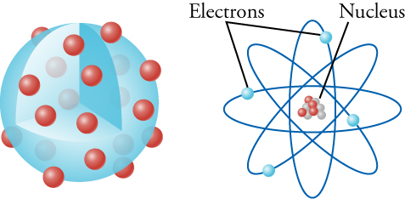
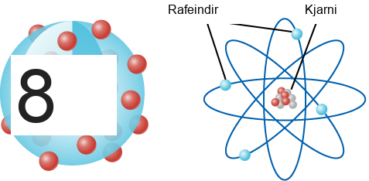
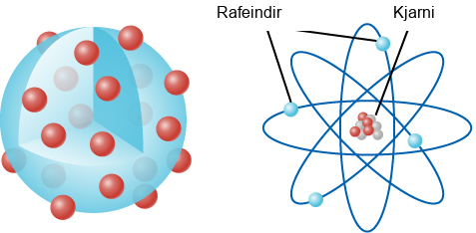
Mynd 18.3
Vinstri myndin sýnir rúsínukökulíkan Thomsons, þar sem rafeindirnar svífa um í óljósum massa jákvæðrar hleðslu. Hægri myndin sýnir líkan Rutherfords, þar sem rafeindirnar ganga á braut um örlítinn, massamikinn kjarna. Athugið að stærð kjarnans er mjög ýkt á þessari mynd. Ef hann væri teiknaður í réttum hlutföllum við stærð rafeindabrautanna væri kjarninn ekki sýnilegur með berum augum á þessari mynd. Einnig, að því er vísindin geta greint um þessar mundir, eru rafeindir punkteindir, sem þýðir að þær hafa enga stærð yfirleitt!
Notes:
This figure has two drawings, side by side. The drawing on the left shows a large blue sphere, one-eighth of which has been cut out. A number of small red spheres are on the surface of the blue sphere and within the cut-away part of the blue sphere. Also, a number of faded red spheres lie within the blue sphere. The drawing on the right shows four ellipses evenly spaced around a common center, with a small blue sphere in each ellipse. Near the top is the word “Electrons,” with two lines connecting that word to two of the blue spheres. The common center contains a clump of four small red spheres and five small gray spheres. Near the top is another word, “Nucleus,” with a line connecting that word to the clump of spheres at the center.

Slide 6
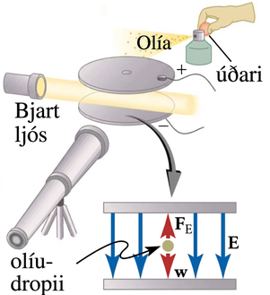
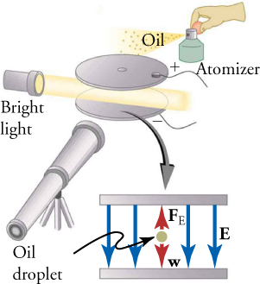
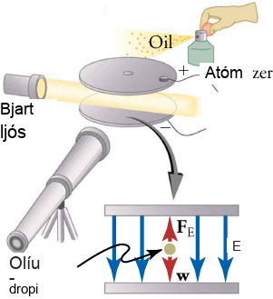

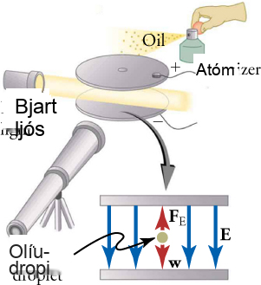
Mynd 18.4
Olíudropatilraunin fólst í því að úða fíngerðum olíuúða milli tveggja málmplatna með andstæðar hleðslur. Með því að þekkja massa olíudropanna og stilla rafhleðsluna á plötunum er hægt að ákvarða hleðslu olíudropanna af mikilli nákvæmni.
Notes:
This figure is a two-part drawing. One part consists of two circular plates held parallel to each other, with a beam of light shining between them. Each plate has a wire attached to it. The upper plate, with a tiny hole at its center, is marked with a plus sign, and the lower plate is marked with a minus sign. A small spray bottle, labeled “Atomizer,” is held by a hand near and just above the upper plate. The hand squeezes a bulb on the Atomizer, and a spray labeled “Oil” emerges just above the upper plate. The beam of light emerges from a source labeled “Bright light.” The drawing includes a telescope-like device aimed for viewing between the circular plates. The second part of the drawing, located slightly below the first part, shows an edge-on view of the two plates. A downward pointing arrow connects the plates in the first part of the drawing to those in the second part. In the latter drawing, four vertical blue arrows point from the upper to the lower plate, and the arrow on the extreme right is labeled as E. A gray sphere between the two plates is labeled “Oil droplet.” A short red arrow, labeled F subscript E, points from the sphere to the upper plate, and another short red arrow, labeled w, points from the sphere to the lower plate.

Slide 7
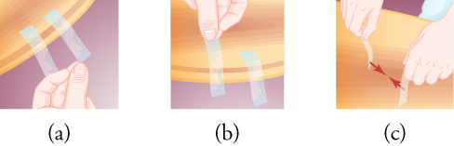

Mynd 18.5
Þessi mynd er í þremur hlutum. Hluti a sýnir tvo límbandsbúta festa við brún bogalaga hlutar, þar sem fingur einhvers eru nálægt enda annars límbandsins. Hluti b sýnir fingur lyfta öðrum límbandsbútnum frá bogalaga hlutnum, á meðan hinn límbandsbúturinn er áfram fastur við hlutinn. Hluti c sýnir vinstri og hægri hönd, sem hvor um sig heldur á límbandsbút á öðrum endanum. Tvær stuttar rauðar örvar, sem báðar byrja á lausa enda límbandsbútsins, benda hvor á aðra.
Notes:
This image has three parts. Part a shows two pieces of sticky tape attached to the edge of an arc-shaped object, with someone's fingers near the end of one tape. Part b shows someone's fingers lifting one tape piece away from the arc-shaped object, while the other tape piece remains attached to the object. Part c shows a left hand and a right hand, each holding a piece of tape from one end. Two short red arrows, each starting from the free end of a piece of tape, point toward each other.

Slide 8
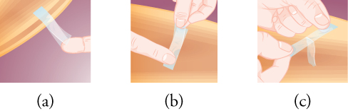

Mynd 18.6
Þessi mynd er í þremur hlutum. Hluti a sýnir tvo búta af límbandi, þar sem annar er límdur yfir hinn, og neðra límbandið er fest við brún á bogadregnum hlut. Límböndin tvö eru aðeins aðskilin á öðrum endanum. Í hluta b heldur hönd á límbandsbútunum tveimur á þeim enda þar sem þeir eru aðskildir, á meðan fingur snertir hinn endann. Hluti c sýnir tvær hendur toga límbandsbútana tvo í sundur.
Notes:
This image has three parts. Part a shows two pieces of sticky tape, with one stuck over the other, and with the lower tape attached to the edge of an arc-shaped object. The two tapes are slightly separated from each other at one end. In part b, someone's hand holds the two pieces of tape from the end where they are separated, while a finger touches the other end. Part c shows two hands pulling the two pieces of tape apart.

Slide 9
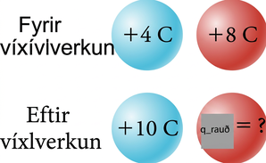
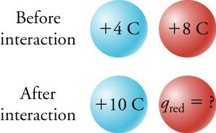
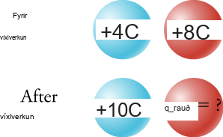
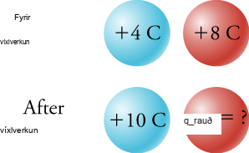
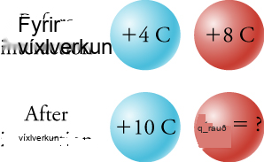
Mynd 18.7
Tvær kúlur, ein blá og ein rauð, hafa upphaflega hleðsluna have +4 C og and +8 C, hvor um sig. Eftir að kúlurnar tvær víxlverka hefur bláa kúlan hleðsluna of +10 C. Lögmálið um varðveislu hleðslu gerir okkur kleift að finna lokahleðsluna q red á rauðu kúlunni.
Notes:
This figure has two rows, one below the other. The upper row is labeled “Before interaction”, and the lower row is labeled “After interaction”. Each row has a blue sphere and a red sphere next to each other. In the upper row, the blue sphere is marked as “plus 4 C” and the red sphere is marked as “plus 8 C”. In the lower row, the blue sphere is marked as “plus 10 C” and the red sphere is marked as “q subscript red = ?”

Slide 10
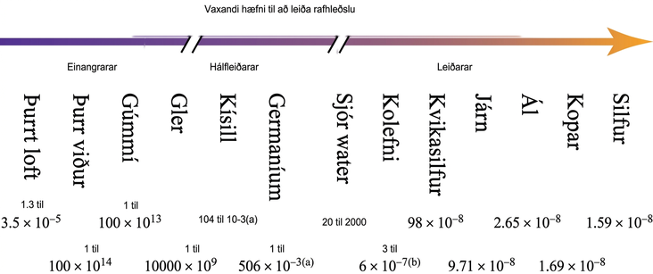
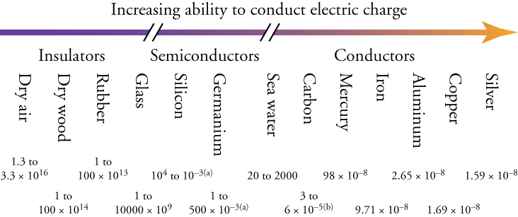
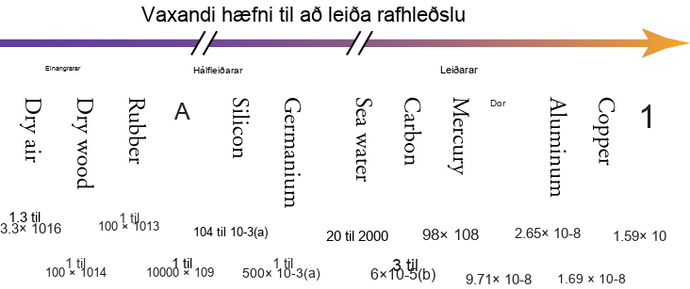
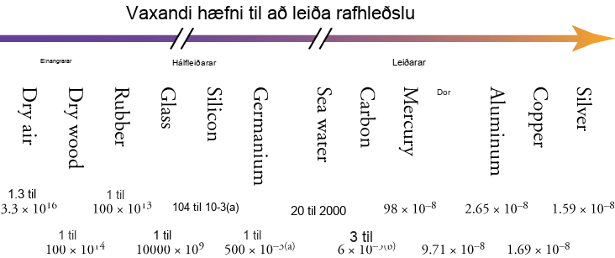
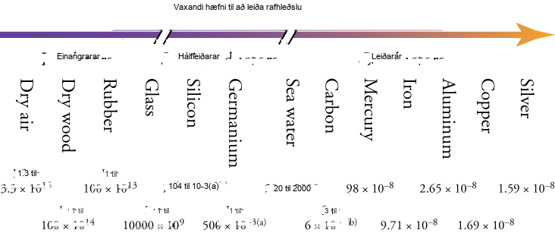
Mynd 18.8
Hægt er að raða efnum eftir getu þeirra til að leiða rafhleðslu. Skástrikin á örinni merkja að það er mjög stórt bil í leiðnigetu milli leiðara, hálfleiðara og einangrara, en myndin er þjöppuð til að komast fyrir á síðunni. Tölurnar fyrir neðan efnin gefa upp eðlisviðnám þeirra í Ω•m (which you will learn about below). Eðlisviðnám er mælikvarði á hversu erfitt það er að fá hleðslu til að hreyfast í gegnum tiltekið efni.
Notes:
Thirteen materials are arranged in a horizontal series, according to their ability to conduct electric charge. The materials, ranging from the least conductive on the left to the most conductive on the right, are: “Dry air”, “Dry wood”, “Rubber8, “Glass”, “Silicon”, “Germanium”, “Sea water”, “Carbon”, “Mercury”, “Iron”, “Aluminum”, “Copper”, and “Silver”. Above the names of the materials is a long, horizontal arrow pointing rightward. The arrow is broken in two places, producing three segments. The left segment, labeled “Insulators”, is above the materials Dry air to Glass; the middle segment, labeled “Semiconductors”, is above Silicon and Germanium; and the right segment, labeled “Conductors”, is above the materials Sea water to Silver. Below the names of the materials are numbers that give the resistivity of each material in ohm-meter.

Slide 11
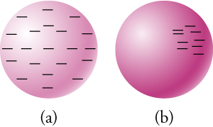

Mynd 18.9
(a) Leiðandi kúla með umfram neikvæða hleðslu (þ.e. rafeindir). Rafeindirnar hrinda hver annarri frá sér og dreifast þannig að þær þekja ytra yfirborð kúlunnar. (b) Einangrandi kúla með umfram neikvæða hleðslu. Rafeindirnar geta ekki hreyfst og haldast því í upprunalegum stöðum sínum.
Notes:
This figure has two parts, each consisting of a sphere. In Part a, there are minus signs distributed relatively evenly around the sphere. In Part b, there are minus signs concentrated in the upper right quadrant of the face of the sphere.

Slide 12
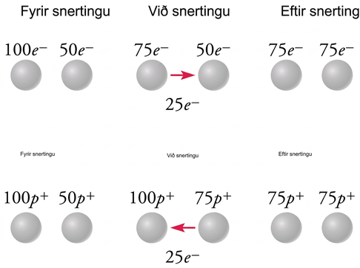
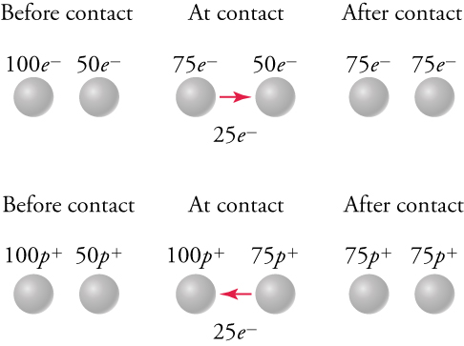
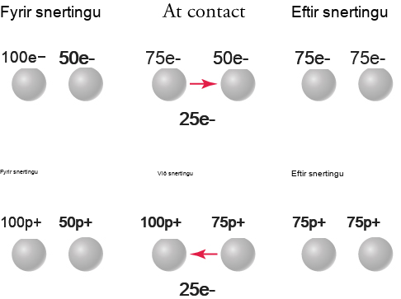
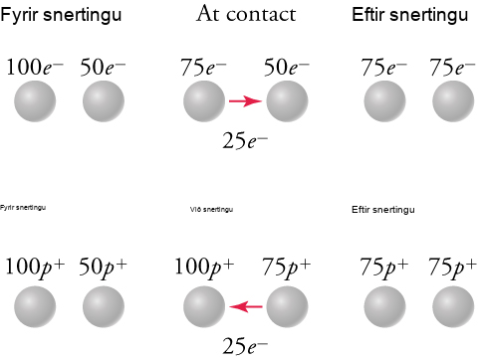
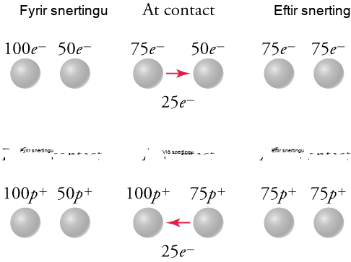
Mynd 18.10
Í efri röðinni flytur málmkúla með 100 umframrafeindir 25 rafeindir yfir á málmkúlu sem hefur 50 umframrafeindir. Eftir flutninginn hafa báðar kúlurnar 75 umframrafeindir. Í neðri röðinni tekur málmkúla með 100 umframróteindir við 25 rafeindum frá kúlu með 50 umframróteindir. Eftir flutninginn hafa báðar kúlurnar 75 umframróteindir.
Notes:
This figure consists of two rows, and each row is divided into three columns labeled as “Before contact”, “At contact”, and “After contact”. Each column contains two small spheres. First consider the top row: In the “Before contact” column, the left sphere is labeled “100 e superscript minus”, the right sphere is labeled “50 e superscript minus”. In the “At contact” column, the left sphere is labeled “75 e superscript minus”, the right sphere is labeled “50 e superscript minus”. An arrow points from the left sphere to the right one and is labeled “25 e superscript minus”. In the “After contact” column, the left sphere is labeled “75 e superscript minus”, the right sphere is labeled “75 e superscript minus”. Next consider the bottom row: In the “Before contact” column, the left sphere is labeled “100 p superscript plus”, the right sphere is labeled “50 p superscript plus”. In the “At contact” column, the left sphere is labeled “100 p superscript plus”, the right sphere is labeled “75 p superscript plus”. An arrow points from the right sphere to the left one and is labeled “25 e superscript minus”. In the “After contact” column, the left sphere is labeled “75 p superscript plus”, the right sphere is labeled “75 p superscript plus”.

Slide 13
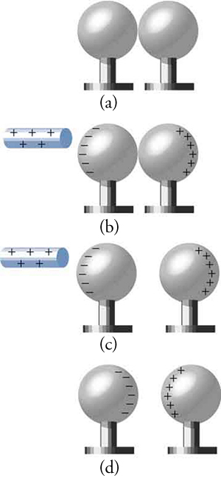

Mynd 18.11
(a) Tvær óhlaðnar leiðandi kúlur snertast, þannig að hleðslan dreifist jafnt yfir báðar kúlurnar. (b) Jákvætt hlaðin stöng nálgast, sem dregur að sér neikvæðar hleðslur og skilur eftir umfram jákvæða hleðslu á hægri kúlunni. (c) Kúlurnar eru aðskildar. Hvor kúla ber nú jafn mikla umframhleðslu. (d) Þegar jákvætt hlaðna stöngin er fjarlægð dregst umfram neikvæð hleðsla á vinstri kúlunni að umfram jákvæðri hleðslu á hægri kúlunni.
Notes:
This figure has four parts, each consisting of a pair of spheres adjacent to each other. Each sphere is on a short pedestal, and all spheres and pedestals are equal in size. In Parts (a) and (b), the pair of spheres are touching each other, but in Parts (c) and (d), the pair of spheres are slightly separated from each other. In Part (a), there is no charge on either sphere. In Part (b), a rod marked with plus signs is shown close to the left sphere, which in turn has minus signs along its left edge. The right sphere has plus signs along its right edge. Part (c) is similar to Part (b), except for separation between the pair of spheres. In Part (d), minus signs are aligned along the right edge of the left sphere, and plus signs are aligned along the left edge of the right sphere. There is no rod in Part (d).

Slide 14
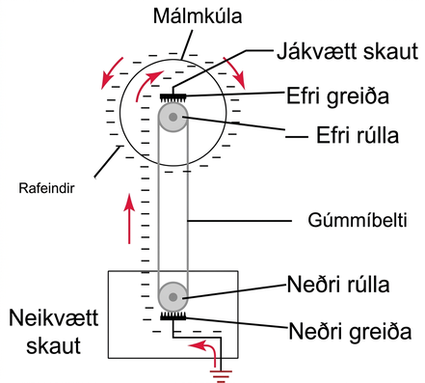
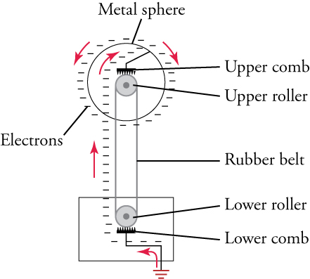
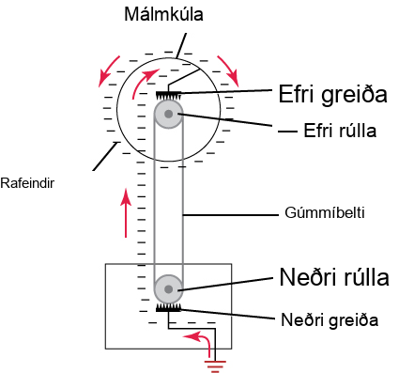
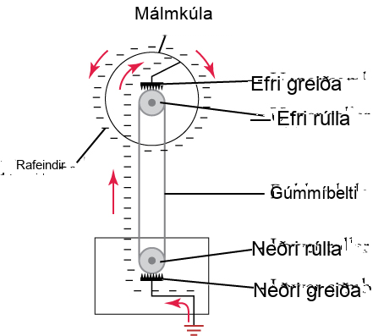
Mynd 18.12
Van de Graaff rafalarnir flytja rafeindir yfir á málmkúlu, þar sem rafeindirnar dreifa sér jafnt yfir ytra yfirborðið.
Notes:
This is a diagram in which two small circles are arranged vertically and are labeled “Upper roller” and “Lower roller”. The two circles are connected by a band labeled “Rubber belt”. A comb-shaped structure touches each circle, and these structures are labeled “Upper comb” and “Lower comb”. The upper circle is in the center of a larger circle labeled “Metal sphere”, and the lower circle is enclosed in a rectangle. A bent line connects the upper comb to the larger circle, and another bent line connects the lower comb to the rectangle and to the ground below the rectangle. A series of minus signs, labeled “Electrons”, is accompanied by a series of arrows, suggesting the flow of electrons from within the rectangle and the lower circle to the upper circle and then to the larger circle.

Slide 15
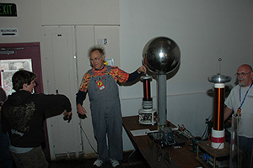

Mynd 18.13
Maðurinn sem snertir Van de Graaff rafalinn hefur umframhleðslu sem dreifist yfir hár hans og hrindir hárstráum frá nágrönnum sínum. (mynd: Jon „ShakataGaNai“ Davis)
Notes:
This is a photograph of a man touching the large sphere of a Van de Graaff generator, causing his hair to stand on end. The picture also shows two observers, one of whom has extended his right arm toward the man touching the generator.

Slide 16
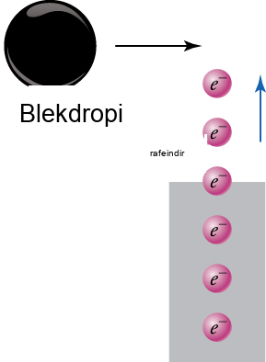
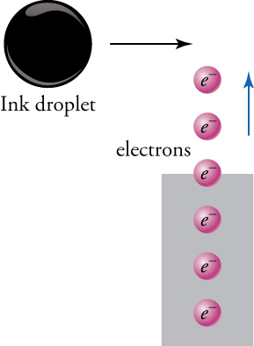
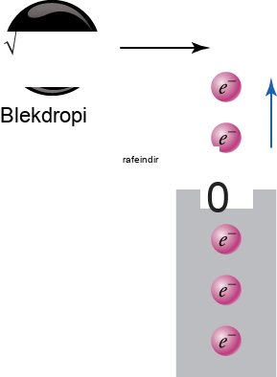
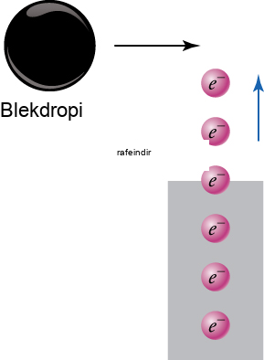

Mynd 18.14
Rafeindir úr rafeindabyssu hlaða blekdropa sem fer hjá.
Notes:
Six small purple spheres, each marked as “e superscript minus”, are arranged vertically and labeled as “electrons”. The three lowest spheres are enclosed in a rectangle, the fourth one above them is crossing the upper edge of the rectangle, and the two uppermost spheres are outside the rectangle. An arrow next to the two uppermost spheres is pointing upward, suggesting the direction of movement of the purple spheres. A much larger black sphere, labeled “Ink droplet”, is above and to the left of the column of purple spheres, and an arrow pointing toward the right suggests the direction of movement of the black sphere.

Slide 17
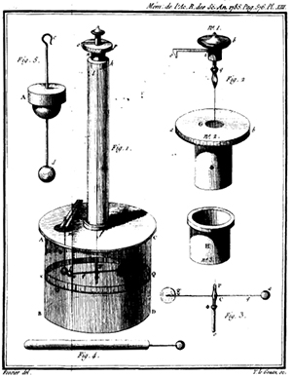
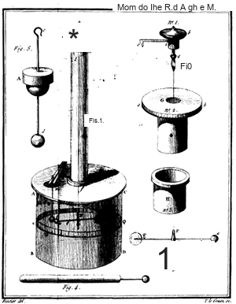

Mynd 18.15
Teikning af snúningsvog Coulombs, sem hann notaði til að mæla rafkraftinn milli hlaðinna kúlna. (inneign: Charles-Augustin de Coulomb)
Notes:
This figure consists of seven drawings, the largest of which is labeled “Fig. 1”. The largest structure appears as follows: there is a cap at the top, and below that are a disc, a long cylinder, a wider disc, and a shorter cylinder. The six smaller drawings show the parts from which the large structure is assembled. One part, labeled “Fig. 5” and placed nearest the upper left corner, consists of a vertical rod with a hook at the top, a sphere at the bottom, and a disc over a hemisphere near the middle. Another part, labeled “Fig. 4”, lies parallel to the bottom edge of the figure. It consists of a rod with a short line and a small sphere attached to one end. Three parts, labeled “Fig. 2”, are arranged in a column on the right side of the figure. Of these, the upper part consists of a cap-shaped structure with a horizontal projection and a vertical projection; the middle part consists of a cylinder with a wider discover it; and the lower part consists of another cylinder with a lip. The final part, labeled “Fig. 3” and placed near the bottom right corner of the figure, is a T-shaped structure with a small sphere at each end of the horizontal line.

Slide 18
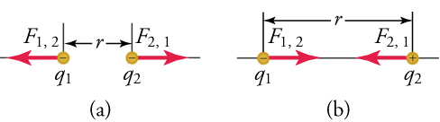

Mynd 18.16
Stærð rafstöðukraftsins F milli punkthleðslna q1 og q2 sem eru í fjarlægðinni r er gefin með lögmáli Coulombs. Athugið að þriðja lögmál Newtons (sérhver kraftur skapar jafnstóran gagnstæðan kraft) gildir sem fyrr — krafturinn (F1,2) á q1 er jafnstór og hefur gagnstæða stefnu við kraftinn (F2,1) sem hún verkar með á q2. (a) Samskonar hleðslur. (b) Ólíkar hleðslur.
Notes:
This figure has two parts. Part a shows two small spheres of equal size, labeled “q subscript 1” and “q subscript 2”, separated by a distance marked as “r”. Each sphere contains a minus sign. Two arrows, labeled “F subscript 1,2” and “F subscript 2,1”, point from the spheres away from each other. Part b also shows two small spheres of equal size, labeled “q subscript 1” and “q subscript 2”, separated by a larger distance marked as “r”. One of these spheres contains a minus sign and the other contains a plus sign. Two arrows, labeled 7F subscript 1,2” and “F subscript 2,1”, point from the spheres toward each other.

Slide 19
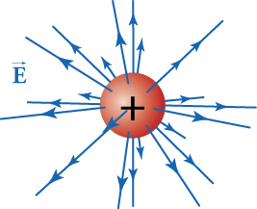

Mynd 18.17
Þrívíð framsetning á rafsviðinu sem myndast af jákvæðri hleðslu.
Notes:
This figure shows a sphere with a plus sign at its center and arrows of varying lengths pointing in every direction away from it. Between the arrows to the left of the sphere is the letter E with an arrow above the letter, indicating that E is a vector.

Slide 20
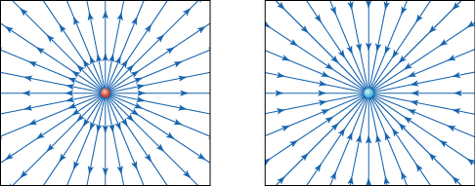

Mynd 18.18
Rafsviðslínur frá tveimur punkthleðslum. Rauði punkturinn vinstra megin hefur hleðsluna of +1 nC og blái punkturinn hægra megin hefur hleðsluna –1 nC. Örvarnar benda í þá átt sem jákvæð prufuhleðsla myndi hreyfast. Sviðslínurnar eru þéttari því nær sem komið er punkthleðslunni.
Notes:
This figure has two parts, each enclosed in a square. At the center of the square on the left is a tiny red circle from which emanate numerous arrows that end on the sides of the square. At the center of the square on the right is a tiny blue circle, and numerous arrows that start from the sides of the square point toward and end at this circle.

Slide 21
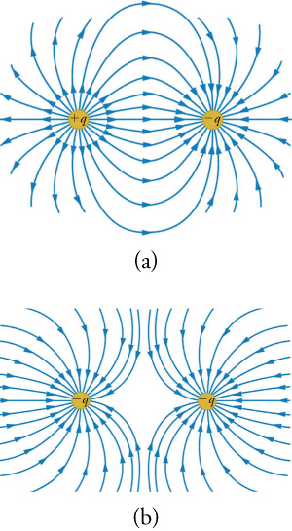

Mynd 18.19
(a) Rafsviðið sem myndað er af jákvæðri punkthleðslu (vinstri) og neikvæðri punkthleðslu af sömu stærð (hægri). (b) Rafsviðið sem myndað er af tveimur jafnstórum neikvæðum hleðslum.
Notes:
This figure has two parts, each of which displays two small circles and numerous curved arrows. In Part a, the circle on the left is marked “plus q” and the one on the right is marked “minus q”. Numerous curved arrows emanate from the circle on the left, and many of them terminate on the circle on the right. In Part b, both circles are marked “minus q”. Numerous curved arrows coming from outside these circles terminate on them. Between the two circles is a gap, because the arrows terminating on the left circle do not touch those terminating on the right circle.

Slide 22
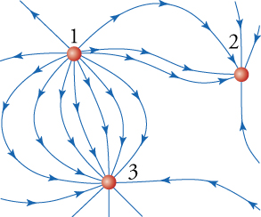

Mynd 18.20
Kort af rafsviði vegna þriggja hlaðinna agna.
Notes:
This diagram shows three small circles and various curved arrows pointing toward or away from them. A circle near the top left corner is labeled “1”, another located east of it is labeled “2”, and a third located roughly south of the first circle is labeled “3”. Some curved arrows emanating from circle 1 terminate on circle 2, and other curved arrows emanating from circle 1 terminate on circle 3.

Slide 23
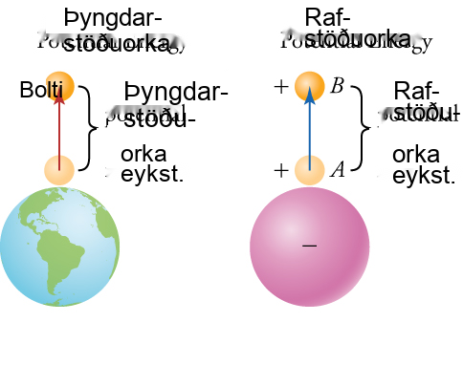
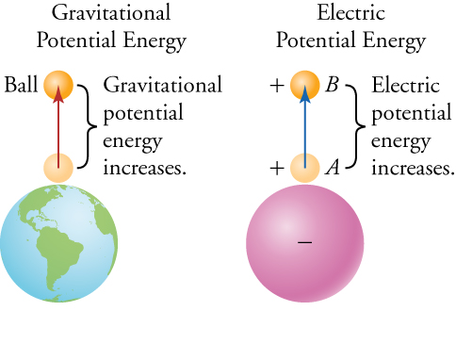
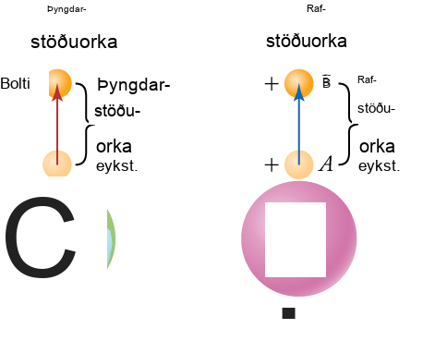
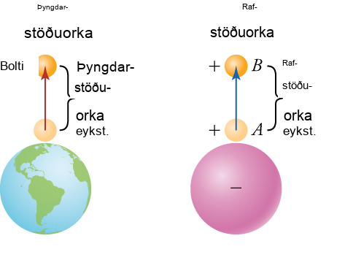
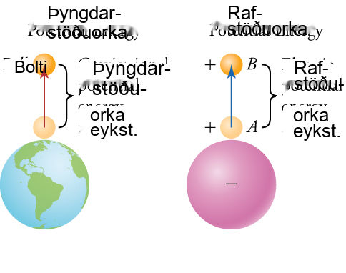
Mynd 18.21
Til vinstri vísar þyngdarsviðið í átt að jörðinni. Því ofar sem boltinn er í þyngdarsviðinu, því meiri er stöðuorka kerfisins jörð-bolti. Til hægri vísar rafsviðið í átt að neikvæðri hleðslu. Því lengra sem jákvæða hleðslan er frá neikvæðu hleðslunni, því meiri er stöðuorka tveggja hleðslna kerfisins.
Notes:
This figure has two columns. The left column is labeled “Gravitational Potential Energy”, and the right column is labeled “Electric Potential Energy”. In the left column, a large sphere represents planet Earth, as it shows features of land and water. Above it are two small balls, with an arrow pointing from the lower to the upper ball. The gap between the two small balls is labeled “Gravitational potential energy increases.” In the right column, a large sphere is marked with a minus sign at its center. Above it are two small balls, each marked with a plus sign, and an arrow points from the lower to the upper ball. The gap between the two small balls is labeled “Electric potential energy increases.”

Slide 24



Mynd 18.22
Á efri myndinni fær massi hröðun vegna stöðugs rafsviðs. Á neðri myndinni fær massinn hröðun vegna stöðugs þyngdarsviðs.
Notes:
This figure is divided into two parts. The upper part shows a vertical strip on the left marked with plus signs and two vertical strips on the right marked with minus signs. A series of horizontal arrows point from the left strip to the strips on the right. A small sphere, labeled “plus q”, is located between these arrows and near the strip on the left. Another horizontal arrow, with ends labeled “A” and “B”, points from the sphere toward a gap between the strips on the right. Above this drawing is an equation: delta P E subscript elec equals delta K E. The lower part of the figure shows a small sphere, labeled “m”, on the slope of a small green hill. An arrow points from the sphere downward, parallel to the slope of the hill. To the right of the hill is a flat green area. Above the flat area is an equation: delta P E subscript grav equals delta K E.

Slide 25





Mynd 18.23
Stöðuorkan er háð formerki hleðslnanna og fjarlægðinni á milli þeirra. Örvarnar á hleðslunum sýna í hvaða stefnu þær myndu hreyfast ef þeim væri sleppt. Þegar hleðslur með sama formerki eru langt frá hvor annarri er stöðuorka þeirra lág, eins og sýnt er á efri myndinni fyrir tvær jákvæðar hleðslur. Staðan er öfug fyrir hleðslur með ólík formerki, eins og sýnt er á neðri myndinni.
Notes:
This figure has two panels. The upper panel shows a pair of red spheres, labeled “plus q subscript 1” and “plus q subscript 2”, separated horizontally by a distance marked “far apart”, and a label to their right says “Low potential energy”. Below them is a similar pair of spheres, but they are at a distance marked “close together”, and a label to their right says “High potential energy”. The lower panel shows a blue sphere on the left labeled “minus q subscript 1” and a red sphere on the right labeled “plus q subscript 2”. They are separated horizontally by a distance marked “far apart”, and a label to their right says “High potential energy”. Below them is a similar pair of spheres, but they are at a distance marked “close together”, and a label to their right says “Low potential energy”.

Slide 26


Mynd 18.24
Mættið í rauða punktinum er einfaldlega summa mættanna frá hverri einstöku hleðslu.
Notes:
This figure shows three small blue spheres distributed around a much smaller red sphere. One blue sphere, labeled “q subscript 1”, lies roughly northwest of the red sphere, and an arrow labeled “r subscript 1” points from the blue sphere to the red one. A second blue sphere, labeled “q subscript 2”, lies roughly southwest of the red sphere, and an arrow labeled “r subscript 2” points from this blue sphere to the red one. The third blue sphere, labeled “q subscript 3”, lies directly south of the red sphere, and an arrow labeled “r subscript 3” points from this blue sphere to the red one.

Slide 27


Mynd 18.25
Rafáll í náttúrulegu umhverfi sínu. (mynd: Steven G. Johnson)
Notes:
This is a photograph showing the head of an electric eel just above water, next to the leaves of a plant growing in the water.

Slide 28




Mynd 18.26
Í röntgenlampa fer mikill straumur um rafeindagjafann, sem veldur því að rafeindir losna frá honum. Losnuðu rafeindunum er hraðað að skotmarkinu af rafsviðinu. Þegar þær lenda á skotmarkinu myndast röntgengeislar.
Notes:
This diagram shows a vertically oriented ellipse labeled “Electron source” on the left, and a trapezoid labeled “Target” on the right. Between them, in the middle section of the diagram, there are four tiny spheres labeled “Electrons”, each of which has a short, rightward pointing arrow attached to it. Five long, horizontal arrows point from the trapezoid to the ellipse, and a label between them says “Electric field”. Near the middle of the left edge of the trapezoid is a yellow circle from which emerge three long, orange, wavy lines, as well as a number of short yellow and red lines. The long wavy lines are labeled “X-rays”.

Slide 29


Mynd 18.27
Rauðu punktarnir eru jákvæðar hleðslur og bláu punktarnir eru neikvæðar hleðslur. Stefna rafsviðsins er sýnd með rauðu örvunum. Taktu eftir að rafsviðið á milli jákvæðu og neikvæðu punktanna er nokkuð jafnt.
Notes:
This diagram shows five red dots forming a vertical column on the left side and five blue dots forming a second vertical column on the right side. Each red dot is marked with a “plus” symbol, and each blue dot is marked with a “minus” symbol. Surrounding these dots are small arrows pointing in various directions. Between the two columns of dots, most of the arrows point rightward, from the red dots toward the blue ones. The arrows around each red dot point away from it, and most arrows around each blue dot point toward it.

Slide 30


Mynd 18.28
Tvær samsíða málmplötur eru hlaðnar með andstæðri hleðslu með því að tengja plöturnar við andstæð skaut rafhlöðu. Stærð hleðslunnar á hvorri plötu er sú sama.
Notes:
This figure shows two parallel strips in vertical orientation connected to the terminals of a battery. The strip on the left has a series of “plus” signs and is labeled “plus Q”. It is connected to the battery terminal marked with a “plus” sign. The strip on the right has a series of “minus” signs and is labeled “minus Q”. It is connected to the battery terminal marked with a “minus” sign. Between the strips is a series of horizontal lines, and below these lines is a label that says, “E is proportional to Q”, using a proportionality sign.

Slide 31



Mynd 18.29
Nokkrir dæmigerðir þéttar. (mynd: Windell Oskay)
Notes:
This is a photograph showing seven small capacitors, of varying shapes and colors, usually found in electronic circuits.

Slide 32





Mynd 18.30
Efri og neðri þéttirinn bera sömu hleðslu Q. Efri þéttirinn hefur ekkert rafsvarsefni á milli platnanna. Neðri þéttirinn hefur rafsvarsefni á milli platnanna. Sameindirnar í rafsvarsefninu skautast af rafsviði þéttisins.
Notes:
This figure has two panels. The upper panel shows two parallel strips in vertical orientation. The strip on the left has a series of “plus” signs and is labeled “plus Q”. The strip on the right has a series of “minus” signs and is labeled “minus Q”. Between the strips is a series of horizontal arrows pointing from left to right, and below the arrows is a label that says “No dielectric”. The lower panel shows two similar strips, with the strip on the left containing “plus” signs and labeled “plus Q”, and the one on the right containing “minus” signs and labeled “minus Q”. Between the strips is a grid of elliptical shapes of equal size, each containing a “minus” sign on the left and a “plus” sign on the right. The whole group of ellipses is labeled “With dielectric”, and one ellipse is labeled “Polarized molecule”. A label pointing to a minus sign within an ellipse says “Negative charge on surface”, and another label pointing to a plus sign within an ellipse says “Positive charge on surface”. Also, a series of short, rightward pointing arrows lie on each side of the grid of ellipses.

Slide 33





Mynd 18.31
Efri og neðri þéttarnir bera sömu hleðslu Q. Efri þéttirinn hefur ekkert rafsvaraefni milli platna sinna. Neðri þéttirinn hefur rafsvaraefni milli platna sinna. Vegna þess að sumar rafsviðslínur enda og byrja á skautunarhleðslum í rafsvaraefninu er rafsviðið minna í þéttinum. Þannig geymir þéttir minni orku fyrir sömu hleðslu þegar hann inniheldur rafsvaraefni.
Þetta OpenStax viðbótarefni er © Rice University undir CC BY-NC-SA 4.0 alþjóðlegu leyfi; það má afrita eða breyta því eingöngu í óviðskiptalegum tilgangi, en eigna verður OpenStax og Rice University og taka skal fram allar breytingar. Öllum aðlögunum skal deila undir sams konar leyfi.
Notes:
This figure has two panels. The upper panel shows two parallel strips in vertical orientation. The strip on the left has a series of plus signs and is labeled “plus Q”. The strip on the right has a series of minus signs and is labeled “minus Q”. Between the strips is a series of horizontal arrows pointing from left to right, and below the arrows is a label that says “No dielectric”. The lower panel shows two similar strips, with the strip on the left containing plus signs and labeled “plus Q”, and the one on the right containing minus signs and labeled “minus Q”. Between the strips is a rectangle labeled “With dielectric”, with a few minus signs along its left edge and a few plus signs along its right edge. Also, between the strips are several long arrows pointing rightward and going from the left strip to the right one. In addition, a series of short, rightward pointing arrows lie between the left strip and the rectangle and between the rectangle and the right strip.

