Slide 1





Eðlisfræði
Kafli 9 Vinna, orka og einfaldar vélar

Slide 2
Yfirlit kafla
Vinna, afl og vinnu-orkusetningin
Vélræn orka og varðveisla orku
Einfaldar vélar

Slide 3
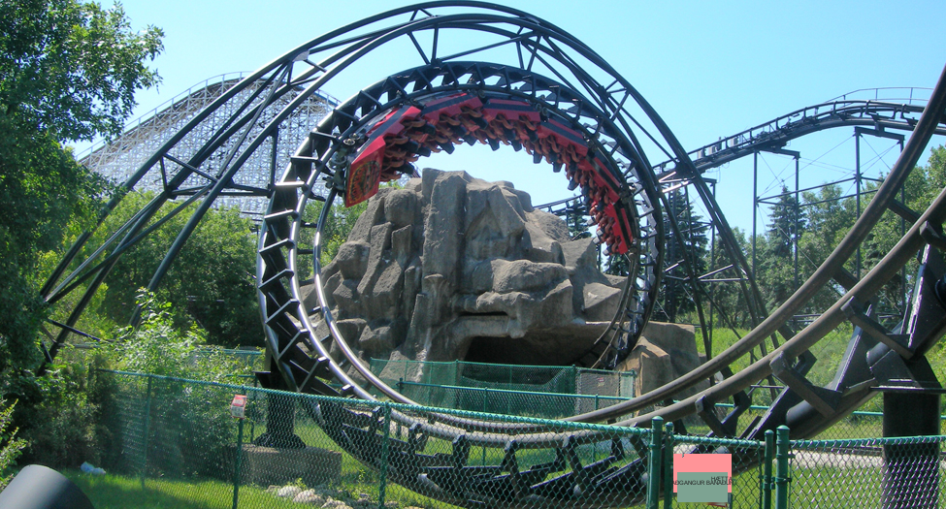
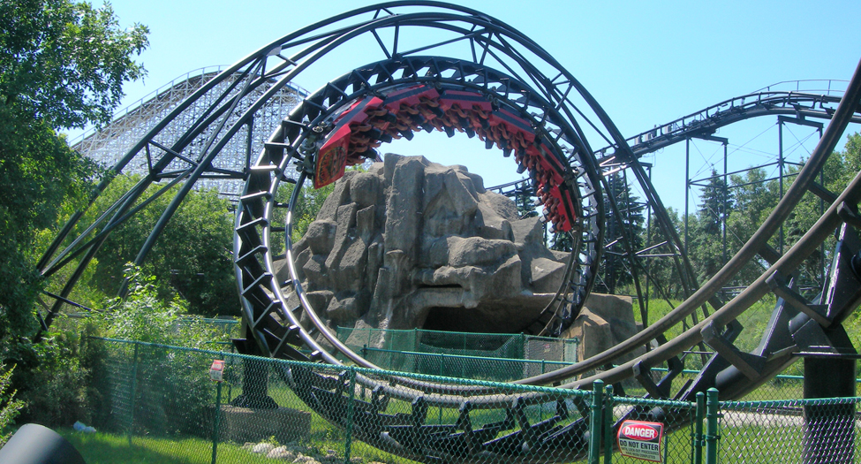
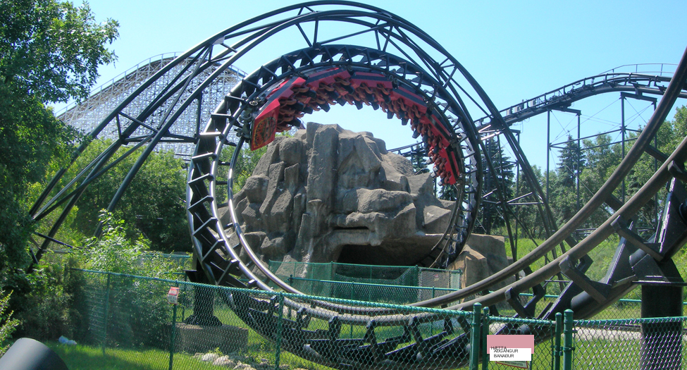

Mynd 9.1
Fólk í rússíbana upplifir spennu sem stafar af breytingum á orkuformum. (Jonrev, Wikimedia Commons)
Notes:
A photograph shows a roller coaster cart in an upside down position inside a roller coaster loop of a track

Slide 4
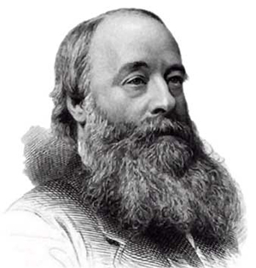

Mynd 9.2
Mælieiningin júl er nefnd eftir eðlisfræðingnum James Joule (1818–1889). (C. H. Jeens, Wikimedia Commons)
Notes:
A black and white photograph of James Joule is shown.

Slide 5
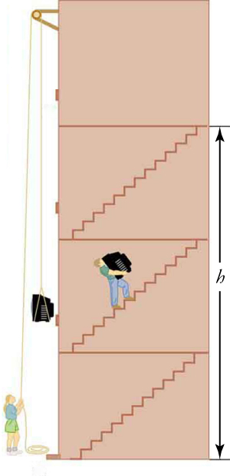

Mynd 9.3
Sama hvernig sjónvarp er flutt upp á fjórðu hæð, er unnin vinna og aukning stöðuorku sú sama.
Notes:
A cross-section view of a four-story elevator is shown. The first three floors are labeled with h. A person is carrying a television up a flight of stairs on the second floor. Another person is standing on the ground floor, using a pulley to move a television up the floors.

Slide 6
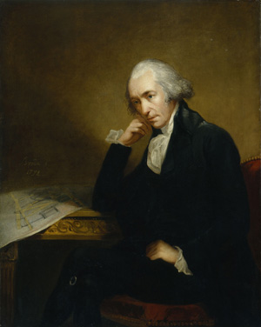

Mynd 9.4
Er James Watt að hugsa um vött? (Carl Frederik von Breda, Wikimedia Commons)
Notes:
A painting of James Watt is shown.

Slide 7
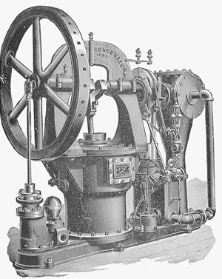


Mynd 9.5
Síðari gerð af gufuvél Watts. (Nehemiah Hawkins, Wikimedia Commons)
Notes:
A black and white illustration of an early steam engine is shown.

Slide 8
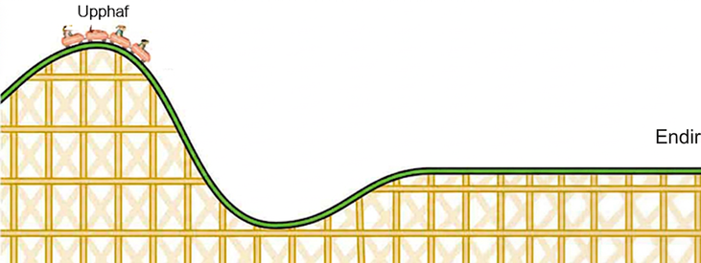

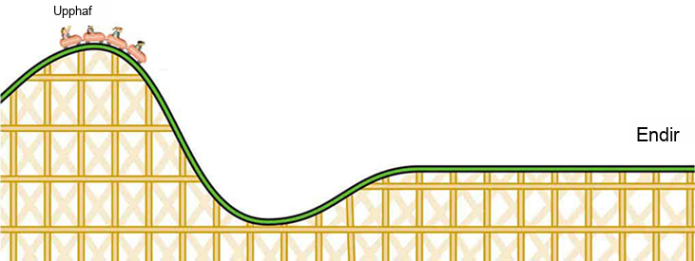
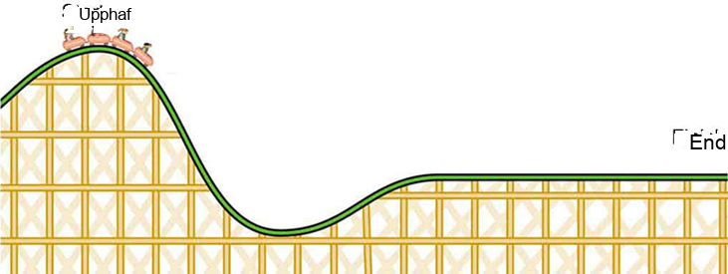
Mynd 9.6
Í þessari rússíbanareið á sér stað umbreyting á milli stöðuorku og hreyfiorku.
Notes:
An illustration shows a side view of a roller coaster. People in a cart are at the top of a hill, and the cart is labeled Start. The cart is heading towards a downward slope. The opposite end of the roller coaster is flat and is labeled Finish.

Slide 9
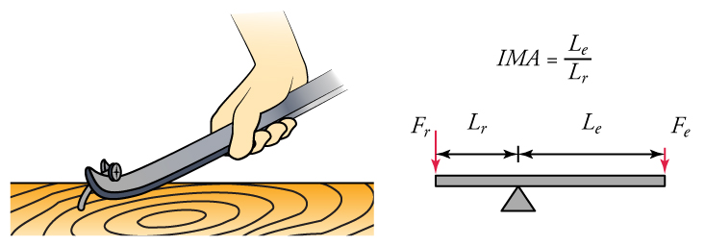
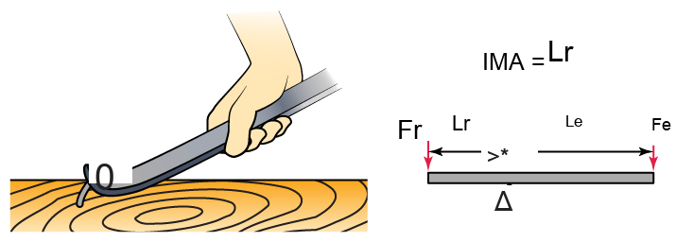

Mynd 9.7
(a) Kúbein er tegund af vogarafli. (b) Kjörvélrænn ávinningur er jafn lengd átaksarmsins deilt með lengd mótstöðuarms vogaraflsins.
Notes:
Two diagrams are shown side by side. The diagram on the left shows a drawing of a hand pulling a mail out of wood using a lever. The diagram on the right shows an illustration of a lever and a fulcrum. The fulcrum is closer to the left side of the lever than the right side. The distance of the left side of the lever is labeled L subscript r and the distance of the right side is labeled L subscript e. A force vector is pointing down on the left side and is labeled F subscript r, and a force vector is pointing down on the right side and is labeled F subscript e. The equation IMA equals L subscript e over L subscript r is also shown.

Slide 10
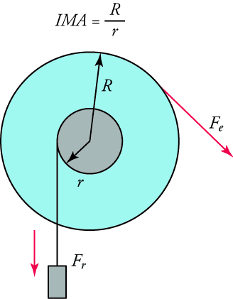

Mynd 9.8
Kraftur sem beitt er á hjól framkallar kraft á öxul þess.
Notes:
A diagram of a wheel is shown. The equation IMA equals capital R over lowercase r. A small grey circle is inside a larger blue circle. An arrow labeled lowercase r points from the center of the smaller circle to its edge. An arrow labeled capital R points from the center of the smaller circle to the edge of the larger circle. A mass is attached to the smaller circle and has a force vector, F subscript r, pointing downward from it. Another force vector, F subscript e, points downward and to the right from the edge of the larger circle.

Slide 11
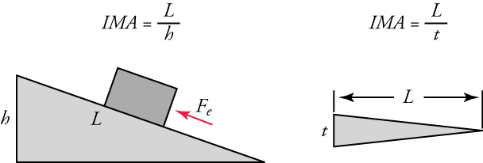
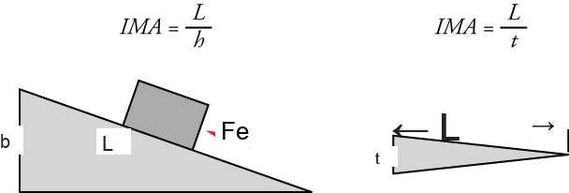
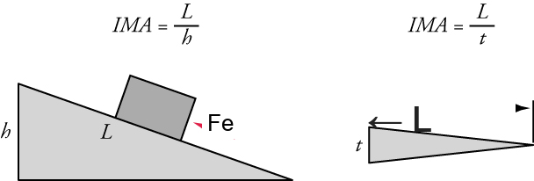
Mynd 9.9
Skáborð er sýnt til vinstri og fleygur er sýndur til hægri.
Notes:
Two diagrams are shown side-by-side. On the left, an inclined plane is shown. Its horizontal surface distance is labeled L and its height is labeled h. A box is shown on the surface with a force vector that points up the plane. The equation IMA equals L over h is shown. On the right, a wedge is shown. Its horizontal surface distance is labeled L. Its height is labeled t. The equation IMA equals L over t is also shown.

Slide 12
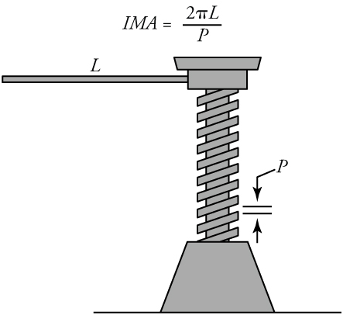
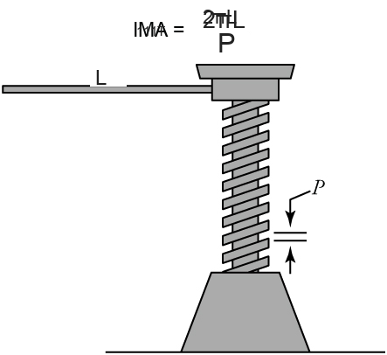
Mynd 9.10
Skrúfan sem hér er sýnd er notuð til að lyfta mjög þungum hlutum, eins og horni á bíl eða húsi, stutta vegalengd.
Notes:
An illustration of a screw is shown. It has a long lever, labeled L. P is pitch, the distance between the threads.

Slide 13
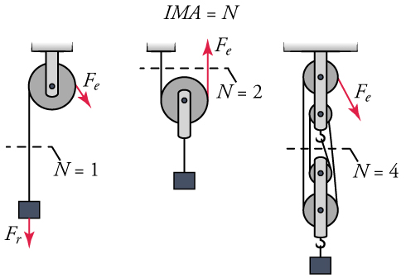
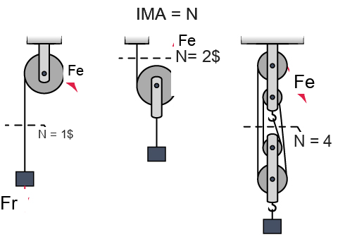
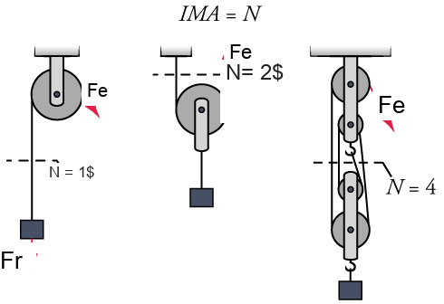
Mynd 9.11
Hér eru sýnd þrjú trissukerfi.
Notes:
Three pulley systems are shown in side-by-side diagrams. The first consists of a single pulley and is shown holding a mass. The mass is labeled with a force vector, F r, that also points downward. Another force vector, F e, is shown pointing downward from the pulley. N equals one is also shown. The second pulley system consists of a single pulley holding a mass. A force vector, F e, points upward from the pulley. N equals two is shown. The last pulley system shows four pulleys holding a mass with a hook. A force vector, F e, points downward from the pulley. N equals four is shown.

Slide 14
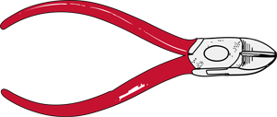

Mynd 9.12
Vírklippur eru algeng samsett vél.
Þetta OpenStax viðbótarefni er © Rice University undir CC BY-NC-SA 4.0 alþjóðlegu leyfi; það má afrita eða breyta því eingöngu í óviðskiptalegum tilgangi, en eigna verður OpenStax og Rice University og taka skal fram allar breytingar. Öllum aðlögunum skal deila undir sams konar leyfi.
Notes:
An illustration shows a pair of hand-held wire cutters.

