Slide 1


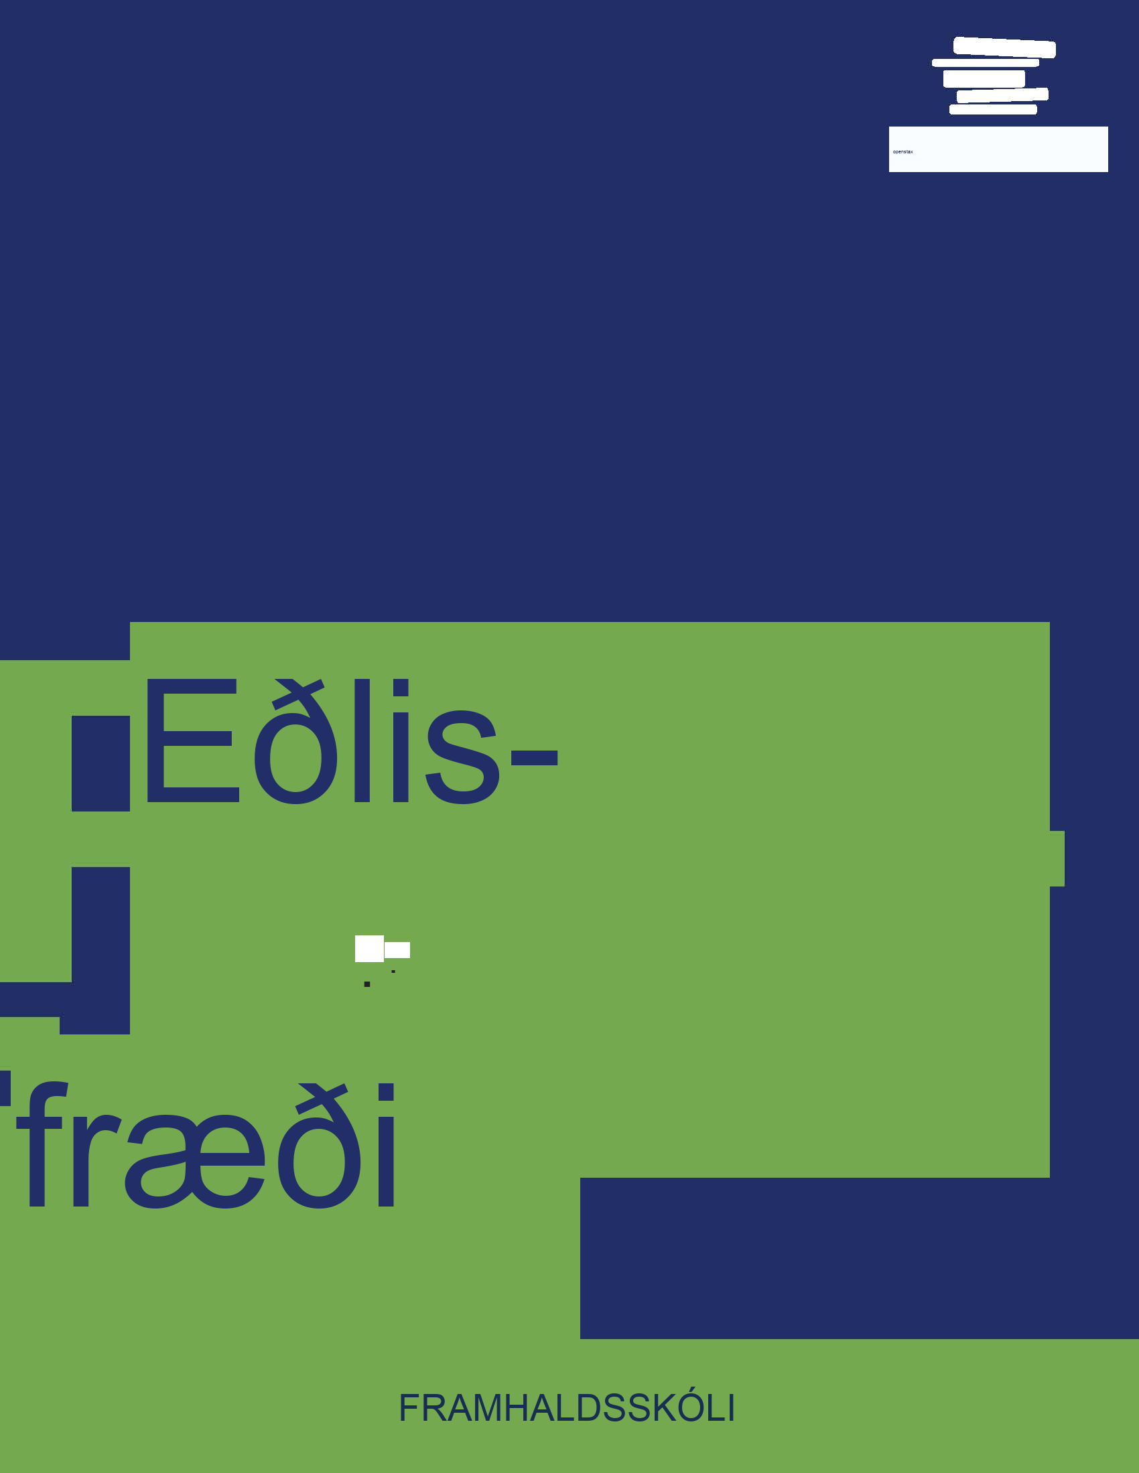


Eðlisfræði
Kafli 15 Ljós

Slide 2
Yfirlit kafla
Rafsegulrófið
Hegðun rafsegulgeislunar

Slide 3
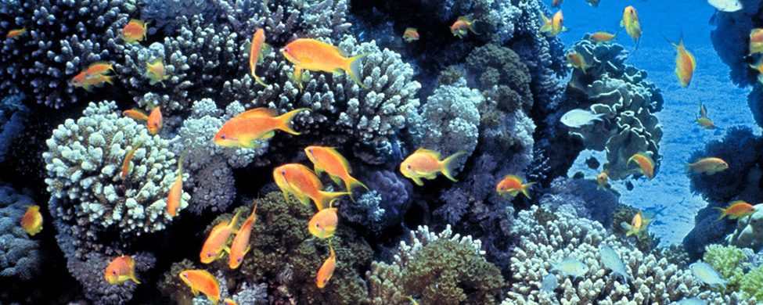

Mynd 15.1
Augu manna greina þessa appelsínugulu sægullfiska synda yfir kóralrifi í bláum sjó Eilat-flóa í Rauðahafinu með hjálp sýnilegs ljóss. (mynd: David Darom, Wikimedia Commons)
Notes:
The figure is a photograph of small, colorful fish swimming around a coral reef.

Slide 4
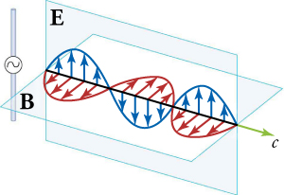

Mynd 15.2
Hluti af rafsegulbylgju sem send er út frá sveiflandi hleðslu á einu augnabliki. Raf- og segulsviðin (E og B) eru í fasa og þau eru hornrétt hvort á annað og á útbreiðslustefnuna. Til skýringar eru bylgjurnar aðeins sýndar í eina stefnu, en þær breiðast einnig út í aðrar stefnur.
Notes:
The diagram shows two intersecting planes: a vertical plane labeled “E” and a horizontal plane labeled “B”. The line of intersection is drawn as an arrow, with the letter “c” next to the arrowhead. Within the vertical plane are the crest, trough, and crest of a blue wave, enclosing arrows that point from the baseline to the line of the wave. Likewise, within the horizontal plane are the crest, trough, and crest of a red wave, enclosing arrows that point from the baseline to the line of the wave. To the left of the intersecting planes is a thin vertical bar with a small circle in the middle and a wave symbol within the circle.

Slide 5
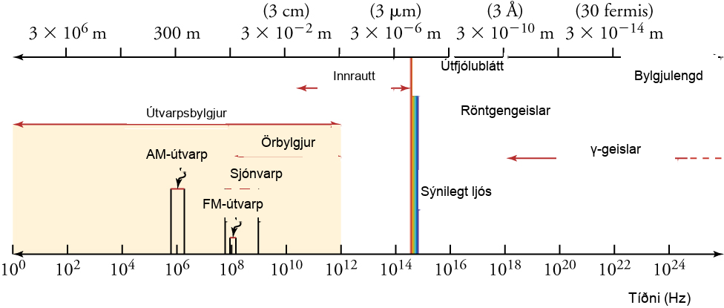
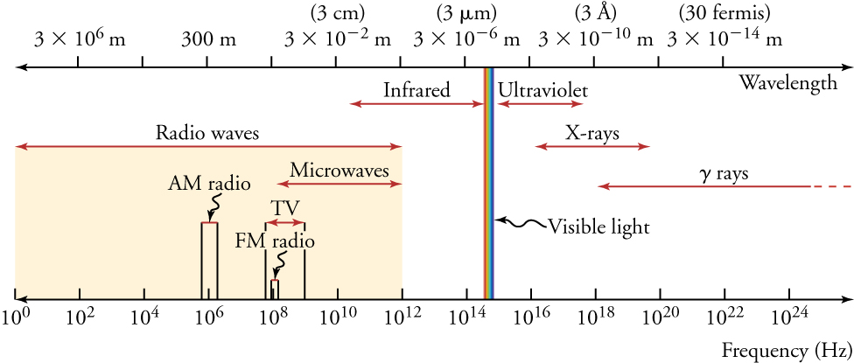
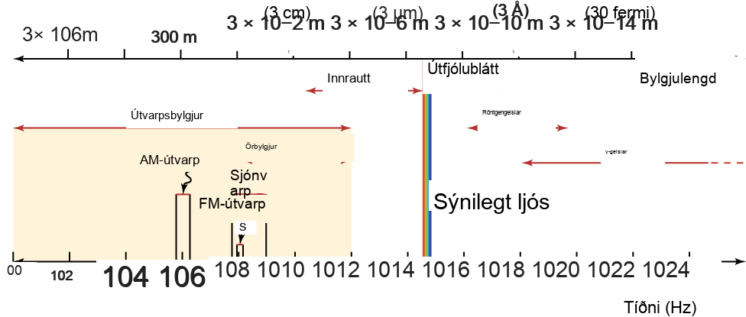

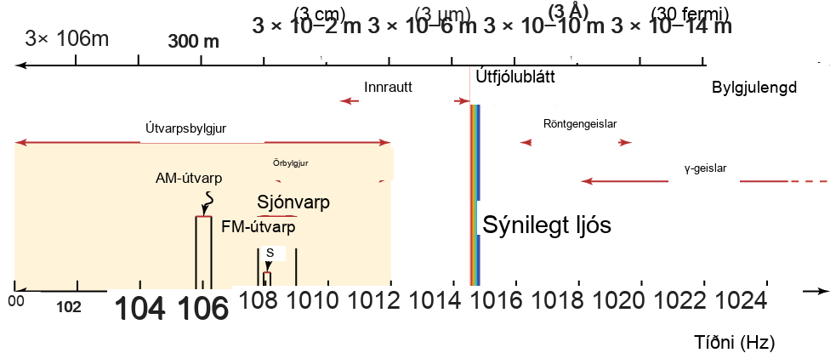

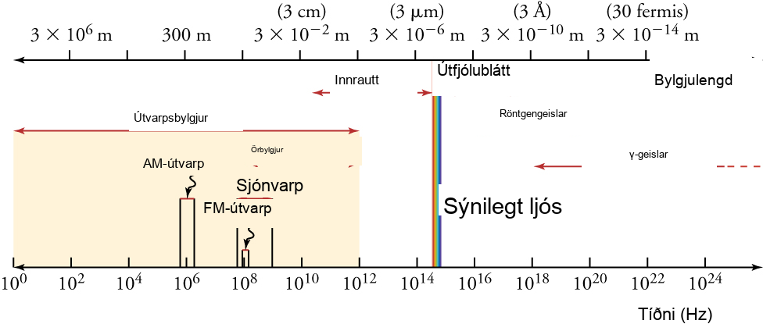
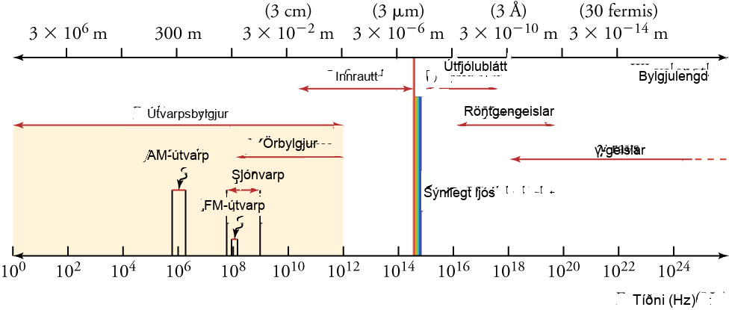
Mynd 15.3
Rafsegulrófið, sem sýnir helstu flokka rafsegulbylgna. Spönn tíðni og bylgjulengda er gríðarstór. Skilin milli sumra flokka eru skýr, en aðrir flokkar skarast.
Notes:
This figure shows the electromagnetic spectrum between two parallel, horizontal lines. The lower line, labeled “Frequency (Hz)”, is calibrated in increments that increase by 100-fold, starting from 10 superscript 0 at the extreme left and ending beyond 10 superscript 24 on the extreme right. The upper line, labeled “Wavelength”, is calibrated in increments that decrease by 100-fold, starting from 3 times 10 superscript 6 on the left and ending with 3 times 10 superscript minus 14 on the right. Each wavelength measure has the unit “m” after it. The various categories of the spectrum are written between the parallel lines, with a double-headed arrow showing the range of each category. Starting from the left, they are: “Radio waves”, “Infrared”, “Visible light”, “Ultraviolet”, “X rays”, and “gamma rays”. Within the range for “Radio waves” are the subcategories labeled as “AM radio”, “TV”, and “Microwaves”. Within the range for “TV” is the subcategory FM radio.

Slide 6
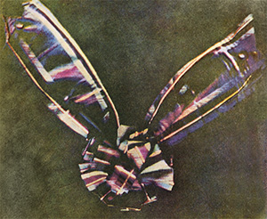

Mynd 15.4
Ljósmynd Maxwells og Suttons af lituðum borða. Þetta var fyrsta varanlega litljósmyndin. Skoska köflótta mynstrið var litríkt myndefni.
Notes:
Photograph of a tartan ribbon tied like a bow.

Slide 7
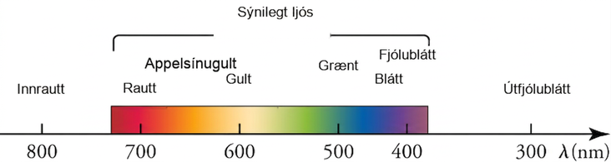
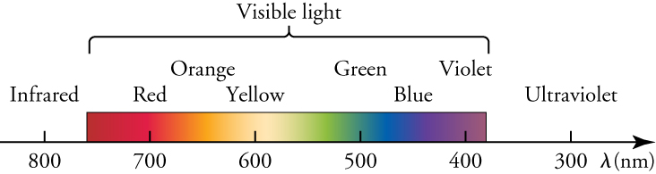
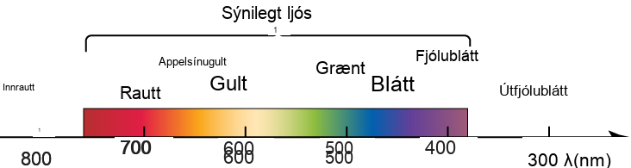
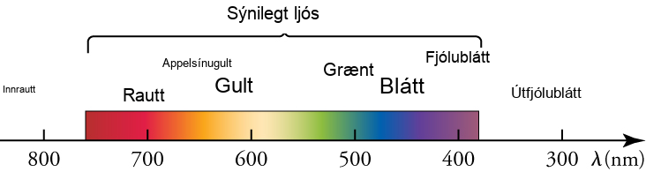
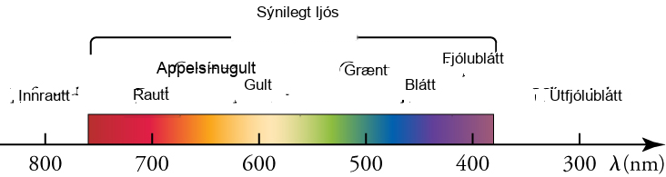
Mynd 15.5
Lítill hluti rafsegulrófsins sem inniheldur sýnilega hluta þess. Mörkin milli innrauðs, sýnilegs og útfjólublás ljóss eru ekki fullkomlega skýr, og ekki heldur mörkin milli sjö lita regnbogans.
Notes:
This diagram focuses on the visible section of the electromagnetic spectrum. A horizontal arrow represents wavelengths of light decreasing from left to right. The arrow is calibrated with numbers ranging from 800 on the left to 300 on the right, and the line is labeled with the Greek letter lambda, followed by the letters n m in parentheses. Above the arrow is a colored band stretching from about 760 up to about 420. The band, labeled as “Visible light”, shows colors labeled as “Red”, “Orange”, “Yellow”, “Green”, “Blue”, and “Violet”. To the left of the band is a region labeled as “Infrared”, above the 800 mark. To the right of the band is a region labeled as “Ultraviolet”, above the 300 mark.

Slide 8
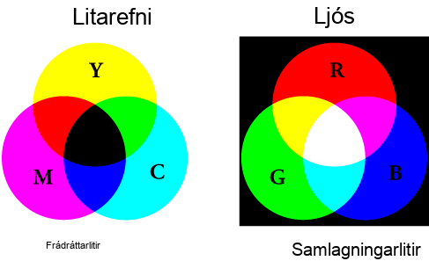
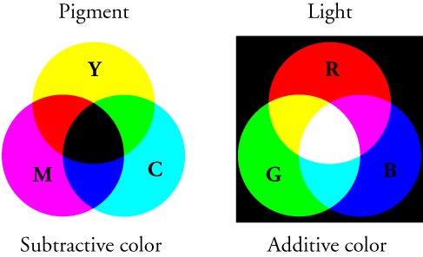
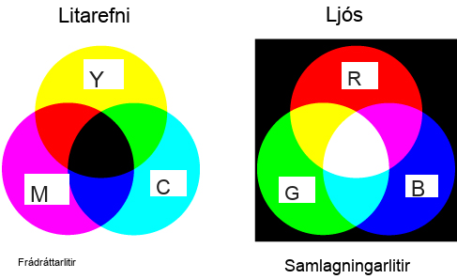
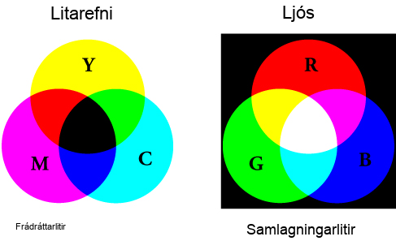
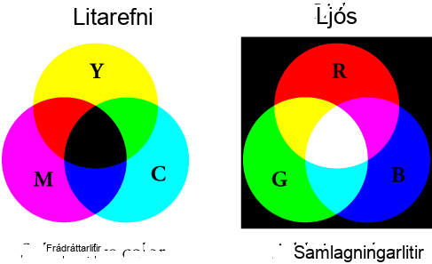
Mynd 15.6
Blöndun litaðra litarefna fylgir frádráttarlitahringnum og blöndun litaðs ljóss fylgir samlagningarlitahringnum.
Notes:
The figure shows two panels arranged side by side. Each panel consists of three overlapping circles, arranged such that the intersection of any two circles passes through the center of the third circle. The left panel, labeled “Pigment” at the top and “Subtractive color” at the bottom, has the three circles on a white background. The top circle is labeled “Y” and colored yellow; the bottom left circle is labeled “M” and colored magenta; the bottom right circle is labeled “C” and colored cyan. The areas of overlap of pairs of circles are colored red, dark blue, and green, and the area of overlap of all three circles is black. The right panel, labeled “Light” at the top and “Additive color” at the bottom, has the three circles on a black background. The top circle is labeled “R” and colored red; the bottom left circle is labeled “G” and colored green; the bottom right circle is labeled “B” and colored dark blue. The areas of overlap of pairs of circles are colored yellow, cyan, and magenta, and the area of overlap of all three circles is white.

Slide 9
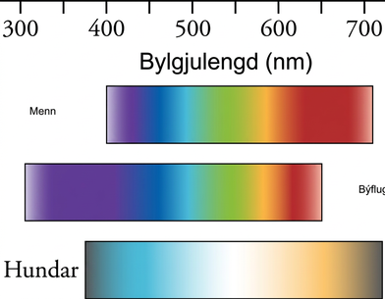
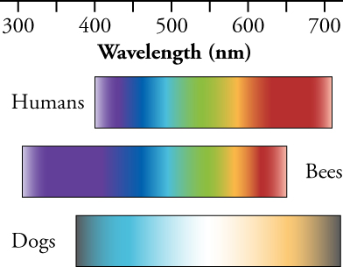
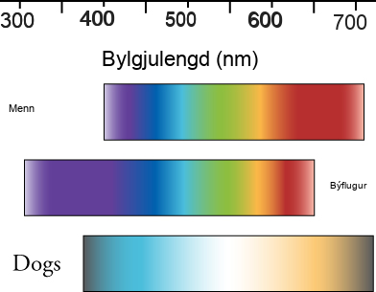


Mynd 15.7
Menn, býflugur og hundar sjá liti á mismunandi hátt. Hundar sjá færri liti en menn og býflugur sjá annað litróf.
Notes:
This figure shows three parallel, horizontal bands of colors, labeled “Humans”, “Bees”, and “Dogs”. Each band starts with the blue color on the left and ends with the red color on the right. Above the bands is a horizontal line calibrated with numbers ranging from 300 on the left to 700 on the right, and the line is labeled as “Wavelength”, followed by the letters n m in parentheses.

Slide 10
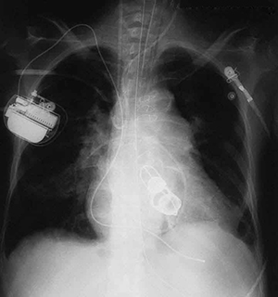

Mynd 15.8
Þessi röntgenmynd sýnir mörg áhugaverð atriði, eins og gervihjartalokur, gangráð og víra sem notaðir eru til að loka bringubeininu. (mynd: P.P. Urone)
Notes:
This figure is an X-ray of a person's chest cavity. It includes the outlines of artificial heart valves, a pacemaker, and some wires.

Slide 11
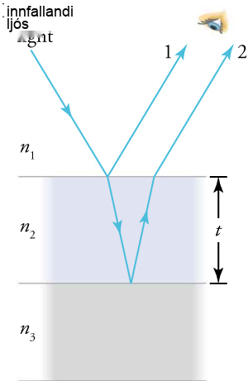
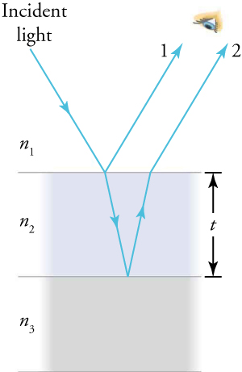
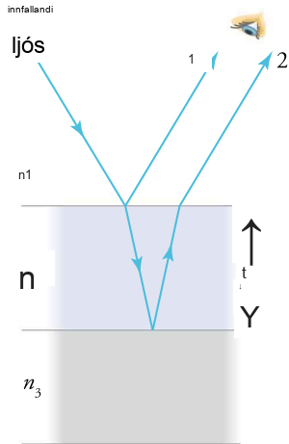
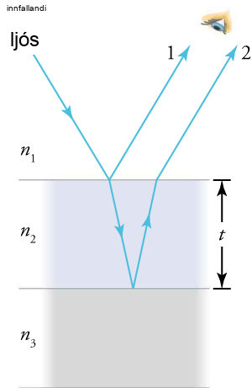
Mynd 15.9
Ljós sem skellur á þunnri filmu endurkastast að hluta (geisli 1) og brotnar að hluta á efra yfirborðinu. Brotni geislinn endurkastast að hluta á neðra yfirborðinu og kemur út sem geisli 2. Þessir geislar munu trufla hvor annan á þann hátt sem fer eftir þykkt filmunnar og brotstuðlum hinna ýmsu efna.
Notes:
This diagram shows three areas separated by two parallel, horizontal lines. The distance between the two lines is labeled “t”. The top area, labeled n subscript 1, has a white background. The middle area, labeled n subscript 2, has a hazy bluish background. The bottom area, labeled n subscript 3, has a hazy gray background. An arrow labeled “Incident light” starts from the top left of the white area, points in a southeasterly direction, and ends on the upper horizontal line. At that point, two arrows emerge: one of them, labeled number 1, travels back through the white area in the northeast direction; the other travels through the bluish area in a south-southeast direction until it reaches the lower horizontal line. At the point where the lower arrow ends, another arrow begins, pointing in the north-northeast direction until it reaches the upper horizontal line. From that junction, a new arrow emerges, labeled number 2, traveling in the white area and parallel to the arrow labeled number 1. A human eye observes the arrows marked 1 and 2.

Slide 12
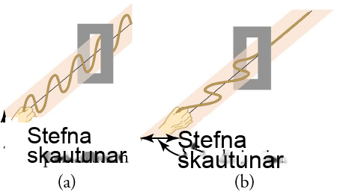
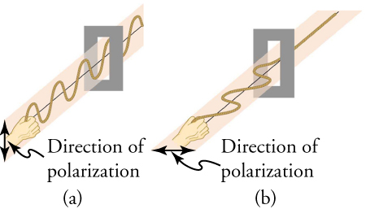
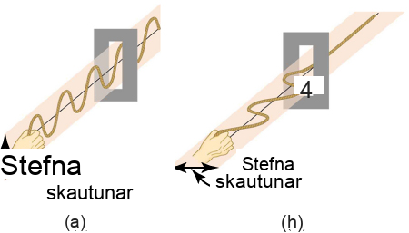
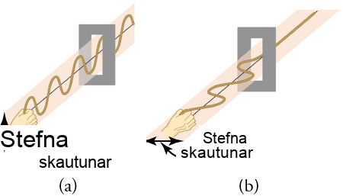
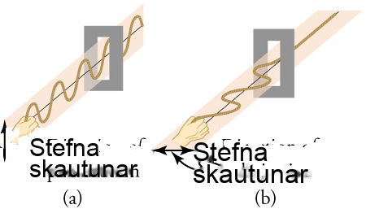
Mynd 15.10
Þversveiflurnar í öðru reipinu eru í lóðréttum fleti, en í hinu reipinu eru þær í láréttum fleti. Fyrri bylgjan er sögð vera lóðrétt skautuð, en hin er sögð vera lárétt skautuð. Lóðréttar raufar hleypa lóðrétt skautuðum bylgjum í gegn en stöðva lárétt skautaðar bylgjur.
Notes:
This figure has two panels arranged side by side. The left panel, labeled “(a)”, shows a hand holding one end of a wave moving in a vertical plane and passing through a vertically oriented slit. Next to the hand is a double-headed vertical arrow labeled “Direction of polarization”. The right panel, labeled “(b)”, shows a hand holding one end of a wave moving in a horizontal plane and passing through a horizontally oriented slit. Next to the hand is a double-headed horizontal arrow labeled “Direction of polarization.

Slide 13
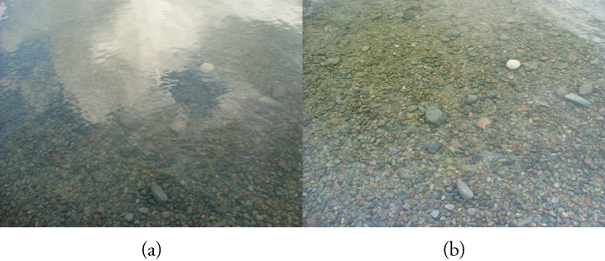

Mynd 15.11
Þessar tvær ljósmyndir af á sýna áhrif skautsíu til að draga úr glampa í ljósi sem endurkastast frá yfirborði vatns. Hluti (b) af þessari mynd var tekinn með skautsíu og hluti (a) var tekinn án hennar. Þar af leiðandi sést endurkast skýja og himins sem sést í hluta (a) ekki í hluta (b). Skautsólgleraugu eru sérstaklega gagnleg á snjó og vatni.
Notes:
This figure shows two photographs arranged side by side. The left photograph, labeled “(a)”, shows a river bed that looks hazy because of interfering gray and white patches. The right photograph, labeled “(b)”, shows the same area of the river bed with almost no interfering gray patches, so that the pebbles on the bed are clearly visible.

Slide 14
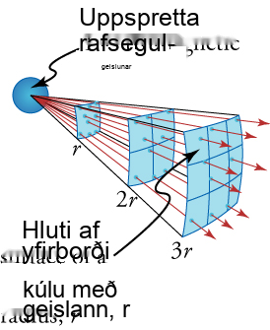
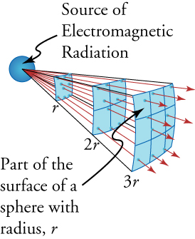
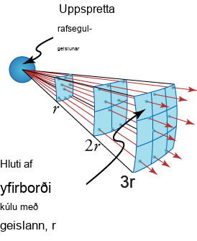
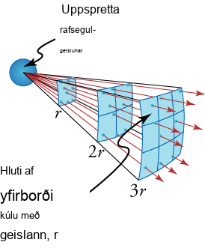

Mynd 15.12
Skýringarmyndin sýnir hvers vegna lýsingin er í öfugu hlutfalli við fjarlægðina í öðru veldi frá ljósgjafanum.
Þetta OpenStax viðbótarefni er © Rice University undir CC BY-NC-SA 4.0 alþjóðlegu leyfi; það má afrita eða breyta því eingöngu í óviðskiptalegum tilgangi, en eigna verður OpenStax og Rice University og taka skal fram allar breytingar. Öllum aðlögunum skal deila undir sams konar leyfi.
Notes:
This diagram shows a small sphere on the left, labeled “Source of Electromagnetic Radiation”, and a series of arrows emerging from it, pointing rightward. Three curved surfaces are separated from the sphere by distances labeled as “r”, “2r”, and “3r”. One of these surfaces is labeled “Part of the surface of a sphere with radius r”. The arrows penetrate these three surfaces and move farther and farther apart as they move away from the sphere.

