Slide 1


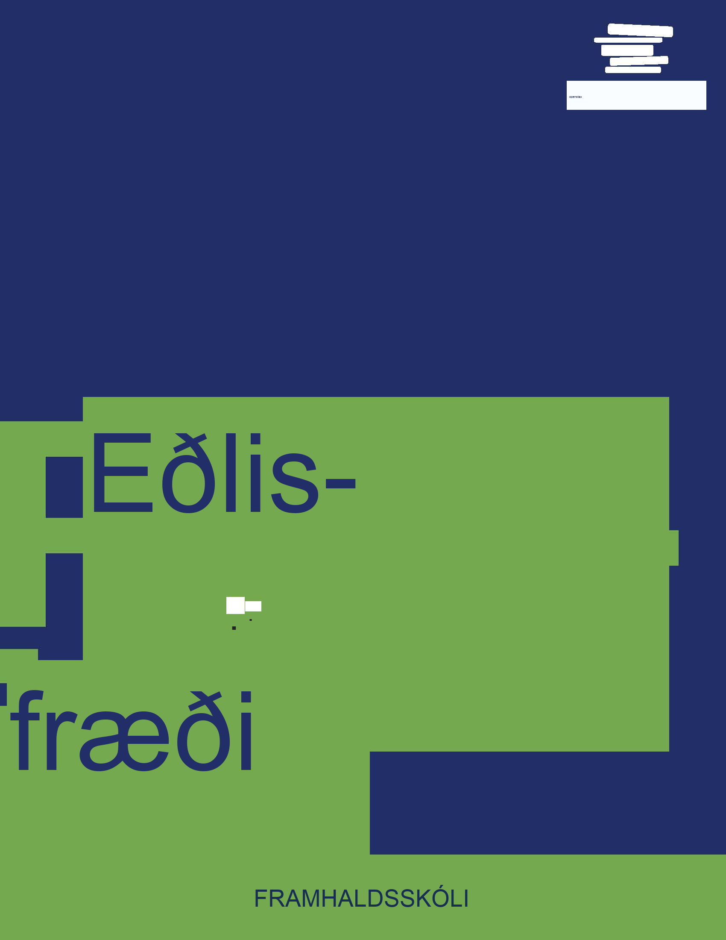


Eðlisfræði
Kafli 8 Skriðþungi

Slide 2
Yfirlit kafla
Línulegur skriðþungi, kraftur og atlag
Varðveisla skriðþunga
Fjaðrandi og ófjaðrandi árekstrar

Slide 3
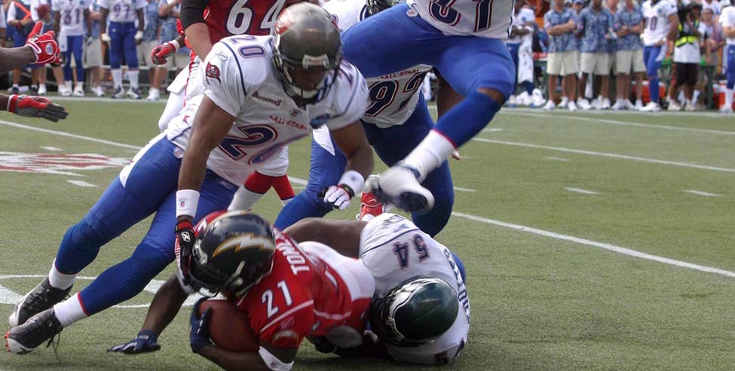

Mynd 8.1
Varnarmenn NFC, þeir Ronde Barber og Roy Williams, ásamt miðverðinum Jeremiah Trotter, fella í sameiningu hlaupara AFC, LaDainian Tomlinson, í Pro Bowl leiknum á Hawaii árið 2006. (Landgöngulið Bandaríkjanna)
Notes:
A photograph shows a football game with four football players trying to tackle a fifth player. A crowd is shown in the background.

Slide 4
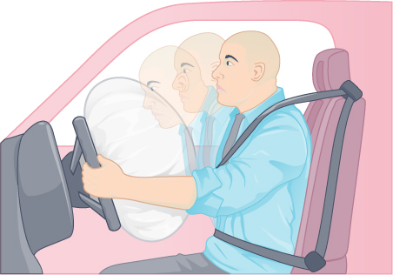

Mynd 8.2
Ökutæki eru búin öryggisbúnaði eins og loftpúðum og öryggisbeltum.
Notes:
An illustration is shown of a man sitting in a car seat behind the wheel, wearing a seat belt. An airbag has been deployed from the wheel. The illustration indicates that the man's body is moving toward the airbag.

Slide 5
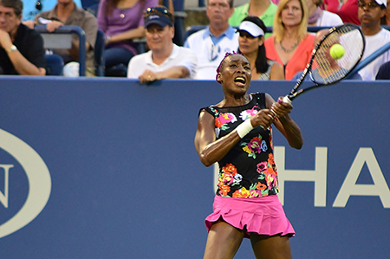
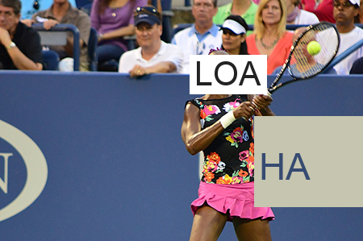
Mynd 8.3
Venus Williams að spila á US Open 2013 (Edwin Martinez, Flickr)
Notes:
Serena Williams is a famous tennis player. In this image she is hitting a tennis ball with a tennis racket.

Slide 6
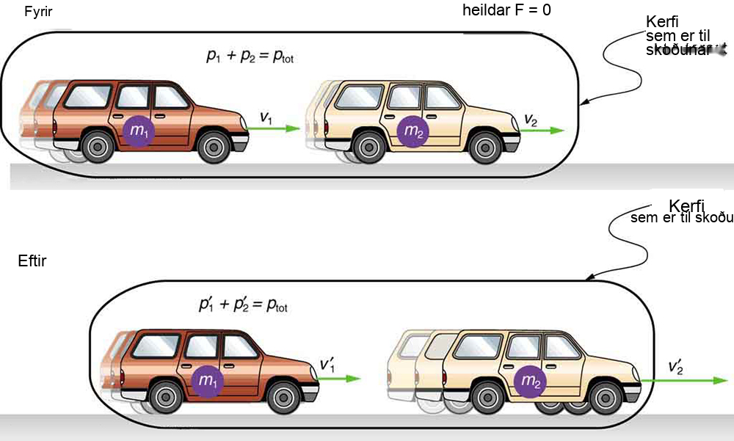

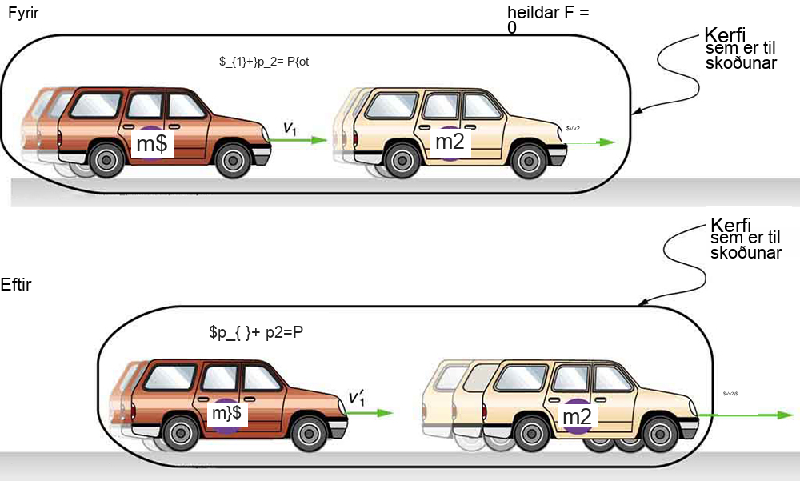
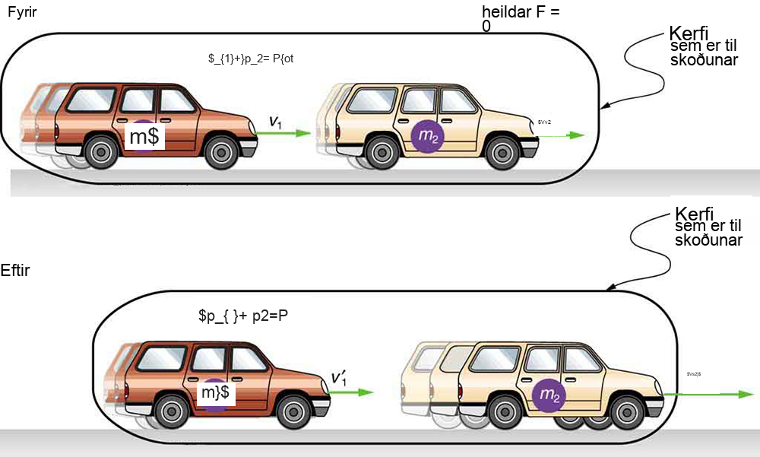

Mynd 8.4
Bíll með massann m1 á hraðanum v1 rekst á annan bíl með massann m2 og hraðann v2. Við það hægir fyrri bíllinn á sér niður í hraðann v′1 og sá síðari eykur hraðann upp í v′2. Skriðþungi hvors bíls um sig breytist, en heildarskriðþungi ptot beggja bíla er sá sami fyrir og eftir áreksturinn ef gert er ráð fyrir að núningur sé hverfandi.
Notes:
Revise alt text to: An illustration shows before and after diagrams of two cars, one in front of the other. The car in the back is labeled m one and the car in the front is labeled m two. Both diagrams are labeled System of Interest. In the before diagram, a velocity vector points from the car in the back to the car in the front. A second velocity vector of equal magnitude points from the car in the front to the right. Two equations are shown: p one plus p two equals p total and net F equals zero. In the after diagram, the velocity vector pointing from the car in the back is shorter. The velocity vector pointing from the car in the front is longer. They are labeled v one prime and v two prime. The equation p one prime plus p two prime equals p total is shown.

Slide 7
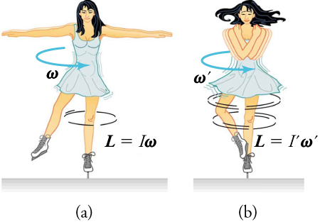

Mynd 8.5
(a) Listskautakona snýst á skautabroddinum með útrétta arma. Á næstu mynd, (b), eykst snúningshraði hennar verulega þegar hún dregur handleggina að sér.
Notes:
An illustration shows an ice skater in two positions. She is spinning on the tip of her skate with her arms extended in the first position. In the second position, her arms are pulled in as she is spinning. In the first position, an arrow labeled w shows the direction of her spin and the equation L equals I times w is shown. In the second position, an arrow labeled w prime shows the direction of her spin and the equation L equals I prime times w prime is shown.

Slide 8
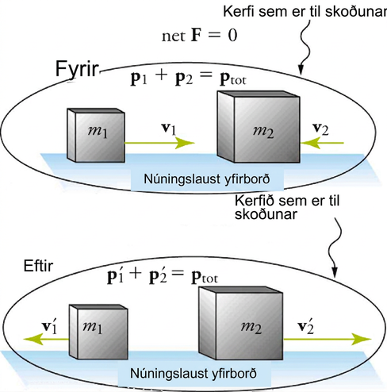
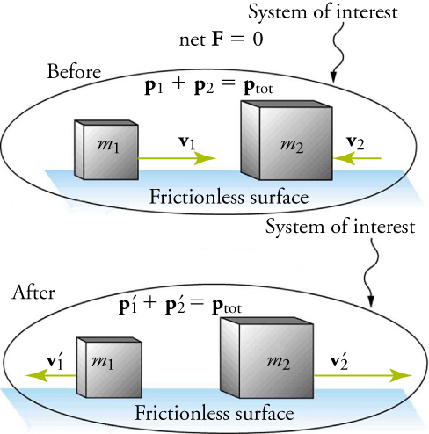
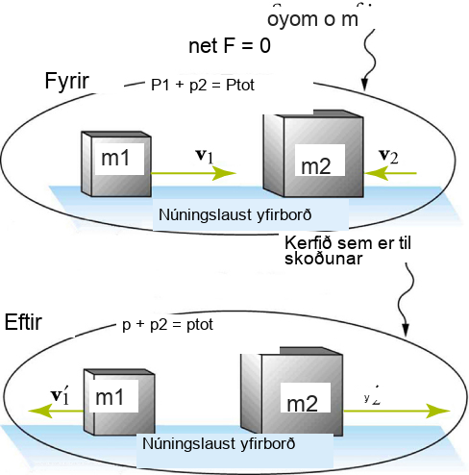
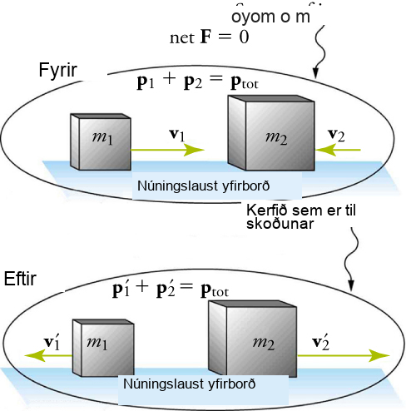
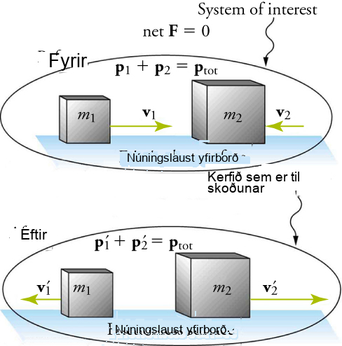
Mynd 8.6
Myndin sýnir einvíðan, fjaðrandi árekstur milli tveggja hluta.
Notes:
An illustration shows before and after diagrams of two boxes moving toward each other on a frictionless surface. The box on the left is labeled m one and the box on the right is labeled m two. Both diagrams are labeled System of Interest. In the before diagram, a velocity vector, v one, points from m one toward m two. A second, shorter velocity vector, v two, points from the left side of m two toward m one. Two equations are shown: p one plus p one equals p total and net F equals zero. In the after diagram, both velocity vectors point away from each mass, m one and m two. The vector on the left is shorter than the one on the right. The equation p one prime plus p one prime equals p total is shown.

Slide 9
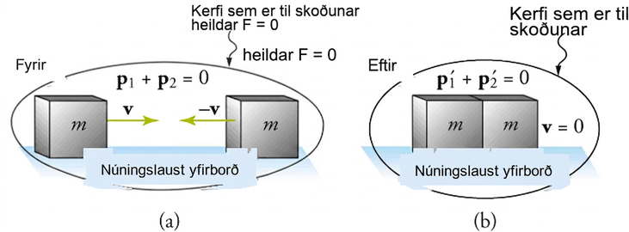
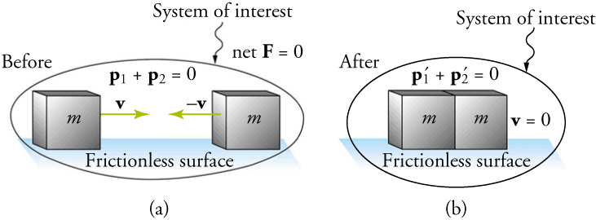
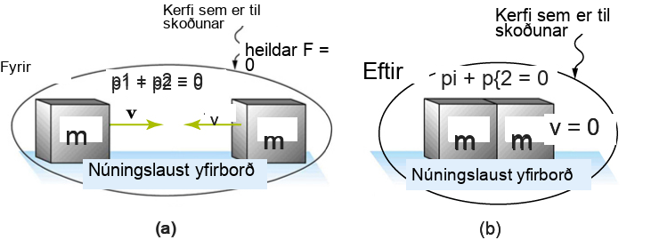
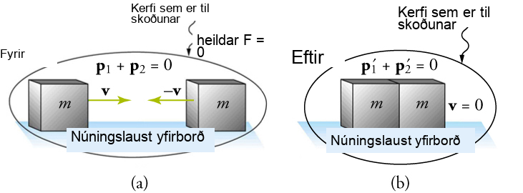
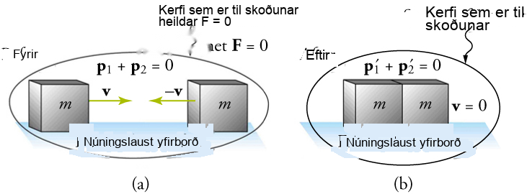
Mynd 8.7
Einvíður ófjaðrandi árekstur milli tveggja hluta. Skriðþungi varðveitist, en hreyfiorka varðveitist ekki. (a) Tveir hlutir með sama massa stefna upphaflega beint hvor á móti öðrum á sama hraða. (b) Hlutirnir festast saman og mynda fullkomlega ófjaðrandi árekstur. Í tilvikinu sem sýnt er á þessari mynd stöðvast sameinaðir hlutirnir; þetta á ekki við um alla ófjaðrandi árekstra.
Notes:
An illustration shows before and after diagrams of two boxes moving toward each other on a frictionless surface. Both boxes are labeled m. Both diagrams are labeled System of Interest. In the before diagram, a velocity vector, v, points from the left box to the right box. A second vector of equal magnitude, negative v, points from right box toward the left box. Two equations are shown: p one plus p two equals zero and net F equals zero. In the after diagram, the boxes are touching. The equations p one prime plus p two prime equals zero and v equals zero are shown.

Slide 10
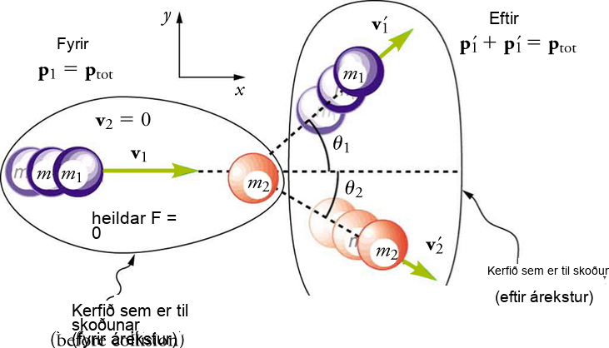
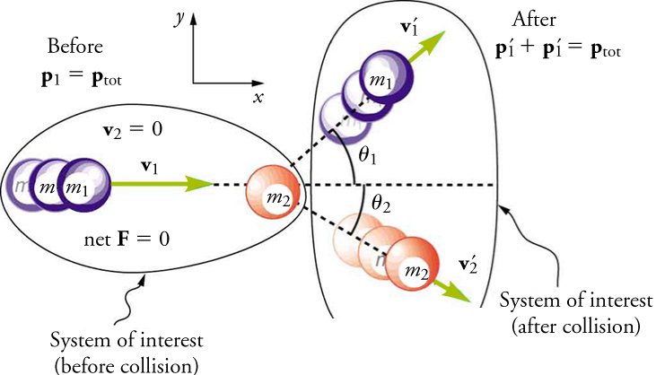
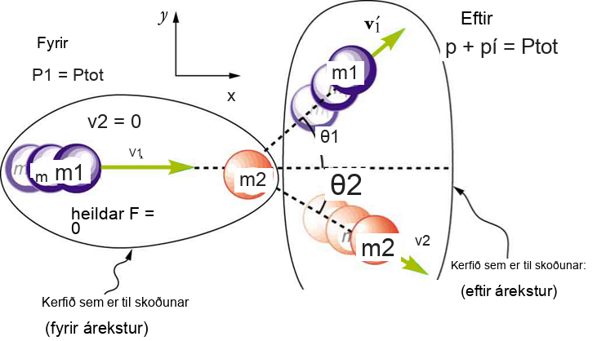
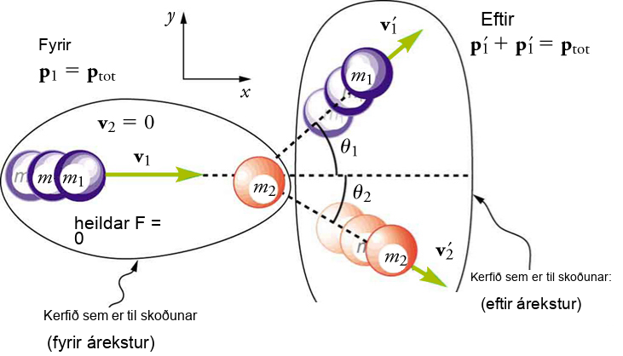

Mynd 8.8
Tvívíður árekstur þar sem hnitakerfið er valið þannig að m2 er upphaflega í kyrrstöðu og v1 er samsíða x-ásnum.
Notes:
An illustration shows before and after diagrams of two balls, one moving toward the other. The first ball is labeled m one and the second ball is labeled m two. Both diagrams are labeled System of Interest, but the diagram on the left specifies before collision and the diagram on the right specifies after collision. In the before diagram, a velocity vector, v one, points from m one to m two. The following are also shown: v two equals zero, net F equals zero, and p one equals p total. In the after diagram, m one is moving in an upward direction and m two is moving in a downward direction. Vectors labeled v one prime and v two prime show their directional movements. M one and m two are shown forming angles with the x-axis. The equation p one prime plus p one prime equals p total is shown.

Slide 11
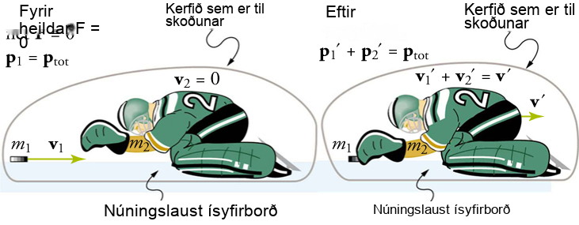
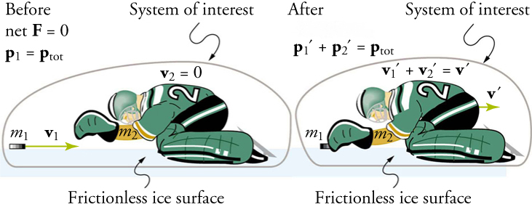
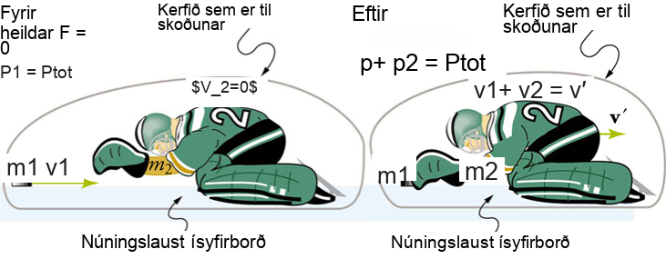
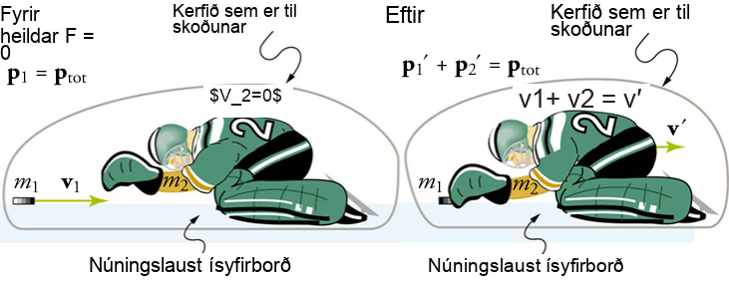
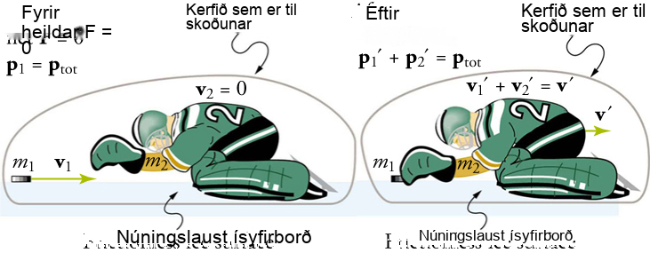
Mynd 8.9
Íshokkímarkvörður grípur pökk og hrökklast afturábak í ófjaðrandi árekstri.
Notes:
An illustration shows before and after diagrams of a hockey puck and an ice hockey player on a frictionless ice surface. The hockey puck is labeled m one and the hockey player is labeled m two. Both diagrams are labeled System of Interest. In the before diagram, a velocity vector, v one, points from the puck to the player. The following are shown: p one equals p total, v two equals zero, and net F equals zero. In the after diagram, the hockey puck has made contact with the player. A velocity vector, v prime, points from the hockey player to the right. The equation p one prime plus p two prime equals p total is shown. The equation v one prime plus v two prime equals v prime is also shown.

Slide 12
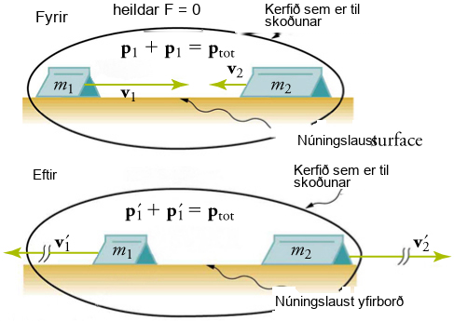
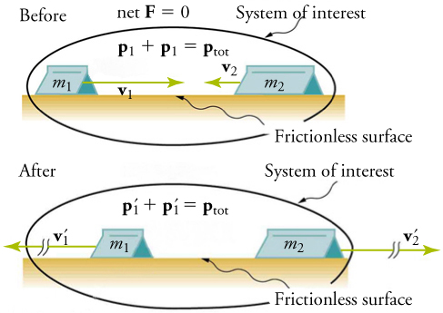
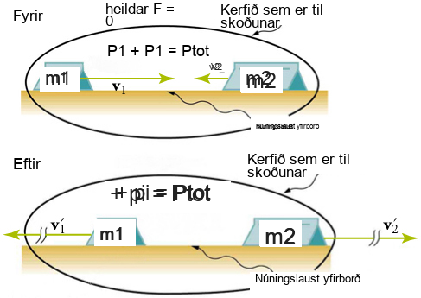
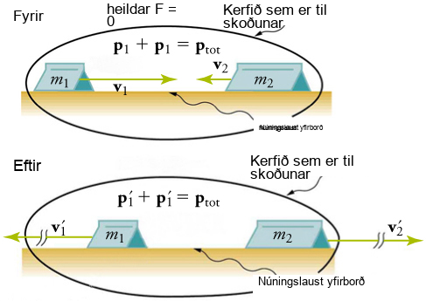
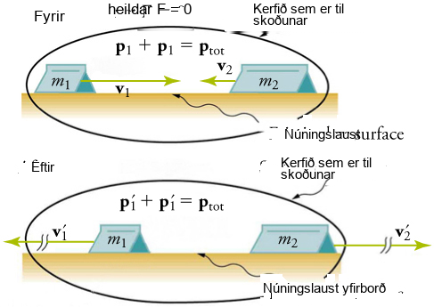
Mynd 8.10
Tveir vagnar rekast á hvor annan í fjaðrandi árekstri.
Notes:
An illustration shows before and after diagrams of two carts moving toward each other on a frictionless surface. The cart on the left is labeled m one and the car on the right is labeled m two. Both diagrams are labeled System of Interest. In the before diagram, a velocity vector, v one, points from the cart on the left to the cart on the right. A second, shorter velocity vector, v two, points from the cart on the right to the cart on the left. Two equations are shown: p one plus p one equals p total and net F equals zero. In the after diagram, the velocity vectors are equal in magnitude and point away from the carts. They are labeled v one prime and v two prime. The equation p one prime plus p one prime equals p total is shown.

Slide 13
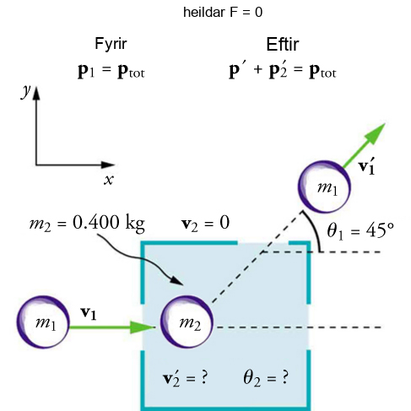
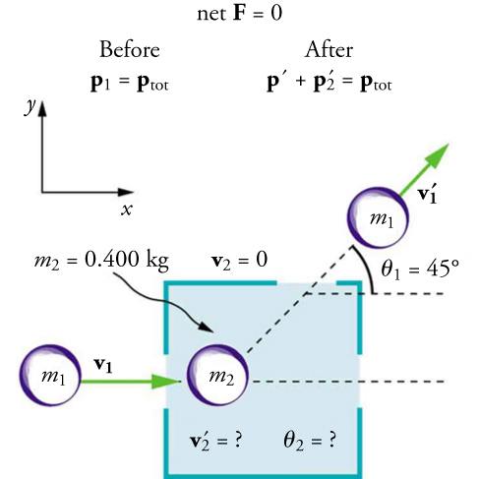
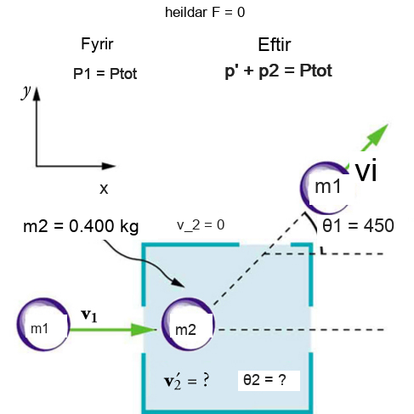
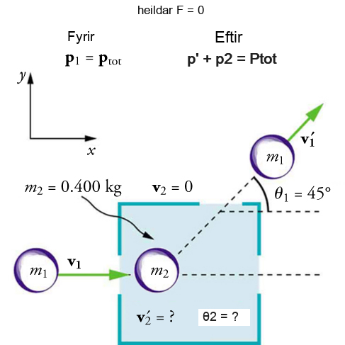

Mynd 8.11
Aðkomandi hlutur með massann m1 dreifist af hlut sem er upphaflega kyrrstæður. Aðeins massi kyrrstæða hlutarins m2 er þekktur. Með því að mæla hornið og hraðann sem hluturinn með massann m1 kemur út úr herberginu með, er hægt að reikna út stærð og stefnu hraða upphaflega kyrrstæða hlutarins eftir áreksturinn.
Þetta OpenStax viðbótarefni er © Rice University undir CC BY-NC-SA 4.0 alþjóðlegu leyfi; það má afrita eða breyta því eingöngu í óviðskiptalegum tilgangi, en eigna verður OpenStax og Rice University og taka skal fram allar breytingar. Öllum aðlögunum skal deila undir sams konar leyfi.
Notes:
An illustration shows before and after diagrams of two balls, one moving toward the other. The first ball is labeled m one and the second ball is labeled m two and point four kilograms. In the before diagram, a velocity vector, v one, points from m one to m two. In the after diagram, m one is moving in an upward direction with a velocity vector, v one prime, indicating its direction. It forms an angle of forty-five degrees with the x-axis. The following are also shown: before, p one equal p total; after, prime plus p two prime equals p total; net F equals zero; v two equals zero; v two prime is unknown; angle two is unknown.

