Slide 1





Eðlisfræði
Kafli 6 Hringhreyfing og snúningshreyfing

Slide 2
Efnisyfirlit kafla
Snúningshorn og hornhraði
Jöfn hringhreyfing
Snúningshreyfing

Slide 3
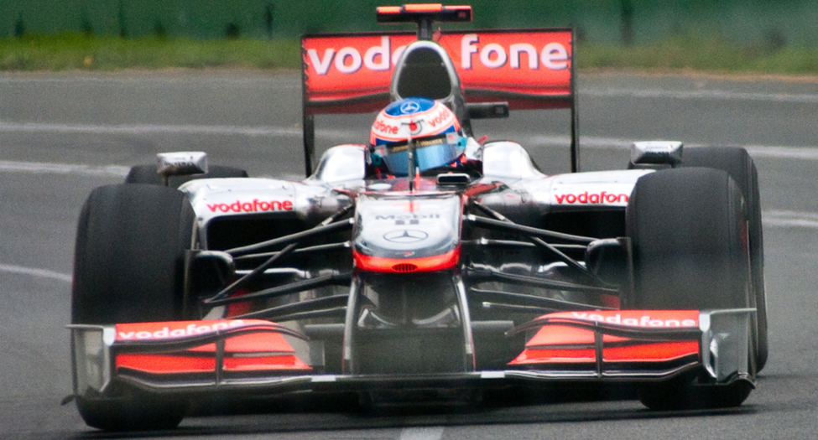

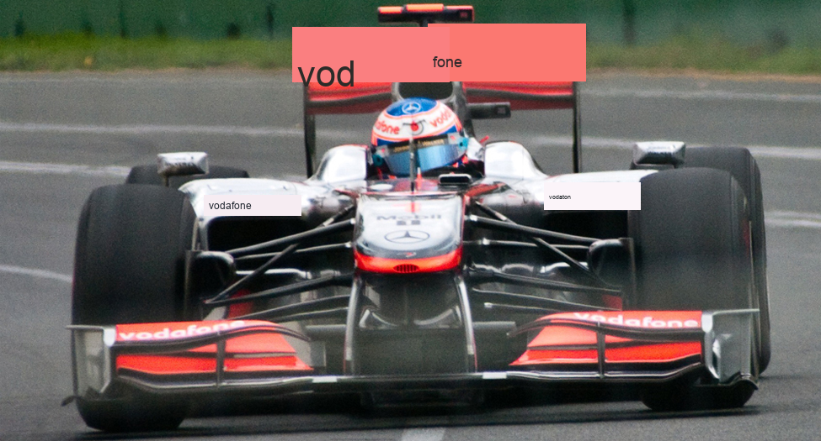
Mynd 6.1
Þessi ástralski Formúlu 1 kappakstursbíll hreyfist á hringlaga braut þegar hann tekur beygjuna. Hjólin á honum snúast einnig hratt. Sömu eðlisfræðilegu lögmál gilda um báðar þessar hreyfingar. (Richard Munckton).
Notes:
The picture is a race car with large wheels turning on a track.

Slide 4
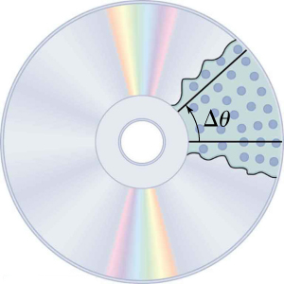


Mynd 6.2
Allir punktar á geisladiski hreyfast á hringlaga brautum. Gígarnir (punktarnir) á línu frá miðju að brún færast allir um sama horn Δθ á tímanum Δt .
Notes:
The diagram shows a picture of a CD with about an eighth of the shiny surface peeled away to display the inside of the CD with pits (dots) arranged in lines from the center. An angle theta is marked from one line of dots to another.

Slide 5
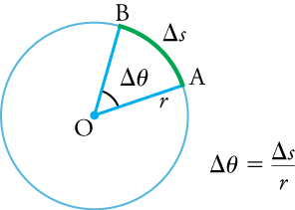

Mynd 6.3
Geisla (r) hringsins er snúið um hornið Δθ . Bogalengdin, Δs , er vegalengdin sem farin er eftir ummálinu.
Notes:
The diagram shows a circle with the center marked O, a radius r ending on the circumference at A, an arc change of s starting at A and ending at B. The angle for the arc is change of theta. A formula to the right of the circle says change of theta is equal to change of s divided by r.

Slide 6
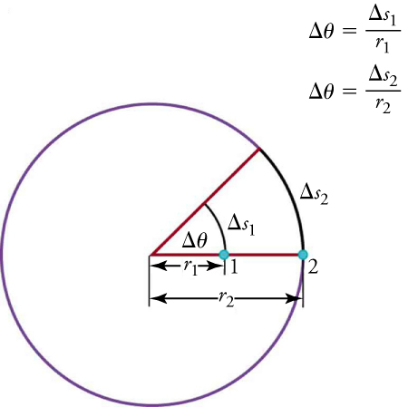

Mynd 6.4
Punktar 1 og 2 snúast um sama horn ( Δθ ), en punktur 2 fer lengri bogalengd ( Δ s 2 ) vegna þess að hann er lengra frá snúningsmiðjunni.
Notes:
The picture shows a circle with a radius r2 going from the center, through a point 1 half-way on the radius and point 2 on the circumference. The distance from center to point 1 is labeled r1. A second radius line is drawn with an angle of change in theta. The arc from point 1 to the second radius is labeled change s1. The arc at point 2 is labeled change s2. There are two formulas to the right of the diagram: theta is equal to change of s1 over r1 and theta is equal to change of s2 over r2.

Slide 7
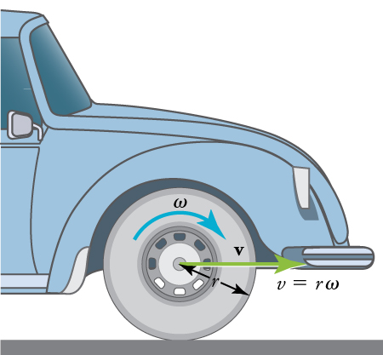

Mynd 6.5
Bíll sem hreyfist með hraðanum v til hægri er með dekk sem snýst með hornhraðanum ω . Hraði slitlags dekksins miðað við öxulinn er v, sá sami og ef bíllinn væri tjakkkaður upp og hjólin snerust án þess að snerta veginn. Beint undir öxlinum, þar sem dekkið snertir veginn, hreyfist slitlag dekksins afturábak miðað við öxulinn með snertihraðanum v=rω , þar sem r er radíus dekksins. Vegna þess að vegurinn er kyrrstæður miðað við þennan punkt á dekkinu, hlýtur bíllinn að hreyfast áfram með línulega hraðanum v. Meiri hornhraði dekksins þýðir meiri línulegan hraða fyrir bílinn.
Notes:
The diagram shows an illustration of the front part of a car. The diagram shows an arrow on the wheel pointing clockwise and labeled omega (angular velocity). There is a green arrow pointing toward the front of the car labeled v (velocity). The radius of the wheel is labeled r. To the right of the wheel is an equation v equals r times omega.

Slide 8
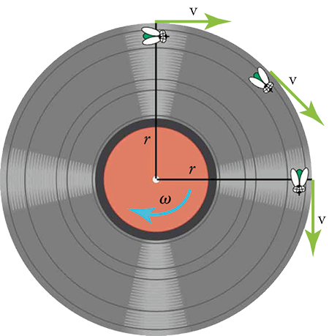
Mynd 6.6
Þegar flugan á brún gamaldags vínylplötu hreyfist í hring er stundarhraði hennar alltaf í snertilstefnu við hringinn. Stefna hornhraðans er inn í síðuna í þessu tilviki.
Notes:
The figure shows an illustration of a vinyl record with an arrow omega (angular velocity) pointing in a clockwise direction. There are two lines for the radius, marked r, one going from the center up and the other going from the center to the right. There are three flies on the record. One is positioned at the top of the record on the vertical radius. A v (velocity) arrow points to the right. A second fly is half-way around the circumference toward the horizontal radius and an arrow v is pointing tangential to the fly. The third fly is on the circumference at the horizontal radius and an arrow v is pointing down.

Slide 9
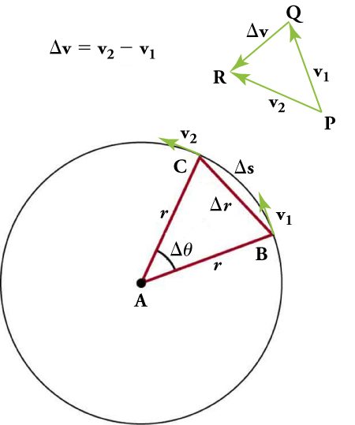
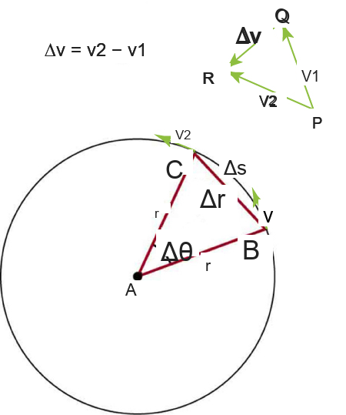
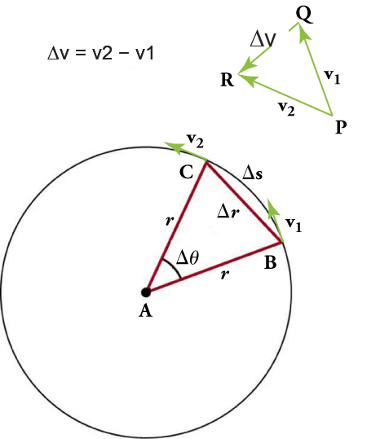
Mynd 6.7
Stefna hraða hlutar á tveimur mismunandi punktum er sýnd, og sjá má að hraðabreytingin Δv stefnir um það bil að miðju sveigjunnar (sjá litla innfellda mynd). Fyrir mjög lítið gildi á Δs stefnir Δv nákvæmlega að miðju hringsins (en það er erfitt að teikna). Vegna þess að a c =Δv/Δt stefnir hröðunin einnig að miðjunni, þannig að ac kallast miðsóknarhröðun.
Notes:
The diagram shows a formula: change in v is equal to v2 minus v1. There are three rays positioned on a triangle with points P, Q, and R. The ray between P and Q is labeled v1. The ray between P and R is labeled v2 and the ray opposite P between Q and R is labeled change in v. Below the formula and triangle is a circle with center A and two radii labeled r with the angle between them labeled change in theta. The points on the circumference for the two radii are labeled B and C with a line segment of change in r indicated for the distance between the two points. The arc going from B to C along the circumference is labeled change of s and the velocity arrow at point B is labeled v1 and at C is labeled v2.

Slide 10
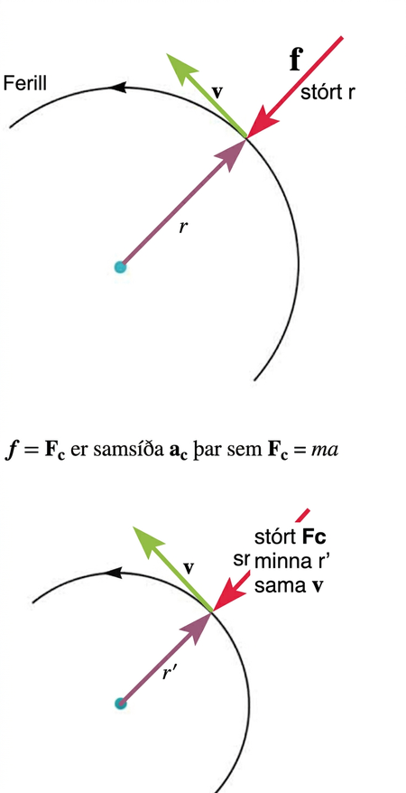
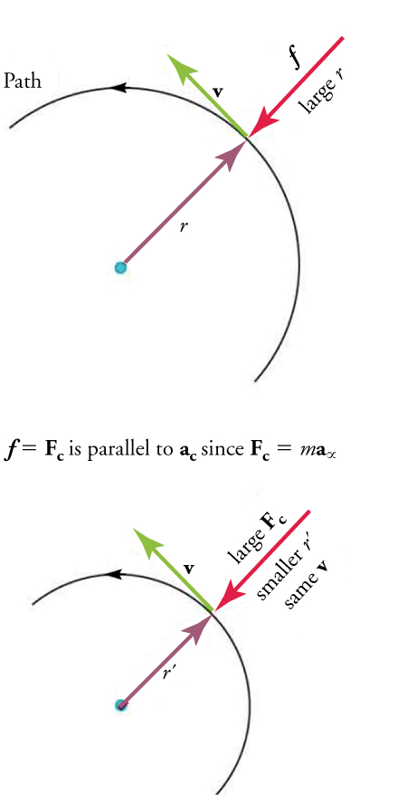
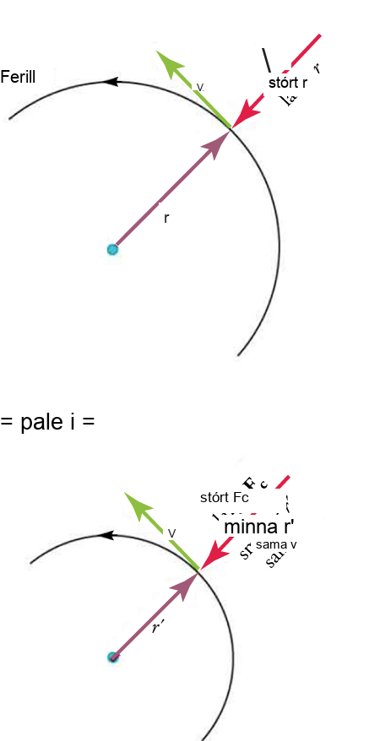
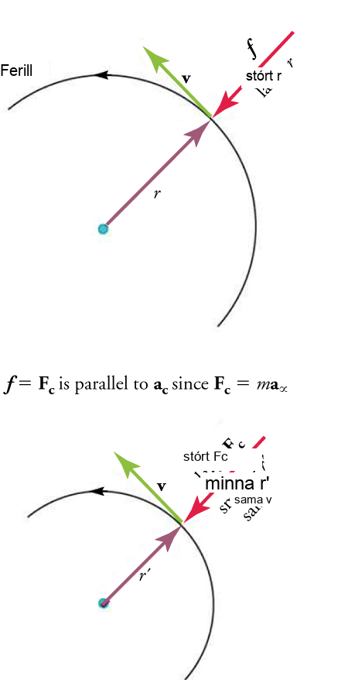
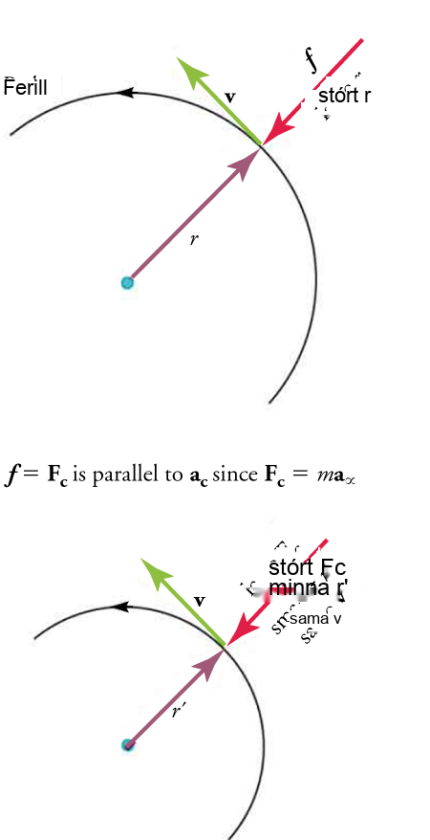
Mynd 6.8
Á þessari mynd verkar núningskrafturinn f sem miðsóknarkraftur Fc. Miðsóknarkraftur er hornréttur á snertilhraða og veldur jafnri hringhreyfingu. Því stærri sem miðsóknarkrafturinn Fc er, því minni er sveigjuradíusinn r og því kröppari er beygjan. Neðri beygjan hefur sama hraða v, en stærri miðsóknarkraftur Fc skapar minni radíus r ′ .
Notes:
The figure shows a semicircle with an arrow indicating a counterclockwise Path with radius labeled r, and arrow pointing from the outside of the circle towards the radius arrow. The arrow opposite the radius is labeled large r and has an f indicating force. The arrow tangential to the circle between the radius and large r arrows is labeled v (velocity). Below the first semicircle is a formula: f equals Fc is parallel to ac since Fc equals m times a alpha. Another semicircle with the same directional path is drawn below formula with a radius r prime, velocity v, large Fc pointing toward the r prime radius arrow and a label below the large Fc showing smaller r prime and same v.

Slide 11
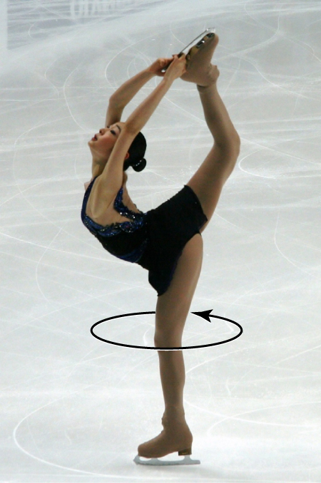

Mynd 6.9
Listskautari snýst rangsælis, þannig að hornhraði hennar er venjulega talinn jákvæður. (Luu, Wikimedia Commons)
Notes:
The diagram shows a picture of an ice skater with an arrow pointing around her leg indicating that she is spinning in a counterclockwise direction.

Slide 12
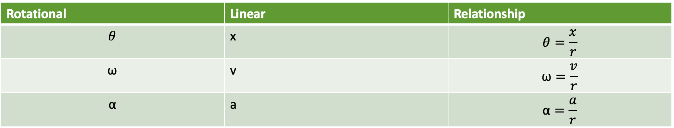
Tafla 6.2 Snúnings- og línulegar breytur
Rotational | Linear | Relationship
$$θ$$ | x | $$θ=\frac{x}{r}$$
$$\text{ω}$$ | v | $$\text{ω}=\frac{v}{r}$$
$$\text{α}$$ | a | $$\text{α}=\frac{a}{r}$$

Slide 13
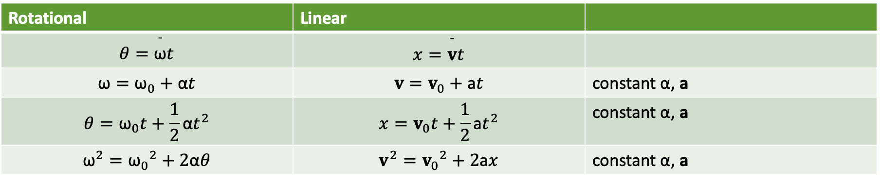
Tafla 6.3 Jöfnur fyrir snúningshreyfifræði
Rotational | Linear
$$θ=\overset{¯}{\text{ω}}t$$ | $$x=\overset{¯}{v}t$$
$$\text{ω}={\text{ω}}_{0}+\text{α}t$$ | $$v=v_{0}+\text{a}t$$ | constant $\text{α}$, a
$$θ={\text{ω}}_{0}t+\frac{1}{2}\text{α}t^{2}$$ | $$x=v_{0}t+\frac{1}{2}\text{a}t^{2}$$ | constant $\text{α}$, a
$${\text{ω}}^{2}={\text{ω}}_{0}​^{2}+2\text{α}θ$$ | $$v^{2}=v_{0}​^{2}+2\text{a}x$$ | constant $\text{α}$, a

Slide 14
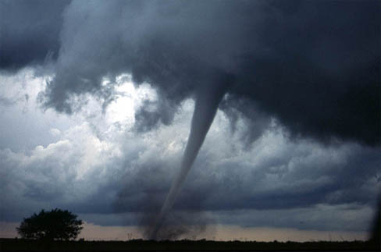

Mynd 6.10
Skýstrokkar stíga niður úr skýjum í trektlaga formum sem snúast af miklum krafti. (Daphne Zaras, U.S. National Oceanic and Atmospheric Administration)
Notes:
The figure shows a photograph of a dark tornado funnel cloud touching the ground and kicking up a lot of debris.

Slide 15
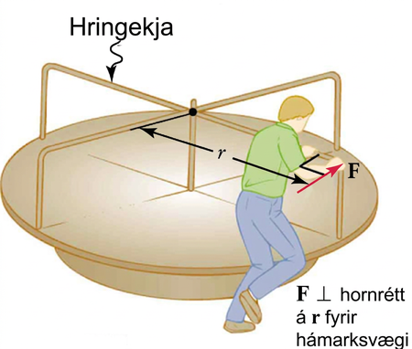
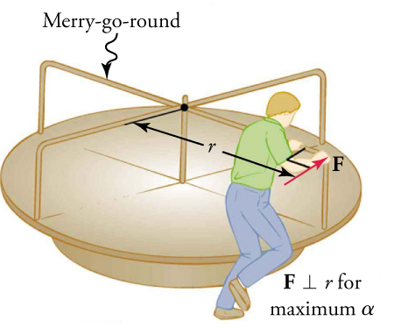
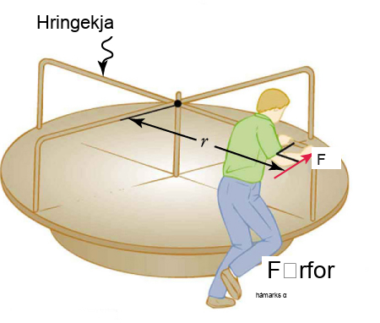
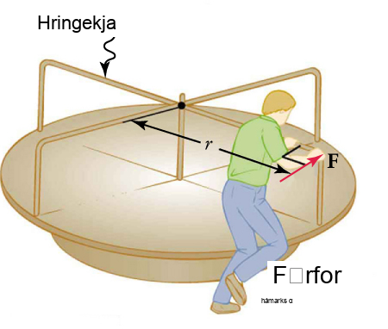
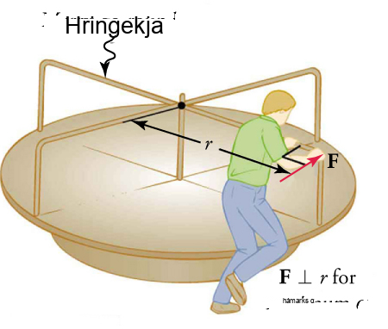
Mynd 6.11
Maður ýtir á hringekju á brún hennar og hornrétt á vogararminn til að ná fram hámarksvægi.
Þetta OpenStax viðbótarefni er © Rice University undir CC BY-NC-SA 4.0 alþjóðlegu leyfi; það má afrita eða breyta því eingöngu í óviðskiptalegum tilgangi, en eigna verður OpenStax og Rice University og taka skal fram allar breytingar. Öllum aðlögunum skal deila undir sams konar leyfi.
Notes:
The figure shows an illustration of a merry-go-round with a radius of r and a man pushing on a bar on the circumference with an arrow indicating a force of F. To the right of the diagram, it is noted that F is perpendicular to r for maximum alpha.

