Slide 1


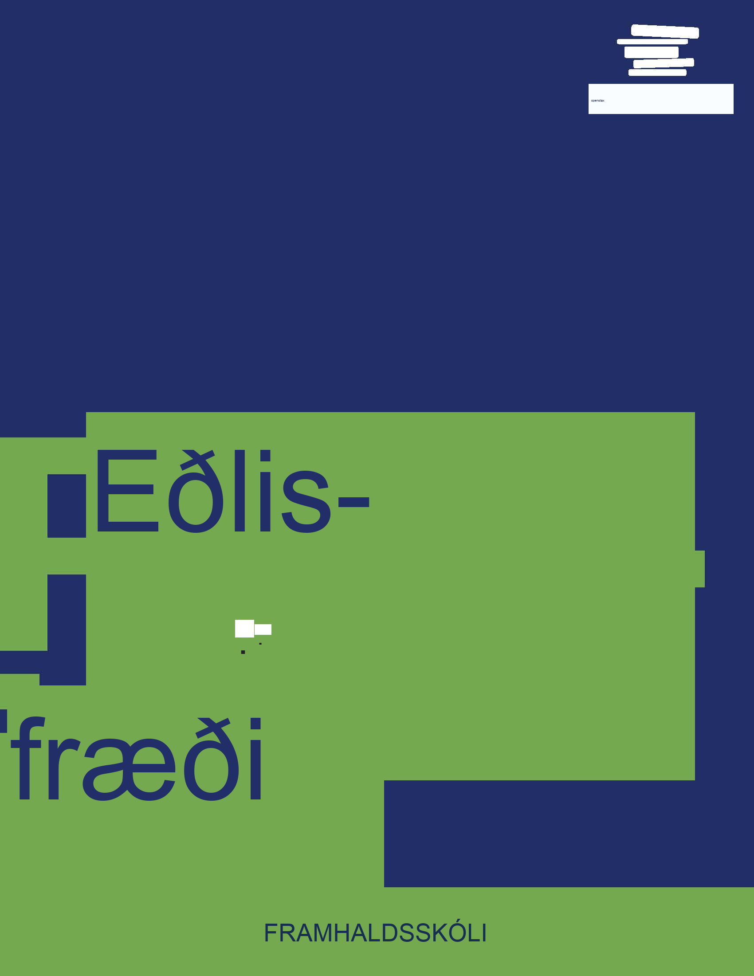
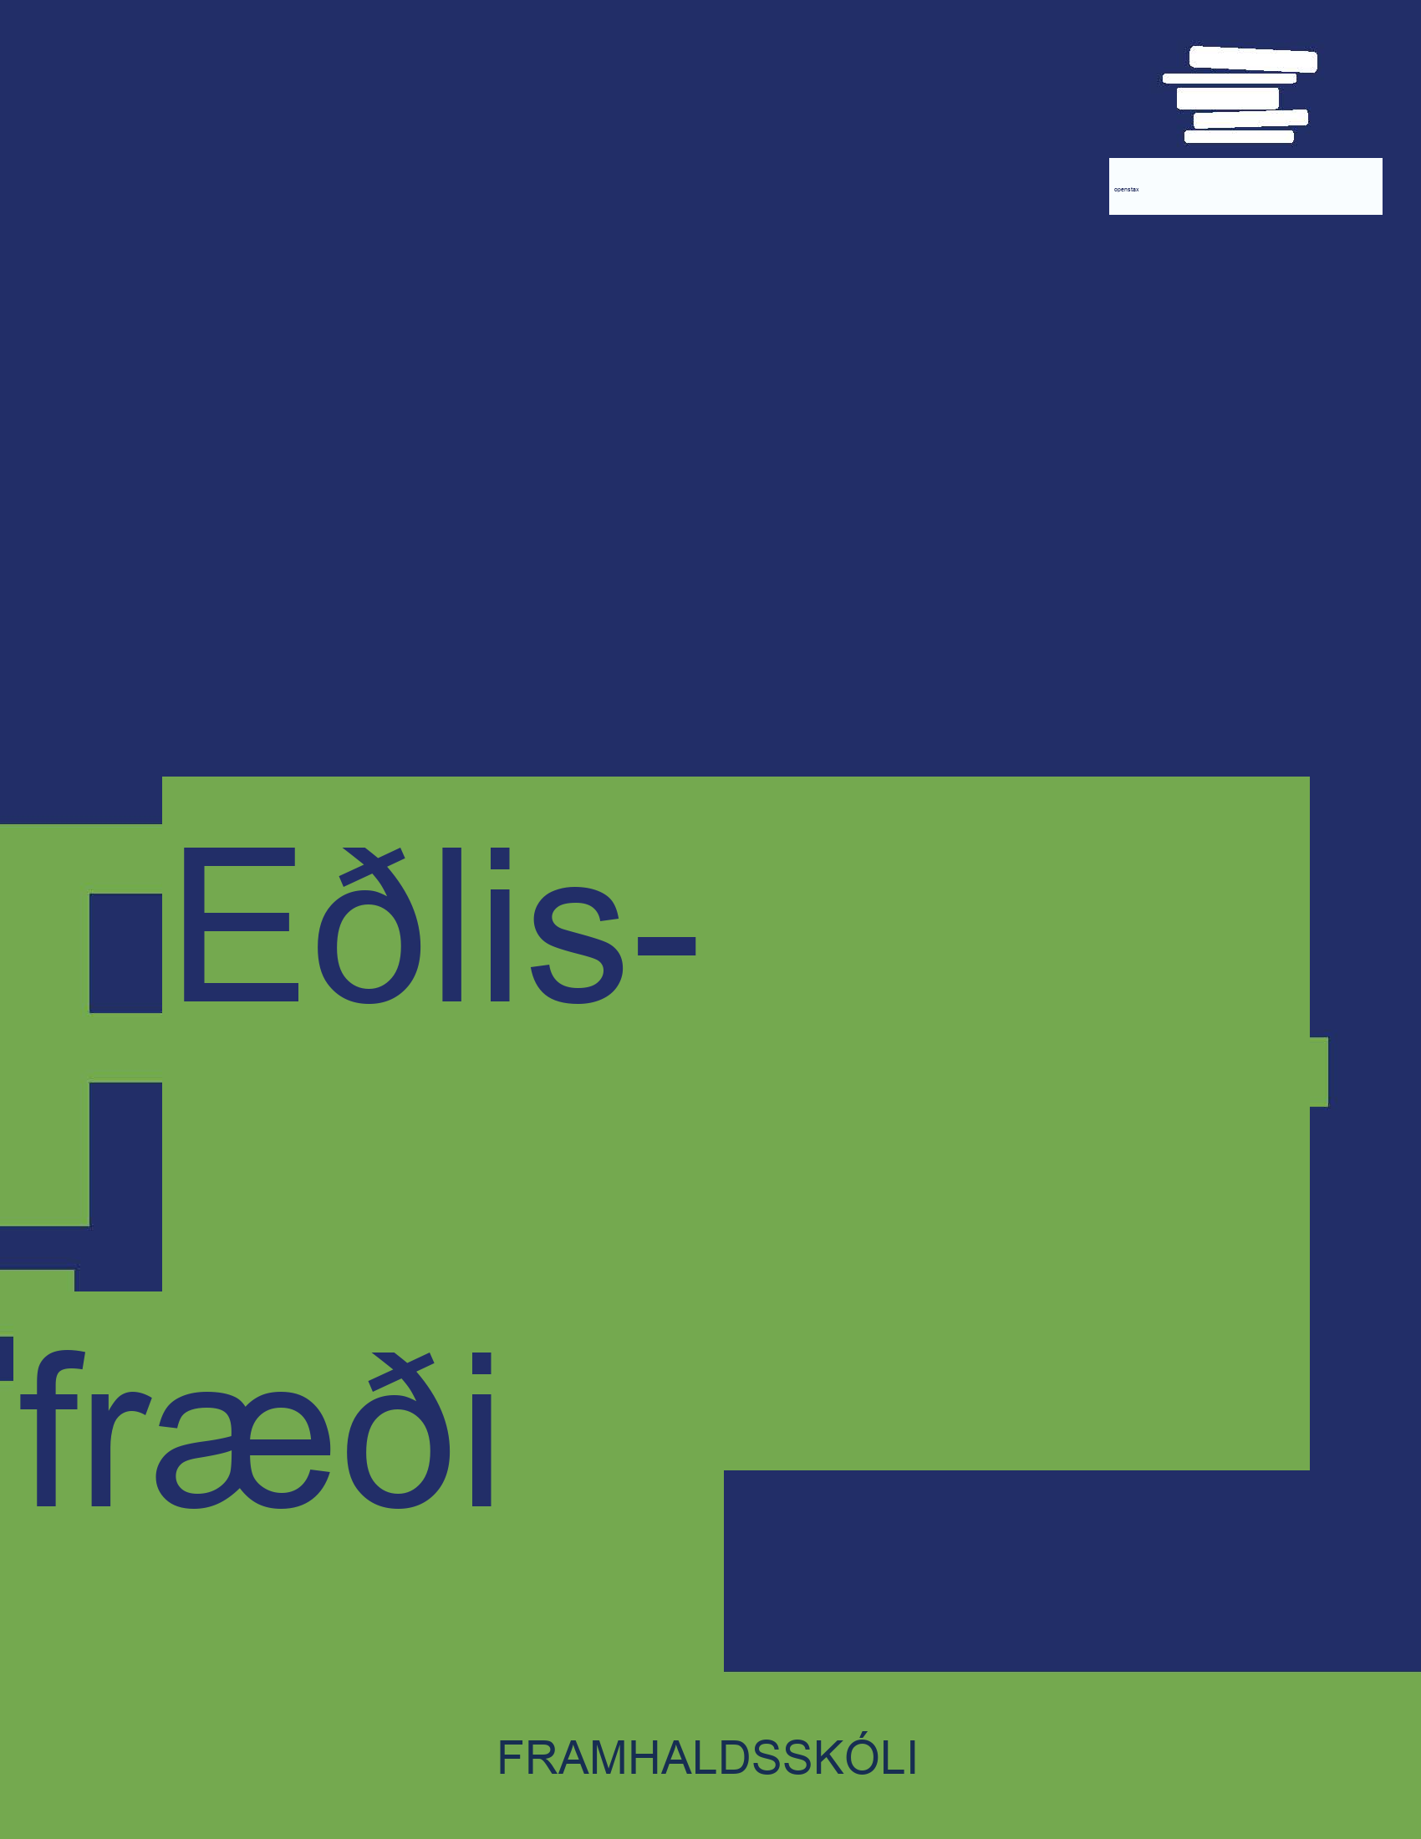

Eðlisfræði
Kafli 17 Beygja og samliðun

Slide 2
Yfirlit kafla
Skilningur á beygju og samliðun
Hagnýting beygju, samliðunar og samfasa

Slide 3
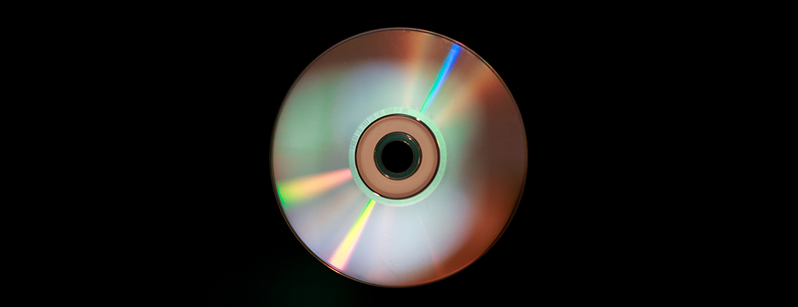

Mynd 17.1
Litirnir sem endurkastast af þessum geisladiski breytast eftir sjónarhorni og stafa ekki af litarefnum. Litir sem þessir eru bein sönnun fyrir bylgjueðli ljóss. (mynd: Reggie Mathalone)
Notes:
Photograph of a compact disc, showing arcs of rainbow colors produced by diffraction.

Slide 4
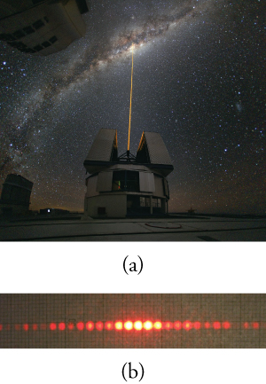

Mynd 17.2
(a) Ljósgeislinn sem leysir sendir frá sér í Paranal-stjörnustöðinni (hluti af Stjörnustöð Evrópulanda á suðurhveli í Síle) hegðar sér eins og geisli og ferðast í beinni línu. (mynd: Yuri Beletsky, European Southern Observatory) (b) Leysigeisli sem fer í gegnum net af lóðréttum raufum myndar samliðunarmynstur — sem er einkennandi fyrir bylgju. (mynd: Shim’on og Slava Rybka, Wikimedia Commons)
Notes:
(a) Photo of a laser beam directed vertically from an observatory into a night sky. (b) Photo of a horizontal line of about twenty closely spaced red dots. The five dots in the center are much brighter than the others.

Slide 5
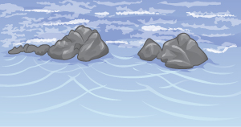

Mynd 17.3
Aðkomandi bylgjur (efst á myndinni) fara í gegnum skörðin í klettunum og mynda samliðunarmynstur (í forgrunni).
Notes:
Drawing of two groups of rocks on a beach. Waves from the top of figure produce three sets of curved wavefronts that expand outward as they pass through gaps between the rocks.

Slide 6
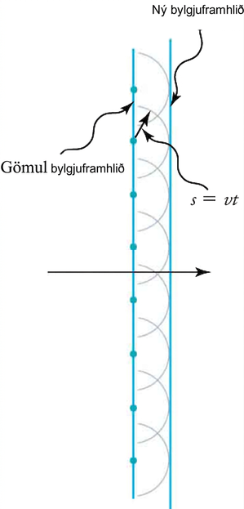
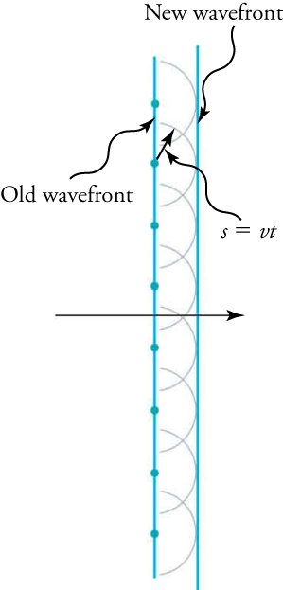
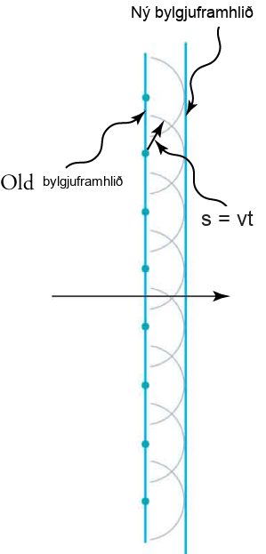
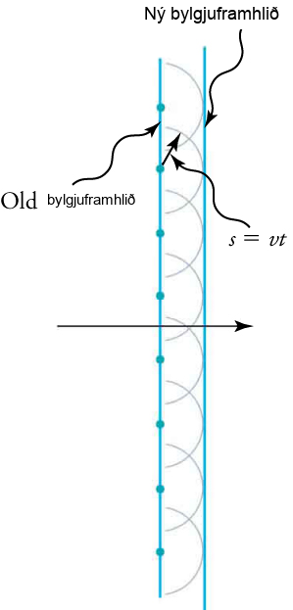
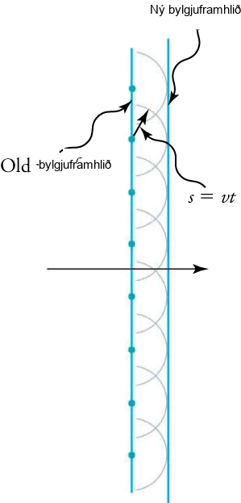
Mynd 17.4
Lögmál Huygens beitt á beina bylgjuframhlið. Hver punktur á bylgjuframhliðinni sendir frá sér hálfhringlaga smábylgju sem færist um vegalengdina s=vt . Nýja bylgjuframhliðin er lína sem snertir smábylgjurnar.
Notes:
Drawing with vertical lines labeled “old wavefront” (on the left) and “new wavefront” (on the right). Semicircular wavelets expand to the right from points on the old wavefront. The new wavefront is the tangent to those circles. The two wavefronts are separated by a distance s. A formula states “s is the product of the wave speed v and time t.”

Slide 7
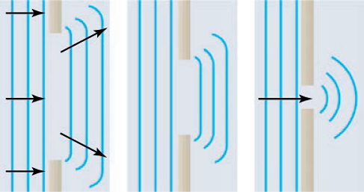
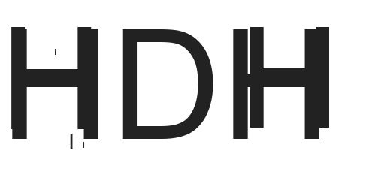
Mynd 17.5
Lögmál Huygens beitt á beina bylgjuframhlið sem skellur á opi. Jaðrar bylgjuframhliðarinnar beygja af eftir að hafa farið í gegnum opið, ferli sem kallast bylgjubrot. Beygjan er meiri fyrir lítið op, sem er í samræmi við þá staðreynd að bylgjueiginleikar eru mest áberandi við víxlverkun við hluti sem eru álíka stórir og bylgjulengdin.
Notes:
Three drawings of evenly spaced parallel vertical lines represent straight wavefronts moving to the right and passing through three openings in a barrier. The drawing on the left shows vertical straight lines to the left of a wide opening, overlaid with horizontal arrows pointing to the right, and three parallel lines to the right of the opening. The lines to the right of the opening are roughly the same length as the opening. The upper and lower ends of the lines to the right are swept to the left, forming small curves, but the lines are mostly straight. The small curves at the top are overlaid with an arrow pointing to the right and slightly upward; the small curves at the bottom are overlaid with an arrow pointing to the right and slightly downward. The drawing in the middle shows vertical straight lines to the left of a narrower opening and three parallel lines to the right of the opening. The lines to the right of the opening are roughly the same length as the opening, which is smaller than the opening in the drawing on the left. The upper and lower ends of the lines to the right of the opening are swept to the left, forming small curves, but the lines are mostly straight. The drawing on the right shows vertical straight lines to the left of a very narrow opening, overlaid with one horizontal arrows pointing to the right, and three concentric circular arcs to the right of the opening.

Slide 8
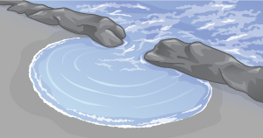

Mynd 17.6
Sjávarbylgjur fara í gegnum op í rifi, sem leiðir til bognunar (diffraction). Bognun á sér stað vegna þess að opið er svipað að breidd og bylgjulengd bylgjanna.
Notes:
Drawing of ocean waves passing through a narrow gap in a reef. The waves form semicircular wavelets on the beach, which are centered on the gap in the reef.

Slide 9
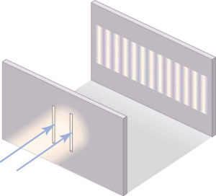

Mynd 17.7
Tvöföld raufartilraun Youngs. Hér fer ljós með eina bylgjulengd í gegnum par af lóðréttum raufum og myndar beygjumynstur á skjánum — fjölmargar lóðréttar ljósar og dökkar línur sem dreifast lárétt. Án beygju og samliðunar myndi ljósið einfaldlega mynda tvær línur á skjánum.
Notes:
Drawing of a beam of light diffracted by two slits. Two arrows pointing upward and to the right have their points at the vertical slits. A pattern is on a second screen, upward and to the right, consists of about 14 vertical bright bands that are the same height as the slits but have a horizontal spacing closer than the slits.

Slide 10
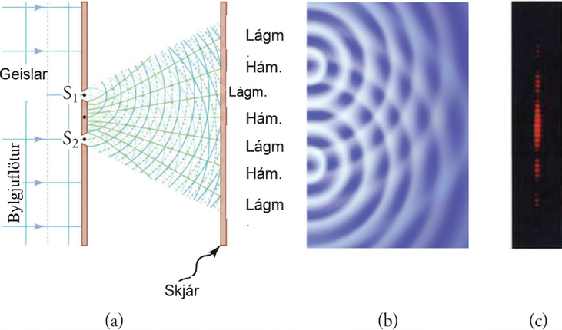
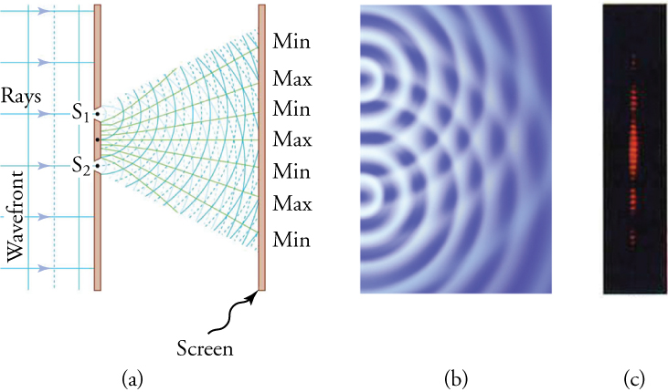
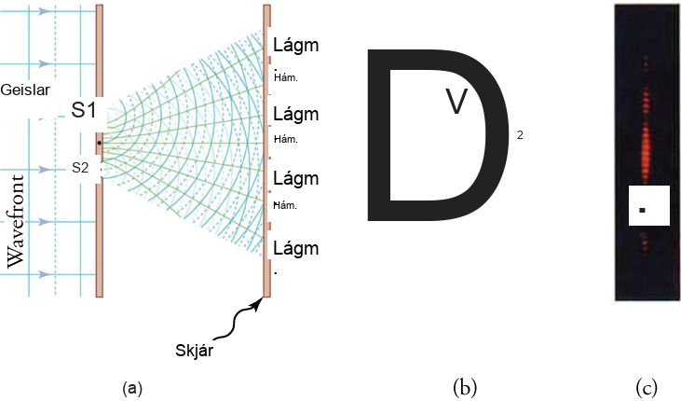
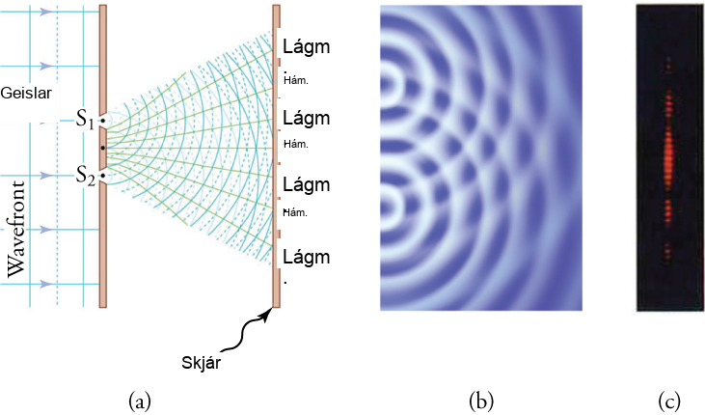
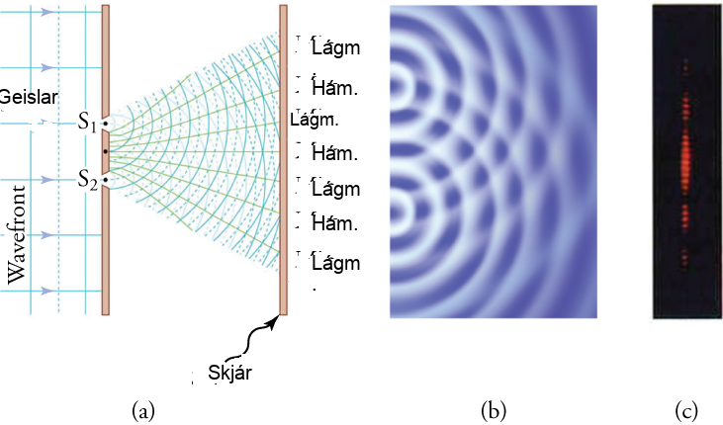
Mynd 17.8
Tvær raufar mynda tvær bylgjuuppsprettur sem samliðast. (a) Ljós dreifist (beygir) frá hvorri rauf, þar sem raufarnar eru þröngar. Bylgjurnar skarast og samliðast styrkjandi (ljósar línur) og eyðandi (dökk svæði). Þessi áhrif sjást aðeins ef ljósið fellur á skjá og dreifist í augu þín. (b) Samliðunarmynstur tveggja raufa fyrir vatnsbylgjur er næstum nákvæmlega eins og fyrir ljós. Bylgjuvirkni er mest á svæðum þar sem styrkjandi samliðun á sér stað og minnst á svæðum með eyðandi samliðun. (c) Þegar ljós sem hefur farið í gegnum tvær raufar fellur á skjá, sjáum við mynstur sem þetta.
Notes:
(a) Drawing of vertical lines to the left of a screen with two slits, labeled “S-one” and “S-two.” Vertical lines on the left are labeled “Wavefront.” They are overlaid with arrows labeled “Rays.” Two sets of overlapping circular arcs expand outward from the two slits to a screen at the right. The screen on the right is labeled “Screen.” Each set consists of alternating solid and dotted lines. A line from the point on the screen midway between the two slits extends to the center of the screen on the right, toward a label “Max.” Above the Max are other labels on the screen. They are “Min,” “Max,” and another “Min.” Lines run from the screen at the left to those labels at the right. The screen at the right also has a symmetrical arrangement of lines and labels “Min” and “Max” below the central Max. (b) Drawing of semicircles waves moving to the right from two points. (c) A vertical band of closely spaced horizontal red bands. There are about nine bands in the center with a dark space below, four bands that are somewhat dimmer, another dark space, and a still dimmer group of three bands. A symmetrical pattern of red bands and dark spaces and minima appears above the central maximum.

Slide 11
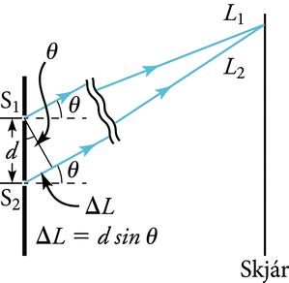
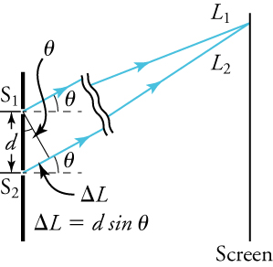
Mynd 17.9
Leiðirnar frá hvorri rauf að sameiginlegum punkti á skjánum eru mismunandi sem nemur d sin θ, að því gefnu að fjarlægðin að skjánum sé mun meiri en fjarlægðin milli raufanna (ekki í réttum hlutföllum hér).
Notes:
Drawing showing two vertical screens. The screen the left has two slits labeled “S-one” and “S-two.” The screen on the right is labeled “Screen.” Two arrows labeled “L-one” and “L-two” point upward and to the right. They begin at their respective slits and meet at the screen on the right. The distance between slits S-one and S-two is labeled “d,” and that distance is the hypotenuse of a right triangle. The shorter leg of the right triangle is labeled “delta-L.” It extends from the lower slit, S-two, upward and to the right along the arrow leaving slit S-two. The longer leg of the triangle is a line perpendicular to the two light rays and having one end at the upper slit, S-one. The angle of the vertex of the triangle located at slit S-one is labeled “theta.” A formula states “the distance delta-L as the product of the distance d and the sine of the angle theta.”

Slide 12
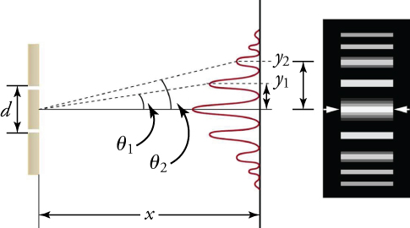

Mynd 17.10
Samliðunarmynstur fyrir tvírauf hefur styrk sem minnkar með horni. Ljósmyndin sýnir margar ljósar og dökkar línur, eða rendur, sem myndast þegar ljós fer í gegnum tvírauf.
Notes:
Two drawings showing diffraction by two slits. The first drawing, on the left shows, two vertical screens. The screen on the left has two slits separated by a vertical distance labeled “d.” A second screen is shown a to the right of the screen with the slits, separated by a horizontal distance labeled “x.” The vertical screen at the right shows a graph of a series of peaks and valleys that grow horizontally to the left. The tallest peak is at the center, with valleys and successively smaller peaks arranged symmetrically above and below it. A horizontal line runs from the point midway between the slits in the screen at the left through the central peak of the graph. A dotted line runs from that midway point through the first peak above the center. A second dotted line runs from the midway point through the second maximum. Those dotted lines make angles labeled “theta-one” and “theta-two” with the horizontal line. The peaks above the center are distances labeled “y-one” and “y-two” above the center. The second drawing, on the right shows, a vertical array of horizontal bright bands on a black background. They are aligned with the peaks of the graph in the first drawing. The bands are all of the same length but are of differing widths. The widest band is in the center and successively narrower bands are arranged symmetrically above and below it.

Slide 13
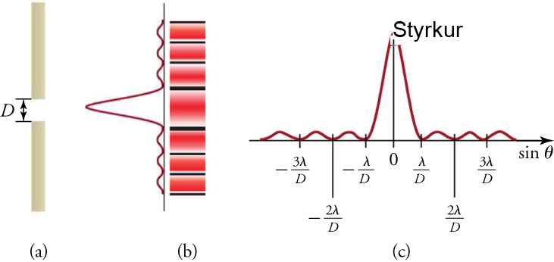
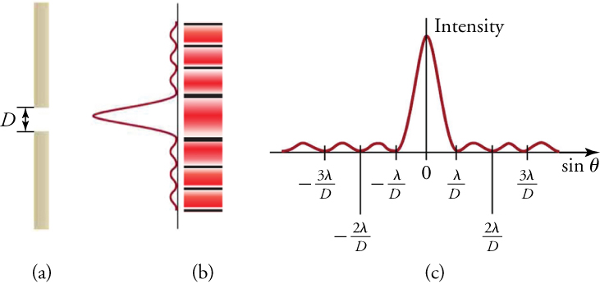
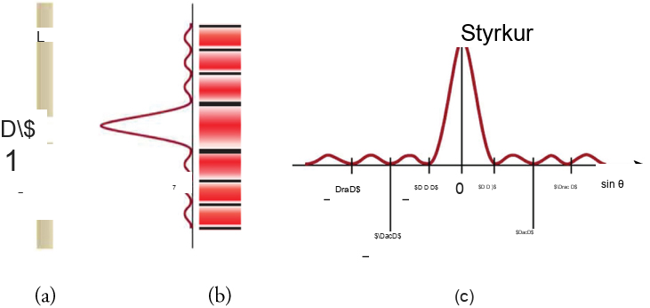
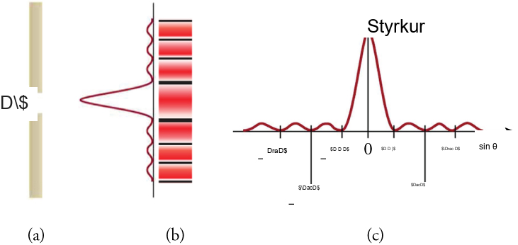

Mynd 17.11
(a) Beygjujafna fyrir eina rauf. Einlitt ljós sem fer í gegnum eina rauf myndar miðjuhámark og mörg smærri og daufari hámörk hvoru megin. Miðjuhámarkið er sex sinnum hærra en sýnt er. (b) Teikningin sýnir bjarta miðjuhámarkið og daufari og þynnri hámörk hvoru megin. (c) Staðsetning lágmarkanna er sýnd með tilliti til λ og D.
Notes:
(a) A drawing of a single slit in a vertical screen. The slit has width labeled “D.” (b) Drawing showing two patterns. On the left, a graph has a series of peaks and valleys that grow horizontally to the left. The central peak is largest, with much smaller peaks arranged symmetrically above and below it. To the right of the graph, a second pattern is a vertical array of horizontal bright bands separated by dark bands. They are aligned with the peaks of the graph in the first drawing. The bands are all of the same length but are of differing widths. The widest band is in the center and narrower bands are arranged symmetrically above and below it. (c) A version of the graph of the pattern in drawing (b) rotated so that the peaks grow upward from a horizontal axis. The height of the peaks is labeled “Intensity,” and the central peak is much higher and wider than the other peaks. The horizontal axis is labeled as the “sine of theta,” and the largest, central peak is located at a point on the horizontal axis labeled “zero.” Three valleys are located to the right of the central maximum at distances that are labeled “lambda divided by D,” “two lambda divided by D,” and “three lambda divided by D.” Three other valleys are located to the left of the center at distances that are labeled “negative lambda divided by D,” “negative two lambda divided by D,” and “negative three lambda divided by D.”

Slide 14
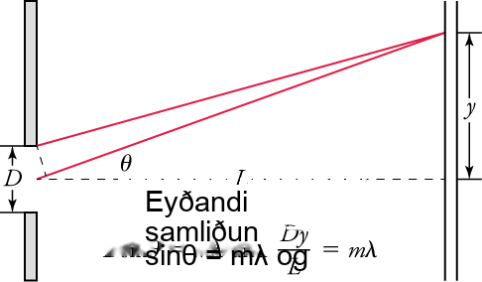
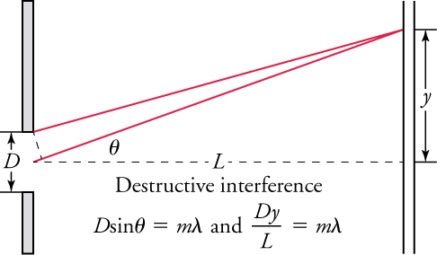
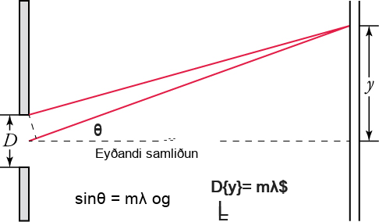
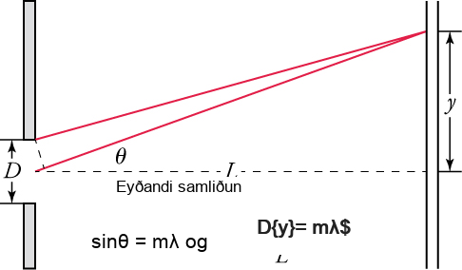

Mynd 17.12
Jöfnur fyrir beygjumynstur einnar raufar, þar sem λ er bylgjulengd ljóssins, D er breidd raufarinnar, θ er hornið milli línu frá raufinni að lágmarki og línu sem er hornrétt á skjáinn, L er fjarlægðin frá raufinni að skjánum, y er fjarlægðin frá miðju mynstursins að lágmarkinu, og m er heiltala, ójöfn núlli, sem gefur til kynna röð lágmarksins.
Notes:
Drawing entitled “Destructive interference.” It shows two screens, one on the left having a slit with width labeled “D.” The distance from the slit to the screen on the right is labeled “L.” It is represented as a dashed line that runs through the center of the slit and is perpendicular to both screens. A solid line extends upward and to the right from the center of the slit to strike the screen on the right. That line forms an angle labeled “theta” with the horizontal dashed line. A second solid line, from the top of the slit, extends upward and to the right to strike the same point as the first solid line. That point is a distance labeled “y” above the horizontal dashed line. A formula states that “D times the sine of the angle theta is equal to m times the wavelength lambda.” A second formula states that “D times y divided by L is equal to m times lambda.”

Slide 15
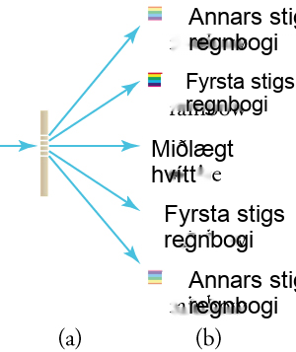
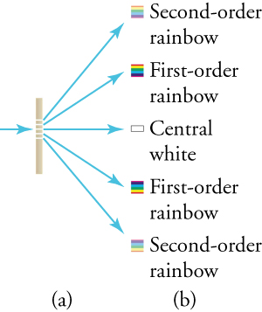
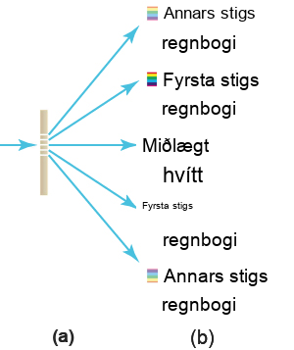
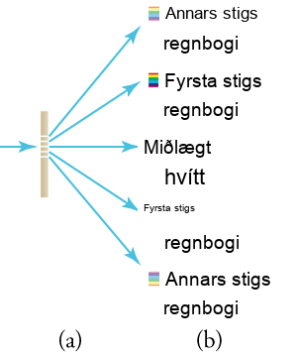
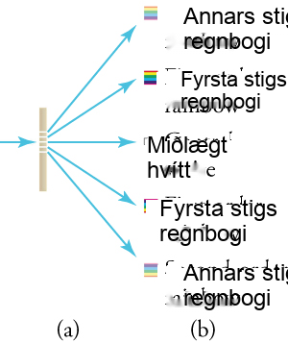
Mynd 17.13
Ljósröst samanstendur af miklum fjölda jafn dreifðra, samsíða raufa. (a) Ljós sem fer í gegnum röstina beygir í mynstri sem svipar til tvíraufar, með björtum svæðum við ýmis horn. (b) Mynstrið sem fæst þegar hvítt ljós fellur á röst. Miðjuhámarkið er hvítt og hámörk af hærri gráðu dreifa hvítu ljósi í regnboga lita.
Notes:
(a) Drawing of a vertical screen with five equally spaced horizontal slits that take up the middle third. A single blue arrow to the left of the barrier point to the right. Five blue arrows from the five slits point to the right, to five small diagrams arranged vertically. (b) Five small diagrams arranged vertically. The middle diagram is a white rectangle. It is labeled “Central white.” Above it is a square with colored bands; from the top, they are red, yellow, green, blue, and purple. The square is labeled “First-order rainbow.” Above the first rainbow is another small square, with the same colors as the one below, but fainter. It is labeled “Second-order rainbow.” Below the central white square is another square with colored bands. They are purple, blue, green, yellow, and red (the opposite order from the upper rainbows), and the square is labeled “First-order rainbow.” The lowest of the five diagrams is a fainter version of the square above it. It is labeled “Second-order rainbow.”

Slide 16
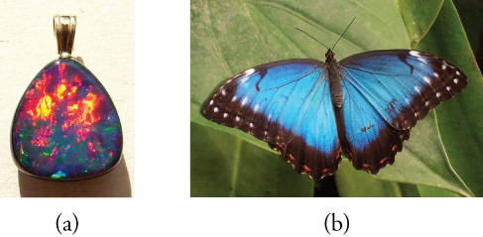

Mynd 17.14
(a) Þessi ástralski ópalsteinn og (b) fiðrildavængirnir hafa raðir endurkastandi flata sem virka eins og ljósbeygjuristir og endurkasta mismunandi litum við mismunandi horn. (mynd: (a) Opals-On-Black.com, Flickr (b) whologwhy, Flickr)
Notes:
(a) Photograph of an opal, with a rounded triangular shape. Most of the upper portion of the triangle is red and yellow. The lower portion is blue, green, and purple. (b) Photograph of a butterfly on a leaf. The wings are blue with white spots at the points of the wings and black bands at the rear edges of the wings.

Slide 17
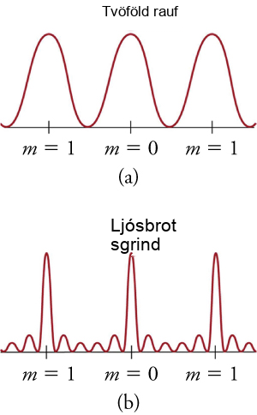
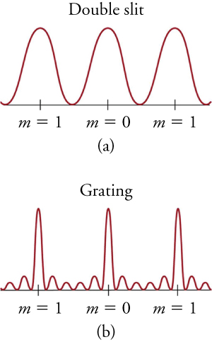
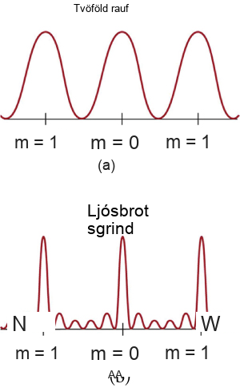
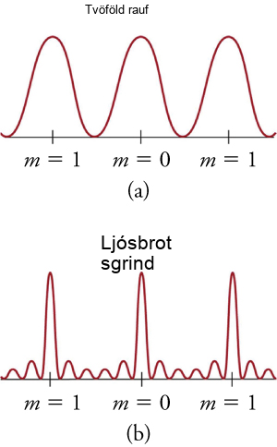

Mynd 17.15
Hugsjónalínurit af styrk ljóss sem fer í gegnum tvöfalda rauf (a) og ljósbrotsgrind (b) fyrir einlitt ljós. Hágildi geta myndast við sömu horn, en þau fyrir ljósbrotsgrindina eru mjórri og þar af leiðandi skarpari. Hágildin verða mjórri og svæðin á milli verða dekkri eftir því sem raufunum fjölgar.
Notes:
(a) Graph labeled “double slit.” A sine curve with three peaks is plotted with its troughs on a horizontal axis. Three points on the axis are labeled, corresponding to three maxima. Left to right, the points are labeled “m equals 1,” m equals zero,” and “m equals 1.” (b) Graph labeled “grating.” A curve with three tall narrow peaks is plotted with its troughs on a horizontal axis. On either side of the three peaks are two much smaller peaks (the larger peaks are separated by a total of four smaller peaks). Three points on the axis are labeled, corresponding to three maxima. Left to right, the points are labeled “m equals 1,” m equals zero,” and “m equals 1.”

Slide 18


Mynd 17.16
Miðað við stærð geymir þessi geisladiskur ótrúlega mikið af upplýsingum. Sömuleiðis inniheldur geislaspilarinn sem hann er í ótrúlegan fjölda rafeindaíhluta.
Notes:
Drawing of a portable CD player. Its cover is open, showing a CD that has a red sector on the lower left, of about 90 degrees, a blue sector on the upper right of about 120 degrees, and a yellow sector between them of about 30 degrees.

Slide 19
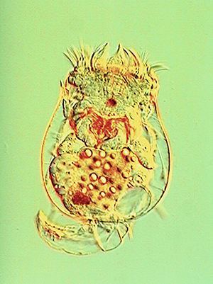

Mynd 17.17
Þessi vatnalífvera var ljósmynduð með DIC-smásjá. (mynd: Public Library of Science)
Notes:
Photo of freshwater alga. A flat green object with a rough texture is divided into forking branches. The largest resembles the letter Y with a very thick stem, tipped to the left so the stem is horizontal. Both arms of the Y fork into two very small branches. Joined to the base of the stem of the Y are other pairs of branches that resemble the letter V, one above and one below, and both angled slightly to the left. Each arm of the V splits into two branches, and then again into very small branches. A mirror image of the Y and two V’s is to the right and the two Y stems are joined.

Slide 20
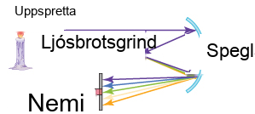
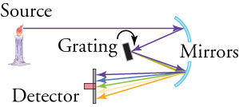
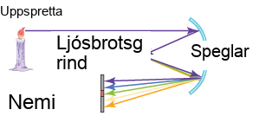
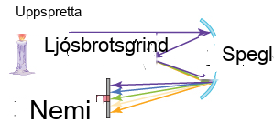
Mynd 17.18
Skýringarmyndin sýnir virkni ljósgreiðu í litrófssjá.
Notes:
Drawing of a spectroscope. Drawing shows a flame, two mirrors, grating and detector. A yellow flame at the upper left is labeled “source.” A horizontal arrow from the source extends to a small circular arc, which is concave to the left and slightly downward. The arc is one of two that are labeled “mirrors.” A second arrow extends to the left and downward from the point where the first arrow strikes the mirror, and in turn strikes a rectangular object that is tilted from vertical slightly to the left. The object is labeled “grating.” From the point where the second arrow strikes the grating, a number of colored arrows fan out downward and to the right, forming a narrow triangle. Those arrows in turn strike the second circular arc, labeled as one of the “mirrors,” which is concave to the left and slightly upward. From the second mirror, five colored arrows fan out to the left and slightly downward to form a wider triangle, and they strike a vertical surface labeled “detector.” The purple arrow strikes the top of the detector and the blue arrow slightly below it. The green arrow strikes the middle of the detector, the yellow arrow slightly lower, and the red arrow the bottom of the detector.

Slide 21
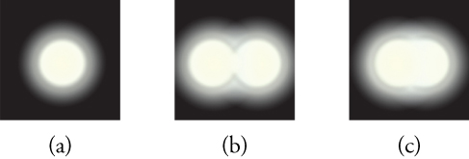

Mynd 17.19
(a) Einlitt ljós sem fer í gegnum lítið hringlaga ljósop myndar þetta beygjumynstur. (b) Tveir punktljósgjafar sem eru nálægt hvor öðrum mynda skarast myndir vegna beygju. (c) Ef þeir eru nær hvor öðrum er ekki hægt að greina þá að.
Notes:
(a) A white circle on a black background is surrounded by a ring that fades outward from gray to black. (b) Two circles, one on the left and one on the right, are surrounded by gray rings. Their circumferences touch, but the circles are distinguishable. (c)Two circles, with surrounding gray rings, have moved closer together and now are indistinguishable. They form a horizontal oval.

Slide 22
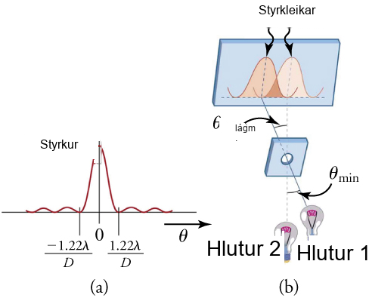
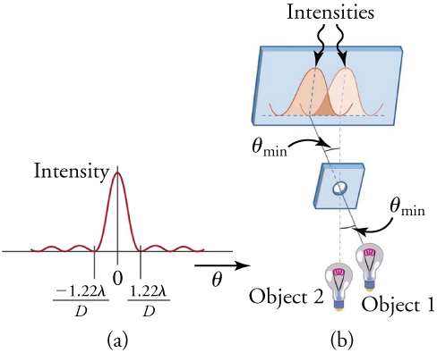
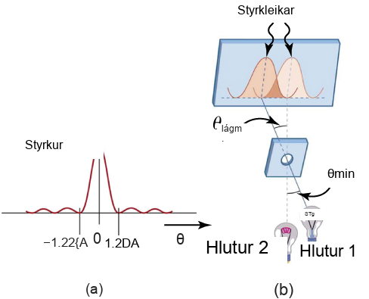
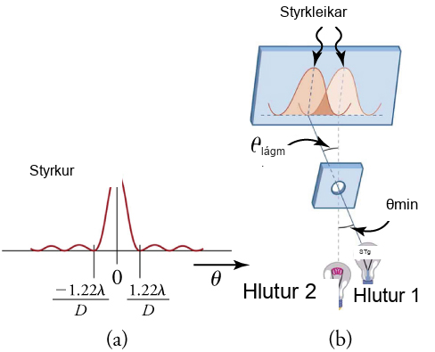

Mynd 17.20
(a) Línurit af styrk beygjunnar fyrir hringlaga ljósop. Athugið að, líkt og við eina rauf, er miðjuhágildið breiðara og bjartara en þau til hliðanna. (b) Tveir punktar mynda skörun á beygjumynstrum. Hér er sýnd Rayleigh-viðmiðunin fyrir því að þeir séu rétt svo aðgreinanlegir. Miðjuhágildi annars mynstursins liggur á fyrsta lágildi hins.
Þetta OpenStax viðbótarefni er © Rice University undir CC BY-NC-SA 4.0 alþjóðlegu leyfi; það má afrita eða breyta því eingöngu í óviðskiptalegum tilgangi, en eigna verður OpenStax og Rice University og taka skal fram allar breytingar. Öllum aðlögunum skal deila undir sams konar leyfi.
Notes:
(a) A graph with five peaks. The valleys are on a horizontal axis. The central peak is largest, and it is labeled “intensity.” Four much smaller peaks are arranged symmetrically, two to the left and two to the right. An arrow below the horizontal axis points to the right and is labeled “theta.” Three points are labeled on the horizontal axis, “zero” for the central peak, “negative 1.22 lamda divided by D” for the valley on its left, and “1.22 lamda divided by D” for the valley on its right. (b) A drawing shows two lightbulbs at the bottom. One is labeled “Object 1,” and it is to the right and slightly above the other, labeled “Object 2.” In the middle of the drawing is a vertical screen with a circular hole in it. At the top of the drawing is a vertical screen with two wide peaks graphed on it, which are labeled “Intensities.” A line from Object 1 extends through the hole in the screen and strikes the horizontal axis of the graph directly below the left peak on the graph. Another line from Object two extends through the hole in the screen and strikes the horizontal axis of the graph directly below the right peak on the graph. The angle formed when the two lines cross (where they pass through the hole in the middle screen) is labeled “theta min.”

